Slide 1




MAG-2.2-T020-D001
CEA thermohydraulic analyses
on DEMO TF design
&
MAG-2.3-T008-D001
CEA electromagnetic calculations
B. Lacroix, Q. Le Coz, S. Nicollet,
A. Torre, R. Vallcorba, L. Zani
WPMAG Final Meeting
12th Feb. 2020, Frascati

Slide 2

Status of CEA Thermo-hydraulic ANALYSES
On DEMO TF design
Burn studies on TF WP#3 2018 design: assessment of 2018 TF configuration for burn. The work includes TACTICS model building. The outcomes on new NH loads will focus on option WP#3 without radial plates. Start of implementation in TACTICS of radial plates option WP#4.
→ WP#3 completed
Quench simulations on TF design
  Quench simulations on TF WP#3 2015 design with transverse thermal coupling for CEA thermo-mechanical analyses (MAG-3.2)
  → completed, data provided to MAG-3.2
  More accurate analyses of boundary conditions on TF WP#3 2018 design: introduction of safety valve modelling (THEA+FLOWER and/or THEA+SimCryogenics)
  → completed with THEA+FLOWER
Page 2

Slide 3
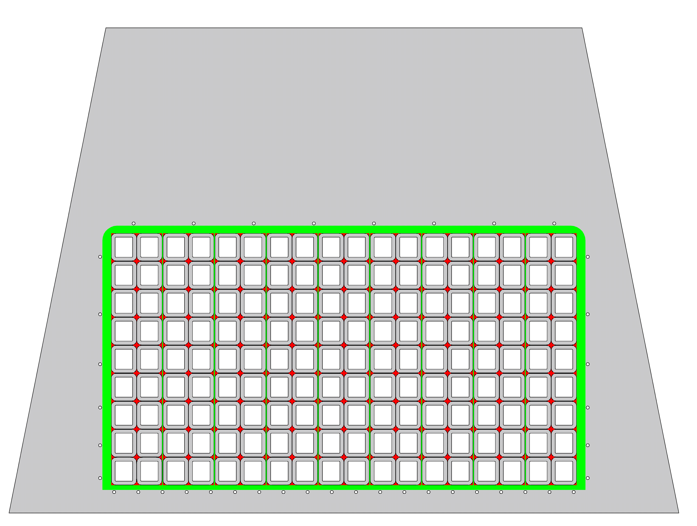
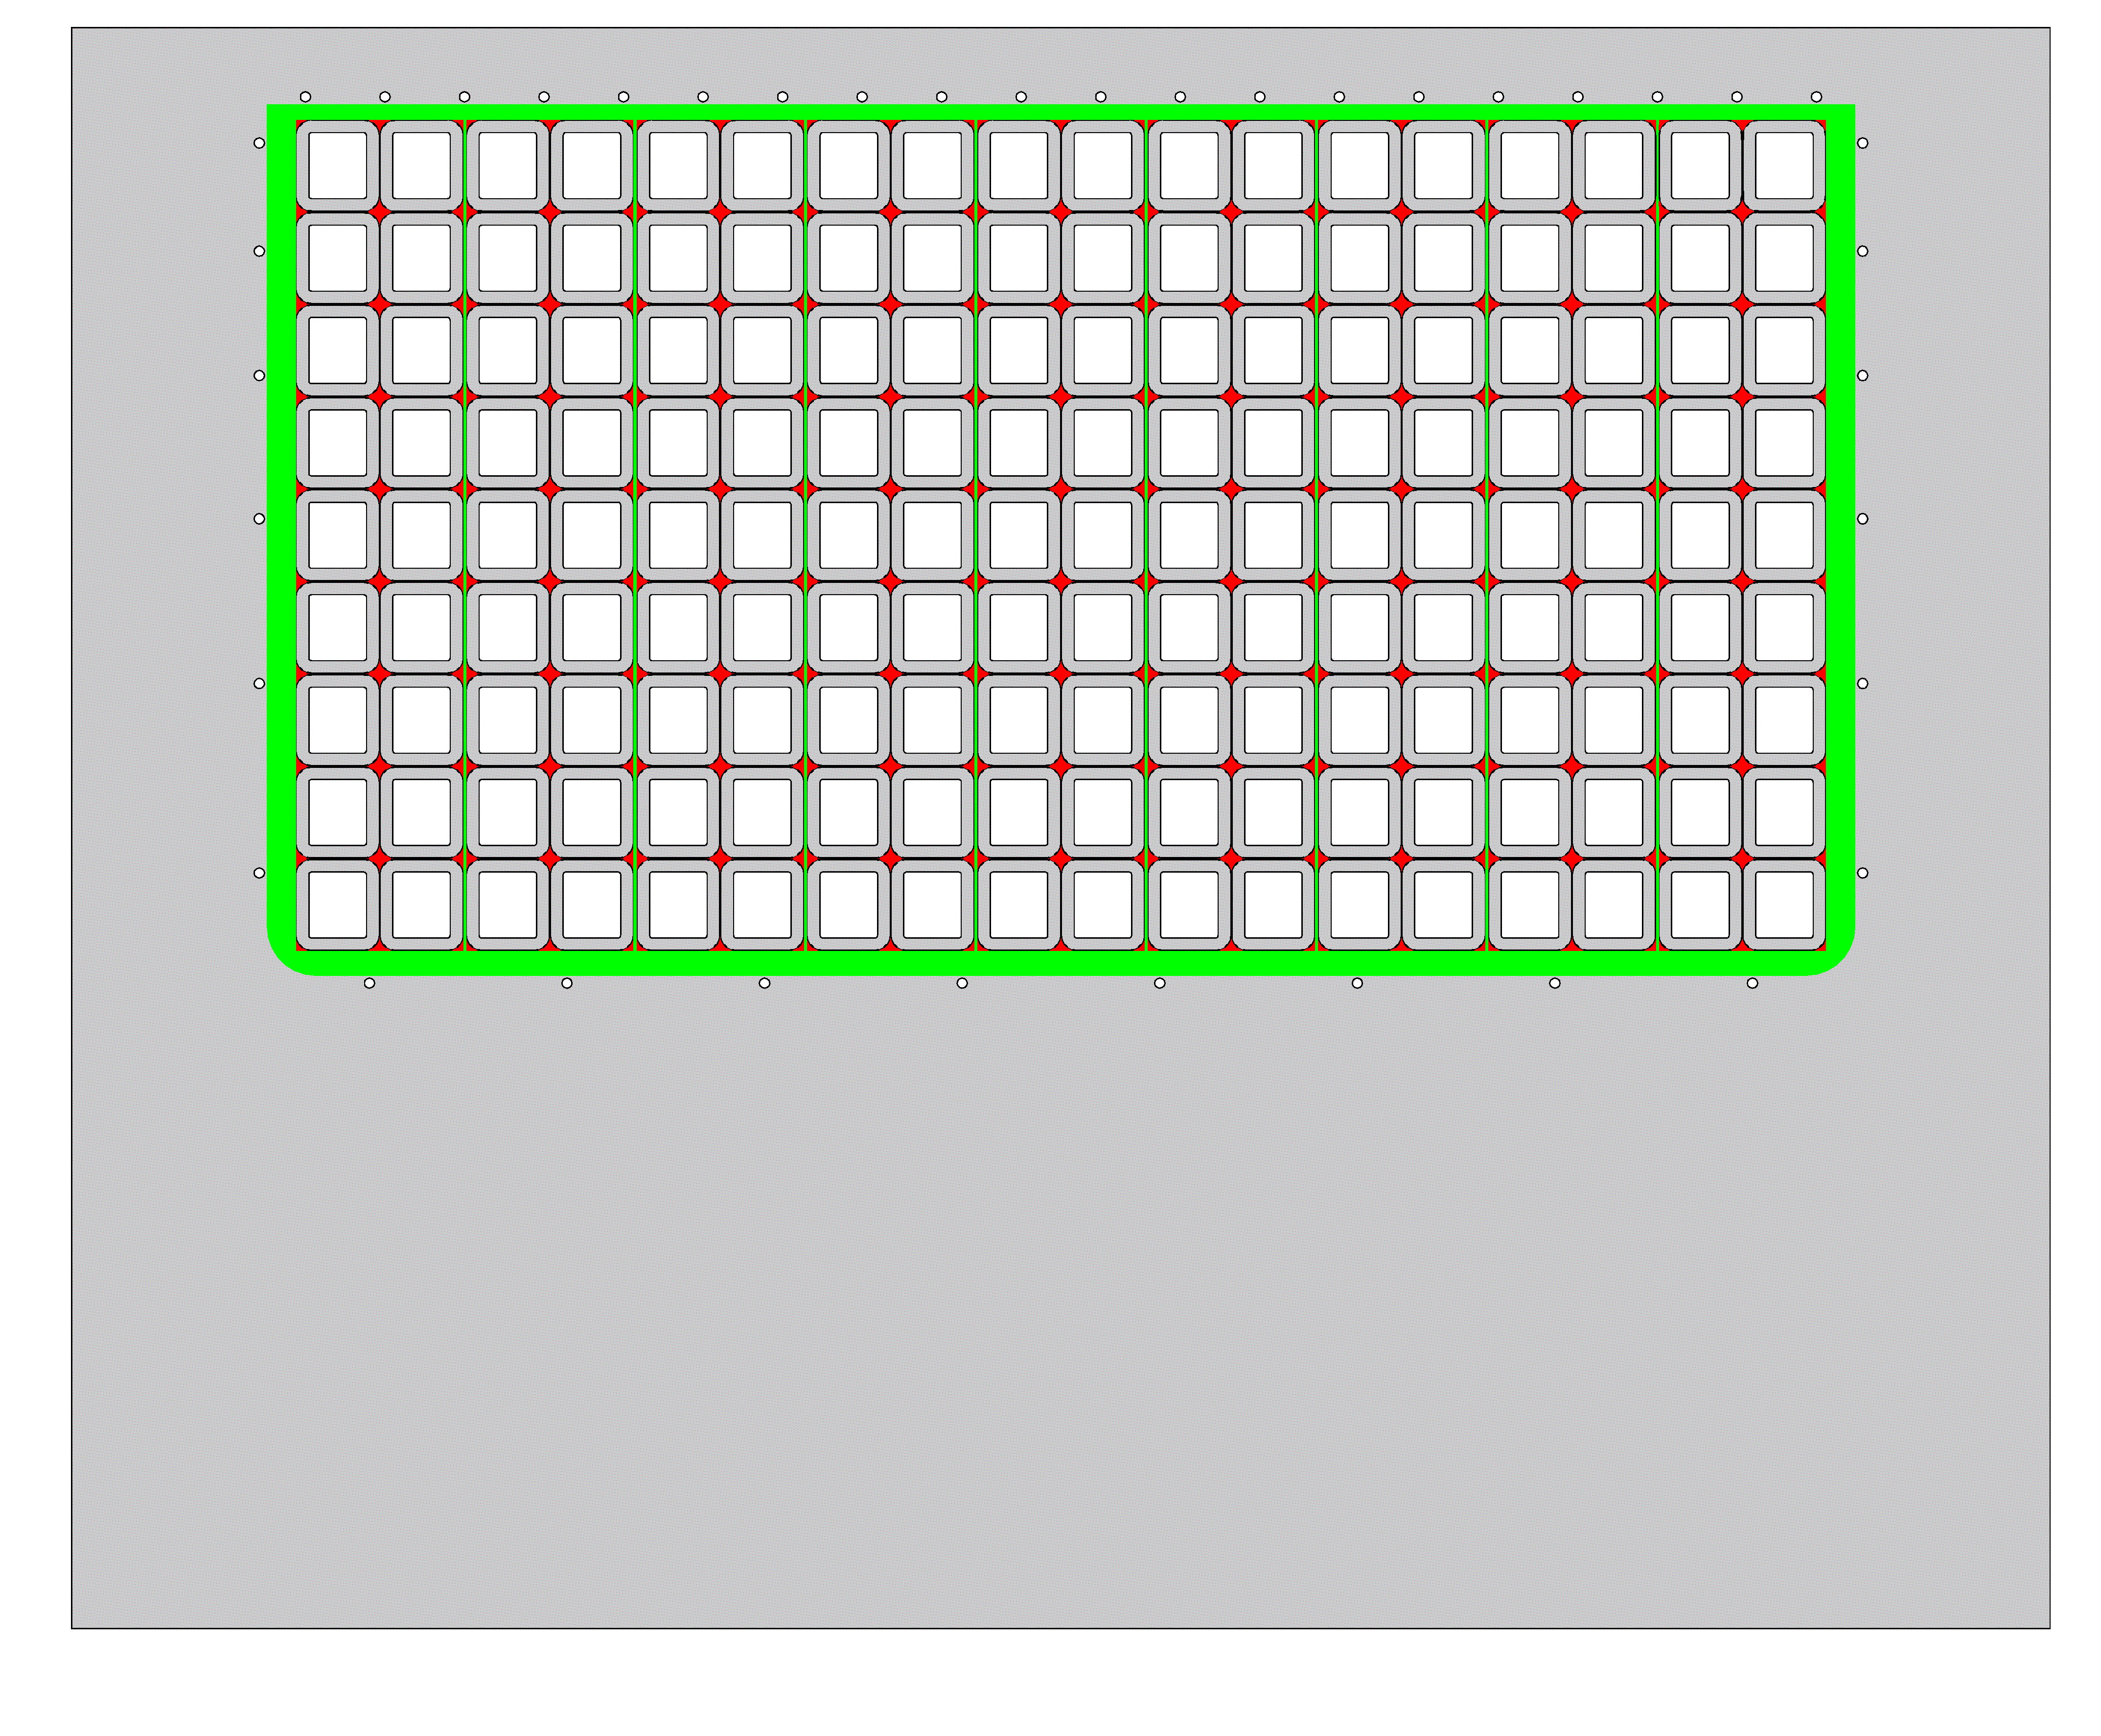
Status of CEA Thermo-hydraulic ANALYSES
Burn studies on TF WP#3 2018 design
TF WP#3 2018 features
Conductor current (A) | 92091
T_{DELAY} / T_{DISCHARGE} (s) | 3 / 35
Max. field on conductor (T) | 11.99
# of SC /Cu strands | 848 / 965
Void fraction | 32%
Top (K) | 4.7
T_{HOTSPOT} (K) | 250
Cable aspect ratio (rad/tor) | 1.15
Conductor radial size (mm) | 70.15
Conductor toroidal size (mm) | 63.51
Jacket thickness (mm) | 9.3
# of pancakes | 18
# of turns (regular pancakes) | 9
Max. unit length (m) | 997
Casing Tresca stress (MPa) | 630
Jacket Tresca stress (MPa) | 620
WP radial dimensions (mm) | 0.68
WP toroidal size (mm) | 1.240
Casing min. thickness (mm) | 97.7
SC strand amount (t) | 873
TF total thickness (m) | 1.25
TF I_{TOT} (MA.turn) | 14.92
Page 3

Slide 4
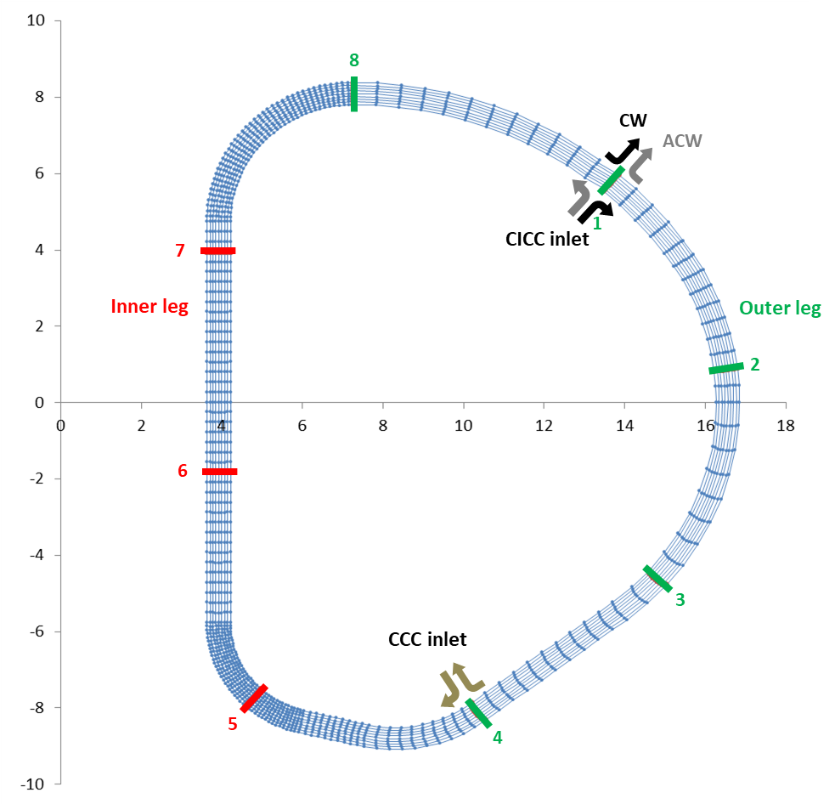
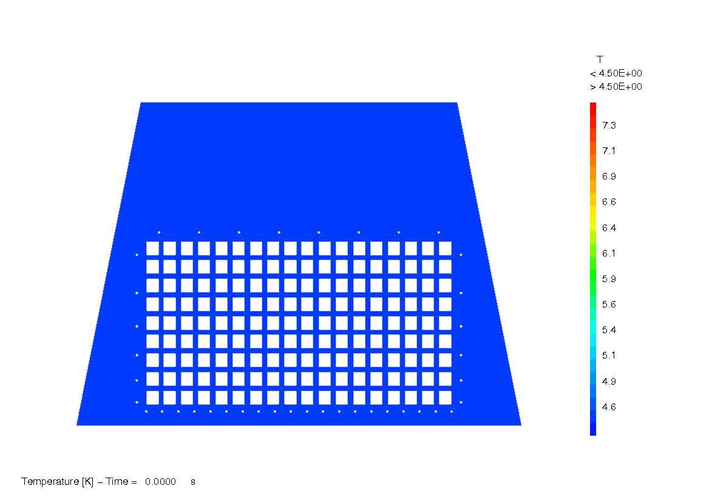
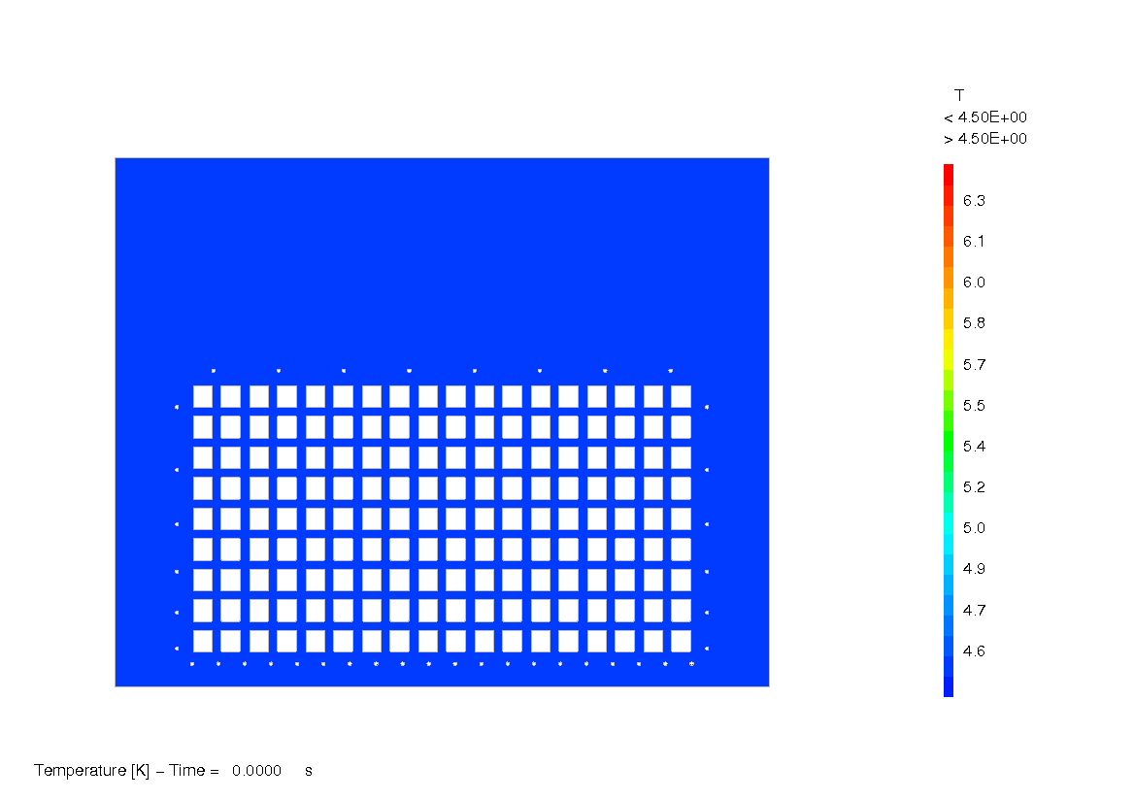
Status of CEA Thermo-hydraulic ANALYSES
Burn studies on TF WP#3 2018 design
  TACTICS model with 8 sections
  Simulation of 2 h burn + 10 minute dwell
Page 4

Slide 5
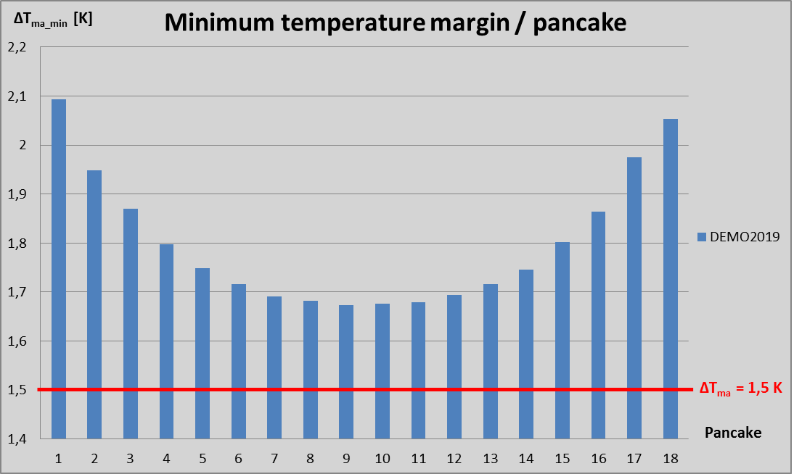
Status of CEA Thermo-hydraulic ANALYSES
Burn studies on TF WP#3 2018 design
  ΔT_{MARG} quite homogeneous on central pancakes
  (little impact of flow path)
  Impact of flow path more
  significant on lateral conductors
  Critical pancake = median ACW (#9) – ΔTma = 1.67 K
  Calculation done without contribution of PF, CS and plasma on Beff
Page 5

Slide 6
Status of CEA Thermo-hydraulic ANALYSES
On DEMO TF design
Burn studies on TF WP#3 2018 design: assessment of 2018 TF configuration for burn. The work will include TACTICS model building. The outcomes on new NH loads will focus on option WP#3 without radial plates. Implementation in TACTICS of radial plates option WP#4 will be conducted according to the resources available
Quench simulations on TF design
  Quench simulations on TF WP#3 2015 design with transverse thermal coupling for CEA thermo-mechanical analyses (MAG-3.2)
  → completed, data provided to MAG-3.2
  More accurate analyses of boundary conditions on TF WP#3 2018 design: introduction of safety valve modelling (THEA+FLOWER and/or THEA+SimCryogenics)
Page 6

Slide 7
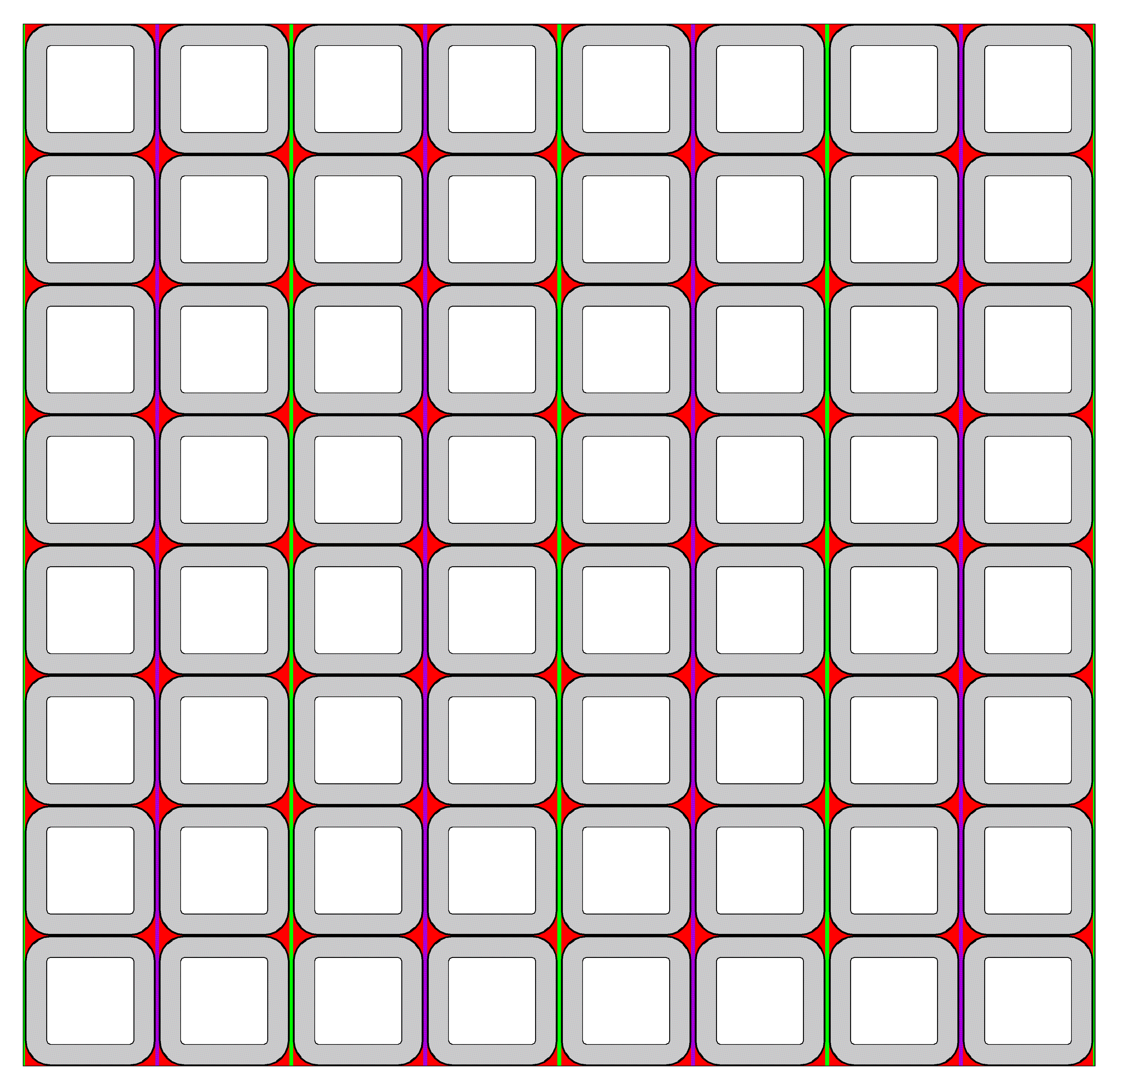
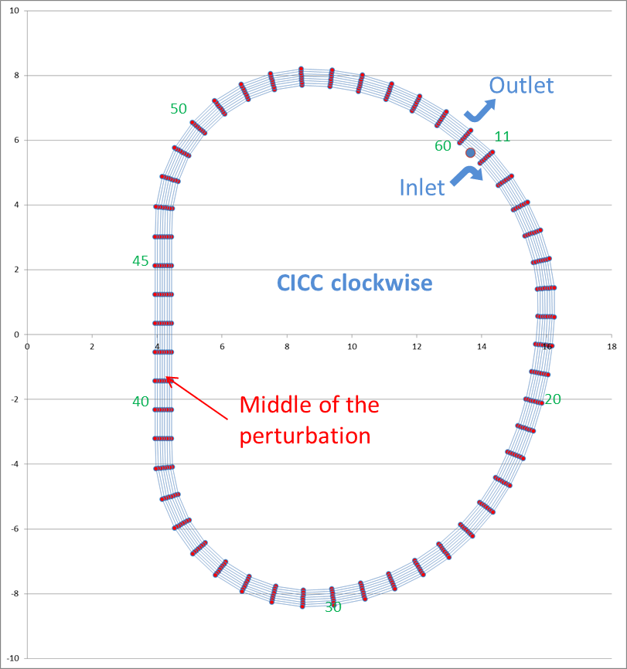
Status of CEA Thermo-hydraulic ANALYSES
Quench simulations for thermo-mechanical analyses
CW median pancake
TACTICS model of TF 2015
  ½ winding pack (without casing)
  50 sections
  Quench initiated on turn 5 of pancake 5
  100 s simulation
  τ_{delay} before FSD tuned (= 10 s) so that T_{hot spot} ~ 150 K
Page 7

Slide 8
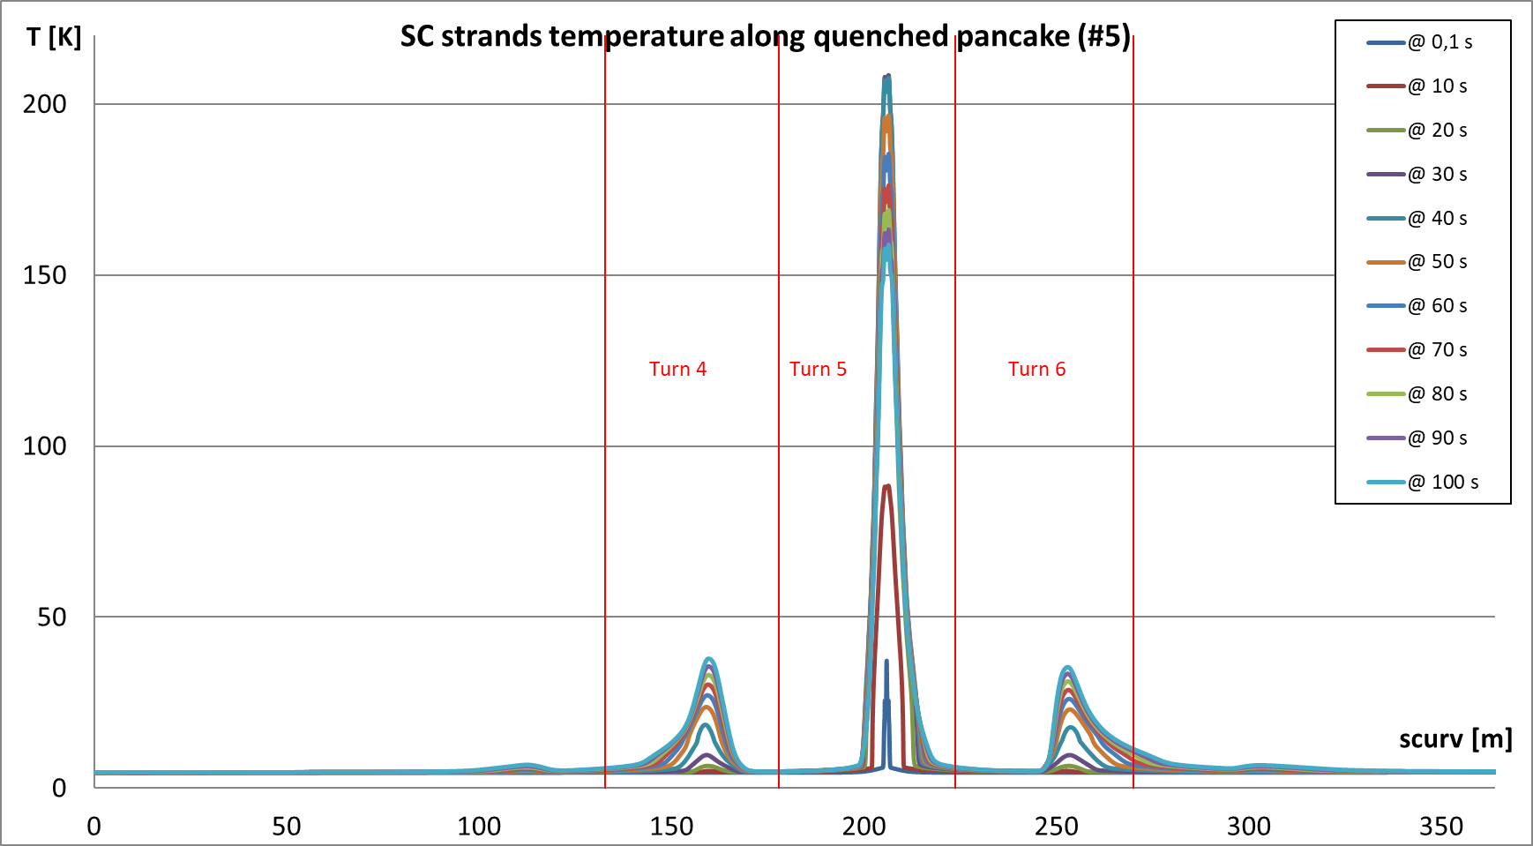
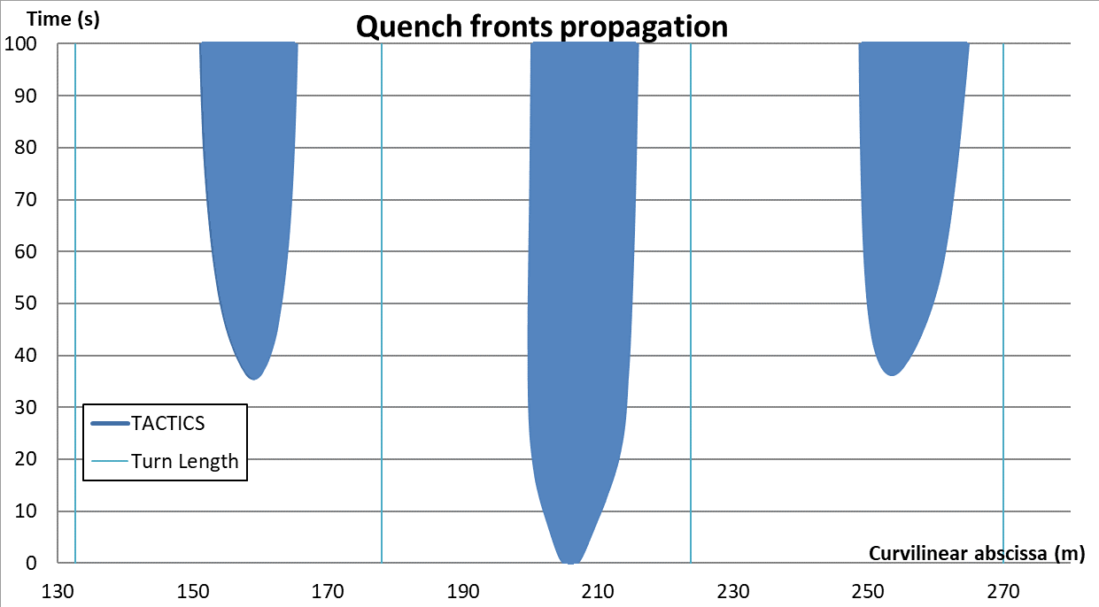
Status of CEA Thermo-hydraulic ANALYSES
Quench simulations for thermo-mechanical analyses
Quench propagation is almost symmetrical along conductor, upstream and downstream, on both sides of pertubated area
Page 8

Slide 9
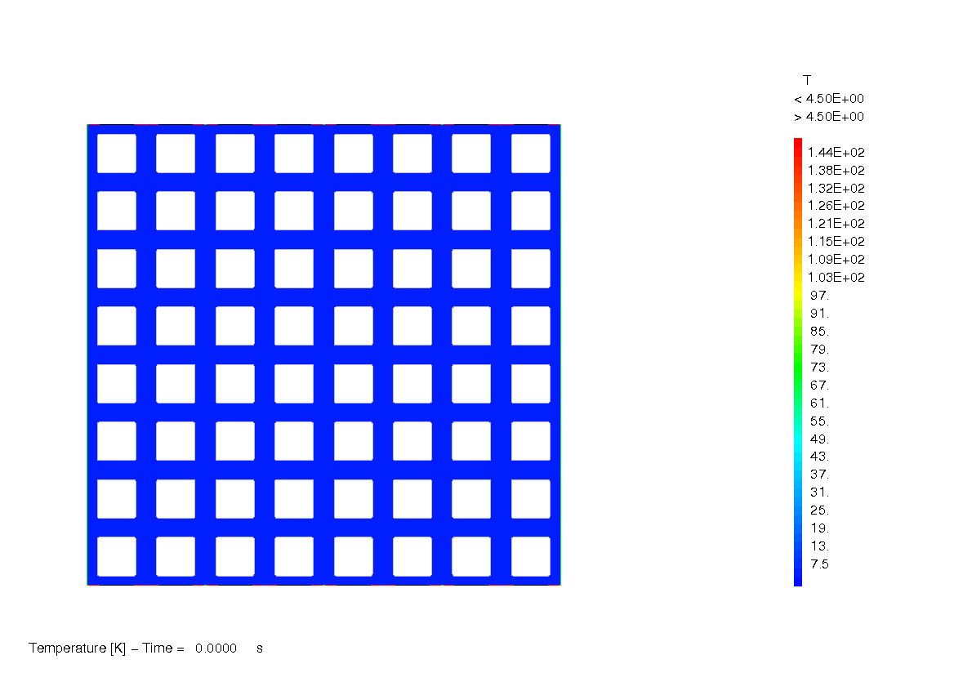
Status of CEA Thermo-hydraulic ANALYSES
Quench simulations for thermo-mechanical analyses
Quench first propagates along the conductor (t_{quench} = 36 s for upstream and downstream turns)
Quench then propagates to adjacent pancakes (t_{quench} = 46 s for pancakes 4 and 6)
Page 9

Slide 10
Status of CEA Thermo-hydraulic ANALYSES
IMPACT OF boundary conditions ON TF QUENCH
Burn studies on TF WP#3 2018 design: assessment of 2018 TF configuration for burn. The work will include TACTICS model building. The outcomes on new NH loads will focus on option WP#3 without radial plates. Implementation in TACTICS of radial plates option WP#4 will be conducted according to the resources available
→ WP#3 completed
Quench simulations on TF design
  Quench simulations on TF WP#3 2015 design with transverse thermal coupling for CEA thermo-mechanical analyses (MAG-3.2)
  → completed, data provided to MAG-3.2
  More accurate analyses of boundary conditions on TF WP#3 2018 design: introduction of safety valve modelling (THEA+FLOWER and/or THEA+SimCryogenics)
  → completed with THEA+FLOWER
Page 10

Slide 11
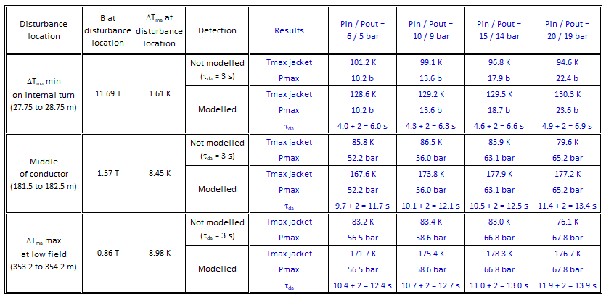
Status of CEA Thermo-hydraulic ANALYSES
IMPACT OF boundary conditions ON TF QUENCH
Recall:
in 2018, quench simulations were performed on 2015 TF WP#3 (88 kA conductor design)
THEA standard analyses with different imposed pressures at inlet/outlet (ΔP kept at 1 bar)
→ assessment of effect of boundary conditions similar to safety valve opening
Limited impact on T_{hot spot} criterion (T_{jacket}) : taking Pin/Pout = 6/5 bar as reference, the variations are comprised between -7 K and + 10 K for T_{max} jacket
Page 11

Slide 12
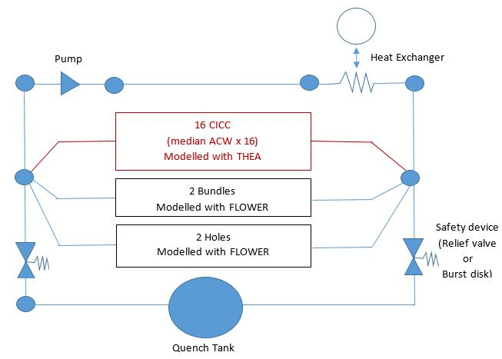
Status of CEA Thermo-hydraulic ANALYSES
IMPACT OF boundary conditions ON TF QUENCH
In 2019, more accurate analyses of sensitivity to boundary conditions were performed on TF WP#3 2018 design (92.1 kA)
→ Introduction of safety valve or burst disk modelling with THEA+FLOWER (SuperMagnet)
18 CICCs
for 1 TF coil model
All 16 CICCs modelled with a single THEA model are quenched simultaneously
Page 12

Slide 13
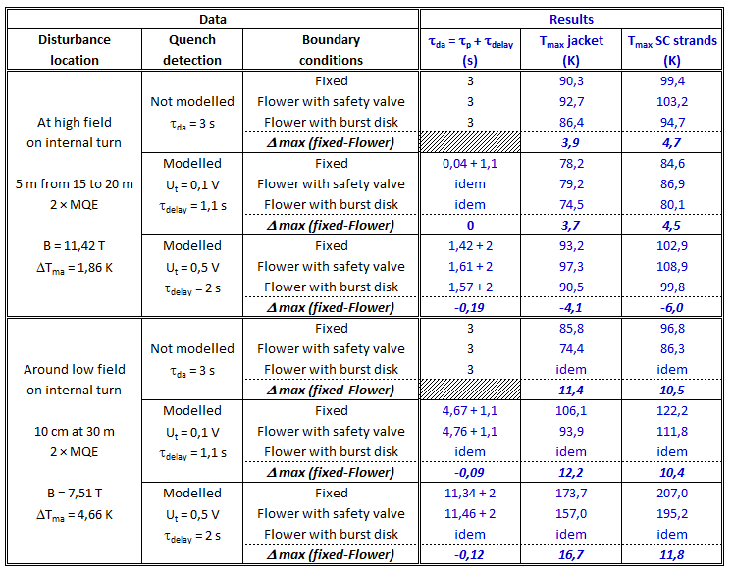
Status of CEA Thermo-hydraulic ANALYSES
IMPACT OF boundary conditions ON TF QUENCH
2 quench locations considered on internal turn (B_{max} and ~ B_{low})
Quench detection modelled (U_{t} = 0.1V, τ_{delay} = 1.1s / U_{t} = 0.5V, τ_{delay} = 2s) or not (τ_{da} = 3s)
For each case : ● 1 THEA standard calculation with Pin/Pout imposed at 6/5 bar
● 2 THEA/Flower calculations with Safety Valve or Burst Disk – P_{opening} = 20 bar
● For the quench at B_{low} , the safety device opening is not reached
(P_{max} ~ 16 bar < P_{opening} = 20 bar)
● Here again, regarding the hot spot criterion (T_{max} jacket), the impact of boundary conditions modelling is limited or conservative (THEA alone)
● Strong impact of Flower model introduction on simulation time consumption: from ~ 20 min (THEA alone) to 9 hours (THEA+Flower) for simulating 200 s
For design analyses,
a standard THEA approach seems sufficient at a first stage
Page 13

Slide 14
PERsPECTIVES
Task Specifications 2020: ~ 0.4 to 0.5 ppy
Analyses subjects proposal :
  CS breakdown analysis on CS 2018 « target flux » design
  TF WP#4 model finalization & sensitivity to Nuclear Heating deposition
  Simulation of current fast discharge in TF WP#3 and/or WP#4
  Additional simulations with THEA/Flower for assessing the impact of boundary conditions on quench development (different quench initiations)
NB: this proposal should be adjusted according to the volume of work (when identified) which is needed for addressing Gate Review documentation
Page 14

Slide 15
Status of CEA electromagnetic calculationS
This task should provide electromagnetic calculations for all magnet designers, as well as for other possible actors of Eurofusion-DEMO project. In particular, and taking into account workload and priorities, the work would focus on:
Field maps on specific conductor designs for TF, CS and PF winding packs.
→ Performed on TF 2018, with PF, CS and plasma contributions corresponding to “Reference Equilibrium for 2018 WPMAG DEMO Single Null”
Calculation of effective field Beff, and/or hoop strain in the conductor.
→ Performed for Beff calculation on 9 points instead of 2 points previously
Post-treatment of field maps to take into account thermohydraulic paths.
→ done
Calculation of transient field maps (with varying currents in the coils during scenario).
Evaluation of vertical forces in PF/CS systems.
Page 15

Slide 16
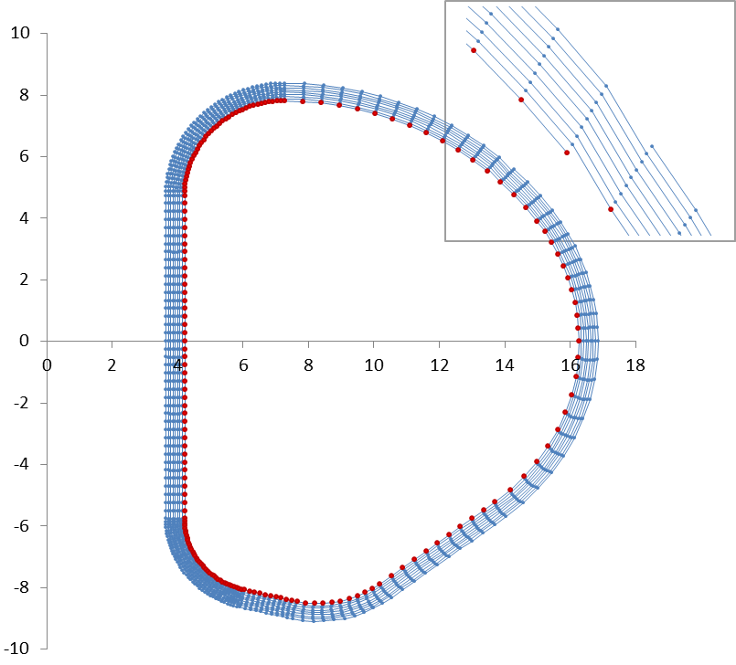
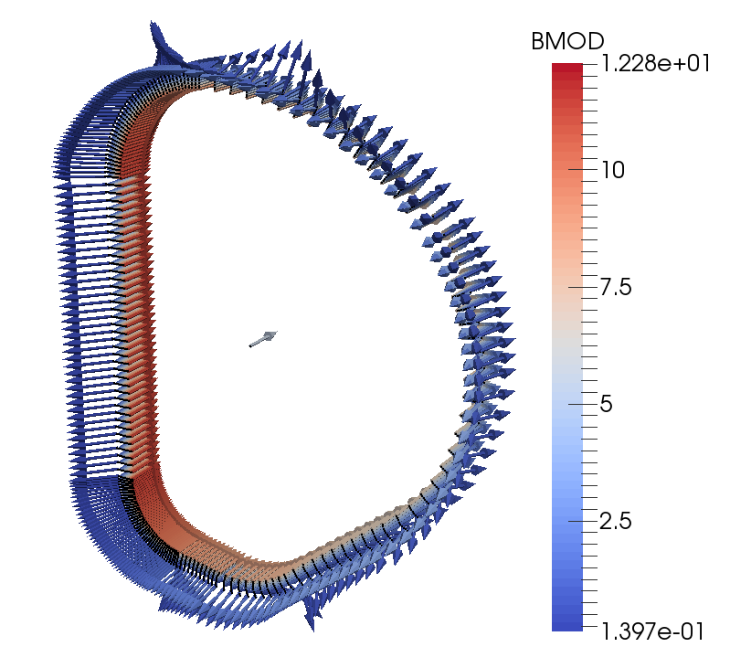
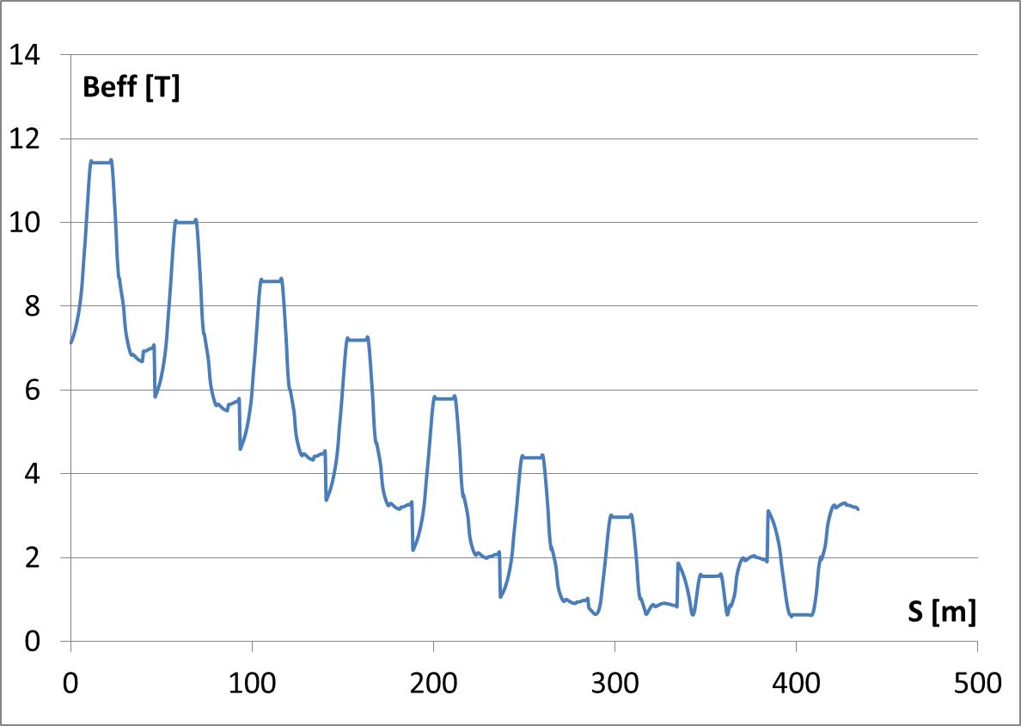
Status of CEA electromagnetic calculationS
Field map calculation on 2018 TF WP#3
  B_{EFF} calculations ongoing with CS & PF contribution
  (post-treatment to be completed, to be included in report)
Page 16

Slide 17
Status of CEA electromagnetic calculationS
Manpower = 0.15 ppy
This task should provide electromagnetic calculations for all magnet designers, as well as for other possible actors of Eurofusion-DEMO project. In particular, and taking into account workload and priorities, the work would focus on:
Field maps on specific conductor designs for TF, CS and PF winding packs.
→ Performed on TF 2018, with PF, CS and plasma contributions corresponding to “Reference Equilibrium for 2018 WPMAG DEMO Single Null”
Calculation of effective field Beff, and/or hoop strain in the conductor.
→ Performed for Beff calculation on 9 points instead of 2 points previously
Post-treatment of field maps to take into account thermohydraulic paths.
→ done
Calculation of transient field maps (with varying currents in the coils during scenario).
Evaluation of vertical forces in PF/CS systems.
Page 17

Slide 18
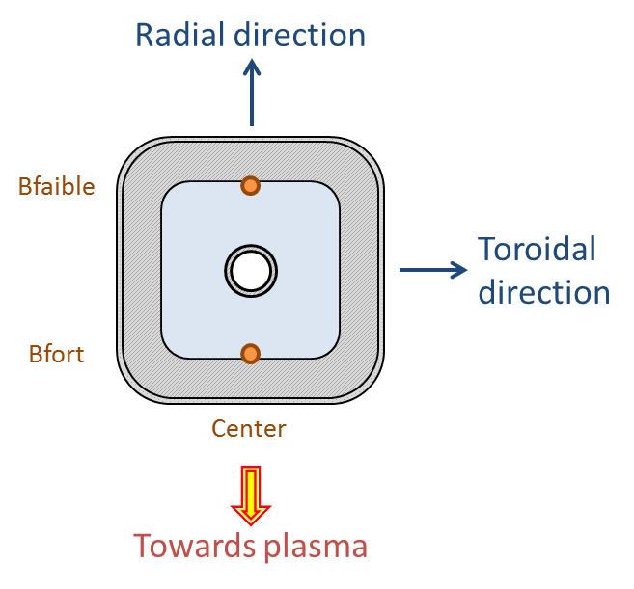
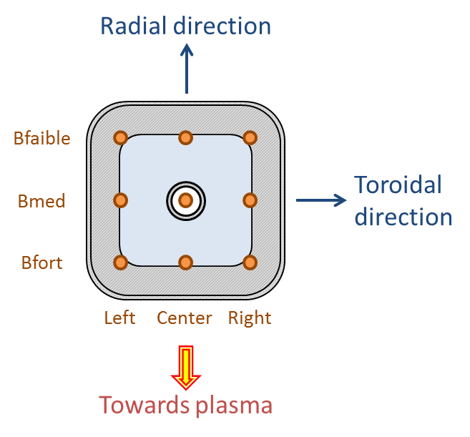

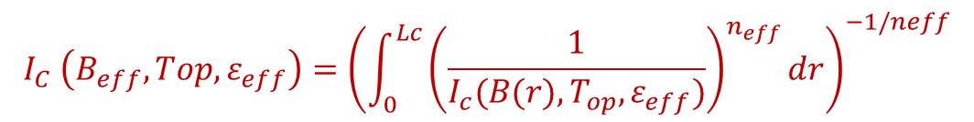
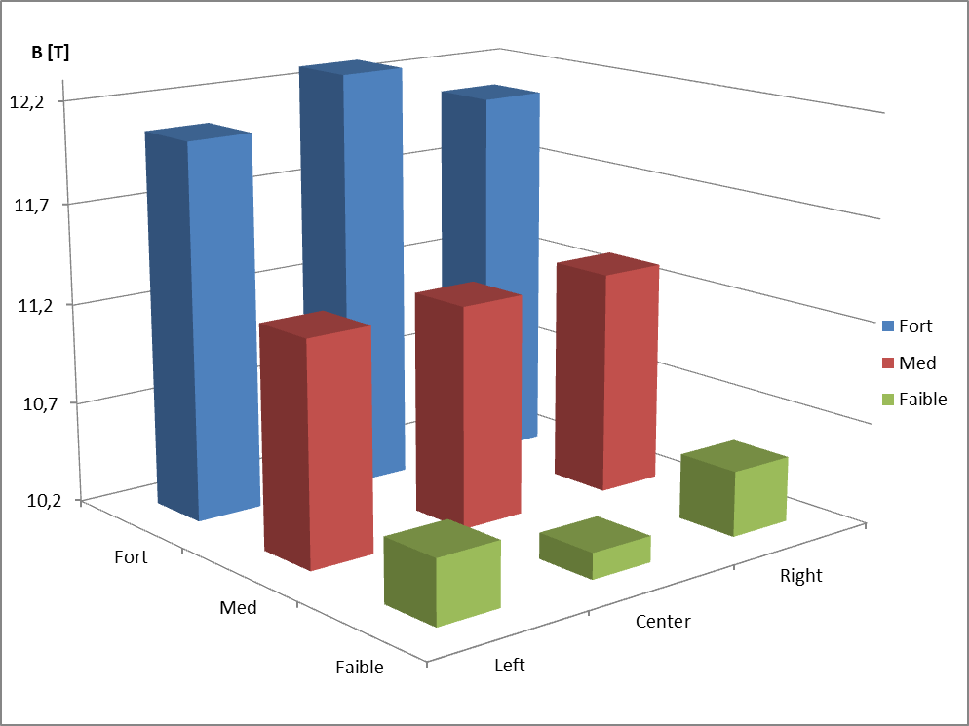
Status of CEA electromagnetic calculationS
Calculation of effective field B_{eff}
$$I_{C} \left(B_{eff},Top,ε_{eff}\right)={\left(\int_{0}^{Lc}{{\left(\frac{1}{I_{c}(B(r),T_{op},ε_{eff})}\right)}^{n_{eff}}}dr\right)}^{−1/neff}$$
B_{eff} is defined by:
  New calculation
  based on 9 points
Effect of 9 points calculation on 2018 TF conductor :
B_{eff} decreased by 58 mT
T_{cs} increased by 25 mK
→ Impact is modest
  but not negligible
2 points calculation assumptions:
Linear decrease of the field in radial direction
Uniform field in toroidal direction
Page 18

Slide 19
Status of CEA electromagnetic calculationS
Calculation of effective field B_{eff}
Calculation of B_{EFF} and ε_{EFF} in CS for two DEMO 2018 configurations :
At maximum flux
At target flux
> see MAG-2.1 CEA presentation
For case 1) the case includes the breakdown
  B_{int} calculated in the THEA code
> see MAG-2.1 CEA presentation
For case 2) the case is with 3 points
  B_{INT} = B_{APP} considered
> see MAG-2.2 IPPLM presentation
➔ Data sent for THEA calculations
Page 19

Slide 20
Status of CEA electromagnetic calculationS
Manpower = 0.15 ppy
This task should provide electromagnetic calculations for all magnet designers, as well as for other possible actors of Eurofusion-DEMO project. In particular, and taking into account workload and priorities, the work would focus on:
Field maps on specific conductor designs for TF, CS and PF winding packs.
→ Performed on TF 2018, with PF, CS and plasma contributions corresponding to “Reference Equilibrium for 2018 WPMAG DEMO Single Null”
Calculation of effective field Beff, and/or hoop strain in the conductor.
→ Performed for Beff calculation on 9 points instead of 2 points previously
Post-treatment of field maps to take into account thermohydraulic paths.
→ done
Calculation of transient field maps (with varying currents in the coils during scenario).
Evaluation of vertical forces in PF/CS systems.
Page 20

Slide 21
Status of CEA electromagnetic calculationS
Evalution of CS/PF forces
The configuration considered is the Maximum flux design including Premag PF current
CEA tool used is ELSA (Matlab version)
CS currents were rescaled from CREATE study (DEMO 2018) to fit the CEA design
 | R [m] | Z [m] | DR [m] | DZ [m]
CS3U | 2.5141 | 7.5354 | 0.8678 | 2.8492
CS2U | 2.5141 | 4.5638 | 0.8678 | 2.8492
CS1 | 2.5141 | 0 | 0.8678 | 6.0336
CS2L | 2.5141 | -4.5638 | 0.8678 | 2.8492
CS3L | 2.5141 | -7.5354 | 0.8678 | 2.8492
PF1 | 5.4 | 9.66 | 1.189 | 1.223
PF2 | 14 | 7.9 | 0.544 | 1.798
PF3 | 17.97 | 2.5 | 0.343 | 0.624
PF4 | 17.97 | -2.5 | 0.244 | 1.184
PF5 | 14 | -7.9 | 0.262 | 1.815
PF6 | 7 | -10.6 | 1.165 | 1.942
Plasma | 9.54 | -0.01 | 0.1 | 0.1
COILS CURRENTS [A]
PRE | SOF | EOF
36 652 000 | 17 161 345 | -7 478 972
36 652 000 | -1 787 902 | -36 652 000
77 616 000 | -12 087 228 | -73 316 591
36 652 000 | -9 027 648 | -36 652 000
36 652 000 | 31 653 428 | -15 663 033
Page 21

Slide 22
Status of CEA electromagnetic calculationS
Evalution of CS/PF forces
Two examples of ouputs are shown below
SOF
CS3U / CS2U+CS1+CS2L+CS3L | -107 MN
CS3U+CS2U / CS1+CS2L+CS3L | -74 MN
CS3U+CS2U+CS1 / CS2L+CS3L | -50 MN
CS3U+CS2U+CS1+CS2L / CS3L | -308 MN
To be noted: in ITER this load criteria is -120MN
Net vertical force: 7.04 MN Interface load (positive=compression)
Page 22

Slide 23
Status of CEA electromagnetic calculationS
Evalution of CS/PF forces
Two examples of ouputs are shown below
EOF
CS3U / CS2U+CS1+CS2L+CS3L | 286 MN
CS3U+CS2U / CS1+CS2L+CS3L | 1120 MN
CS3U+CS2U+CS1 / CS2L+CS3L | 1335 MN
CS3U+CS2U+CS1+CS2L / CS3L | 49 MN
Net vertical force: 78.7 MN
Interface load (positive=compression)
➔ Data will be used for first pre-compression stuctures dimensionning
Page 23

Slide 24
Status of CEA electromagnetic calculationS
Conclusions and perspectives
Conclusions
EM calculations on DEMO 2018 TF WP#3 were carried out with a comparative study on the effect of number of calculation point in conductor section. The number is set to 9 points.
EM calculations of B_{eff} and ε_{eff} on two CS configuarations for transient analyses were conducted, then transferred to THEA actors
EM forces CS/PF were calculated and can stand as input for CS structures dimensionning
Perspectives TS 2020 – Total ~ 0.15 ppy
Calculation of power deposition due to fast discharge in TF WP#3 and WP#4
(input for TH calculation)
Calculation of B_{eff} and ε_{eff} in CS 2018 « target flux » for fast breakdown analysis
(ΔT_{ma} sensitivity to nτ and fast breakdown duration)
Computation of B_{eff} in TF WP#3 and WP#4 taking into account PF, CS and plasma contribution with CEA updated PF design
NB: this proposal should be adjusted according to the volume of work (when identified) which is needed for addressing Gate Review documentation
Page 24

