Slide 1
SPC PF coil design MAG-2.1-T025; MAG-2.3-T007; MAG-3.1-T017-D002
Mithlesh Kumar
Roberto Guarino
Xabier Sarasola
Kamil Sedlak
WPMAG Final Meeting 2019
11-13 February 2020

Slide 2
Outline
Task Specifications 2019
PF coil proposed design 2019
Design parameters
Nb₃Sn vs NbTi for PF1 and PF6
Coil cross-section Aspect ratio effects
3D fast mechanical analysis: takes TF ripple into account
Conclusions and Task Specifications 2020
In appendix
EUROFUSION Demo 2018 baseline (updated July 2019)

Slide 3
Task Specifications 2019
The PF coil design update on new baseline.
The allowable stress in the jacket (from the 3.1 task) and the resulting calculation of peak field (from the 2.3 task) will be used to re-assess the conductor layout.
Advantages/disadvantages of the conductor design with and without cooling channel, pancake vs. layer will be investigated.
The option of using Nb₃Sn conductors in PF1 and PF6 will be revised.
Deliverables uploaded to IDM (0.1 ppy):
MAG-2.1-T025-D003 - Design of the PF coil based on the 2018 DEMO reference.
MAG-2.3-T007-D003 - Magnetic field calculation for the PF coil.
MAG-3.1-T017-D002 - Mechanical analysis of the PF coils.

Slide 4
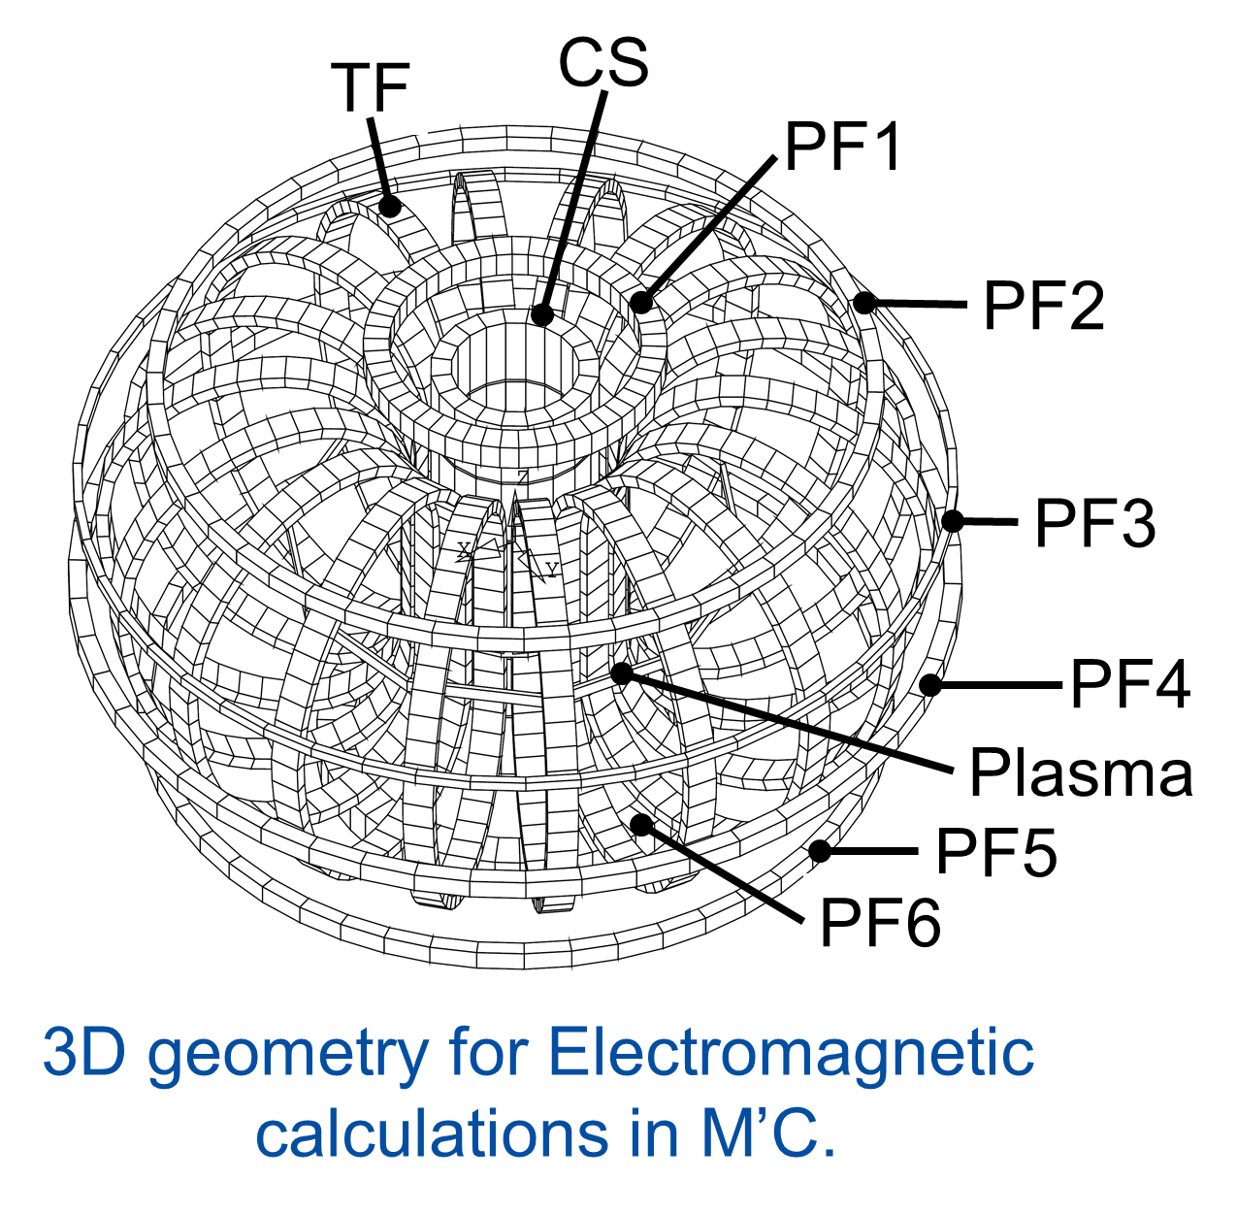
PF coil proposed design Methodology
Electromagnetic Analysis
Full 3-dimensional calculations using M’C (Cryosoft) module. All the coils, as well as, plasma is present.
3 Current States: Pre-magnetization (Premag), Start of Flat top (SOF), End of Flat top (EOF).
Mechanical Analysis
FE simulations are performed on 2D-axisymmetric geometry in ANSYS. Consequently, TF coils are not simulated.
Cool down from room temperature to 4.5 K.
Static stress analysis in different current states.
Fatigue stress analysis which assumes 20,000 fusion cycles; SS316 LN conductor jacket; 2.0 mm² surface crack and 5.0 mm² embedded crack in conductor jacket and 240 MPa residual hoop stress from butt joint.
NbTi conductor
Location of the stress classification lines for the extraction of the membrane and bending stresses in the conductor jacket of the DEMO PF coils
Nb₃Sn conductor
2D axisymmetric geometry of WP in ANSYS

Slide 5
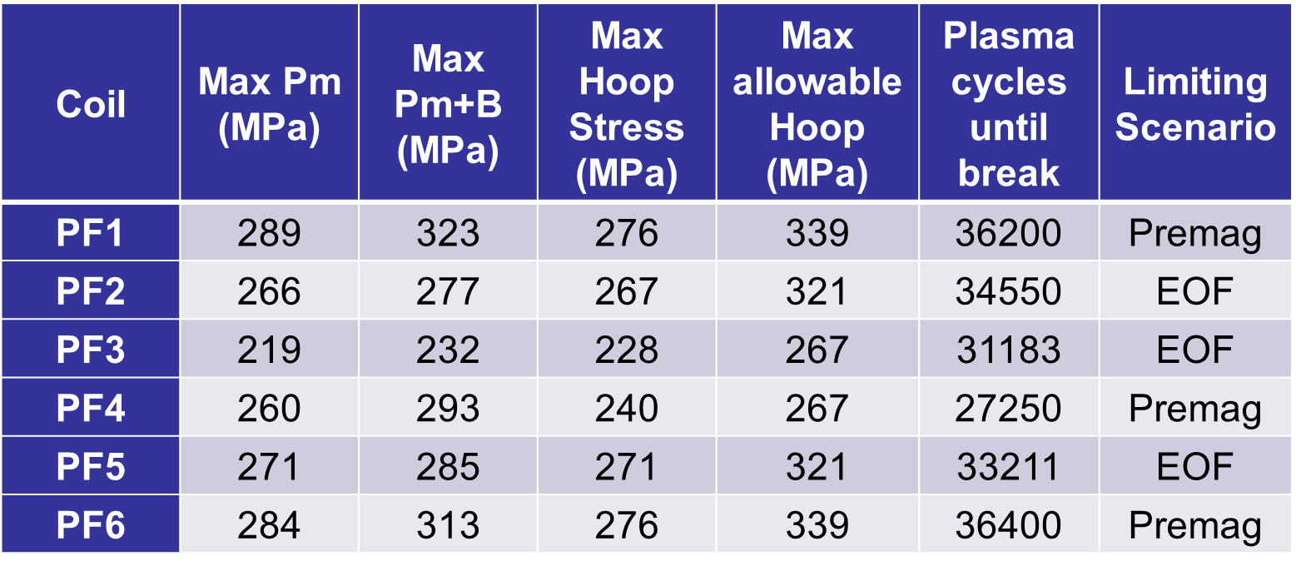
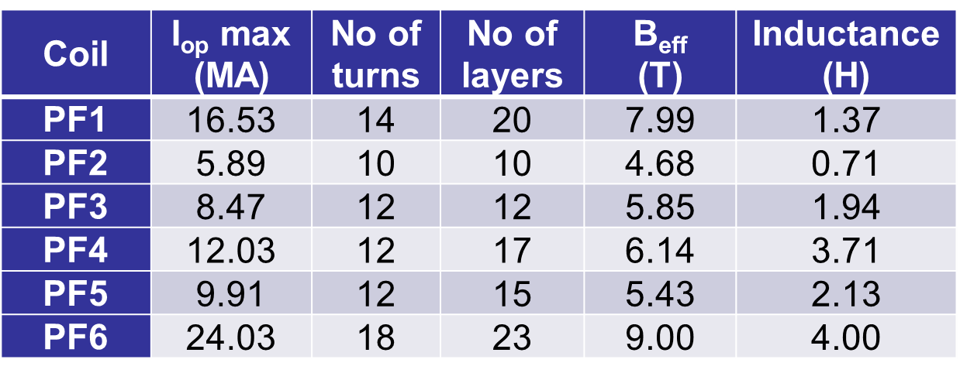
PF coil proposed design Results
WP layout
Mechanical parameters
EM parameters

Slide 6
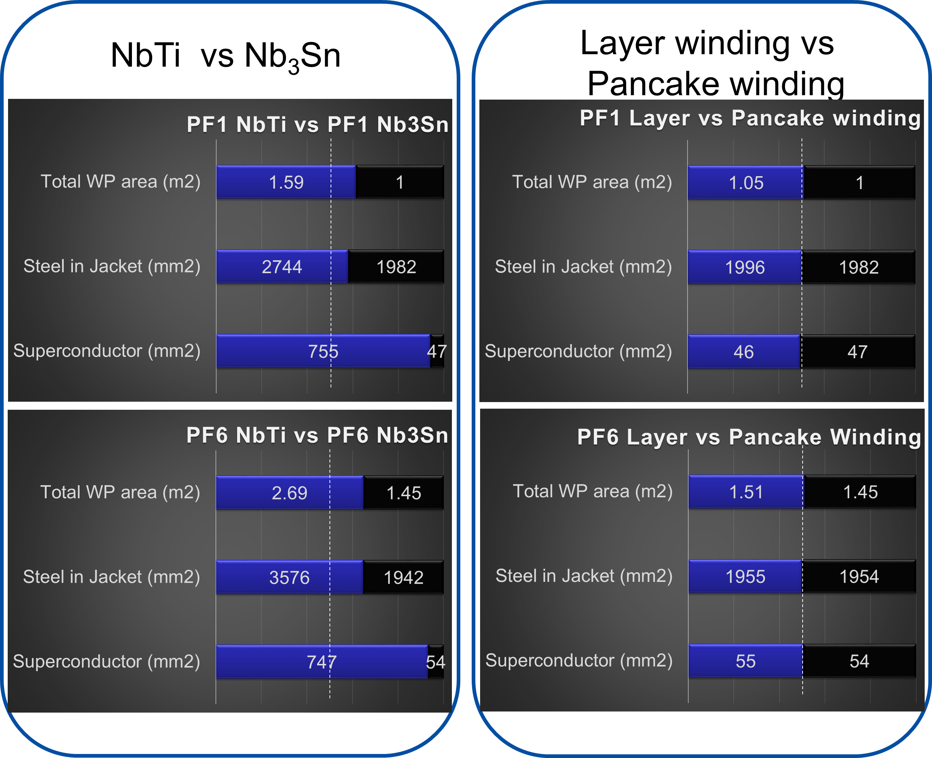
PF coil proposed design Results

Slide 7
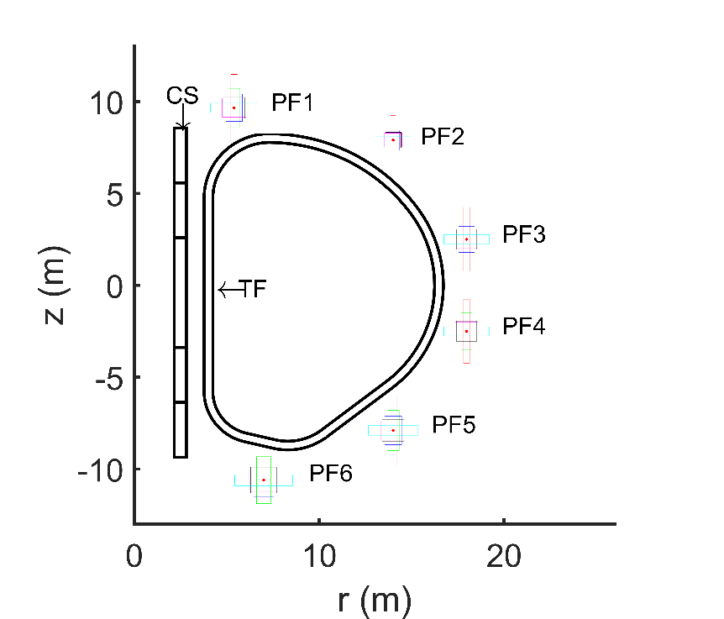
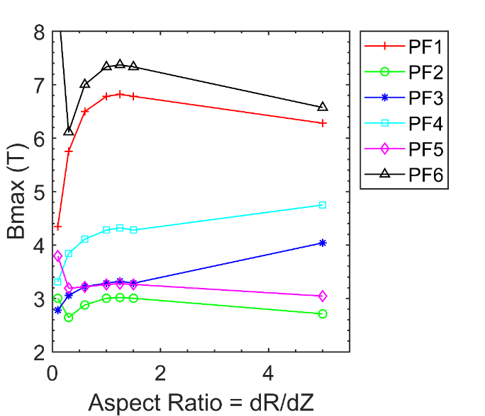
Coil cross-section Aspect ratio effects
Effective magnetic fields on conductor cross-section for square WP design proposed in previous section and new proposal based on extreme aspect ratio.
Coil | B_{eff} |  | Aspect Ratio=dR/dZ
 | Proposed design 2018 | New proposal 2018 | Proposed design 2018 | New proposal 2018
PF1 | 8.06 | 7.70 | 0.999 | 0.585
PF2 | 4.93 | 4.55 | 0.840 | 0.505
PF3 | 6.02 | 5.86 | 0.777 | 0.363
PF4 | 6.26 | 6.07 | 1.000 | 0.242
PF5 | 5.62 | 5.22 | 0.998 | 0.297
PF6 | 9.10 | 8.73 | 1.000 | 0.711
Peak magnetic field as a function of WP aspect ratios for PF coils
Position and shape of different coils of different aspect ratios.

Slide 8
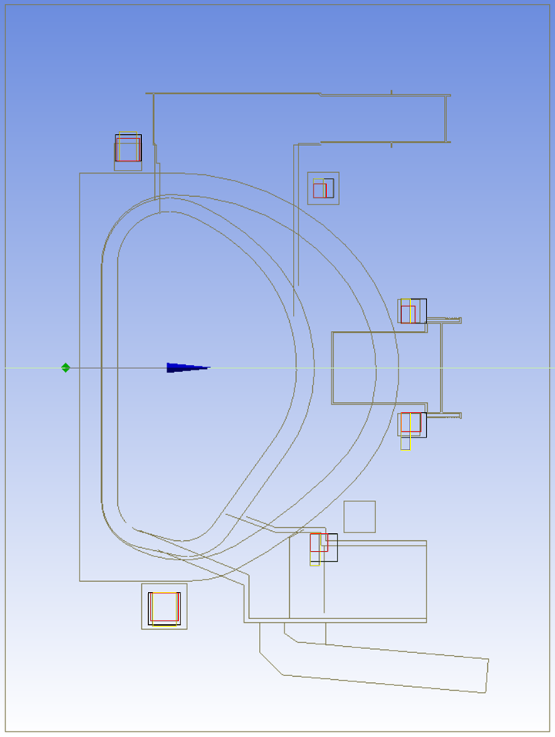
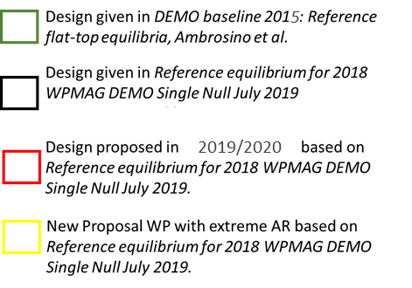
Coil cross-section Aspect ratio effects
Comparison of the positions of WPs in two proposals with respect to the whole machine (latest CAD of Whole machine on IDM dated April 2019 based on DEMO baseline 2015: Reference flat-top equilibria, Ambrosino et al).
Notes:
PF1: I would prefer the yellow configuration as it provides more poloidal space for the upper ports and the pellet fuel injection line
PF2: I have no preference
PF3 and PF4: I would prefer the yellow configuration. PF3 and PF4 define the required radius of the cryostat and bioshield. As the yellow configuration has the smallest radius it is the best for me. Also: It allows the port duct and therefore the equatorial port vacuum closure plate to be move closer to the plasma.
PF5: I would prefer the red configuration as it seem to fit best above the lower port (where it must be shifted to)
PF6: I have no preference, Francesco should decide.

Slide 9
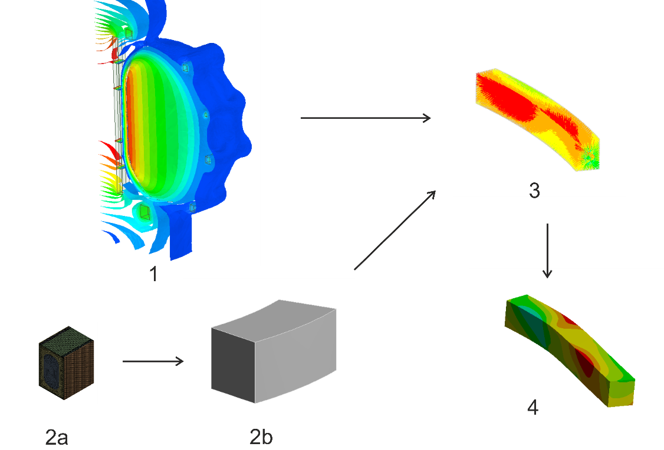
3D fast mechanical analysis
Objectives
Fully-detailed 3D simulations of the PF coils are excessively expensive…
Development of a tool for the 3D structural analysis of the PF coils, including the effect of the ripples of the magnetic field (due to the TF coils)
Procedure
Electromagnetic FE simulations
2a. Homogeneised thermo-mechanical properties
2b. Coil with equivalent properties
3. Application of the Lorentz forces on the model
4. Extraction of max stresses in the jacket
Validation on a 2D geometry σ_{max} (MPa)
Coil | Model with full details [4] | Proposed fast tool | Critical scenario
PF1 | 190 | 186 | PREMAG
PF2 | 315 | 297 | EOF
PF3 | 275 | 245 | PREMAG
PF4 | 312 | 302 | SOF
PF5 | 321 | 301 | SOF
PF6 | 157 | 153 | PREMAG

Slide 10
3D fast mechanical analysis
Results
the average hoop stresses can be computed by 2D analyses (TF coils have no effect)
TF coils have limited effect on PF1, PF5 and PF6 (max stress within +5% w.r.t. 2D analyses)
PF2, PF3 and PF4 have max stresses strongly influenced by the TF coils (up to +110%)
ripples of the magnetic field due to TF coils must be taken into account for PF2, PF3 and PF4 jacket design
3D effect of the TF coils σ_{max} (MPa)
Coil | Model without TF | Model with TF | Difference
PF1 | 152.5 | 152.6 | +0.1%
PF2 | 351.4 | 460.2 | +31.0%
PF3 | 480.8 | 1008.0 | +109.7%
PF4 | 372.5 | 412.7 | +10.8%
PF5 | 378.9 | 396.2 | +4.6%
PF6 | 154.9 | 155.2 | +0.2%
PF2
PF3
PF4

Slide 11
Conclusions
PF coils are pancake-wound unlike previously proposed design. The WP dimensions have also increased proportionally to current.
The optimized WP dimensions are mainly driven by magnetic field distributions and mechanical fatigue stress limits.
For PF1 and PF6, Nb₃Sn based design makes WP more compact and lighter. NbTi based design makes PF1 and PF6 coils huge and heavy.
No significant difference in dimensions of WP between the layer-wound and pancake-wound coils.
From WP cross-section Aspect ratio study we learn that elongating the coil cross-section vertically
reduces peak magnetic field on the conductor
reduces hydraulic length
the machine radial extent.
Fast 3D analysis is useful: accounts for TF coil ripple, gives fairly accurate results.

Slide 12
Task specifications 2020
The PF coil design developed in 2019 has been reviewed by Christian Bachmann and Roberto Ambrosino, who addressed especially the design options with the coil aspect ratio, a_{r}, deviating from 1. With respect to integration with whole machine, they proposed to elaborate some of the PF coil design options with a_{r}≠1. The following tasks will be done for the PF coil winding packs:
Detailed design of the newly proposed PF coils with high aspect ratios, a_{r}≠1.
A high-current PF coil design (conductor current in the range of 80 kA) will be investigated.
Deliverable: Exploration of alternative PF coil design: 0.2 ppy

Slide 13
Appendix

Slide 14
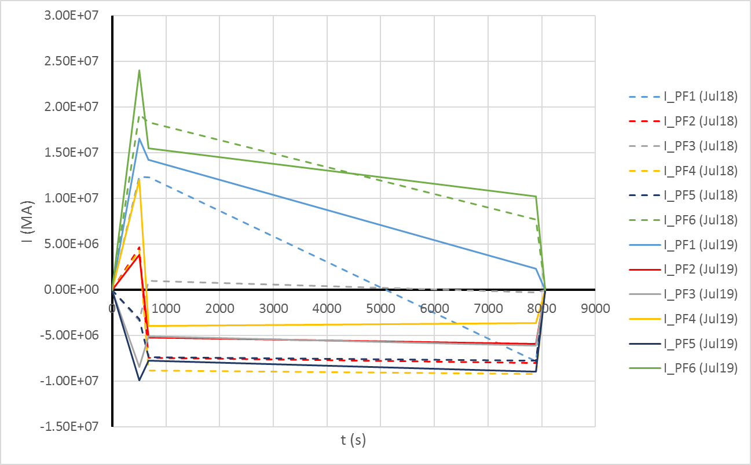
EUROFUSION Demo 2018 baseline
Total current in each coil increased in new baseline

