Slide 1
SPC CS coil design and analyses
(2.1-T025, 2.3-T007)
X. Sarasola & R. Wesche
February 12th, 2020

Slide 2
Outline
Requirements and assumptions
Methodology
Uniform current density vs graded designs
Conclusions

Slide 3
Requirements and assumptions
Update the CS coil design to the baseline 2018:
  The generated magnetic flux is maximized for the outer radius (R_{o}) and height (h) given in [1].
  A radial space of 115 mm is preliminary allocated for the pre-compression structure, allowing a maximum R_{o} = 2.7 m for the solenoid winding pack.
  Fatigue is the main design driver for the DEMO CS:
    The EU DEMO is designed to operate 20,000 plasma cycles [2].
    Therefore, the CS coil design has to ensure survival of 40,000 mech cycles.
The studies focus on the design of the CS1 winding pack:
  Layer-wound.
  10 double-layer sub-coils.
  RE-123, Nb₃Sn, and Nb-Ti are used respectively for the high, medium, and low field layers of the solenoid.
[1] R. Ambrosino, “Equilibria EOF/SOF 2018 PhysMag.” https://idm.euro-fusion.org/?uid=2NV5BB.
[2] C. Bachmann, “DEMO Plant Load Specification,” 21-Sep-2017. https://idm.euro-fusion.org/?uid=2MY7H3.

Slide 4
Requirements and assumptions
Note on baseline 2018:
  The peak B field is observed in module CSL2 (not CS1!) during pre-mag.
  It does not include 100 mm insulation spacing between the CS modules.
  If 100 mm spacing is included between modules:
    ΔB is a bit larger (but small, in any case, ΔB = +0.063 T compared to CS1)
    The current density also becomes slightly larger in CSL2
The design studies focus on the CS1 WP.
No gap is considered between modules.
Baseline 2018 |  | CSU3 | CSU2 | CS1 | CSL2 | CSL3
Max B (T) | No mod gap | 12.177 | 12.288 | 12.324 | 12.329 | 12.099
 | With mod gap | 12.195 | 12.443 | 12.428 | 12.491 | 12.011

Slide 5
Outline
Requirements and assumptions
Methodology
Uniform current density vs graded designs
Conclusions

Slide 6
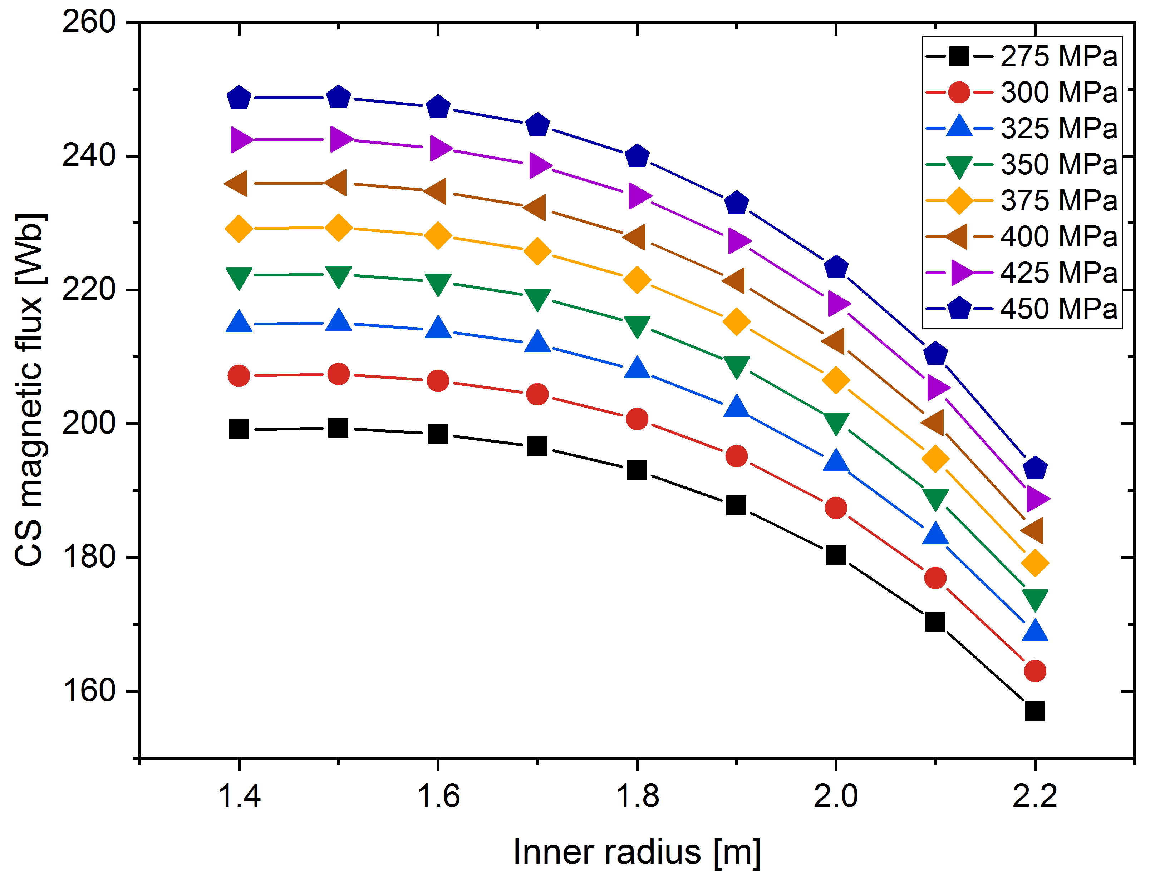
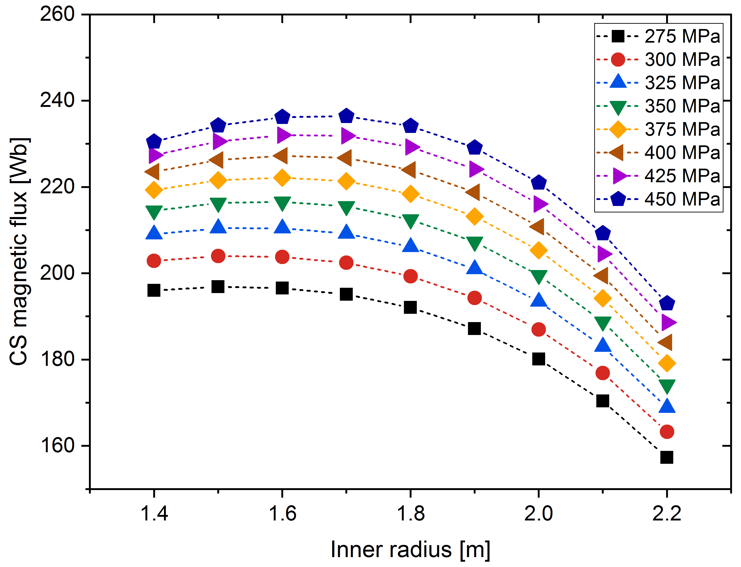
Methodology
In a finite uniform current density solenoid, the magnetic field, flux, and hoop stress experienced in the mid-plane, can be computed analytically.
Simple parametric studies are used to find the maximum magnetic flux for a given outer radius and hoop stress.
HTS uniform current density, R_{o} = 2.7 m
Nb₃Sn (ε_{eff} = -0.25%) uniform current density, R_{o} = 2.7 m

Slide 7
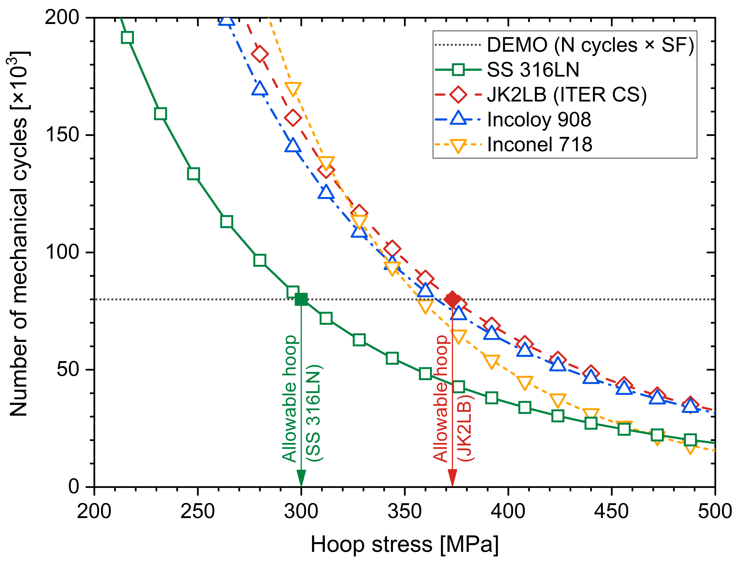

Methodology: Fatigue Crack Growth Model
Paris Law: $\frac{da}{dN}=C{\left(∆K\right)}^{m}$
Assumptions:
  Initial defect size:
    2 mm² (surface)
    5 mm² (embedded)
  Stress intensity factor:
    Elliptical cracks
    σ_{residual} = 240 MPa
  Safety factors [3]:
    2× in number of cycles
    2× in defect area
    1.5× in fracture toughness
70×22 mm plate, 2 mm² initial surface crack
[3] C. Jong, “Magnet Structural Design Criteria Part 1: Main Structural Components and Welds,” 2012. https://user.iter.org/?uid=2FMHHS.

Slide 8
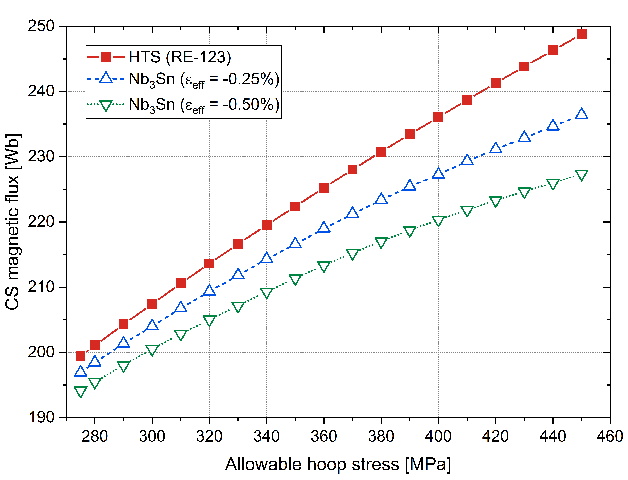
Methodology
Designs with higher allowable hoop stress can operate at larger j_{eng} (larger B and φ)
The benefit of using HTS dilutes for low allowable hoop stress.
In order to ensure fatigue lifetime (assumptions in previous slide):
  The σ_{hoop} has to be limited to 300 MPa if SS316LN is used for the conduits (~375 MPa in the case of JK2LB)

Slide 9
Outline
Requirements and assumptions
Methodology
Uniform current density vs graded designs
Conclusions

Slide 10
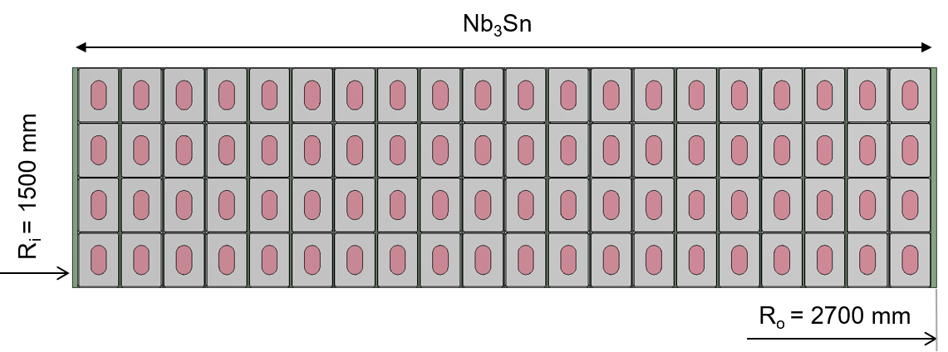
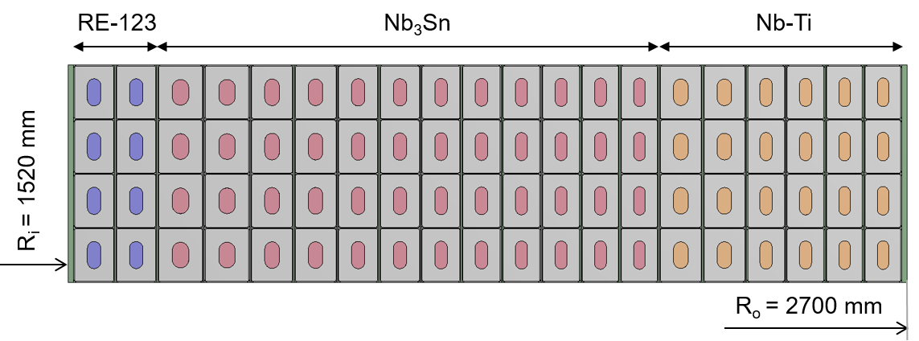
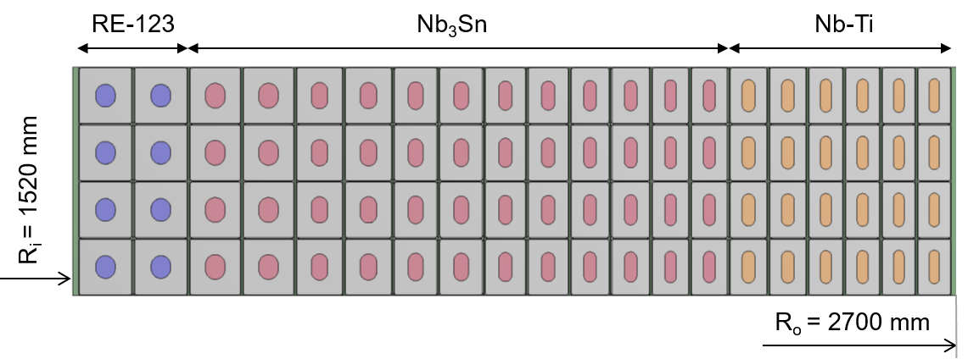
Uniform current density vs graded designs
For an allowable σ_{hoop} = 300 MPa and R_{o} = 2.7 m, the maximum flux is generated for R_{i} ≈ 1.5 m.
The proposed Uniform Current Density (UCD) design is analyzed in ANSYS.
The radial distribution of the B field is used to propose a more economically sensible superconductor (SC) graded design.
The stainless steel fraction can be adjusted across the winding pack.
  The radial stress in the insulation shall be always compressive
  The hoop stress is such that fatigue lifetime is guaranteed using jackets made of SS316LN.
UCD
SC graded
SC+SS graded

Slide 11
SPC designs (baseline 2018)
Design |  | LTS-only designs
 |  | UCD | SC grad | SC+SS grad
Total current [MAt] |  | 71.044
Cond current [kA] |  | 45.541
R_{i} [mm] |  | 1500 | 1540 | 1540
R_{o} [mm] |  | 2700
SC material subcoils [HTS/Nb₃Sn/Nb-Ti] |  | -/10/- | -/7/3 | -/7/3
Max B [T] |  | 15.43 | 15.45 | 15.45
Mag flux [Wb] | Only CS | 204 | 211.6 (+3.7%) | 215.4 (+5.6%)
 | CS+PF | 218.0 | 225.6 (+3.5%) | 229.4 (+5.2%)
σ_{memb, L01} [MPa] |  | 358.6 | 352.3 | 347.9
σ_{hoop, L01} [MPa] |  | 289.8 | 292.0 | 291.9
Cycles until break [#] |  | 82.4×10³ | 84.0×10³ | 85.4×10³

Slide 12
SPC designs (baseline 2018)
Design |  | LTS-only designs |  |  | HTS designs
 |  | UCD | SC grad | SC+SS grad | UCD | SC grad | SC+SS grad
Total current [MAt] |  | 71.044 |  |  | 72.235
Cond current [kA] |  | 45.541 |  |  | 46.305
R_{i} [mm] |  | 1500 | 1540 | 1540 | 1500 | 1520 | 1520
R_{o} [mm] |  | 2700 |  |  | 2700
SC material subcoils [HTS/Nb₃Sn/Nb-Ti] |  | -/10/- | -/7/3 | -/7/3 | 10/-/- | 1/6/3 | 1/6/3
Max B [T] |  | 15.43 | 15.45 | 15.45 | 15.72 | 15.71 | 15.76
Mag flux [Wb] | Only CS | 204 | 211.6 (+3.7%) | 215.4 (+5.6%) | 207.4 (+1.7%) | 211.6 (+3.7%) | 218.5 (+7.1%)
 | CS+PF | 218.0 | 225.6 (+3.5%) | 229.4 (+5.2%) | 221.6 (+1.7%) | 225.8 (+3.6%) | 232.7 (+6.7%)
σ_{memb, L01} [MPa] |  | 358.6 | 352.3 | 347.9 | 356.0 | 362.1 | 350.0
σ_{hoop, L01} [MPa] |  | 289.8 | 292.0 | 291.9 | 288.9 | 294.5 | 295.4
Cycles until break [#] |  | 82.4×10³ | 84.0×10³ | 85.4×10³ | 84.2×10³ | 80.0×10³ | 83.6×10³

Slide 13
Outline
Requirements and assumptions
Methodology
Uniform current density vs graded designs
Conclusions

Slide 14
Conclusions
The requirements for the CS in the Baseline 2018 are inconsistent:
  Given the space allocated for the CS coil, it is not possible to satisfy simultaneously two fundamental design requirements:
    Required magnetic flux (Ψ = 250 Wb)
    Fatigue lifetime (20,000 plasma cycles + Safety factors)
At low allowable hoop stress (~300 MPa), the use of HTS only provides a small gain in flux compared to Nb₃Sn R&W.
Use of superconductor and stainless steel grading:
  More cost-effective layout.
  Modest increase the generated magnetic flux (only a few percentage points relative to the uniform current density designs).
Other strategies to mitigate the effect of fatigue are under study (see tomorrow’s presentation on mechanical analyses).

Slide 15
Proposal 2020
Further investigation of the CS coil alternative conductor design options.
Dimensioning of the pre-compression structure based on Baseline 2018.
Start: 01.03.2020
End: 31.10.2020
Resources: 0.2 ppy

