Slide 1
SPC TF Coil Design and Analyses
Kamil Sedlák

Slide 2
Tasks to be done
A nominal TF WP design with the nominal TF field
The maximum-field TF WP design that fits into the allocated space
Corresponding thermal-hydraulic analysis
Corresponding electromagnetic analyses

Slide 3
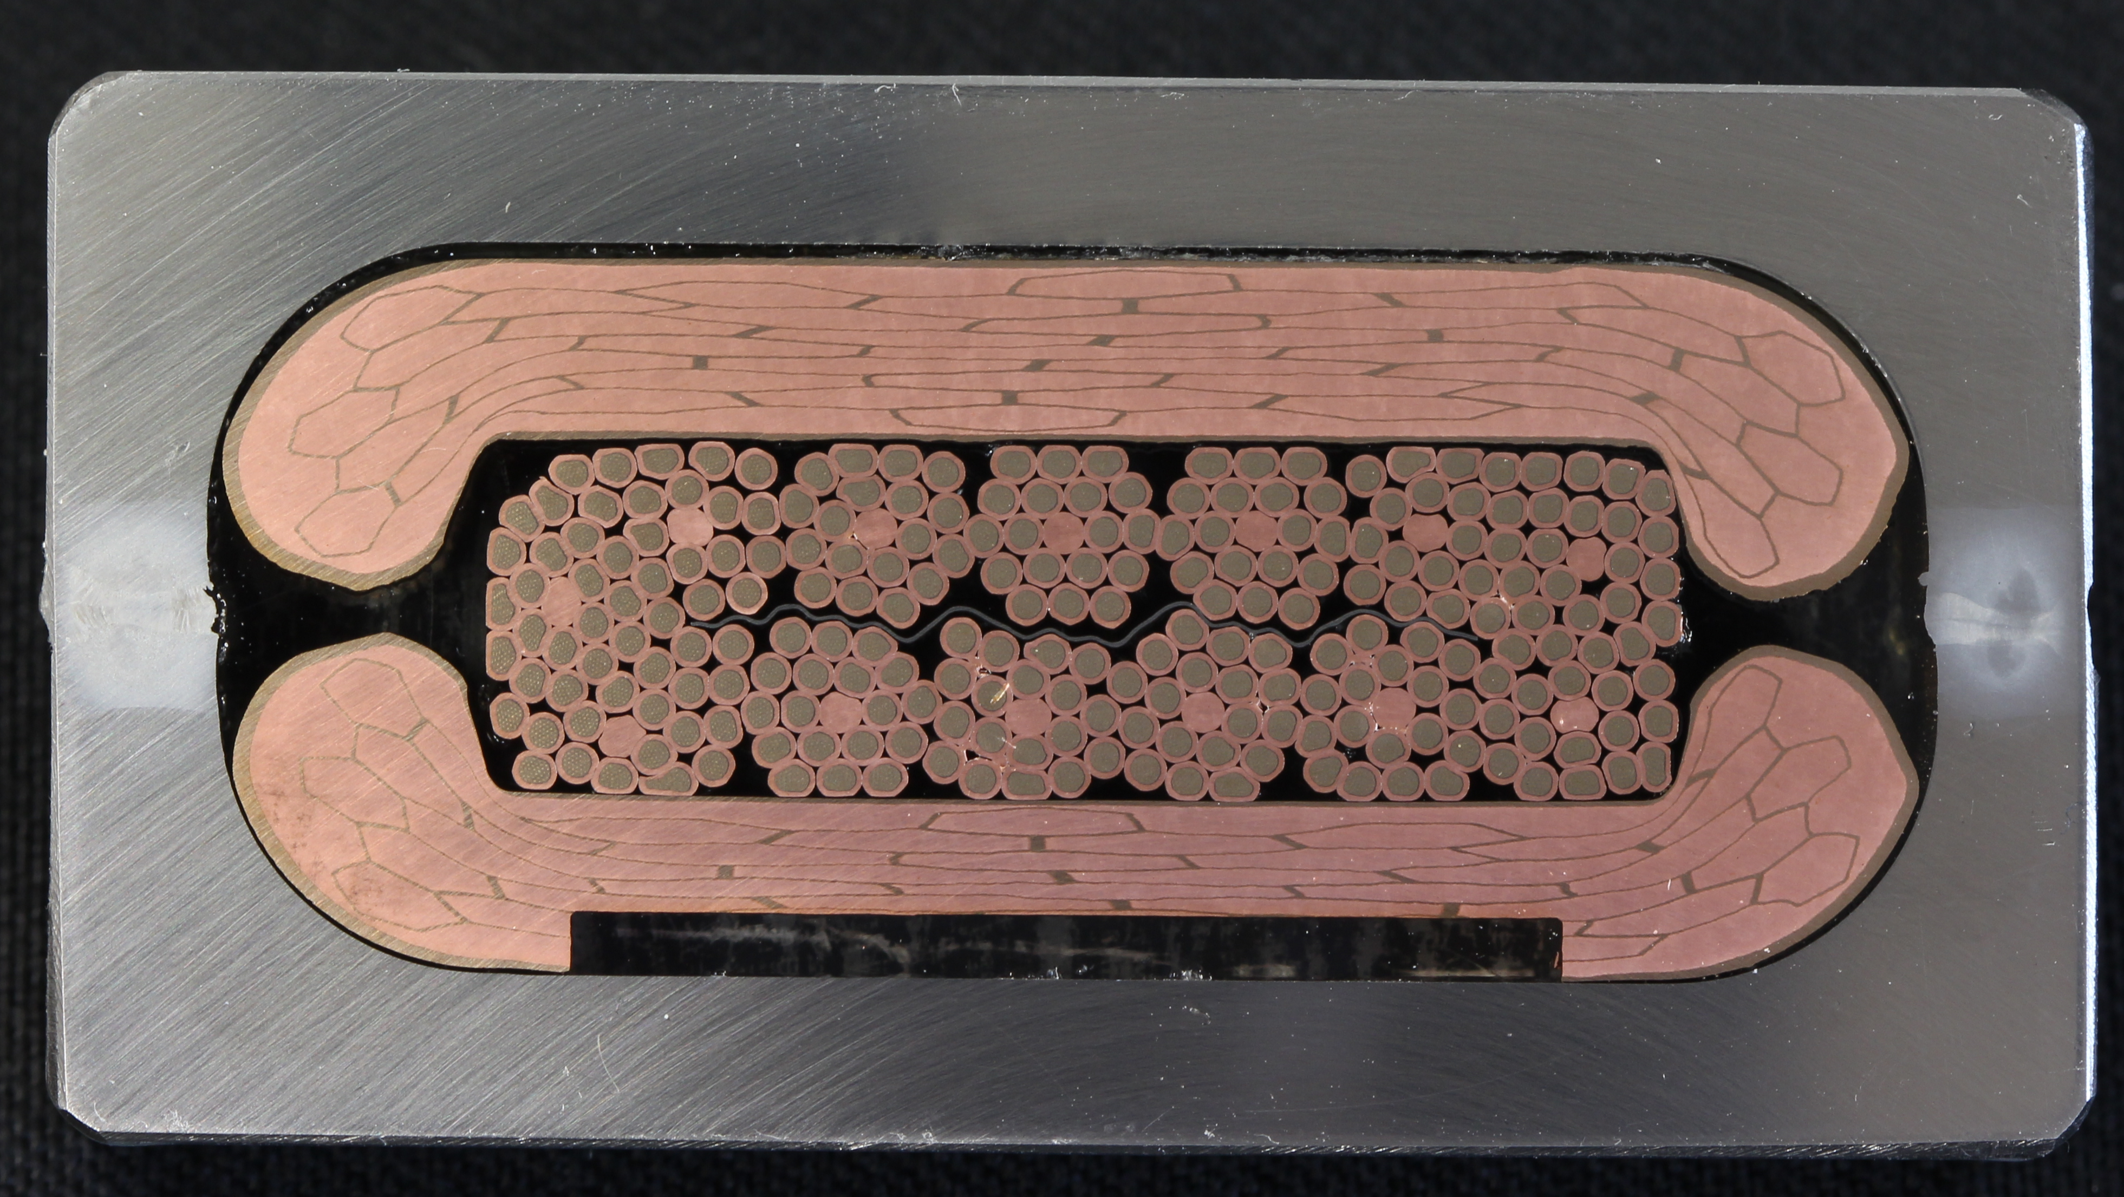
2015 TF Conductor Design
  Lesson from the RW2 prototype testing:
  High eddy current loss due to the mixed-matrix-stabilizer
  Stable DC performance of the R&W conductor requires mechanical pre-load in the transverse direction – incompatible with the rectangular cooling channel.

Slide 4
New Cond. Design (2018 DEMO baseline)
Mixed-matrix replaced by a higly-compacted Rutherford cable made of CuNi-cladded Cu wires. Void fraction of ~10%.
Cooling channel moved next to the cable – preload compatible.
Conductor design already tested with RW2 cable – see the R&D presentation of Pierluigi Bruzzone.

Slide 5
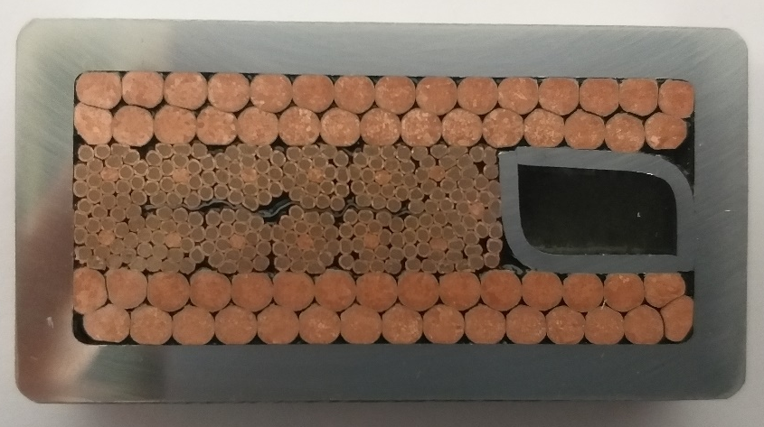
New Cond. Design (2018 DEMO baseline)
Mixed-matrix replaced by a higly-compacted Rutherford cable made of CuNi-cladded Cu wires. Void fraction of ~10%.
Cooling channel moved next to the cable – preload can be done.
Conductor design already tested with RW2 cable – see the R&D presentation of Pierluigi Bruzzone.

Slide 6
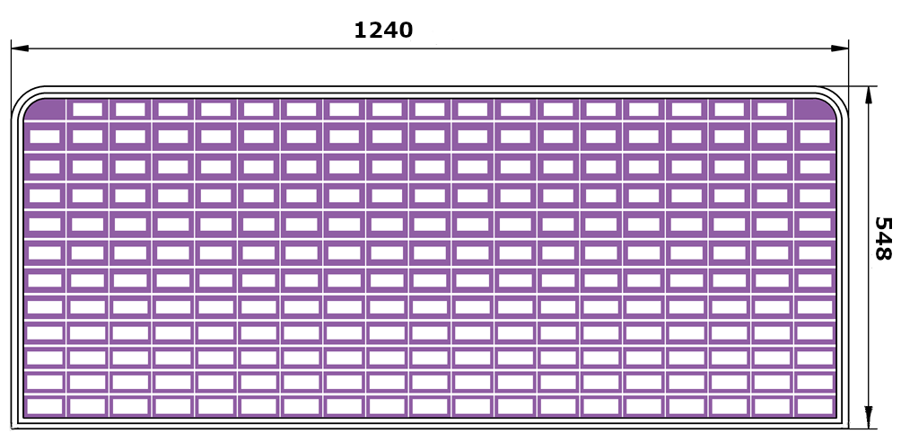
TF Nominal WP design
Low field region, accumulated stress
High field region, plasma facing side, high Nuclear heat load

Slide 7
Main Design Features
Conductor dimensions: L1 = 61 x 33; L11 = 61 x 46 (mm²)
Cable dimensions: L1 = 34 x 9; L12 = 22 x 5 (mm²)
N_{turns} = 226
A_{sc}: L1 = 116 mm²; L12 = 38 mm²
I_{op} = 66 kA
Jsc: L1 = 560 A/mm²; J12 = 1826 A/mm²
J_{Cu} = 90 A/mm²
Assumed effective strain: ε = -0.30%
B_{eff} (L1) =12.1 T; B_{eff}(L12) = 6.45 T
A_{He}: cooling of L1 relies on the transverse heat transfer.
Layer | He in cooling channel
 | mm2
1 | 112.7
2 | 136.6
3 | 124.9
4 | 134.5
5 | 126.4
6 | 58.3
7 | 58.3
8 | 50.5
9 | 49.3
10 | 50.6
11 | 49.1
12 | 51.4

Slide 8
Max. Field Design

Slide 9
Max. Field Design
Increased operating current: 66 kA → 71.5 kA
Decreased number of turns (19 → 18) – to gain more space for more superconductor (higher field, higher current)
Increased number of layers (12 → 14) – to increase overall current in the WP.
N_{turns} : 226 → 250
A_{sc}: L1 = 116 mm² → 215 mm²
Jsc: L1 = 560 A/mm² → 330 A/mm²
J_{Cu} = 90 A/mm² (no change)
Assumed effective strain: ε = -0.30% (no change)
B_{eff} (L1) =12.1 T → 14.2 T

Slide 10
Max. Field Design
Preliminary

Slide 11
Magnetic Field Calculations

Slide 12
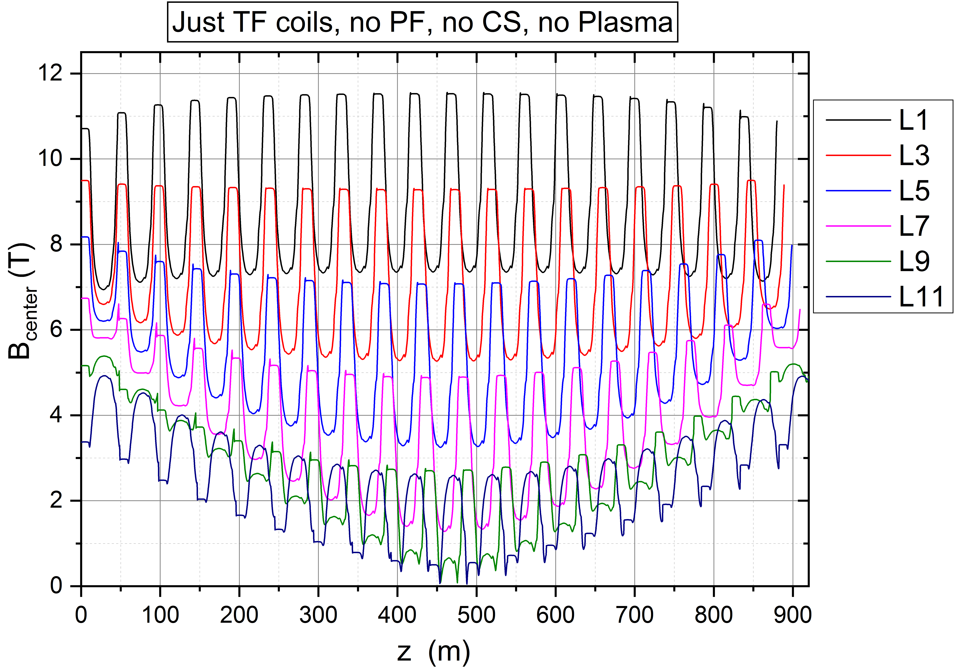
B_{c} along the Conductor (Nom. Design)

Slide 13
Conclusions
Task Status:
TF nominal design – finished.
TF maximum field design – small adjustment still needed
Electromagnetic analysis – finished for nom. design
Thermal-hydraulic analysis – still to be done.
General Comments:
The design updates reflect experience gained in the R&D program.
Alternative designs might be investigated.

Slide 14
TS Proposal 2020
The recommendation of the Panel of experts of the Design Progress Review meeting in December 2019 was to study a possible voltage reduction of the TF coils. Initial considerations in the running PMU task PMI-2.1-T30-D002. Within the WPMAG task, that preliminary PMI study will be extended by:
Assessment of the impact of mechanical loads on the TF winding pack design (amount of stainless steel in different layers).
More precise assessment of the required copper cross-section taking into consideration radial heat transfer for increased discharge times.
Discussion of combined effect of higher conductor current and longer discharge times on TF voltage or number of TF feeders.
Deliverable: TF coil design with the reduced HV operation. (R. Wesche) 0.3 ppy

