Slide 1
MAG-2.1-T026-D003: CEA TF WP design
L. ZANI & CEA team
WPMAG Final Meeting, 12th Feb. 2020, Frascati

Slide 2
Introduction
Task content
TF system
  Refine radial plates (RP) TF WP#4 design on 2018 DEMO baseline through working on inputs and upgrading MADMACS-TF tool RP option features (e.g. RP radial thickness, mechanical approach including small FEA mechanical studies…).
  Pre-CDR preparation: for DN, Snowflake and Super-X, establish cross-section of TF coils at the poloidal locations of the VV ports, alternatively: statement that TF coil is infeasible including justification.
  Run MADMACS-TF to carry out optimization loops on DEMO 2018 configuration with impact on TF design of refined input calculations loops (EM map, TH calculation, cryoplant operation optimization…). Provide recommendations on the most valuable flow to proceed with
not conducted ⇨ inputs to be provided

Slide 3
Methodologic considerations
Recall: WP#4 RP concept remains within the ITER-like approach
No side pancakes
Similar CICC embedding in RPs as ITER approach

Slide 4
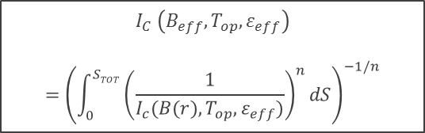
Methodologic considerations
Objectives: after 2018 DPRM recommendations tentative improvements were considered
r
geometry
mechanical
EM
Insulation layers
● ground + ins. gap
● inter-plates
● inter-turn
⇦ 8 + 10 mm
F_{L}(r)
B_{MAX}
⇦ 2 mm
cable
⇦ 1 mm
dS
etc…
B_{MIN}
$$I_{C} \left(B_{eff},T_{op},ε_{eff}\right)$$
$$={\left(\int_{0}^{STOT}{{\left(\frac{1}{I_{c}(B(r),T_{op},ε_{eff})}\right)}^{n}}dS\right)}^{−1/n}$$
a
a
a/2
a/2
etc…
I_{c}(B_{eff}) adapted
a/2
decouple r-q
& optimize
Refined gradient
increase
F_{L}(r)
Jacket + RP merged
Check with FEA

Slide 5
Methodologic considerations
The design changes were still carried out with CEA tool ➔ MADMACS-TF
The workflow was adapted to allow decorrelating the radial and toroidal RP thicknesses
First attempt was to decrease the radial thickness to gain radial built…but…as per ITER DDD…
Critical zones appear to be in the radial part of the RPs thickness
Toroidal parts of RP thickness seem to be safe
Image extracted from ITER DDD
This difference might come from the addition of the vault effect and compression
➔ The FEA will give an answer to this interrogation
➔ At pre-design stage a similar approach will be applied for DEMO WP#4

Slide 6
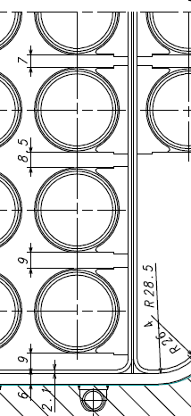
Methodologic considerations
The design approach considers a graded radial thickness that can accomodate the possible contrains on the inner parts of the WP#4, with the rules as:
- highest value possible on last turn
- high value on the two previous turns
- low value on other turns, min. ½ max
Rad. thck.
λ_{R}
λ_{T}
Rad. thck.
The radial thickness pattern was considered in confrontation with ITER one
Tor. thck.
7
λ_{R}
8.5
DP insulation
RP insulation
The reference design is carried out with overall constrains consistent with the the DEMO 2018 reference baseline for WP#3
- maximum width of WP housing = 1240 mm
(mechanical rationale > outerleg under OOP loads)
- maximum total TF thickness = 1.25 m
(EM rationale > same room for CS > constant flux)
- same maximum field (11.99 T)
9
9

Slide 7
WP#4 updated design
As result the WP#4 (upgraded approach) features are below
DEMO 2018 Reference
TF features | WP#4 | WP#3
Conductor current (kA) | 93242 | 92091
# of SC strands | 831 | 848
# of Cu strands | 996 | 965
Cable dimensions (mm) | 52.9 | 51.6 x 44.9
# of pancakes | 16 | 18
# of turns (regular pancakes) | 10 | 9
Jacket thickness (mm) | 1.5 | 9.3
RP toroidal thickness λ_{T} (mm) | 17.2 | -
RP radial thickness λ_{R} (mm) | Turns 1~7 → 6 mm Turns 7~8 → 11 mm Turn 9 → 12 mm | -
Casing Tresca stress (MPa) | 623.3 | 629.6
Jacket+RP Tresca stress (MPa) | 616.9 | 620
SC strand amount (t) | 840 | 873
The leftover space for insultation allowed the below features
  Conductor insulation = 0.5 mm
  RP insulation = 1 mm
The SC amount is slightly smaller (~ - 4%) than WP#3
  Similar B_{EFF} effect as for DEMO 2015 comparison
small figures ➔ possible optimization of insulation
➔ refinement of B_{EFF} calculation

Slide 8
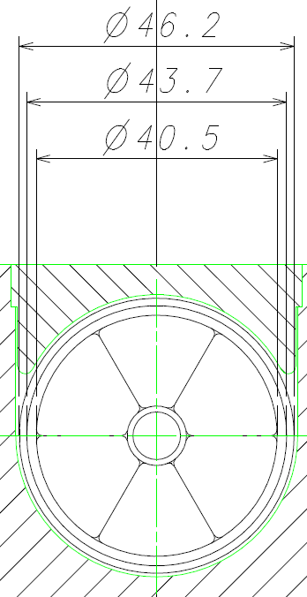
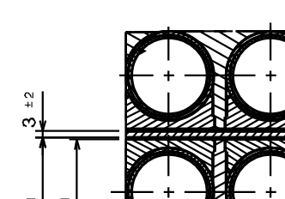
Updated WP#4 optimization
Insulation dimension improvement
Conductor insulation
All WP#4 features are unchanged, except:
 housing toroidal dimensions
→ increase from 1240 to 1310 mm (+ 70 mm)
→ outer leg side thickness decrease ( -35 mm over 150 mm)
► consequences on OOP load absorption?
 housing radial dimensions
→ increase from 680 to 700 mm (+ 20 mm)
→ s_{CAS} increase 623 to 643 MPa (+20 MPa)
→ no TF inner boundary change (CS unchanged)
► no strong consequences
ITER reference
→ 1.25 mm
DEMO
→ 1.5 mm
RP insulation
ITER reference
→ 3 mm
the mecanical FEA is expected to give guidelines to identify the upgrades boundaries
FEA carried out on the reference design
DEMO
→ 5 mm
          ⇨ see MAG-3.1 presentation

Slide 9
Updated WP#4 optimization
Electromagnetical representation improvement
→ calculate more accurately B gradient with WP#4
With MADMACS-TF model
> linear approach with direct correlation between radial excursion (from machine axis to plasma side) and B variation (from B_{MAX} to zero) ΔB = 0.88 T B_{EFF}= 11.54 T
With improved approach
> self-field is considered as acting on the most loaded conductor (infinite round cable) exclusively (no grading from other conductors)
DB = 1.43 T B_{EFF}= 11.31 T
DEMO 2018 Reference
TF features | WP#4 ref | WP#4 + self fied
# of SC strands | 831 | 774
# of Cu strands | 996 | 138
Cable dimensions (mm) | 52.9 | 52.7
SC strand amount (t) | 840 | 783
An improved field determination can save SC amount (~ 7% in simple approach)
An overall precise B map calculation is foreseen with an adapation of CEA tool (TRAPS) to round geometry

Slide 10
Thermo-hydraulic considerations
First Termo-Hydraulic approach with WP#4 upgraded design
In a first attempt a « first degree check » was conducted to see the difference with WP#3
Simplified calculation hypotheses are as below:
B_{EFF} map is deduced from the WP#3 one (calculated with TRAPS)
THEA only is used
  No interpancake heat flux considerations
  No heat load from casing
  WP heat load calculated with “equivalent squares”
- Optimistic approach
- Comparative trend with WP#3 targeted
- ΔT_{MARG} 0.06 K lower than WP#3 in simplified conditions
- WP#3 ΔT_{MARG} evaluated at 1.62 K in relevant conditions (TACTICS)
- WP#4 ΔT_{MARG} expected in suitable range with TACTICS
WP#4 TACTICS model to be run
DT_{MARG} = 1.74 K
          ⇨ see MAG-2.2 presentation

Slide 11
Conclusions - perspectives
Conclusions
  TF WP#4 upgraded design was proposed according to the recommendations of DPRM 2018 panel, with a graded RP concept, within unchanged WP housing.
  Optimisation was attempted, regarding insulation and B_{EFF} calculation. Further investigations on dimensional impact should be evaluated by detailed studies
  First TH analysis is provided, to be followed by another one
Perspectives TS 2020
  Adjustment of WP#4 design according to mechanical FEA
  EM calculation update > transfer to TH
NB: this proposal should be adjusted according to the volume of work (when identified) which is needed for addressing Gate Review documentation

Slide 12
Thank you for your attention
Questions ?

