Slide 1
WPMAG final meeting ENEA TF winding pack design ENEA 2D optimization to maximize the magnetic field MAG-2.1-T027 MAG-3.1-T019
Task Coordinator & Author: G. Tomassetti
Co-author(s): F. Giorgetti, G. de Marzi, C. F. Zignani

Slide 2
Aim
Starting point:
Design Report MAG 2.1 T023 D001 (Layer-wound WP#2 configuration)
Already existing FEA model (see MAG 2.1 T023 D001)
Aim:
update the design in order to achieve a peak magnetic field higher than 11.8 T

Slide 3
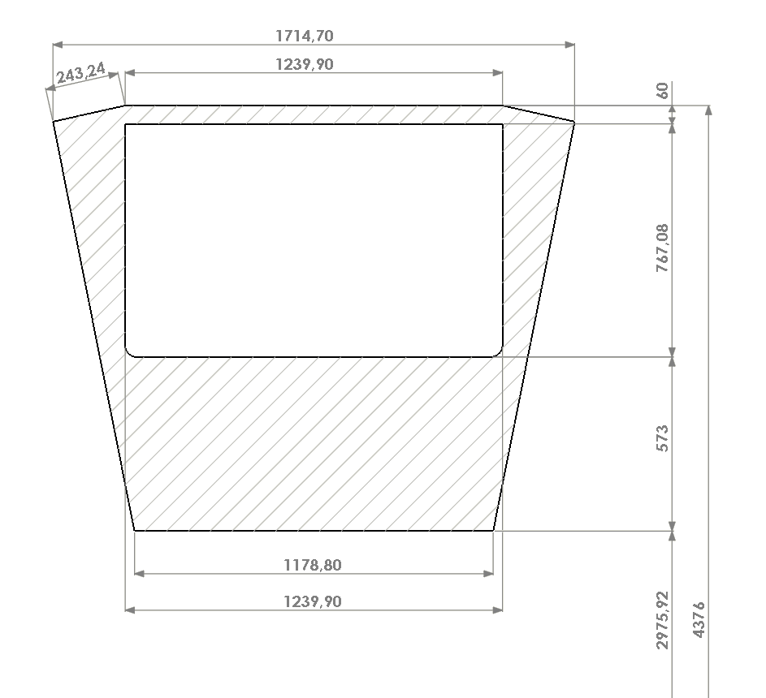
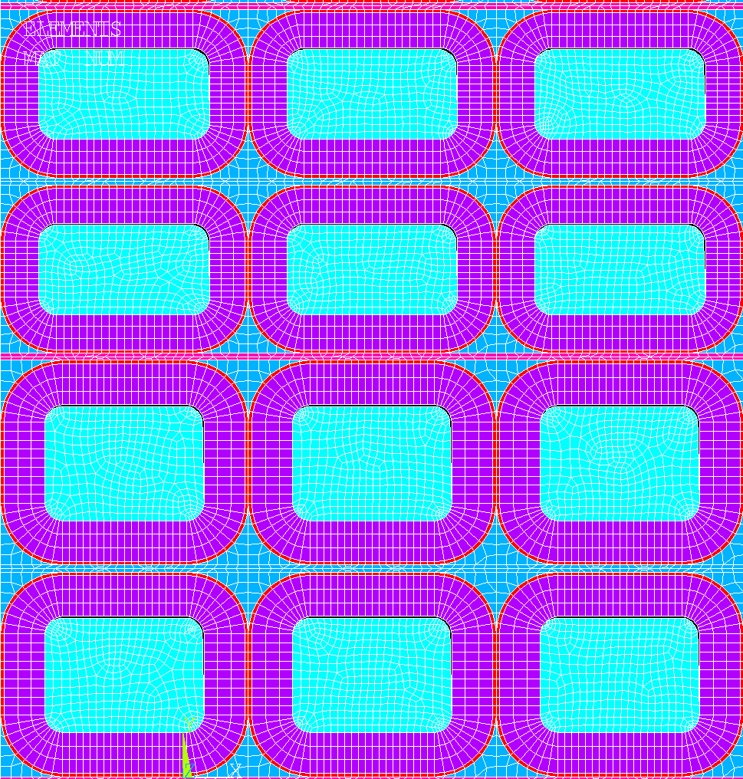
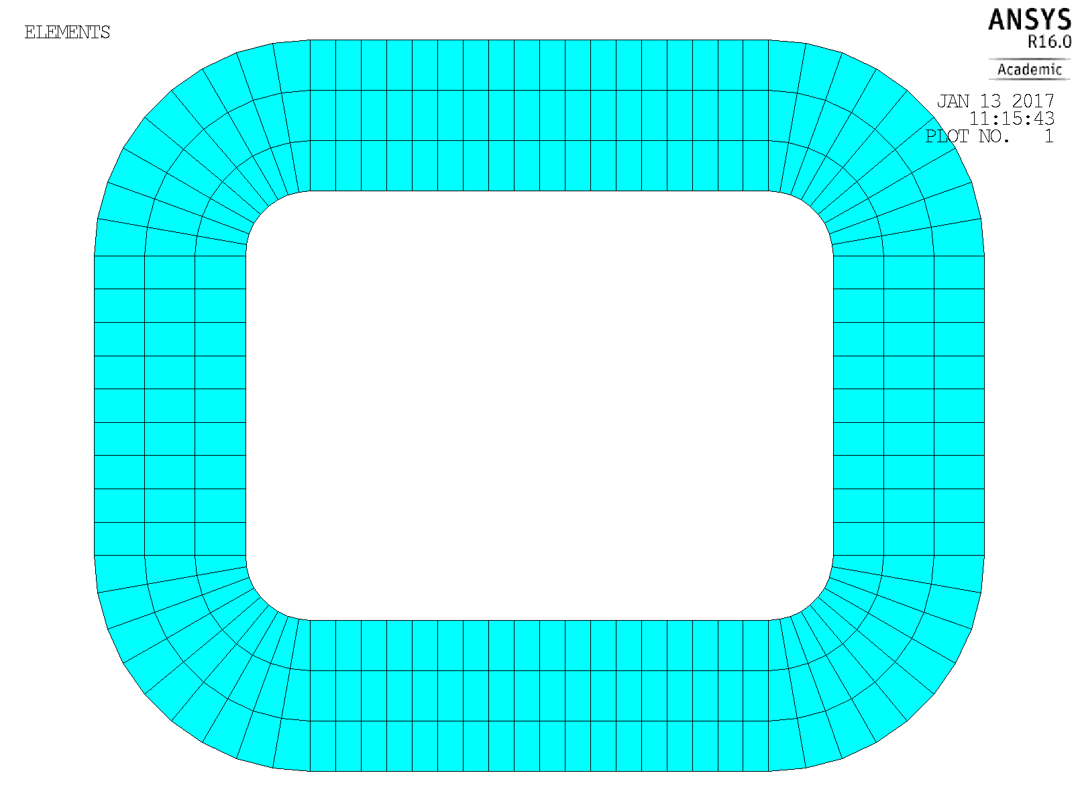
Optimization
Optimization procedure to:
increase the peak field by increasing the current-carrying cross-sections within the TF magnet baseline (MAG 2.1 T023 D001)
As a consequence, needed to:
increase the steel jacket thickness and cable’s height of each conductor
increase the casing nose thickness
n: nose thickness
h: cable’s height
t : jacket thickness

Slide 4
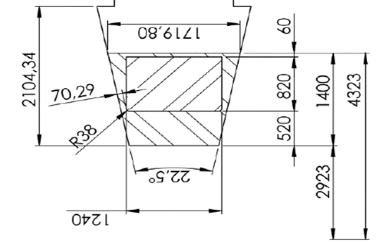
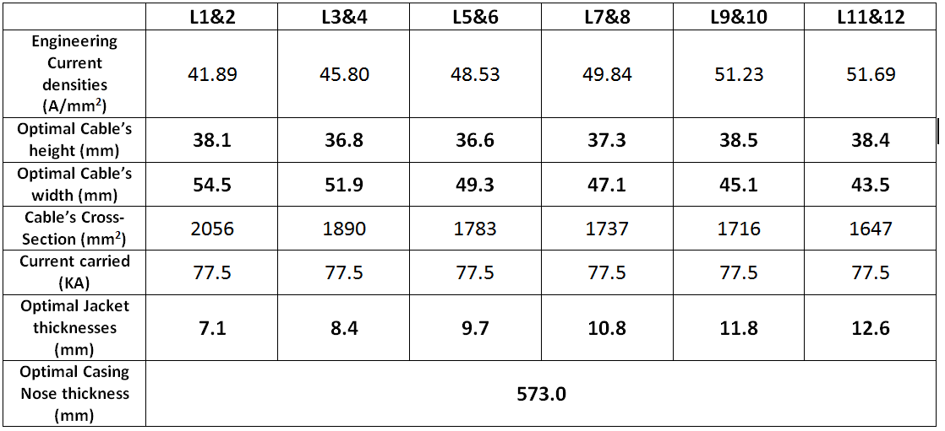
12.5 T - Optimal configuration
2018
Baseline
12.5 T
Optimal configuration found

Slide 5
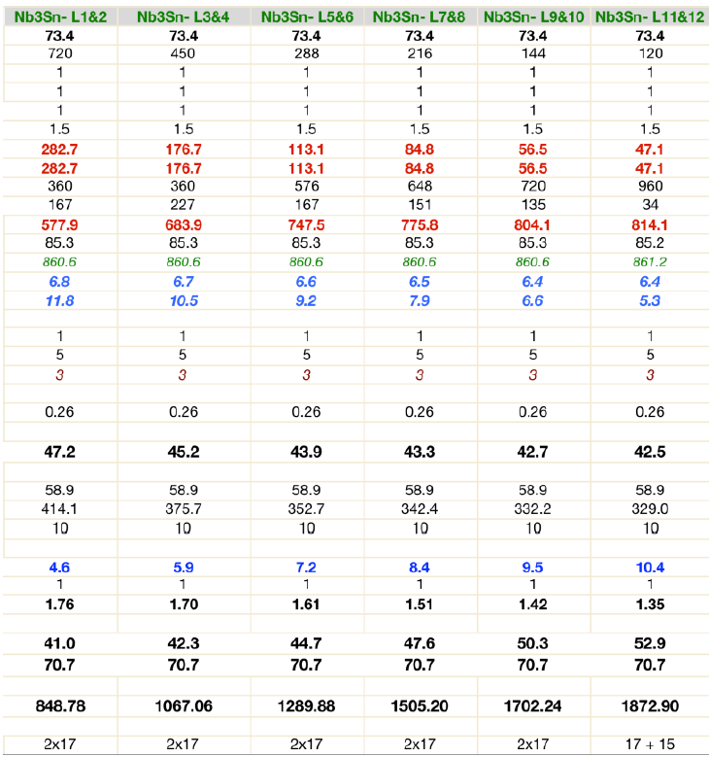
Main conductors’ features
2019
12.5 T
1400 mm
Optimal configuration
2018
11.8 T
1137 mm
Configuration

Slide 6
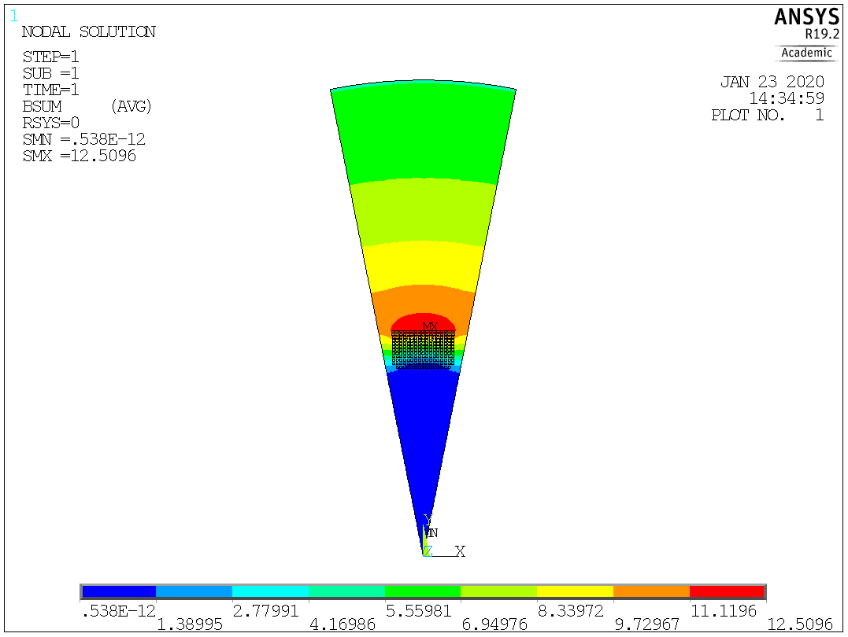
Electro-magnetic results for the optimal configuration / 1

Slide 7
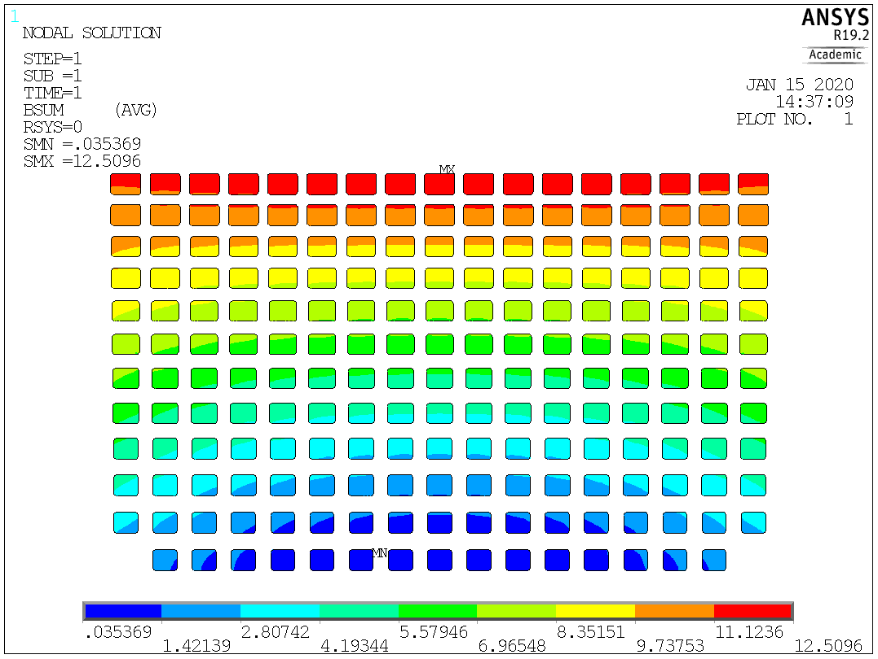
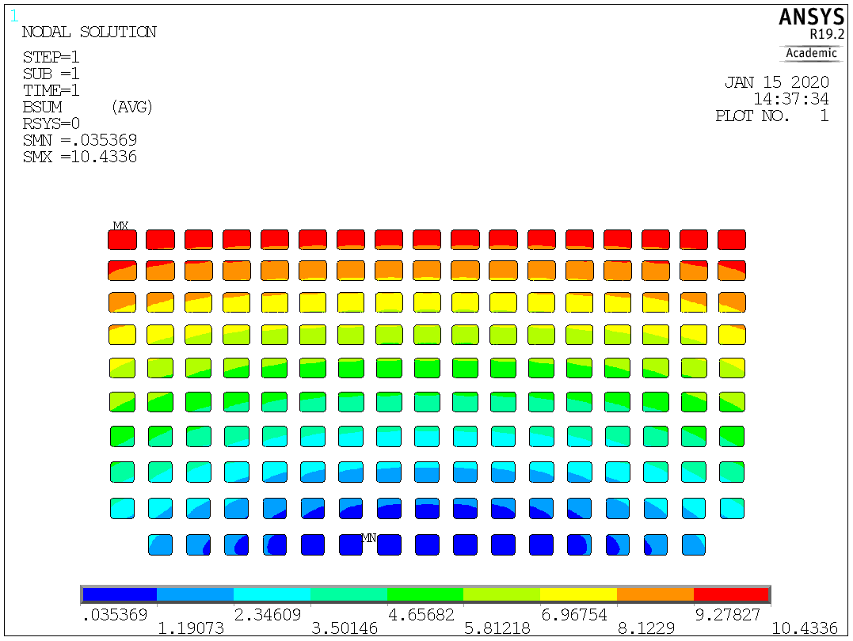
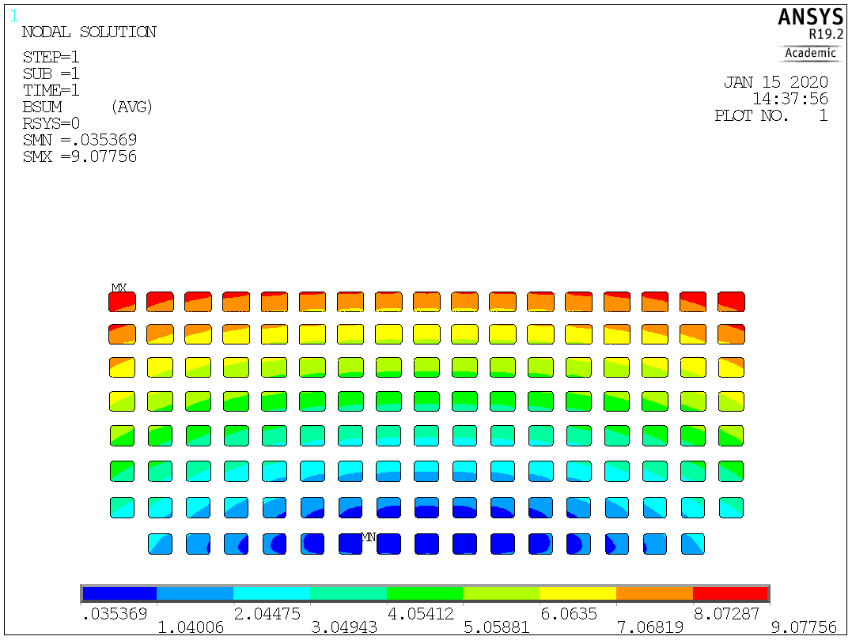
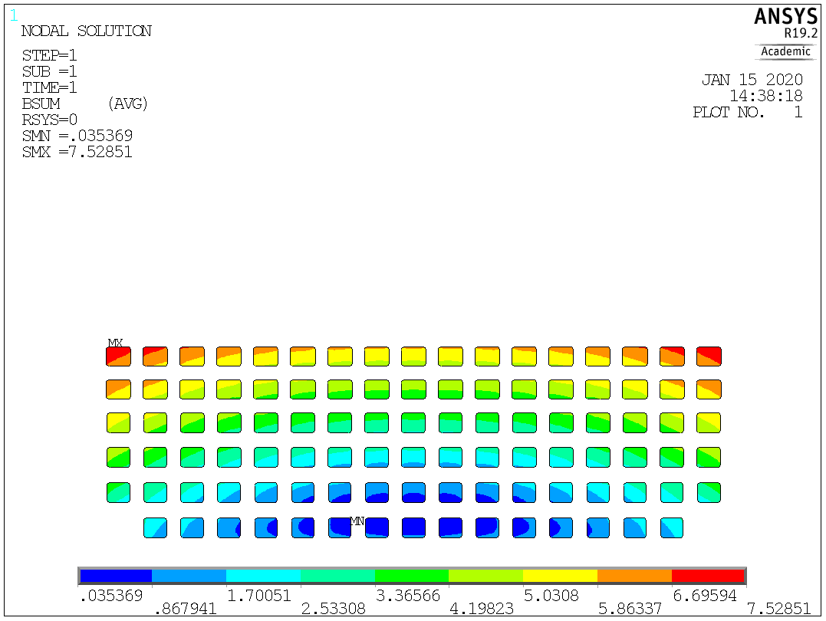
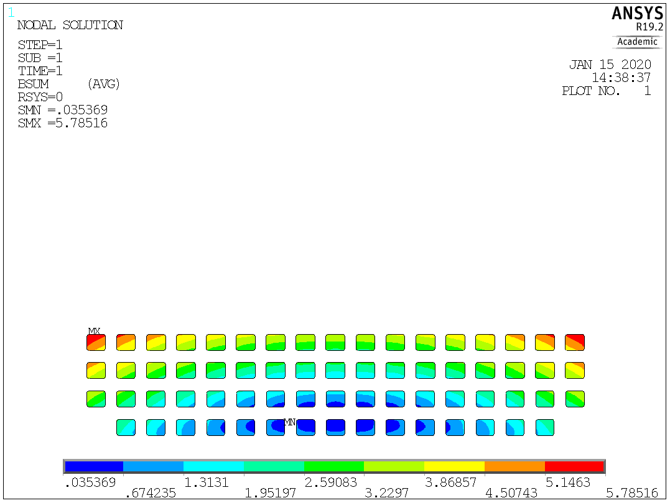
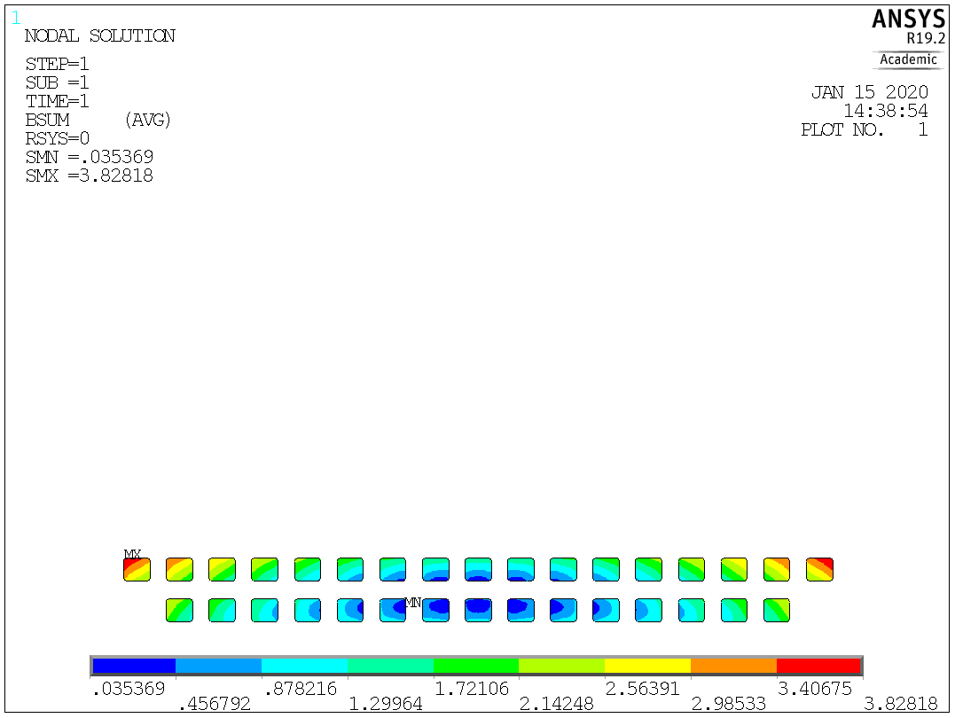
Electro-magnetic results for the optimal configuration / 2
 | L1&2 | L3&4 | L5&6 | L7&8 | L9&10 | L11&12
Max Magnetic Field (T) | 12.5 | 10.4 | 9.1 | 7.5 | 5.8 | 3.8

Slide 8
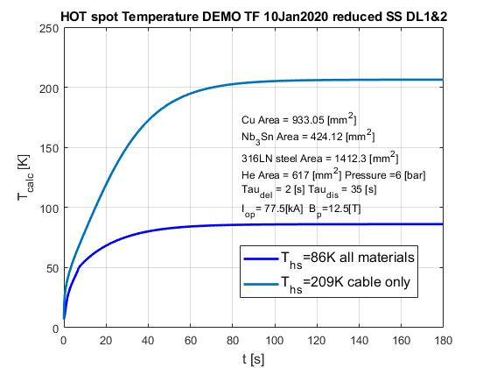
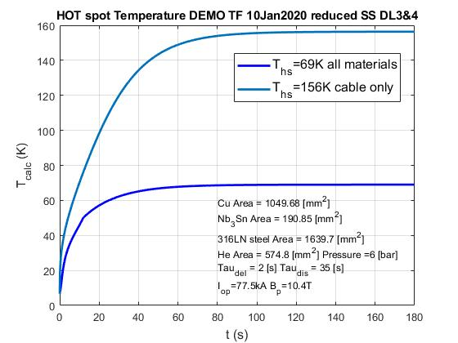
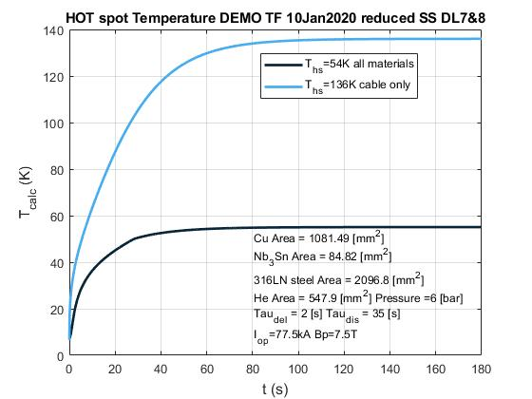
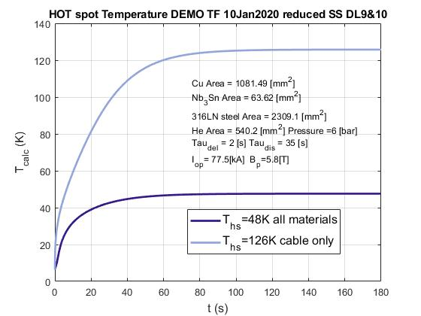
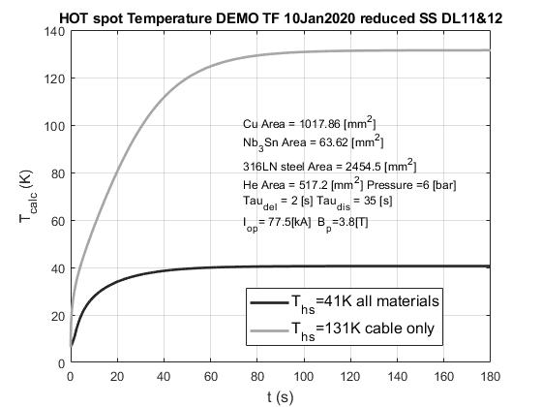
Hotspot calculations
ITER design criteria:
T_{hot spot} < 150 K, if including all conductor components;
T_{hot spot} < 250 K, if only cable materials (Nb₃Sn + Cu) are considered.

Slide 9
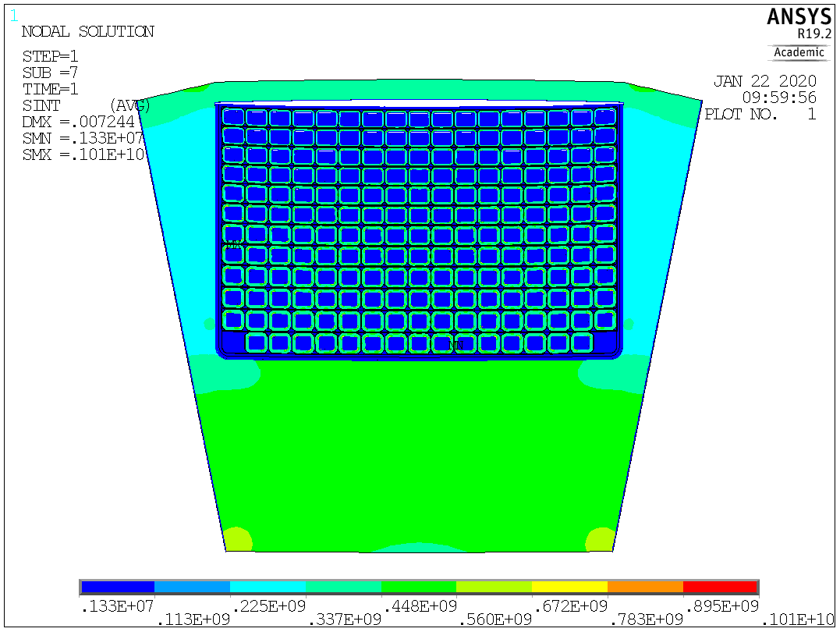
Structural results for the optimal configuration / 1

Slide 10
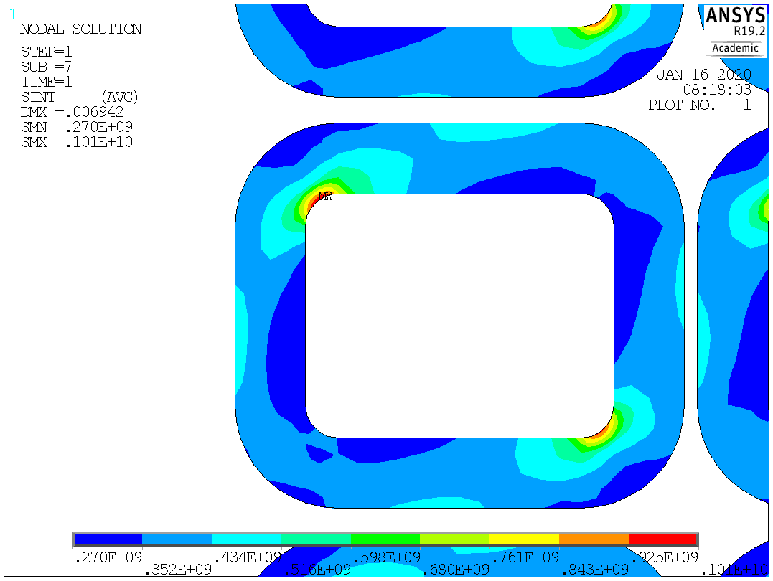
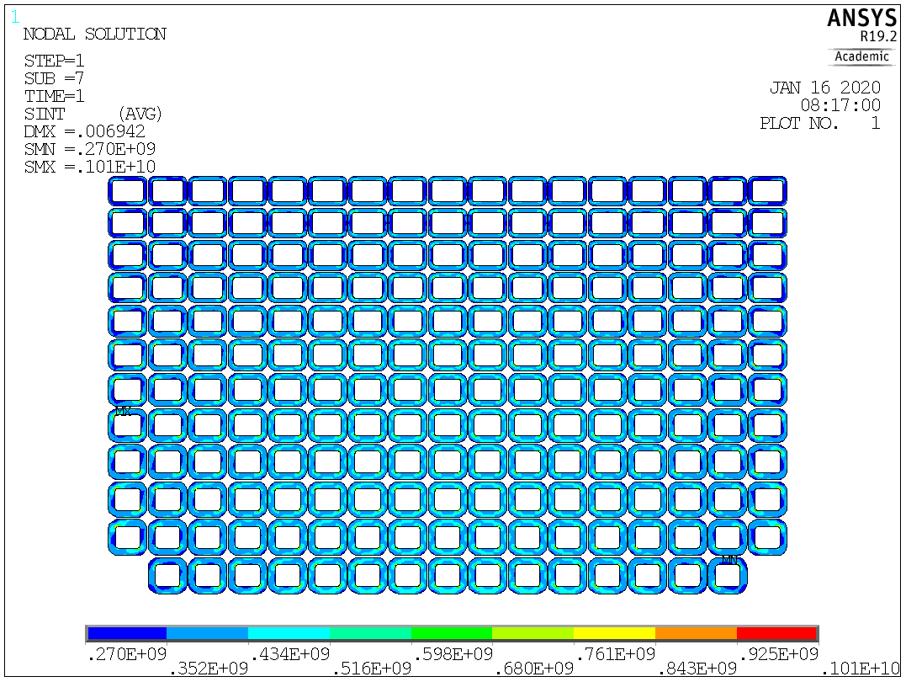
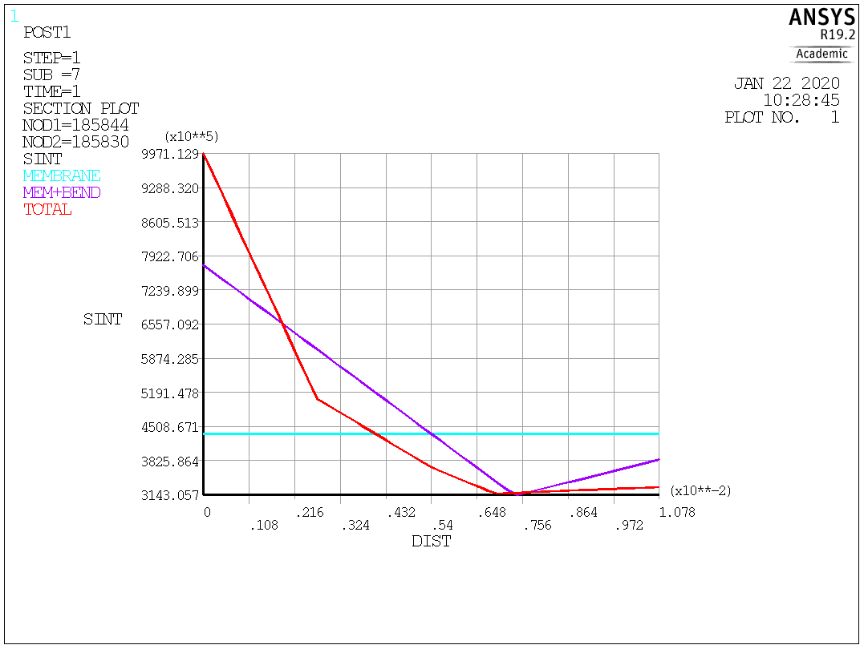
Structural results for the optimal configuration / 2
Pm = 436 MPa < 667 MPa
Pm+Pb = 774 MPa < 867 MPa

Slide 11
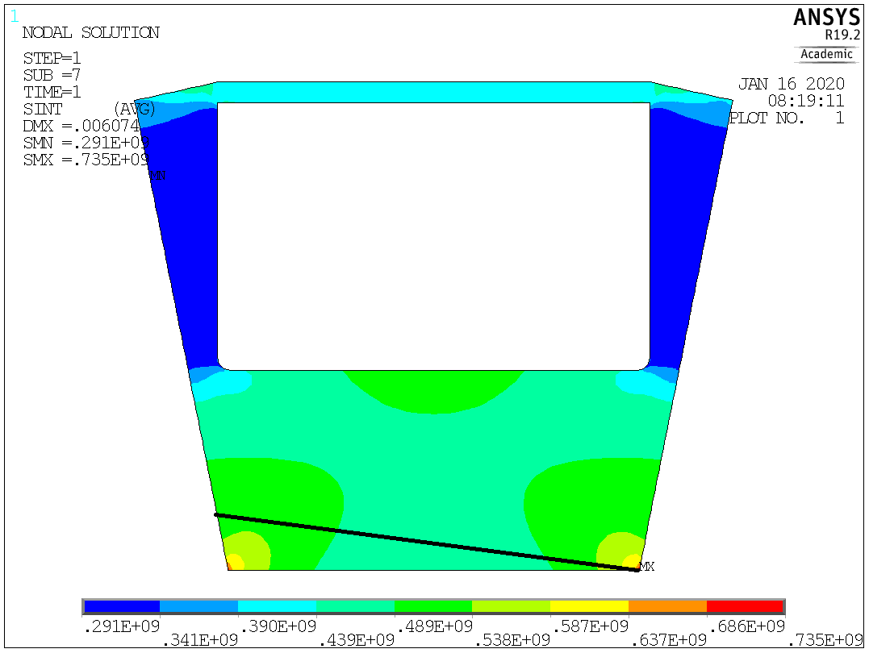
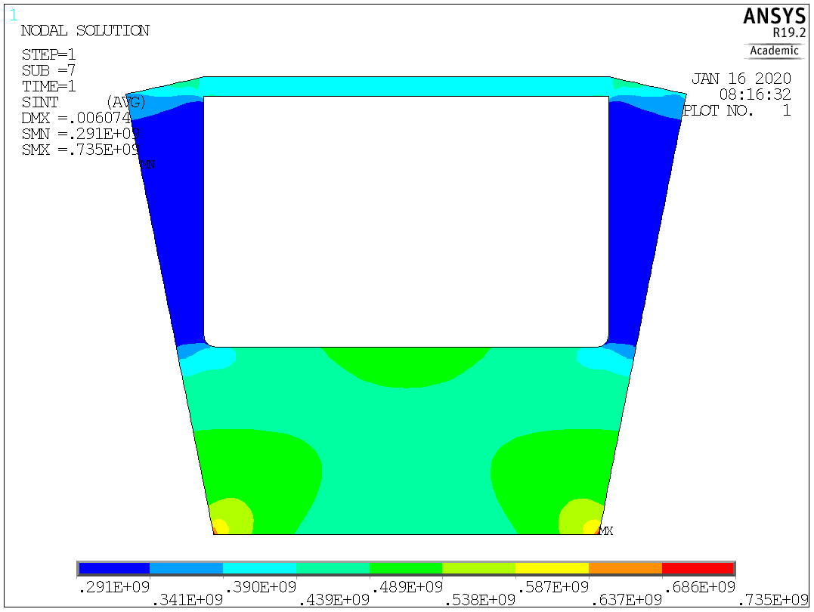
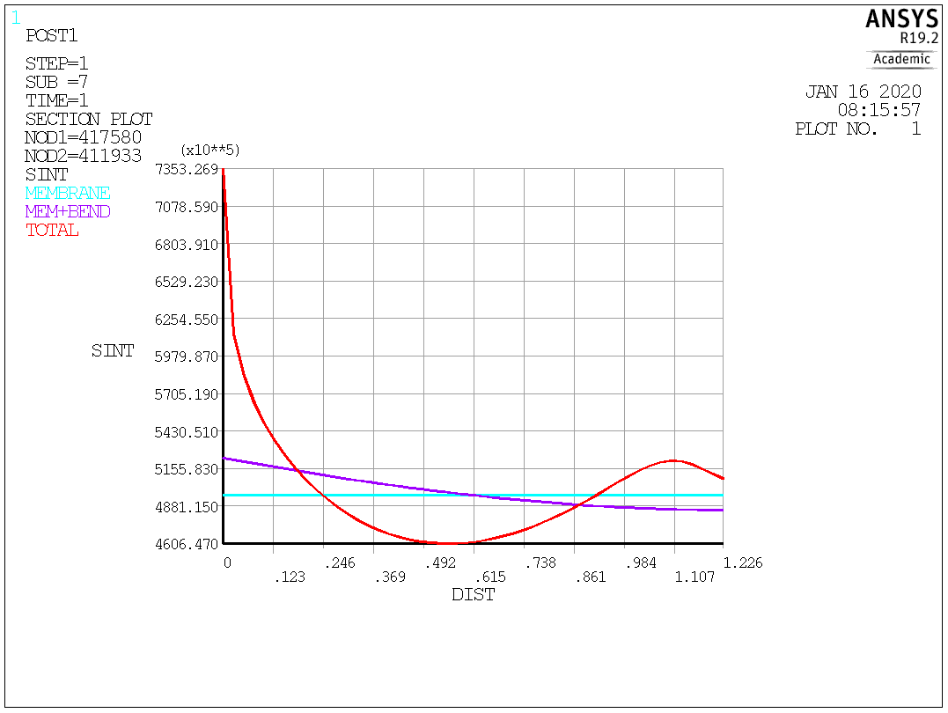
Structural results for the optimal configuration / 3
Pm = 496 MPa < 667 MPa Pm+Pb = 520 MPa < 867 MPa

Slide 12
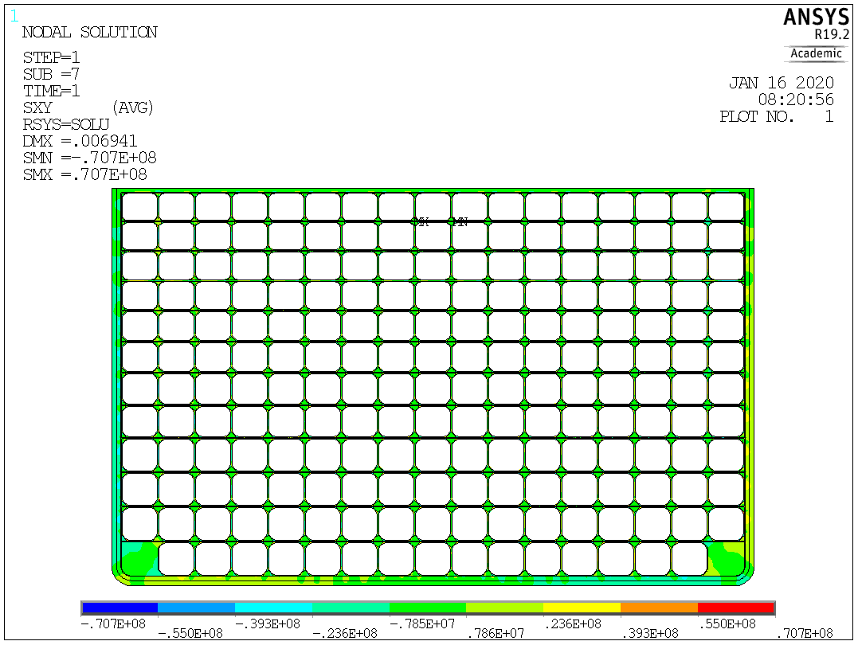
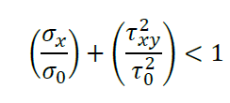
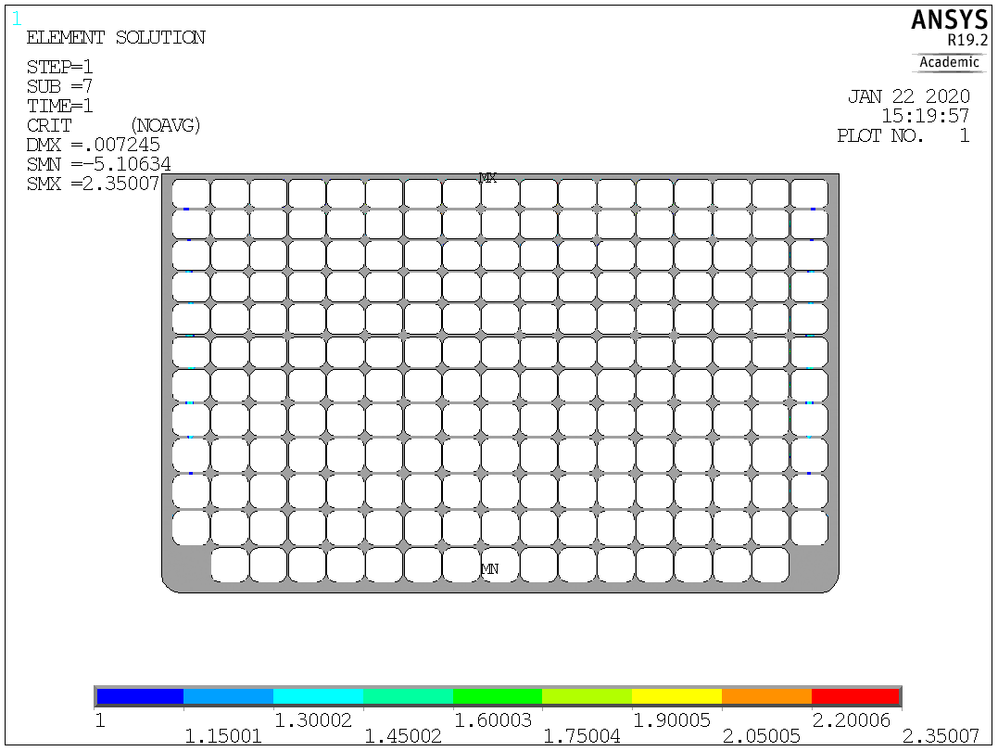
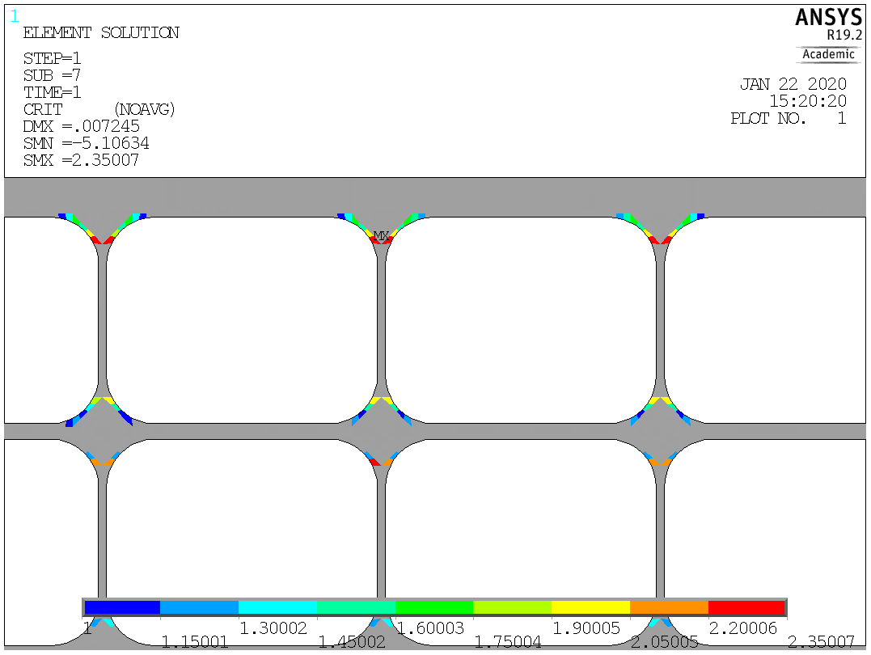
Structural results for the optimal configuration / 4

Slide 13
Conclusions
 | 2018 | 2019
Peak Magnetic Field (T) | 11.8 | 12.5
TF Operating Current (KA) | 73.4 | 77.5
Length in the radial direction (mm) | 1137 | 1400
Max Membrane stress in Jacket (MPa) | 439 | 436
Max Membrane+Bending stress in Jacket (MPa) | 847 | 774
Max Stress Intensity in Jacket (MPa) | 1090 | 1010
Max Stress Intensity in casing (MPa) | 740 | 735
Max Shear Stress in Insulation Materials (MPa) | 77 | 71
Max Shear stress parameter in Insulation Materials | 2.94 | 2.35
Hotspot Temperature DL 1&2 (only cable materials) (K) | 247 | 209
Hotspot Temperature DL 1&2 (all materials) (K) | 106 | 86
With respect to the 2018 design:
length in the radial direction was increased to 1400 mm
peak magnetic field was increased to 12.5 T
cabling analyses and hotspot calculations are ok
mechanical stress in cables’ jackets, casing structure and insulation material is less critical than in 2018 design
mechanical stress in cable’s jacket and casing are ok (*)
insulation material is still not compliant (*) but critical areas are smaller and the peak failure criterion parameter is lower
(*) according to the acceptance criteria described in MAG 2.1 T023 D001

Slide 14
Future work
Considering the stress state in SS, there is a mechanical margin for a further increase of the peak magnetic field
Limitations to increase the peak field are mainly due to hotspot calculations and shear stress in the insulation materials

