Slide 1
MAG EU-CN collaboration 2019-2020
ENEA HTS Cable-in-Conduit Conductor Sample
Final meeting – ENEA, February 11th 2020
Andrea Augieri
ENEA, Frascati Research Centre - Superconductivity Laboratory

Slide 2
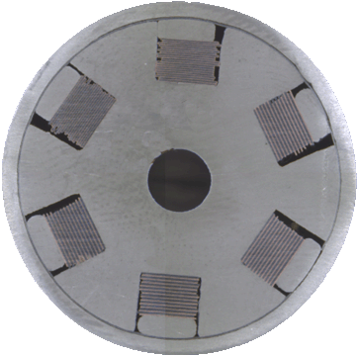
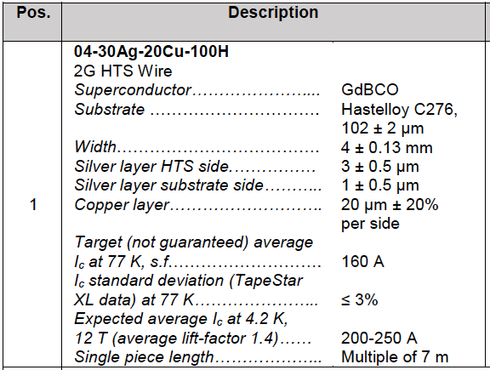
ENEA HTS cable – layout
Twisted 6 slot Al-core (t.p. = 500 mm)
3 HTS stacks + 3 empty slots (no tapes)
HTS tape from SuperOx (4 mm x 0.15 mm)
Expected average I_{c}(4.2 K, 12 T) = 200-250 A
Stack configuration 20 tapes per stack
Expected cable I_{c} @ 12 T, 4.2 K: 250 × # tapes = 12 – 15 kA
Stack distribution: alternate HTS
Empty slots : for tape voltage and temperature sensors wiring

Slide 3
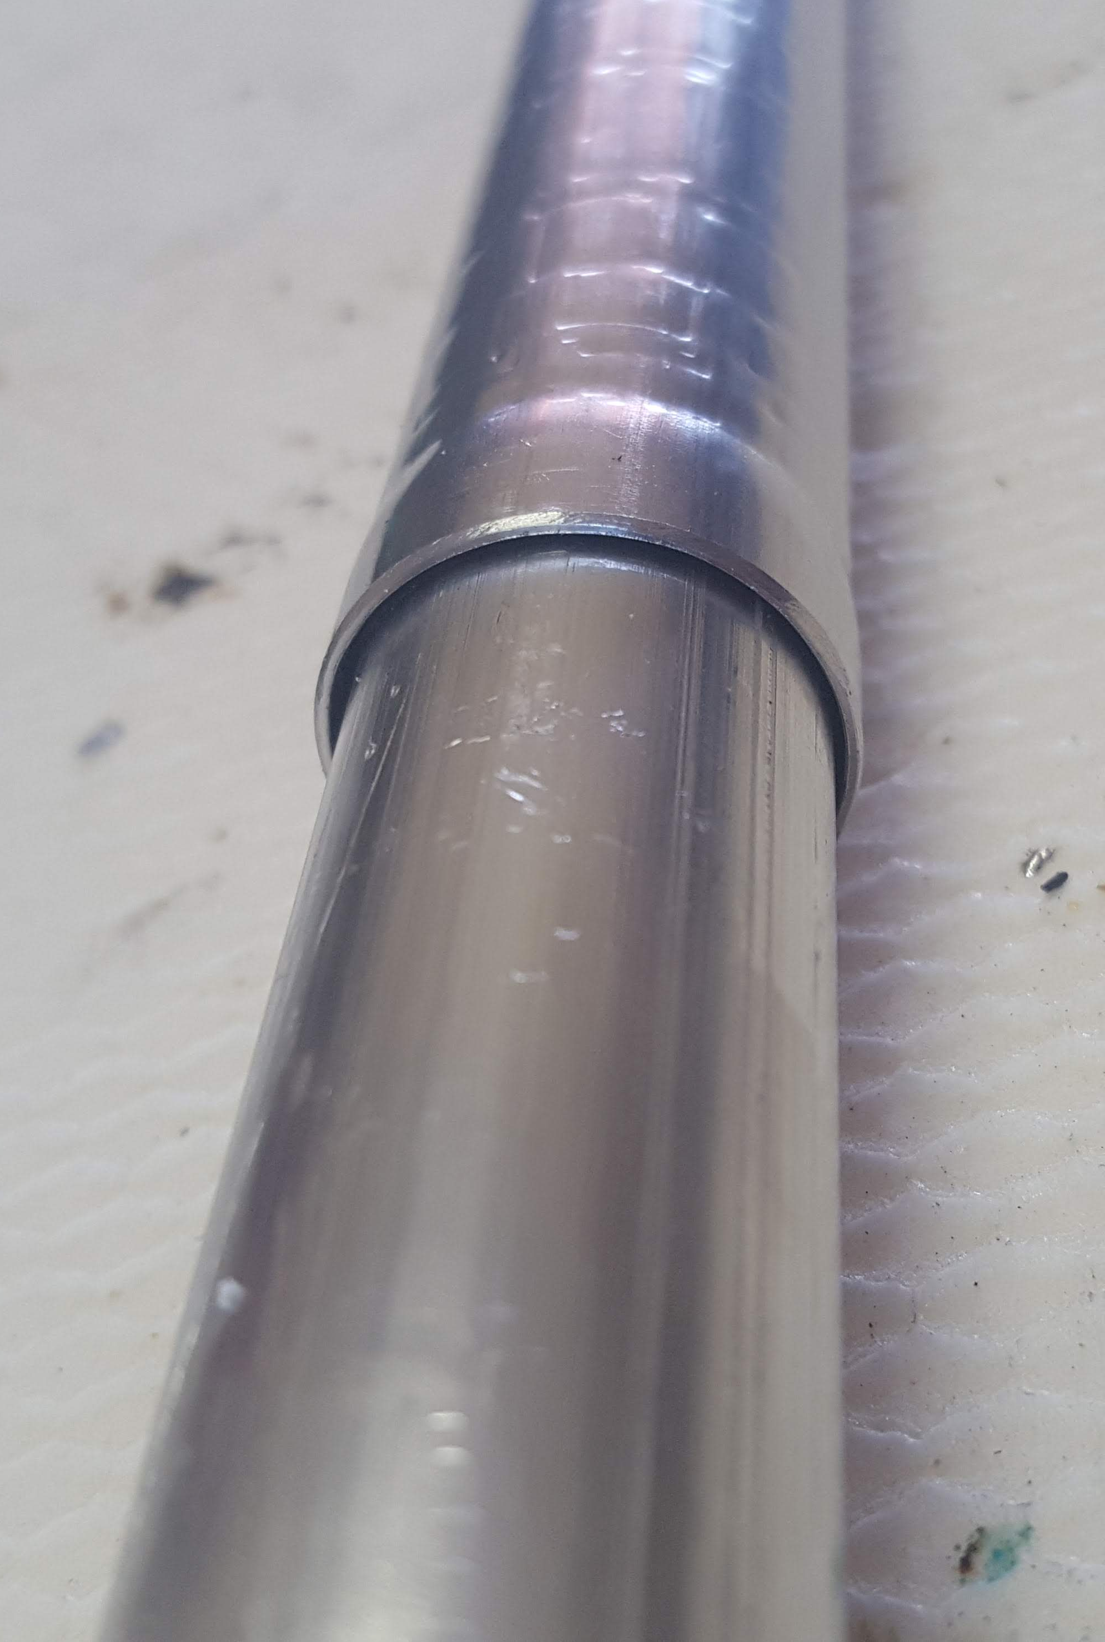
ENEA HTS cable – layout: jacket
Round jacket Al-foil 1.5 mm welded and compacted by drawing
+
SS-tube (1 mm thick) crimped on Al-jacket
SS tube is functional for the cooling purpose:
guarantee suitable He-tight for the cooling system

Slide 4
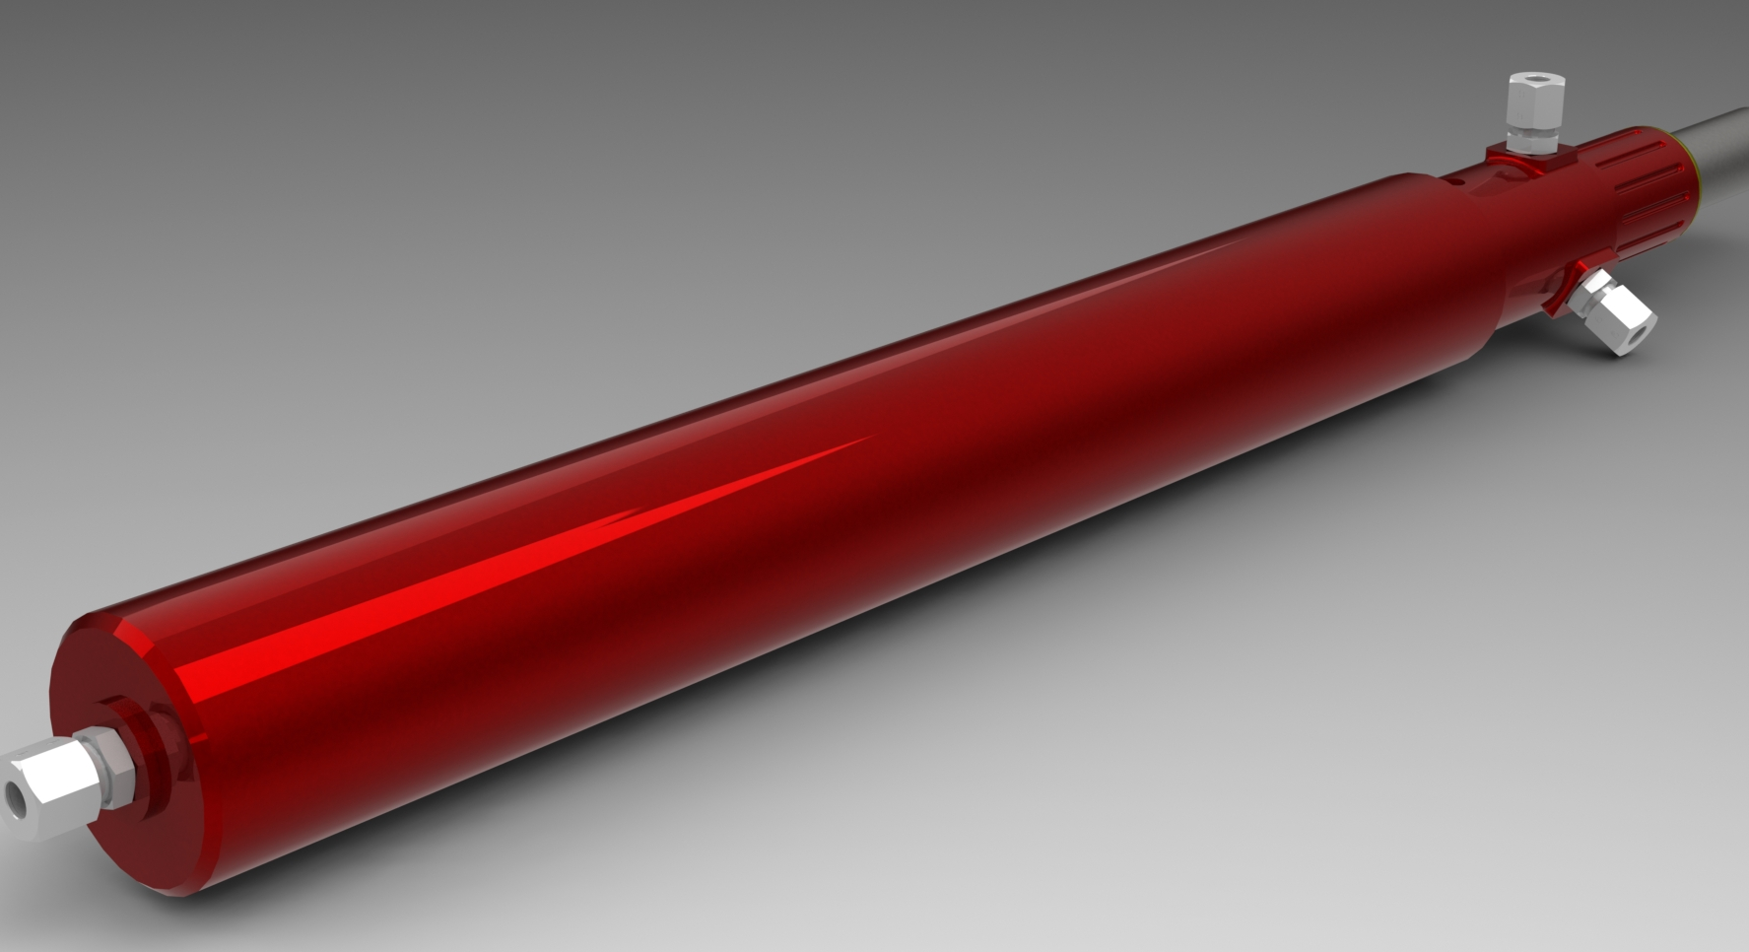
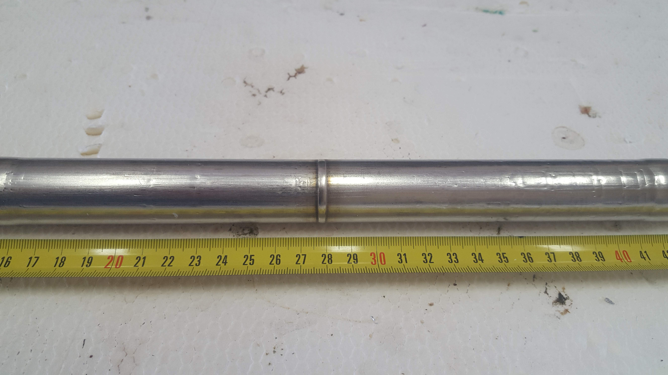
ENEA HTS cable – layout: termination
SS tube external jacket
Cu cylinder
Tig-welded joint
SS
Terminator:
Cu cylinder
+
SS extremity
He inlet
Bottom box based on the same concept
Tig-welded joint
No damage occurred on HTS tape after welding.
Successfully tested!

Slide 5
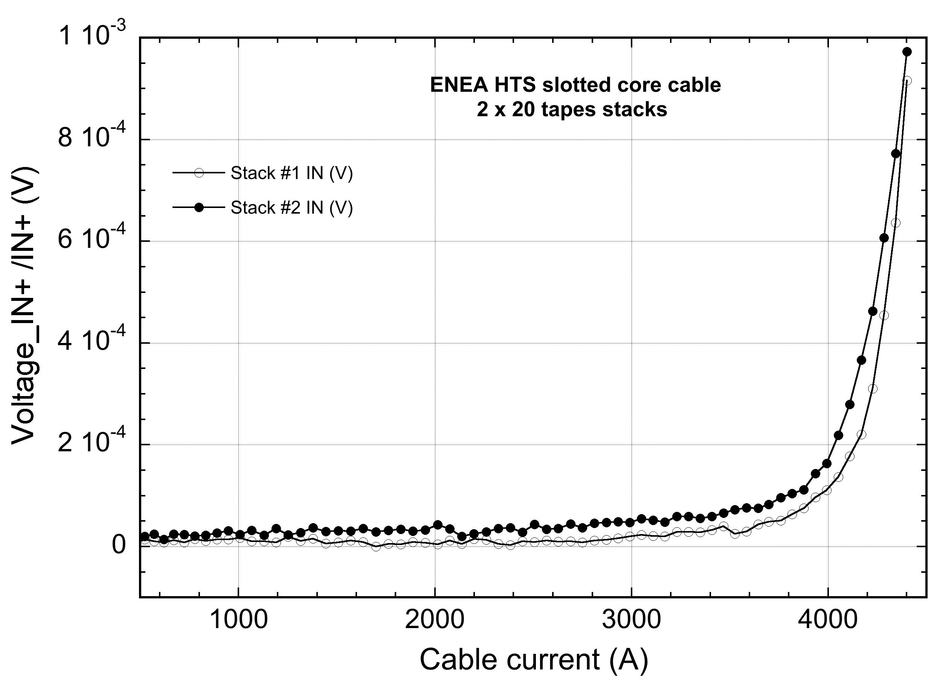
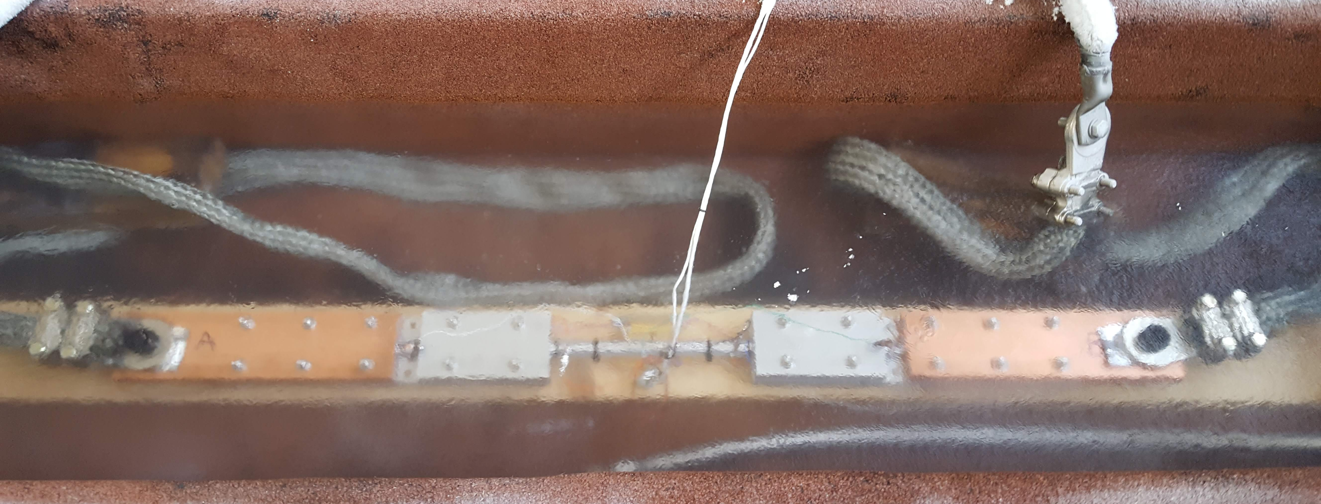
ENEA HTS cable – layout: termination
electrodeposited Cu coating of slots;
Basic features:
staggered stack end inserted into the slot of the Al-core;
triangle-shaped Cu filler
soldered with Pb-Sn paste
Cu-SS cylinder crimped on
I_{c} = 4.2 kA - cable with 2 stacks: 2 x 20 tapes
R_{term} ~ 130 nΩ
LN2 bath Test @ ENEA 20 kA facility

Slide 6
ENEA HTS cable – mock-up sample
Prototype cable fro SULTAN quench experiment has been manufactured
2 m long – 3 HTS slots (20x3 tapes)
He leak test done: PASSED!
Electrical test: on going (in few weeks)
Manufacturing Photo Story
STEPS
Several problems encountered
Several solutions found
Slots Cu electro-deposition
Stack insertion
Wrapping + jacketing
Stack staggering
Cu filler insertion and soldering
Termination soldering and crimping
Thanks to Marcello Marchetti

Slide 7
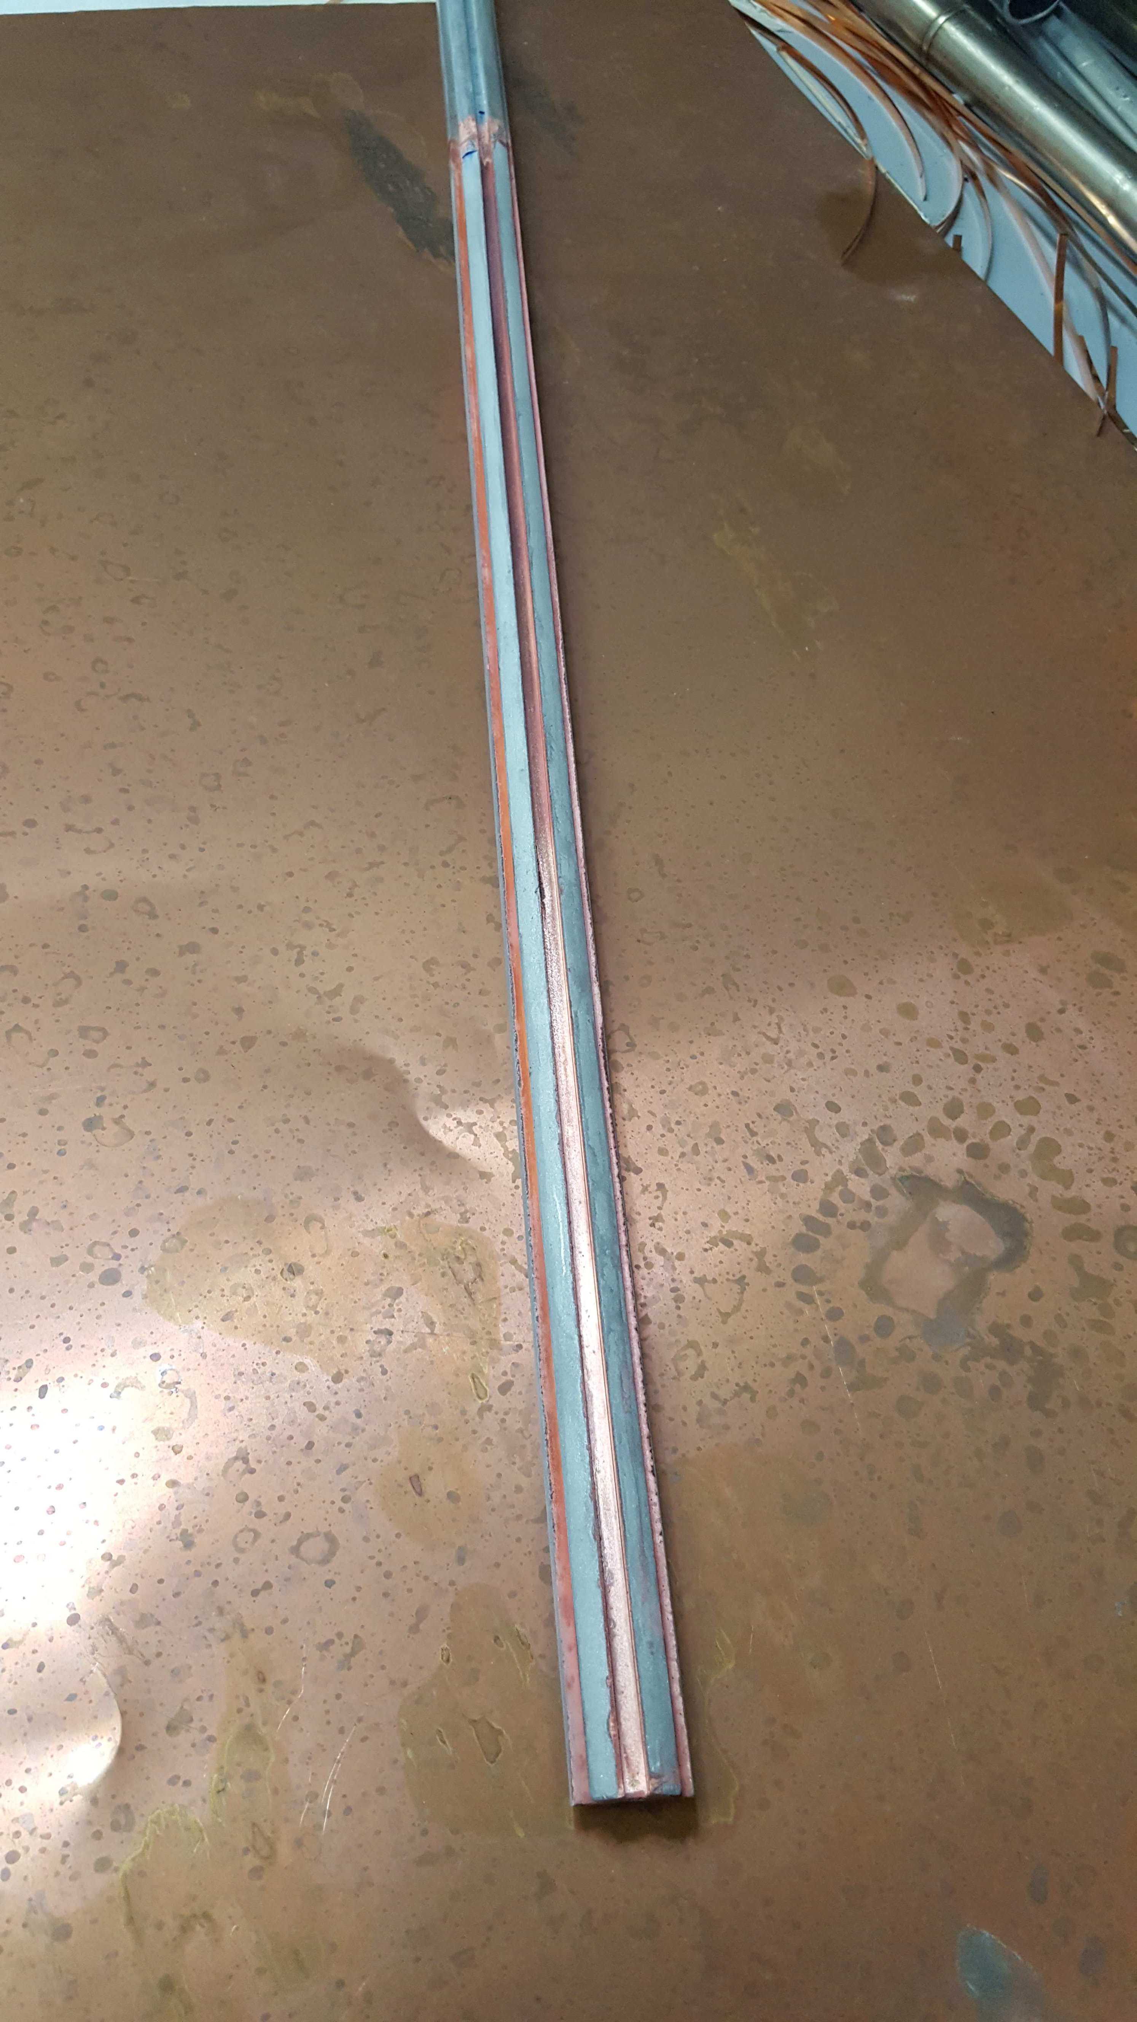
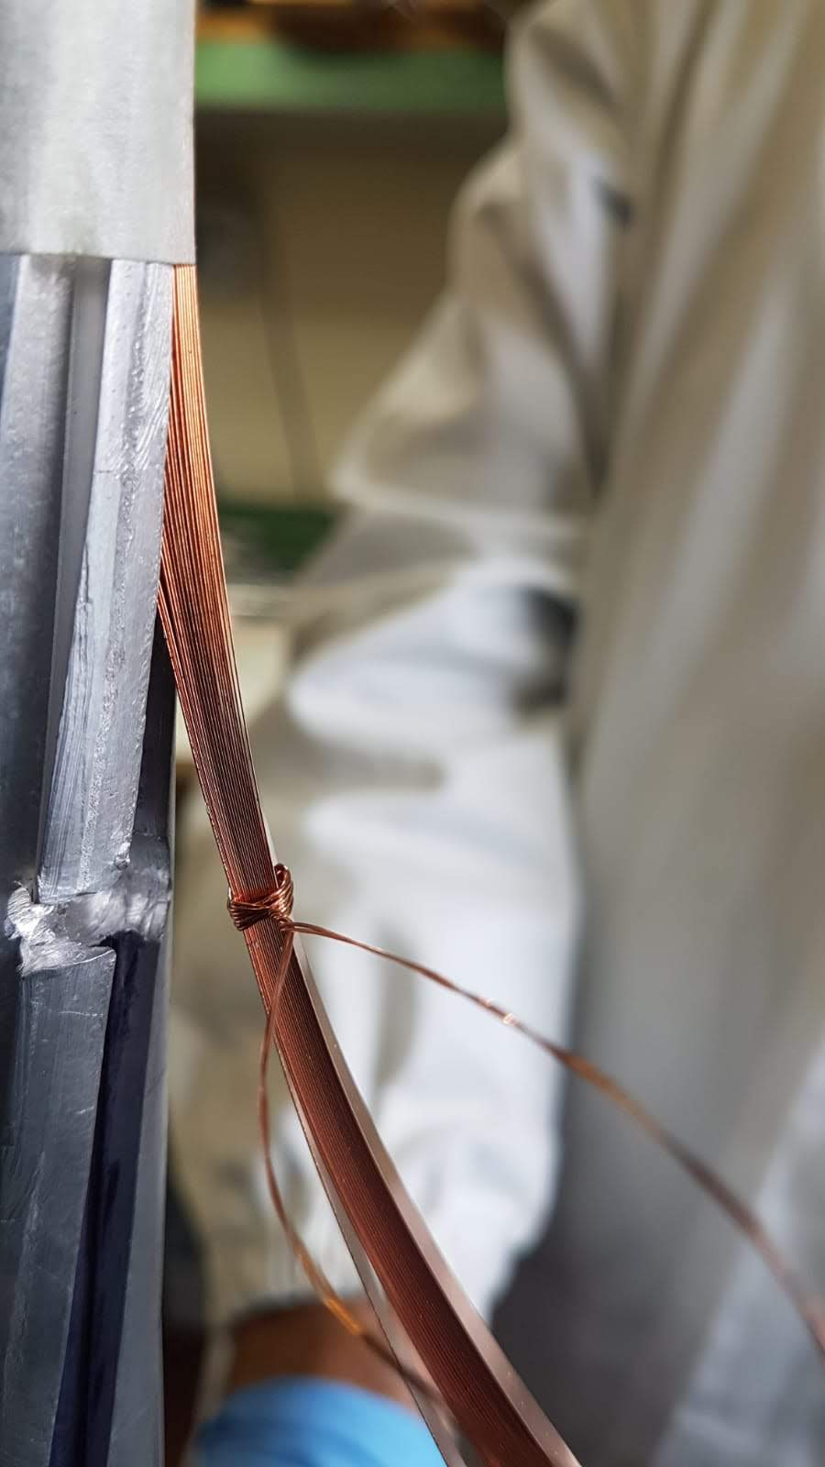
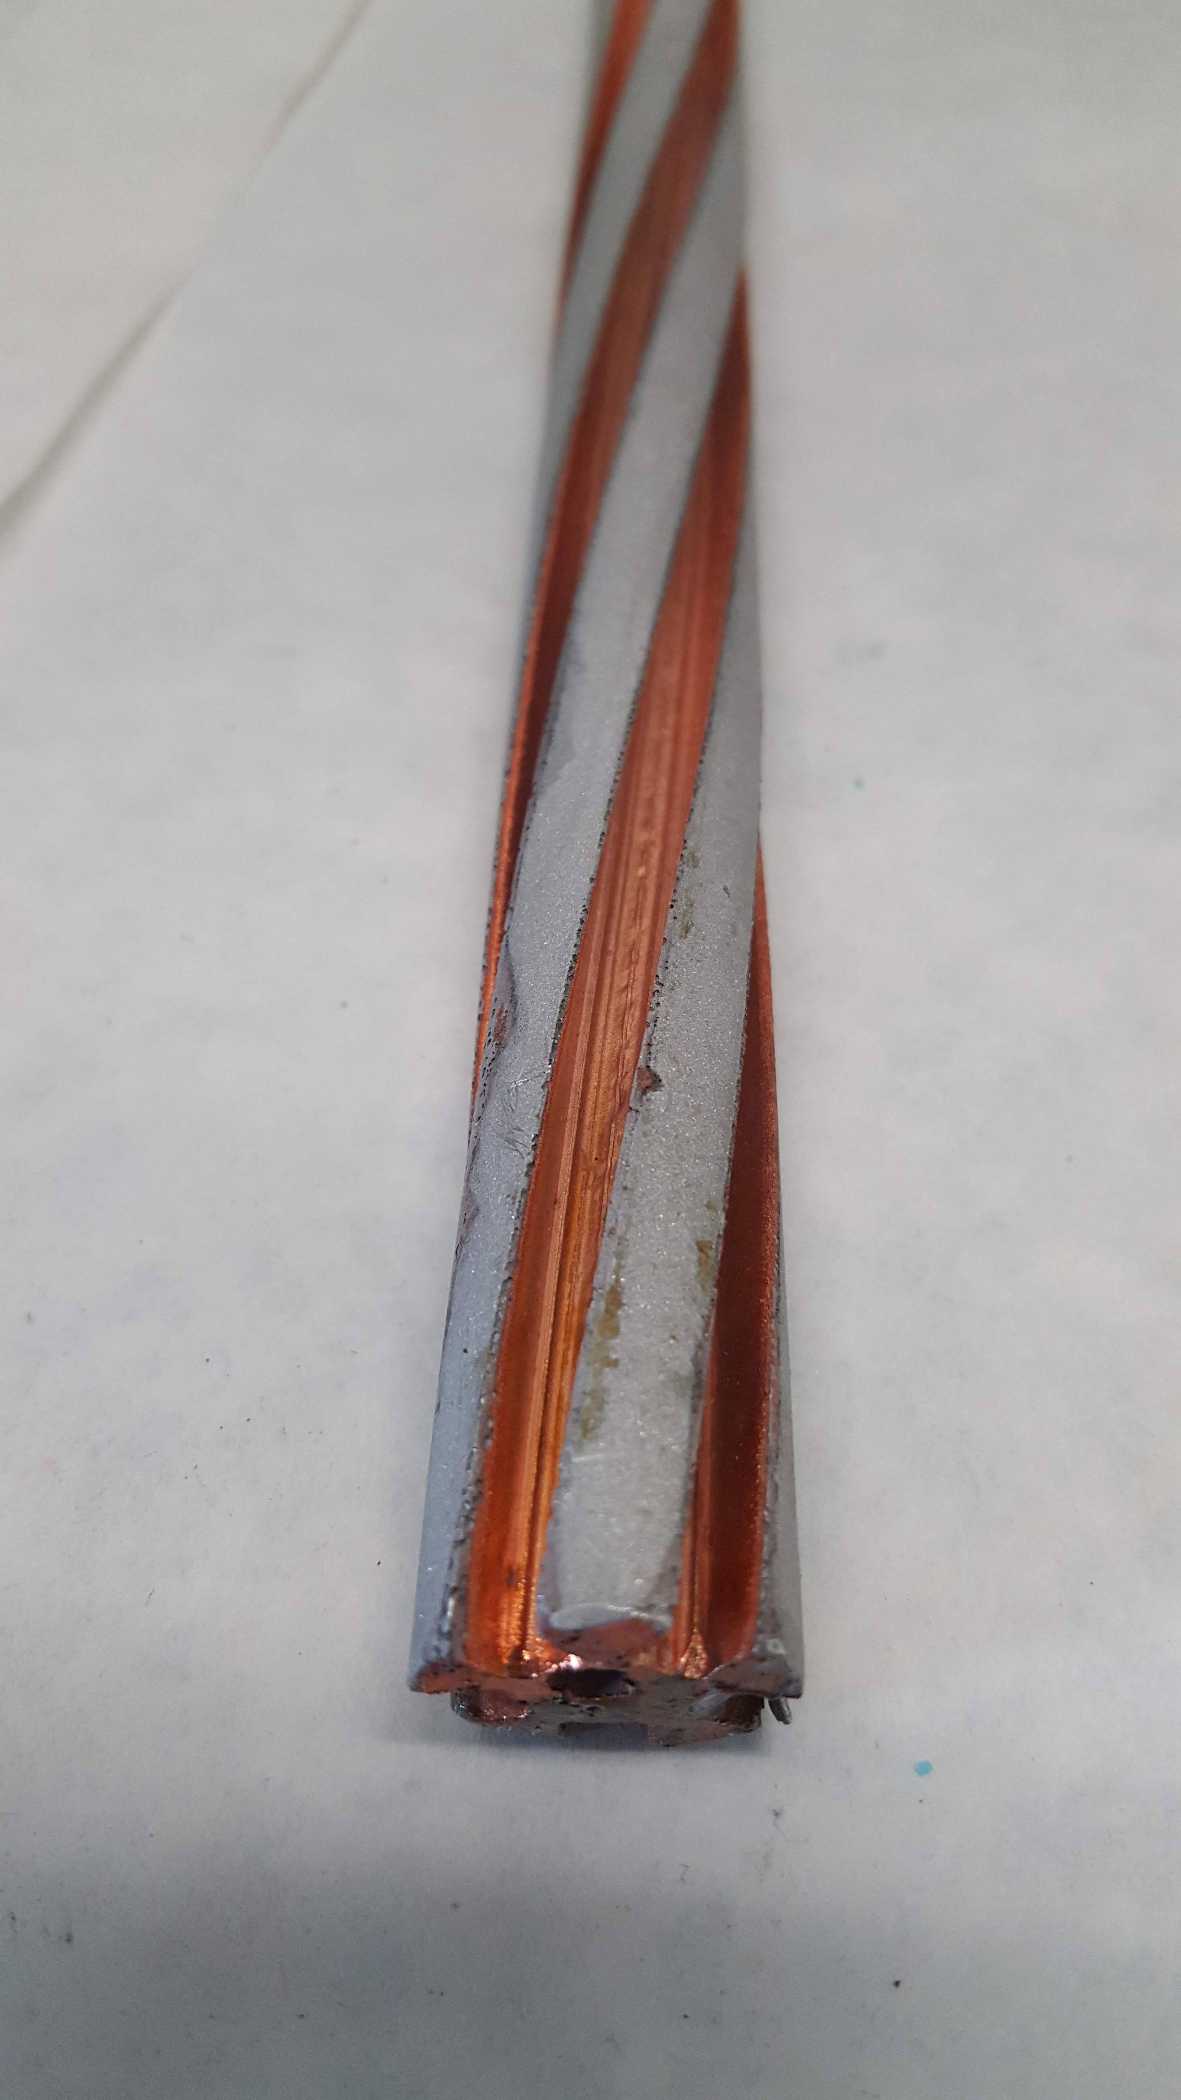
ENEA HTS cable – mock-up sample
Slots Cu electro-deposition
Stack insertion
termination region
Cu only inside the slots
1st stack

Slide 8
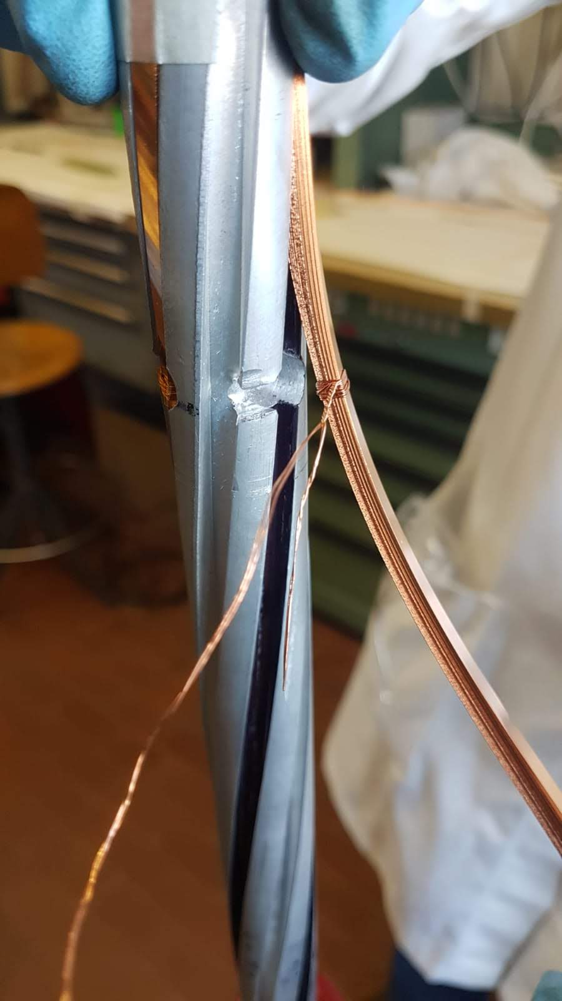
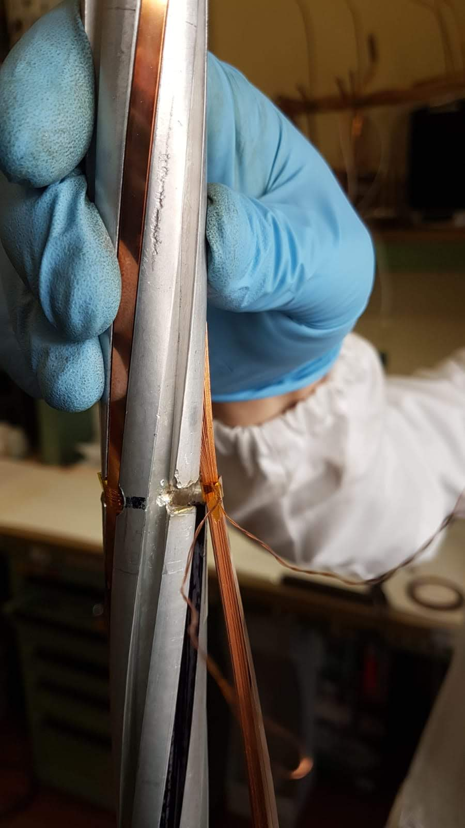
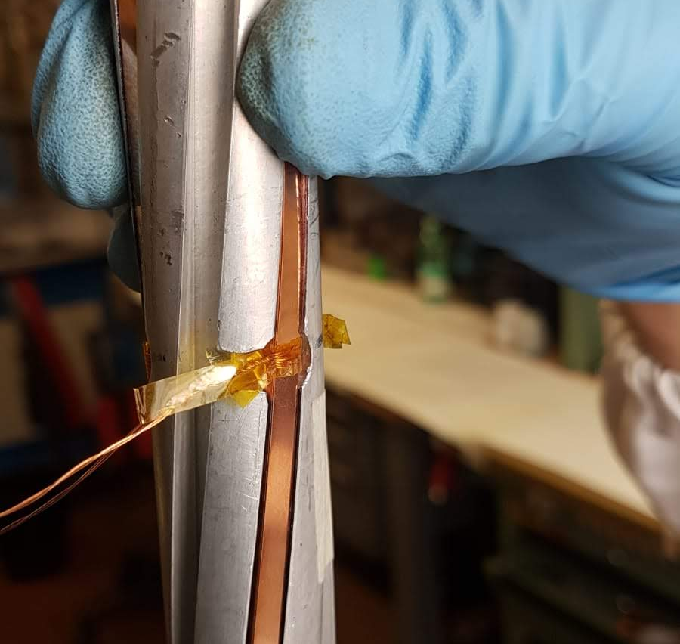
ENEA HTS cable – mock-up sample
Stack insertion
Voltage taps on each stack insulated with Kapton
Wires running out from the closest empty slot
2nd stack
3rd stack

Slide 9
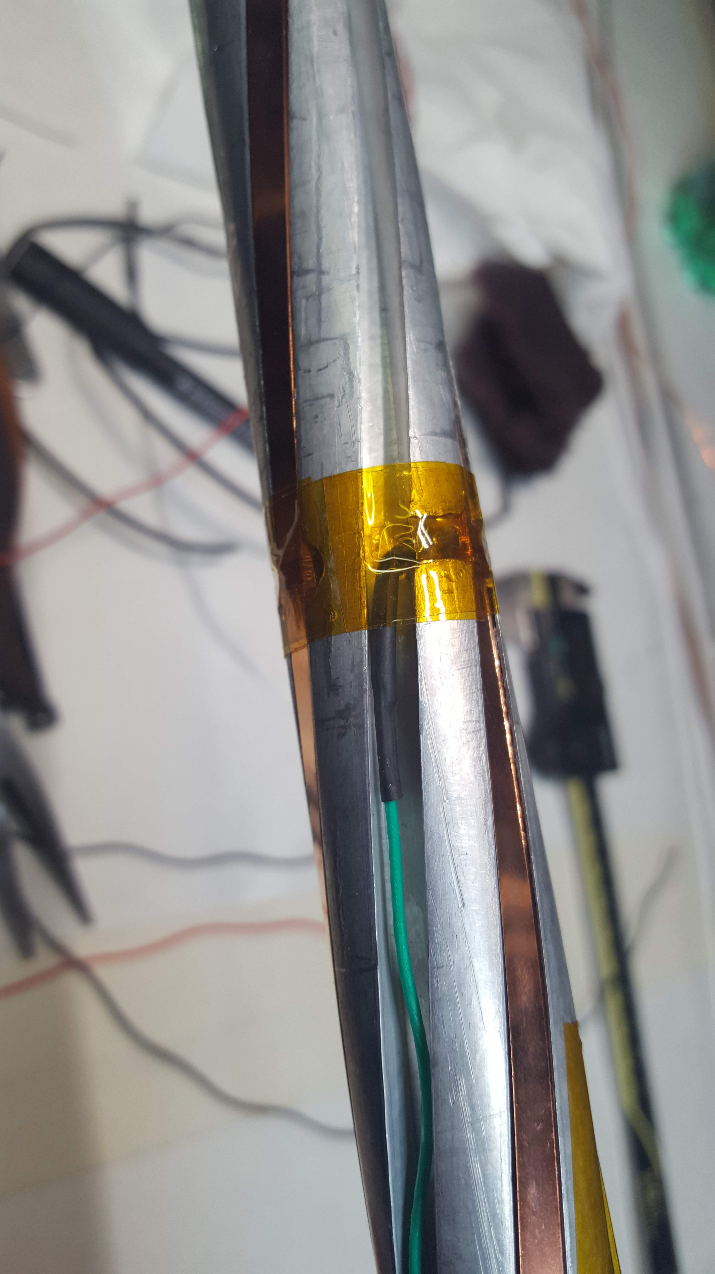
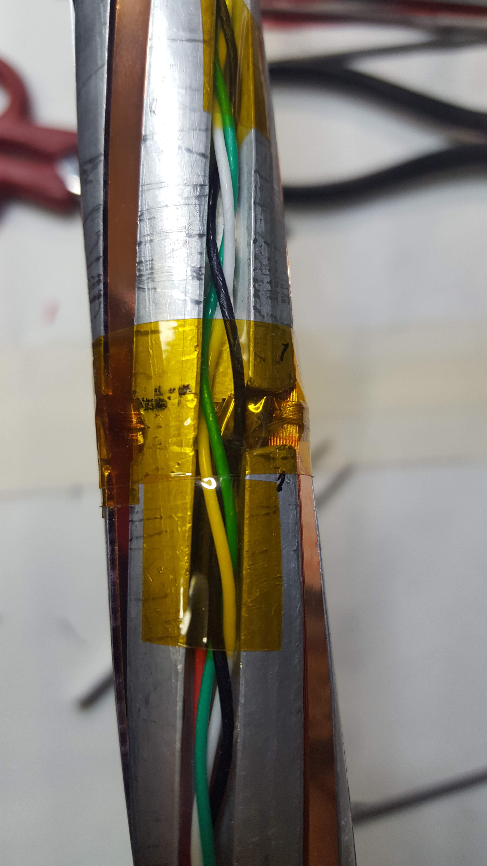
ENEA HTS cable – mock-up sample
4 voltage taps on each stack
in the central region of the cable
15 cm
30 cm
More than 4 voltage taps can be placed using thinner wires

Slide 10
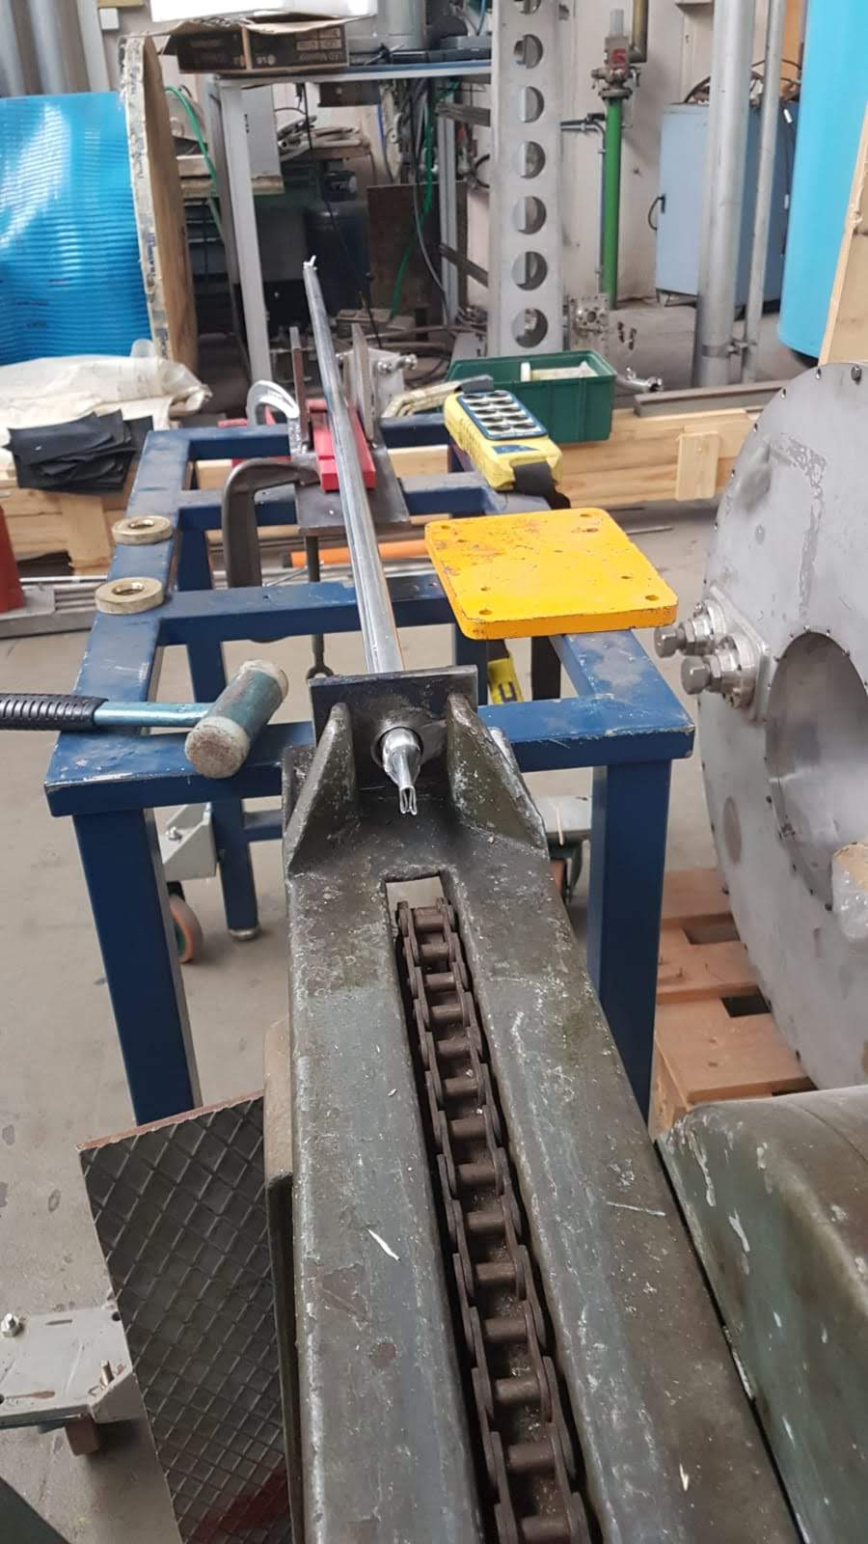
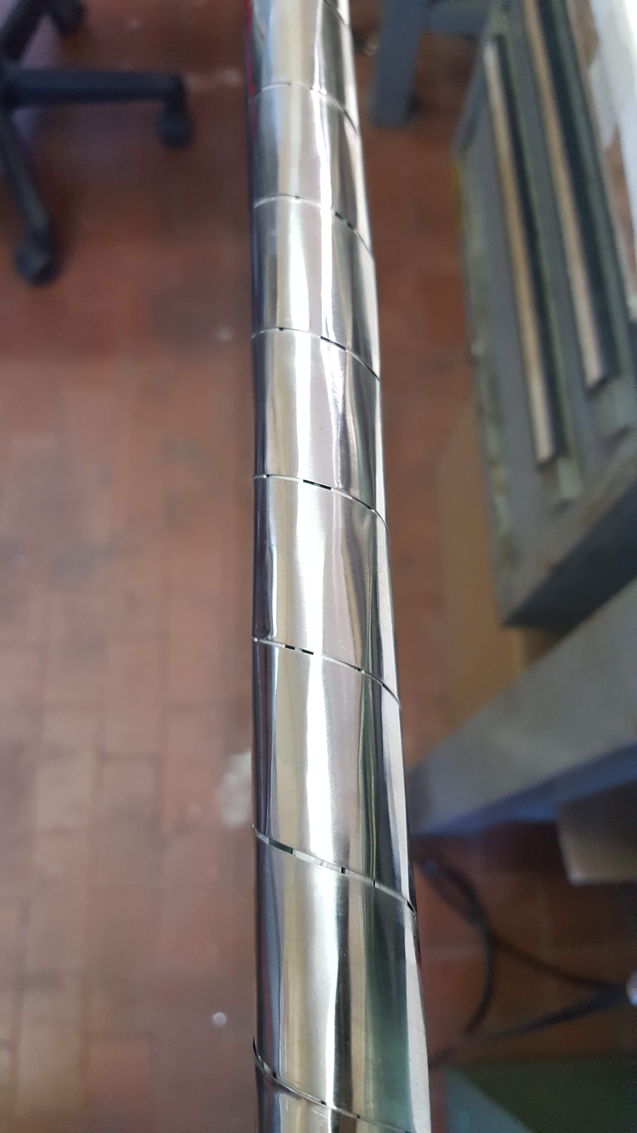
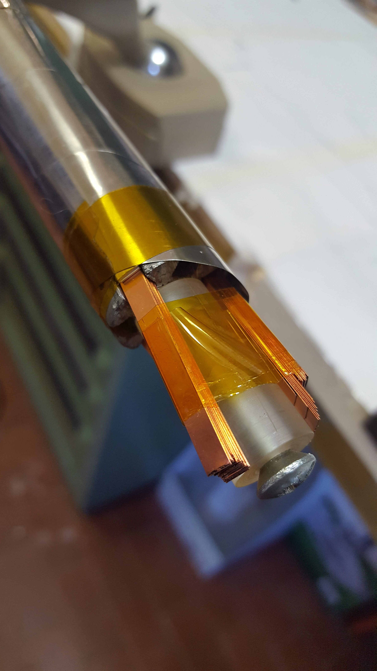
ENEA HTS cable – mock-up sample
Wrapping + jacketing
1.5 mm Al jacket
(drawing)
1.0 mm SS jacket
(no crimping)
Al foil

Slide 11
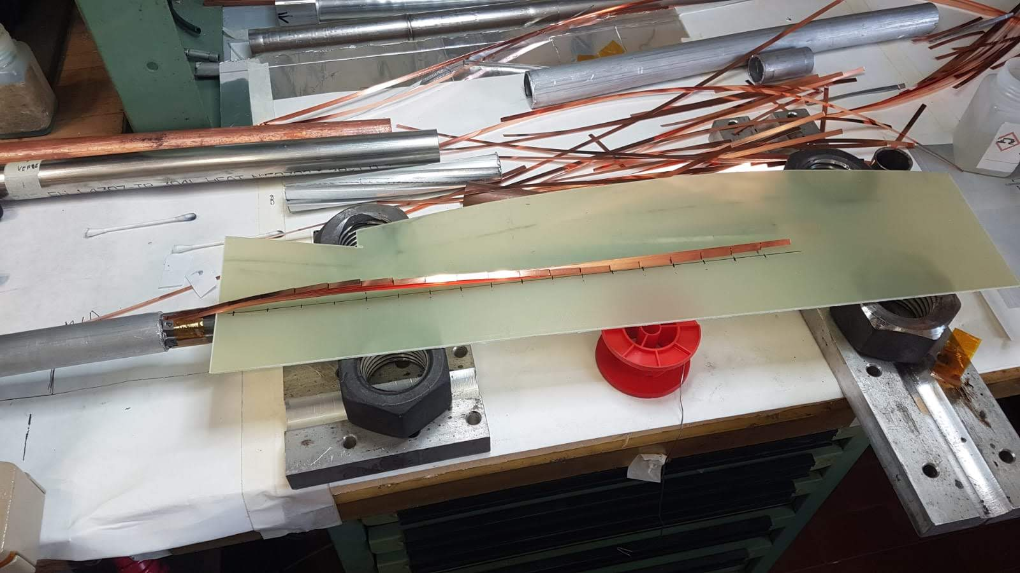
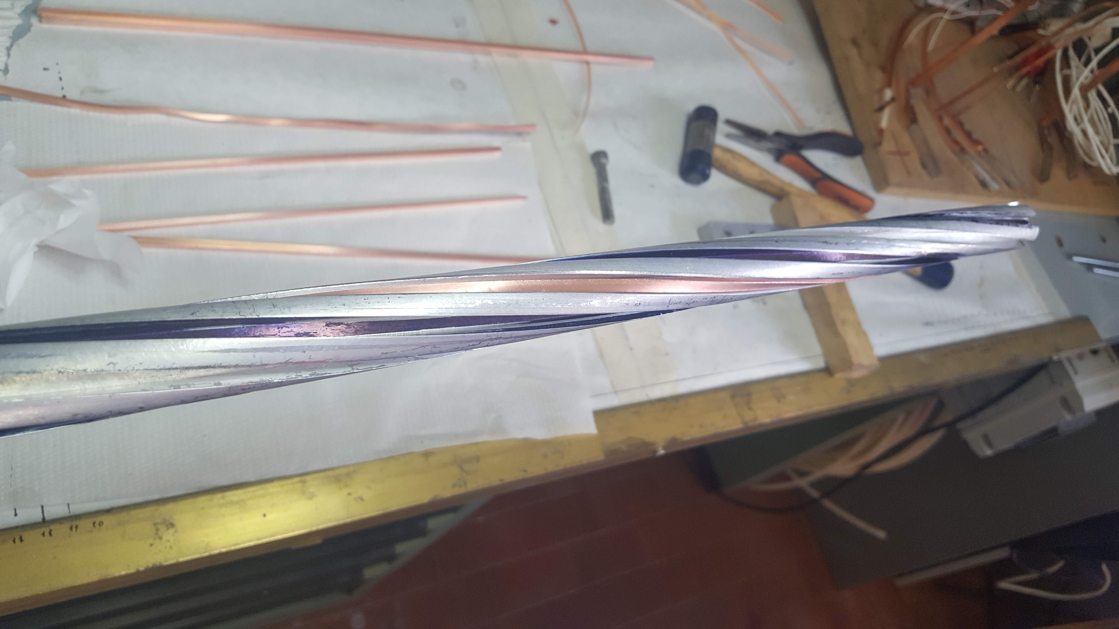
ENEA HTS cable – mock-up sample
Stack staggering
Al and SS jacket removed from the termination region
Stack staggered in 1 cm steps
Cu filler pre-shaped in the core slots

Slide 12
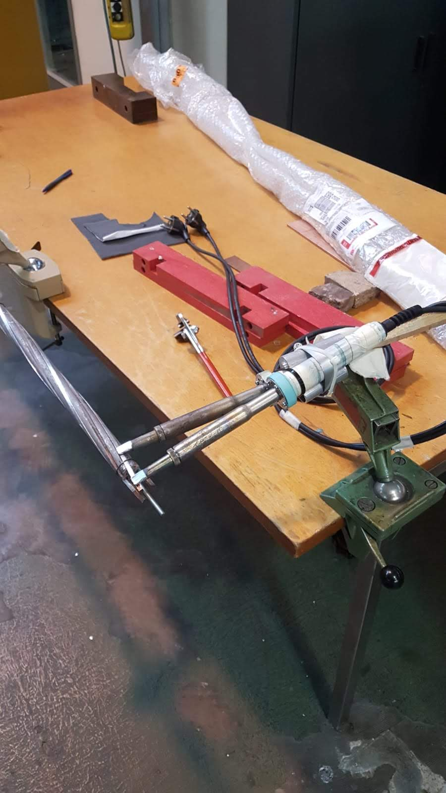
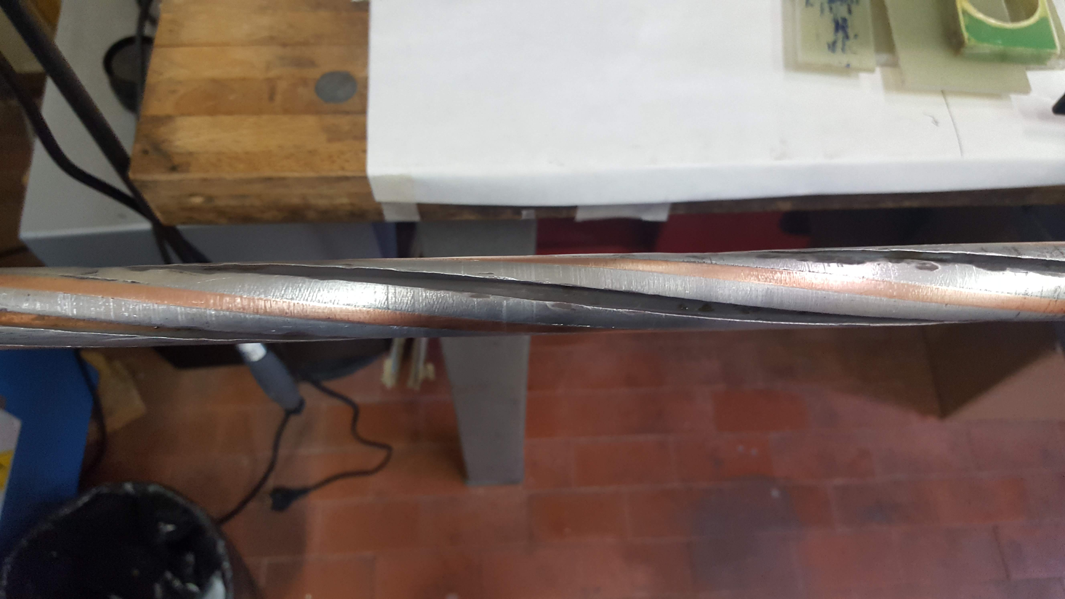
ENEA HTS cable – mock-up sample
Cu filler insertion and soldering
Termination region after soldering e polishing

Slide 13
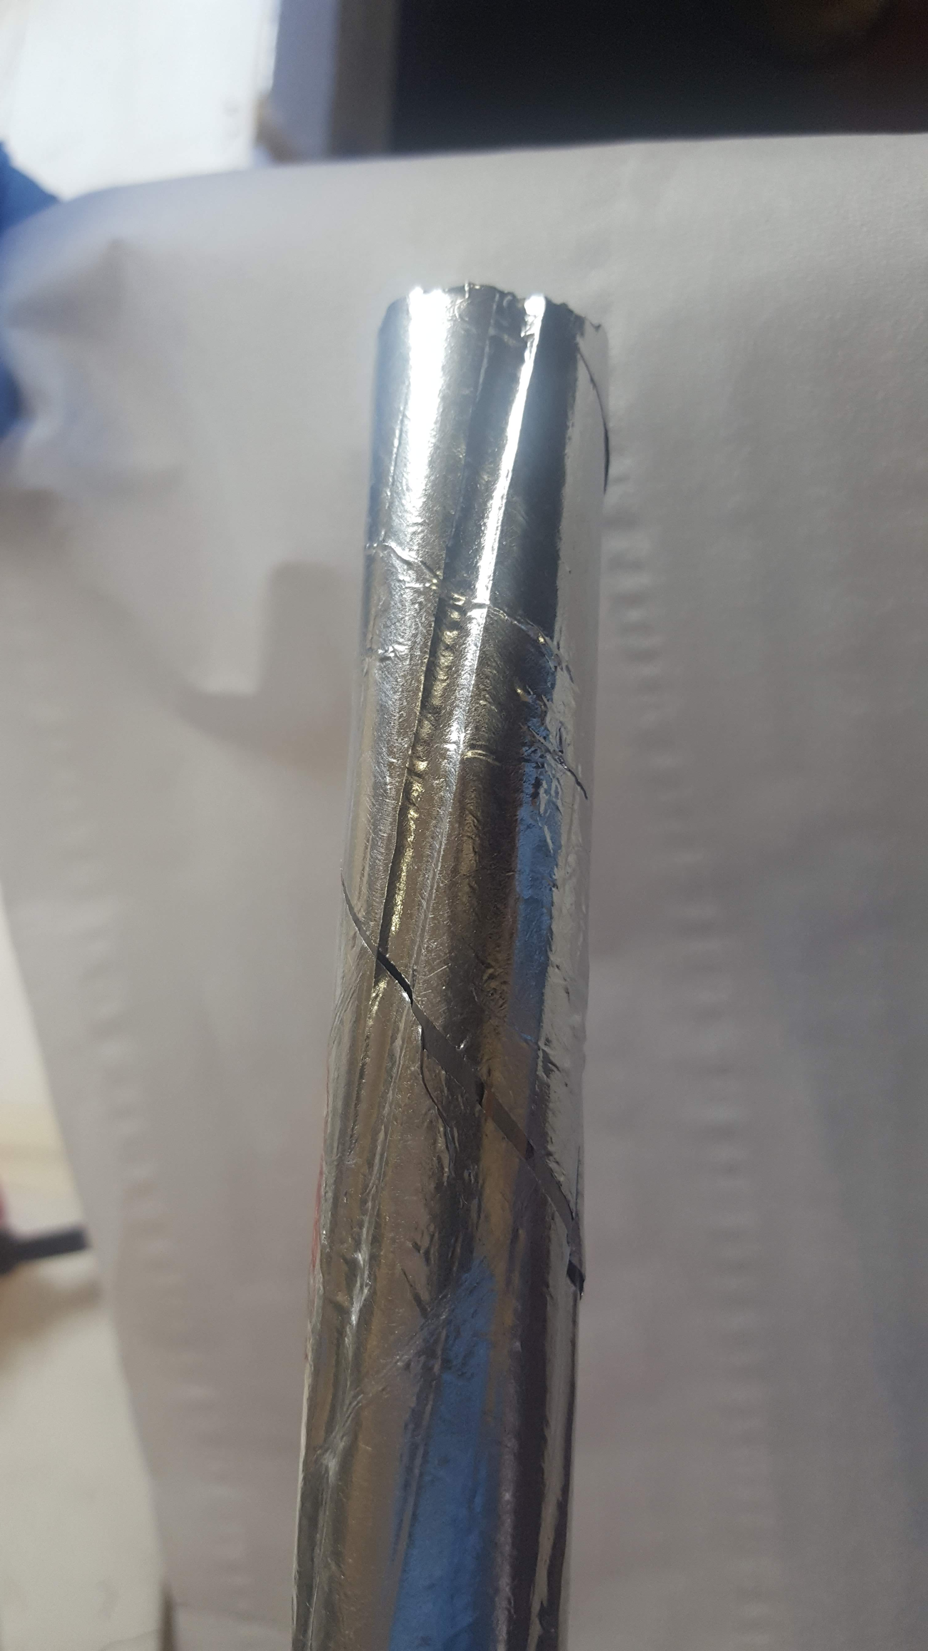
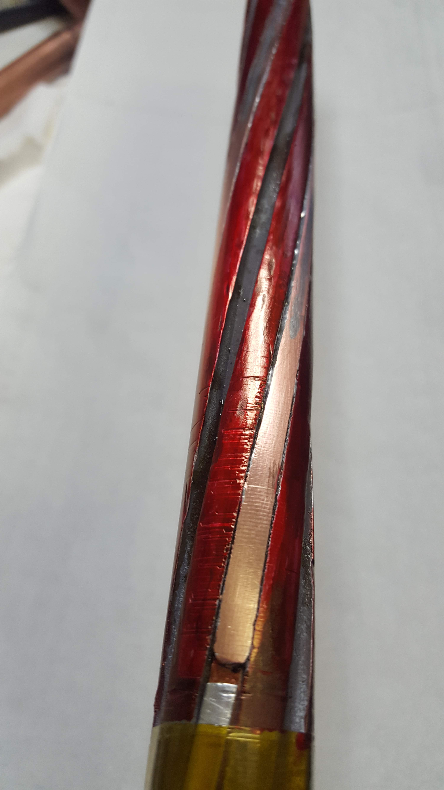
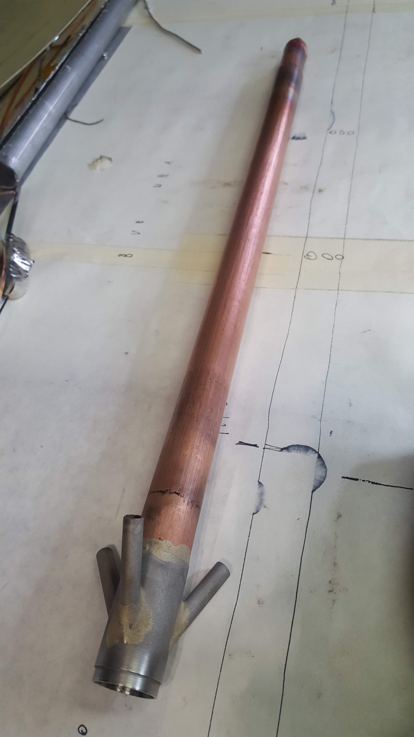
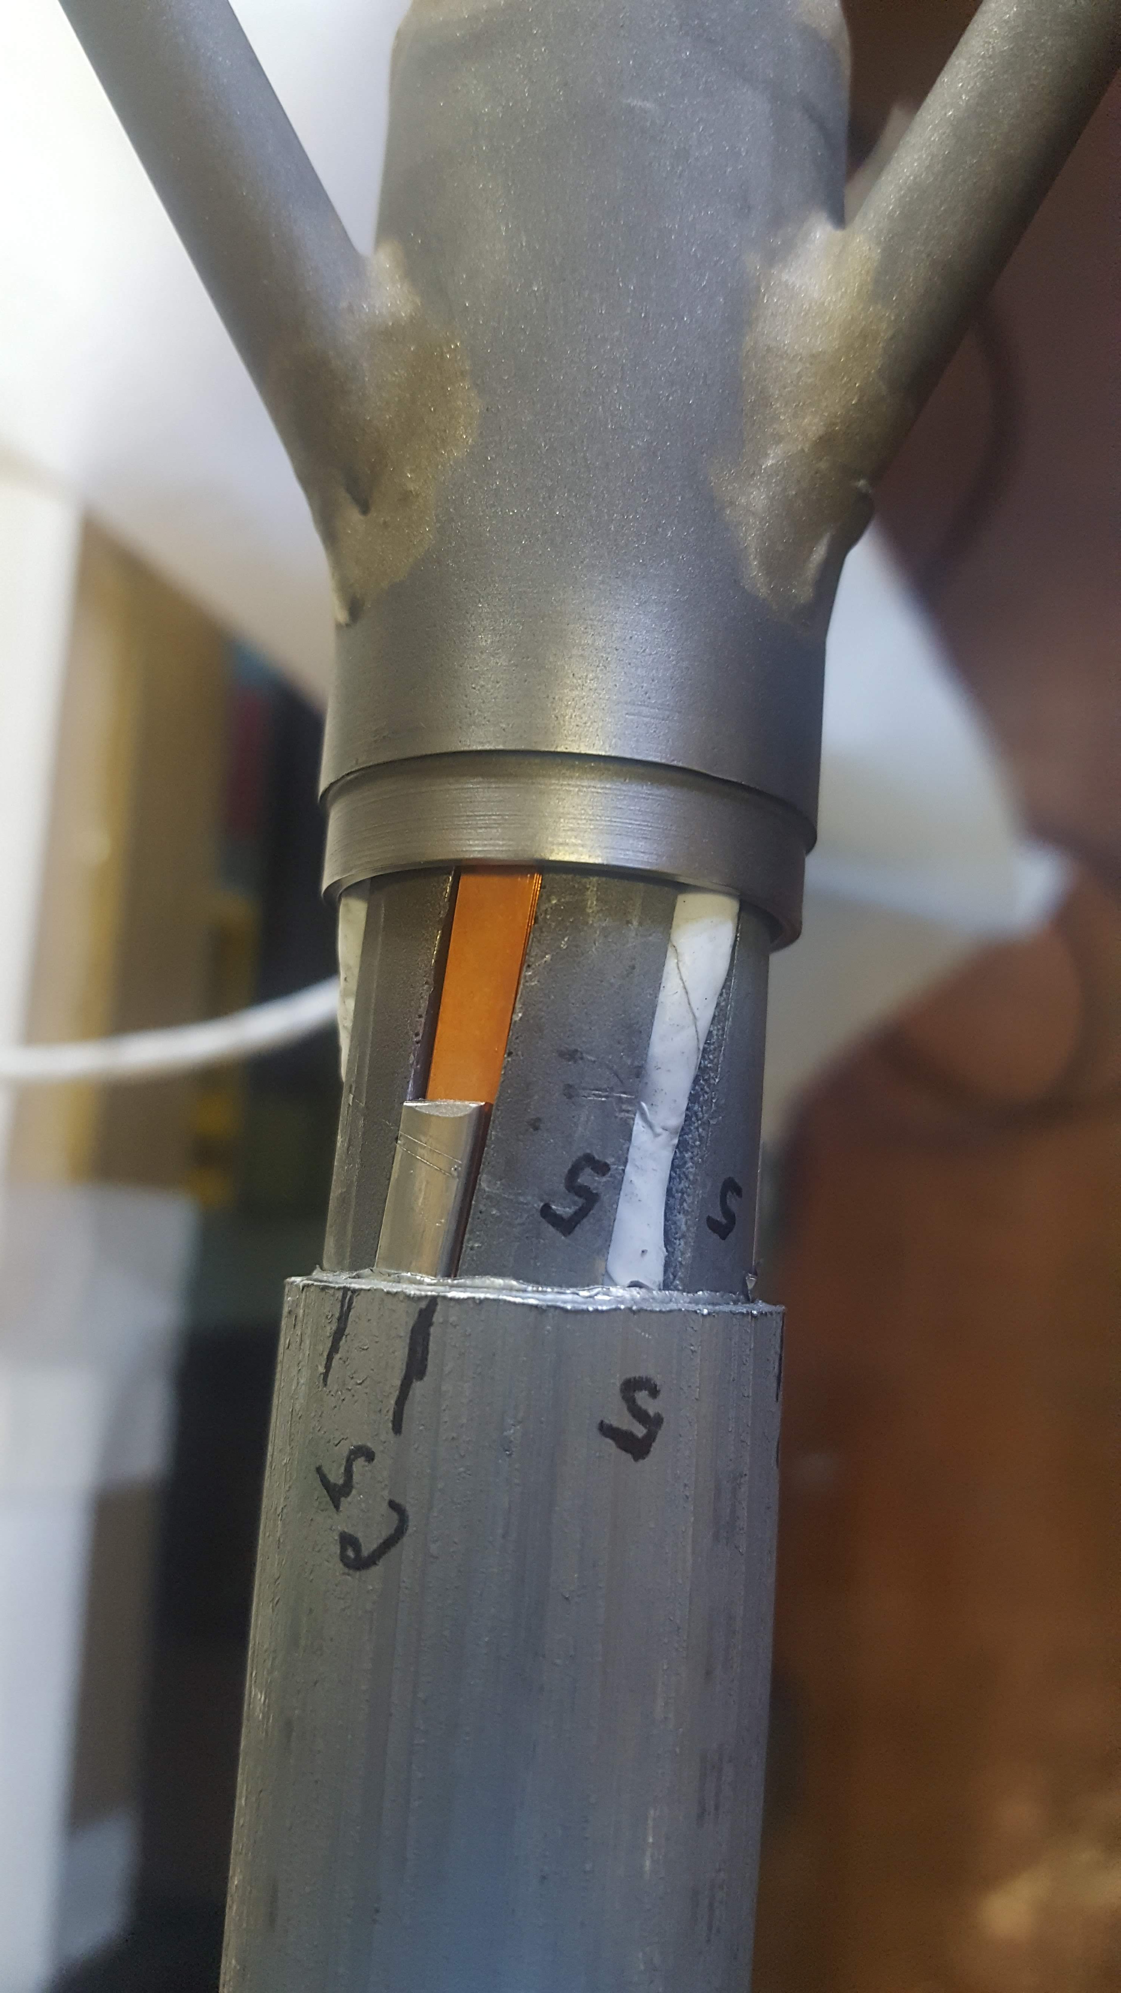
ENEA HTS cable – mock-up sample
Termination soldering and crimping
Cu
Term A: In-foil
Term B: coated
SS
wires

Slide 14
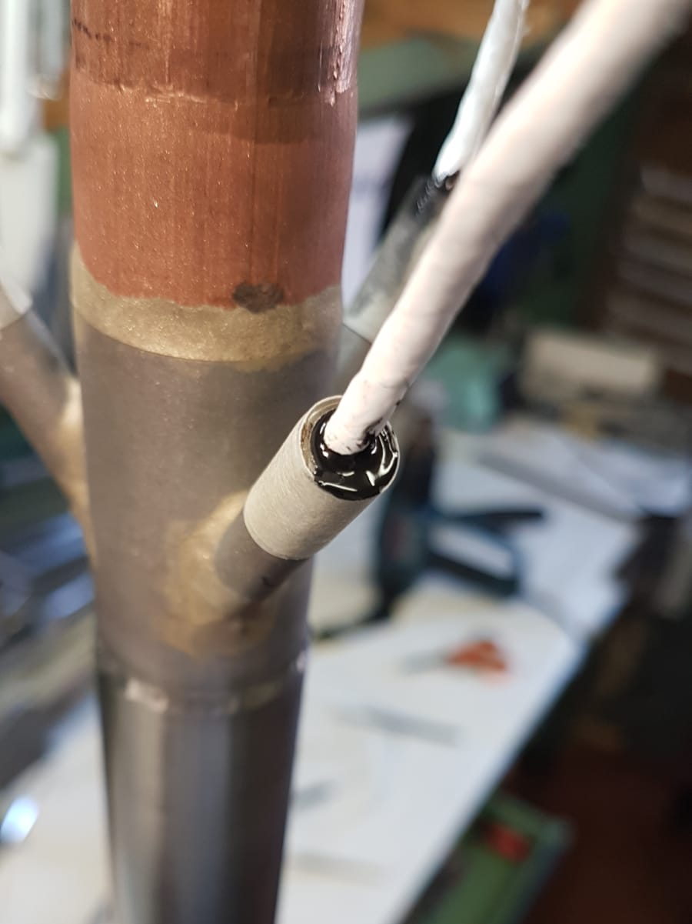
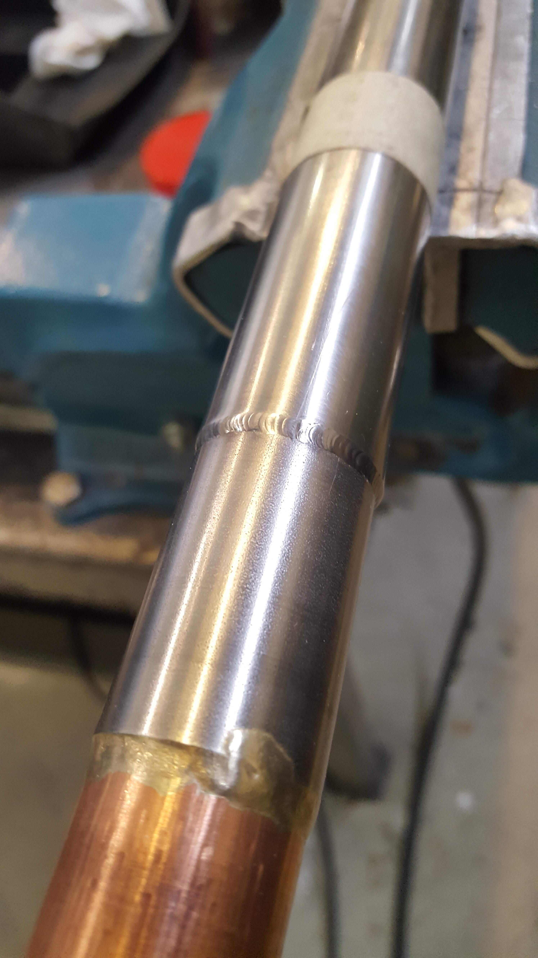
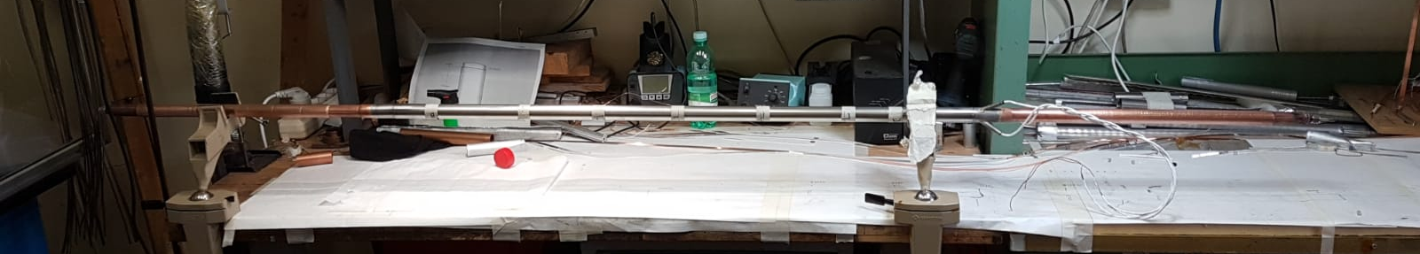
ENEA HTS cable – mock-up sample
Termination soldering and crimping
TIG soldered
filled with stycast epoxy
CABLE READY

Slide 15
ENEA HTS cable – mock-up sample
We are currently manufacturing the termination plates (Cu)
The same design, with two holes, will be used in the SULTAN sample as bottom connection
ELECTRICAL TEST AT LN2 SCHEDULED FOR THE END OF FEBRUARY

Slide 16





ENEA HTS cable – SULTAN Quench Experiment
Thank you for your
Thanks to all the ENEA HTS Cable Team and especially to M. Marchetti

