Slide 1
MAG-5.3: HTS conductor design and development
Ortensia Dicuonzo
Davide Uglietti

Slide 2
Task specification 2019
FEM: understand the stress components in the stack under transverse compression and identify which type of reinforcement should be used to limit the strand deformation.
Testing various types of reinforcement on dummy strands.
Preparation and test of sub-size samples for a new cable concept: the stacks are directly cabled and soldered around a flat core and soldered to the jacket (solder filled or monolithic conductor).
In summer 2019 selection of two designs.
Conductor preparation in the second half of 2019.

Slide 3
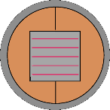
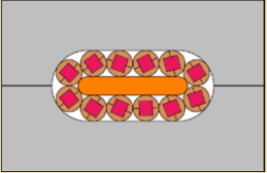
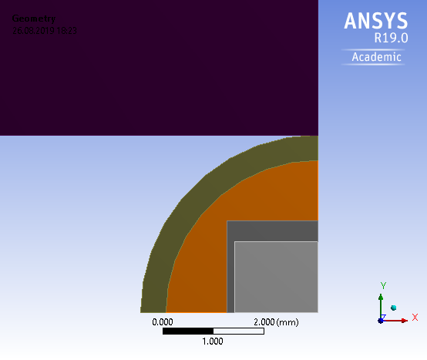

1. Mechanical model features
Reinforced soldered TSTC in round shells
2D Generalized plain strain, free endings;
Force 0-115 kN·m→ (80 kN·m max force in the cable);
Cool down RT-77K→ thermal expansion coefficient of the materials;
Symmetric wrt to the xz and yz plane;
Plastic (Bilinear), yield strength(T);
90º and 45º.
F
Anvil
Force
Wire
Copper
Solder
Stack
Delamination tension ($σ_{xx}$)
Pretension in the wire

Slide 4
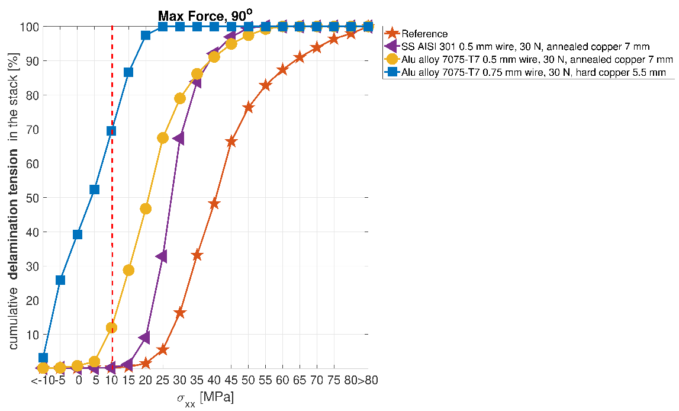
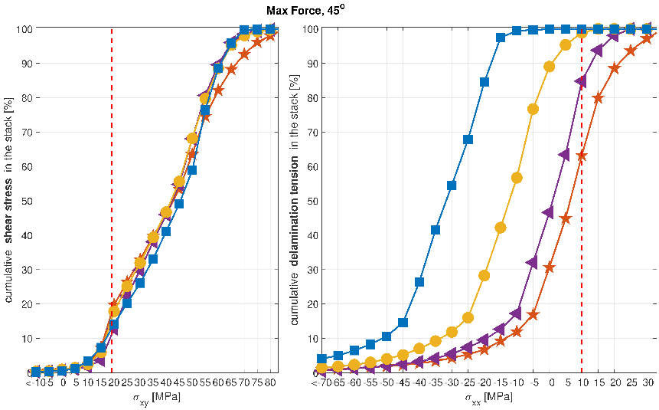
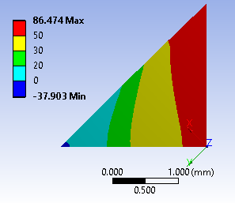
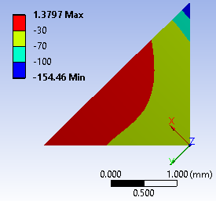
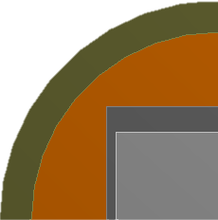
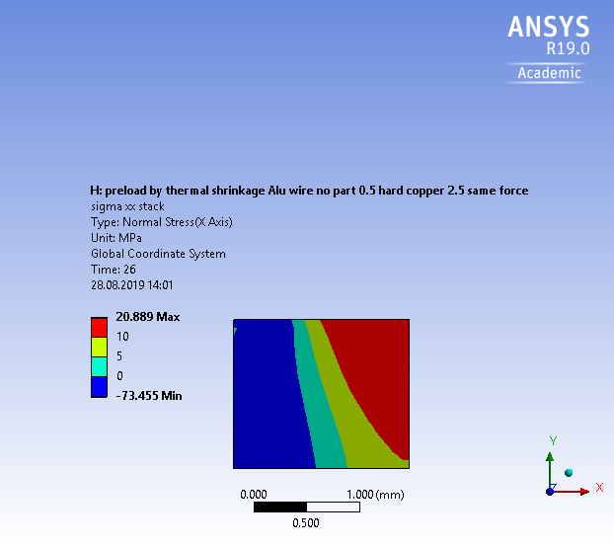
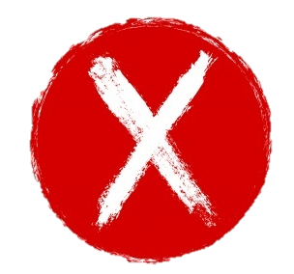
1. Results
Reference case
Annealed copper;
7 mm Φ
(*)
(*) H. Maeda et al., DOI:10.1109/TASC.2013.2287707
Tape mechanical properties, Nathaniel C. Allen et al., DOI: 10.1109/TASC.2017.2652304
(*)
(*)
Big improvement can be obtained by using aluminum alloy 7075-T7 and reducing the copper cross section.
Unfortunately, it was not possible to find the aluminium alloy 7075 in wire form and this design option was abandoned.
The solutions proposed are not helpful wrt the shear stress at 45º;
The delamination at 45º can be eliminated by using alloy 7075-T7.

Slide 5
Task specification 2019
FEM: understand the stress components in the stack under transverse compression and identify which type of reinforcement should be used to limit the strand deformation.
Testing various types of reinforcement on dummy strands.
Preparation and test of sub-size samples for a new cable concept: the stacks are directly cabled and soldered around a flat core and soldered to the jacket (solder filled or monolithic conductor).
In summer 2019 selection of two designs.
Conductor preparation in the second half of 2019.

Slide 6
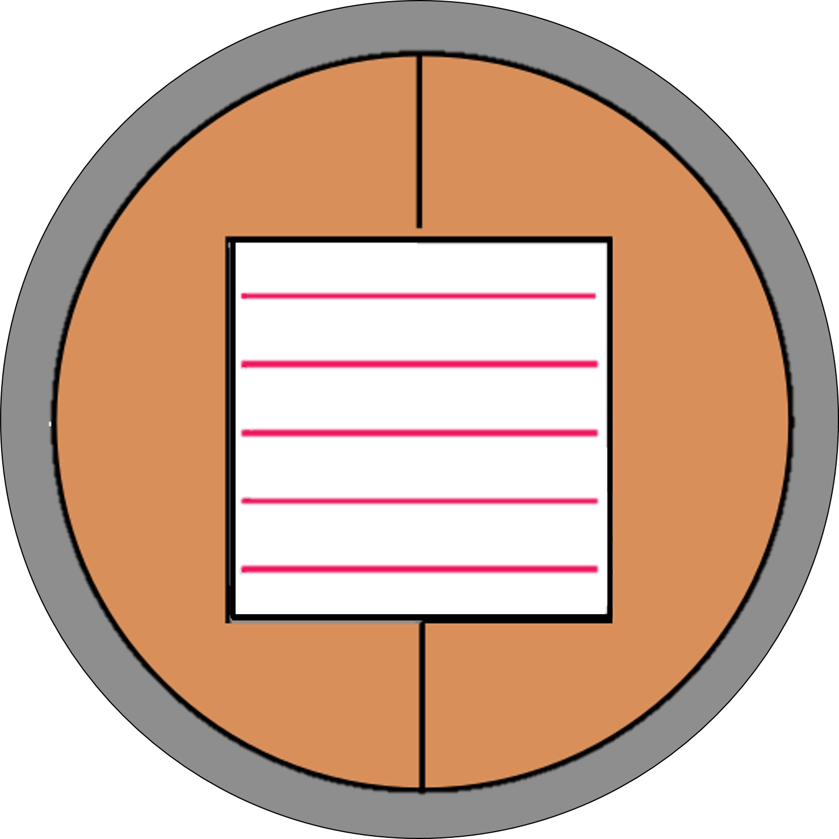
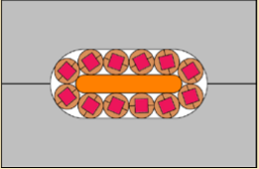
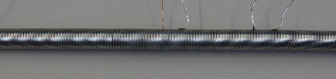
2. Sample description
Indium tape across the stack to increase the contact between tapes and copper.
Not-soldered TSTC in round shells
Stainless steel wire diameter (AISI 304), 0.5 mm
Features of the sample
Tape | SST tape, 3.3 mm width
Number of tapes | 28
Two copper tapes: ↑the compactness of the stack→ ↓ the intertape resistance.
Annealed copper shells, Φ 7 mm
The strand is twisted and then wrapped with stainless steel wire at constant tension of 30 N.
The tested regions belong to the same sample.

Slide 7
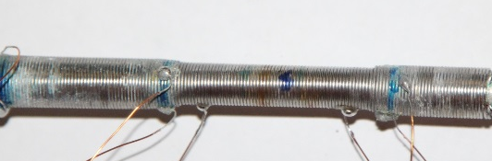
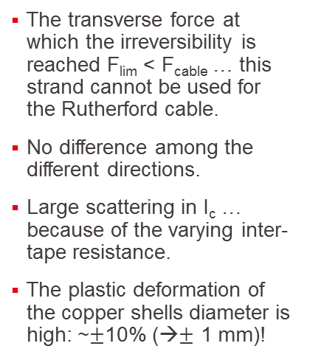
2. Experimental set-up and Results
F₀º
The transverse force at which the irreversibility is reached F_{lim} < F_{cable} … this strand cannot be used for the Rutherford cable.
No difference among the different directions.
Large scattering in I_{c} … because of the varying inter-tape resistance.
The plastic deformation of the copper shells diameter is high: ~$±$10% (→$±$ 1 mm)!
F₄₅º
F₉₀º
77 K, s.f., 4 points method

Slide 8
Task specification 2019
FEM: understand the stress components in the stack under transverse compression and identify which type of reinforcement should be used to limit the strand deformation.
Testing various types of reinforcement on dummy strands.
Preparation and test of sub-size samples for a new cable concept: the stacks are directly cabled and soldered around a flat core and soldered to the jacket (solder filled or monolithic conductor).
In summer 2019 selection of two designs.
Conductor preparation in the second half of 2019.

Slide 9
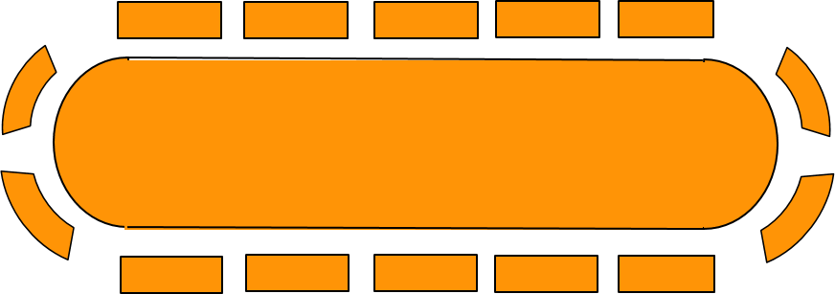
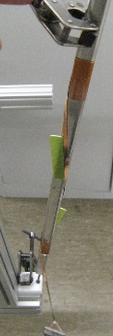
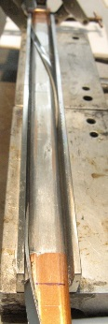
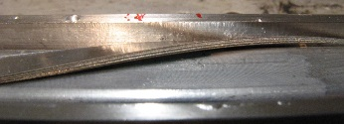
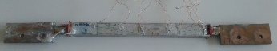
3. Sample preparation
No tensile strain during cabling;
Solder filled after cabling;
the stacks are fixed in place;
the solder filling should ensure hydrostatic distribution of transverse pressure;
high thermal conductivity between cable and jacket.
Cable twist pitch: ~600mm.
Features of the sample
Tape | SST tape, 3.3 mm width
Tapes/stack | 10
Cabling angle | 10º
Core thickness | 6 mm
One stack of tapes cabled around the copper core…
The sample is placed inside a stainless steel jacket…
The most critical part under transverse pressure is where the tapes are bent!
and filled by
Sn₆₀Pb₄₀ solder.

Slide 10
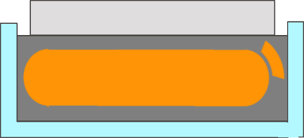
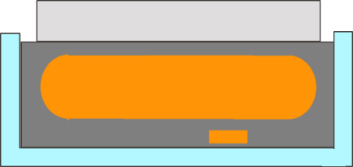

3. Experimental set-up and Results
F
w
Stack
Copper core
Solder
The regions belong to the same sample;
Length of the anvil, l=30 mm.
Jacket
F

Slide 11
Selected designs
5-6 mm core thickness
~45 mm wide (flat part)
~28-30 stacks
~10-12 SST 3.3 mm wide tapes per stack
Strand was tested successfully last year
6 around 1
10 mm hard copper shells
40 SST 4.8 mm wide tapes per strand
Rated for 53 kA at 18T

Slide 12
Task specification 2019
FEM: understand the stress components in the stack under transverse compression and identify which type of reinforcement should be used to limit the strand deformation.
Testing various types of reinforcement on dummy strands.
Preparation and test of sub-size samples for a new cable concept: the stacks are directly cabled and soldered around a flat core and soldered to the jacket (solder filled or monolithic conductor).
In summer 2019 selection of two designs.
Conductor preparation in the second half of 2019.

Slide 13
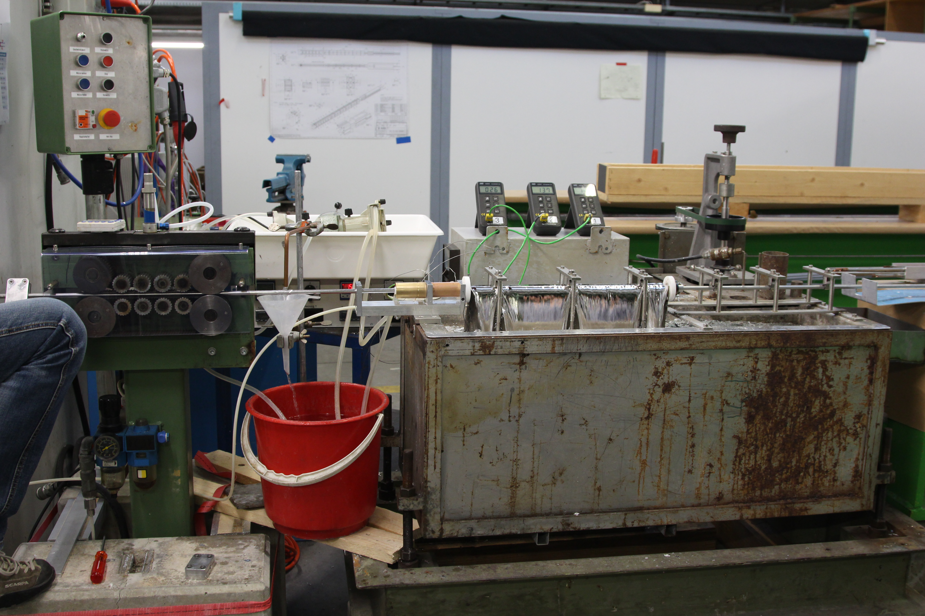
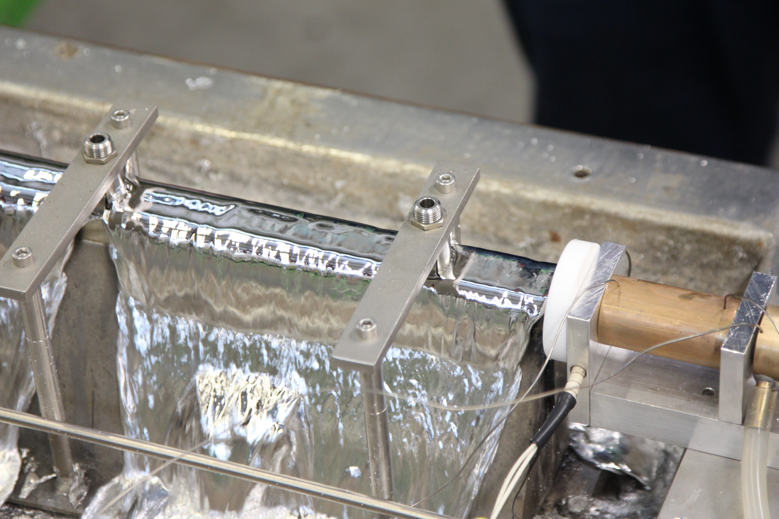
5. Conductor preparation
Done:
Copper shells and core procured;
Copper shells pre-tinned;
Tapes procured and pre-tinned.
New online soldering procedure
Done:
Tapes procured and pre-tinned;
Core procured.
Mock-up in construction;

Slide 14
2020
To finish the task for 2019:
  Finalization of the drawings for the cable and for the terminations;
  Jacket procurement;
  Cable assembly;
  Conductor assembly.

