Slide 1
MAG-5.5-T006 - D001
Test on High-Current HTS cables
D.S. Nickel, N. Bagrets, K.-P. Weiss

Slide 2
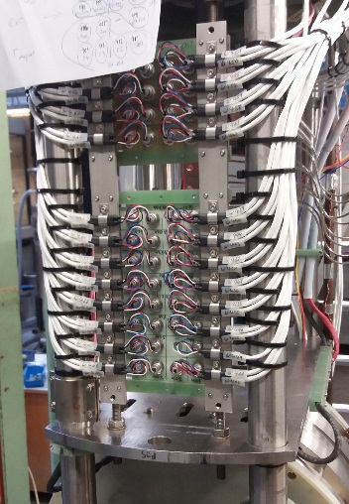
FBI – Repair and Upgrade - UPDATE
Old current leads and wiring were removed
New current leads were constructed, and prepared for installation
Installation of current leads completed
Sensor wiring in cryostat completed
95% of electronics finished
Work in progress:
Finalization of interconnection of electronics & software
FBI facility is upgraded to offer additional measurement channels of low voltage signals

Slide 3
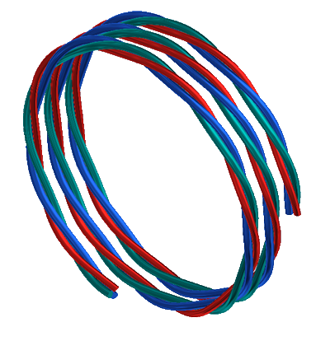
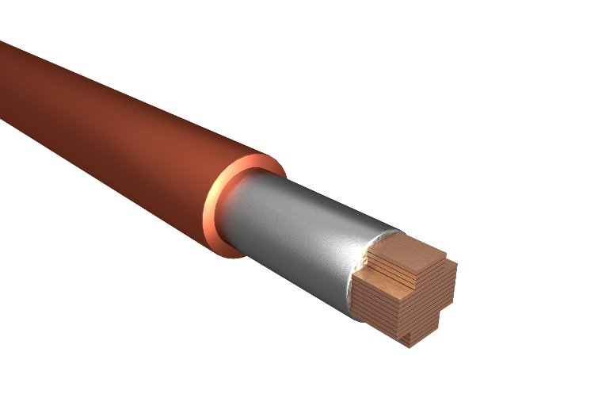
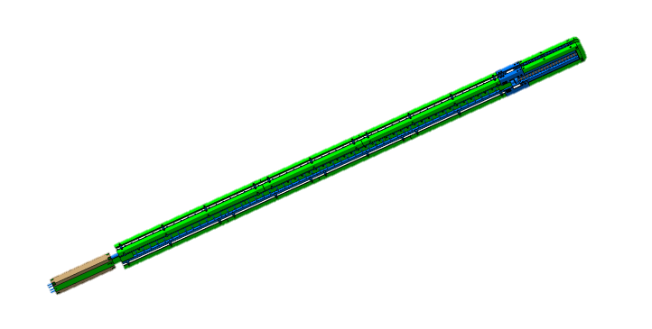
Towards the triplet conductor testing
HTS CroCo
EU-CN Straight Sample
Winding demonstrator
Full-size coil
Fusion relevant conditions:
Triplet configuration
Iop > 10 kA @ B > 10 T
Top ≈ 4.5 K
Tests @ 77K, investigating:
Lorentz-forces
bending radii

Slide 4
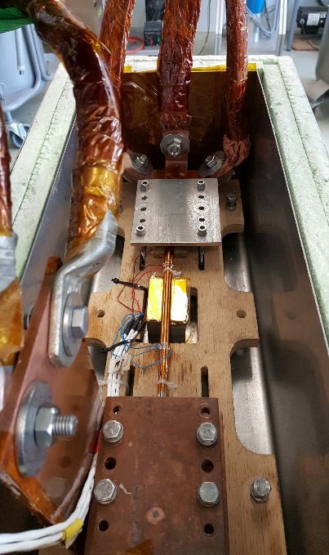
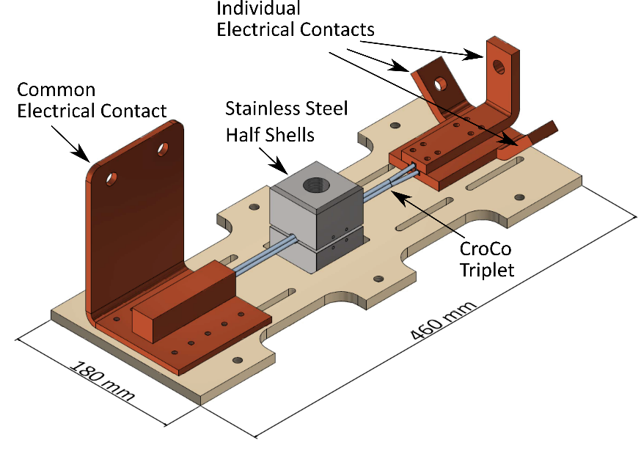
Triplet transversal pressure testing
Experimental setup
Experimental conditions:
T = 77 K Fmax = 100 kN
l,comp = 56.7 mm

Slide 5
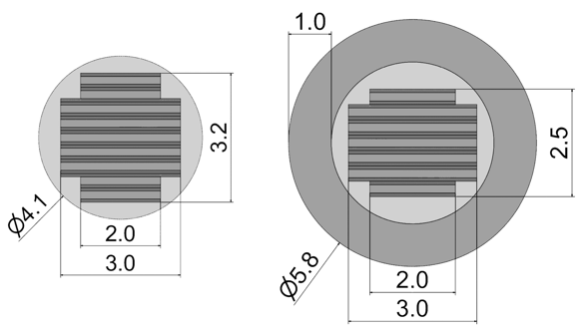
Triplet transversal pressure testing
Sample preparation
HTS CroCo samples:
Tapes by Shanghai Supercon. Techn.
3mm ST 1706-07/08/12 and 1708-09/13
2mm ST 1706-13/14 and 1708-28
with intermediate Cu
HTS CroCo triplet layouts:

Slide 6
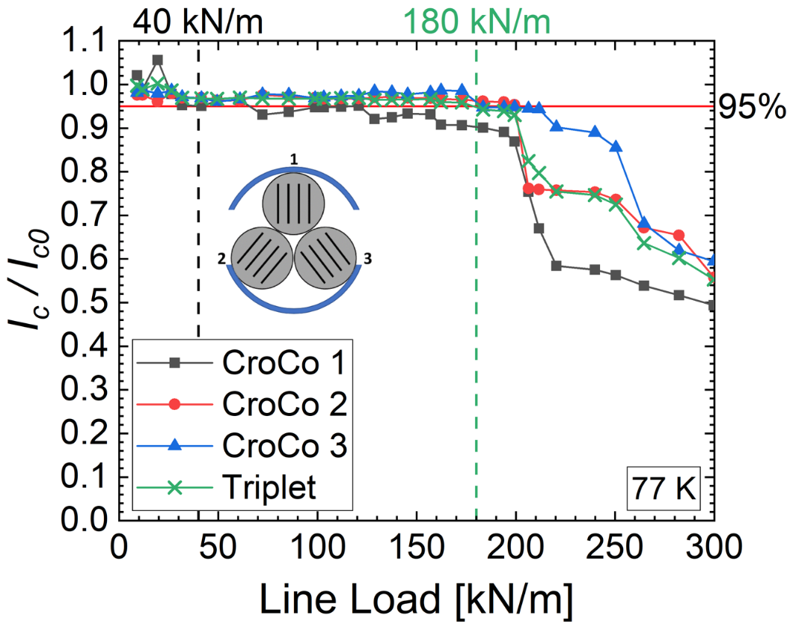
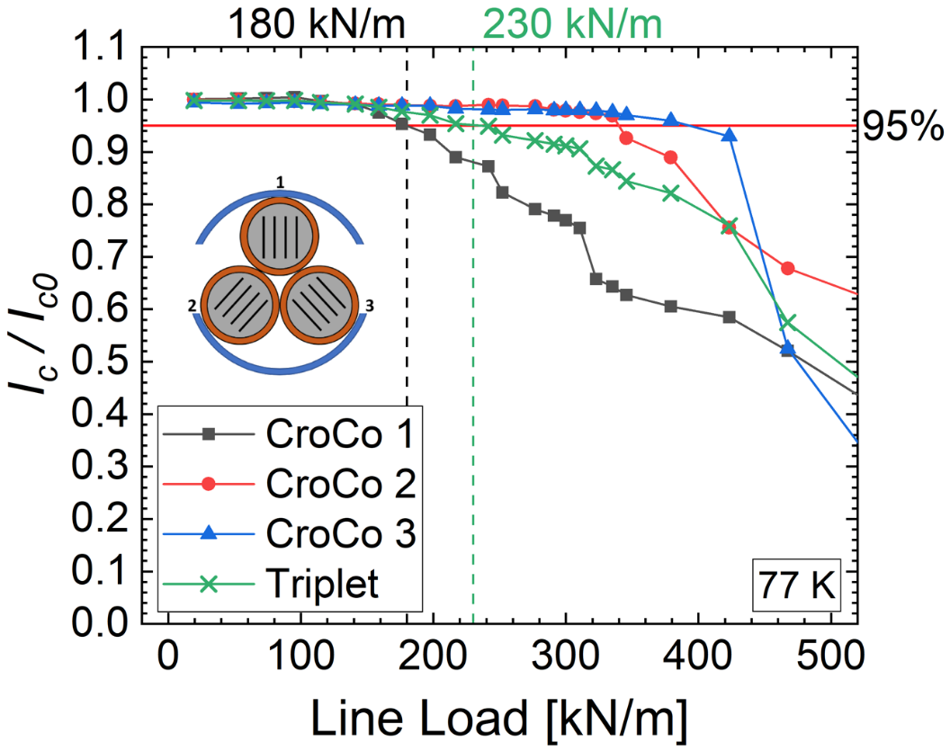
Triplet transversal pressure testing
Results 1/2
T-I
T-II
Critical load of CroCo 1 was increased by 350 % from 40 kN/m to 180 kN/m

Slide 7
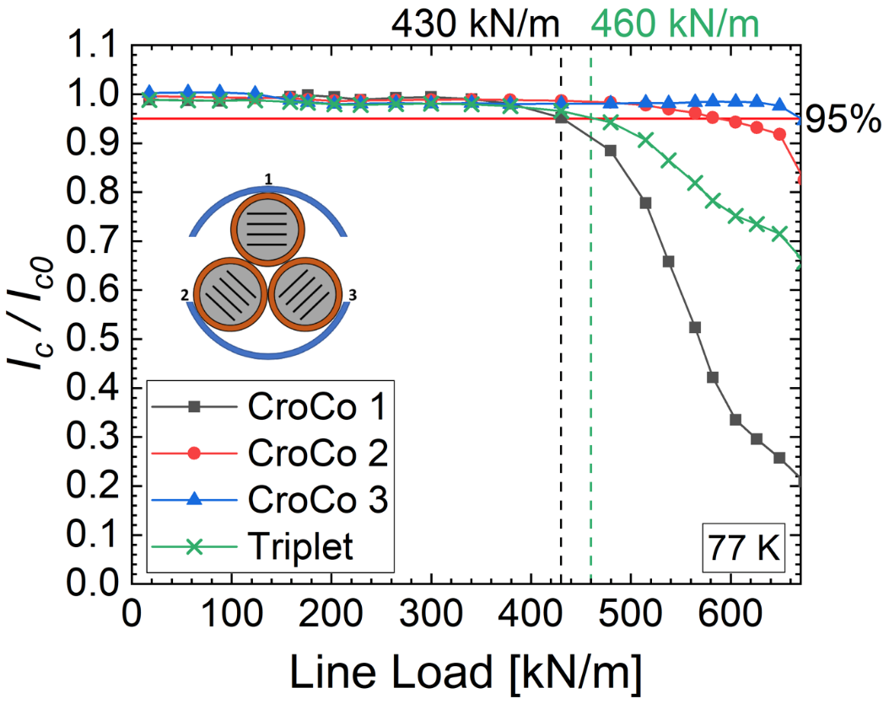
Triplet transversal pressure testing
Results 2/2
T-III
T-IV
Critical load of CroCo 1 was increased by 110 % from 205 kN/m to 430 kN/m

Slide 8
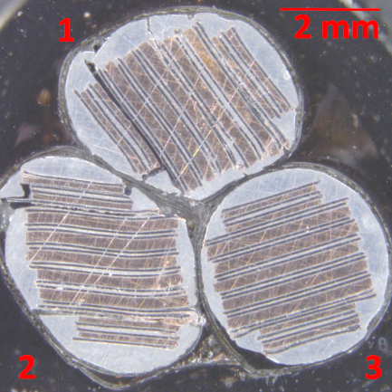
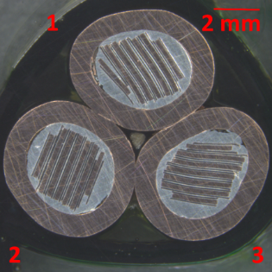
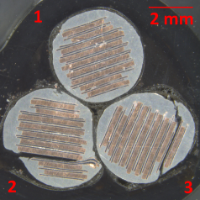
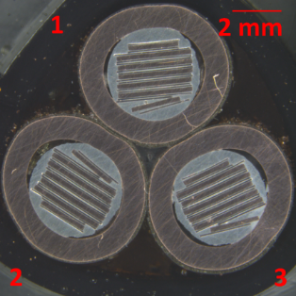
Triplet transversal pressure testing
Post Mortem
After the highest loads the triplet cross-sections reveal massive damages
in case of the samples T-I and T-III without Cu-envelope.
T-I
T-II
T-III
T-IV
Obviously, the outer Cu-envelope reinforces the HTS CroCos and allows the triplet to withstand higher forces.

Slide 9
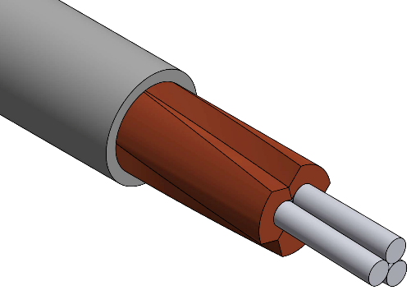
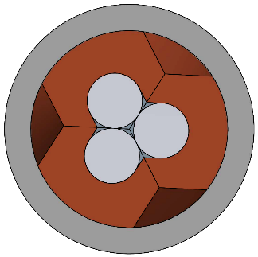
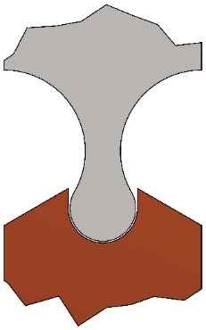
Proposal 2020
Measurements considering bending and cyclic loading are necessary
Minimizing the impact of Lorentz forces - by using suitable copper profiles - each conductor is only loaded with his own Lorentz force - neighboring forces mitigated through the copper profiles
Mechanical testing of solder to properly design triplet arrangements with conductors in profiles
Tests on LTS-cable joints (SPC)
Start: 01.03.2020
End: 31.10.2020
Resources: 0.1 ppy

