Slide 1
MAG-5.3-T016 -
Development of High Current HTS cables
M. J. Wolf

Slide 2
Task completion schedule
MAG-5.3-T016 | D001 | Development of High Current HTS cables
Technical Specification:
• Design of HTS CroCo winding demonstrator - postponed to 2020 or later
• Adaptation of HTS CroCo samples
towards a winding demonstrator - ongoing (focused)

Slide 3
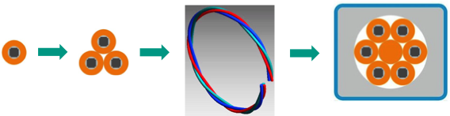
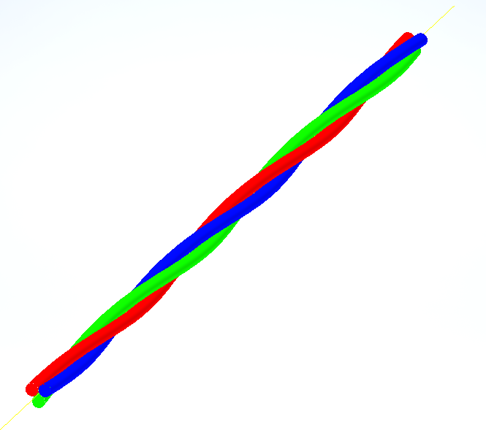
Proposed modification of the „long-term agenda“
Integration of the following intermediate step:
Detailed Investigation of straight HTS CroCo triplet samples

Slide 4
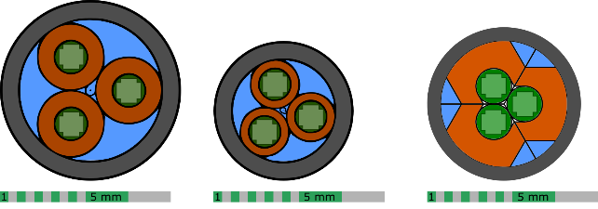
Determination of the friction factor of triplet samples
So far, we used the friction factor correlation of the EURATOM LCT coil in the thermohydraulic calculations of HTS CroCo-based conductors, e.g. tripletts samples.
This should be checked by dedicated experiments.
Three samples with different strand diameters and copper profiles
were prepared and shipped to Monika Lewandowska for testing.

Slide 5
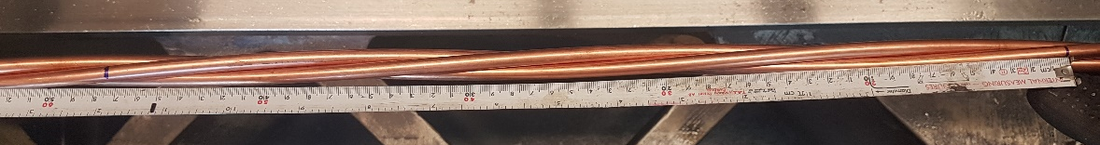
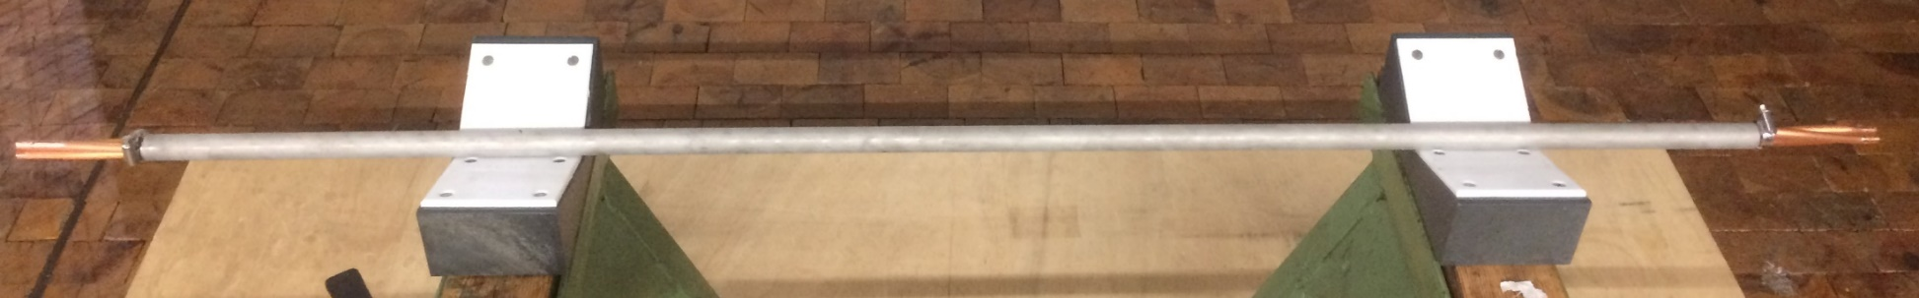

Preparation of triplet samples
Three soft-annealed copper rods of 6.0 and 8.0 mm diameter served as HTS CroCo dummy conductor and were manually twisted.
The twisted triplet samples were inserted into a stainless-steel tube and compacted to touch the twisted triplet.
Sample (steel tube) length ~ 1.3 m

Slide 6
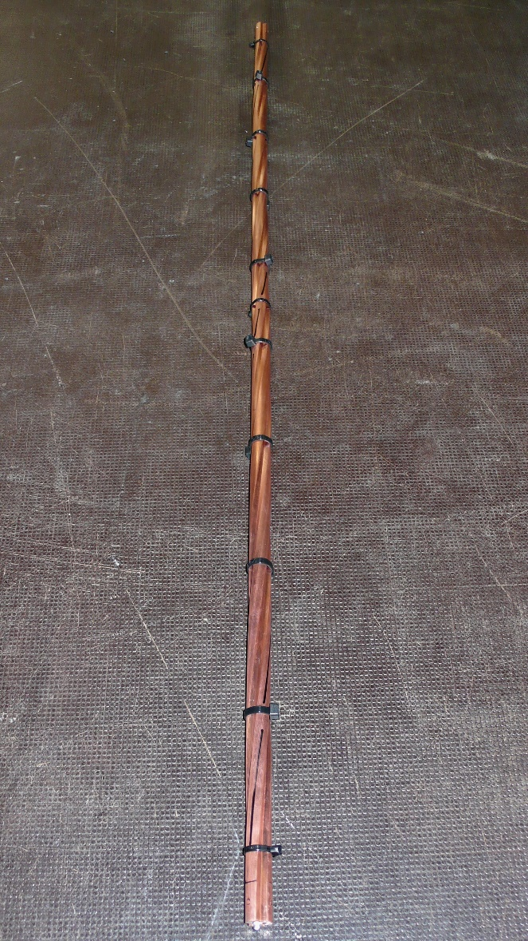
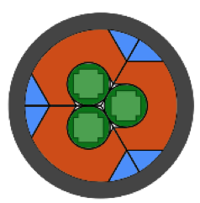
Preparation of triplet samples with Cu-profiles
Three copper profiles were equipped with (dummy) HTS CroCos by soldering them to the profiles with In50Sn50 solder.
The triplet was manually twisted (TP = 40 cm).
The twisted triplet samples were inserted into a stainless-steel tube and compacted to touch the twisted triplet.
Sample length: 1.0 m
Pressure drop measurements to be performed in 2020
(→ TS proposal for 2020 by M. Lewandowska)

Slide 7


Test results of sample 1&2 (by M. Lewandowska)
M. Lewandowska, et al.,
“Hydraulic characterization of conductor prototypes for fusion magnets”
presented at CHATS-AS 9-12 July 2019, Szczecin, Poland,
online: https://indico.cern.ch/event/776034/contributions/3445045/attachments/1878471/3094079/ML_CHATS-AS-2019_hydraulic.pdf
$$f_{WDS}\left(Re\right)=0.06308⋅Re^{−0.2665}$$
$$f_{WDS}\left(Re\right)=0.06414⋅Re^{−0.2270}$$

Slide 8
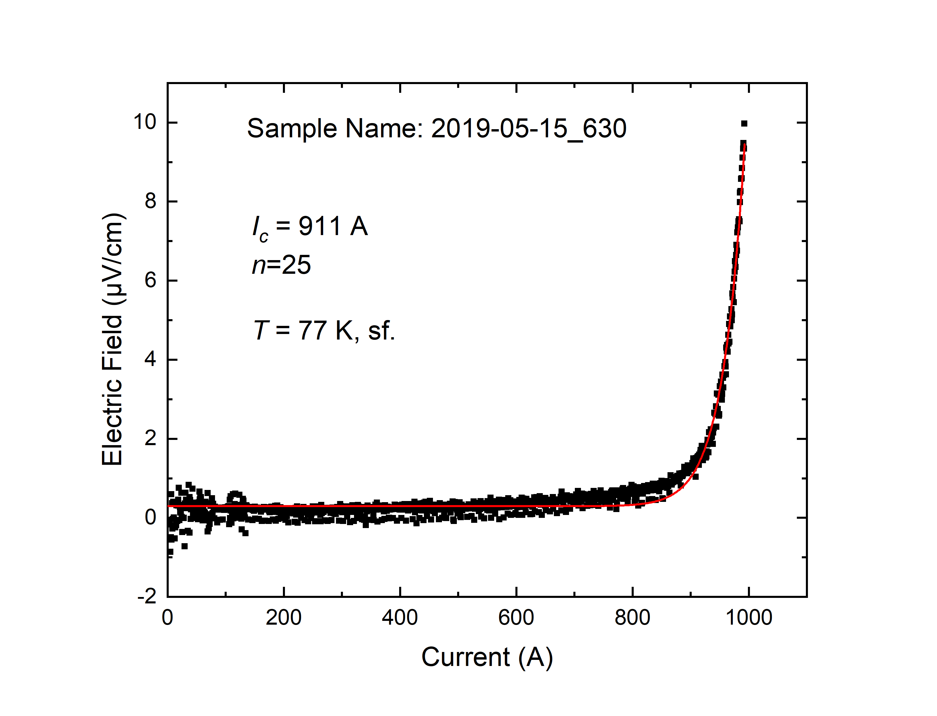
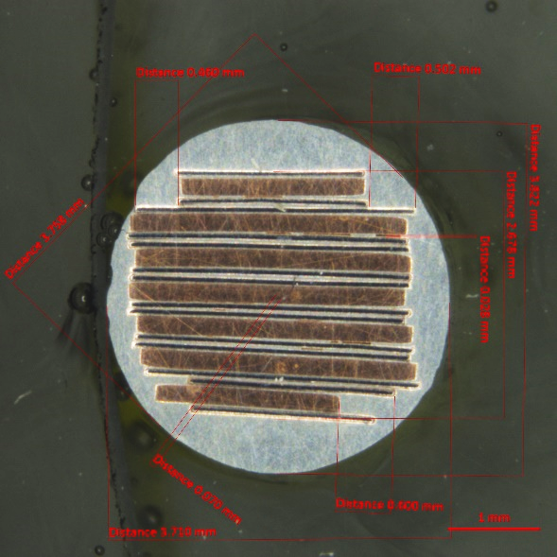
Preparation of HTS CroCo samples for electromechanical testing
For details, refer to the (following) presentation by K.-P. Weiss:
Material | Width | Thickness | Length | Number | I_{c} (77K, sf) min/max
Cu | 3 mm / 2 mm | 200 µm | 8 m | 5 / 2 | -
HTS tape | 3 mm / 2 mm | ~ 90 µm | 8 m | 10 / 4 | 90 - 118 / 60 – 80

Slide 9
Summary
Preparation of three samples for pressure drop testing
Preparation of HTS CroCo samples for further electro-mechanical testing

Slide 10
Proposal 2020
Development of High Current HTS cables
Preparation of HTS CroCo triplet samples,
profile mockup-preparation for further testing (AMT 5.5, K.-P. Weiss)
Start: 01.03.2020
End: 31.10.2020
Resources: 0.1 ppy

