Slide 1
Progress at SPC on the EU-CN collaboration
P. Bruzzone ++
February 13 , 2020

Slide 2
Outline
Background and administrative status
The SPC task
Facility preparation
Conductor assembly
Outlook in 2020

Slide 3
EU-CN International Collaboration
Germinated in spring 2018 from the wish to establish technical links with other DEMO projects.
Draft Agreement with work packages and task sharing in Aug. 2018, listed under EUROfusion IC (not MAG).
Informal Kick-off meeting in April 2019 at SPC Villigen.
WP1 on “Quench experiment” – WP2 “Cross check of TF coil design”
Long lasting signature procedures till late 2019.
Substantially funded in EU by unspent JET money. Originally planned to end Dec 2020, meanwhile extended.

Slide 4
The tasks of SPC
SPC participates to and drives the WP1 “Quench Experiment”, aimed at experimental assessment of the quench evolution in high current HTS forced flow conductors.
The main responsibilities of SPC:
Modify the SULTAN sample environment replacing the transformer sample holder by a sample holder with direct current supply up to 15 kA.
Design and manufacture a number of HTS conductors in the 15 kA class applying parametric layout modifications.
Test in SULTAN the own conductor samples and those prepared by the other partners (KIT, ENEA, ASIPP).
In agreement with PMU, SPC started the work in late 2018 without waiting for the full signature of the EU-CN collaboration. Formal IC- tasks are now enforced.

Slide 5
Modification of the SULTAN sample environment
The sample environment of SULTAN, with the superconducting transformer, allows supplying operating current up to 100kA to the sample at very low voltage < 0.1 V.
To investigate the quench evolution, it is necessary to maintain the operating current, i.e. sustain the quench voltage. This can only be done replacing the transformer by a direct power supply.
The limited space at the top flange of the sample environment determines the maximum size of the (HTS) current leads. A compromise for operating current is found at 15 kA.
The Danfysik power converter used for EDIPO, 18 kA / 10 V is used for the quench experiment.

Slide 6
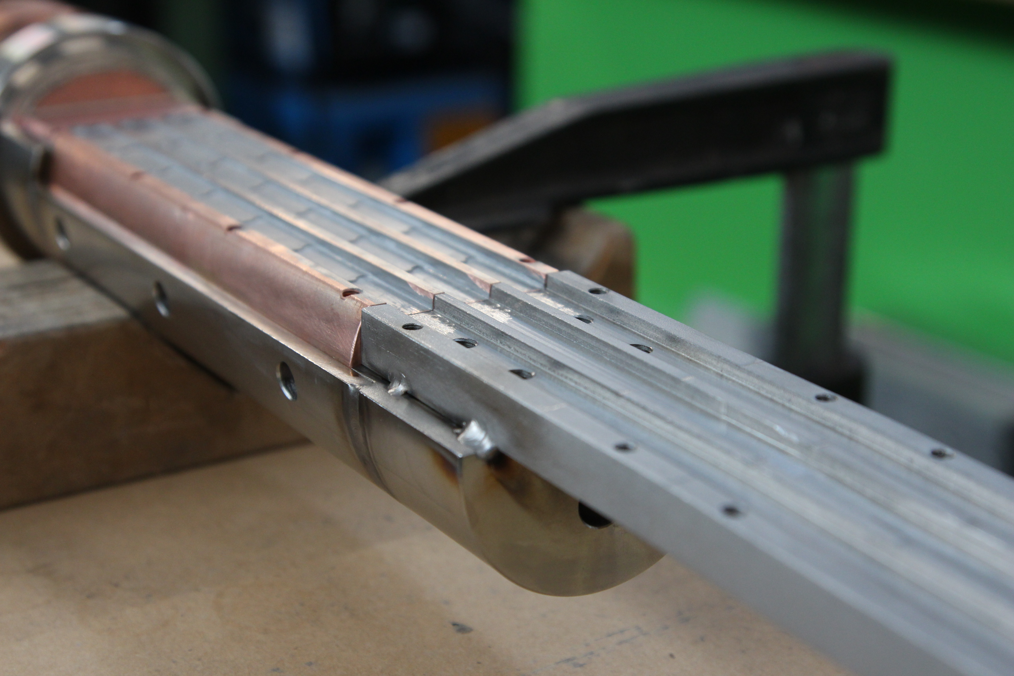
A new pair of HTS current leads for 15 kA
HTS module by three stacks of staggered, soldered 10 mm wide REBCO tape, interleaved with brass tapes for stability. Very long HTS module with thick steel support to match the standard location of the sample attachment.

Slide 7
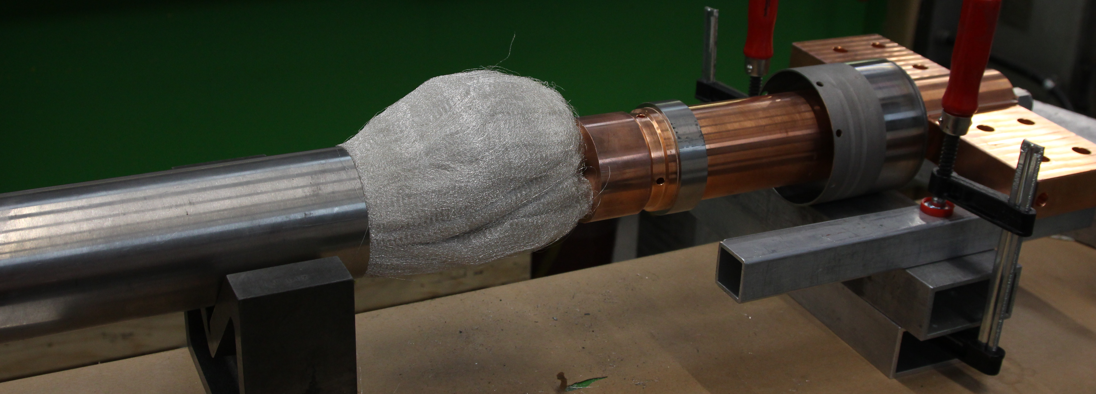
A new pair of HTS current leads for 15 kA
Heat exchanger by a large bundle of thin copper wires.

Slide 8
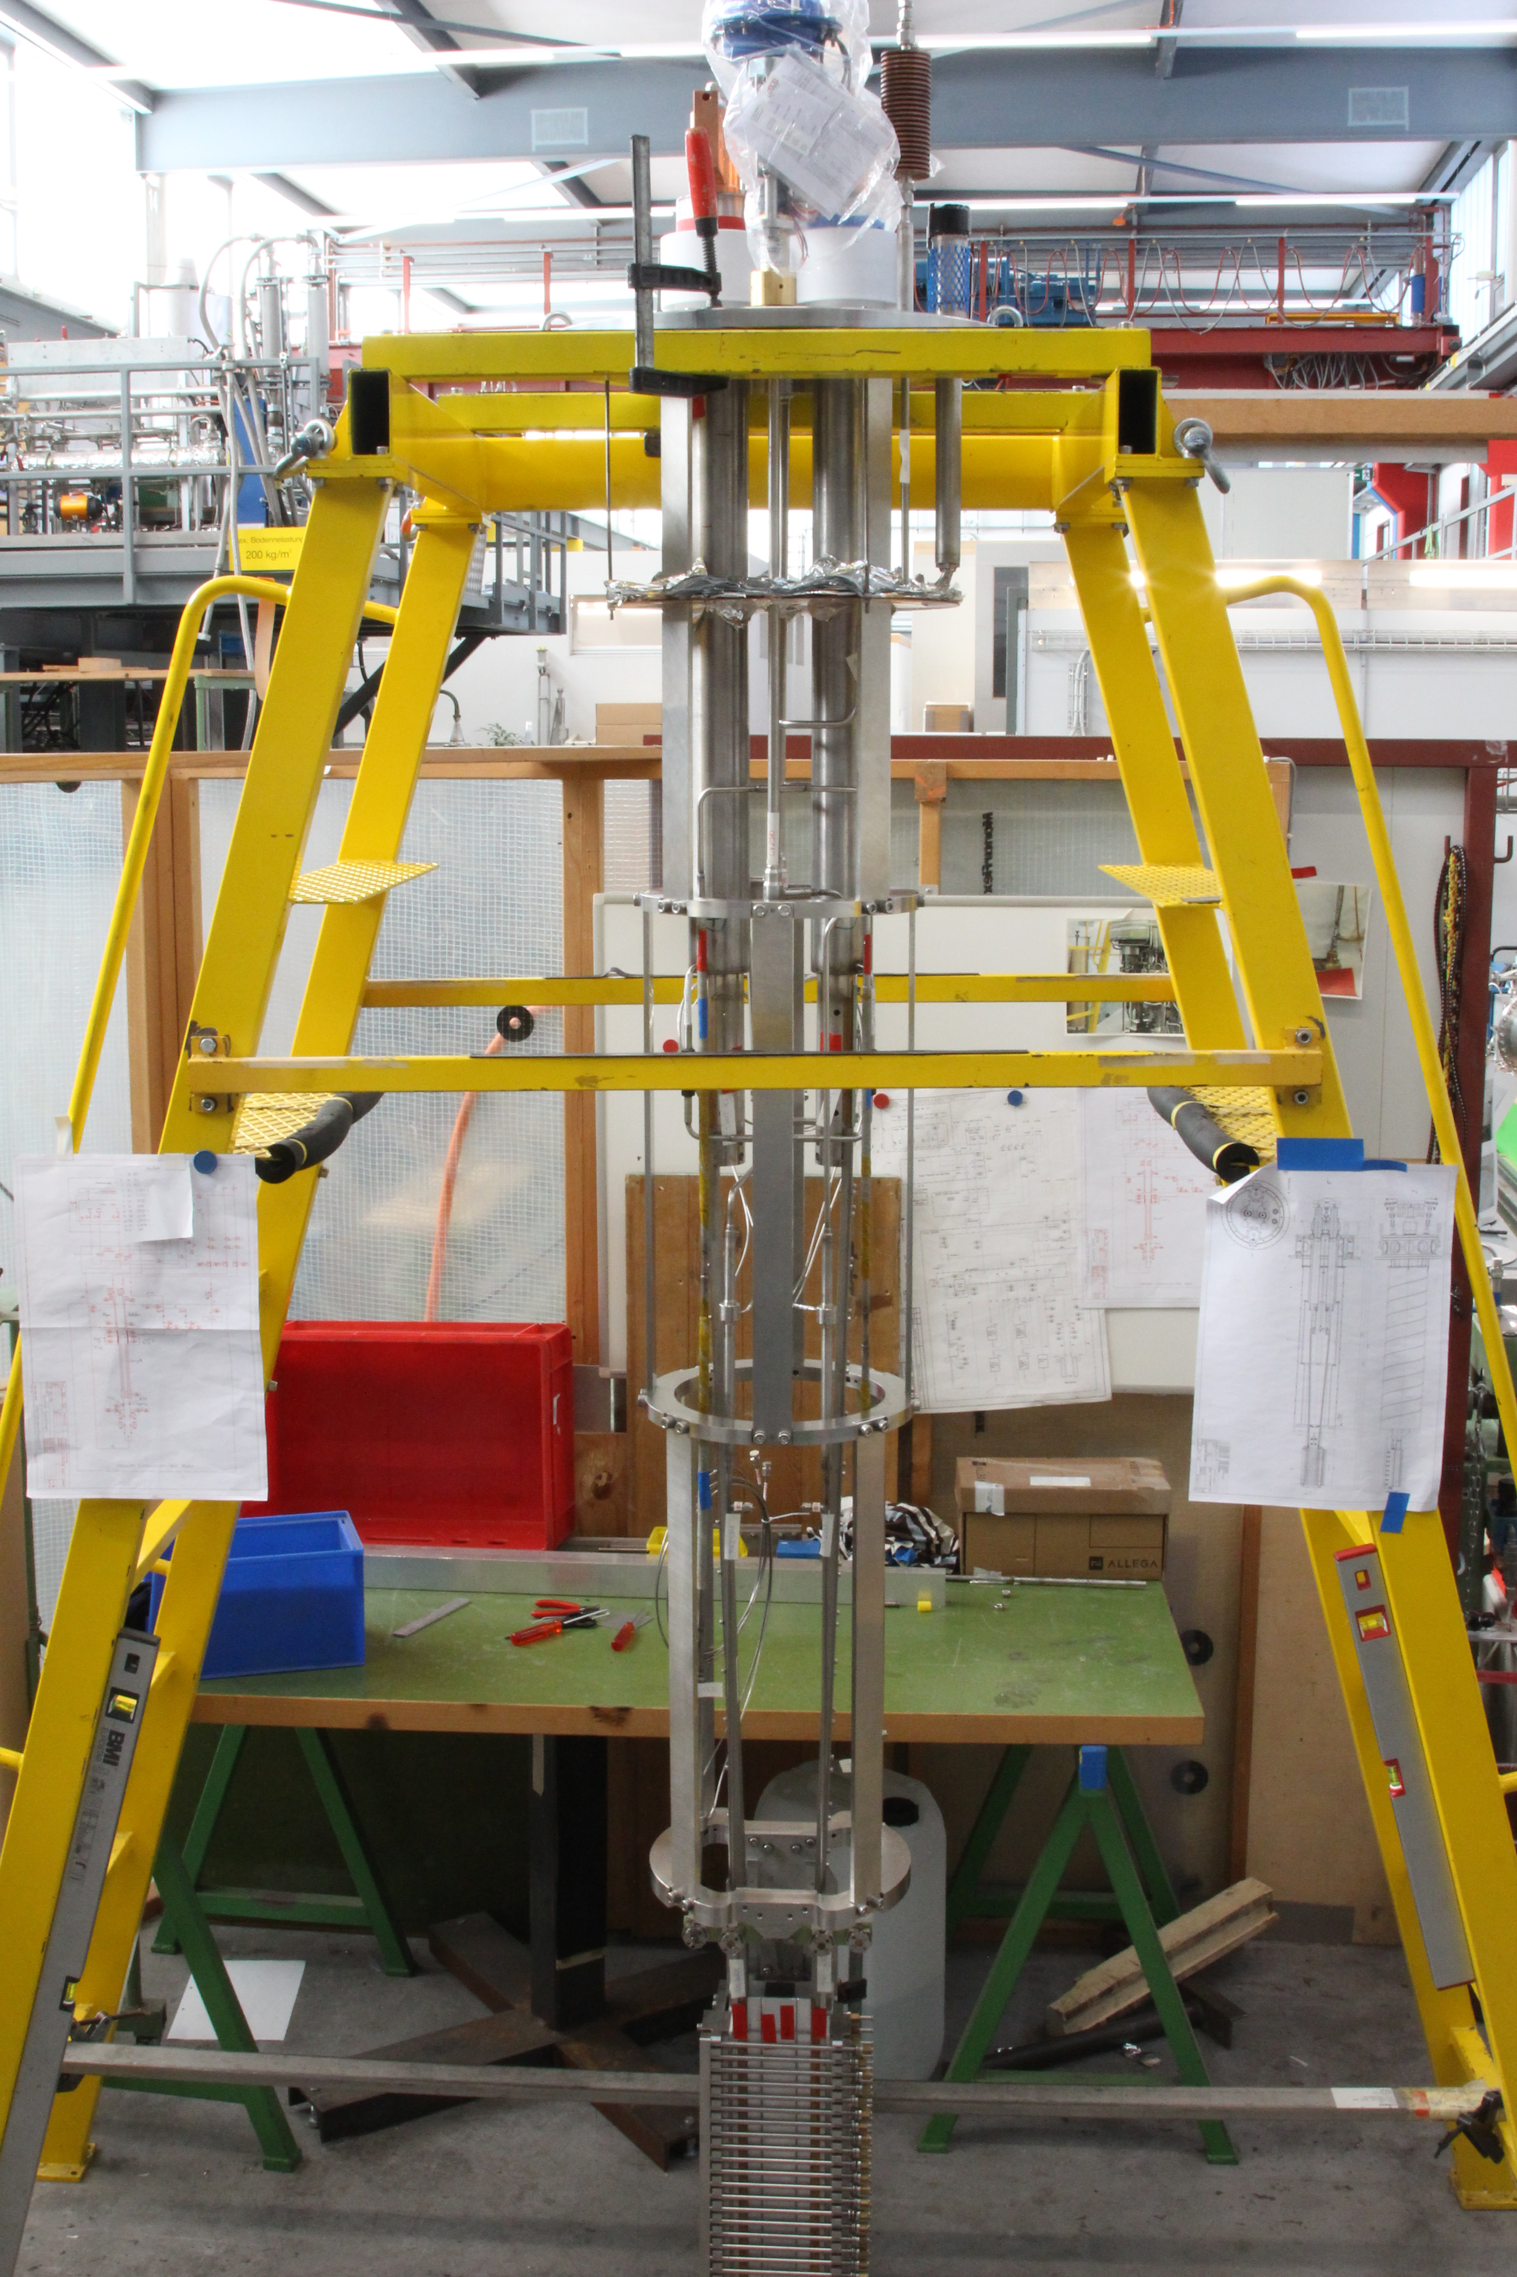
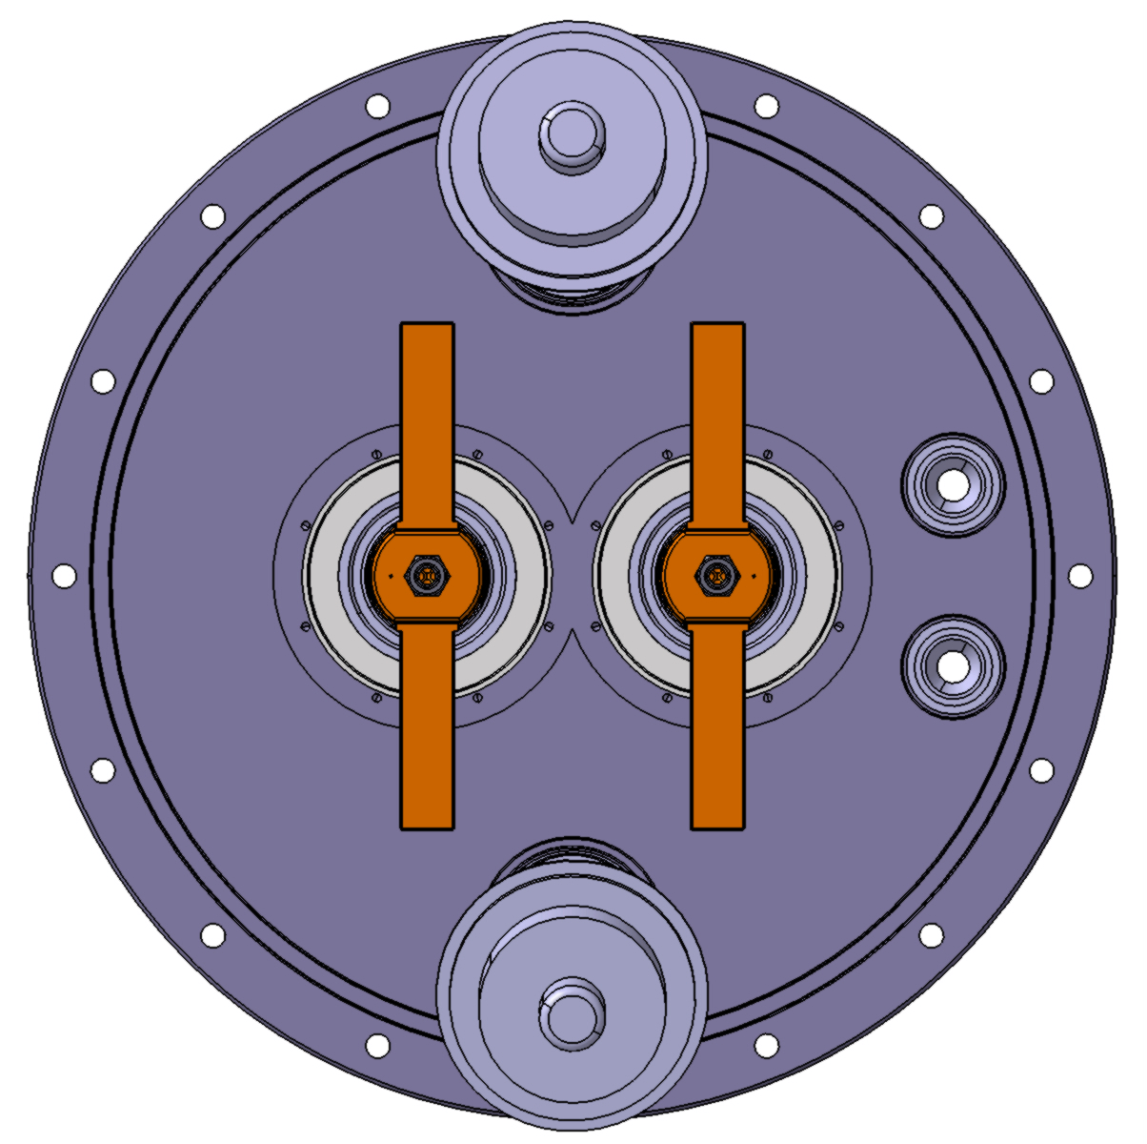
Sample holder with current leads, valves and piping

Slide 9
Interfaces and test
The interfaces for the sample are kept almost identical as in regular SULTAN samples.
An interface document has been compiled and sent to the partners who are assembling quench experiment samples.
The main test will be a T_{cs} run ending with a quench. The current will be not switched down after quench, to observe quench propagation speed and hot spot temperature.
For the main test, the operating current will be 15 kA, the field 10.9 T (maximum SULTAN background field) and the inlet temperature will be slowly increased.
The instrumentation includes also intrusive sensors to measure/compare the coolant temperature and the jacket temperature during transients.

Slide 10
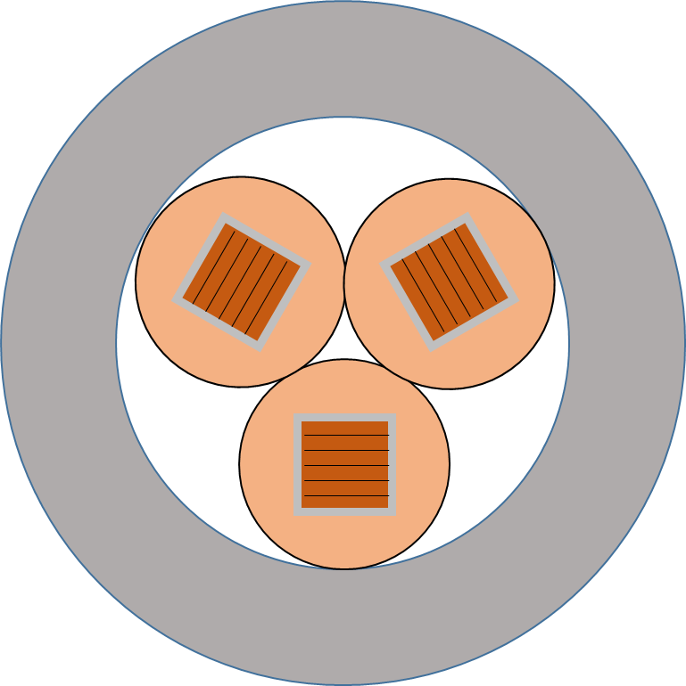
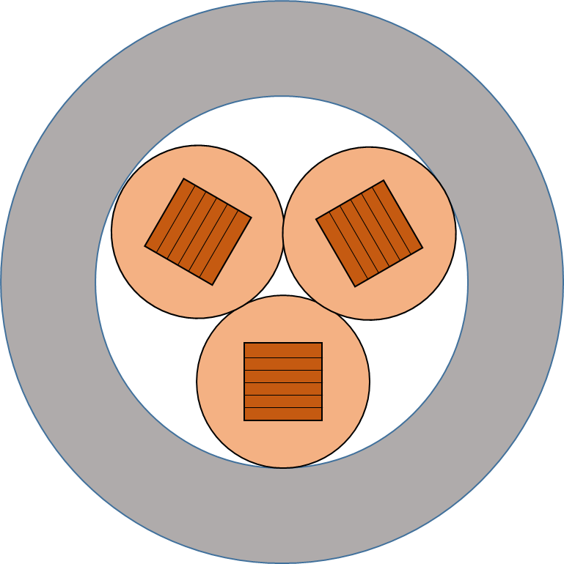
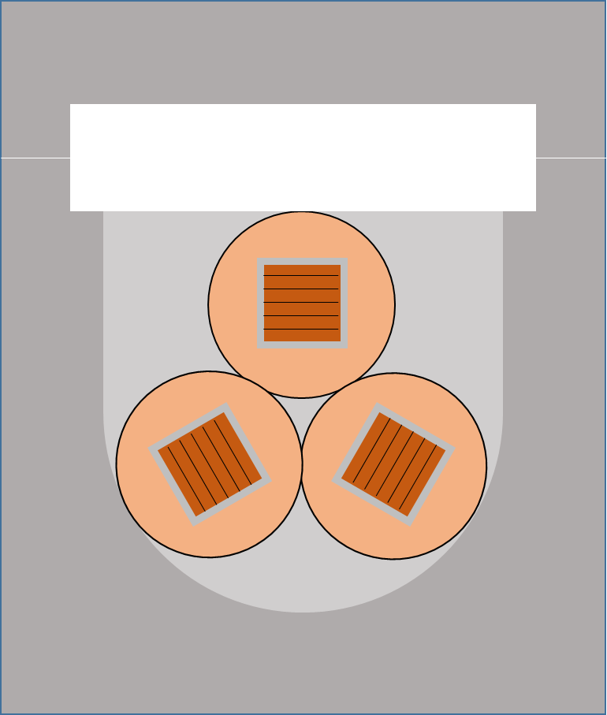
Conductors
Four conductors are prepared based on a triplet of strands made of stacks of REBCO tapes.
All the four conductors have the same number of tapes from the same supplier
The impact of the parametric variations on the quench evolution is the object of the test.
Reference
Twisted/soldered
Non-twisted,
soldered
Non-soldered, twisted
Strand-jacket soldered
A fifth conductor with same strand size, steel, copper, helium cross section, is planned using Bi2223 tapes instead of REBCO.

Slide 11
Status as February 12th 2020
The thee round conductors with REBCO tapes are completed, including termination.
The sample holder is completed except instrumentation and wiring.
The control system for the quench experiment is commissioned.

Slide 12
Outlook in 2020
By the end of March 2020
Sample holder instrumented
One sample assembled and instrumented
April 2020
Installation of sample holder and sample
Connection of 15kA leads
Commissioning of the quench experiment and test of the first sample
Further in 2020
Assembly of the fourth (soldered jacket) and fifth (Bi2223) conductors
Assembly and test of second and third samples
Data reduction and analysis
Test of partner samples???

