Slide 1
Direct Spooling of partially equipped CroCos
ENR-PRD.Extra
W.H. Fietz, M.J. Wolf, D. Nickel, K.-P. Weiss

Slide 2
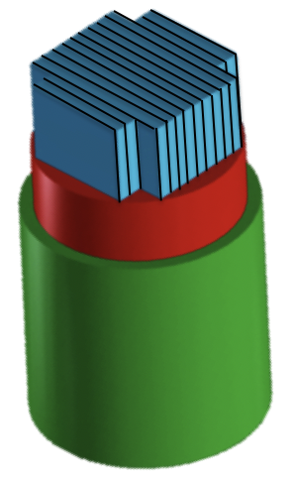
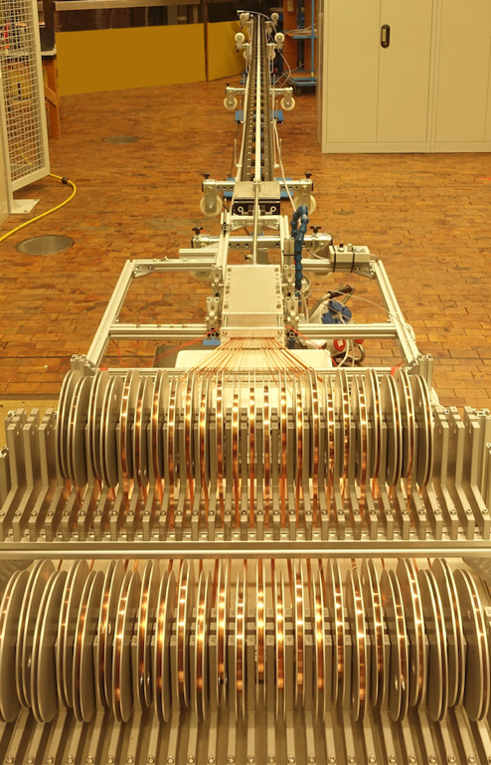
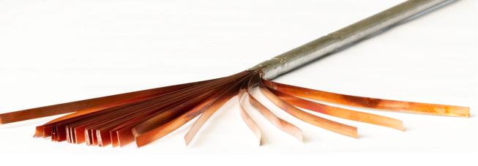
Formation of straight HTS CroCos
From single tapes a long length straight HTS CroCo was formed with up to 60 Cu and HTS tapes in lengths up to 8 m.
This is proofed technology and was used to build 35 kA @ 77K, sf demonstrator

Slide 3
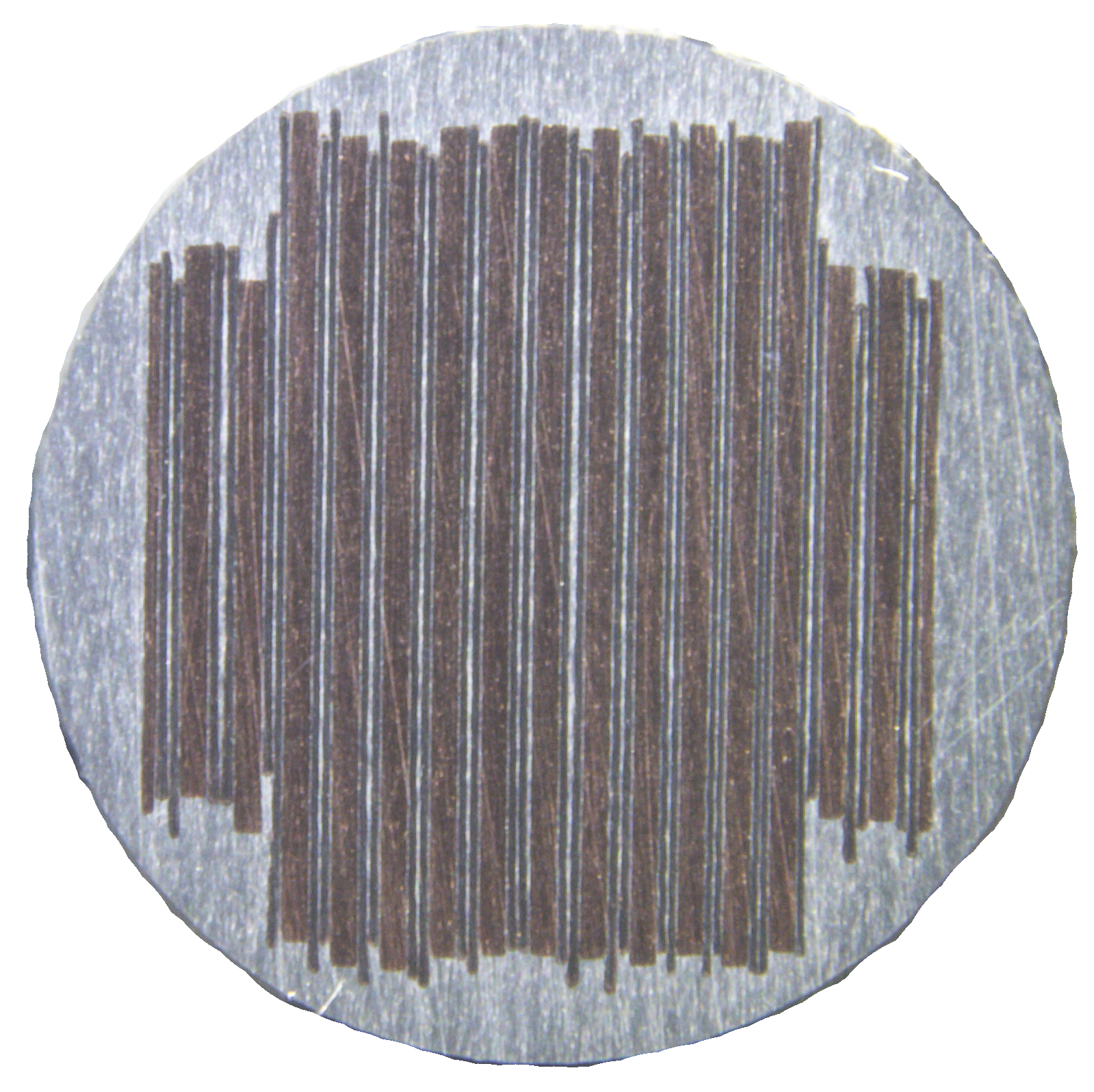
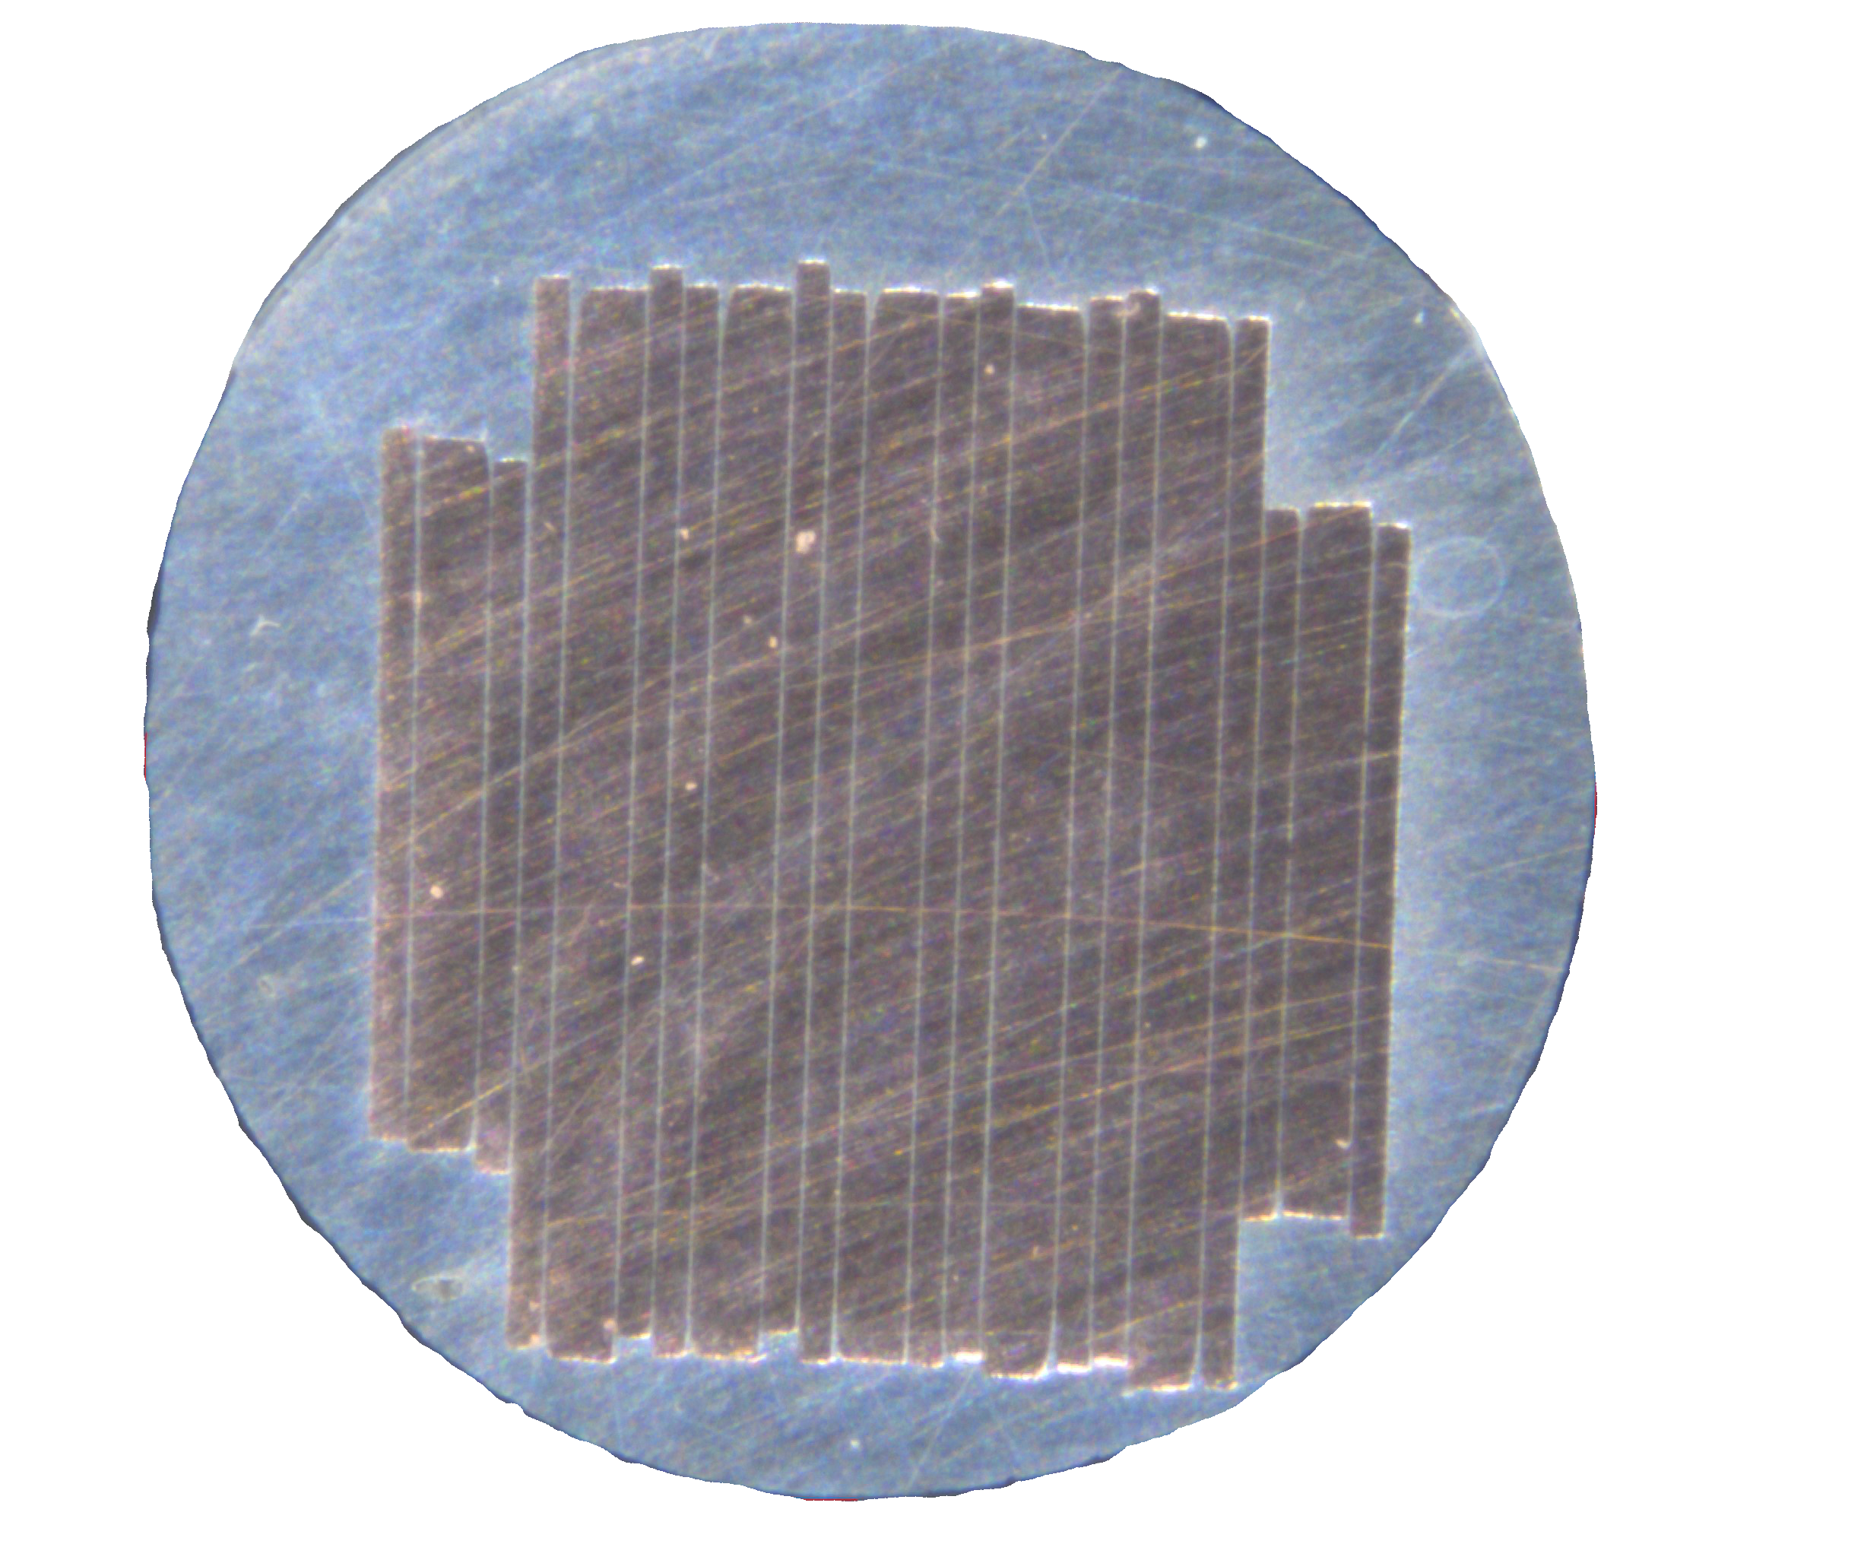
Bending Radius of HTS CroCos
With respect to winding, the small 3/2 HTS CroCos from 3 mm and 2 mm tapes offer an advantageous small acceptable bending radius.
 | 6/4 CroCo | 3/2 CroCo
Typical number of REBCO tapes | 22 x 6 mm | 18 x 3 mm
 | 10 x 4 mm | 10 x 2 mm
Cross diagonal | 7.2 mm | 3.6 mm
Min. bending radius | 60 cm | 30 cm
I_{c} T = 77 K, self field | 3 100 A | 1 460 A
I_{c} T = 4 K, B = 12 T | > 10 000 A | 6 000 A
Is it possible to spool 3/2 mm HTS CroCos directly from reel to reel to fabricate long lengths of such 3/2 HTS CroCos?

Slide 4
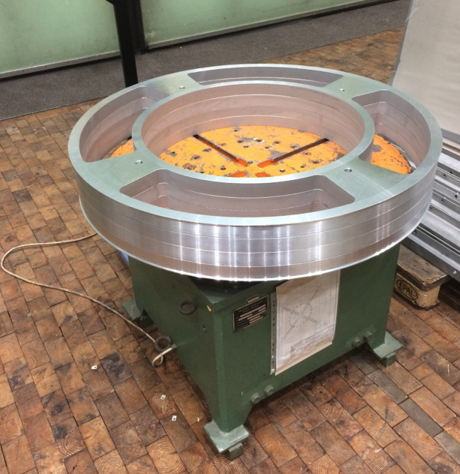
Spooling of 3/2 HTS CroCos
Due to the limited resources, existing equipment was used
In this case, several welding positioners were tested to identify the best one for spooling the HTS CroCos

Slide 5
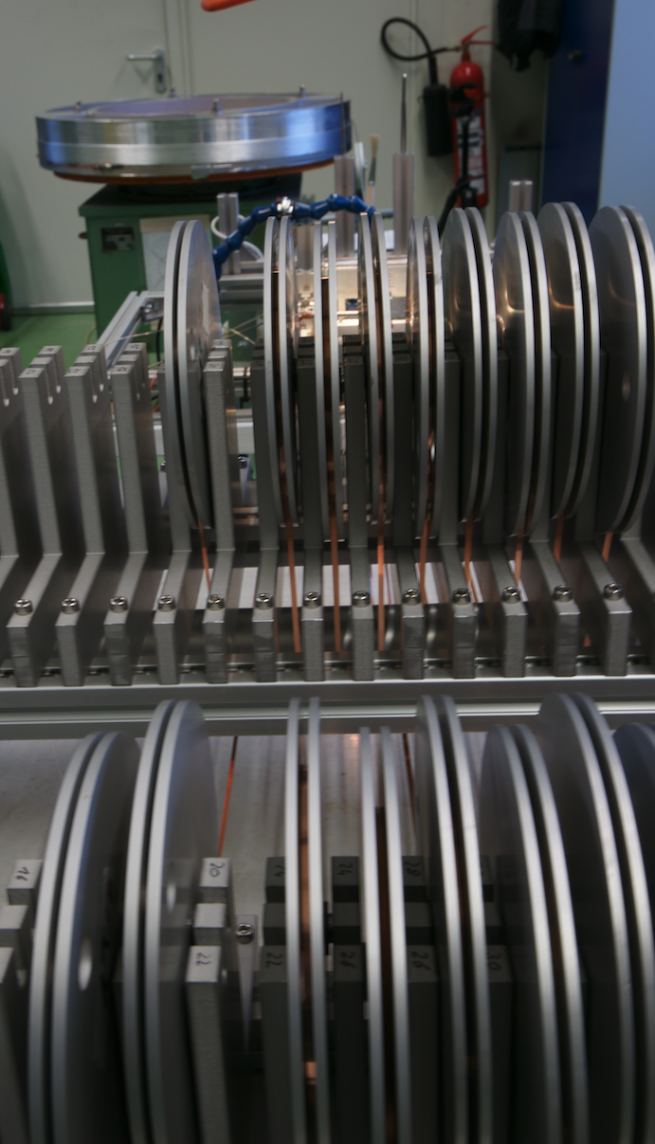
Reel to Reel situation
The 1 m diameter reel
of the welding positioner
receives the HTS CroCos
prepared from the individual reels of the REBCO and Cu tapes

Slide 6
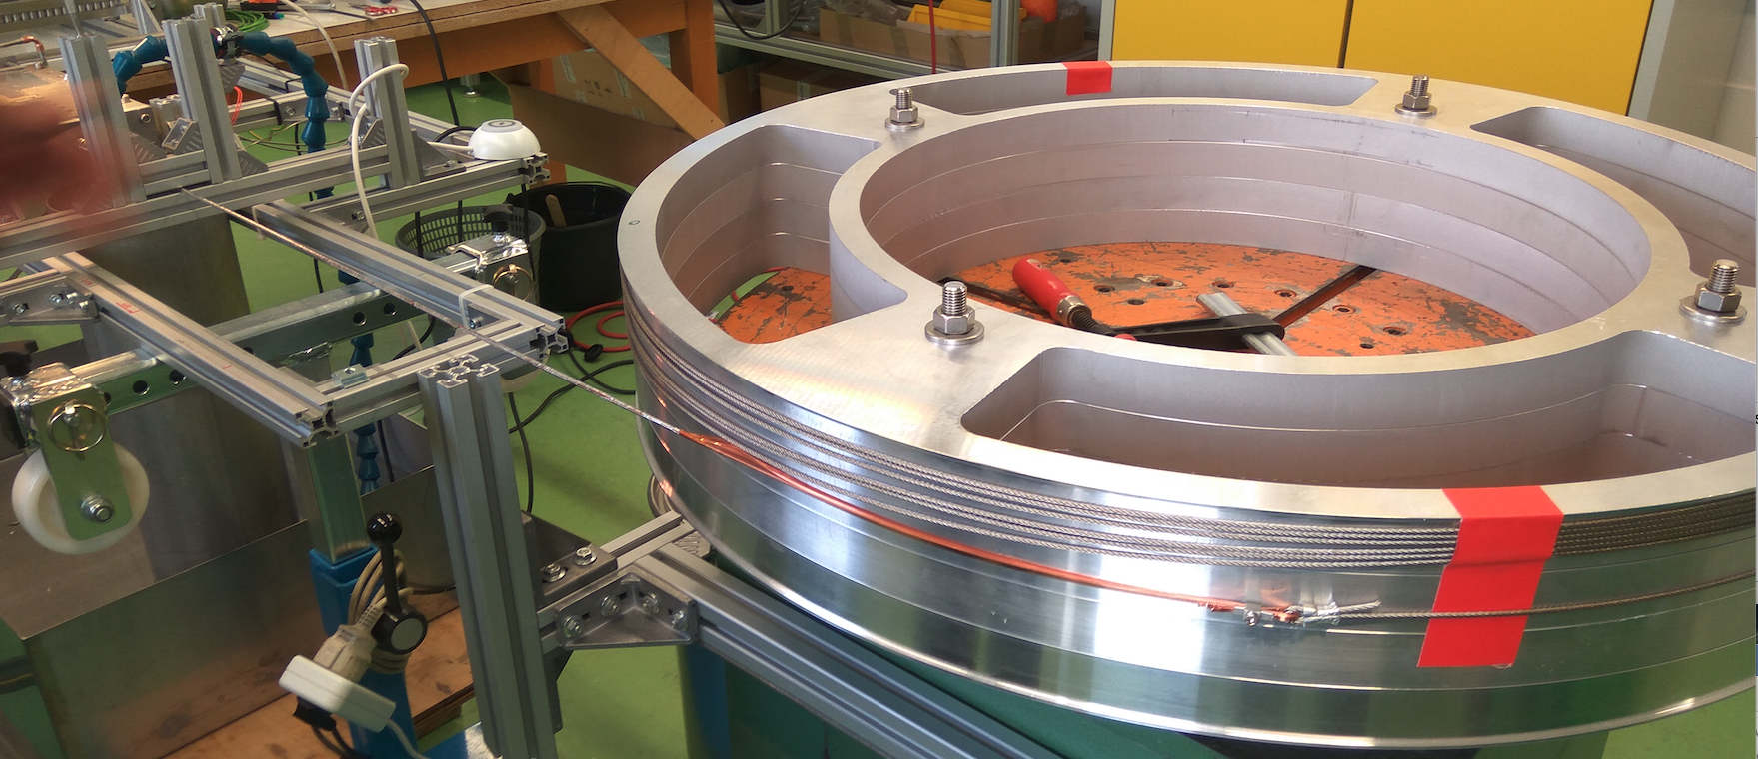
First run of reel to reel spooling

Slide 7
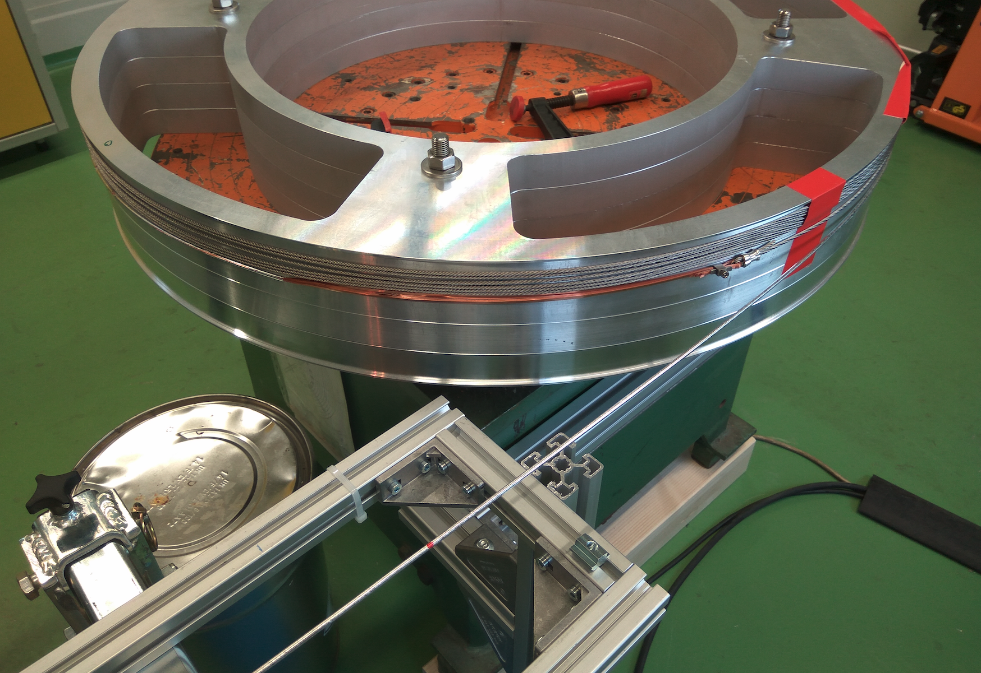
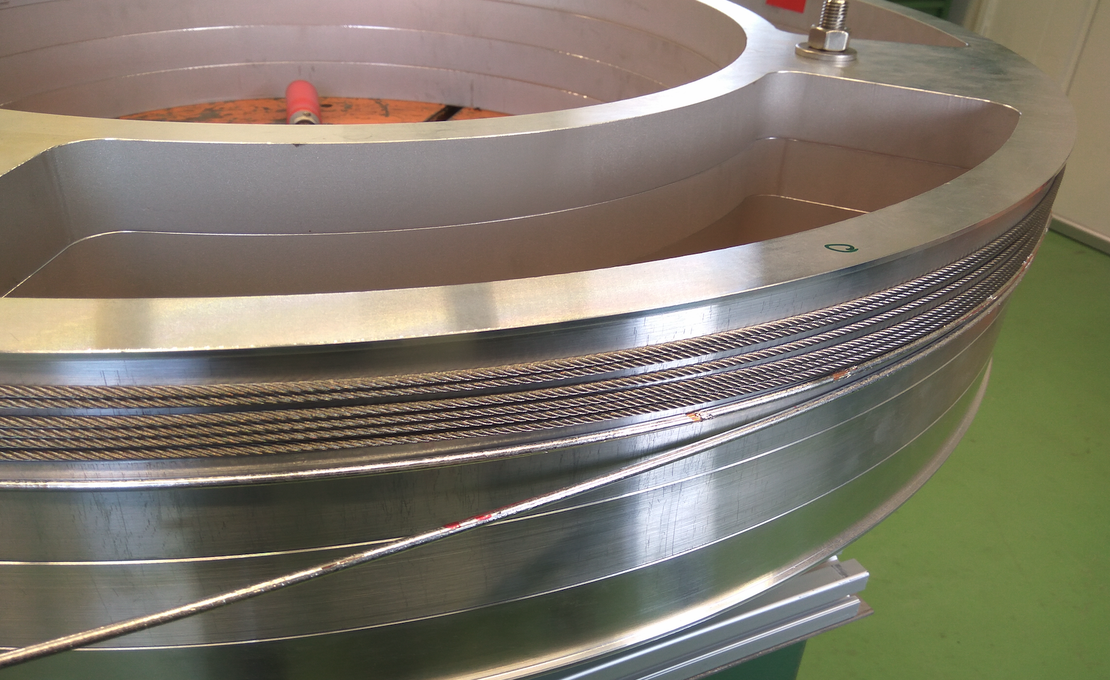
Spooling of the 3/2 HTS CroCo

Slide 8
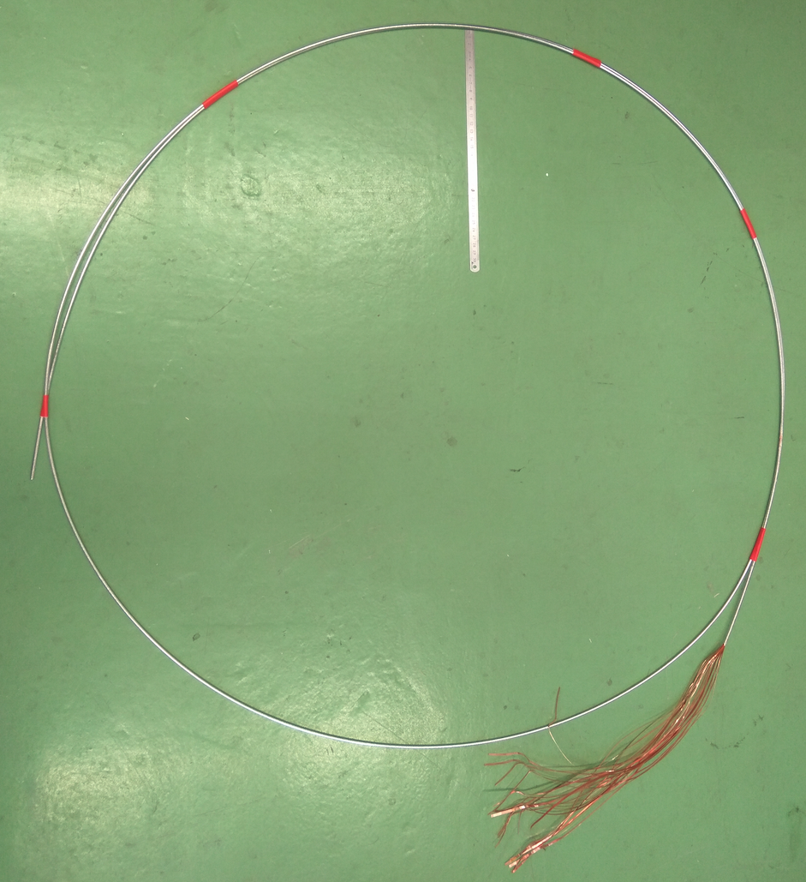
HTS CroCo after removal from the welding positioner
30 cm

Slide 9
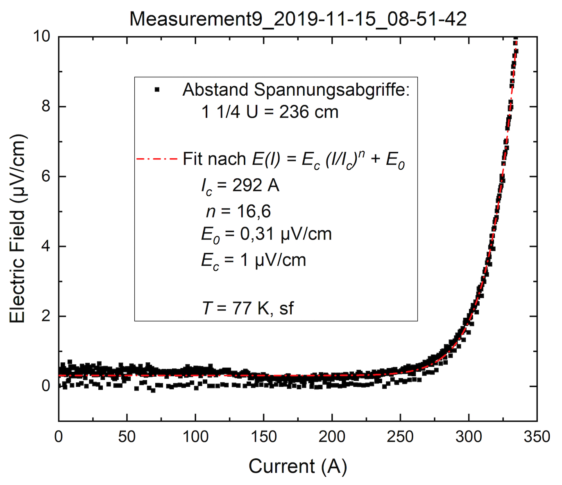
This CroCo was wound to a 60 cm diameter spool and tested. The CroCo is still superconducting after the reel-to-reel fabrication.

Slide 10
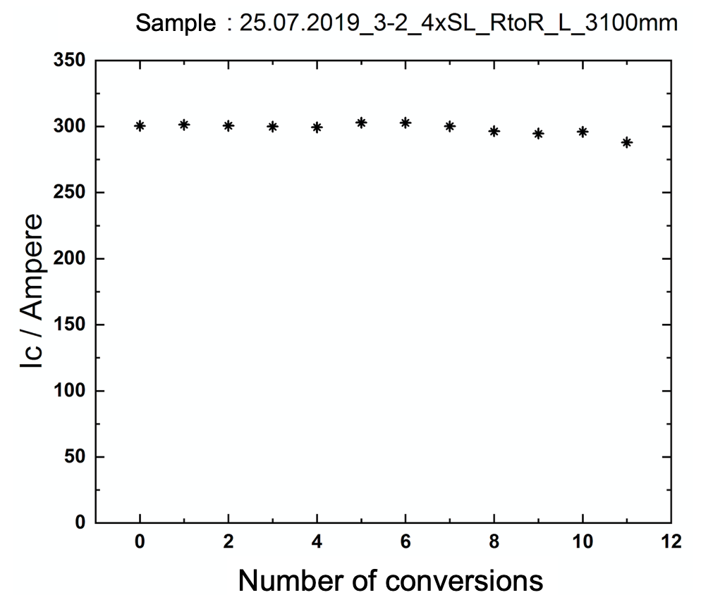
The 3/2 HTS CroCo was straighten and re-bend several times to check degradation issues
wound in counter direction

Slide 11
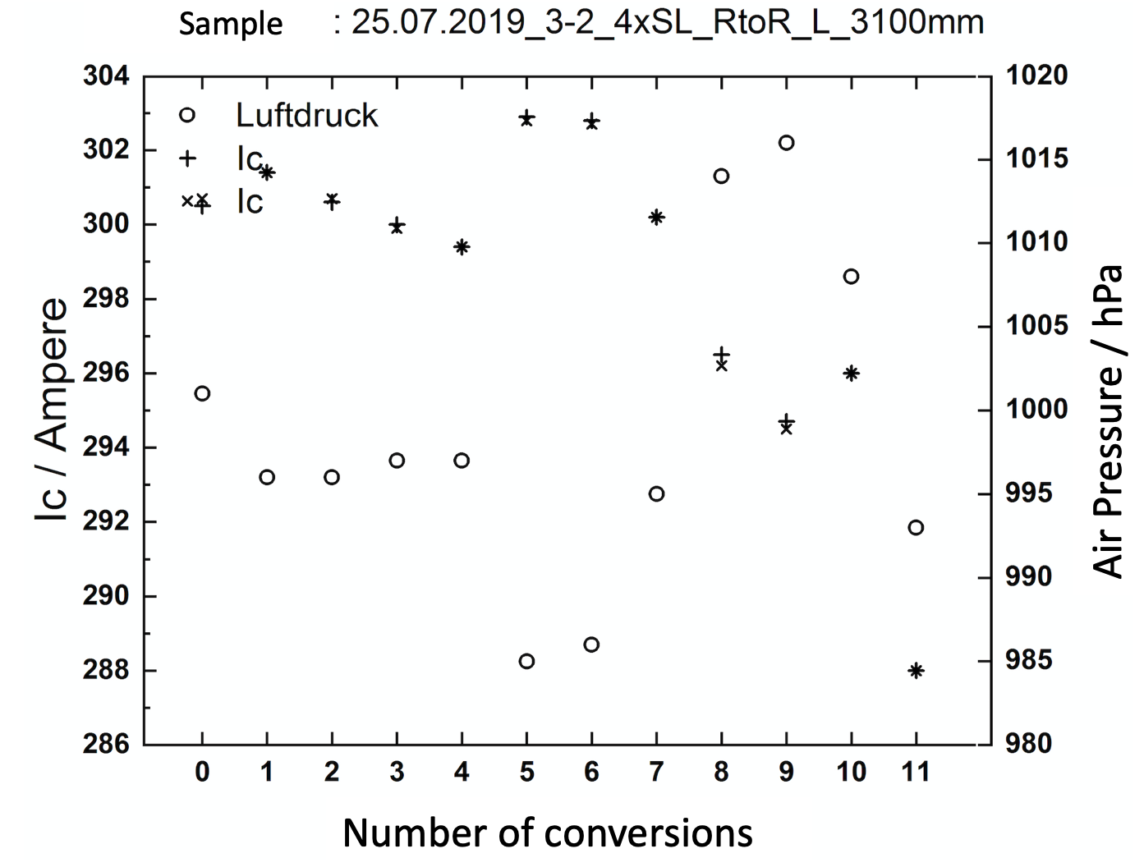
The 3/2 HTS CroCo was straighten and re-bend several times to check degradation issues
wound in counter direction

Slide 12
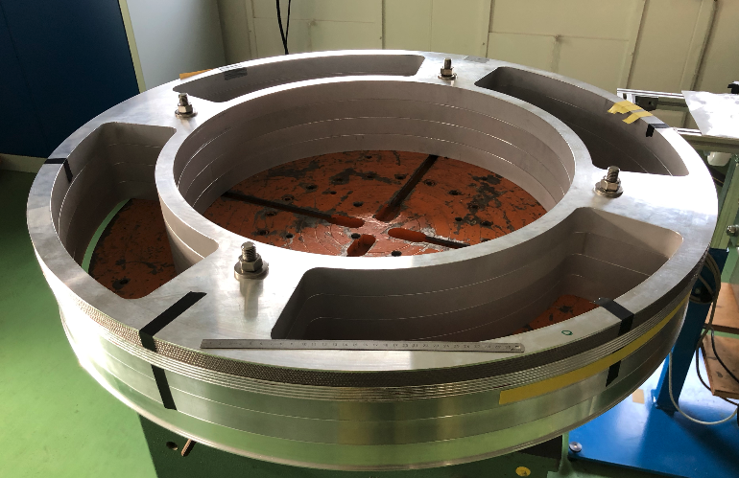
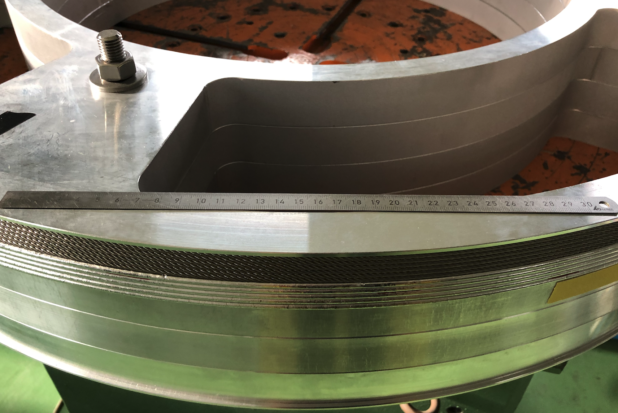
8 m HTS CroCo wound to the 1m diameter reel
In Dec 2019 approx. 8 m of HTS CroCos were fabricated –
starting from the REBCO and Cu-tape reels with subsequent winding
of the fabricated CroCo to the 1 m diameter reel.

Slide 13
Proposal 2020
Long length fabrication and detailed analyses of CroCos towards HTS feeders for future fusion machines
Spooling of long length partially equipped CroCos
Preparation of 8 m fully equipped TS CroCos
Intensive examination of fully equipped CroCos
Start: 01.03.2020
End: 31.10.2020
Resources: 2.0 ppy

