Slide 1
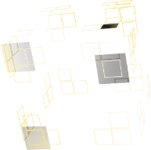
ENR-PRD.MAG5.3-T017, EM & mechanical modeling and experiments on CORC® cables
A. Nijhuis¹, V.A. Anvar^{1, 2}, K. Wang³, C.B. Varun^{1,4}, R.J. Thomas⁴, T.J. Haugan⁵, J.D. Weiss⁶, D.C. van der Laan⁶, M.S.A. Hossain^{2,7}
¹The University of Twente, Faculty of Science & Technology, 7522 NB Enschede, the Netherlands
²Institute for Superconducting and Electronic Materials, University of Wollongong, Wollongong, Australia
³Keyang Wang. College of Civil Engineering and Mechanics, Lanzhou University, Lanzhou, Gansu, P.R.China
⁴Department of Mechanical Engineering, T.K.M.C.E, India
⁵US Air Force Research Laboratory, Wright Patterson AFB, OH 45433, USA
⁶Advanced Conductor Technologies and University of Colorado, Boulder CO 80301, USA
⁷School of Mechanical and Mining Engineering, the University of Queensland, Brisbane, QLD 4072, Australia
EUROfusion, WPMAG19, Final Meeting, ENEA, February 2020

Slide 2
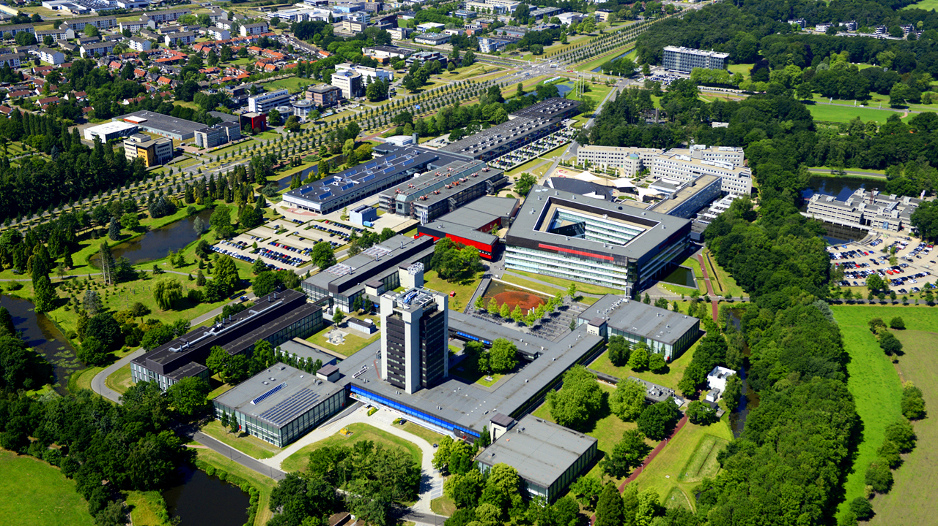
Content
CORC bending, ABACUS™️ model & experiments
New COMSOL™️ model
Contact resistances in CORC™️
Proposal 2020

Slide 3
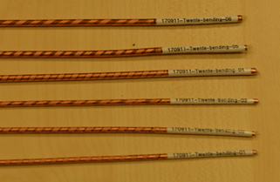
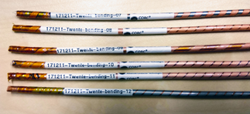
CORC ® samples from ACT
Second sample set from Advanced Conductor Technologies
id | Winding parameters
 | Number of SC tapes | Core [mm] | Winding angle [ º ] | Tape width [mm] | Lubrication | Number of samples measured
1 | 1 | 2.55 | 35 | 2.03 | Lubrication #1 | 2
2 | 1 | 2.55 | 45 | 2.03 | Lubrication #1 | 2
3 | 1 | 2.55 | 55 | 2.03 | Lubrication #1 | 2
4 | 1 | 3.2 | 35 | 2.03 | Lubrication #1 | 2
5 | 1 | 3.2 | 45 | 2.03 | Lubrication #1 | 2
6 | 1 | 3.2 | 55 | 2.03 | Lubrication #1 | 1
Variable parameters:
Core diameter
Winding angle
Friction coefficient (via lubrication and tapes soldering)
7 | 1 | 3.2 | 35 | 3.03 | Lubrication #1 | 1
8 | 2 | 3.2 | 45 | 3.03 | Lubrication #1
9 | 1 | 3.2 | 55 | 3.03 | Lubrication #1 | 1
10 | 2 | 3.2 | 45 | 3.03 | Lubrication #2
11 | 2 | 3.2 | 45 | 3.03 | Unlubricated
12 | 2 | 3.2 | 45 | 3.03 | Lubrication #1 solder coated

Slide 4
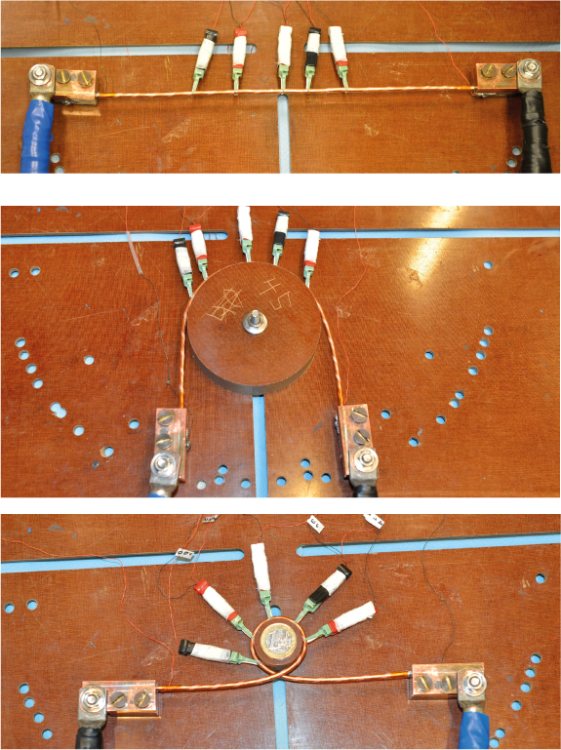
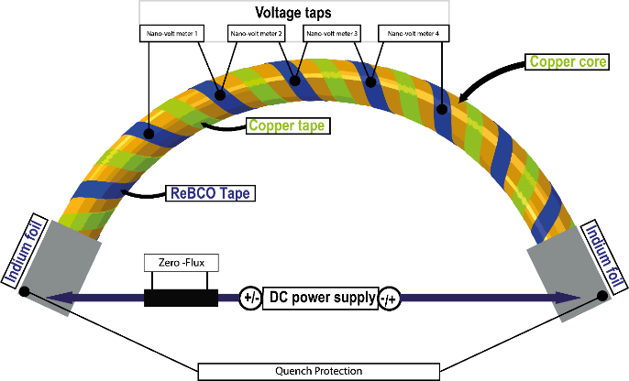
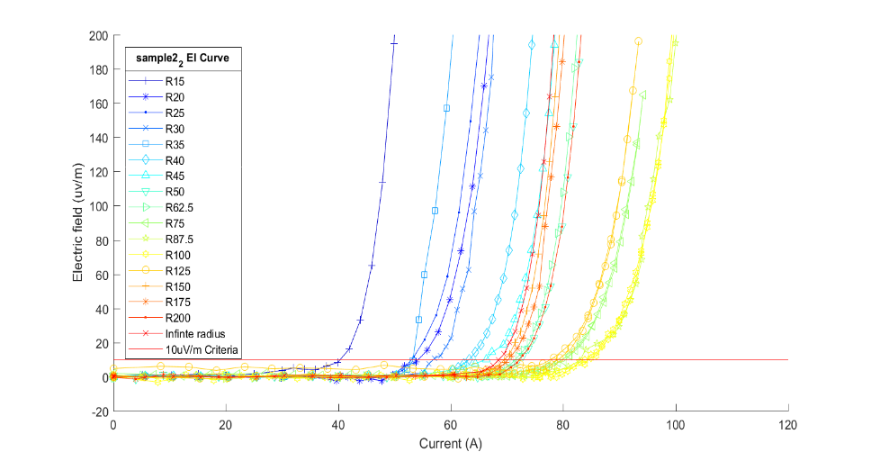
CORC ® bending experiments
R = inf
R = 45 mm
Bending setup schematic
R = 15 mm

Slide 5
CORC ® bending experiments, effect core
Current conduction through copper core influences the results

Slide 6
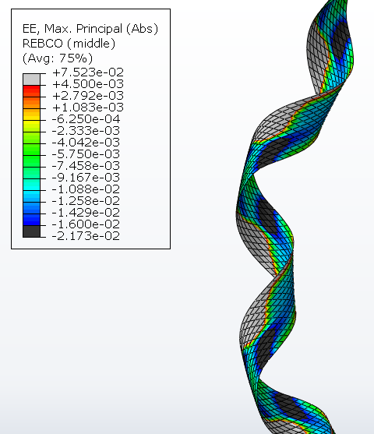
Tape strain in CORC® bending
2.5 mm core diameter | 2 mm wide tape | SCS2030 | Winding angle 45 deg
Strain distribution at higher friction coefficient is similar to hard-way plane bending of REBCO tape
Kink
High compressive strain in the tape leading to damage by kink formation
Extracted tape showing periodic kinks

Slide 7
CORC ® experiments vs modeling
Kirill Ilin
Calculated volumetric damage in ReBCO layer.
Friction coefficient 0.1, 0.2 and 0.3 almost similar results
Start of degradation of the sample elements at these coefficients of friction values similar to experimental data.

Slide 8
CORC ® modeling, ABACUS
Parameters:
Winding Angle,α
Core diameter
Tape width
Substrate thickness
Copper thickness
Tape SCS2030
Width = 2 mm
Hastelloy thickness= 30 µm
Copper thickness= 5 µm
Winding Angle= 45⁰
Core diameter= 2 mm
Kirill Ilin
At lower core diameter the compressive strain will exceeds the reversible -2% strain limit
Larger winding angle will increase the tensile and compressive strain on the ReBCO layer.

Slide 9
CORC ® modeling, ABACUS
Smaller Hastelloy thickness reduces the compressive strain in the ReBCO layer.
Kirill Ilin
For smaller tape width tape edge effect will enhance strain.
Increasing copper thickness layer hardy affects strain.
Copper thickness at one side increased, to shift ReBCO layer to neutral axis.

Slide 10
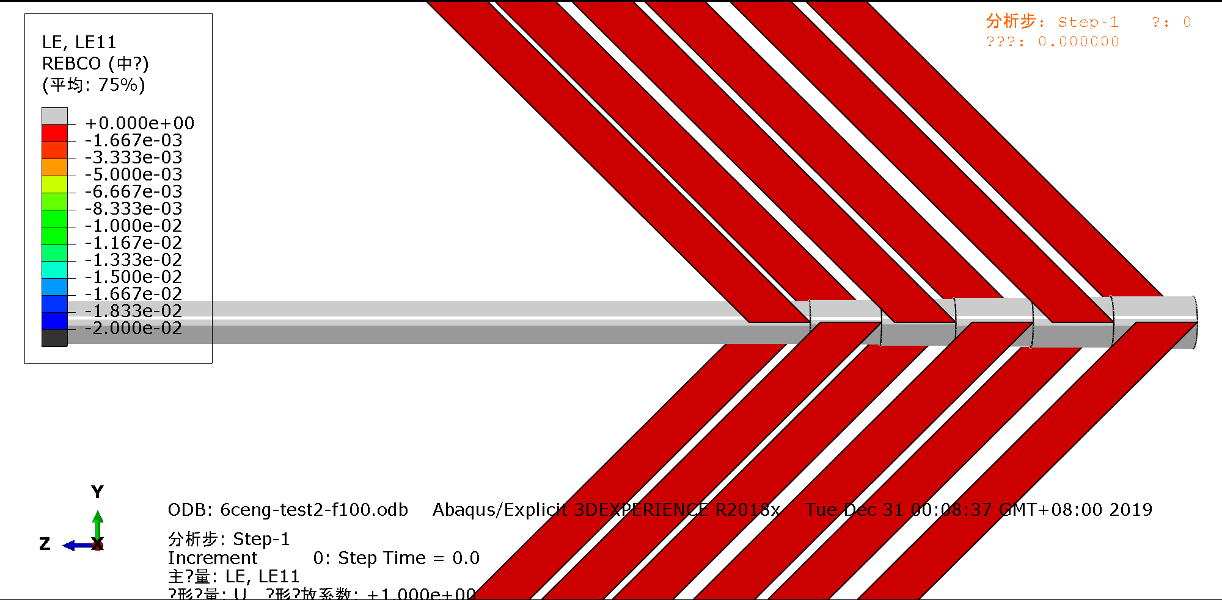
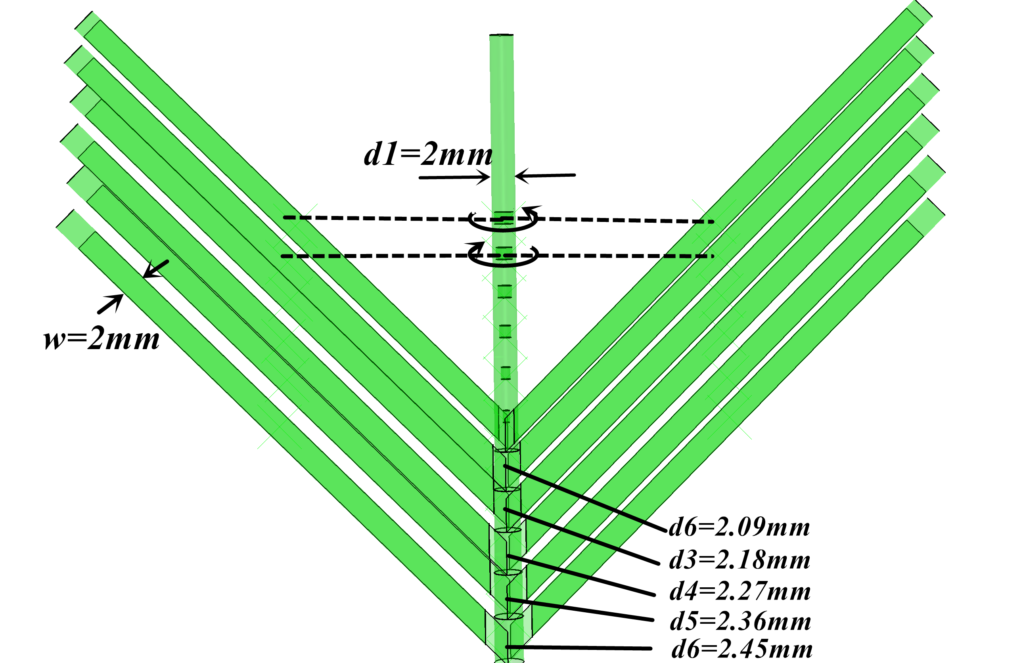
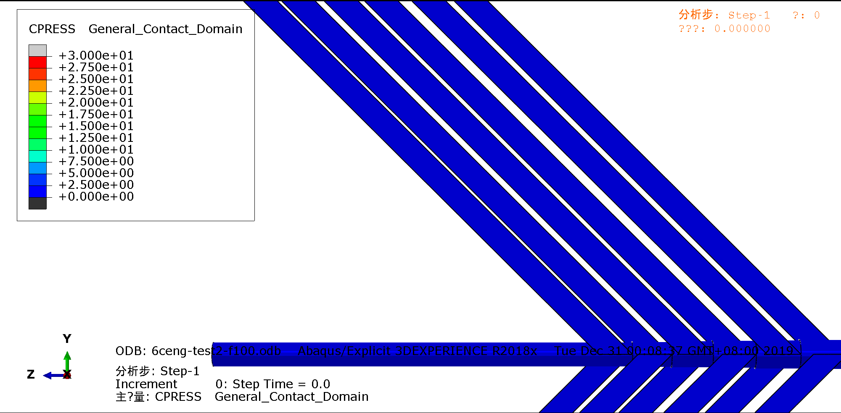
COMSOL™️ numerical model: parameters
Parameters | Young’s modulus of Hastelloy (293K) | Young’s modulus of copper (293K) | Plastic yield stress of the Hastelloy | Plastic yield stress of copper | Poisson ratio of the tape | Friction factor | HTS tape (Thickness(t)×Width(w)) | Copper Core radius (r) | CORC wire length | helix angle (α)
Value | 186 | 75 | 837 | 150 | 0.32 | 0.1 | 0.045×2 | 1 | 100 | 45°
Unit | GPa | GPa | MPa | MPa | - | - | mm | mm | mm | degree
Keyang Wang

Slide 11
R_{c} vs cooldown cycle – No lubrication
Cooldown cycle | R_{c} (µΩm)
1 | 7.2 ± 0.6
2 | 4.2 ± 0.6
3 | 5.5 ± 0.55
4 | 10.7 ± 0.6
5 | 5.7 ± 0.6
6 | 5.3 ± 0.55
7 | 6.7 ± 0.55
8 | 6.6 ± 0.55
9 | 5.9 ± 0.55
Average | 5.9
*Solid line is ramped up;
dashed line is ramped down
No clear influence of multiple cooldown cycles on contact resistance
Spread between measurements 29%
R_{c} cooldown cycle 4 is 81% higher than average.

Slide 12
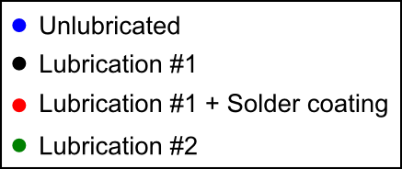
R_{c} vs cooldown cycle – comparison all samples
Sample | R_{c} [µΩm] | Spread [%]
Unlubricated | 5.9 ± 1.7 | 29
Lubrication #1 | 740 ± 600 | 82
Lubrication #1 + solder coating | 870 ± 450 | 51
Lubrication #2 | 84 ± 33 | 40

Slide 13
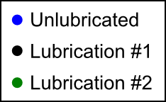
R_{c} vs bending radius – comparison all samples
R_{c} lubrication #2 approaches R_{c} unlubricated sample below 40 mm bending radius
R_{c} lubrication #1 remains two orders of magnitude higher than R_{c} unlubricated sample
*Lubrication #1 + solder coating
next to be measured

Slide 14
Summary bending R_{c} & I_{c}
Increase I_{c} versus bending anomaly was not observed in core-insulated samples.
Experimental results in agreement with FEM model prediction.
Threshold bending radius of all samples is 25 mm; marginal effect of winding angle and core diameter.
FEM & experimental results with frictional coefficient < 0.3 have similar critical bending radius.
After ABACUS™️ FEM model, also COMSOL™️ modeling started in 2019.
Lubrication #1: Rc two orders of magnitude higher compared to unlubricated, Lubrication #2 Rc one order of magnitude higher compared to unlubricated.
Cooldown cycles have no influence on Rc.
Bending reduces Rc with one order of magnitude for the unlubricated sample, two orders of magnitude for both lubricated samples.

Slide 15
Proposal 2020
More CORC® samples are being prepared by Advanced Conductor Technologies to confirm core and tape to layer to layer contact resistance results and impact of lubrication.
FEM analysis extended in COMSOL including effect of transverse and axial loading forces on CORC® stiffness and transport performance.

