Slide 1
Effect of neutron irradiation on HTS tapes properties
M. Jirsa¹, I. Ďuran², M. Rameš¹, J. Duchoň¹, T. Entler², L. Viererbl³
¹ Institute of Physics ASCR
² Institute of Plasma Physics ASCR
³ Research Center Řež
WP MAG final meeting 2019

Slide 2
Task specifications for 2019
Neutron irradiation experiments + magnetic measurements
SEM and TEM of the tapes, morphology and chemical analyses
WP MAG final meeting 2019

Slide 3
WP MAG final meeting 2019

Slide 4
Neutron irradiation 2019
Inside of Cd box
Neutrons |  | Energy interval |  |  |  | Fluence (m⁻²)
thermal |  | (0.100 meV – 0.550 eV) |  |  |  | 3,95E+20
epithermal |  | (0.550 eV – 110.0 keV) |  |  |  | 3,18E+21
fast |  | (110.0 keV – 20.0 MeV) |  |  |  | 5,71E+21
fast |  | ( 1.0 MeV – 20.0 MeV) |  |  |  | 2,86E+21
total |  |  |  |  |  | 9,29E+21
18 samples with 3 different irradiation histories were irradiated to the following fluence:
WP MAG final meeting 2019

Slide 5
WP MAG final meeting 2019

Slide 6
Fast neutron fluence up to 4.02x10²² m⁻², E ≥ 0.1 MeV
WP MAG final meeting 2019

Slide 7
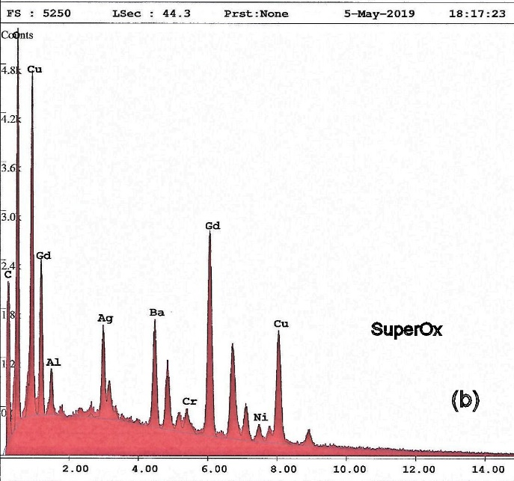
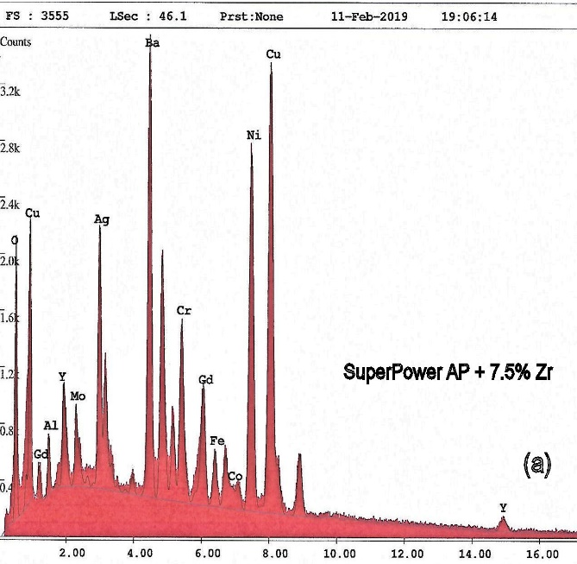
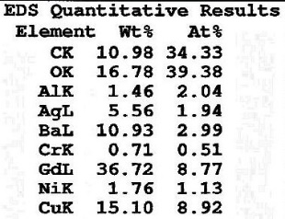
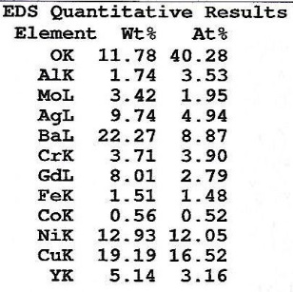
WP MAG intermediate meeting 2019

Slide 8
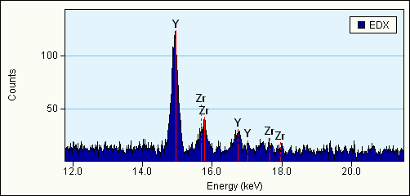
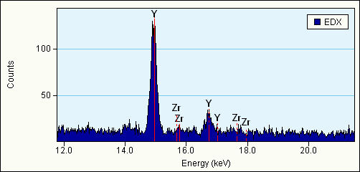
Pristine SuperPower 4050 AP +7.5 mol% Zr
WP MAG final meeting 2019

Slide 9
Conclusions:
At temperatures below 30 K, I_{c} at high magnetic fields grows with irradiation fluence
but at a certain dose this tendency turns to a gradual I_{c} degradation.
Anyway, at our highest fluence, about 4×10²² m⁻² of fast neutrons, I_{c} at low temperatures and high magnetic fields remained close to the values of intact tapes (around 100-300 A at 14 T). The degradation was not severe.
SEM/EDS analysis started. It confirmed the SuperPower 4050 tapes were Y-123, the SuperPower 4050 AP tapes were (Y+Gd)-123, and Sunam and SuperOx samples were Gd-123. TEM/EDX studies proved presence of ZrBaO₃ columnar structure in the SuperPower 4050 AP tapes with Zr.
WP MAG final meeting 2019

Slide 10
Task for 2020 :
Continuation in neutron irradiation experiments
SEM and TEM tests
WP MAG final meeting 2019

