Slide 1
Conceptual Design of an HTS TF coil for DEMO
ENR-PRD.MAG-T014
W.H. Fietz (R. Heller), N. Bagrets, T. Vogel, K.-P. Weiss, M.J. Wolf

Slide 2

TS 2019
      Continuation of 2-D and 3-D structural analysis on TF-coil WP (baseline 2015)
      Support for development of HTS-module in PROCESS
No support request

Slide 3
Work in 2019
      Planned work has been postponed due to higher priority of other work
        Design of triplet samples for quench experiment
        Determination of the thermal resistance between pressed copper-copper and copper-stainless steel interfaces

Slide 4
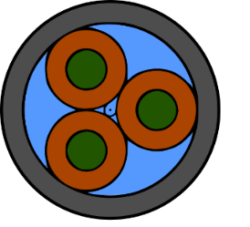
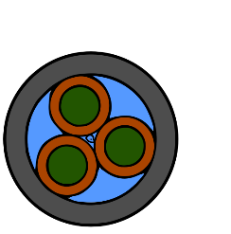
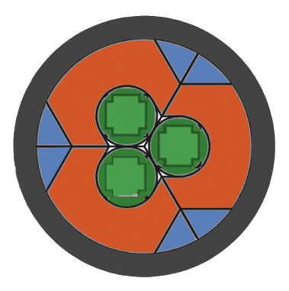
Triplet samples for quench experiment
      Design of triplet samples
Option 1 (Reference):
Similar cross-sectional areas as for the HTS TF cable,
but 3/2 mm tapes to come to I_{c}~12-15 kA @ 4.5 K, 12 T for a triplet
Intentional(!)
increase
of j_{Cu}
Larger interfaces,
similar cross-sections
Option 2:
Cu tube wall thickness reduced to 1 mm
Option 3:
Use of Cu profiles for larger contact areas

Slide 5
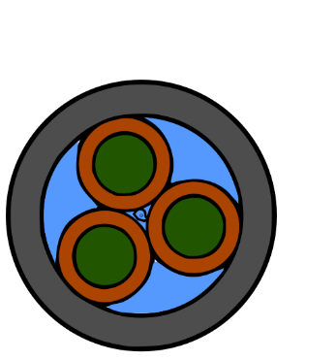

Triplet samples for quench experiment
Geometric and electric parameters | Option 1 | Option 2 | Option 3
Image
CroCo ∅ incl Cu / mm | 8.0 | 6.0 | -
Outer Sample ∅ / mm | 21.2 | 16.9 | 20.0
Cu cross-section / mm² | 126.54 | 60.56 | 131.2
j_{Cu} / A/mm² | 118.5 | 247.7 | 114.3
I_{op} per CroCo / A | 5000 | 5000 | 5000
Max. self-field B_{sf,max} / T | 0.82 | 0.87 | 0.96
Current sharing temp.T_{CS} / K | 5.62 | 5.56 | 5.46
Crit. Curr. I_{C} (4.5 K, B_{tot}) / A | 15941 | 15891 | 15828
      Design of triplet samples

Slide 6
Triplet samples for quench experiment
Thermal & hydraulic parameter | Option 1 | Option 2 | Option 3
Image
He / mm² | 82.5 | 46.4 | 35.3
Cooling perimeter CroCo | 69.4 | 50.6 | 9.5
Cooling perimeter jacket | 51.2 | 37.6 | 19.7
Cooling perimeter Cu profile | - | - | 22.05
Hydraulic diameter | 2.74 | 2.11 | 2.76
Contact (CroCo_{i} - Jacket) /mm | 1 | 1 | 10.2
Contact (CroCo_{i} - CroCo_{j}) /mm | 1 | 1 | 6.15

Slide 7
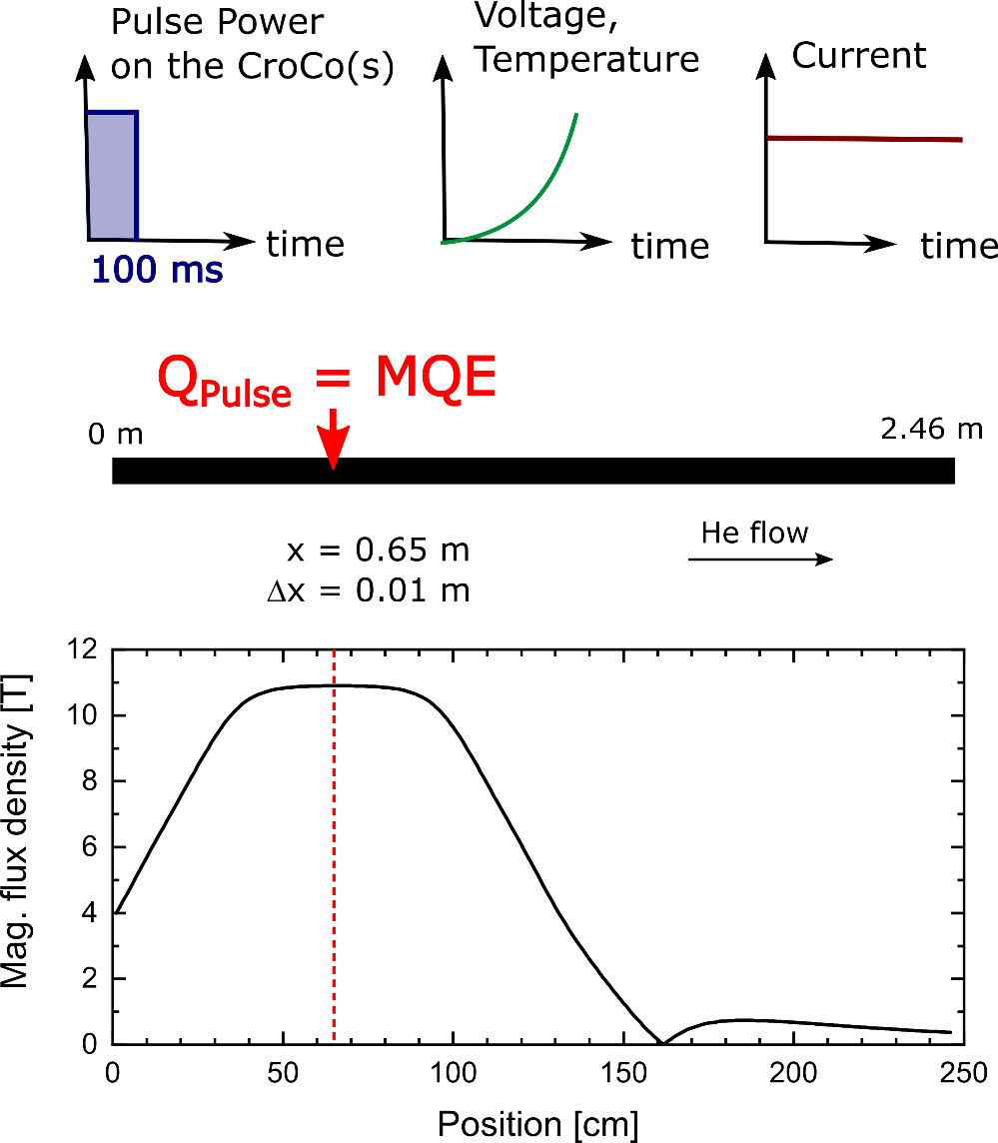
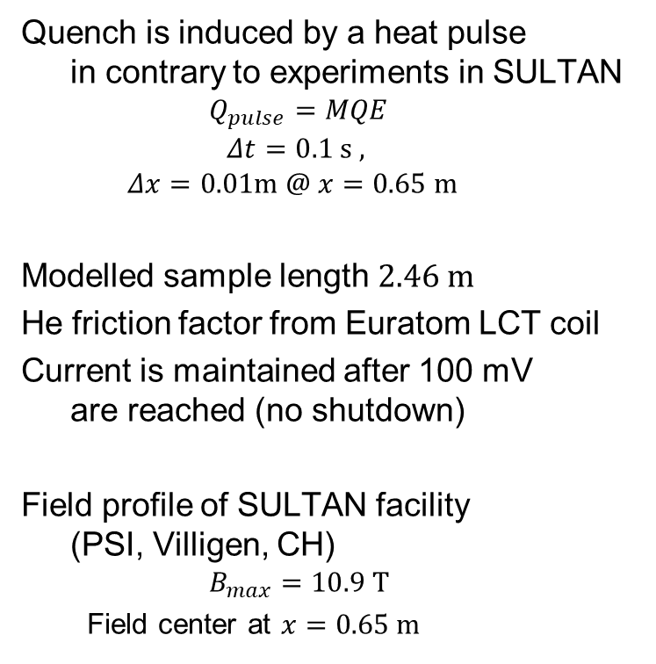
Triplet samples for quench experiment
Parameters for THEA modelling
Quench is induced by a heat pulse
in contrary to experiments in SULTAN
  $$Q_{pulse}=MQE$$
  $$Δt=0.1 s ,$$
  $$Δx=0.01m @ x=0.65 m$$
Modelled sample length $2.46 m$
He friction factor from Euratom LCT coil
Current is maintained after 100 mV
are reached (no shutdown)
Field profile of SULTAN facility
(PSI, Villigen, CH)
  $$B_{max}=10.9 T$$
  Field center at $x=0.65 m$

Slide 8
Triplet samples for quench experiment
      For the three conductor options, two models are analyzed with THEA
        Homogenized model, i.e., 3 CroCos were merged to form one single thermal element, embedded in a stainless-steel tube (1 mm wall thickness) and cooled by supercritical helium.
        Heat pulse goes to all three CroCos simultaneously.
        Segregated model, i.e. 3 individual CroCos, embedded in a stainless- steel tube (1 mm wall thickness) and cooled by supercritical helium.
        Only a single CroCo is heated.

Slide 9
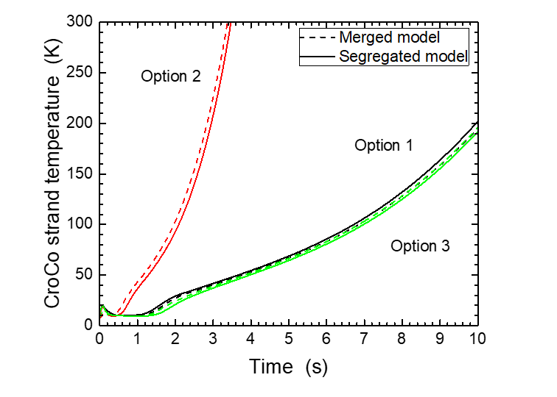
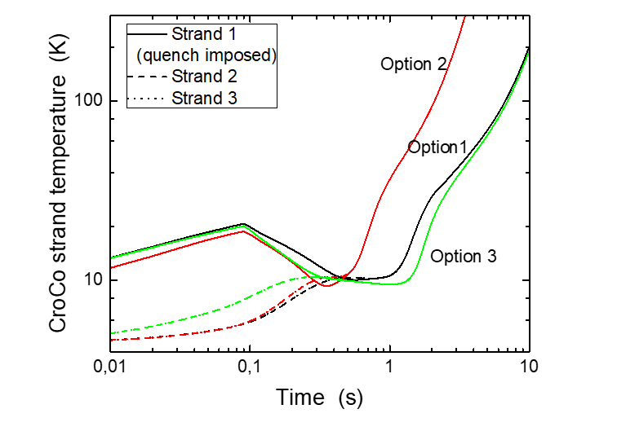
Triplet samples for quench experiment
Evolution of the heated strand temperature at the location of the maximum temperature for conductor options 1 to 3 and the merged and segregated models.
Temperature rise depends on the amount of copper stabilizer present in the conductor but there is a similar behavior observed for both models (merged and segregated).
For the segregated model, the strand temperature is plotted as a function of time in a log-scale to see details.
Due to the perturbation, the temperature of the heated strand 1 rises first to 10 - 20 K at the end of the heat pulse (0.1 s) and decreases then while the temperatures of strands 2 and 3 are increasing.
After about 1 s the current redistribution process is finished, all strands have been quenched and their temperatures are the same.

Slide 10
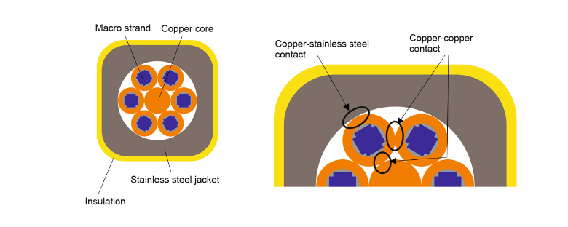
Determination of the thermal resistance
      Determination of the thermal resistance between pressed copper-copper and copper-stainless steel interfaces
Physical background
Thermal contact resistance R_{th} is defined as
R_{th} =ΔT/Q
At T < ~30 K, acoustic mismatch model can explain boundary resistances. The phonon wavelength λ_{phonon} is long compared to the characteristic thickness of the interface region. As a result R_{th} = α*T⁻³
At higher temperatures, the λ_{phonon} is shorter.
As a result, R_{th} approaches a constant value at high temperatures.
Schematic view of an HTS CICC, consisting of macro strands around a copper core embedded in a stainless steel jacket and covered by insulation.
Enlarged view showing the copper-stainless steel and copper-copper contacts.

Slide 11
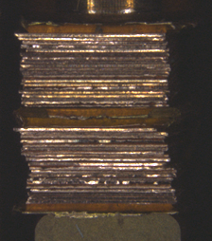
Determination of the thermal resistance
      The thermal contact resistance can be determined via the thermal conductance measured across the contact
      For this, n quadratic copper and stainless- steel plates of cross section A were stacked on each other to form a block of the length l, l = n*l_{plate}.
      The thermal conductivity is measured with the axial heat flow method within the PPMS of Quantum Design
Copper-copper sample prepared for the experiments.

Slide 12
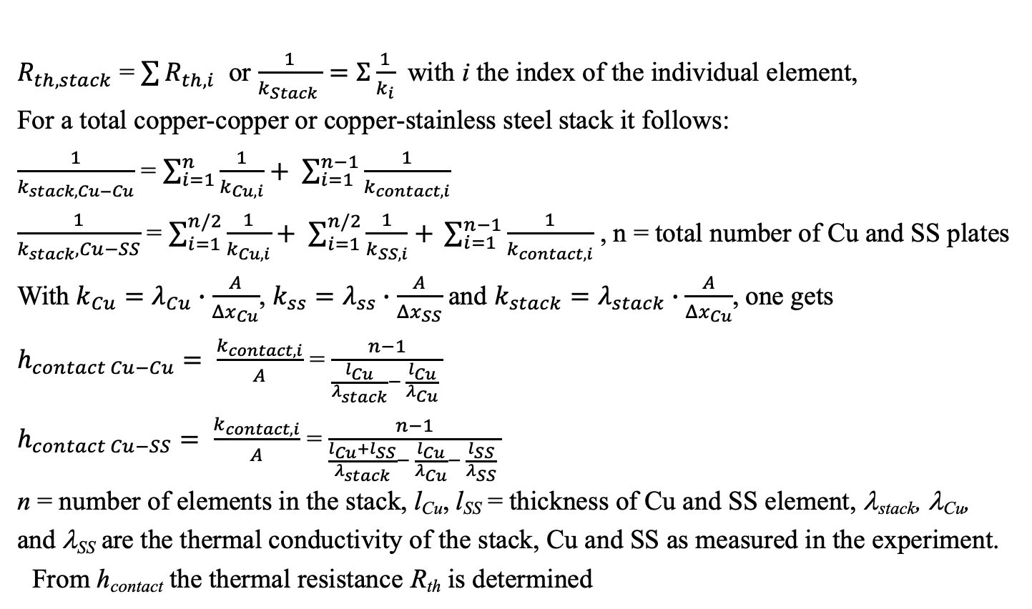
Determination of the thermal resistance
$R_{th,stack}$ = $\sum{R_{th,i}}$ or $\frac{1}{k_{Stack }}=Σ\frac{1}{k_{i}}$ with i the index of the individual element,
For a total copper-copper or copper-stainless steel stack it follows:
$\frac{1}{k_{stack,Cu−Cu}}$ = $\sum_{i=1}^{n}{\frac{1}{k_{Cu,i}}+ \sum_{i=1}^{n−1}{\frac{1}{k_{contact,i}}}}$
$\frac{1}{k_{stack},Cu−SS}$ = $\sum_{i=1}^{n/2}{\frac{1}{k_{Cu,i}}+ \sum_{i=1}^{n/2}{\frac{1}{k_{SS,i}}+ }\sum_{i=1}^{n−1}{\frac{1}{k_{contact,i}}}}$ , n = total number of Cu and SS plates With $k_{Cu}=λ_{Cu}∙\frac{A}{Δx_{Cu}}$, $k_{ss}=λ_{ss}∙\frac{A}{Δx_{SS}}$ and $k_{stack}=λ_{stack}∙\frac{A}{Δx_{Cu}}$, one gets
$h_{contact Cu−Cu}= \frac{k_{contact,i}}{A}$ = $\frac{n−1}{\frac{l_{Cu}}{λ_{stack}}− \frac{l_{Cu}}{λ_{Cu}} }$
$h_{contact Cu−SS}= \frac{k_{contact,i}}{A}$ = $\frac{n−1}{\frac{l_{Cu}+l_{SS}}{λ_{stack}}− \frac{l_{Cu}}{λ_{Cu}}− \frac{l_{SS}}{λ_{SS}} }$
n = number of elements in the stack, l_{Cu}, l_{SS} = thickness of Cu and SS element, λ_{stack}, λ_{Cu}, and λ_{SS} are the thermal conductivity of the stack, Cu and SS as measured in the experiment.
From h_{contact} the thermal resistance R_{th} is determined

Slide 13
Determination of the thermal resistance
Sample | Stack number |  | Number of tapes in stack | Cross section [mm²]
1 | 1 | Cu-SS | 20 | 16
 | 2 | Cu-SS | 20 | 16
2 | 3 | Cu-Cu | 20 | 16
 | 4 | Cu-Cu | 20 | 16
3 | 5 | Cu-Cu | 30 | 16
 | 6 | Cu-Cu | 30 | 16
4 | 7 | Cu-Cu | 20 | 4
 | 8 | Cu-Cu | 20 | 4
      Heat transfer of the stacks has a strong temperature dependence, in particular at low temperatures, which is in accordance with theory.
      Heat transfer for the stacks made of Cu plates is much larger than that of Cu-SS plates.
      Issue is lack of knowledge of the contact pressure. Sample was pressed in the sample holder, but the applied force is not measured. Samples with smaller cross section may have a higher contact pressure than those with larger cross section. This is qualitatively confirmed by the results of stacks with smaller cross section (7&8) which show larger and more scattered values which could be an effect of higher contact pressure

Slide 14
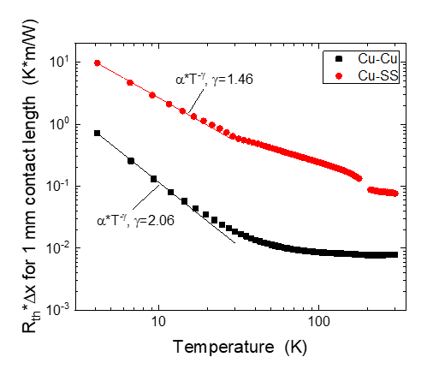
Determination of the thermal resistance
R. Heller, N. Bagrets, W.H. Fietz, L. Savoldi, K.P. Weiss, M.J. Wolf, R. Zanino, A. Zappatore,
"Determination of the thermal resistance between pressed copper-copper and copper-stainless steel interfaces for a high current conductor made of HTS CrossConductor"
Presented at 26th International Conference on Magnet Technology, Vancouver, Canada, Sep 22-27, 2019
M. J. Wolf, R. Heller, W. H. Fietz, “Design and analysis of HTS
subsize-conductors for quench investigations towards future
HTS fusion magnets”, Cryogenics 104 (2019) 102980
      R_{th} for a 1 mm wide contact is 0.008 – 0.7 m*K/W (Cu contact) and 0.08 – 10 m*K/W (Cu-SS contact) in the temperature range of 300 K to 4 K, i.e.
      R_{th} of Cu-Cu contact is one order of magnitude smaller than for the Cu-SS contact.
      Until now a temperature independent R_{th} is used in WPMAG.
      To apply the results presented to DEMO analysis shall have an impact in particular if considering the temperature dependence because during quench the capability to transfer heat from the quenched strands to the jacket and copper stabilizer will increase with temperature significantly. This is much more relevant for HTS than for LTS.
      This may be compared to results obtained on dummy triplet conductors at RT in air where R_{th} was in the range of ∼0.4 - 5 K*m/W (R. Kang, D. Uglietti, C. Kan, “Strand-Jacket Contact thermal resistance measurement on dummy conductors”, presented at CHATS-AS 2019, Szczecin, Poland, July 2-5, 2019)
Notes:
1 mm wide contact ist die Kontaktbreite. Diese Definition braucht es, da ein Linienkontakts eines idealen Kreisquerschnitt eines CroCos auf gerader Fläche ja die Quer-Ausdehnung Null hätte, so dass gar keine Wärme übertragen werden kann.
Irgendwas muss man annehmen – hier halt 1 mm für diese Querausdehnung.
* irgendwelche Messungen bei SPC...

Slide 15
Proposal 2020
Conceptual Design of an HTS TF coil for DEMO
Further mechanical assessment towards a 3/2 CroCo cable design,
e.g. multiple CroCos with Cu-profiles
Start: 01.03.2020
End: 31.10.2020
Resources: 0.1 ppy

