Slide 1
ENR-PRD.MAG-T013 –
Progress in chemical HTS tape preparation
M. J. Wolf

Slide 2
Task completion schedule
ENR-PRD. MAG-T013 | D001 | Report on progress in chemical HTS tape preparation
Technical Specification:
Monitoring of progress of HTS tapes produced by chemical methods
Investigation of HTS cable using REBCO tapes prepared by chemical methods

Slide 3
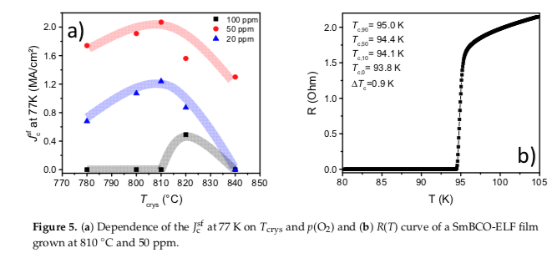
Progress of HTS tapes
Basic understanding of chemical HTS deposition is growing (e.g. Minjuan Li et al. Coatings 2020, 10, 31; doi:10.3390/coatings10010031 Different oxygen partial pressure and heating conditions allow to optimize J_{c}

Slide 4
Industry is optimizing performance (even at 5 T and 20 K, ≈ 100 A is feasible in the disadvantageous field orientation for a 4 mm wide tape )
M. Bäcker et al. EUCAS, Glasgow (1-5. Sept. 2019)

Slide 5
Large scale 40 mm wide tape production is at hand
M. Bäcker et al. EUCAS, Glasgow (1-5. Sept. 2019)

Slide 6
400 m tape length is targeted
M. Bäcker et al. EUCAS, Glasgow (1-5. Sept. 2019)

Slide 7
Slicing of 4 mm strips gives good results
M. Bäcker et al. EUCAS, Glasgow (1-5. Sept. 2019)

Slide 8
Ni9W substrate gives more mechanical strength, optimized texture and is nonmagnetic
M. Bäcker et al. EUCAS, Glasgow (1-5. Sept. 2019)

Slide 9
Next step: from 40 mm to 100 mm tape width will increase efficiency
M. Bäcker et al. EUCAS, Glasgow (1-5. Sept. 2019)

Slide 10
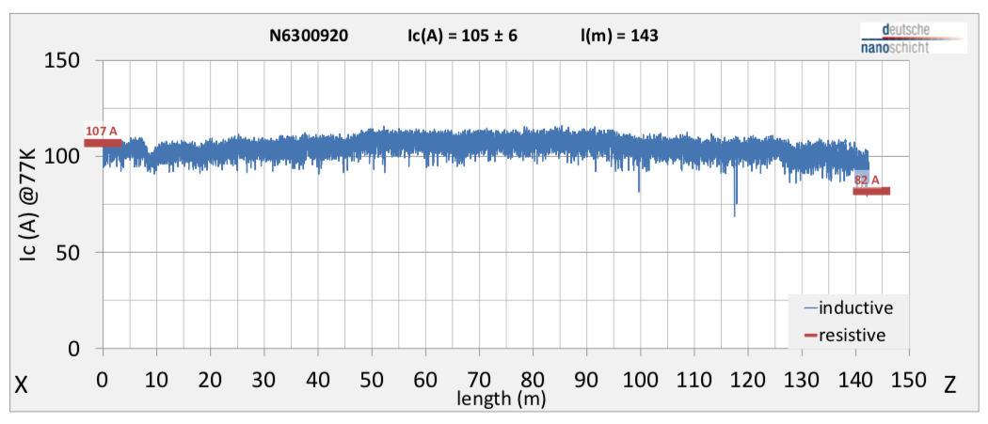
Investigation of HTS cable using REBCO tapes prepared by chemical methods
d-nano tape of the Ni5W type was purchased with an Ic (77 K, sf) of approx. 90 K

Slide 11
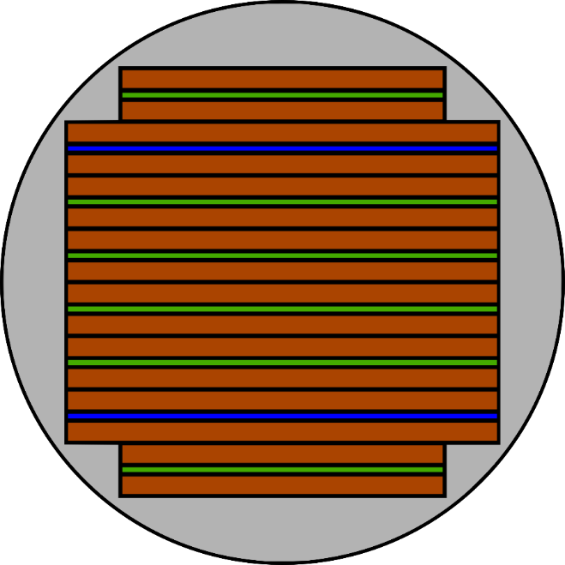
HTS CroCo - geometry
The mechanical performance of d-nano tapes is weaker than most Hastelloy-based coated conductors due to the RABITS – Ni5W – substrate of d-nano tapes.
We used copper-plated steel tapes in the HTS CroCos for mechanical reinforcement
D-nano tapes are available only in 4 mm width → change of geometry compared to CroCos of other recent projects.
Orange: copper tape
Green: copper-plated steel tape
Blue: HTS tape
3 mm
4 mm

Slide 12
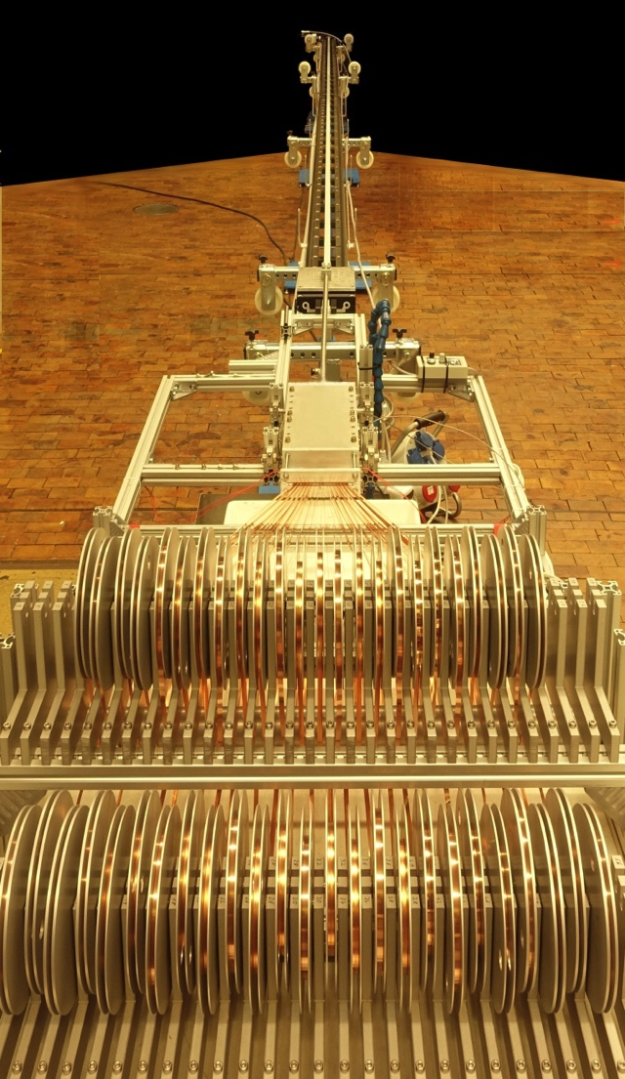
HTS CroCo fabrication
Use of the new HTS CroCo fabrication setup

Slide 13
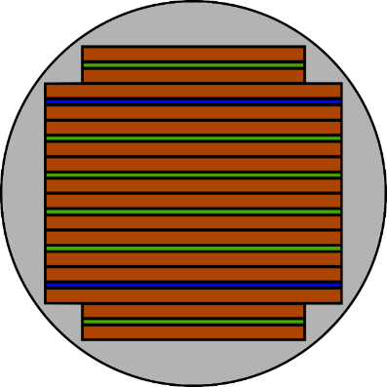
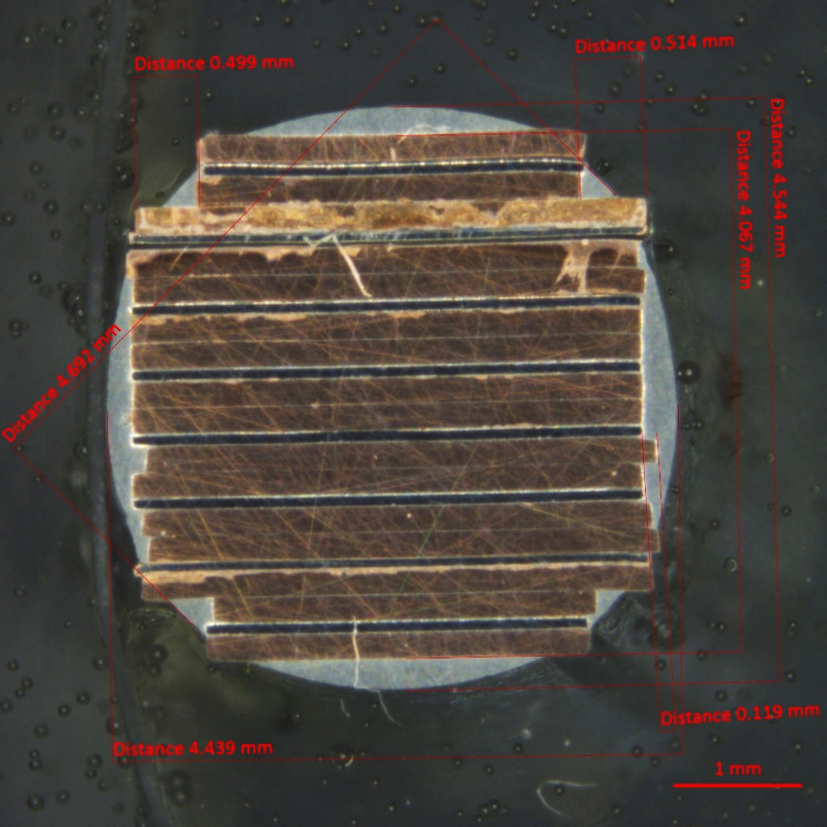
Sample preparation of a d-nano HTS CroCo
Material | Width | Thickness | Length | Number
Cu | 3 mm / 4 mm | 200 µm | 4 m | 4 / 12
Steel | 3 mm / 4 mm | 87 µm | 4 m | 2 / 4
D-nano | 4 mm | 75 µm | 4 m | 2
Untwisted sample
Cross-shape of tapes very good,
Round overall shape to be optimized

Slide 14
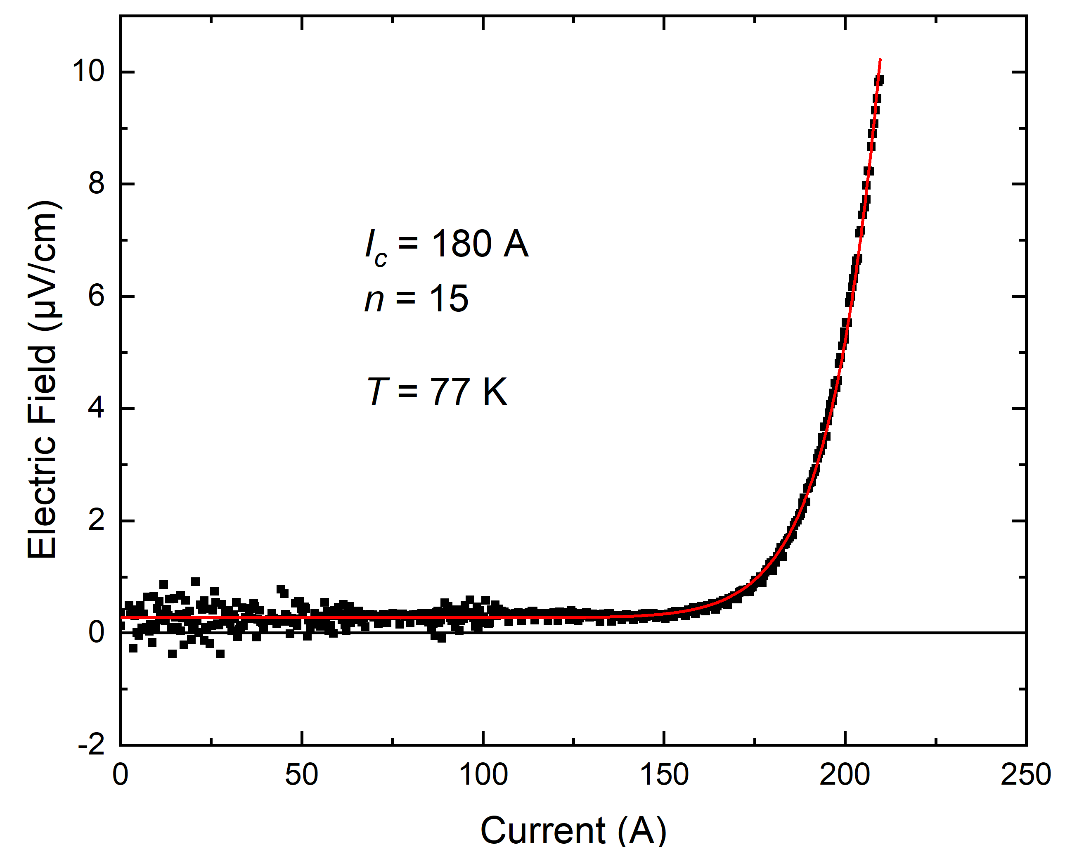
Critical Current Measurement at 77 K
June 2019
Critical current of HTS CroCo as expected with two REBCO tapes, due to I_{c} of individual tape segments ~ 90 - 100 A

Slide 15
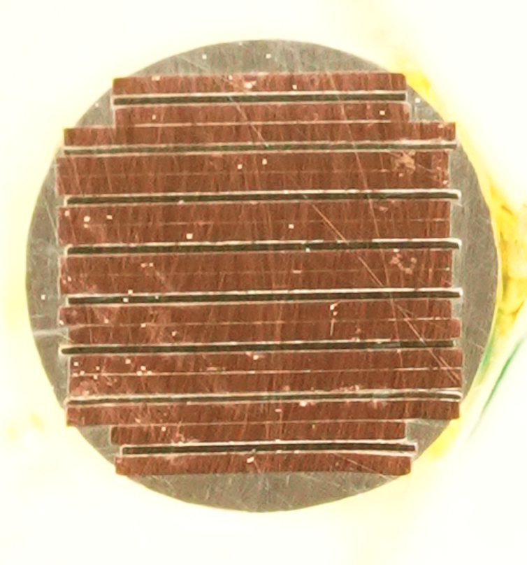
New CroCo formed with optimized outer form
Steel tape
REBCO tape
Steel tape
Steel tape
Steel tape
Steel tape
REBCO tape
Steel tape

Slide 16
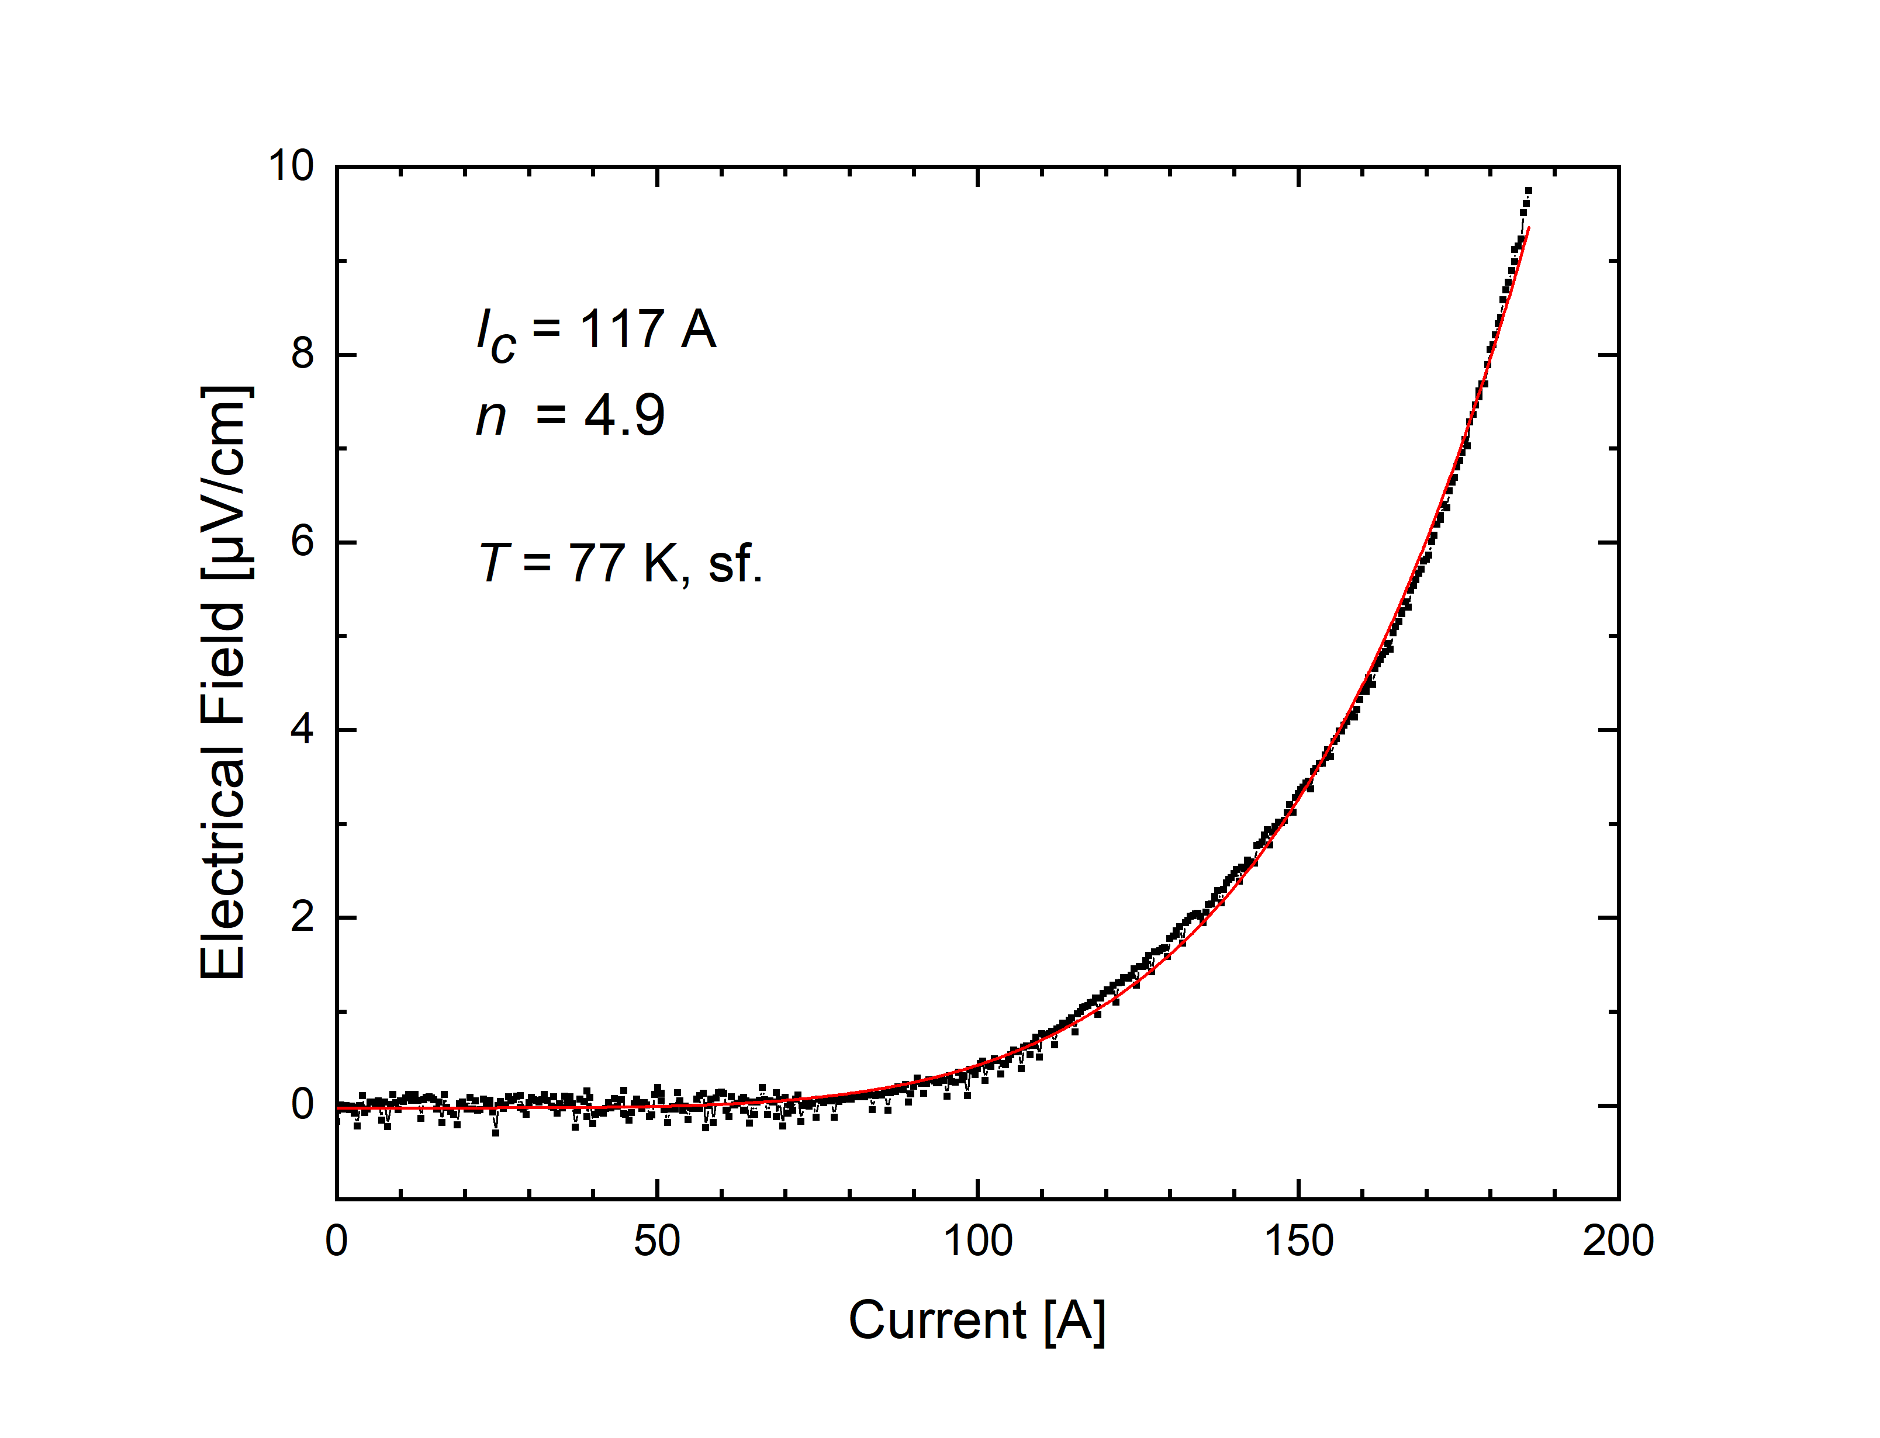
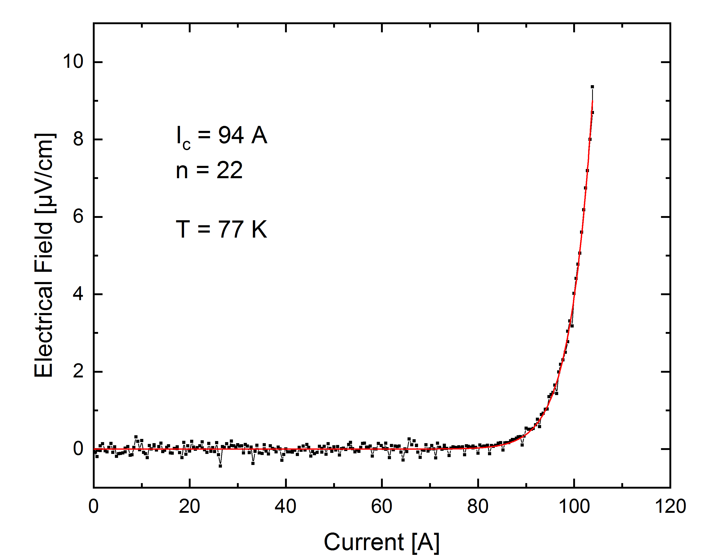
I_{c} of new CroCo reduced with low n-value
Recheck of an unprocessed d-nano REBCO tape
Problem: too high forces during CroCo manufacturing?

Slide 17
Next steps in 2020
Continued analysis of degraded sample
Force monitoring during CroCo processing should be implemented
New d-nano Ni9W REBCO tapes with higher mechanical strength should be investigated (if material is available in time)

Slide 18
Proposal 2020
Progress in chemical HTS tape preparation
Monitoring of progress of HTS tapes produced by chemical methods
Investigation of HTS cable using REBCO tapes prepared by chemical methods
Start: 01.03.2020
End: 31.10.2020
Resources: 0.1 ppy

