Slide 1
ENR-PRD.MAG-T012 - D001
Test of HTS Tapes
N. Bagrets, K.-P. Weiss

Slide 2

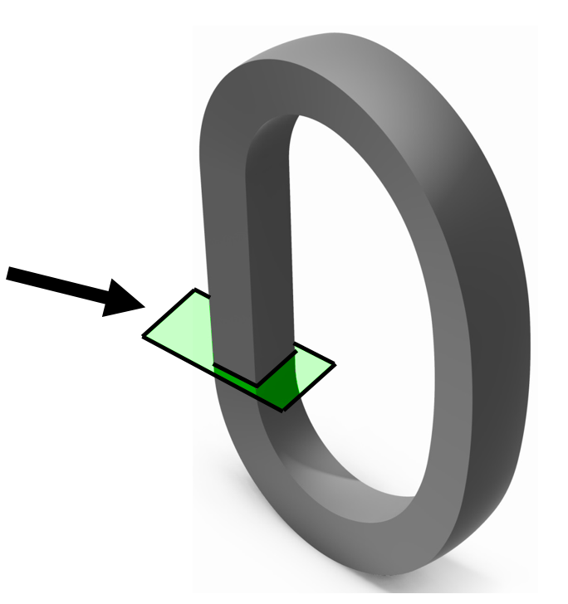
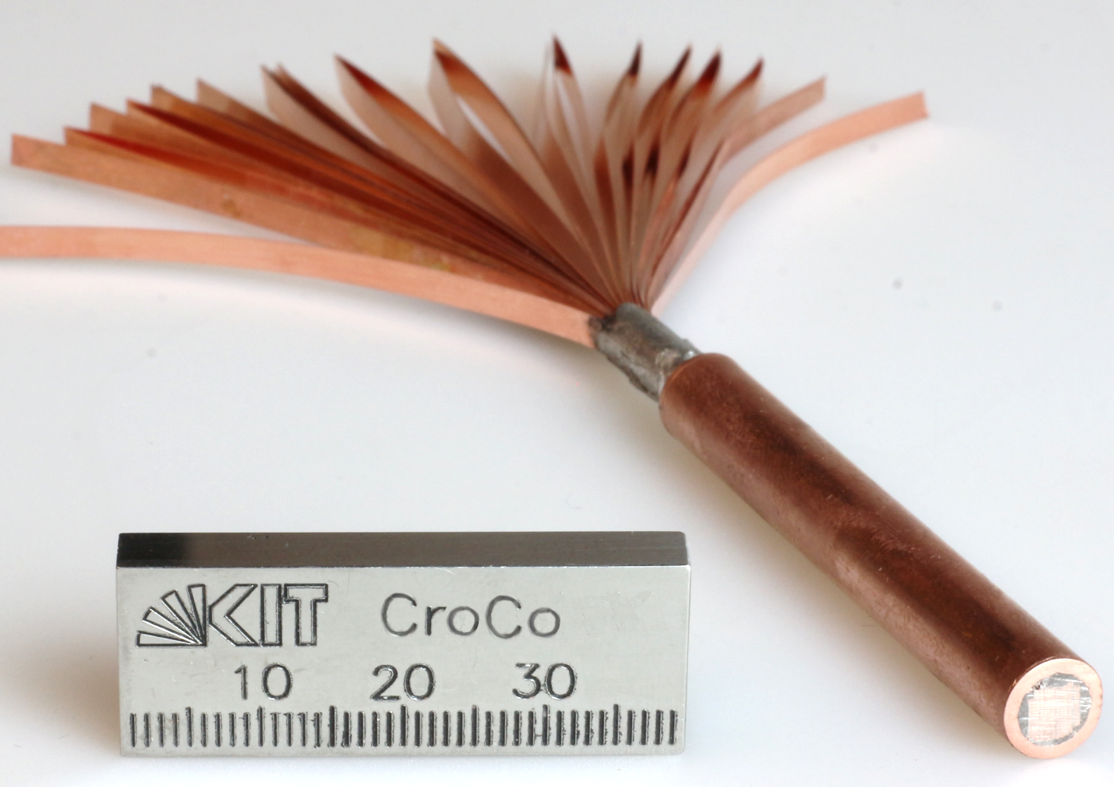
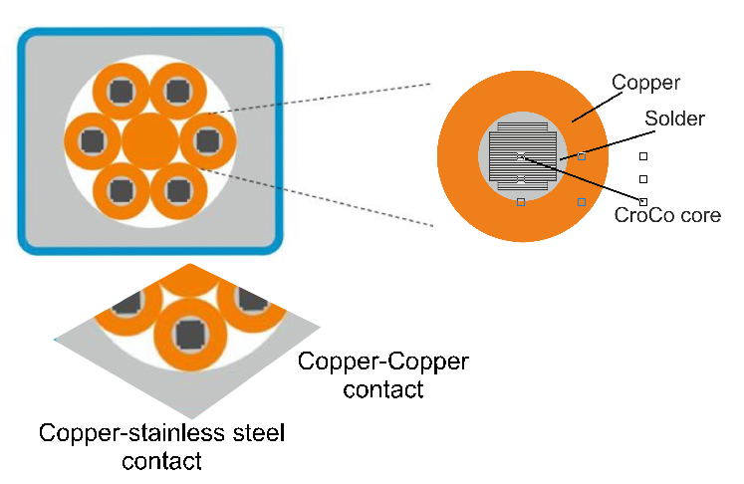
Thermal resistance for high current HTS CICC
3 / 2 mm
4 / 3 mm
6 / 4 mm
Measurement of the thermal conductivity to determine the resistance
Assessment by R. Heller (ENR-PRD MAG-T014 - Conceptual Design for DEMO)

Slide 3
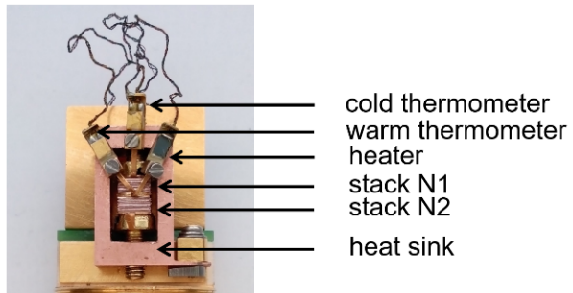
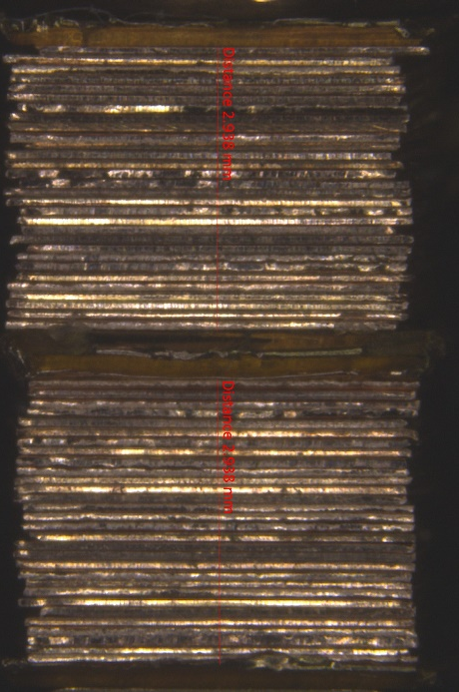
Thermal conductivity test setup
Measurement of the thermal conductivity of stacks made of copper strips and
of copper-stainless steel strips
as a function of temperature.
Several samples of copper-copper and copper stainless steel stacks were prepared.
PPMS as experimental device
Stack number |  | Number of tapes in stack | Cross section [mm²]
1 | Cu-SS | 20 | 16
2 | Cu-SS | 20 | 16
3 | Cu-Cu | 20 | 16
4 | Cu-Cu | 20 | 16
5 | Cu-Cu | 30 | 16
6 | Cu-Cu | 30 | 16
7 | Cu-Cu | 20 | 4
8 | Cu-Cu | 20 | 4
Copper-stainless steel (left) and copper-copper (right) samples.

Slide 4
Thermal conductivity results
Heat Transfer at Contact (W/K*m²)
Thermal conductivity of selected Cu-SS and Cu-Cu stacks and of Cu and SS solid material as a function of temperature.
Heat transfer at Cu-SS and Cu-Cu contact as a function of temperature.
Notes:
Heat transfer of stacks show strong temperature dependence
Heat transfer for stacks made of copper strips is much larger than that of copper-stainless steel strips
Sample 3 shows much higher values than samples 4, 5, and 6 and the measurement signals are also rather noisy. Sample 3 was not used furthermore.
A kink is observed in the Cu-SS samples around 200 K whose origin is not known
Average values were calculated for Cu-SS (samples 1&2) and Cu-Cu (samples 4-6), the error bars were 12%-14% for Cu-SS and 12%-22% for Cu-Cu
An open issue is knowledge of the contact pressure. All samples were fixed by screws but the applied force is not measured. Samples with smaller cross section may get a higher contact pressure than those with larger cross section
This is qualitatively confirmed by the results of samples with smaller cross section (7&8) which show larger (factor 3) and more scattered (15%-30%) values

Slide 5
Proposal 2020
Contact resistance assessment with variable contact pressure
Preparation of FBI-Lite for HTS tape testing (former small FBI)
Target:
tape width < 4 mm
test parameter: max 2 kA, max 12T, 4.2 K – 100 K
Start: 01.03.2020
End: 31.10.2020
Resources: 0.1 ppy

