Slide 1

First results of the new CVD Diamond detector on FTU
Team Tor Vergata: M. Marinelli, G. Verona-Rinati, C. Verona, S. Cesaroni, E. Milani
Team ENEA: F. Bombarda, L. Gabellieri, A. Romano, C. Centioli
Pool Tecnici: B. Tilia, A. Sibio, G. Rocchi, V. Piergotti, L.A. Grosso
+ M. Iafrati e M. Angelone
WIP - Frascati 1/07/2019

Slide 2
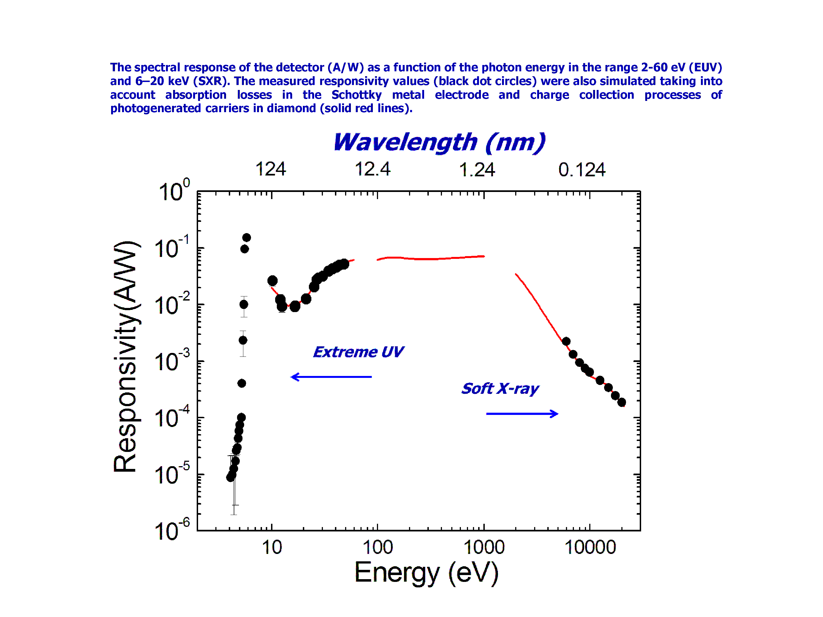
CVD Diamond detectors
The collected I_{PH} current measures the power flux deposited into the detector across the contact surface
Ciancaglioni et al., Journal of Applied Physics 110, 054513 (2011).

Slide 3


Diamond Detectors on FTU
First detector installed on TLL structure during Easter break, but did not work: electrical connections too noisy
Second detector installed in time sharing with the LBO line (port 9) and on SXT acquisition line (DIAVUV_DIALBO) at 500 kHz.
Data from shot 42969 (29/05/2019) with FEMTO set at 10 kHz bandwidth --> good results !
New detector added on the same support at about 15 mm, aimed at selecting Soft-X (4 μm+1.5 μm Al coating) --> no results !
Several attempts at switching data lines DIALBO and DIALB1 between 17/06 and 26/06 --> be careful when looking up Diamond data
Present data acquired with a gain of 1e6 and 500 kHz bandwidth

Slide 4
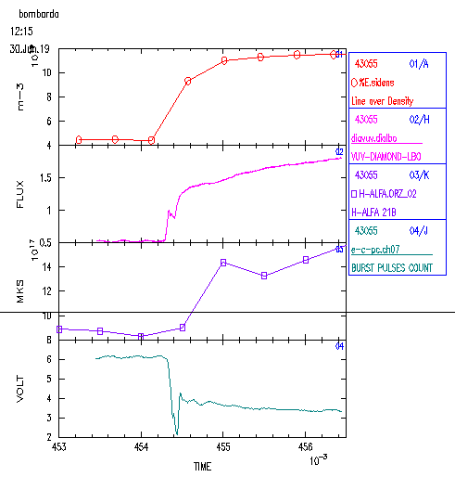
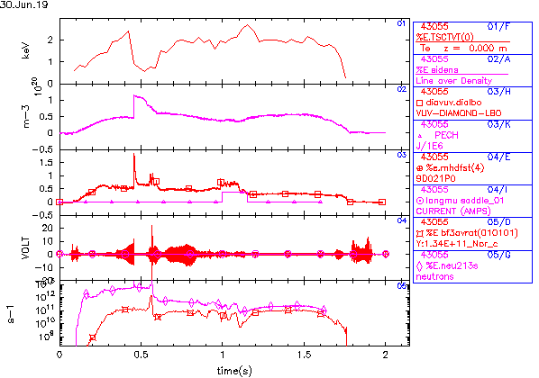
SH 43055 (CTS)
The Diamond can follow very well fast events such as pellet ablation, better than Hα monitors
Crossing of rational surfaces?

Slide 5
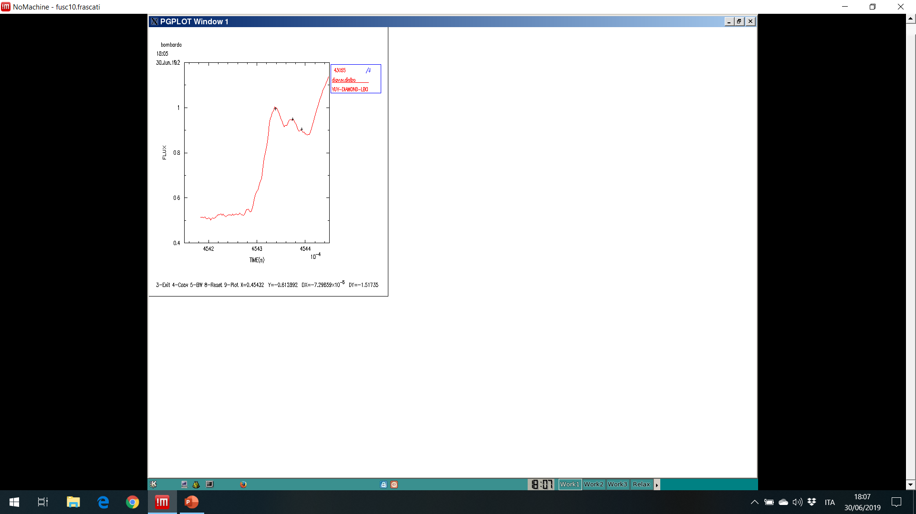
SH 43055 (CTS)
Crossing of rational surfaces?
The Diamond can follow very well fast events such as pellet ablation, better than Hα monitors

Slide 6
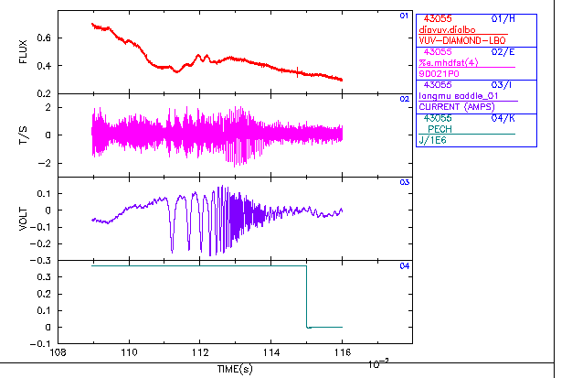
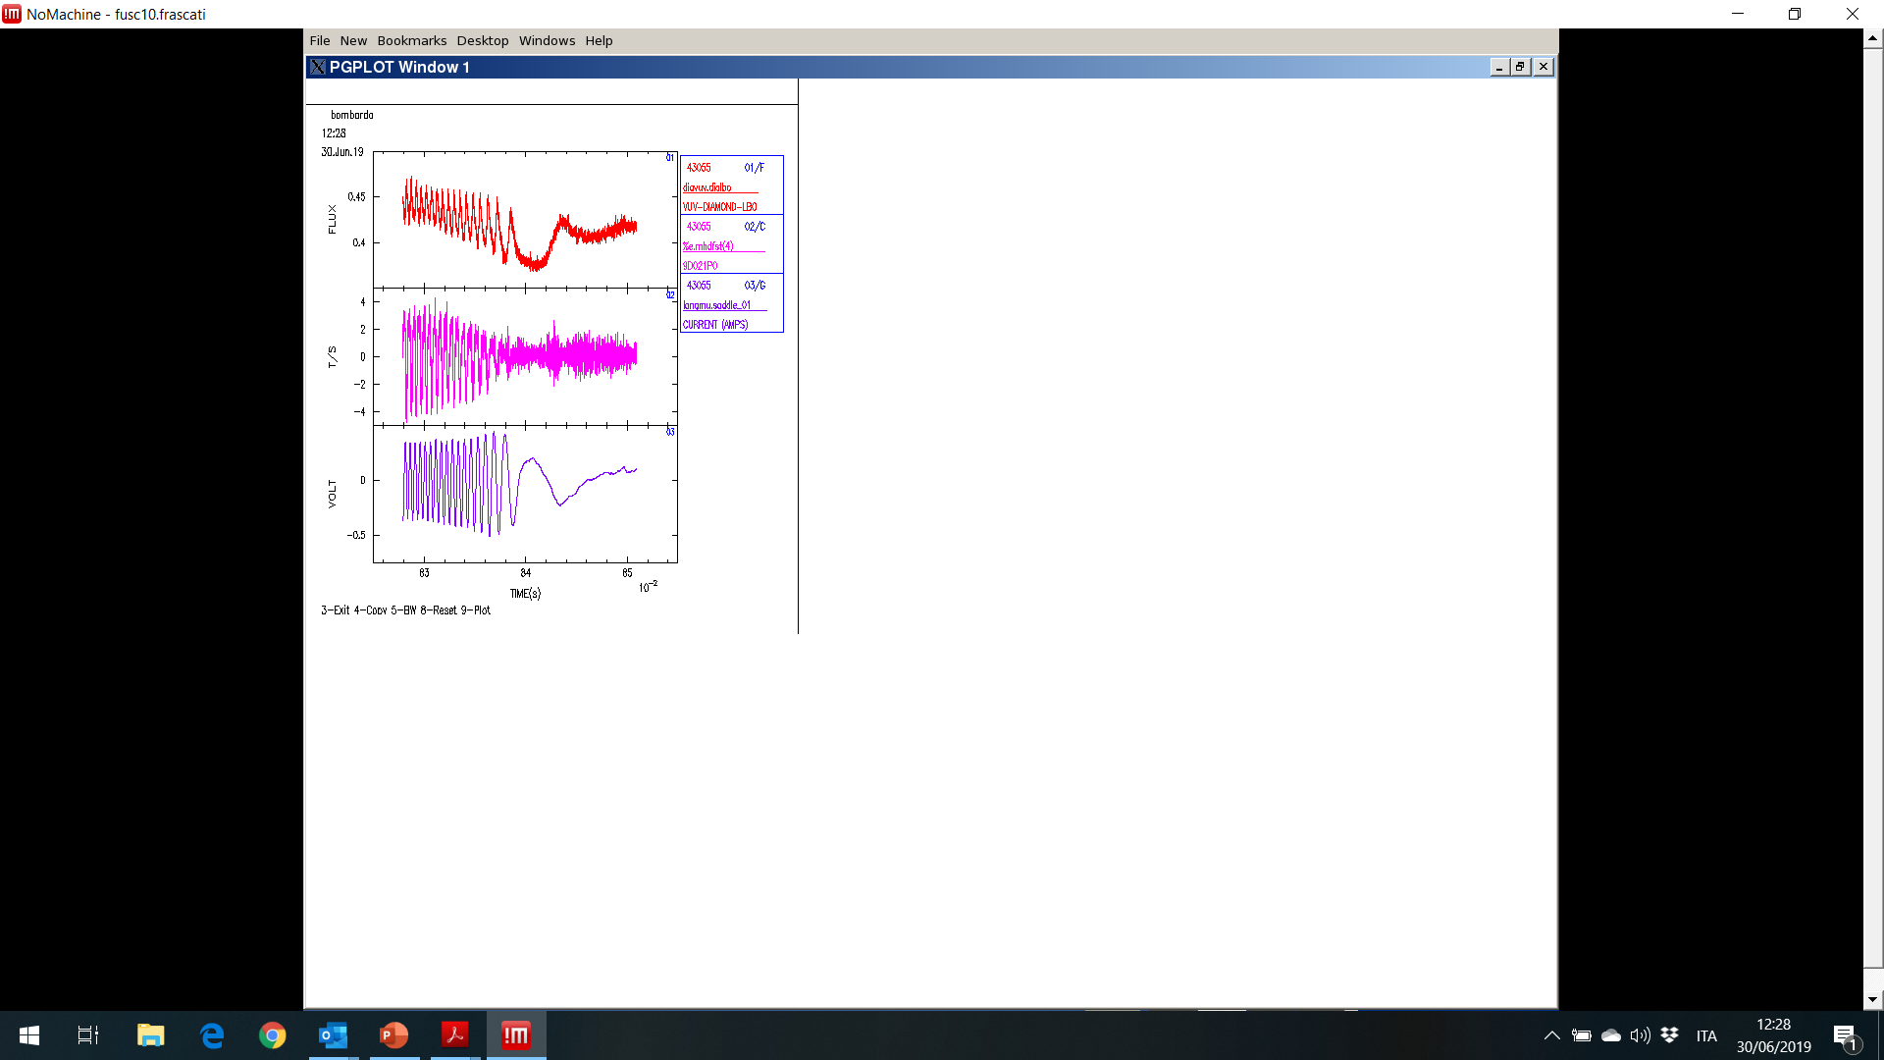
SH 43055 (CTS)
The Diamond "sees" MHD fluctuations, but not always
--> TO BE INTERPRETED

Slide 7
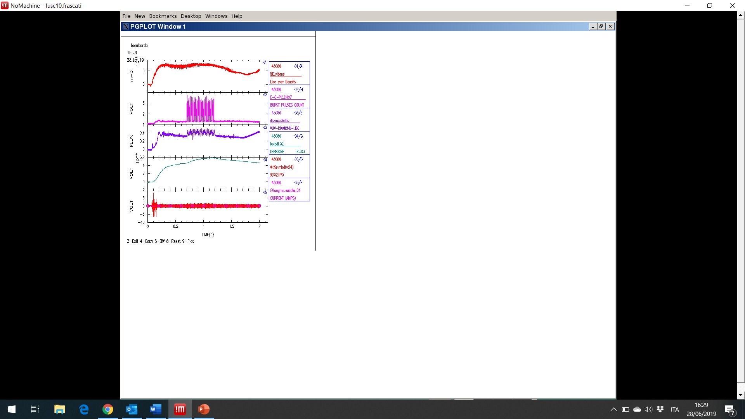
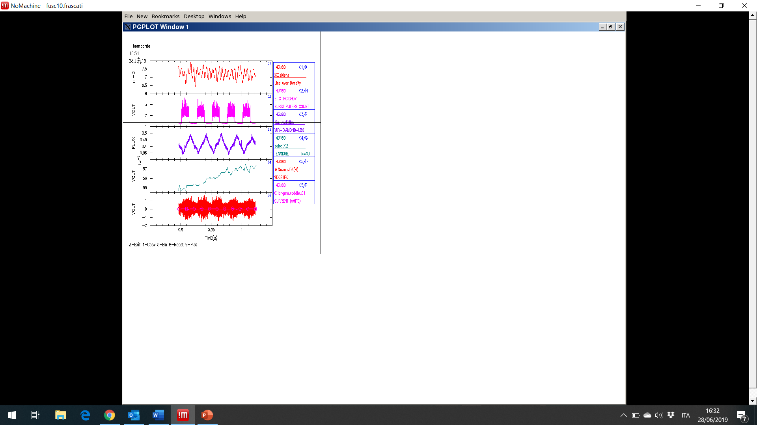
SH 43080 (modulated ECH for RE program )

Slide 8
Future Plans
Have the SX detector working
Analyze all data to establish correlations with other signals and find physical meanings
Define new diagnostic applications: there appear to be many!
Propose them to other experiments, starting from ProtoSphera, and JET

