Slide 1
FTU 2019 F08 - Elongated Plasmas
Motivations, strategy and pulse plan
WIP 17/06/ 2019 - ENEA Frascati
Giuseppe Ramogida / FSN-FUSTEC-TES
G. Calabrò, F. Bombarda, L. Boncagni, D. Carnevale, M. Iafrati, R. Lombroni

Slide 2
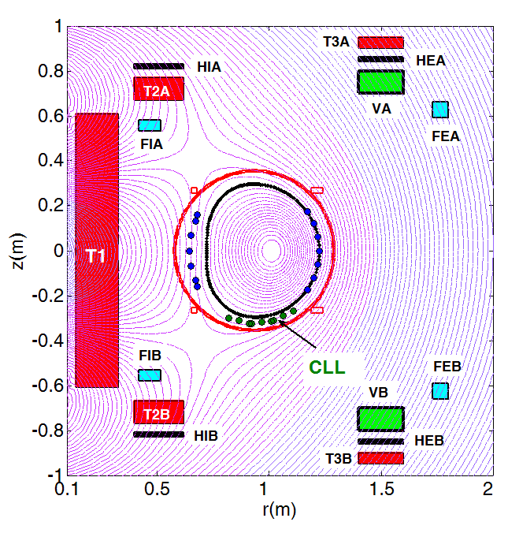
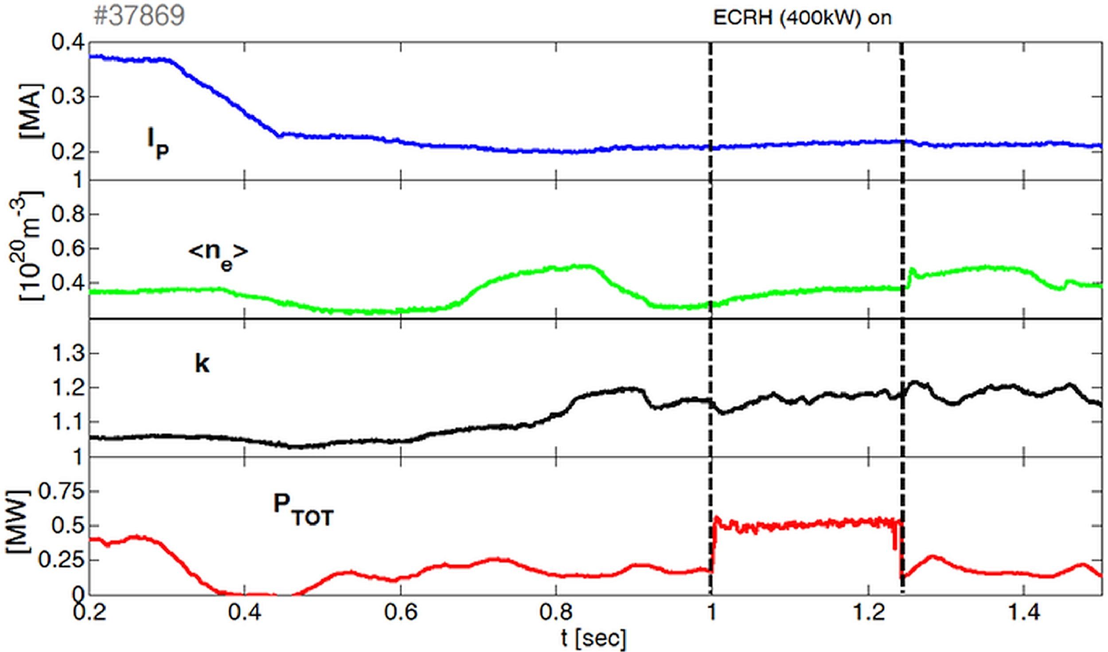
Motivations and previous results
Investigation on possible LH transitions, aiming to study the impact of ELMs on the LM limiter
IAEA 2014:
Elongated plasmas (5.5 T, 200kA, k∼1.2, t_{pulse} ∼ 1.5s) with ECW additional heating (500 kW)
Vary local magnetic shear (flux surfaces opening) at the CLL
IAEA 2016:
Ohmic elongated configurations (k∼1.2) obtained for 3.5s
z [m]
r [m]
Since 2012 experiments were carried out, obtaining ohmic elongated configurations (k > 1.2), but it was not possible to investigate H‑mode access due to the lack of enough EC heating

Slide 3
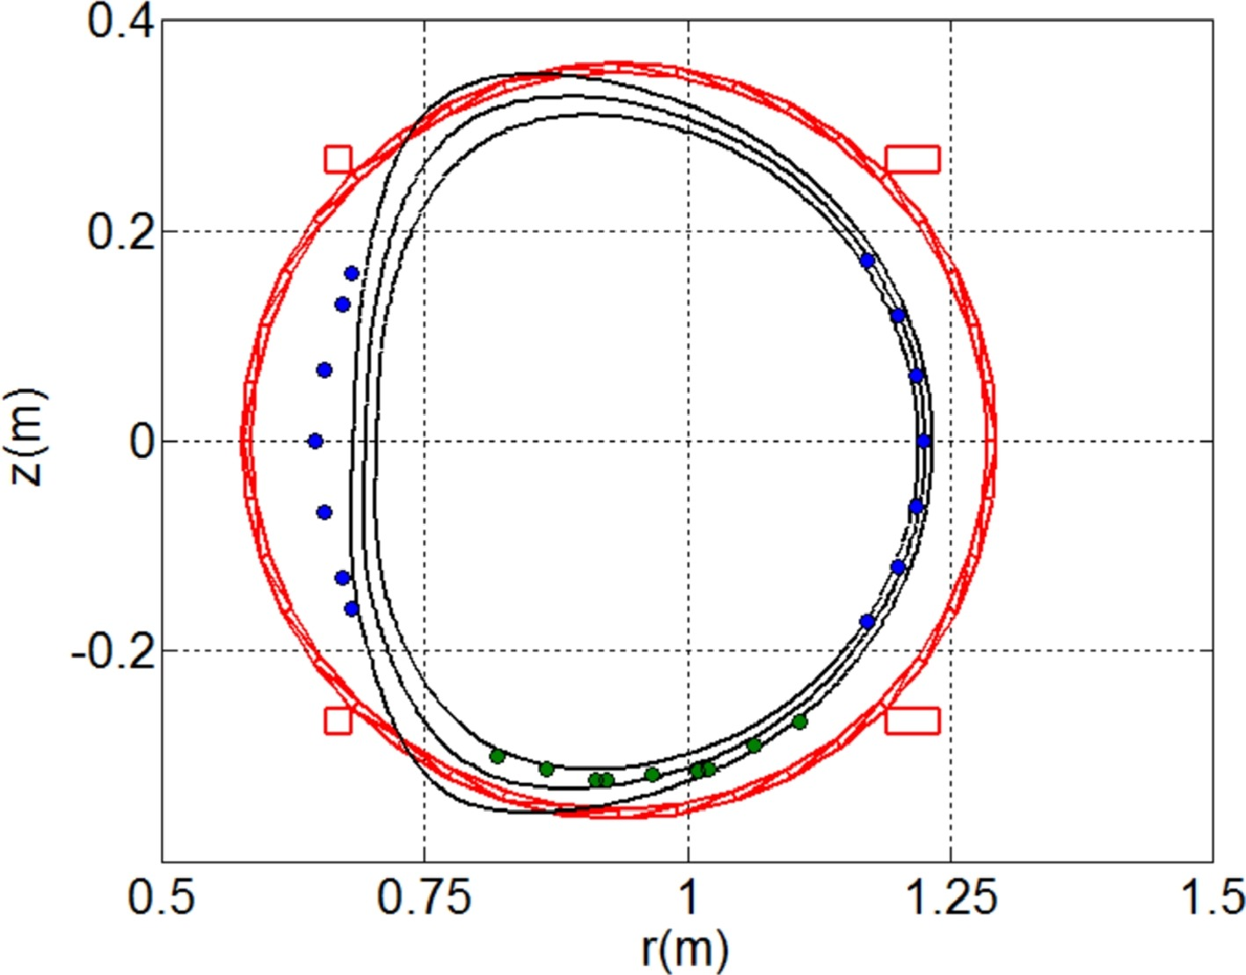
Reference #37869

Slide 4
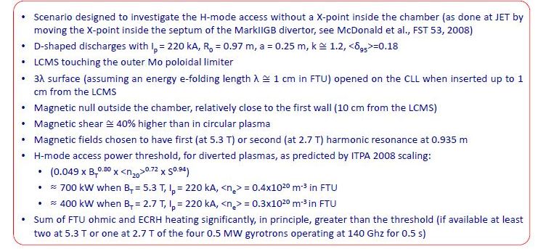
Investigating LH transitions with outer X-point

Slide 5
Experimental strategy - 2019
Experimental aims
Assess low current, max elongation k>1.2 discharges with LM limiter achievable without loss of vertical control with improved PID
Attempt to observe LH transitions (2.7 T, two gyrotrons required) in k > 1.2 discharges
Compare with circular, standard elongation, discharge, same EC power
LM limiter position scan, same EC power
Density (0.3-0.6 x10²⁰ m⁻³) scan, same EC power
EC deposition scan
Experimental setup
2.7 T, 250-300 kA, 0.4 x 10²⁰m⁻³

Slide 6
Pulse plan
Zero at 2.7 T
2.7 T / 250-300 kA / 0.3-0.4·10²⁰ m⁻³ with elongation steps
Repeat, if vertical control is lost, tuning parameters
2.7 T / 250-300 kA / 0.3-0.4·10²⁰ m⁻³ at maximum elongation
2.7 T / 250-300 kA / 0.3-0.4·10²⁰ m⁻³ / max k with 700 kW EC
2.7 T / 250-300 kA / 0.3-0.4·10²⁰ m⁻³ / standard k with 700 kW EC
2.7 T / 250-300 kA / 0.3-0.4·10²⁰ m⁻³ / max k with 700 kW EC, reducing distance from LM limiter
2.7 T / 250-300 kA / 0.3-0.4·10²⁰ m⁻³ / max k with 700 kW EC, reducing or increasing density

Slide 7
Technical requests and diagnostics
Technical requirements:
At least two gyrotrons
Poloidal limiter inserted
Liquid Metal limiter as target
Vertical control parameters should be tuned
F current limit close to the max value (i.e. 11.5kA)
Low recycling conditions
Essential diagnostics:
Magnetics
H_{α} at high voltage when operating at low density
Interferometer, Michelson, Thomson Scattering
Edge probes
Liquid Metal limiter diagnostics

