Slide 1

Yttrium spectrum identification 23/5/2019
SC: F. Bombarda, A. Romano
RdO: M. Baruzzo, G. Ramogida
PIC: G. Apruzzese, F. Napoli
Team: L. Gabellieri, G. Apruzzese, L. Carraro, M.E. Puiatti, M. Valisa, B. Zaniol, M. Salvadori, F. Consoli, M. Cipriani
WIP - Frascati 27/05(2019)

Slide 2
F12 Yttrium spectrum identification (23/5)
6 shots (42892-42897), OH 5.3T/500 kA, Y LBO injection @ 0.5 s, dia=1.8
T_{e} ∼ 1.7-2.0 keV, n_{e} ∼ 0.58 - 0.7 x 10²⁰ m⁻³.
Schwob with 600 g/mm grating, 4 positions: 155, 115, 180, 215 (20 - 120 Å)
1 shot (42897) SPRED had RET1 (200 - 1700 Å)
1 shot (42892) Schwob was off
Signals were weak on bolometry and SXT, negligible effect on temperature, but in some cases MHD activity was triggered, reducing impurity penetration (observed also with W)
No lines observed by visible spectrometer
Lowest wavelengths accessible by SOXMOS were not explored (will do next time)
WIP - Frascati 27/05(2019)

Slide 3
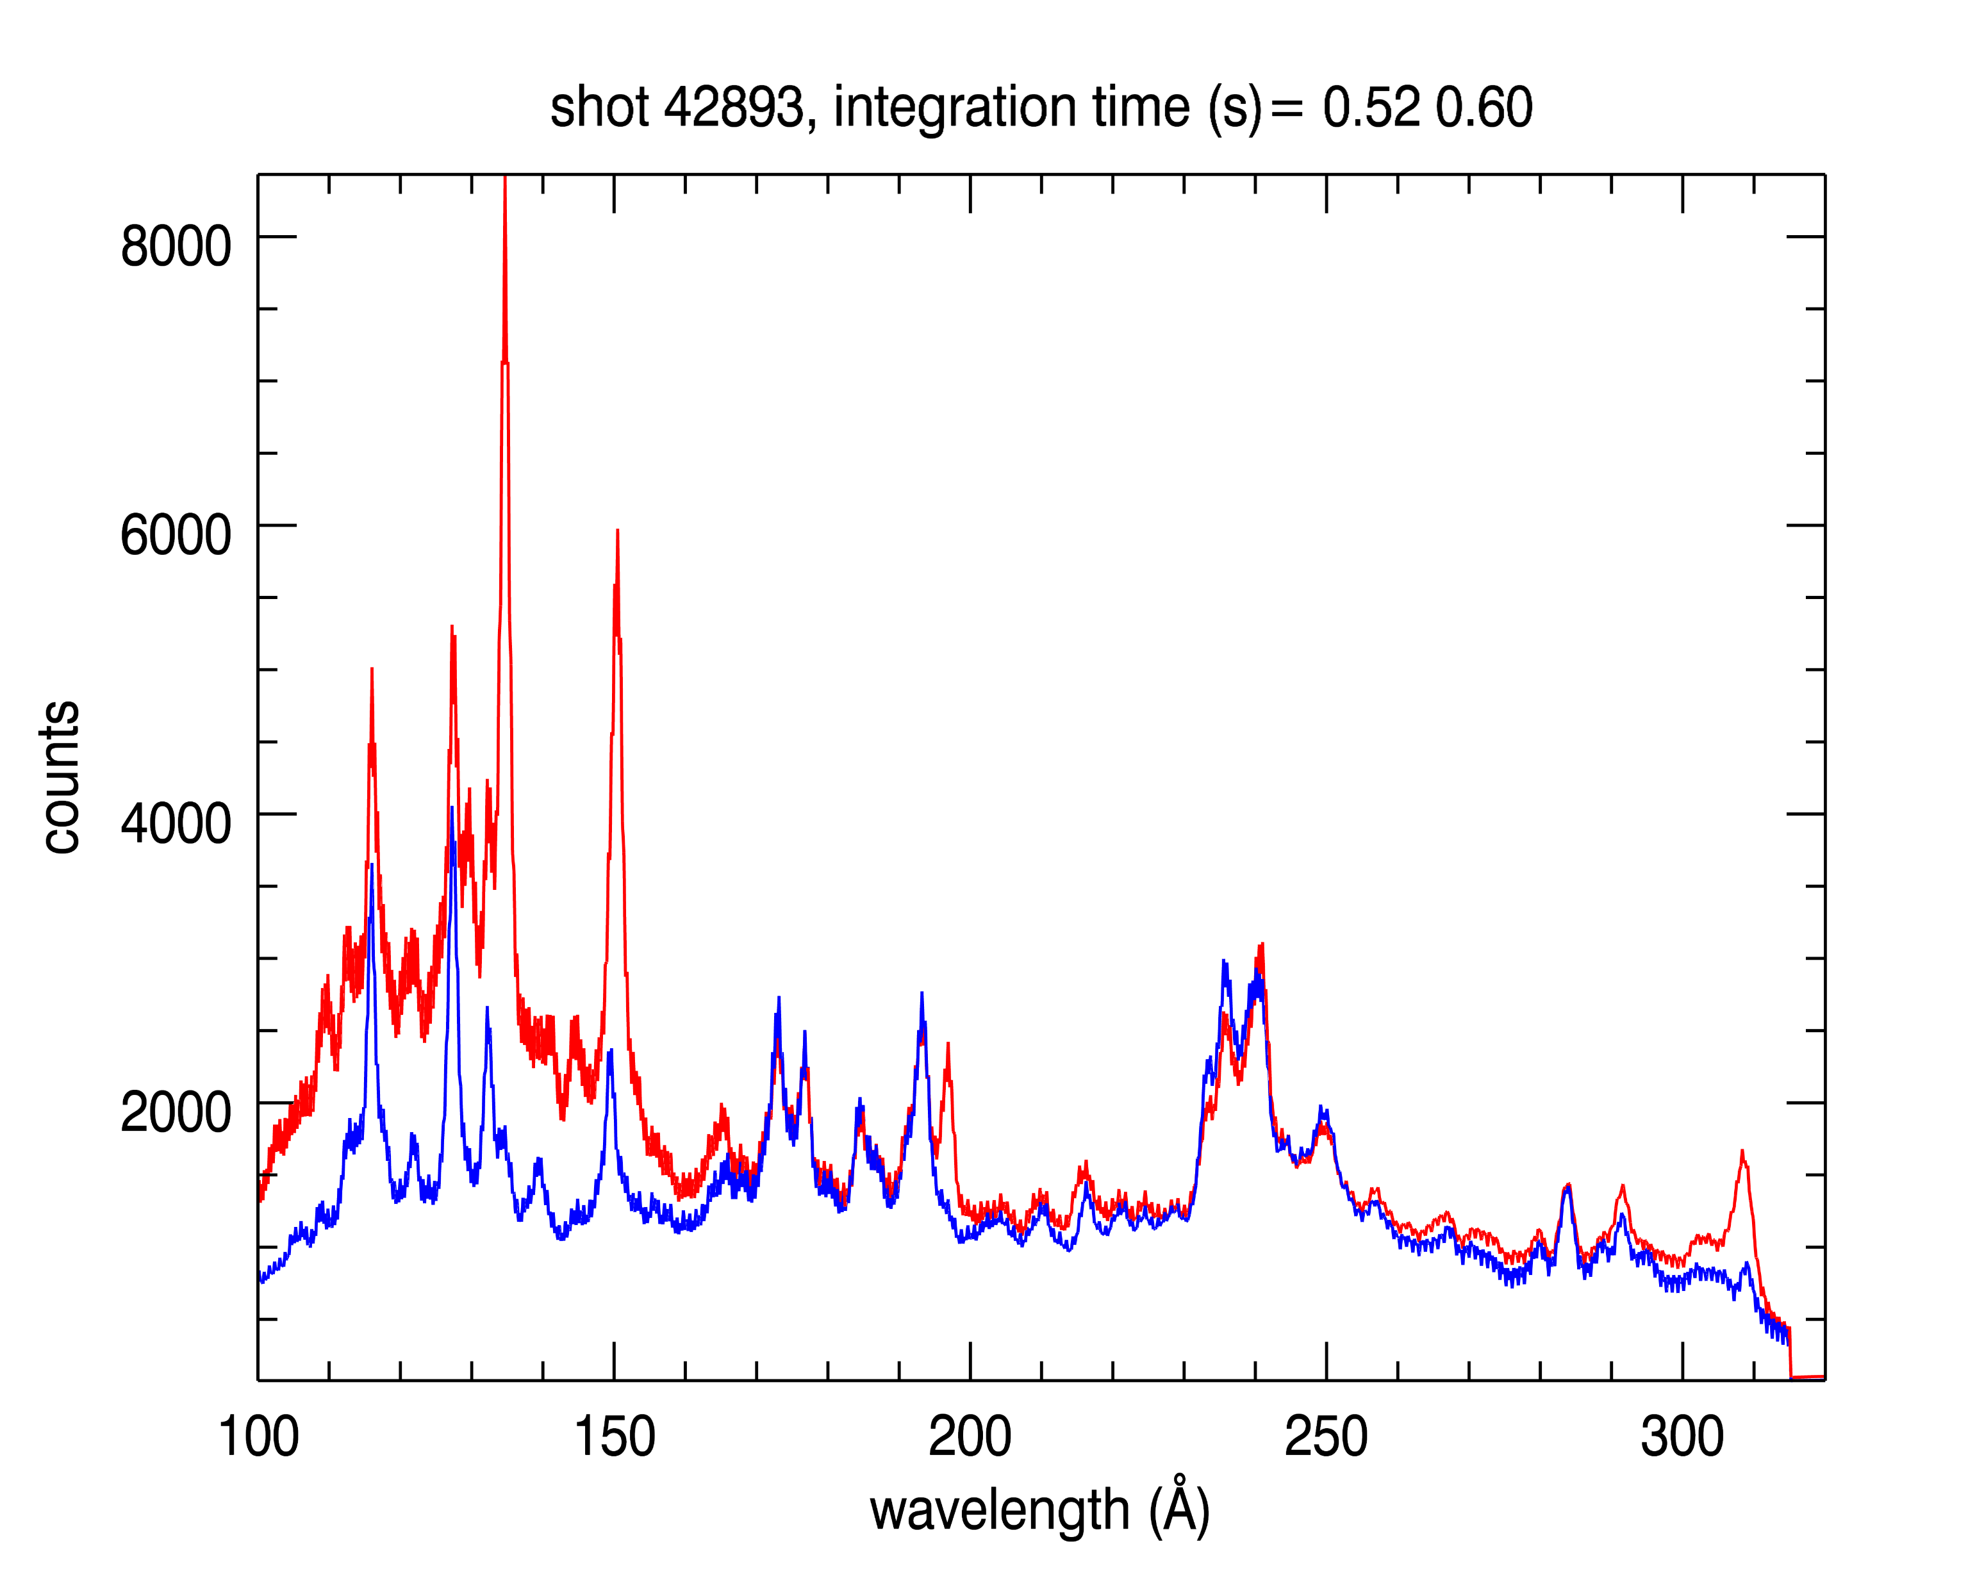
SPRED
134.2
Shot 42893
0.52-0.6 s
0.42-0.5 s
Previous lines are confirmed
plus a new one@135Å, double line
Broad unresolved band 100-150 Å, maybe due to Neon contamination
132.2
215
308
 | SPRED (Å)
L1 | 135
L2 | 150
L3 | 197
L4 | 308
L5 | 145
WIP - Frascati 27/05(2019)

Slide 4
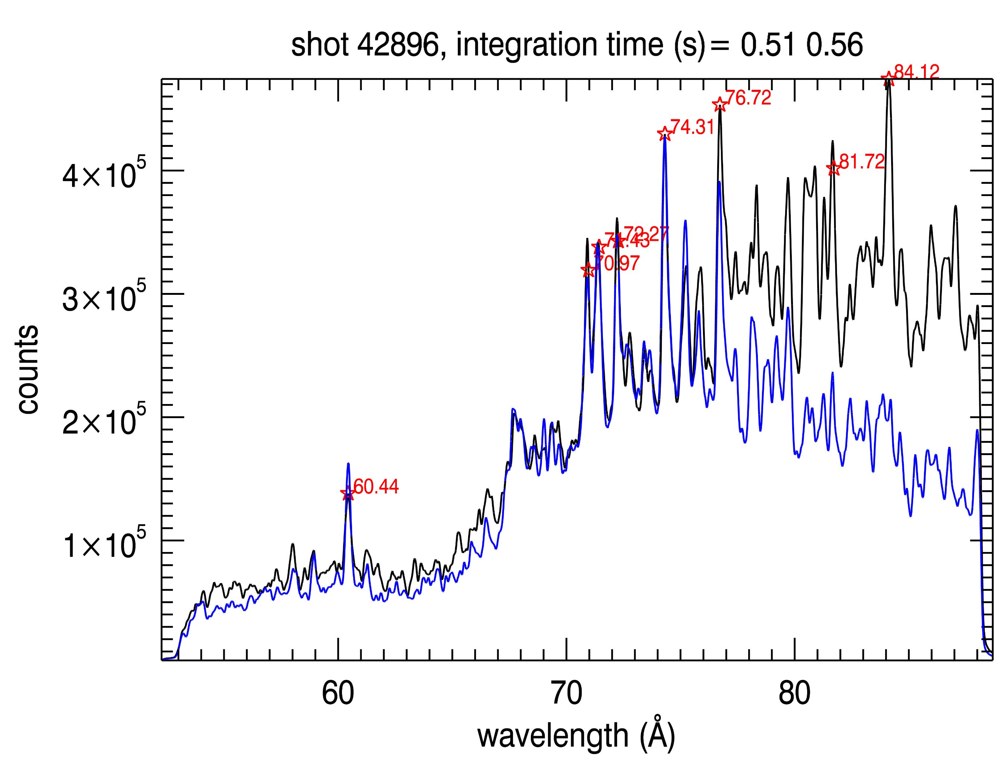
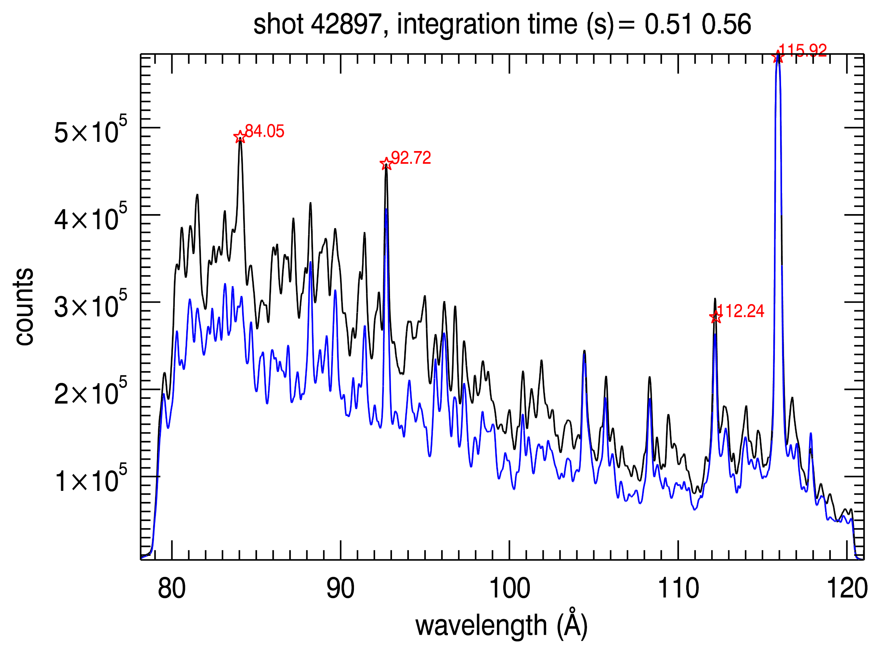
SCHWOB
Clear increase of signal and lines in the range 70-100 Å to be interpreted
Similar feature around 40 Å and below to be resolved
Use 1200 g/mm grating for the lowest wavelength range (3 shots)
Use 600 g/mm grating to complete scan above 120 Å (4 shots)
WIP - Frascati 27/05(2019)

