Slide 1
Tungsten spectral identification and transport in FTU plasmas: W LBO injection
G.Apruzzese, F.Bombarda, L.Carraro, F. Cordella, L.Gabellieri, M O’Mullane, G. Pucella, M.E. Puiatti, A.Romano, M.Valisa, B.Zaniol

Slide 2
THE MOTIVATION IS TWOFOLD
Spectral identification of W line emission ( ADAS atomic database)
Tungsten is to be used as plasma facing material on future
machines and is presently being tested on existing experiments
To assess if W accumulates, comparison with lighter element Ni ( W transport code not available)

Slide 3
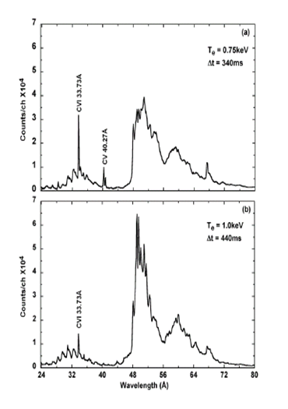
Background
PLT, ASDEX-U, LHD, JET, RFX-mod, as well as FTU, recorded quasi continuum bands of W in the spectral regions of 20-40 and 45-65 Angstrom.
W transport properties can be qualified from time history and space distribution of its emission ( lines, Prad, SXR)
LHD

Slide 4
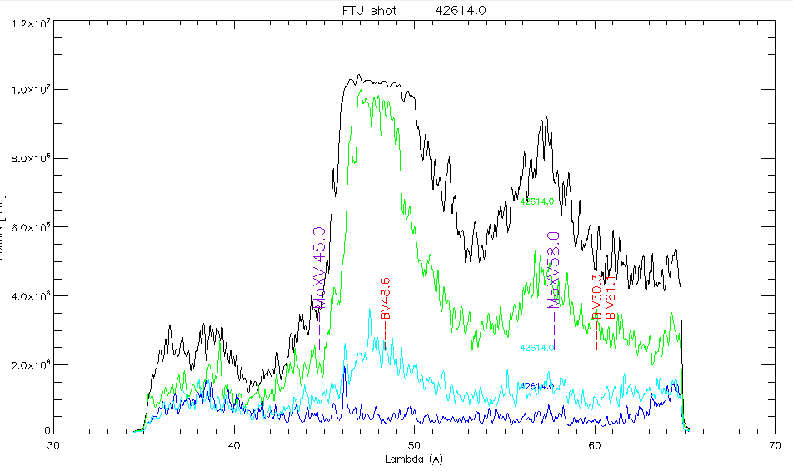
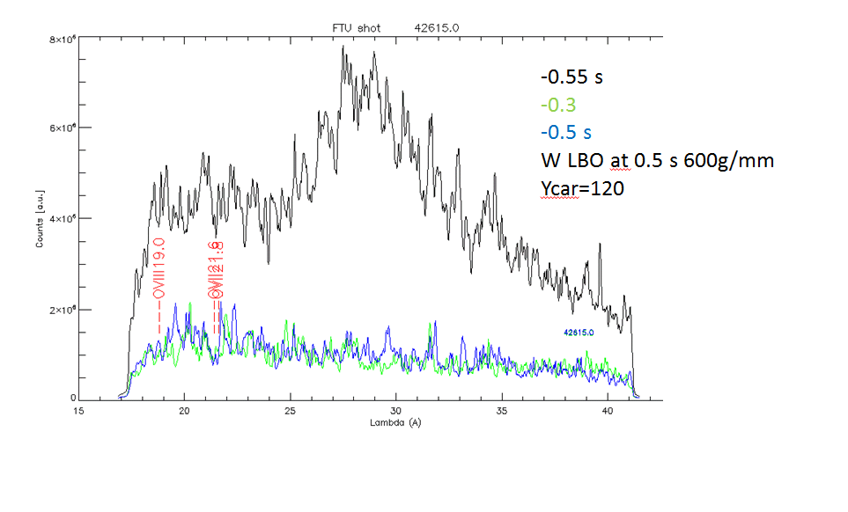
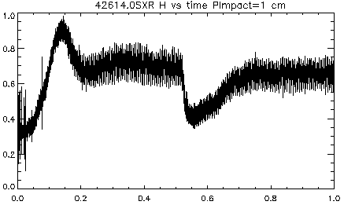
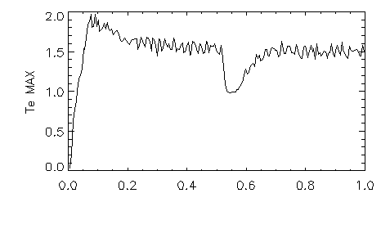
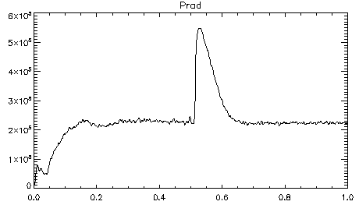
W emission Features have been identified in FTU C1-A April 2019 campaign
perturbations of Te make very difficult the W transport analysis : Te decrease dominates SXR (t)
42614

Slide 5
Goals and experimental strategy
The W emission bands result from overlapping of the emission from several ionizations states, therefore a well resolved identification of W spectrum in those spectral regions would be of great interest in order to increase the confidence on the atomic physics models ( M.O’Mullane ADAS) => use of SOXMOS spectrometer on loan from Padova ( 2 gratings: 600g/mm and higher resolution 1200 g/mm)
SXR tomography would contribute to the radial localization of the W emission.
The W penetration into the core plasma and its accumulation can be determined by analyzing the time evolution and radial profiles of SXR, P_{rad} and by tilting the SPRED LoS.
Injection of Ni in comparable discharges would add the possibility of comparing transport properties of impurities with different mass and charge, ( 1-dim transport code for Ni available , NOT AVAILABLE FOR W)

Slide 6
EXPERIMENTAL STRATEGY and REQUIREMENTS
‘Short ‘ discharges ( 1.s) : inject W with LBO at 0.4/0.5 s
At High Te ( ECRH in the core) (stationary conditions, to be discussed with Ec group )
-Collect spectra with SOXMOS 600 g/mm grating
-Repeat with 1200g/mm to better resolve lines in the emission feature.
-Tilt the SPRED to compare core and edge emission behaviors vs time.
-Repeat (partially ) with Ni injection
n_{e} (10²⁰ particles m⁻³) 0.5 (to be checked with EC group)
B (T) 5.3
I (kA) 500
Special requirements
change of SOXMOS spectral range and grating (access to the torus hall)
ECRH for maximum Te
Essential diagnostics
SOXMOS, SPRED
n_{e}, T_{e} profiles,
SXR Tomography profiles
Visible Bremsstrahlung, Visible spectroscopy

Slide 7
Pulse Plan ( total 10 shots)
Ip 500 kA Bt=5.3 T ,ECRH n_{e}=0.5 10 ²⁰m⁻³
W quasi continuum 40-70 Å shot
600g/mm y=155 (36-65 A) 1 check of W quantity
Repeate with different LBO diaphragm 1 SCAN THE SPRED POSITION
Y=160
W quasi continuum 20-40 Å
600 g/mm y=120 (15-40) with different LBO diaphragm 1 check of W quantity
Repeat Y=115, or 125 , check the feature ends 1
W quasi continuum 40-70 Å
1200 g/mm Y=210 (37-57), 230 (45-67) 2 SCAN THE SPRED POSITION
W quasi continuum 20-40 Å
1200 g/mm y=160 (20-36) , y=170 (23-40) 2
Repeat ( partially) with LBO Ni 2 SCAN THE SPRED POSITION
SOXMOS wavelength scan (600g/mm)
y=230(87-131) Ni XXI 96, XXII 103, XXIII 111, XXIV 104, XXV 118
Y=360(229-296), Ni XV 249, NI XVIII 292)

