Slide 1

Yttrium spectrum identification
F. Bombarda, A. Romano
L. Gabellieri, G. Apruzzese, L. Carraro, M.E. Puiatti, M. Valisa, B. Zaniol, M. Salvadori, F. Consoli, M. Cipriani
WIP - Frascati 20/05(2019)

Slide 2
F12 Yttrium spectrum identification
Background : The ABC experiment at Frascati used Yttrium targets to produce intense radiation sources [M. Salvadori, et al., article in press)]. Y atomic and experimental data are scanty, therefore the spectra interpretation is also prone to large uncertainties. Yttrium was never injected into tokamak plasmas.
Goals : Acquire high resolution spectra of Yttrium (Z=39, A=89) in the full spectral range covered by the SOXMOS instrument (6-340 Å), by the SPRED (100-300 Å), and by the visible spectrometers in well diagnosed (temperature and density), stationary hot plasmas. Line wavelengths and relative intensities will be compared to code predictions, and to former and future results obtained on ABC. In addition, it would be of interest to operate at relatively low temperatures and high density to simulate plasma conditions similar to those of ABC, as well as in the presence of suprathermal tails in the electron distribution functions (at low density and/or with ECRH)
Experimental strategy : Y will be only partially ionized in FTU plasmas. For the sake of repeatability, a series of standard shots at 500 kA/5.3 T will be used to acquire the spectra over the entire instrumental range with Y LBO injection. Shorter pulses (FT = 1 s) increase pulse rate. The highest electron temperatures are desirable in order to observe as many spectral emission lines as possible, eventually with the additional heating provided by ECRH.
WIP - Frascati 20/05(2019)

Slide 3
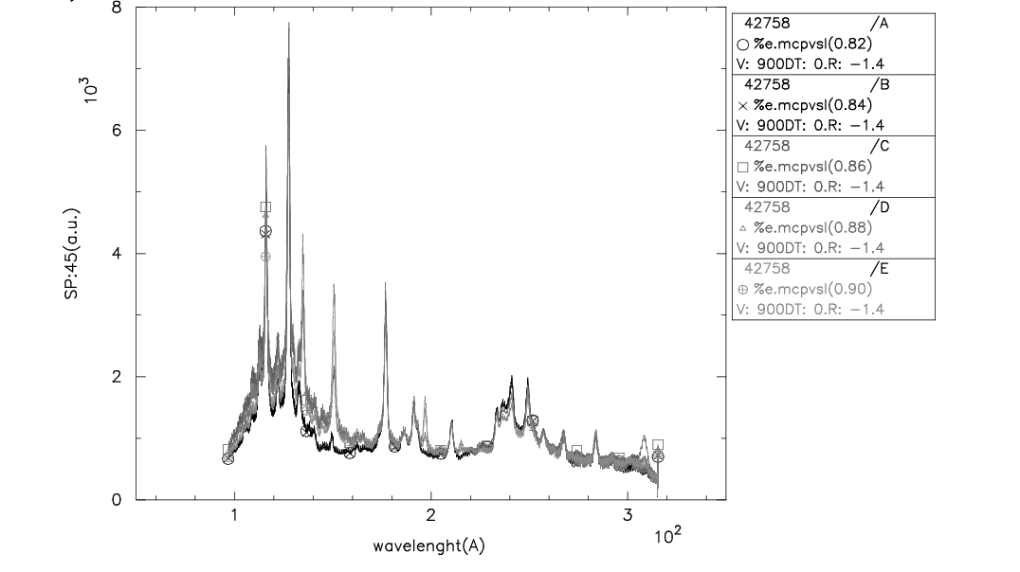
Preliminary observations
A limited number (6) of LBO injections was performed in April, in support of RE experiments and prior to TLL program.
Few lines were observed with the SPRED, none with Schwob, which was off most of the time
 | SPRED (Å)
L1 | 135
L2 | 150
L3 | 197
L4 | 308
These lines probably come from different ionization stages. They are not reported in literature (NIST & other).
WIP - Frascati 20/05(2019)

Slide 4
Experimental Plan
B_{T} = 5.3 T, I_{P} = 500 kA, n_{e} ∼ 0.7 x 10²⁰ m⁻³ , flat-top 1 s, LBO @ 0.5 s (same as for the W exp), stationary conditions.
ECH (central heating) is welcome, but not necessary: 300 ms from 0.35 to 0.65 s. In case, density can be set at 0.5 x 10²⁰ m⁻³ .
Schwob starts from lowest wavelength (5 Å) with 1200 g/mm grating. (3 shots at increasing ranges), then continues scan with 600 g/mm grating (8 shots) to cover whole range (access to Hall required).
SPRED starts with usual setting, then changes to lower resolution grating.
Other diagnostics: Ne, Te, SXT, Vis. Spectroscopy.
WIP - Frascati 20/05(2019)

