Slide 1
Maximum peaking by impurity injection
FTU experimental campaign 2019 - program F04 Impurity Injection
Scientific Coordinators: C.Mazzotta, G.Pucella
Scientific team: G.Aruzzese, F.Bombarda, L.Boncagni, L.Carraro, O.D’Arcangelo, D.Frigione, L.Gabellieri, E.Giovannozzi, M.Marinucci, M.E.Puiatti, A.Romano, O.Tudisco, et al.
C.Mazzotta
WIP 1th Apr 2019

Slide 2

Impact of peaking on fusion power Angioni EPS 2009
2
Pressure profile peaking increases with increasing density peaking (decreasing collisionality ) [Angioni PPCF 09]
[ Weisen PPCF 06 ]
No (inverse) correlation observed between density peaking and temperature peaking [AUG Angioni PoP 03, JET Weisen PPCF 06, JT-60U Takenaga NF 08]
Fixed β and
Greenwald fraction
Projection from JET profiles, at predicted density peaking, increase of fusion power by ~30% with respect to flat density [Weisen PPCF 06]
Impact of peaked density profile on impurity transport, MHD and fast particle instabilities under assessment
In a reactor, operation above density limit possible, thanks to density peaking

Slide 3
Outline
Historical excursus by K.A. Razumova at EPS 2017 self-organized plasma
  Dependence of stored energy with electron density - Helium and Neon puffing
Alcator summary by A. Hubbard EPS 2017 I and H-mode plasmas at high B_{T} and P Implications for future fusion devices. Extrapolations, open issues, and needed research
Impurity Injection in T-10 N. Kirneva EPS 2017 Helium and Neon doped plasmas
FTU behavior in terms of density limit, peaking, ITB and collisionality Pucella 2015, Mazzotta NF 2015 e EPS 2017, in the past Frigione and more…
  Impurity Injection in T-10 N. Kirneva EPS 2017 Helium and Neon doped plasmas
  Density peaking with Neon Mazzotta FTU 2014-2018, Frigione JET 2018
  JET hybrid plasmas Neon scan Frigione NF 2019
Conclusions and FTU experimental proposal for the next campaign
ALFVEN PRIZE

Slide 4
Not only FTU…
W(n_{e}) or n_{e}(W)? Razumova EPS 2017 and Plasma Physics Report 2017
With He injection, plasma density may increase without changes in confinement.
There is no dependence of confinement on plasma density. We have confused the reason and the consequence. The plasma density depends on confinement.

Slide 5
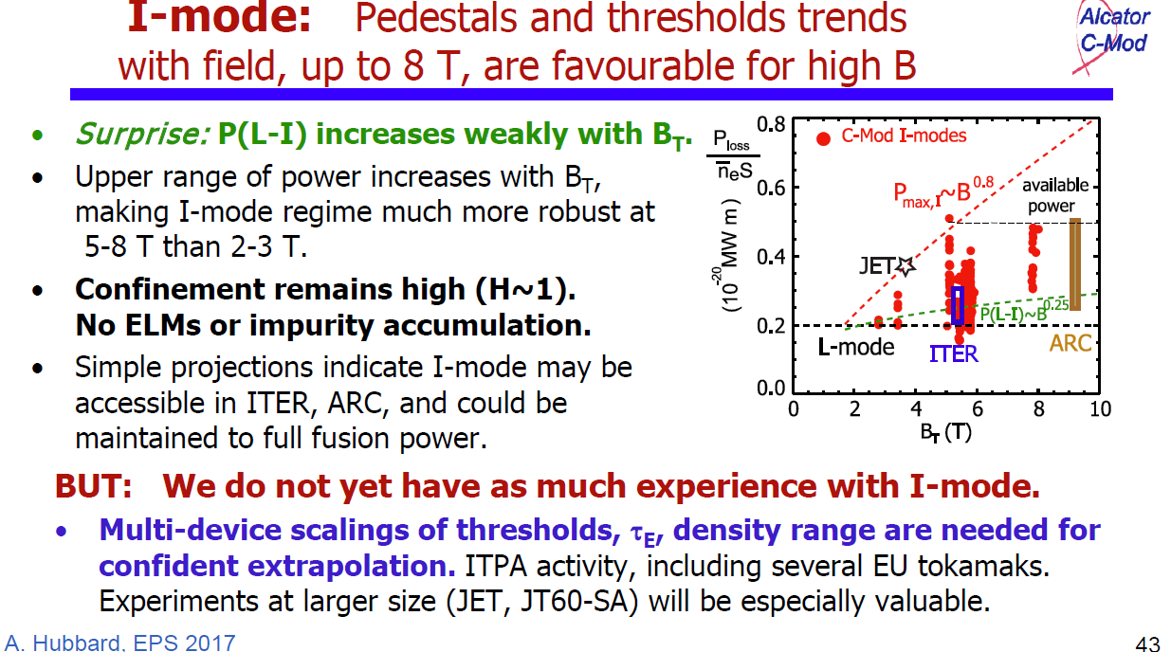
Not only FTU…
Alcator summary Hubbard EPS 2017

Slide 6
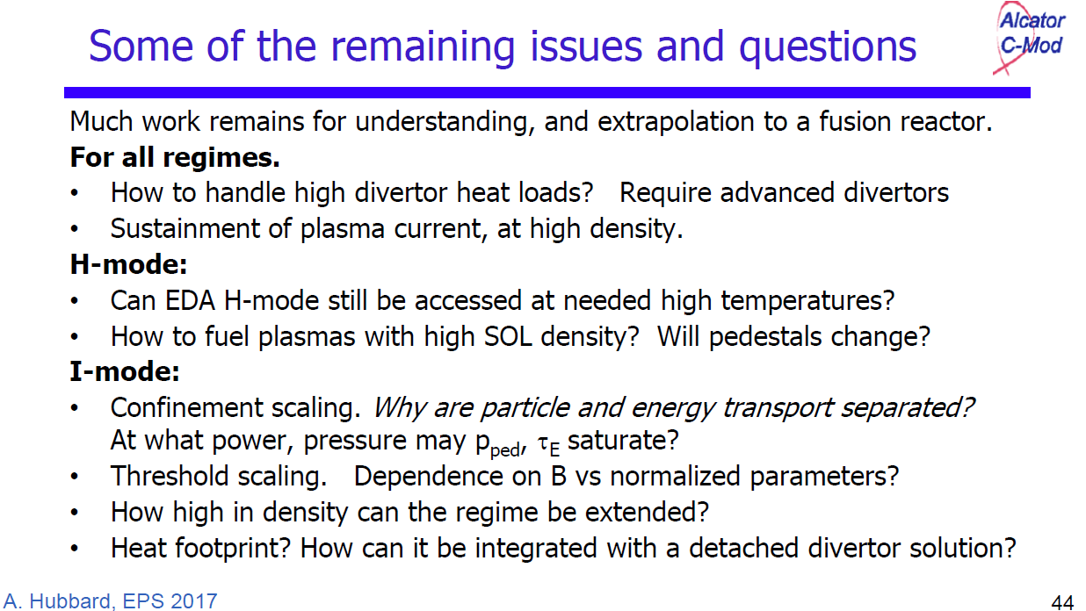
Not only FTU…
Alcator summary Hubbard EPS 2017

Slide 7
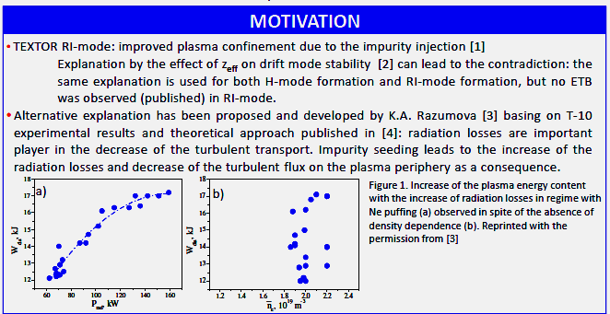
Not only FTU…
Effect of the Impurity Injection on plasma confinement in T-10 tokamak Kirneva EPS 2017

Slide 8
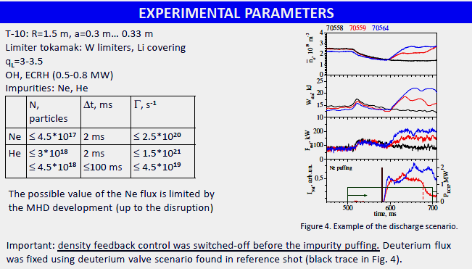
He & Ne combined doping Kirneva EPS 2017

Slide 9
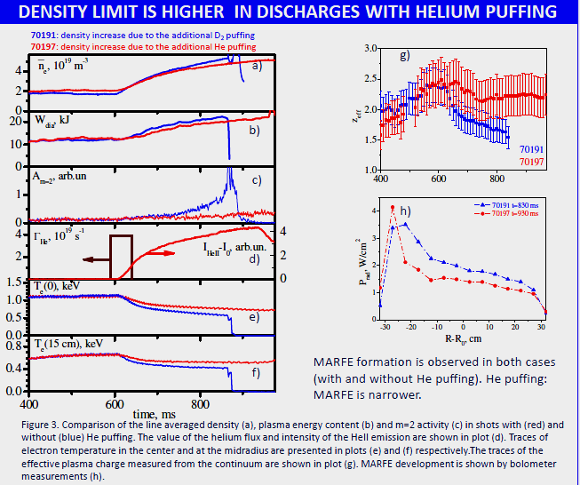
Helium doping Kirneva EPS 2017

Slide 10
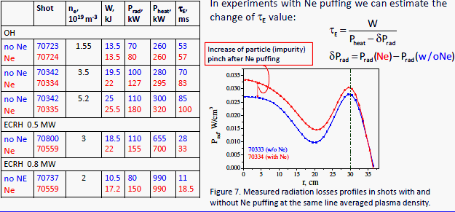
Neon doping Kirneva EPS 2017

Slide 11
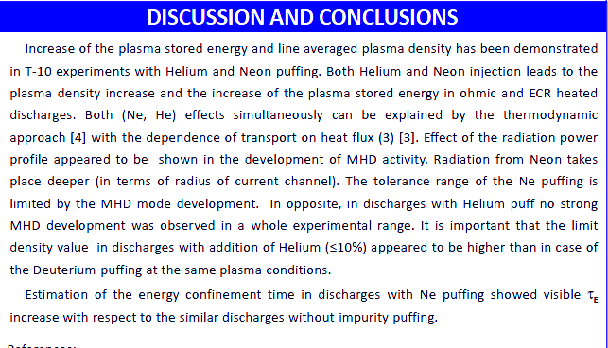
He & Ne combined doping Kirneva EPS 2017

Slide 12
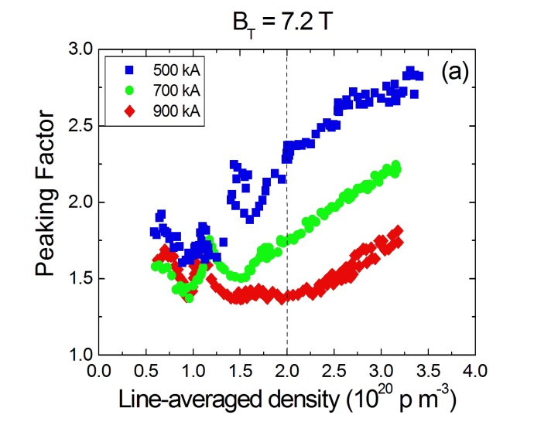
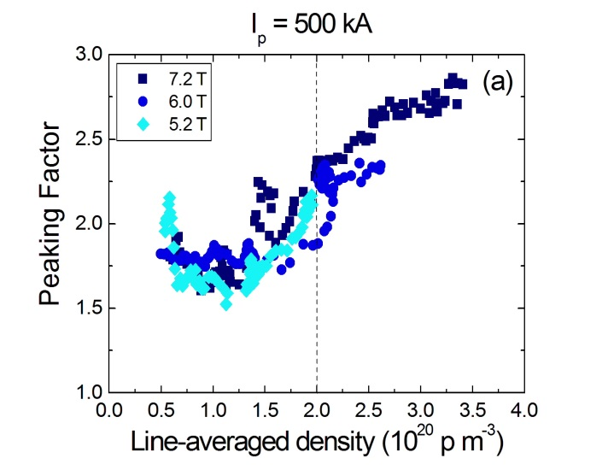
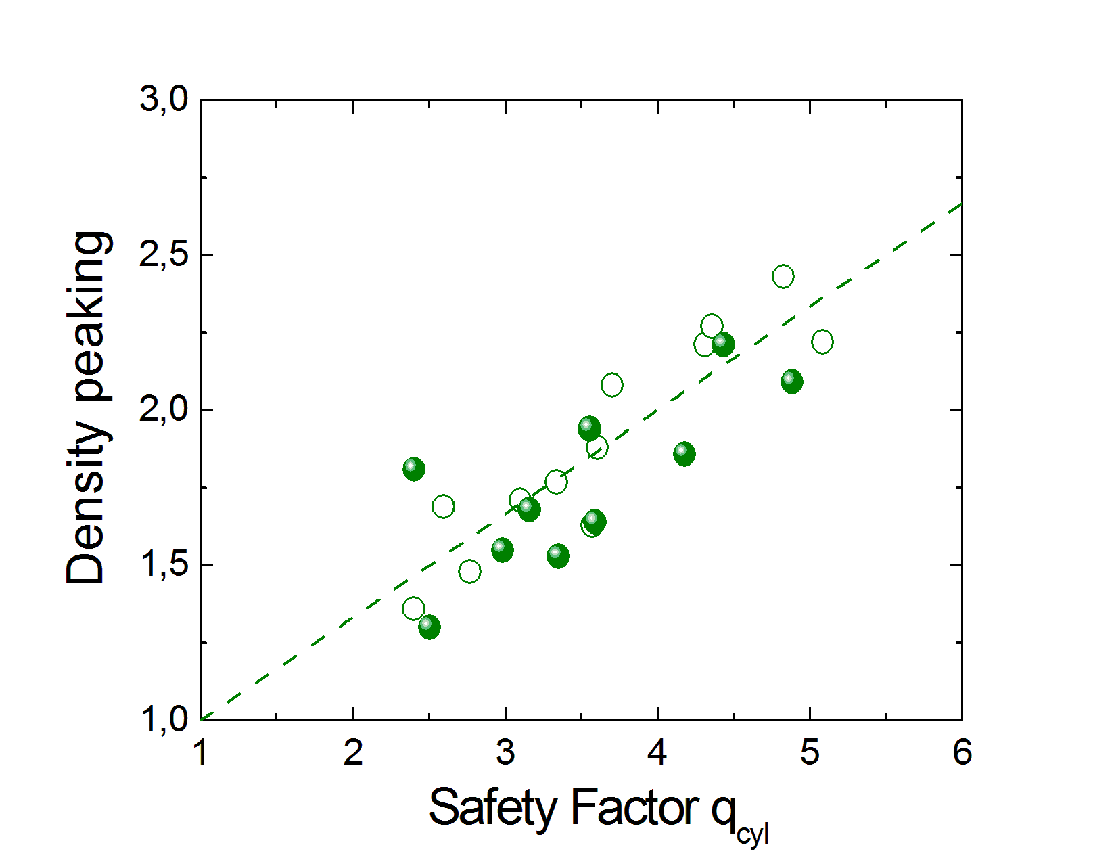
FTU Density limit and peaking Pucella, Tudisco, Mazzotta et al.
12
At the first order, the shape of the density profile on FTU depends on the central line-averaged density and, for a given central line-averaged density, it depends on the plasma current, and it does not depend on the toroidal magnetic field. Finally the peaking factor at the disruption linearly depends on the edge safety factor q.
The experiments on FTU highlights the edge nature of the density limit, as a holds for the maximum achievable line-averaged density along a peripheral chord, whilst Greenwald-like scaling is not valid for the central chord, where the maximum achievable line-averaged density essentially depends on the toroidal magnetic field only. This behavior is explained in terms of density profile effects. [Pucella NF 13]

Slide 13
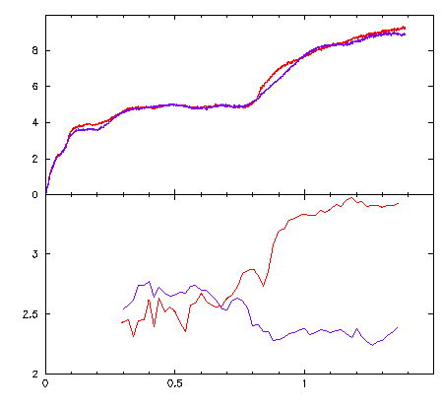
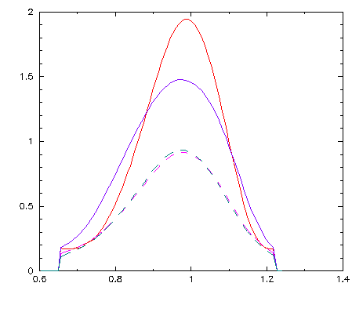
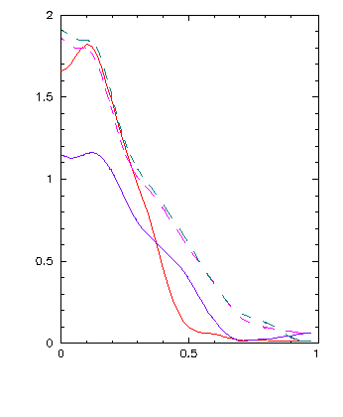
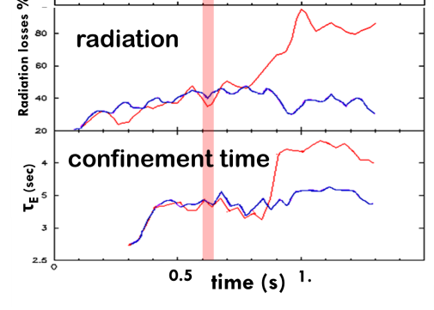
FTU peaking with Neon injection Mazzotta, Pucella, Tudisco et al
1.2 s
#37342
#37344
n_{e} (10¹⁹ m⁻³)
0.5s
#37342 Neon injection at 0.6 s
#37344 D puffing only
n_{e} (10²⁰ m⁻³)
0.5s
Te (keV)
1.2s
n_{e 0}/< n_{e} >_{vol}
time (s)
Major Radius (m)
ρ
#37342 has 50 ms Neon puff at 0.6 s (the D fuelling is off) provokes a spontaneous increase of the density and peaking [Mazzotta NF 15]
Spectroscopic evaluation: a small fraction of electrons stripped from Neon can contribute to the density rise. [Mazzotta EPS 13]
From JETTO: the Neon impurity induces a decrease of the ion thermal diffusivity coefficient due to the suppression of the turbulent component of the ion transport, but leaves the electron energy transport unchanged. [Mazzotta NF 15]

Slide 14
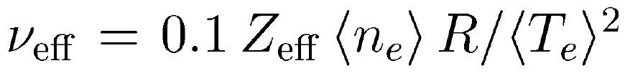
Density peaking observed to increase with decreasing collisionality in H-mode plasmas Angioni EPS 2009
14
Statistical analyses identify collisionality as the most relevant parameter
[Angioni PPCF 09]
Consistent observations in
AUG [ Angioni PRL 03 ]
JET [ Weisen NF 05 ]
C-Mod [ Greenwald NF 07 ]
and JT-60U [ Takenaga NF 08 ]

Slide 15
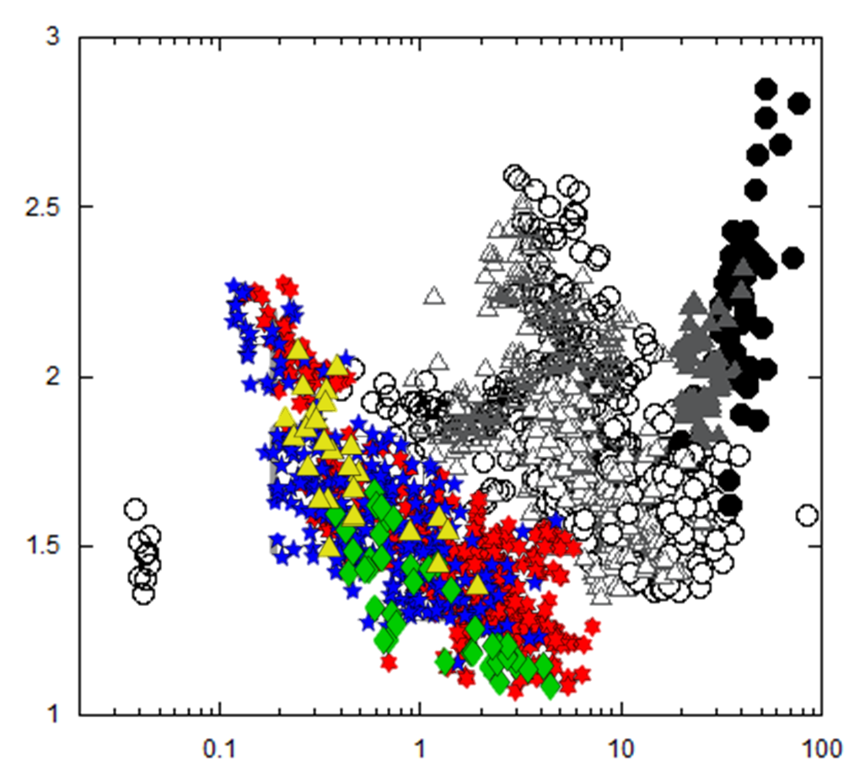
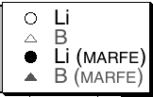
FTU collisionality Mazzotta EPS 2017, Tudisco FED 2010, M.Romanelli PPCF 2007
15
Statistical analyses identify collisionality as the most relevant parameter
FTU
Consistent observations in
AUG [ Angioni PRL 03 ]
JET [ Weisen NF 05 ]
C-Mod [ Greenwald NF 07 ]
and JT-60U [ Takenaga NF 08 ]
FTU [ Mazzotta EPS 17,
Tudisco FED 10
M.Romanelli PPCF 2007 ]

Slide 16
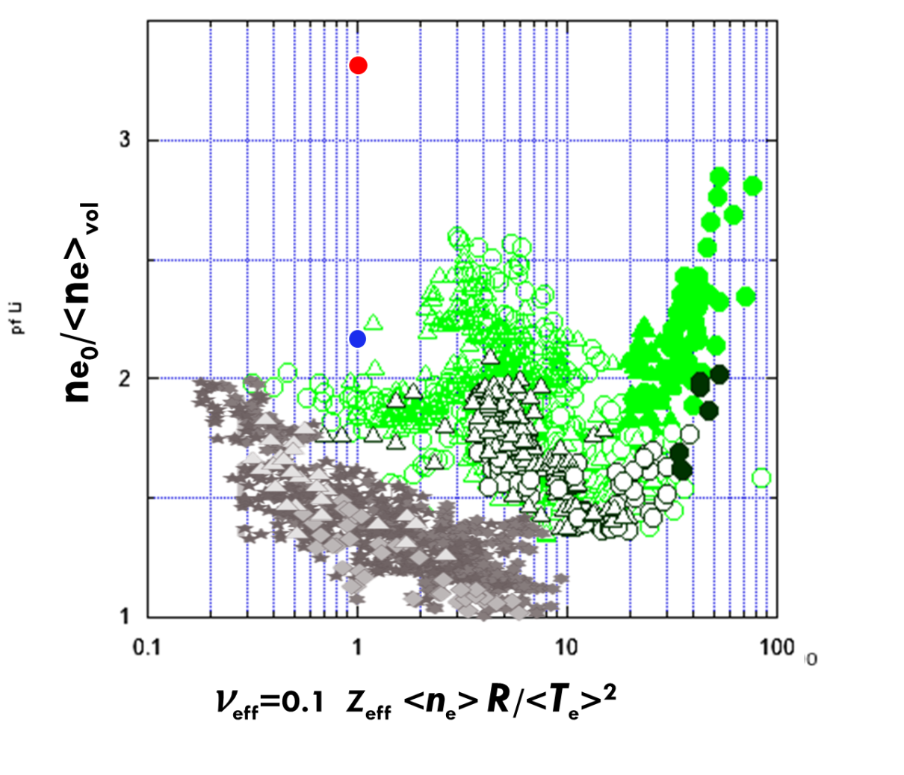
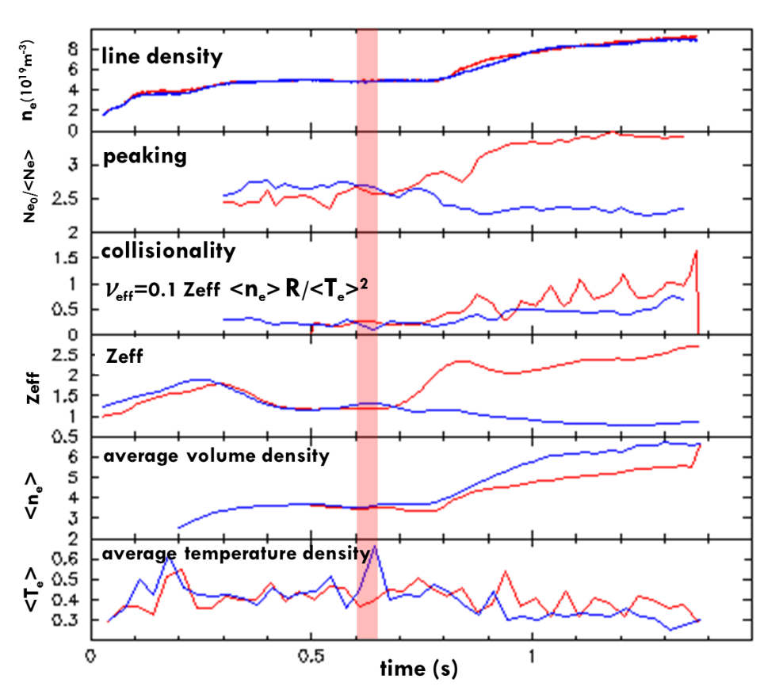
FTU collisionality Mazzotta EPS 2017
16
FTU [ Mazzotta EPS 17, NF 2015 ]
37342 Neon doped
37344 Undoped
FTU

Slide 17
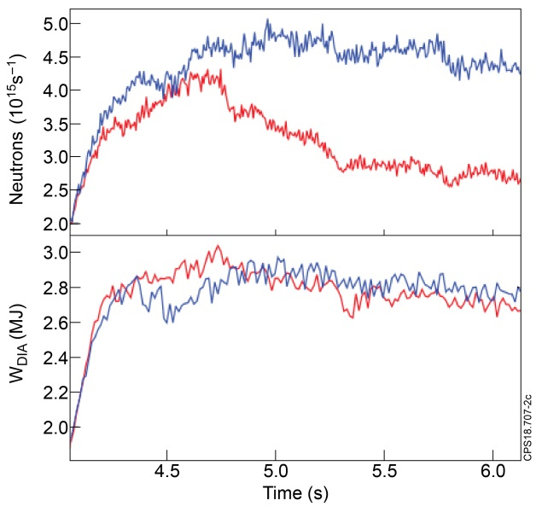
JET Frigione NF 2019
17
#90280 seeded
#90287
un-seeded
t₂=6.5s
t₂=6.6s
t₁=4.9s
t₁=4.9s
1.4 MA, 1.9 T
#90280 seeded
#90287 un-seeded
A Neon scan was performed in JET Hybrid plasmas to study impurity seeding technique for power exhaust mitigation (reducing the divertor tile temperature without affecting the global confinement).
The fusion performance represented by the total neutron yield was reduced.
The core electron density profiles featured a peaking effect increasing with Ne injected.
The peaking is reproduced if a particle pinch to ZEFF and grad Ti is introduced as (ITG) theory.
Further experimental activity is planned to extend this study in the baseline scenario

Slide 18
FTU experiments: possible goals for combined doping Ne + He
We can confirm the T-10 results
We can reach higher peaking (and improved density limit ?)
We can delay the MHD activity and disruption
We can understand better the MARFE dynamic
We can obtain pressure record
We can confirm (or not) the saturation of τ_{E}
We can better understand the collisionality role
We can confirm neutron rate and energy behaviour
We can study the particle transport in the ITB to assess the role of the ETG and the absence of TEM
Or are the ITG?
More… what happen if I heat in the gradient region?

Slide 19
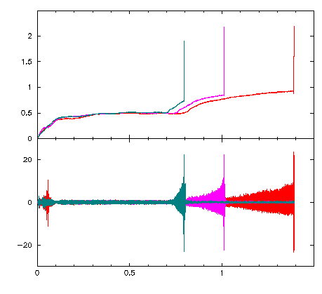
Experimental proposal for combined doping Ne + He
Conclusions: what we know about Neon injection
more impurity is injected more disruptive MHD activity is observed
strong increase of the electron density for the Neon seeded discharges, also the density peaking factors were found to be in excess of three
at higher starting density, the same injected impurity amount induces an abrupt density rise and the discharge rapidly ends in a disruption (right fig.)
Our neutron rate increase, as well as τ_{E}
#37340 V-on 90mV
#37341 V-on 85mV
#37342 V-on 82mV
n_{e} (10²⁰ m⁻³)
dB_{θ}/dt (T/s)
Proposal for: before Helium and after Neon combined injection
The combinations He before Ne and Ne before He must be explored at leaste once. The confinement could be different.
More: we can consider the possibility to have the He/D fuel mixture. In this case we have to assess the reference scenario
time (s)

Slide 20
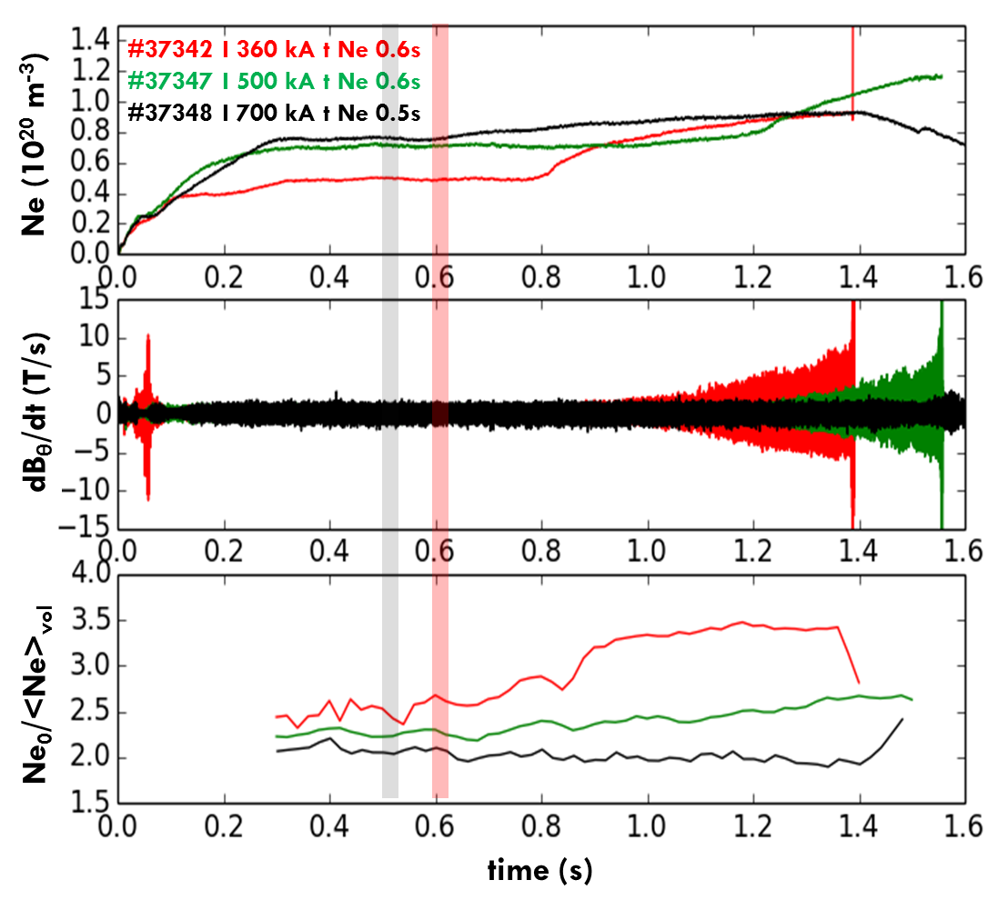
Experimental proposal Ne + He (or one doping alnone): Current Scan
As current increases the induced density rise is less steep and the peaking effect is milder
At 700 kA, no disruption. It’s interesting to get a long pulse…
Proposal for: Helium and Neon combined injection
Also in this case, the combinations He before Ne, and Ne before He must be explored at least once.
What happen if I heat in the gradient region?

Slide 21

THE END ?

Slide 22
W(n_{e}) or n_{e}(W)? Razumova EPS 2017
W(n_{e}) or n_{e}(W)? W(n_{e}) or n_{e}(W)? W(n_{e}) or n_{e}(W)?
With Ne injection, strong changes in the stored energy W_{d} lead to low changes in the plasma density n_{e}

