Slide 1
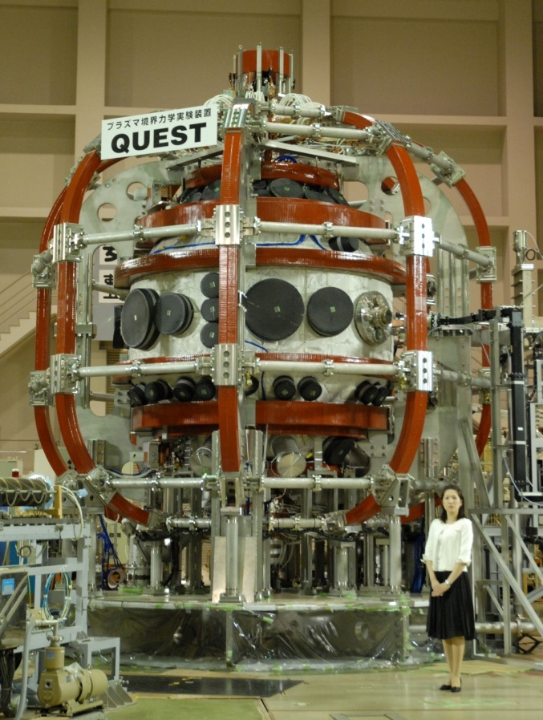
Overview of Recent Progress on the QUEST experiments
Kazuaki Hanada1, Hiroshi Idei1, Yoshihiko Nagashima1, Ryuya Ikezoe¹, Makoto Hasegawa1, Takumi Onchi1, Makoto Oya², Kengo Kuroda1, Shoji Kawasaki1, Aki Higashijima1, Takahiro Nagata1, Shun Shimabukuro1, Shinichiro Kojima³, Hatem O ELSerafy³, Naoaki Yoshida1, Kazuo Nakamura1, Atsushi Fukuyama4, Sadayoshi Murakami⁴, Yuichi Takase5, Akira Ejiri5,Roger Raman6, and Masayuki Ono7.
¹ Research Institute for Applied Mechanics, Kyushu University, Kasuga 816-8580, Japan: ²Faculty of Engineering Science, Kyushu University, Kasuga 816-8580, Japan: ³Interdisciplinary Graduate School of Engineering Science, Kyusyu University, Kasuga 816-8580, Japan: ⁴Graduate School of Engineering, Kyoto University, Kyoto 615-8530, Japan: ⁵ Graduate School of Frontier Science, University of Tokyo, Kashiwa 277-8561, Japan: ⁶ University of Washington, Seattle, WA, USA: ⁷ Princeton Plasma Physics Laboratory, Princeton University, Princeton, NJ, USA
Presented by 花田 和明
応用力学研究所
九州大学
We would like to special thanks to collaborators to make the presentation.

Slide 2
Outline
Background
Introduction of QUEST
Equipment for ECCD experiment of 28 GHz
Experiment with the 28GHz ECCD
High field side (HFS) injection of RF for efficient plasma start-up
Plasma breakdown with 2nd harmonic ECW
Steady state operation using ECCD with 8.2GHz RF
Summary

Slide 3
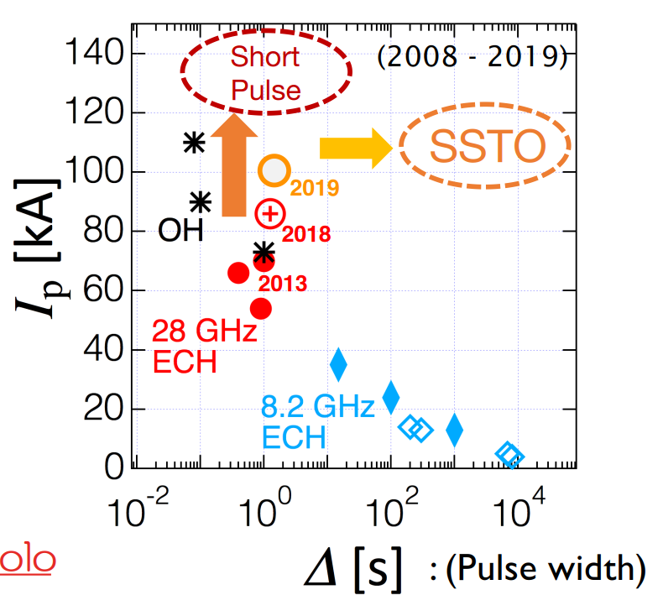
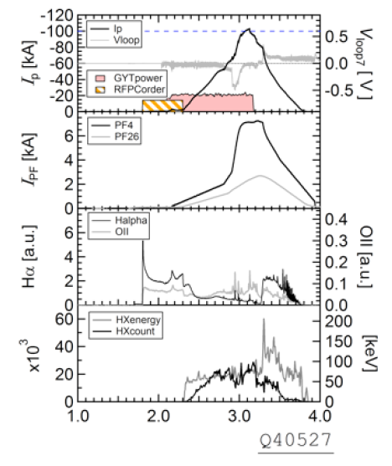
Summary of progress on QUEST experiments
Summary of progress on plasma paramters on QUEST in 2019
More than 100 kA in plasma current could be obtained

Slide 4
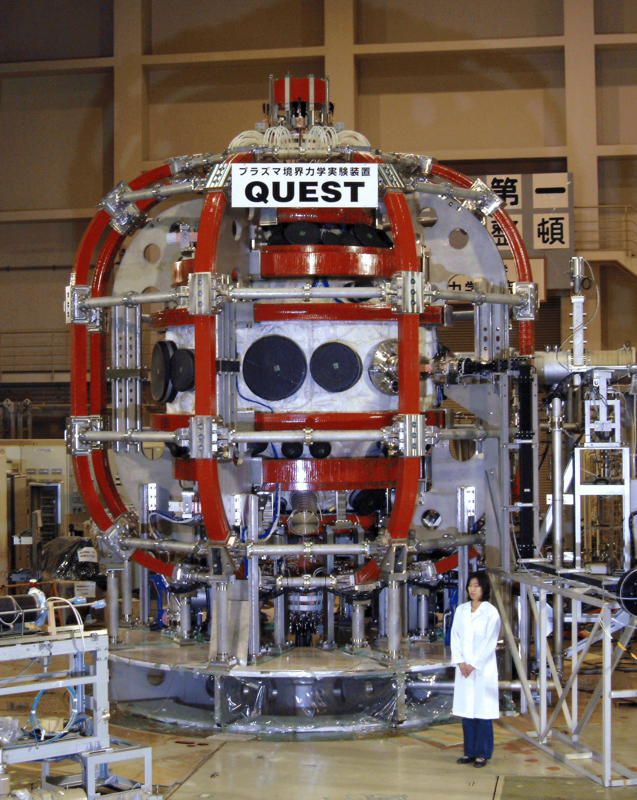
Introduction of QUEST
QUEST (Q-shu University Experiment with Steady-State Spherical Tokamak)
Height : ～6.6 m
Width : 5 m
Vessel Radius : 1.4 m
Vessel Height : 2.8 m
Vessel Volume: 13.5m³
Toroidal field: <0.25T@0.64m
Plasma heating source
2.45GHz : <50kW, CW
8.2GHz : <100kW, CW
(8.56GHz : <250kW, CW)
28GHz : <350kW, 1 sec
OH : 0.2 Vs

Slide 5
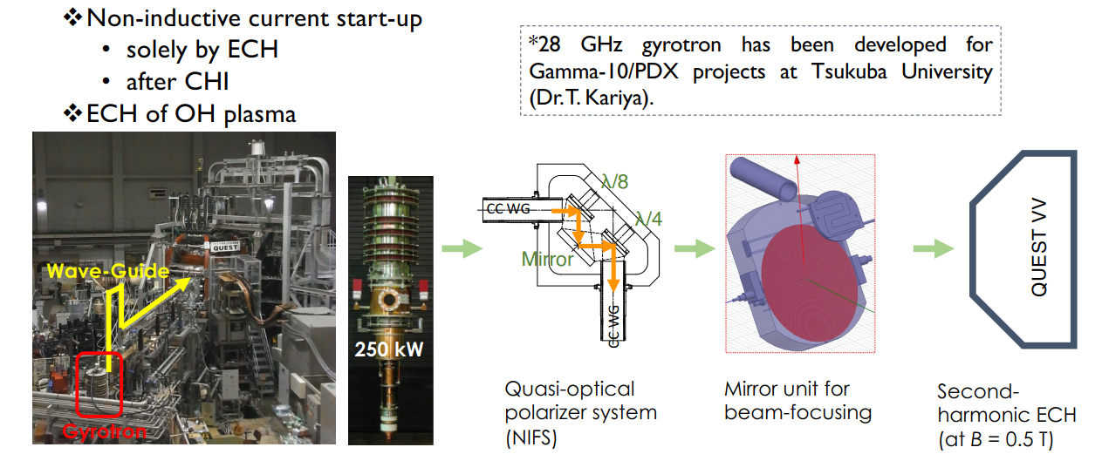
The 28 GHz RF injection system for QUEST
The 28 GHz RF injection system for QUEST
Two 90 degree refrector were used for adjusting RF polarization

Slide 6
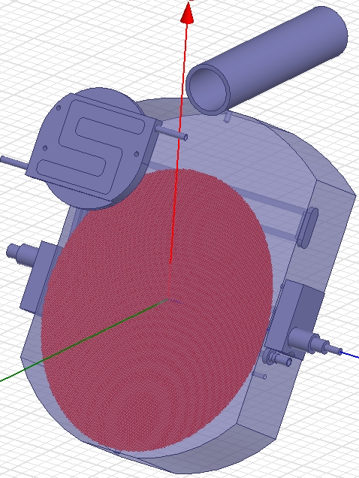
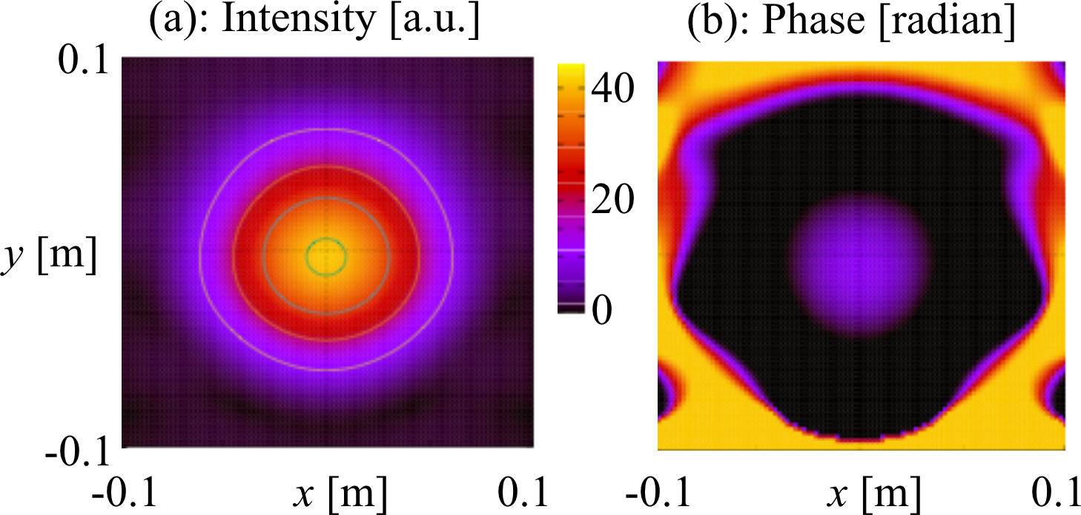
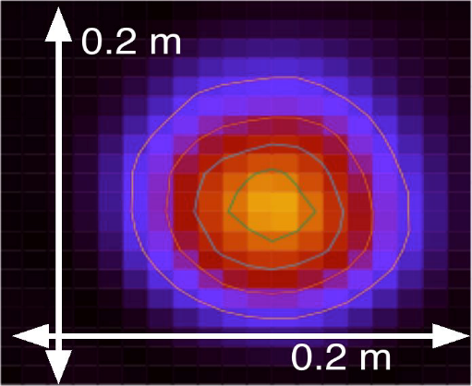
Beam Focusing for 28GHz RF
Approximately 5 cm waist size could be obtained
Beam Forcusing for the 28 GHz RF
Approximately 5 cm waist size could be obtained
The irradiant HE11 beam was converted to Gaussian
beam and expanded at the 1st mirror. The mirror
was designed on the phase surfaces to be matched
between the incident HE11 and output Gaussian
beams using a developed Kirchhoff integral code.
The 2nd large mirror sharply focused the expanded
Gaussian beam to a narrow beam with a 5-cm waist
size at the ECR layer.
Full Wave
Simulation
Full wave simulation
at the ECR layer for
a launching beam
from a 2.5-inch CC WG.
Low power
test results

Slide 7
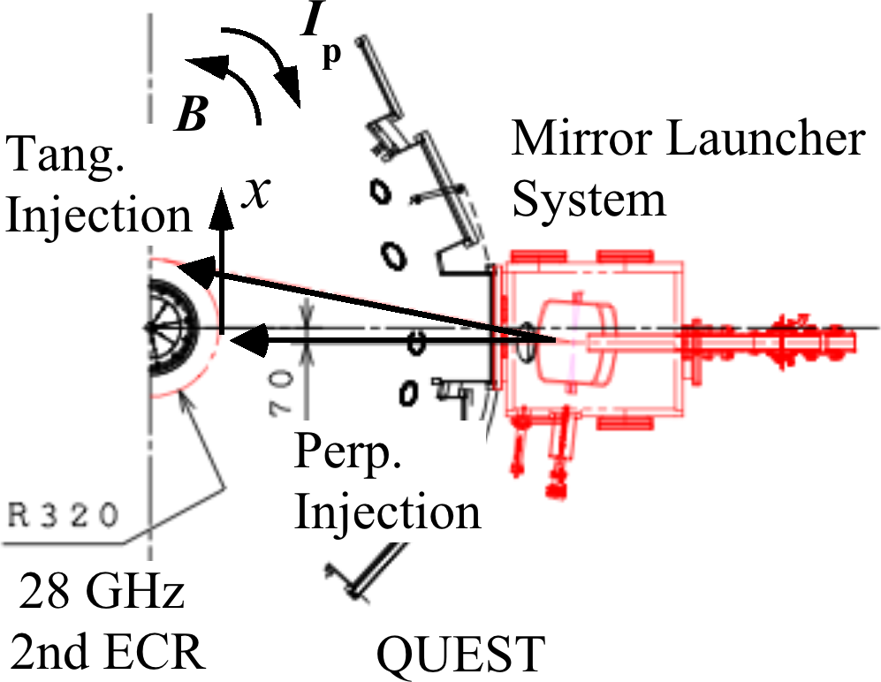
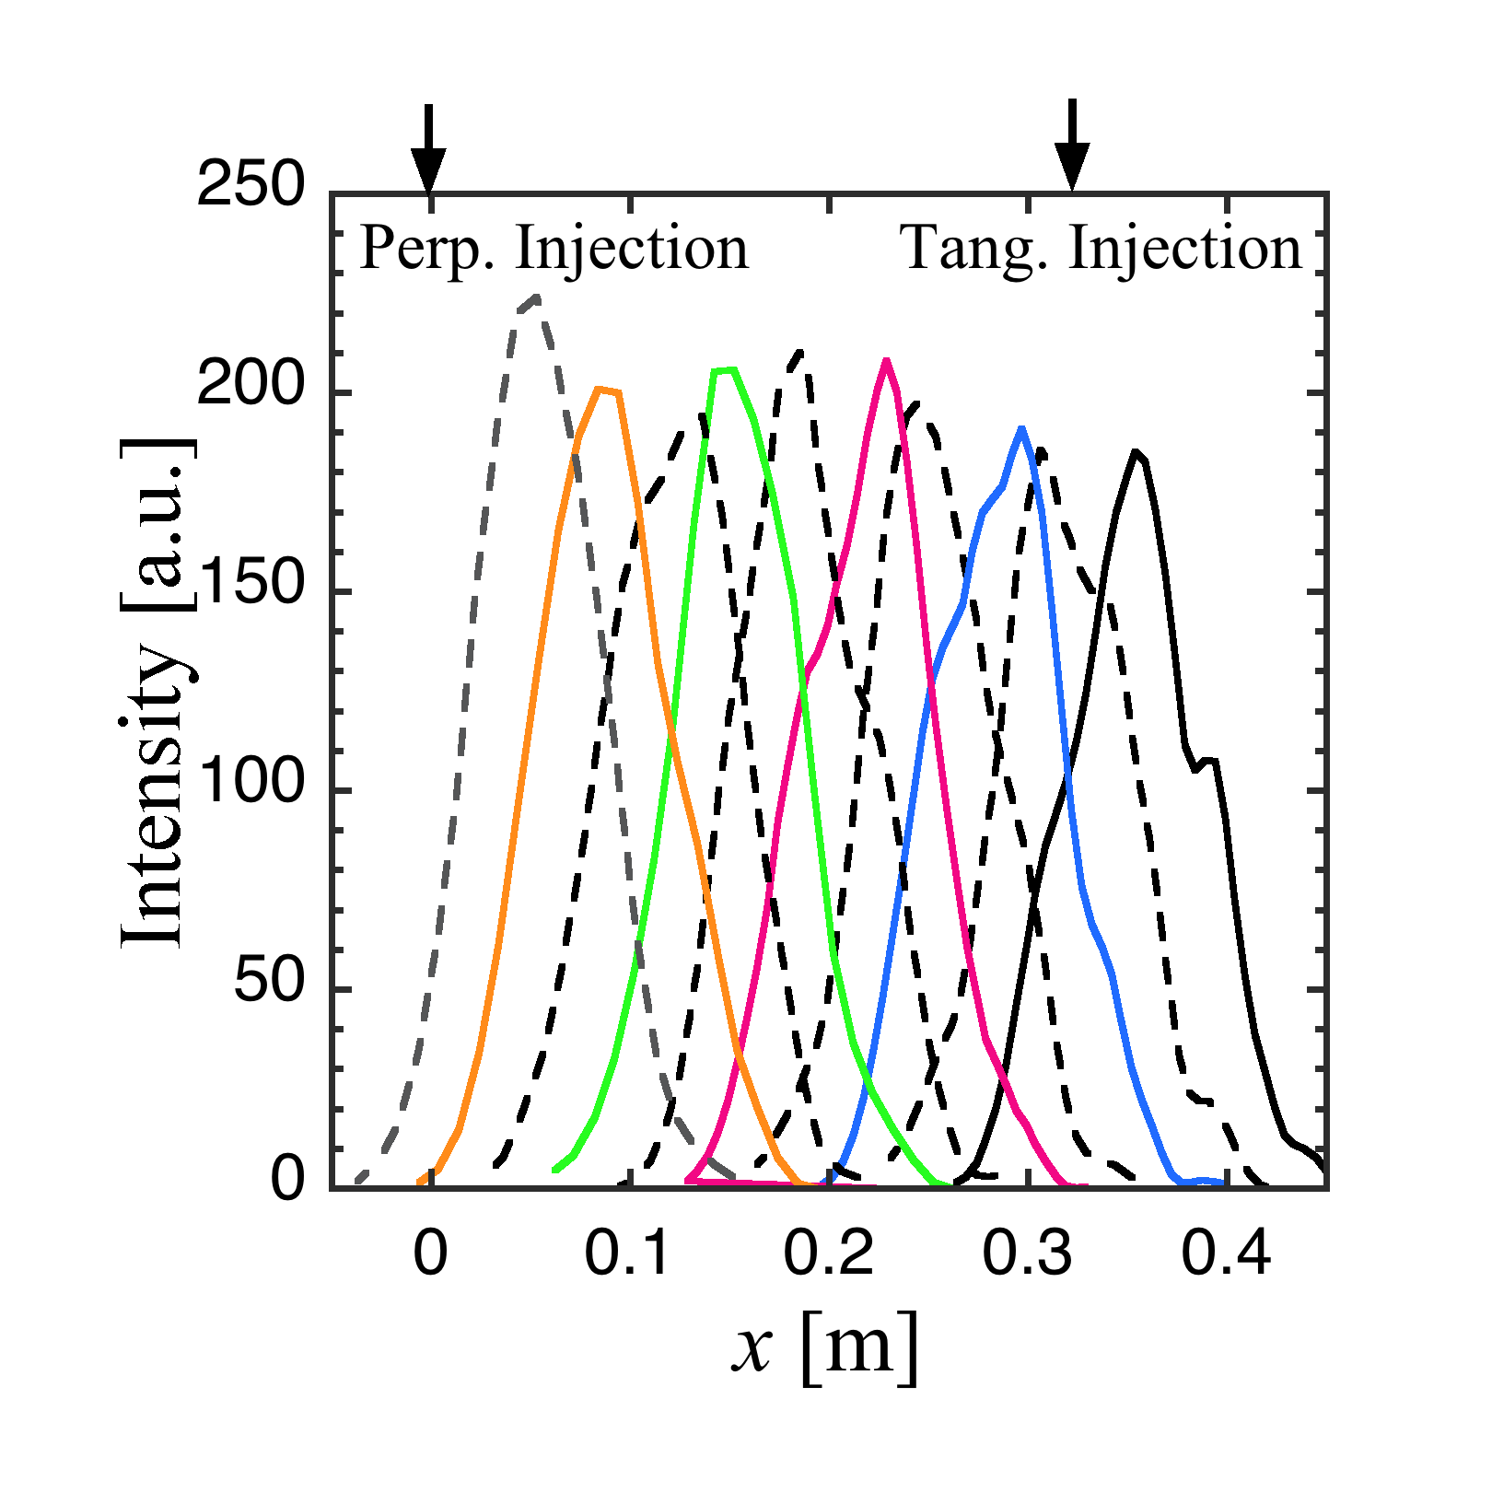
Beam Steering for 28GHz
N//=0-1 could be obtained
Beam Steering for the 28 GHz RF
N// = 0-1 at the 2nd ECR layer could be obtained
CC WG
1st Convex Mirror
Center
Post
Full Wave
Simulation
2nd Focusing
Mirror
The beam can be steered mainly in the
toroidal direction to have the refractive
parallel index N// from 0 to 1.
Low power
test results

Slide 8
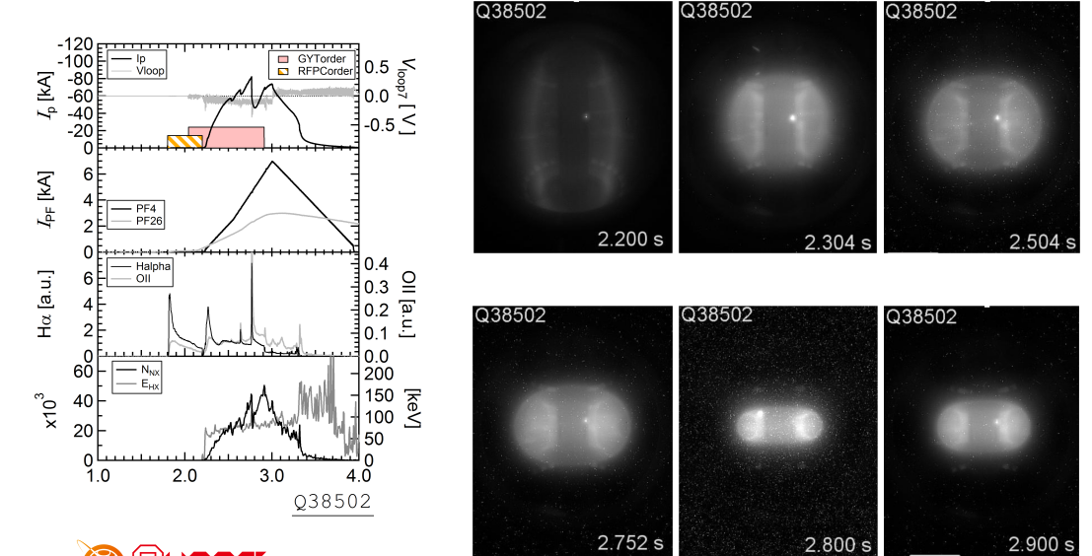
High N// ~0.78 RF injection is better to get higher plasma current.
Hard X-ray of several 10 keV was observed.
Te~5eV

Slide 9
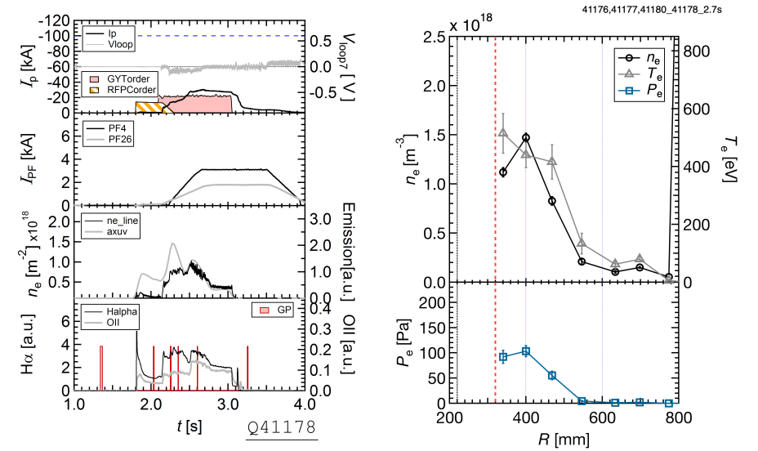
Low N// ~0.1 RF injection is better to get higher electron temperature. 0.5 keV in electron temperature could be obtained.
Te~0.5keV

Slide 10
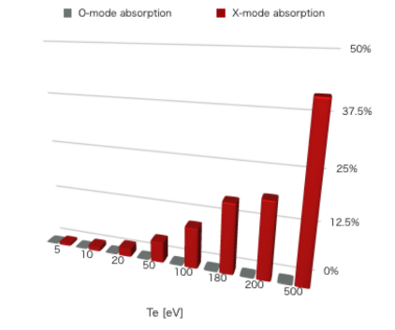
RF absorption with bi-Maxwell denotes electron energy selectivity.
Energetic electron could absorb well the RF power in higher N//.
Bulk Te =100eV
Bulk Te =10eV
N//=0.78
Positive feedback can be expected in low N//.
Even in low N// injection, energetic electron could be produced. Collision of electron with neutral particle plays an important role in energy selectivity.
(In details, Kojima’s presentation)
2x10¹⁸ m⁻³
N//=0.1
~40%
500eV
Collaboration with PPPL (N. Bertelli and M.Ono)

Slide 11
N// scan experiment in non-inductive CD.
N// has a significant impact to plasm production, however the velue of Ip is not affected so much.
E
X-mode like
E
O-mode like
AAAPS-DPP 2018 H.Idei, et al.

Slide 12
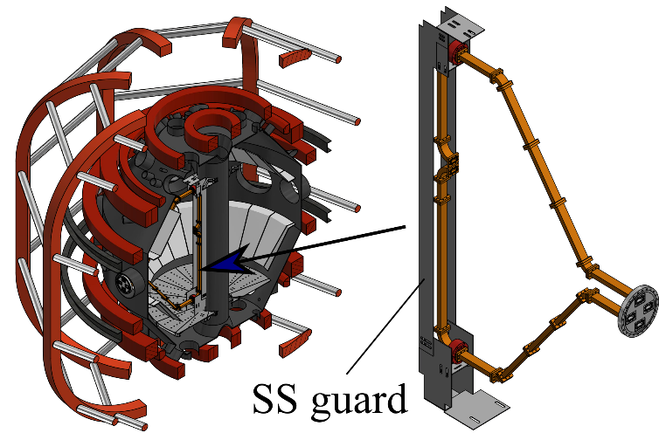
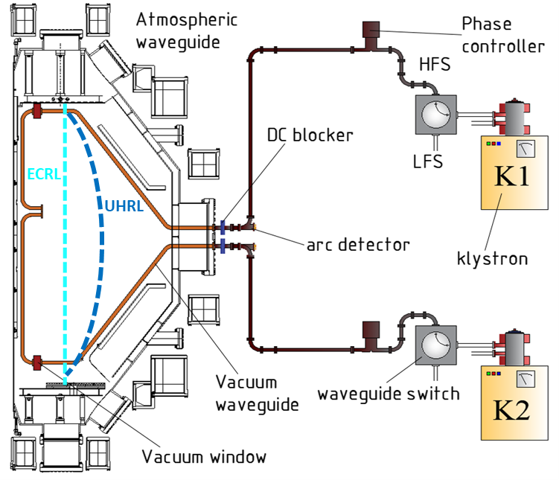
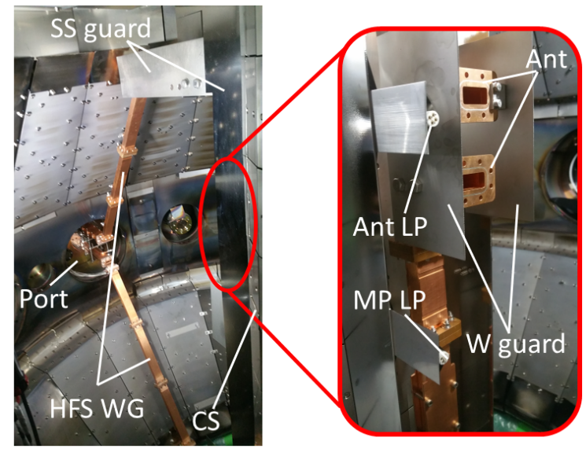
Electron Bernstein wave conversion of high-field side injected X-modes.
A new tentative waveguide was installed for the experiment.

Slide 13
Higher density and absorption than LFS launch could be obtained.
Effective mode conversion to EBW is expected.
Only several % RF could be absorbed in 1st ECR
HFS
LFS
W/O
PF
Leak RF is significantly small in HFS
with
PF

Slide 14
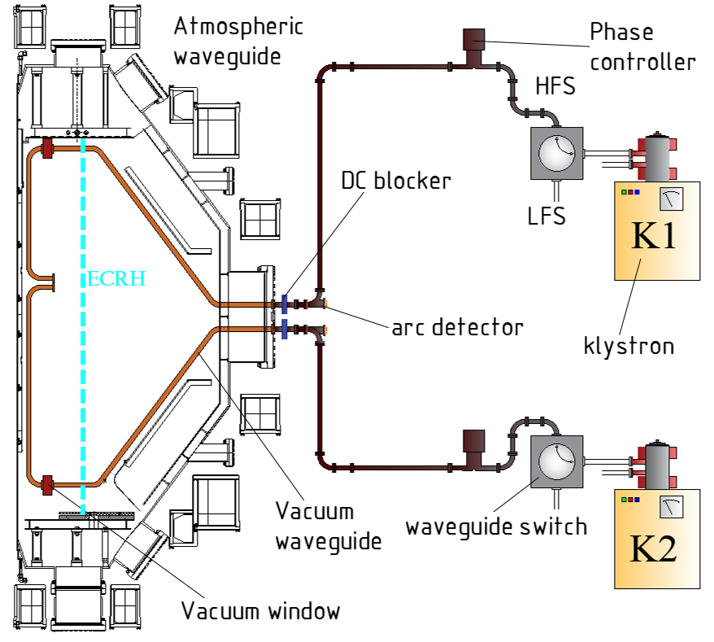
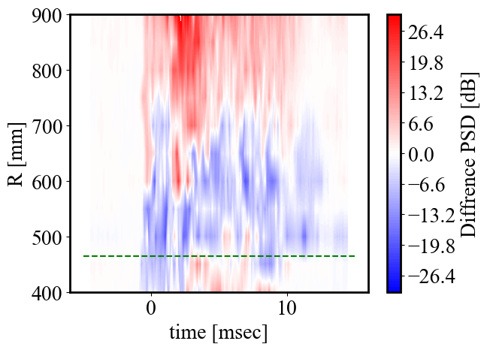
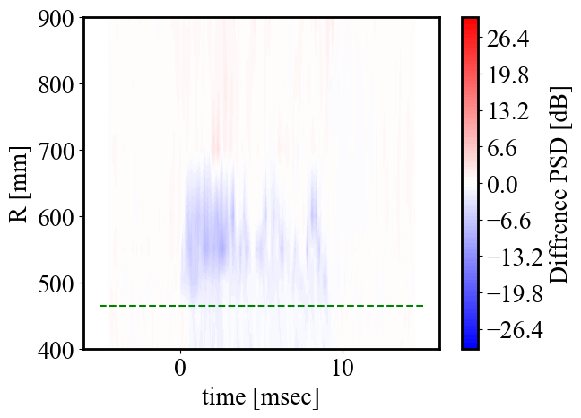

Parametric decay signal was observed in an inserting probe around the lower hybrid frequency in the HFS injection.
R = 46.5 cm
80-90MHz
HFS
ECRL
R=37 cm ~ 115 cm
R = 37 cm
LFS
expected
$$ω_{1}$$

Slide 15
GENRAY calculation predicts EBWCD direction is decided by the direction of TF and PF.
TF CCW
TF CW
A
CNT CD
D
Co CD
TF+ [CCW]
PF+ [CCW]
TF- [CW]
PF+ [CCW]
GENRAY:
Ip = +22.8kA [CCW]
Measured:
Ip = -2.38 [CW]
GENRAY:
Ip = -22.8kA [CW]
Measured:
Ip = -2.67 [CW]
I cannot understand why Ip is not opposing PF in GENRAY in cases A & B
B
CNT CD
E
Co CD
TF+ [CCW]
PF- [CW]
TF- [CW]
PF- [CW]
GENRAY:
Ip = -22.8kA [CW]
Measured:
Ip = +3.02 [CCW]
GENRAY:
Ip = 22.8kA [CCW]
Measured:
Ip = +2.51 [CCW]
In GENRAY, quantitatively, all 4 cases are the same except for Ip direction

Slide 16
Investigation of EBWCD with TF and PF direction modification.
As the current is not so high compared with pressure driven current,
we could not confirm the evidence of EBWCD.
The reproducibility of plasmas was not sufficient.
B
CNTCD
E
CoCD

Slide 17
Investigation of EBWCD with TF and PF direction modification.
As the current is not so high compared with pressure driven current,
we could not confirm the evidence of EBWCD.
The reproducibility of plasmas was not sufficient.
A
(CNTCD)
D
CoCD

Slide 18
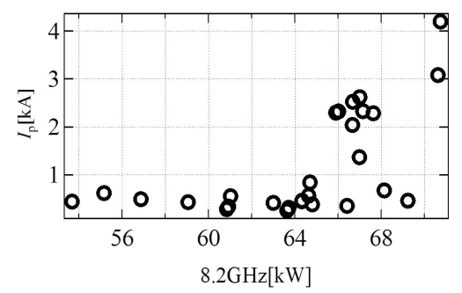
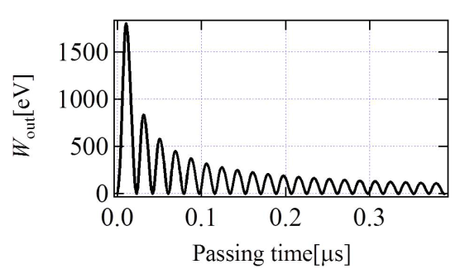
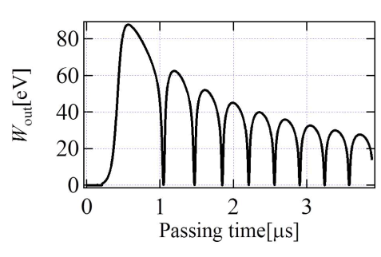
2nd Harmonic ECW breakdown has been invetigated.
High power threshold was observed.
Higher frequency give higher power threshold
8.2GHz Approximately 50kW
28GHz Approximately 150kW
Model calculation predicts higher power is necessary to drive ionization
Fundamental
2nd Harmonics
Miura et al. Plasma Fusion Research 10, 3402066 (2015)

Slide 19
2nd Harmonic ECW breakdown has been invetigated.
Longer connection length is not effective to make a breakdon
in 2nd harmonics, different from fungamental ECW
28 GHz 2nd harmonics
N//=0.78
2.45 GHz fundamental
8.2 GHz fundamental
Longer connection length
Longer connection length

Slide 20
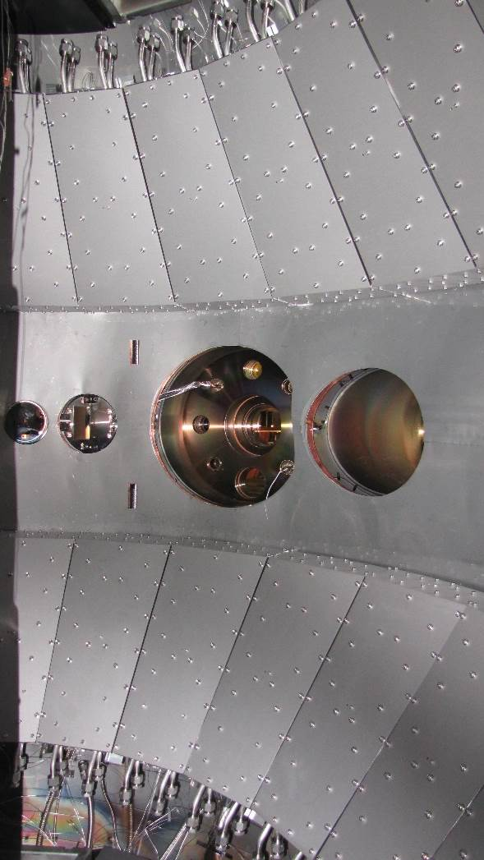
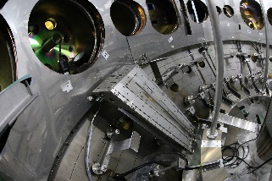
The hot wall making of all-metal has been developed to control wall temperature to modify hydrogen recycling since 2015.
APS-W
SUS316L
APS-W
Y. Takase et al. Nucl. Fusion 57 (2017) 102005

Slide 21

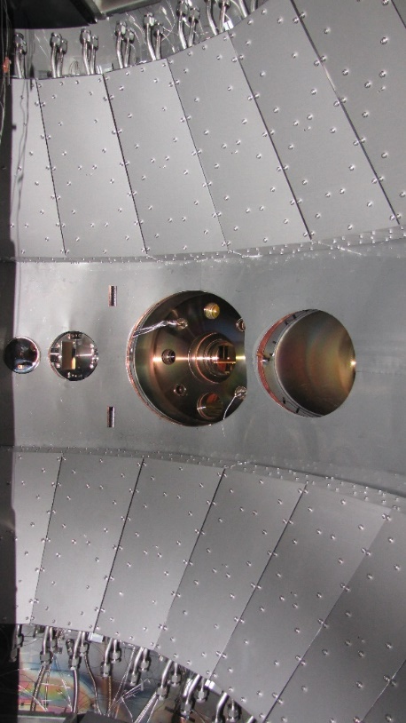
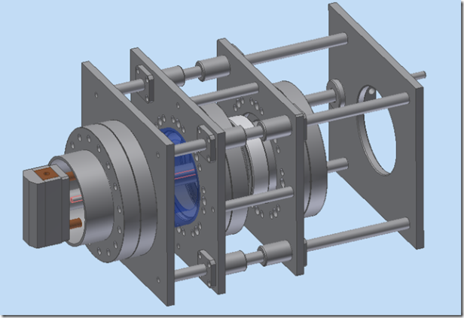
Development of long pulse in QUEST
Development of long pulse operation in QUEST

Slide 22
2018SS campaign experimental set-up for steady state operation.
Only top hot wall has the capability to water-cooldown during discharge
Cooling down with water
Every pump was calibrated with a flowmeter
2 CryoPump

Slide 23
The cooling down from 473K of only top hot wall with water and can obtain a good response on H_{a} radaiation.
W/O hot wall cooling
With hot wall cooling

Slide 24
An unbalanced wall temperature gives rise to fuel particle compression behind divertor plates in the bottom.

Slide 25
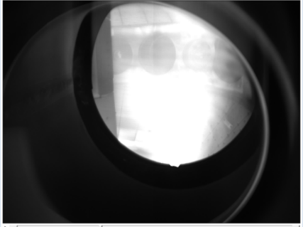
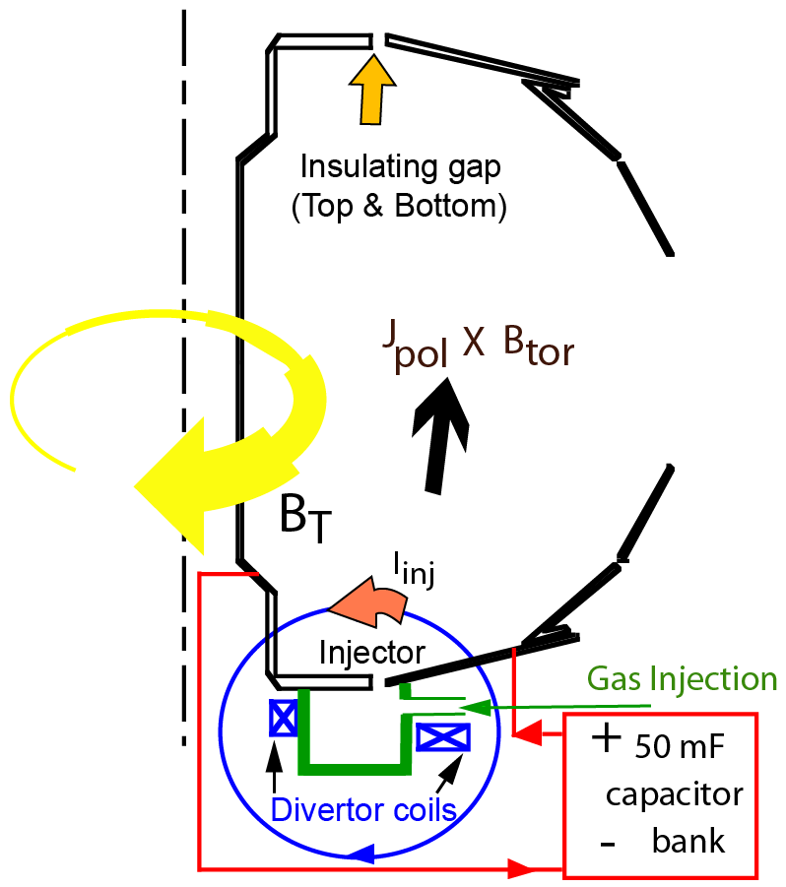
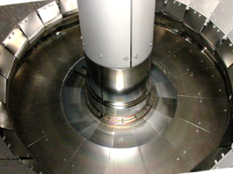
Collaborative work with PPPL and University of Washingoton.
Start-up using transiti-CHI is a promising. The different electroad configuration has been developed for future reactor application.
NSTX
NSTX
QUEST
NSTX Concept
New Concept
R. Raman and K. Kuroda’s presentation.

Slide 26
Summary
The QUEST project is focusing on plasma start-up with RFCD and steady state operation.
The 28GHz RF injection system has the capability to regulate both the wave polarization and N//. The system has also the capability to focus RF beam down to 5 cm in radius.
More than 100kA could be obtained in N//=0.78 X-mode with a little OH provided from the poloidal field increment. According to the RF absorption, the RF is likely to absorb to energetic electrons. Which is useful to drive plasma current.
Low N//=0.1, X-mode injection could successfully heat up bulk plasma up to 0.5 keV of Te. Single pass absorption of achieved plasma parameters is expected to be approximately 40%, therefore the effective bulk heating could be obtained with a sophisticated neutral control to avoid production of energetic electron.
High field launch of RF has been tried to effectively excite EBW in the plasma. A new tentative waveguide and antenna was installed for the experiment. The designed value of mode conversion to EBW is 93%. The rest RF is absorbed at the fundamental ECR.
Higher density and better absorption of RF in HFS launch than those in the LFS launch could be obtained. PDI signal was measured with a movable probe and larger PDI in the HFS launch was measured. This supports to higher mode conversion to EBW.
To get evidence of EBWCD, TF and PF direction modification has been executed. The plasma reproducibility is insufficient to compare the value of plasma current. The flux loop signals denote the inversion of plasma current direction in the mid-plane, bur need to more confirmation.

Slide 27
Summary2
Plasma Breakdown has been investigated with 2nd harmonic ECW. The threshold power was much higher than fundamental ECW predicted by numerical calculation. The connection length dependence was different from fundamental ECW.
The hot wall plays essential roles in reducing the amount of wall-stored H and facilitating H recycling. Only top hot wall has the capability to water cool down since 2018SS campaign.
The clear reduction of Ha after water cooling of the top hot wall. This indicates the recycling could be control by wall temperature.
During long duration discharges, neutral compression could be achieved behind the bottom divertor plate. The reason is still unclear, because there are many candidate to make this to-bottom asymmetry. It is a future work.

Slide 28


Slide 29
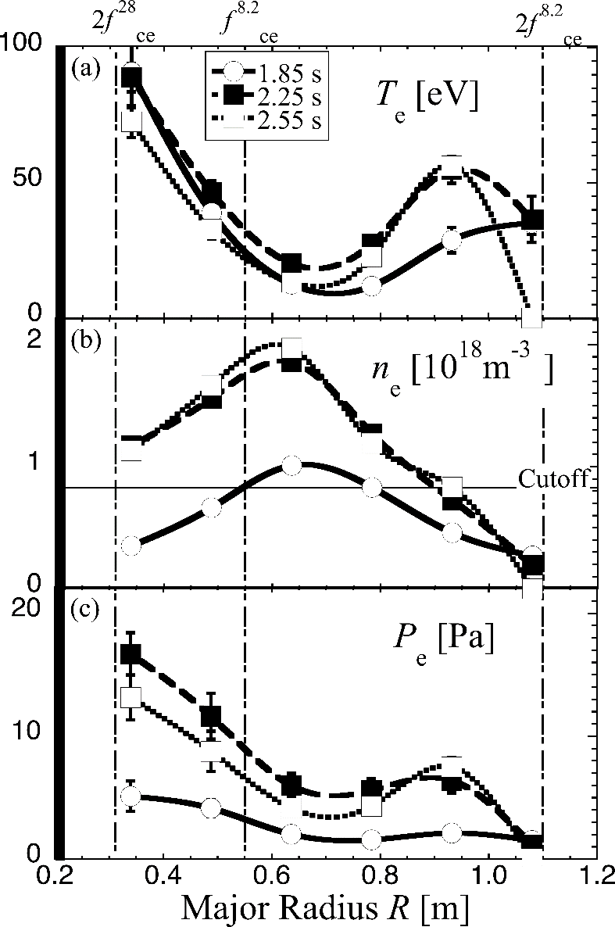
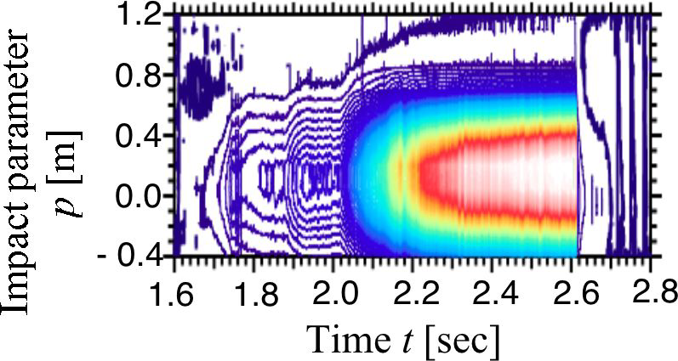
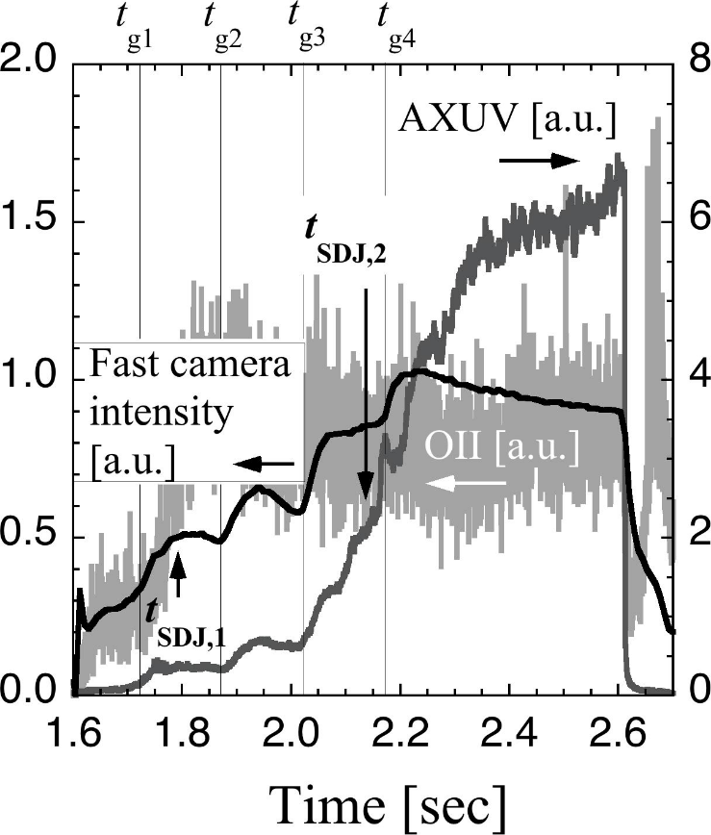
Dual-f Experiments with
8.2-GHz and 28 GHz waves
Heating effect in the
over-dense plasma
Fan-arrayed
AXUV
bulk electron
heating
R=0.93 m
Shift of
boundary
and axis
Core
mildly
energetic
electron
heating
The AXUV diagnostic,
which is sensitive
in the SX energy range,
showed extremely
enhanced signals
after the 2nd SDJ
in the over-dense plasma

Slide 30
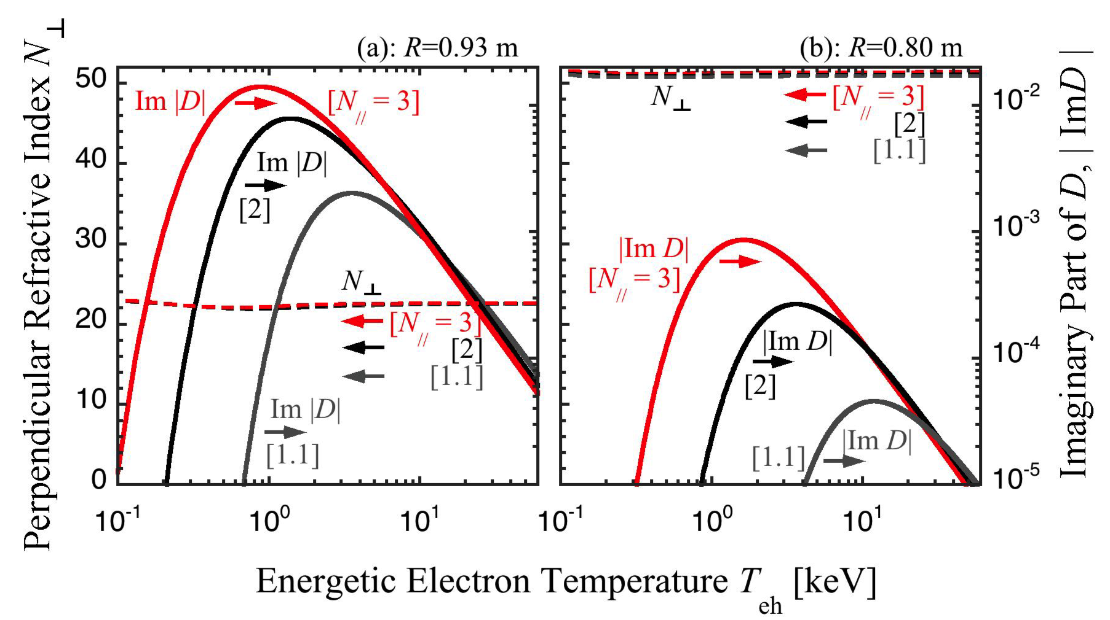
Dual-f Experiments with
8.2-GHz and 28 GHz waves
N⊥ and |Im D|
at R = 0.93 and 0.8 m
3 %
bulk
energetic
Heating P_{e, b-h} with relaxation process from ~ 1 keV to bulk electrons

Slide 31
N// scan experiment with liner vertical field
E
X-mode like
E
O-mode like
AAAPS-DPP 2018 H.Idei, et al.

Slide 32
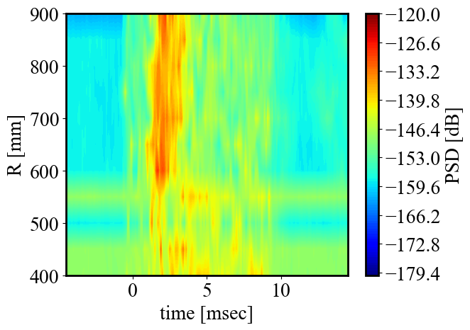
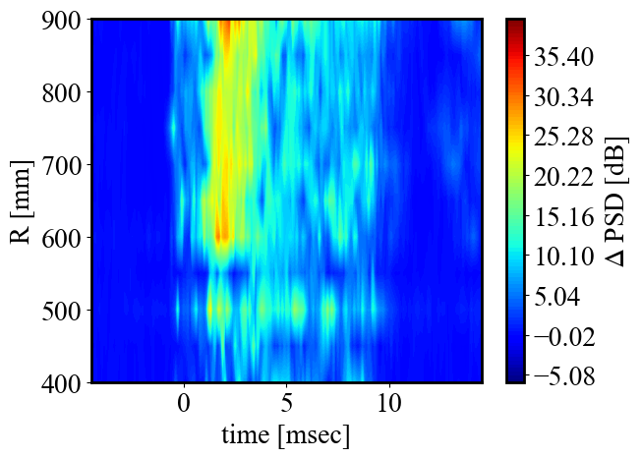
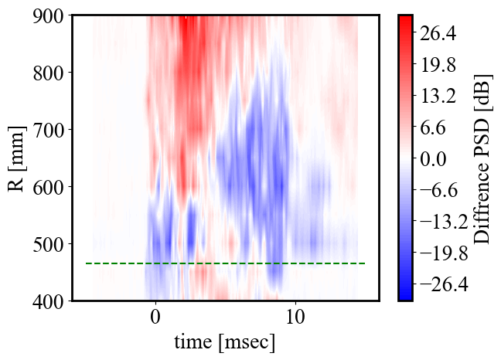
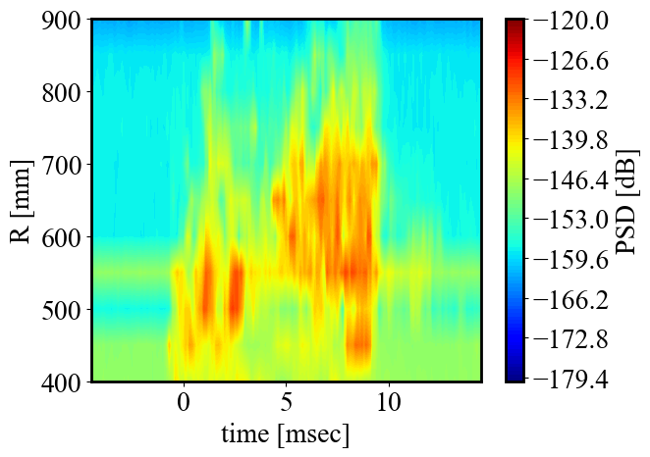
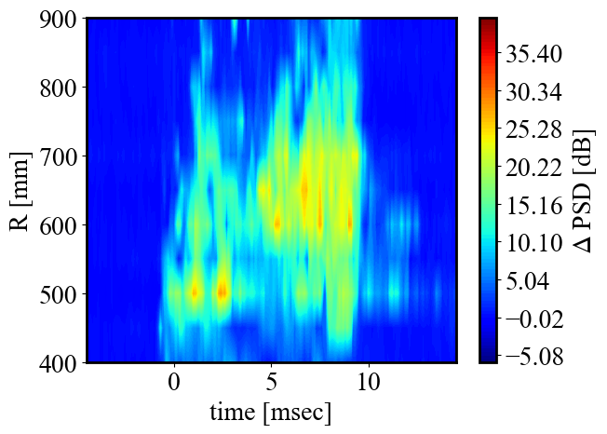
Difference between ECR probe and movable probe signal shows strength depending R
ECR probe signal @f=100~110 MHz
ECR probe signal should be reference signal
Movable probe signal includes the signal depending location
Row signal
No offset
Movable probe signal @f=100~110 MHz
Difference between ECR and Movable probe shows signal strength by depending location.
Row signal
No offset

Slide 33
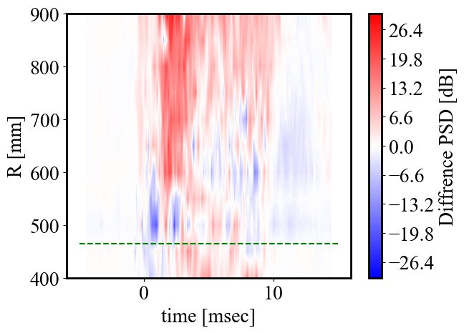
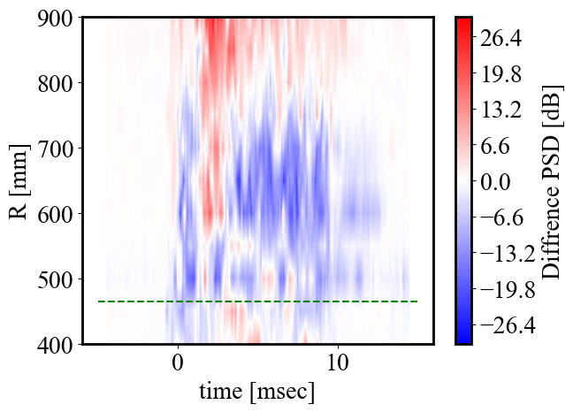
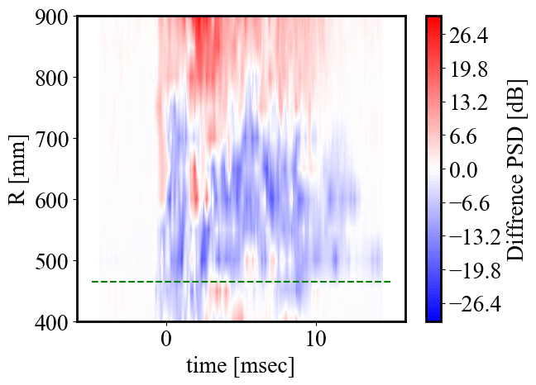
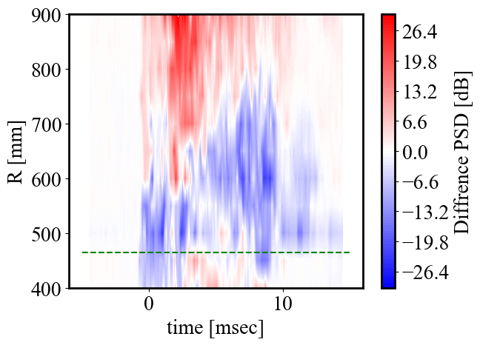
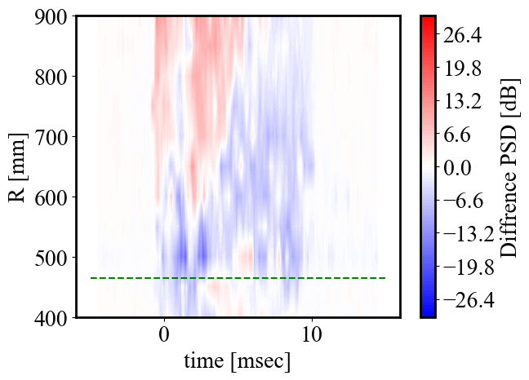
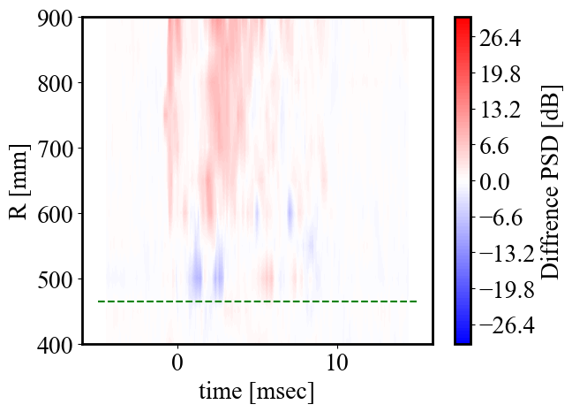
The signal depending location was observed around LHW frequency and ion plasma frequency
30 ~ 40 MHz
50 ~ 60 MHz
70 ~ 80 MHz
80 ~ 90 MHz
90 ~ 100 MHz
100 ~ 110 MHz
200 ~ 210 MHz
300 ~ 310 MHz
The signal of lower limit of LHW is small
Ion plasma frequency was also measured.
LHW tendency was observed.
Be higher frequency, be existed in LFS.

Slide 34
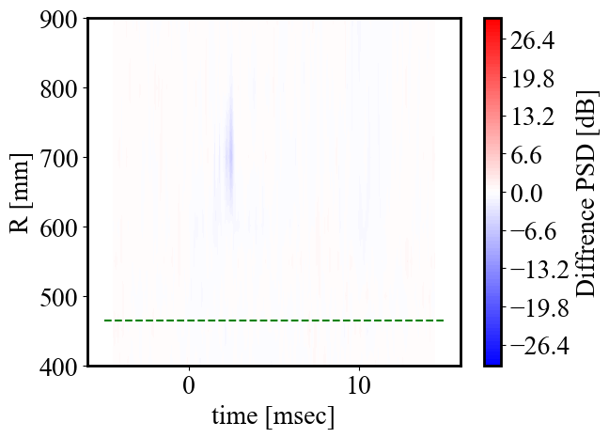
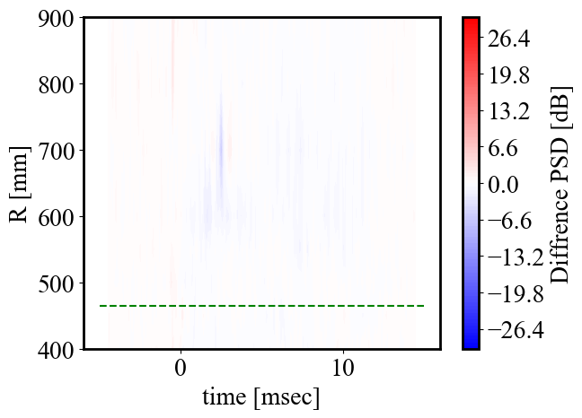
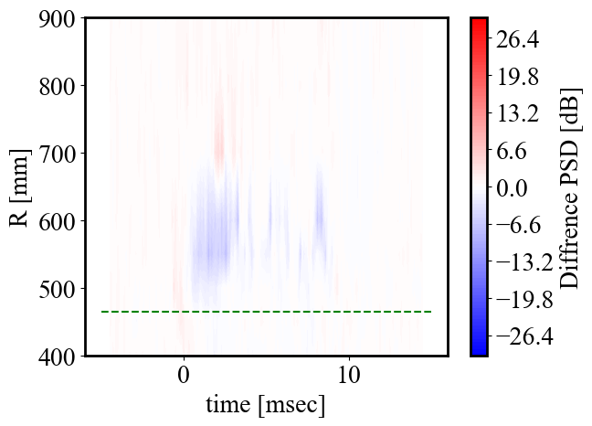
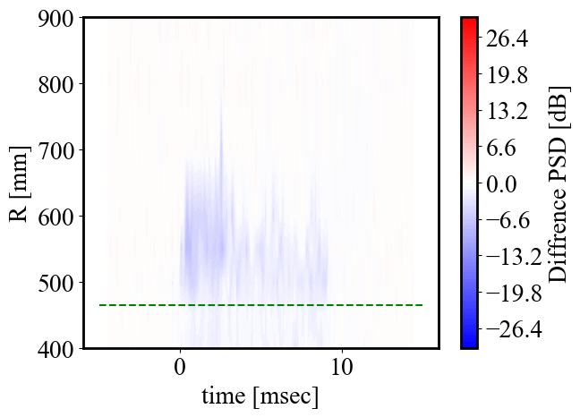
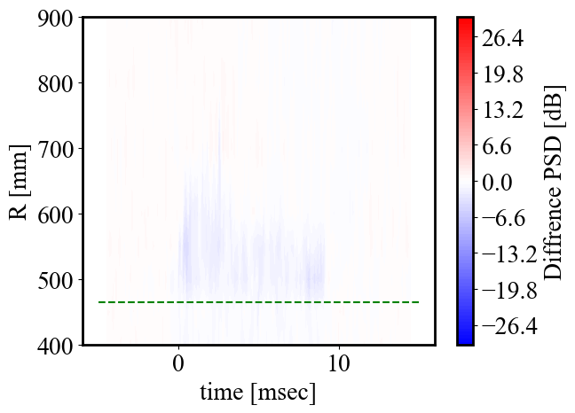
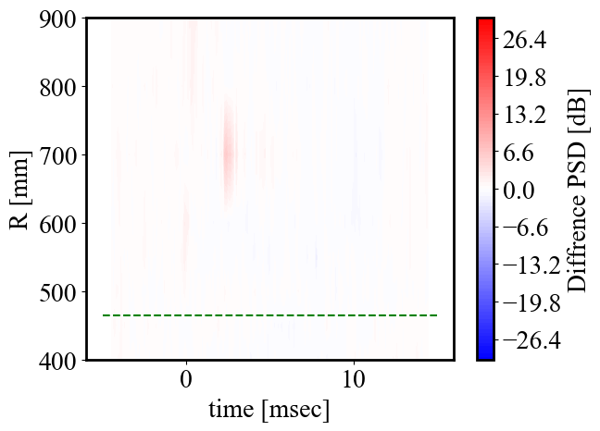

Similar signal with HFS case, however signal level is quite low and no ion plasma frequency signal
30 ~ 40 MHz
50 ~ 60 MHz
70 ~ 80 MHz
80 ~ 90 MHz
90 ~ 100 MHz
100 ~ 110 MHz
200 ~ 210 MHz
300 ~ 310 MHz
No signal on ion plasma frequency was measured.
Quite small signal on LHW frequency was measured.

Slide 35

Hydrogen barrier is forming between substrate and deposition layer. The model including the effect of the hydrogen barrier is proposed.
The hydrogen barrier model can provide new time scale to be in wall-saturation which is the condition that out-flux from the plasma facing wall balances with in-flux of Hydrogen into the material.
K. Hanada et al. / Journal of Nuclear Materials 463 (2015) 1084–1086

Slide 36











The hydrogen barrier model including the effect of trapping in the deposition layer is proposed to express hydrogen behaviour in plasma facing materials.
In this model, H atoms don’t move from deposition layer to metal substrate and vice versa due to high chemical potential.
H_{w} and H_{T} are total numbers of H atoms in deposition layer.
$$\frac{d\left(H_{W}+H_{T}\right)}{dt}=Γ_{in} S−\frac{k}{S d_{R}^{2}}H_{W}^{2}$$
Release due to
recombination
Influx to the deposition layer
$$\frac{dH_{T}}{dt}=αH_{W}\left(1−\frac{H_{T}}{H_{T}^{0}}\right)−γH_{T}$$
Trapping
De-trapping
$H_{W}$ :the number of H dissolved in wall material
$H_{T}$ :the number of H trapped in defects
$H_{T}^{0}$ :the upper-limit number of $H_{T}$
$Γ_{in}$ :net influx per unit area into wall material
$S$ : surface area
$k$ : surface recombination coefficient of H atoms
$d_{R}$ : thickness of deposition layer
$α$ : H trapping rate
$γ$ : H de-trapping rate

Slide 37
The outgas just after the discharge termination during wall-saturation is proportional to IHα. This indicates the influx to the wall can be estimated by IHα. It is naturally explained by the simple discussion.
393 K
473 K

Slide 38
The influx ti the wall can be controlled by keeping IHα constant and the outgas just after the discharge termination must be proportional to the square of wall stroed hydrogen. This is confirmed by reproducible long discharges on QUEST.
The big dust provide a large impact on particle balance on long duration discharge.
393 K
473 K

Slide 39
The hydrogen barrier model including trapped site effect is able to express the temperature dependence on hydrogen recycling.
In the Phase III, the recycling ratio is beyond unity. It is the main reason to be difficult to control density at the targeted value.
200℃
120℃
K. Hanada et al Nucl. Fusion 57 (2017) 126061

