Slide 1
20th International Spherical Torus Workshop
MAST Upgrade – features & status
Brian Lloyd for the MAST-U team

Slide 2
Outline
Key features of MAST-U
MAST-U status
MAST- U Enhancement Project
STEP
Summary

Slide 3
MAST-U Mission & Goals
The original mission of MAST was:
to explore the long-term potential of the spherical tokamak as a future fusion device
to advance key tokamak physics for optimal exploitation of ITER and DEMO design optimization
to provide unique insight into underlying tokamak physics
Building on this mission, the specific goals of MAST-U are to:
    test a range of novel exhaust concepts including the Super-X divertor
    contribute to the ITER/DEMO physics base to improve predictive capability
    explore the feasibility of the spherical tokamak as a future fusion device

Slide 4
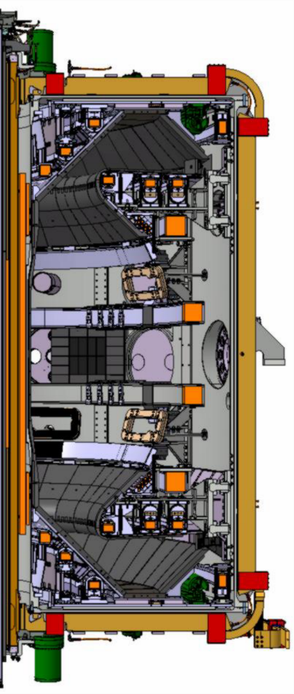
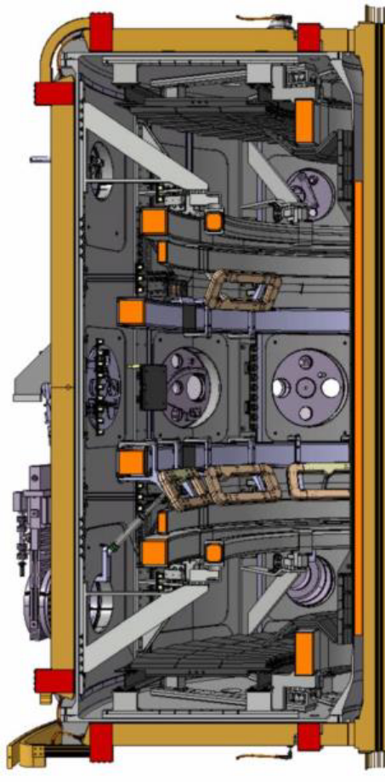
MAST to MAST-U
MAST
MAST-U
MAST-U is a substantial upgrade to the MAST spherical tokamak

Slide 5
MAST to MAST-U
MAST
MAST-U
MAST-U is a substantial upgrade to the MAST spherical tokamak comprising:
Closed divertors with Super-X capability for improved power handling

Slide 6
MAST to MAST-U
MAST
MAST-U
MAST-U is a substantial upgrade to the MAST spherical tokamak comprising:
Closed divertors with Super-X capability for improved power handling
On and off-axis neutral beam heating for improved profile control

Slide 7
MAST to MAST-U
MAST
MAST-U
MAST-U is a substantial upgrade to the MAST spherical tokamak comprising:
Closed divertors with Super-X capability for improved power handling
On and off-axis neutral beam heating for improved profile control
Increased toroidal field (0.5 → 0.8T at 0.8m) for improved confinement

Slide 8
MAST to MAST-U
MAST
MAST-U
MAST-U is a substantial upgrade to the MAST spherical tokamak comprising:
Closed divertors with Super-X capability for improved power handling
On and off-axis neutral beam heating for improved profile control
Increased toroidal field (0.5 → 0.8T at 0.8m) for improved confinement
19 new poloidal field coils for improved shaping capabilities

Slide 9
MAST to MAST-U
MAST
MAST-U
MAST-U is a substantial upgrade to the MAST spherical tokamak comprising:
Closed divertors with Super-X capability for improved power handling
On and off-axis neutral beam heating for improved profile control
Increased toroidal field (0.5 → 0.8T at 0.8m) for improved confinement
19 new poloidal field coils for improved shaping capabilities
New solenoid to increase I_{p} (1MA → 2MA) and pulse duration (0.7s → 5.0s)

Slide 10
MAST to MAST-U
MAST
MAST-U
MAST-U is a substantial upgrade to the MAST spherical tokamak comprising:
Closed divertors with Super-X capability for improved power handling
On and off-axis neutral beam heating for improved profile control
Increased toroidal field (0.5 → 0.8T at 0.8m) for improved confinement
19 new poloidal field coils for improved shaping capabilities
New solenoid to increase I_{p} (1MA → 2MA) and pulse duration (0.7s → 5.0s)
New diagnostics
90% of the Load Assembly is new (only vacuum vessel and a few coils re-used)

Slide 11
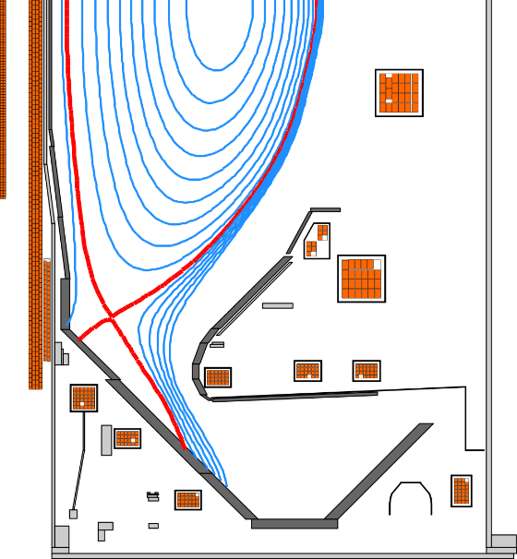
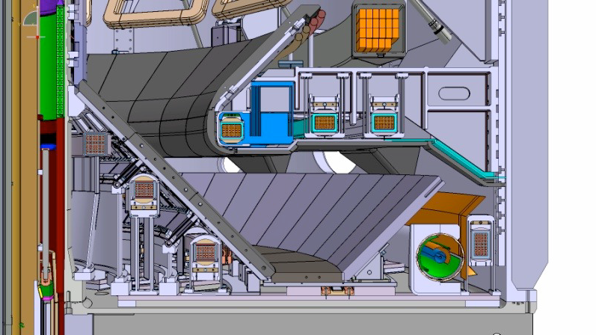
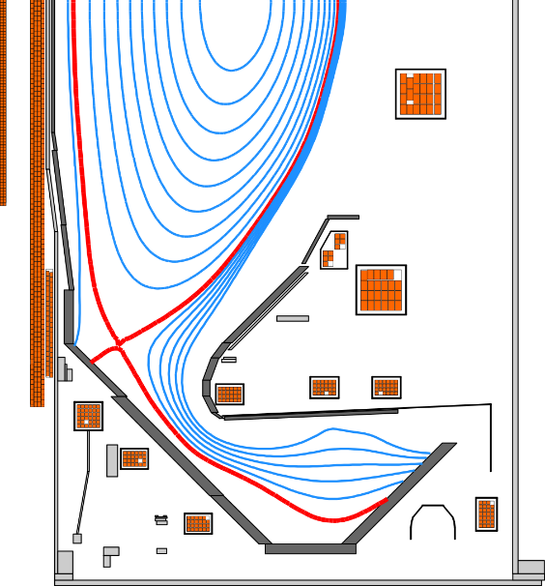
MAST-U divertor
MAST Upgrade is designed to operate primarily in the connected double null configuration
Upper and lower divertors are identical
All divertor tiles made from fine-grain graphite
Conventional
P4
PX
N1
T1
Gas baffle
DP
D6
D7
D1
N2
Super-X
T2
D2
T3
T5
D3
D5
T4
Cryopump

Slide 12
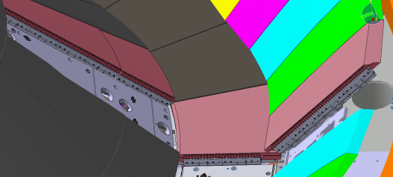
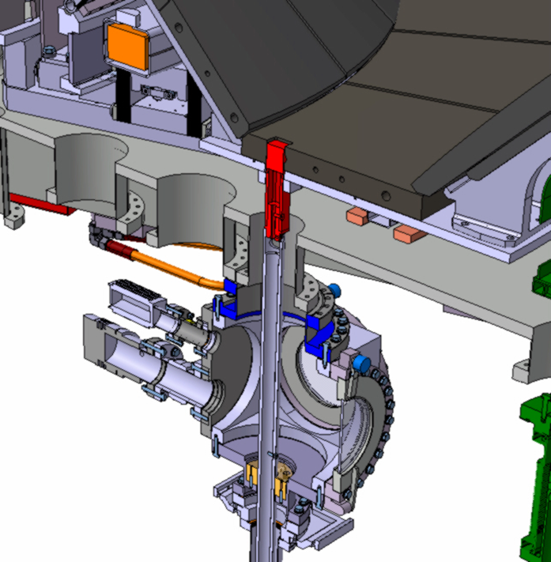
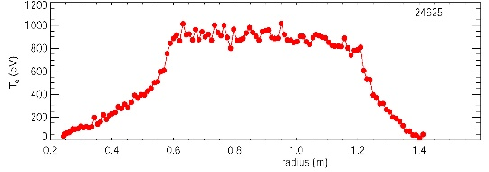
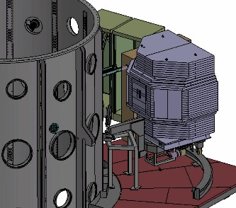
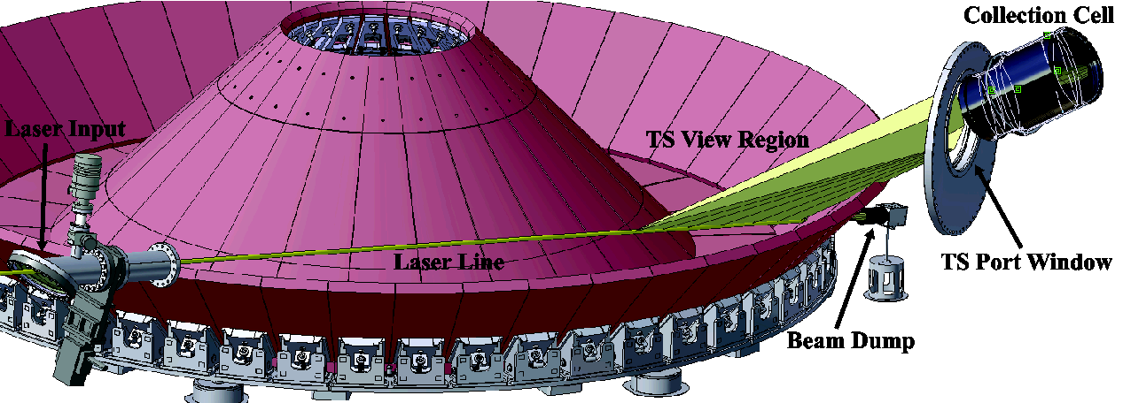
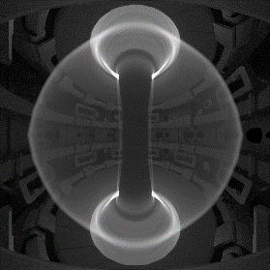
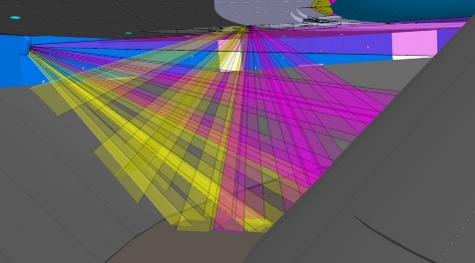
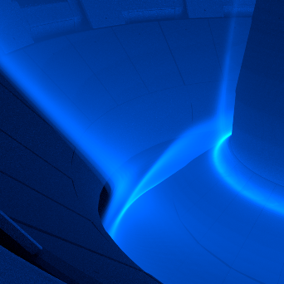
MAST Upgrade: Diagnostics
MAST-U has a comprehensive suite of state of the art diagnostics
Divertor
Divertor Science Facility
Core & edge
Fast particle
850 Langmuir probes
130 pt Thomson scattering
Neutron camera
Divertor Thomson scattering
Visible imaging
Magnetics
Fast ion loss detector
IR & visible imaging, spectroscopy
Foil Bolometers
Fast Ion D_{α}
Beam spectroscopy
CXRS, MSE, BES
Doppler Backscattering x2
Core SPRED
SSNPA
Proton detector
Divertor SPRED
FIGs, Penning gauge

Slide 13
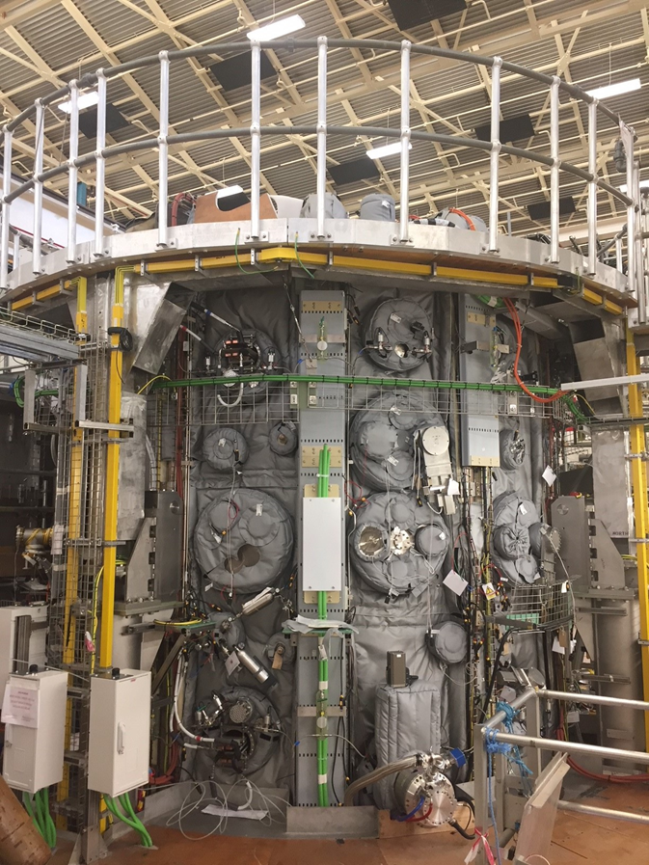
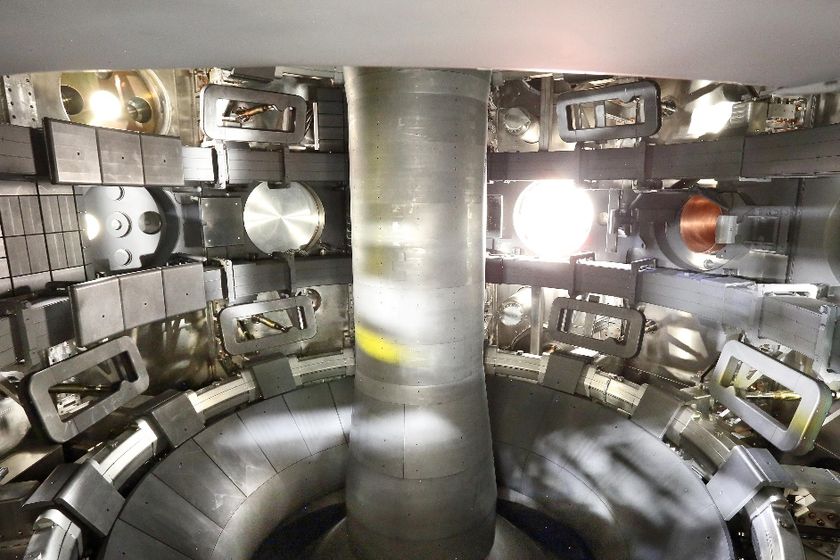
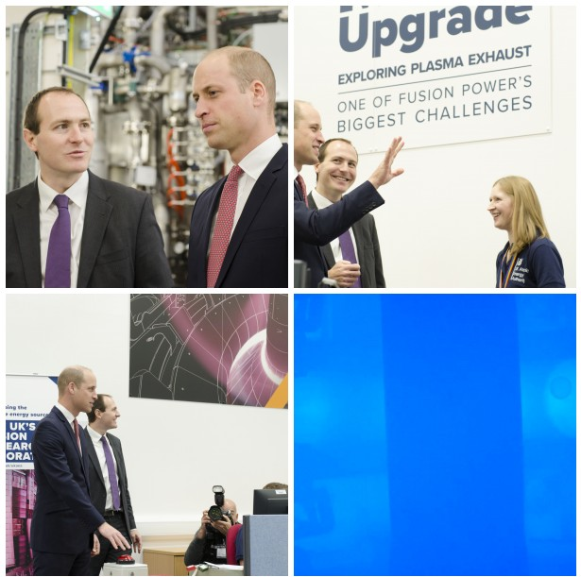
Construction completed October 2018

Slide 14
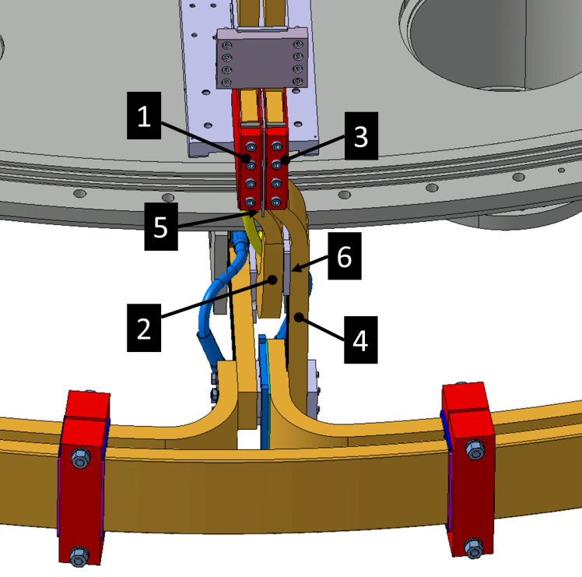
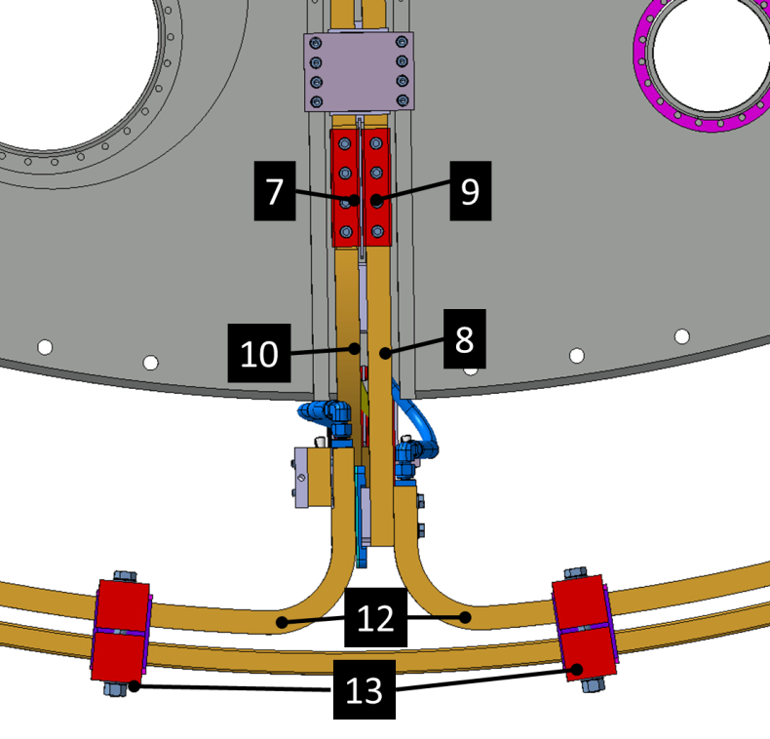
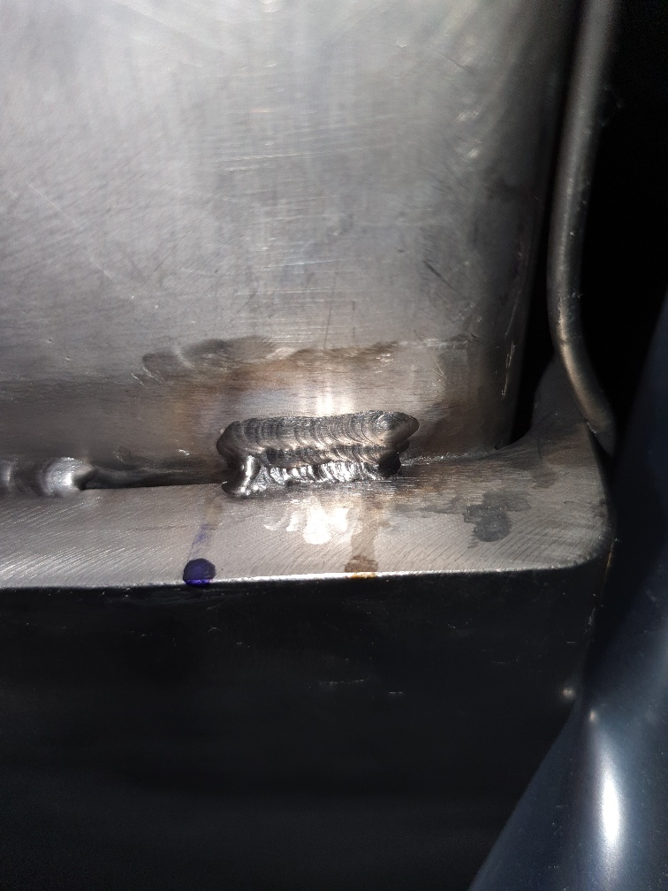
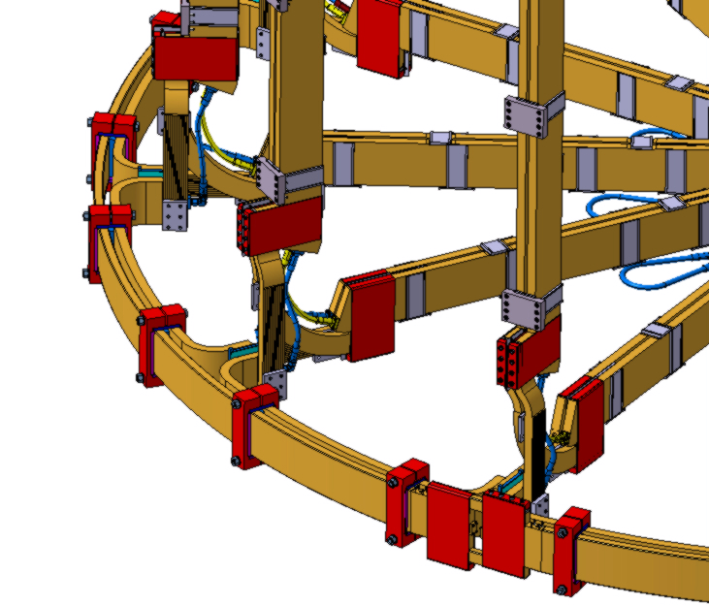
Remedial work
Two major pieces of remedial work delayed the transition to integrated commissioning:
Vacuum leak isolated and repaired
During cool-down after an initial bake, an air leak became apparent
(5 x 10⁻³ mbar.l/s). Located to upper P5 coil and weld repair made.
TF busbar reassembly
156 joints reworked and checked
10mm
3mm

Slide 15
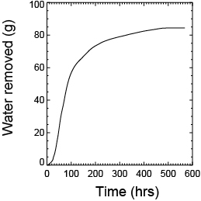
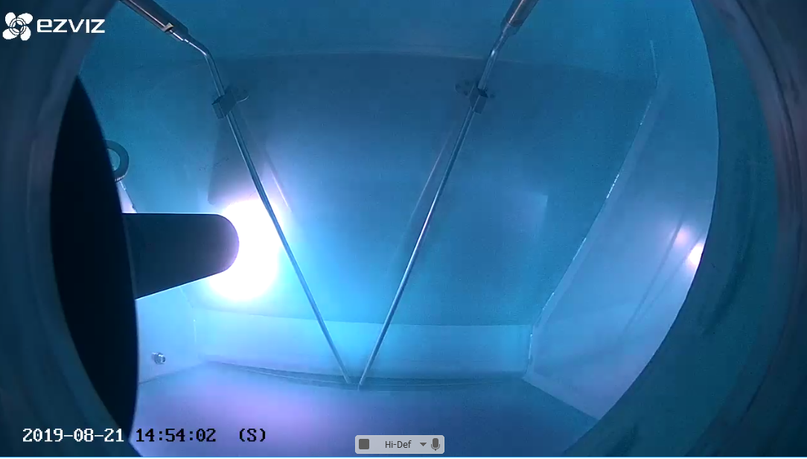
Recent progress
Personnel Access Safety System commissioned (April 2019):
  Emergency stops
  PES – PLC based safety system
  MKIS – Mechanical Key Interlock System
First fully integrated pulse (off coil) has been run (June 2019) integrating machine control, fast timers, PCS, real time protection system, data acquisition, power supplies.
High temperature bake complete. Helium GDC carried out in the main chamber and divertors (Aug 2019). Base pressure ~ 4 x 10⁻⁸ mbar

Slide 16
Latest schedule
2019
2020
Jan
Apr
July
Oct
Jan
Apr
July
Oct
Off-coil commissioning
On-coil commissioning
1st plasma
Plasma scenario development
1st physics campaign
Engineering break

Slide 17
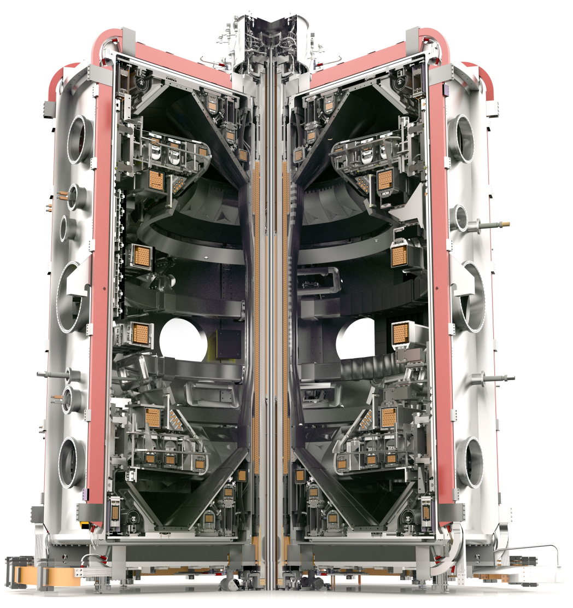
MAST-U enhancements 2018-22
Additional enhancements to MAST Upgrade are planned & underway over 5 years
Additional diagnostics
X-point Thomson scattering
RT Langmuir probes
Multiple extra IR cameras
2 fast visible cameras
Flexible Fuelling
HF Pellet injector + 48 gas valves
Non PEX upgrades
NBI power supply upgrade for 5 sec pulses
Galden cooling for solenoid
etc.
Cryoplant
Divertor & DBB particle control
Double NBI Box
Additional 5MW auxiliary heating
Power Supplies
PINI PS, HVPS-6, APC
Upgraded control
New Vertical Control and RT enhancements

Slide 18
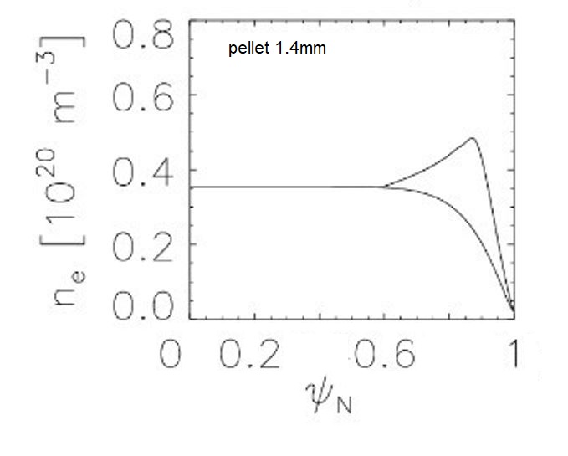
High frequency pellet injector
The HFPI has been delivered and is presently being installed
The pellet enters plasma from HFS position close to X-point, similar to ITER. LFS injection is also possible and will be implemented initially.
Simulation L Garzotti
Injector parameters:
Pellet train duration 3s
Injection frequency 25 Hz upgrade to 50 Hz
Pellet material H₂, D₂ or any mix
Pellet doping Ne, Ar, N₂
Pellet size diameter = 1.4mm or 1.6mm
length = 1.1 - 1.7mm
Propellant gas H₂, D₂
Pellet velocity 100 - 300 m/s

Slide 19
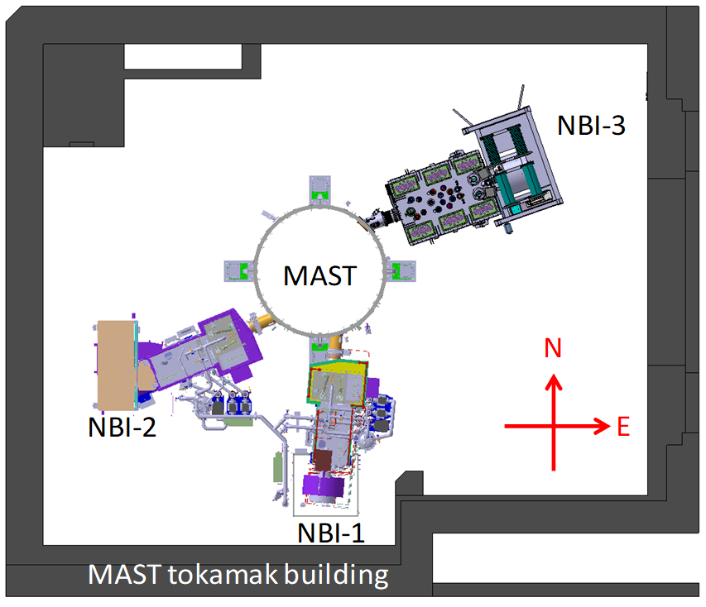
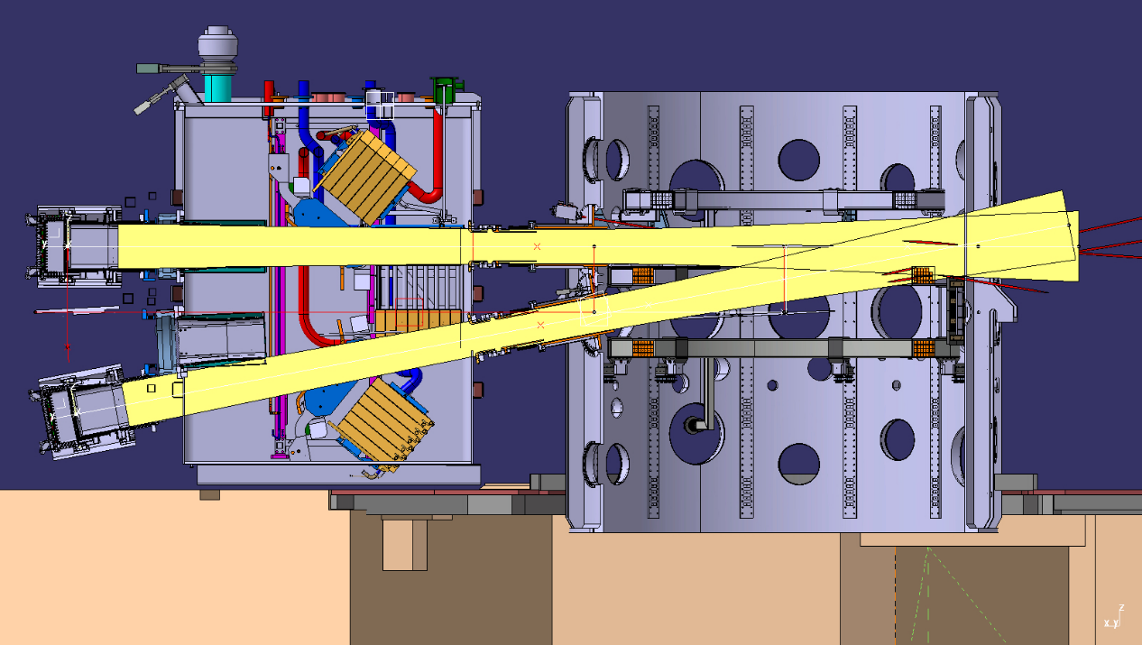
Double Beam Box
Increases installed NBI power from 5MW to 10MW
Installation 2022

Slide 20
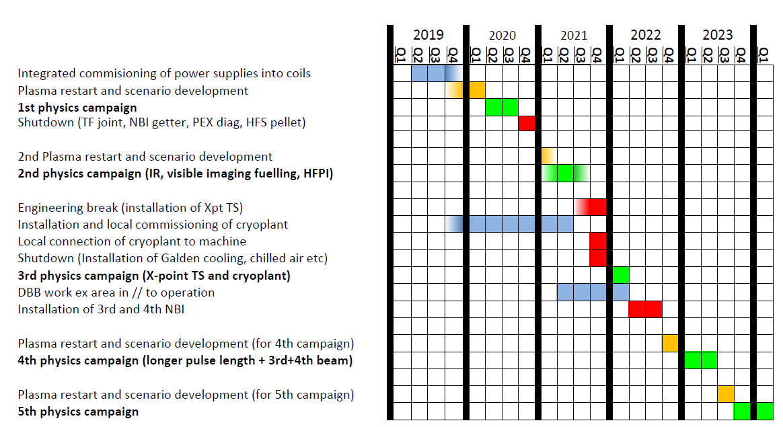
MAST Upgrade enhancements

Slide 21
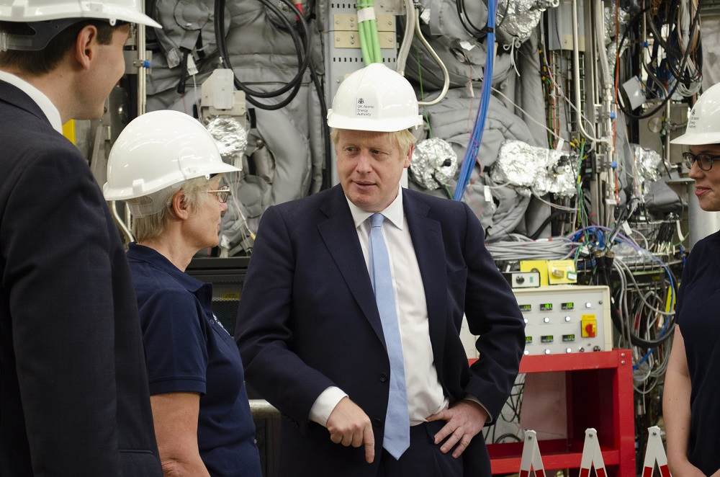
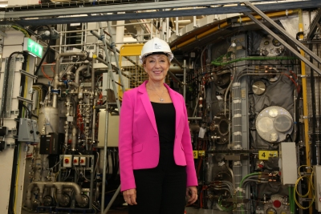
STEP
Following visits to Culham by Boris Johnson, Prime Minister, on 8th August and Andrea Leadsom, Secretary of State for Business, Energy and Industrial Strategy (BEIS) on 27th September the government announced funding of £220M to design a fusion power plant – the Spherical Tokamak for Energy Production (STEP).
In parallel the government will provide £184M over the next 5 years to develop new fusion facilities, infrastructure and apprenticeships at Culham, to establish a global hub for fusion innovation, support the delivery of STEP and attract private sector fusion companies.

Slide 22
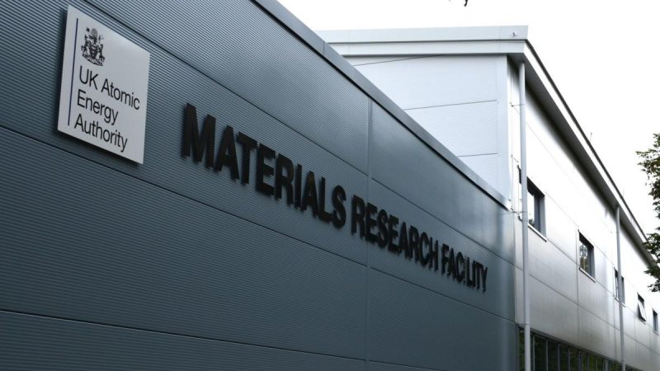
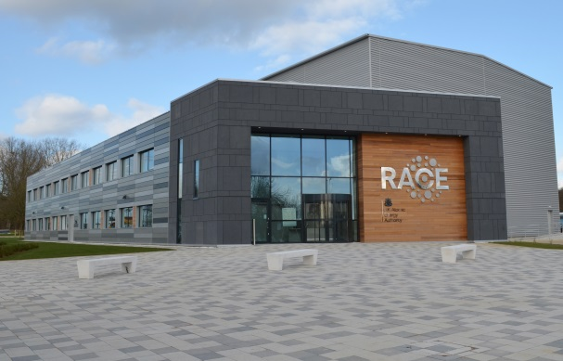
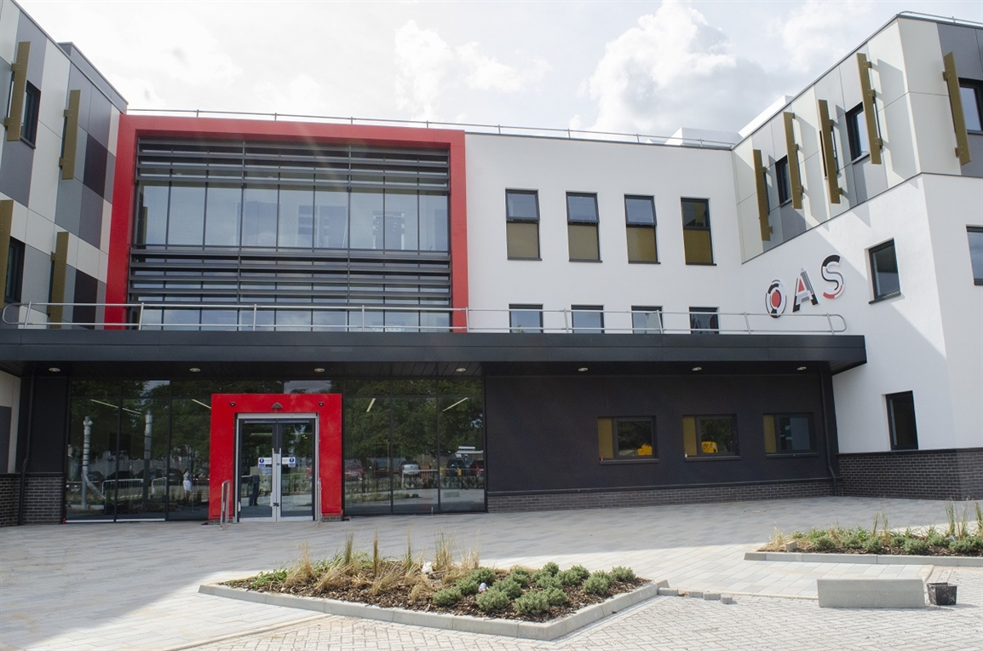
STEP
These funding announcements follow on from recent investments in MRF (Materials Research Facility), RACE (Remote Applications in Challenging Environments) and the £86M investment in a National Fusion Technology Facility (NFTF) announced in December 2017. A new Oxfordshire Advanced Skills (OAS) apprentice training centre opened at Culham Science Centre in September 2019
NFTF comprises two new centres of excellence:
- Hydrogen-3 Advanced Technology (H3AT)
- Fusion Technology Facilities (FTF)
Fusion technology facilities will be located at a new UKAEA site in the north of England as well as at Culham Science Centre.

Slide 23
STEP
The Spherical Tokamak for Energy Production is an ambitious programme to accelerate the delivery of sustainable fusion energy, benefiting from UKAEA’s breadth of expertise and research facilities (H3AT, FTF, RACE, MRF, MAST-U etc)
H3AT
FTF
RACE
MRF
MAST-U
Tritium science & technology
Fusion technology
Robotics
Materials science
Plasma science
£220M investment over the next four years to develop the conceptual design of a fusion power plant by 2024 offering the prospect of constructing a fusion power station to provide energy to the grid by 2040.
Industrial and academic partners will be engaged from the outset

Slide 24
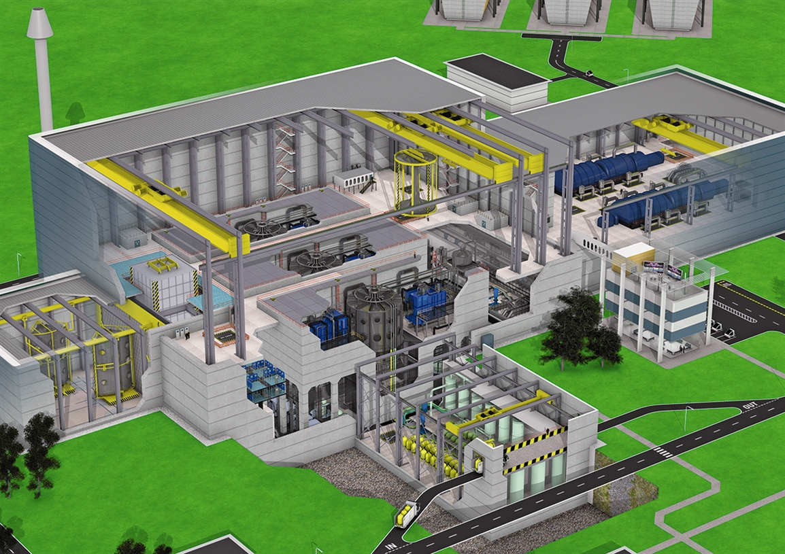
STEP
The technical objectives of STEP are:
Deliver predictable net electricity > 100MW
Innovate to exploit fusion energy beyond electricity production
Ensure tritium self-sufficiency
Materials and components qualification under appropriate fusion conditions
Viable path to affordable lifecycle costs
UKAEA will continue to play a full role in the international fusion programme, e.g. JET, ITER, EU-DEMO

Slide 25
Summary
MAST-U is in the final stage of commissioning & plasma operation is imminent
Additional enhancements underway will further extend the capabilities of the device, most notably a doubling of the installed NBI heating power, by 2022.
The UK government has announced major new investments to accelerate the delivery of fusion energy. The STEP programme aims to develop the conceptual design of a fusion power plant by 2024.

