Slide 1
Control of Parametric Instabilities by means of
Non-monochromatic RF Power Injection
PDR SOLUTIONS for EAST and FTU
By
FRANCESCO NAPOLI

Slide 2
OUTLINE
PARAMETRIC DECAY STABILIZATION METHODS
LITERATURE BACKGROUD
PUMP SPECTRAL REPRESENTATION
FEATURES OF THE SPECTRAL BROADENING MODEL
NEW PARAMETRIC DISPERTION RELATION (PDR)
PDR VALIDATION
PDR SOLUTIONS FOR EAST AND FTU
BREAKTHROUGH: PDR SOLUTIONS FOR EAST AND FTU
CONCEPTUAL DESIGN OF A RF DRIVER FOR FTU
N// SPECTRUM CONTROL OF A MULTI-JUNCTION ANTENNA
CONCEPTUAL DESIGN OF A RF DRIVER FOR EAST
CONCLUSIONS

Slide 3
PARAMETRIC DECAY STABILIZATION METHODS
INTRINSIC PARAMETERS:
DENSITY
TEMPERATURE
PLASMA COMPOSITION
EXTRINSIC PARAMETERS:
PUMP POWER DENSITY
PUMP FREQUENCY
PUMP SPECTRUM (MODULATED/MULTI PUMP)

Slide 4
LITERATURE BACKGROUD
In laser-pellet fusion, the application of a finite bandwidth pump to stabilize PIs is well known (Brillouin and Raman scattering):
Theoretical studies: VALEO et al 1973; THOMSON et al 1974, 1975
Experimental studies: OBENSCHAIN et al 1976, 1977; MIZUNO et al. 1977
In magnetic confinement fusion, this method has attracted less attention:
Theoretical studies: STEFAN Phys. Fluids 26 1983
Experimental studies: MATSUMOTO et al Plasma Physics 12 25 1983; ARKHIPENKO et al Journal of Physics Conf. Series 257 2010

Slide 5




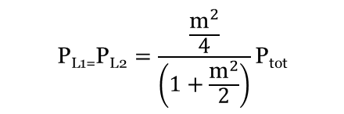
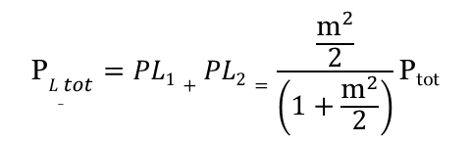



PUMP SPECTRAL REPRESENTATION
AMPLITUDE MODULATED DRIVER-PUMP:
E(t)$=\left(A+B\cos\left(ω_{M}t\right)\right)\cos\left(ω_{c}t\right)=A\left(1+m\cos\left(ω_{M}t\right)\right)\cos\left(ω_{c}t\right)=A\cos\left(ω_{c}t\right)$+$\frac{m }{2}A\cos\left(ω_{L1}t\right)$+$\frac{m }{2}A\cos\left(ω_{L2}t\right)$
$$\text{P}L_{_tot}=PL1+PL2=\frac{\frac{{\text{m}}^{2}}{2}}{\left(1+\frac{{\text{m}}^{2}}{2}\right)}\text{P}\text{tot}$$
$ω_{L1}=ω_{c}$-$ω_{M}$
$$\text{P}\text{tot}\text{=}\text{cost}$$
$ω_{L2}=ω_{c}$+$ω_{M}$
P_{c}
$$\text{P}\text{L}\text{1=}\text{P}\text{L}\text{2}=\frac{\frac{{\text{m}}^{2}}{4}}{\left(1+\frac{{\text{m}}^{2}}{2}\right)}\text{P}\text{tot}$$
P_{L1}
P_{L2}
$$P_{c}=\frac{\text{P}\text{tot}}{\left(1+\frac{{\text{m}}^{2}}{2}\right)}$$
f_{c}-f_{M}
f_{c}
f_{c}+f_{M}
P_{L1}=P_{L2}=$\frac{{\text{m}}^{2}}{4}P_{c}$
$m$=B/A
P_{tot}=$\left(1+\frac{{\text{m}}^{2}}{2}\right)P_{c}$

Slide 6
PUMP SPECTRAL REPRESENTATION
m=B/A > 1: overmodulation
m=1: P_{Ltot} = (1/3)P_{tot}, P_{c}=(2/3)P_{tot}
m=2: P_{c}=P_{L1}=P_{L2}=(1/3)P_{tot} (triple driver pump)
m=10: P_{Ltot} = (49/51)P_{tot}, P_{c}=(1/51)P_{tot}
m->Inf: P_{L1}=P_{L2}->(1/2)P_{tot}; P_{c}->0 (double driver pump)
In the overmodulation regime, nonlinearities must be taken into account (AM nonlinear distortions).
The multiple driver-pump scheme should be preferred due to destabilizing effects on PIs caused by a narrow bandwidth AM pump as observed by K. Matsumoto (Plasma Physics 12 25 1983) and in agreement with theoretical considerations by Aliev (Journal de Physique 7 40 1979).
Within the multiple driver-pump scheme, intermodulation products must be taken into account not only to avoid power losses in not useful spectral components but also to avoid amplitude modulations able to destabilize PIs.
An optimum backoff of the power amplifier and the equalization of multiple drivers can minimize the nonlinear distortions due to the non-ideal behaviour of the tube (klystron).
Note: in this power application, tube nonlinearities could be not as detrimental as in telecoms!
Notes:
As AM modulator, a voltage controlled amplifier should not be used but instead a multiplier circuit (mixer) should be preferred to avoid most of nonlinear distortions. Also AM modulation in undermodulation regime with an amplitude equalization could be a solution to avoid the nonlinearities of the AM modulator…
Tube nonlinear distortions can be detrimental due to amplitude and phase changing.

Slide 7
Features of the Spectral Broadening model
Standard theory | Spectral Broadening model
WKB approximation | full-wave analysis in radial direction
4 waves interaction | full-spectrum analysis
No pump depletion | Pump depletion
No collisions | Collisions
Poisson-Vlasov system | Maxwell-Boltzmann system
Simplified model of thermal noise | Analytical model of thermal noise
No RF antenna noise | RF antenna noise

Slide 8

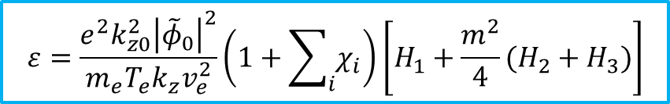




NEW PARAMETRIC DISPERSION RELATION
$$ω_{L1}=ω_{0}−ω_{M}$$
AM:
P_{c}
$$ω_{L2}=ω_{0}+ω_{M}$$
P_{L1}
P_{L2}
$ω_{1,2}=ω∓ω_{0}$, $k_{1,2}=k∓k_{0}$
Selection
Rules:
$ω_{3,4}=ω∓ω_{L1}$, $k_{3,4}=k∓k_{L1}$
f₃
f₀-f_{M}
f₄
f₁
f_{c}
f₂
f₅
f₀+f_{M}
f₆
$ω_{5,6}=ω∓ω_{L2}$, $k_{5,6}=k∓k_{L2}$
$$ε=\frac{e^{2}k_{z0}^{2}{\left|{\tilde{φ}}_{0}\right|}^{2}}{m_{e}T_{e}k_{z}v_{e}^{2}}\left(1+\sum_{i}{χ_{i}}\right)\left[H_{1}+\frac{m^{2}}{4}(H_{2}+H_{3})\right]$$
PDR:
Case
Studies:
$m≠0$: PDR with a non-monochromatic pump
$m=0$: PDR with a monochromatic pump as in standard theory

Slide 9
PDR VALIDATION
FTU (SOL)
ne (10^12 m^-3) | 2
Te (eV) | 10
nz0 | 2
f0 (GHz) | 8
B0 (T) | 4.5
Pden (kW/cm^2) | 3.06
(c/ω₀)k// | theoretical gamma | max gamma | Δgamma %
5 | 0.0016876 | 0.001974526 | 17.00%
10 | 0.0027476 | 0.003077283 | 12.00%
15 | 0.0036335 | 0.003960563 | 9.00%

Slide 10
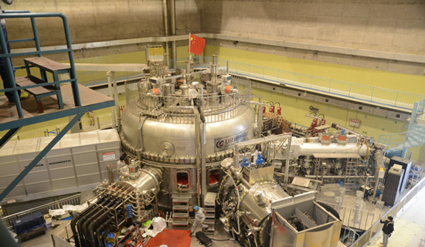
Experimental Advanced Superconducting Tokamak
EAST (SOL)
ne (10^12 cm^-3) | 1
Te (eV) | 12
nz0 | 2.1
f0 (GHz) | 2.45
B0 (T) | 1.8
Pden (kW/cm^2) | 1.45

Slide 11

MAX GAMMA vs MODULATION INDEX
f_{M} ≈ 10-60 MHz
(c/ω₀)k// | Pden (m=0) | omega_M | ne | Te
15 | 1.45*10^3 | gamma_0 /5*gamma_0 | 1*10^12 | 12

Slide 12
MAX GAMMA vs MODULATION INDEX
f_{M} ≈ 10-20 MHz
(c/ω₀)k// | Pden (m=0) | omega_M | ne | Te
5-7-10-15 | 1.45*10^3 | 2*gamma_0 | 1*10^12 | 12

Slide 13
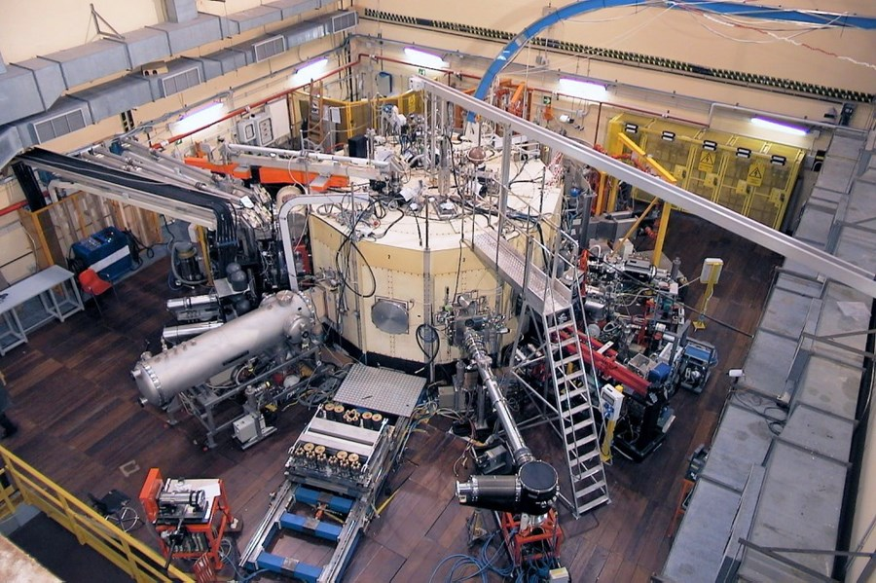
FRASCATI TOKAMAK UPGRADE
FTU (SOL)
ne (10^12 m^-3) | 2
Te (eV) | 10
nz0 | 2
f0 (GHz) | 8
B0 (T) | 4.5
Pden (kW/cm^2) | 3.06

Slide 14
MAX GAMMA vs MODULATION INDEX
Results consistent with K. Matsumoto et al. Plasma Phys. 25 (1983) and V.Stefan, Phys. Fluids, 26 (1983)
f_{M} ≈ 15-95 MHz
(c/ω₀)k// | Pden (m=0) | omega_M | ne | Te
15 | 3.06*10^3 | 0.5*gamma_0/3*gamma_0 | 2*10^12 | 10

Slide 15
MAX GAMMA vs MODULATION INDEX
f_{M} ≈ 30-65 MHz
(c/ω₀)k// | Pden (m=0) | omega_M | ne | Te
5-7-10-15 | 3.06*10^3 | 2*gamma_0 | 2*10^12 | 10

Slide 16
breakthrough
P_{c}
P_{L1}
P_{L2}
n_{zL1,2}= n_{z0}
n_{zL1,2}= n_{z0} ± Δn_{z0}
f₀-f_{M}
f_{c}
f₀+f_{M}
P_{c}
P_{c}
P_{L2}
P_{L2}
P_{L1}
P_{L1}
n_{z0}
n_{z0}
n_{z0}
n_{z0}
n_{zL2}
n_{zL1}

Slide 17
breakthrough
|Δn_{//0}|/n_{//0} ≈ 0%
f_{M} = 100 kHz
(c/ω₀)k// = 10
f_{M} << γ₀/2 π ≈ 5-15 MHz
|Δn_{//0}|/n_{//0} ≈ 10%
67.86%

Slide 18
breakthrough
f_{M} = 100 kHz
(c/ω₀)k// = 5
f_{M} << γ₀/2 π ≈ 5 MHz

Slide 19
breakthrough
f_{M} = 100 kHz
|Δn_{//0}|/n_{//0} ≈ 10%
f_{M} << γ₀/2 π ≈ 5 MHz

Slide 20
EAST – MAX GAMMA vs DENSITY
cm⁻³
(c/ω₀)k// | Pden (m=0) | ne | Te | nz0
10 | 1.45*10^3 | 1*10^12 – 2*10^12 | 12 | 2.1
caso 1 | f_{M} = 10 kHz
10% | m = 2

Slide 21
EAST – MAX GAMMA vs POWER DENSITY
(c/ω₀)k// | Pden (m=0) | ne | Te | nz0
10 | 1.45-2-3*10^3 | 1*10^12 | 12 | 2.1
caso 1 | f_{M} = 10 kHz
10% | m = 2

Slide 22
CONCEPTUAL DESIGN OF A RF DRIVER FOR FTU
In FTU a full phased waveguide antenna array is employed.
Unfortunately, the Brambilla code shows that an optimum waveguide phasing for a double peaked n// spectrum would imply impractical reflection levels.
Hence, it is only possible to use a multiple driver-pump scheme.
Necessary changes to the LHCD system to make a double driver-pump scheme:
Combine two power transmission lines in oversized circular waveguide (bringing power from two gyrotrons working at two different frequencies) just before the 12-way LH power splitter/mode converter.
Modify the terminal part of the power transmission line: after the 12-way LH power splitter/mode converter, on each of 12 WR 137 rectangular waveguides, the phase shifter should be replaced by a cascaded system based on waveguide directional filters (each made of two band-pass power filters and two hybrid junctions) which should allow to phasing selectively the two different spectral driver components.
Design and development of the new power microwave system is required.
Unfortunately, this system implementation is not ITER relevant because the LHCD system of ITER is foreseen with a passive active multi-junction (PAM) antenna.

Slide 23
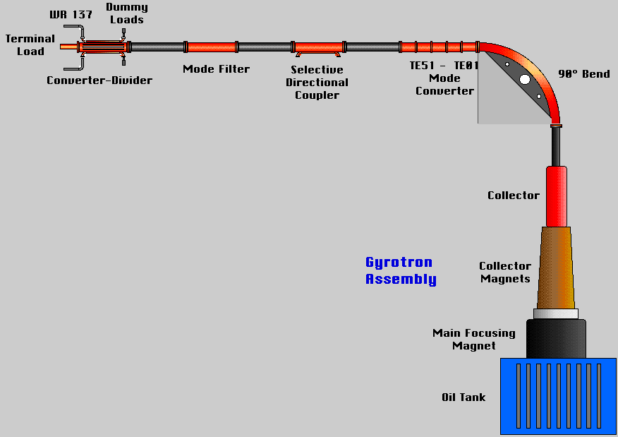
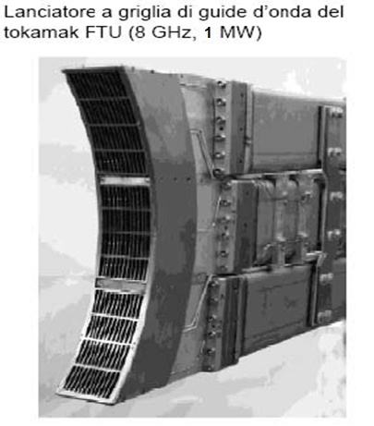
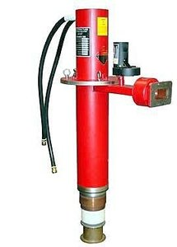
CONCEPTUAL DESIGN OF A RF DRIVER FOR FTU
FTU LHCD System
Nominal frequency | 8 GHz
RF Source | Gyrotron
Nominal RF power | 1 MW
Number of RF sources | 6
Maximum overall power | 6 MW
Maxiumum pulse length | 1 s
Maximum duty cycle | 1/600

Slide 24
CONCEPTUAL DESIGN OF A RF DRIVER FOR FTU
Φ
Φ
f₁
a
f₂
b
b
f₂
a
f₁
Φ
f₀+f₁+f₂
f₀+f₂
f₀
f₀
f₀+f₂
f₀+f₁+f₂
Φ
f₁
a
a
f₁
Φ
f₁+f₂
f₂
f₂
f₁+f₂

Slide 25
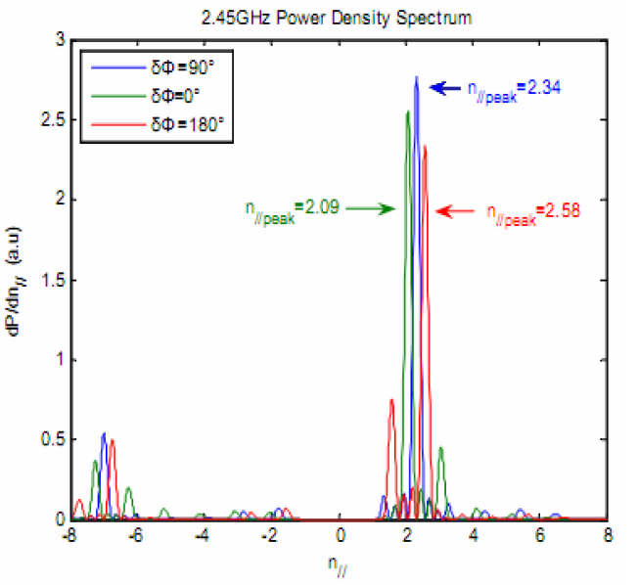
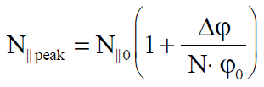
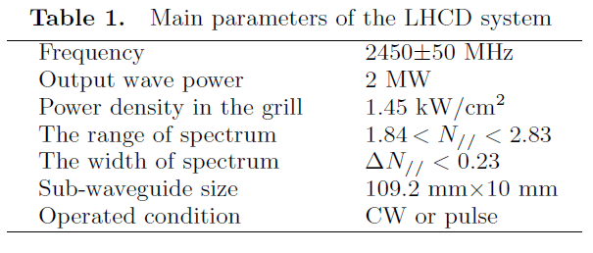
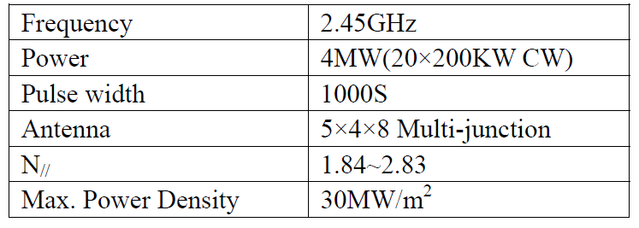
N// SPECTRUM CONTROL OF A
MULTI-JUNCTION ANTENNA (FAM/PAM)
Phase difference between two adjacent modules
N// peak of a single module
Number of active waveguides in a module
Intrinsic phase shift of the multijunction waveguide array
(3 kW/cm²)

Slide 26
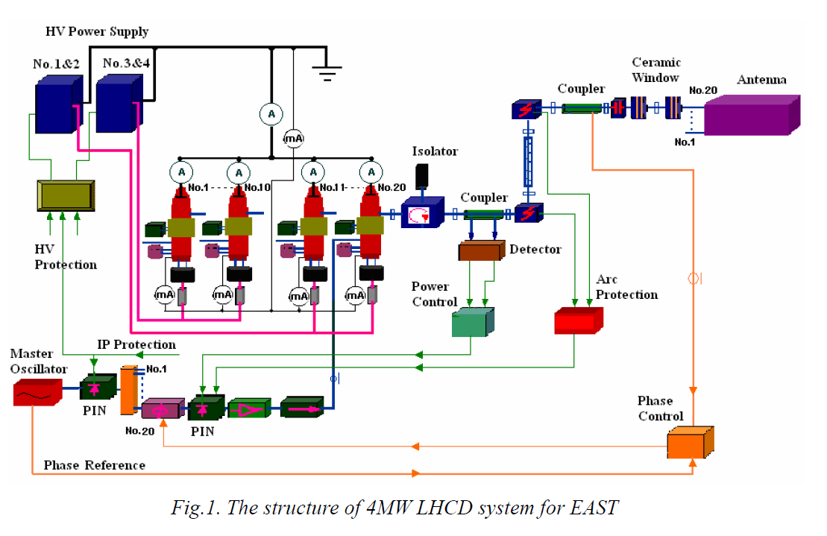
CONCEPTUAL DESIGN OF A RF DRIVER FOR EAST
Digital phase shifter

Slide 27

CONCEPTUAL DESIGN OF A RF DRIVER FOR EAST
Double driver-pump scheme:
x 20
Master oscillator f01
Power divider
20 identical RF drive chains
ΔΦ₀₁
Phase
control
Phase
Ref.
ΔΦ₀₂
Master oscillator
f02
Power divider
20 identical RF drive chains
NB1: the multiple driver-pump scheme can be ideally applied at the same frequency but this is not desirable in practice for two reasons: 1) the operating point of the tube should be kept in linear region to avoid nonlinear distortions and this is helped by the power splitting on different (but close) frequencies within the klystron bandwidth; 2) to phase out independently different drivers among antenna modules, it is necessary to have a spectral separation (not time coherence) among different drivers.
NB2: at the same time, to avoid nonlinear self-interactions among pump components, it’s important to keep the spectral separation as small as possible!

Slide 28
CONCLUSIONS
WE DISCOVERED A NEW METHOD TO CONTROL PIs BY MEANS OF AN AMPLITUDE MODULATED PUMP/ MULTIPLE DRIVER-PUMP WITHIN THE KLYSTRON BANDWIDTH.
SIMULATIONS SUGGEST THIS RESULT CAN BE ACHIEVED WITH A DIFFERENT N// PEAKING OF THE AM SIDEBANDS/MULTIPLE DRIVER-PUMP.
UNFORTUNATELY, IT IS VERY DIFFICULT TO APPLY THIS METHOD ON THE LHCD SYSTEM OF FTU (NECESSARY CHANGES ON THE POWER TRASMISSION LINE).
INSTEAD IT IS STRAIGHTFORWARD TO APPLY THIS METHOD ON THE LHCD SYSTEM OF EAST (NECESSARY CHANGES ON THE RF TRASMISSION LINE).
WE HAVE SHOWN HOW THE RF DRIVER OF EAST SHOULD BE MODIFIED.
THIS METHOD CAN BE APPLIED ALSO ON THE FUTURE LHCD SYSTEM OF ITER.

Slide 29
THANK YOU!

Slide 30
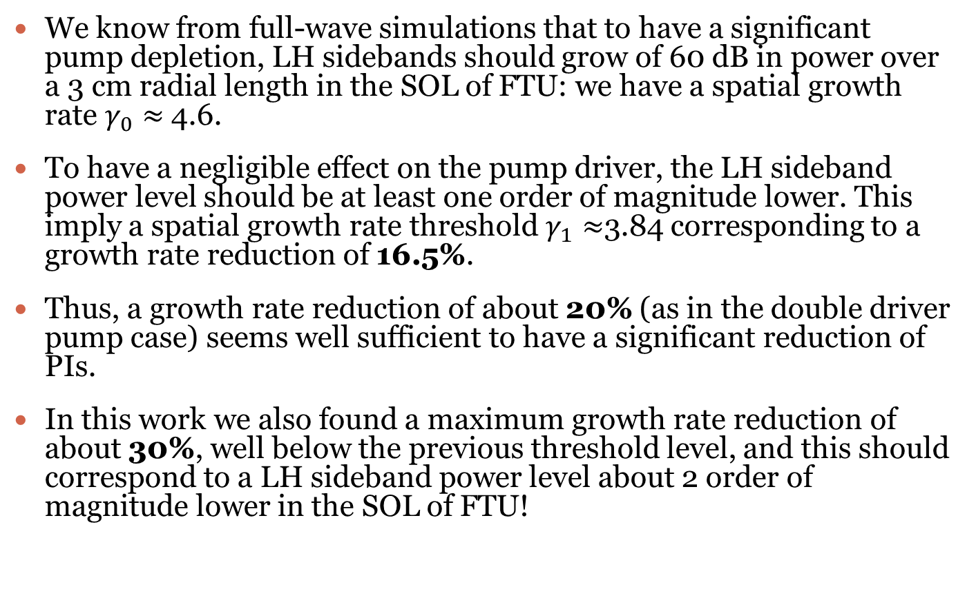
growth rate estimation for pis suppression
We know from full-wave simulations that to have a significant pump depletion, LH sidebands should grow of 60 dB in power over a 3 cm radial length in the SOL of FTU: we have a spatial growth rate $γ_{0}≈$4.6.
To have a negligible effect on the pump driver, the LH sideband power level should be at least one order of magnitude lower. This imply a spatial growth rate threshold$γ_{1}≈$3.84 corresponding to a growth rate reduction of 16.5%.
Thus, a growth rate reduction of about 20% (as in the double driver pump case) seems well sufficient to have a significant reduction of PIs.
In this work we also found a maximum growth rate reduction of about 30%, well below the previous threshold level, and this should correspond to a LH sideband power level about 2 order of magnitude lower in the SOL of FTU!

Slide 31
PDR VALIDATION
(c/ω₀)k// | omega_guess | gamma_guess | omega_0 | gamma_0 | delta_omega% | delta_gamma%
5 | 0.0005163 | 0.0016876 | 0.001239133 | 0.001974526 | 140.00% | 17.00%
10 | 0.0010326 | 0.0027476 | 0.001941309 | 0.003077283 | 88.00% | 12.00%
15 | 0.0015489 | 0.0036335 | 0.00260218 | 0.003960563 | 68.00% | 9.00%
FTU (SOL)
ne (10^12 m^-3) | 2
Te (eV) | 10
nz0 | 2
f0 (GHz) | 8
B0 (T) | 4.5
Pden (kW/cm^2) | 3.06

Slide 32
PDR VALIDATION
(c/ω₀)k// | omega_guess | gamma_guess | omega_0 | gamma_0 | delta_omega% | delta_gamma%
5 | 0.0005163 | 0.0016876 | 0.001239133 | 0.001974526 | 140.00% | 17.00%
10 | 0.0010326 | 0.0027476 | 0.001941309 | 0.003077283 | 88.00% | 12.00%
15 | 0.0015489 | 0.0036335 | 0.00260218 | 0.003960563 | 68.00% | 9.00%
FTU (SOL)
ne (10^12 cm^-3) | 2
Te (eV) | 10
nz0 | 2
f0 (GHz) | 8
B0 (T) | 4.5
Pden (kW/cm^2) | 3.06
(c/ω₀)k//

Slide 33
EAST
(c/ω₀)k// | Pden (m=0) | omega_M | ne | Te
5-6-7-8-9-10-15 | 1.45*10^3 | 2*gamma_0 | 1*10^12 | 12
f_{M} ≈ 10-20 MHz

Slide 34
EAST
Results consistent with K. Matsumoto et al. Plasma Phys. 25 (1983) and V.Stefan, Phys. Fluids, 26 (1983)
(c/ω₀)k// | Pden (m=0) | omega_M | ne | Te
15 | 1.45*10^3 | gamma_0 /5*gamma_0 | 1*10^12 | 12
f_{M} ≈ 10-60 MHz

Slide 35
EAST
(c/ω₀)k// | Pden (m=0) | ne | Te
6 | 1.45*10^3 | 1*10^12 | 12

Slide 36
EAST
(c/ω₀)k// | Pden (m=0) | omega_M | ne | Te
6 | 1.45*10^3 | 2*gamma_0 | 1*10^12 | 12
f_{M} ≈ 15 MHz

Slide 37
FTU
(c/ω₀)k// | Pden (m=0) | omega_M | ne | Te
5-10-15 | 3.06*10^3 | 2*gamma_0 | 2*10^12 | 10
f_{M} ≈ 30-65 MHz

Slide 38
FTU
(c/ω₀)k// | Pden (m=0) | omega_M | ne | Te
15 | 3.06*10^3 | 0.5*gamma_0/3*gamma_0 | 2*10^12 | 10
f_{M} ≈ 15-95 MHz

Slide 39
FTU
(c/ω₀)k// | Pden (m=0) | ne | Te
5 | 3.06E+03 | 2*10^12 | 10

Slide 40
FTU
(c/ω₀)k// | Pden (m=0) | omega_M | ne | Te
5 | 3.06E+03 | 2*gamma_0 | 2*10^12 | 10
f_{M} ≈ 30 MHz

Slide 41
FTU – max gamma vs collision frequency
f_col (MHz)
(c/ω₀)k// | Pden (m=0) | omega_M | ne | Te
5 | 3.06E+03 | 2*gamma_0 | 2*10^12 | 10
f_{M} ≈ 30 MHz

Slide 42
EAST - breakthrough
(c/ω₀)k// | delta_fo (MHz) | delta_nzo | kperp
10 | 0 | 0% | 10.64117869
10 | -0.1 | -10% | 11.40537123
10 | 0.1 | 10% | 9.876998323
10 | 0.1 | -10% | 11.40519236
10 | -0.1 | 10% | 9.877152846
10 | -1 | -10% | 11.40617567
10 | 1 | 10% | 9.876302559
10 | -1 | 0% | 10.64201173
10 | 1 | 0% | 10.64034476
10 | -10 | 0% | 10.64946863
10 | 10 | 0% | 10.63279888
10 | -20 | 0% | 10.65766891
10 | 20 | 0% | 10.62432897
10 | -30 | 0% | 10.66577972
10 | 30 | 0% | 10.61576876
10 | -100 | 0% | 11.67376017
10 | 100 | 0% | 10.55330004
(c/ω₀)k// | delta_fo (MHz) | delta_nzo | kperp
5 | 0 | 0% | 1.474070014
5 | -0.1 | -10% | 2.236307631
5 | 0.1 | 10% | 0.711844599
5 | -0.1 | 10% | 0.711855285
5 | 0.1 | -10% | 2.236272537
5 | -1 | -10% | 2.23646546
5 | 1 | 10% | 0.711796484
5 | -10 | 0% | 1.475208349
5 | 10 | 0% | 1.472919346
5 | -20 | 0% | 1.47633438
5 | 20 | 0% | 1.471756316
5 | -30 | 0% | 1.477448134
5 | 30 | 0% | 1.470580896
(c/ω₀)k// | Pden (m=0) | ne | Te | nz0
5-10 | 1.45*10^3 | 1*10^12 | 12 | 2.1
Case 1
Case 2

Slide 43
EAST – Δnz = 5 (Δnz0 = 0%)
Results consistent with K. Matsumoto et al. Plasma Phys. 25 (1983) and V.Stefan, Phys. Fluids, 26 (1983)
(c/ω₀)k// | Pden (m=0) | omega_M | ne | Te | nz0
5 | 1.45*10^3 | 2*pi*10^6 | 1*10^12 | 12 | 2.1
f_{M} = 1 MHz

Slide 44
EAST – CASE1 Δnz = 5 (Δnz0 = 5%)
k_perp
(c/ω₀)k// | Pden (m=0) | omega_M | ne | Te | nz0
5 | 1.45*10^3 | 2*pi*10^6 | 1*10^12 | 12 | 2.1
f_{M} = 1 MHz

Slide 45
EAST – CASE1 Δnz = 5 (Δnz0 = 10%)
(c/ω₀)k// | Pden (m=0) | omega_M | ne | Te | nz0
5 | 1.45*10^3 | 2*pi*10^6 | 1*10^12 | 12 | 2.1
f_{M} = 1 MHz

Slide 46
EAST – CASE1 Δnz = 10 (Δnz0 = 10%)
k_perp
(c/ω₀)k// | Pden (m=0) | omega_M | ne | Te | nz0
10 | 1.45*10^3 | 2*pi*10^6 | 1*10^12 | 12 | 2.1
f_{M} = 1 MHz

Slide 47
EAST – CASE1 Δnz = 5 (Δnz0 = 0% – 5% – 10%)
(c/ω₀)k// | Pden (m=0) | omega_M | ne | Te | nz0
5 | 1.45*10^3 | 2*pi*10^6 | 1*10^12 | 12 | 2.1
f_{M} = 1 MHz

Slide 48
EAST – CASE1 (Δnz0 = 10%) Δnz = 5 vs Δnz =10
Now the growth rate reduction
seems almost insensitive to N//
variation!
(c/ω₀)k// | Pden (m=0) | omega_M | ne | Te | nz0
5 | 1.45*10^3 | 2*pi*10^6 | 1*10^12 | 12 | 2.1
10 | 1.45*10^3 | 2*pi*10^6 | 1*10^12 | 12 | 2.1
f_{M} = 1 MHz

Slide 49
EAST – CASE1 vs CASE2 Δnz = 10 (Δnz0 = 10%)
(c/ω₀)k// | Pden (m=0) | omega_M | ne | Te | nz0
10 | 1.45*10^3 | 2*pi*10^6 | 1*10^12 | 12 | 2.1
f_{M} = 1 MHz

Slide 50
EAST – CASE1 (Δnz0 = 5% - 10%) m=2 vs modulation frequency
f_{M}
(c/ω₀)k// | Pden (m=0) | deltaf_M | ne | Te | nz0
10 | 1.45*10^3 | 10^3 – 10^6 | 1*10^12 | 12 | 2.1
f_{M} = 1 kHz – 1 MHz

Slide 51
FTU - breakthrough
(c/ω₀)k// | delta_fo (MHz) | delta_nzo | kperp
10 | 0 | 0% | 12.627472
10 | -1 | 0% | 12.635479
10 | 1 | 0% | 12.619451
10 | -1 | -10% | 13.468361
10 | 1 | 10% | 11.78765
10 | -1 | 10% | 11.802597
10 | 1 | -10% | 13.451252
Case 1
Case 2
(c/ω₀)k// | Pden (m=0) | ne | Te | nz0
10 | 3.06E+03 | 2*10^12 | 10 | 2

Slide 52
FTU – CASE1 Δnz = 10 (Δnz0 = 10%)
k_perp
(c/ω₀)k// | Pden (m=0) | omega_M | ne | Te | nz0
10 | 3.06E+03 | 2*pi*10^6 | 2*10^12 | 10 | 2
f_{M} = 1 MHz

Slide 53
FTU – CASE2 Δnz = 10 (Δnz0 = 10%)
k_perp
(c/ω₀)k// | Pden (m=0) | omega_M | ne | Te | nz0
10 | 3.06E+03 | 2*pi*10^6 | 2*10^12 | 10 | 2
f_{M} = 1 MHz

Slide 54
FTU – CASE1 vs CASE2 Δnz = 10 (Δnz0 = 10%)
(c/ω₀)k// | Pden (m=0) | omega_M | ne | Te | nz0
10 | 3.06E+03 | 2*pi*10^6 | 2*10^12 | 10 | 2
f_{M} = 1 MHz

