Slide 1
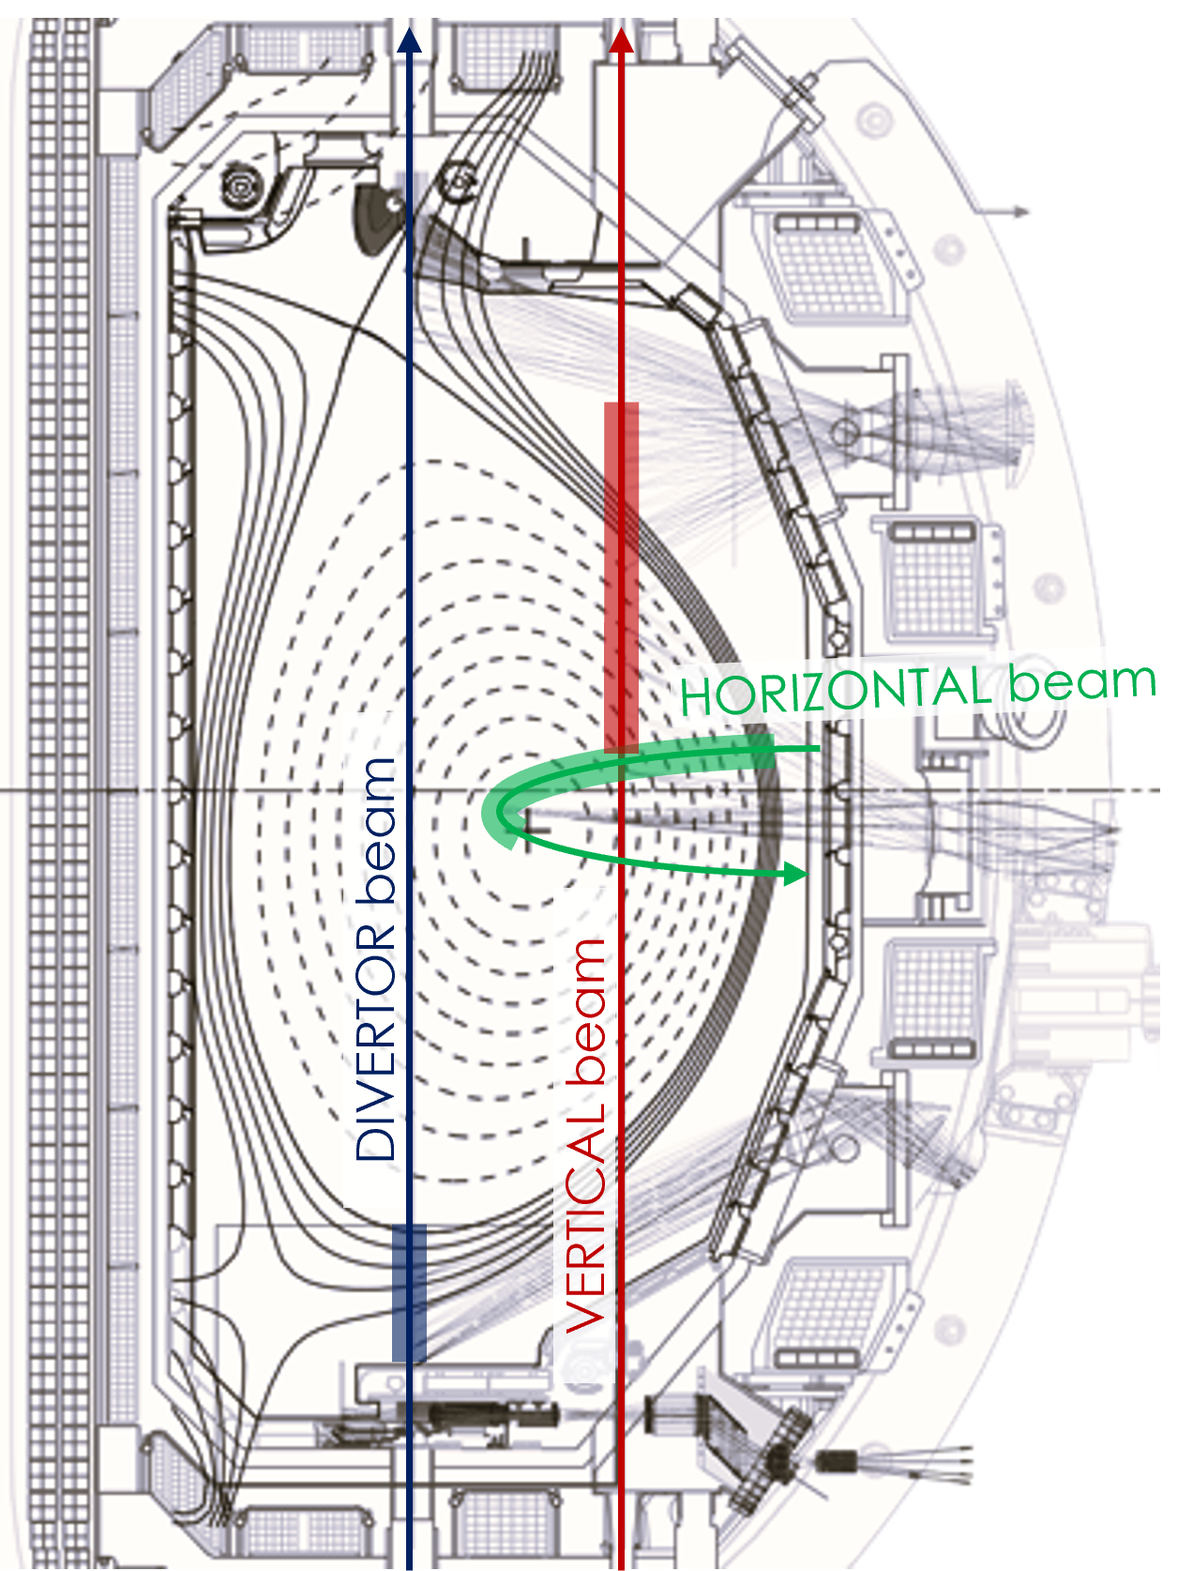
Improving Electron Density Calibration Techniques for the DIII-D Thomson Scattering Diagnostic
Fabio Conti ^{1,*}
Fenton Glass ¹
Richard Carr ¹
Adam G. McLean ²
¹General Atomics
San Diego, Calif., USA
²Lawrence Livermore National Laboratory
Livermore, Calif., USA
*contif@fusion.gat.com

Slide 2
Background & Motivation
Accurate electron density (n_{e}) profiles are crucial:
  plasma control, performance evaluation,
  study confinement, transport, edge physics, & exhaust
  require absolute calibration of system response

Slide 3
Background & Motivation
Accurate electron density (n_{e}) profiles are crucial:
  plasma control, performance evaluation,
  study confinement, transport, edge physics, & exhaust
  require absolute calibration of system response
Rayleigh scattering-based calibration of DIII-D Thomson scattering^{[1]} vulnerable to stray laser light contamination
Locations with high stray light (e.g., in the divertor) cannot be directly calibrated using Rayleigh scattering

Slide 4
Background & Motivation
Accurate electron density (n_{e}) profiles are crucial:
  plasma control, performance evaluation,
  study confinement, transport, edge physics, & exhaust
  require absolute calibration of system response
Rayleigh scattering-based calibration of DIII-D Thomson scattering^{[1]} vulnerable to stray laser light contamination
Locations with high stray light (e.g., in the divertor) cannot be directly calibrated using Rayleigh scattering
Rotational Raman scattering from diatomic gas shifts scattered wavelengths away from laser wavelength^{[2]}
[1] B. Bray et al., RSI 72, 1115 (2001) [2] J. Howard, J. Phys. D 12 (1979)

Slide 5
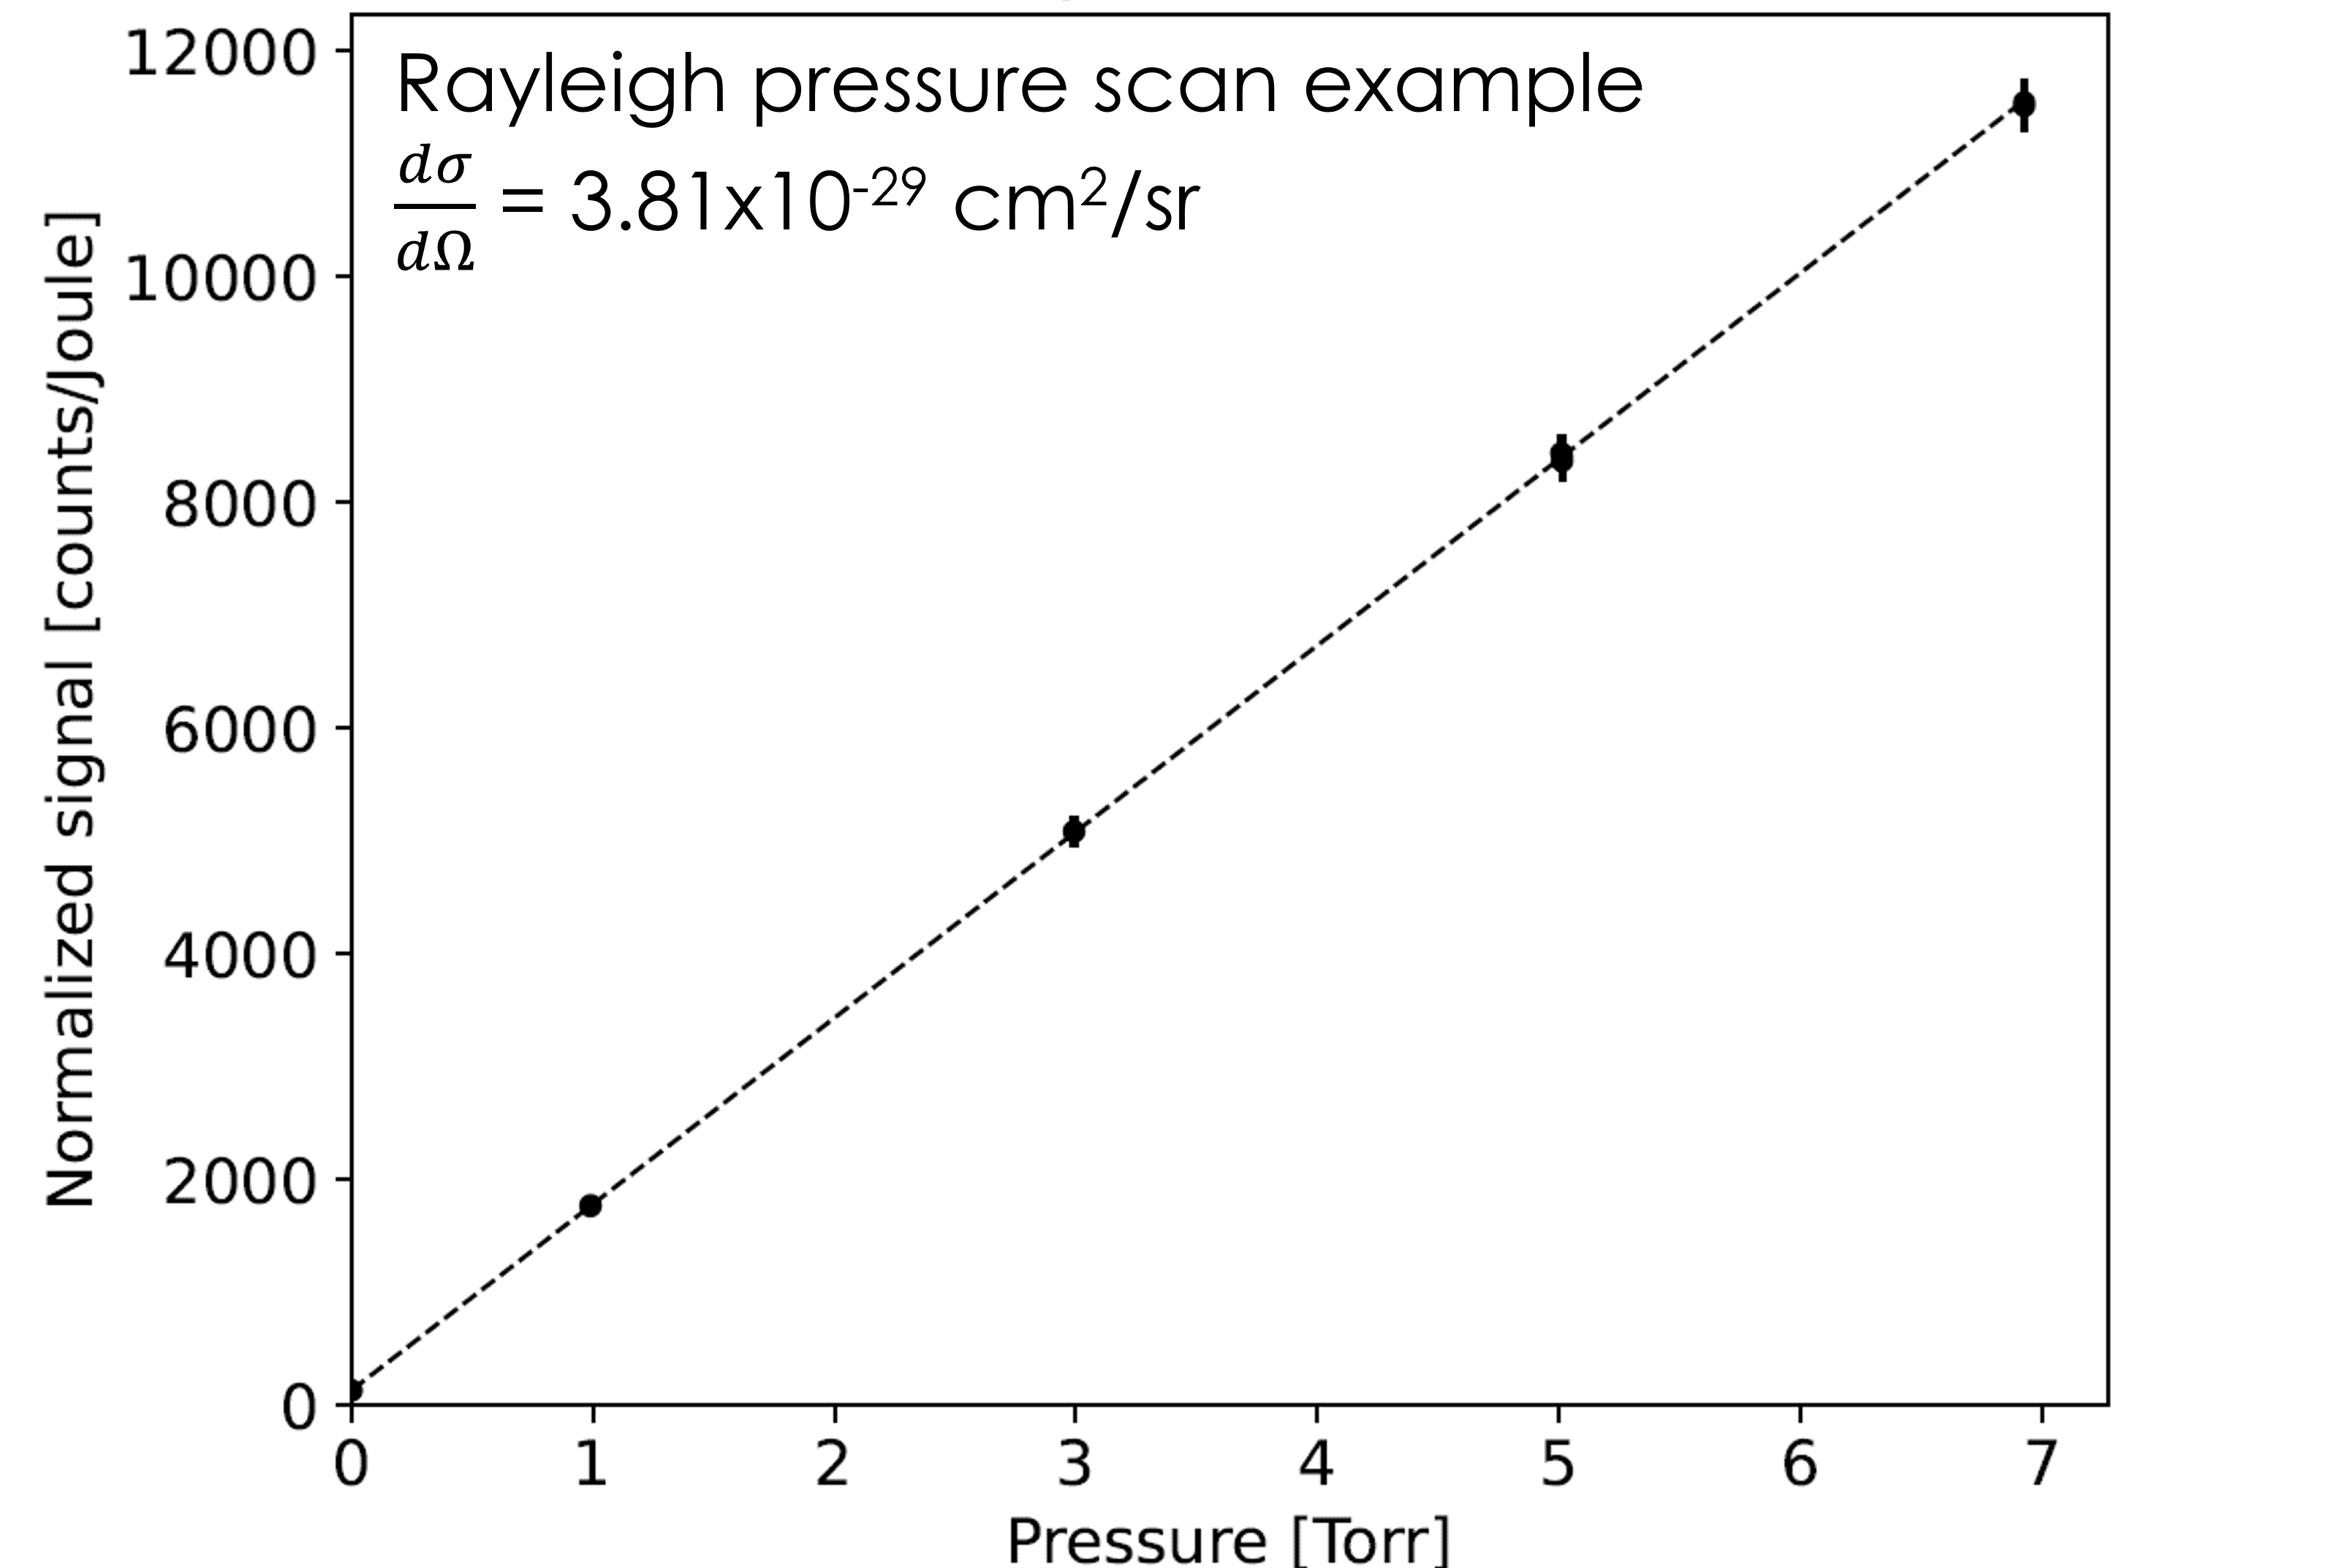
Rayleigh scattering
System response measured at various gas fill pressures
Signal normalized to laser energy
Slope of linear fit provides calibration factor
Single spectral channel only (1064nm)
Well-known cross section

Slide 6
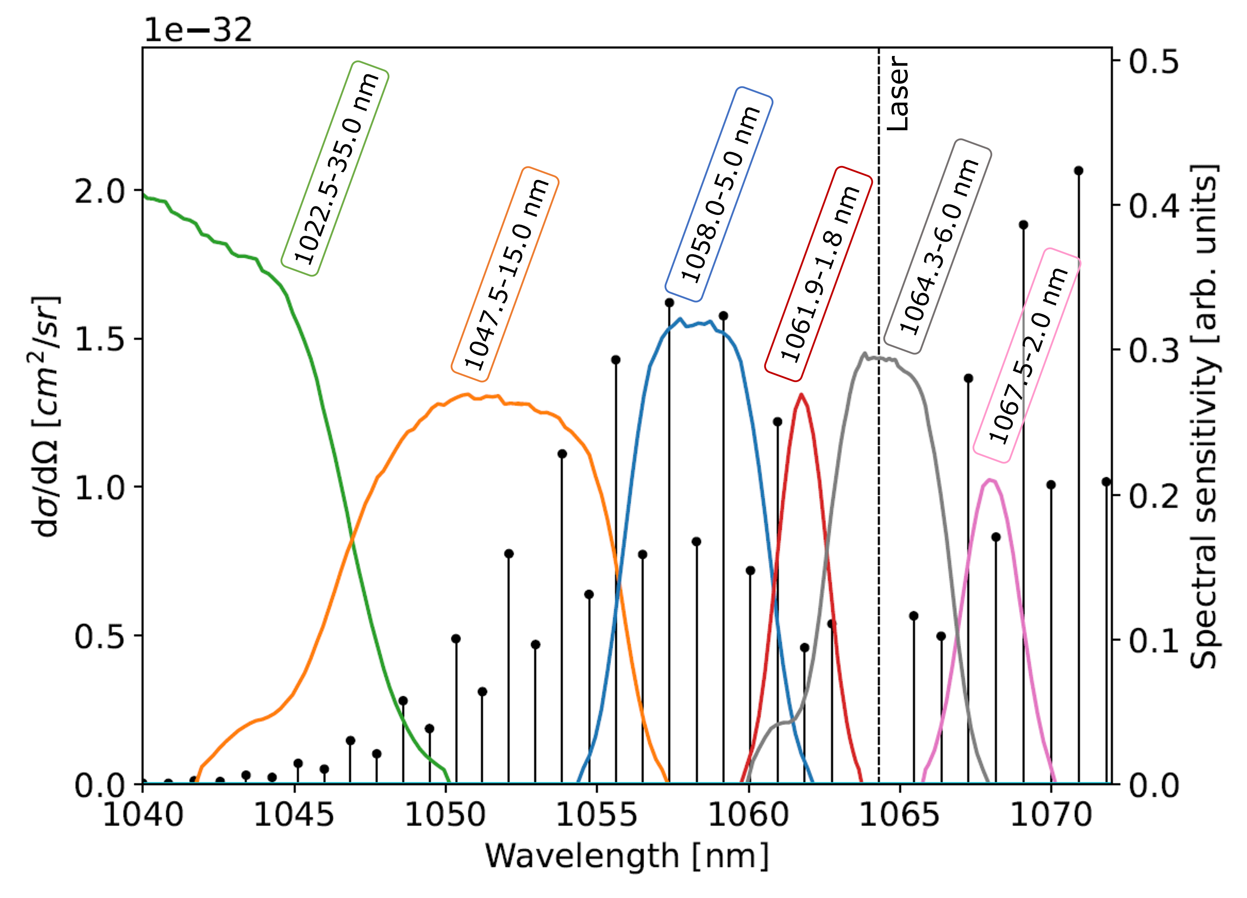
Raman scattering
Sum of Raman lines
weighted by filter transmission

Slide 7
Raman scattering
Sum of Raman lines
weighted by filter transmission
Usability of spectral channels:
  1047nm, 1058nm
  reliably good signals
  1062nm, 1067nm possible Rayleigh bleed-through
  1022nm low Raman signal

Slide 8
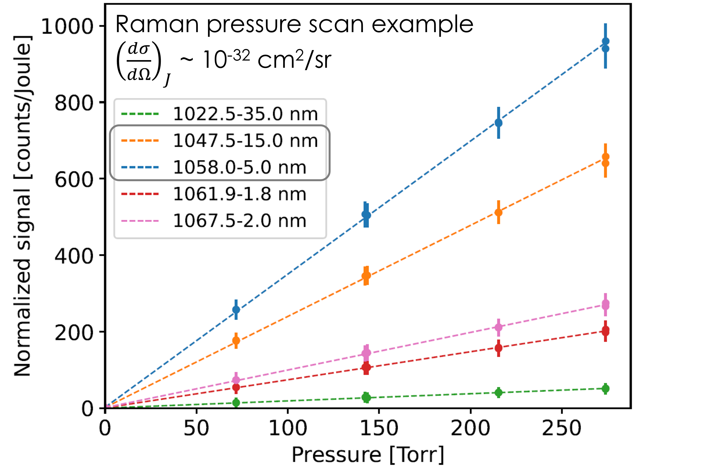
Raman scattering
Sum of Raman lines
weighted by filter transmission
Usability of spectral channels:
  1047nm, 1058nm
  reliably good signals
  1062nm, 1067nm possible Rayleigh bleed-through
  1022nm low Raman signal
100-1000x lower signal
(per filter) vs Rayleigh

Slide 9
Rayleigh vs Raman
56 scattering volumes (42 vert. + 14 hor.) over (6 vert. + 1 hor.) lasers
→ 266 coefficients have both Rayleigh and Raman values

Slide 10
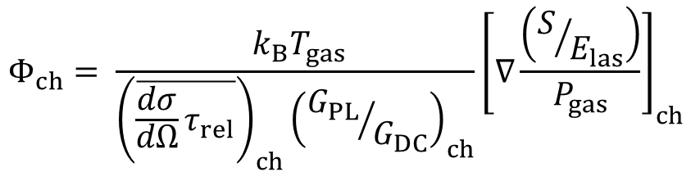
Rayleigh vs Raman
56 scattering volumes (42 vert. + 14 hor.) over (6 vert. + 1 hor.) lasers
→ 266 coefficients have both Rayleigh and Raman values
Geometry factor Φ should be the same for Rayleigh / Raman (& Thomson)
For each spectral channel:
$$Φ_{ch}= \frac{{ k}_{B}T_{gas}}{{\left(\overline{{\frac{dσ}{dΩ}τ}_{rel}}\right)}_{ch}{\left({G_{PL}}/{G_{DC}}\right)}_{ch}}{\left[∇\frac{\left(S/{E_{las}}\right)}{P_{gas}}\right]}_{ch}$$

Slide 11
Rayleigh vs Raman
56 scattering volumes (42 vert. + 14 hor.) over (6 vert. + 1 hor.) lasers
→ 266 coefficients have both Rayleigh and Raman values
Geometry factor Φ should be the same for Rayleigh / Raman (& Thomson)
For each spectral channel:
$$Φ_{ch}= \frac{{ k}_{B}T_{gas}}{{\left(\overline{{\frac{dσ}{dΩ}τ}_{rel}}\right)}_{ch}{\left({G_{PL}}/{G_{DC}}\right)}_{ch}}{\left[∇\frac{\left(S/{E_{las}}\right)}{P_{gas}}\right]}_{ch}$$
ratio of detector
signal to laser
energy
cross-section
ratio of detector gains
(DC spectral calibrations)
relative transmission
of collection optics + filter

Slide 12

Rayleigh vs Raman
Geometry factor Φ should be the same for Rayleigh / Raman (& Thomson)
DIII-D Thomson system produces lower Raman sensitivity than Rayleigh:
→ gives ~25% higher n_{e} for same Thomson signal
$${\left\langle Φ\right\rangle }_{Raman}\sim 0.8 {\left\langle Φ\right\rangle }_{Rayleigh}$$
Notes:
Mention bulk comparison with CO2?

Slide 13
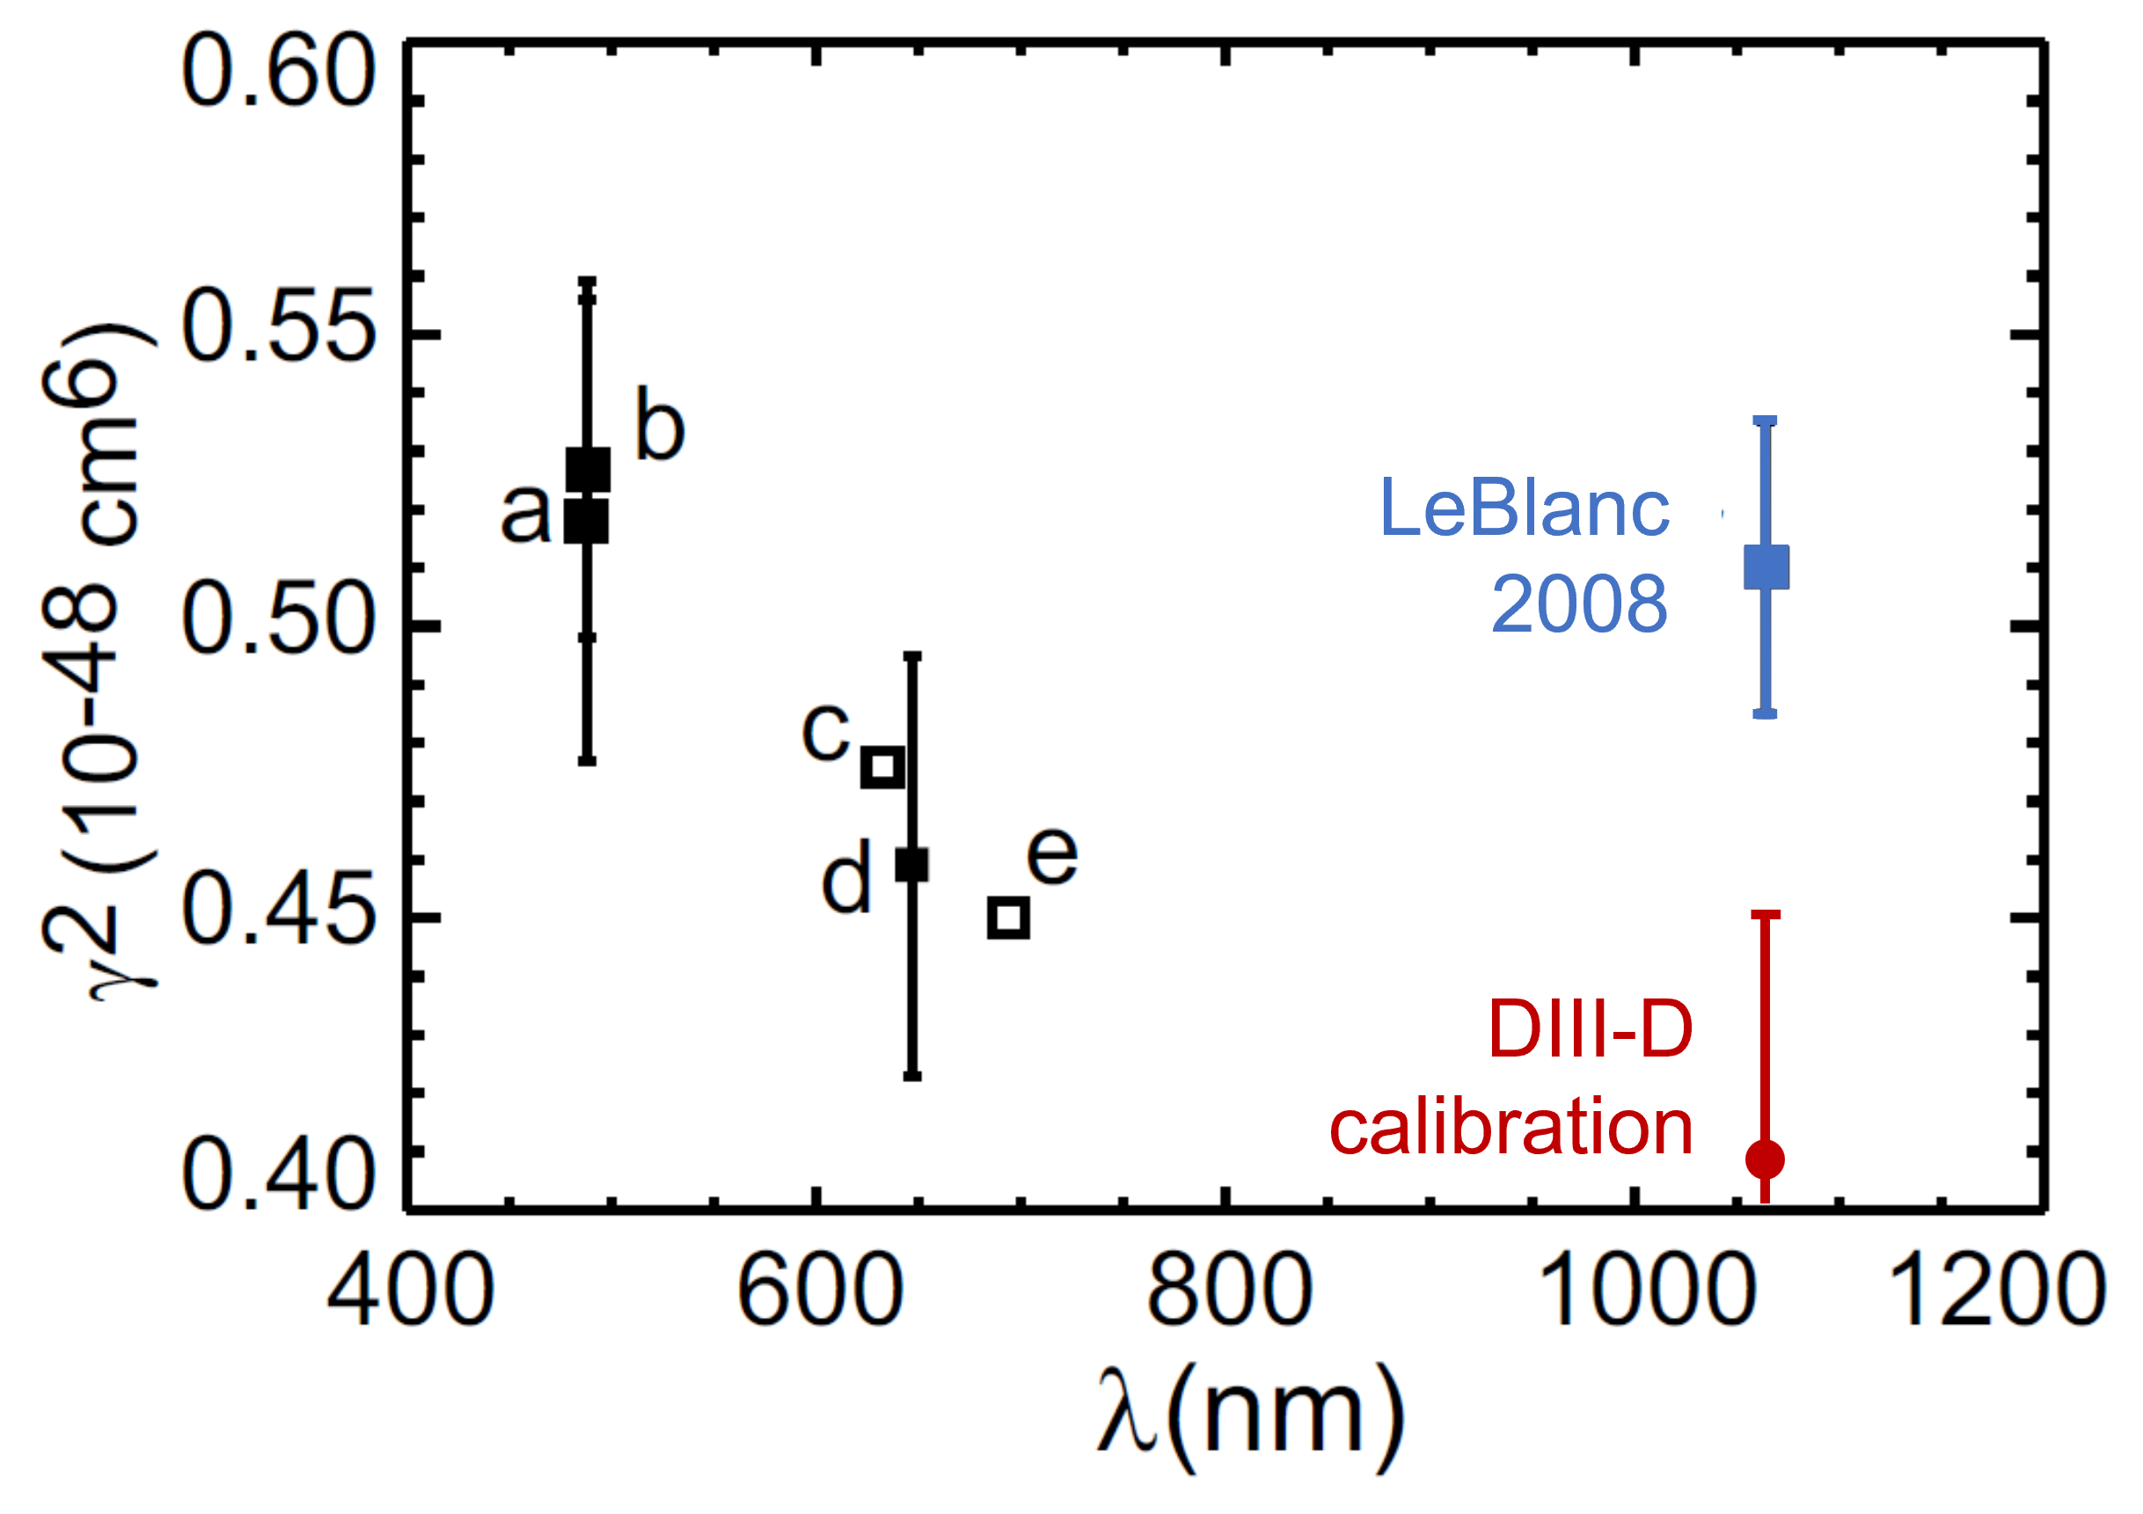

Rayleigh vs Raman
Geometry factor Φ should be the same for Rayleigh / Raman (& Thomson)
DIII-D Thomson system produces lower Raman sensitivity than Rayleigh:
→ gives ~25% higher n_{e} for same Thomson signal
$${\left\langle Φ\right\rangle }_{Raman}\sim 0.8 {\left\langle Φ\right\rangle }_{Rayleigh}$$
Raman σ ∝ γ² where
γ = molecular polarizability anisotropy^{[3]}
Manually adjust value to improve agreement
γ² = 0.51 → 0.40 x10⁻⁴⁸ cm⁶
Still use Rayleigh where possible
until discrepancy is resolved
[3] B. P. LeBlanc, RSI 79, 10E737 (2008)
Notes:
Mention bulk comparison with CO2?

Slide 14
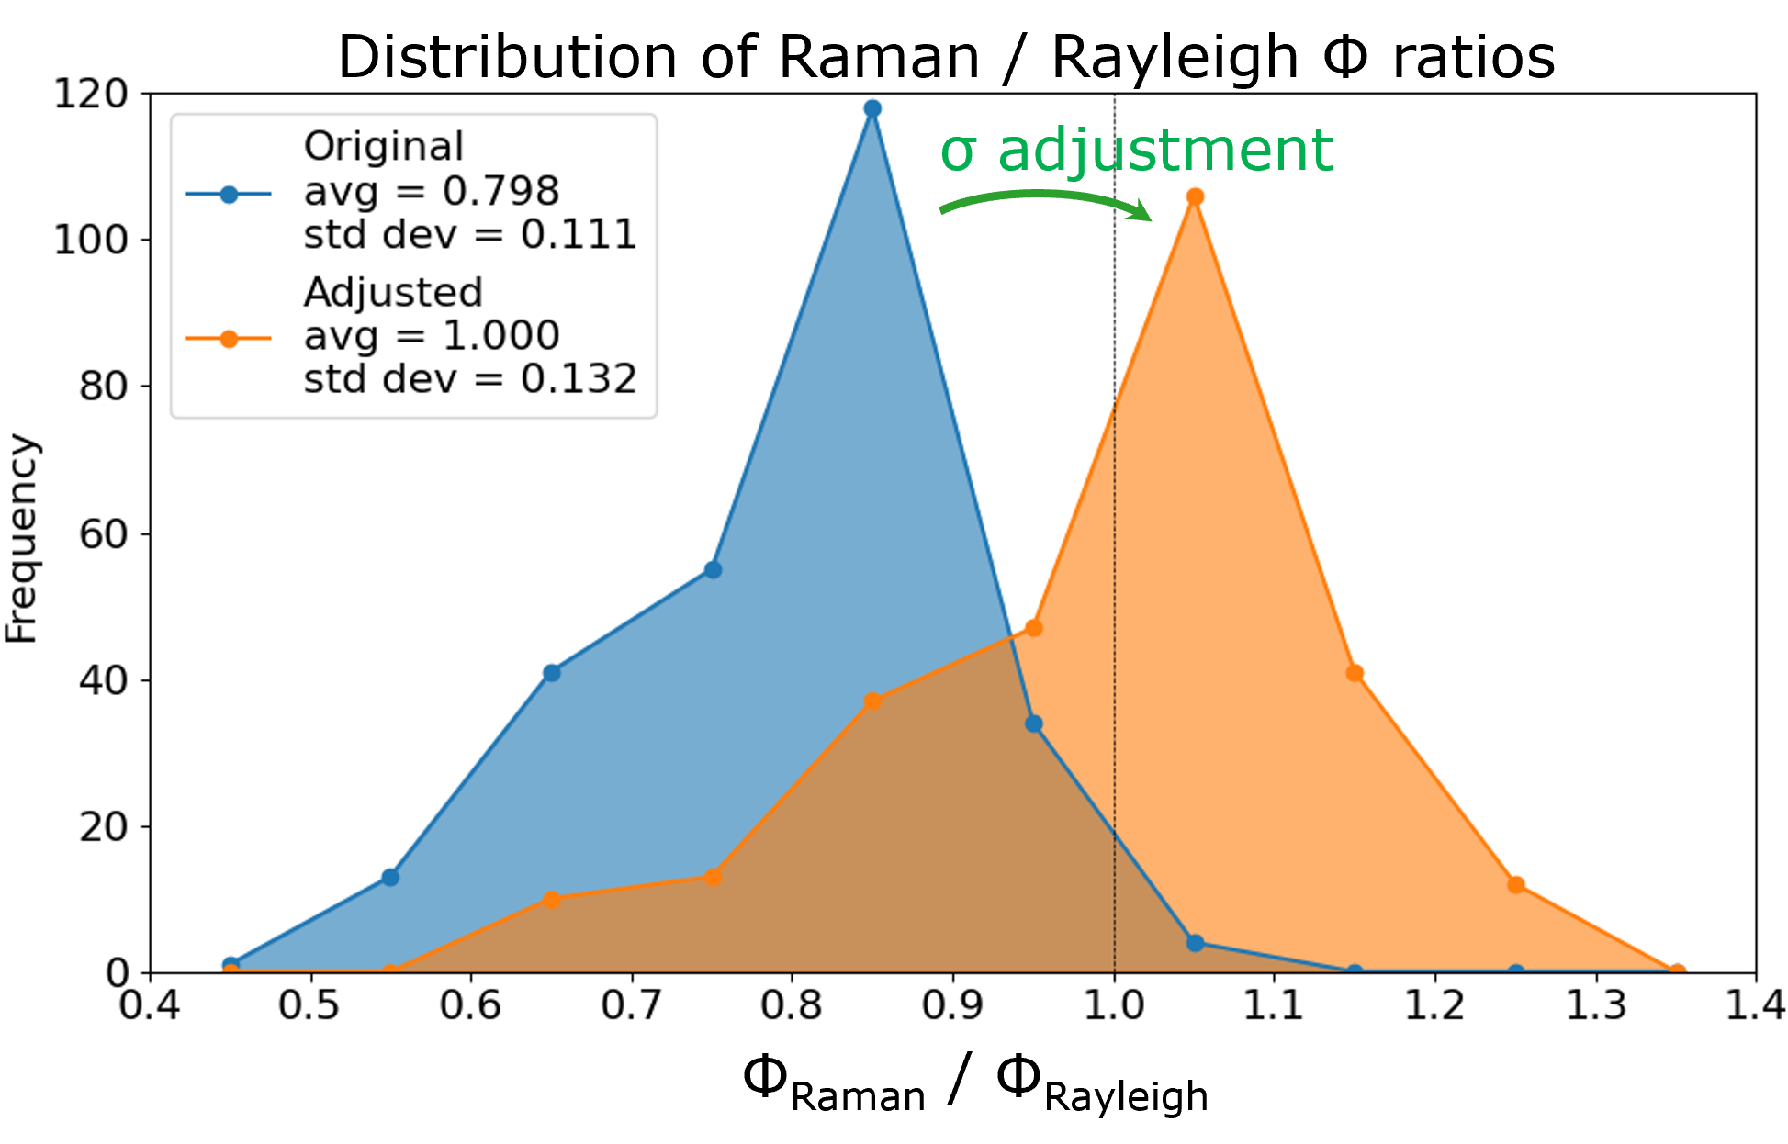
Rayleigh vs Raman
Ratio Γ_{Raman} / Γ_{Rayleigh} has ~20% point-to-point variability
[Raman value is mean of 1058 & 1047 nm channels]

Slide 15
Rayleigh vs Raman
Ratio Γ_{Raman} / Γ_{Rayleigh} has ~20% point-to-point variability
Possible causes:
  measurement accuracy of detector Pulse / DC gain
  → whole system pulsed calibration
  accuracy of optics spectral calibrations: angle-of-incidence, coating, aging, irradiation
  → in situ (re)calibrations
  Residual Rayleigh cross-filter bleed-through during high-pressure Raman? → measure
[Raman value is mean of 1058 & 1047 nm channels]

Slide 16
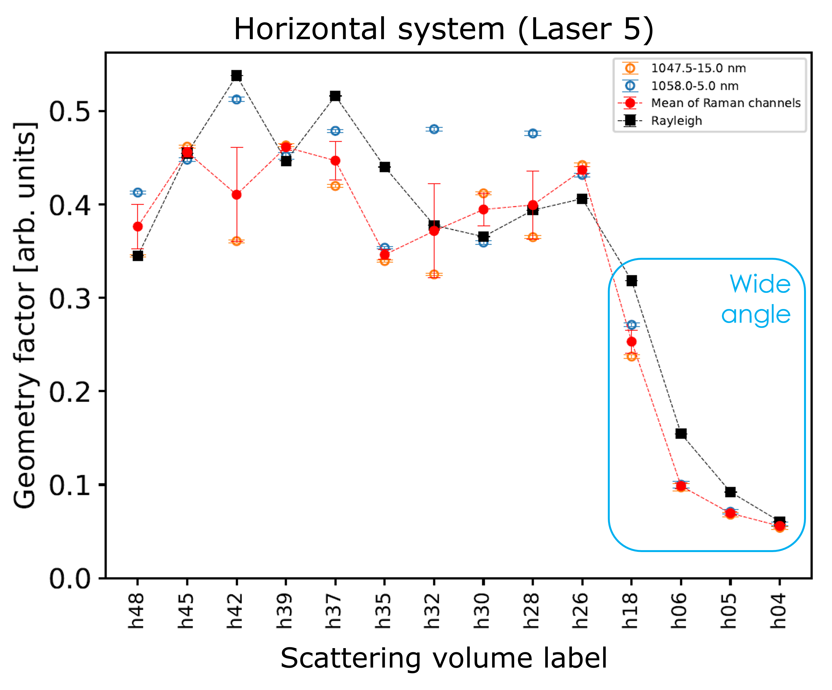
Rayleigh vs Raman
Neither 1047nm nor 1058nm factor alone is better matched to Rayleigh
If ‘good’ is within 10% of Rayleigh:
Good channel(s) | Frequency
1047nm only | 28%
1058nm only | 20%
Both | 28%
Neither | 23%
Mean of channels | 58%

Slide 17
Rayleigh vs Raman
Neither 1047nm nor 1058nm factor alone is better matched to Rayleigh
If ‘good’ is within 10% of Rayleigh:
Good channel(s) | Frequency
1047nm only | 28%
1058nm only | 20%
Both | 28%
Neither | 23%
Mean of channels | 58%
Where both are available, Raman is not clearly better than Rayleigh at DIII-D

Slide 18
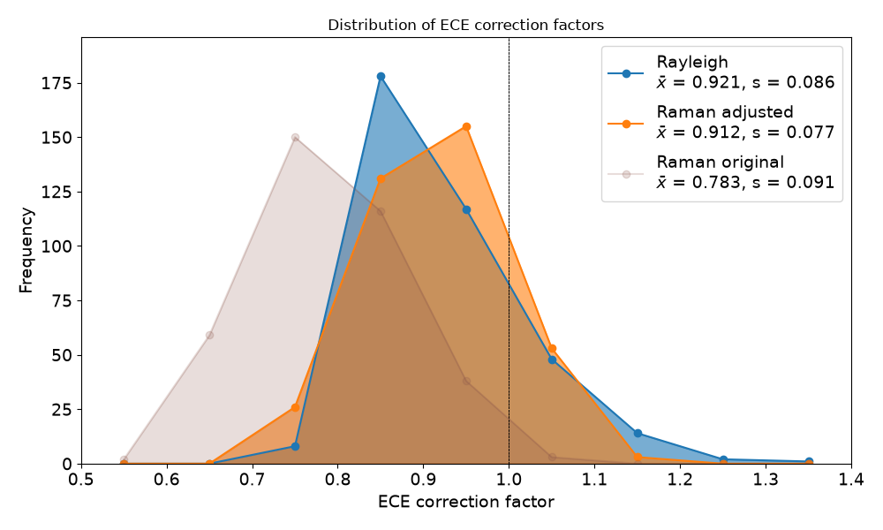
Cross-calibration with ECE improves n_{e} calibration and profiles
Dedicated shots with gradual ramp-up of n_{e} and I_{p} to
send ECE channels into cutoff
Fit signal extinction: known ECE f_{n} and B(R) gives n_{e}(R_{n}, t_{n}) ^{[4, 5]}
Mapping + interpolation in ψ space to get correction factors for Rayleigh/Raman
Can introduce errors ∝ 𝛻ψ
[4] K. Zhurovich et al., RSI 76, 053506 (2005) [5] M. Brookman et al., RSI 87, 11E517 (2016)

Slide 19
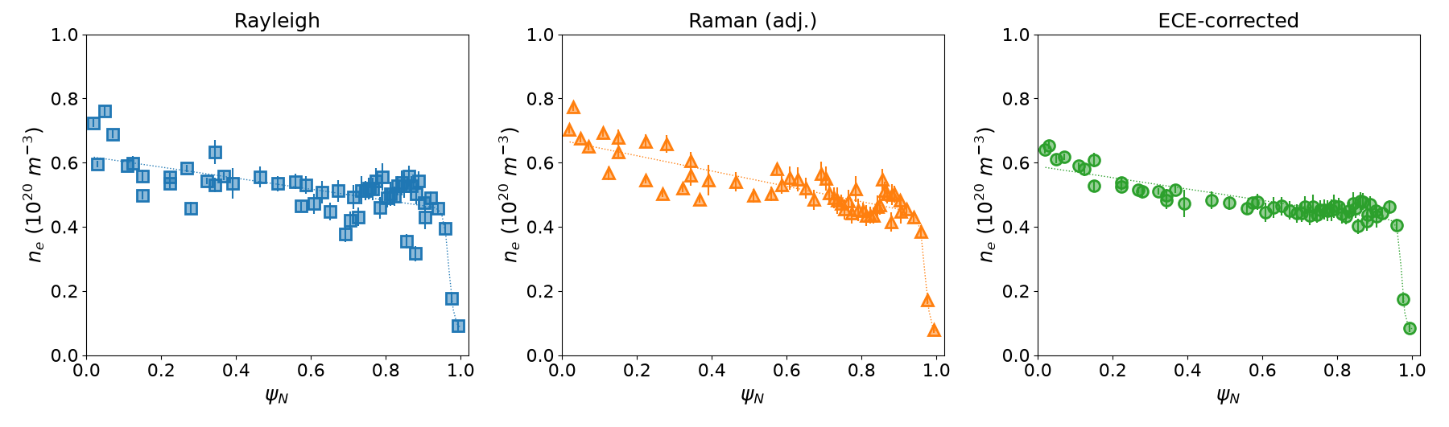
Cross-calibration with ECE improves n_{e} calibration and profiles
DIII-D shot 205686, t = 2750 ms
Use ECE correction to Rayleigh/Raman in plasma core & edge (53/56 volumes)

Slide 20
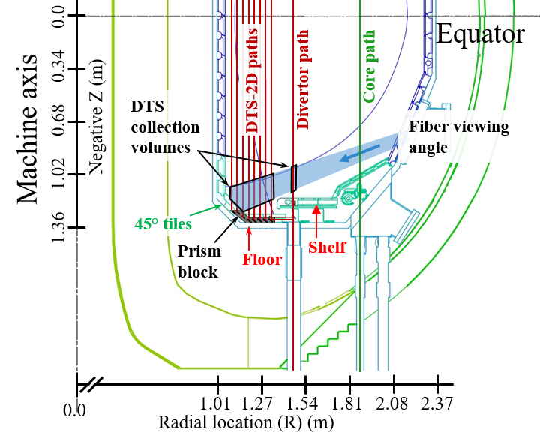
Density calibration is more challenging in divertor
Ultra-narrowband filters reduce cross-filter stray light contamination
  Rayleigh calibration not possible
Raman calibration used
with adjusted σ
Possible cross-checks / corrections being evaluated
  ECE-based
  P_{e} based

Slide 21
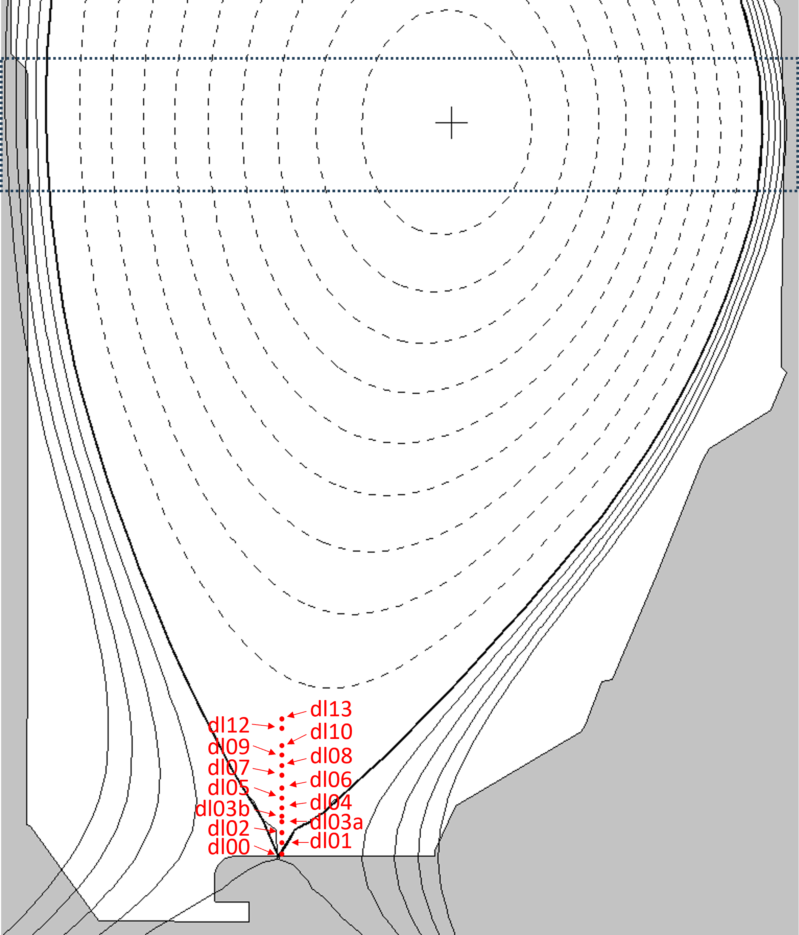
Calibration of Divertor Density – ECE and P_{e} checks
ECE: expanded plasma shape, divertor TS locations inside separatrix
  ECE mapped from mid-plane (steep 𝛻Ψ) to expanded flux in divertor
ECE mapped from midplane
Divertor scattering volumes

Slide 22
Calibration of Divertor Density – ECE and P_{e} checks
ECE: expanded plasma shape, divertor TS locations inside separatrix
  ECE mapped from mid-plane (steep 𝛻Ψ) to expanded flux in divertor.
Assuming P_{e} balance along field lines for independent check
  Radial sweep of strike point, L-mode steady state. Each volume sees varying Ψ(t).
  Corrections relative to a reference volume
ECE mapped from midplane
Divertor scattering volumes

Slide 23
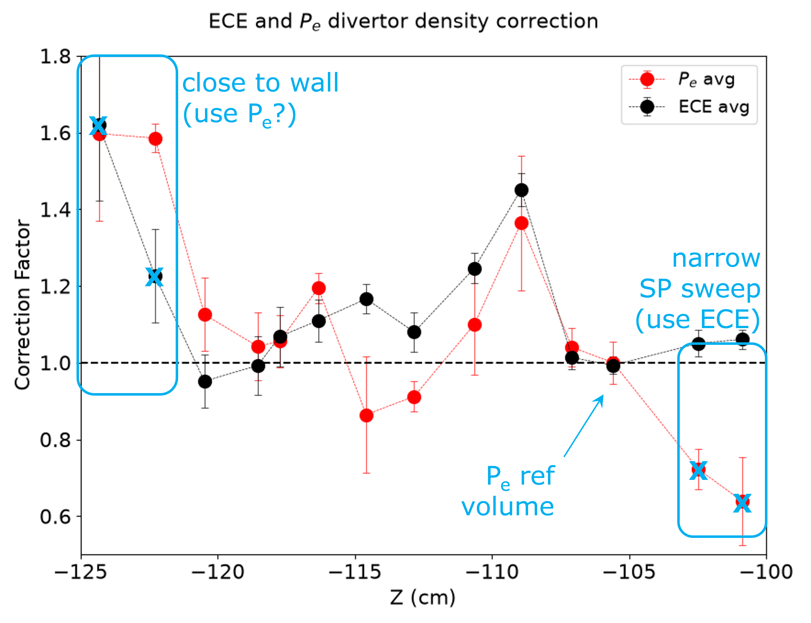
Calibration of Divertor Density – ECE and P_{e} checks
Independent ECE and P_{e} methods complement each other
  agreement within ~10% in
  most locations
  Can use P_{e} near wall and
  ECE in top-most volumes
Notes:
Due to sweep, getting overlap between adjacent points through nearby psi.
More complicated physics for dl00 and dl01 near the tile.
CHECK ECE VS PE values (should match at -106 cm)
ADD ERROR BARS
Show DTS profiles?

Slide 24
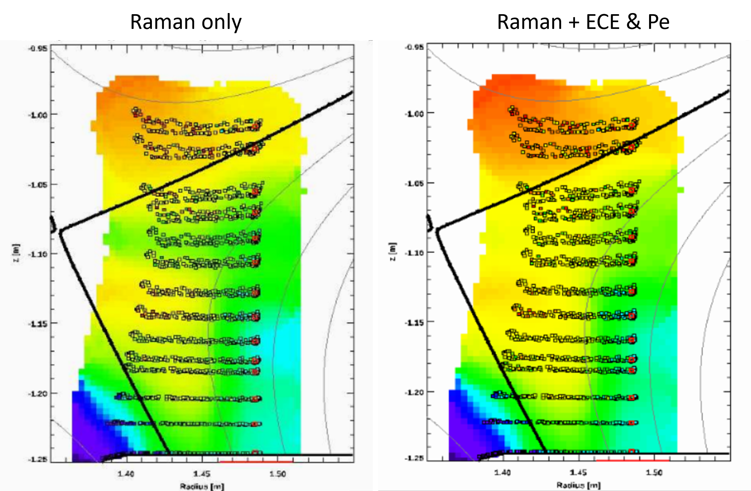
Calibration of Divertor Density – ECE and P_{e} checks
Independent ECE and P_{e} methods complement each other
  agreement within ~10% in
  most locations
  Can use P_{e} near wall and
  ECE in top-most volumes
  To be implemented in new data
  for smoother profiles
Notes:
Due to sweep, getting overlap between adjacent points through nearby psi.
More complicated physics for dl00 and dl01 near the tile.
CHECK ECE VS PE values (should match at -106 cm)
ADD ERROR BARS
Show DTS profiles?

Slide 25
Conclusion & Further Development
Raman and Rayleigh scattering used to calibrate DIII-D TS for n_{e}
Raman underestimates sensitivity: systematic error or adjust γ
Where both are available, Raman is not clearly better than Rayleigh
ECE cutoff used to refine Rayleigh calibrations / ne profiles
in plasma core & edge beam paths
Divertor regions use adjusted-γ Raman; ECE and P-balance used to cross-check results, combining the two seems to work well
Calibrating diagnostics in multiple ways – understand discrepancies
  point-to-point and spectral channel-to-channel variation
  consistency between techniques
  improve ECE and P-balance correction methods
Calibration process improvements: whole system pulsed calibration, measure Rayleigh cross-filter bleed-through
Notes:
Summarize what factors are used where. Circle back to motivation of precise profiles
Do we need Rayleigh/Raman as baseline? Yes, since cross-calibrations need critical analysis and are not applied everywhere.
Measuring the same thing multiple ways. Understanding why they don’t agree (“discrepancies”)

Slide 26
THANK YOU

Slide 28
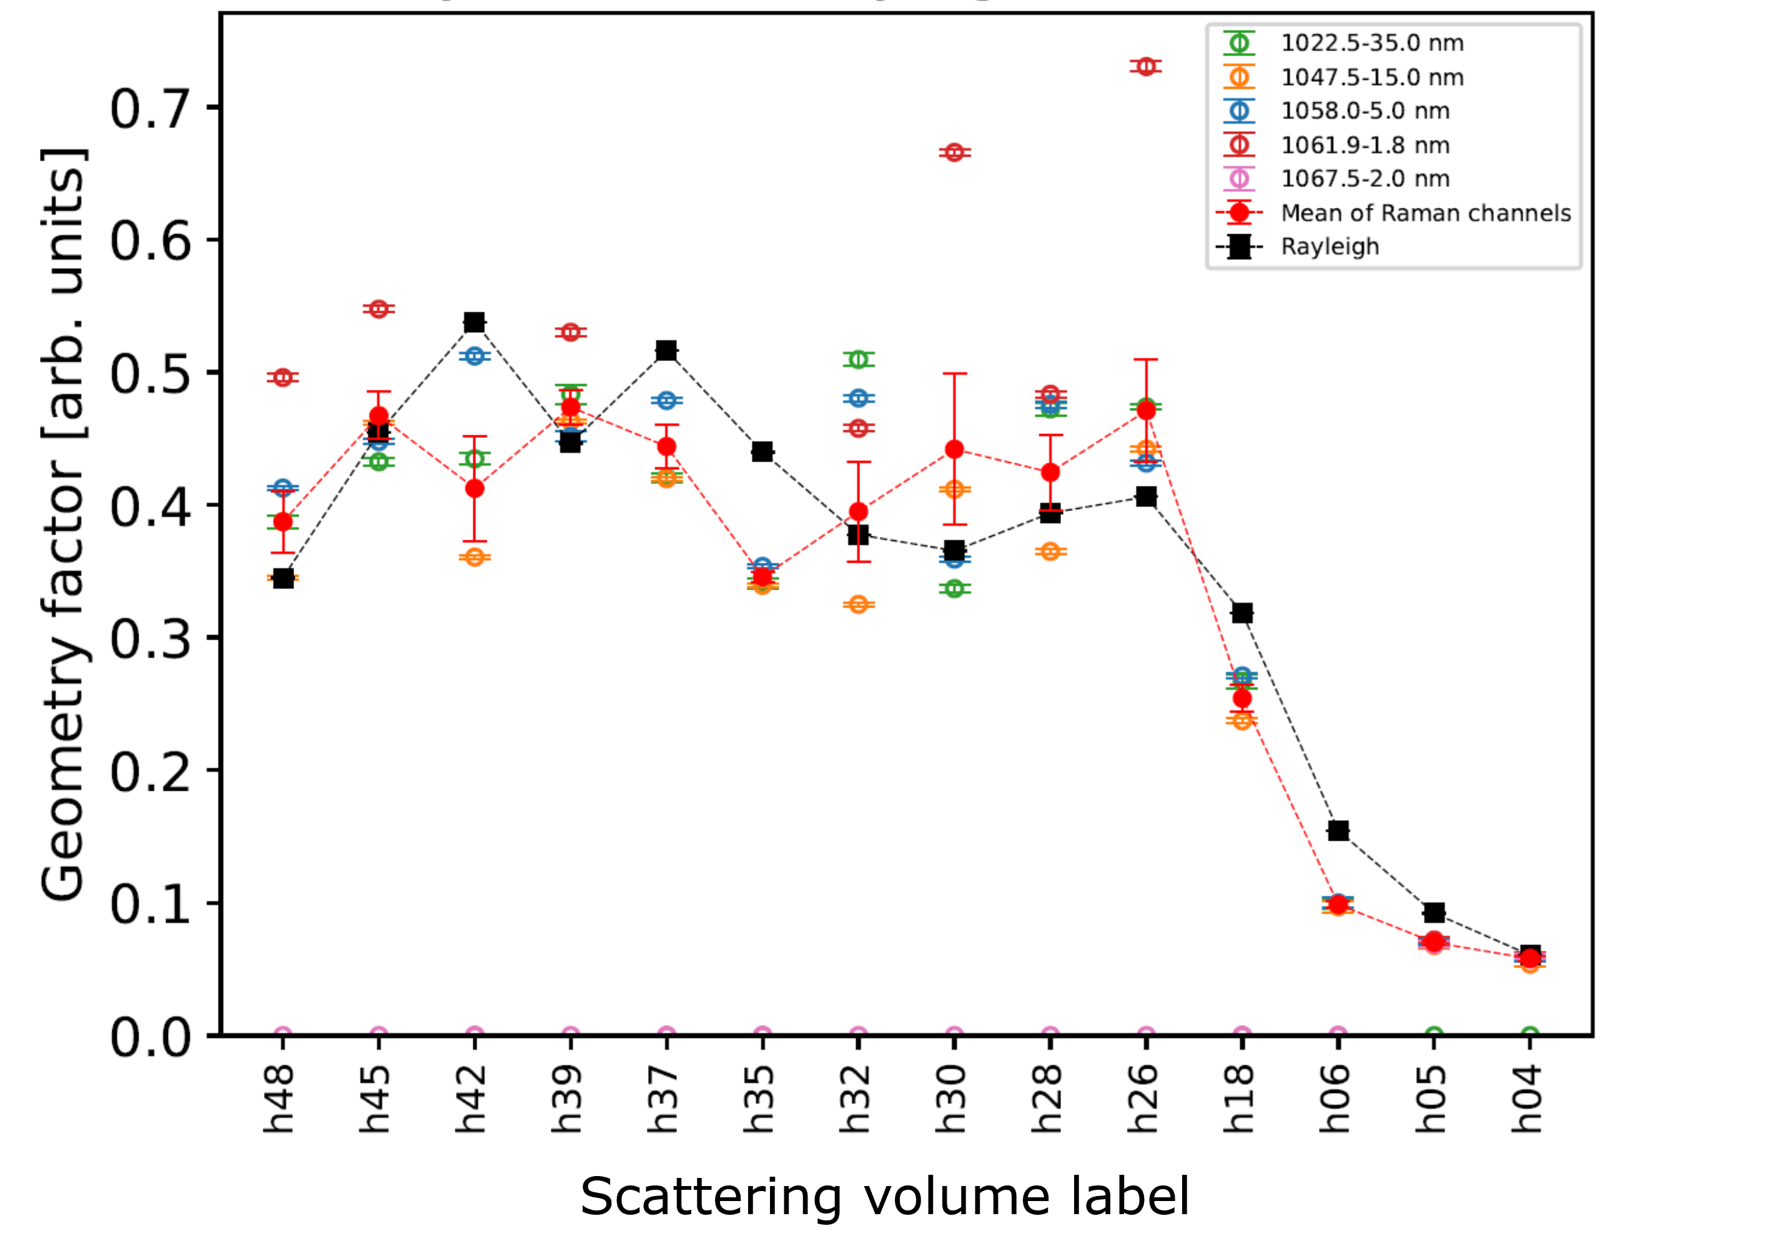
Comparison of Raman spectral channels

Slide 29
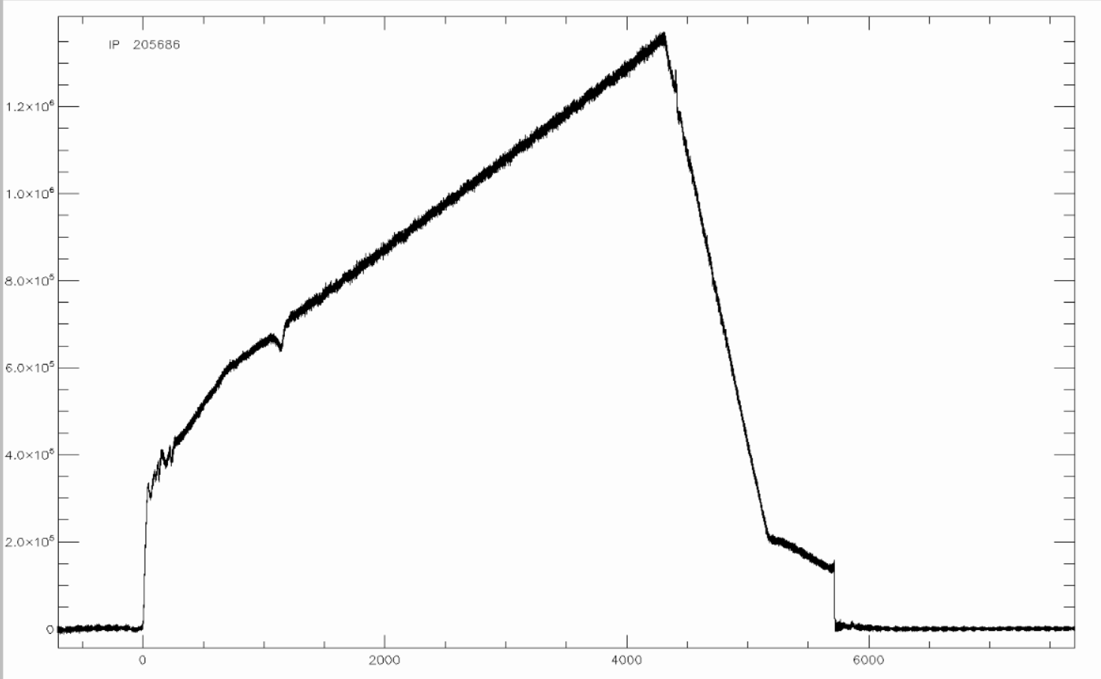
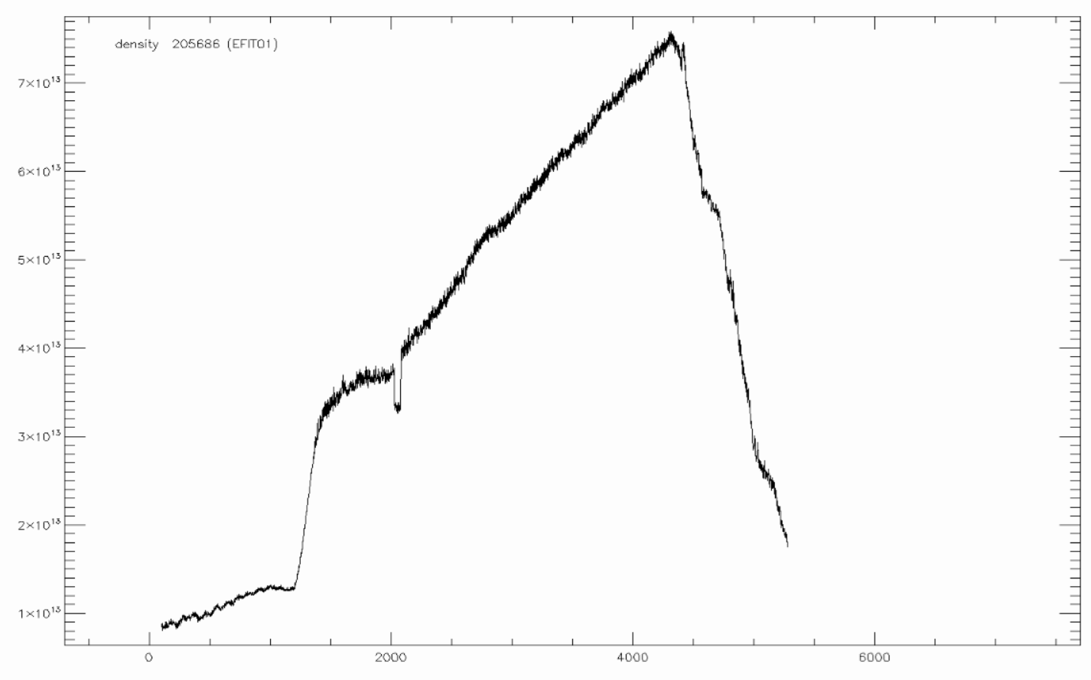
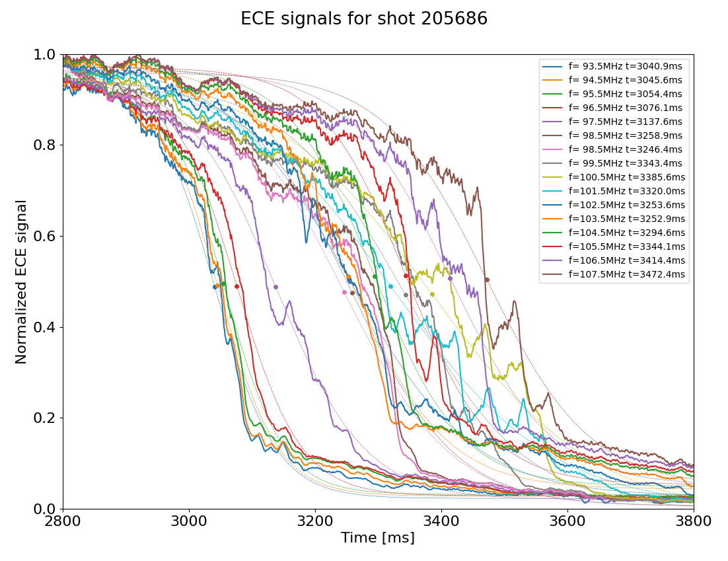
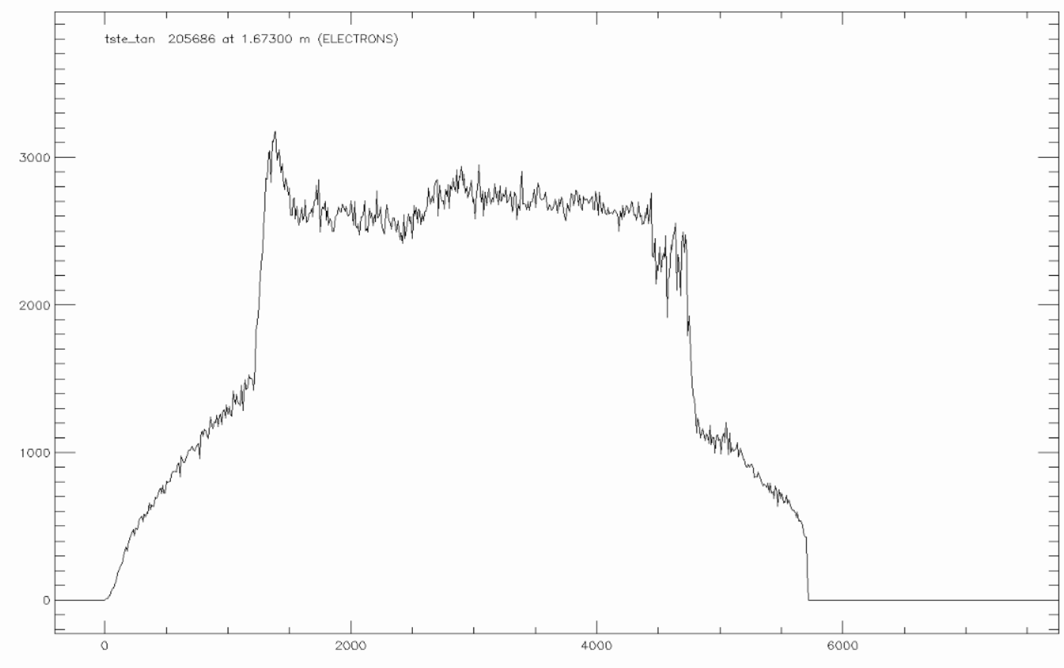
ECE cutoff
I_{p}
n_{e}
T_{e}

Slide 30
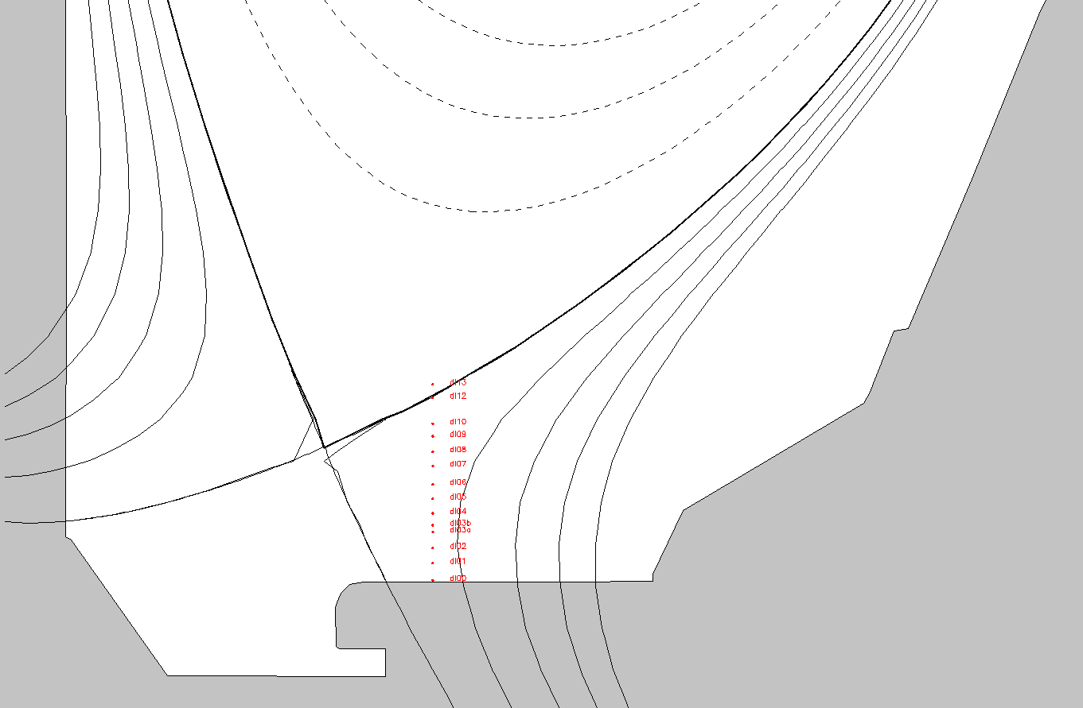
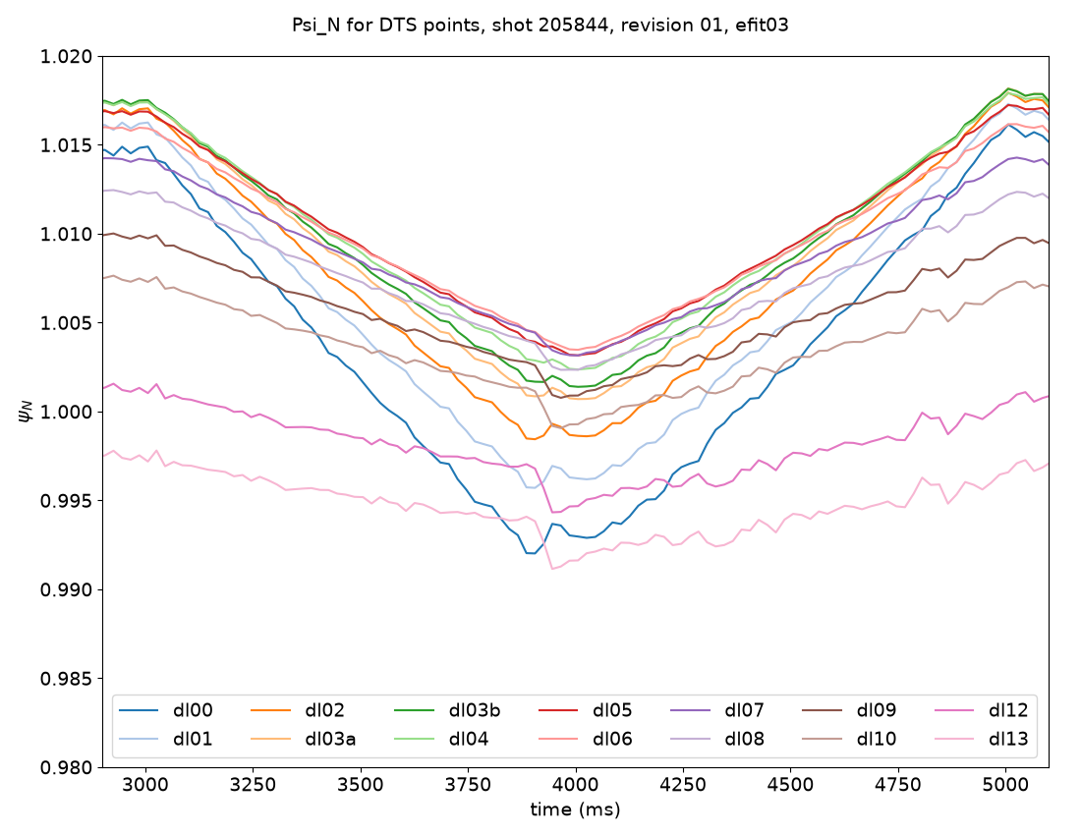

Divertor strike point sweep

