Slide 1
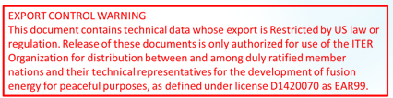
Electron density measurements for high power magnetic confinement fusion
George Vayakis, Aleksandr Frolov, Mark Kempenaars, Martin Kocan, Yong Liu, Lucas Moser, Pavel Shigin and Victor Udintsev
for the ITER Organization and Domestic Agency diagnostic design and construction teams

Slide 2
Outline
Introduction:
  High power fusion
  The ITER diagnostic mission
  Role of density in ITER
Electron density technique application in ITER
  Interferometry with Polarimetry
  Thomson scattering
  Reflectometry
Concluding remarks

Slide 3
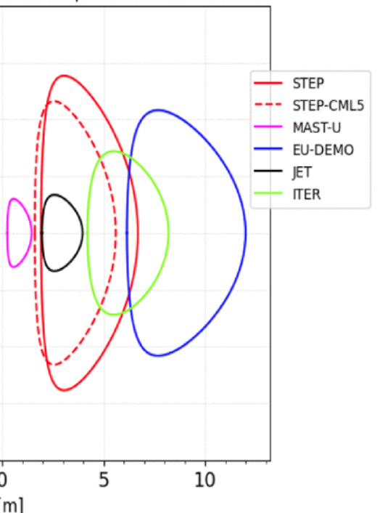
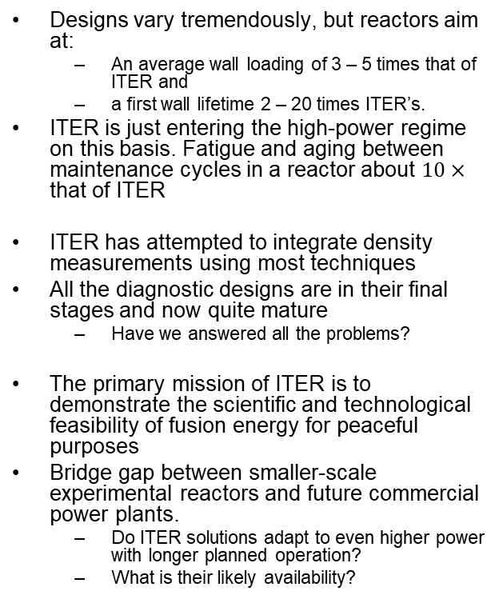
What is “high power fusion”
Designs vary tremendously, but reactors aim at:
  An average wall loading of 3 – 5 times that of ITER and
  a first wall lifetime 2 – 20 times ITER’s.
ITER is just entering the high-power regime on this basis. Fatigue and aging between maintenance cycles in a reactor about $10×$ that of ITER
ITER has attempted to integrate density measurements using most techniques
All the diagnostic designs are in their final stages and now quite mature
  Have we answered all the problems?
The primary mission of ITER is to demonstrate the scientific and technological feasibility of fusion energy for peaceful purposes
Bridge gap between smaller-scale experimental reactors and future commercial power plants.
  Do ITER solutions adapt to even higher power with longer planned operation?
  What is their likely availability?
Machine | Fusion / Power [MW] | FW area [m2] | < Wall Load > [MW / m2] | FW Lifetime [FPY]
ITER | 500 | ~ 1000 | 0.5 | 0.5
SPARC [1] | 140 | ~ 56 | 2.5 | <<1
ARC [2] | 525 | ~200 | 2.5 | 9
EU DEMO 17 [3] | 2000 | ~1250 | 1.5 | “several”
SPP [4] | 1680 | ~800 | 2.0 | 1~2
[4] Muldrew et al 2026
0
5
10
[m]
0
[2] Sorbom et al, 2015,
[1] P. Rodriguez-Fernandez et al 2022
[3] Federici et al 2017
[4] Muldrew et al 2026

Slide 4
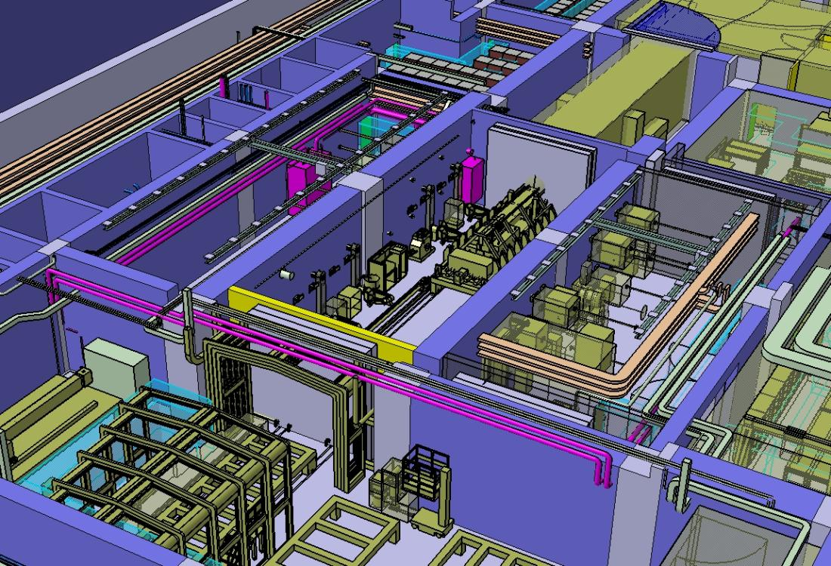
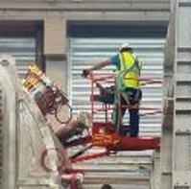
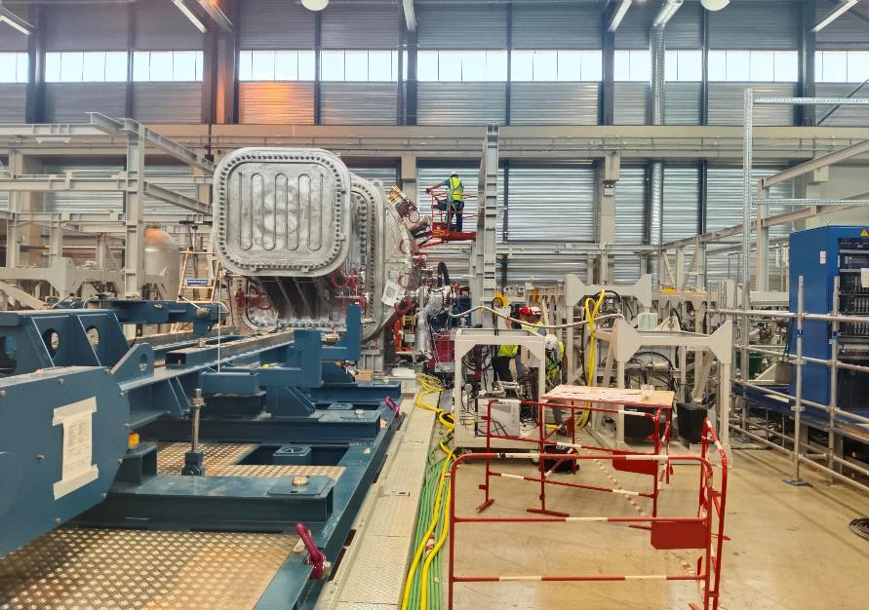
Why reliability matters
Maintenance of diagnostics can burn through resources
  Large, activated items to be removed / repaired or replaced
  Replacement modules in the 10-100 M€ range
Replacement times are long – several months
Remanufacture even longer – several years
High power devices rely on diagnostics for key machine protection and control functions
  Low reliability of diagnostic front ends can have a heavy impact on machine availability.

Slide 5
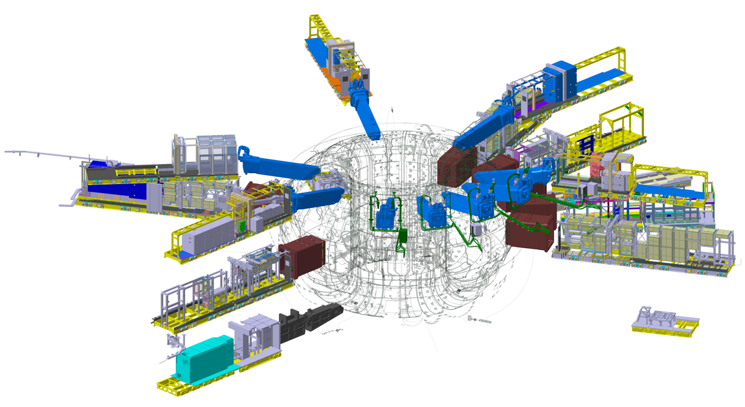
Large diagnostic set reflects the breadth of ITER mission
SRO
ITER Research Plan relies on a broad and deliberately selected diagnostics set
Many there from the first ITER phase (SRO) – exploration and preparation for DT exploitation
High power machines would typically follow these stages
All electron density diagnostics planned for first phase
ITER research plan report (2024)
Magnetics
Plasma Current Monitor
Neutron Activation System
Divertor Neutron Flux Monitor
Bolometers
High Field Side Reflectometry
Pressure Gauges
Dust Monitor
In-Vessel ECH Detectors
Core Thomson Scattering
Edge Thomson Scattering
Toroidal Interfometer Polarimeter
Poloidal Polarimeter
H-alpha & Vis Spectroscopy
Vacuum Ultraviolet Survey
Divertor Impurity Monitor
Core Imaging X-ray Spectrometer
Visible Continuum Array
Radial X-ray Camera
Neutral Particle Analyzer
X-Ray Crystal Spectro. Survey
Hard X-ray Monitor
Vacuum Ultraviolet Divertor
Vacuum Ultraviolet Edge Imaging
Electron Cyclotron Emission
Low Field Side Reflectometry
Density Interfometer Polarimeter
Visible / IR in Equatorial Ports
Thermocouples
Residual Gas Analysis
Divertor IR Thermography
Langmuir Probes
Visible / IR in Upper Ports
Tritium Monitor
First Wall Samples
Boundary Imaging System
In-Vessel Viewing System
After SRO
Radial Neutron Camera | High Resolution Neutron Spectrometer | Charge Exchange Recomb. Spectr – Edge
Vertical Neutron Camera | Divertor Thomson Scattering | CXRS Pedestal - Beam Emission Spectroscopy
Neutron Flux Monitor | Collective Thomson Scattering | XRCS Edge Imaging
Radial Gamma Ray Spectrometer | Charge Exchange Recomb. Spectr - Core | Calorimetry
Lost Alpha Monitor | Motional Stark Effect | Microfission chambers

Slide 6
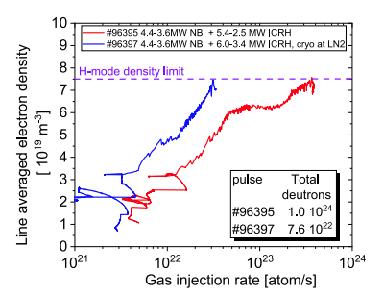
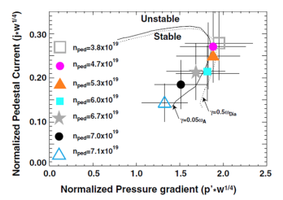
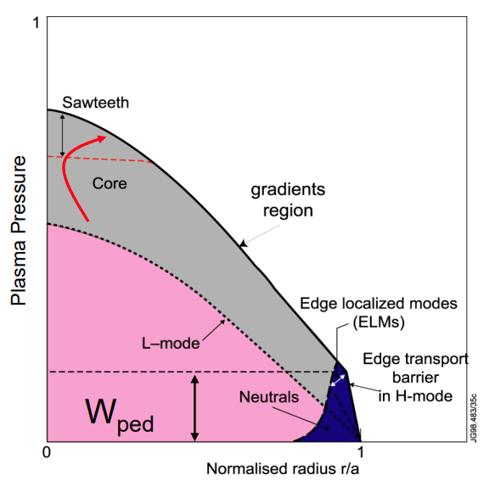
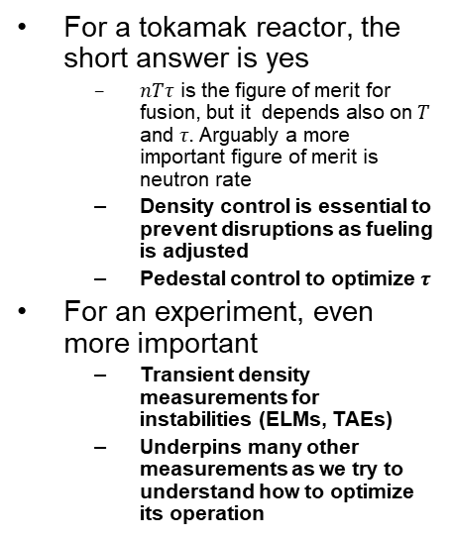
A step back…
Do we really need density measurements at all?
For a tokamak reactor, the short answer is yes
  $nTτ$ is the figure of merit for fusion, but it depends also on $T$ and $τ.$ Arguably a more important figure of merit is neutron rate
  Density control is essential to prevent disruptions as fueling is adjusted
  Pedestal control to optimize $τ$
For an experiment, even more important
  Transient density measurements for instabilities (ELMs, TAEs)
  Underpins many other measurements as we try to understand how to optimize its operation
To steer away from the density limit.
To estimate the pressure gradient
Huber et al NF (2024)
AW Leonard et al, JNM (2014)

Slide 7
ITER measurements of density - contributions
Measurement | Parameter | Core Plasma Thomson Scattering | Thomson Scattering - Edge | Toroidal Interferometer/Polarimeter | Polarimeter Poloidal | Reflectometer (Main Plasma, LFS) | Reflectometer (Main Plasma, HFS) | Density Interferometer Polarimeter (DIP)
06. Line-averaged electron density | 011: ∫ne dl / ∫ dl | S |  | P | S | S | S | P
24. Electron density profile | 054: Core ne profile | P |  | S | S | S | P
 | 055: Edge ne profile |  | P | S | S | P
27. High frequency instabilities (MHD, NTMs, AEs, turbulence) | 063: TAE δN / n, δT/T |  |  | P | B | P | P
14. H-mode, ELMs and L-H mode transition indicator | 031: ELM density transient |  | S |  |  | P | P
Primary – well suited
Backup – can be OK but limited in some way
Supplementary – supplies input but does not stand alone
Some key inputs not shown esp. magnetics equilibrium
Further reading: D Mazon et al, NF (2026) – subchapter 1

Slide 8
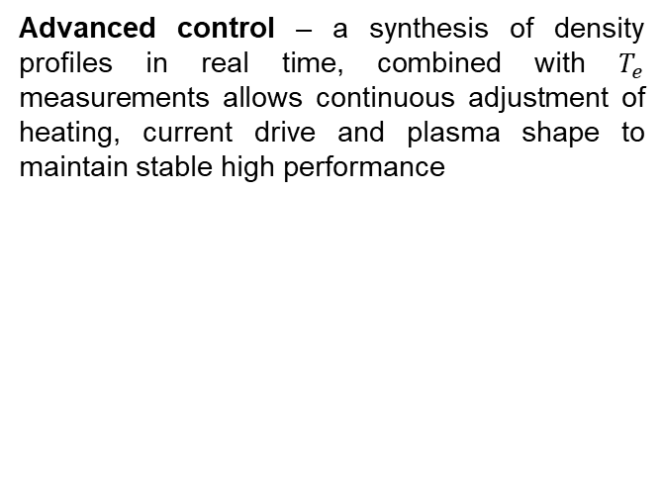
How are the parameters used in ITER ?
011: ∫ne dl / ∫ dl
054: Core ne profile
054: Core ne profile
055: Edge ne profile
Basic control: Adjust fueling to maintain fusion power while monitoring proximity to the density limit.
Advanced control – a synthesis of density profiles in real time, combined with $T_{e}$ measurements allows continuous adjustment of heating, current drive and plasma shape to maintain stable high performance
Parameter | Role | Condition | Range or Coverage | Time or Freq | Spatial or Wave No. | Accuracy
011: ∫ne dl / ∫ dl | 1a.2 BC | Default | 1E18 - 4E20 m-3 | 1 ms | Integral | 1 %
 |  | DMS | 8E20 - 2E22 m-3 | 1 ms | Integral | 100 %
054: Core ne profile | 1b. AC | r/a < 0.85 | 3E19 - 3E20 m-3 | 10 ms | 65 mm | 5 %
055: Edge ne profile | 1b. AC | r/a > 0.85 | 5E18 - 3E20 m-3 | 10 ms | 5 mm | 5 %

Slide 9
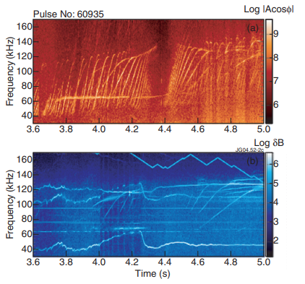
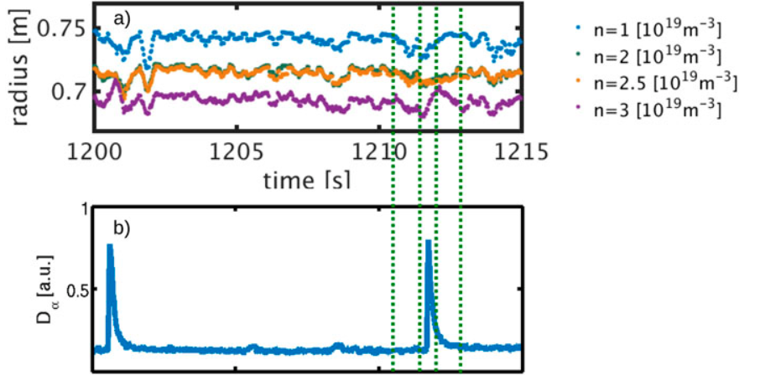
How are the parameters used in ITER ?
< 063: TAE δN / n, δT/T
031: ELM density transient >
.
Monitor the evolution of TAE modes for physics understanding
Monitor ELM size for physics understanding
Sharapov et al, PRL (2004)
O Bogar et al RSI (2020)
Parameter | Role | Condition | Range or Coverage | Time or Freq | Spatial or Wave No. | Accuracy
063: TAE δN / n, δT/T | 2. PHY | - | 5E-6 - 5E-4 | 30kHz—0.5MHz | n=2—50 | 30 % (rel)
031: ELM density transient | 2. PHY | r/a > 0.85 | 5E18 - 3E20/m3 | 0.1 ms | 5 mm | 5 %

Slide 10
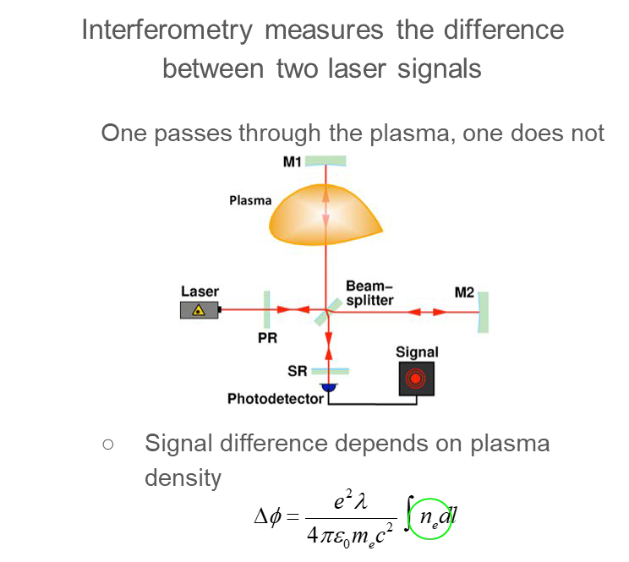

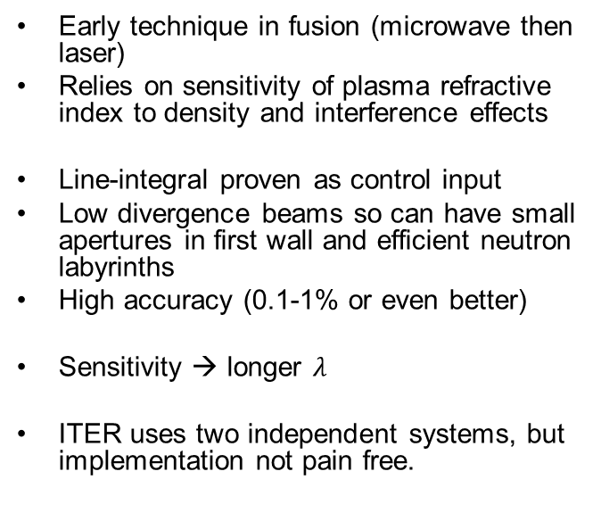
Interferometry – an essential tool
Early technique in fusion (microwave then laser)
Relies on sensitivity of plasma refractive index to density and interference effects
Line-integral proven as control input
Low divergence beams so can have small apertures in first wall and efficient neutron labyrinths
High accuracy (0.1-1% or even better)
Sensitivity → longer $λ$
ITER uses two independent systems, but implementation not pain free.

Slide 11
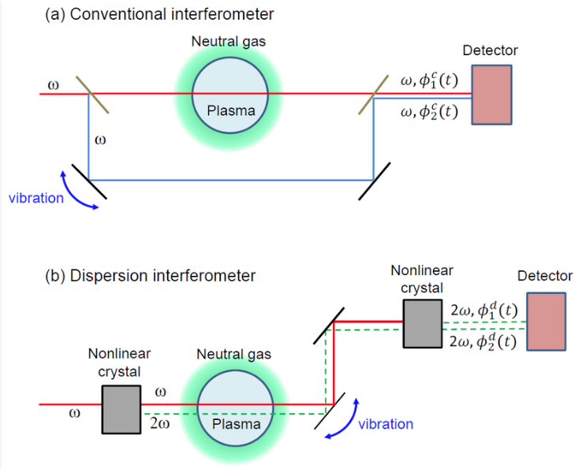
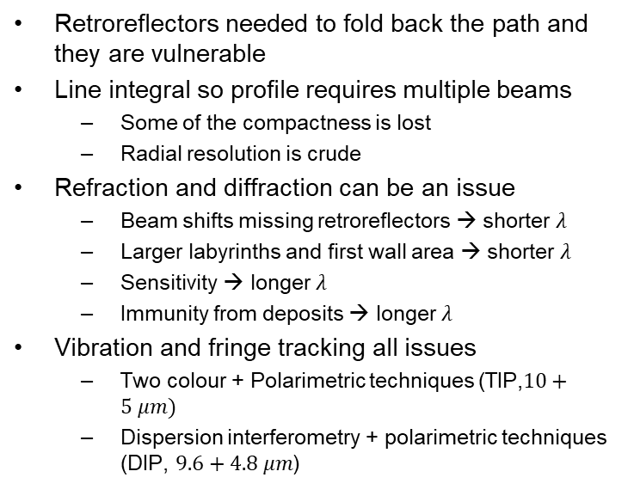
Interferometry / Polarimetry
Issues and evolution
Retroreflectors needed to fold back the path and they are vulnerable
Line integral so profile requires multiple beams
  Some of the compactness is lost
  Radial resolution is crude
Refraction and diffraction can be an issue
  Beam shifts missing retroreflectors → shorter $λ$
  Larger labyrinths and first wall area → shorter $λ$
  Sensitivity → longer $λ$
  Immunity from deposits → longer $λ$
Vibration and fringe tracking all issues
  Two colour + Polarimetric techniques (TIP,$10+5 μm)$
  Dispersion interferometry + polarimetric techniques (DIP, $9.6+4.8 μm$)
Akiyama et al, 2015

Slide 12
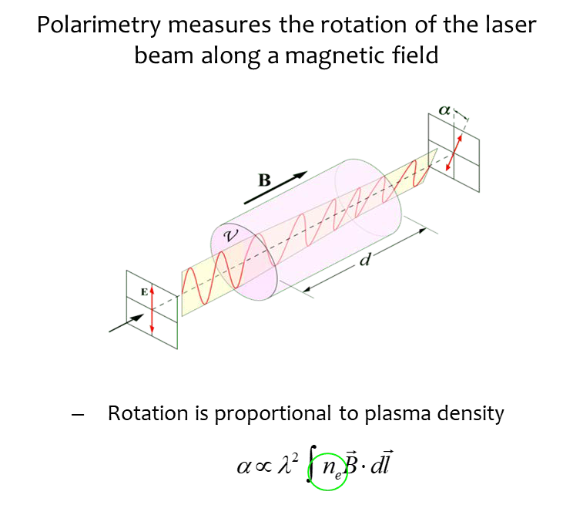
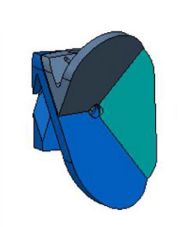
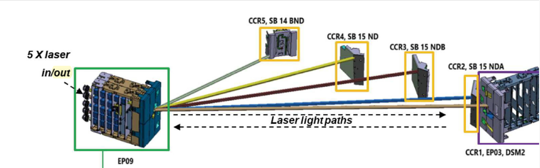
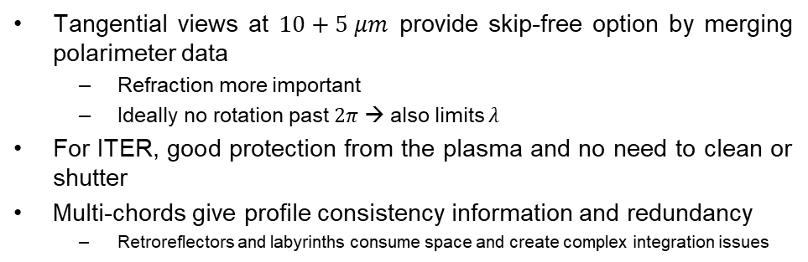

TIP: improving interferometry by adding polarimetry
Tangential views at $10+5 μm$provide skip-free option by merging polarimeter data
  Refraction more important
  Ideally no rotation past $2π$ → also limits $λ$
For ITER, good protection from the plasma and no need to clean or shutter
Multi-chords give profile consistency information and redundancy
  Retroreflectors and labyrinths consume space and create complex integration issues
5 x

Slide 13
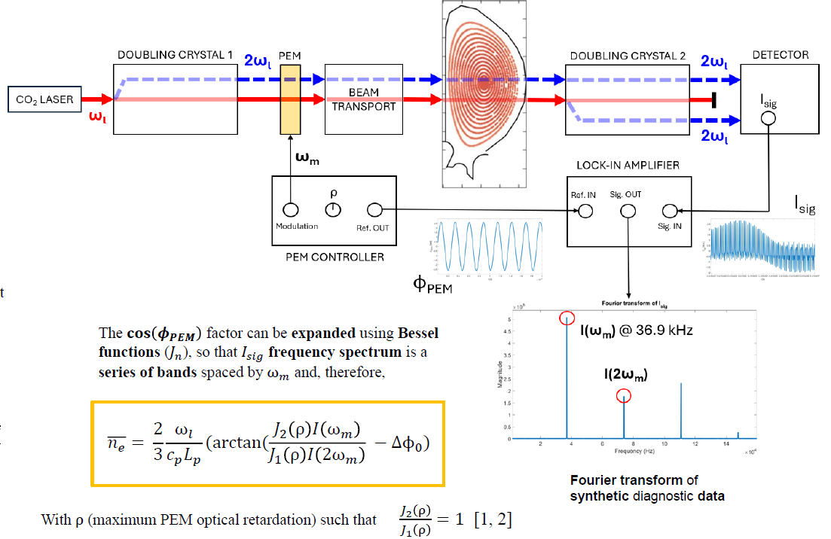
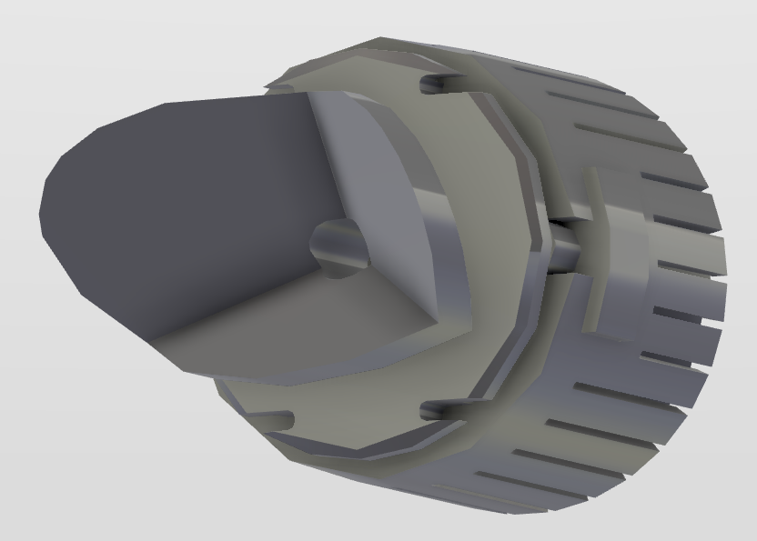
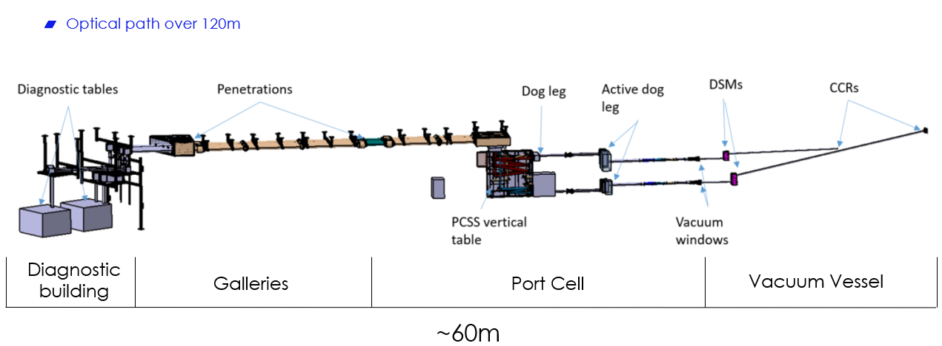
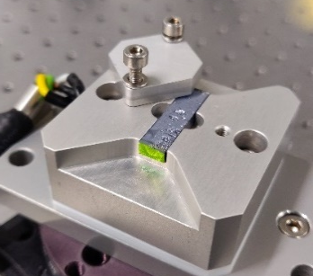



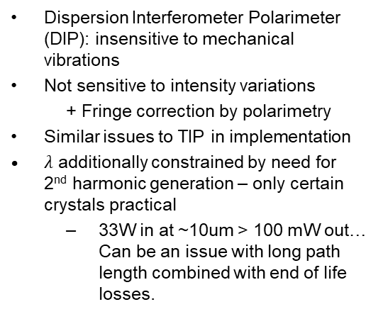


DIP: Eliminating path length effects intrinsically
F Bagnato et al, JINST (2024)
Dispersion Interferometer Polarimeter (DIP): insensitive to mechanical vibrations
Not sensitive to intensity variations
  + Fringe correction by polarimetry
Similar issues to TIP in implementation
$λ$ additionally constrained by need for 2nd harmonic generation – only certain crystals practical
  33W in at ~10um > 100 mW out… Can be an issue with long path length combined with end of life losses.
OpGaAs crystal

Slide 14
Key points from ITER for interferometry / polarimetry
Lesson | TIP | DIP | Towards Reactor
Wavelength is a compromise that is machine and technology dependent | X | X | Likely
Neutron shielding is relatively easy to manage | Yes, with some compromises made | Yes | (-)
Mirror cleaning and shutters not necessary | X | X | Likely yes, but not certain as lifetime needs higher
Retroreflectors hard to design and should be integrated into first wall from the start | X | X | X
First wall occupancy / interface is extensive | 0.2% | 0.1% | Lower, if the shielding is moved further out
Unrecoverable failure modes are few | One common mirror, well protected | None specific | Likely few
Redundancy must be high as basic control | 2 equivalent measurements within system | 2 equivalent measurements within system, but only one fringe jump corrected | Will depend on risk appetite of reactor designer

Slide 15
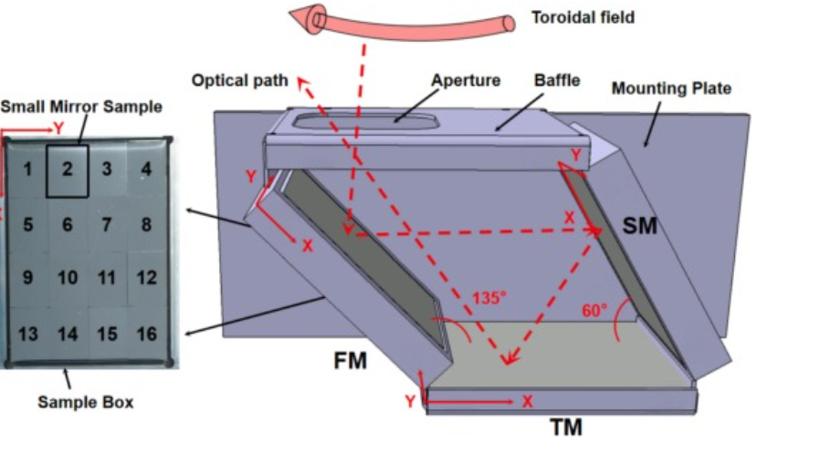
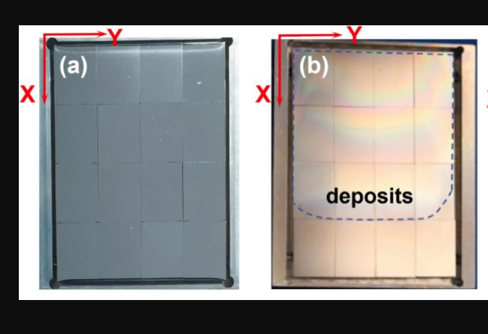
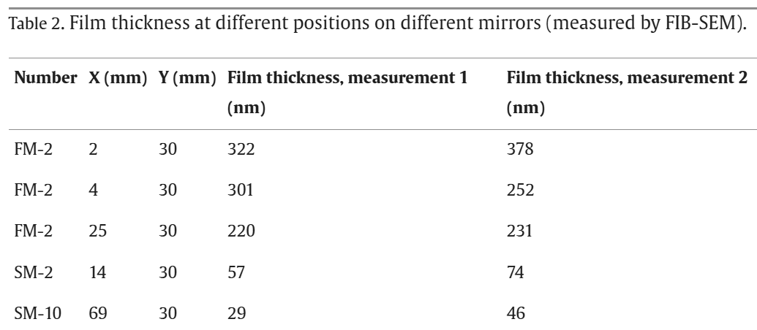
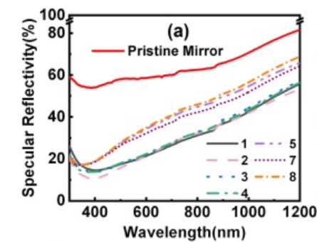
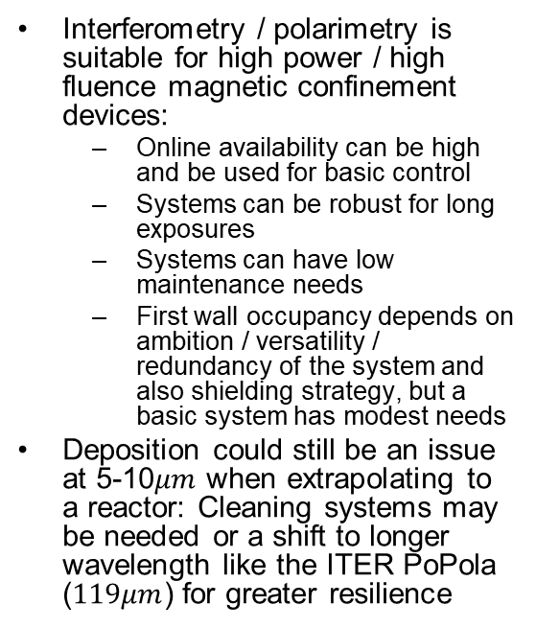
Application summary for interferometry / polarimetry
Interferometry / polarimetry is suitable for high power / high fluence magnetic confinement devices:
  Online availability can be high and be used for basic control
  Systems can be robust for long exposures
  Systems can have low maintenance needs
  First wall occupancy depends on ambition / versatility / redundancy of the system and also shielding strategy, but a basic system has modest needs
Deposition could still be an issue at 5-10$μm$ when extrapolating to a reactor: Cleaning systems may be needed or a shift to longer wavelength like the ITER PoPola ($119μm$) for greater resilience
8 cycles of boronization in EAST Wang et al, J NME (2026)

Slide 16
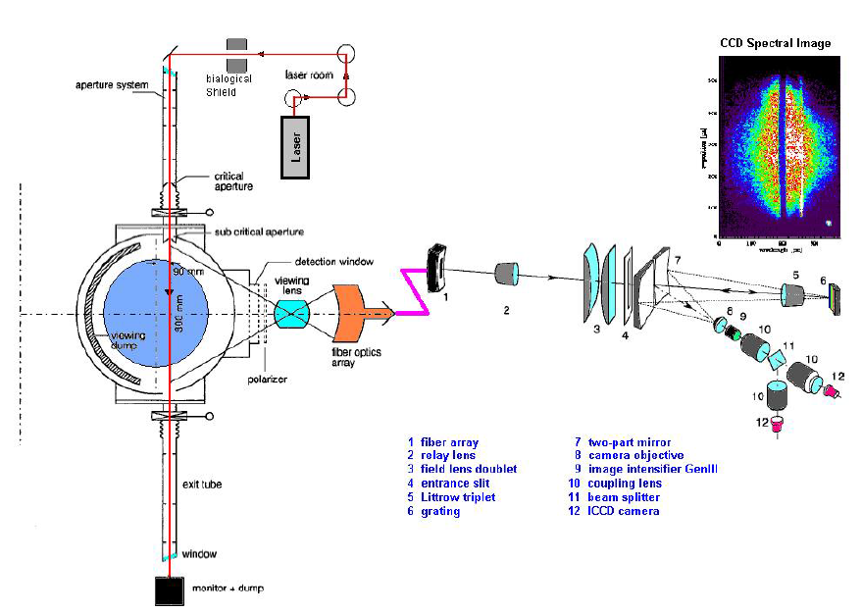
Thomson Scattering – the gold standard?
Direct scattering off the electron cloud → Electron distribution function
  Absolute measurement of the local density.
  Bonus: provides temperature!
  Control level accuracy: usually <5%
Time resolution limited by laser repetition rate and power handling on beam dump, typically 10 ms for extended periods
Many, many examples in the literature
Varshney et al, 2003

Slide 17
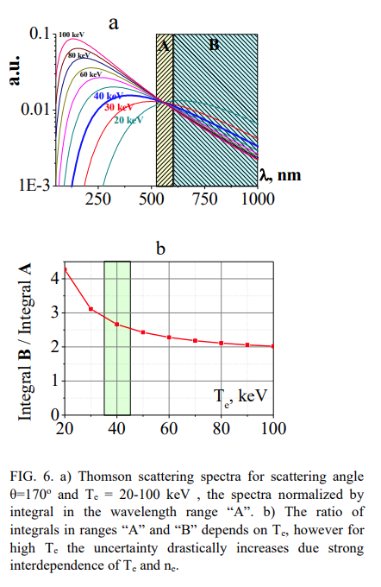
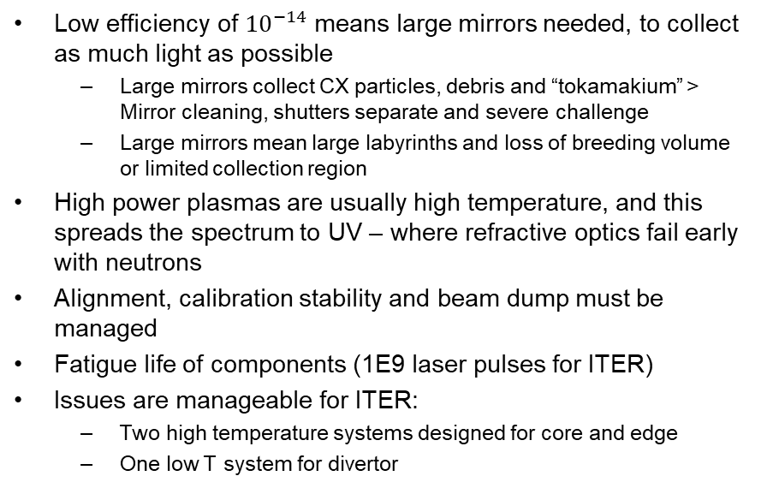
Thomson Scattering Issues for high power / fluence
Low efficiency of ${10}^{−14}$ means large mirrors needed, to collect as much light as possible
  Large mirrors collect CX particles, debris and “tokamakium” > Mirror cleaning, shutters separate and severe challenge
  Large mirrors mean large labyrinths and loss of breeding volume or limited collection region
High power plasmas are usually high temperature, and this spreads the spectrum to UV – where refractive optics fail early with neutrons
Alignment, calibration stability and beam dump must be managed
Fatigue life of components (1E9 laser pulses for ITER)
Issues are manageable for ITER:
  Two high temperature systems designed for core and edge
  One low T system for divertor
D Mazon et al, NF (2026) - subchapter 6

Slide 18
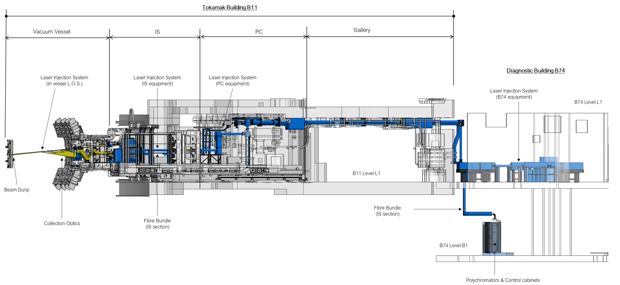

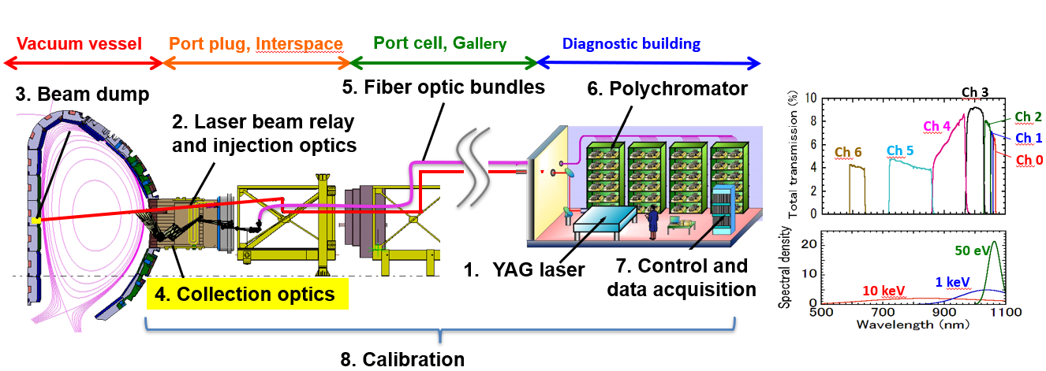

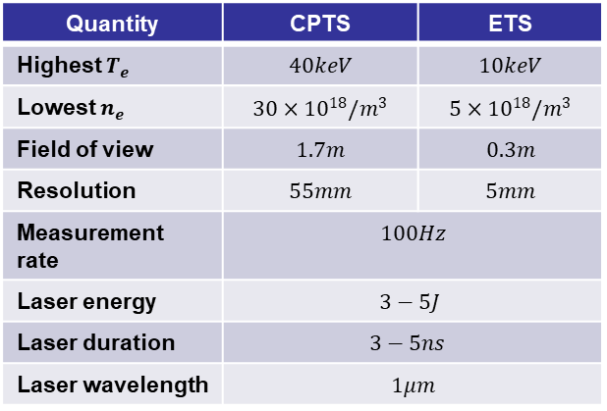
Core and Edge system are very similar
Extended optical laser input path from Diagnostic Hall to the ISS then in free space to the laser beam dump on the plasma facing first wall, ~40m
Collection is complex optical in-vessel system, relaying the data on a set of optical fibres in the ISS, which then relay the photons to the spectrometers in the diagnostic hall, B1-level.
Quantity | CPTS | ETS
Highest $T_{e}$ | $$40keV$$ | $$10keV$$
Lowest $n_{e}$ | $$30×{10}^{18}/m^{3}$$ | $$5×{10}^{18}/m^{3}$$
Field of view | $$1.7m$$ | $$0.3m$$
Resolution | $$55mm$$ | $$5mm$$
Measurement rate | $$100Hz$$
Laser energy | $$3−5J$$
Laser duration | $$3−5ns$$
Laser wavelength | $$1μm$$

Slide 19
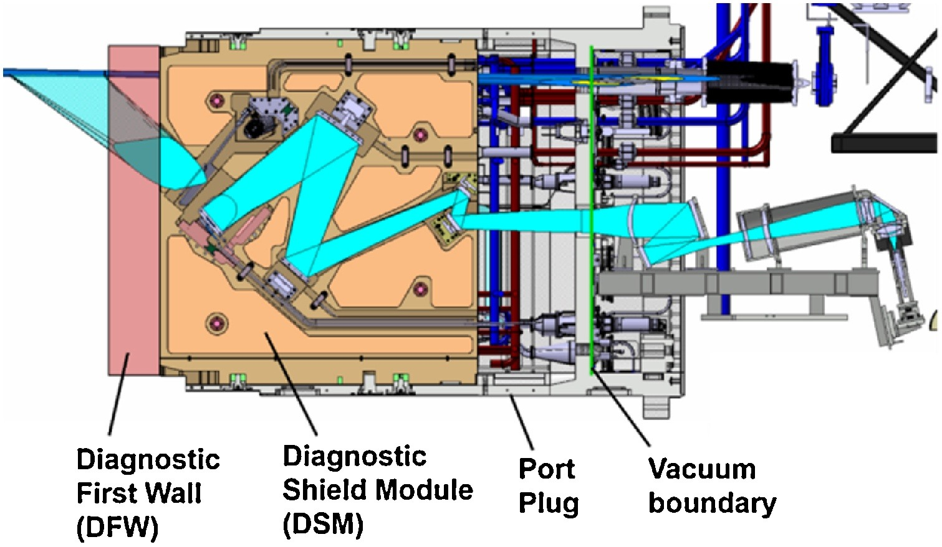
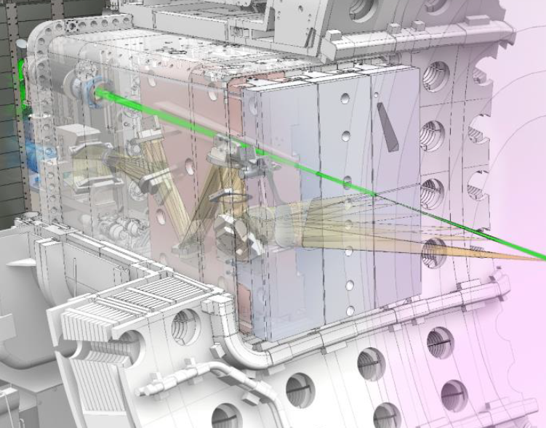
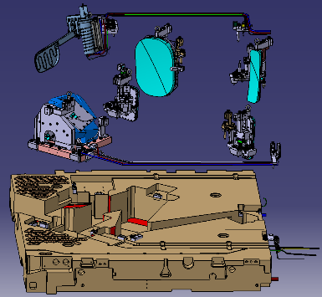
Port occupancy also the same …
CPTS: 1/3rd of a port or 0.1% of the FW. Multiple reflective optics in vacuum. Complex refractive optics just outside.
ETS: 1/3rd of a port or 0.1% of the FW. Multiple reflective optics in vacuum. Complex refractive optics just outside.
Yatsuka et al, 2017

Slide 20
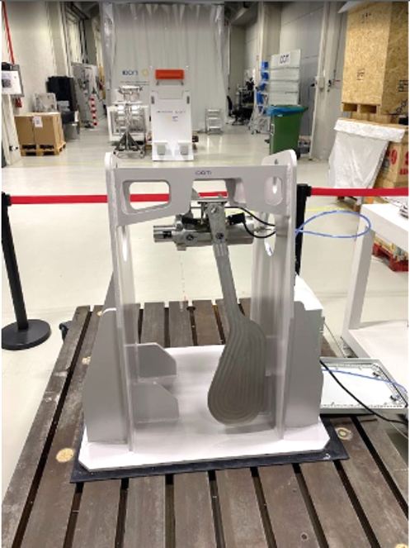
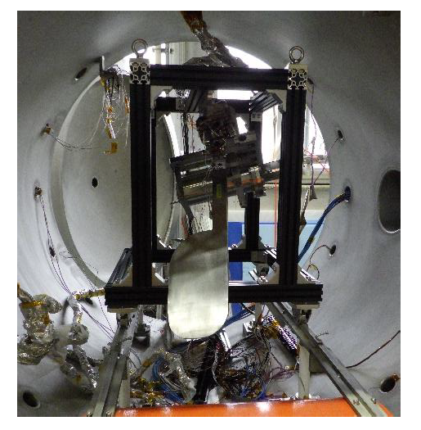
TS Mirror protection technologically successful
Prototype shutter for CPTS, closed during machine conditioning / boronization
Prototype shutter for ETS during in-vacuum tests

Slide 21
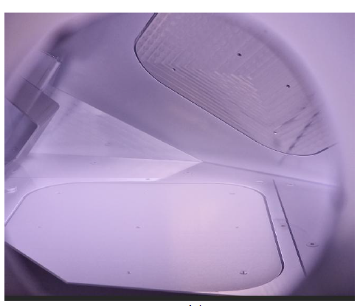
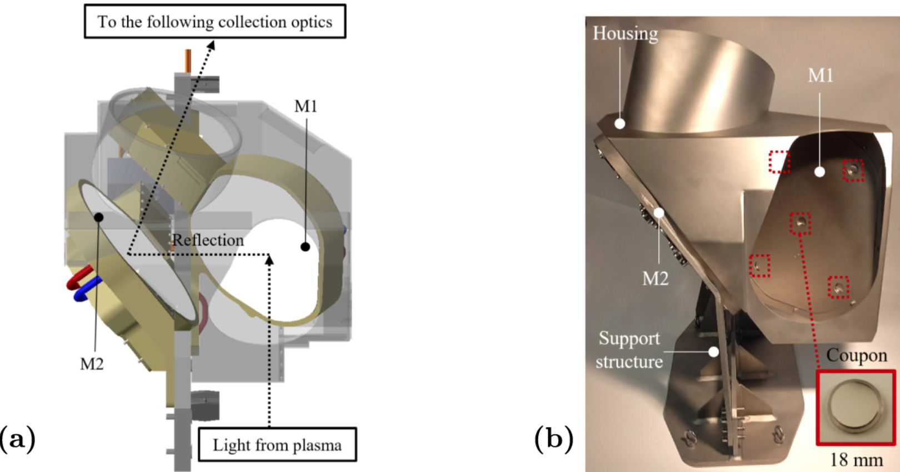

TS Mirror cleaning is similar for these systems and can restore reflectivity for ITER conditions, but some aging is expected
Mirror cleaning for CPTS: Mockup of the first two mirrors to be tested in an RF discharge
Mirror cleaning for ETS: Photo of the plasma maintained in the ETS test mock-up: 40.68 MHz discharge in argon at 5 Pa, WRFG=300 W
Wang et al, NF, 2026

Slide 22
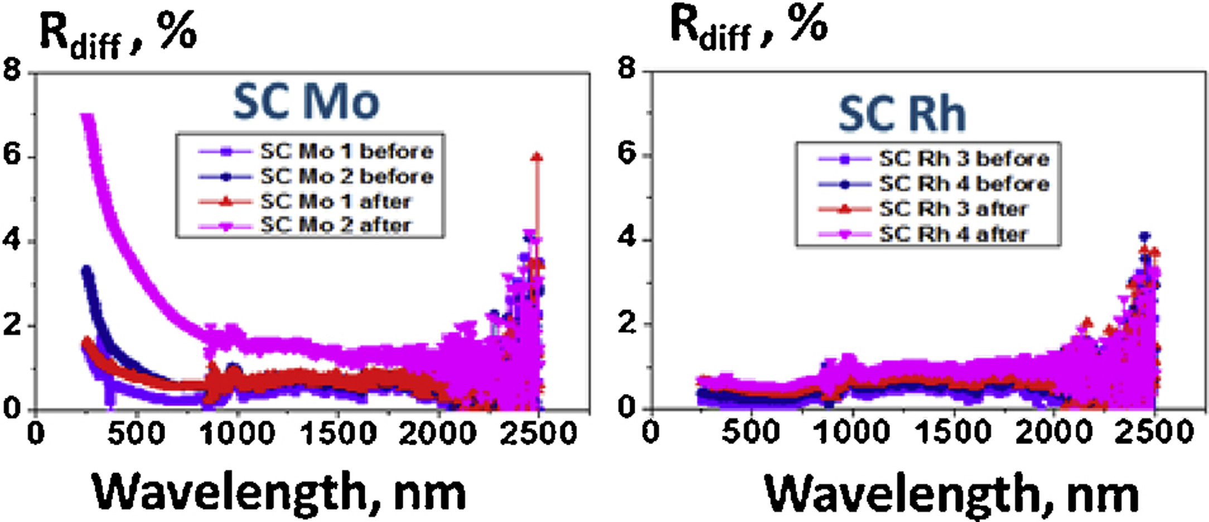
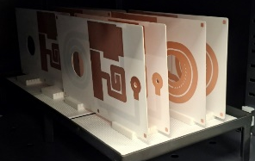
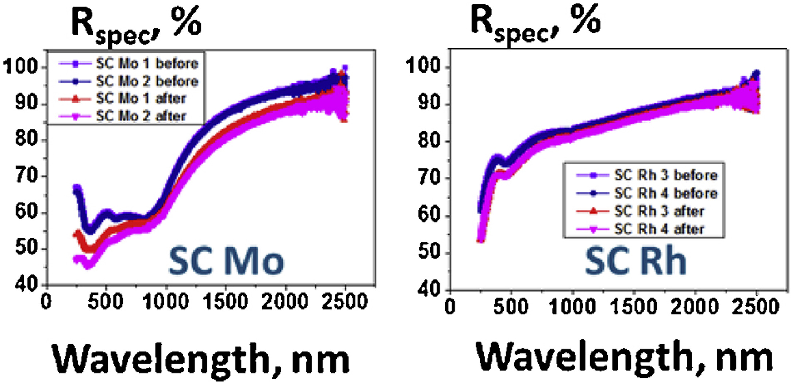
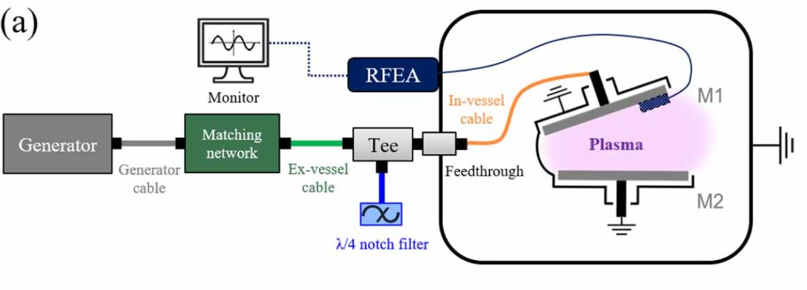
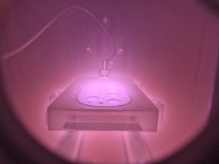
Mirror recipe (pictures from 55.E6 VSRS system)
Most common solution: RF cleaning somewhere in the 13.5 – 80 MHz range
Cooled mirrors floating at RF using tuned stubs
Matching circuit directly behind 1st mirrors to match plasma / cavity impedance (here printed and fired copper circuits on Alumina substrates – other technologies possible)
Cleaning of pairs of mirrors in one cavity
Generally - restores specular reflectivity, but minor degradation could occur over many cleaning cycles
Y Wang et al, NF, 2026
Further reading: D Mazon et al, NF (2026) - subchapter 9
A Litnovski et al, FED (2017)

Slide 23
Key points from ITER for Thomson Scattering
Lesson | Core | Edge | Towards Reactor
Near back-scattering configuration tricky to work at high temperature as UV transmission difficult | X |  | Avoid, but other problems
High etendue and neutron suppression require complex and expensive labyrinths – hard to avoid | X | X | Same, but use of space in ITER lower than interferometry
Mirror cleaning and shutters necessary | X | X | Harder to avoid and do not extrapolate well to longer lifetimes
Beam-dump requires careful design and may limit lifetime – design without if possible | X | X | May be possible if replaced with FW (integral part) and well shielded. Integrate from the start
Maintenance can be needed every ~1 FPY | N/A | N/A | Likely due to optics degradation
First wall occupancy / interface is manageable | 0.1% | 0.1% | About the same
Optics in-vessel complexity / tolerances are high and tight | X | X | Same or more difficult
Unrecoverable failure modes (mitigated for ITER) remain | Shutter breakdown, mirror degradation, optics darkening |  | These, plus refractive optics replacement?

Slide 24




Application summary for Thomson Scattering
For ITER, problems were foreseeable and foreseen:
  High $T_{e}$ → managed for Core TS with calibration laser. Two-port solution works better and allows polarimetric Thomson as a bonus – but worsens alignment issues
  Alignment → solved, partially by using one port only, with consequences on integration
  Radiation shielding → partially solved, maintenance conditions just outside port could still improve
  Radiation effects → solved, but risks remain
  Mirror degradation → solved, but risks remain
  Stray light → solved, but risks remain
These problems all worsen for higher power and fluence
Breeding volume loss aside, traditional multi-point design TS for density profiles looks like a risky investment for higher power devices as maintenance needs high
→ Some version of TS clearly feasible for first of a kind reactor prototypes but will have limited lifetime.
R Scannell (Private Communication, 2016)
F Bagnato et al, RSI (2024) study of polarimetric Thomson in ITER to reach high Te

Slide 25



Reflectometry
Basics + pluses
Issues and evolution
Full coverage requires many bands and access from both high and low-field side
3D- sensitive
  Multiple sightlines to cover plasma movement
  Sensitive to plasma modes and interference from complex shapes during MHD (“multi-path”)
  For control, real-time quality of the data must improve
Mechanical precision very hard to achieve for large machines and high-power environment.
  Parasitic reflections, mode conversion and multipath effects
Initialization of the profile can be troublesome
Still relatively young technique but with plenty of implementation examples
Group delay to a plasma cutoff layer > invert to profile
Rad hard and can be small- can be integrated
Maintenance free if well designed
Time resolution from 1 $μs$ possible
Range uncertainty<> resolution of a few mm limits accuracy depending on gradient
Santos et al, PPCF (1999)

Slide 26


ITER systems / LFSR
Low field side reflectometry
Constraints
O- and X-mode reflectometry from the low field side
Multi-band to cover full density range
Multi level for robustness with plasma movement
Monostatic to reduce waveguide count
Flat / hollow profiles for O-mode
For upper X-mode
  Full and half-field operation
  Downshifted absorption at high $T_{e}$
Primary measurement only for edge density profile
Long waveguide runs

Slide 27





LFSR System Overview
6-antenna array provides required measurement functions
Reflected waves are received by the launching antenna (monostatic) in the Diagnostic Hall
Water-cooled antennas and support block receive the main nuclear heat loads
Front end components will be installed in first-plasma port EP11 diagnostic shield module, DSM#1

Slide 28





LFSR System Front End
1
2
3
4
Test Antenna Block Advancement
Achieving the precision required for monostatic radar in a high-power environment is very challenging
Essentially, we are designing a custom first wall component for a reactor
1. Block with Gun Drilled channels
2. Block with further machining to connect vertical and horizontal channels
3. Block weld plugs
welded
4. Block Final machining completed
3 – Water-Cooled Antenna Array

Slide 29

ITER systems / HFSR+
Features
Constraints
O- and X-mode reflectometry from the high field side
Multi-band to cover full density range
Bistatic to tolerate more waveguide imperfections and fit!
Primary measurement for core $n_{e}$
Allows refractometry (group delay across the plasma) as a backup measurement
Path and size of waveguides totally determined by machine radial build and shape
Antenna necessarily a compromise
Vertical tolerance more limited

Slide 30


High Field Side Reflectometry in ITER: waveguides
4 independent lines of sights (2 waveguides per transmission line):
  2 lines in Sector 4 (Upper Port #8)
  1 line in Sector 5 (Upper Port #9)
  1 line in Sector 9 (Upper Port #17)
1 single waveguide for refractometry in Equatorial Port #8

Slide 31


High Field Side Reflectometry in ITER: waveguides
Waveguides specially developed for the environment
  Special materials
  Special coating
  Special flanges
  Special mounts
Careful matching to remain in tension despite large shape changes of the VV and heating environment

Slide 32


High Field Side Reflectometry in ITER: Other elements
TL9VLR v1.1
Transmit / Receive antenna pair also special so it can:
  Fit between blanket shields
  Accommodate wide range of target distance (0.5 – 3 m)
  Survive, despite passive cooling only

Slide 33
Key points from ITER for Reflectometry
Lesson Learnt | Core | Edge | Towards Reactor
Engineering integration of antenna (tight tolerances with high loads) is extremely challenging | X | X | Expect problems to be harder
Actual manufacture of the paper solution proves time consuming and expensive | X | X | Can be avoided by early prototyping
Mirror cleaning and shutters necessary | No | No | No
Maintenance needed | No | No | No
First wall occupancy is low to modest | 0.1% | 0.01% | Core system can be reduced with higher power and different front end choices
Assembly complexity is medium | X | X | Same…
Unrecoverable failure modes can be eliminated | X | X | Same

Slide 34




Application Summary for Reflectometry
C Muscatello et al PPCF (2025) for more details of the implemetation of the LFSR
For ITER, design problems were tackled early and solved
  Antenna / waveguide integration
  Antenna heating and mechanical loadings
  Window design
  Machine movements
  Access to the right views (High field side)
Manufacturing problems proved very hard:
  key innovations in design details need to be trialed early in the design phase
Nonetheless, features in the ITER design scale well for a reactor
D Mamchits et al, FED (2018) for more details of the engineering implementation of the HFSR

Slide 35

Concluding remarks
Interferometry / Polarimetry, Thomson Scattering and Reflectometry together provide, for ITER, a robust diagnostic set for density-related parameters:
  Interferometry handles time resolutions from $μs$ upwards with limited spatial resolution but high accuracy
  Thomson scattering handles control-relevant time resolution of 10s of $ms$ upwards with good spatial resolution and reasonable accuracy
  Reflectometry handles time resolutions from ~$5 μs$ upwards with similar accuracy (profiles and disturbances)
As devices move to reactor level power densities and fluence, engineering robustness and simplicity favour first reflectometry, then interferometry.
Thomson performance difficult to ensure long term at reasonable maintenance cost and opportunity cost for T breeding or heating first wall real estate
  A sacrificial system in the startup / exploration phase of the reactor, combined with machine learning and other diagnostics could form a basis for the machine exploitation phase
Interferometry may also be limited by coating buildup on retroreflectors and cleaning / replacement is impractical.
Robust reactor relevant alternatives can be exploited and need a buildup of experience in current devices:
  Refractometry shifts from phase measurements in the IR to group delay measurements in the mm wave range. It is seems robust and we have made provision to explore it in ITER.
  Fast wave interferometry shifts to the RF domain for a mass / fuel density integral and should be as robust as magnetics - it can be an effective backup and should be explored further
D Mazon et al, NF (2026) - subchapters 1, 6, 7 and 9
ITER research plan report (2024)

Slide 36

Thank you for your attention!

Slide 37

The teams
Core Thomson Final Design
Concluding by F4E and contractors
Edge Thomson Final Design
Poloidal Polarimeter
Final design and manufacture by JA-DA and contractors
Toroidal Interferometer / Polarimeter
Low field side Reflectomery
Final design and manufacture by US-ITER and contractors
High Field side Reflectometry, with refractometry option
Final design by and manufacture by Project Center ITER and contractors
Density Interferometer Polarimeter
Final design and manufacture underway by ITER Organization and contractors

Slide 38
Backup slides
Density in the ITER research plan
Refractometry in ITER
Fast wave interferometry on DIIID

Slide 39
Electron density is embedded across the SRO Research Plan
Nearly every SRO activity depends on a combination of complementary measurements. Electron density a key input for many
SRO capability (examples) | What diagnostics enable | Representative diagnostics
Establish the plasma | Ip, equilibrium, density | magnetics, interferometer, visible camera
Control & protect the machine | control inputs, event detection, protection quantities | magnetics, density, radiation, IR cameras, spectroscopy
Develop SRO scenarios | profiles, MHD, H-mode access, heating response | TS, ECE, reflectometry, spectroscopy, X-ray
Understand disruptions | precursors, loads, radiation, runaway electrons | magnetics, bolometry, HXR, IR cameras
Manage plasma-wall interaction | heat loads, W sources, detachment, wall conditioning | IR cameras, spectroscopy, bolometry, Langmuir probes
Build nuclear safety knowledge for D-T | neutron/fluence, dust/tritium/wall inventory, post-operation condition | neutron diagnostics, dust/T monitor, first wall samples, in-vessel viewing system

Slide 40



Refractometry…
Option combines high field side (HFSR antenna) and dedicated low field side antenna
Multifrequency allows reconstruction of $∫n_{e}dl$
Profile dependent, so NN methods envisaged for relevant speed needed (ms) with nonlinearities of order 2%
Of course, for control, the group delay function is well-behaved and can be used directly.
I.A. Vladimirov et al, private communication (2024)

Slide 41



… and beyond: fast wave interferometry for mass integral
Needs two pick up coils
  RF (fast alfven wave, 10s of MHz)
  Radiation Hard
  Mass density so needs $Z_{eff}$
Demonstrated at DIIID
  1997 proof of principle
  2024 -25 exploration
Fast wave reflectometry also promising for $n_{T}/n_{D}$
T Akiyama et al Private Communication (2024)
→ Fast wave interferometer and reflectometer for density measurements on DIII-D and prospects for magnetic confinement fusion reactors
T Akiyama et al J Inst (2025)
Ikezi et al, RSI (1997)

