Slide 1
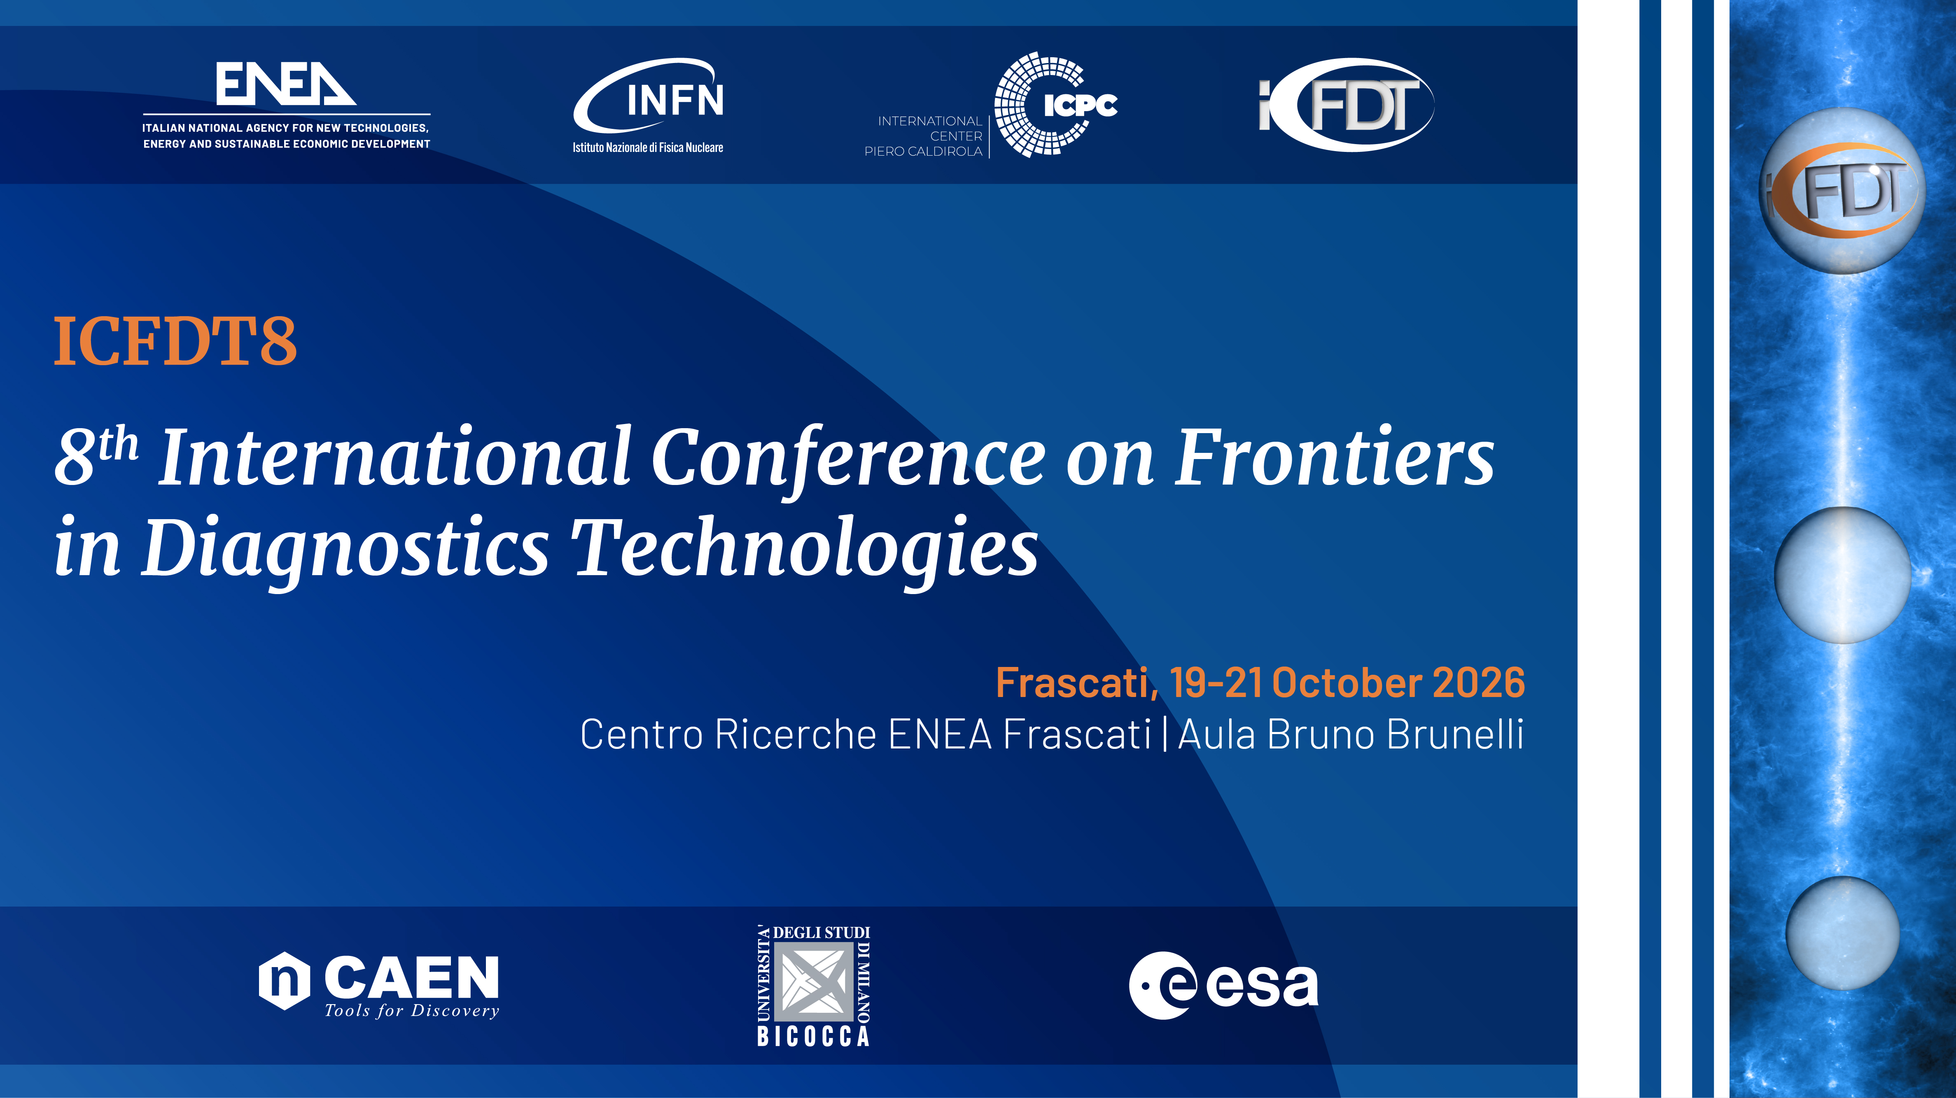
Prototype of a remote LIBS system for the chemical characterization of tungsten-based PFCs
Salvatore Almaviva¹, Danilo Dongiovanni¹, Marco Pistilli¹
¹ ENEA, Italian National agency for new technologies, environment and sustainable economic development,
Frascati research center. Via E. Fermi, 45, 00040, Frascati, Italy.
8th International Conference Frontiers in Diagnostic Technologies (ICFDT8)
19-21 October, 2026, ENEA, Centro Ricerche Frascati, Italy

Slide 2
Outline
What is LIBS?
LIBS as diagnostics to probe the Plasma Facing Components (PFCs)
The first prototype: remote LIBS for FTU
Results
Conclusions

Slide 3
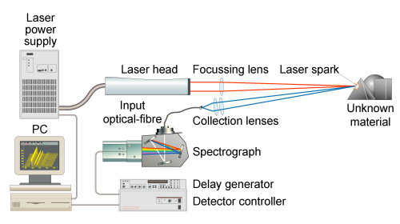
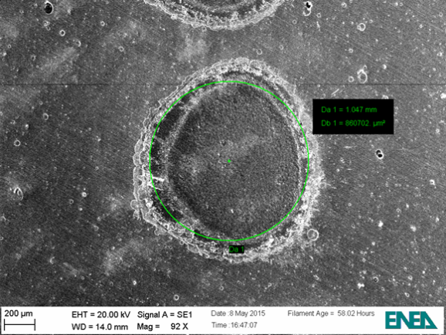
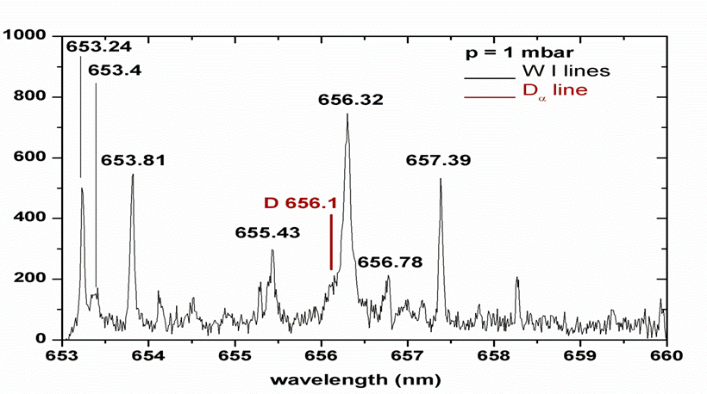
What is LIBS?
LIBS is a rapid chemical analysis technique using a short laser pulse (≤ 10⁻⁹ s) to create a micro-plasma on the sample surface (e.g. PFCs).
1 mm
The LIBS plasma is spectrally analyzed giving the chemical composition of the sample. Laser and optics can be several meters away from the target.

Slide 4
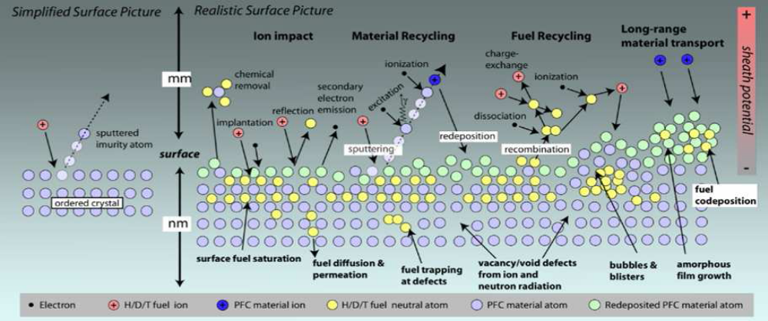
LIBS as suitable diagnostics for PFCs
Whenever a plasma facing component (PFC) is exposed to a fusion plasma it undergoes wall erosion and re-deposition of the unburned fusion fuel (D-T), which determine the lifetime of internal components and the in-vessel T inventory, and thus the availability of the device.
A constant physical-chemical monitoring of the reactor inner walls is mandatory.
Sputtered
Impurity atoms

Slide 5
LIBS as suitable diagnostics for PFCs
Today this is performed by using ex-situ techniques (SIMS, NRA, GDOES etc.), removing PFCs from the inner walls of the fusion device. In next generation fusion devices this task need to be performed with in-situ techniques, avoiding vacuum breaking and not removing PFCs from the inner walls. LIBS can perform this task (for fusion) thanks to its peculiarities:
Simultaneous detection of ALL chemical species in the UV-VIS-NIR spectral range
Hydrogen isotope identification and discrimination
Trace element detection, down to ppm (depending on the chemical species)
Microdistructivity (only few μg of sample are needed for analysis by one laser shot)
No sample preparation is needed
Depth profiling capabilities – multilayer stratigraphy with sub-μm resolution is feasible
Remote detection – either from optical ports or miniaturized robotic probes
Suitable for hostile environments – Hard Rad compatibility
Qualitative and quantitative chemical analysis
Data acquisition in real time

Slide 6
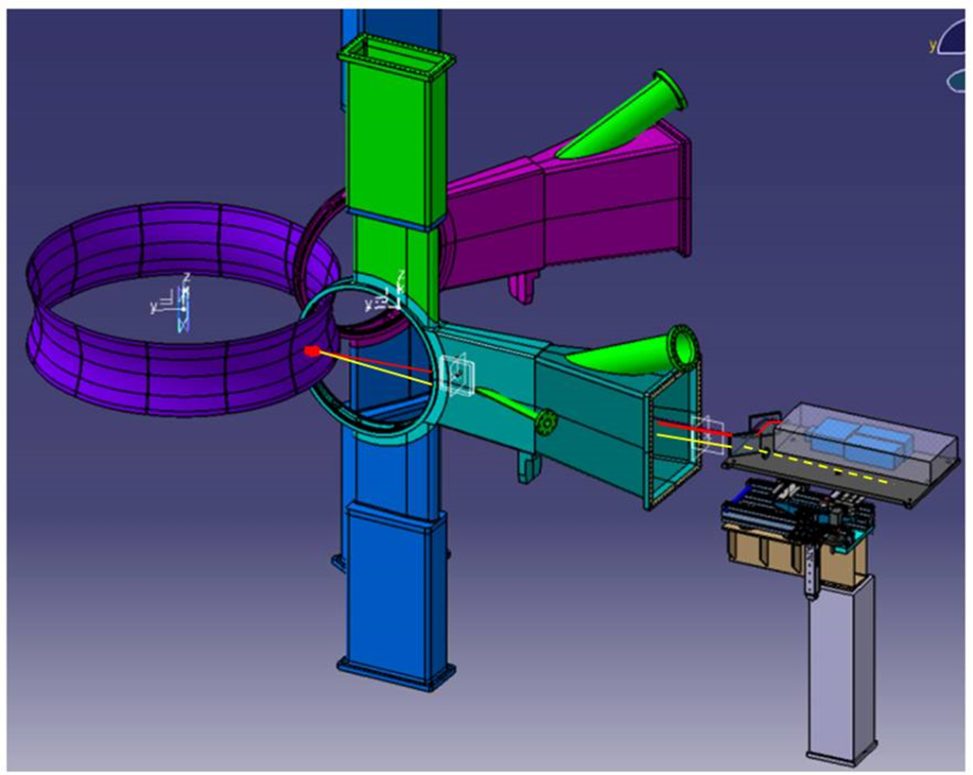
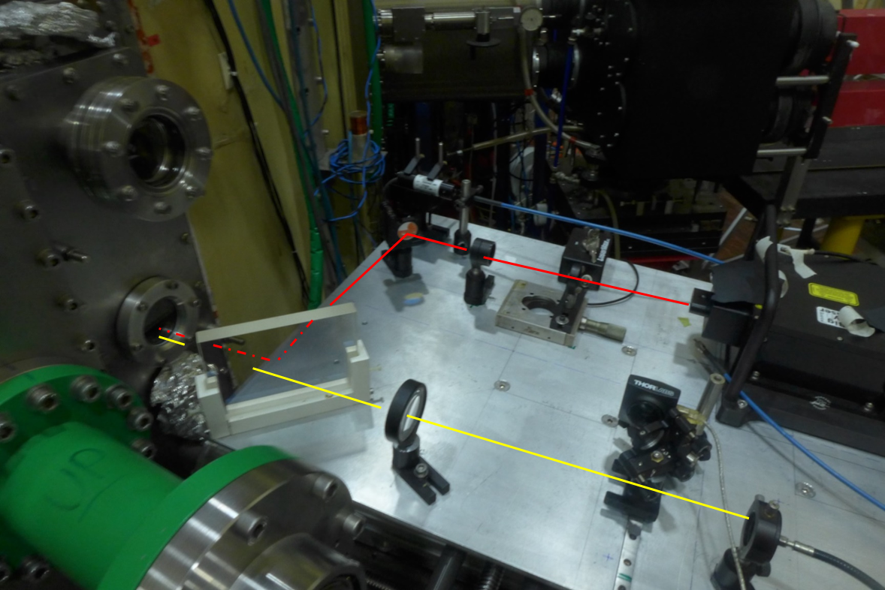
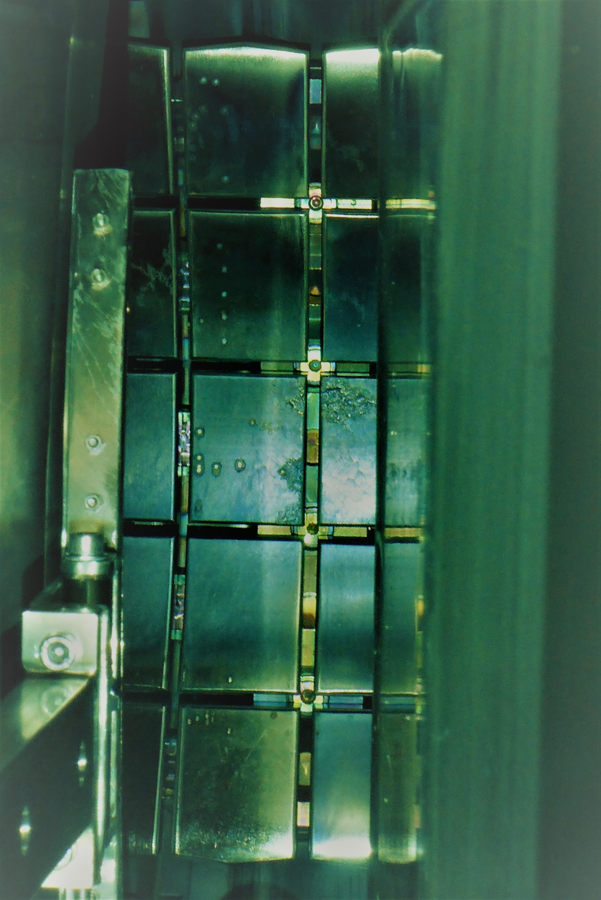
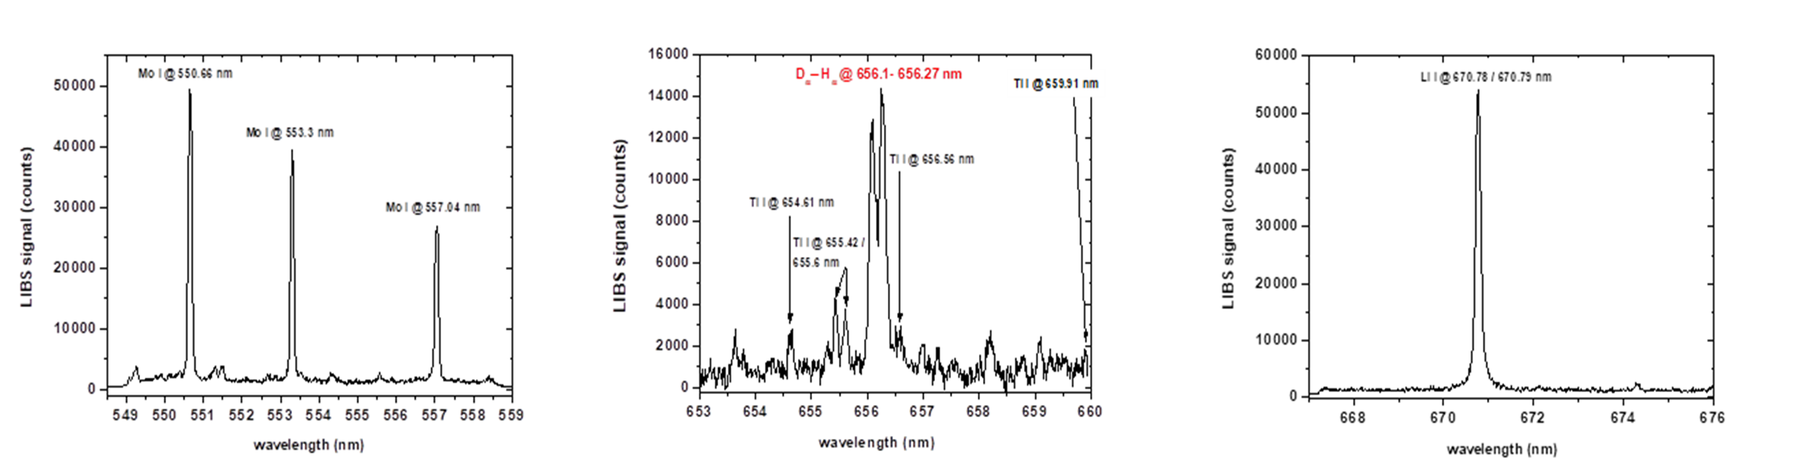
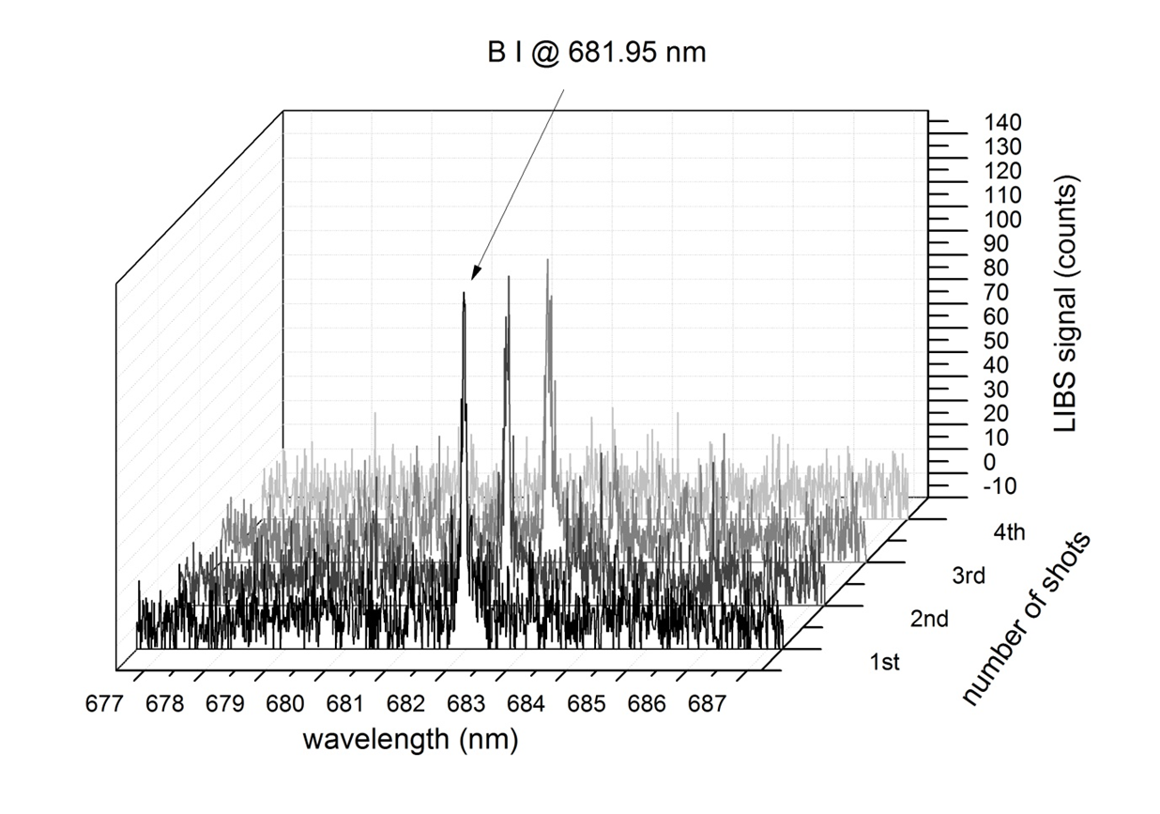
First prototype of a remote LIBS system (FTU)
The first LIBS system for in-situ, in-vacuum, remote characterization of PFCs has been developed in ENEA for the Frascati Tokamak Upgrade (FTU) in 2017*
FTU VV (section)
Laser beam path (---)
LIBS system
LIBS spot on the TZM limiter of FTU
Distance target - LIBS ≈ 2.3 m
Laser
TZM limiter
Plasma light (---)
Collection fiber
a)
b)
c)
d)
Main results: a/b) composition of the TZM limiter b) detection of Hydrogen isotopes in vacuum c) detection of
Lithium deposited on PFCs d) Detection of Boron after the boronization procedure of the FTU inner walls
* G. maddaluno et al. Num Mat En 18 (2019) 208-211

Slide 7
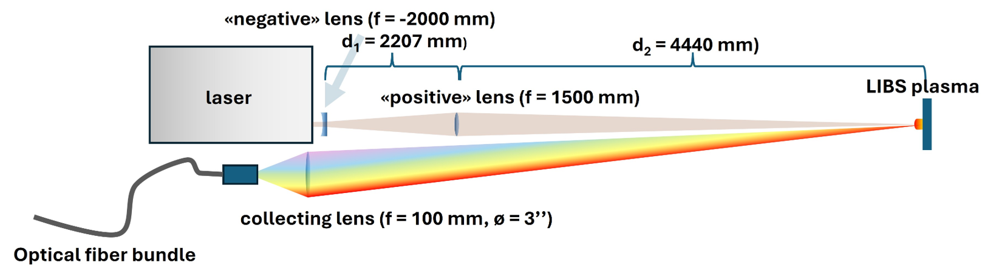
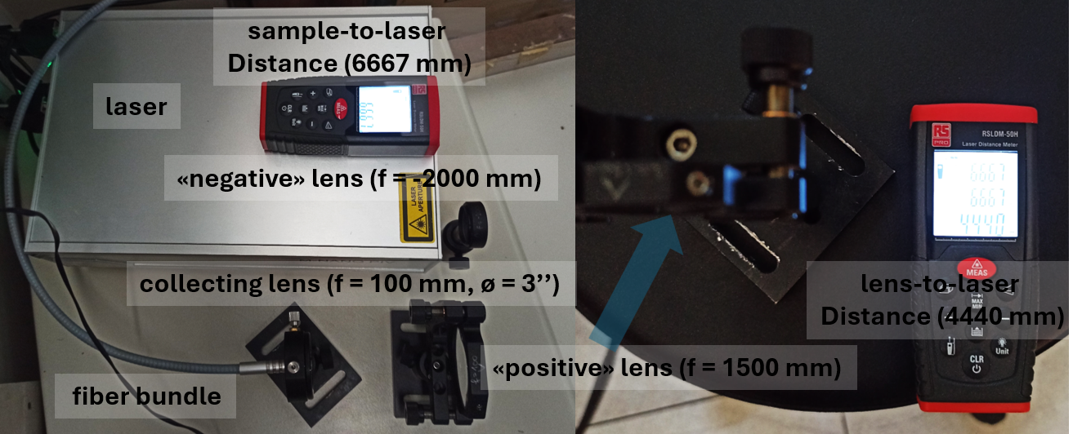
New prototype of a remote LIBS system
The laboratory prototype aims to increase the system-to-target distance, making it more suitable for larger devices, such as the future DTT, paving also the way for a remote system on ITER.
Laser source: Nd:YAG
Wavelength: 1064 nm
Pulse energy: up to 130 mJ
Pulse duration: 9 ns
Beam ø (laser exit): 3 mm
Beam ø (on the target): ≈ 0.9 mm
Repetition rate. 2 Hz
Laser fluence: ≈ 20J/cm²*shot

Slide 8
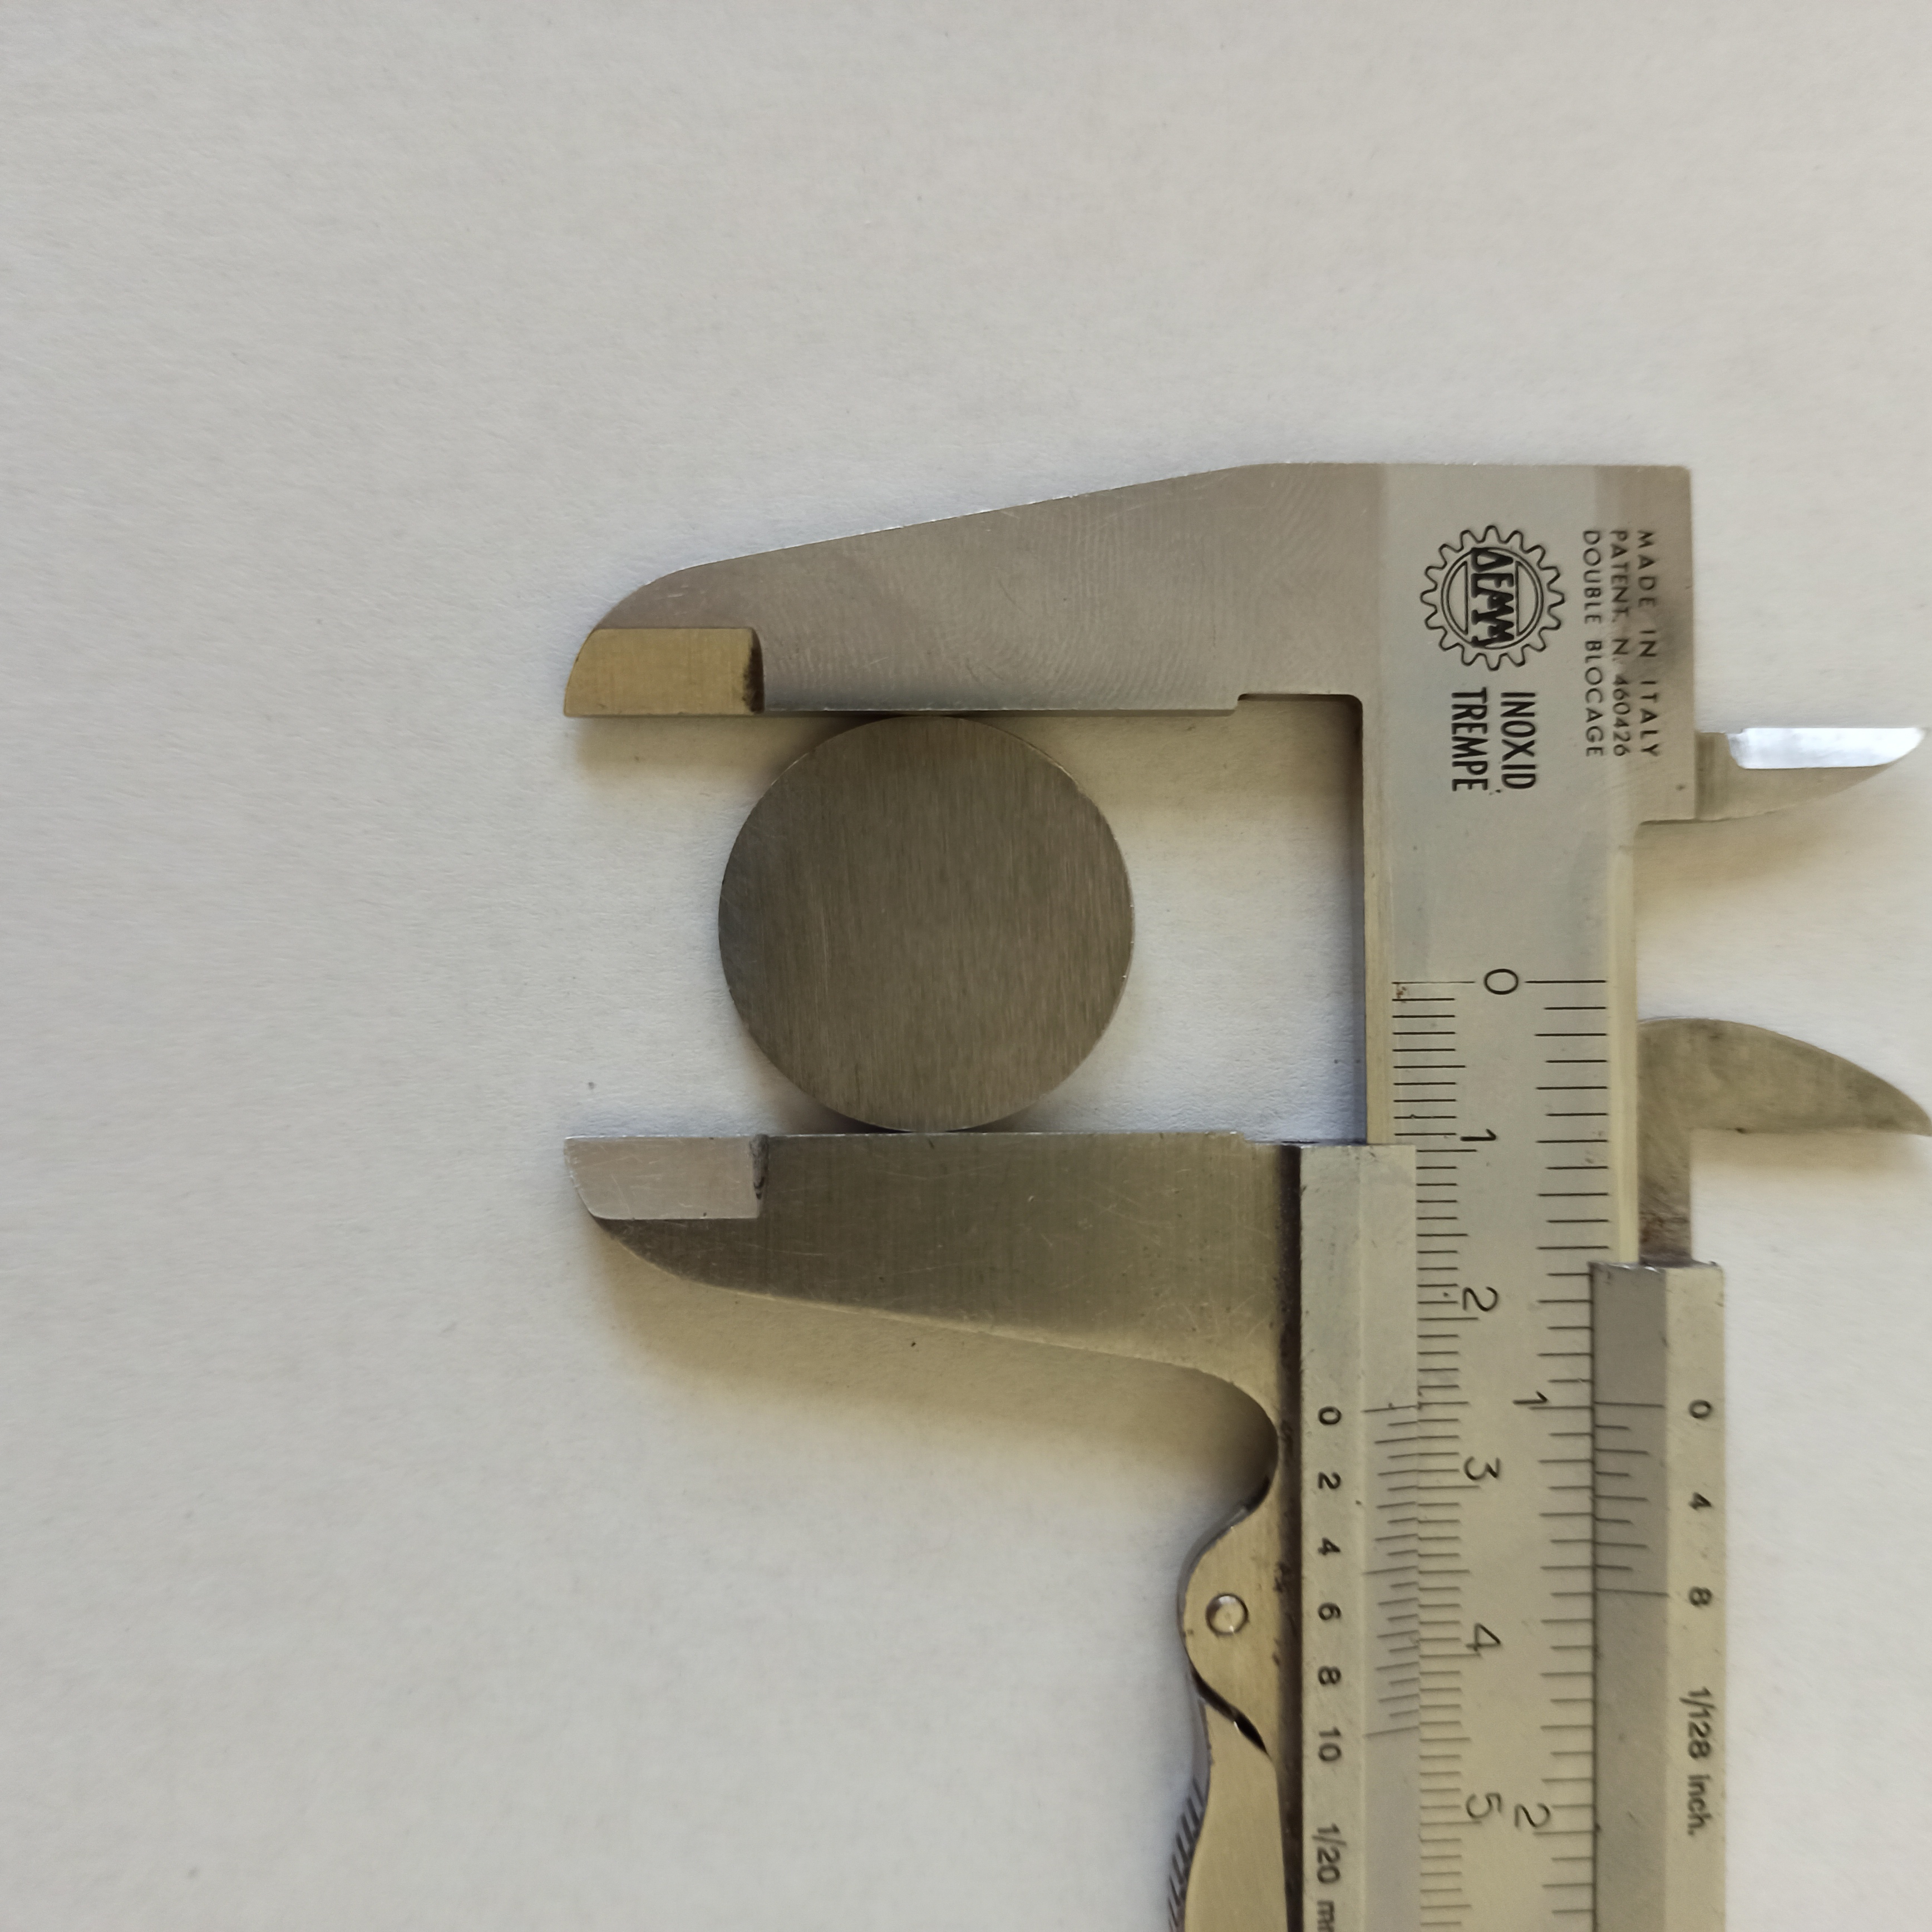
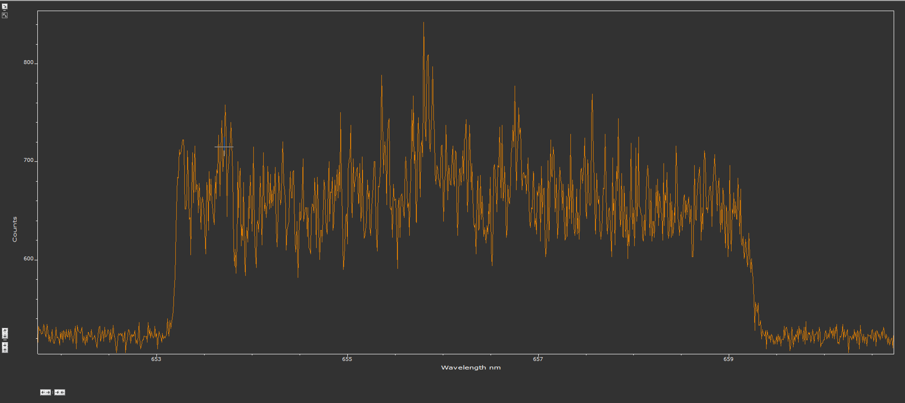
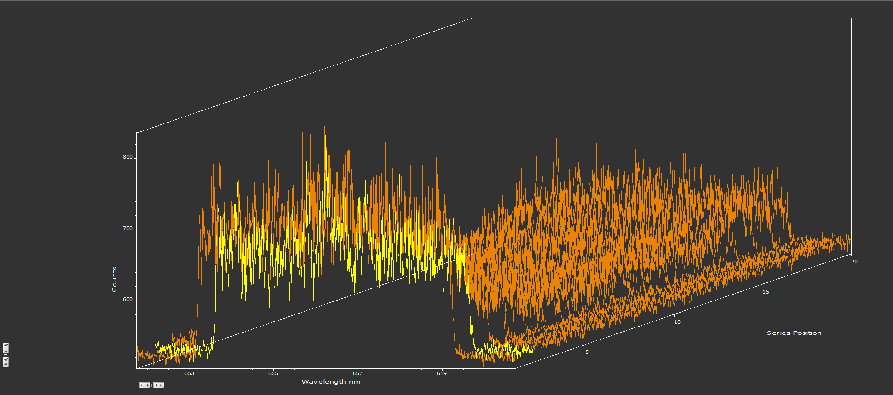
Results
Circular tungsten discs (25 mm in diameter, 1 mm thick), simulating DTT (and ITER) divertor PFCs, were measured. The detection of unburnt fuel was simulated by detecting ambient hydrogen via H-alpha spectral emission at 656.27 nm. Series of LIBS spectra were recorded at the same location to assess the signal-to-background ratio (SBR) as a function of the number of laser shots.
2nd shot
1-20° shot

Slide 9
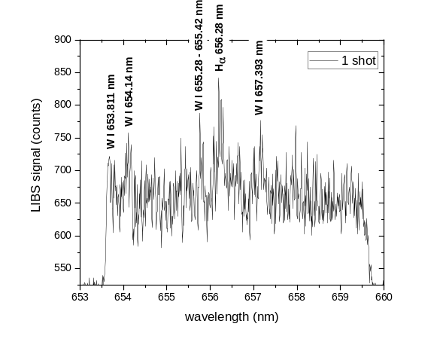
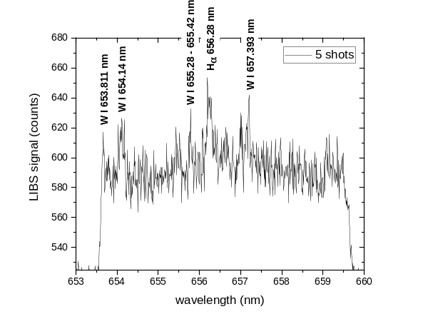
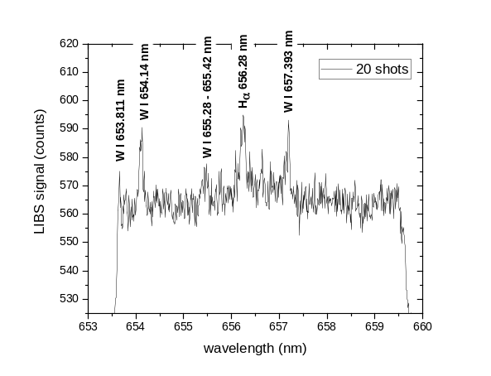
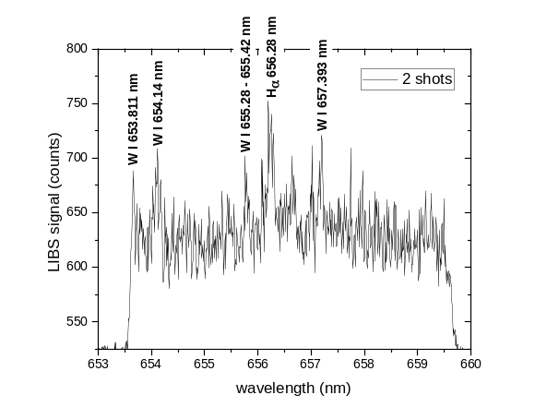
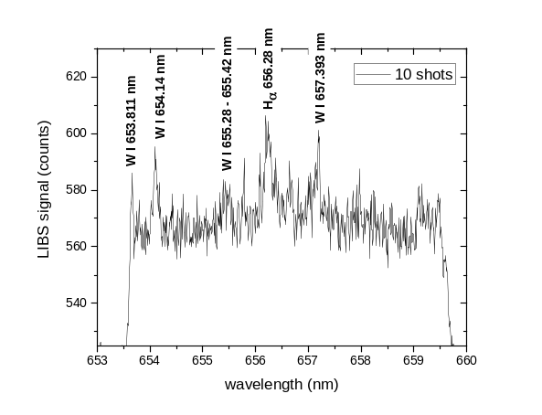
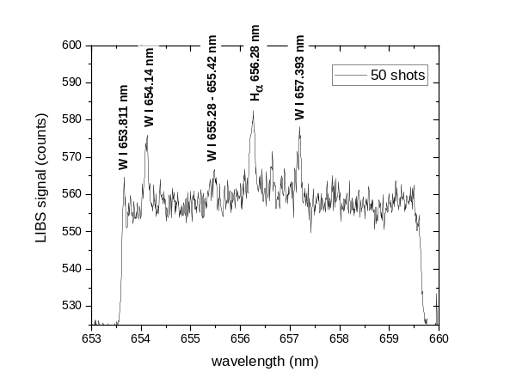
Results
The tungsten emission lines and the hydrogen H-alpha line were observed even with a single laser shot. By accumulating multiple shots, the SBR increases significantly.
Camera setup was: 1) camera delay from laser: 1 μs, 2) camera integration time: 5 μs.
Fluence 20 J/cm²
Fluence 100 J/cm²
Fluence 400 J/cm²
SBR 1.96
SBR 2.8
2nd shot
SBR 4.5
Fluence 40 J/cm²
Fluence 200 J/cm²
Fluence 1 kJ/cm²
SBR 2.24
SBR 3.33
SBR 5.3

Slide 10
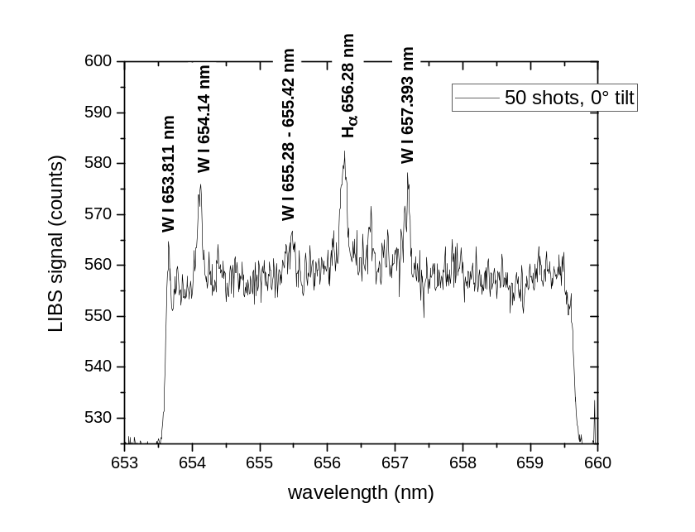
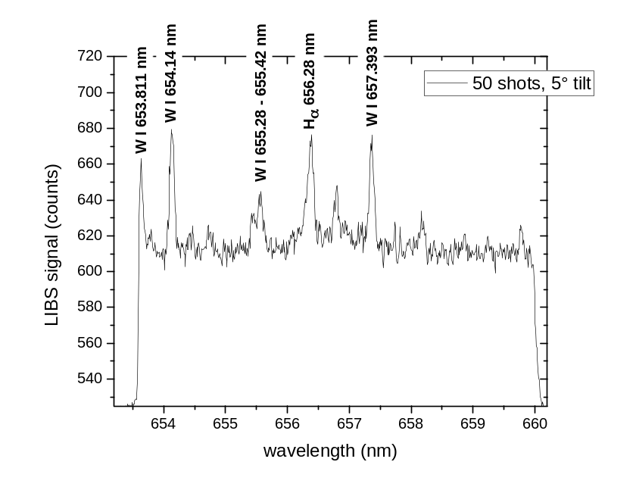
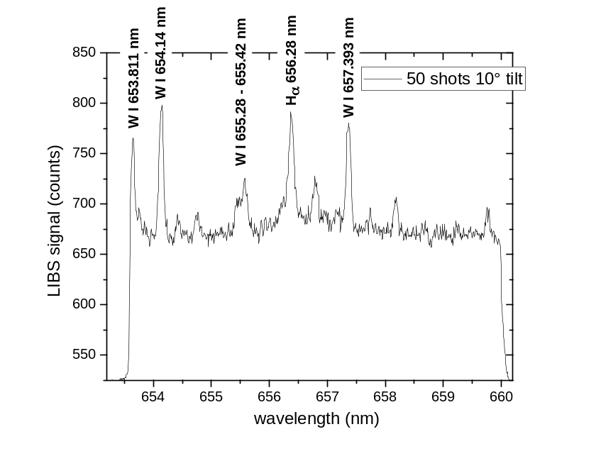
Results
The effect of the tilt angle (laser beam not perfectly perpendicular to the surface) was investigated by tilting the laser beam by 5 and 10 degrees relative to the normal to the target surface at the same distance of 4.4 m from the focusing optics → no significant loss of the spectral signal was observed → a tilted surface up to 10° with respect the normal does not affect the LIBS spectrum.
0°
5°
10°
1-20° shot

Slide 11
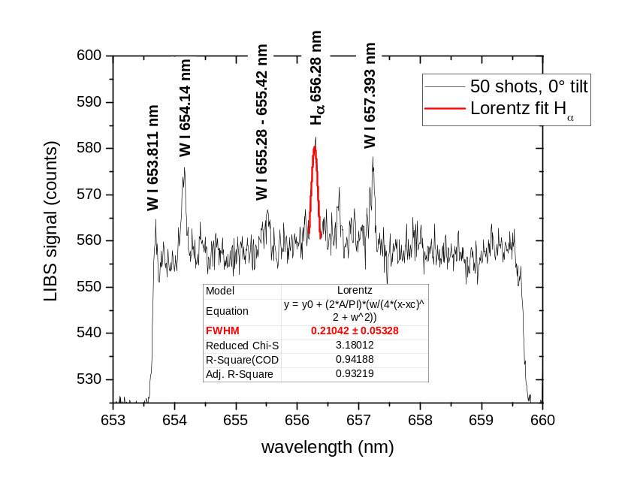
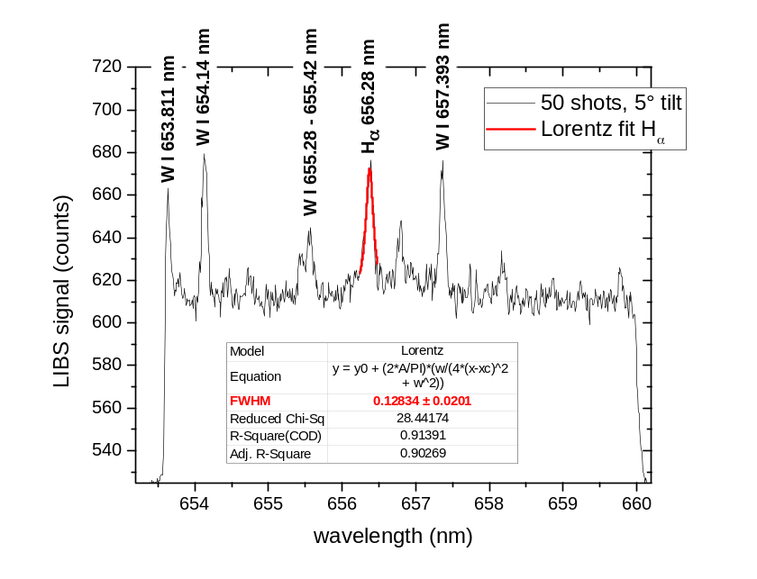
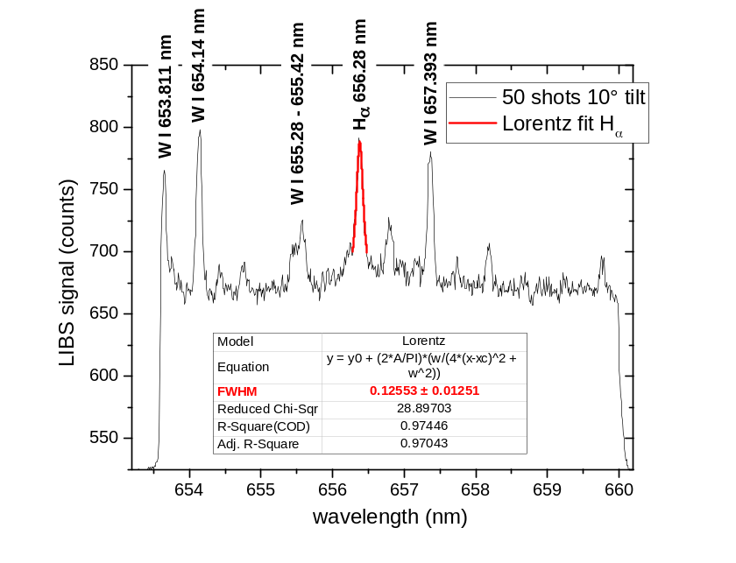
Results
Can, in principle, the D-alpha (at 656.1 nm) and H-alpha (at 656.28 nm) emission lines of deuterium and hydrogen resolvable using this setup?
Given that the D-alpha, and H-alpha lines are spectrally similar, we fitted the experimental H-alpha line with a Lorentzian peak to have the FWHM and estimate the discrimination by applying the Rayleigh criterion:
Δλ ≥ FWHM
By fitting the H-alpha line the two peaks could be potentially resolved
1-20° shot

Slide 12
Conclusions
In this contribution an in-lab LIBS prototype for remote measurements has been described and tested, featuring laser-source focusing optics positioned at a maximum distance of 4.7 m from the target and LIBS plasma collection optics positioned at a distance of 6.6 m from the target.
The sensitivity of the system was sufficient to observe the emission lines of tungsten and ambient hydrogen with a single laser shot, with a pulse energy of 130 mJ and a fluence of 20 J/cm² per shot.
It has been experimentally demonstrated that any misalignment of the laser beam up to 10°relative to the normal to the target surface doesn’t significantly influence the SBR.
The FWHM of the hydrogen H-alpha line is sufficiently narrow to potentially resolve the deuterium D-alpha line.
A laser source with a higher energy pulse would allow for sampling at even greater distances, potentially ITER-relevant.
Next step of this activity is to test the system's sensitivity with the target in vacuum and the collection optics positioned remotely, mimicking the setup of a LIBS measurement in a closed vacuum vessel, collecting the plasma light through an optical vacuum window.
Thank you for
your attention
1-20° shot

