Slide 1


Fast particle effects on plasma polarimetry in high performance fusion scenarios
ICFDT8 19-21 october 2026 ENEA Frascati
Francesco Paolo Orsitto¹, F Auriemma², A Boboc³ , G Szepesi³, D Terranova² and JET Contributors and The EURO-fusion exploitation Team .
¹ Consorzio CREATE, Napoli , and CNR IAC Roma , ITALY
²Consorzio RFX and CNR ISTP Corso Stati Uniti , Padova, (Italy)
³ UKAEA Culham Campus, Abingdon, Oxfordshire OX14 3DB (UK)

Slide 2
Introduction
In the context of tokamak diagnostics , The polarimetry measurements , i.e. the Faraday rotation and Cotton-Mouton ellipticity are very useful because they give quantitative evaluations of the poloidal magnetic field and plasma density respectively[1,3].
In this report effects on the Faraday rotation measurements linked to fast particles in a D-T plasma are reported.
[1] F.P. Orsitto et al. Modelling of polarimetry measurements at JET, Plasma Phys. Control. Fusion 50 (2008) 115009 and ibid. 53(2011)035001
[2] B. Faugeras and F.P. Orsitto, Equilibrium reconstruction at JET using stokes model for polarimetry, Nuclear Fusion 58 (2018) 106032.
[3] F P Orsitto and S Segre , Plasma Phys Contr Fusion 61(2019)055008

Slide 3
Elements of plasma polarimetry
The measurements of polarimetry in tokamak plasmas give important information on plasma current , density and temperature
• In a plasma, a magnetic field component parallel to a laser beam propagation direction causes the polarization plane rotation (Faraday effect).
• The Faraday rotation depends on ne*IP value.
• Whereas, the magnetic field components perpendicular to the laser beam propagation direction causes a change in the ellipticity of the probing beam (Cotton-Mouton effect).
• The Cotton-Mouton depends on ne*Bt*Bt value.
This scheme is valid for small values of Faraday and ellipticity : the Stokes model Is the general framework where the polarimetry modelling is inserted
⁽ F Orsitto et al PPCF 2008, 2011, 2019, and B Faugeras , F Orsitto Nuclear Fusion 2018, 2019)
• In a tokamak plasma both effects are presents: the polarization becomes elliptical and the plane of the polarization rotates; the value of these effects depend on plasma parameters, the beam propagation direction and initial state polarization.

Slide 4
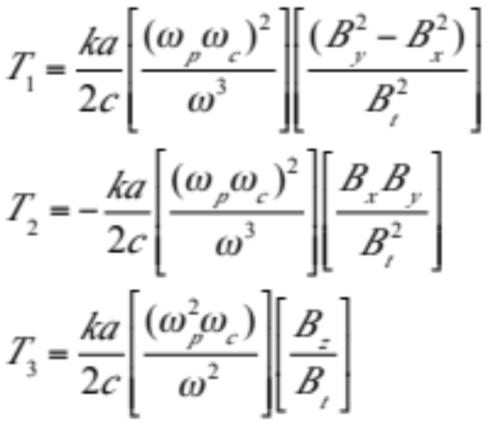
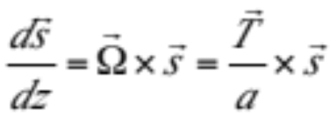
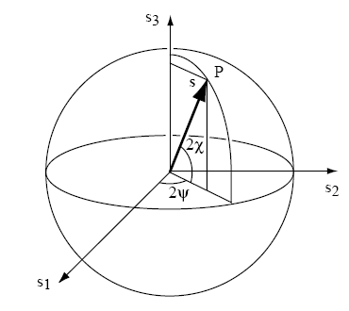
Elements of plasma polarimetry
The Stokes model , which describes the spatial evolution of the polarization of the wave inside the plasma, is defined by the vector equation :

Slide 5
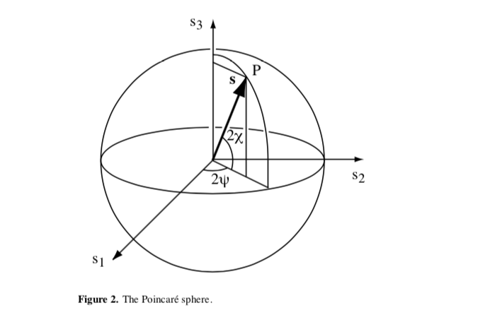
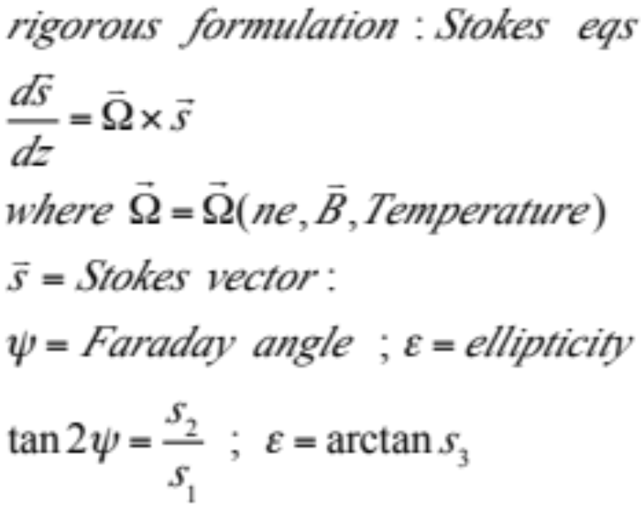
Approximation for small polarimetry effects and Stokes eqs.
(Type I approx F P Orsitto PPCF 2008)
Poincare sphere

Slide 6
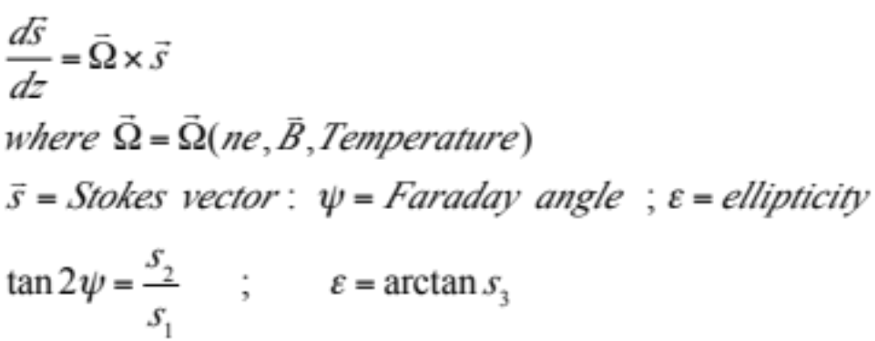
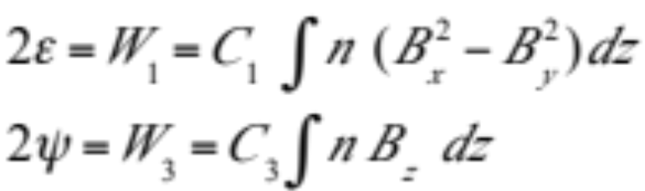
Solution of Stokes eq Type I approximation (Small signals)
C₁=2.42 10⁻²⁰ λ³ (m² T⁻²)
C₃=5.23 10⁻¹⁹ λ² (m² T⁻¹)

Slide 7
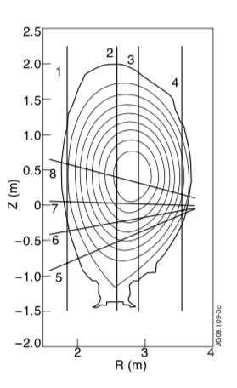
JET interfero-polarimeter

Slide 8
Main message I
The polarimetry KG4R/FAR_CH3 measurements can be reproduced using Stokes code ( F P Orsitto et al. PPCF 2008, 2011, 2019) using EFTP EQUILIBRIUM with fast particle pressure included
The KG4R/FAR_CH3 is the channel more sensible to this effect SINCE the line of sight is close to the plasma magnetic centre.( The channel 4 is also sensible).
The Cotton mouton ellipticity is not sensible to this FP effect because does not depend on the poloidal magnetic field .

Slide 9
JET DTE2 Pulses included in the polarimetry ANALYSIS
( in yellow the pulses included in this report)
shot # | scenario
99643 | hybrid w modulation of ICRF
99965 | hybrid w modulation of ICRF
99971 | non-thermal
99946 | afterglow
99801 | afterglow
99634 | Hybrid w modulation ICRF
99639 | hybrid w modulation ICRF

Slide 10
Physics
The fast particles produce a pressure and carry out a current
The FAST PARTICLE CURRENT produces a contribution to the plasma poloidal magnetic field
The pressure of FAST PARTICLES changes the plasma equilibrium and then the components of the magnetic fields which determine the Faraday rotation .
The pressure of FAST PARTICLES CHANGES THE PLASMA POSITION .

Slide 11
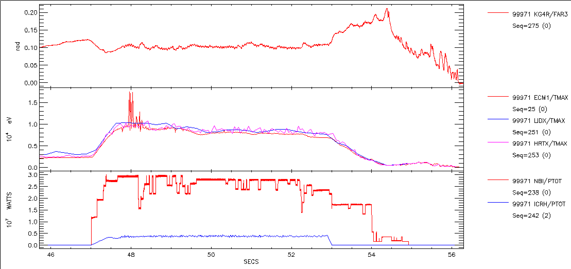
GENERAL TRACES OF NON-THERMAL PULSE #99971
KG4R/FAR3
TE MEAS BY ECE AND THOMSON
NBI AND ICRH POWER

Slide 12
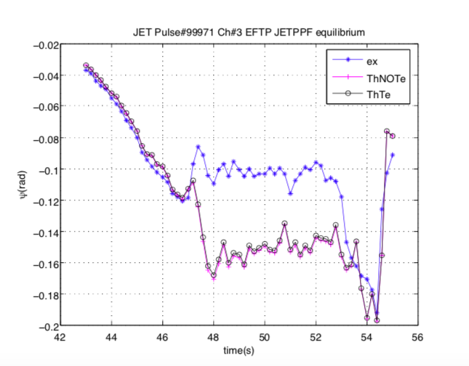
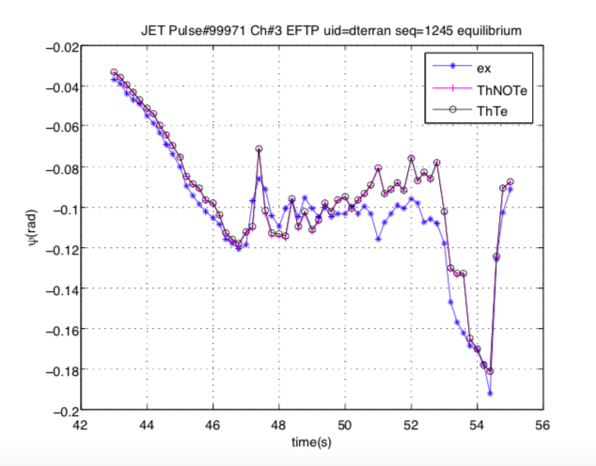
JPN 99971 non-thermal fusion
FARADAY ROTATION EVALUATION USING STOKES MODEL
LEFT PLOT USES EFTP EQUILIBRIUM WITHOUT FAST PARTICLE PRESSURE
RIGHT PLOT USES EFTP EQUILIBRIUM WITH FAST PARTICLE PRESSURE

Slide 13
Conclusions
1. A correlation is found between the Faraday rotation measurements
And fast particle content of the discharges in particular in high performance
DTE2 scenarios.( non-thermal , hybrid ICRH modulated, afterglow ),
where the fast particle pressure is an important fraction of the total pressure.
2. The Stokes model ( which was demonstrated very useful in modelling polarimetry
at JET ) is able to reproduce the Faraday Rotation measurements
when the equilibrium evaluated includes Fast Particle Pressure: examples are
Reported for pulses IN DTE2 HIGH PERFORMANCE SCENARIOS.

