Slide 1





ICFDT8 · 8th International Conference on Frontiers in Diagnostic Technologies
Frascati, 19–21 October 2026
MiniTRUST: A UNITUS–ASIPP China Collaboration for Tokamak Engineering and Magnetic Diagnostics
M. Notazio^{1*}, S. Carusotti¹, F. Desana^{1**}, T. Fontana¹, A. Marchegiani¹, C. Avanzato¹, G. Liuzzo¹, P. Fanelli¹,
M. Iafrati², L. Boncagni², K. Wu³, Z. Luo³, B. Xiao⁴, J. Li³, F. Crisanti¹, G. Calabrò¹
¹ Department of Economy, Engineering, Society and Business Organization (DEIM), University of Tuscia, Largo dell’Università, Viterbo, 01100, Italy
² ENEA, Fusion and Nuclear Safety Department, C. R. Frascati, Frascati, 00044, Italy
³ Institute of Plasma Physics, CAS, PO Box 1126, Hefei 230031, People’s Republic of China
⁴ Hefei Comprehensive National Science Center (Anhui Energy Laboratory), Hefei 230031, People’s Republic of China
*Corresponding author: matteo.notazio@unitus.it
**Presenting author: francesco.desana@unitus.it
@trust_project
Notes:
Good afternoon, everyone. I'm Francesco Desana from the University of Tuscia. Today I'll present miniTRUST, a small tokamak born from a collaboration between UNITUS, ASIPP in Hefei and ENEA Frascati. I'll tell you why we built it, what it is, where we are now, and a method to test magnetic diagnostics that could be useful well beyond our machine.

Slide 2
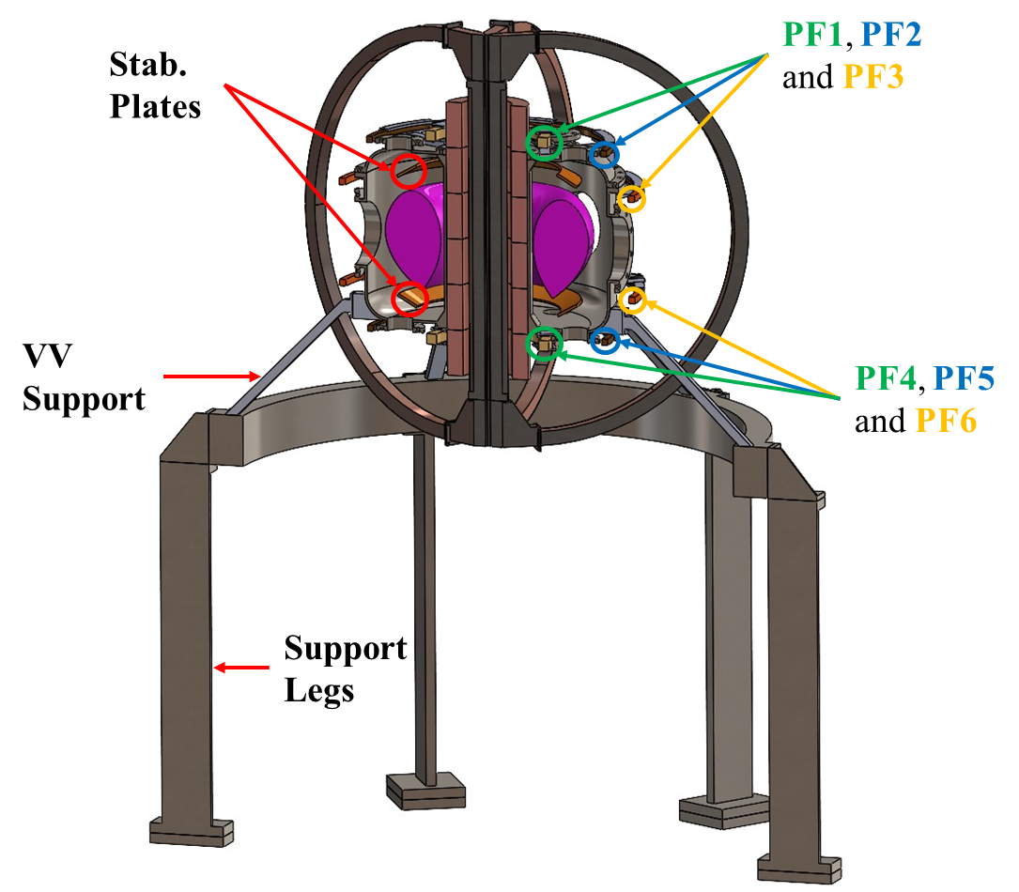
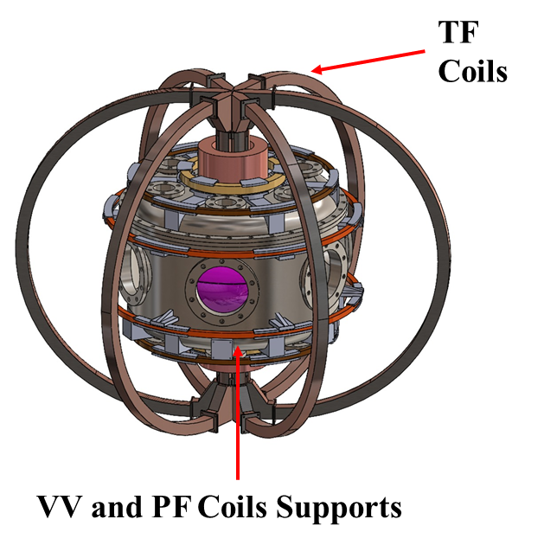
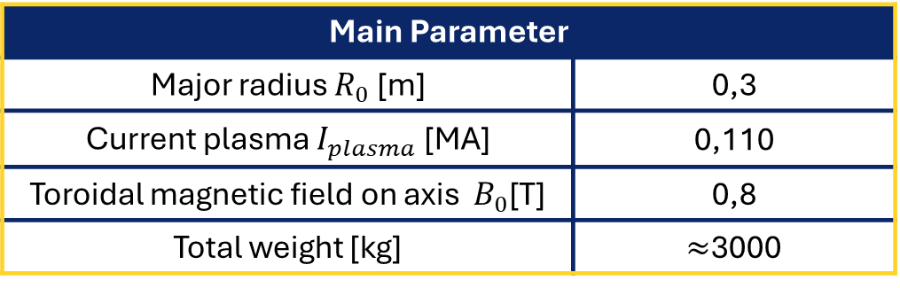
TRUST
Tuscia Research University Small Tokamak
A new modular and compact tokamak for research and educational experiments at the University of Tuscia (UNITUS).
1
Training
Students and researchers work on a real machine in an interdisciplinary environment with industrial partners.
2
Advanced Technologies
A testbed for high-temperature superconductors (HTS) and metamaterials.
Main Parameter
Major radius $R_{0}$ [m] | 0,3
Current plasma $I_{plasma}$ [MA] | 0,110
Toroidal magnetic field on axis $B_{0}$[T] | 0,8
Total weight [kg] | $≈$3000
3
Alternative Magnetic Layout
A pre-conceptual design to simplify fusion reactors and reduce their size while maintaining operational efficiency.
ICFDT8 · Frascati, 19–21 Oct 2026
@trust_project
2
Notes:
Everything starts from TRUST, the Tuscia Research University Small Tokamak: a modular, compact machine for research and education, with a major radius of 0.3 metres, a plasma current of 110 kiloamps and 0.8 tesla on axis. It has three goals. First, training: students and researchers working on a real machine, together with industry. Second, testing advanced technologies such as high-temperature superconductors and metamaterials. Third, the Alternative Magnetic Layout, a concept to make fusion reactors simpler and smaller. TRUST weighs about three tonnes, and before building a machine like that, it's wise to build a smaller one.

Slide 3
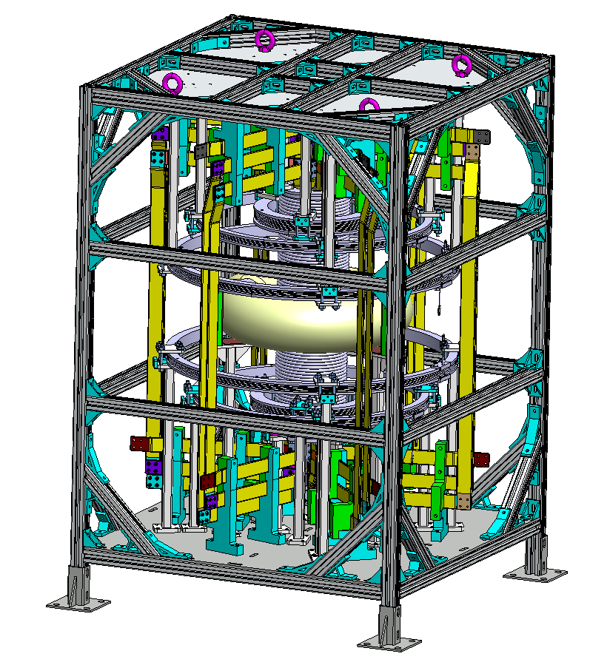
miniTRUST
Why do we need miniTRUST?
“A method is not truly useful if it only works in theory, on one machine, on a lucky day.”
miniTRUST is the bench version of TRUST: lighter, easier to operate and accessible even to students.
Test and validate: Magnets, power supplies, diagnostics, control and data acquisition on a simpler system.
De-risk: Find problems now while they are small and cheap to fix.
Reuse & train: The same procedures move to TRUST, with people already trained on them.
miniTRUST is the small machine that prevents big headaches.
ICFDT8 · Frascati, 19–21 Oct 2026
@trust_project
3
Notes:
As we like to say, a method is not truly useful if it only works in theory, on one machine, on a lucky day. miniTRUST is the bench version of TRUST: lighter, easier to operate and accessible even to students. It lets us test and validate magnets, power supplies, diagnostics, control and data acquisition on a simpler system; find problems now, while they're small and cheap to fix; and reuse the same procedures on TRUST, with people already trained on them. In short, it's the small machine that prevents big headaches.

Slide 4
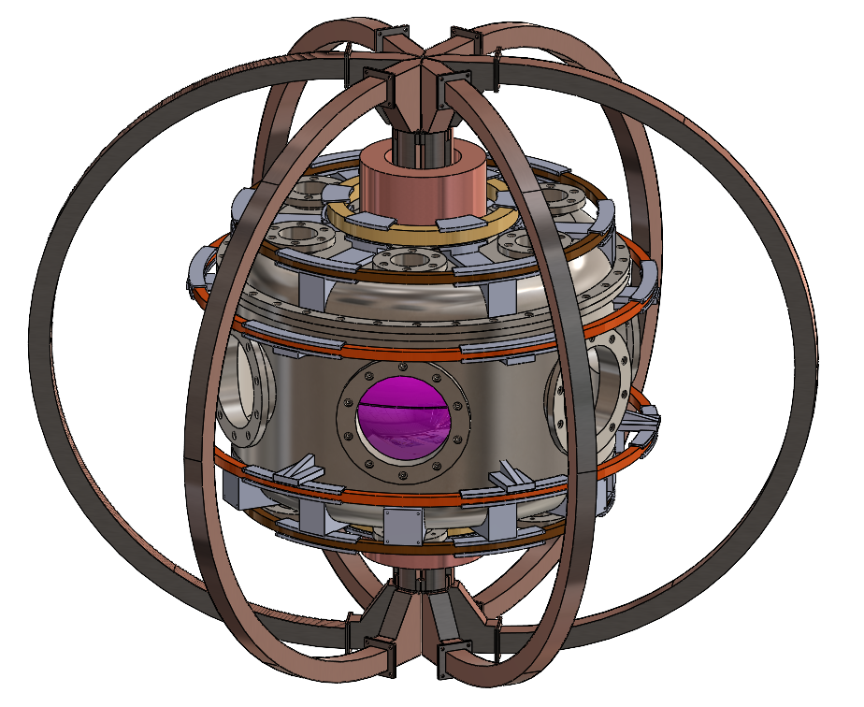

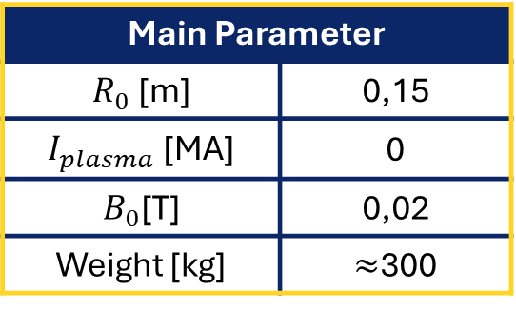
From TRUST to miniTRUST
A bench-scale tokamak to test before we build
SHARE
An open platform for students, researchers, and industrial partners
REFLECT
Why a scaled-down tokamak inside a university matters
CONNECT
An international collaboration: UNITUS, ASIPP and ENEA
TRUST
miniTRUST
Main Parameter
$R_{0}$ [m] | 0,15
$I_{plasma}$ [MA] | 0
$B_{0}$[T] | 0,02
Weight [kg] | $≈$300
$${R_{0}}/2$$
ICFDT8 · Frascati, 19–21 Oct 2026
@trust_project
4
Notes:
Here are the two machines side by side. The architecture is the same, but the major radius is halved, from 0.3 to 0.15 metres; the field on axis goes from 0.8 to 0.02 tesla, and the weight from three tonnes to about 300 kilograms. In this first configuration there is no plasma current, only glow discharges. Behind miniTRUST there are three ideas: share an open platform with students, researchers and industry; reflect on why a scaled-down tokamak belongs in a university; and connect institutions, here UNITUS, ASIPP and ENEA.

Slide 5
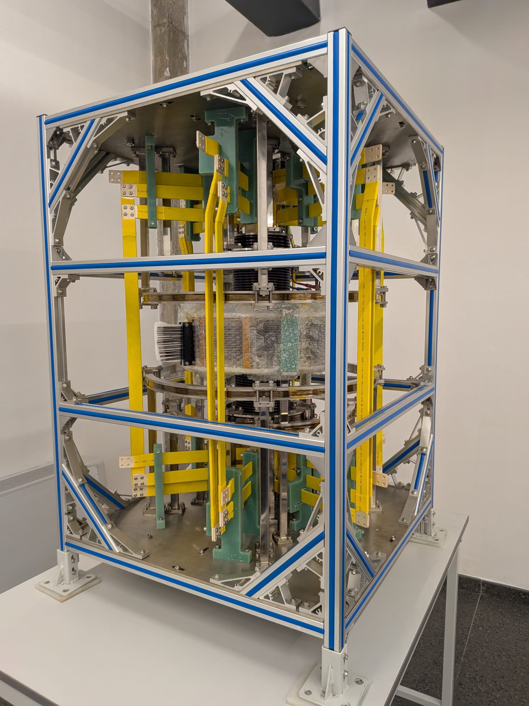
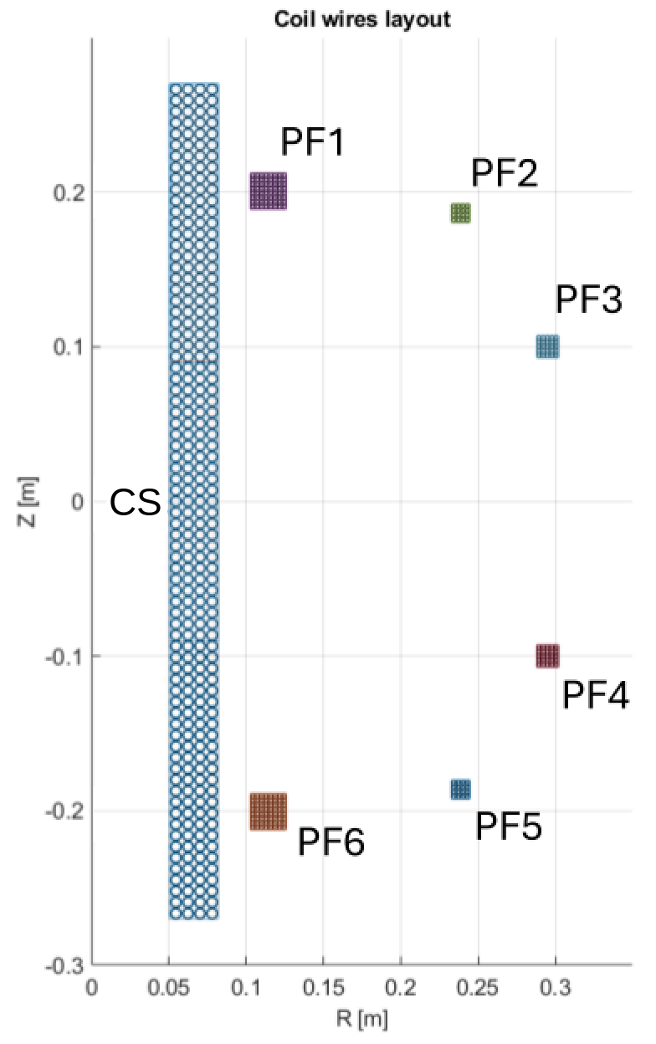
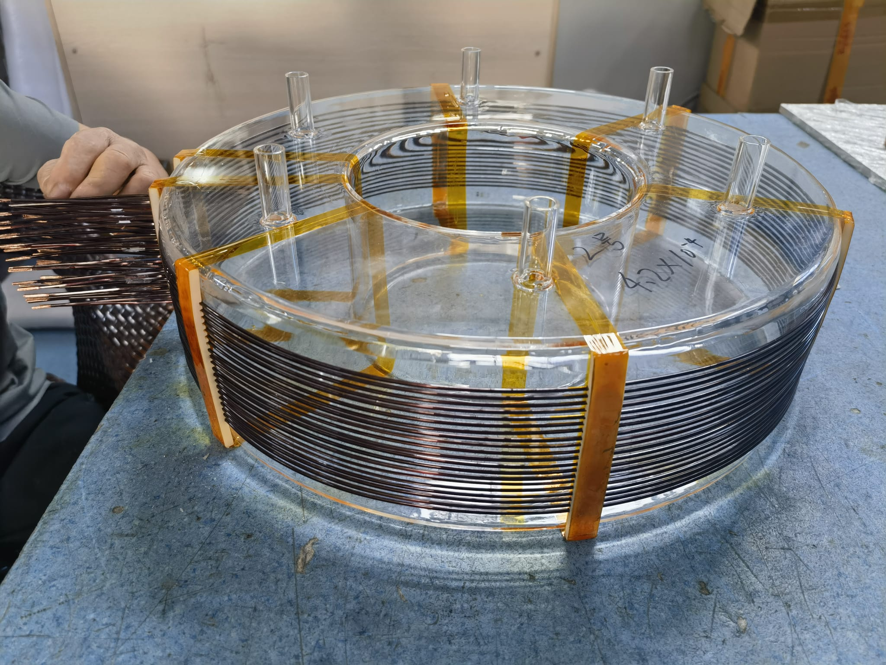
miniTRUST
What is miniTRUST?
A bench-scale tokamak with the same architecture as TRUST, but with a few small differences:
Copper Coils
1 - Central Solenoid (CS)
6 - Poloidal field coils (PF)
6 - Toroidal field coils (TF)
Vacuum chamber
Quartz
Rectangular section, 3 mm walls, 6 KF16 ports · glow discharges
ICFDT8 · Frascati, 19–21 Oct 2026
@trust_project
5
Notes:
Looking closer, miniTRUST has copper coils: one central solenoid, six poloidal and six toroidal field coils, arranged as in the layout in the middle. The vacuum chamber is made of quartz, with a rectangular section, 3-millimetre walls and six KF16 ports, and it is designed for glow discharges. On the right you can see the machine as it is today in our lab.

Slide 6
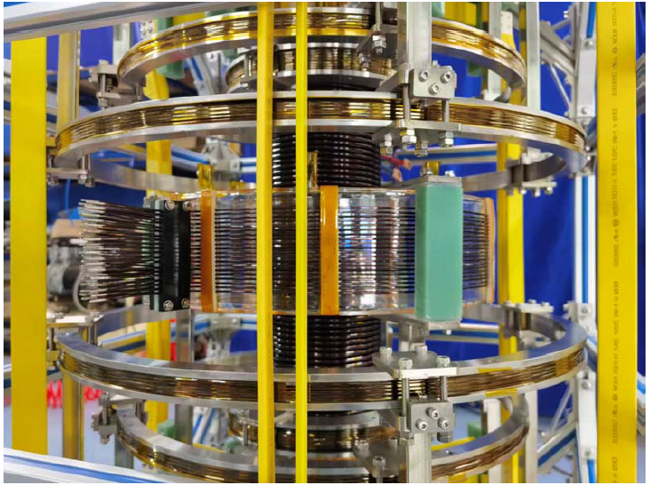
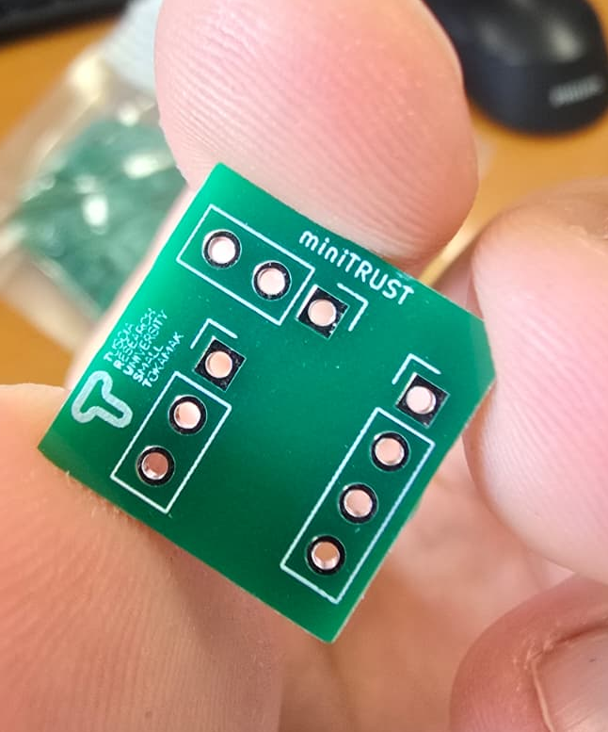
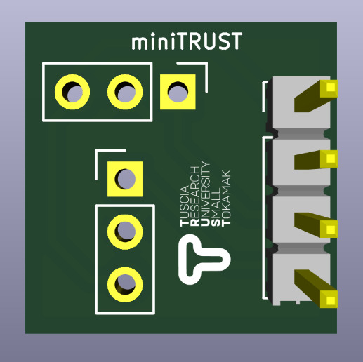
miniTRUST
Magnetic diagnostics
miniTRUST is equipped with 20 flux loops for magnetic flux measurements.
It is also designed to host in-house double-axis Hall probe arrays around the chamber, enabling local magnetic field measurements in both the radial and vertical directions.
First production
First Design
ICFDT8 · Frascati, 19–21 Oct 2026
@trust_project
6
Notes:
For magnetic diagnostics, miniTRUST has 20 flux loops, and it is designed to host arrays of double-axis Hall probes around the chamber, measuring the field in both the radial and the vertical direction. The probes are developed in-house: here you can see the first board design and the first production.

Slide 7
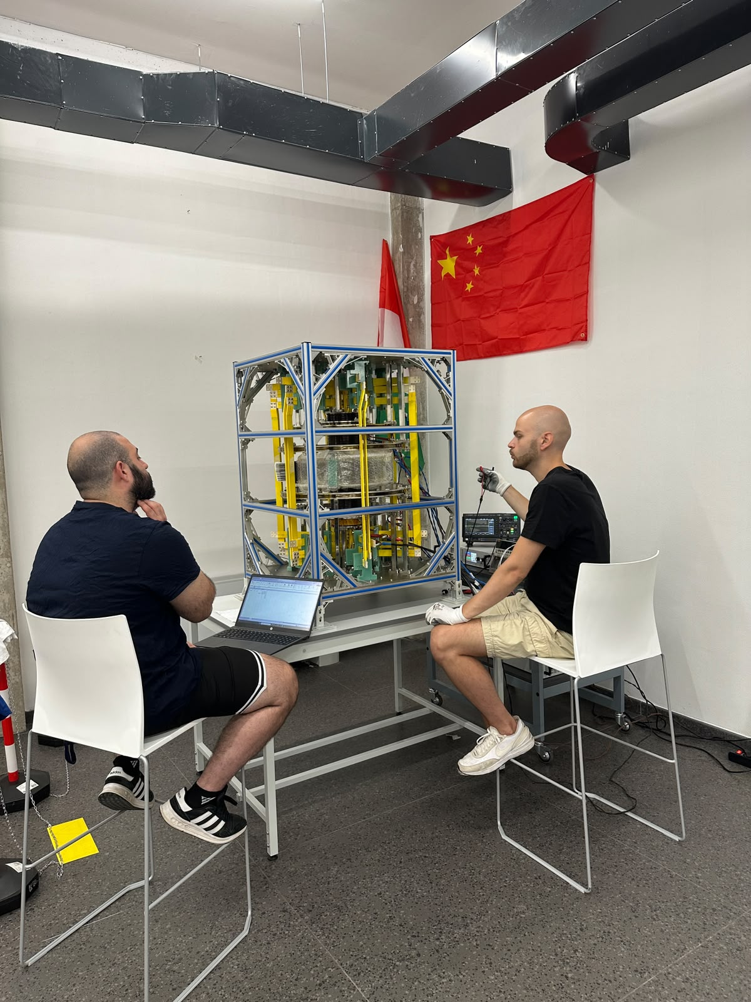
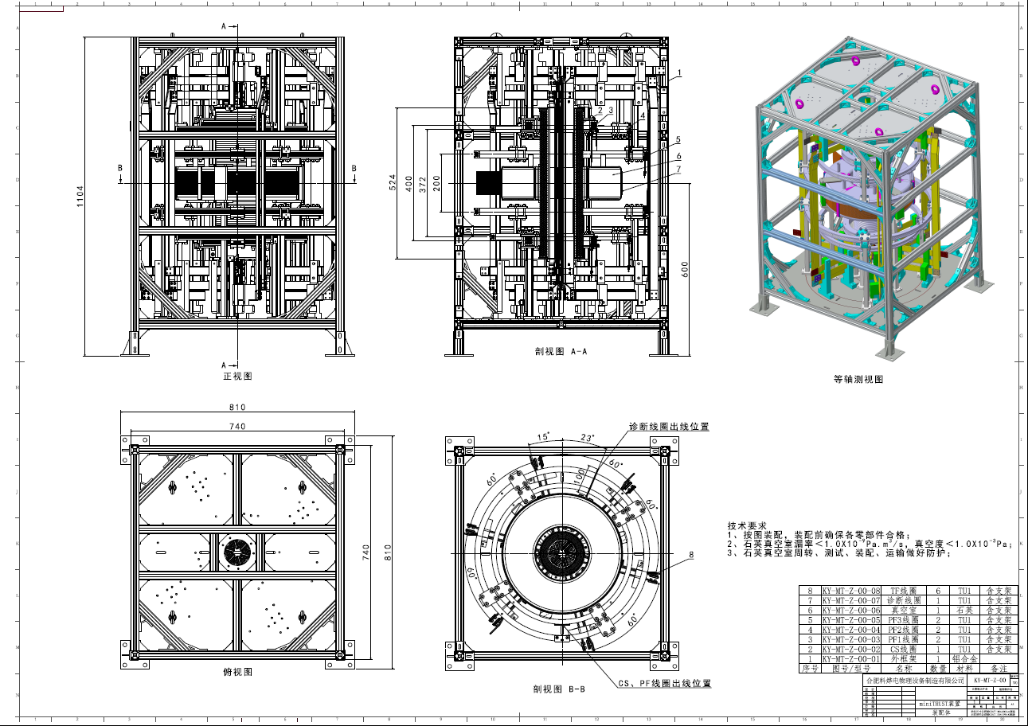
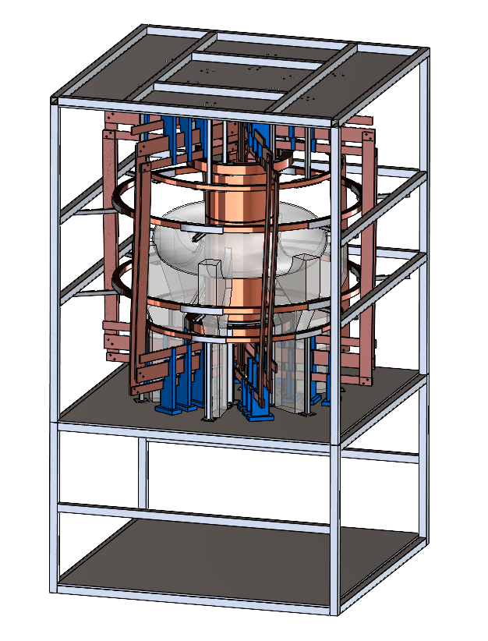
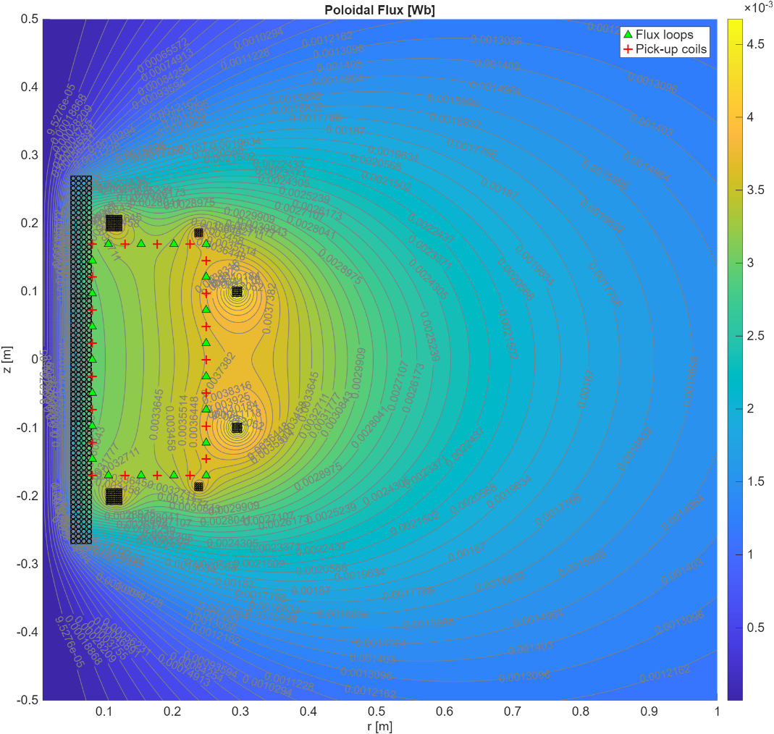
miniTRUST
From design to hardware
January 2026
April 2026
July 2026
Conceptual design
Engineering design
Arrival in Viterbo
ICFDT8 · Frascati, 19–21 Oct 2026
@trust_project
7
Notes:
The timeline was fast. In January 2026 we completed the conceptual design at UNITUS; in April ASIPP delivered the engineering design; and in July the machine arrived in Viterbo. From concept to hardware in about six months.

Slide 8
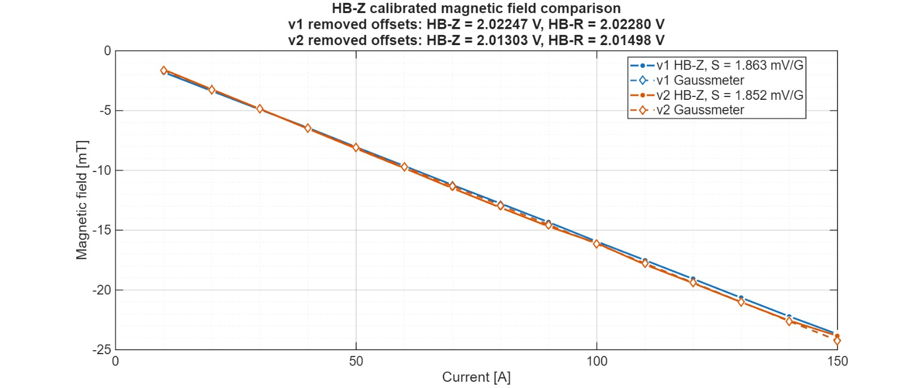
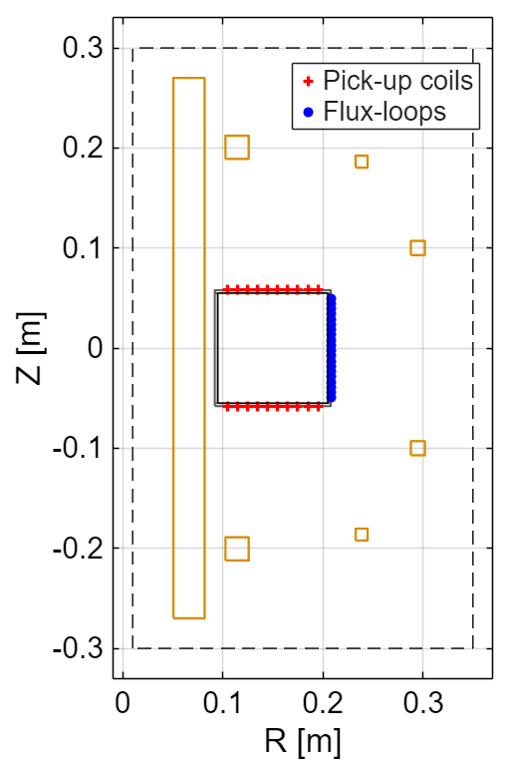
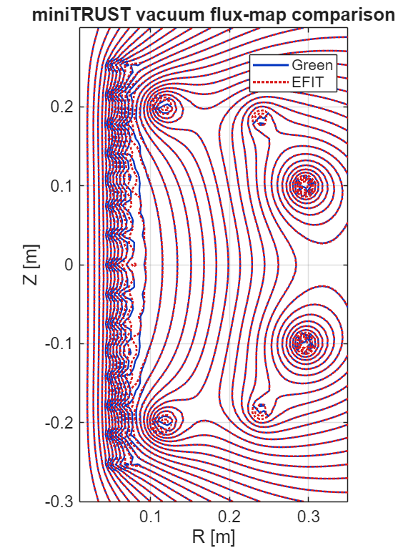
miniTRUST
First tests on miniTRUST
We have started testing the machine:
Coil resistance, inductance, and mutual inductance matrix;
Hall probe production and calibration;
Data acquisition system setup;
Vacuum and gas injection design for glow discharges;
EFIT workflow validation for flux map reconstruction;
ICFDT8 · Frascati, 19–21 Oct 2026
@trust_project
8
Notes:
We have already started testing the machine. We are measuring coil resistances, inductances and the mutual inductance matrix; producing and calibrating the Hall probes, as in the calibration curve at the top right; setting up the data acquisition; designing the vacuum and gas injection for glow discharges; and validating the EFIT workflow, by comparing the reconstructed vacuum flux map with our reference.

Slide 9
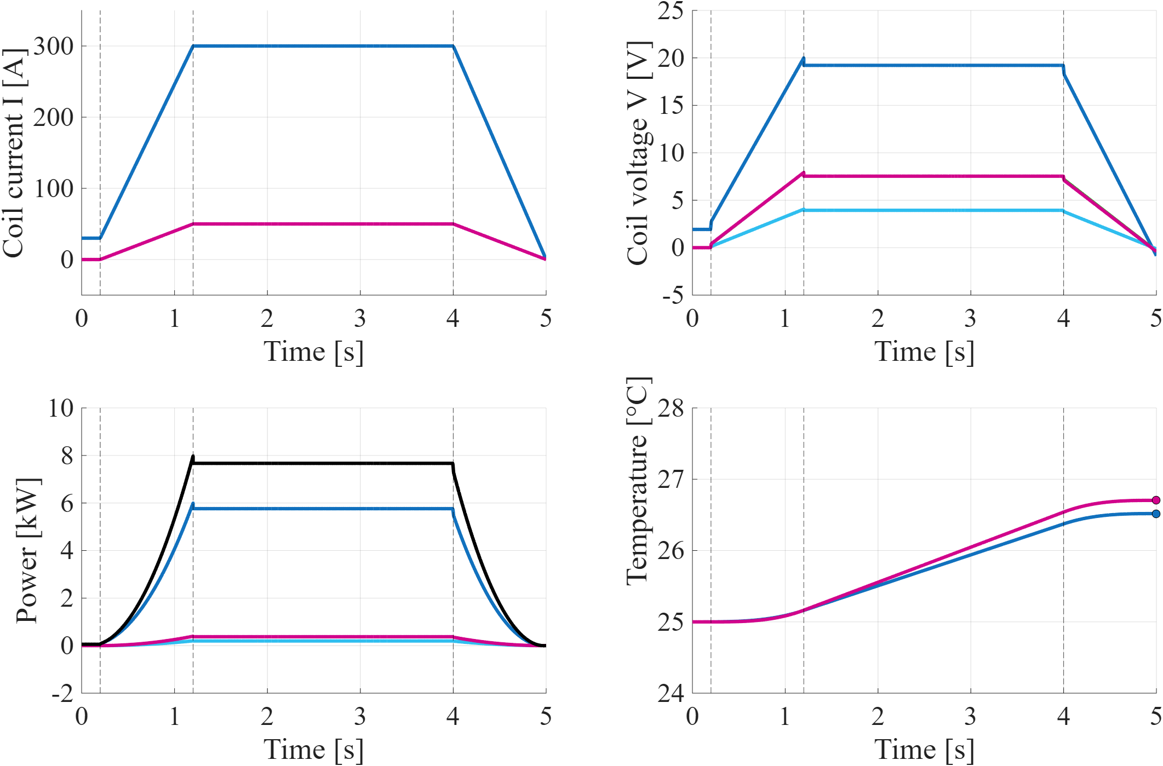
miniTRUST
The lab power budget
CS
CS
5 s Vacuum Shot
CS current -> 300 A
PF current -> 50 A
150 ms current rise time
Reference Scenario
PF1-PF3-PF4-PF6
All PF
PF2 – PF5
9 kW < 24 kW
Power required out of the total available
Total Power
All PF
CS
CS
PF1-PF3-PF4-PF6
< 5 °C
Coil temperature rise during the shot
PF2 – PF5
ICFDT8 · Frascati, 19–21 Oct 2026
@trust_project
9
Notes:
We also checked that the lab could support a reference scenario: a 5-second vacuum shot, with 300 amps in the central solenoid, 50 amps in the PF coils and a 150-millisecond current rise. The plots show currents, voltages, power and coil temperature. The required power is about 9 kilowatts, well below the 24 available, and the coils heat up by less than 5 degrees during the shot.

Slide 10
miniTRUST
The roadmap
1. Magnetostatic Tests in Vacuum
NOW · 2026
Validate coils, power supplies, diagnostics, and data acquisition
2. Glow Discharges
NEXT
Test first discharge operation in the quartz chamber.
3. Steel Chamber & Ohmic Plasmas
FUTURE UPGRADE
Upgrade the vessel and move toward ohmic plasma operation.
ICFDT8 · Frascati, 19–21 Oct 2026
@trust_project
10
Notes:
So, where do we go from here? We are now in the first phase: magnetostatic tests in vacuum, to validate coils, power supplies, diagnostics and data acquisition. Next come the first glow discharges in the quartz chamber. And later, a steel vessel to move towards ohmic plasma operation.

Slide 11
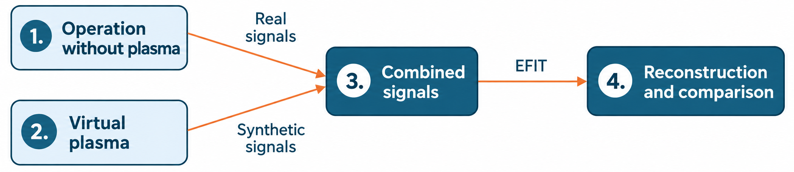
miniTRUST
Magnetic diagnostics test method for larger tokamaks
The proposed testing approach for miniTRUST’s magnetic diagnostics is applicable to TRUST and can be extended to larger tokamaks, including ITER, DTT and BEST, by adapting the model to each machine’s geometry and electromagnetic response.
Objective: assess reconstruction accuracy using real experimental background signals before plasma operation.
Key idea: the plasma parameters are known by construction so that the reconstruction error can be measured directly, including the real noise, offsets, and diagnostic pick-up.
ICFDT8 · Frascati, 19–21 Oct 2026
@trust_project
11
Notes:
Now the part that reaches beyond miniTRUST. How do you know your magnetic reconstruction is accurate before you have a plasma? First, we run the coils through a real scenario without plasma and record the real diagnostic signals, with their noise and offsets. Second, we define a virtual plasma: current filaments with known parameters. Third, we add its simulated signals to the measured ones. Fourth, EFIT reconstructs the combined signals, and since we know the right answer by construction, we can measure the reconstruction error directly. By adapting the model to each machine, the same method can be applied to TRUST and to larger tokamaks like DTT, ITER or BEST.

Slide 12
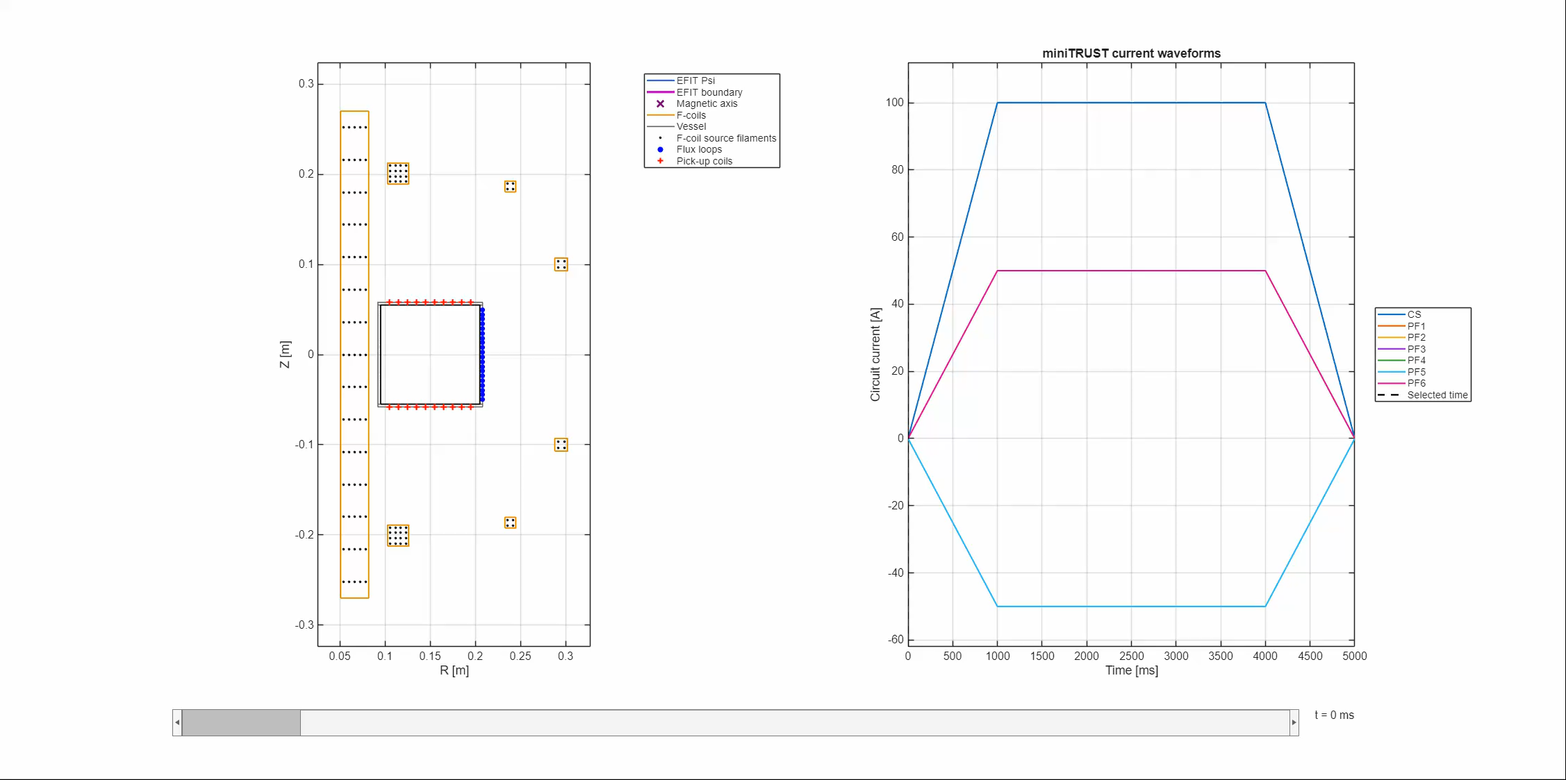
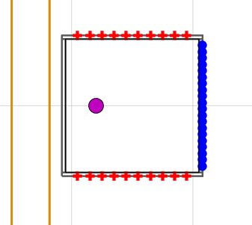
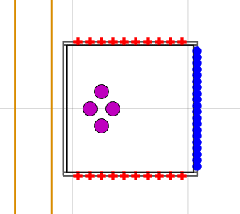
miniTRUST
Magnetic diagnostics test method for larger tokamaks
1 filament with constant current during the shot
4 filaments with varying current during the shot
*These are simulations with all synthetic signals, both for coils and virtual plasma
ICFDT8 · Frascati, 19–21 Oct 2026
@trust_project
12
Notes:
Here are two test cases: on the left, one filament with constant current during the shot; on the right, four filaments with varying currents, a more realistic and more demanding case. The animations show the EFIT flux map, the boundary and the magnetic axis following the virtual plasma during the shot. For now these are fully synthetic simulations; the next step is to use real signals measured on miniTRUST and quantify the reconstruction error.

Slide 13
Conclusions and outlook
1
Test platform
2
Diagnostic test method
A compact machine to commission magnets, power supplies, diagnostics and data acquisition for TRUST, and a hands-on training tool for students and researchers.
Real magnetic signals combined with a virtual plasma to assess reconstruction accuracy before any plasma operation.
3
Scalable approach
4
Next steps
The same method can be applied to larger tokamaks (DTT, ITER, BEST) by adapting the model to each machine’s geometry and electromagnetic response.
Magnetic system validation and first glow discharges in the quartz chamber, then a steel vessel upgrade for ohmic plasma experiments.
ICFDT8 · Frascati, 19–21 Oct 2026
@trust_project
13
Notes:
To conclude. miniTRUST is a compact test platform for TRUST's magnets, power supplies, diagnostics and data acquisition, and a hands-on training tool for students and researchers. Our diagnostic test method combines real magnetic signals with a virtual plasma to assess reconstruction accuracy before any plasma operation, and it can be applied to larger tokamaks like DTT, ITER and BEST. Next, we will validate the magnetic system and run the first glow discharges and then move to a steel vessel for ohmic plasmas.

Slide 14
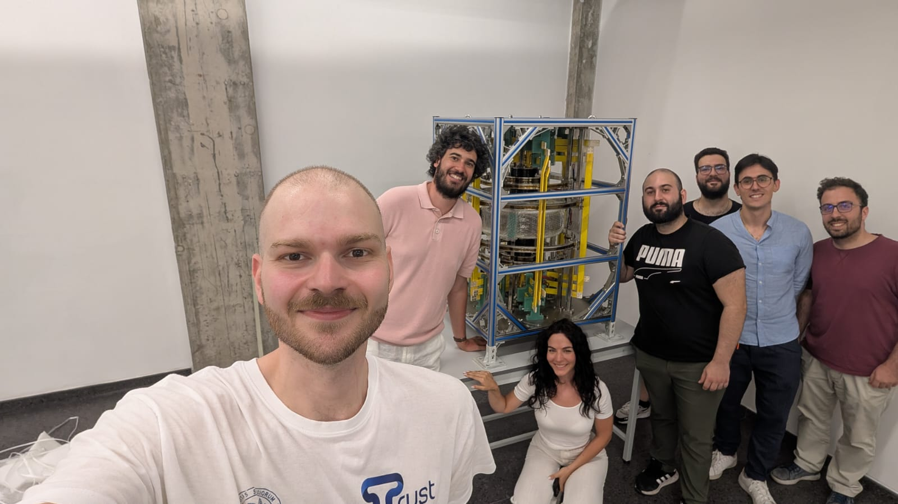
ICFDT8 · 8th International Conference on Frontiers in Diagnostics Technologies · Frascati, 19–21 October 2026
MiniTRUST: A UNITUS–ASIPP China Collaboration for Tokamak Engineering and Magnetic Diagnostics
Thank You for your Kind Attention!
@trust_project
Notes:
This is the team behind miniTRUST. I'd like to thank our colleagues at ASIPP and ENEA for this collaboration, and all of you for your attention. I'm happy to take any questions.

Slide 15
miniTRUST
Glass vacuum chamber
miniTRUST is currently equipped with a glass/quartz vacuum chamber designed for the first glow discharge experiments.
rectangular cross-section chamber;
wall thickness: 3 mm;
6 ports
KF16 connectors available for vacuum connections;
baking temperature below 200 °C;
one spare glass chamber delivered with the device.
This chamber represents the first operational configuration of miniTRUST, allowing vacuum conditioning, gas injection tests, and glow discharge operation before the future upgrade to a steel vessel.
www.unitus.it | Largo dell’Università snc, Viterbo, Italy
@trust_project
Notes:
The first vacuum chamber is made of quartz glass: rectangular cross-section, 3 mm walls, six ports with KF16 connectors, and it can be baked up to just under 200 °C. A spare chamber was delivered with the machine. It allows vacuum conditioning, gas injection tests and glow discharges before the upgrade to a steel vessel.

Slide 16
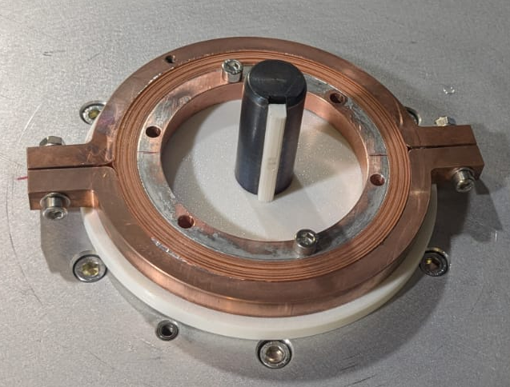
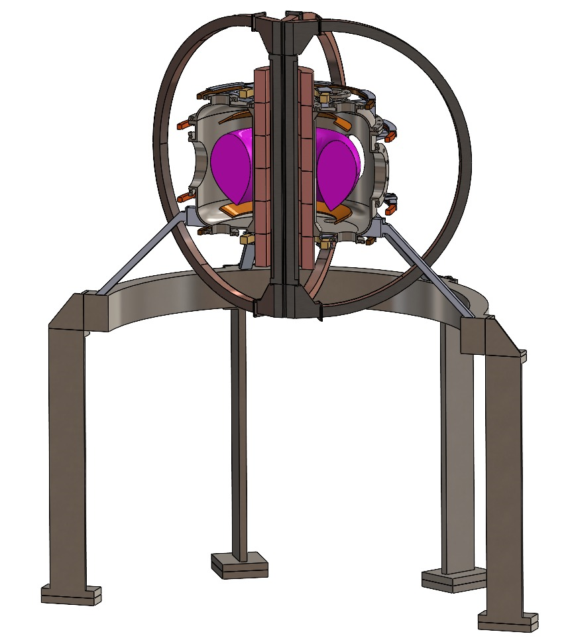
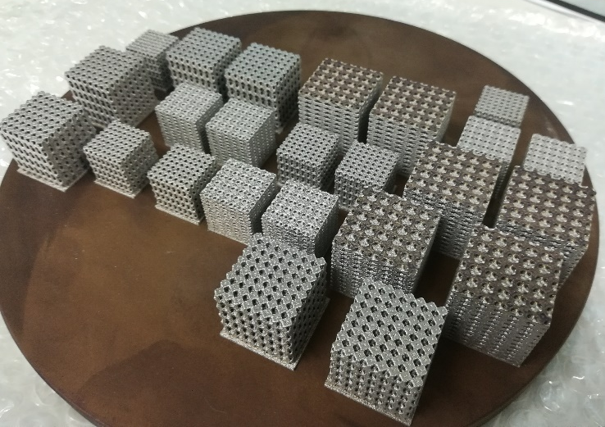
TRUST & miniTRUST
A comparison
TRUST (2027)
HTS coil
Main Parameter | TRUST | miniTRUST
Ipla [MA] | 0.110 | 0*
R0 [m] | 0.3 | 0.15
B0 [T] | 0.8 | 0.02
Bmax | 4.5 | 0.25
Number of PF coils | 6 | 6
Number of CS modules | 6 | 1
Number of TF coils | 6 | 6
Vessel Material | AISI 316 LN | Quartz Glass**
Coils and Magnets materials | Copper*** | Copper***
Total Weight [kg] | ≈3000 | ≈300
Operating Current (TF/CS/PF) [A] | 1000/1000/1000 | 1000/300/50
Operating Voltage (TF/CS/PF) [V] | ≈100/1000/1000 | ≈10/100/10
miniTRUST (2026)
~ 2.5 m
~ 1.1 m
Meta-Materials
*miniTRUST will be used for the commissioning of the magnetic system, diagnostics, power supply, control and data acquisition. For the glass vessel configuration only glow plasma discharge are foreseen using metallic electrodes.
**a miniTRUST upgrade is foreseen in the future to implement a stainless-steel vessel to reach higher vacuum condition to perform some ohmic plasma discharge.
***Both device are compatible with HTS coils for a future upgrade
www.unitus.it | Largo dell’Università snc, Viterbo, Italy
@trust_project
Notes:
The full comparison: same number of PF and TF coils, one CS module instead of six, copper coils on both machines, compatible with a future HTS upgrade. Operating currents are 1000, 300 and 50 amps for TF, CS and PF on miniTRUST, against 1000 amps for all coils on TRUST.

