Slide 1


8th International Conference on Frontier in Diagnostic Technologies, Oct. 19-21, 2026, Frascati, Italy
Research Progress of the Polarimeter/Interferometer on the EAST and BEST Tokamak
Shouxin Wang¹, Haiqing Liu¹, Yinxian Jie¹, Yang Zhang¹, Ling Zhang¹ , Weiming Li¹ , Yuan Yao¹, Hui Lian¹, Xuechao Wei¹, Ting Lan¹, Ximo Peng², Yao Zhang¹, Weixing Ding³
¹Institute of Plasma Physics, Hefei Institutes of Physical Science. Chinese Academy of Sciences, Hefei 230031, China
²University of Science and Technology of China, Hefei 230026, China
³University of California Los Angeles, Los Angeles, CA 90095, United States of America
OCT 21, 2026
Notes:
姓名；来自哪里；EAST POINT， BEST 前向模型

Slide 2
CONTENTS
01 Introduction
02 Application of POINT on EAST tokamak
03 Development of POINT Model for BEST tokamak
04 Summary and Outlook

Slide 3
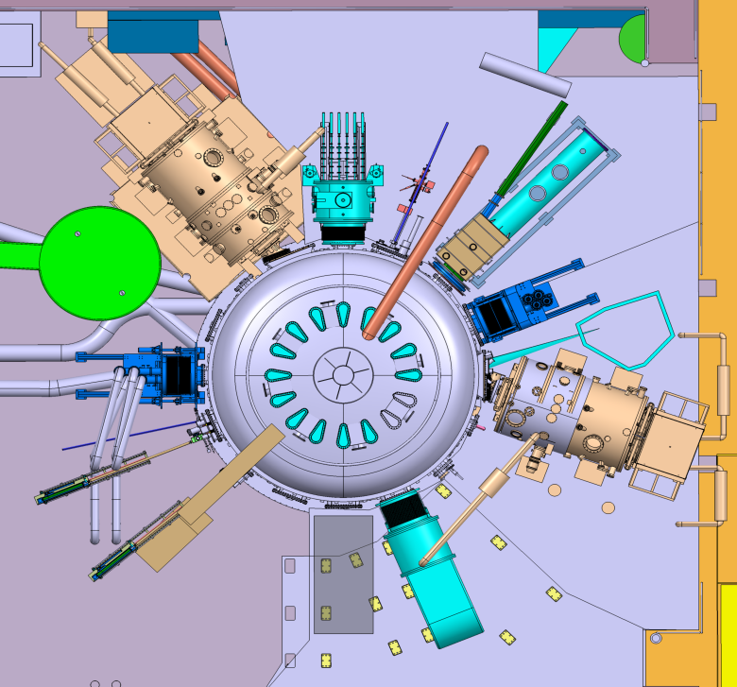


EAST Far-Infrared System Layout
HCN interferometer (HCN@ 337 mm)
F
E
D
C
Line-integrated${ n}_{e}$
G
Solid-state diode Sources Interferometer（SSI@461 μm）
B
D
H
Line-integrated $n_{e，}{\tilde{ n}}_{e}$
CO₂ Dispersion Interferometer）
I
A
I
POlarimeter-INTerferometer (POINT@432 μm)
M
P
A
J
L
O
Core$n_{e}, j_{∅},q,B_{p}$ profiles, $\tilde{J},\tilde{B},{\tilde{n}}_{e}.$
K
M
N
CO₂ Dispersion Interferometer (DI@9.3 μm)
HCN interferometer
solid-state diode sources inteferometer
Polarimeter-interferometer
（POINT）
Line-integrated $n_{e}\text{（}\text{for} high ne\text{）}$

Slide 4
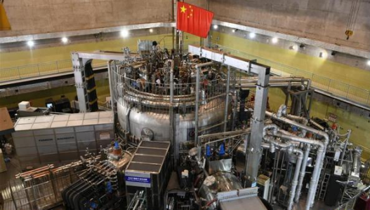
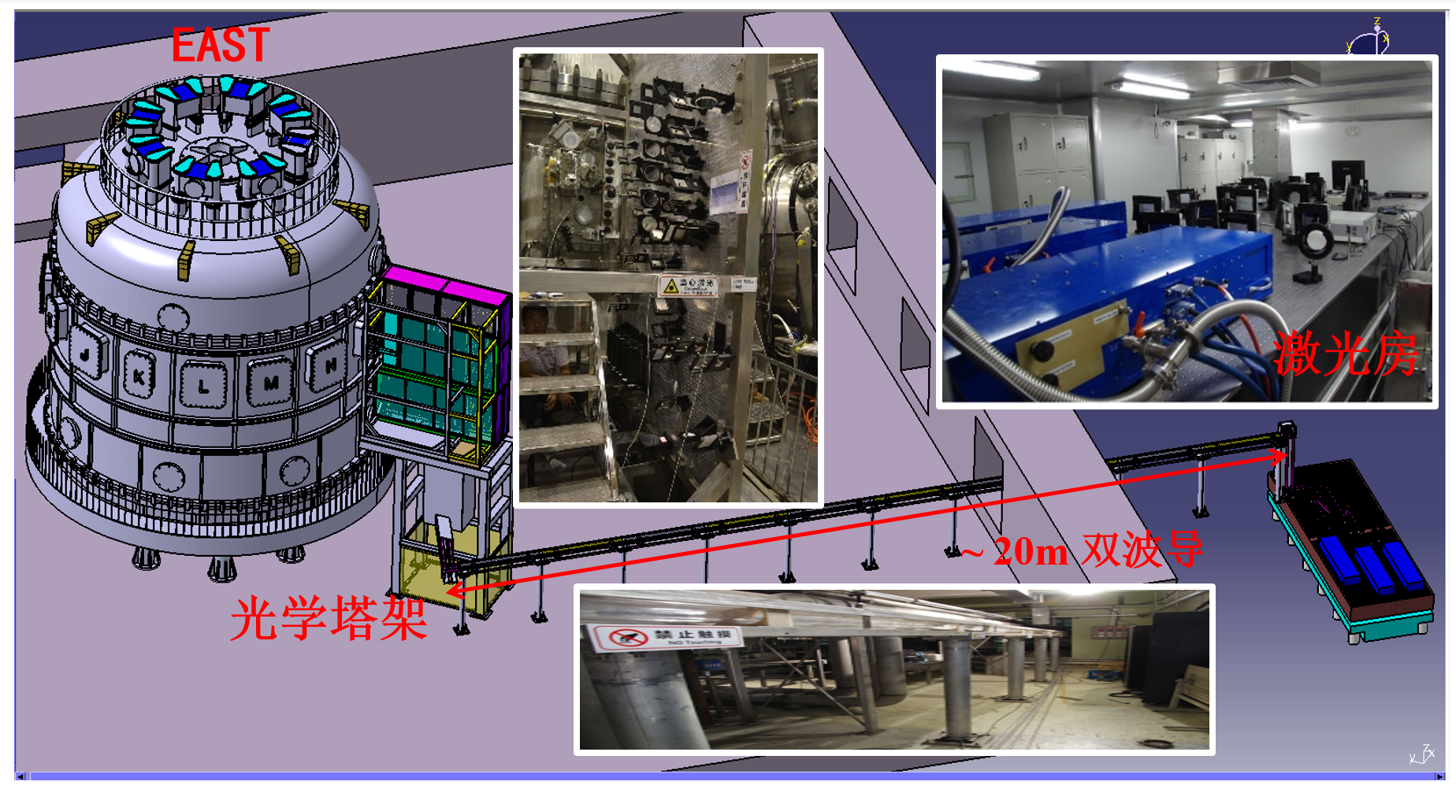

POlarimeter and Interferometer (POINT) on EAST
EAST
Real-time n_{e} measurement
MHD
instabilities
Real-time $j_{∅}$ profile monitoring
Disruption
POINT
Plasma displacement
POINT
Real-time feedback control
Perturbation measurement
Core density fluctuation
The polarimeter-interferometer is one of the most critical diagnostics on EAST, serving three main roles : i. Device protection (disruption warning); ii. Operational control (feedback control of electron density, current density, etc.); iii. Physical understanding.

Slide 5
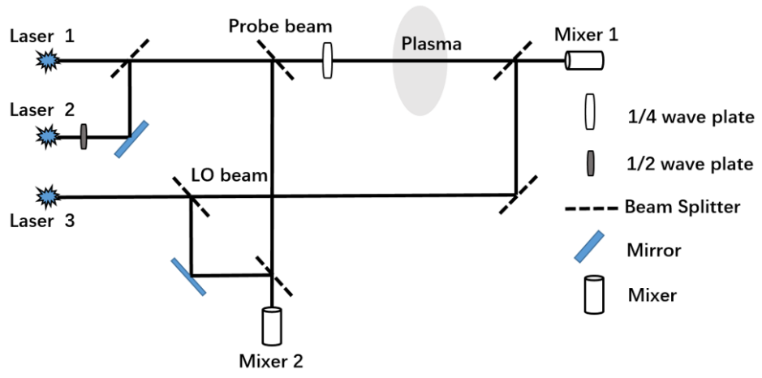
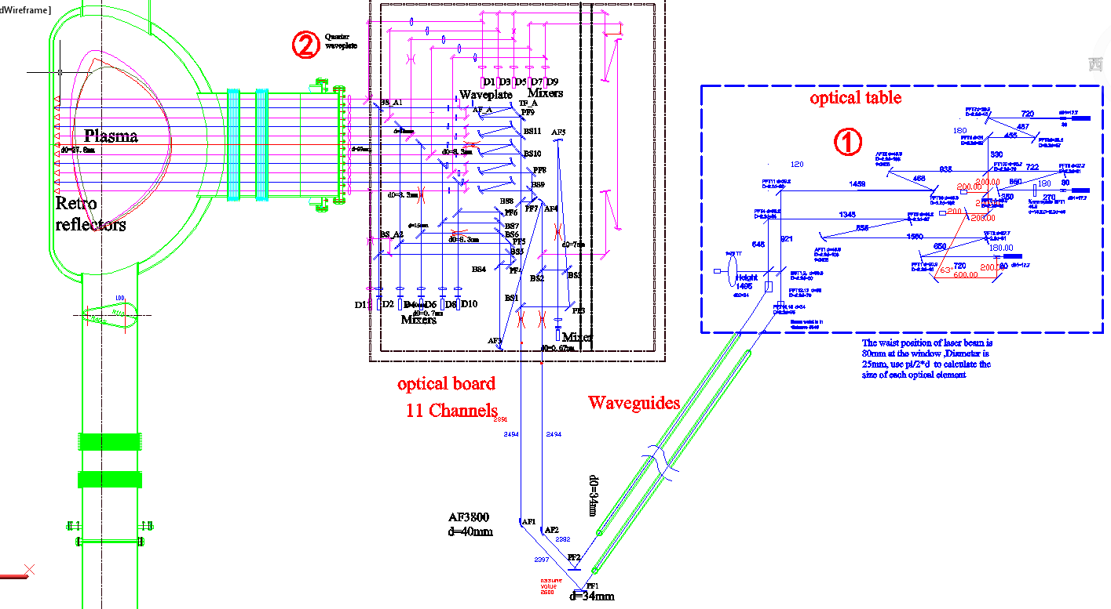
POlarimeter and Interferometer (POINT) on EAST
Three wave technique
Real-time n_{e} measurement
MHD
instabilities
Real-time $j_{∅}$ profile monitoring
Disruption
POINT
Plasma displacement
POINT Optical Layout
Real-time feedback control
Perturbation measurement
Core density fluctuation
The polarimeter-interferometer is one of the most critical diagnostics on EAST, serving three main roles : i. Device protection (disruption warning); ii. Operational control (feedback control of electron density, current density, etc.); iii. Physical understanding.

Slide 6
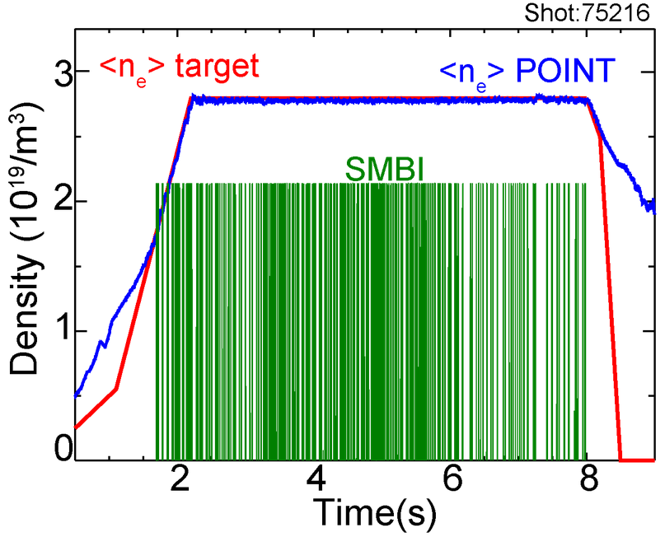
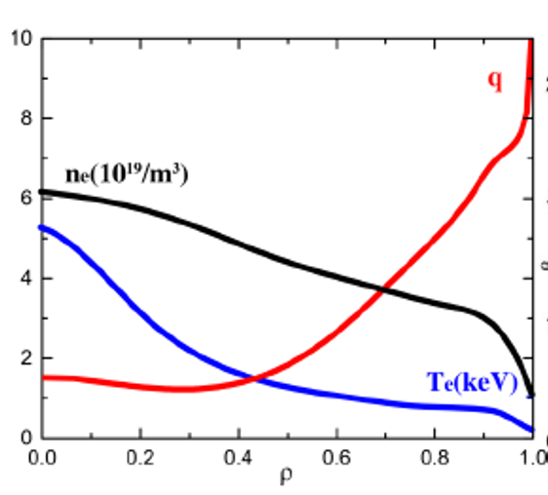
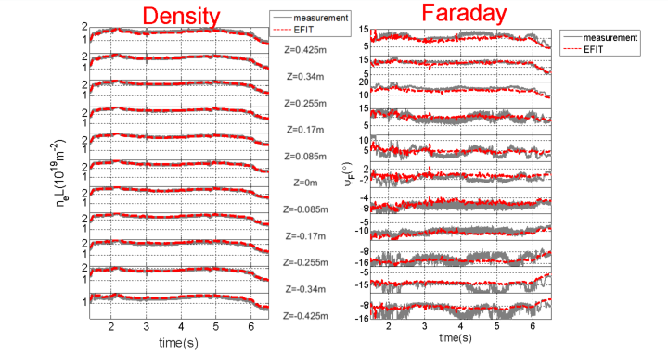
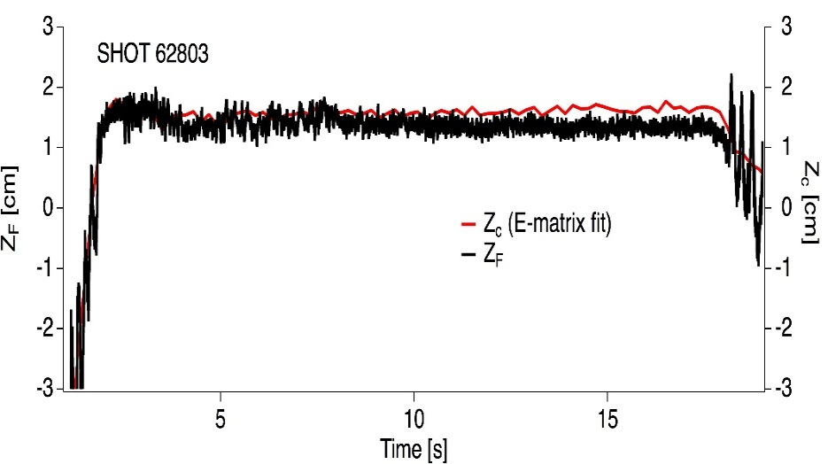
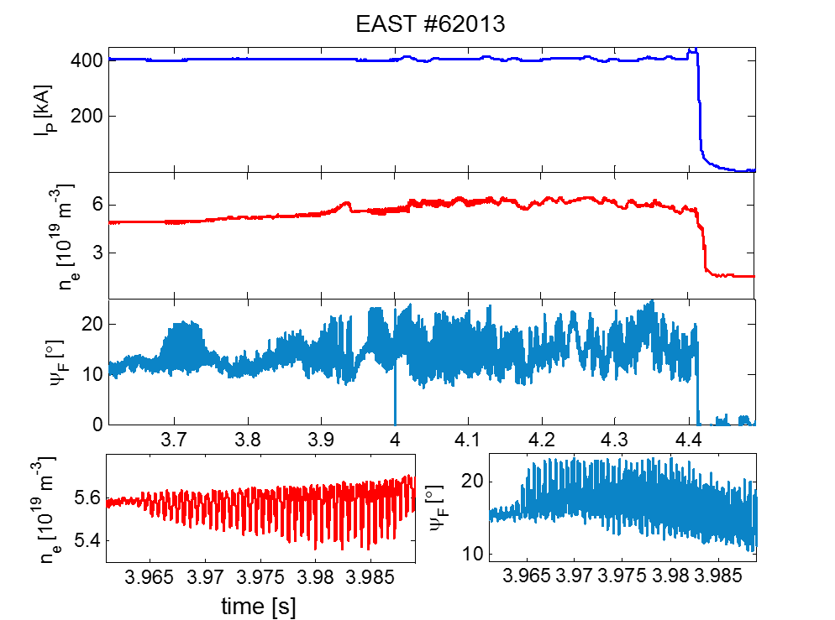
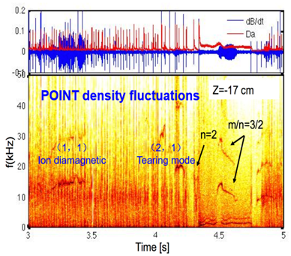
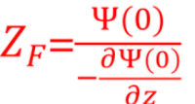
POINT System Measurement Results
Line-integrated density and Faraday rotation angle measurement
Density Feedback
n_{e} and q profiles
Vertical displacement measurement
Disruption precursor
Density fluctuation

Slide 7
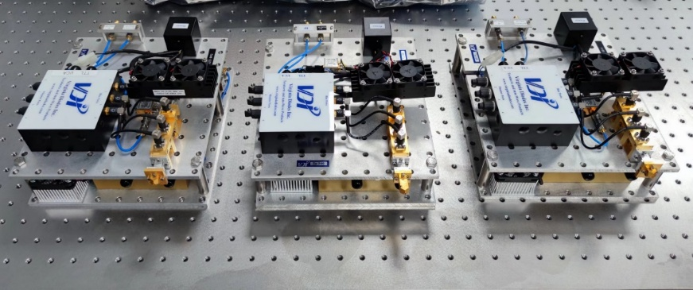
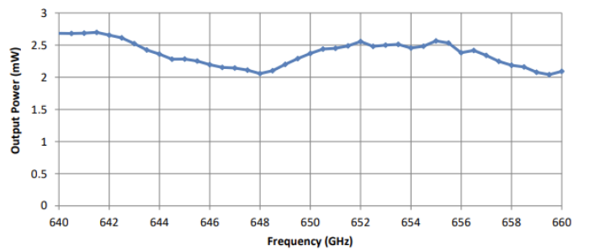
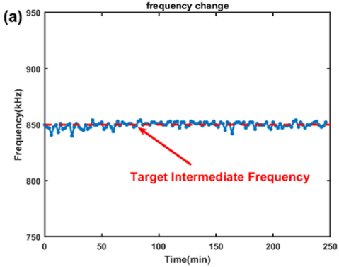
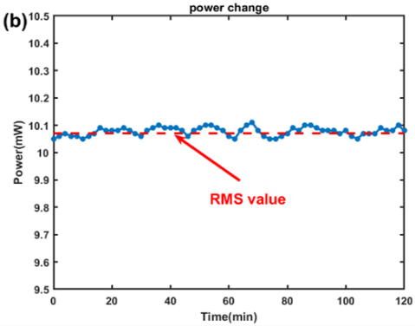
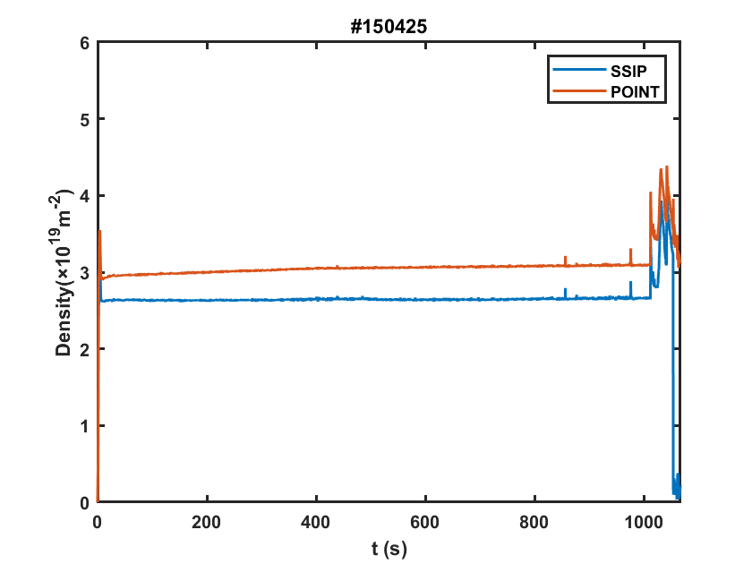
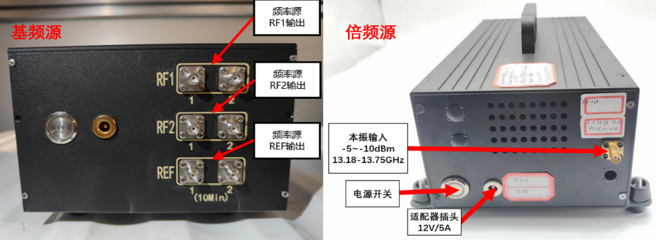
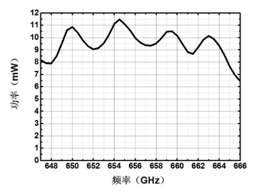
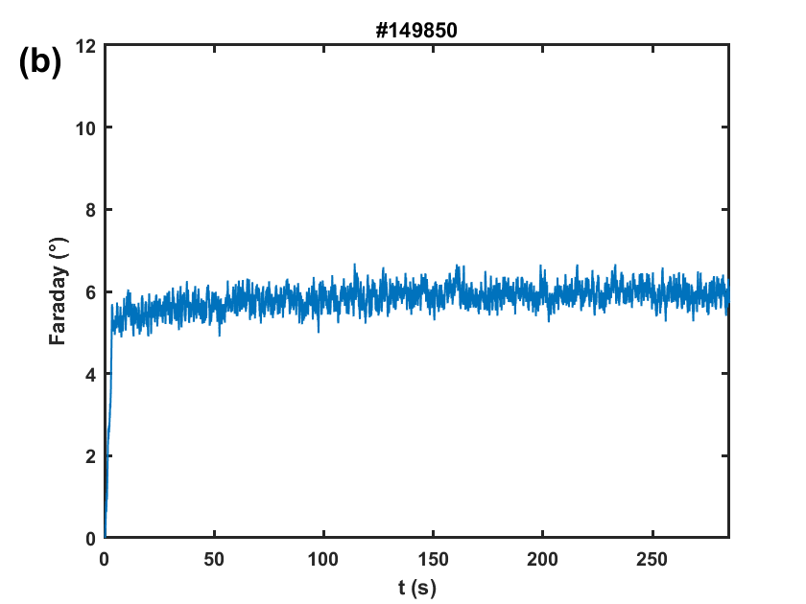
Solid - State Source Lasers for POINT
VDI Solid - State Source Lasers
Intermediate Frequency and Power Stability
Domestic Solid - State Source Lasers
1000s H - mode measurement
  Easy operation No preheating required
  Frequency stability Suitable for long - pulse operation
  Smaller size Easy to implement electromagnetic shielding
Long pulse faraday measurement
Operability, stability, and reliability have all been significantly improved!
BUT the out power is much lower than gas laser, especially for higher frequency.

Slide 8
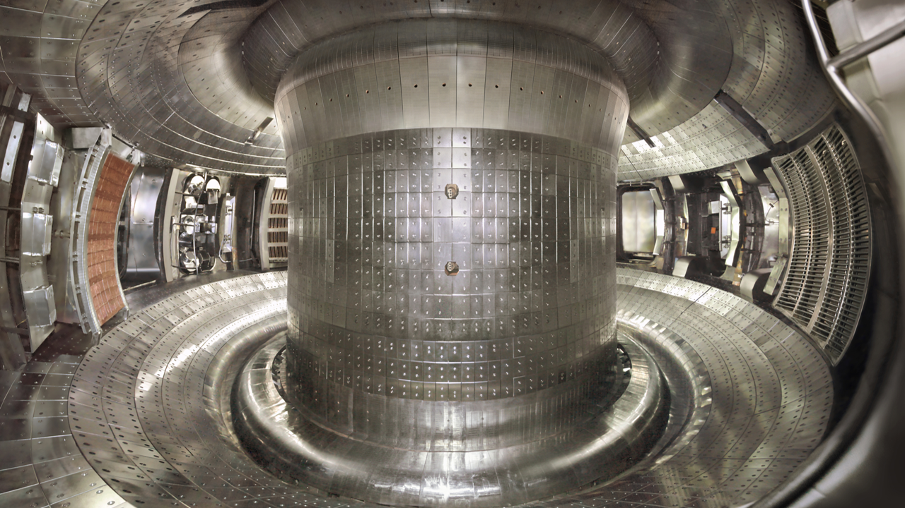
Development of POINT Model for BEST

Slide 9
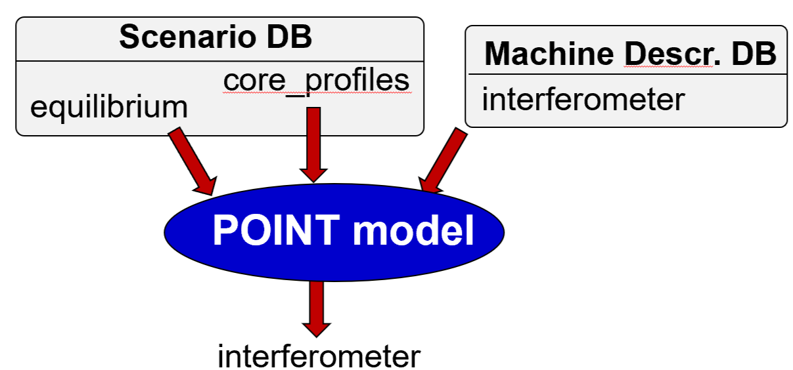
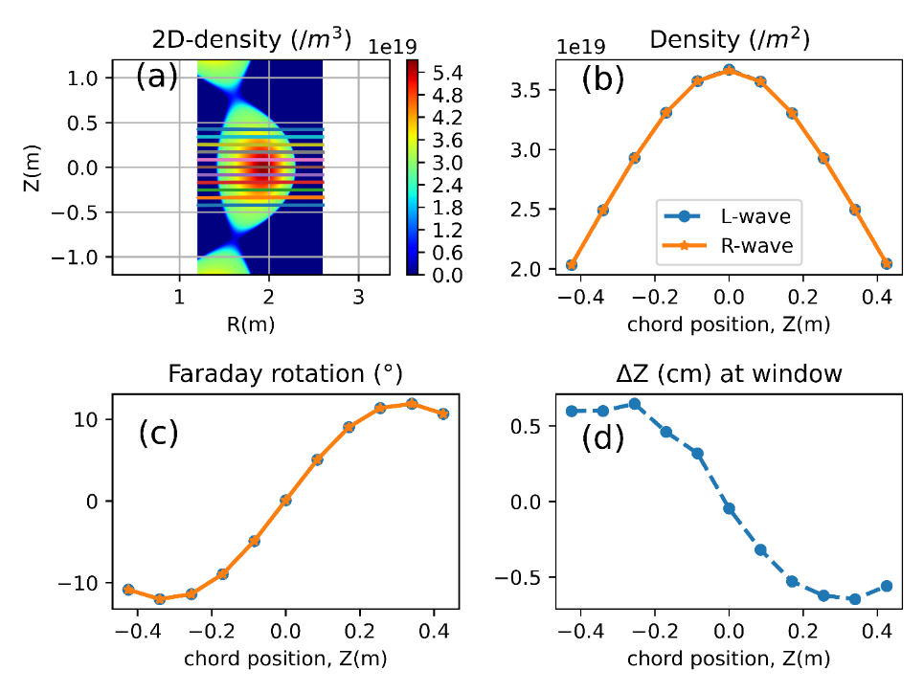
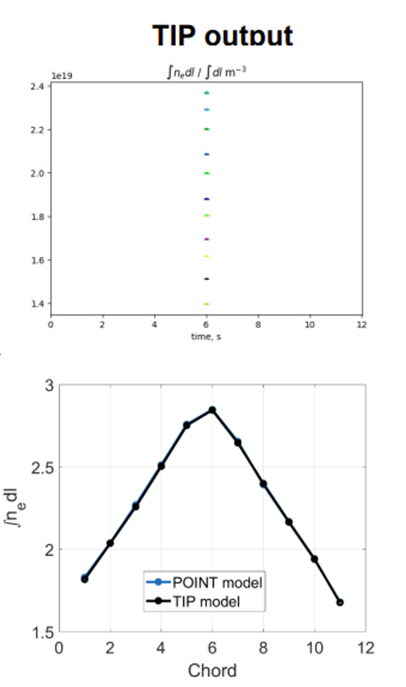
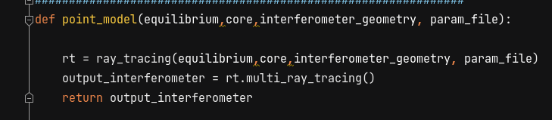
POINT model based on ray tracing
03
Integrated into IMAS, validated EAST data;
Good agreement between POINT model and TIP model
Assumption： Collisionless, cold plasma
Measurement：integral density and faraday
Programming: Python
Validation: EAST data and POINT system configuration
  interferometer =point_model(equilibrium,core_profiles,geometry)

Slide 10
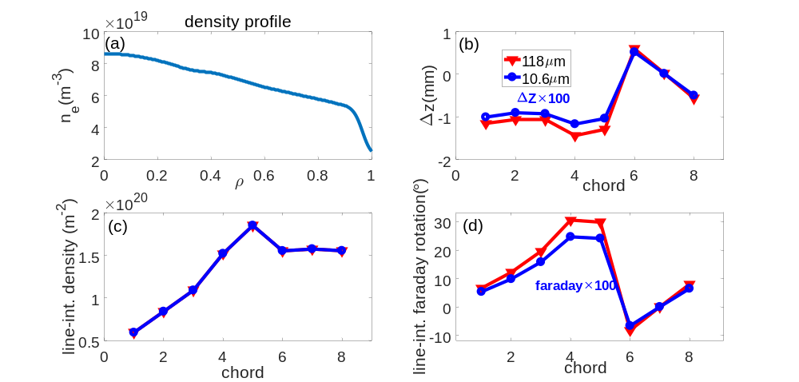
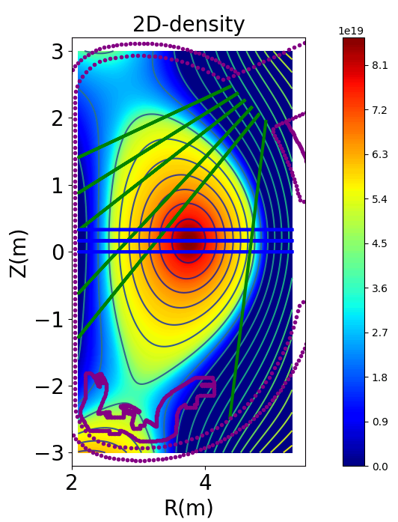
Physical Design of BEST POINT diagnostic
Schematic illustration of the designed LOS for the POINT
Central horizontal chords cover plasma current center
BEST Q~1 scenario
Ip | 5.3MA
Te0 | 18keV
B_{T} | 6T
ne | 7.2×10¹⁹m⁻³
118 μm offers a Faraday rotation signal two orders of magnitude stronger than 10.6 μm, making it the clear choice for robust polarimetric measurements, also exhibits larger beam deflection.
For BEST, the signal advantage decisively outweighs the refraction penalty.
*For Q>5, ne will be 2×10²⁰m⁻³

Slide 11
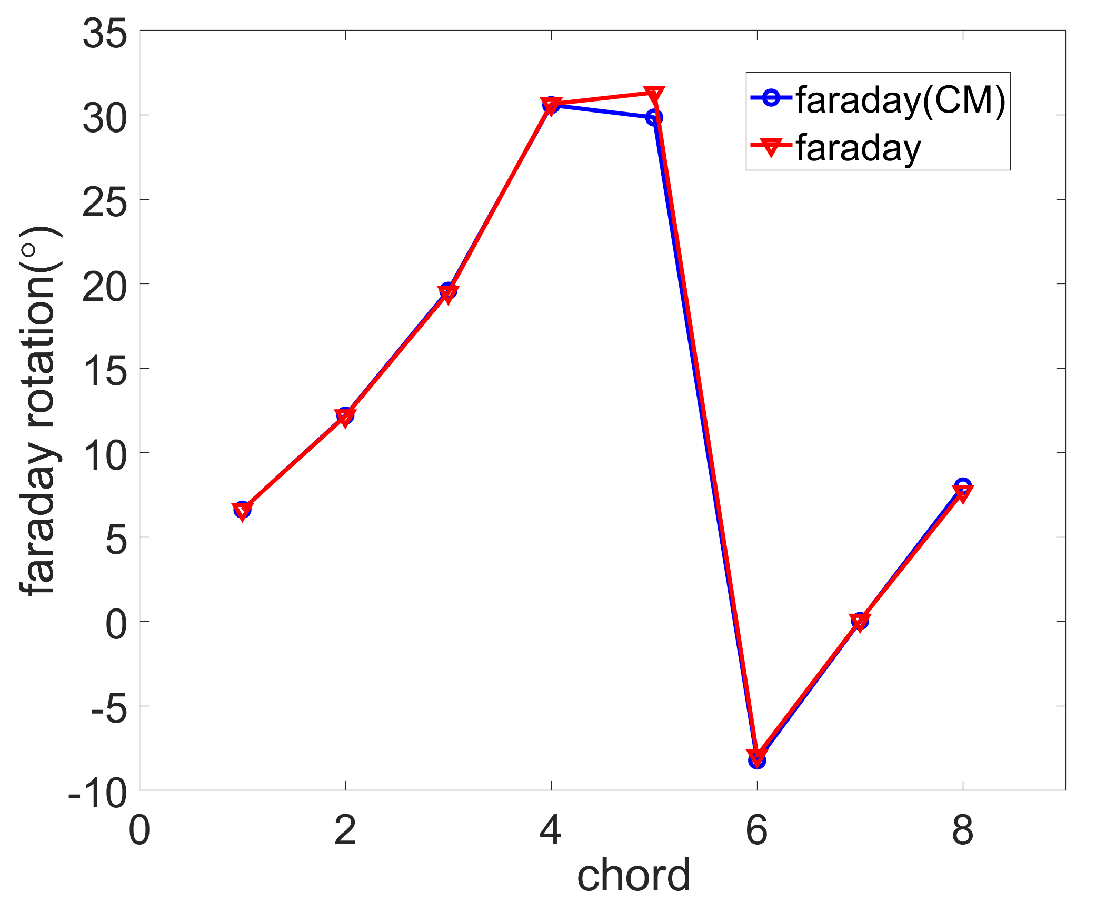
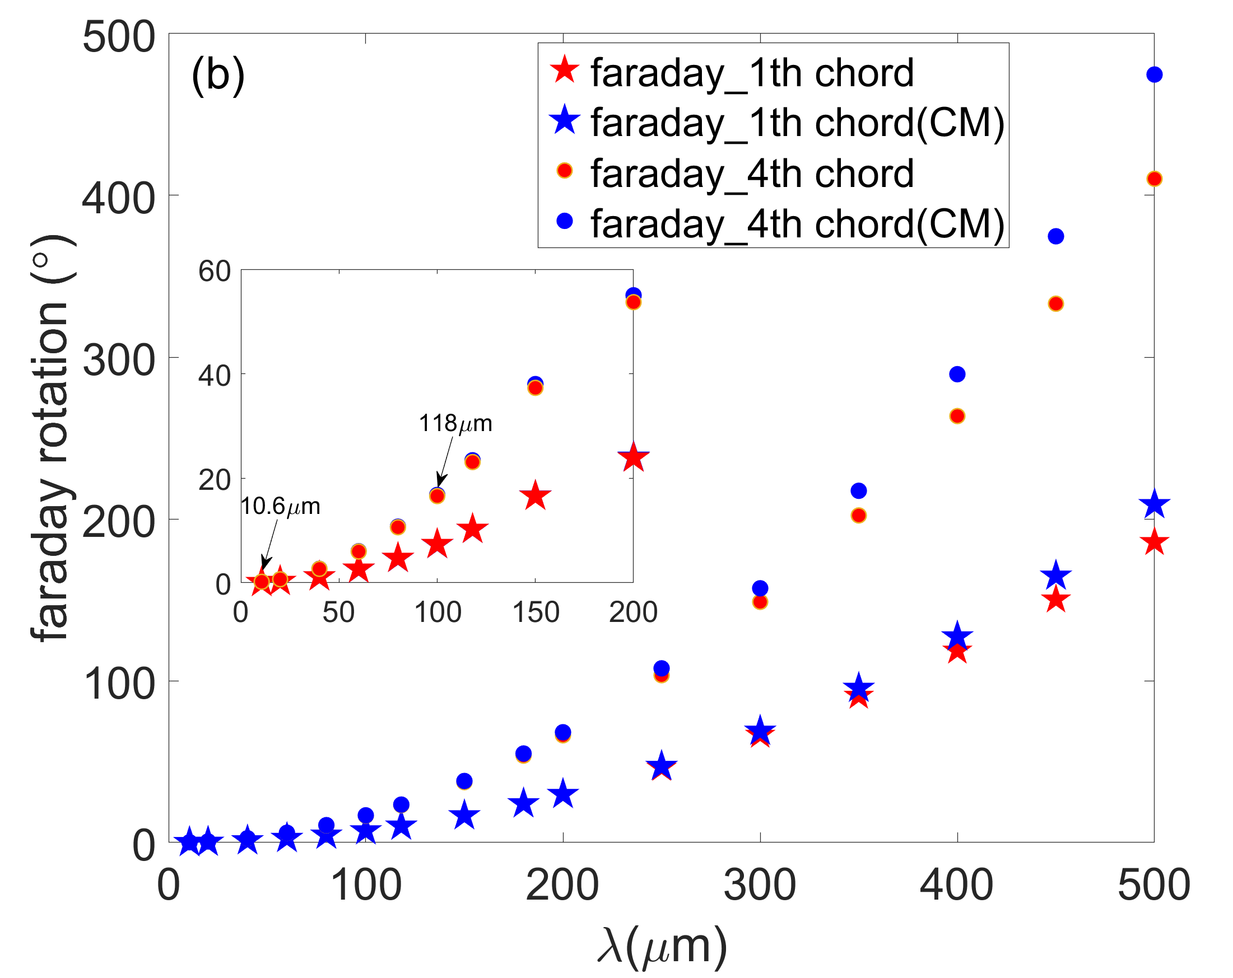
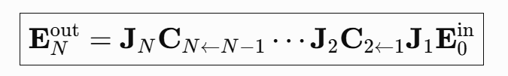
Cotton-Mutton effect
03
Cotton-mutton effect
CM also has little effect on faraday rotation, except for the 5th chord which is poloidal chord passes the plasma center.
As wavelength increases, the CM effect becomes more pronounced, reaching a 15.7% contribution at 500 µm.
CM effect is calculated using Matrix Propagation Along the Ray Path

Slide 12
Summary and Outlook

Slide 13
04 Summary and Outlook
Summary:
POINT supports density and faraday rotation measurements and the long-pulse H-mode measurements demonstrate system operability and stability.
An IMAS-integrated ray-tracing model has been developed, with results compared against EAST data and the TIP model.
Initial LOS and wavelength studies indicate a strong Faraday signal at 118 μm; CM effects and beam deflection have also be assessed.
Future Plans：
Extend validation and quantify CM for more BEST scenario.
And finite-temperature effects should be considered.

Slide 14
Thank You!

Slide 15
backup

Slide 16
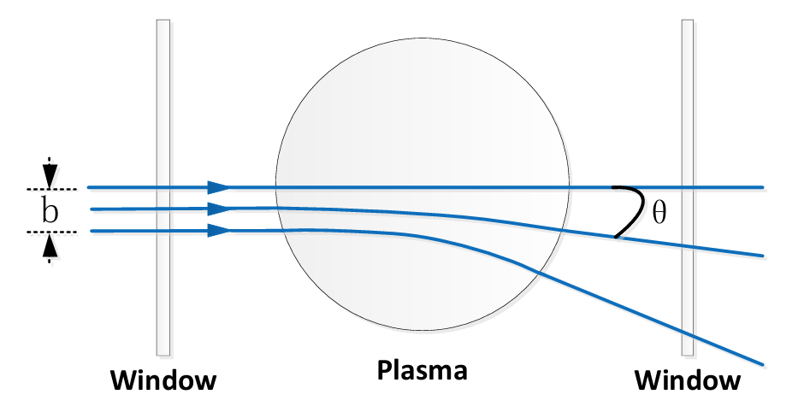
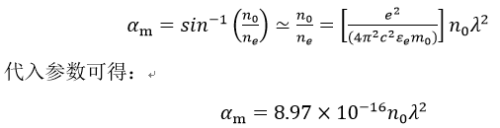
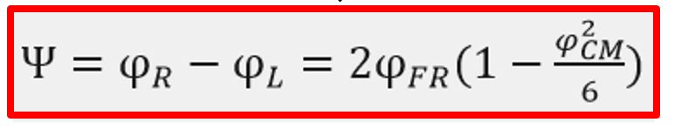
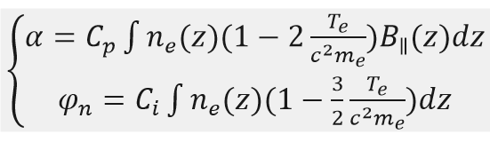

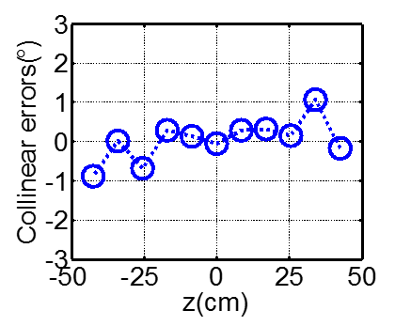
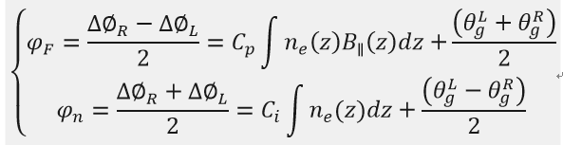


System Error
02
Cotton-mutton effect
Refraction effect
The plasma birefringence effect leads to a change in polarization ellipticity
May cause optical path deviation
Substituting EAST parameters:
Simple calculation shows a maximum POINT deviation of 14 mm for an 82 mm
window, with minor impact.
J. Chen et al PPCF 60 (2018) 085001
Finite temperature effect，Geometric phase error
Mechanical vibration and intermediate frequency error
Finite temperature effect: when the plasma temperature is high, the dielectric tensor needs to be corrected
Mechanical vibration error:
$$φ_{vibration}={2π∆L}/λ$$
Intermediate frequency error:
Electron density measurement error caused by mechanical vibration is less than 10¹⁶ /m²
electron temperature is below 10 keV, the measurement error is within 10%
Geometric phase error: considering the electromagnetic wave propagation path in the plasma
Collinearity error
$$\frac{∆∅_{R}−∆∅_{L}}{2}=α+C_{i}\int{{∇n}_{e}∆xdL}$$
System collinearity error is approximately 0.2°
the maximum system geometric phase is on the order of 0.01°, negligible
Jie Chen, PhD Thesis, HUST, 2013
T. Lan et al POP 23, 072109 (2016)
Zhiyong Zou, PhD Thesis, ASIPP, CAS, 2018

