Slide 1

Application of Raman micro-spectroscopy and confocal optical microscopy for monitoring and supporting the conservation/consolidation strategies of ancient papers
Francesca Bonfigli, Sabina Botti
ENEA, NUC Dept., TECFIS Div., MNF Lab., C.R. Frascati, Via E. Fermi 45 – 00044 Frascati (Italy)
Frascati, 19-21 October ENEA Research Center

Slide 2
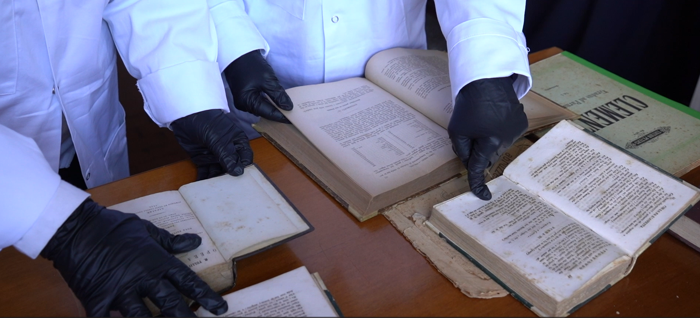
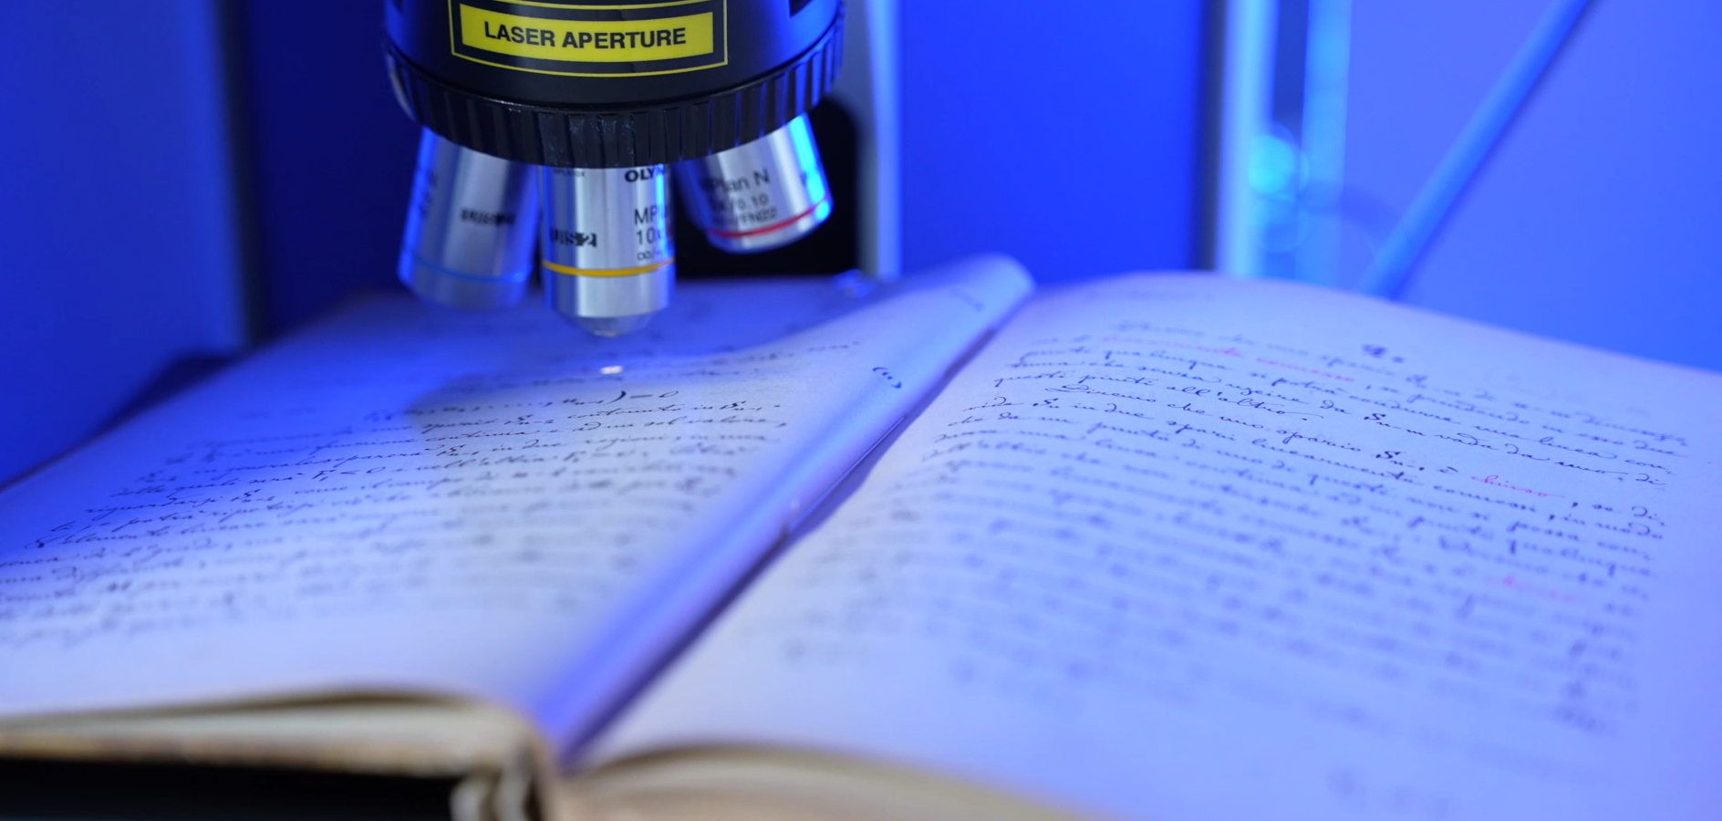
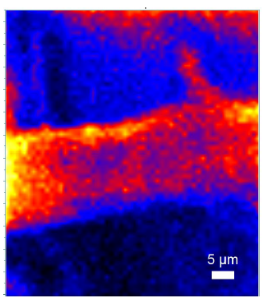
Objectives and Methods
Archival and library materials represent an invaluable cultural heritage, yet they are inherently vulnerable to both natural and accidental degradation. Preserving the structural and chemical integrity of paper, while mitigating ageing processes, remains a central challenge in the field of cultural heritage science.
Ageing deteriorates the mechanical and the optical properties of paper material, leading to thinner and more fragile yellowed/darkened sheets, compromising the readability of the text. No significant variations in mechanical/optical properties of paper are detected at the beginning of the ageing process, whose evidence is only provided by measuring the variation of cellulose structure at molecular level.
The ageing paper study can take advantages from using non-destructive spectroscopic technique.
We have developed a DIAGNOSTIC PROTOCOL based on spectroscopic markers derived from Raman signatures, that can follow degradation mechanism of the paper mainly due to hydrolisis and oxidation process.
Our aim is the developing of a non-destructive diagnostic procedure able to characterize the state of conservation of paper support and the advancement of degradation processes before an evident damage occurs assessing minimally invasive techniques to prevent or slow down the ageing process
As a light–matter interaction technique, Raman spectroscopy requires no physical contact with the sample, making it inherently non-destructive and particularly well suited for fragile substrates such as paper.

Slide 3
OUTLINE
Paper degradation mechanisms
Diagnostic protocol based on spectroscopic markers derived from Raman signatures
This diagnostic protocol has been applied to a variety of case studies, as tool to evaluate the conservation state of books from different historical periods.
Ageing/degradation markers measured for ancient and modern papers (samples span over three centuries XIX-XX-XXI).
Diagnostic protocol was used for assessment of innovative cleaning/restoring/consolidation treatments, such as composite hydrogels and photon irradiation.

Slide 4
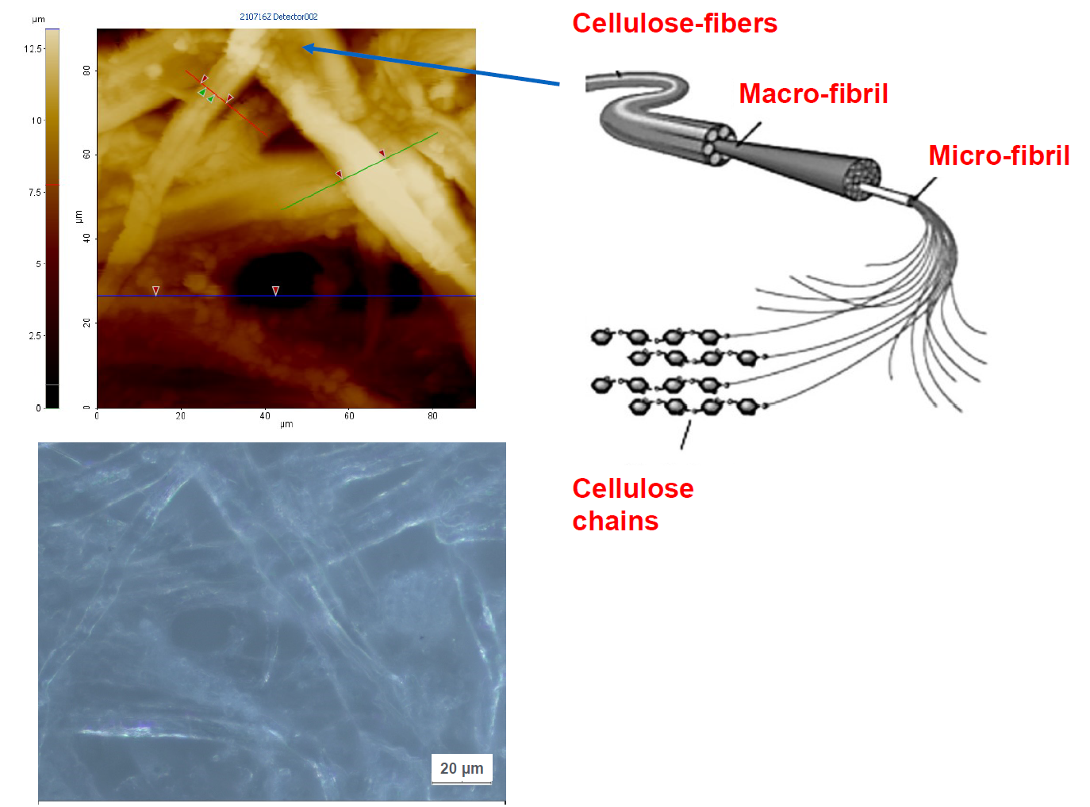


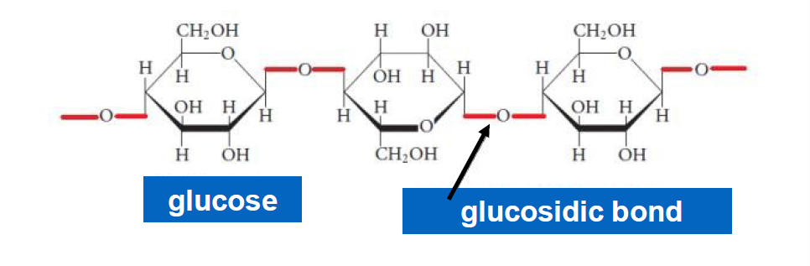
Cellulose chain structure
Paper is produced by pressing together cellulose fibers derived from wood, rags, or grasses, and drying them into flexible sheets. In addition to cellulose fibers, paper contains hemicellulose, lignin and a certain amount of fillers that are used for bleaching and strengthening.
Cellulose is a natural linear polymer of gluocose monomers linked by glucosidic C-O-C bond.
The number of the glucose monomers, indicated as polymerization degree, can be hundreds or thousands of single units, depending on the cellulose origin (wood pulp, cotton, or plant).
Cellulose: a linear polymer of D-glucose units linked by β-(1→4)-glycosidic bonds.
Cellulose chains are held together by strong hydrogen bonds that promote the aggregation of single chains into a highly oriented structure, progressively forming the microfiber, the fibril, and the fiber.
In cellulose, regions with regular and well-organized structure (crystalline part) and others with disordered structure (amorphous part) coexist. The ordered aggregation gives high tensile strength to cellulose fibers
The lower the crystallinity and polymerization degree of cellulose, the faster the deterioration, due to the higher accessibility to external agents
Notes:
4

Slide 5
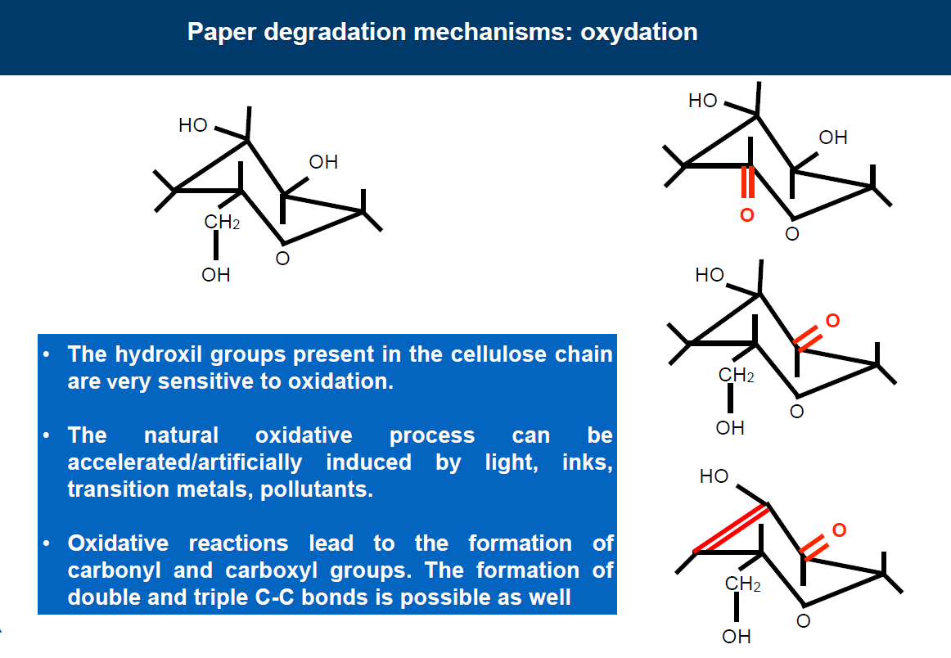

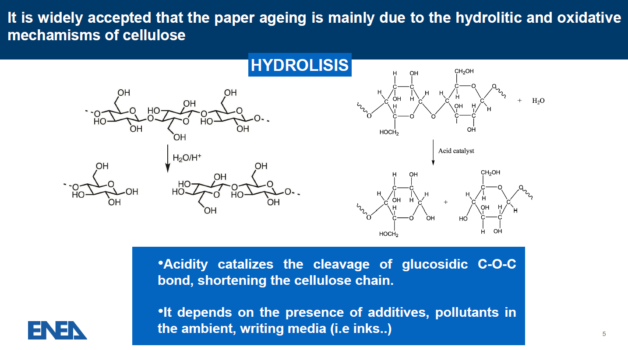
Paper degradation mechanisms
Main degradation mechanisms of cellulose
Hydrolisis
Oxydation
Hydrolysis can occur in both acidic and basic environments causing depolymerization
Oxidation leads to the carbonyl C=O and
carboxyl group formation that bind to cellulose disrupting its structure.
Hydrolysis breaks the glucosidic bond (C-O-C linkages) between glucose monomers, resulting in a shortening of the cellulose chain, with a consequent reduction in content of the crystalline form
The formation of double and triple C-C bonds is possible as well.
The hydroxil groups –OH present in the cellulose chain are very sensitive to oxydation
The recent approach of several works is to correlate these variations to the change of quantities that can be measured with non-destructive tools. In this respect, intrinsically non-destructive spectroscopic techniques gained prime importance. The changes in the structural properties of paper due to degradation are reflected in a change of spectroscopic fingerprints values. IR, Raman, and luminescence spectroscopy were employed to study paper ageing.
Notes:
5

Slide 6
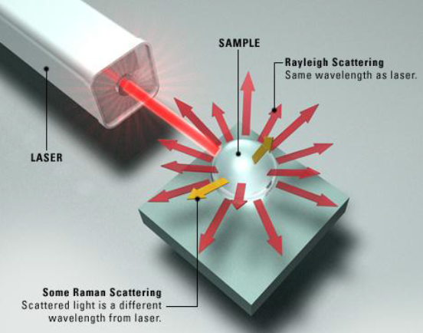
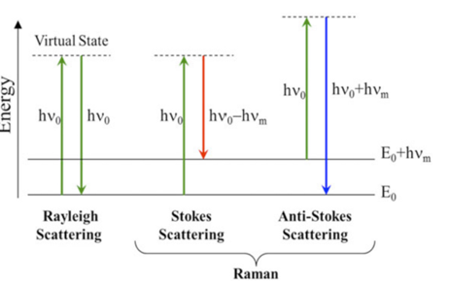
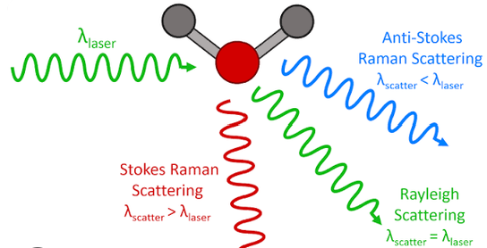
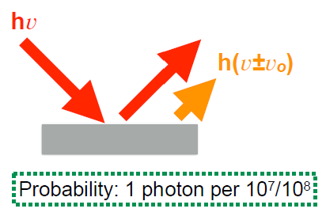
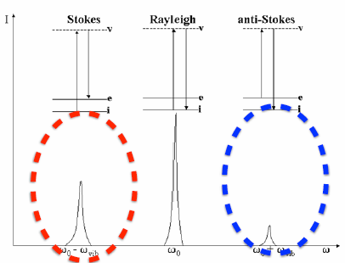
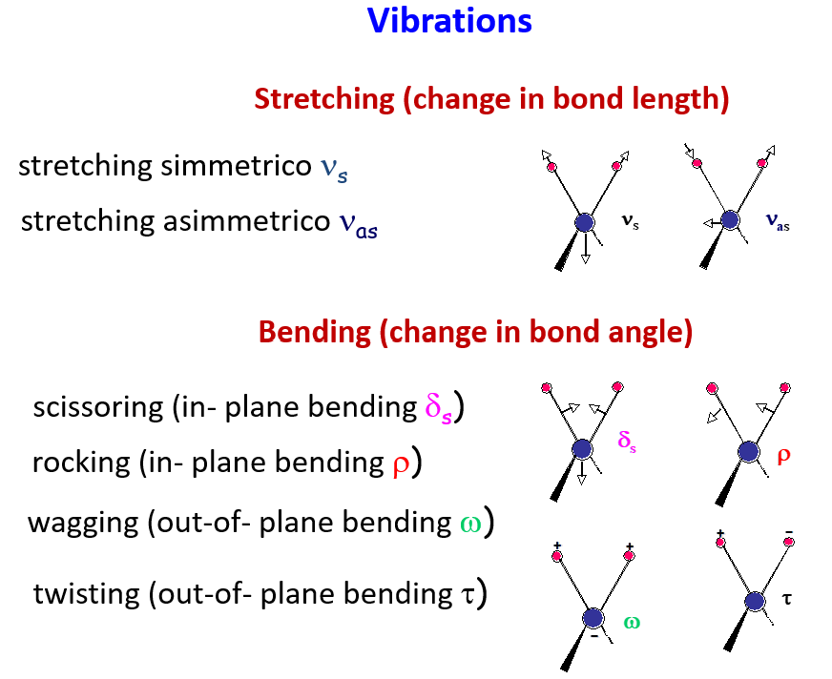
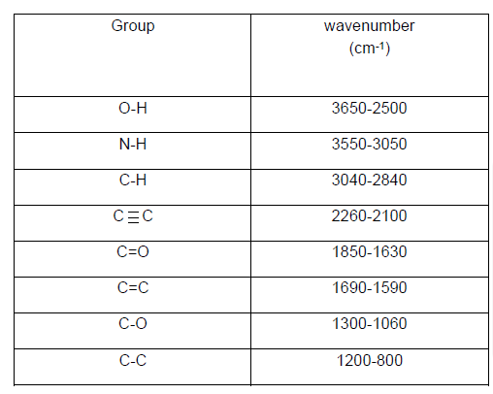
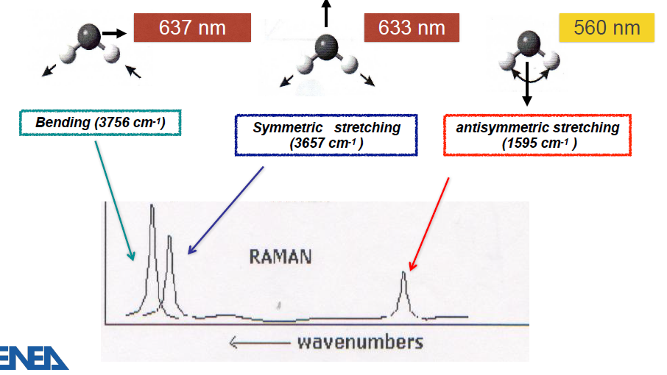

Raman spectroscopy
The aim of our work was to define a non-destructive diagnostic protocol based on Raman micro-spectroscopy
Raman spectroscopy is a non-destructive and non-invasive chemical and structural analysis technique based on the phenomenon of inelastic light scattering (known as Raman scattering). It is a spectroscopic technique typically used to determine vibrational modes of molecules, although rotational and other low-frequency modes of systems may also be observed.
Raman spectroscopy is commonly used to provide a structural fingerprint by which molecules can be identified, study chemical bonds, and determine crystalline structure.
Two situations can arise when Raman scattering occurs:
Scattered photons have a lower energy (Stokes scattering – phonon absorbed)
Scattered photons have a higher energy (anti-Stokes scattering – phonon emitted).
The inelastic scattering of light is due to the interaction of radiation field with the chemical bonds within a material, with consequent energy exchange. This interaction leads to a specific energy shift in the scattered light. This energy shift is measured in the Raman spectrum, which can be considered as a fingerprint of each chemical compound.
Raman lines are related to the vibrations of the functional groups of the molecules in the sample and to their vibrational modes.
GROUP FREQUENCIES
Water molecule (excitation 514 nm)
Normal modes are often localized in a part of molecules, involving only few atoms with a frequency that is about the same for different molecular environment (group frequencies)
Notes:
6

Slide 7
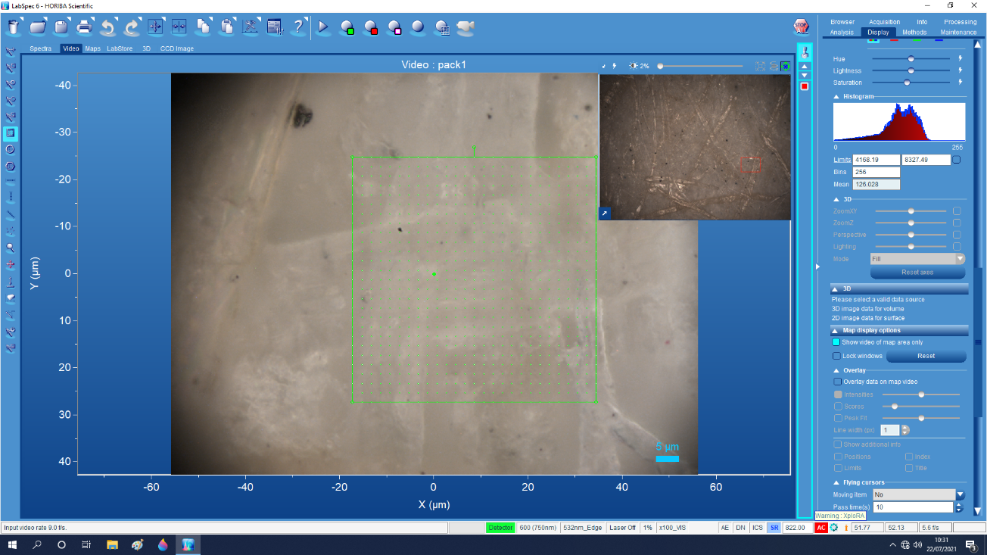
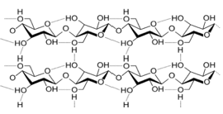
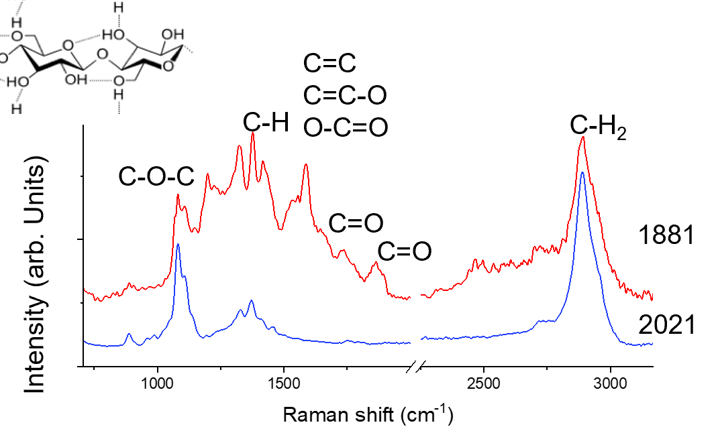
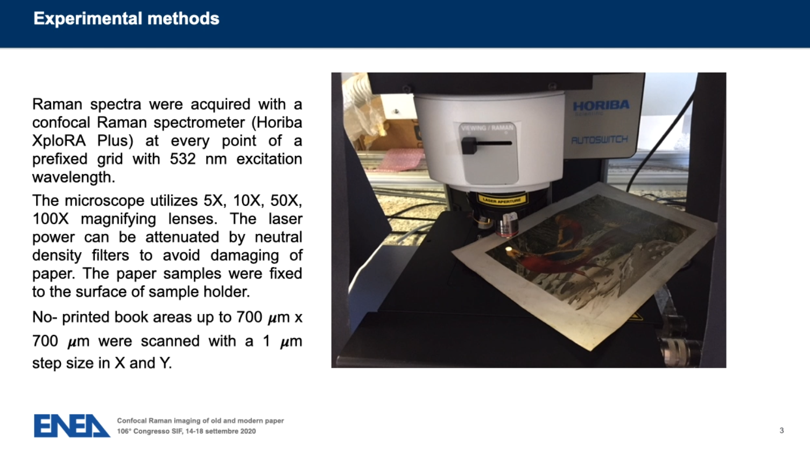
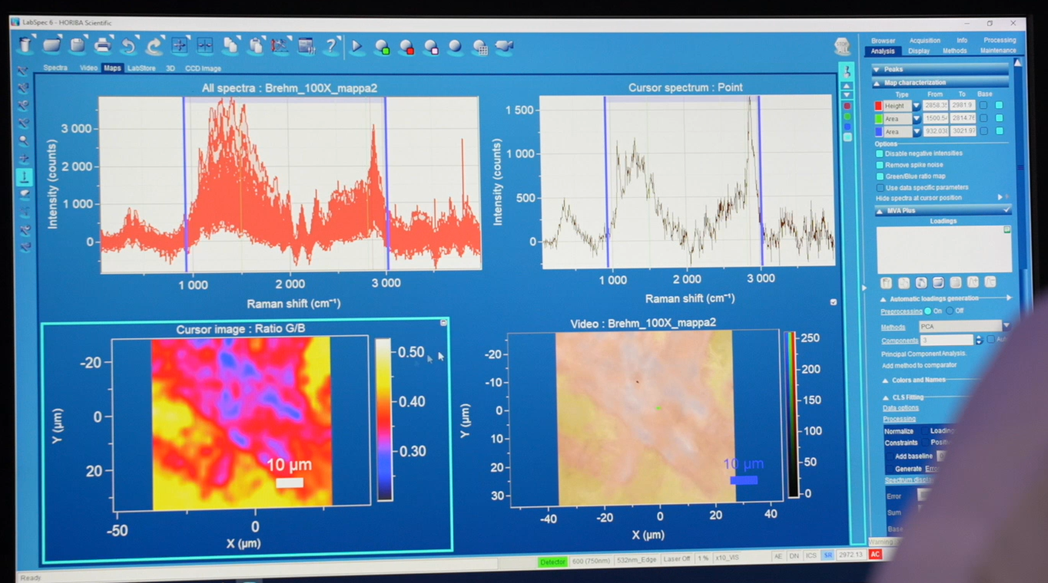
Procedure: Raman micro-spectroscopy
Selection and imaging with optical microscope of sample paper region of interest.
Acquisition of a Raman spectrum for each point of the prefixed grid
- Selection of Raman shift intervals of the Raman spectrum
- Visualization of the Raman map at the selected Raman shift intervals
- Overlapping of the Raman maps to the otpcal image of the sample
Notes:
7

Slide 8
Raman micro-spectroscopy as non-destructive diagnostic procedure for state of conservation of paper
The Raman micro-spectroscopy combines a Raman spectrometer with a confocal microscope allowing to study objects with a spatial resolution of about 1 μm, which is the same order of magnitude of a cellulose fiber diameter (0.4–20 μm).
Moreover, by operating in confocal mode, only the in-focus and on-axis portion of sample contributes to the Raman signal, strongly reducing the fluorescence background.
Surface scanning measurements allow the detection of signals at several points, taking into account the intrinsic heterogeneity of paper material.
From single FIBER to FULL PAGE
The novelty of our procedure is the possibility to obtain an image with μm scale spatial resolution of paper conservation state

Slide 9
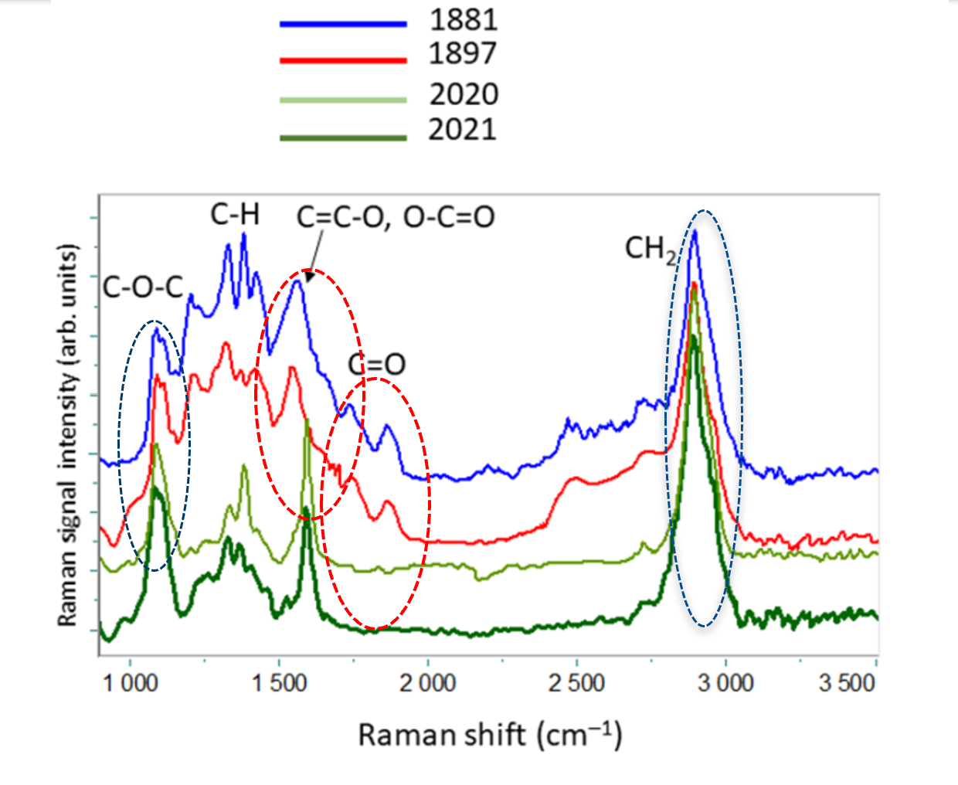
Ancient papers: is it possible to define aging markers?
The main peaks observed in Raman spectrum can be related to vibrational features of cellulose carbon groups
CH₂ stretching peak, which is related to the crystalline degree of cellulose (2890 cm⁻¹).
stretching of C–O–C glycosidic bonds between cellulose monomers (1100 cm⁻¹ )
In the Raman spectra of modern paper, a lignin peak at 1600 cm⁻¹ is present.
The use of wood pulp rather than rags causes an increase in lignin content in paper that can be eliminated only with secondary long chemical processes using toxic substances.
Today, it is preferred not to eliminate lignin, leading to the production of low-cost, low-quality paper
Carbonyl, carboxyl
internal vibrations of the C–H groups (1300–1470 cm cm⁻¹)
Bands of oxidized species attached to cellulose chain:
@ 1580 cm⁻¹ (stretching of double bonds in C=C–O and O–C=O groups)
@1640 cm⁻¹, @1740 cm⁻¹ (stretching of C=O in the carbonyl),
@1850 cm⁻¹ (stretching of C=O in the carboxyl groups)
- (2300–2800) cm⁻¹ region (overtones and combination of carboxylic group frequencies)
Notes:
9

Slide 10


Spectroscopic markers for degradation mechanisms
Definition of markers based on spectroscopic fingerprints that can follow the paper degradation processes
Polymerization degree - Hydrolysis
R_{H}= I₁₁₀₀/I₁₃₈₀
Oxidation
O_{I}= A₁₆₄₀₋₁₈₅₀/A₁₅₀₀₋₁₆₀₀
O_{T}= A₁₅₀₀₋₂₈₀₀/A₇₀₀₋₃₀₀₀
Crystallinity
C_{I}= I₂₈₉₄/I₁₃₈₀
R_{H}= I_{C-O-C}/I_{C-H}
O_{I} = A_{C=O}/A_{C-O}
CH₂
C_{I}= I_{CH2}/ I_{C-H}
R_{H} marker decreases as the ageing time of the paper increases
C_{I} marker decreases as the ageing of the paper increases
Polymerization Degree R_{H}
As paper ageing proceeds, the length of cellulose polymer chain decreases due to hydrolysis reactions of the first band, ascribed to the stretching of the C–O–C glycosidic bond (proportional to the number of linkages in the cellulose while the intensity of the second band, related to the vibrations of C–H groups in the glucose monomer, is weakly sensitive to the cellulose polymerization degree.
Crystallinity index C_{I}
Crystallinity in paper refers
to the degree of structural order of cellulose molecules
Cristallinity index of cellulose describes the decrease in CH₂ peak intensity due to the reduction in content of crystalline form, consequent to the shortening of cellulose chain length in aged papers.
O_{I} marker increase as the ageing of the paper increases
Oxidation index O_{I}
The modification in cellulose chain induced by oxidation can be evaluated from the strength of new peaks appearing in the Raman spectra of aged papers. The oxidation of hydroxyl groups in a cellulose chain in an ambient atmosphere leads to the formation of both C=C double bonds in glucose ring and of C=O bonds (carbonyl groups), which can be further oxidized to carboxylic groups. The ratio OI between the area of carbonyl bands in the range 1640–1850 cm-1, representing the final oxidation stage of cellulose, and that of the band at 1580 cm-1 (corresponding to the presence of intermediate species, gives information on how advanced the oxidation process is. In contrast, the ratio OT between the area of Raman bands of oxidized functional groups in the range 1500–2800 cm-1 and the area of whole spectrum (A700–3000) measures the amount of oxidation products linked to the cellulose backbone.
Notes:
10

Slide 11
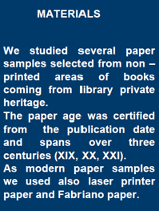
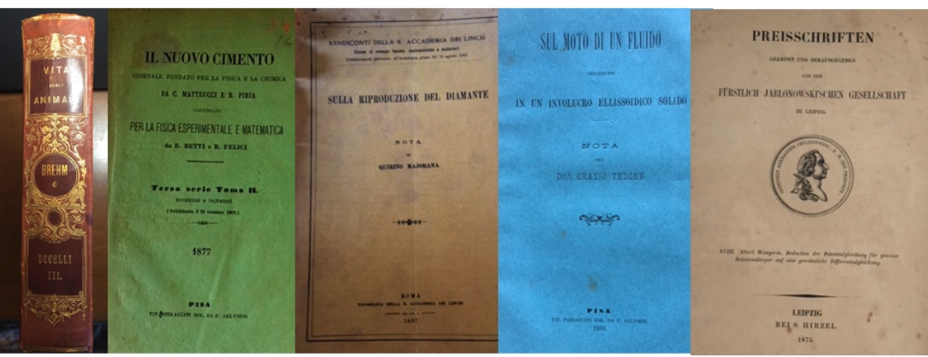
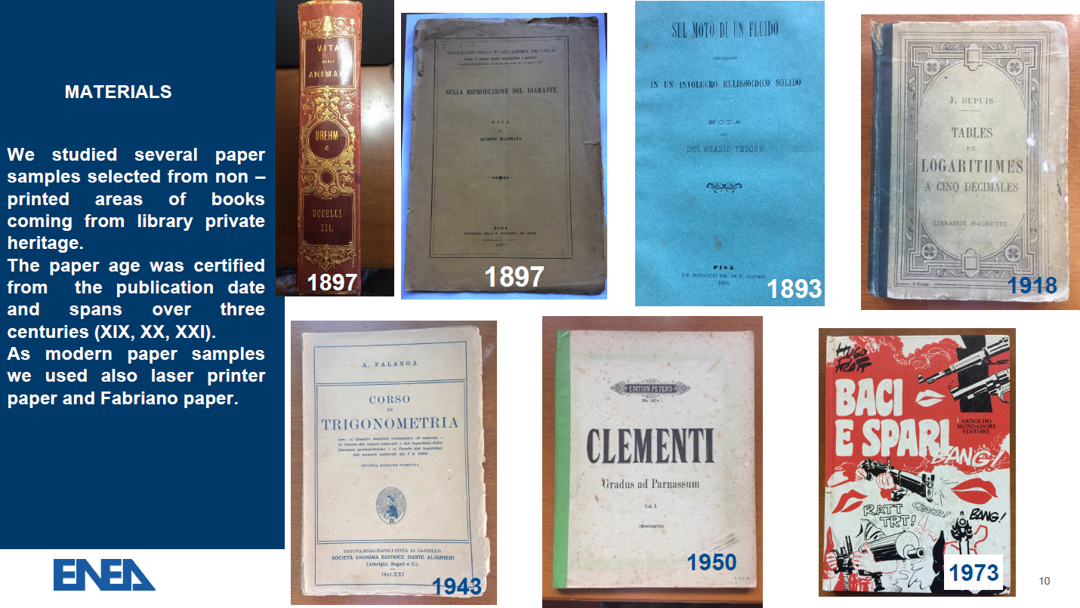
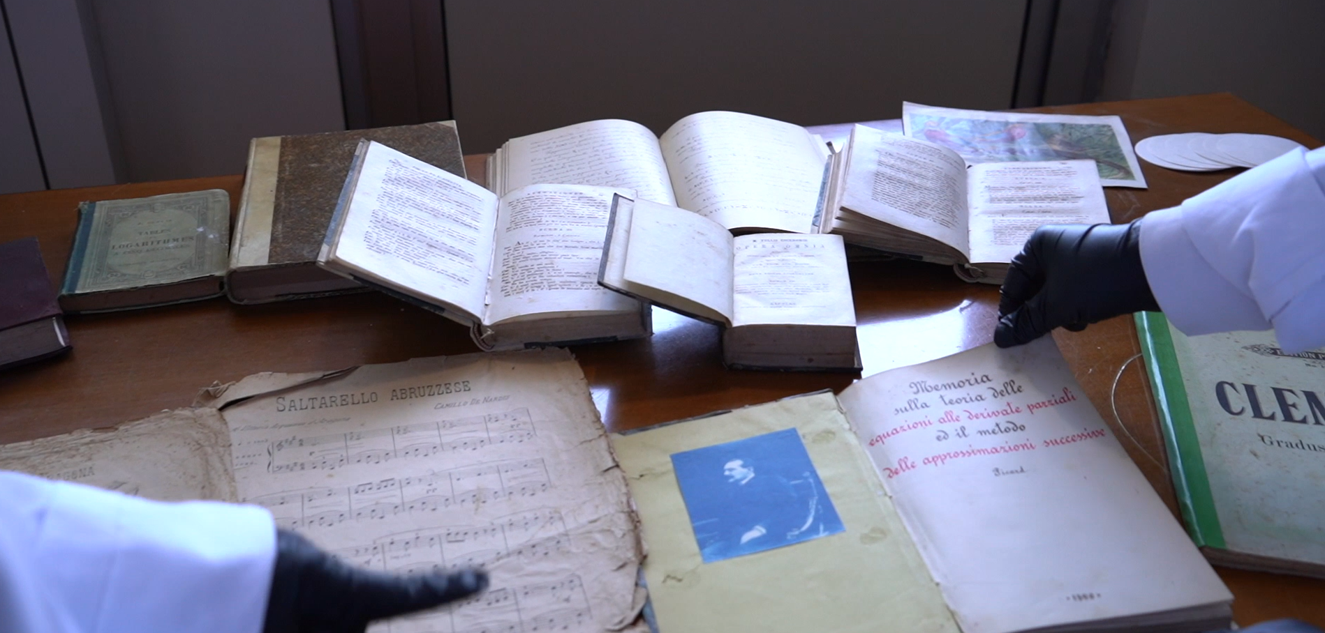
Sampled books
1897
1877
1897
1893
1875
Courtesy of L. Ricca, F. Bonfigli, S. Botti, E. Giovenale, V. Nigro
Notes:
11

Slide 12
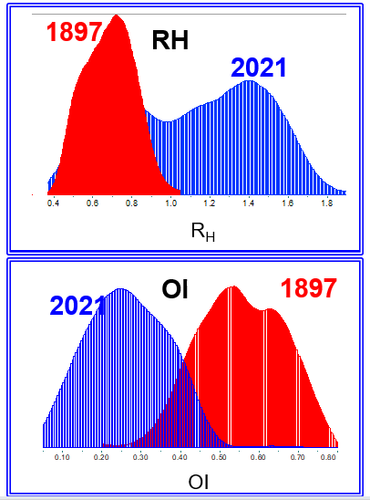
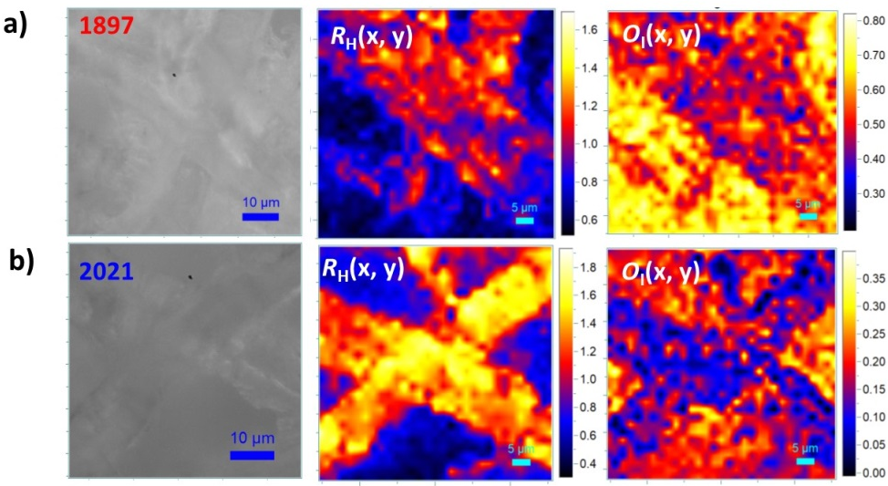
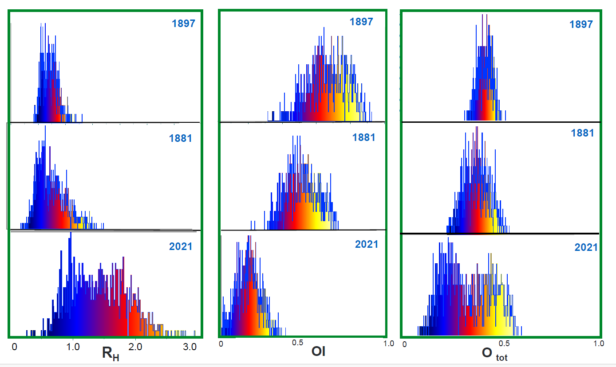
Ancient and modern papers: spectroscopic markers
From Raman maps we can calculate the distribution for each marker value.
Polymerization marker decreases in ancient papers
Oxydation marker increases in ancient papers
60 μm x 60 μm, 900 spectra
White light optical image and correlated Raman maps of R_{H} and O_{I} markers for XIX century paper sample from E.Brehm, Vita degli animali, vol. lII, Torino 1897 and XXII century Fabriano paper sample.
RH
OI
(60 μm x 60 μm, 2 μm grid step size, 900 spectra)
Distribution maps of RH and OI markers measured on a cross of fibers
Larger values of RH markers, measured along the cellulose fiber wall are correlated with smaller values of OI markers.
RH distribution shape
Modern paper displays a long tail of RH values larger than those of ancient paper and a double peak.
This behavior can be ascribed to the inhomogeneous composition of modern paper with respect the ancient ones.

Slide 13
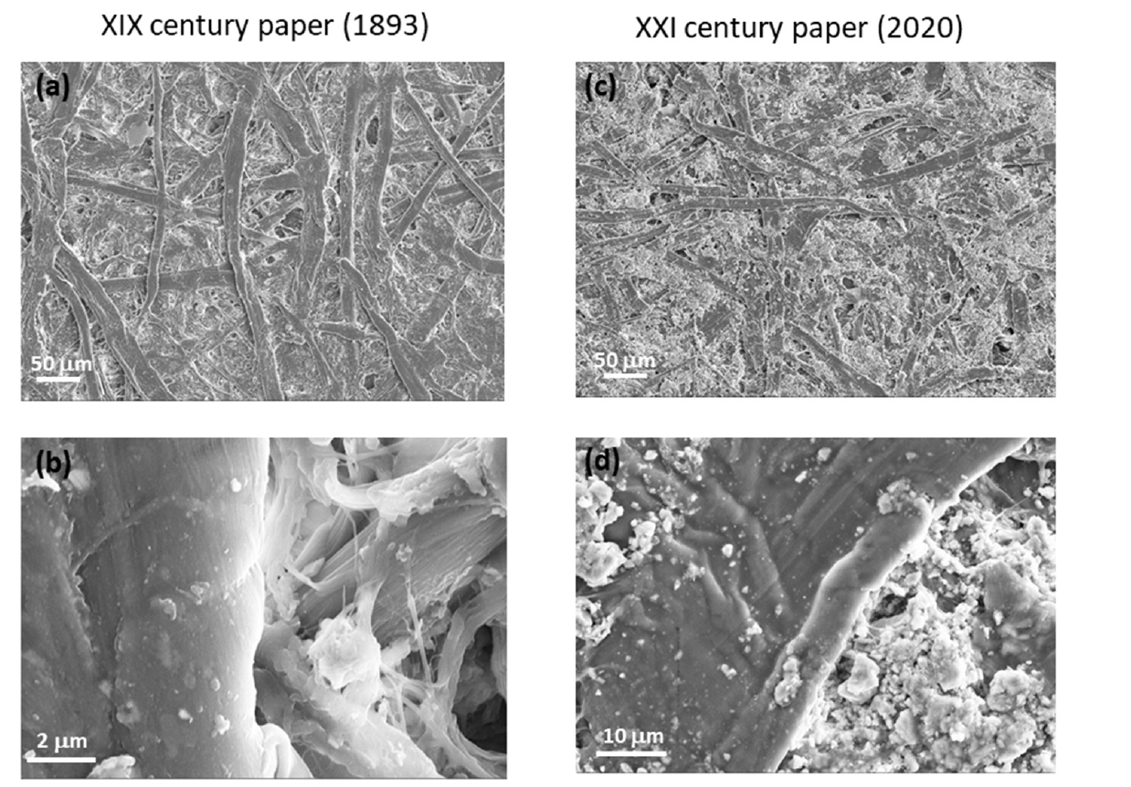
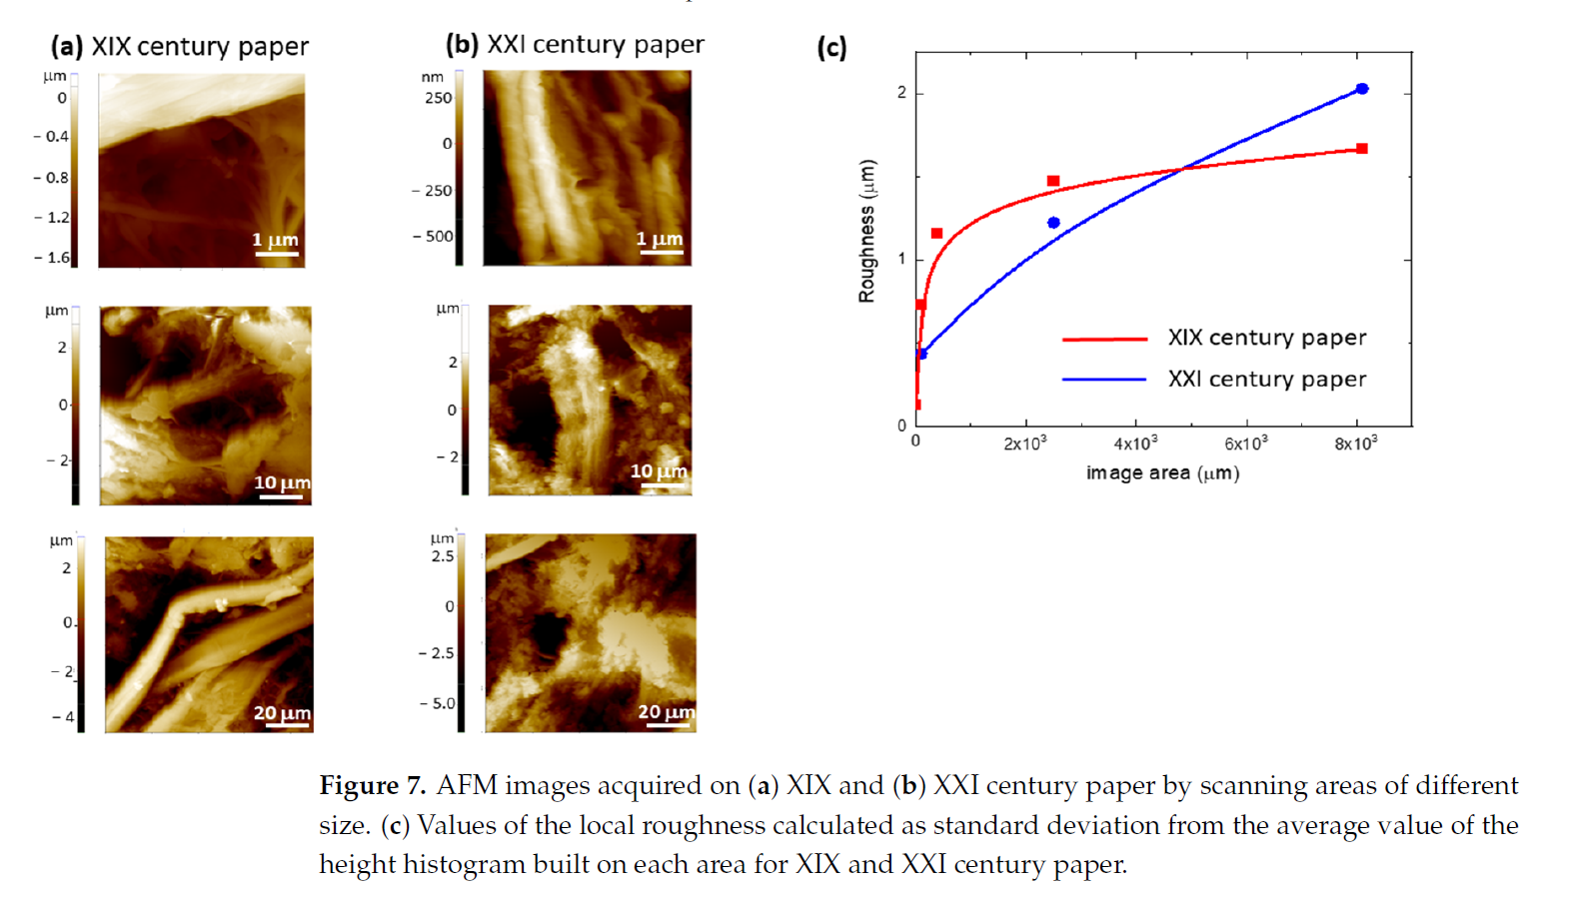

SEM and AFM characterization
HR-SEM images of two paper samples of XIX and XXI centuries.
Long cellulose fibers are clearly visible in the pictures related to the ancient paper sample, whereas in those of modern paper, the fibers are mixed with the presence of granular material. This finding demonstrated the change in paper composition over the centuries. In fact, modern paper is composed of only up to 50% short cellulosic fibers, the remaining part being hemicellulose and lignin. On the other hand, ancient paper was manufactured from long cellulose fibers in larger percentages with respect to the hemicellulose/lignin content.
AFM images of two paper samples of XIX and XXI centuries.
The AFM images show that the cellulose fibers of both samples are in a good conservation state without visible breakages, at least in the analyzed regions, and demonstrate the presence of disordered material in between the fibers.
By increasing the AFM image area, the roughness of ancient paper increases and saturates at 1.7 μm, whereas modern paper roughness progressively increases with any saturation observed.
This behavior can be ascribed to the more homogeneous composition of ancient paper with respect to modern paper, as evidenced in the HR-SEM images.
The literature data report that paper ageing causes a lack of fiber surface compactness; instead, in this experiment, the roughness of modern paper is larger than that of ancient paper due to its inhomogeneous composition and its short cellulosic fibers content.
From: Molecules 2022,27, 1712. https://doi.org/10.3390/molecules27051712
Collaboration with A. Rufoloni, A. Vannozzi, ENEA - NUC

Slide 14
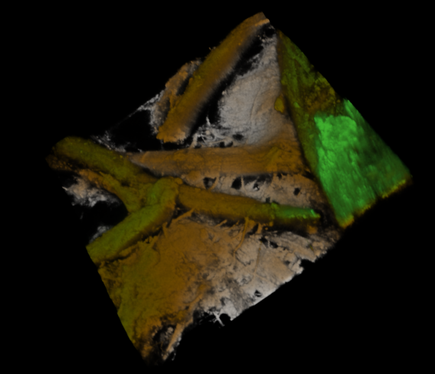
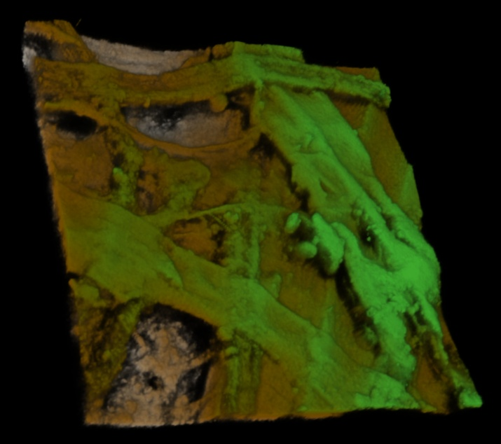
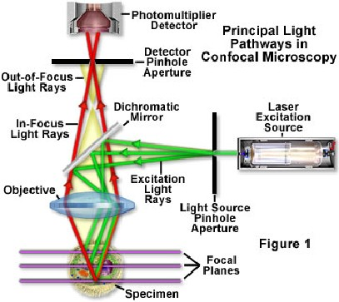
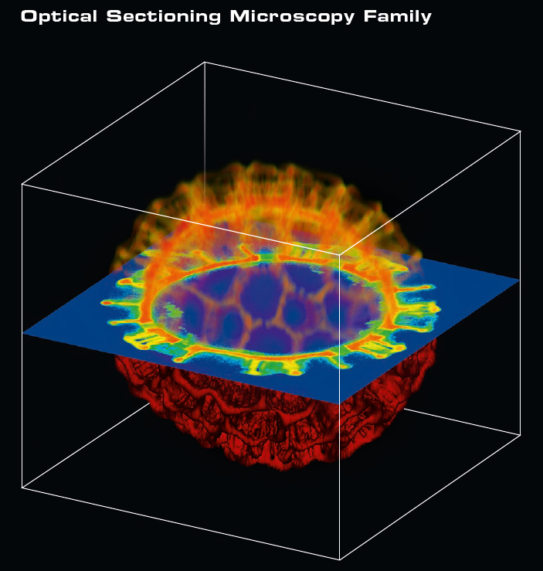
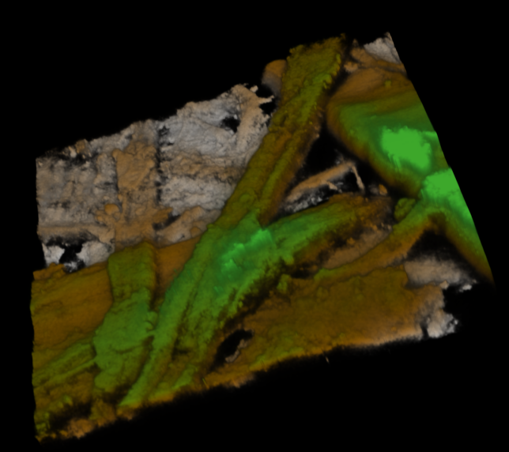
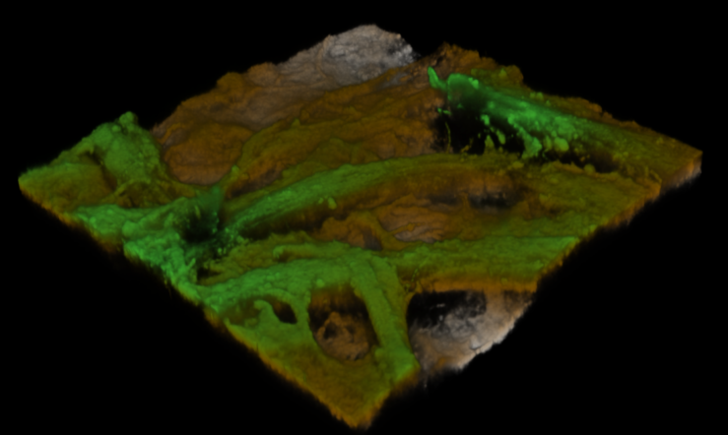
3D images acquired with confocal optical microscope
Paper XIX
Paper XXI
Confocal Laser Scanning Microsocpe
CLSM images (127 μm x 127 μm) Z=0-20 μm

Slide 15
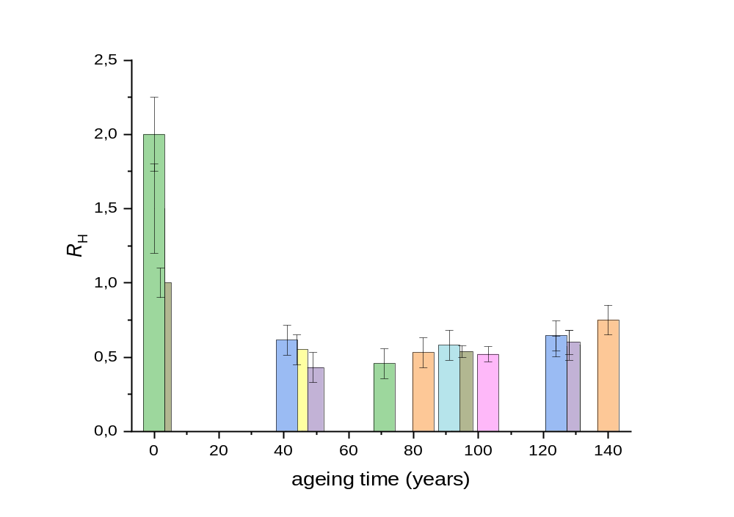
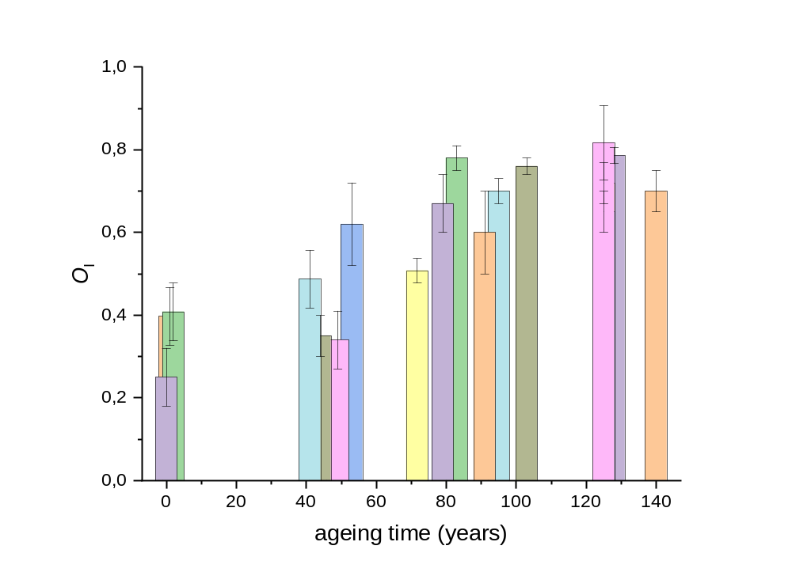
Variation of spectroscopic markers with book age
The aging markers were used to study the conservation state of tens of different paper samples covering a period of three centuries (XIX–XXI).
Evolution of RH and OI markers with ageing time
The reported values are the mean values calculated over the distributions, and the error bars are the calculated standard deviations
Hydrolisis effect - R_{H}
Oxydation effect - O_{I}
R_{H} marker shows a steep decrease with ageing time
O_{I} marker increase, fluctuations due to the different storage conditions and paper manufacturing
From: Botti, Sabina, Francesca Bonfigli, Valentina Nigro, Alessandro Rufoloni, and Angelo Vannozzi. "Evaluating the Conservation State of Naturally Aged Paper with Raman and Luminescence Spectral Mapping: Toward a Non-Destructive Diagnostic Protocol" Molecules 27, no. 5: 1712, 2022 (https://doi.org/10.3390/molecules27051712)
Notes:
15

Slide 16
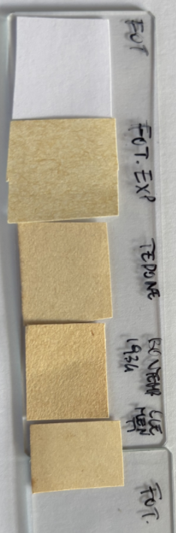
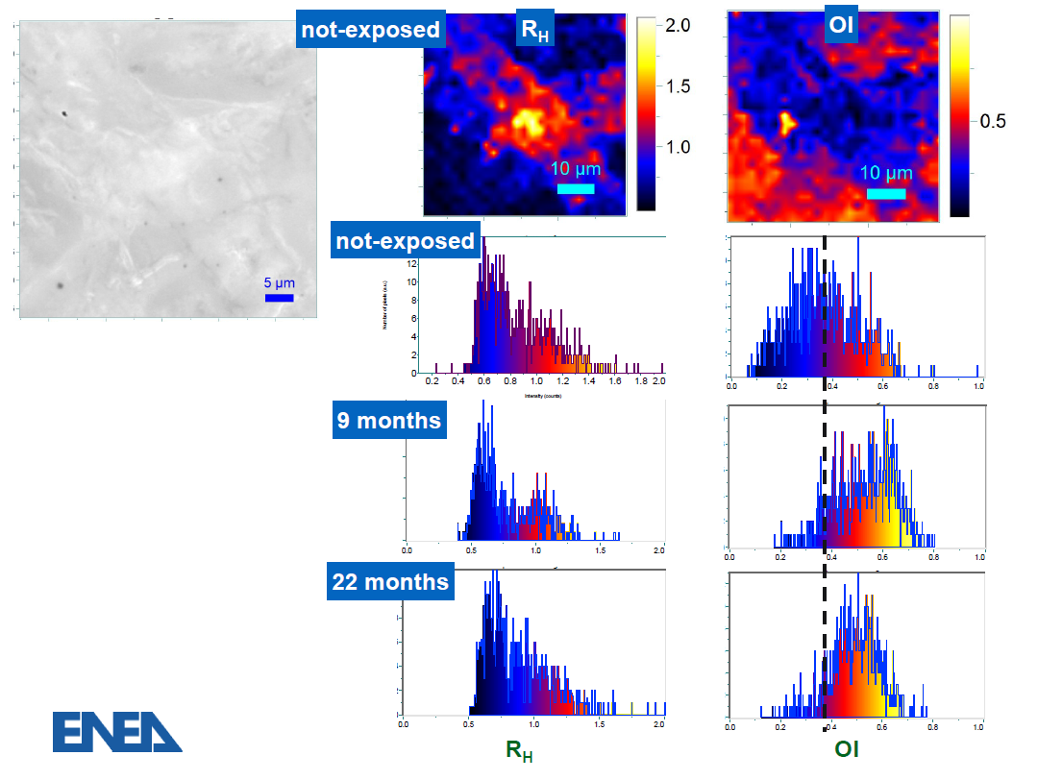
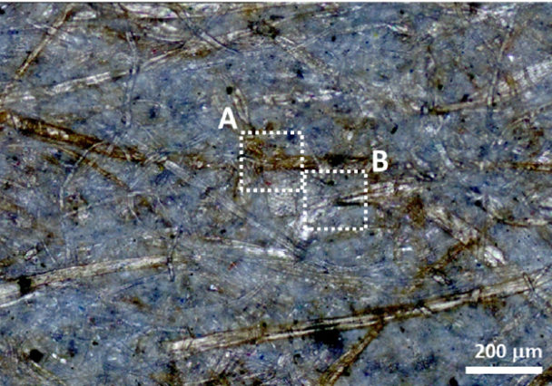
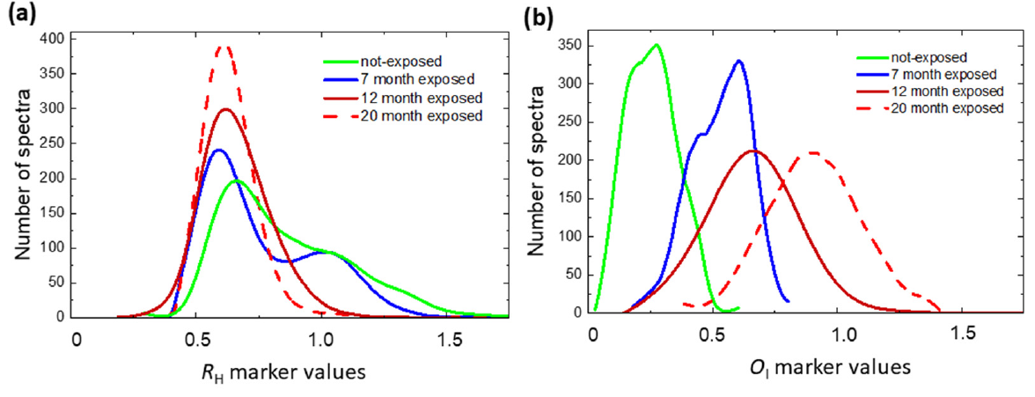
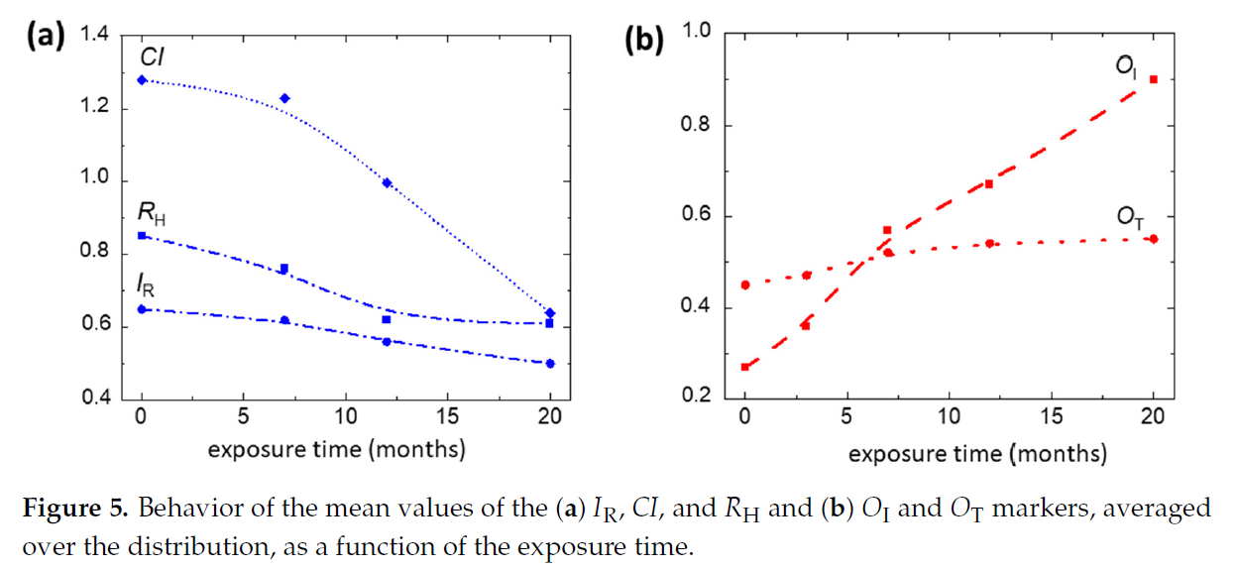

Modern papers: natural light exposition
Spectroscopic markers
We exposed a piece of printer paper (2019) to natural light in the laboratory for about two years, following the natural degradation evolution.
Browing effect
Modern not-exposed paper
natural light exposed modern paper
Larger values of RH markers, measured along the cellulose fiber wall are correlated with smaller values of OI markers.
R_{H}
O_{I}
By increasing the exposition time, the RH (OI) distribution peak decreases (increases) as expected, and the shape of distributions changes, becoming unimodal (as ancient paper)
Decrease in polymerization degree (RH)
is accompanied by a decrease in crystalline index (CI)
RH markers show an initial rapid decrease followed by a slower variation.
C_{I}
O_{I}
In the first stage rapid increase in OT marker, proportional to the content of oxidized groups in the cellulose backbone, saturates after 12 months of exposure.
In contrast, the continuous increase in OI marker indicates a progressive advancement of oxidation state with the production of C=O double bonds.
Mean values of markers, averaged over the distribution as function of the exposure time
From: Molecules 27, no. 5: 1712, 2022
Notes:
16

Slide 17
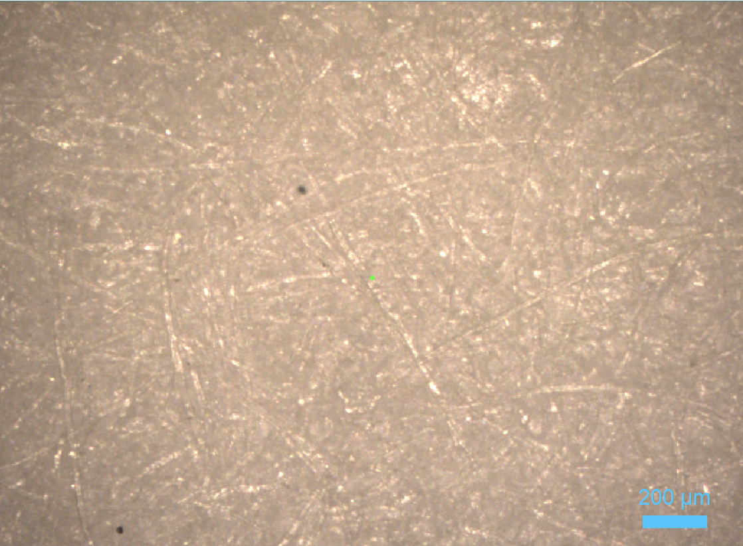
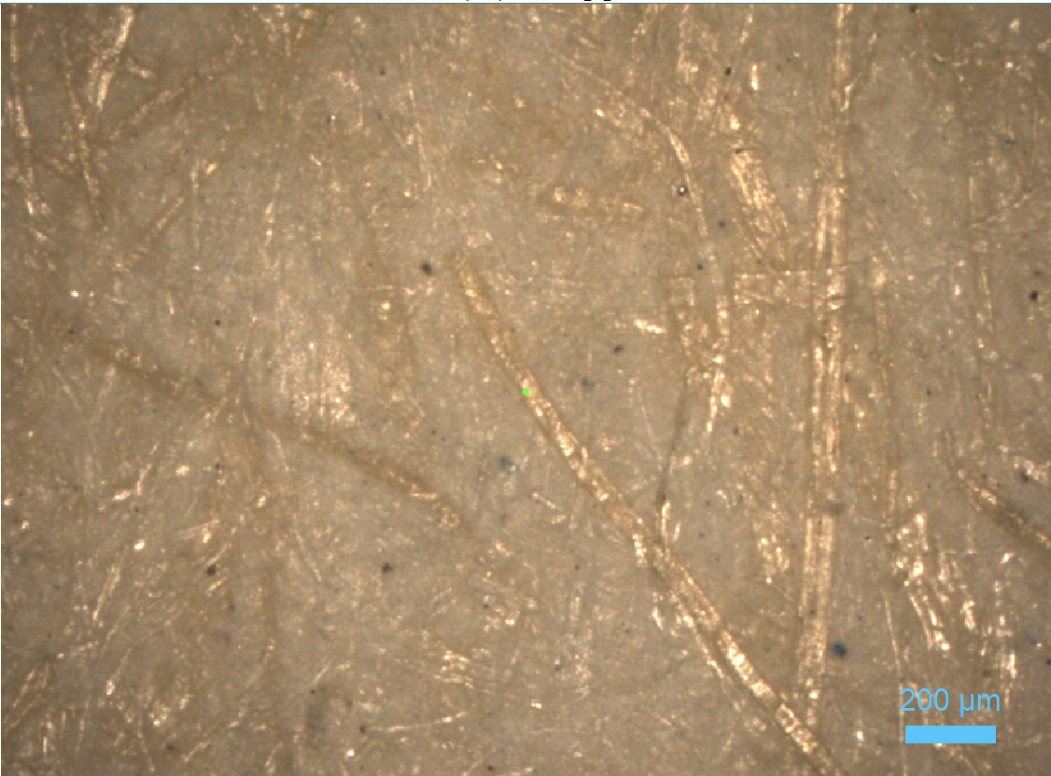
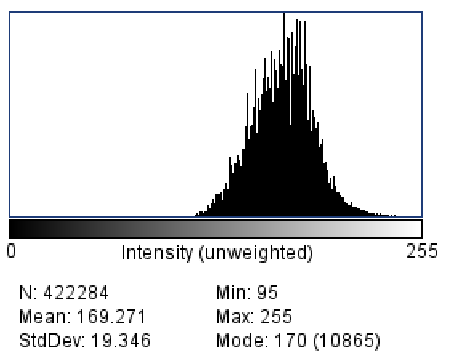
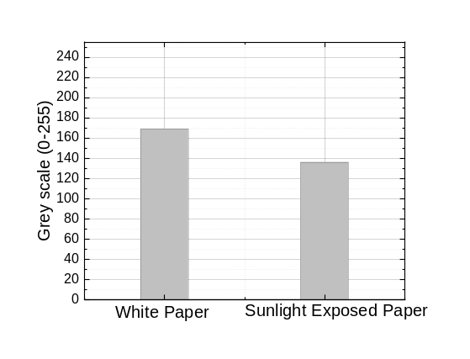

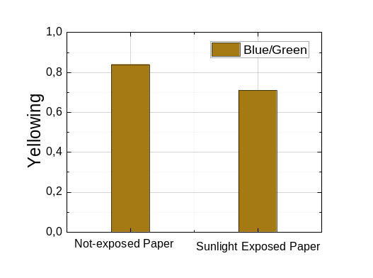
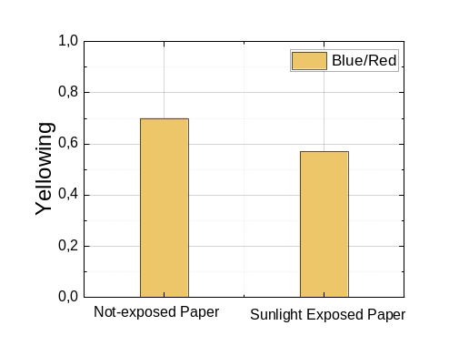
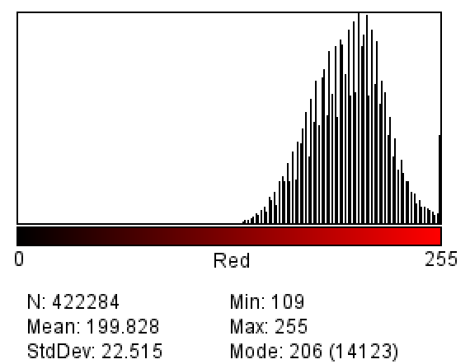







Modern papers: natural light exposition
Yellowing phenomenon
Yellowing is a phenomenon occurs in paper ageing process
Modern not exposed paper
Exposed modern paper
C=O carbonyl-containing groups contribute to the formation of chromophore molecules responsible for the yellowish color typical of aged paper.
Optical images acquired by optical microscope in reflection mode illuminating with white light
White not- exposed paper
Natural light exposed paper
Yellowing Index YI
Pure yellow is expressed by the values ​​(255, 255, 0): the maximum level of red (255) and green (255), combined with the absence of blue (0). In terms of RGB, yellowing consists of a decrease of the blue (B) component with respect the red (R) and and th egreen (G) components.
Darkening
Brightness/Whiteness Index measures the loss of reflectance of light. The more the paper yellows, the lower this value drops.
White paper
Brightness
R
G
B
Exposed paper
YI -15%
YI -19%
Image J (1.53t http://imagej.nih.gov//ij)
Image J (1.53t http://imagej.nih.gov//ij)
Notes:
17

Slide 18




Modern Papers
Whatmann (cotton) – Filter Lab. Whatman filter lab papers are produced from high-quality cotton fibers, Whatman cellulose filter papers are processed to achieve an α-cellulose content of >98%.
Antaimoro (avoha). Antaimoro paper is a traditional handmade paper from Madagascar by the Antaimoro people from the bark of the *avoha*—a semi-aquatic shrub belonging to the Moraceae family. It features a unique, parchment-like texture and is famously decorated with fresh flowers and leaves pressed directly into the wet pulp. exposed to the air for drying.
Funori (red algae) Japanes paper- Funori is a polysaccharide (funoran) obtained from the mucilage of three seaweed species living in the sea waters of Japan, Korea, South China, and North America, i.e., Gloiopeltis Furcata, Gloiopeltis Complanata, and Gloiopeltis Tenax
While it does not refer to a type of paper itself, it is intrinsically linked to paper because it has been used for centuries to treat, size, and consolidate fragile papers like Japanese Washi.
Notes:
18

Slide 19






Different papers: spectroscopic markers
Antaimoro (avoha)
Whatmann (cotton)
Funori (red algae)
R_{H}
280 μmx160 μm, step: 10μm, 448 spectra
Antaimoro
Whatmann
Funori
Antaimoro
Antaimoro
Funori
Whatmann
Whatmann
Funori
RH the degree of polymerization - highest value is that of Whatman paper sample, which is derived from cotton fibers.
The paper samples with larger values of RH and CI parameters show a smaller value of the oxidation parameter OT. This is due to the fact that more ordered and longer cellulose fibers are also more resistant to oxidation attacks and functional group linkages. However, the OI index is large, indicating that in the Antaimoro paper sample, there is a large content of C=O bonds, due to a more advanced oxidation stage
Notes:
19

Slide 20

Different papers: spectroscopic markers
Project with High Schools

Slide 21




3D images acquired with confocal optical microscope
20X
40X
Whatman paper
Antaimoro paper

Slide 22


Cleaning/protective treatment of paper with composite hydrogels
Traditional wet restoration methods for librarian and archival artifacts—such as cleaning by immersion—present lots of limitations that are primarily due to the uncontrolled release of water onto the paper supports.
Hydrogels as cleaning products minimize the impact on the paper supports during cleaning treatments and have been used to control volume and speed of water flow.
Hydrogels are not reactive and retain large volumes of water and/or other solvents, releasing them on the paper surface upon contact. These solvents dissolve the target substances, which are subsequently re-adsorbed by the hydrogels together with the solvents used.
When the gel is removed, there is a removal of contaminants that are on and within the paper surface.
Collaboration with V. Nigro (ENEA-NUC)
We investigated the use of composite hydrogels as cleaning and protective treatment.
The composite hydrogel was produced by incorporating laser synthesized TiO₂ nanoparticles (synthesized via CO2 laser-induced pyrolysis reactions in a titanium(IV) isopropoxide aerosol) into a Poly(acrylic acid) PAAc (trade name CBP Carbopol) matrix to create a composite hydrogel.
Collaboration with Prof. M.G. Santonicola, Dr. J. Rodesi (University of Rome Sapienza-DICMA)
Dr. R. D’Amato (ENEA – NUC)
Hydrogels allow for controlled water flow in a cleaning process and photocatalytic TiO₂ nanoparticles enhance the hydrogel’s efficacy by enabling the removal of oxidation products and inactivating biological contaminants.
The advantage to use the composite gel is that the presence of TiO2 nanoparticles provides a biocidal effect.
From Botti, S.; Bonfigli, F.; D’Amato, R.; Rodesi, J.; Santonicola, M.G. Poly(Acrylic Acid)/TiO2 Nanocomposite Hydrogels for Paper
Artwork Cleaning and Protection. Molecules 2025, 30, 75. https:// doi.org/10.3390/molecules30010075

Slide 23


Monitoring the cleaning treatment of paper with composite hydrogels
CBP/TiO2 hydrogel as cleaning agent
The cleaning treatments were carried out by applying the hydrogel onto the paper samples, with contact times of up to 1 h. During the cleaning treatment the gel was irradiated with UV light for the duration of the treatment. After cleaning procedure the gel was removed by the paper sample.
Optical images in bright field of XIX paper.
Following the cleaning treatment, the intensity of carbonyl and
carboxyl group peaks decreases indicating that the gel application removes the oxidation products from the paper surface.
Before the cleaning treatment
After the cleaning treatment
O_{T} marker maps co-localized with the optical image of the paper sample
By monitoring the peaks associated with the formation of oxidized molecular groups using the O_{T} marker, we can clarify the activity of CBT.
Following the cleaning treatment, the yellow-red areas of the paper, corresponding to higher OT values, decreased.
From Botti, S.; Bonfigli, F.; D’Amato, R.; Rodesi, J.; Santonicola, M.G. Poly(Acrylic Acid)/TiO2 Nanocomposite Hydrogels for Paper
Artwork Cleaning and Protection. Molecules 2025, 30, 75. https:// doi.org/10.3390/molecules30010075

Slide 24


Monitoring the cleaning treatment of paper with composite hydrogels
Markers variations before and after treatments at different application time (15 minutes, 60 minutes):
-Increasing in the C_{I} and R_{H} markers. This finding can be attributed to the formation of hydrogen bonds between cellulose fibers facilitated by the hydrogel’s water content. It was shown that after washing and drying processes the formation of additional hydrogen bonds can occur, enhancing some mechanical properties of the paper, such as bending resistance.
- Significant decreasing of oxidation markers (−20% O_{T} and −30% O_{I} after 1 h of treatment with CBP with and without TiO₂ addition).
The reduction in O_{I}, which is proportional to the carbonyl content, suggests that oxidation products containing C=O groups were primarily removed. This is particularly noteworthy because such carbonyl-containing groups contribute to the formation of chromophore molecules responsible for the yellowish color typical of aged paper.
- These effects are most pronounced in the XIX century paper
Botti, S.; Bonfigli, F.; D’Amato, R.; Rodesi, J.; Santonicola, M.G. Poly(Acrylic Acid)/TiO2 Nanocomposite Hydrogels for Paper
Artwork Cleaning and Protection. Molecules 2025, 30, 75. https:// doi.org/10.3390/molecules30010075

Slide 25





Monitoring the protective treatment of paper with composite hydrogels
Monitoring of CBP/TiO2 gel performance as a protective coating against light-induced aging.
CBP/TiO2 gel coated modern paper and uncoated modern paper were aged by UVA irradiation at 385 nm for 31 h.
uncoated paper
Raman spectra acquired from uncoated and coated paper before and after 31 h
CBP/TiO2 coated paper
The protective effect of the coating against cellulose hydrolisis
Decrease of polymerization and crystallinity
C–O–C and CH2 peaks are notably reduced after UVA exposure.
The C-O-C peak is proportional to the cellulose chain length (RH marker) CH2 peak is related to the order of fibrils (crystallinity degree, CI marker).
For the coated paper, the decrease in the C–O–C and CH2 peaks is less pronounced
The protective effect of the coating against cellulose oxidation
After UVA exposure the OT marker increases for uncoated paper, due to the incorporation of oxidized functional groups into the cellulose backbone.
As for the coated paper, the OT marker decreases suggesting that the UVA irradiation may prolong the cleaning action of the gel.
The application of CBP/TiO2 coating does not alter the RGB values of the paper making this treatment of potential interest for cultural paper artifacts.
This innovative material can act as a protective coating against UV-induced aging
Our findings demonstrate that papers coated with poly(acrylic acid)/TiO2 composite hydrogels exhibit significant reductions in oxidative markers, an enhanced color stability, and an overall improved resistance to degradation compared to uncoated samples.
From Molecules 2025, 30, 75. https:// doi.org/10.3390/molecules30010075

Slide 26
Raman mapping monitoring the UV-EUV effect on cellulose
for cleaning/restoration/consolidate paper surface
We irradiated ancient/modern papers of XIX and XXI century, with UV radiation in air and with EUV radiation in vacuum, with the aim of defining an appropriate restoration/consolidation/cleaning from contamination treatment minimally invasive that do not use chemical substances.
The effects of radiation exposure on cellulose were evaluated by monitoring the spectroscopic markers.
UV-EUV Paper treatments
The UV paper treatments were performed with a UVP LLC (USA) mod. 3UV-38, 8W lamp, in atmosphere at DICMA, Sapienza. Prof. MG Santonicola
For the EUV irradiation was used the ENEA Discharge Produced Plasma DPP EUV source (10-18 nm, 0.1 mJ/cm⁻²/shot, pulse duration 100ns, rep. rate 5/10 Hz). The papers were irradiated in vacuum. Dr. L. Mezi (ENEA-NUC)

Slide 27


EUV irradiation (10-18 nm)
EUV irradiated
XIX century paper
EUV irradiation fluence 200 mJ/cm²
The EUV (10-18 nm) irradiation mainly produces:
- The intensity peak increase of the C-O-C band indicates the formation of
new C-O-C groups, suggesting the occurrence of reactions forming covalent cross-links, It is worth noticing that this is not accompanied by an appreciable increase in RH parameter.
- The increase in C=O peak indicates that there is oxidation with carbonyl formation, although the variation of the OI index also is not so evident considering all the analyzed areas.
- The significant increase of the CH2 stretching peak and the appearance of a band above 3000 cm⁻¹ in the OH stretching region indicates structural changes in the cellulose chain arrangement, which affects the degree of crystallinity, evaluated through the CI marker increase of 20%, well above the intrinsic variation of this marker.
The crystallinity index increase can be related both to the formation of additional links that helps to arrange the fiber in a more ordered way and to the fact that the EUV irradiation preferentially ablates more superficial aged layers and amorphous part.
These changes lead to a stiffening of polymer structure. The increased stiffness of EUV irradiated papers concerns only a small portion of fibers that could better resist to ageing without loosing their tensile strength.
Botti, S.; Bonfigli, F.; Mezi, L.; Flora, F. Monitoring of Cleaning Treatments for Paper Heritage with Raman Spectroscopy Mapping. Molecules 2024, 29, 15. https://doi.org/10.3390/molecules29010015

Slide 28









EUV irradiation: no yellowing effects
0 mJ/cm²
50 mJ/cm²
75 mJ/cm²
100 mJ/cm²
150 mJ/cm²
200 mJ/cm²
250 mJ/cm²

Slide 29





UV-C irradiation (254 nm): effects on ancient papers
XIX century paper
Dose: 38 mJ/cm²
XXI century paper
O_{I}
R_{H}
-17%
-2%
+5%
-3%
not irradiated
UVC Irradiated 38 J/cm²
UV-A 365 nm
UV-B 305 nm
UV-C 254 nm
UVC irradiation leads to a different behavior for ancient and modern papers. In the case of modern papers the increase of O_{I} and the decrease of R_{H} indicates an advancement of ageing process, while in the case of old papers the O_{I} value decreases. This different behavior can be ascribed to the different lignin content.

Slide 30







UV-C irradiation: yellowing effects on modern paper
Aging and Yellowing (Photo-oxidation) is enhanced in the modern paper.
XXI century paper
not exposed
-4.8% YI
UV exposed
XIX century paper
-3,4% YI

Slide 31
Concluding remarks
Raman spectral imaging is an invaluable technique for scientists in many field, since it allows to view the chemical distribution which is invisible by standard optical microscopy.
The proposed diagnostic protocol based on Raman micro-spectroscopy combined with morphological analysis is able to obtain 2D chemical mapping of paper artwork conservation state across the whole page and on single fiber. This technique is most suitable in the case of inhomegeneuos system as paper.
Moreover, it has been shown that this protocol, being non-destructive, can be successfully applied to precious and ancient paper samples, avoiding damaging.
It is of particular interest because it opens the possibility of choosing the most appropriate cleaning/consolidation/restoration treatment evaluating the effectiveness of the used treatment.

Slide 32
Acknowledgements
ENEA
R. D’Amato
L. Mezi
V. Nigro
F. Rondino
A.Rufoloni
A. Vannozzi
High school students
Liceo Scientifico Touschek(Grottaferrata)
Liceo Scientifico Spallanzani (Tivoli)
Liceo Scientifico Leonardo Murialdo (Albano)
Liceo Classico “Marco Tullio Cicerone” (Frascati)
Thank you
for your attention
University of Rome Sapienza –
DICMA
M.G. Santonicola
J. Rodesi
francesca.bonfigli@enea.it
sabina.botti@enea.it

