Slide 1
The Modular Diagnostics Platform (MDP): a standardized, port-integrated architecture for utility-scale fusion plasma
Georgy Subbotin¹, Aleksandr Kachkin¹, Antoine Sirinelli¹, Maxim Nurgaliev¹, Suk-Ho Hong²
¹ Next Step Fusion S.à r.l., Luxembourg ² General Atomics
ICFDT8 · Frascati (Rome), Italy · 19–21 October 2026
Notes:
Title. The Modular Diagnostics Platform: a standardized, port-integrated architecture for utility-scale fusion plasma. Next Step Fusion with General Atomics.

Slide 2




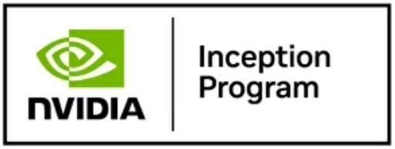
A specialized fusion supply chain company
NEXT STEP FUSION — WHO WE ARE
We accelerate fusion companies with industry-ready integrated modeling, plasma diagnostics and control solutions for MCF devices — combining deep understanding of plasma physics and fusion engineering with extensive experience on public and private fusion devices.
2023
20+
100%
5+
Founded in Luxembourg (HQ), UK office, distributed team across Europe
Plasma physicists, fusion engineers & machine learning specialists
Fusion-focused, all-in on the industry’s unlimited potential
Tokamak startups supported across design & engineering
Notes:
[0:30] Next Step Fusion: a fusion supply-chain company for MCF device builders — integrated modelling, plasma diagnostics and plasma control. Today: diagnostics.

Slide 3
Reactor environment: fewer diagnostics, less access
01 · CHALLENGE — REACTOR ENVIRONMENT
Fewer diagnostics: neutron and gamma fluxes, breeding blanket and shielding leave room for only a minimal set of measurements — one-of-a-kind, low-TRL diagnostics neither survive nor fit.
Less effective diagnostics: shielding, larger distance to the plasma and reduced port access degrade what the remaining systems can see.
Long pulses, 24/7 operation: robust, maintainable systems with off-the-shelf spare parts.
Consequence: control and protection must rely on a few robust sensors — and on reconstructing the missing plasma parameters.
HOT ZONE
INTERSPACE
SHIELDED AREA
Front-end in a narrow port
BLANKET
SHIELD
Acquisition &
processing
Plasma
Long transmission lines
Bioshield
Neutron and gamma flux
up to 10¹⁴ n cm⁻² s⁻¹
min. 10⁹ n cm⁻² s⁻¹
ITER neutron flux, depending on location
PUBLICATIONS Scheme: after the NSF MDP concept · ITER neutron flux: A.E. Costley et al., Fusion Eng. Des. 55, 331 (2001), Table 1
Notes:
[1:00] In a power plant the diagnostic set changes: fewer systems fit through blanket and shielding, and those that remain look at the plasma through narrow ports, from further away and via long transmission lines to protected electronics. ITER numbers for scale: neutron flux from about 1e9 to 1e14 n/cm2/s depending on location.

Slide 4
Diagnostics in a power plant: what changes
01 · CHALLENGE — WHAT CHANGES
ENVIRONMENT AND PHYSICS
INDUSTRY AND OPERATION
Burning plasma, long pulses: intense high-energy neutron fluxes, gamma heating, high thermal loads
High magnetic fields, plasma density and neutrons limit measurement capabilities
Shielding, component durability and lifetime become design drivers
Every opening costs breeding and shielding volume: minimal footprint in blanket and shielding
One-of-a-kind, low-TRL systems today, not optimised for harsh environments
No standardization in sensor solutions
24/7 uptime: robust, maintainable systems
Industrial procurement: off-the-shelf solutions and spare parts
Today's scientific multi-diagnostic approach becomes impractical: a plant needs a minimal yet sufficient, standardized and maintainable set of diagnostics.
PUBLICATIONS A. Sirinelli, G. Subbotin, M. Nurgaliev, Y. Zhu, On-Chip Microwave Diagnostics for Fusion Power Plants, 17th International Reflectometry Workshop (IRW17), York, UK (2026)
Notes:
[1:00] What changes for diagnostics in a power plant — for any diagnostic, not only microwave. The plant runs long pulses with a burning plasma: intense neutron fluxes, gamma heating, high thermal loads. High fields, density and neutrons limit what we can measure; shielding, durability and lifetime become design drivers; and every opening costs breeding and shielding volume. On the industry side, today's diagnostics are one-of-a-kind, low-TRL systems with no standardization, while a plant needs 24/7 uptime and off-the-shelf solutions with spare parts. So the scientific multi-diagnostic approach becomes impractical: a plant needs a minimal yet sufficient, standardized and maintainable set.

Slide 5
Our product: three directions, one platform
02 · PRODUCT
Stand-alone diagnostics
VIDA software
Port plug
MDP-ready diagnostics, each usable on its own
Versatile Integrated Data Acquisition
The port as a product
Microwave core: reflectometry, ECE, interferometry–polarimetry, CTS
On-chip receivers with UC Davis
First prototype: ECE + profile reflectometry for TCV and DIII-D
Also under consideration: SXR / HXR, neutron diagnostics, bolometry
Synchronized acquisition and control
Processing and real-time-compatible reconstruction of plasma parameters
Self-monitoring of every channel
Plasma state with uncertainties and reliabilities for control and protection
Several diagnostics behind one interface specification
Fewer external interfaces and penetrations
Reactor-ready: graded shielding, factory qualification, remote-handling exchange
Three directions, each with its own perspective — combined, they form the Modular Diagnostics Platform.
Notes:
[1:00] Our product has three directions — not steps of one roadmap, but three directions with their own perspectives. First, stand-alone MDP-ready diagnostics: the microwave core, on-chip receivers with UC Davis, our first prototype, ECE plus profile reflectometry for TCV and DIII-D, and further systems we are considering — soft and hard X-ray, neutron diagnostics and bolometry. Second, VIDA: synchronized acquisition and control, processing and real-time-compatible reconstruction, self-monitoring, and a plasma state with uncertainties and reliabilities rather than raw signals. Third, the port plug: several diagnostics behind one interface specification, fewer external interfaces, and a reactor-ready architecture. Combined, they form the Modular Diagnostics Platform.

Slide 6
Our selection: a microwave core
03 · DIAGNOSTICS — OUR SELECTION
Diagnostic
Plasma parameters
WHY MICROWAVE
Reflectometry
n_{e} profile, plasma position, fluctuations
Electronics behind the shield: generating and receiving equipment behind neutron and gamma barriers
Combined waveguide lines → fewer at-risk components, more shielding volume
Robust and real-time, with fewer constraints than visible or laser-based systems
ECE radiometry
T_{e} profile
Interferometry–polarimetry
line-integrated n_{e}, q profile
Collective Thomson scattering
T_{i}, D/T ratio, fast-particle distribution
Reconstructed parameters: confinement mode, fusion power, neutron flux, turbulence-related parameters, loop voltage, impurity accumulation, divertor exhaust.
BEYOND THE CORE — RESEARCH ONGOING
Neutron diagnostics
Bolometry
Soft and hard X-ray (SXR / HXR)
PUBLICATIONS A. Sirinelli, G. Subbotin, M. Nurgaliev, Y. Zhu, On-Chip Microwave Diagnostics for Fusion Power Plants, 17th International Reflectometry Workshop (IRW17), York, UK (2026)
Notes:
[0:50] Our selection for the core is microwave: reflectometry for the density profile, position and fluctuations; ECE for electron temperature; interferometry-polarimetry for line-integrated density and the q profile; collective Thomson scattering for ion temperature, D/T ratio and fast particles. More parameters are reconstructed from these. Microwaves keep the electronics behind the shield and let us combine transmission lines. The core is not the whole plant set: neutron diagnostics, bolometry and soft and hard X-ray are also part of the picture, and our research on them is ongoing.

Slide 7
Reactor conditions: higher frequencies, new supply chain
03 · DIAGNOSTICS — REACTOR REQUIREMENTS
> 300 GHz
50–300 GHz
7–10 T
ECE in high-field devices (> 70 GHz for reflectometry)
broadband reflectometry needed by FPPs; ECE at 200 GHz and above
toroidal field assumed for high-field FPPs
SUPPLY CHAIN TODAY
WHAT WE DO
Components borrowed from other industries get discontinued as those industries move on
Enabling components for reflectometry are discontinued or rare on the market
Custom components made in limited batches in small workshops
Hardware must adopt new generations of equipment and software
We are studying the supply chain: research and negotiations with suppliers; proof-of-concepts for MDP components
Goal: a consolidated supply chain that accumulates fusion demand and scales custom production
On-chip millimetre-wave components: partnership with the UC Davis Fusion Diagnostics Group
PUBLICATIONS A. Sirinelli, G. Subbotin, M. Nurgaliev, Y. Zhu, On-Chip Microwave Diagnostics for Fusion Power Plants, 17th International Reflectometry Workshop (IRW17), York, UK (2026)
Notes:
[1:00] Reactor conditions set two requirements. First, frequency: with 7-10 T assumed for high-field FPPs, ECE moves above 300 GHz, reflectometry needs broadband coverage over 50-300 GHz. Second, the supply chain: many diagnostic components are borrowed from other industries and get discontinued, enabling components for reflectometry are already rare, custom parts come in small batches, and the hardware must adopt new generations. We are studying the supply chain — research and negotiations with suppliers and proof-of-concepts for MDP components — aiming at a consolidated supply chain. For on-chip millimetre-wave components our partner is the UC Davis Fusion Diagnostics Group.

Slide 8

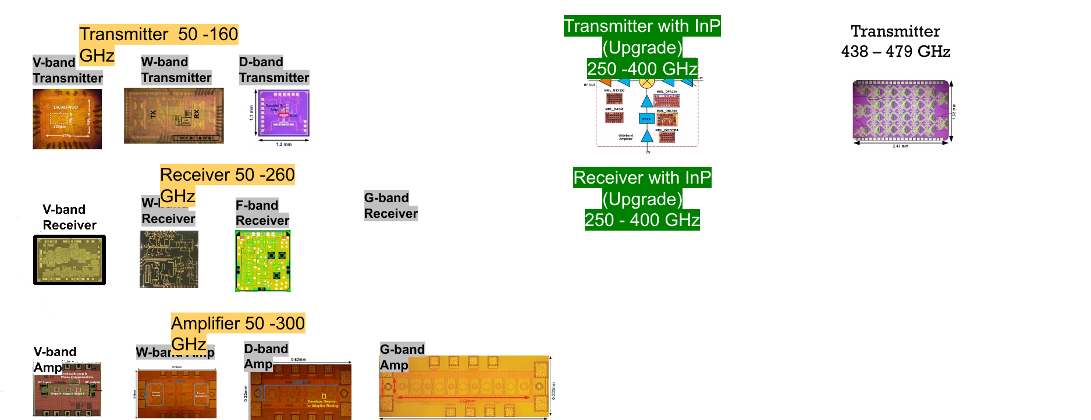
On-chip components from UC Davis: 50 to 479 GHz
03 · DIAGNOSTICS — PARTNER: UC DAVIS
Today: transmitters 50–160 GHz, receivers 50–260 GHz, amplifiers 50–300 GHz
Upgrades: InP transmitter and receiver, 250–400 GHz
Transmitter: 438–479 GHz
Supply-chain role: a standardized receiver turns custom laboratory electronics into a repeatable, manufacturable building block — produced, stocked, qualified, replaced
100 GHz
200 GHz
300 GHz
400 GHz
500 GHz
PUBLICATIONS A. Sirinelli et al., IRW17, York (2026) · UC Davis Fusion Diagnostics Group, Millimeter-wave System-on-Chip Solution for Fusion Reactor Diagnostics, white paper v4.0 (2026)
Notes:
[0:50] This is where UC Davis comes in. Their on-chip family already covers transmitters, receivers and amplifiers from about 50 to 300 GHz, with InP upgrades for 250-400 GHz and a transmitter at 438-479 GHz. For the supply chain this matters as much as the frequency: a standardized receiver turns custom laboratory electronics into a repeatable, manufacturable building block that can be produced, stocked, qualified and replaced.

Slide 9
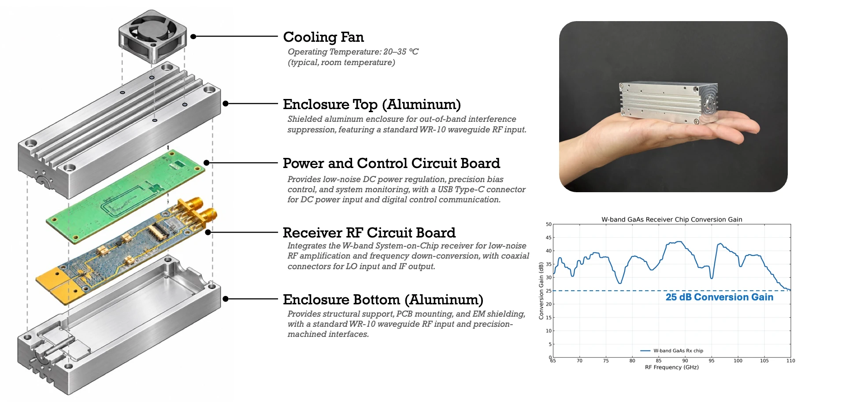
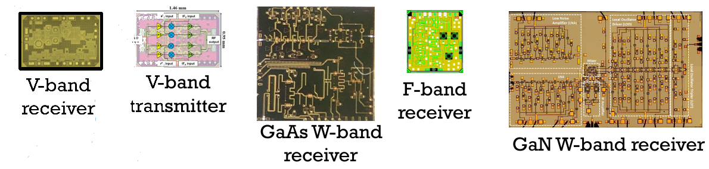
On-chip receivers: compact, sensitive, proven
03 · DIAGNOSTICS — ON-CHIP RECEIVERS
Proven at DIII-D: ECE imaging built on system-on-chip receivers; 7 years maintenance-free operation
High gain: > 30 dB, 0.1 nW detectable power
Compact: 120 ECEI channels in one rack
Band coverage today: 55–220 GHz (CMOS, GaAs, GaN, SOI)
Radiation hardness: wide-bandgap GaN W-band receiver chip demonstrated
In collaboration with Yilun Zhu, UC Davis Fusion Diagnostics Group
W-band GaAs system-on-chip receiver module
PUBLICATIONS SoC ECEI on DIII-D: Y. Zhu et al., Rev. Sci. Instrum. 91, 093504 (2020) · A. Sirinelli, G. Subbotin, M. Nurgaliev, Y. Zhu, On-Chip Microwave Diagnostics for Fusion Power Plants, 17th International Reflectometry Workshop (IRW17), York, UK (2026)
Notes:
[1:00] The key hardware enabler: millimetre-wave system-on-chip receivers developed by the UC Davis Fusion Diagnostics Group — thanks to Yilun Zhu. ECE imaging at DIII-D on these chips has run 7 years without maintenance; over 30 dB gain, 0.1 nW detectable power, 120 channels in one rack. Today 55-220 GHz, and a GaN W-band receiver demonstrates the route to radiation hardness.

Slide 10
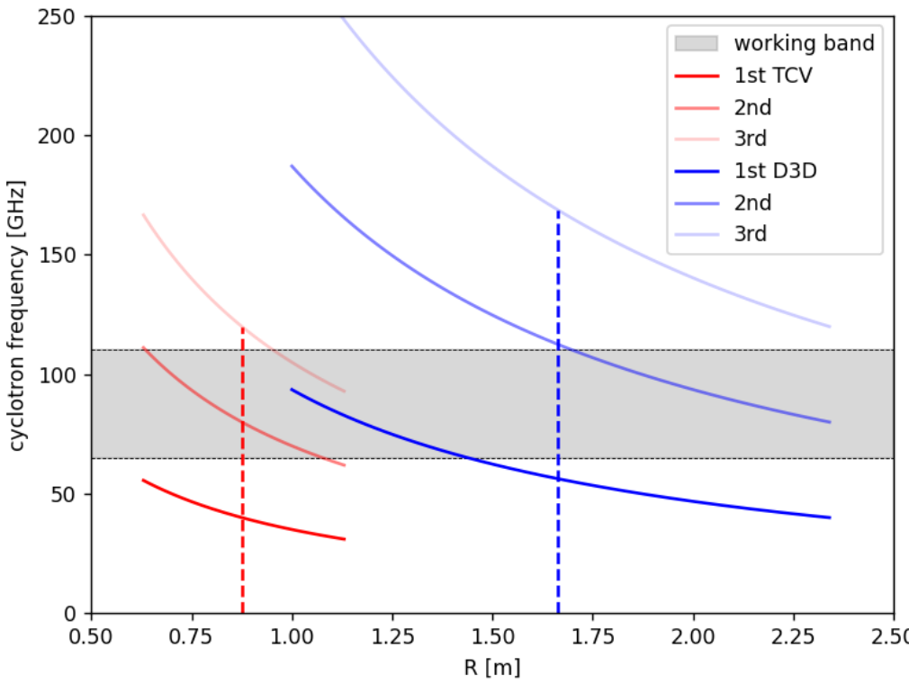
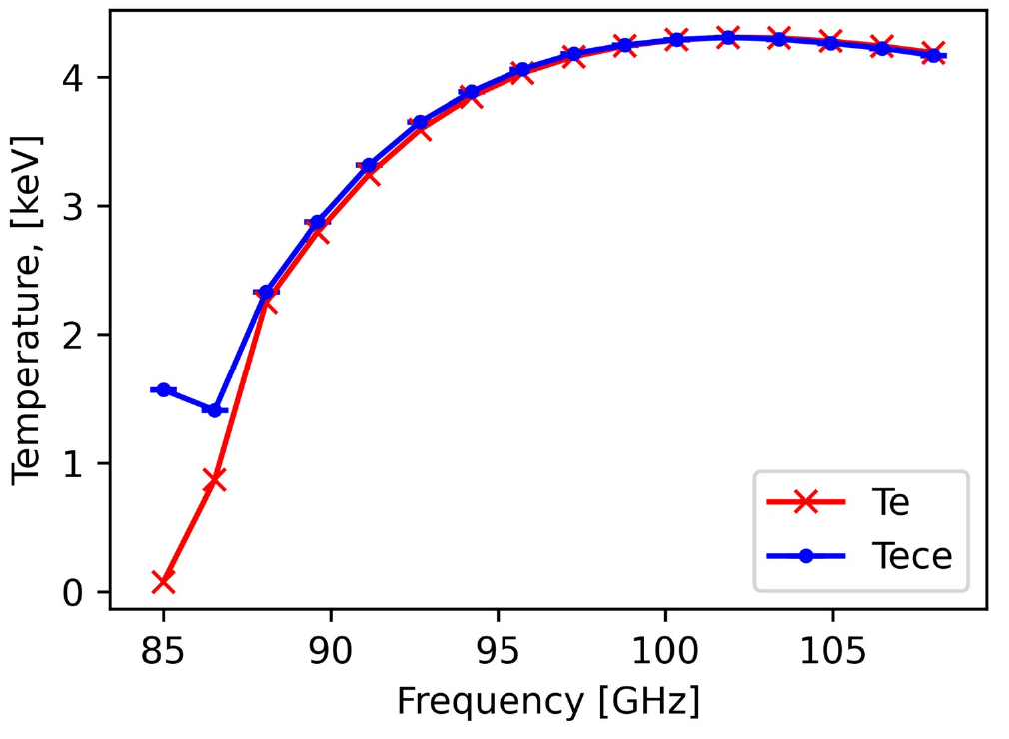
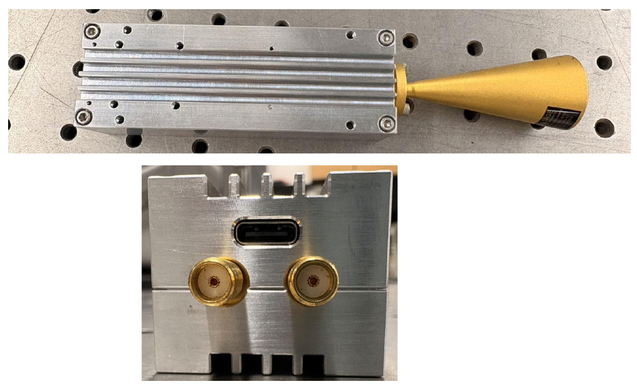
First MDP prototype: the ECE channel
03 · DIAGNOSTICS — PROTOTYPE: ECE
One hardware core, two devices: TCV (B₀ = 1.4 T) and DIII-D (B₀ = 2.0 T)
65–108 GHz, X-mode 2nd harmonic; 16 channels over 85–108 GHz at DIII-D
TRAVIS ray tracing: black-body condition almost everywhere satisfied
100 µs temporal resolution; stand-alone absolute calibration
Success criterion: profiles match existing ECE and Thomson scattering
Receivers based on UC Davis on-chip technology
Cyclotron harmonics vs working band
TRAVIS: T_{e} vs T_{ece}, DIII-D #161414
PUBLICATIONS A. Sirinelli et al., Design and manufacturing of the Modular Diagnostic Platform prototype, ICFDT8 Poster session B (20 Oct 2026) · Next Step Fusion, Physics Validation Review: joint ECE–reflectometry diagnostics (2026) · TRAVIS: N.B. Marushchenko et al., Comput. Phys. Commun. 185, 165 (2014)
Notes:
[1:00] The first MDP prototype combines ECE and profile reflectometry. The ECE channel uses one hardware core for TCV and DIII-D, 65-108 GHz in second-harmonic X-mode, 16 channels across 85-108 GHz at DIII-D. TRAVIS ray tracing shows black-body conditions almost everywhere. Absolute calibration is stand-alone, and success means matching existing ECE and Thomson scattering. Design and manufacturing details of the prototype are on our poster in Poster session B, tomorrow, 20 October at 16:00 — Antoine Sirinelli.

Slide 11
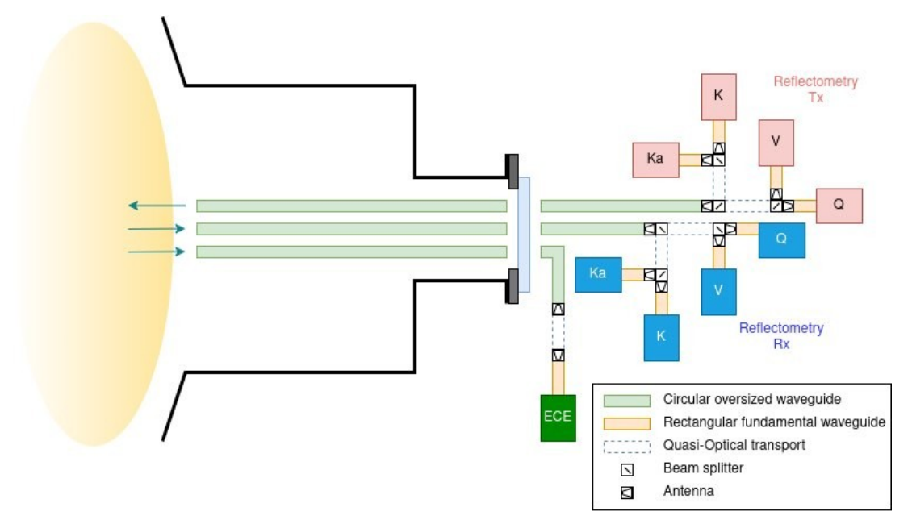
Four reflectometers and ECE share one transmission line
03 · DIAGNOSTICS — PROTOTYPE: REFLECTOMETRY
Profile reflectometry in 4 bands, 2 polarisations:
O-mode: K 18–28 GHz, Ka 26.5–40 GHz
X-mode: Q 33–51 GHz, V 49–75 GHz
~20 µs frequency sweep; ~0.5 cm spatial resolution; transients such as ELM crashes and pellets
Joint transmission line: overmoded circular corrugated waveguides; dichroic filters split polarisations and bands
Fewer lines = fewer openings in shielding and breeding structures
Full system architecture: one combined line to the reflectometry multiplexer and ECE
PUBLICATIONS A. Sirinelli et al., Design and manufacturing of the Modular Diagnostic Platform prototype, ICFDT8 Poster session B (20 Oct 2026) · Next Step Fusion, Physics Validation Review: joint ECE–reflectometry diagnostics (2026)
Notes:
[1:00] Reflectometry covers four bands in two polarisations — K, 18 to 28 GHz, and Ka, 26.5 to 40 GHz, in O-mode; Q, 33 to 51, and V, 49 to 75 GHz, in X-mode — with about 20 microsecond sweeps. All of it shares one overmoded corrugated transmission line with the ECE; dichroic filters split polarisations and bands. Fewer lines mean fewer openings in the shielding and the breeding blanket.

Slide 12
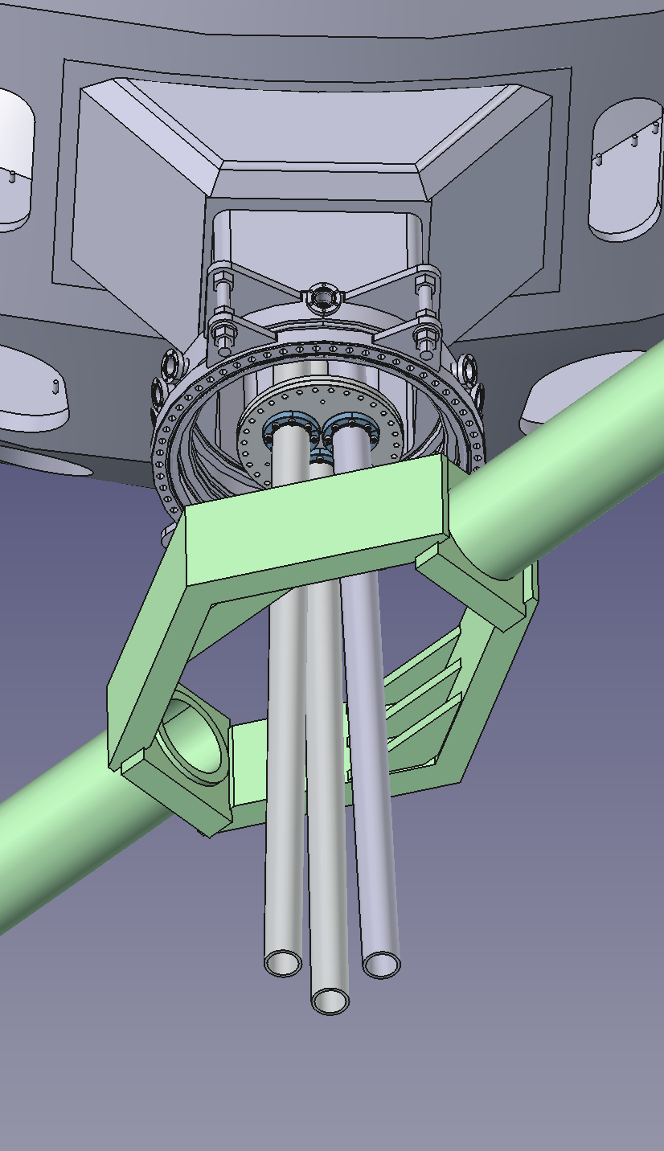
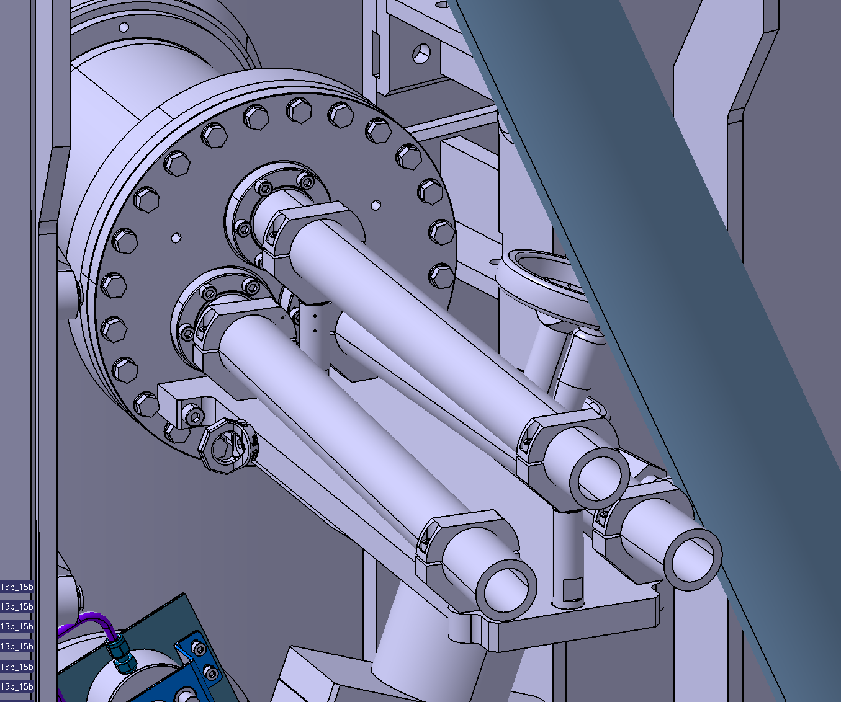
One port, five diagnostics
03 · DIAGNOSTICS — INTEGRATION
3 waveguides (2 reflectometry + 1 ECE) with vacuum windows on a single 13-inch flange
Practically five diagnostics through one port: four reflectometer bands and ECE
DIII-D port 0R0; ex-vessel straight waveguide runs to the ECE receivers and reflectometry multiplexers
Same hardware core for TCV and DIII-D — plug-and-play between devices
DIII-D port 0R0: three waveguides through one flange (CAD)
PUBLICATIONS A. Sirinelli et al., Design and manufacturing of the Modular Diagnostic Platform prototype, ICFDT8 Poster session B (20 Oct 2026) · Next Step Fusion, Physics Validation Review: joint ECE–reflectometry diagnostics (2026)
Notes:
[0:50] Integration at DIII-D, port 0R0. Three waveguides — two for reflectometry, one for ECE — pass through one 13-inch flange with vacuum windows. Through them run four reflectometer bands and ECE: practically five diagnostics through one port. The same hardware core serves TCV and DIII-D.

Slide 13
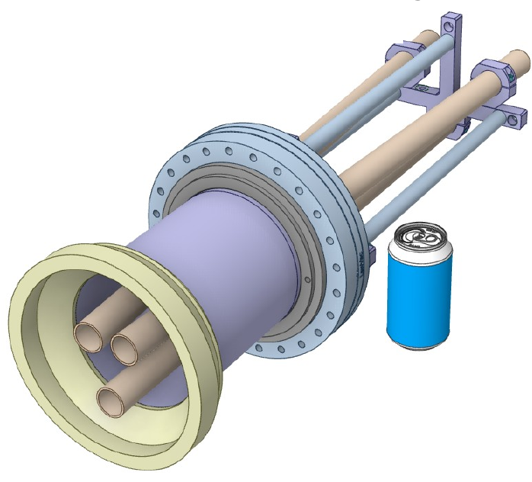
Prototype under development: tests in 2027
03 · DIAGNOSTICS — PROTOTYPE STATUS
RF components
most ordered, in shipping
TCV flange
production started
Data acquisition and control
equipment ordered
Software
in development
Beginning of 2027
Spring 2027
Plasma tests on TCV
Plasma tests on DIII-D
Validation against existing ECE, reflectometry and Thomson scattering
Prototype poster: Poster session B · Tue 20 Oct
A. Sirinelli et al., Design and manufacturing of the Modular Diagnostic Platform prototype
TCV in-vessel and ex-vessel parts (CAD)
PUBLICATIONS A. Sirinelli et al., Design and manufacturing of the Modular Diagnostic Platform prototype, ICFDT8 Poster session B (20 Oct 2026) · Next Step Fusion, Physics Validation Review: joint ECE–reflectometry diagnostics (2026)
Notes:
[0:40] Status: the prototype is under development. Most RF components are ordered and being shipped, production of the TCV flange has started, data-acquisition and control equipment is ordered and the software is in development. Plasma tests: TCV at the beginning of 2027, DIII-D in spring 2027, validated against the existing ECE, reflectometry and Thomson scattering. For the design and manufacturing details, please visit our poster in Poster session B tomorrow, 20 October at 16:00.

Slide 14
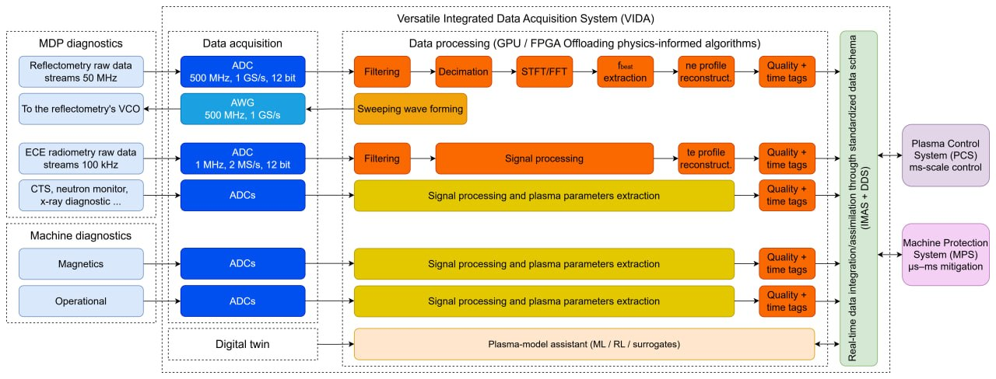
VIDA: from raw signals to a plasma state
04 · SOFTWARE — VIDA
PROTOTYPE DAQ
NI PXIe chassis
2 × 4-channel, 12-bit, 2.5 GS/s digitizers
16-channel, 16-bit, 1.25 MS/s ADC
10 MHz clock synchronization
Arbitrary waveform generators for VCO control
Synchronized control and acquisition for all diagnostics in the plug
Model-based software and synthetic diagnostics for real-time reconstruction of the plasma state
Standardized plasma parameters with uncertainties and reliabilities for plant control and protection
PUBLICATIONS VIDA scheme: Next Step Fusion, Modular Diagnostics Platform · Next Step Fusion, Physics Validation Review: joint ECE–reflectometry diagnostics (2026) · A. Sirinelli et al., Design and manufacturing of the Modular Diagnostic Platform prototype, ICFDT8 Poster session B (20 Oct 2026)
Notes:
[1:00] VIDA, our Versatile Integrated Data Acquisition, closes the loop from raw signals to a plasma state: synchronized control and acquisition, model-based software and synthetic diagnostics, and a standardized set of plasma parameters with uncertainties and reliabilities for plant control and protection. The prototype runs on an NI PXIe system.

Slide 15
Self-monitoring: diagnostics that check themselves
04 · SOFTWARE — SELF-MONITORING
In a power plant, calibration drift and faults must be handled without in-vessel access.
Pre-discharge
Discharge
Post-discharge
Identify hardware, validate configuration; check power, gain, noise, frequency response, references, links, interlocks
Monitor health and measurement quality; detect saturation, drift, faults, loss of reference
Assess anomalies, update trends, preserve calibration; recommend maintenance
→ Ready / degraded / not-ready, with reasons
→ Real-time quality flags, alarms, safe-state actions
→ Traceable health record, next-shot readiness
Recovery
Isolate faults, retry approved actions, switch to redundant hardware, restore a known configuration — always returns to readiness validation before service resumes
Routines qualified on the DIII-D ECEI diagnostic since 2025
PUBLICATIONS UC Davis Fusion Diagnostics Group, Millimeter-wave System-on-Chip Solution for Fusion Reactor Diagnostics, white paper v4.0 (2026), Fig. 7
Notes:
[1:00] Self-monitoring. In a plant you cannot walk in and recalibrate, so the diagnostics must check themselves. The UC Davis Diagnostics Agent runs a routine every shot: readiness checks before the discharge, health and quality monitoring during it, and assessment afterwards; faults trigger a recovery routine that always returns to readiness validation. These routines are qualified on DIII-D ECEI since 2025.

Slide 16
Reconstructing density with reduced access
05 · RECONSTRUCTION — PROBLEM
Reactor constraint: no Thomson scattering or multiple interferometer chords — only reflectometry (ρ ≥ 0.7) and one central interferometer chord
Standard practice: fit an mtanh profile [2] to each time slice — no physical constraint in the core
Our approach: infer 11 transport and source coefficients of the 1D particle transport equation, then evolve it — the full n_{e}(ρ, t) with uncertainty
Edge reflectometry
n_{e}(ρ ≥ 0.7, t)
Interferometer chord
line-averaged n_{e}(t)
Inverse problem: 11 coefficients κ
diffusivity D, pinch v, wall and core sources
FNO surrogate of the transport solver
fast, differentiable forward model
Full profile n_{e}(ρ, t) including the unobserved core
with calibrated uncertainty bands
PUBLICATIONS [1] NSF team, manuscript under review (2026) · [2] mtanh: R.J. Groebner & T.H. Osborne, Phys. Plasmas 5, 1800 (1998)
Notes:
[1:00] Density reconstruction with reduced access. A plant will not afford Thomson scattering or many interferometer chords; we assume only edge reflectometry outside rho = 0.7 and one central chord. The standard mtanh fit is per time slice and unconstrained in the core. Instead we infer the 11 transport and source coefficients of the particle transport equation and evolve it, through a neural-operator surrogate of the solver.

Slide 17
A fast, differentiable surrogate of the transport solver
05 · RECONSTRUCTION — METHOD
3.0%
51×
11
relative L² error on held-out trajectories
faster than the solver: 3.0 ms vs 155.4 ms
coefficients for a whole 0.5 s window
TRAINING DATA
NETWORK
INFERENCE
1000 / 200 / 200 trajectories from an implicit-Euler transport solver
Coefficients and geometry sampled from the prior; initial profiles from real DIII-D n_{e}
1D Fourier Neural Operator [3]: 8 input channels → next 64 time steps (0.5 s)
Physics-informed loss: data + PDE residual; ≈ 13 min training on one GPU
Gradient fit of the 11 coefficients, 5 restarts
Realistic noise: interferometer calibration error, reflectometer radial shift
Uncertainty: multi-seed, Laplace, MCMC, Gaussian; scored with CRPS and coverage
PUBLICATIONS [1] NSF team, manuscript under review (2026) · [3] FNO: Z. Li et al., ICLR (2021)
Notes:
[1:00] The surrogate is a one-dimensional Fourier Neural Operator trained on 1000 solver trajectories with real DIII-D initial profiles and a physics-informed loss. It reproduces the solver to 3 percent and runs 51 times faster, 3 milliseconds per rollout. For each discharge we fit the 11 coefficients by gradient descent, with realistic noise on the measurements, and estimate uncertainty with four methods scored by CRPS and coverage.

Slide 18
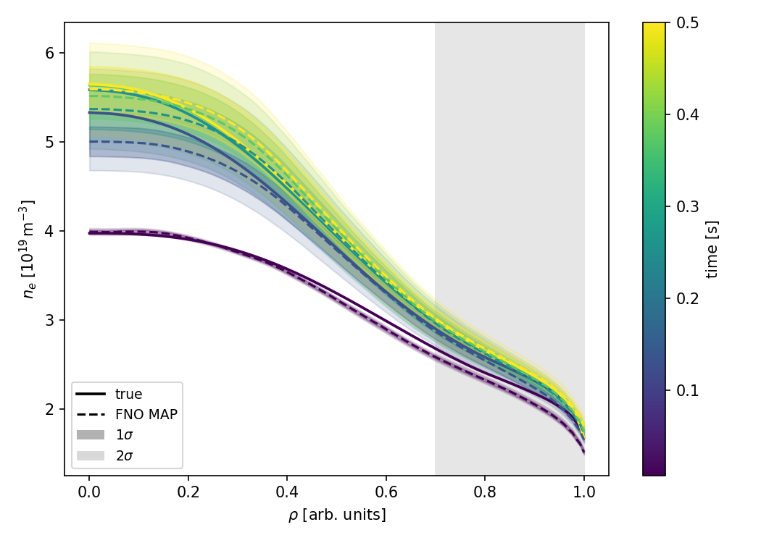
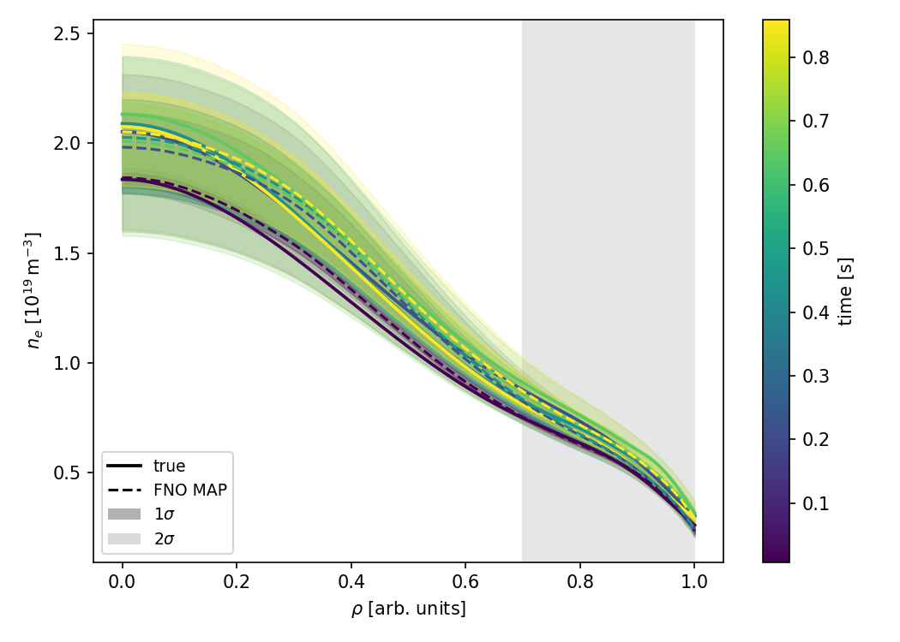
Results on synthetic and DIII-D discharges
05 · RECONSTRUCTION — RESULTS
On axis (unobserved): FNO error 29% lower than the mtanh fit [2] on synthetic data, 36% lower on DIII-D
Core and full profile: mtanh closer — it fits each time slice independently (≈ 320 parameters per 0.5 s window); FNO uses one physics-constrained set of 11 coefficients
Synthetic → DIII-D: errors grow as real profiles leave the fixed transport and source families
Uncertainty: the calibrated Gaussian method gives the best CRPS on both datasets
Synthetic discharge [1]
DIII-D #203011 [1]
Solid: true · dashed: FNO MAP · bands: 1σ/2σ posterior · grey: observed edge (ρ ≥ 0.7)
Relative L² error (MAP) | Axis | Core | Full
lower is better · [1] | ρ < 0.05, unobserved | ρ < 0.7, unobserved | profile
Synthetic · 100 discharges
FNO (this work) | 0.057 | 0.060 | 0.066
mtanh fit [2] | 0.080 | 0.055 | 0.056
DIII-D · 13 discharges
FNO (this work) | 0.103 | 0.102 | 0.106
mtanh fit [2] | 0.161 | 0.089 | 0.082
PUBLICATIONS [1] NSF team, manuscript under review (2026) · [2] mtanh: R.J. Groebner & T.H. Osborne, Phys. Plasmas 5, 1800 (1998)
Notes:
[1:00] Results: on the magnetic axis — the point furthest from any measurement — the error is 29 percent lower than mtanh on synthetic data and 36 percent lower on 13 DIII-D discharges. mtanh is closer in core and full profile because it fits about 320 free parameters per window, without physical constraint. Errors grow on real data where profiles leave the fixed model families. The calibrated Gaussian uncertainty method scores best.

Slide 19
Toward robust reconstruction in reactor conditions
05 · RECONSTRUCTION — OUTLOOK
DEMONSTRATED
NEXT STEPS
Realistic diagnostic errors in the inference: interferometer calibration, reflectometer radial bias and jitter
Unobserved core filled by transport physics, not by extrapolation
Calibrated uncertainty, scored separately on observed and unobserved regions
One coefficient set per window → physically consistent evolution in time
Channel dropouts and degraded channels: the fit is a sum over available channels — a lost channel removes terms, not the model (to be tested)
Uncertainty as a reliability flag passed to plant control through VIDA
Coupled density–temperature transport (ongoing)
Same philosophy in NSF plasma control: dynamic shape control with arbitrary sensor subsets [4]
PUBLICATIONS [1] NSF team, manuscript under review (2026) · [4] D. Sorokin et al., Dynamic Plasma Shape Control with Arbitrary Sensor Subsets, arXiv:2605.15935 (2026)
Notes:
[0:50] Why this matters for reactors. Demonstrated: the inference already includes realistic diagnostic errors, fills the unobserved core with transport physics and gives calibrated uncertainty. Next: channel dropouts — because the fit is a sum over available channels, a lost channel removes terms rather than breaking the model; this still has to be tested. The same philosophy is in our plasma-control work with arbitrary sensor subsets.

Slide 20
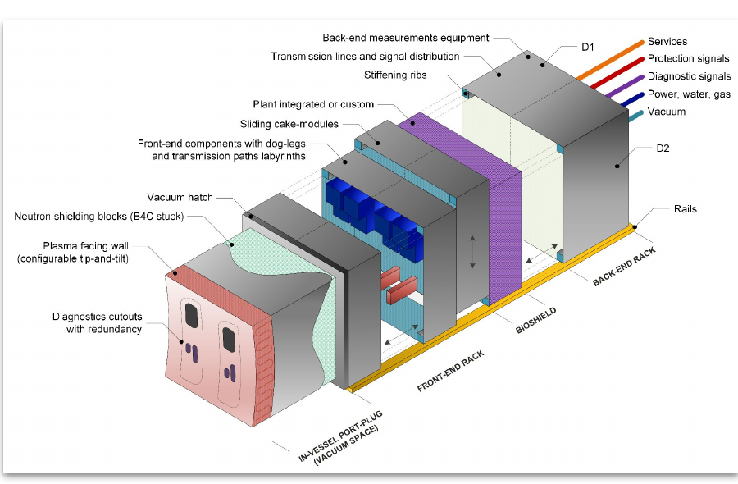
The port as a product
06 · PORT AS A PRODUCT
One mechanical envelope and interface specification: plasma-facing components and apertures, transmission lines, graded neutron/gamma shielding, thermal management, vacuum boundaries
Shared utilities: power, cooling, pneumatics and gas services, tritium monitoring
Factory qualification before installation
Fewer penetrations, smaller first-wall footprint
Remote-handling exchange of the full plug or a sub-module, with vacuum-preserving local isolation
MDP port plug: in-vessel plug, front-end and back-end racks
PUBLICATIONS A. Sirinelli, G. Subbotin, M. Nurgaliev, Y. Zhu, On-Chip Microwave Diagnostics for Fusion Power Plants, 17th International Reflectometry Workshop (IRW17), York, UK (2026)
Notes:
[1:00] The third layer: the port as a product. One envelope and one interface specification integrate plasma-facing components, transmission lines, graded shielding, thermal management, vacuum boundaries and shared utilities. That enables factory qualification, fewer penetrations, and remote-handling exchange of the whole plug or a single sub-module, with vacuum-preserving isolation.

Slide 21
Fewer external interfaces
06 · PORT AS A PRODUCT — INTERFACES
Conventional: each diagnostic is its own subsystem
MDP: all diagnostics organised in one unit
Reflectometry
MDP plug
Reflectometry
ECE
ECE
Interferometry–polarimetry
Interferometry–polarimetry
Collective Thomson scattering
Collective Thomson scattering
shared lines, shielding, vacuum, utilities
wall
wall
signal and transmission lines
vacuum and shielding interfaces
utilities: power, cooling, gas
Every opening costs breeding and shielding volume — MDP shares antennas, transmission lines and one rack across diagnostics.
PUBLICATIONS A. Sirinelli, G. Subbotin, M. Nurgaliev, Y. Zhu, On-Chip Microwave Diagnostics for Fusion Power Plants, 17th International Reflectometry Workshop (IRW17), York, UK (2026)
Notes:
[0:40] A qualitative picture of the interface count. Conventionally each diagnostic — reflectometry, ECE, interferometry-polarimetry, collective Thomson scattering — is its own subsystem with its own penetration through the wall, its own lines, vacuum and shielding interfaces and utilities. In MDP the same diagnostics are organised as modules in one unit, behind one penetration and one interface specification, sharing antennas, transmission lines and rack. Every opening we save is breeding and shielding volume returned to the plant.

Slide 22
Reliability by design
06 · PORT AS A PRODUCT — RELIABILITY
Layer
Mechanism in MDP
Protects against
Geometric
Redundant observation apertures in the plug
loss or degradation of one line of sight
Hardware
Two independent hardware chains
failure of one front-end or receiver chain
Spectral
Several microwave bands cover the same plasma region (K, Ka, Q, V reflectometry)
loss of one band or its components
Algorithmic
Missing parameters reconstructed from the remaining channels
channel dropouts, unobserved regions
Detection
Self-monitoring: every channel reports ready / degraded / not-ready; recovery switches to redundant hardware — this makes the four layers usable in operation
For reference: EU DEMO studies assume about twice the minimum number of channels for every control-relevant method.
PUBLICATIONS W. Biel et al., Diagnostics for plasma control – from ITER to DEMO, Fusion Eng. Des. 146, 465 (2019)
Notes:
[0:50] Reliability by design, layer by layer. Geometric: redundant apertures, so losing one line of sight does not lose the measurement. Hardware: two independent chains, against failure of one front-end or receiver. Spectral: several microwave bands cover the same plasma region, against the loss of one band. Algorithmic: reconstruction fills missing parameters from the remaining channels — section 05. None of this helps unless faults are detected: self-monitoring reports every channel as ready, degraded or not-ready and recovery switches to redundant hardware. For scale, EU DEMO studies assume about twice the minimum number of channels.

Slide 23
Three directions, one platform
SUMMARY
Stand-alone diagnostics
Microwave core set; on-chip receivers with UC Davis; one port carries five diagnostics
VIDA software
Acquisition and processing; self-monitoring; physics-constrained reconstruction with reduced access
Port plug
Fewer external interfaces; redundancy by design; reactor-ready architecture
Prototype under development: plasma tests on TCV at the beginning of 2027 and on DIII-D in spring 2027.
Design and manufacturing of the prototype: Poster session B, Tue 20 Oct, 16:00 (A. Sirinelli et al.)
Notes:
[0:40] Summary — three directions, one platform: stand-alone microwave diagnostics with on-chip receivers, VIDA software that turns signals into a self-checked plasma state with uncertainties — including reconstruction with reduced access — and a port-plug product with fewer interfaces and redundancy by design. The prototype is under development, with plasma tests on TCV and DIII-D in 2027 — and its design and manufacturing are on our poster in Poster session B tomorrow at 16:00.

Slide 24
Thank you for your attention
Notes:
Thank you.

