Slide 1



Soft X-rays Detection for Plasma Temperature Measurement at the ABC Laser Facility
L. Manzoni ^{(1),(2) *}, F. Filippi ⁽²⁾, M. Scisciò ⁽²⁾, M. Alonzo ⁽²⁾, P.L. Andreoli ⁽²⁾, G. Cristofari ⁽²⁾,
E. Di Ferdinando ⁽²⁾, B. Grau ⁽²⁾⁽³⁾, V. Piergotti ⁽²⁾, C. Verona ⁽³⁾, M. Migliorati ⁽¹⁾,
M. Traunfellner ⁽⁴⁾, M. Lunzer ⁽⁴⁾, M. Cipriani ⁽²⁾ and F. Consoli ⁽²⁾.
(1) Università di Roma La Sapienza, Rome, Italy
(2) ENEA, Nuclear Department, C.R. Frascati, Italy
(3) Università di Roma Tor Vergata, Rome, Italy
(4) UpNano GmbH, Vienna, Austria
* leonardo.manzoni@uniroma1.it

Slide 2
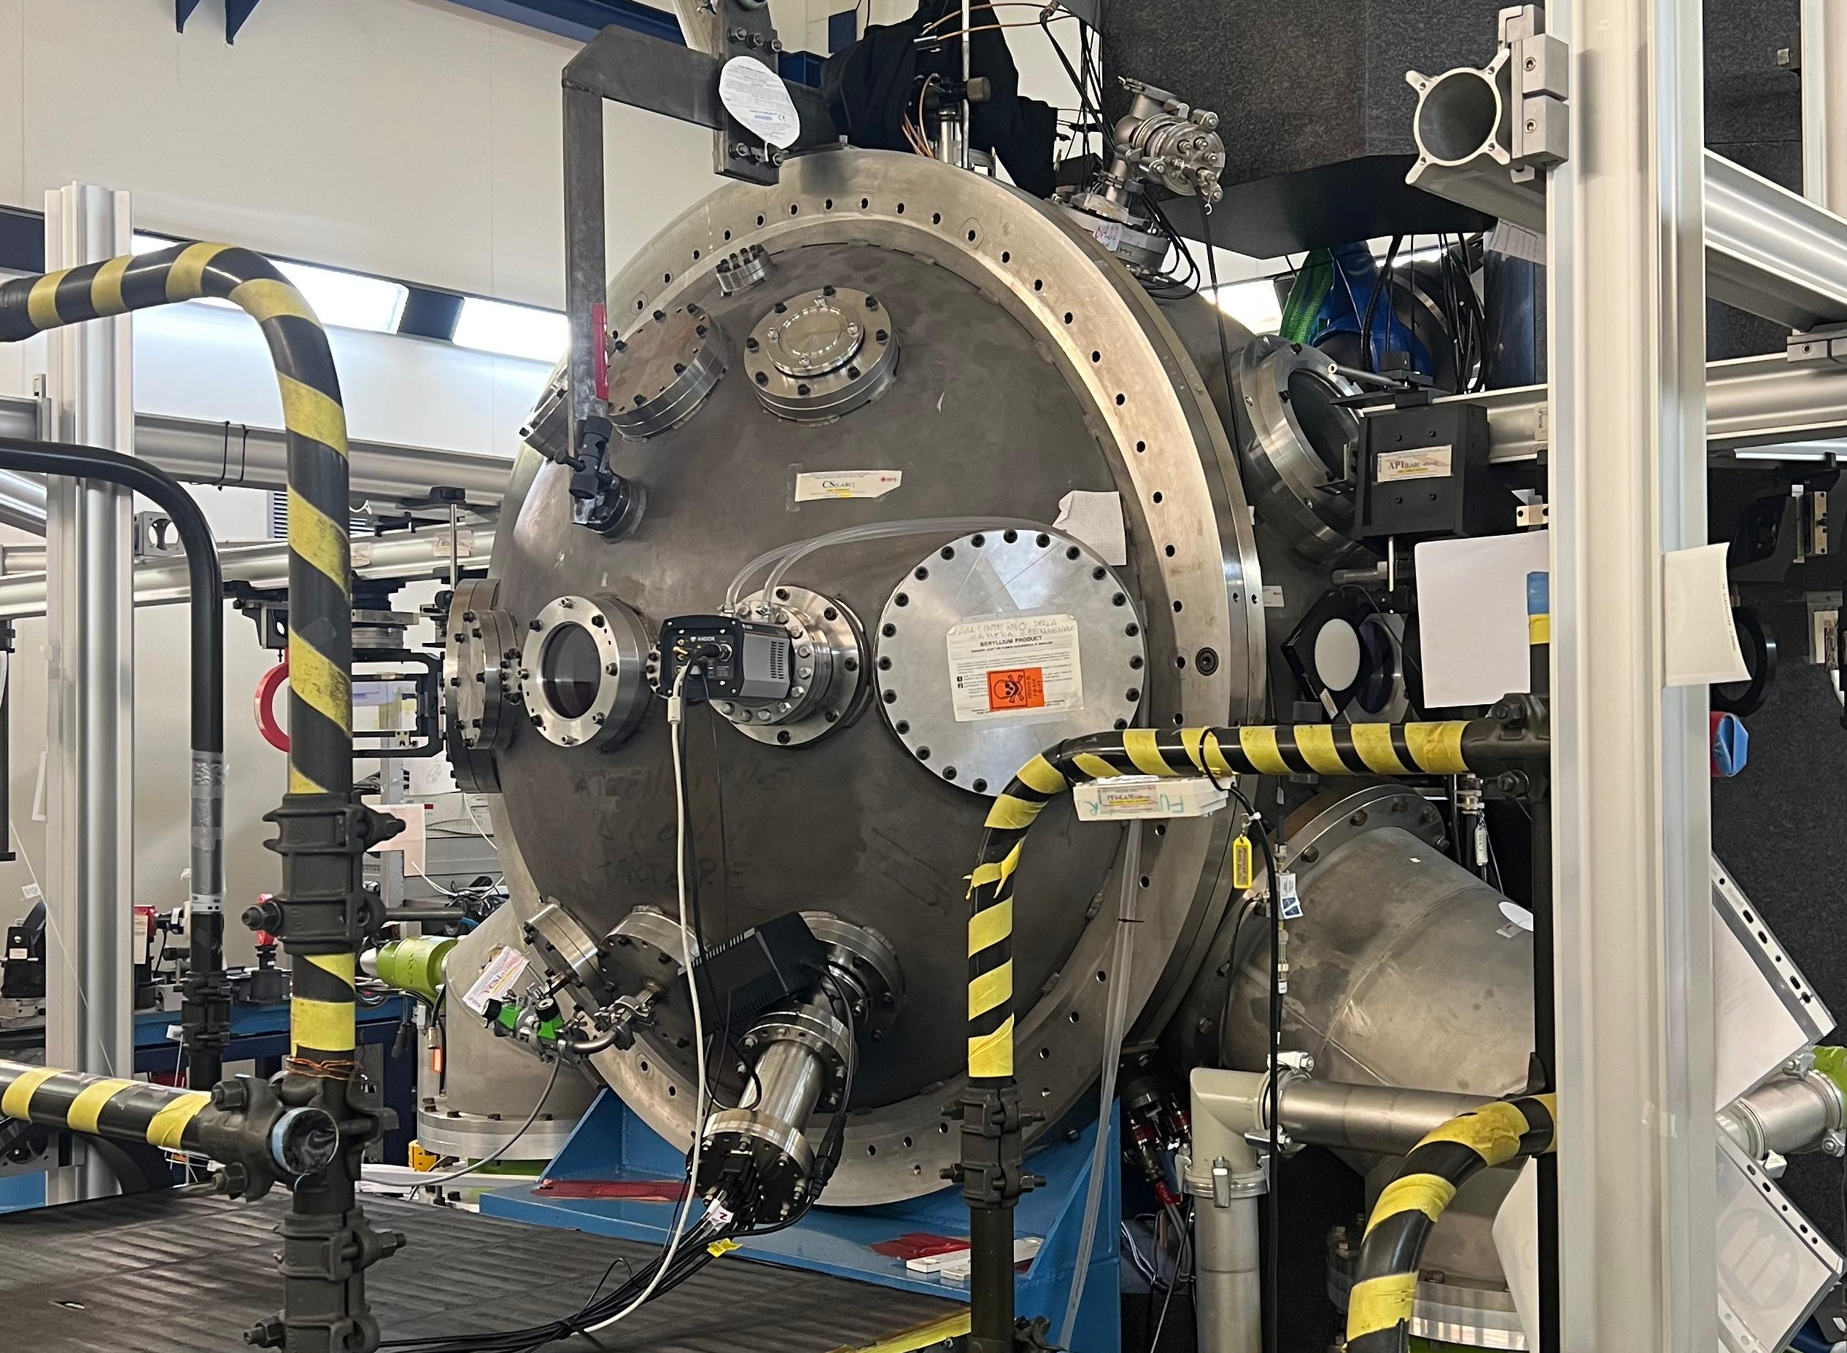
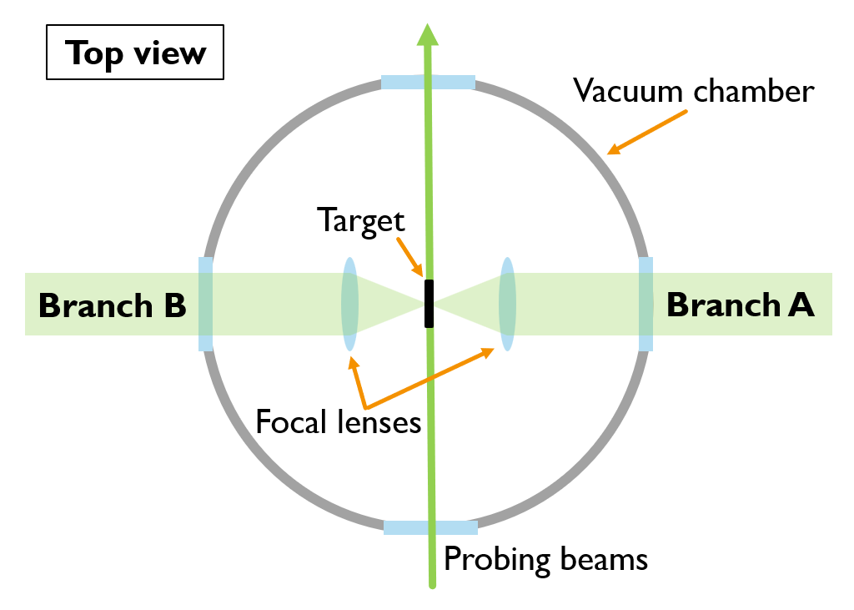

The ABC Laser Facility
The ABC laser facility at ENEA Research Centre (Frascati, Italy) is a high-power laser devoted to experiment of inertial confinement fusion and laser-plasma interaction.
Nd:phosphate glass laser.
Wavelength: 1054 nm.
2 x 100J beams.
3-7 ns pulse duration.
Intensity up to 10¹⁵ W/cm².

Slide 3
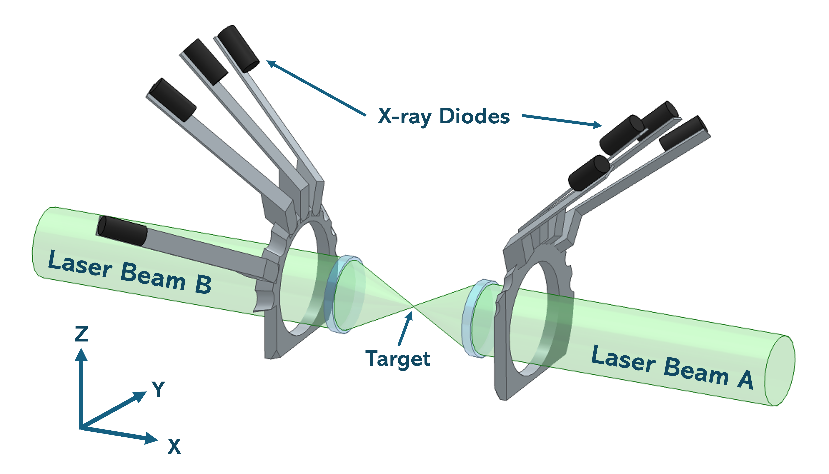
X-Ray Diodes at ABC
The interaction chamber is equipped with diodes to detect soft X-rays emitted by laser-generated plasma, used to determine the plasma electron temperature.
They are a set of eight Ge(Li) semiconductor detectors, equipped with variable-thickness filters and interchangeable positions on both sides of the target, arranged in a radial array around the interaction point.
Active area: 25 mm².
Sensitive thickness:100 µm.
Bias voltage: 50 V

Slide 4
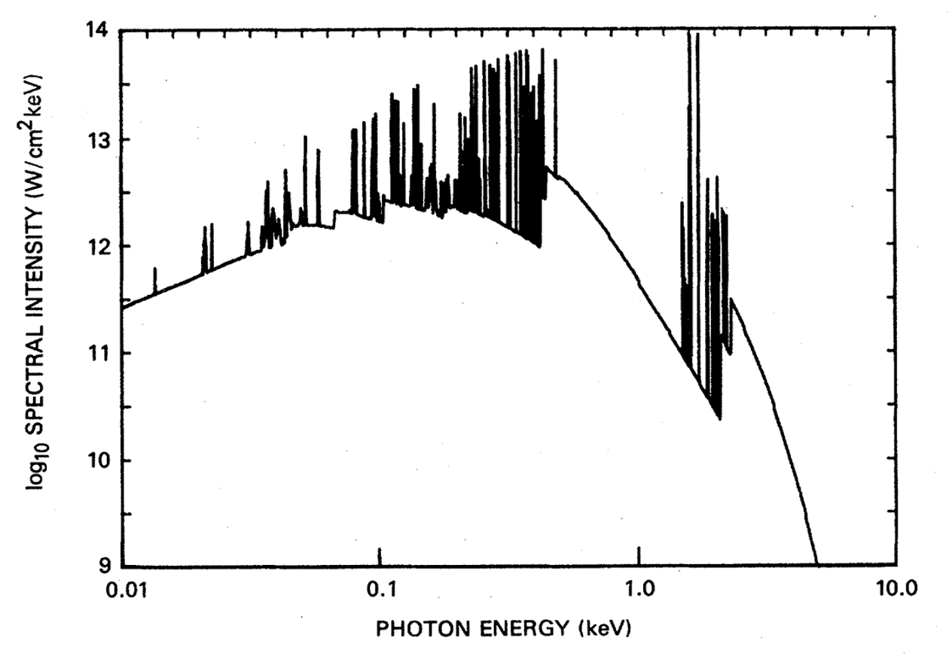
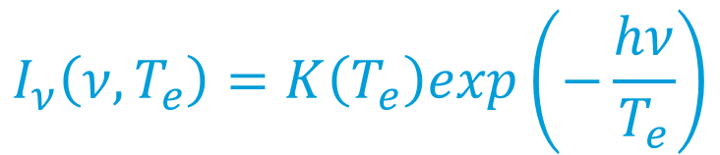
X-Ray Emission from Laser Induced Plasma
X-rays from laser-driven plasma are emitted from 3 kinds of electron transition:
Free – free
Free – bound
Bound – bound
Emitted spectral power:
(Hp: Maxwellian electron velocity distribution)
For ν > ν₁:
$$I_{ν}\left(ν,T_{e}\right)=K\left(T_{e}\right)exp\left(−\frac{hν}{T_{e}}\right)$$
Al plasma
hν₁= 2304 eV
T_{e} = electron plasma temperature
Calculated X-ray spectrum from Al target irradiated at intensities of 10¹⁴ W/cm²
D. Duston et al., Phys. Rev. A 31, 3220 (1985).
Notes:
Per Al, h\nu è 2304 eV

Slide 5
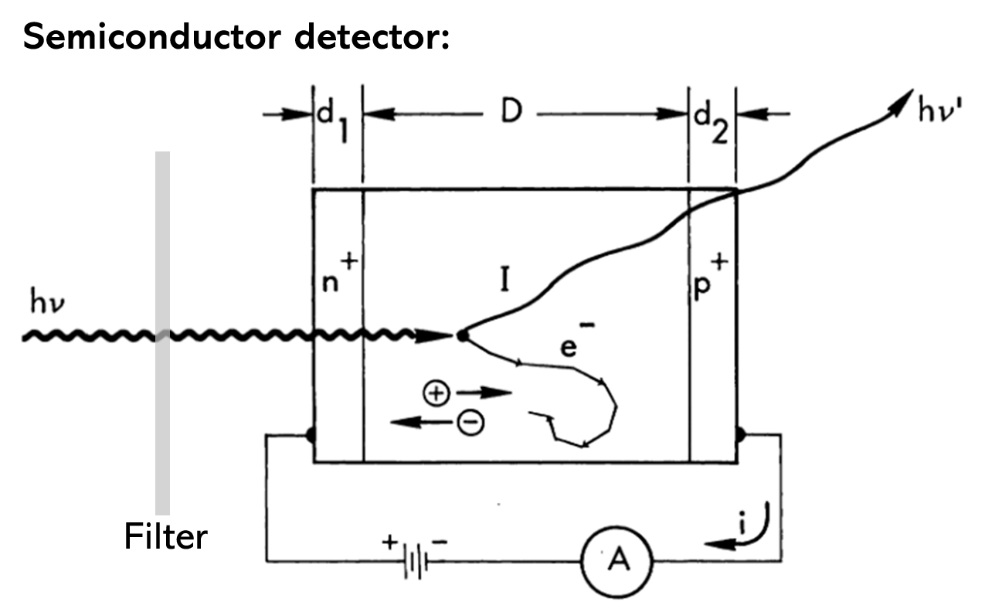
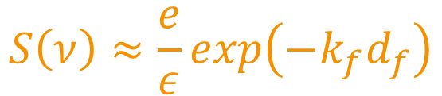
X-Ray Detection
A photon generates a number of electron-hole pairs in the diode proportional to the deposited energy.
Sensitivity:
(generated current/incident photon energy).
$$S\left(ν\right)≈\frac{e}{ε}exp\left(−k_{f}d_{f}\right)$$
Filter transmission
ν = photon frequency.
e = elementary charge.
ε = energy to generate an electron-hole pair.
k_{f} = attenuation coefficient.
d_{f} = filter thickness.
R. W. Kuckuck, Semiconductor Detectors for Use in the Current Mode, Lawrence Radiation Lab (1971).

Slide 6
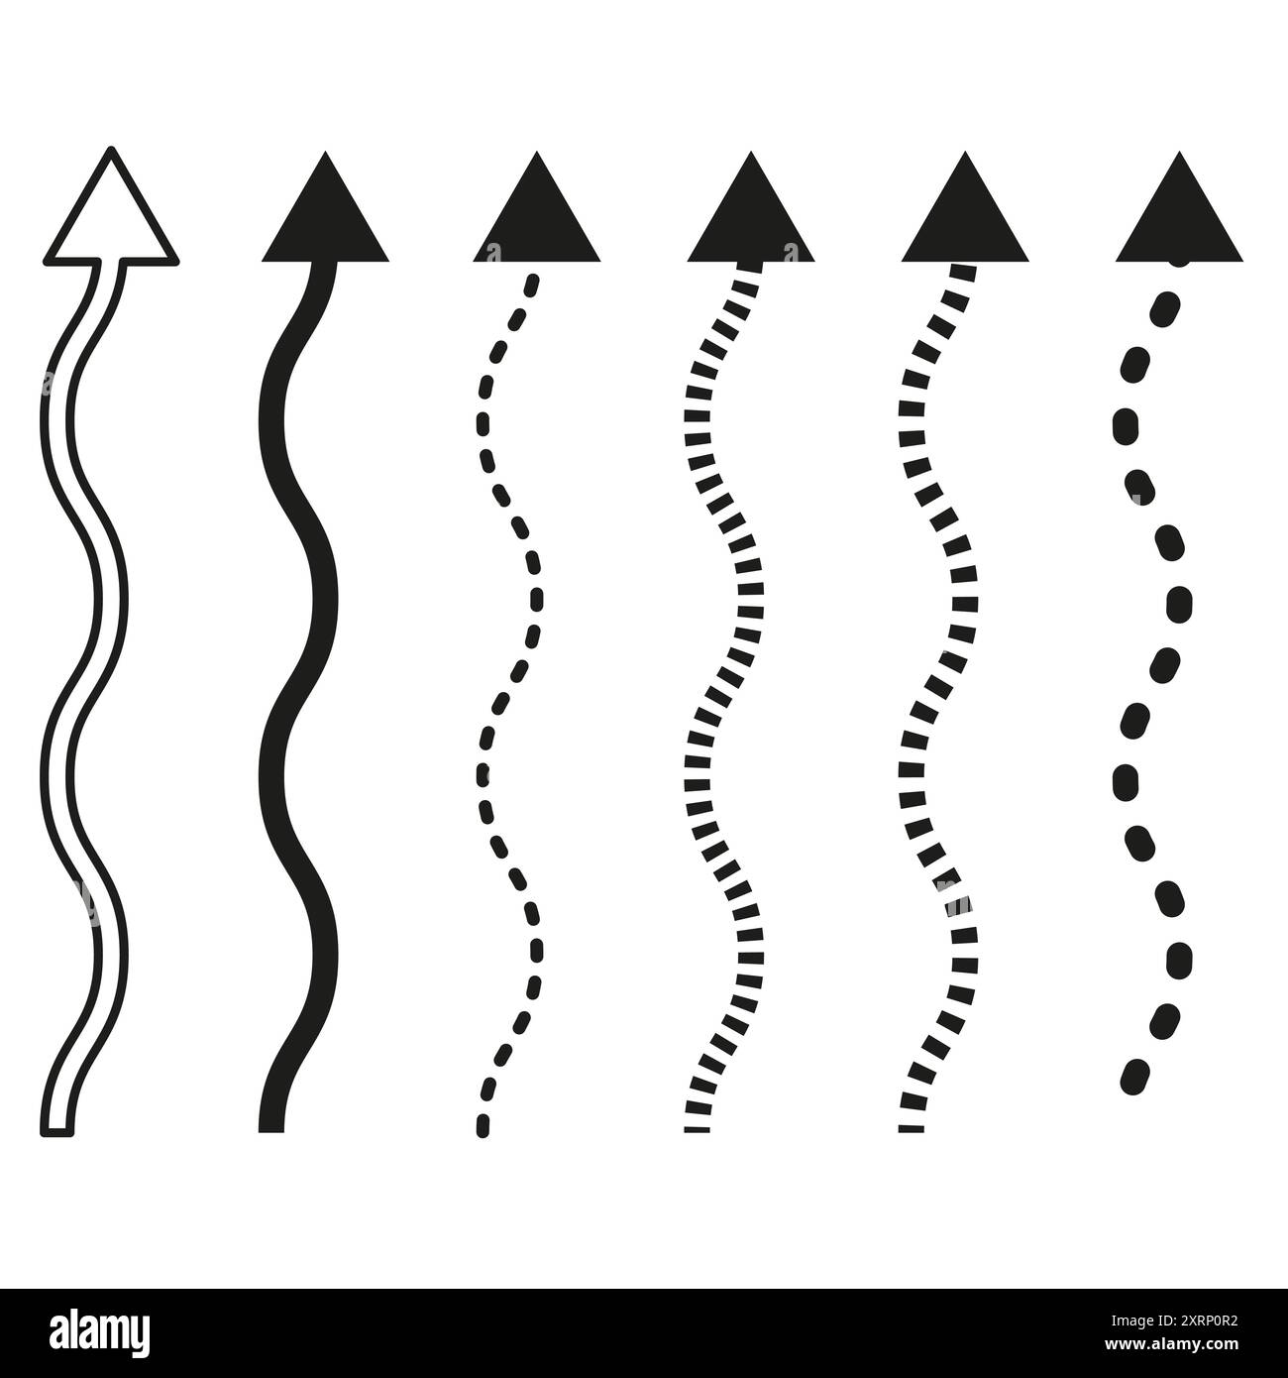
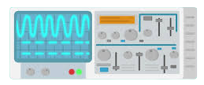
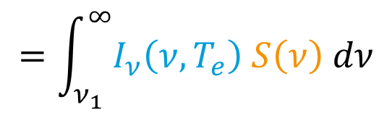

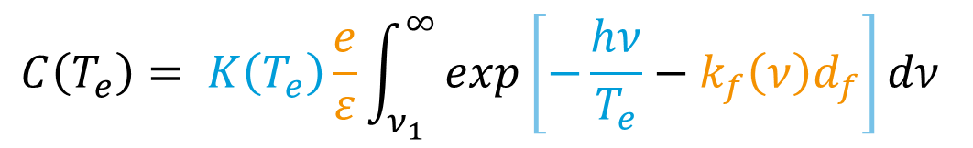
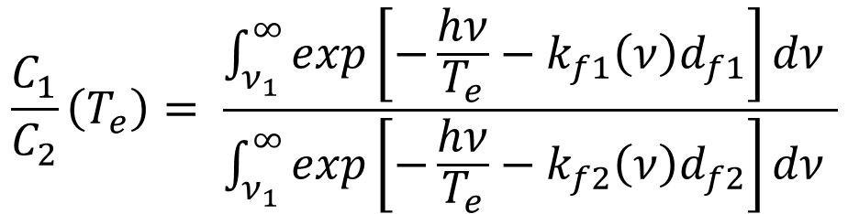
Plasma Temperature Evaluation
X-ray
Filter
X-ray diode
Current from diode:
$$=\int_{ν_{1}}^{∞}{I_{ν}\left(ν,T_{e}\right) S\left(ν\right) dν}$$
$$C\left(T_{e}\right)$$
Emitted spectral power
Diode + filter sensitivity
?
$$C\left(T_{e}\right)= K\left(T_{e}\right)\frac{e}{ε}\int_{ν_{1}}^{∞}{exp\left[−\frac{hν}{T_{e}}−k_{f}\left(ν\right)d_{f}\right]dν }$$
Ratio of two current signals:
$$\frac{C_{1}}{C_{2}}\left(T_{e}\right)= \frac{\int_{ν_{1}}^{∞}{exp\left[−\frac{hν}{T_{e}}−k_{f1}\left(ν\right)d_{f1}\right]dν }}{\int_{ν_{1}}^{∞}{exp\left[−\frac{hν}{T_{e}}−k_{f2}\left(ν\right)d_{f2}\right]dν }}$$
Temperature evaluation with two diodes.
With more than two diodes it is possible to estimate an error on the measurement.
Notes:
Absolute measurements are needed to determine the multiplication constant. The most robust way to determine the temperature is by comparing two signals.

Slide 7
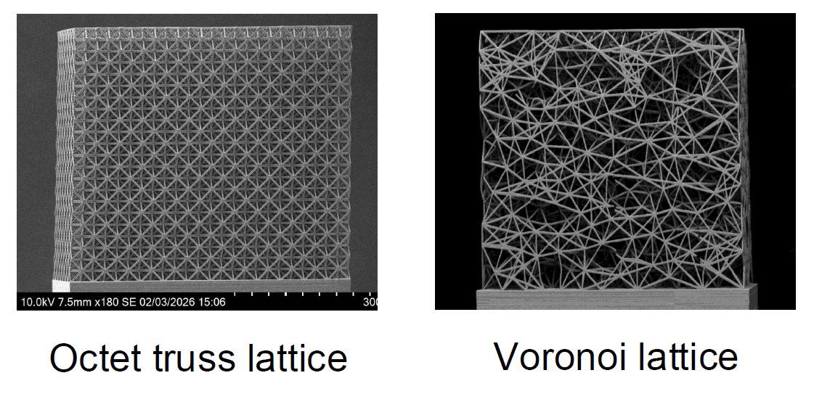
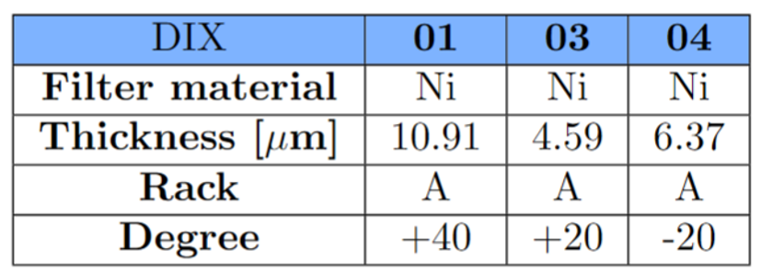

Results from Foam Target
Experimental campaign to study laser interaction with 3D-printed nanostructured plastic foams.
Laser parameters
Energy: 30-40 J.
Pulse duration: 3 ns.
Focal spot size: 100 µm.
Intensity: 1x10¹⁴ W/cm².
X-ray diodes setup
Target manufactured by:
M. Cipriani et al., presented at 21st DDFIW, Frascati, Italy, 8–11 June 2026.

Slide 8
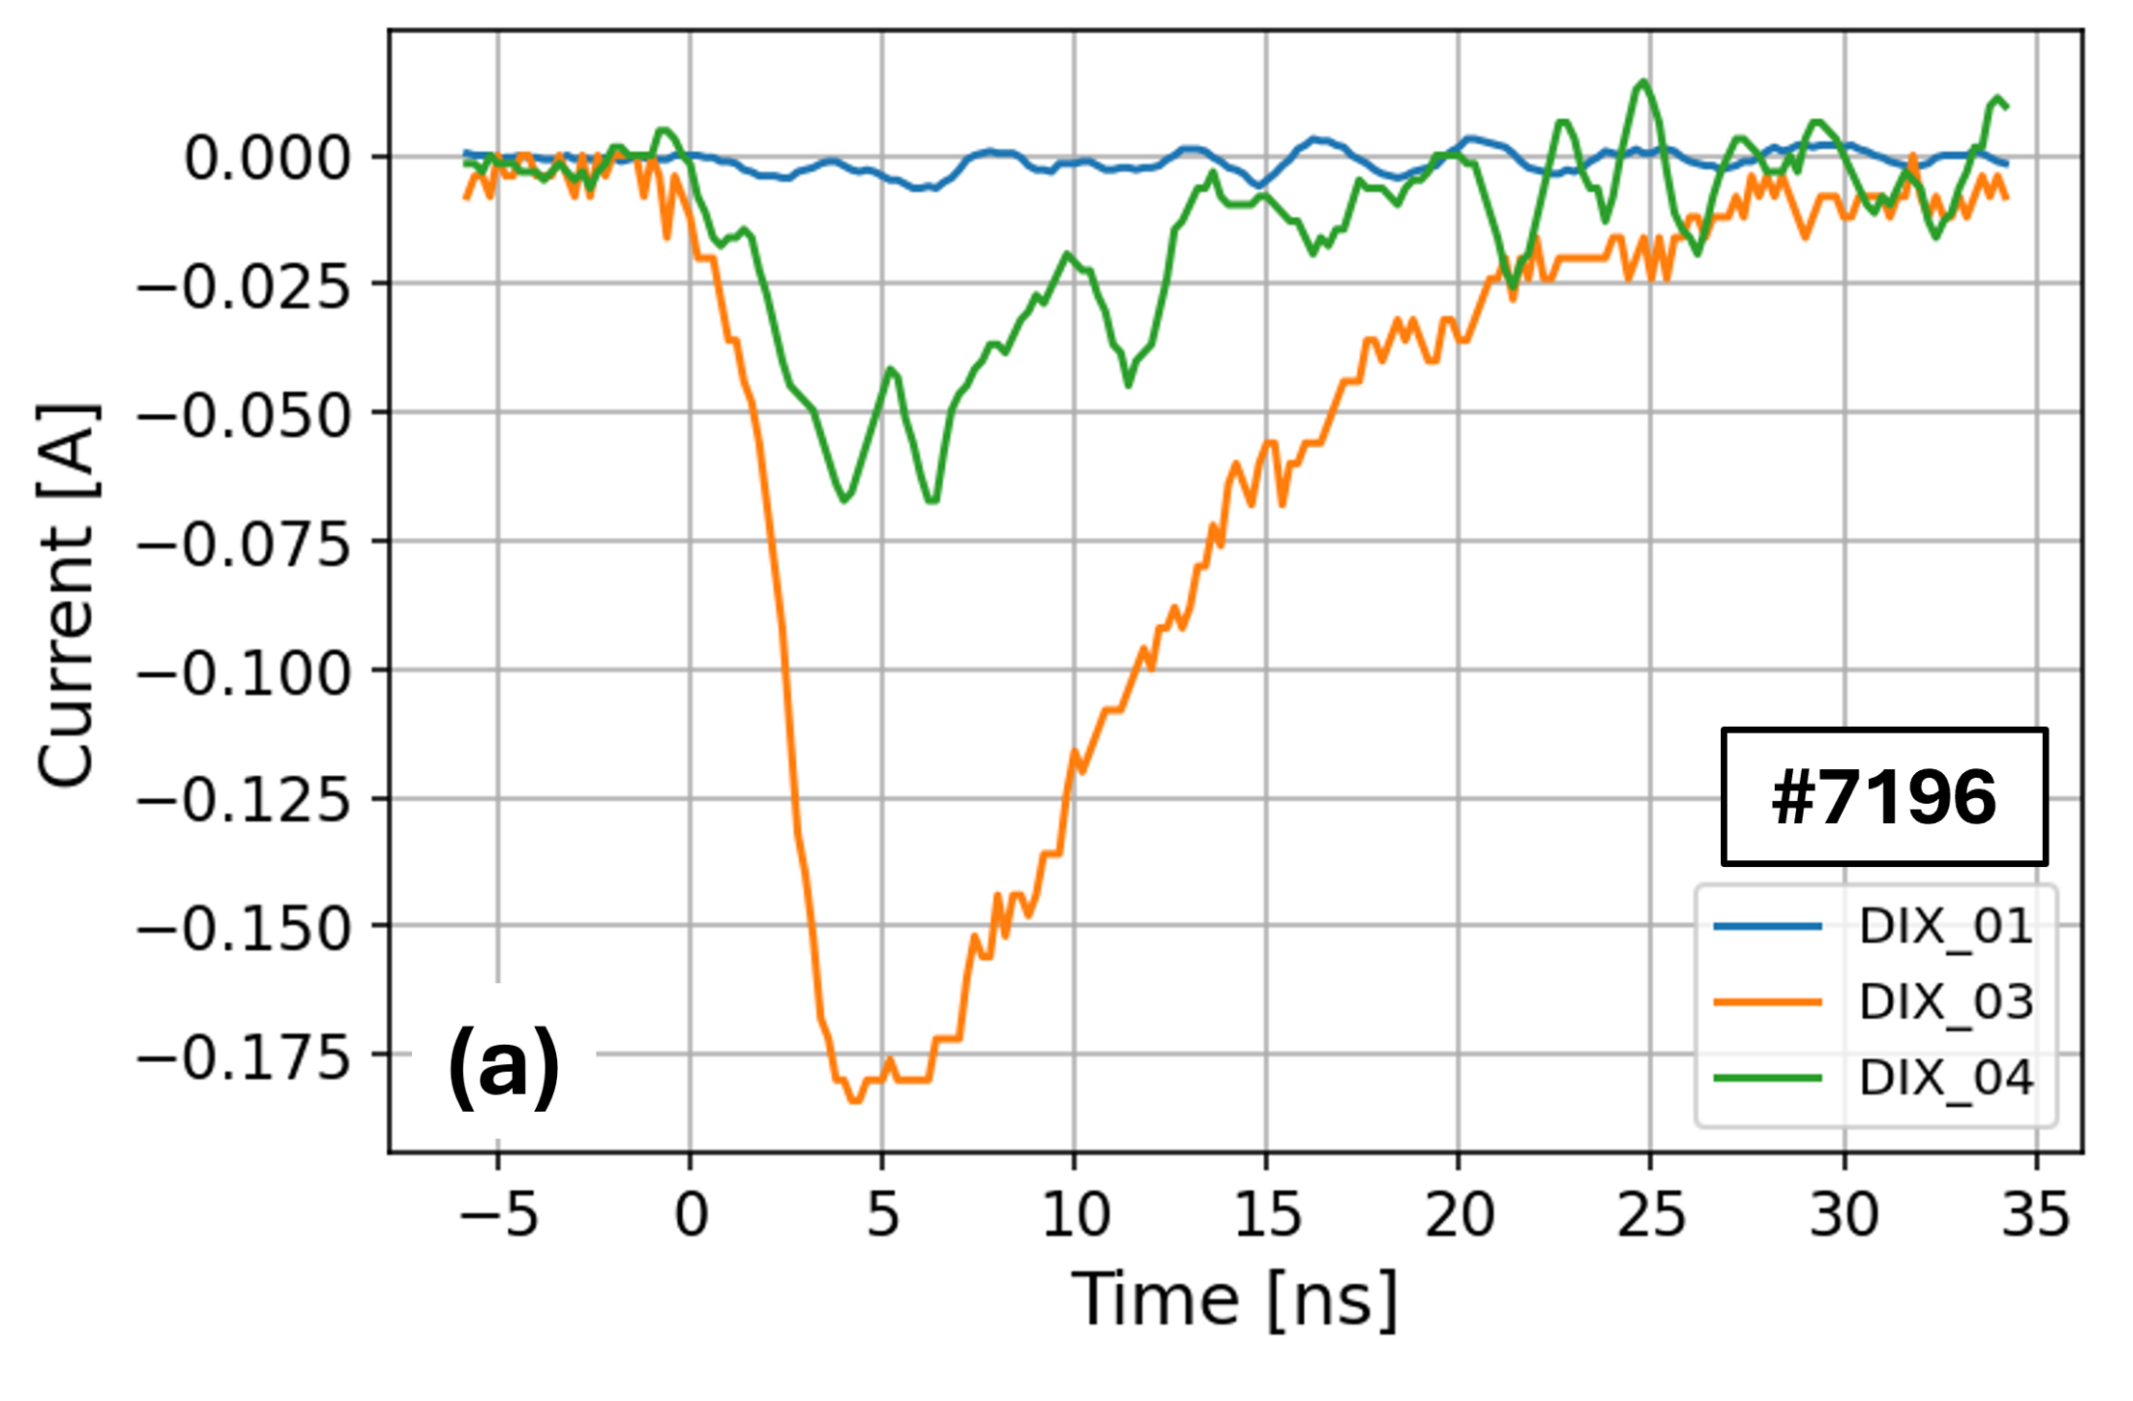
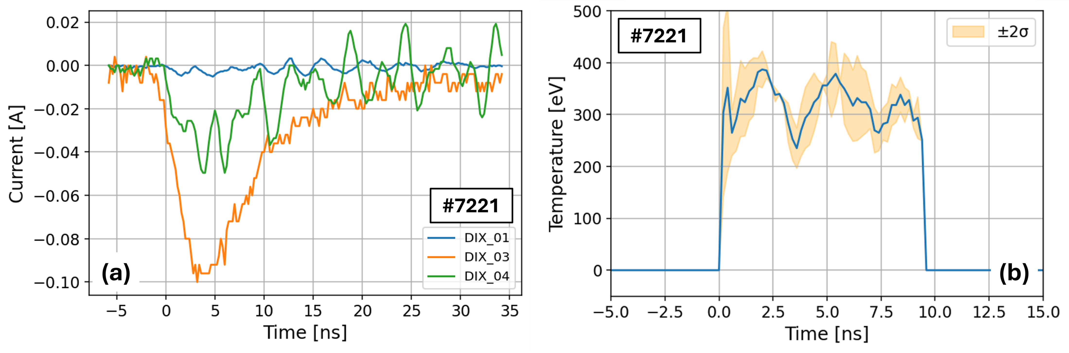

Results from Foam Target
SHOT | T_{e} average [eV]
#7196 | 320 ± 46
#7221 | 334 ± 41

Slide 9
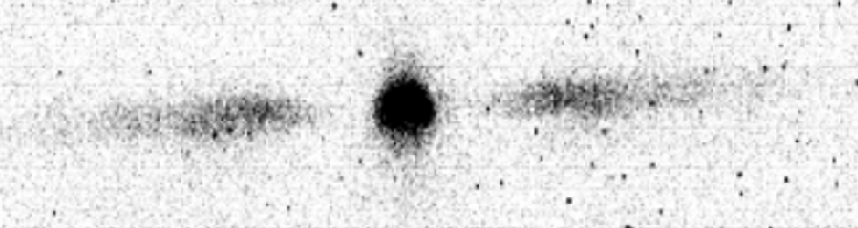
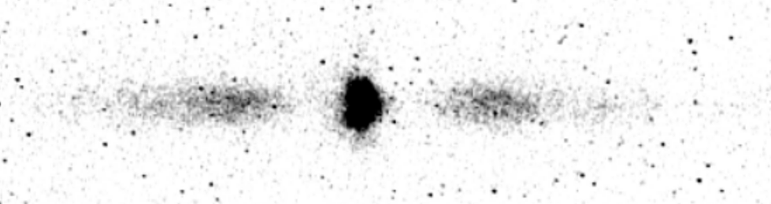
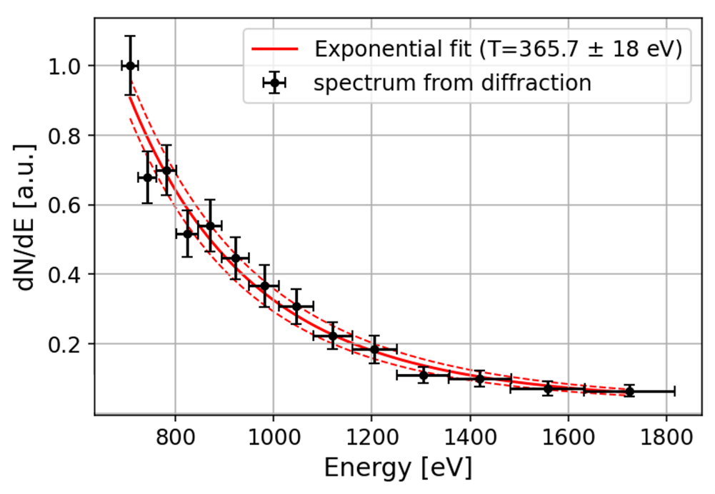
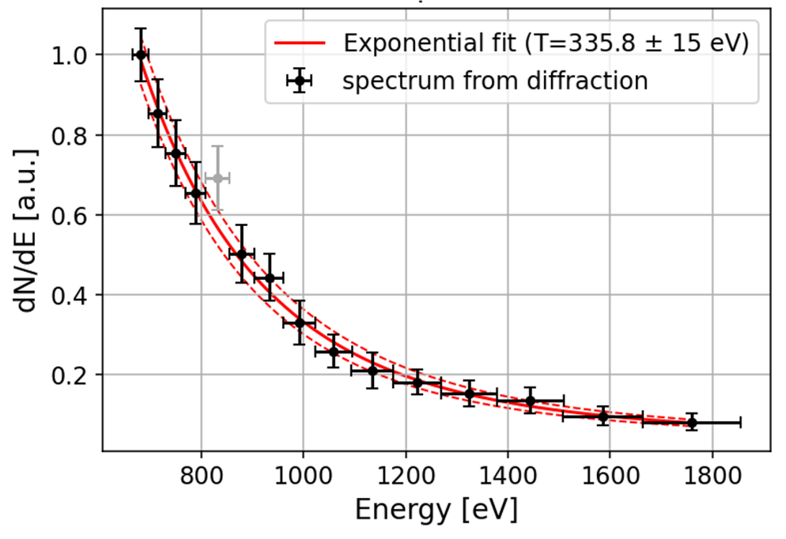
Results Comparison with X-ray Grating
Validation of the results using an X-ray diffraction grating already installed in the chamber.
SHOT | T_{e} average from diodes [eV] | T_{e} from X-ray grating
#7196 | 320 ± 46 | 366 ± 18
#7221 | 334 ± 41 | 336 ± 15
M. Salvadori et al., 2019 JINST 14 C03007.
#7196
#7221

Slide 10
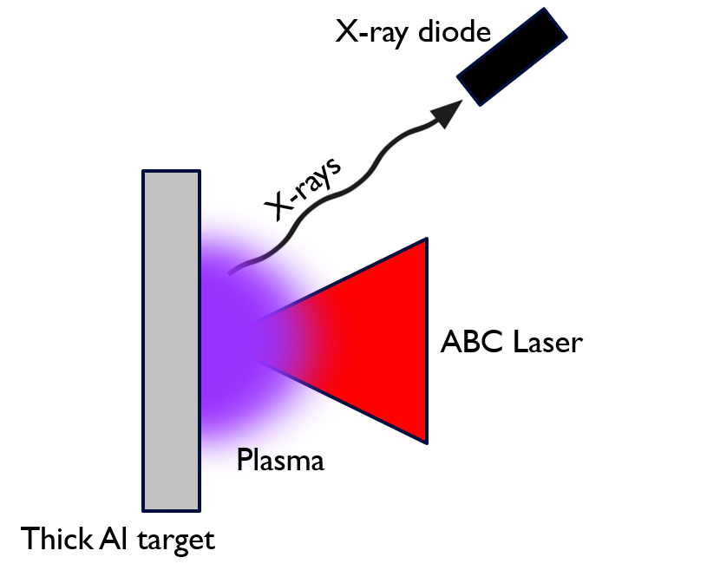
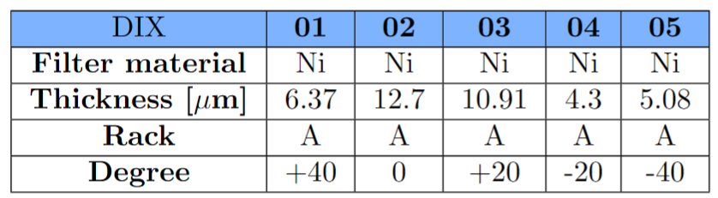
Results from Metallic Target
Experimental campaign conducted with thick aluminum targets.
(Diffraction grating unavailable because the target blocked the line of sight).
Laser parameters
Energy: 30-40 J.
Pulse duration: 3 ns.
Focal spot size: 50 µm.
Intensity: 5x10¹⁴ W/cm².
X-ray diodes setup

Slide 11
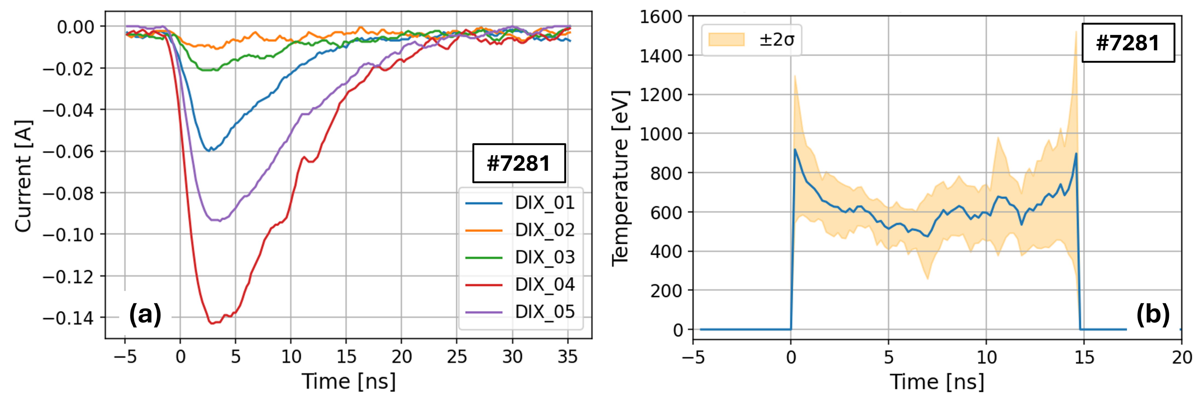
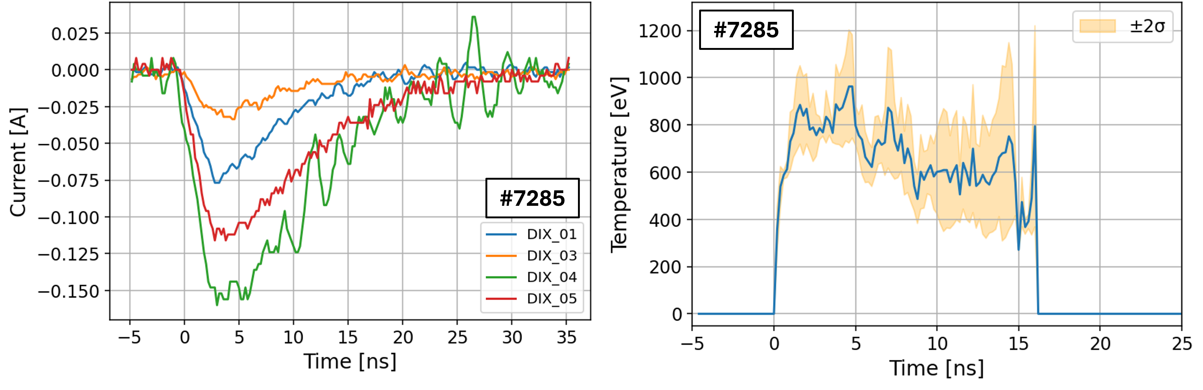
Results from Metallic Target
SHOT | T_{e} average [eV]
#7281 | 604 ± 142
#7285 | 734 ± 120

Slide 12
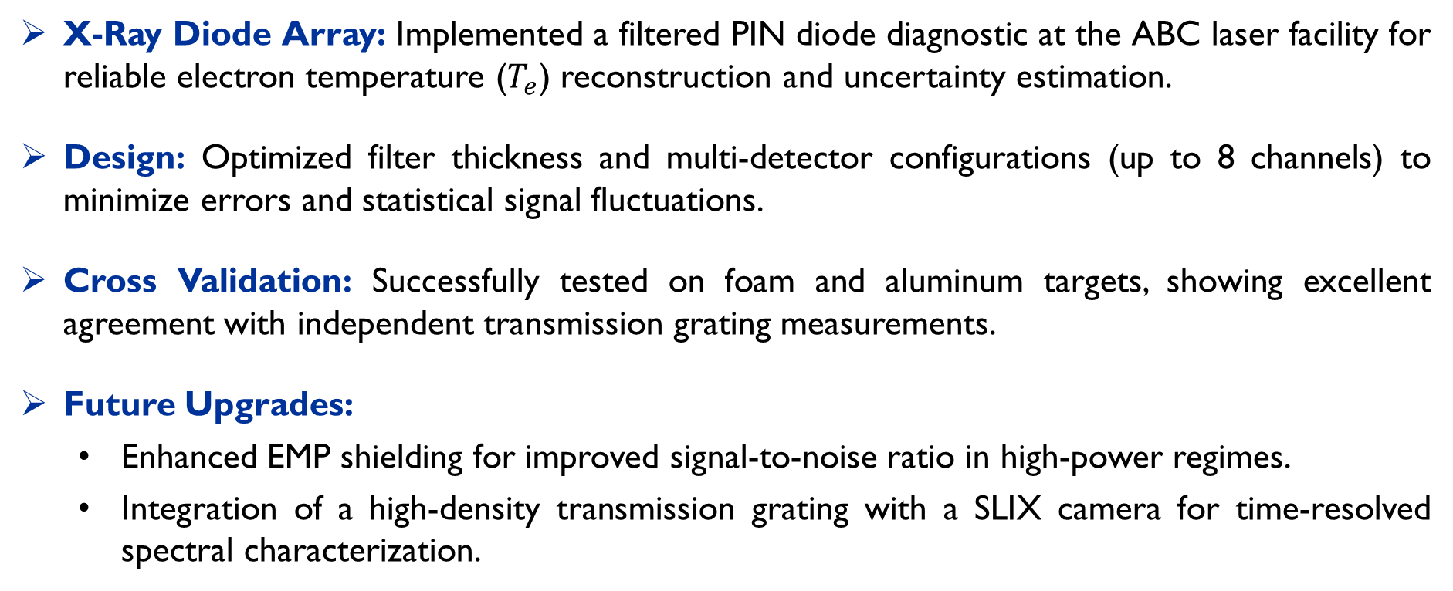
Conclusions
X-Ray Diode Array: Implemented a filtered PIN diode diagnostic at the ABC laser facility for reliable electron temperature ($T_{e}$) reconstruction and uncertainty estimation.
Design: Optimized filter thickness and multi-detector configurations (up to 8 channels) to minimize errors and statistical signal fluctuations.
Cross Validation: Successfully tested on foam and aluminum targets, showing excellent agreement with independent transmission grating measurements.
Future Upgrades:
  Enhanced EMP shielding for improved signal-to-noise ratio in high-power regimes.
  Integration of a high-density transmission grating with a SLIX camera for time-resolved spectral characterization.

Slide 13
Thank you
for your attention
Acknowledgements
Activities partially funded through the ReMade@ARI project by the European Union as part of the Horizon Europe call HORIZON-INFRA-2021-SERV-01 under grant agreement number 101058414 and co-funded by UK Research and Innovation (UKRI) under the UK government’s Horizon Europe funding guarantee (grant number 10039728) and by the Swiss State Secretariat for Education, Research and Innovation (SERI) under contract number 22.00187. Views and opinions expressed are however those of the author(s) only and do not necessarily reflect those of the European Union or the UK Science and Technology Facilities Council or the Swiss State Secretariat for Education, Research and Innovation (SERI). Neither the European Union nor the granting authorities can be held responsible for them.

Slide 14
Backup Slides

Slide 15
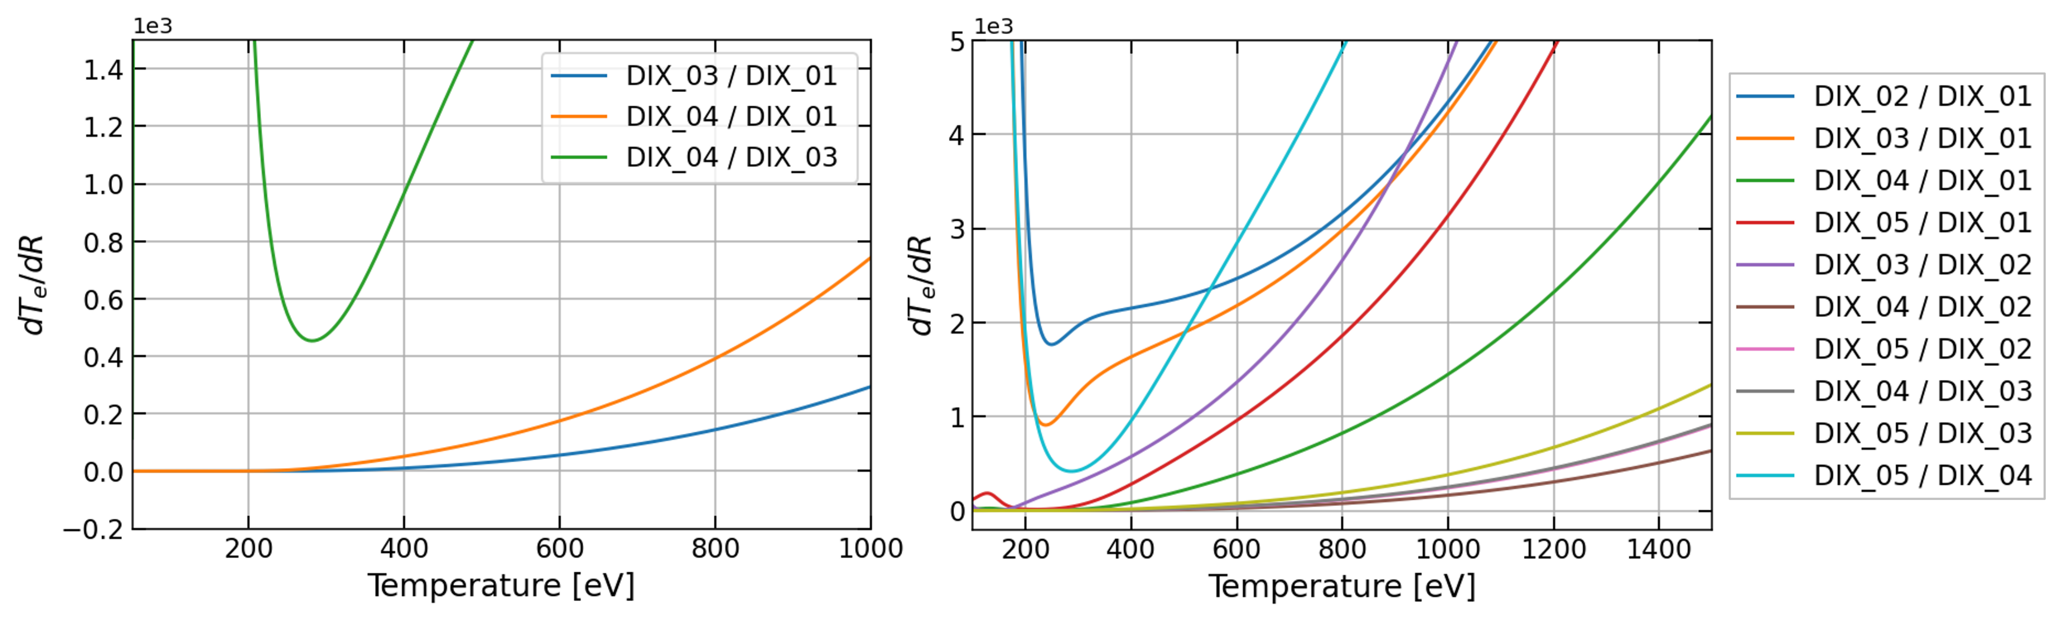
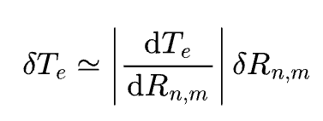
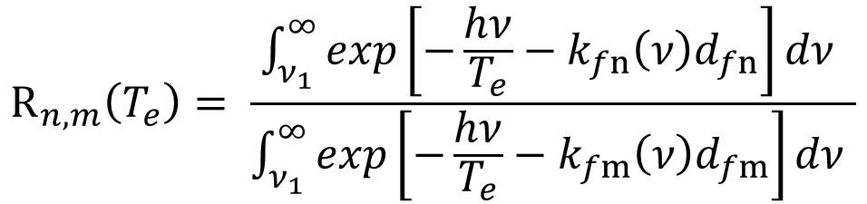
Filter Optimisation
$$R_{n,m}\left(T_{e}\right)= \frac{\int_{ν_{1}}^{∞}{exp\left[−\frac{hν}{T_{e}}−k_{fn}\left(ν\right)d_{fn}\right]dν }}{\int_{ν_{1}}^{∞}{exp\left[−\frac{hν}{T_{e}}−k_{fm}\left(ν\right)d_{fm}\right]dν }}$$
Filter thickness in diode pairs can be optimized to minimize the effect of statistical signal fluctuations on temperature estimation error.
Parameter to minimise

Slide 16
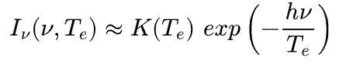
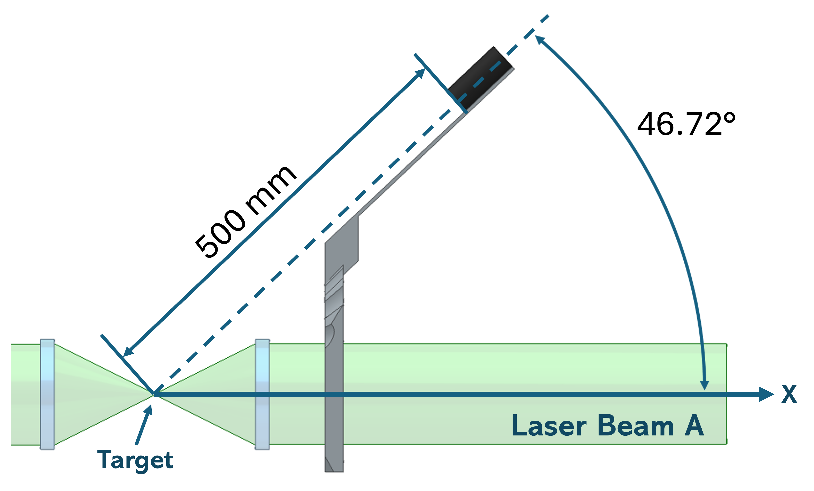

X-Ray Angular Emission
Emitted spectral power:
Angular emission
Cylindrical symmetry around the axis normal to the target [1].
$$I_{ν}\left(θ\right)=I_{ν}\left(0\right)\left[cos\left(θ\right)\right]$$
All the diodes must be positioned at the same angle from the normal to the target.
D. Giulietti e L. A. Gizzi, Riv. Nuovo Cimento 21, 1 (1998).

Slide 17
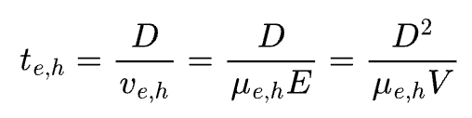
Temporal Resolution
I. C. E. Turcu e G. J. Tallents, X-Rays from Laser-Plasmas: Generation and Applications, John Wiley & Sons (1999).
Charge collection time:
µ_{e,h} = electron and hole mobilities
D = diode thickness
V = voltage
For our Ge(Li) diodes:
t_{e} = 0,5 ns
t_{h} = 1 ns

Slide 18
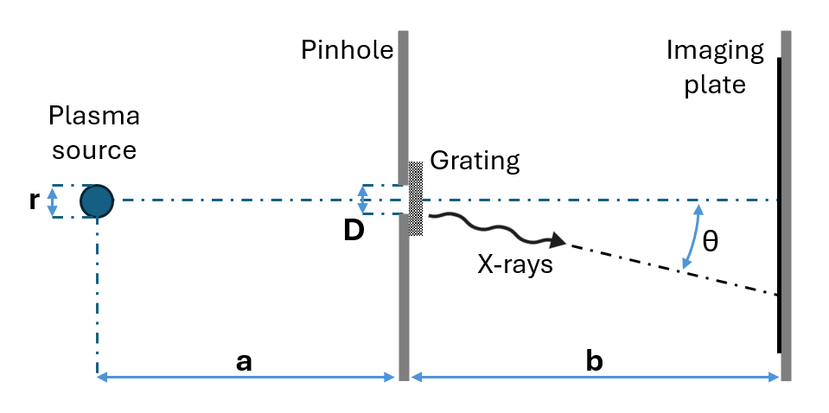


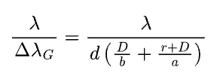
X-Ray Diffraction Grating
Spectrum reconstruction:
d = grating period
m = diffraction order
Spectral resolution:
Diffraction limit:
Geometrical resolution:

