Slide 1
COPYRIGHT NOTICE
This original "Closing the loop: why fusion power demands a new diagnostic blueprint" was created by Alexandru Boboc and Andy Meigs, October 2026
Copyright © UK Industrial Fusion Solutions Ltd. 2025. All rights reserved.
No part of this publication may be reproduced, stored in a retrieval system of any nature, or transmitted, in any form or by any means including photocopying and recording, without the prior written permission of the copyright owner.
Licences issued by the Copyright Licensing Agency or any other reproduction rights organisation do not apply. If any unauthorised acts are carried out in relation to this copyright work, a civil claim for damages may be made and/or a criminal prosecution may result.

Slide 2
Closing the loop: why fusion power demands a new diagnostic blueprint
Alexandru Boboc, Andrew Meigs
Principal Diagnostics Engineers
(Members of STEP Diagnostics Leadership team)
Plasma Science and Operation Division, UKAEA National Lab
Culham Campus, Abingdon, OX14 3DB, UK
ICFDT8 8th International Conference on Frontier in Diagnostic Technologies, 19th -21st October 2026 Frascati, Italy

Slide 3
Outline
What are plasma diagnostic
Dichotomy dilemma
Functional role and link with controls
Key requirements
Strategy points
Conclusion
A.Boboc and A.Meigs "Closing the loop: Why fusion power demands a new diagnostic blueprint"
ICFDT8 8th International Conference on Frontier in Diagnostic Technologies, 19th -21st October 2026 Frascati, Italy

Slide 4
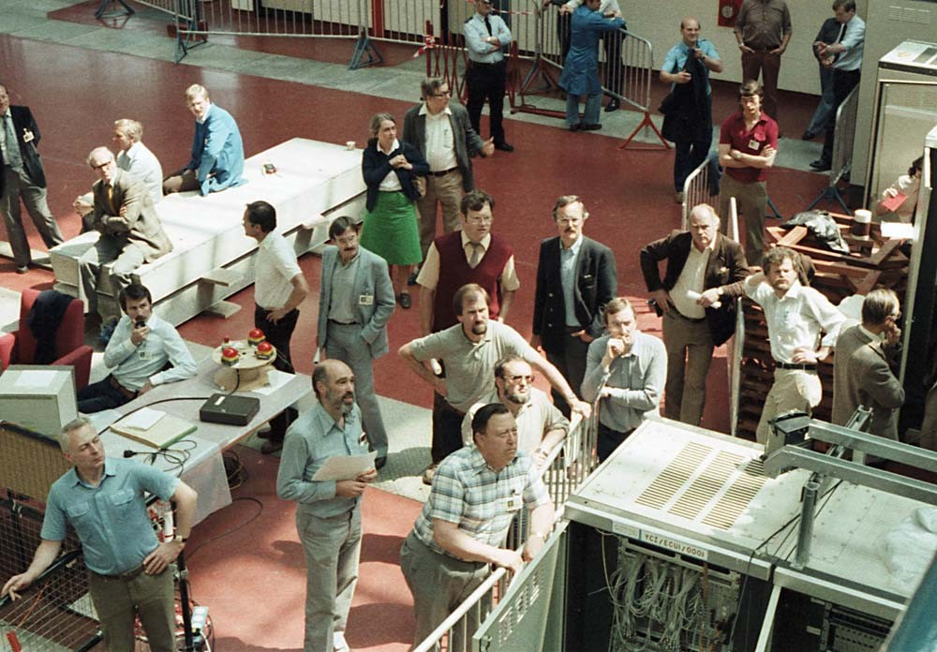
What are plasma diagnostics
A device or something to measure a property of plasma (e.g. density)
Historically most of them are for post-mortem something to understand plasma physics with some for real-time control(e.g. plasma shape from magnetics sensors)
Evolved from getting one point measurement information to something more advanced like a 2-D profiles, 3D tomography or real-time for control
Advanced with help on computing to evaluate the present* and predict* where the plasma will be in the future
*FMIDA (Forward modelling and Integrated Data Analysis)
A.Boboc and A.Meigs "Closing the loop: Why fusion power demands a new diagnostic blueprint"
ICFDT8 8th International Conference on Frontier in Diagnostic Technologies, 19th -21st October 2026 Frascati, Italy

Slide 5
Diagnostics dichotomy
Today’s fusion experiments diagnostic systems strategy
The future burning plasmas reactor needs
(e.g.DEMO*,STEP**)
Physics delivery for the most sophisticated diagnostics
Focus on diagnostic high-quality measurements
Advanced control from diagnostics is a secondary priority
at the start
Diagnostics organised around plasma control
Focus on reliability and resilience
Physics exploration become secondary
Key elements:
  Robust and protected methods
  Plasma-state reconstruction
  Fault detection and classification
  Redundancy in methods and channels
  Detailed measurements where predicted models cannot capture unforeseen events
https://euro-fusion.org/programme/demo/
https://stepfusion.com
A.Boboc and A.Meigs "Closing the loop: Why fusion power demands a new diagnostic blueprint"
ICFDT8 8th International Conference on Frontier in Diagnostic Technologies, 19th -21st October 2026 Frascati, Italy

Slide 6
Burning plasma, reactor mode
Plasma Control Parameters and plant protection primarily define diagnostics
(with some room for still unknown Physics that could impact and drive control)
A.Boboc and A.Meigs "Closing the loop: Why fusion power demands a new diagnostic blueprint"
ICFDT8 8th International Conference on Frontier in Diagnostic Technologies, 19th -21st October 2026 Frascati, Italy

Slide 7

Defining the required plasma diagnostic set
Initial Requirements
Diagnostics Options
Diagnostics set chosen
Assumptions & feasibility
Quantities we need to measure
Range of Technology options to deliver
Candidate Sensor Set
Informed assumptions on achievable measurements
Plasma Control System
Refined Requirements
Requirements for each diagnostic
Plasma scenario input
Market Engagement
R&D on short-list diagnostics set
A.Boboc and A.Meigs "Closing the loop: Why fusion power demands a new diagnostic blueprint"
ICFDT8 8th International Conference on Frontier in Diagnostic Technologies, 19th -21st October 2026 Frascati, Italy
OFFICIAL - Programme Only

Slide 8
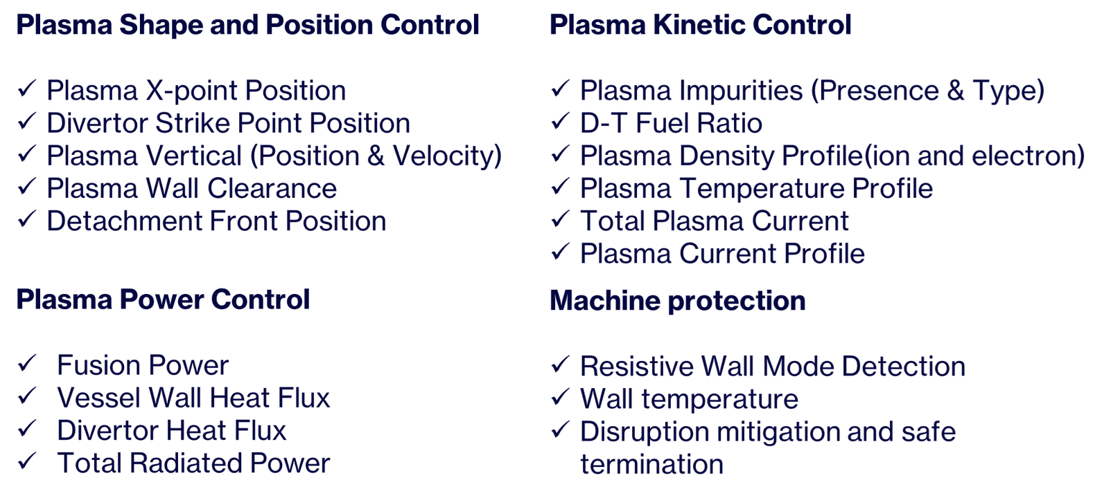
Definition of some Key Physics Parameters* to Control
*this list is not definitive yet
A.Boboc and A.Meigs "Closing the loop: Why fusion power demands a new diagnostic blueprint"
ICFDT8 8th International Conference on Frontier in Diagnostic Technologies, 19th -21st October 2026 Frascati, Italy

Slide 9
Functional role of the diagnostics set - part 1
For the same physical measurements, we have different products, latencies and assurance levels
Control and Protection
Supervision and State
Development and deep analysis
Real-time
Direct and indirect parameter information
Predictive models for control(FMIDA)
Markers,triggers and alarms
Real-time to inter-pulse
Fast fits and reduced models
Consistency checks
Model-measurement residuals
Inter-pulse to offline
Calibrated full spectra
Advanced FMIDA/posterior
Root cause and new metrics
A.Boboc and A.Meigs "Closing the loop: Why fusion power demands a new diagnostic blueprint"
ICFDT8 8th International Conference on Frontier in Diagnostic Technologies, 19th -21st October 2026 Frascati, Italy

Slide 10
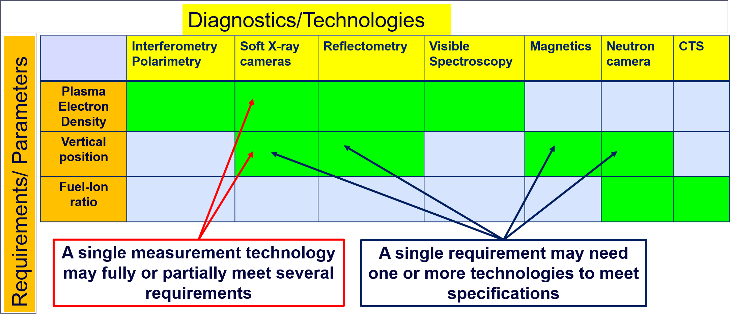
Functional role of the diagnostics set –part 2
Logical connections between requirements and the sensor/diagnostics technologies are complex – this can be managed by capturing relevant information in a matrix* format achieved using System Engineering methodologies as in the example table below:
*T.Beernaert “Implementation of Dependency Structure Matrix-based systems engineering for STEP plant control systems” (Internal STEP document)
A.Boboc and A.Meigs "Closing the loop: Why fusion power demands a new diagnostic blueprint"
ICFDT8 8th International Conference on Frontier in Diagnostic Technologies, 19th -21st October 2026 Frascati, Italy

Slide 11
Functional role of a single diagnostic
Control:
Provide information about one or a set of plasma parameters
Act as backup for another systems
Act as a reference input for another systems
Physics:
Provide high accuracy data for scenario development
Provide high accuracy data for post-mortem analysis
A.Boboc and A.Meigs "Closing the loop: Why fusion power demands a new diagnostic blueprint"
ICFDT8 8th International Conference on Frontier in Diagnostic Technologies, 19th -21st October 2026 Frascati, Italy

Slide 12
Plasma Measurement System (PMS) / Plasma Diagnostics
The new engineering era !
A.Boboc and A.Meigs "Closing the loop: Why fusion power demands a new diagnostic blueprint"
ICFDT8 8th International Conference on Frontier in Diagnostic Technologies, 19th -21st October 2026 Frascati, Italy

Slide 13
R&D Innovation Development Program for Diagnostics
Simplify !!!
New idea
PMS1
CP1
CP1
Control Model A
PMS6
Control Model A
PMS2
Control Task
Enabling Technology
Control Task
PMS3
PMS3
CP2
CP2
PMS4
PMS4
PMS5
PMS5
specific control task performed by control model A requiring parameters CP1 and CP2 to be determined from the PMSS {PMS1, …, PMS5}
Enabling Technology allows direct measurement of CP1 (or reduced) decoupling measurement of CP1 and CP2 ⇒ new PMSS {PMS3, …, PMS6} with new requirements
Legend:
CP: Control Parameter
PMS: Plasma Measurement System (plasma diagnostic)
PMSS: PMS Set
A.Boboc and A.Meigs "Closing the loop: Why fusion power demands a new diagnostic blueprint"
ICFDT8 8th International Conference on Frontier in Diagnostic Technologies, 19th -21st October 2026 Frascati, Italy

Slide 14
How plasma control and diagnostics works together
Simplify !!!
R&D Innovation Development Program for Plasma Control
Issue:
Control parameter 2 is no longer valid
Solution:
Different control model using valid alternative parameters
CP1
CP1
PMS6
Control Model A
Control Model B
PMS6
Control Task
The control CP2 can’t be determined to the required performance ⇒ Control Model A’s performance is inferior to Control Model B’s performance ⇒ new PMSS {PMS3, PMS6, …, PMS9} with new requirements.
PMS3
CP3
PMS3
CP2
PMS4
PMS7
PMS5
CP2 ⇒ A no longer the best for the control task
PMS9
PMS8
Legend:
CP: Control Parameter
PMS: Plasma Measurement System (plasma diagnostic)
PMSS: PMS Set
A.Boboc and A.Meigs "Closing the loop: Why fusion power demands a new diagnostic blueprint"
ICFDT8 8th International Conference on Frontier in Diagnostic Technologies, 19th -21st October 2026 Frascati, Italy

Slide 15
Engineering challenge - System integration
All diagnostics must be integrated with the entire plant from day one of design
Diagnostic number is severely reduced in number as well as resolution (e.g. space limitation)
A novel smart Forward Modelling and Integrated Data Analysis (FMIDA) system
    Combine fewer weaker systems to provide the parameter for control
    Individual optimisation of diagnostic for parameters it infers,
    Grouped diagnostic optimisation to reduce both parameter error/accuracy and further reduce machine impact.
High radiation fluences requires new materials/approaches
A strong tech-gap programme and innovation is required
Lack of an industry chain for diagnostics builders has a direct impact on Delivery & Cost
A.Boboc and A.Meigs "Closing the loop: Why fusion power demands a new diagnostic blueprint"
ICFDT8 8th International Conference on Frontier in Diagnostic Technologies, 19th -21st October 2026 Frascati, Italy

Slide 16
Strategic Plan elements for diagnostic plants
Design and Cost Reduction: Minimalist, Modular, Control-First requirement
Reliability: Radiation tolerant
Remote Handling: Zero manual access, Self-Aligning Mechanical RH Interfaces
Operations: Predictive RAMI Analytics & Automated Failure Isolation, self-calibration
Maintenance: Off-Line "Hot Cell" Refurbishment & Swap Workflows
Decommissioning: Low-Activation Material Selection, designed for waste stream segregation
A.Boboc and A.Meigs "Closing the loop: Why fusion power demands a new diagnostic blueprint"
ICFDT8 8th International Conference on Frontier in Diagnostic Technologies, 19th -21st October 2026 Frascati, Italy

Slide 17
Forward Modelling and Integrated Data Analysis (FMIDA) logic
UKAEA
Forward models turn candidate hardware into quantified information — integration reveals what the whole set can really deliver.
1
DEFINE THE NEED
2
MODEL ONE DIAGNOSTIC
3
OPTIMISE IT
4
INTEGRATE A CLUSTER
5
SELECT THE SET
Control / protection parameters
Accuracy • latency • robustness
Plasma → signal
Physics + instrument + uncertainty
Views • channels • resolution
Maximise useful information
Shared state + joint likelihood
Resolve degeneracy • cross-check
Meet requirements with minimum
machine impact and uncertainty
candidate state x
→
synthetic signal d = F(x, design) + ε
→
posterior p(x | all data)
→
value of the diagnostic set
ITERATE
Add, remove or redesign diagnostics until
the required plasma parameters are identifiable at the required performance.
The output is not a measurement
it is a trusted plasma-state estimate with an uncertainty level
A.Boboc and A.Meigs "Closing the loop: Why fusion power demands a new diagnostic blueprint"
ICFDT8 8th International Conference on Frontier in Diagnostic Technologies, 19th -21st October 2026 Frascati, Italy

Slide 18
Forward Modelling and Integrated Data Analysis (FMIDA) strategy
Qualification of simplified models and software frameworks using data from existing machines suitable for real-time control
Frameworks/techniques that can handle large complex groups of diagnostic and produce surrogate models for control if necessary
Availability of groups of professional scientific programmers for these tasks and integration with new “standards” such as IMAS/SimDB for all input/output data
A.Boboc and A.Meigs "Closing the loop: Why fusion power demands a new diagnostic blueprint"
ICFDT8 8th International Conference on Frontier in Diagnostic Technologies, 19th -21st October 2026 Frascati, Italy

Slide 19
Use the past : staffing and lesson-learned issues from old experiments¹
Human-resource capability is identified as rarely considered at early design phase, yet decisive for systems that must run for decades; succession planning is listed as a day-one design requirement.
Software development is judged to carry the same importance and cost as hardware, if not more — and is routinely unbudgeted.
Diagnosticians must be involved for full mechanical design of the plant, not consulted after it.
Routine tasks are team-sized, not person-sized: full system commissioning could require many people for weeks at a time;
Costing for the diagnostic lifetime never done
All five points paraphrased from the lessons-learned section of [1] — an open-access UKAEA-authored paper (UKAEA-CCFE-PR(24)263), i.e. our own recorded experience, not an external opinion.
A.Boboc and A.Meigs "Closing the loop: Why fusion power demands a new diagnostic blueprint"
ICFDT8 8th International Conference on Frontier in Diagnostic Technologies, 19th -21st October 2026 Frascati, Italy

Slide 20
Conclusion
Operation world for reactor diagnostics
Non-stop operation, full automation
Reliability and availability is essential
Industry chain and skill set ready for building to scale the first fleet of commercial reactors
So, for design any new diagnostic today for any machine use these directive above plus:
Innovation is key, go crazy, build start-ups
Transfer existing technologies from other fields
No perfection required => Design & Build, Fail Fast and Repeat but keep an eye on cost
A.Boboc and A.Meigs "Closing the loop: Why fusion power demands a new diagnostic blueprint"
ICFDT8 8th International Conference on Frontier in Diagnostic Technologies, 19th -21st October 2026 Frascati, Italy

Slide 21
Many thanks !
For more please contact us at:
Alexandru.Boboc@ukaea.uk
Andrew.Meigs@ukaea.uk
Acknowledgments
I would like to thank o all the members Plasma Science and Fusion Operation Division and UKFE for the effort in developing STEP diagnostics. A particular thanks to Neil Conway and Hendrik Meyer for valuable comments to this presentation.
This work has been funded by STEP Fusion, a major technology and infrastructure programme led by UK Fusion Energy Ltd(UKFE), previous named as UK Industrial Fusion Solutions Ltd (UKIFS), which aims to deliver the UK’s prototype fusion powerplant and a path to the commercial viability of fusion.

Slide 22
DELIVER A UK PROTOTYPE FUSION ENERGY PLANT,
TARGETING 2040, AND A PATH TO
COMMERCIAL VIABILITY OF FUSION.
STEP MISSION

