Slide 1

Notes:
Good afternoon, everyone. My name is Wenxue Fu, from the Institute of Plasma Physics, Chinese Academy of Sciences.
Today, I will present our work on a near-infrared camera system for divertor temperature measurements on EAST.

Slide 2
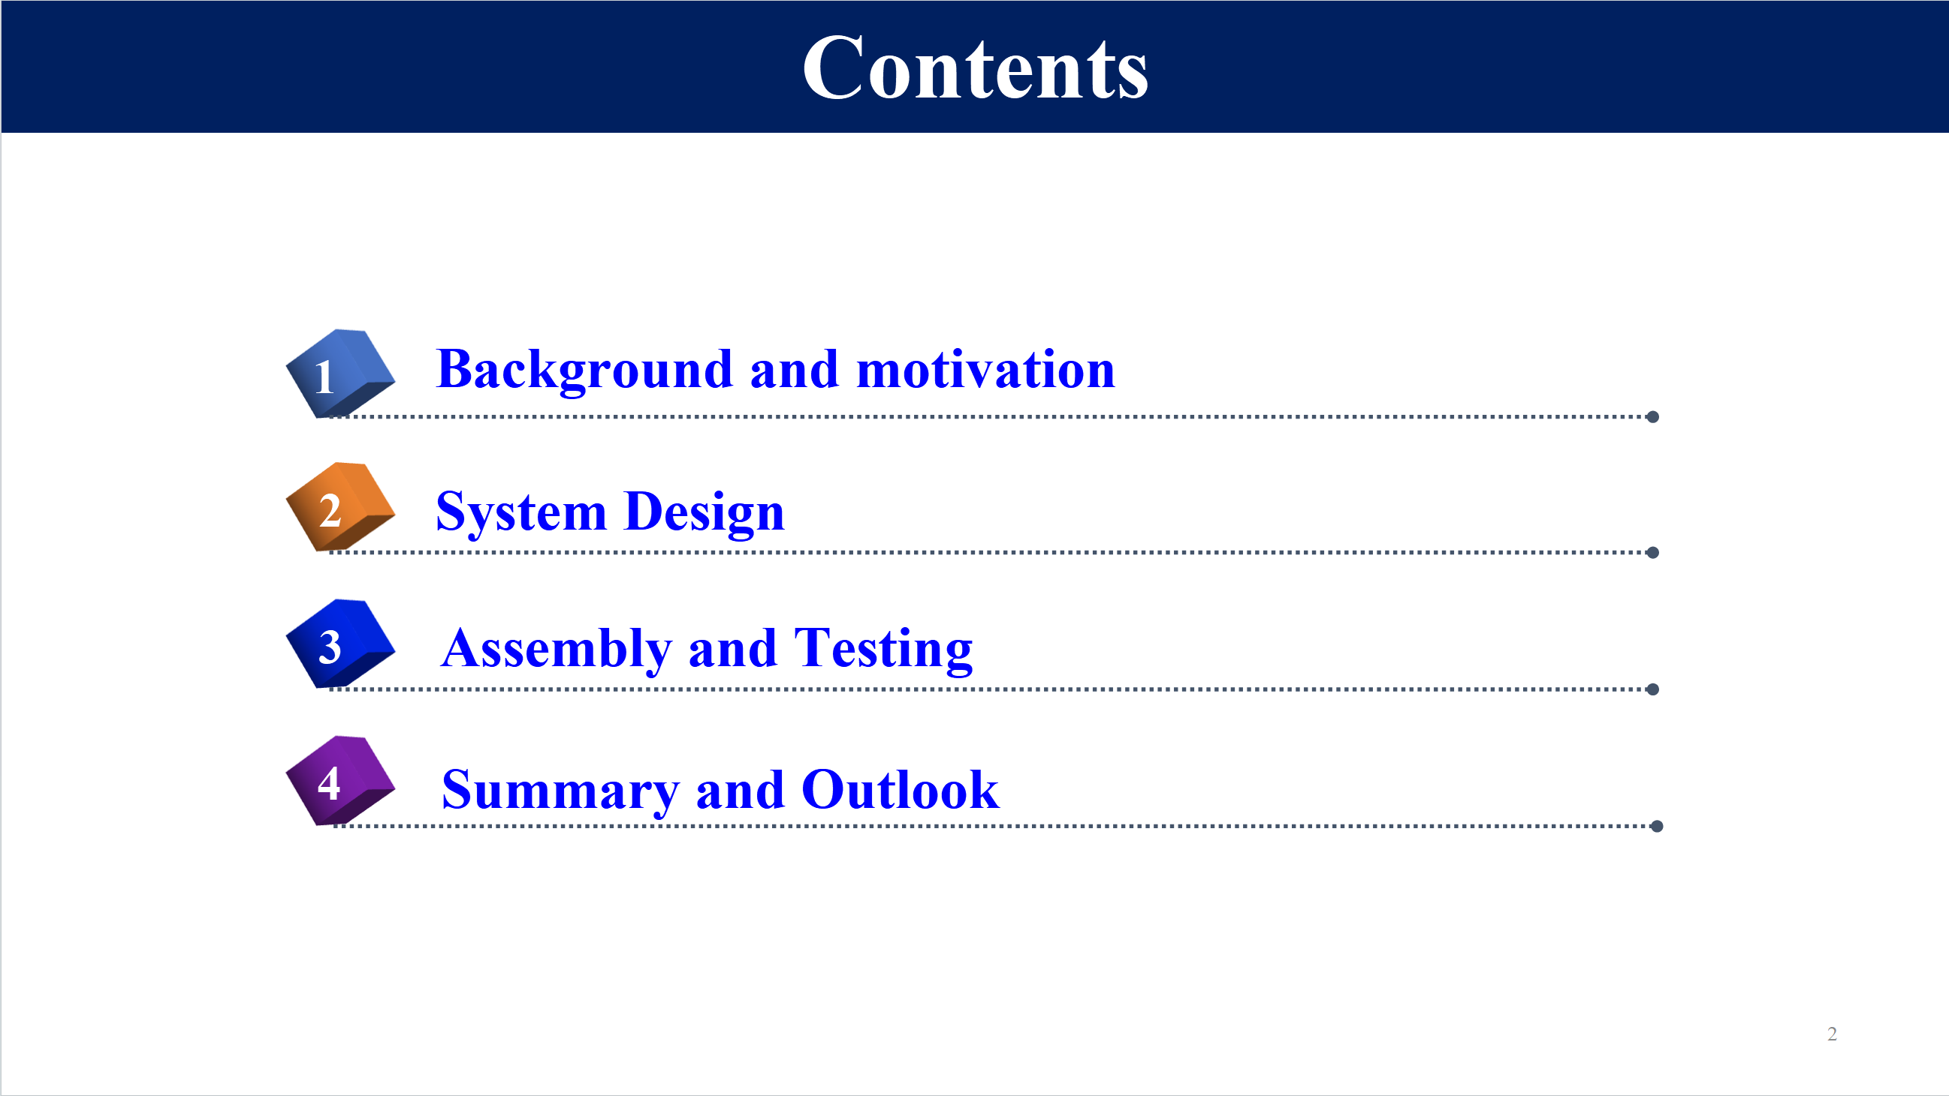
Notes:
I will begin with the motivation, then introduce the system design and testing. And finally summarized our progress and future work.

Slide 3
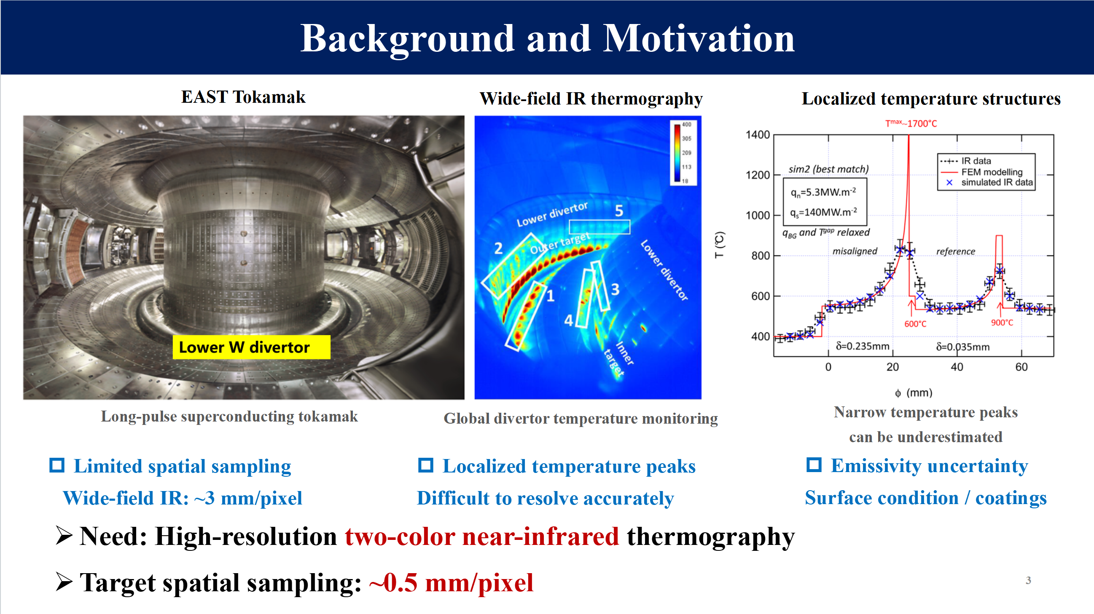
Notes:
On EAST, monitoring the divertor surface temperature is important for long-pulse operation.
Wide-field infrared imaging provides an overall view, but narrow temperature peaks can be difficult to resolve. limited spatial sampling can underestimate these peaks.
Temperature measurements are also affected by surface emissivity, which can vary with surface condition and coatings.
These issues motivate a near-infrared system with finer spatial sampling and two-color thermometry. Our target sampling is approximately zero point five millimeters per pixel

Slide 4
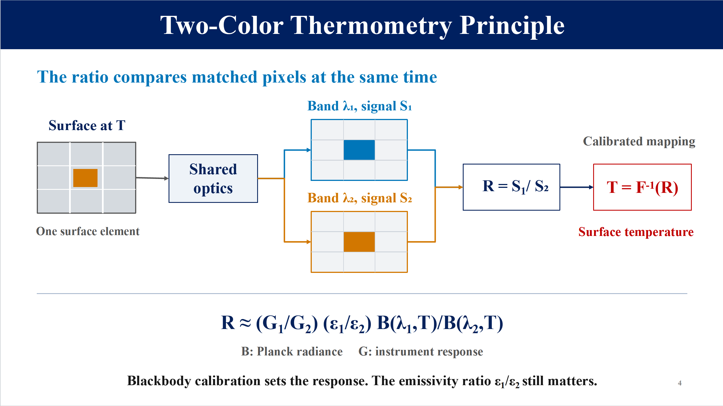
Notes:
The basic idea is to observe the same surface element in two wavelength bands at the same time.
The light passes through shared optics and is recorded in two channels. We then compare the signals from corresponding pixels.
Their ratio depends on temperature through Planck’s law. It also depends on the relative response of the two channels and the emissivity ratio between the bands.
Blackbody calibration establishes the relationship between the signal ratio and temperature.
Two-color thermometry can reduce sensitivity to uncertain absolute emissivity, but the emissivity ratio must still be known or reasonably estimated.
Accurate image registration is also essential: both signals must represent the same surface location.

Slide 5
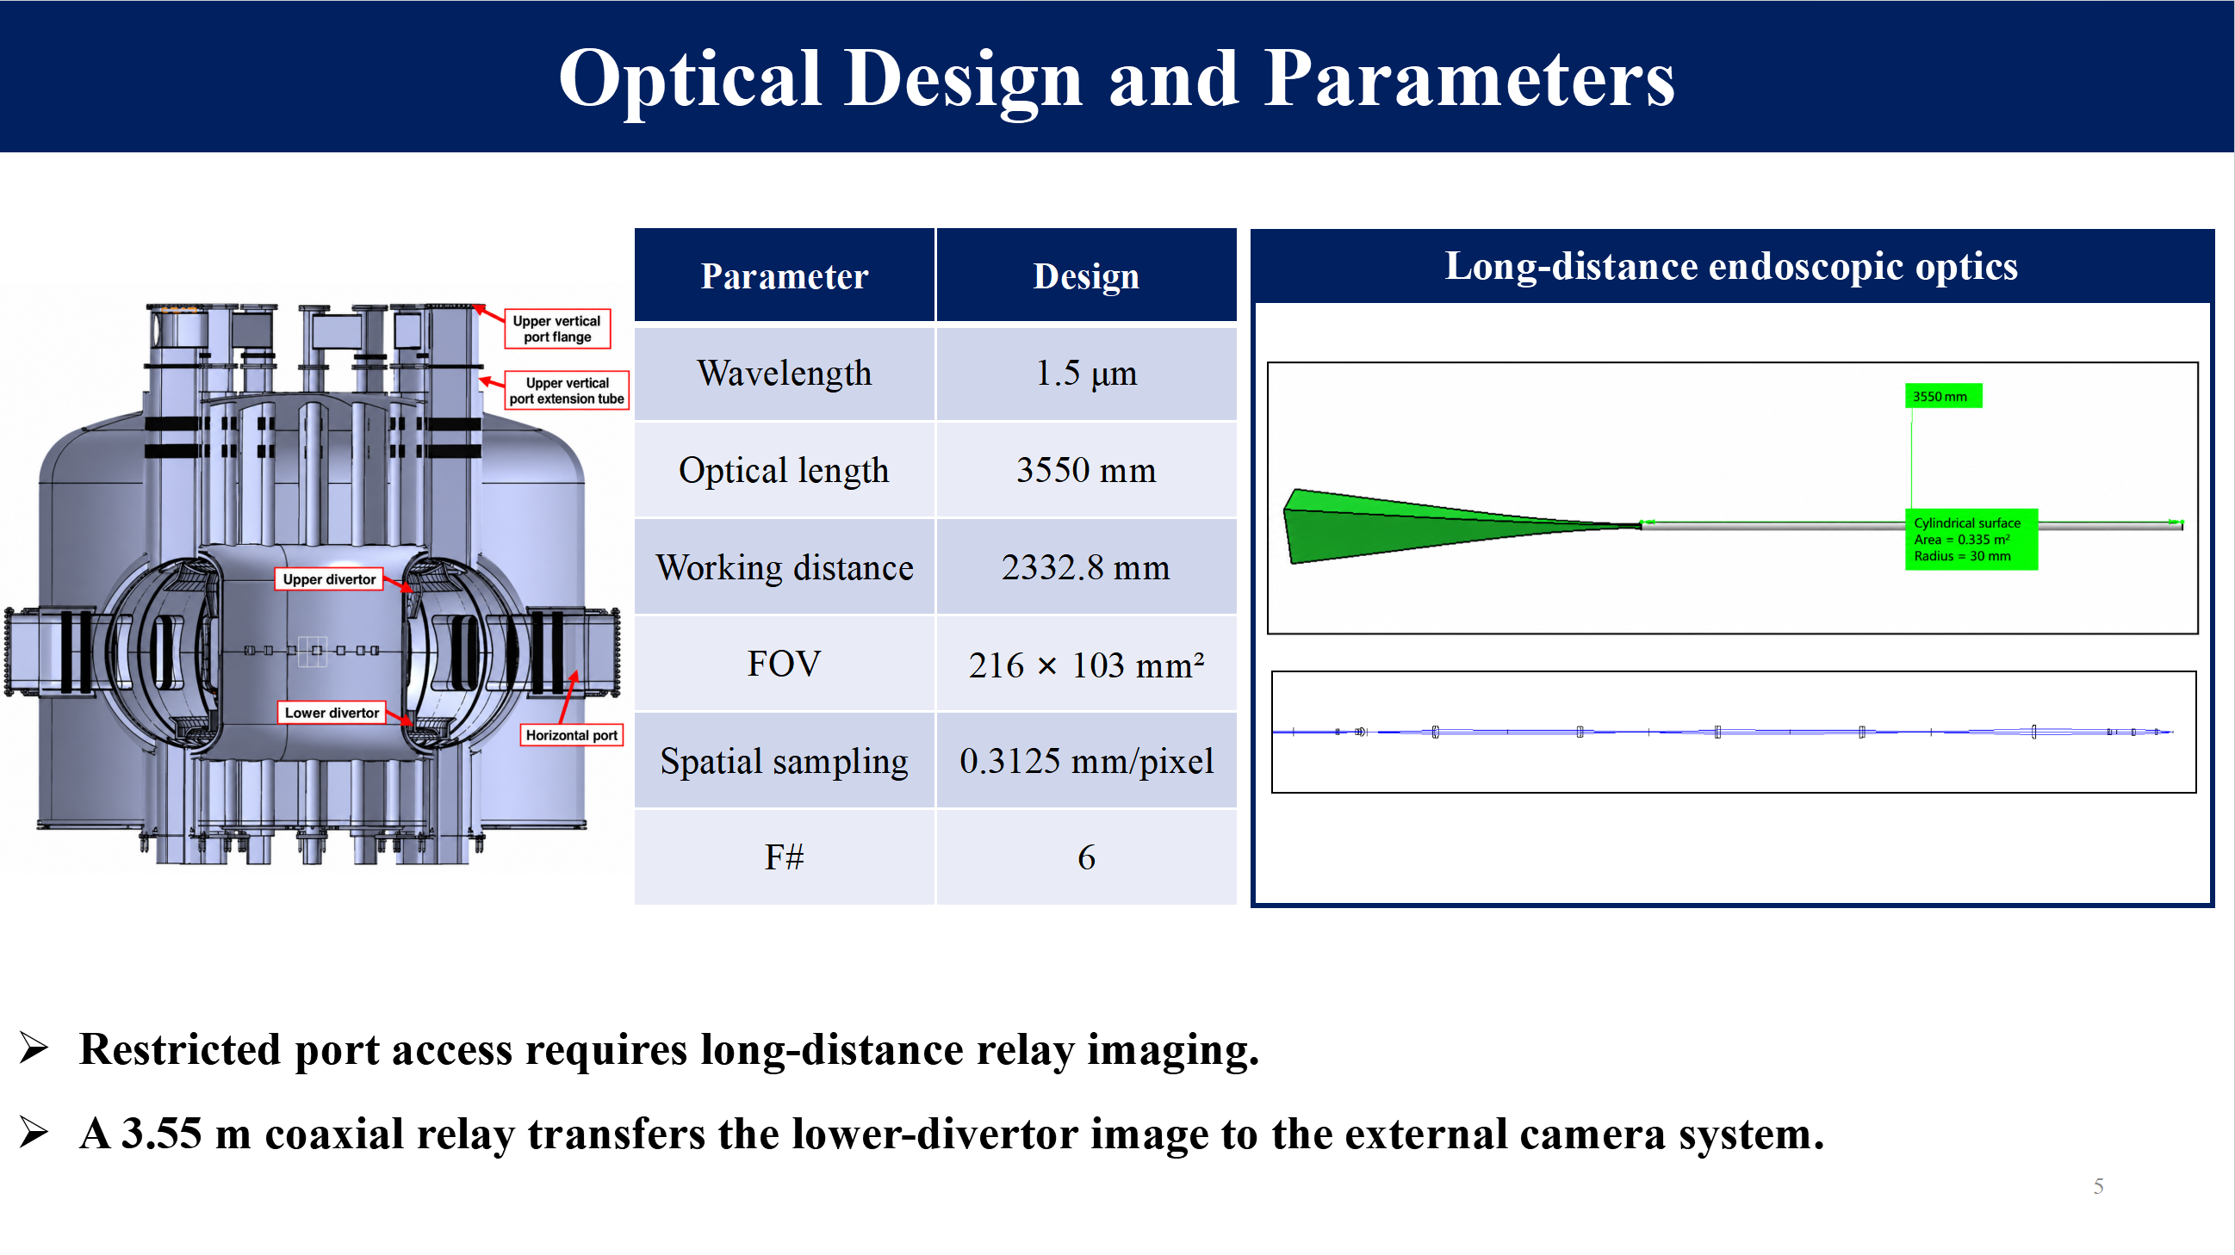
Notes:
The main optical challenge is the long viewing distance through a restricted port.
We therefore designed an endoscopic relay system with a total optical length of approximately three point five five meters. It transfers the lower-divertor image to the external cameras.
The front-end working distance is approximately two point three three meters, and the nominal design operates at F six, around one point five micrometers.

Slide 6
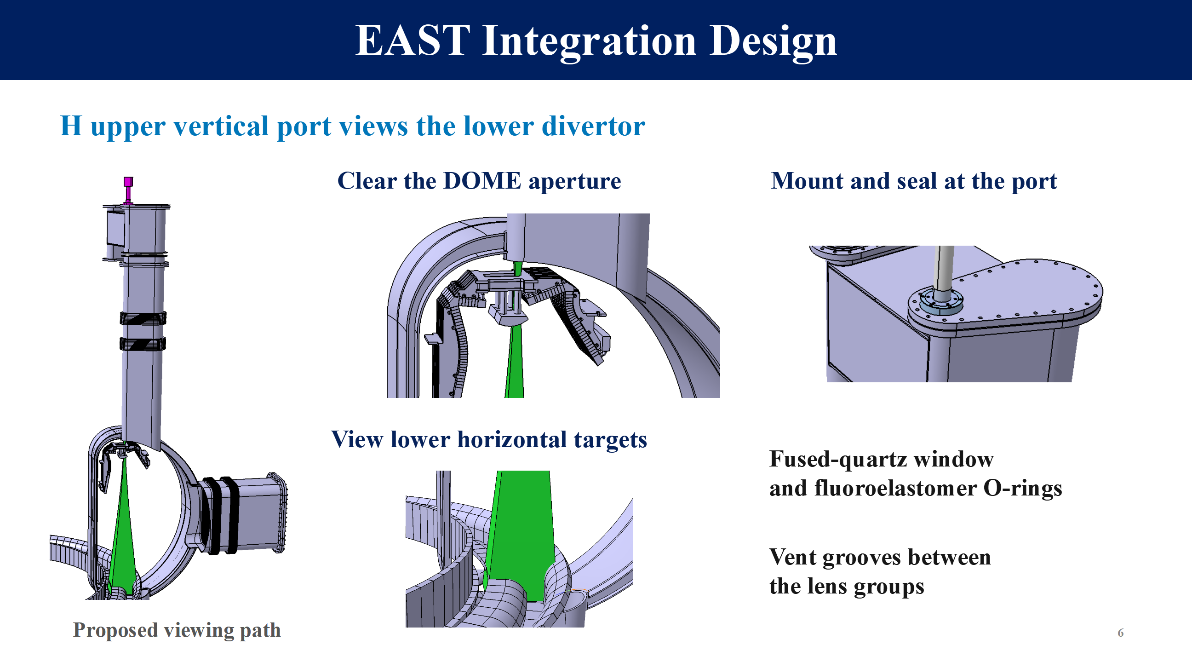
Notes:
This slide shows how the optical system fits into EAST.
The system views the lower divertor through the H upper vertical port. The viewing path must clear the dome aperture and reach the lower horizontal targets.
The mechanical design includes the port mount, a fused-quartz window, sealing rings, and vent grooves between the lens groups.

Slide 7
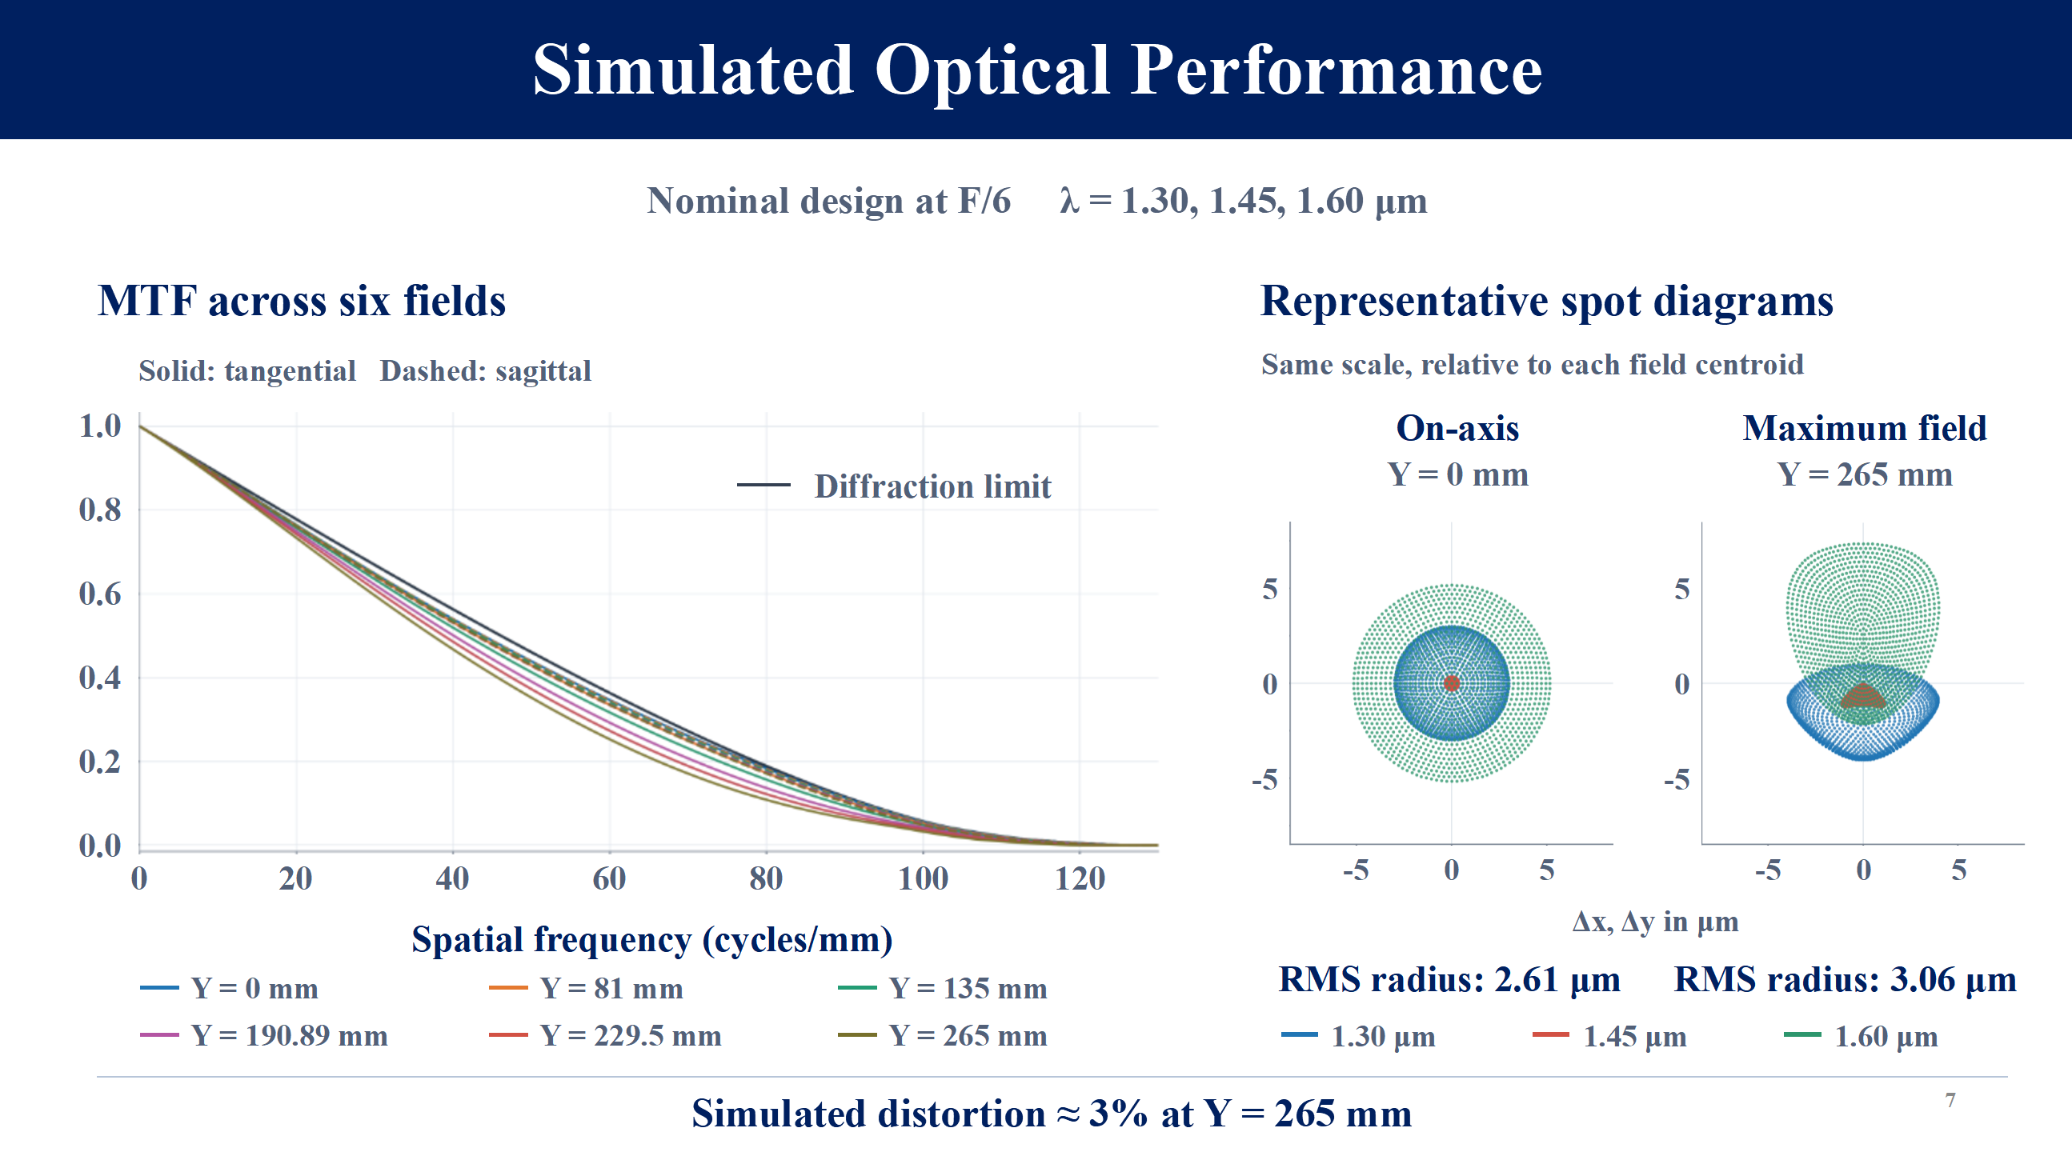
Notes:
We evaluated the optical design at F six using three selected wavelengths.
On the left, the MTF curves show the simulated contrast transfer across six field positions.
On the right, the spot diagrams compare the center with the maximum field position. The geometric RMS spot radius increases from about two point six to three point one micrometers.
The simulated distortion is approximately three percent at the maximum field position.
Simulations indicate well-controlled aberrations across the evaluated field.

Slide 8
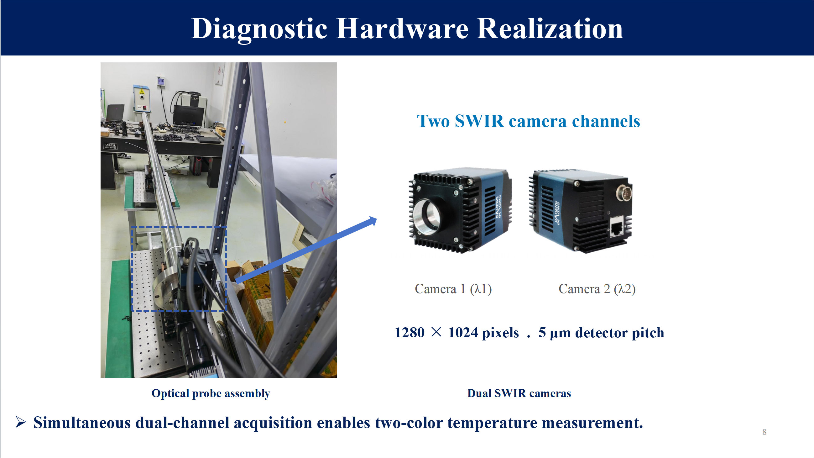
Notes:
The hardware includes the optical probe and two short-wave infrared cameras.
Each camera has 1,280 by 1,024 pixels, with a pixel pitch of five micrometers.
The two channels acquire images in separate wavelength bands. Simultaneous acquisition provides the paired images needed for two-color thermometry.

Slide 9

Notes:
These photographs show the assembly, hoisting, and final installation at the H upper vertical port.
The system has been installed on EAST. Next,I will present the test results.

Slide 10
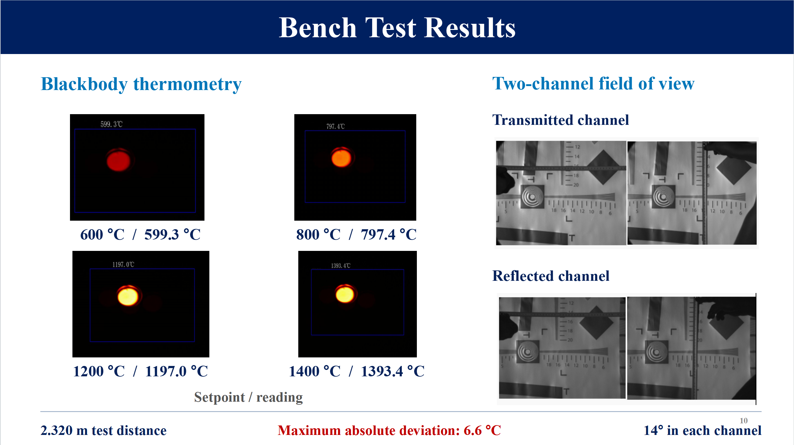
Notes:
The tests examine blackbody temperature readings and the fields of view of the two channels.
Four representative blackbody setpoints are shown, from six hundred to fourteen hundred degrees Celsius.
Across these displayed points, the largest absolute difference between the setpoint and the reported reading is six point six degrees Celsius.
The images on the right show the transmitted and reflected channels at a test distance of two point three two meters.
These results demonstrate dual-channel imaging and good agreement between the temperature readings and blackbody setpoints at the tested temperatures, providing an experimental basis for future two-color measurements on EAST.

Slide 11
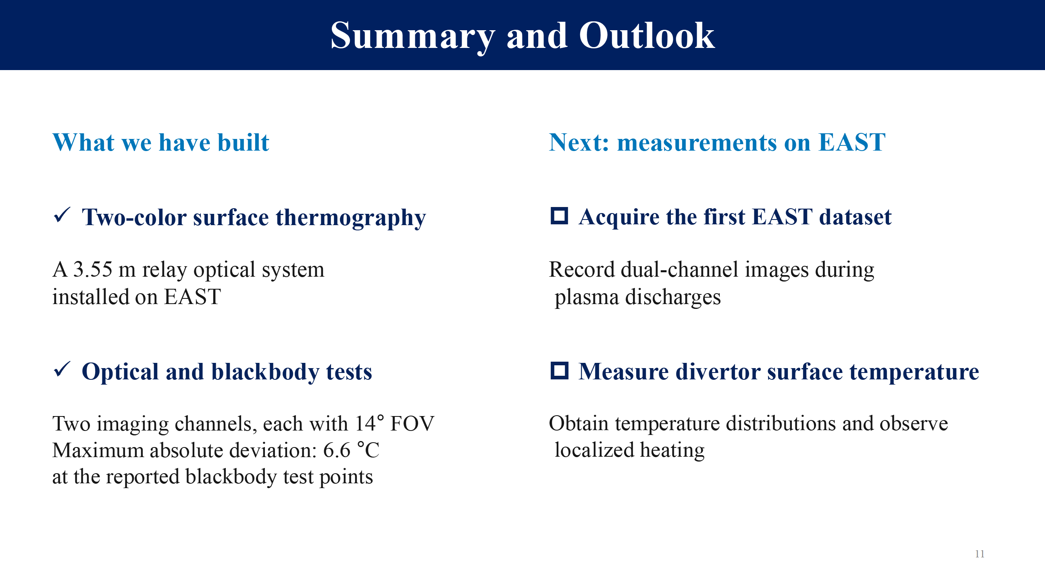
Notes:
To summarize, we have developed a near-infrared diagnostic system with a three point five five meter relay and two camera channels, and installed it on EAST.
Optical and blackbody tests were carried out. With a maximum absolute temperature deviation of six point six degrees Celsius at the reported test points.
Next, we will acquire dual-channel images during EAST plasma discharges to obtain divertor surface temperature distributions.

Slide 12
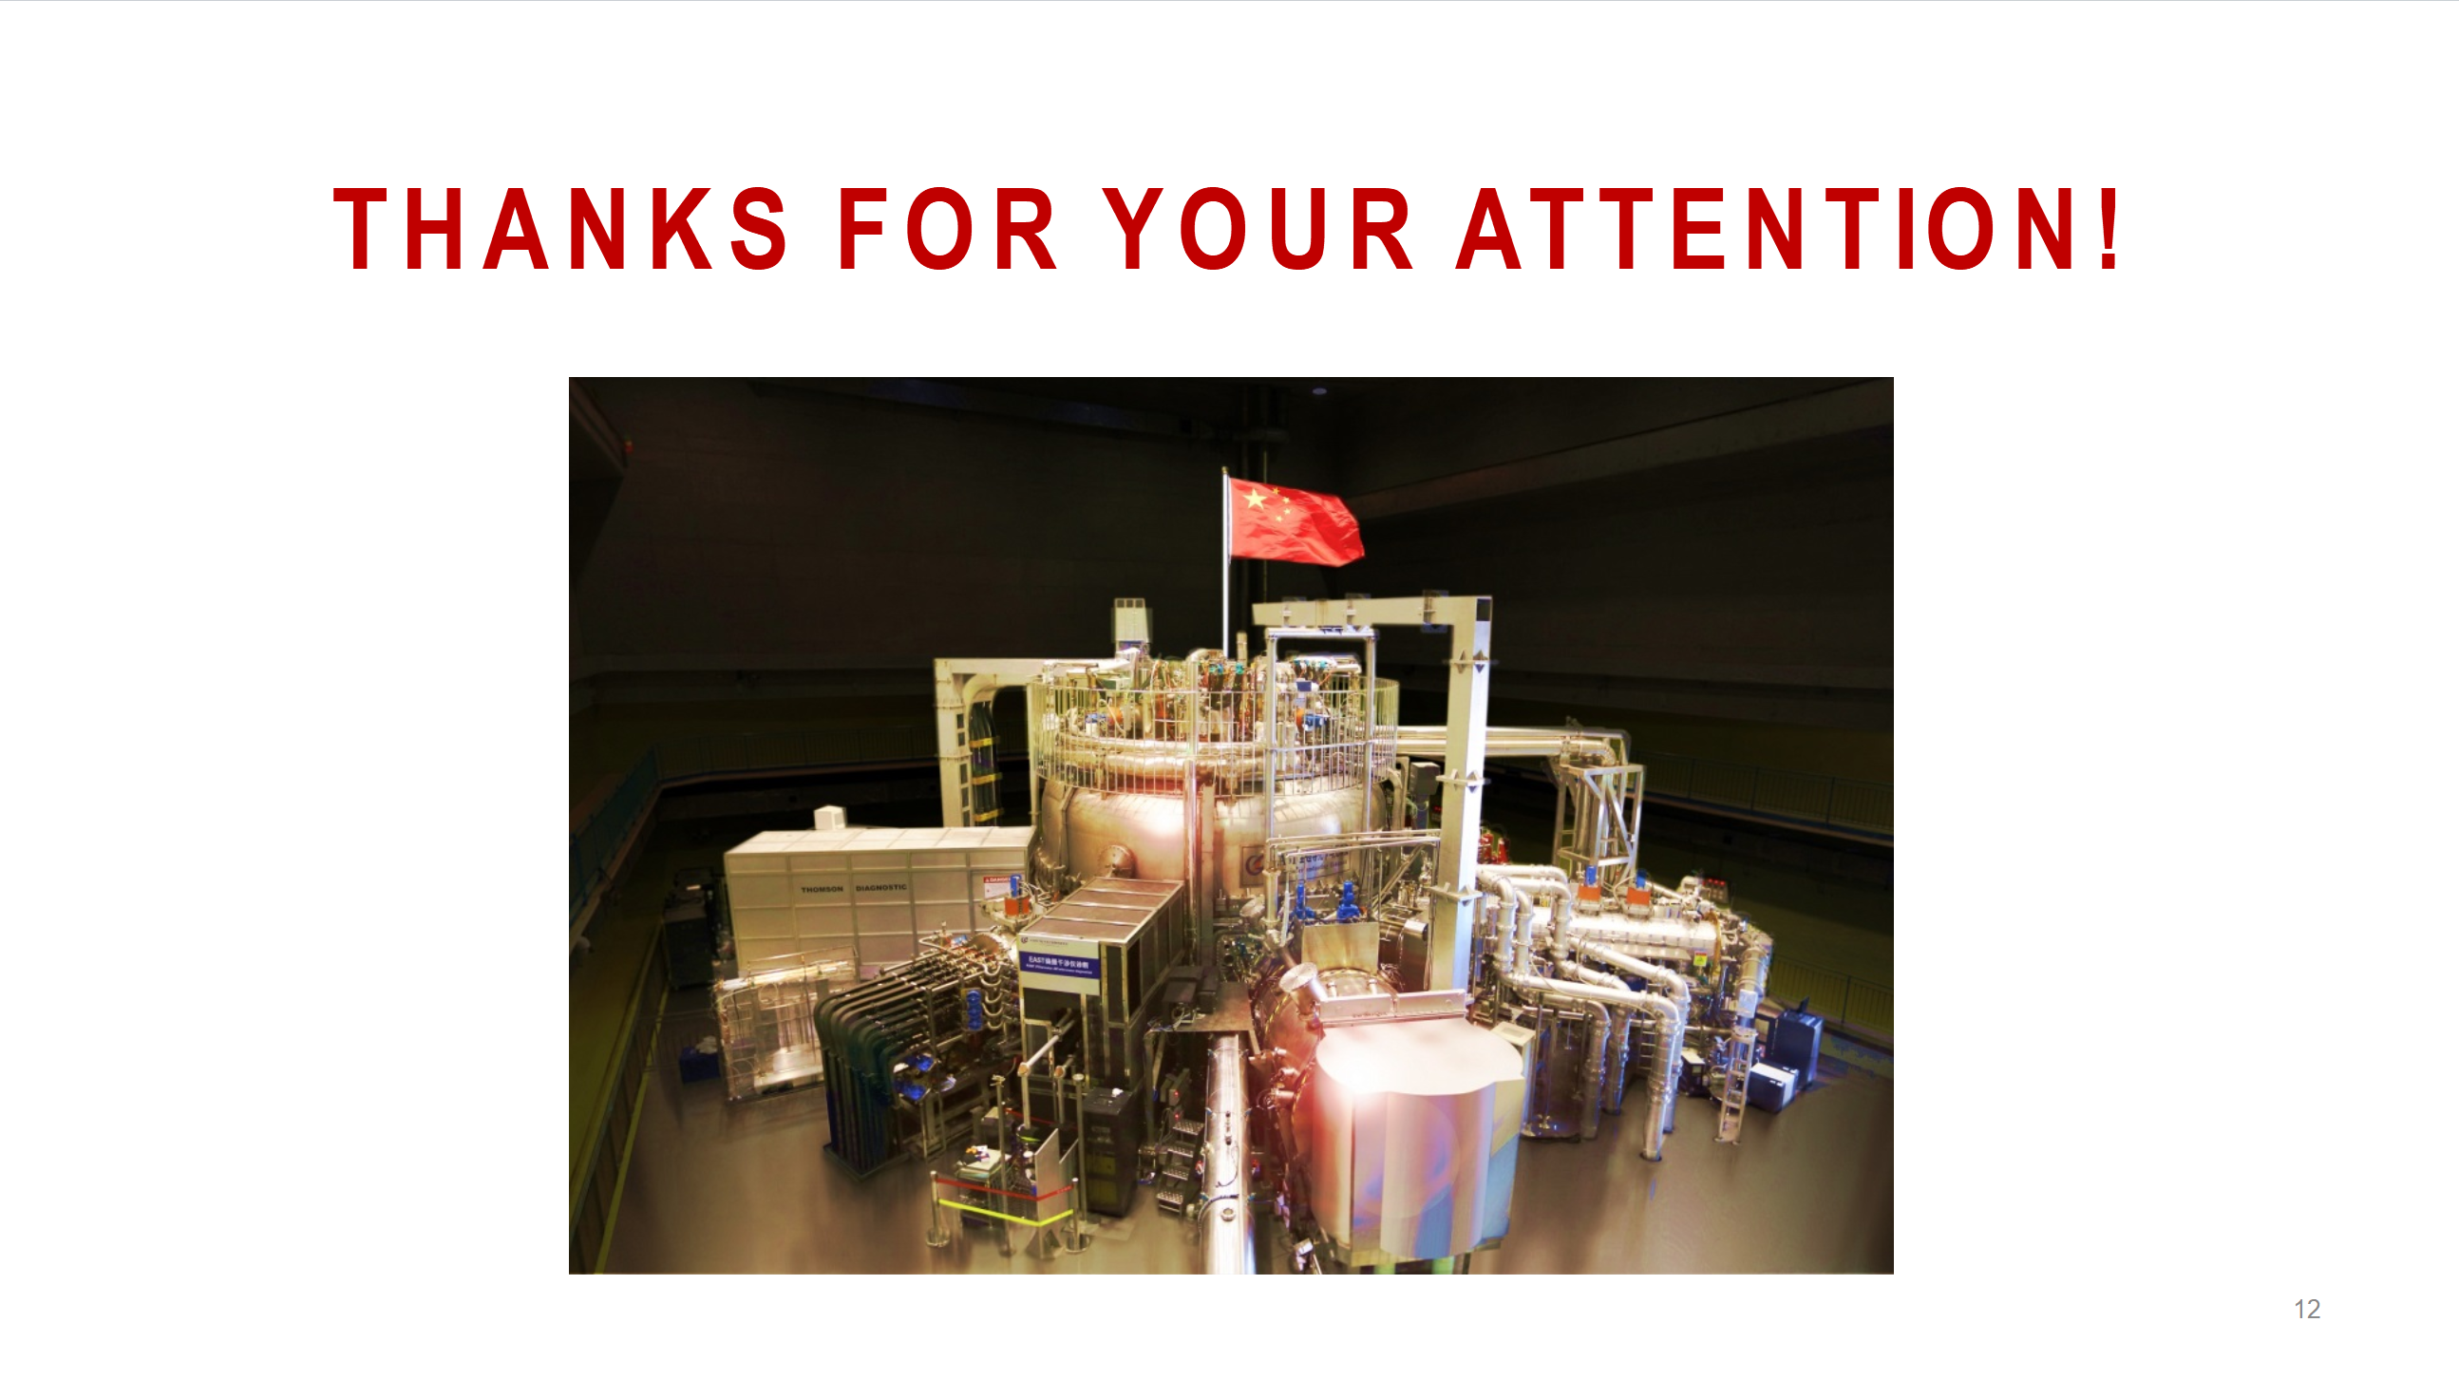
Notes:
Thank you for your attention. I welcome your questions.

