Slide 1
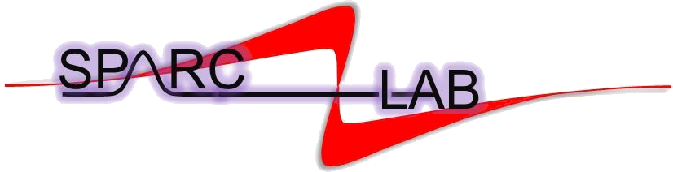

Plasma density diagnostics
and machine-learning jitter analysis
for stable PWFA operation at SPARC_LAB
Romain Demitra
SPARC_LAB · INFN Laboratori Nazionali di Frascati
A. Biagioni, L. Crincoli, M. Ferrario, R. Pompili
On behalf of the SPARC_LAB collaboration
ICFDT8 · ENEA Frascati · 21 October 2026

Slide 2
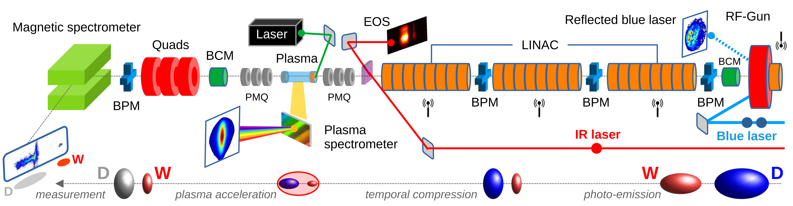
Measuring the plasma and the beam
Driver and witness
Plasma source
Synchronous diagnostics
Two electron bunches:
the driver excites the wake;
the witness gains energy.
3 cm × 2 mm · H₂
3D-printed capillary
9 kV · ≈400 A
Incoming beam, laser and RF
Plasma-density profile
Outgoing energy spectrum
Romain Demitra · SPARC_LAB / INFN-LNF · ICFDT8 · 21 October 2026
02

Slide 3
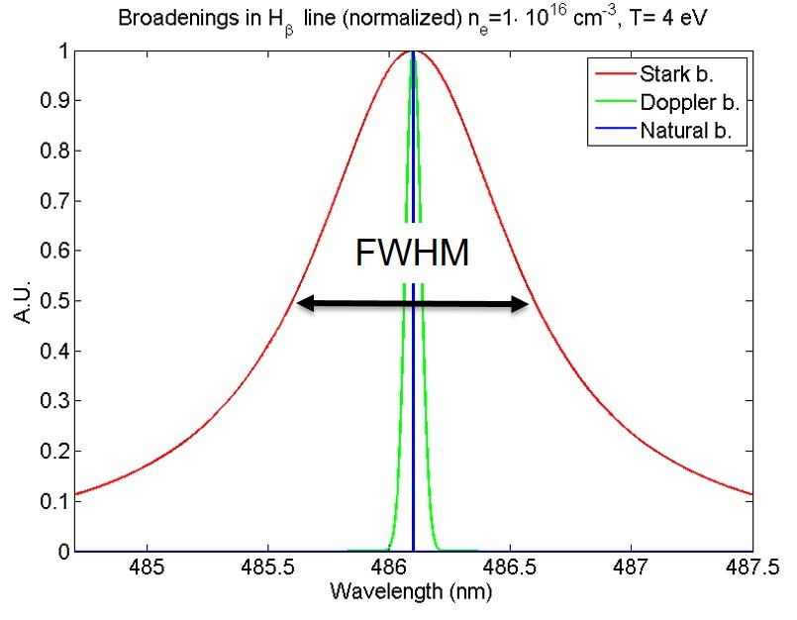
Why Stark broadening measures density
The Hβ line width carries information on electron density
Electric microfields
Nearby charges perturb the hydrogen energy levels and broaden the emission line.
From width to density
Infer nₑ from the Stark contribution using the line-broadening model.
Instrumental and Doppler broadening must also be assessed.
Illustration: SPARC_LAB, Plasma Sources and Diagnostics
Romain Demitra · SPARC_LAB / INFN-LNF · ICFDT8 · 21 October 2026
03

Slide 4
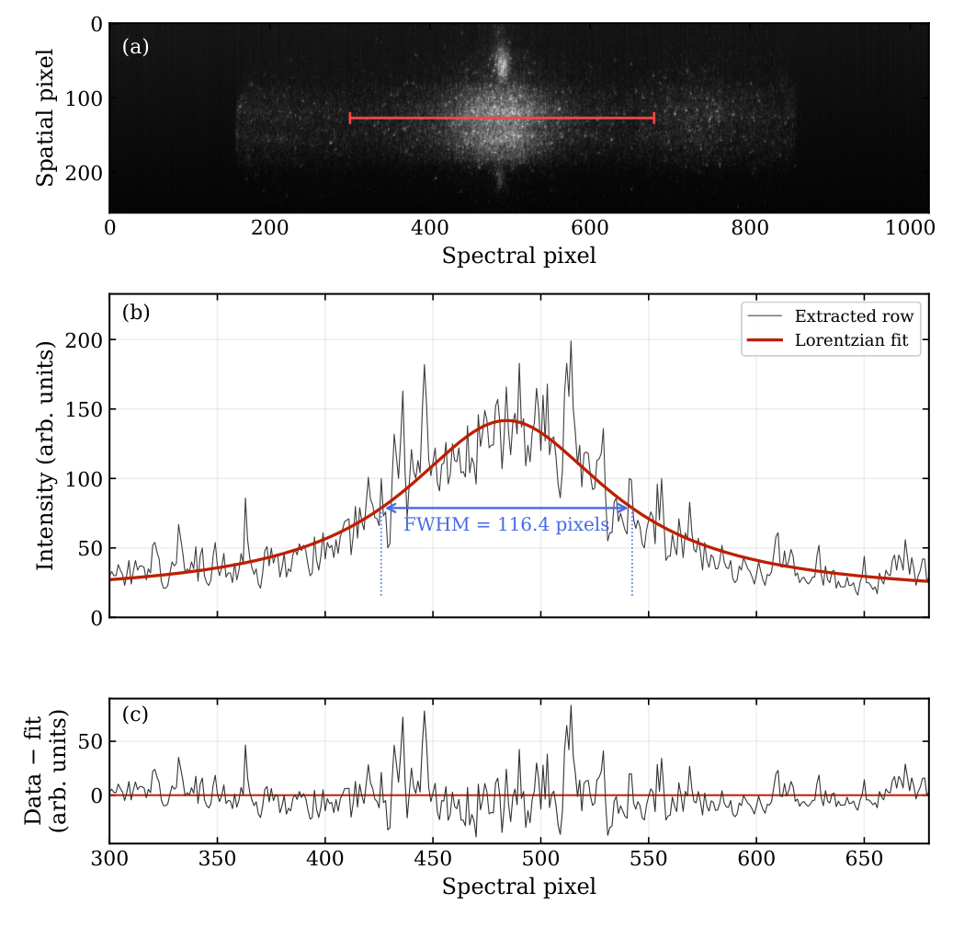
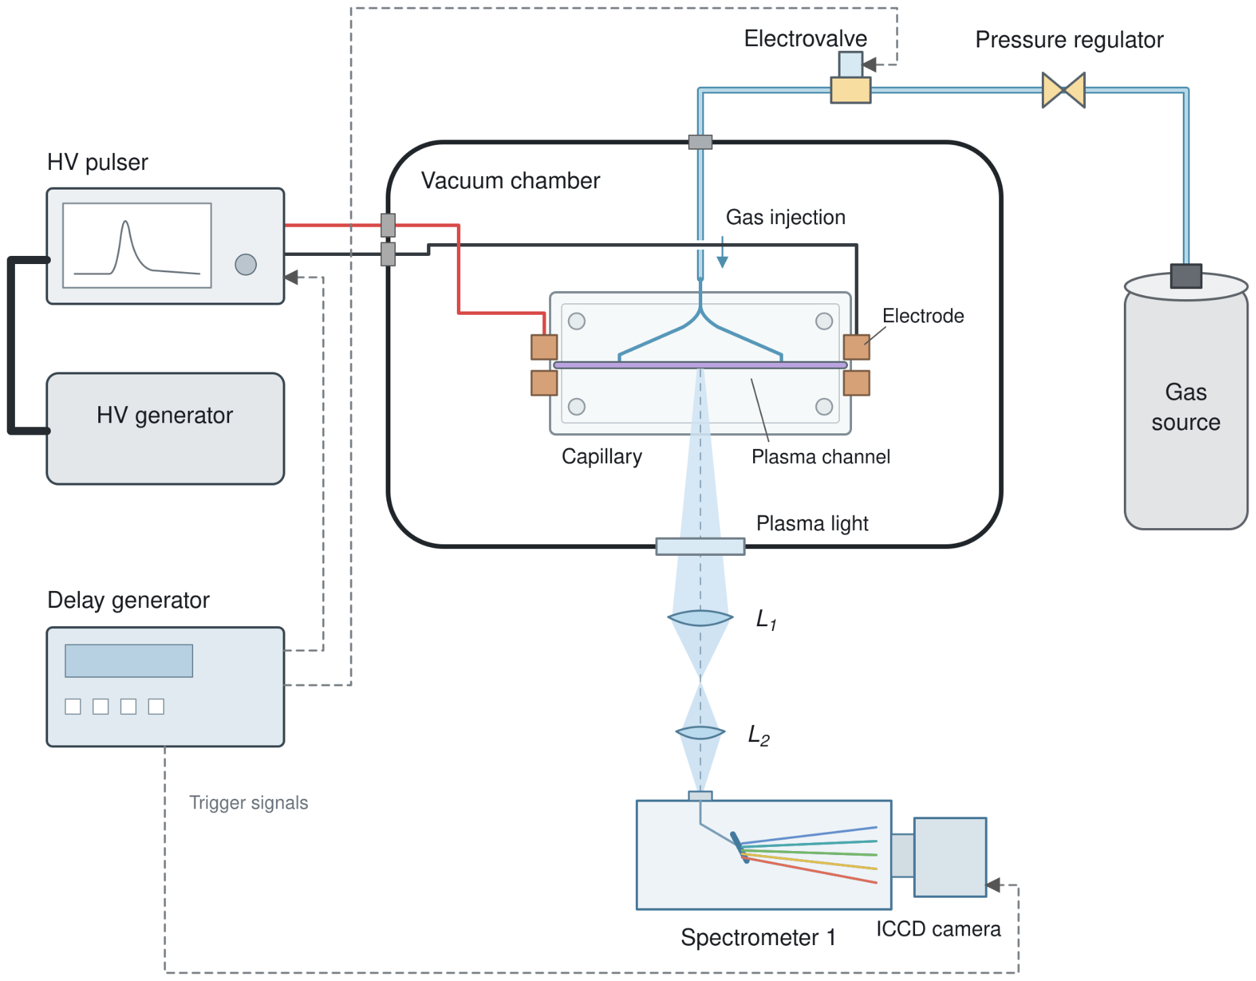
From Hβ spectra to electron density
ACQUISITION
Raw image, fitted line and residuals
Time-gated ICCD images record hydrogen emission from each discharge.
PROCESSING
Extract and fit Hβ for each image; check residuals and instrumental broadening.
DENSITY
Convert the fitted Stark width to nₑ and repeat along the spatial coordinate.
Spatially resolved fits reconstruct the density profile for each shot
Romain Demitra · SPARC_LAB / INFN-LNF · ICFDT8 · 21 October 2026
04

Slide 5
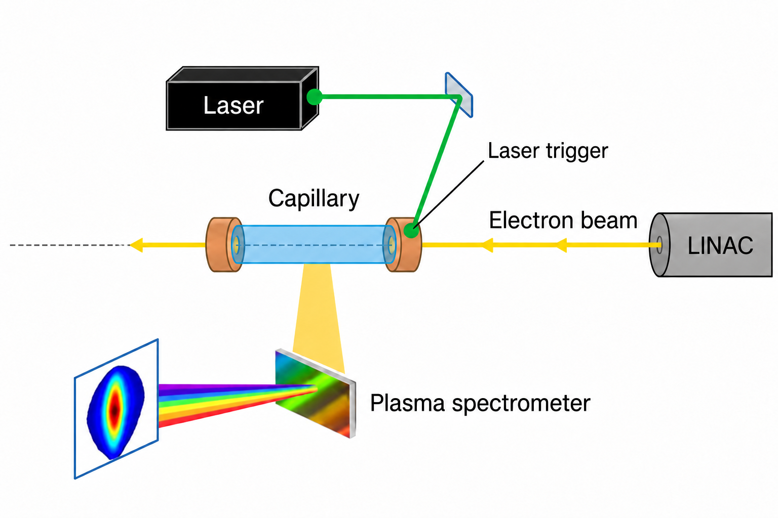
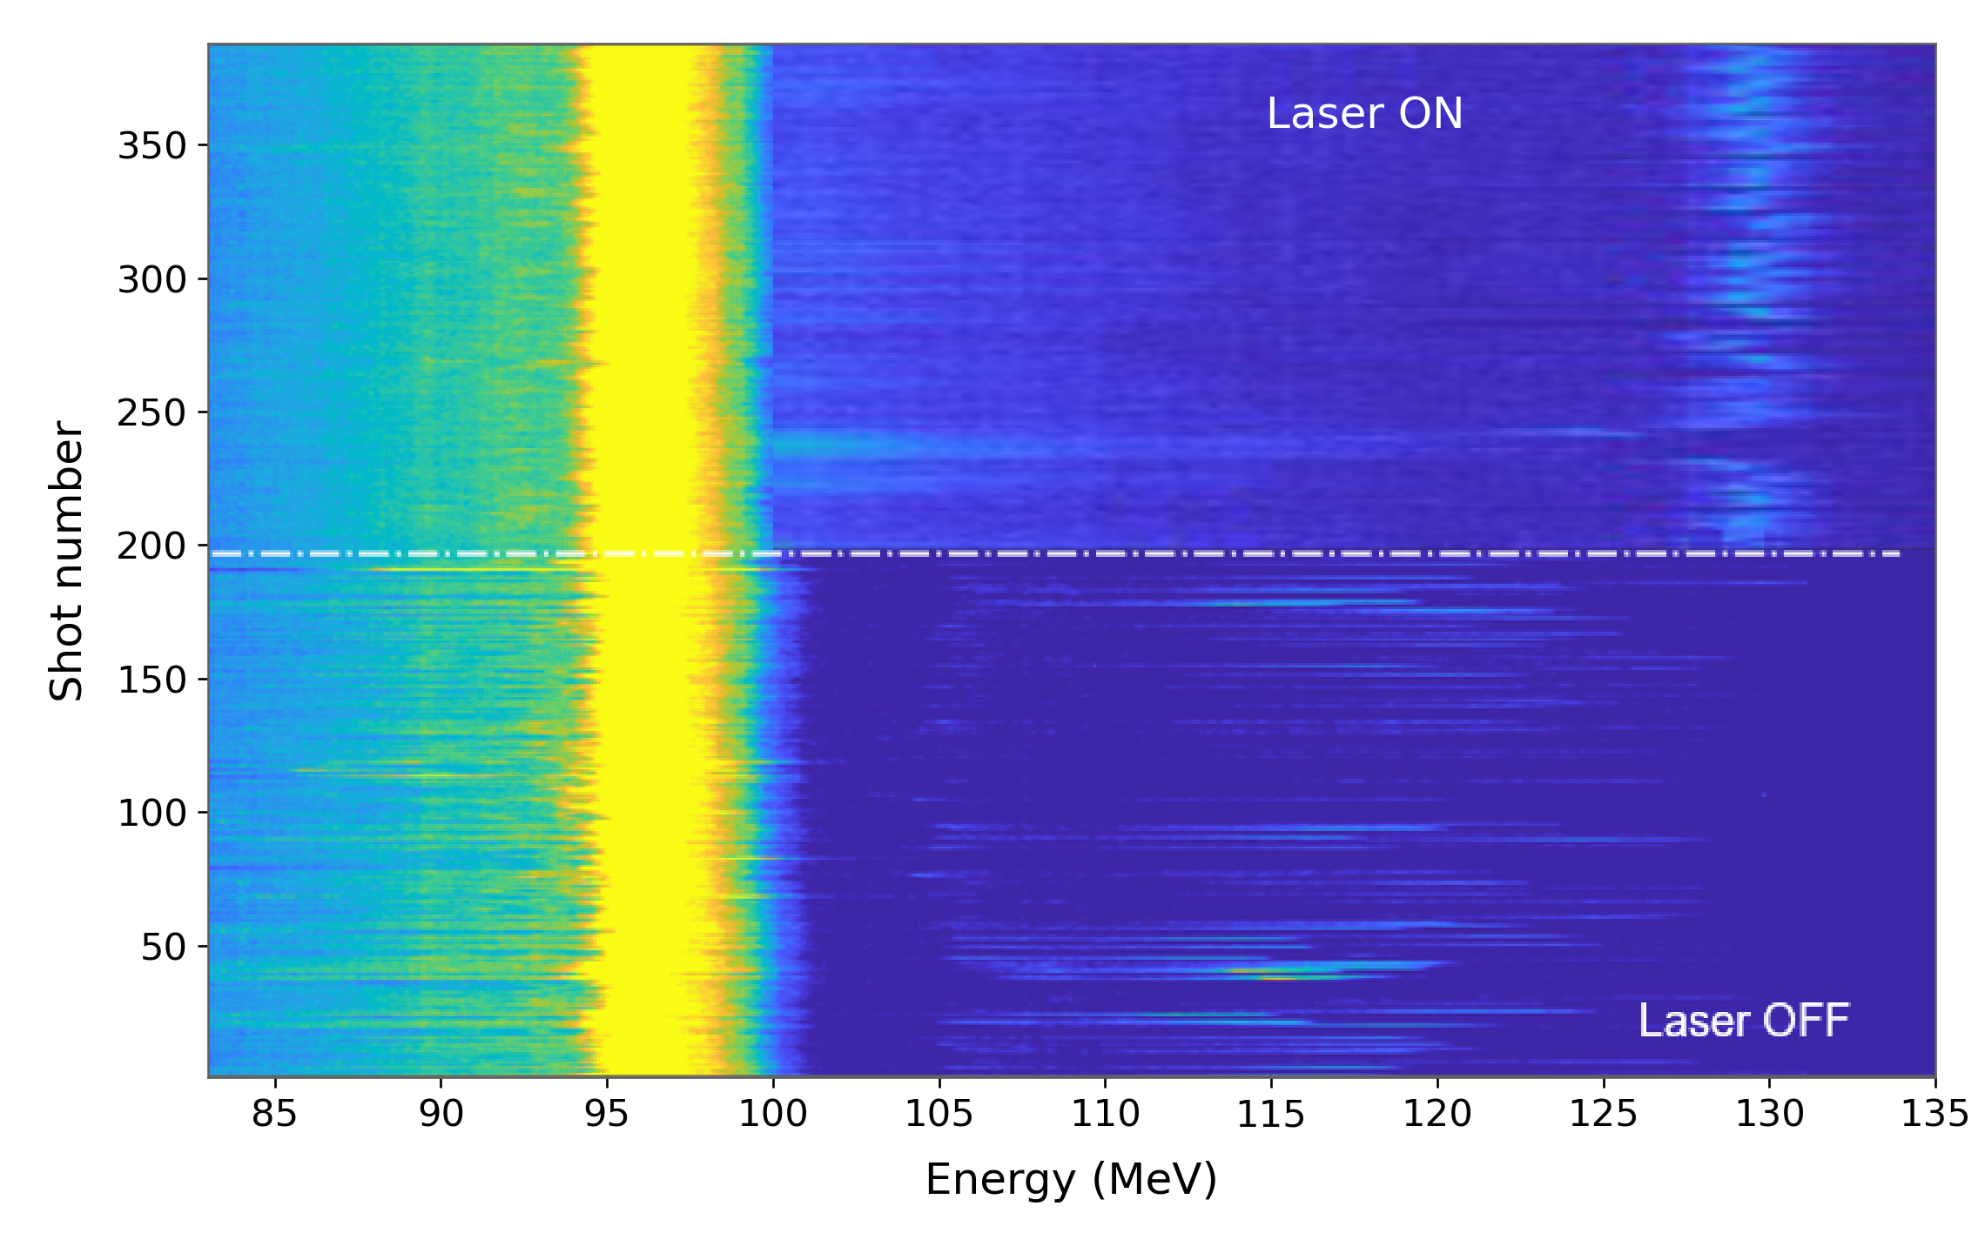
Measuring the effect of laser-assisted ignition
Shot-resolved energy spectra
Plasma density at beam arrival
6% → 0.4%
relative density fluctuations
Laser OFF / ON · each row is one shot
Laser-assisted ignition reduces density fluctuations and shots without acceleration.
Romain Demitra · SPARC_LAB / INFN-LNF · ICFDT8 · 21 October 2026
05

Slide 6
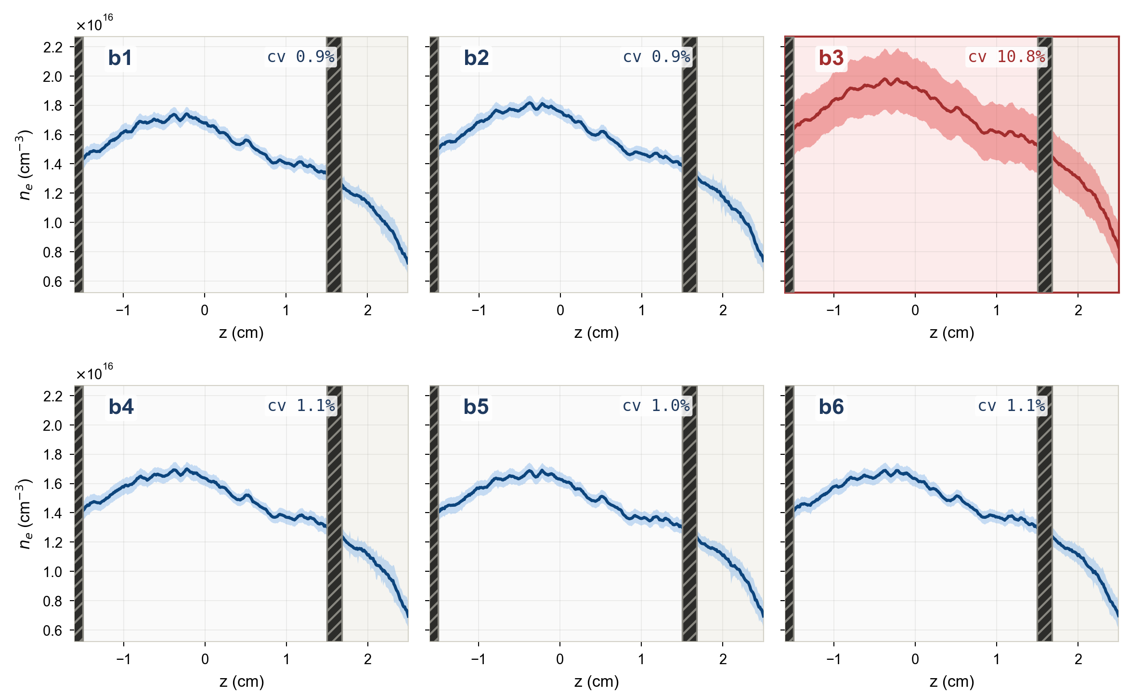
Combining plasma and machine diagnostics
Six working points · 19 measured inputs
Input family
Input features
Beam (7)
Charge, timing, durations,
separation, x/y beam position
Radio-
frequency (4)
Gun / linac phase and power
Laser (4)
Phase, intensity, x/y laser position
Plasma (4)
PC scores a₁/a₂, peak z, length
Principal component analysis (PCA)
Band: shot-to-shot SD · hatching: electrodes
nₑ(z) ≈ mean profile + a₁ u₁(z) + a₂ u₂(z)
σ(nₑ)/⟨nₑ⟩: ≈1% in five runs;
10.8% in B3.
Mode amplitudes a₁ and a₂ are the ML inputs.
Predict witness energy and energy spread
Romain Demitra · SPARC_LAB / INFN-LNF · ICFDT8 · 21 October 2026
06

Slide 7
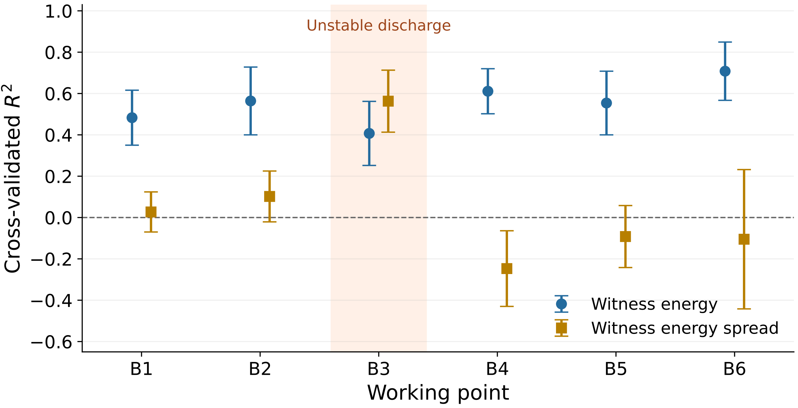
What can the measured state predict?
Six working points, evaluated with held-out shots
Witness energy
R² ≈ 0.48–0.71
in low-density-jitter runs
Witness energy spread
Weak prediction in stable runs
B3 is an exception
Fivefold validation within each run. Error bars: standard deviation across folds.
Predictability depends on both the operating regime and the target quantity.
Romain Demitra · SPARC_LAB / INFN-LNF · ICFDT8 · 21 October 2026
07

Slide 8
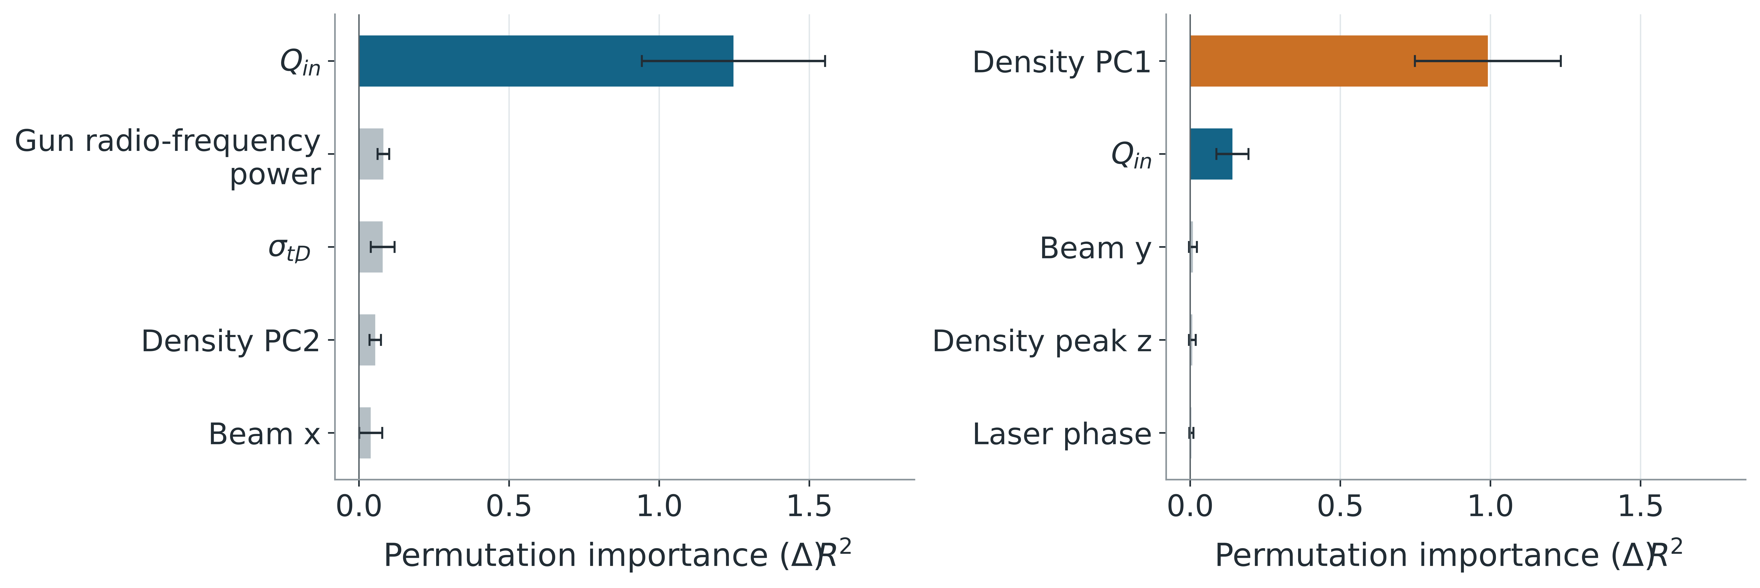
Which measurements support the prediction?
B4 · Ridge regression
B3 · Random forest
Representative of five low-density-jitter runs
Larger density fluctuations
Permutation importance: loss of prediction quality when one input is shuffled.
Injected charge leads the prediction
The density profile leads in B3
Romain Demitra · SPARC_LAB / INFN-LNF · ICFDT8 · 21 October 2026
08

Slide 9
Conclusions
Plasma diagnostics help interpret accelerator stability
Measure the plasma
Verify stabilization
Interpret residual jitter
Hβ spectra
6% to 0.4%
Charge / density
density at each shot
density fluctuations
regime-dependent predictors
Stark spectroscopy resolves density variations during acceleration.
Density and beam diagnostics quantify the improvement with laser-assisted ignition.
Charge leads in stable runs.
Density variations lead in B3.
Spread remains weakly predicted in stable runs.
The useful observables depend on the plasma regime and the beam quantity.
Romain Demitra · SPARC_LAB / INFN-LNF · ICFDT8 · 21 October 2026
09

