Slide 1
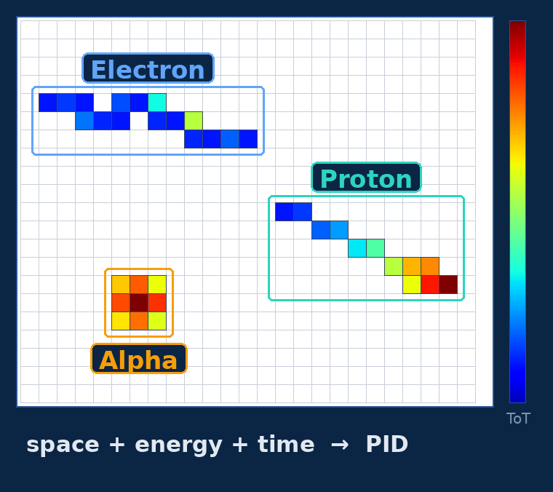
LABNIXT / DETECTOR PHYSICS
4D PointNet++
Particle identification with Timepix3
ICFDT8 · Frascati, 20 October 2026
F. Cordella, G. Claps, V. De Leo, D. Pacella, F. Panza
x · y · ToA · ToT
ENEA C.R. Frascati (LabNIXT) · INFN–LNF
CREF, Roma · INFN Sezione di Genova
DATA, CODE & CHECKPOINTS
DOI 10.5281/zenodo.21643310
Spatio-Temporal Deep Learning for Particle Discrimination in Timepix3 Detectors:
a Diagnostic Tool for the AI Era
Notes:
Good afternoon. This is a methodological talk: we read Timepix3 clusters at pixel level with a point-cloud network and, instead of asserting what that buys, we measure it against the simplest alternative — three scalar summaries — and against a classical feature-based classifier.

Slide 2
Where is the AI in this work? At two levels
01 / WHERE IS THE AI?
1 · A deep network as classifier
2 · The AI era needs a test
level 1 — a deep network reads the pixels: no hand-crafted features
level 2 — a test of what it learns, not a claim
the two together are the method of this talk
Raw pixels x · y · ToA · ToT → one cluster = a 4D point cloud in space, time and charge. Nothing hand-crafted.
Deep networks enter detector diagnostics everywhere, often untested on what they actually learn. Our test:
PointNet++ for point sets — even the distance between pixels is learned
① ablate at fixed architecture, against its own scalar summaries
② read the result against the measured run-to-run noise
+ 3 scalars n_pixels · ΣToT · max ToT: size and charge, the absolute scales normalization removes
③ check generalization and robustness
α / e⁻ — matches a tuned 14-feature Boosted Decision Tree, clearly beats a CNN on images
e.g. metric weights are not feature relevance on 4-pixel objects (backup)
Notes:
Two cards. Left, “A deep network as classifier”: the flow in four blocks. (1) Raw pixels: the network receives x, y, ToA, ToT of every pixel directly; a cluster is a 4D point cloud and there is no hand-built feature. (2) PointNet++: a network designed for point sets, in which even the distance between two pixels is a learned parameter. (3) + 3 scalars: n_pixels, ΣToT and max ToT enter at the head because per-cluster normalization removes absolute size and charge; the three scalars put them back. (4) α / e⁻: the outcome — the network matches a well-tuned 14-feature BDT and clearly beats a CNN on images (from the three-class benchmark: 90.7 % against 81.3 %).
Right, “The AI era needs a test”: deep networks are entering detector diagnostics, often without a check of what they actually learn. Our test has three steps: ① ablate at fixed architecture against the network’s own scalar summaries (the network without the cloud, same parameters); ② read the result against the measured run-to-run noise (backup); ③ check generalization (unseen sources) and robustness (per-pixel gain). An example of what the test produces: the learned metric weights are not a relevance measure on four-pixel objects (backup).

Slide 3
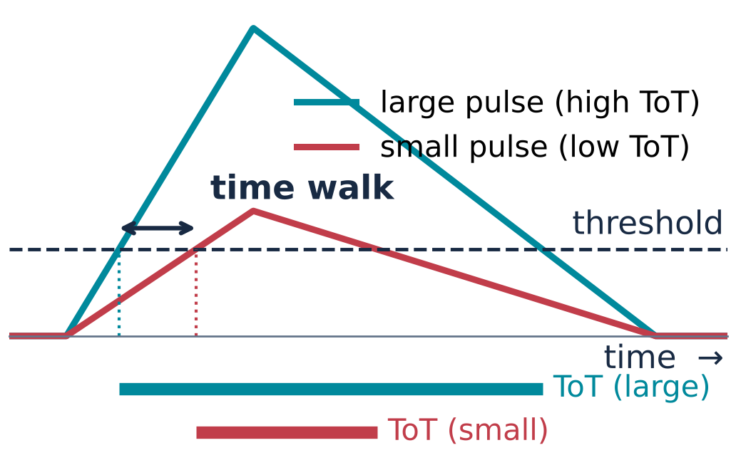
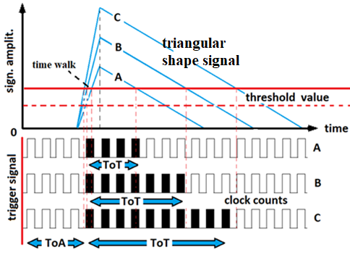
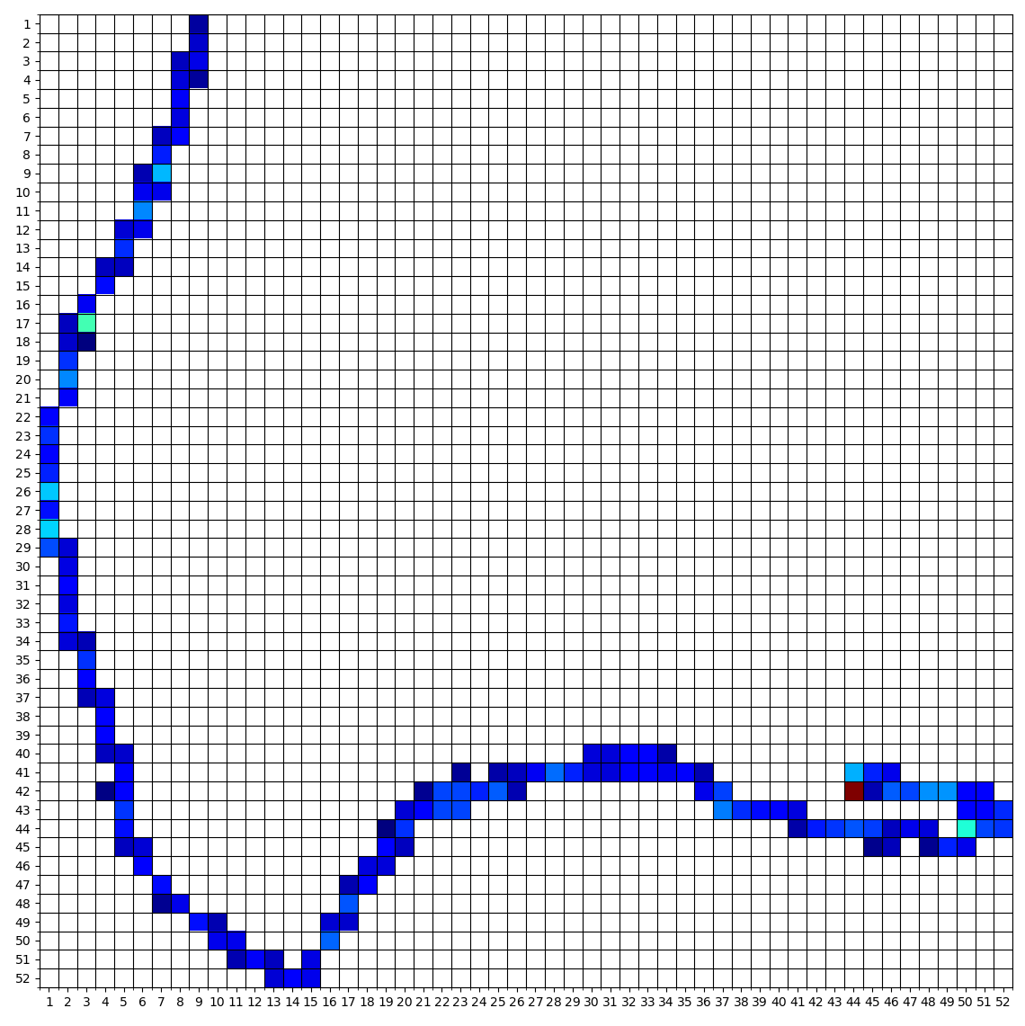
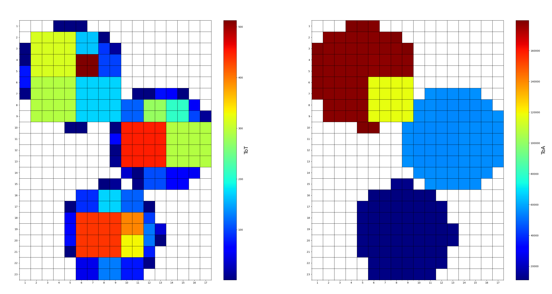
Per pixel, Timepix3 records position, charge and time
02 / THE QUESTION
ToA depends on its own ToT
Per pixel, Timepix3 records position (x, y), charge (ToT) and arrival time (ToA, 1.5625 ns). Classical PID condenses each cluster into a dozen engineered features before any classifier sees it — an irreversible choice made by hand.
ToT
ToA
ToT
single β
three α
Notes:
Timepix3 gives, per pixel, position, charge and time: the ToT is the time over threshold, and — as the sketch shows — a small pixel crosses threshold late: that is the time walk; keep it in mind for later. Classical PID condenses each cluster into about ten engineered features. That step is irreversible and decided by hand, and per-pixel time has no place in an image.

Slide 4
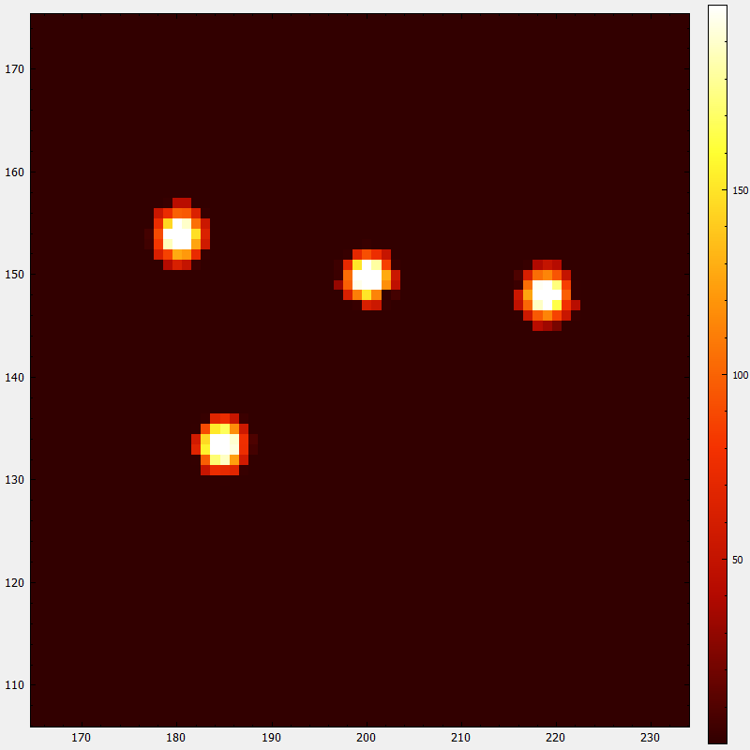
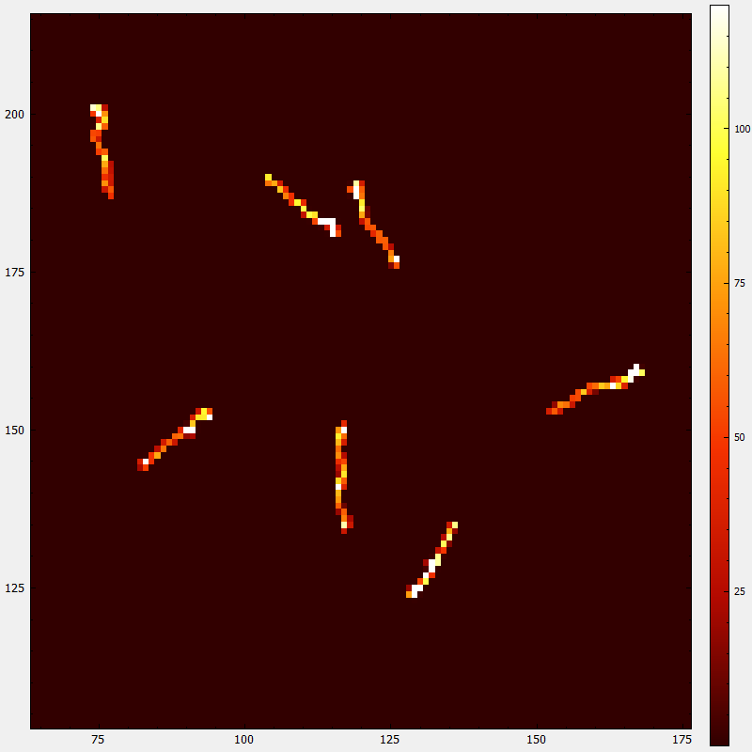
A handful of features, or the pixels themselves?
02 / THE QUESTION
“engineered features”, for example:
n_pixels (Cluster Size)
ΣToT
max ToT
Linearity
Roundness
Feret diameter
…
Am-241 alphas, 5.5 MeV
Cs-137 Compton electrons
from 662 keV gammas
Am-241 is illustrative
The question of this talk: on clusters of a few pixels, what does the pixel-level representation add to three scalar summaries (n_pixels · ΣToT · max ToT) — and how do we measure it, instead of asserting it?
Notes:
Here is what the classical chain does with such clusters: it reduces each one to a handful of engineered features — size, total and maximum ToT, linearity, roundness, Feret diameter. Those features work; the 14-feature tree you will see is a strong baseline. Our question is narrower: on clusters of a few pixels, what does the pixel-level representation add to three scalar summaries, and how do we measure that instead of asserting it?

Slide 5
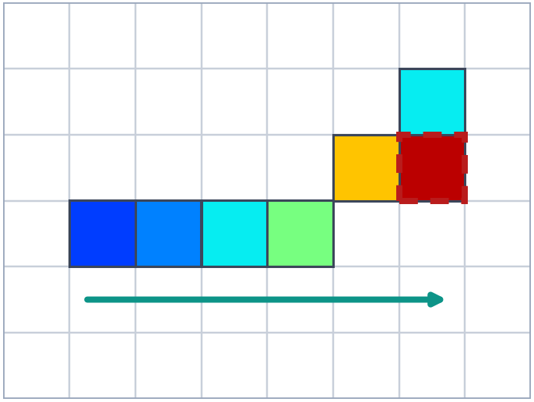
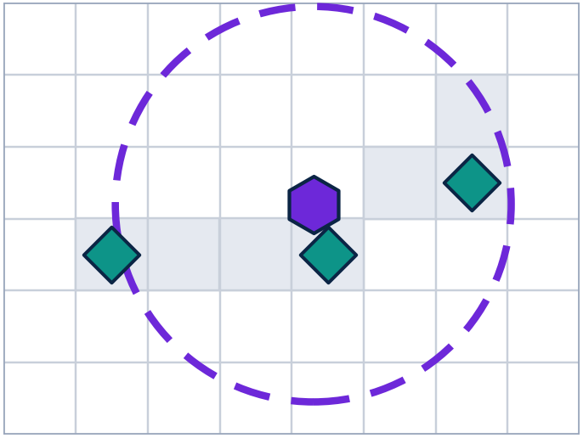
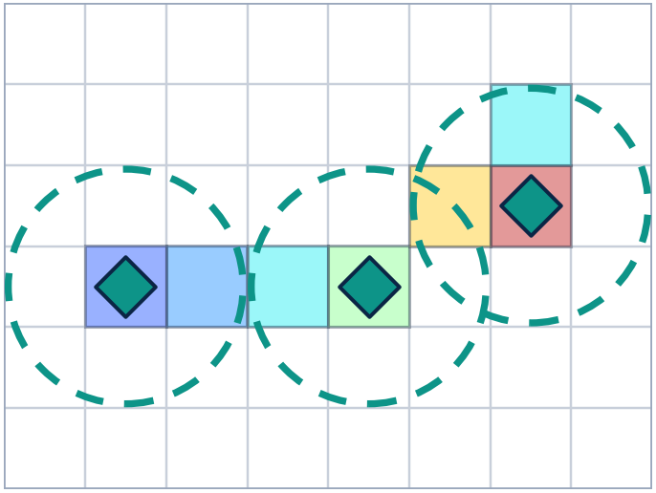
A cluster is a point cloud, not an image
03 / THE IDEA
Qi et al., NeurIPS 2017
two set-abstraction levels:
32 → 8 centroids,
16 neighbours,
166,214 trainable parameters
C = { (x, y, ToA, ToT) } — an unordered set of up to 128 points, normalised per cluster
128 = fixed input size of the network, far above the typical cluster (median 4 px, 95.9 % below 16 px); shorter clusters are zero-padded and the padding is never selected as a neighbour
exchange rate between pixels, nanoseconds and ToT counts: learned, not fixed by hand
① INPUT
② SA 1 · 16-NN
③ SA 2 · 16-NN
④ GLOBAL + 3
⑤ CLASSIFY
time order →
global PointNet
α
9 %
e⁻
+ 3 scalars
91 %
argmax → e⁻
N × 4
32 × 68
8 × 132
1 × (256+3)
K = 2
each pixel = one 4D point (x, y, ToA, ToT) · arrow = time order
32 centroids + 16 nearest neighbours in the learned metric → shared MLP + max-pool
same operation on the 32 SA 1 points: 8 centroids — a coarser view of the cluster
one cluster vector + n_pixels, ΣToT, max ToT: size and charge, which normalisation (*) removes
FC 259 → 256 → 128 → 2, softmax → α, e⁻
(*) Each cluster is re-centred and scaled to unit range — positions, in-cluster time and ToT relative to its maximum
Notes:
Each cluster is an unordered set of up to 128 points in four dimensions, normalised per cluster. Reading the pipeline left to right: every pixel is one 4D point; the first set-abstraction level picks 32 centroids and gathers, for each, its 16 nearest neighbours in the learned metric — the exchange rate between pixels, nanoseconds and counts is learned, not fixed by hand — and summarises them with a shared MLP and a max-pool; the second level does the same on the 32 points with 8 centroids, a coarser view; a global layer turns the cluster into one 256-vector. Because normalisation destroys the absolute scales, three global scalars — number of pixels, total and maximum ToT — are concatenated at the head: they restore size and charge, and they are also the first features any classical chain would compute, which is what makes "cloud versus scalars" a fair question. A fully connected head gives the two class probabilities. 166 thousand trainable parameters, identical in every configuration.

Slide 6
One chip, two classes, raw ToT — and a controlled comparison
04 / PROTOCOL
chip F5 · Si 500 µm · 300 V
clusters ≥ 3 px
70 / 15 / 15 = train / validation / test split (%), stratified by class · five random seeds
no energy calibration · no time-walk correction
BDT = gradient-boosted decision tree (class-balanced): the classical baseline
raw
2,694 clust.
11,650 clust.
α · Po-210
e⁻ · Sr-90 + Cs-137
ToT in 25 ns counts
≈ 3.7 MeV at the sensor · median 8 px
β and Compton electrons · median 3 px
uncalibrated · gain robustness in backup
Seven models — same architecture, same splits and seeds:
A
(x, y) + 3 scalars
B
A + per-pixel ToT
C
A + per-pixel ToA
D
(x, y, ToA, ToT) + 3 scalars — the full reference
G
3 scalars only — point cloud zeroed
E
4D cloud without scalars
BDT
boosted decision tree on 14 engineered features — same splits and seeds
Notes:
Everything is measured on one Timepix3 chip with a 500 micron silicon sensor. Alpha particles from Po-210, electrons from Sr-90 and Cs-137. Raw ToT, no energy calibration, no time-walk correction — I will come back to calibration. Seven models, all on the same splits and seeds. The six network configurations share architecture and parameter count: dropped coordinates are zeroed inside the network. A is positions plus the three scalars; B and C add one per-pixel channel each, ToT or ToA; D has everything; G only the scalars; E the cloud without scalars. The yardstick is a gradient-boosted tree on 14 engineered features. BDT stands for boosted decision tree — a gradient-boosted ensemble, class-balanced, on 14 engineered features; 70/15/15 is the split in per cent between training, validation and test, stratified by class: the model is selected on the validation split only and every number you will see is on the test split.

Slide 7
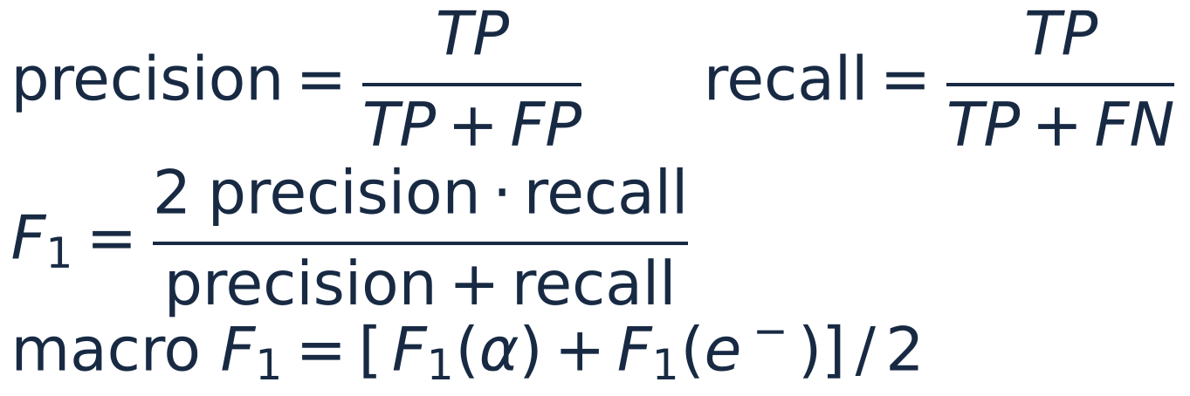
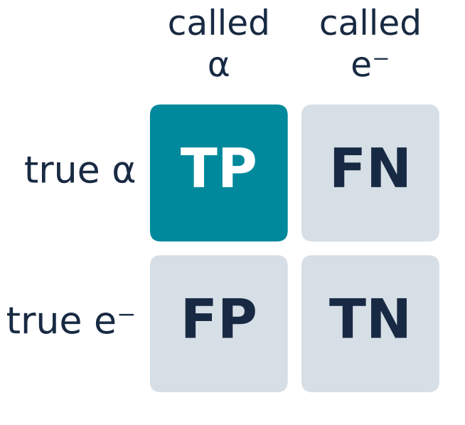
Definitions used throughout: recall, macro F1, p-value
05 / DEFINITIONS
purity of the sample
identification efficiency
macro F1: α and e⁻ weigh the same, although electrons are 4× more numerous.
macro F1 makes the rare class count as much as the common one
A small “p” tells us a difference is real; a large p tells us we cannot see one.
Macro F1 — the score
Recall and precision (α class)
recall(α) = TP / (TP + FN) — the share of true α that are called α
precision(α) = TP / (TP + FP) — the share of α calls that are right
F1 is the harmonic mean of precision and recall for one class; macro F1 averages α and e⁻ with equal weight. With 11,650 e⁻ against 2,694 α, accuracy alone would reward calling everything an electron (81 %) — macro F1 would not.
p — the paired test
The probability of a gap at least this large if the two models were really equal: paired t-test on the five seed-wise differences (same splits), 4 d.o.f.; p = 0.005 means 5 in 1,000.
Notes:
Definitions before the numbers. For one class, say alpha: recall is the share of true alphas that the classifier calls alpha; precision is the share of its alpha calls that are right; F1 is their harmonic mean, and macro F1 averages F1 over the two classes with equal weight — so the alpha class, four times rarer, counts as much as the electrons; accuracy alone would reward a classifier that calls everything an electron, 81 percent. And p: every comparison is paired — the same five splits for both models — and p is the probability of seeing a gap at least this large if the two models were really equal; a paired t-test on five differences, four degrees of freedom. p = 0.005 means five in a thousand.

Slide 8
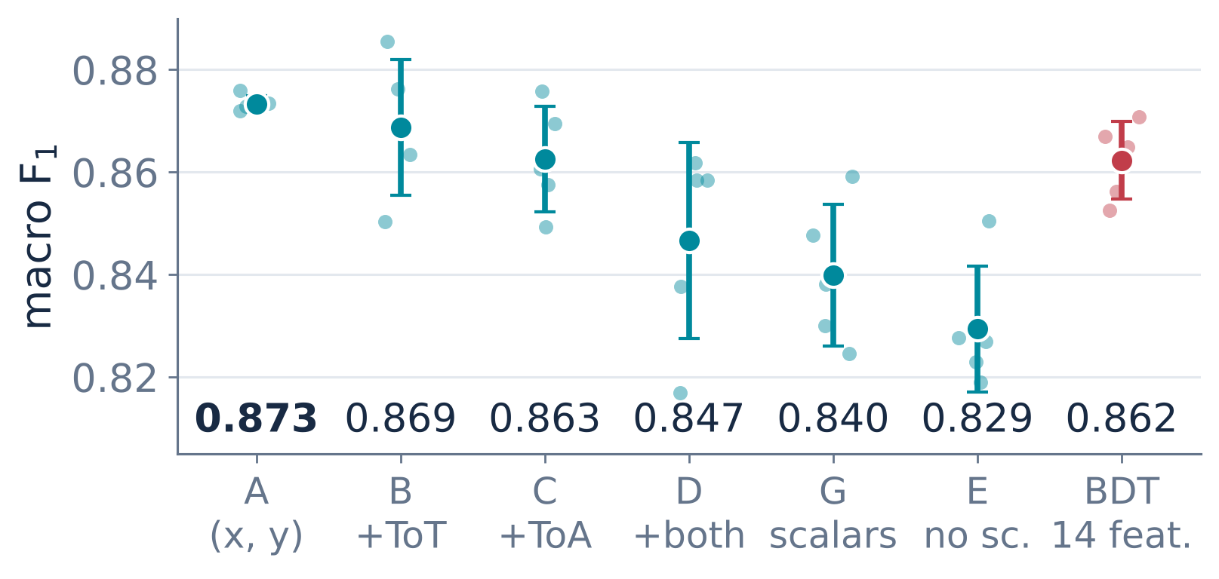
Pixel positions + three scalars: the best configuration
06 / KEY RESULT
macro F1
seed spread
A - G
A - BDT
α / e⁻ test set · 2,152 clusters per split
five seeds · paired contrasts on identical splits
p: paired t-test over the five seeds, 4 d.o.f. (slide 7)
Table 1 · Fig. 1a of the proceedings
run-to-run floor ±0.040 on seed-matched reruns — hence paired (backup)
0.873 ± 0.002
+0.033
+0.011
A: (x, y) + scalars
vs scalars alone (G)
vs 14-feature BDT
92.1 ± 0.3 % accuracy
paired p = 0.005 · 5/5 seeds
paired p = 0.037 · 5/5 seeds
A has the best mean and by far the smallest spread. Per-pixel channels (B, C, D) add noise; dropping the cloud (G) or the scalars (E) loses. Pixel positions carry morphology that three scalars — and 14 engineered features — do not.
Not a case against 4D: on this uncalibrated chip per-pixel ToT and ToA repeat each other through time walk — a finding about the detector, not a limit of the method.
Notes:
Configuration A — pixel positions plus the three scalars — reaches macro F1 0.873 with a seed spread of 0.002, the smallest of all seven models. Paired on identical splits it beats the scalars alone by 0.033, p = 0.005, and the 14-feature tree by 0.011, p = 0.037 — in five seeds out of five, both times. Small markers are the five seeds. Every model that adds per-pixel channels, or drops the cloud or the scalars, does worse. One number behind the pairing: two seed-matched reruns of the same pipeline differ by 0.040 in macro F1 — that floor is why every contrast is paired on identical splits; the details are in the backup.
For context — the abstract quotes it — on the original three-class benchmark (alpha, electron and ambient background, on a CdTe chip) the full network reaches 90.7 % against 90.3 % for the BDT and 81.3 % for a capacity-matched CNN. That table is in the backup.

Slide 9
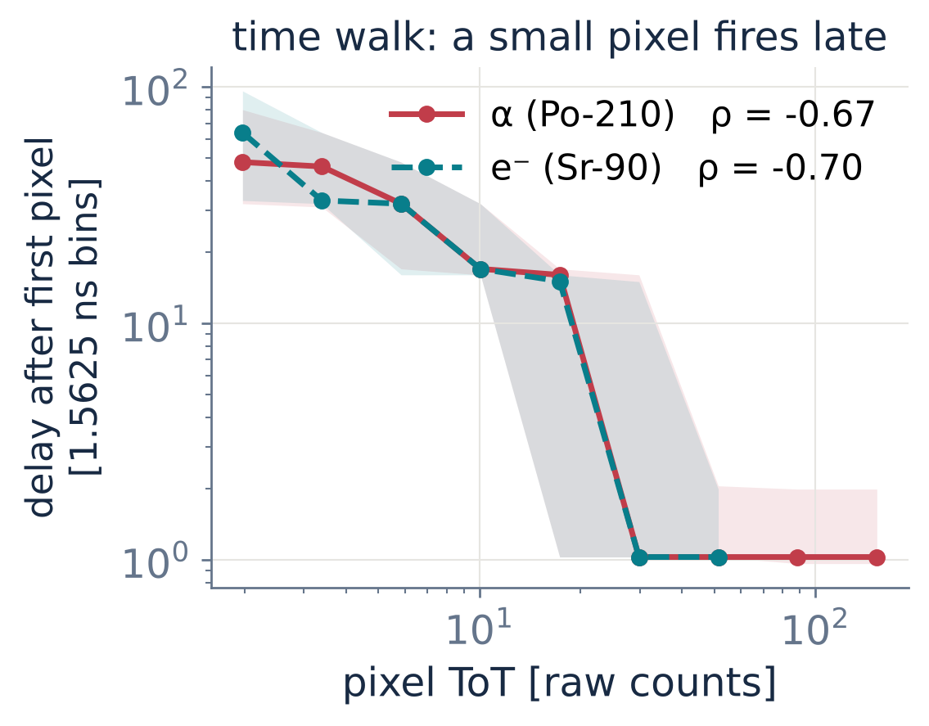
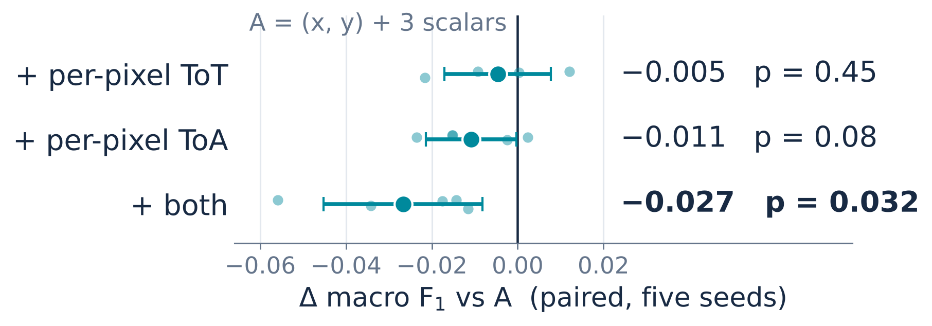
Per-pixel ToT and ToA: harmless alone, harmful together
07 / EXTRA CHANNELS
Alone, each channel is redundant
Per-pixel ToT repeats what ΣToT and max ToT already give the head; ToA alone costs a non-significant 0.011.
paired on identical splits · five seeds
B, C trained on the same splits as A, D
Together, the charge enters twice
Via time walk the delay restates the ToT: D loses 0.027 (ten times A’s spread). Drop both — A is the better design.
clusters ≥ 6 px · median and IQR
Why time walk matters here
Uncorrected, a pixel’s time is a second copy of its charge: “time helps” cannot be claimed on this chip. With a time-walk correction the same test can ask again.
Notes:
Is the loss of the full 4D input due to time, to energy, or to both? We trained the two missing configurations: B adds only the per-pixel ToT to A, C only the per-pixel ToA — same architecture, same splits, same seeds. Alone, neither costs anything significant: minus 0.005, p 0.45, and minus 0.011, p 0.08. Together they cost 0.027, p 0.032. The reason is on the right: without time-walk correction a pixel's arrival time is a function of its own amplitude, rho about minus 0.7 for both classes. So the full input hands the network the charge twice — directly and through the delay — and the duplicate is a noisy axis in the local descriptor. Every per-pixel channel also inflates the seed-to-seed spread, from 0.002 up to 0.019. Drop both. Why does time walk matter so much here? Because without a correction the arrival time of a pixel is a second copy of its charge: any claim that "time helps" on this chip would really be a claim about charge. With a time-walk correction, or a detector with independent timing, the same network and the same test can ask the question again.

Slide 10
Two findings, one recommendation — and what comes next
08 / CONCLUSIONS
single chip · raw ToT · identical splits
robust to a 10–20 % per-pixel gain spread (backup)
NEXT
calibrated data · same sources on a second chip · labelled Am-Be campaign
FULL ACCOUNT
proceedings paper (JINST, ICFDT8) · Zenodo deposit (DOI on slide 1)
01
Geometry helps
The (x, y) point cloud captures morphology that three scalars — and fourteen engineered features — do not contain.
+0.033
macro F1
02
Redundant channels hurt — together
Per-pixel ToT or ToA alone: harmless (p = 0.45, 0.08). Both: −0.027 (p = 0.032) — via time walk the charge enters twice.
spatial cloud vs three scalars
paired p = 0.005 · five seeds, identical splits
+0.011 vs the 14-feature BDT, p = 0.037
A = 0.873 ± 0.002 · accuracy 92.1 %
03
Ablate against your own scalars first
A learned metric is not relevance (p = 0.91, backup): test set-based networks against their own scalar summaries first.
Notes:
Two messages and one recommendation. Geometry helps: the pixel positions beat the scalars and the 14-feature tree. Redundant channels hurt — but only together: per-pixel energy or time alone is harmless, both together cancel the gain, because through time walk the charge enters twice. One recommendation follows: on few-hit detector objects, ablate set-based networks against their own scalar summaries before claiming anything about pixel-level learning — a learned metric is not a relevance readout, and the two-pass test that shows it is in the backup. Generalisation was checked on runs that entered no phase of the study: Tl-204 and Co-60, never seen in training, are called electrons 91 and 96 per cent of the time, with no retraining — backup as well.
Scope, in one breath: everything is measured on a single chip, with raw ToT and on identical splits. The comparisons are internal — tree and network are both invariant under a global gain — and the pixel-to-pixel part was checked directly: a random per-pixel gain map with a 10 or 20 percent spread moves A by two or four thousandths, the tree by up to nine, and A stays the best model (backup). Not tested: the non-linear ToT-to-energy relation near threshold; not claimed: transfer of a trained classifier to another chip. That is the next step: calibrated data, the same sources on a second chip, and a labelled campaign for the Am-Be field. Code, data and every per-run summary are on Zenodo.

Slide 11

ENEA · LABNIXT
Thank you
Proceedings paper: F. Cordella, G. Claps, V. De Leo, D. Pacella, F. Panza, Spatio-Temporal Deep Learning for Particle Discrimination in Timepix3 Detectors: a Diagnostic Tool for the AI Era, ICFDT8 proceedings, JINST (2026) — full method, Table 1 and references.
McCoy: How do you know so much?
Spock: I asked them (Star Trek)
F. Cordella et al. / ICFDT8 · Frascati, 20 October 2026
francesco.cordella@enea.it · data, code & checkpoints: DOI 10.5281/zenodo.21643310
Notes:
Thank you. Questions welcome — the backup slides have the three-class benchmark with the CNN comparison, the full two-class table, the per-pixel gain test, the unseen-source check, the reproducibility yardstick and the two-pass metric test.

Slide 12
Three-class benchmark and the capacity-matched CNN
BACKUP
α / e⁻ / background · 14,716 clusters
five seeds · identical splits · class-weighted
background class acquired on a second chip (CdTe)
benchmark of the Zenodo deposit, quoted in the proceedings abstract
Model | Parameters | Accuracy [%] | Macro F1 | Recall α [%]
4D PointNet++ (config. D) | 166,343 | 90.7 ± 1.5 | 0.838 ± 0.011 | 79.1 ± 3.2
BDT, 14 engineered features | — | 90.3 ± 0.4 | 0.844 ± 0.018 | 82.7 ± 2.5
CNN, rasterised clusters + scalars | 28,211 | 83.1 ± 4.4 | 0.653 ± 0.047 | 69.4 ± 5.8
CNN, capacity-matched | 166,355 | 81.3 ± 3.6 | 0.630 ± 0.031 | 71.7 ± 4.8
Scalars only (config. G) | 166,343 | 90.8 ± 0.9 | 0.849 ± 0.012 | —
On the three-class problem the scalars alone reproduce the full network (paired p = 0.23): that statement is carried by the background class, which absolute charge separates almost entirely. On the confound-free α/e⁻ pair the picture inverts — the spatial cloud wins (slide 8).
Notes:
Backup for questions: the original three-class benchmark, which includes an ambient-background class acquired on a second, CdTe chip. The point-cloud network matches the 14-feature tree and beats a CNN on rasterised clusters even when the CNN is widened to the same parameter count. Because the third class is instrumental, the main study is the two-class one.

Slide 13
Two-class study: seven models and paired contrasts
BACKUP
α / e⁻ · 14,344 clusters · one chip
test set 2,152 clusters per split
paired t-test, 4 d.o.f., uncorrected
Table 1 of the proceedings
Model | Input | Accuracy [%] | Macro F1 | Recall α [%]
A | (x, y) + 3 scalars | 92.1 ± 0.3 | 0.873 ± 0.002 | 82.1 ± 3.1
B | (x, y, ToT) + 3 scalars | 91.8 ± 1.0 | 0.869 ± 0.013 | 80.9 ± 1.3
C | (x, y, ToA) + 3 scalars | 91.2 ± 1.0 | 0.863 ± 0.010 | 83.1 ± 3.5
D | (x, y, ToA, ToT) + 3 scalars | 89.8 ± 1.8 | 0.847 ± 0.019 | 84.7 ± 3.3
G | 3 scalars only | 89.7 ± 1.1 | 0.840 ± 0.014 | 79.9 ± 2.2
E | (x, y, ToA, ToT), no scalars | 89.0 ± 0.9 | 0.829 ± 0.012 | 77.8 ± 1.5
BDT | 14 engineered features | 91.2 ± 0.5 | 0.862 ± 0.008 | 83.2 ± 2.5
Paired contrasts in macro F1 (mean ± SD of the seed-wise differences, p):
A − G +0.033 ± 0.013 (0.005) · A − E +0.044 ± 0.013 (0.002) · A − D +0.027 ± 0.019 (0.032) · A − BDT +0.011 ± 0.008 (0.037) · G − BDT −0.022 ± 0.013 (0.019) · A − B +0.005 ± 0.012 (0.45) · A − C +0.011 ± 0.011 (0.08) · B − D +0.022 ± 0.018 (0.049) · C − D +0.016 ± 0.016 (0.09) · D − G +0.007 (0.63)
Holm correction over the ten contrasts: only A − G and A − E survive.
Notes:
Backup: the complete two-class table. B and C were trained with the deposited pipeline on the same splits and seeds as the other configurations; the tree uses the pinned scikit-learn 1.4.2. Paired t-test over five seeds, four degrees of freedom, no correction for multiplicity.

Slide 14
Robustness to an uncalibrated pixel response
BACKUP
g(x, y) ~ lognormal(0, σ) on raw ToT
test clusters only · same map for all models
models trained on unperturbed data
Model | σ = 0 | σ = 5 % | σ = 10 % | σ = 20 %
A (x, y) + scalars | 0.873 ± 0.002 | 0.872 ± 0.003 | 0.871 ± 0.005 | 0.869 ± 0.006
B + per-pixel ToT | 0.869 ± 0.013 | 0.869 ± 0.010 | 0.867 ± 0.010 | 0.863 ± 0.014
C + per-pixel ToA | 0.863 ± 0.010 | 0.863 ± 0.014 | 0.861 ± 0.012 | 0.856 ± 0.014
D (x, y, ToA, ToT) + scalars | 0.847 ± 0.019 | 0.849 ± 0.021 | 0.842 ± 0.021 | 0.828 ± 0.021
G scalars only | 0.840 ± 0.014 | 0.840 ± 0.010 | 0.838 ± 0.013 | 0.830 ± 0.013
BDT 14 features | 0.862 ± 0.008 | 0.865 ± 0.007 | 0.863 ± 0.009 | 0.854 ± 0.007
Macro F1 on the α/e⁻ test set, mean ± std over five seeds. Paired change at σ = 10 % (20 %): A −0.002 ± 0.004 (−0.004 ± 0.006), BDT +0.001 ± 0.005 (−0.009 ± 0.004). Not tested: the non-linear ToT–energy relation near threshold.
Notes:
Backup for the calibration question. Every pixel's raw ToT in the test clusters is multiplied by a fixed random gain drawn from a log-normal distribution with 5, 10 or 20 percent spread, the same map for every model; the models were trained on unperturbed data and the scalars are standardised with the training statistics, as a deployed model would see them. A moves by at most four thousandths and stays the best model at every level; the full 4D model D is the most sensitive, consistent with its per-pixel ToT channel.

Slide 15
Unseen sources are recognised as what they are
BACKUP
configuration A · five checkpoints · no retraining
same chip, same settings
runs that entered no phase of the study
90.9 ± 2.2 %
95.6 ± 1.1 %
76.5 ± 1.6 %
Tl-204 · β emitter
Co-60 · Compton e⁻
Po-210 · 3600 s run
of 1,048 clusters called electrons · end point 764 keV
of 2,345 clusters called electrons · test recall 94.4 %
of 41,381 clusters called α · test recall 82.1 %
Operating point, not quality
A third configuration: Am-Be
The 3600 s α clusters are slightly softer (median ΣToT 112 vs 123). The full 4D model D calls α more often (80 %) but loses more electrons (86.5 %, 92.1 %).
Four-chip Timepix3 assembly, no retraining: 38.0–38.7 % non-electron clusters in three runs vs 11 % with no source — stable, above background; composition left to a labelled campaign.
Notes:
A check with the same checkpoints and no retraining, on runs of the same chip that entered no phase of the study — this also answers how we know that electron signatures are electrons. Electrons from a Tl-204 source are called electrons 91 percent of the time, Compton electrons from Co-60 96 percent. An independent one-hour run of the Po-210 source, 41 thousand clusters, is called alpha 76.5 percent of the time, against a test recall of 82 — those clusters are slightly less energetic. And on a third configuration, a four-chip assembly in an Am-Be field, the three-class models flag a stable non-electron population, 38 percent in three runs against 11 without source; what it is made of is left to a labelled campaign.

Slide 16
Yardstick: how small a difference can such a study resolve?
BACKUP
two complete passes of the ablation
float32 → float64 timestamps
same seeds, same splits, same code
98.6 %
± 0.040
> 0.035
ToA dead in float32
run-to-run floor
five seeds resolve
3 × 10¹¹ ns on a 16–32 µs grid: 1.5625 ns differences lost
σ of the seed-matched F1 difference between the two passes
unless contrasts are paired on identical splits — as all are here
The lesson transfers
A coordinate ablation is only as meaningful as the coordinate is alive. Report the fraction of objects with non-degenerate values along each axis, and measure the reproducibility of the pipeline before reading any table — most rows of a typical ablation do not clear it.
Notes:
Backup on the reproducibility floor. Before reading differences off a table, one needs to know how large a difference the pipeline can resolve. We ran the whole ablation twice: in the first pass the absolute timestamps had been parsed in single precision, which quantises away the 1.5625-nanosecond in-cluster differences and left the time axis identically zero for 98.6 percent of the clusters; the second pass uses double precision. For the configurations that never see ToA, the two passes are the same experiment up to a perturbation of order ten to the minus eight — and they differ by 0.040 in macro F1. That is the yardstick: a five-seed mean resolves only differences above about 0.035, unless contrasts are paired on identical splits, as all ours are.

Slide 17
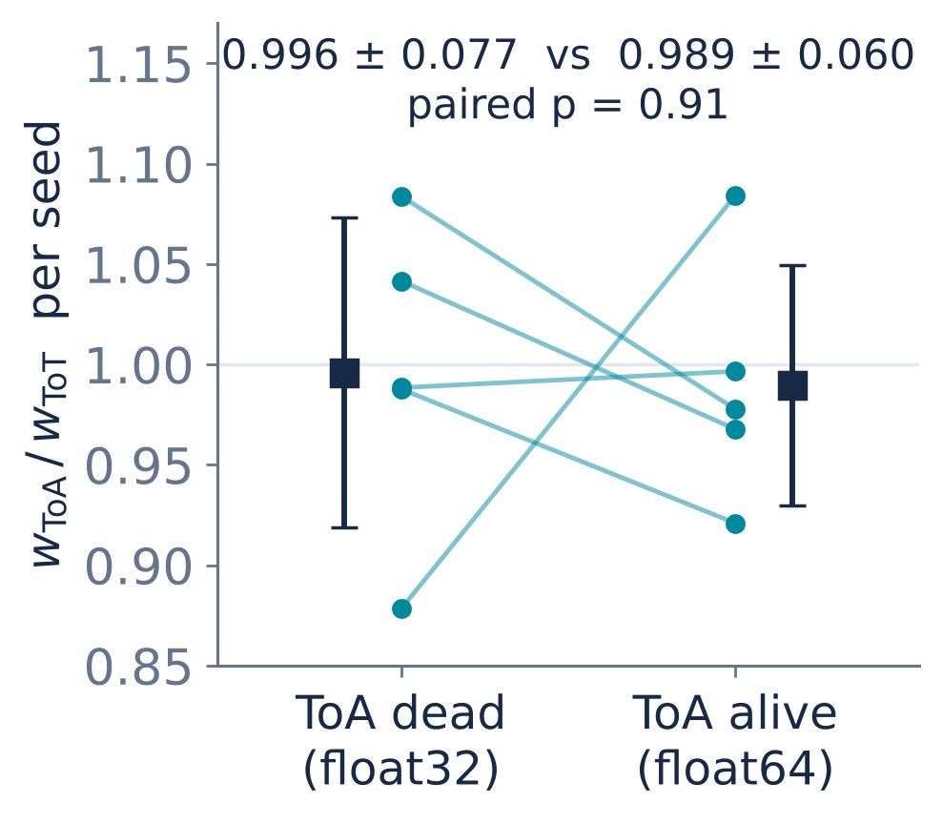
Two passes: a reproducibility floor and a metric test
BACKUP
pass 1: timestamps in float32 → in-cluster ToA dead for 98.6 % of clusters · pass 2: float64
same seeds, same splits, same code
weights: configuration D · median cluster 4 px, 16 neighbours requested
p = 0.91: a change > 0.13 excluded at 90 % CL
Fig. 1b of the proceedings
± 0.040
p = 0.91
run-to-run floor
ratio unchanged
The floor: on configurations that never see ToA, the seed-matched macro F1 of the two passes differs by ±0.040 — hence every contrast here is paired on identical splits.
Reading the figure: one dot per seed — in-cluster ToA dead (pass 1) on the left, alive (pass 2) on the right; a line joins the same seed, squares are mean ± SD. If w_ToA measured relevance, every line would rise. It does not.
Why: for 95.9 % of the clusters the 16-neighbour step returns the whole cluster — the metric survives as a per-axis gain, a scale, not relevance.
Notes:
Two passes of the whole ablation. In the first the absolute timestamps had been parsed in single precision, which quantises away the 1.5625-nanosecond in-cluster differences and left the time axis dead for 98.6 percent of the clusters; the second pass uses double precision. For the configurations that never see ToA the code change is a perturbation of order ten to the minus eight, yet their seed-matched macro F1 differs by 0.040: that is the reproducibility floor of the pipeline, and the reason every contrast in this talk is paired on identical splits — five seeds alone would resolve nothing below 0.035. The two passes also give a controlled test of the learned metric weights as a readout of relevance. If the weight on ToA measured the information content of that axis, its ratio to the ToT weight should rise when the axis goes from numerically dead to alive. How to read the figure: each dot is one of the five seeds, left with the time dead, right with it alive; a line joins the same seed and the black squares are mean and standard deviation. If the weight measured relevance every line should go up; they go both ways: 0.996 against 0.989, paired p = 0.91, a change above 0.13 excluded at 90 percent confidence. The reason is geometric: the median cluster has four pixels while the first abstraction level asks for sixteen neighbours, so for 95.9 percent of the clusters the neighbourhood step returns the whole cluster whatever the weights. The metric survives as a reproducible per-axis gain — a scale of the local descriptor, not a relevance.

