Slide 1

Cross-calibration of AXUV diodes with metal foil bolometers for the resolution of
fast plasma events in TCV
V. D’Agostino^{1,2}, I. Wyss¹, G. Partesotti³, R.Rossi¹, A. Murari^{4,5,6}, U. Sheikh³, M. Gelfusa¹ and the TCV teamª
Industrial Engineering Department, University of Rome Tor Vergata, Via del Politecnico 1, 00010 Rome, Italy
ENEA, Nuclear Department, Via Enrico Fermi 45, 00044 Frascati, Italy
École Polytechnique Fédérale de Lausanne (EPFL), Swiss Plasma Center (SPC), CH-1015 Lausanne, Switzerland
Consorzio RFX (CNR, ENEA, INFN, Università di Padova, Acciaierie Venete SpA), Corso Stati Uniti 4, 35127 Padova, Italy
Istituto per la Scienza e la Tecnologia dei Plasmi, CNR, Corso Stati Uniti 4, 35127, Padua, Italy
CNR - Institute for applied mathematics 'Mauro Picone' (IAC), Via dei Taurini, 19, 00185, Rome, Italy
See author list of "Christian Theiler et al 2026 Nucl. Fusion 66 116007 https://doi.org/10.1088/1741-4326/ae6d12
8th International Conference on Frontier in Diagnostic Technologies, Frascati, 19-21 October 2026

Slide 2
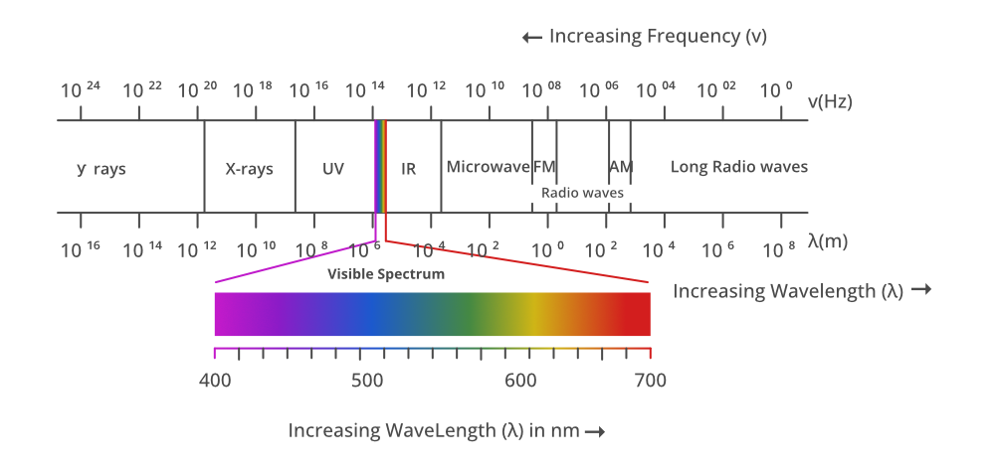
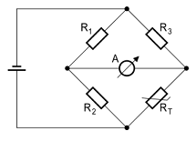
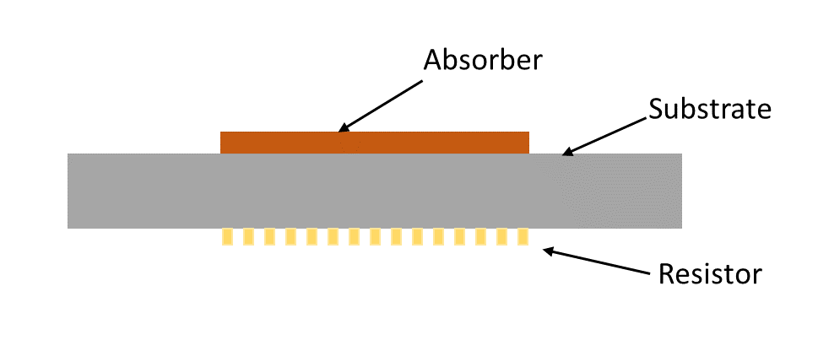
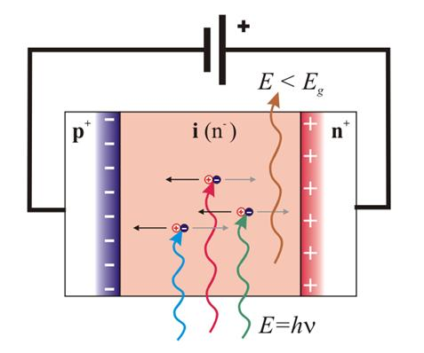
Radiation measurement
Absolute calibrated
Limited temporal resolution (ms)
Radiation emitted by the plasma covers most of the electromagnetic spectrum
Bolometers
AXUV Diodes
Understanding physics
Study the transport
Power balance
Plasma stability
Offline
Real-time
Lack of absolute calibration
High temporal resolution (ns)
Notes:
Immagine diodo

Slide 3
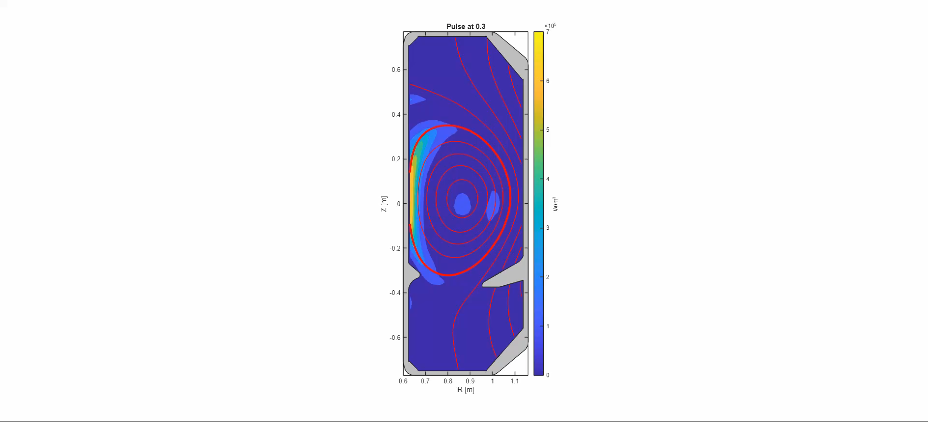
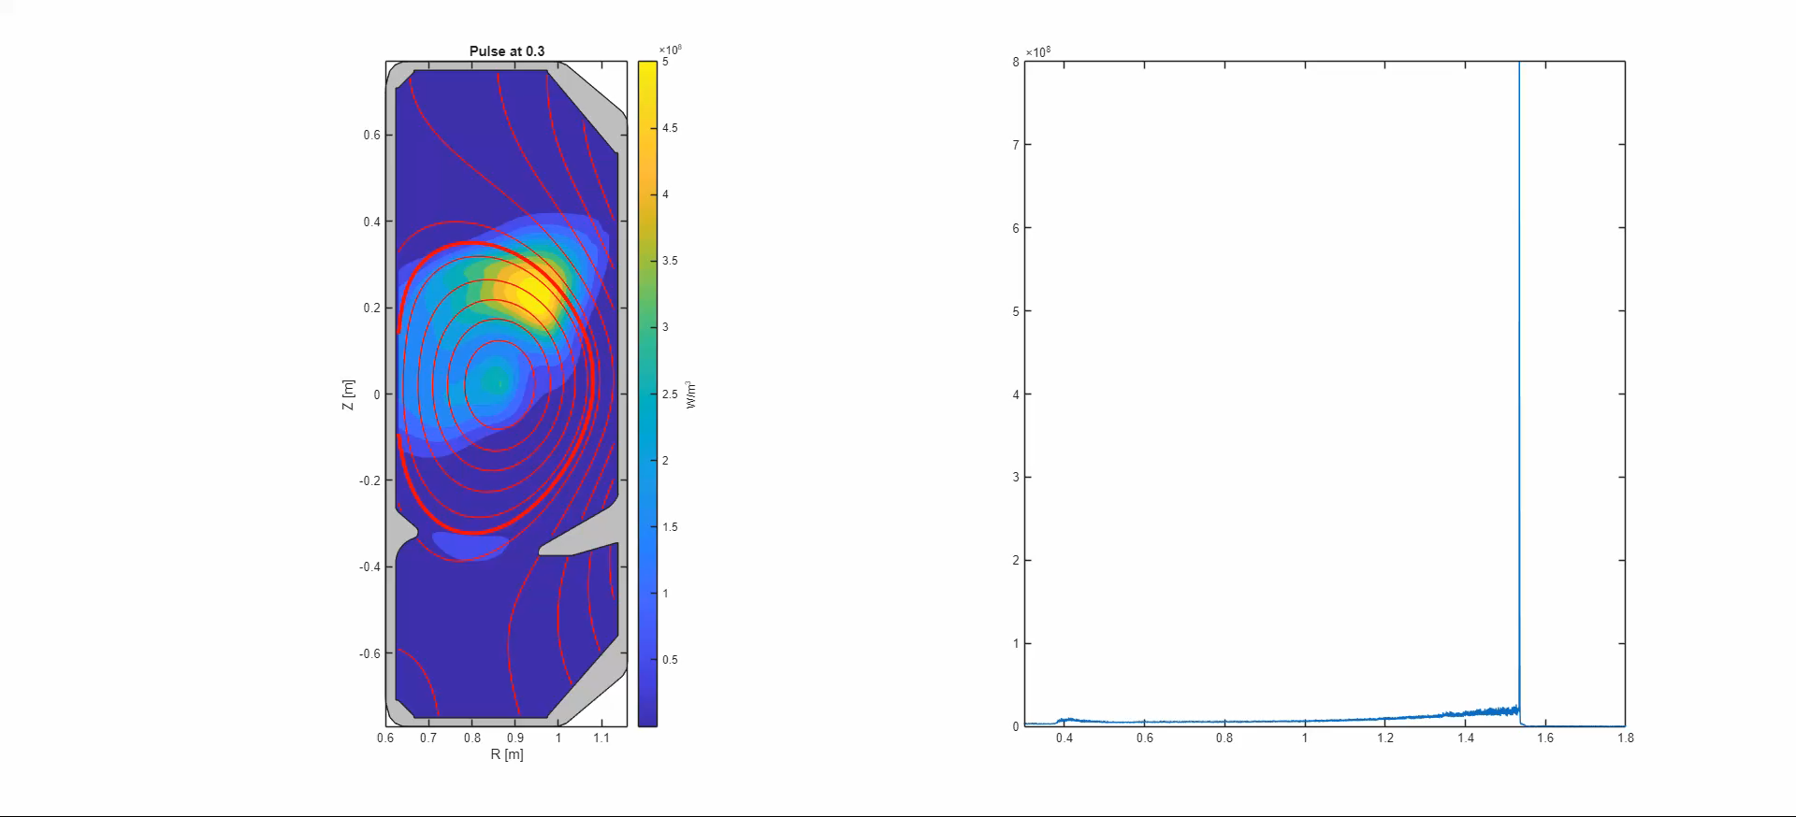
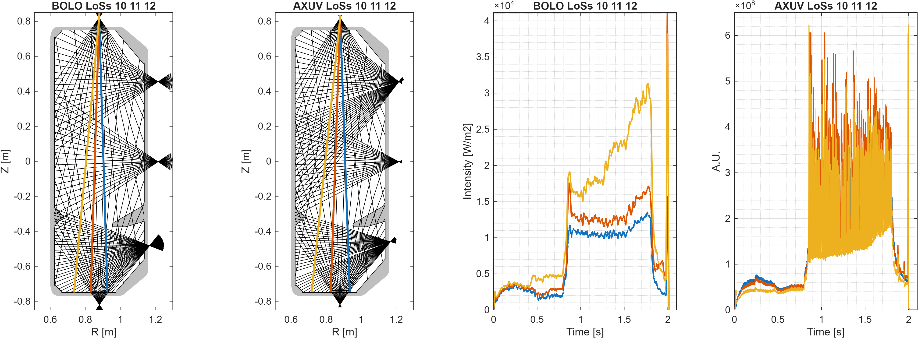
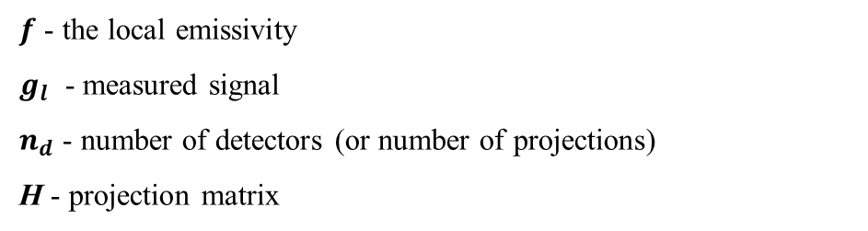
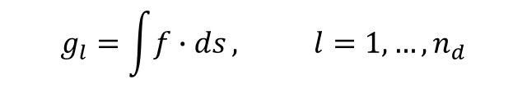

Tomography
Tomography is an ill-posed inverse problem
$$g_{l}=\int{f∙ds}, l=1,…,n_{d}$$
$f$ - the local emissivity
$g_{l}$ - measured signal
$n_{d}$ - number of detectors (or number of projections)
H - projection matrix
Maximum Likelihood (ML) Tomography
$$g=Hf$$
BOLO
AXUV
Filmato Bolo 78746
da 15 s tutta la scarica
Notes:
Levare misure, citare maximum likelihood, provare a compattare con slide della tomografia

Slide 4

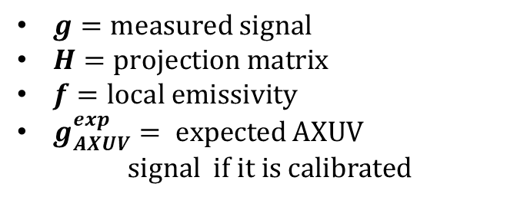

Two cross-calibration methods
Shots from TCV database
1000 time instants x shot
Maximum Likelihood (ML) Tomography
$$g_{AXUV}^{exp} = H_{AXUV}f_{bolo}$$
$$g=Hf$$
$g=measured signal$
$H=projection matrix$
$f=local emissivity$
$g_{AXUV}^{exp}= expected AXUV$
$signal if it is calibrated$
Time Recalibration Factor (TRF)
Linear Regression
Channel-dependent calibration factor averaged in time
Linear fit between the expected and measured AXUV signals
Notes:
Vedere di levare database, tomografia che prende bolo e diodi, migliorare schema a blocchi

Slide 5
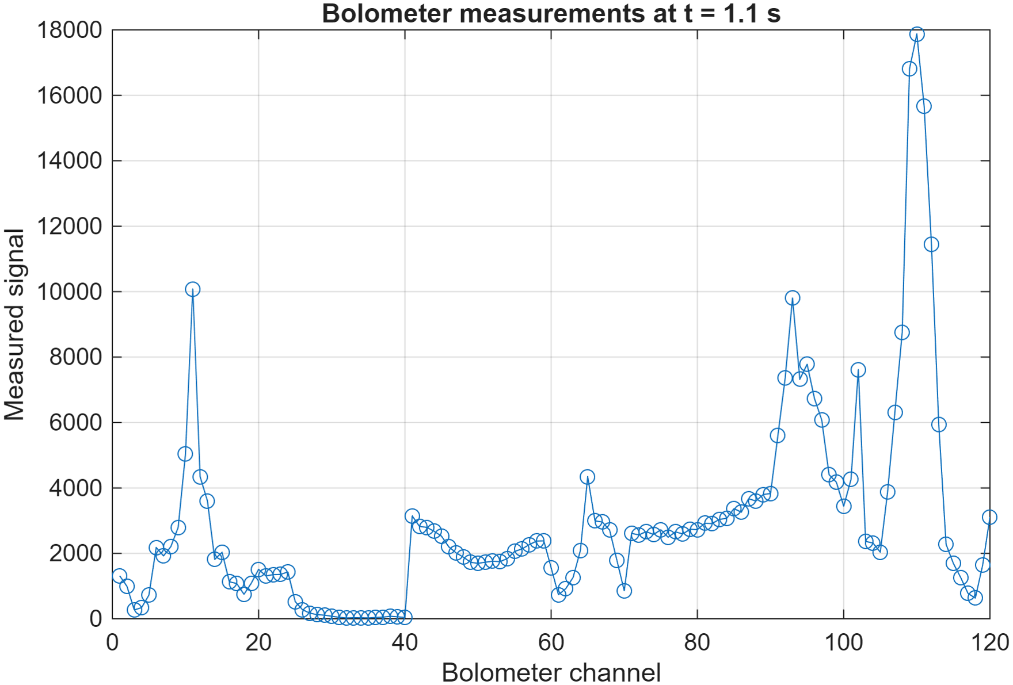
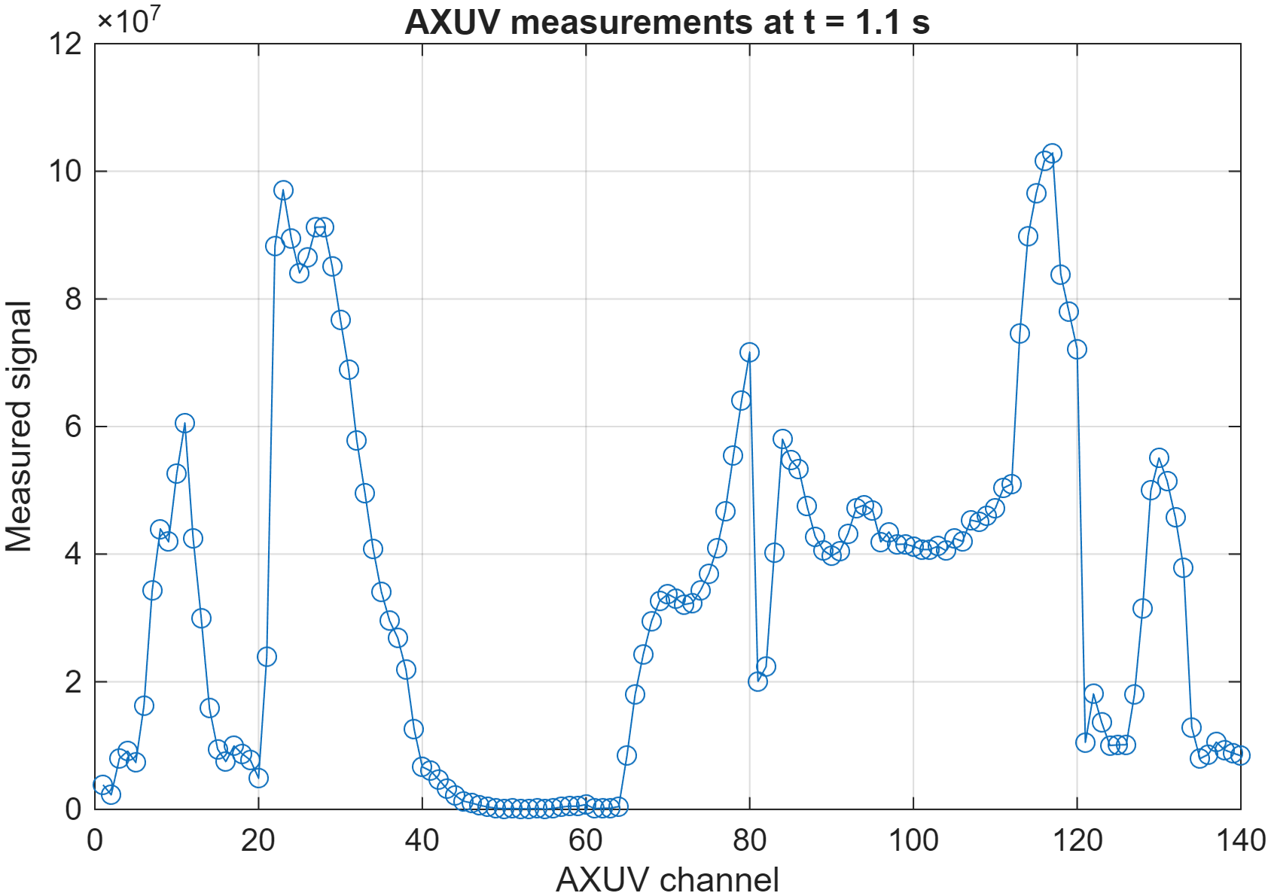
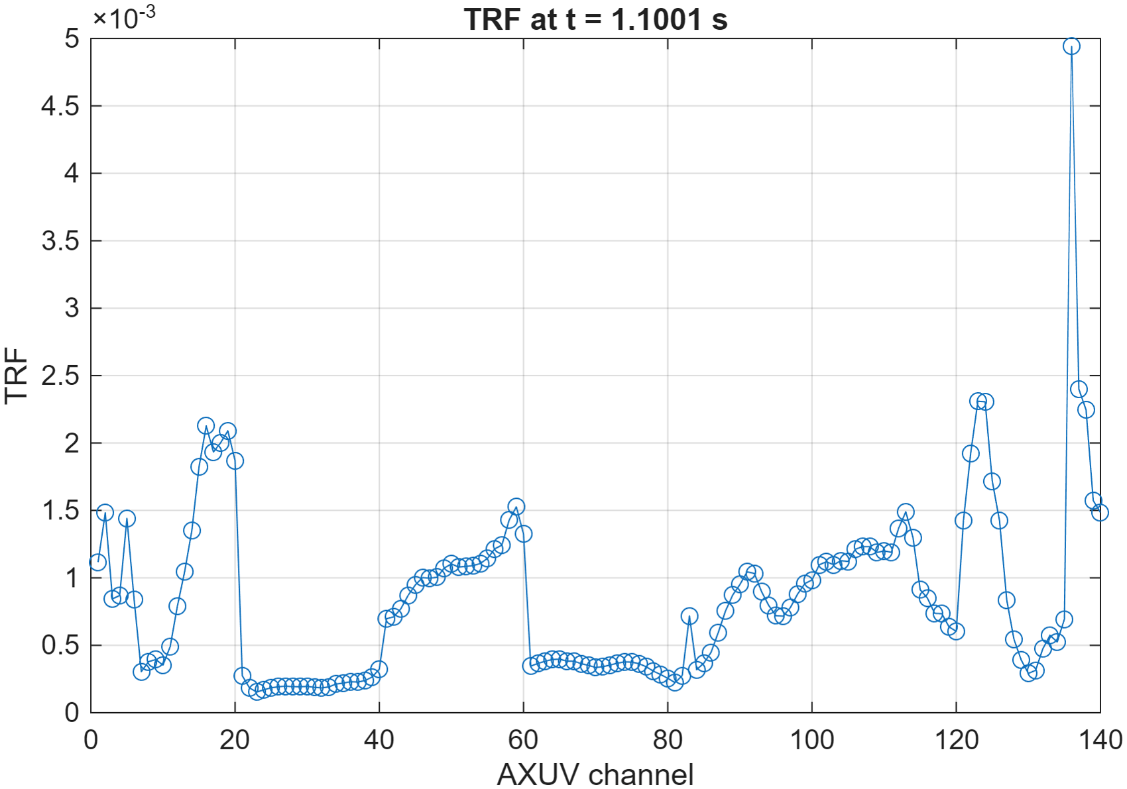
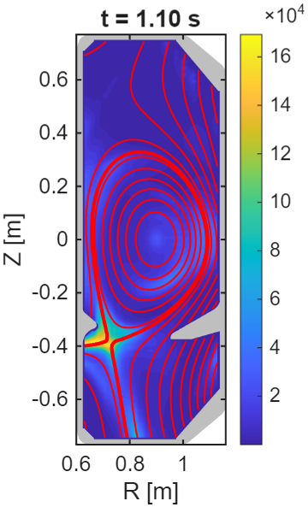
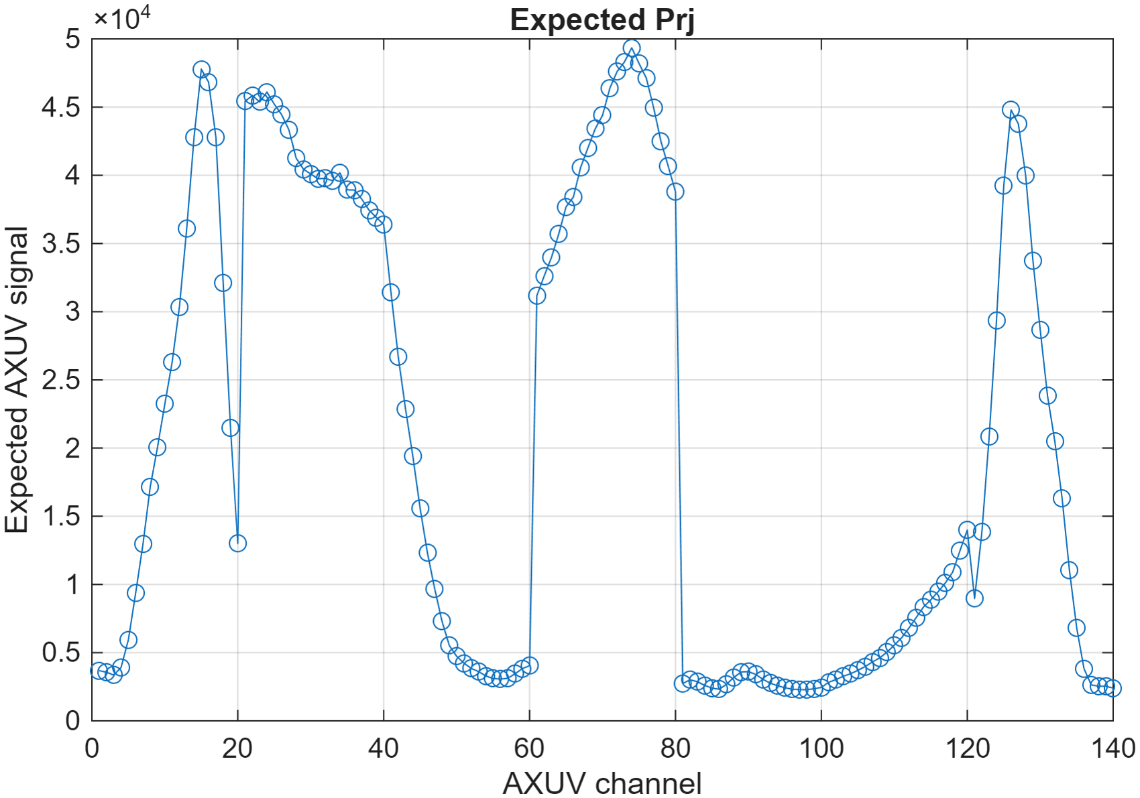
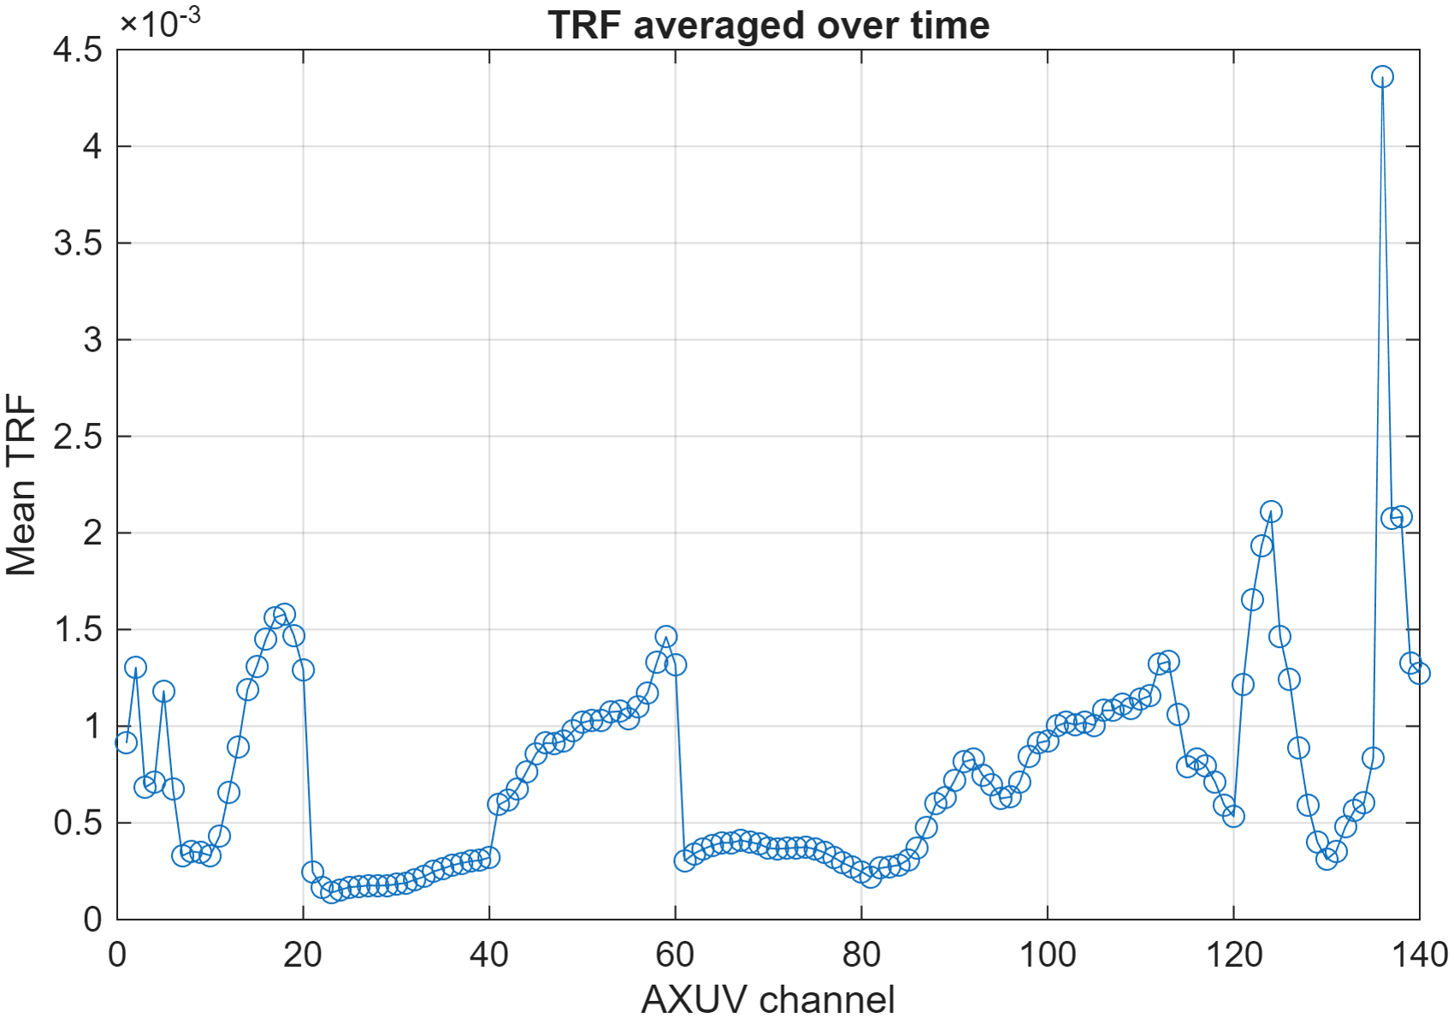
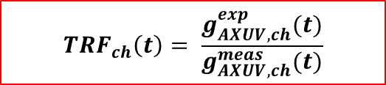


Time Recalibration Factor – (TRF)
$${TRF}_{ch}\left(t\right)= \frac{g_{AXUV,ch}^{exp}(t)}{g_{AXUV,ch}^{meas}(t)}$$
$$g_{AXUV}^{corr}=\overline{TRF}{∙g}_{AXUV}^{meas}$$
BOLO rec
$$g_{AXUV}^{exp} = H_{AXUV}f_{bolo}$$

Slide 6
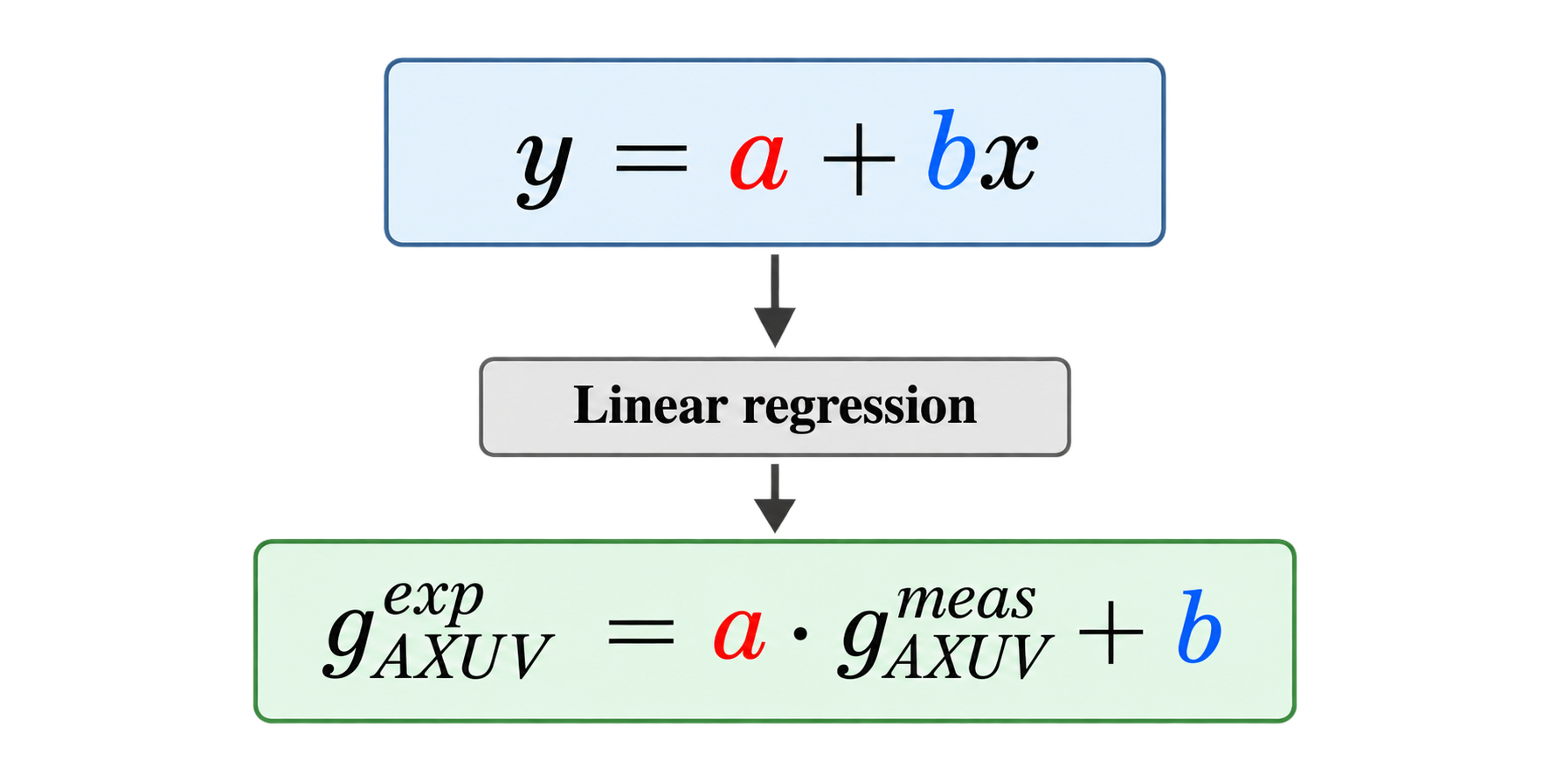
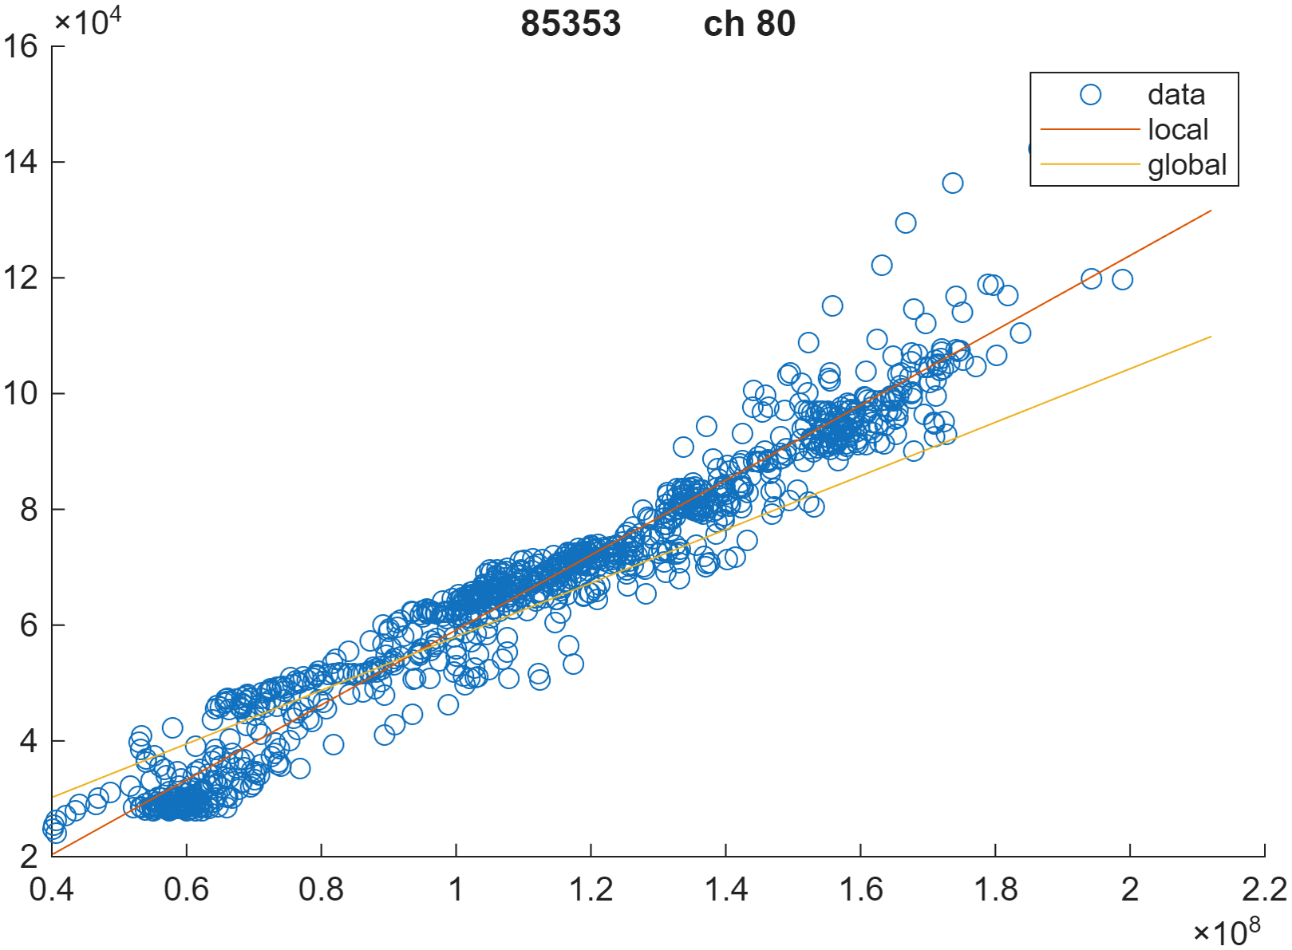


Linear Regression
$$g_{AXUV}^{exp} = H_{AXUV}f_{bolo}$$
BOLO rec
$$g_{AXUV,ch}^{cal}=a_{ch}∙g_{AXUV,ch}^{meas}+b_{ch}$$
Notes:
Lasciare solo regressione su tutto il database

Slide 7
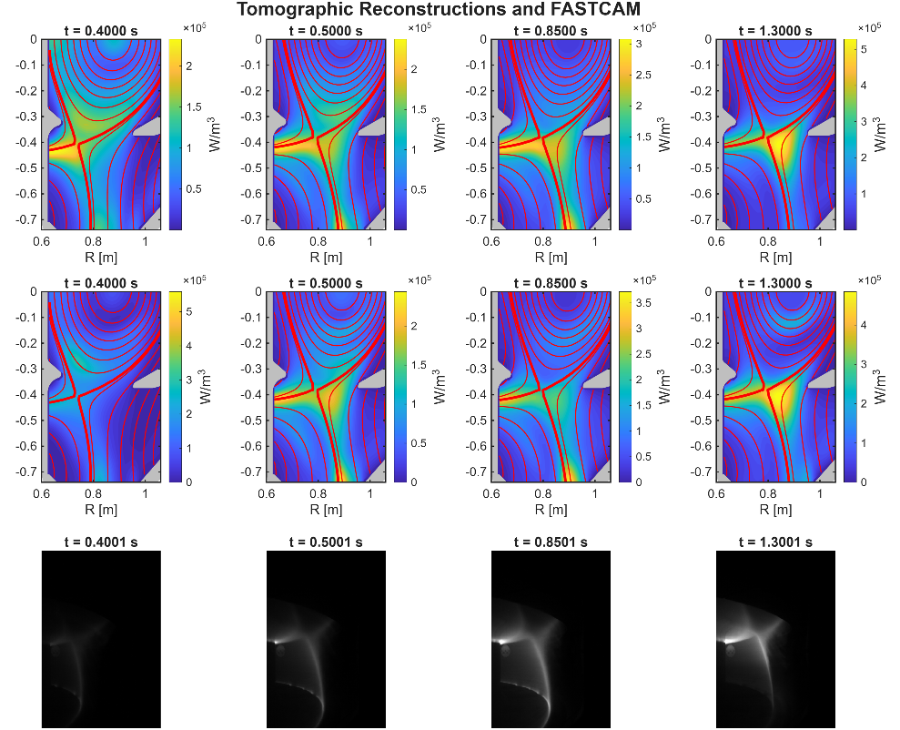

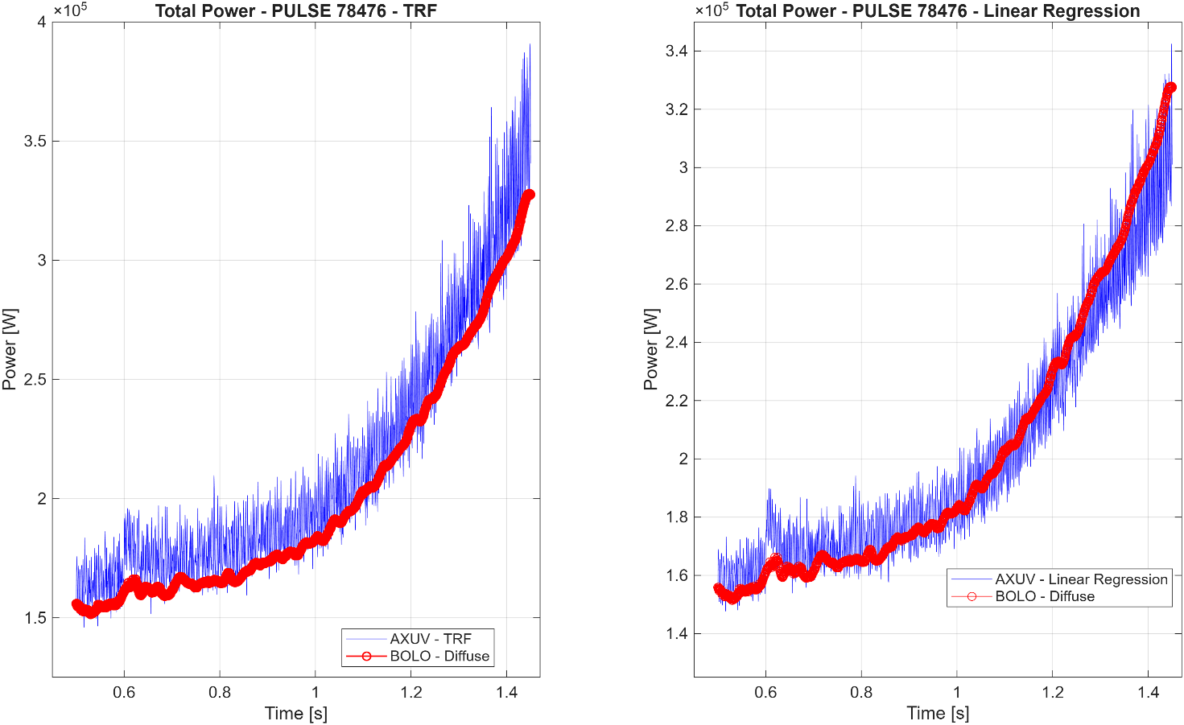
PULSE #78476 - Validation
L-mode pulse
FASTCAM data available
Comparing TRF and linear regression calibrated AXUV tomographies
Comparing BOLO-reconstructed and calibrated AXUV-reconstructed total powers [W]
Notes:
Bullet point, sparo stazionario, bolo tomography, bolo axuv, la potenza torna uguale, scrivere messaggio principale slide

Slide 8
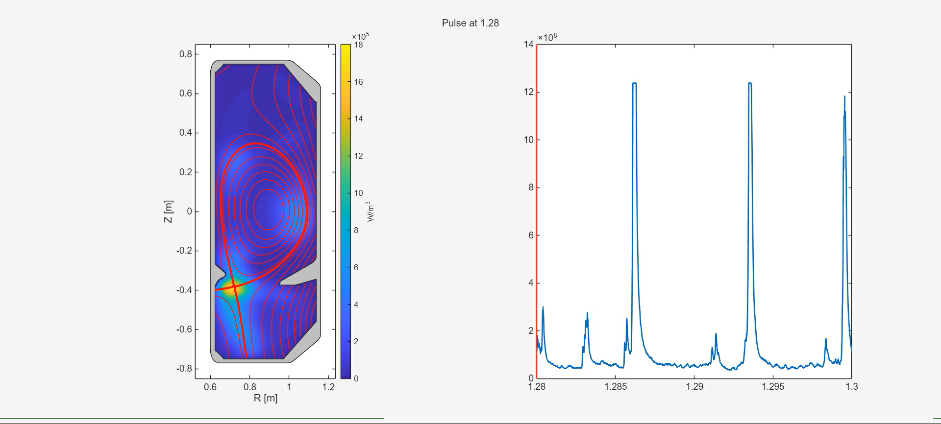
PULSE #71157 – TRF
Radiative reconstruction: the corrected AXUV signals reproduce the main spatial distribution observed by the bolometers, with radiation localized around the X-point and extending towards the divertor.
ELM dynamics: the TRF calibration preserves the fast temporal variations and the characteristic localization of the transient radiation at the outer target during ELMs.
Intensity (W/m²)

Slide 9
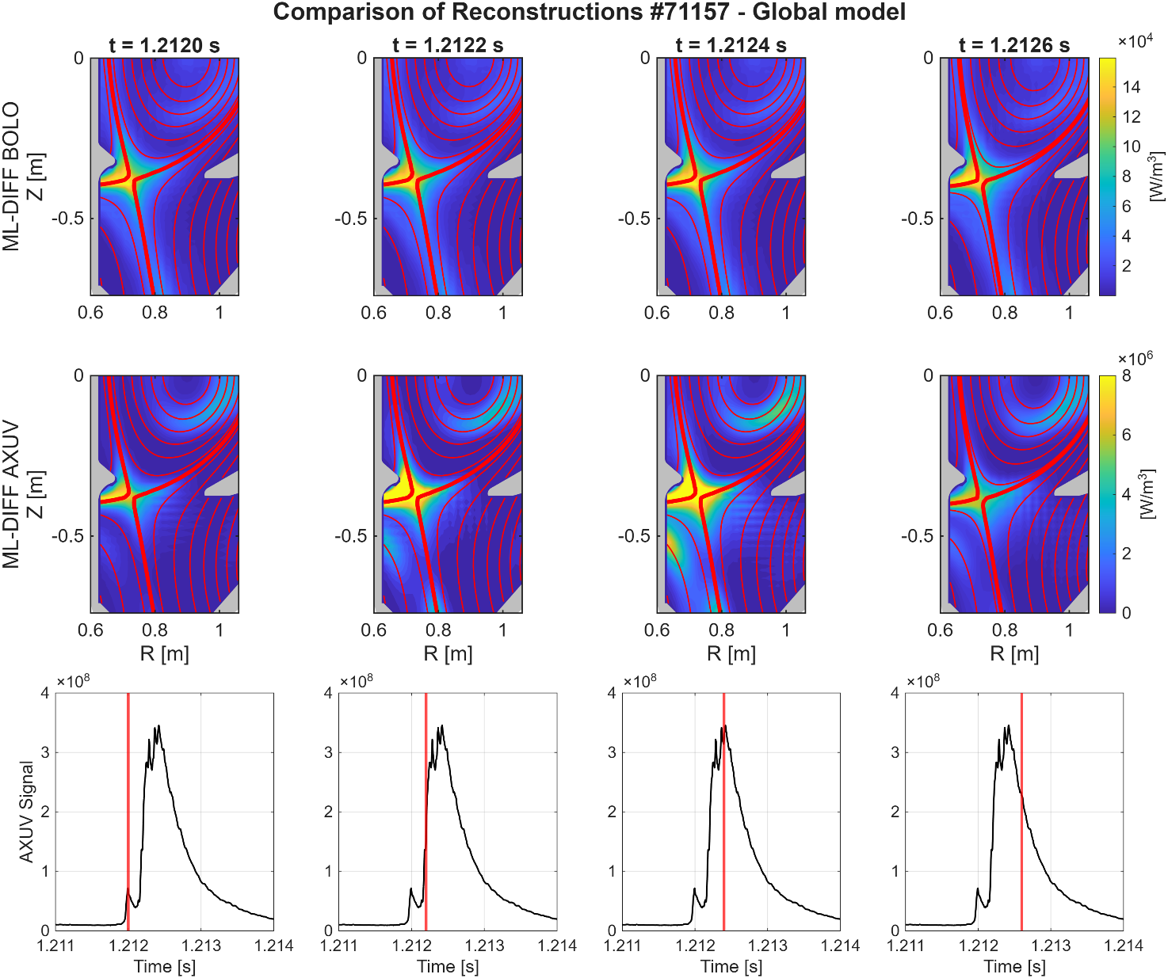
Linear Regression
Multi-shot calibration: a single regression model is derived by combining measurements from all selected discharges.
Generalized response: the model captures the common AXUV–bolometric relationship across different plasma discharges.
ELM reconstruction: for pulse #71157, it reproduces the transient ELM dynamics and the radiation around the X-point, but with a more spatially extended and less localized reconstruction than the TRF model.

Slide 10
Conclusions and future work
TRF provides the best agreement with the bolometric reference, also in terms of reconstructed radiated power. It is suitable for inter-shot and offline analyses, with channel-dependent correction factors.
Linear regression: suitable for repeated/inter-shot application and potential real-time implementation, once calibrated on representative discharges.
Real-time application: investigate the deployment of the trained model for fast, potentially real-time radiation monitoring.
Neural-network-based calibration: train a neural network to learn the relationship between the measured AXUV signals and the corresponding bolometric reference.
Fully connected
20 neurons
4 hidden layers

Slide 11
Thank you!
Cross-calibration of AXUV diodes with metal foil bolometers for the resolution of
fast plasma events in TCV
v.d.agostino@ing.uniroma2.com
8th International Conference on Frontier in Diagnostic Technologies, Frascati, 19-21 October 2026

Slide 12
Appendix

Slide 13
PULSE #78476 - Validation
Method | RMSE | NRMSE
Linear regression | 17824.71 W | 8.6%
TRF | 11890.0 W | 5.74%

Slide 14
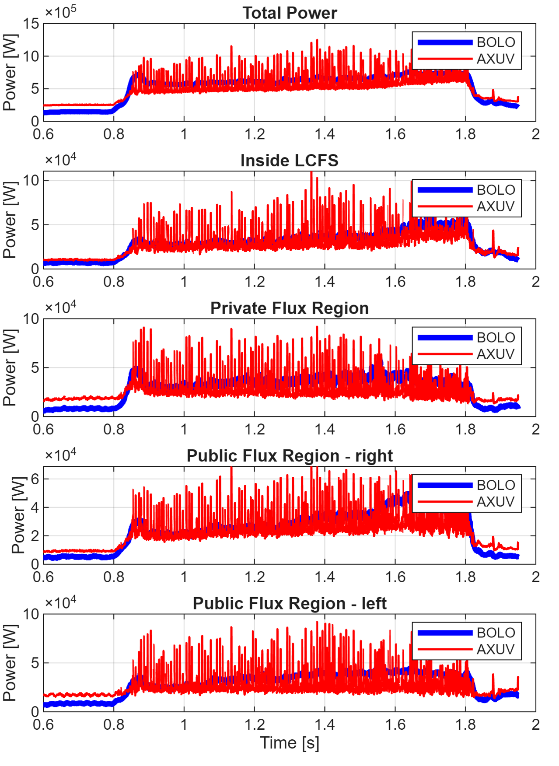
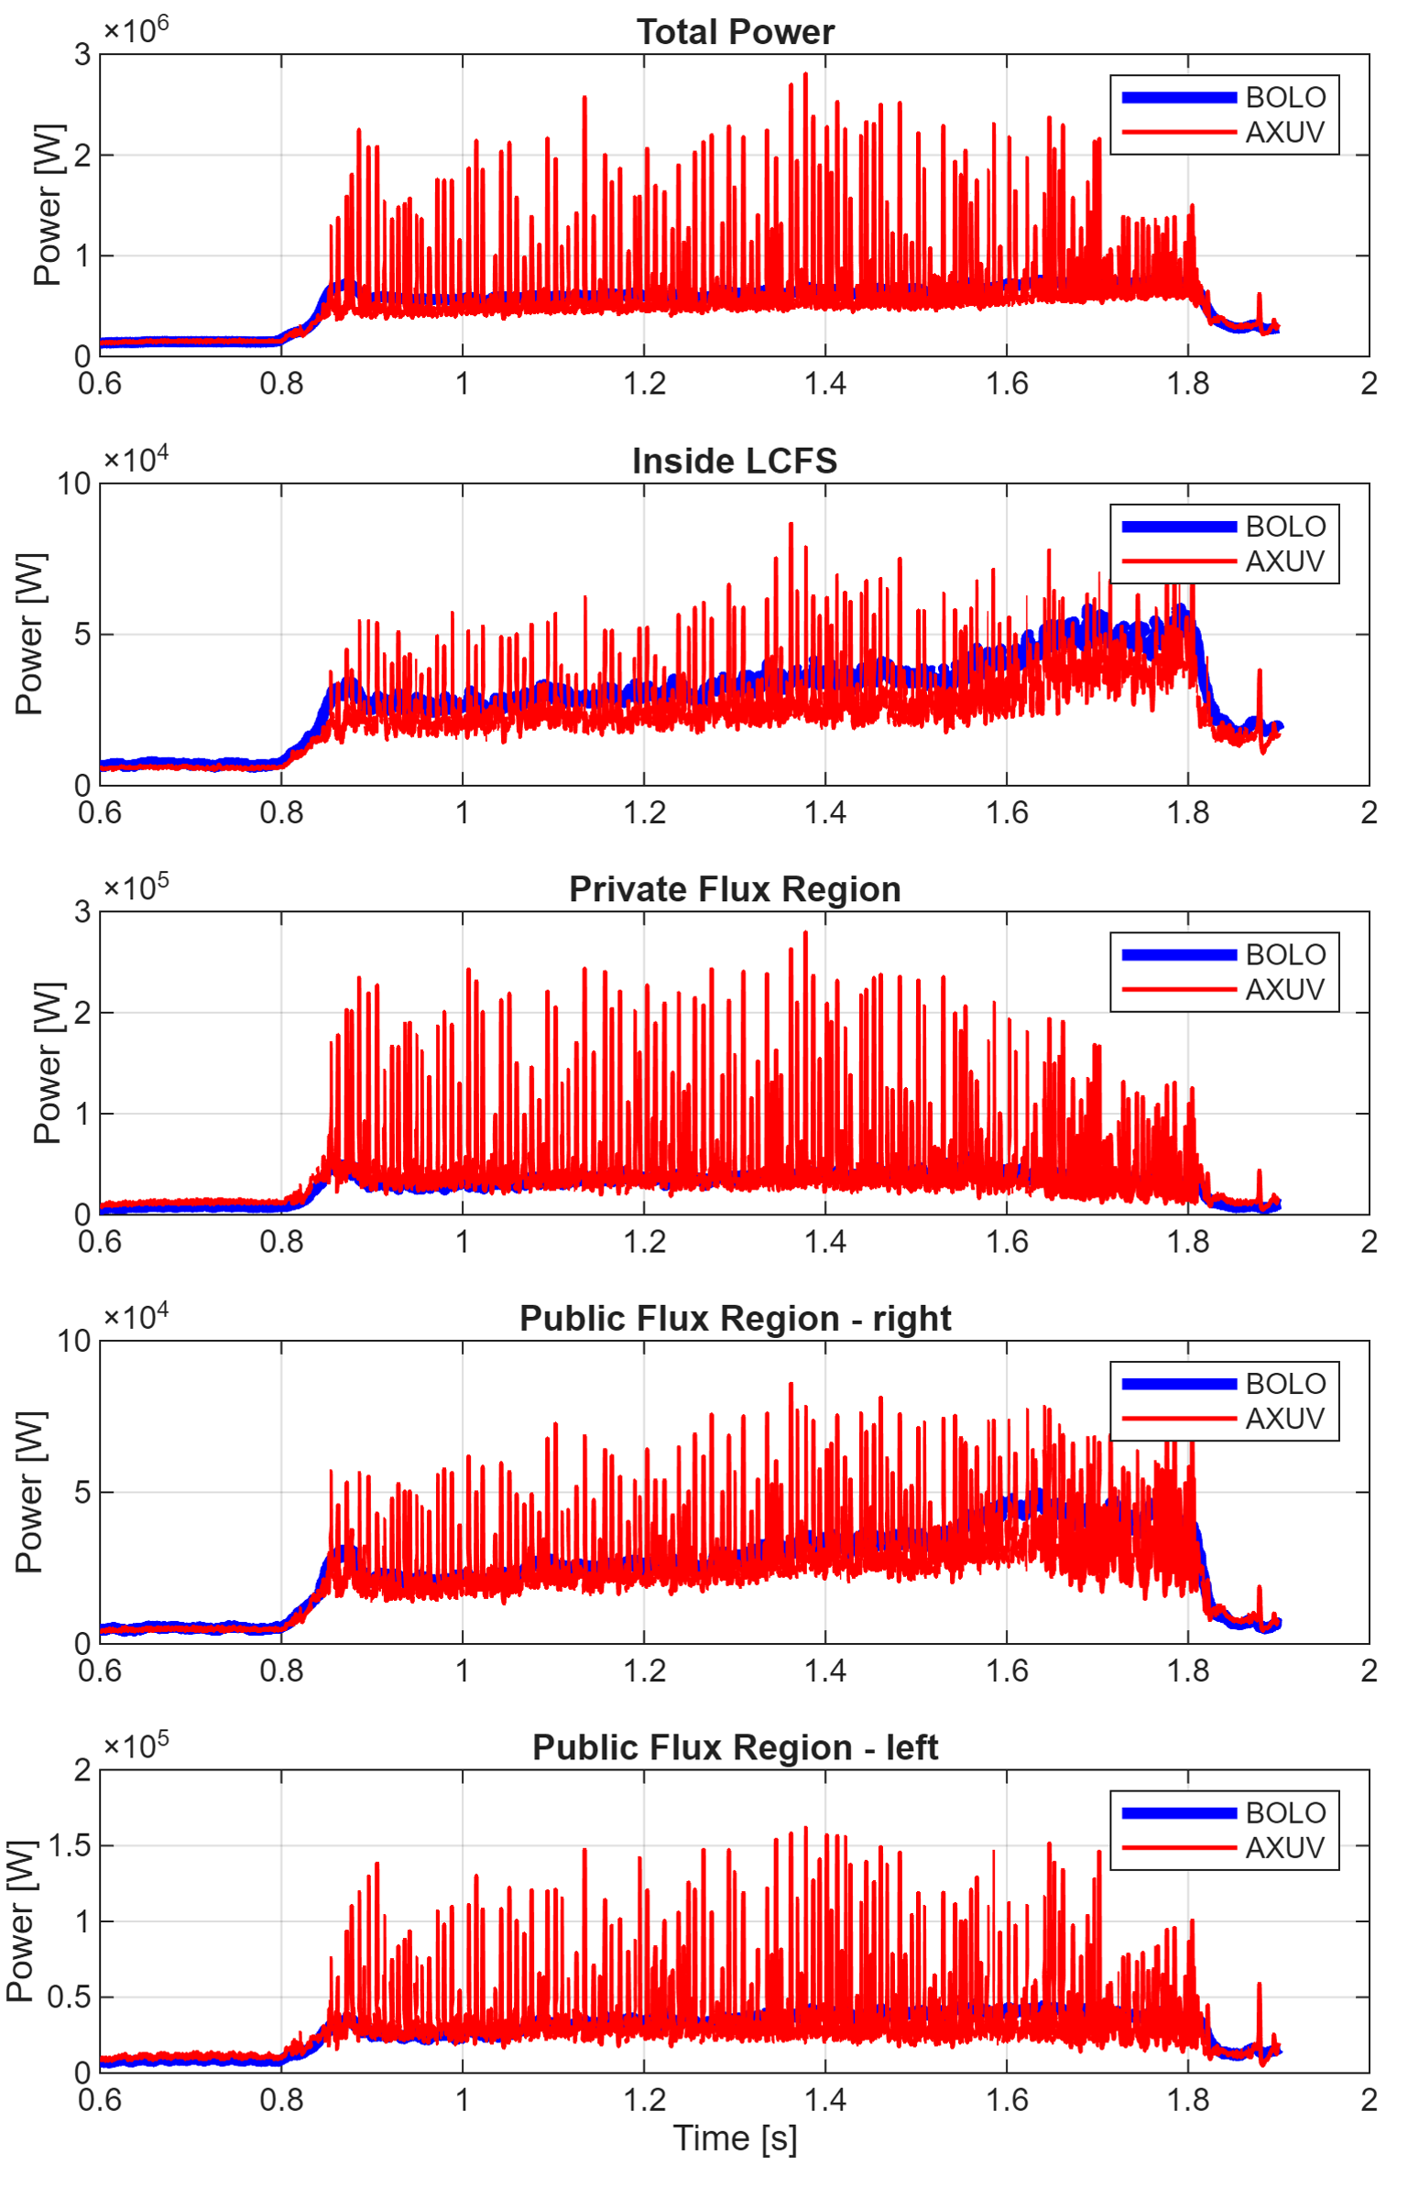
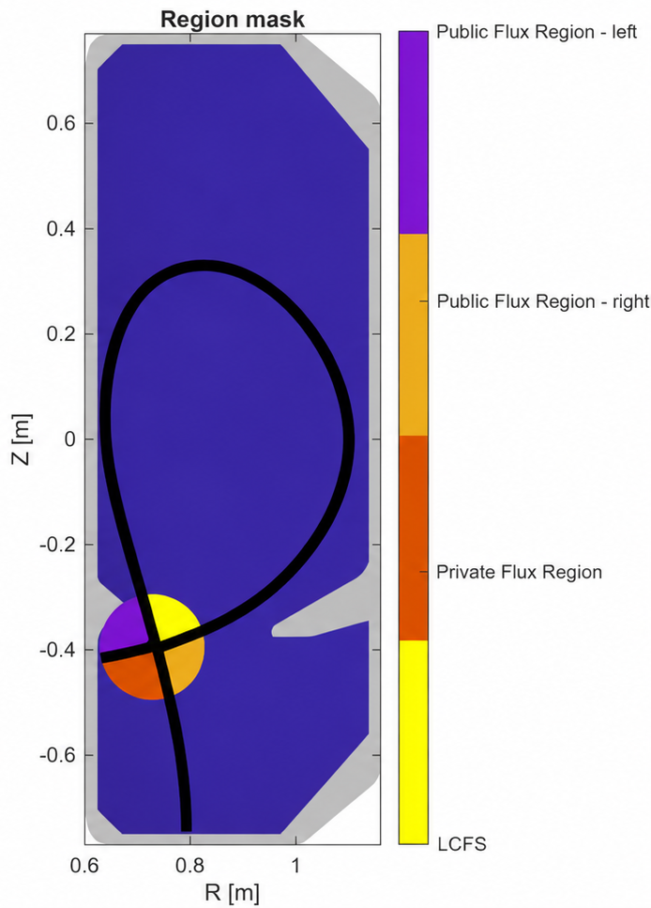
Comparison of radiated power – pulse #71157
Linear regression
TRF

Slide 15
References
K. F. Mast et al., “A low noise highly integrated bolometer array for absolute measurement of VUV and soft x radiation”, Rev. Sci. Instrum. 62, 744–750 (1991), https://doi.org/10.1063/1.1142078
B.P: Duval et al., “Experimental research on the TCV tokamak”, 2024, Nucl. Fusion 64 112023, DOI 10.1088/1741-4326/ad8361
U. Sheikh et al., “RADCAM—A radiation camera system combining foil bolometers, AXUV diodes, and filtered soft x-ray diodes”, Rev. Sci. Instrum. 93, 113513 (2022), https://doi.org/10.1063/5.0095907
I. Wyss et al., “Latest Developments in the Maximum Likelihood Tomography for Offline and Real Time Analysis of Radiation Emission in Tokamaks”, 2026, DOI 10.1088/1361-6587/ae7542

Slide 16
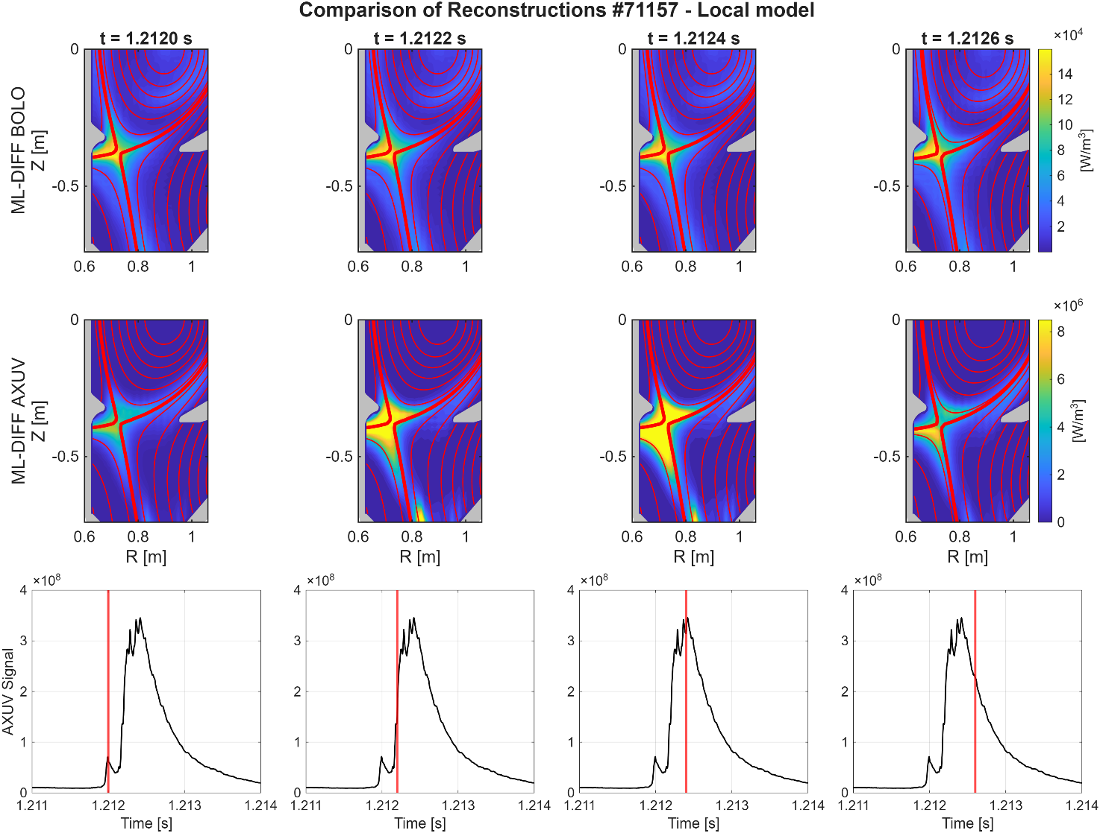
Linear Regression - local model
Shot-specific calibration: regression coefficients are determined independently for each discharge and AXUV channel.
ELM dynamics: the local calibration reproduces the radiative structure around the X-point while resolving the fast oscillations associated with ELMs.
Spatial evolution: during individual ELMs, the radiation propagation along the divertor outer leg is clearly resolved, while preserving the average localization observed by the bolometers.

Slide 17
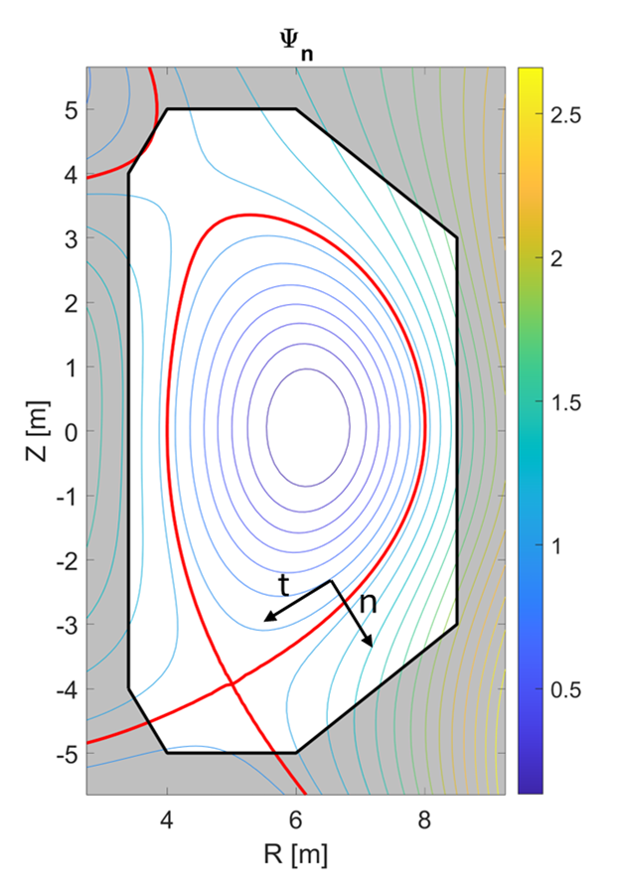
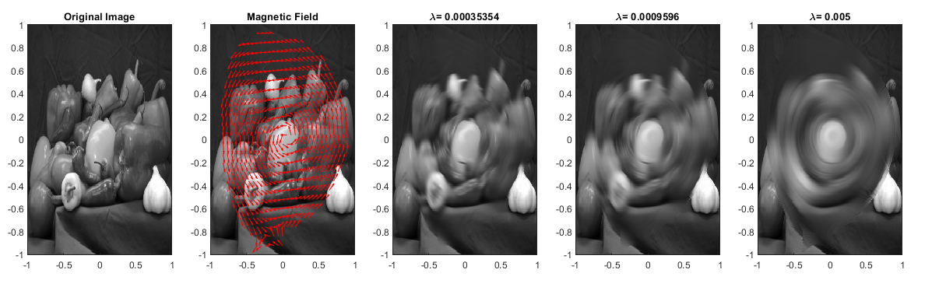
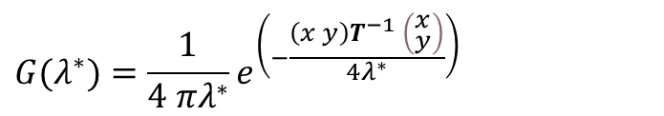
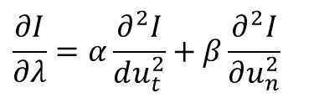

ML Diffuse
Solving the oriented PDE is equivalent to smooth the image with two oriented Gaussian.
$$\frac{∂I}{∂λ}=α\frac{∂^{2}I}{du_{t}^{2}}+β\frac{∂^{2}I}{∂u_{n}^{2}}$$
Solving for λ*
$$I\left(λ^{∗}\right)=I\left(λ=0\right)∗G(λ^{∗})$$
$$G(λ^{∗})=\frac{1}{4 πλ^{∗}}e^{\left(−\frac{\left(x y\right)T^{−1} \left(\begin{aligned}&x \\ &y\end{aligned}\right)}{4λ^{∗}}\right)}$$
I = Original Image
λ = Smoothing parameter

Slide 18
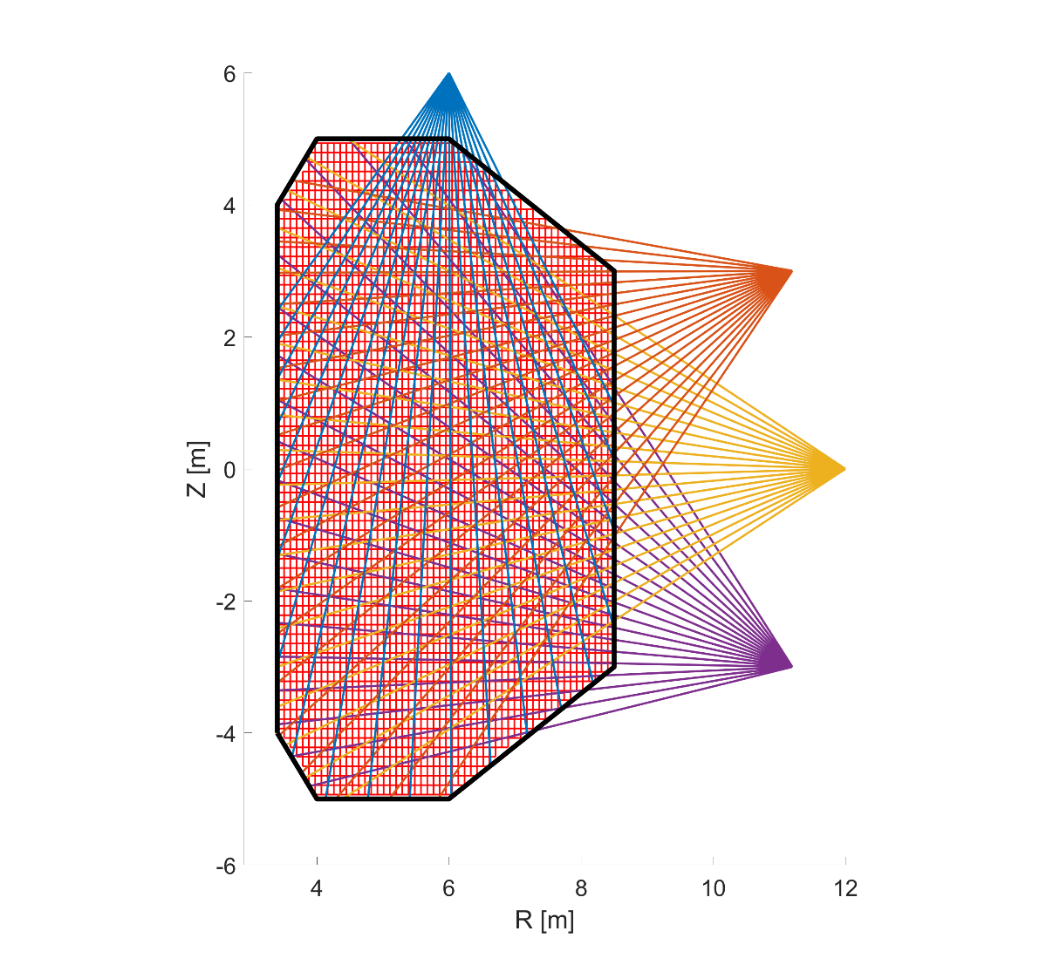


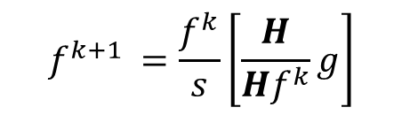



Maximum Likelihood
Discretizing into pixels, it is possiblo to write:
$$g=Hf$$
Assuming there is noise ɛ for the emissivity and n for the measurements
$$f^{k}=\overline{f^{k}}+ε^{k}$$
$$g=\overline{g}+n$$
$$f_{ML}=argmax[L\left(g | f\right)]$$
$$f^{k+1 }=\frac{f^{k}}{s}\left[\frac{H}{Hf^{k}}g\right]$$
$$V^{k+1}=\left[I−A^{k}\right]V^{k}+B^{k}$$
Regularisation
ML-Gauss
ML-Diffuse

Slide 19
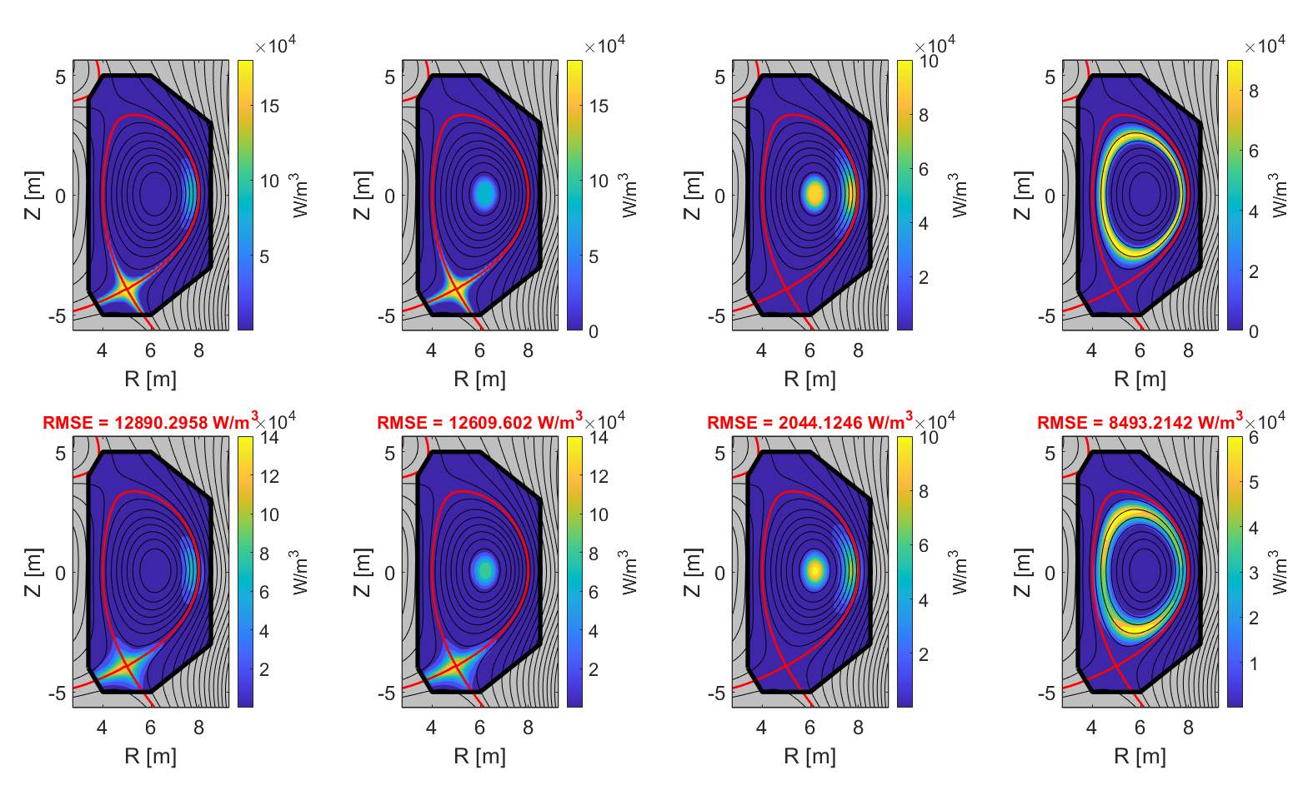
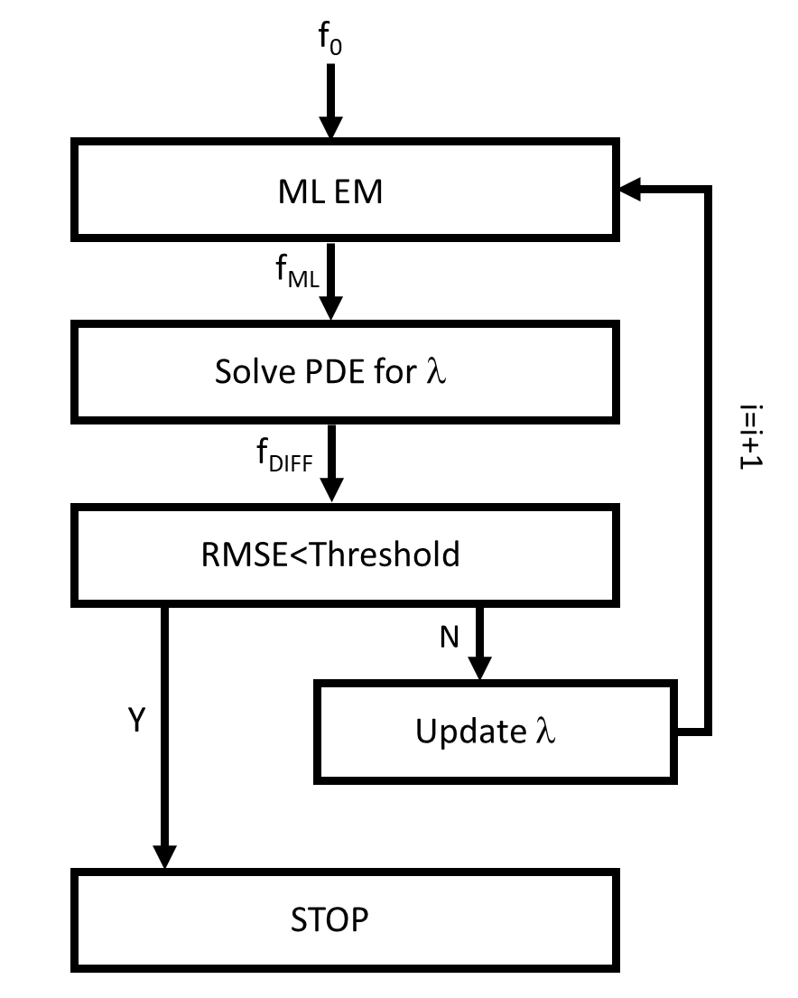
ML Diffuse
A self tuning strategy has been developed, in order to determine the best smoothing parameter. It takes 200 ms per time slices. It can be used for an inter-pulse analysis.
Phantom
Reconstruction

Slide 20
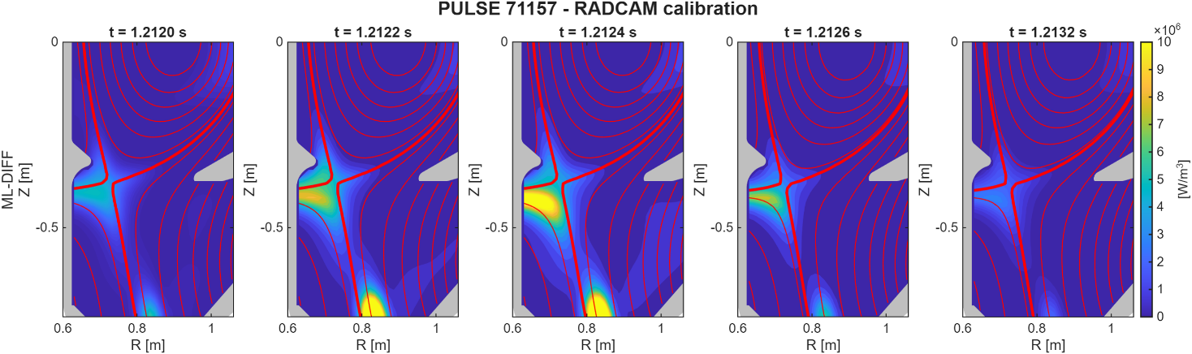
PULSE #71157 – ELM event
Discharge evolution: the plasma current reaches a quasi-stationary flat-top after the ramp-up and plasma formation phase.
Initial emission: during plasma formation, the radiated power is broadly distributed across the plasma volume.
X-point formation: as the magnetic configuration evolves, the radiation progressively moves downward and becomes localized around the X-point and divertor region.
Bolometric temporal resolution: the radiative pattern appears relatively stationary because bolometers provide a time-averaged response and cannot resolve the rapid transient dynamics of individual ELMs.
Notes:
Troppo scritta: initial emission, discharge evolution levare

Slide 21
The problem
BOLO
AXUV
Filmato Bolo 78746
da 15 s tutta la scarica
Notes:
Più piccoli video, elenco puntato differenza bolo e diodi, terzo bullett: cross-calibration

Slide 22
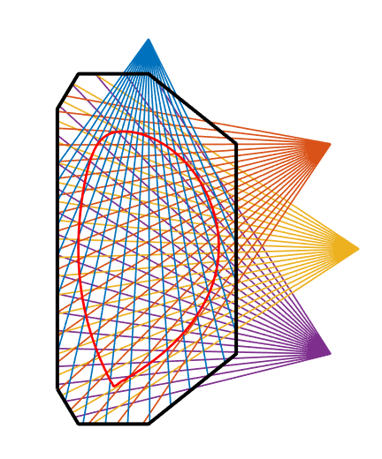
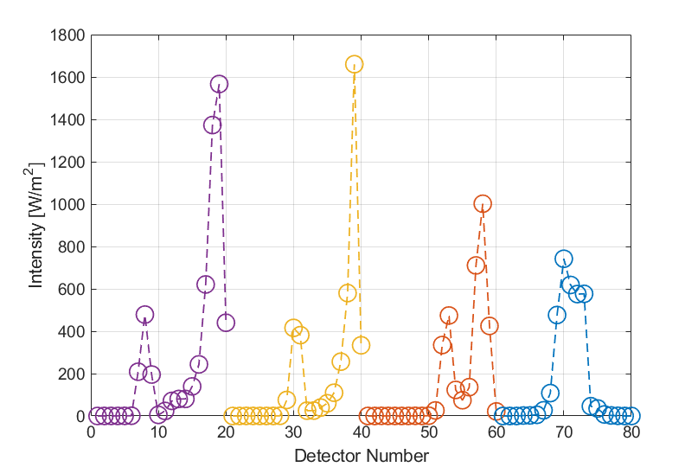
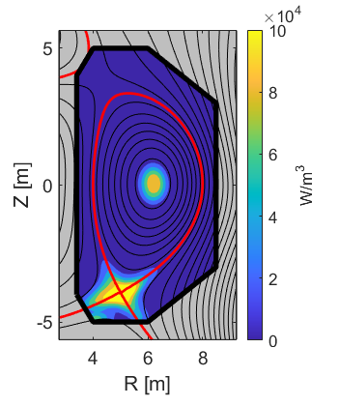
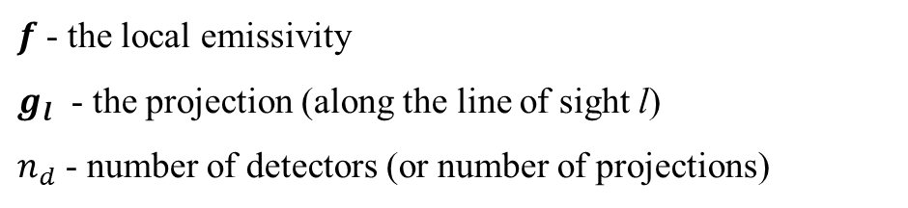
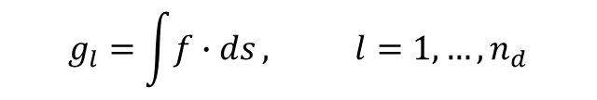
Tomography
Tomography is an ill-posed inverse problem
$f$ - the local emissivity
$g_{l}$ - the projection (along the line of sight l)
$n_{d}$ - number of detectors (or number of projections)
$$g_{l}=\int{f∙ds}, l=1,…,n_{d}$$
Notes:
Levare misure, citare maximum likelihood, provare a compattare con slide della tomografia

