Slide 1





Integrating magnetic and kinetic measurements in the equilibrium reconstruction of tokamaks with Physics Based Neural Networks
ICFDT8 – 8th International Conference on Frontier in Diagnostic Technologies
N. Rutigliano^{1,2} , A. Murari^{3,4}, P. Gaudio², M. Gelfusa², I. Wyss², R. Rossi²
On behalf of JET contributors and the EUROfusion Tokamak Exploitation Team
¹ DTT S.c.a.r.l.
² “Tor Vergata” University of Rome, Industrial Engineering Department
³ Consorzio RFX (CNR, ENEA, INFN, Università di Padova, Acciaierie Venete SpA)
⁴ Istituto per la Scienza e la Tecnologia dei Plasmi, CNR
Contact: novella.rutigliano@dtt-project.it

Slide 2
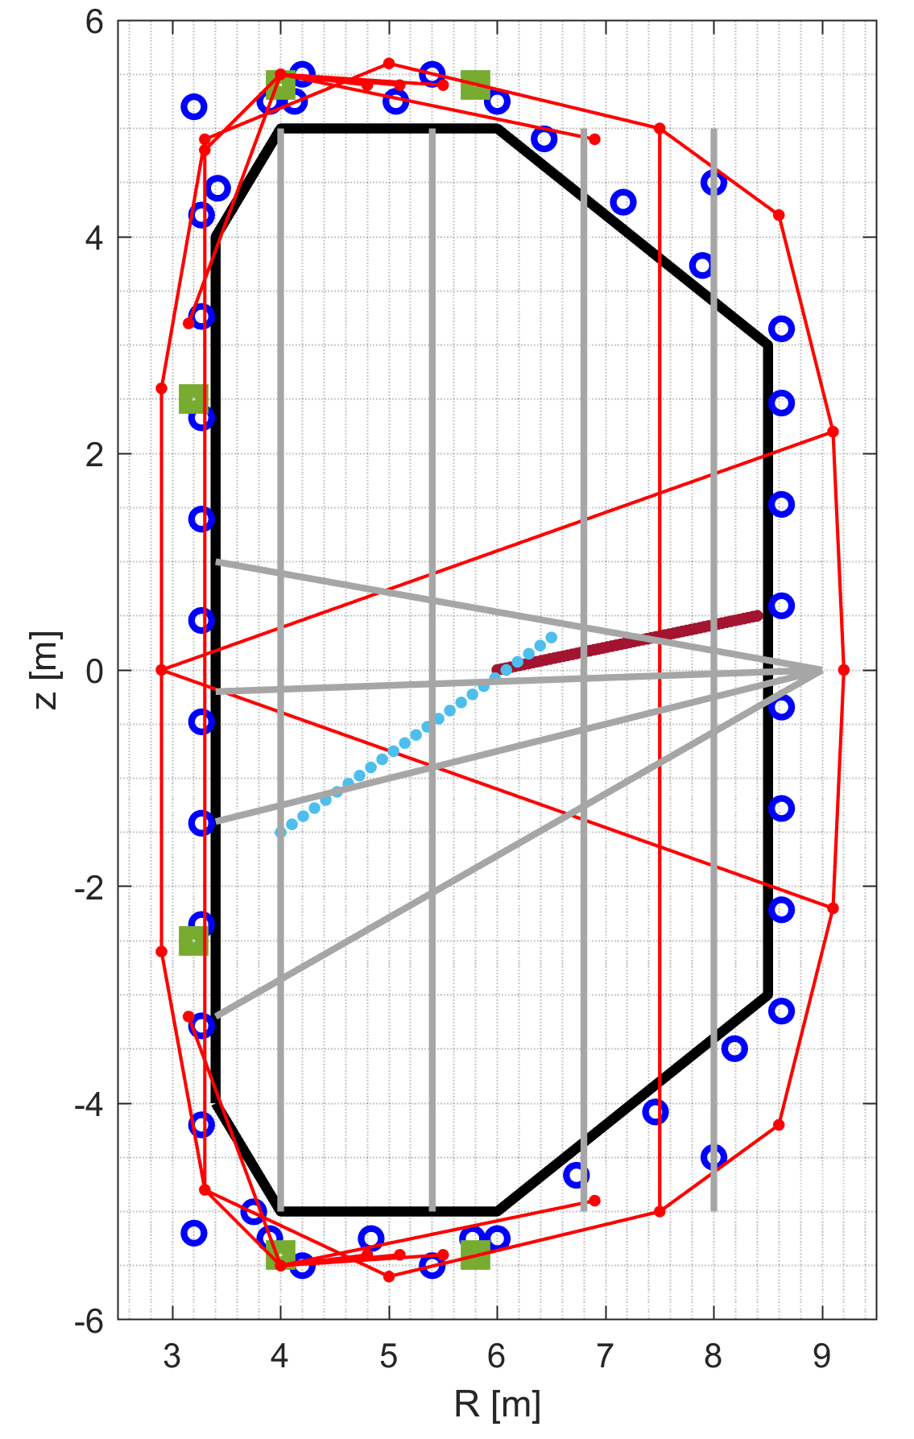
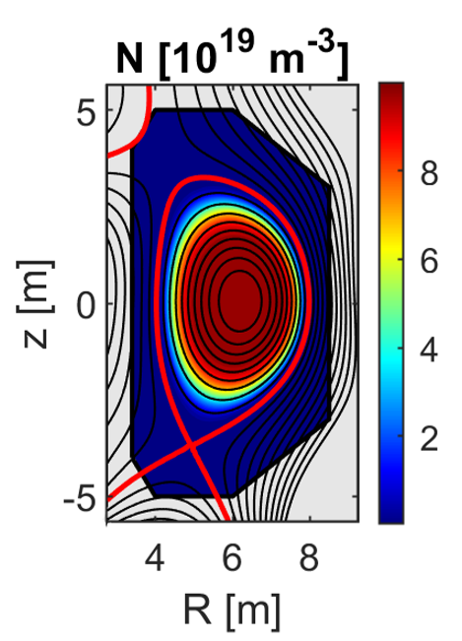
Equilibrium reconstruction in tokamaks
Equilibrium reconstruction in tokamaks is an inverse problem: it aims to infer plasma quantities from measurements.
Reconstructing the plasma state is fundamental
This work’s context
Control
Physics unknowns discovery
Real-time requirements
Accuracy, flexibility and modularity requirements
Diagnostics schematic representation
Inferred plasma density

Slide 3
Equilibrium reconstruction in tokamaks
Equilibrium reconstruction in tokamaks must be must be as accurate and well-resolved as possible.
Diagnostics
Increasing the amount of information (adopting a multi-diagnostics approach)
High-fidelity modelling of diagnostics
Outlier management
Physics
Removing simplifying assumptions to get to a complete model.
AND
Physics-Informed Neural Networks (PINNs)

Slide 4
Integrated Data Analysis and Physics-Informed Neural Networks
PINNs are a deep learning methodology that combines information about the governing physical equations and measurements. (First article on PINNs is from 2019 – Raissi et al., 2019 J. Comp. Phys.)
Useful in various scientific and technological applications: predictive models for physics-guided extrapolation and regularisation, solving PDEs with a meshless approach and domain decomposition, and addressing problems with incomplete physics information
The consistency with the physics equation avoids the overfitting of noise or outliers (noise and outliers are not solutions of the PDE). So, the algorithm can be used to “diagnose diagnostics” and for cross-calibration [1].
The integration of new physical constraints or models and of new diagnostics in the model is very easy [1,2].
Each scenario requires a dedicated training, which takes hours, so the method is not suitable for real-time use. It is meant to support post-pulse analyses for physics interpretation and knowledge discovery.
[1] M. Raissi et al., 2019 Journal of Computational Physics

Slide 5
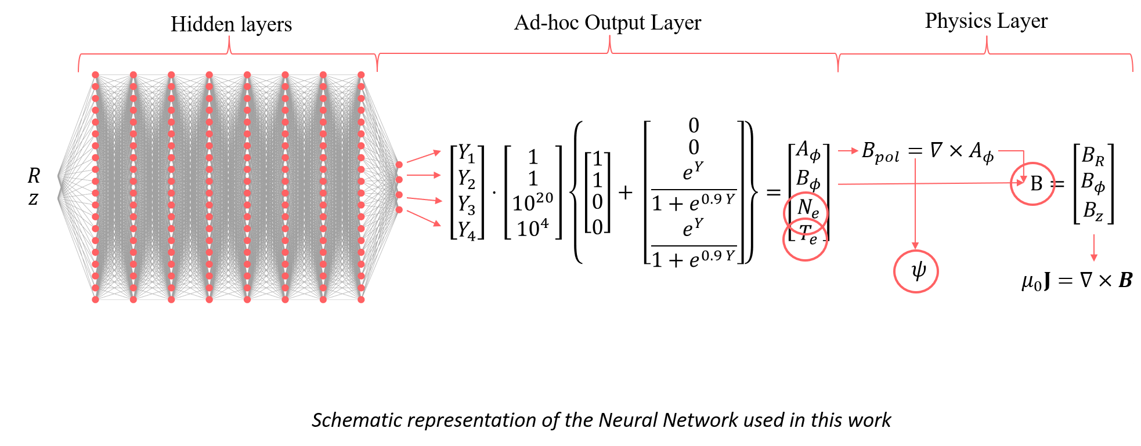
Some preliminaries: neural networks
A neural network (NN) is a mathematical model $f$ defined by several parameters $θ$ that, given the features (or inputs) $X$, returns the targets (or outputs) $Y$: $Y=f\left(θ,X\right)$
From the universal approximation theorem, we can assert that: “a sufficiently deep neural network can approximate any function”. The process to tune the parameters $θ$ is known as training.

Slide 6
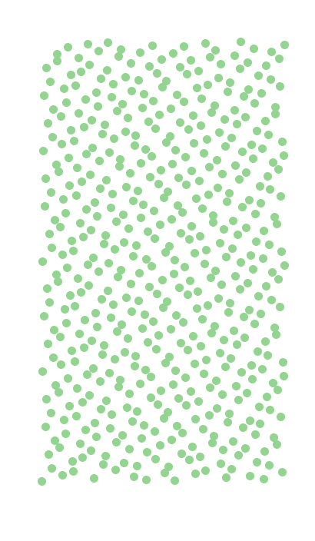
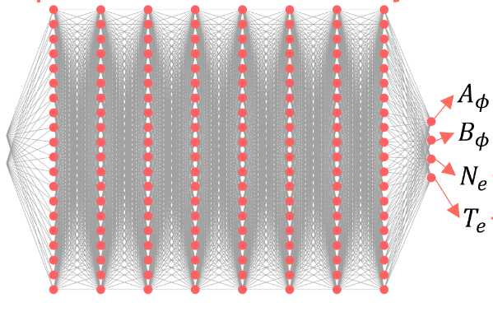
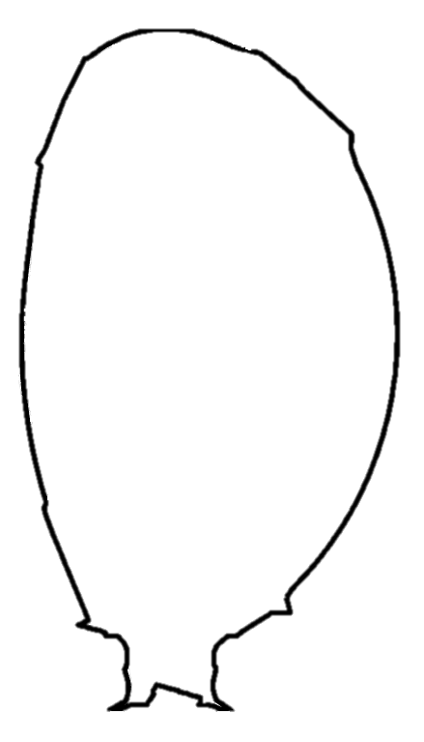
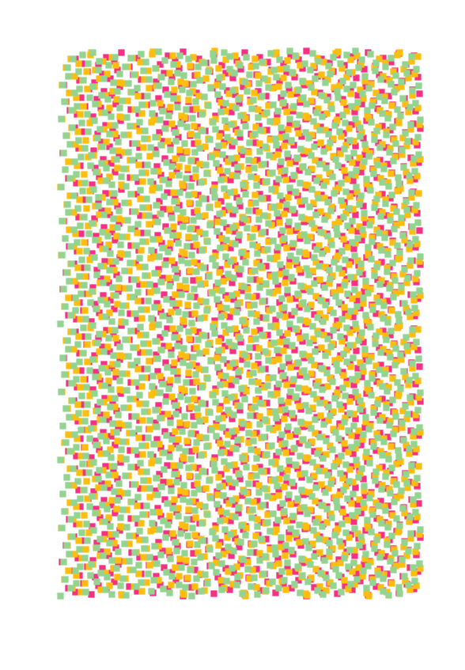


Physics-Informed Neural Network Training Algorithm
Physics equations
Measurements
R
Loss_{measurements}
Collocation points
z
Loss_{physics}
Geometry
R
New mini-batch
Loss_{tot}
z
$θ$ update (ADAM)
$∇_{θ}$(Loss_{tot})
Diagnostics Position (R_{i}, z_{i})
iterations
Stop condition fulfilled?
NO
End of the training process
YES

Slide 7
Working on the diagnostics’ side: multi-diagnostics approach, high-fidelity modelling and outlier management

Slide 8
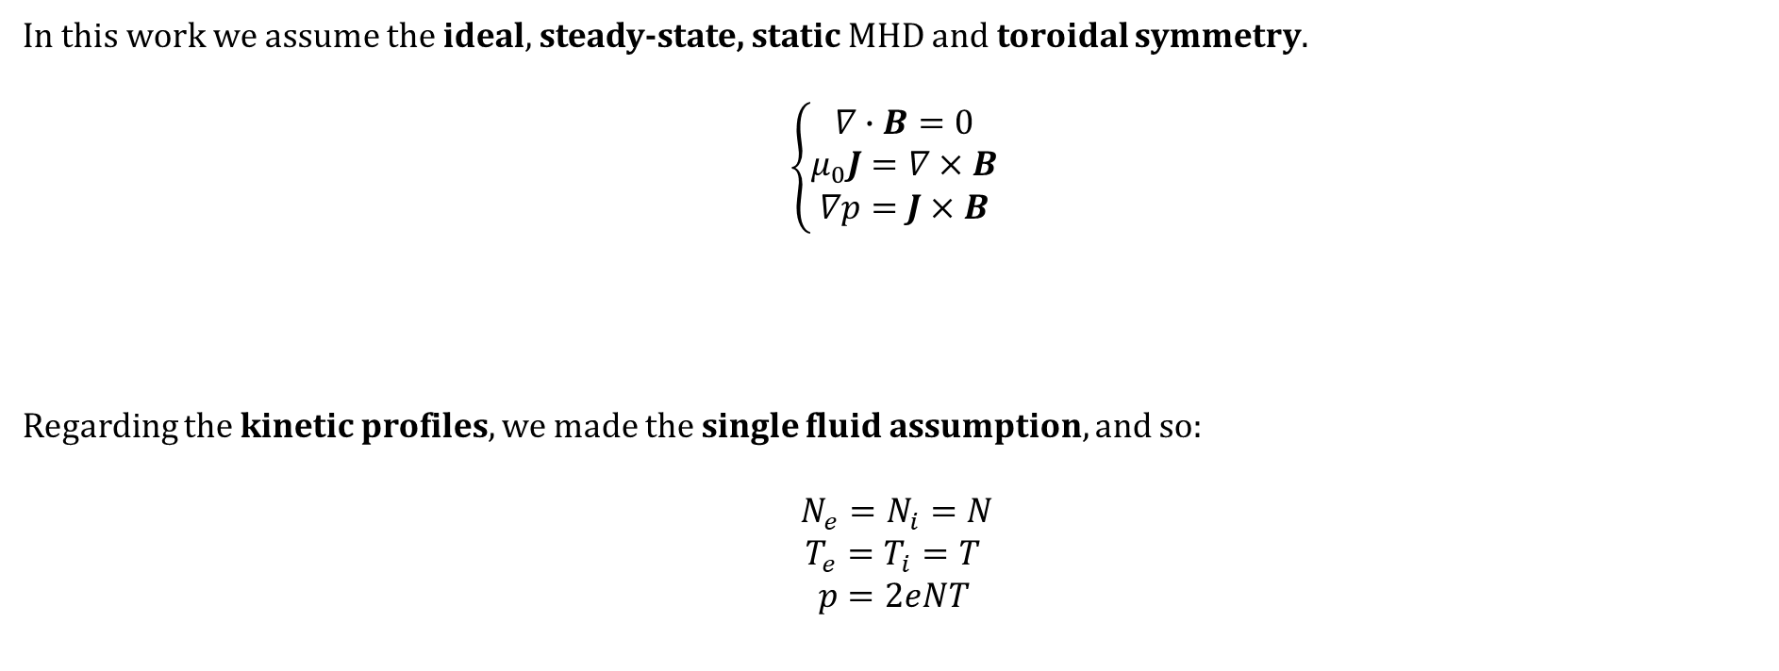
Physics Equations: Standard Assumptions
In this work we assume the ideal, steady-state, static MHD and toroidal symmetry.
$$\left\{\begin{aligned}∇∙B=0 \\ μ_{0}J=∇×B \\ ∇p=J×B\end{aligned}\right.$$
Regarding the kinetic profiles, we made the single fluid assumption, and so:
$N_{e}=N_{i}=N$
$T_{e}=T_{i}=T$
$$p=2eNT$$

Slide 9

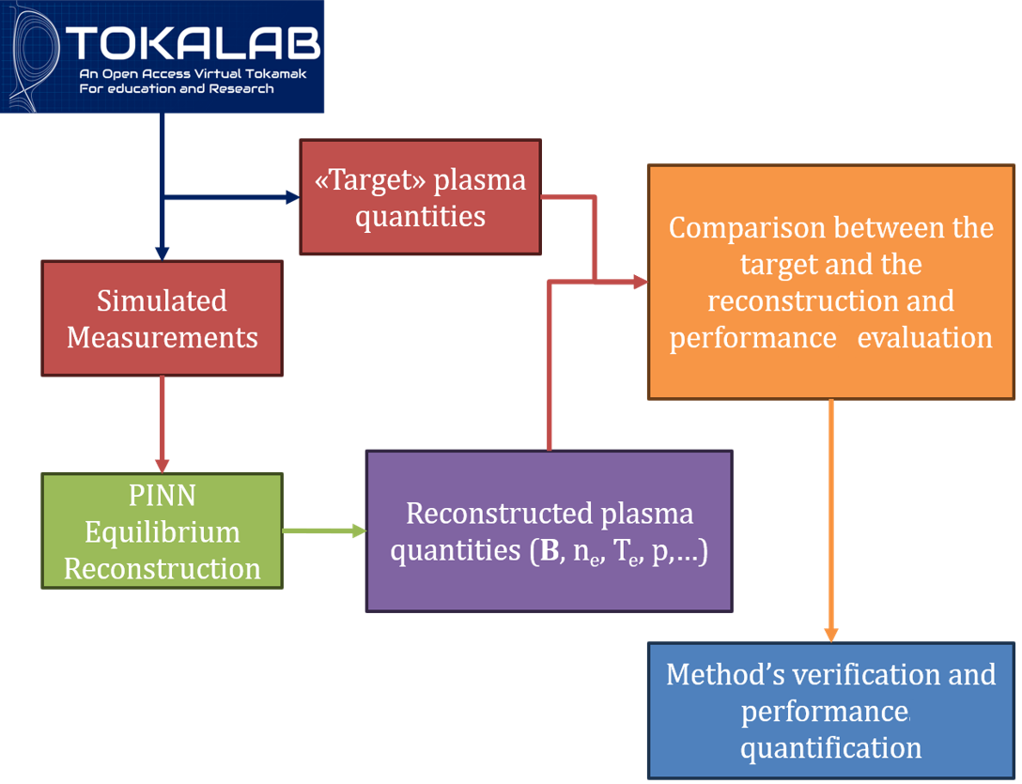
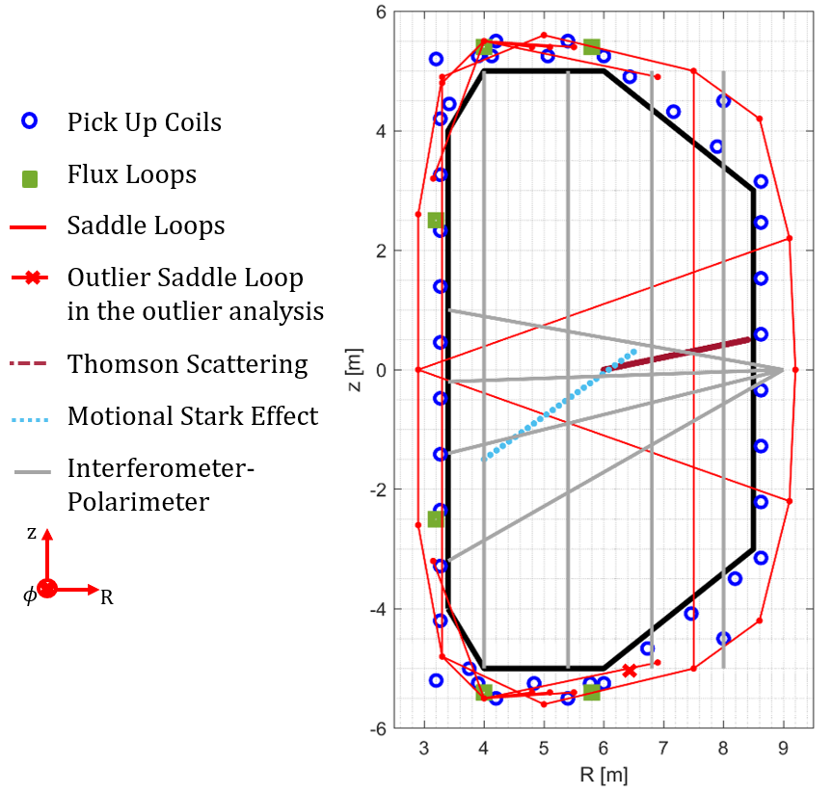
TokaLab Geometry and Diagnostics
We used TokaLab: an open-access virtual tokamak for education and research (available at https://tokalab.github.io/).
Talk by R. Rossi, «TokaLab: an open-access and open-source FAIR framework for tokamak synthetic diagnostics and inverse problems benchmarking»

Slide 10
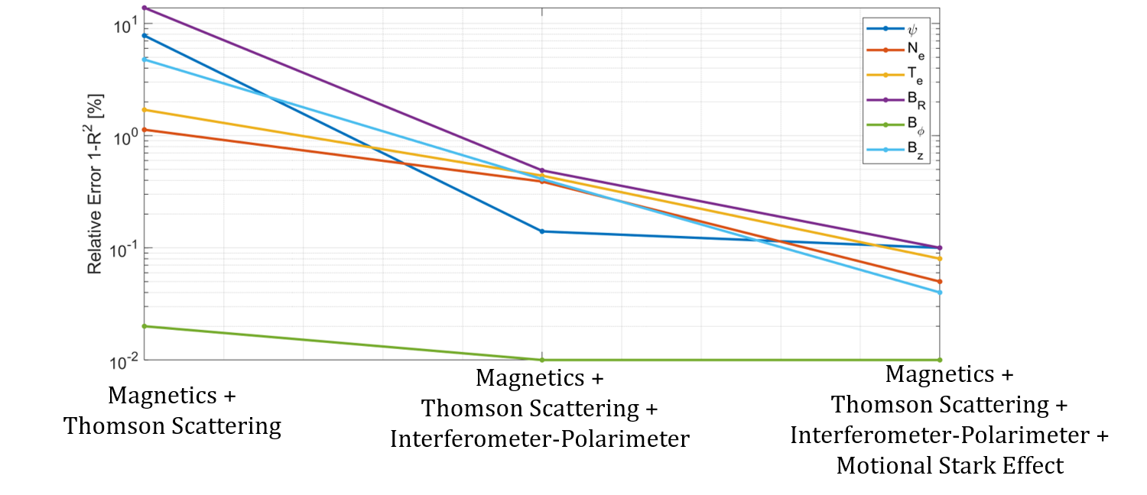
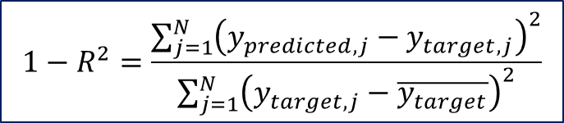
The importance of a multi-diagnostics approach
$$1−R^{2}=\frac{\sum_{j=1}^{N}{{\left(y_{predicted,j}−y_{target,j}\right)}^{2}}}{\sum_{j=1}^{N}{{\left(y_{target,j}−\overline{y_{target}}\right)}^{2}}}$$

Slide 11
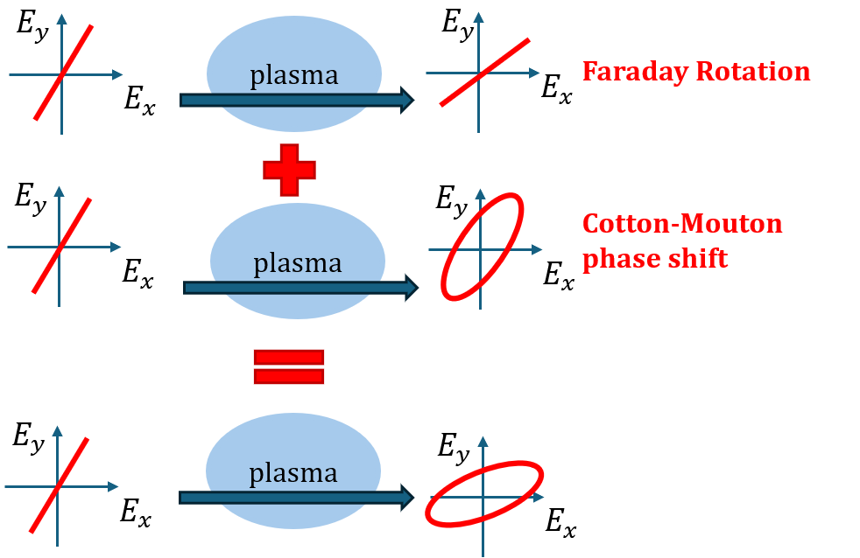
The importance of diagnostics’ high-fidelity modelling
The polarimeter measures two important effects of the interaction between the plasma and a probing laser beam: the Faraday rotation and the Cotton-Mouton phase shift.
These effects are non-linear.
Usually the linear approximation (type-I approximation) is made to reconstruct polarimetric measurements in tokamaks.
In this work we used a complete Stokes formulation for polarimetric measurements and also introduced relativistic effects for the hot plasma approximation.
N. Rutigliano, et al, PPCF 67 (2025), doi: 10.1088/1361-6587/addde6

Slide 12
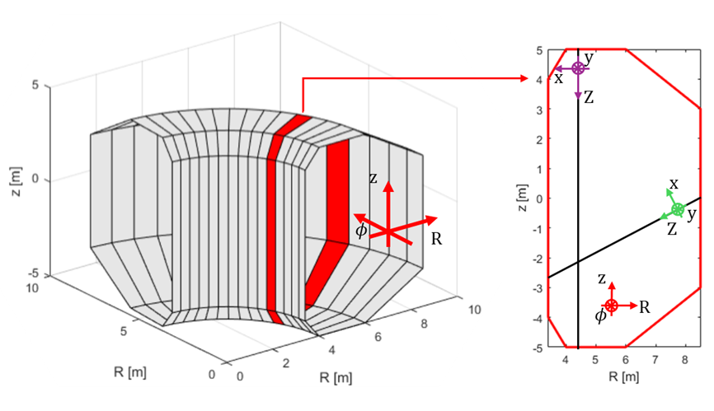
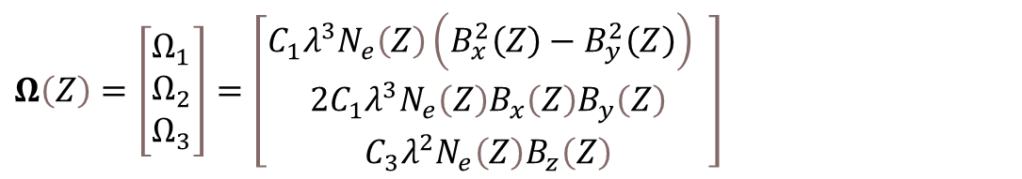
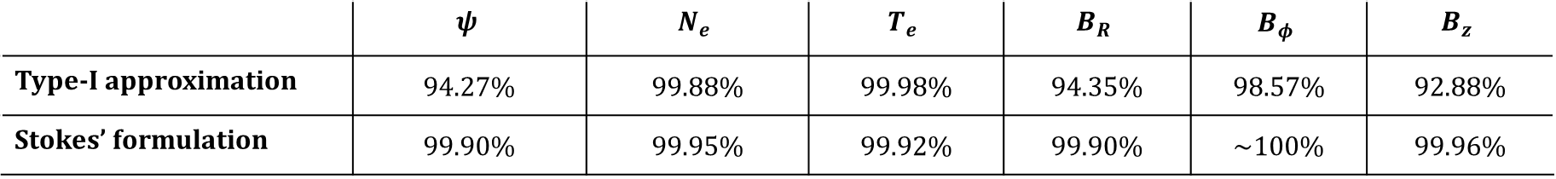
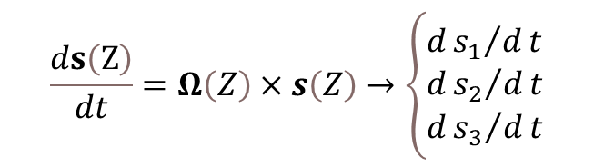
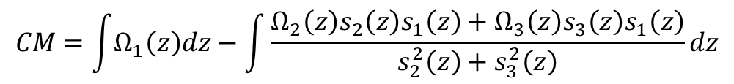
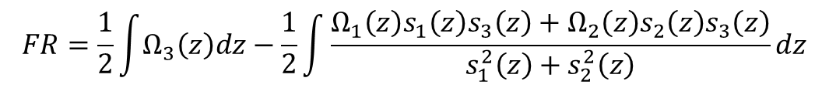
Stokes’ formulation vs type-I assumption
$$\frac{ds\left(Z\right)}{dt}=Ω\left(Z\right)×s\left(Z\right)→\left\{\begin{aligned}&d{s_{1}}/dt \\ &d{s_{2}}/dt \\ &d{s_{3}}/dt\end{aligned}\right.$$
$$Ω\left(Z\right)=\left[\begin{matrix}Ω_{1} \\ Ω_{2} \\ Ω_{3}\end{matrix}\right]=\left[\begin{matrix}C_{1}λ^{3}N_{e}\left(Z\right)\left(B_{x}^{2}\left(Z\right)−B_{y}^{2}\left(Z\right)\right) \\ 2C_{1}λ^{3}N_{e}\left(Z\right)B_{x}\left(Z\right)B_{y}\left(Z\right) \\ C_{3}λ^{2}N_{e}\left(Z\right)B_{z}\left(Z\right)\end{matrix}\right]$$
$$FR=\frac{1}{2}\int{Ω_{3}\left(z\right)dz}−\frac{1}{2}\int{\frac{Ω_{1}\left(z\right)s_{1}\left(z\right)s_{3}\left(z\right)+Ω_{2}\left(z\right)s_{2}\left(z\right)s_{3}\left(z\right)}{s_{1}^{2}\left(z\right)+s_{2}^{2}\left(z\right)}}dz$$
Schematic representation of the frame of reference for both the lab reference system and the interferometer-polarimeter lines of sight
$$CM=\int{Ω_{1}\left(z\right)dz}−\int{\frac{Ω_{2}\left(z\right)s_{2}\left(z\right)s_{1}\left(z\right)+Ω_{3}\left(z\right)s_{3}\left(z\right)s_{1}\left(z\right)}{s_{2}^{2}\left(z\right)+s_{3}^{2}\left(z\right)}dz}$$
 | $$ψ$$ | $$N_{e}$$ | $$T_{e}$$ | $$B_{R}$$ | $$B_{φ}$$ | $$B_{z}$$
Type-I approximation | 94.27% | 99.88% | 99.98% | 94.35% | 98.57% | 92.88%
Stokes’ formulation | 99.90% | 99.95% | 99.92% | 99.90% | ~100% | 99.96%

Slide 13
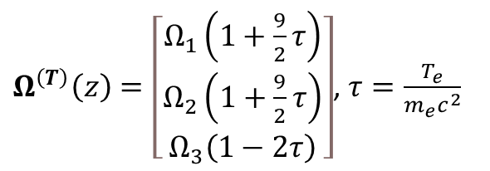
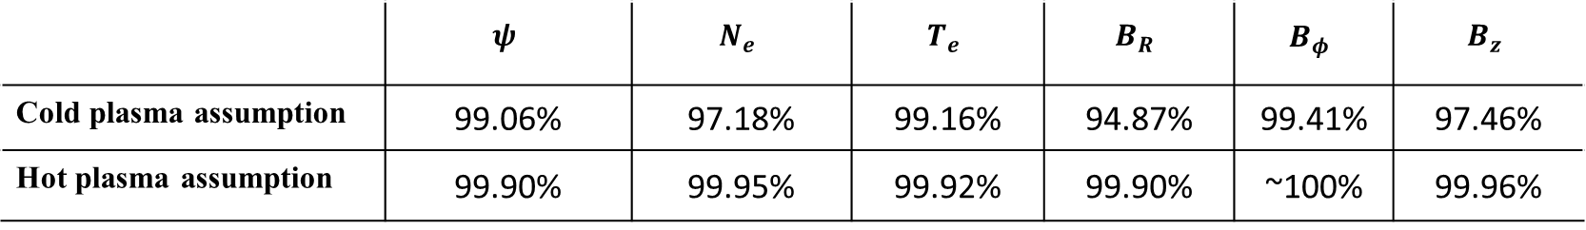
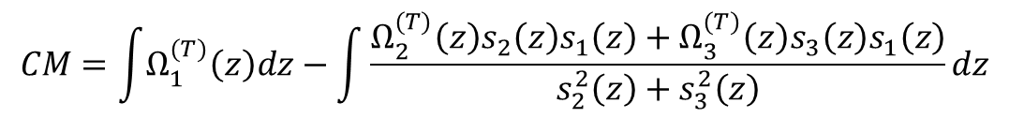
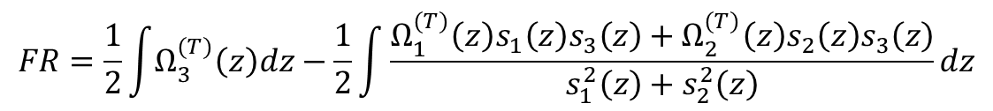
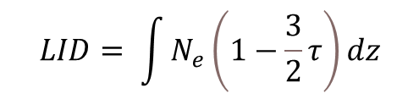
Hot plasma assumption
$$FR=\frac{1}{2}\int{Ω_{3}^{(T)}\left(z\right)dz}−\frac{1}{2}\int{\frac{Ω_{1}^{(T)}\left(z\right)s_{1}\left(z\right)s_{3}\left(z\right)+Ω_{2}^{(T)}\left(z\right)s_{2}\left(z\right)s_{3}\left(z\right)}{s_{1}^{2}\left(z\right)+s_{2}^{2}\left(z\right)}}dz$$
$Ω^{\left(T\right)}\left(z\right)=\left[\begin{matrix}Ω_{1}\left(1+\frac{9}{2}τ\right) \\ Ω_{2}\left(1+\frac{9}{2}τ\right) \\ Ω_{3}\left(1−2τ\right)\end{matrix}\right]$, $τ=\frac{T_{e}}{m_{e}c^{2}}$
$$CM=\int{Ω_{1}^{(T)}\left(z\right)dz}−\int{\frac{Ω_{2}^{(T)}\left(z\right)s_{2}\left(z\right)s_{1}\left(z\right)+Ω_{3}^{(T)}\left(z\right)s_{3}\left(z\right)s_{1}\left(z\right)}{s_{2}^{2}\left(z\right)+s_{3}^{2}\left(z\right)}dz}$$
$$LID= \int{N_{e}\left(1−\frac{3}{2}τ\right)dz}$$
 | $$ψ$$ | $$N_{e}$$ | $$T_{e}$$ | $$B_{R}$$ | $$B_{φ}$$ | $$B_{z}$$
Cold plasma assumption | 99.06% | 97.18% | 99.16% | 94.87% | 99.41% | 97.46%
Hot plasma assumption | 99.90% | 99.95% | 99.92% | 99.90% | ~100% | 99.96%

Slide 14
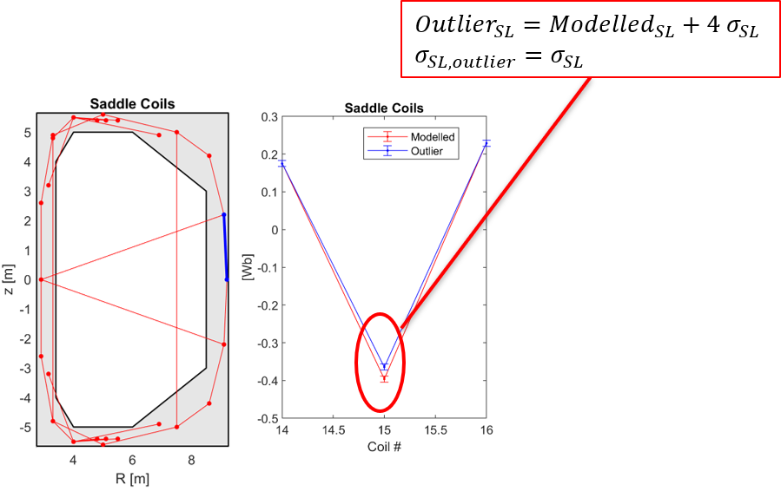
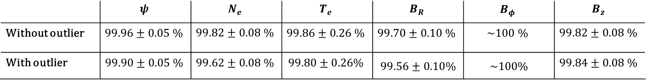
Robustness with respect to outliers
Sometimes diagnostics may be faulty resulting in outlier measurements. It can be difficult to detect them.
Outliers are not a solution to the PDE. So, thanks to the multi-diagnostics approach, the system is over-constrained, and the PINN can filter them out.
Schematic representation of a faulty saddle coil.
Table 1. R² between target and reconstructed fields and associated uncertainties obtained with 10 independent trainings.
 | $$ψ$$ | $$N_{e}$$ | $$T_{e}$$ | $$B_{R}$$ | $$B_{φ}$$ | $$B_{z}$$
Without outlier | $$99.96±0.05 \%$$ | $$99.82±0.08 \%$$ | $$99.86±0.26 \%$$ | $$99.70±0.10 \%$$ | $$\sim 100 \%$$ | $$99.82±0.08 \%$$
With outlier | $$99.90±0.05 \%$$ | $$99.62±0.08 \%$$ | $$99.80±0.26\%$$ | $99.56±0.10$% | ~100% | $$99.84±0.08 \%$$

Slide 15
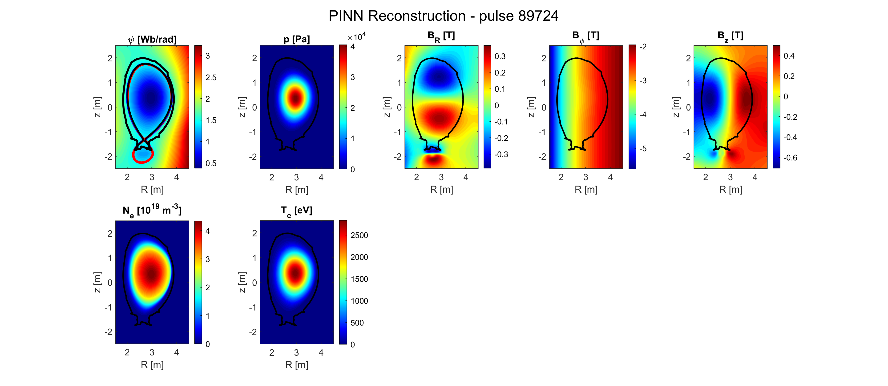
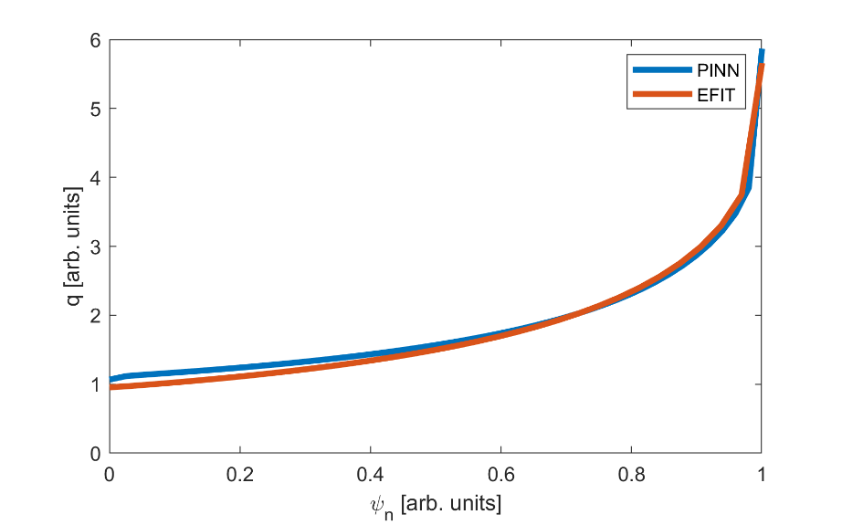
Validation, Benchmarking and Application to JET pulses
Validation with experimental data, benchmark with EFIT++ suite, and application to high-performance pulses (#89724, #99948, #99950).
EFIT
PINN
N. Rutigliano et al., 2026 Nucl. Fusion (66) https://doi.org/10.1088/1741-4326/ae4916
PINN reconstruction of pulse #89724
q profile

Slide 16
Physics’ side: towards a complete model

Slide 17

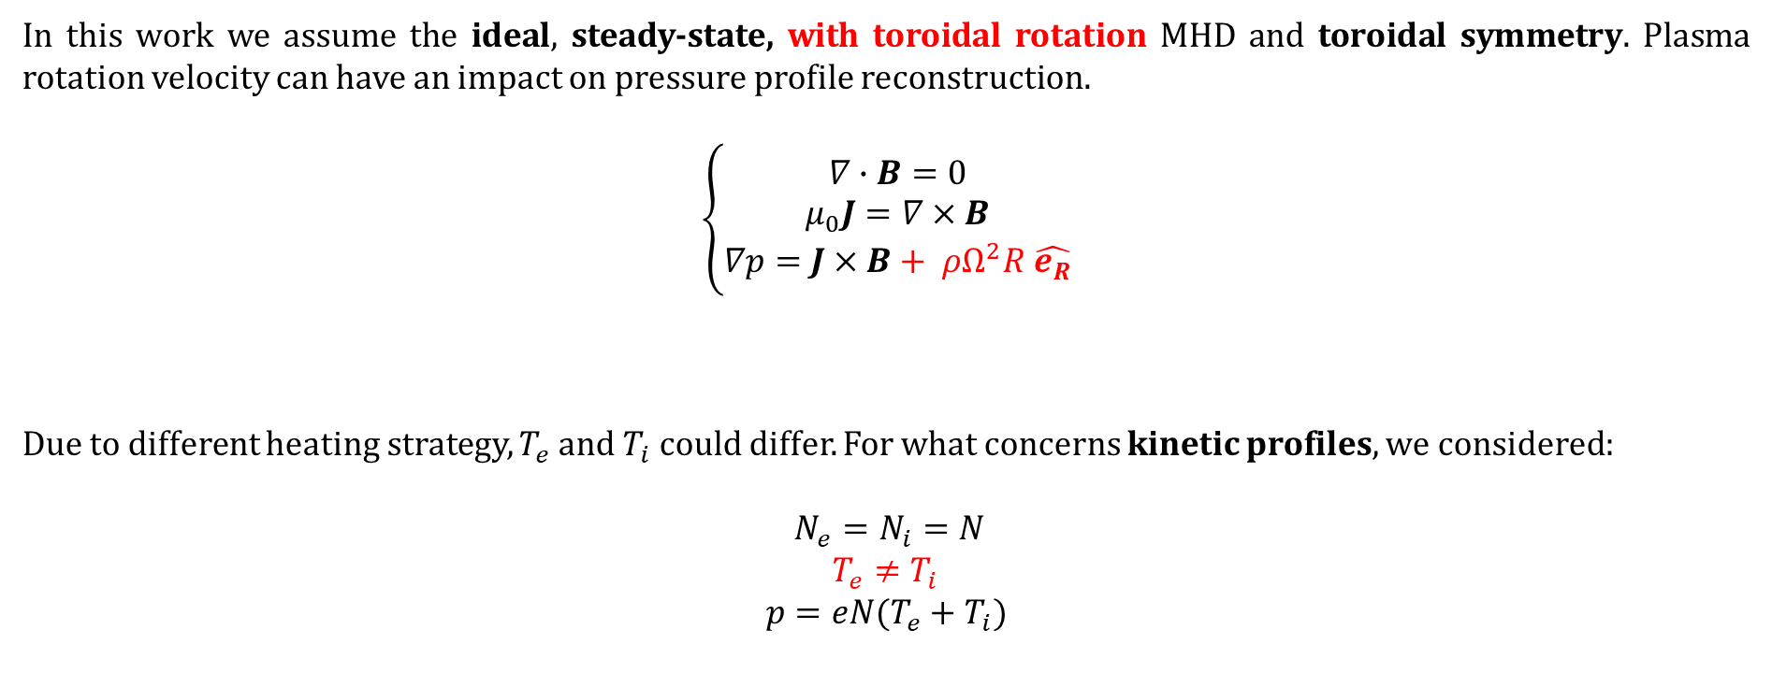
Physics Equations
In this work we assume the ideal, steady-state, with toroidal rotation MHD and toroidal symmetry. Plasma rotation velocity can have an impact on pressure profile reconstruction.
$$\left\{\begin{aligned}∇∙B=0 \\ μ_{0}J=∇×B \\ ∇p=J×B+ ρΩ^{2}R \hat{e_{R}}\end{aligned}\right.$$
Due to different heating strategy, $T_{e}$ and $T_{i}$could differ. For what concerns kinetic profiles, we considered:
$N_{e}=N_{i}=N$
$T_{e}≠T_{i}$
$$p=eN(T_{e}+T_{i})$$
$$ρ=m_{i}n_{i}+m_{e}n_{e}=n_{e}(m_{i}+m_{e})$$

Slide 18
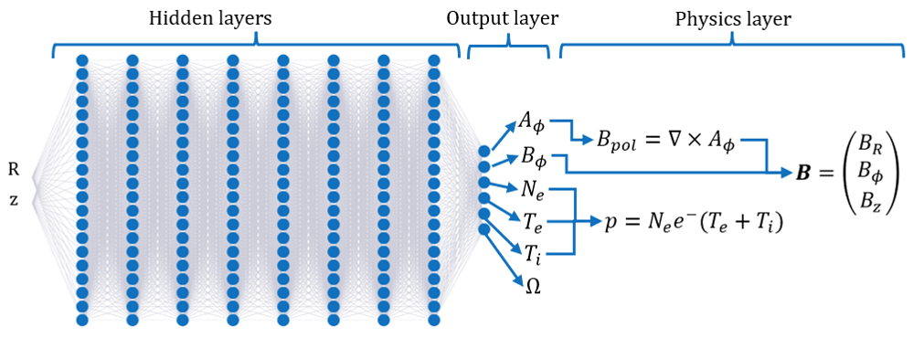
Neural Network
Modified neural network architecture

Slide 19
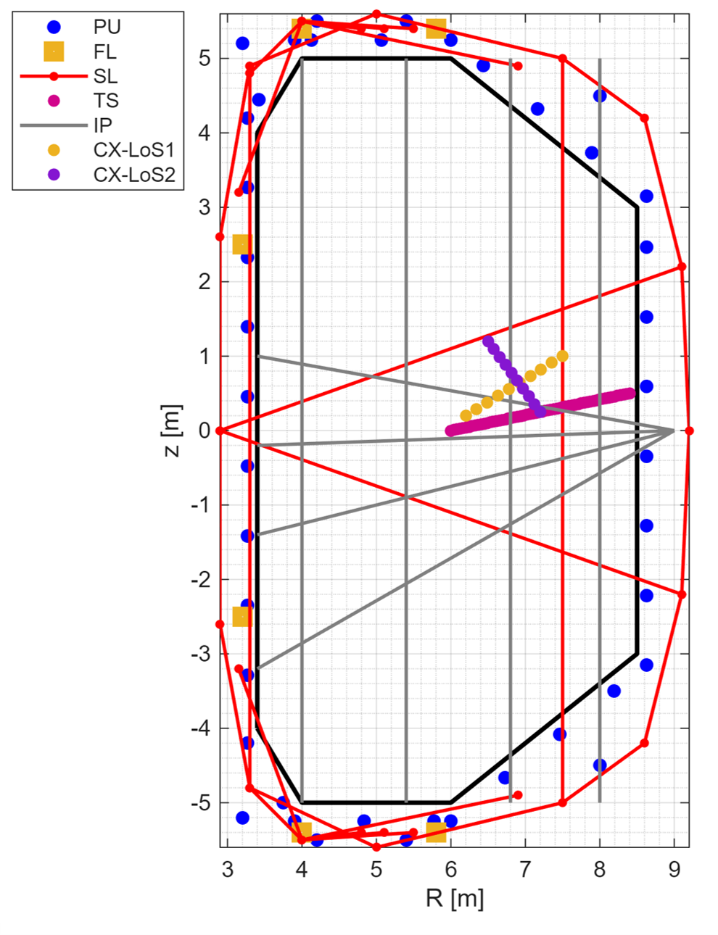
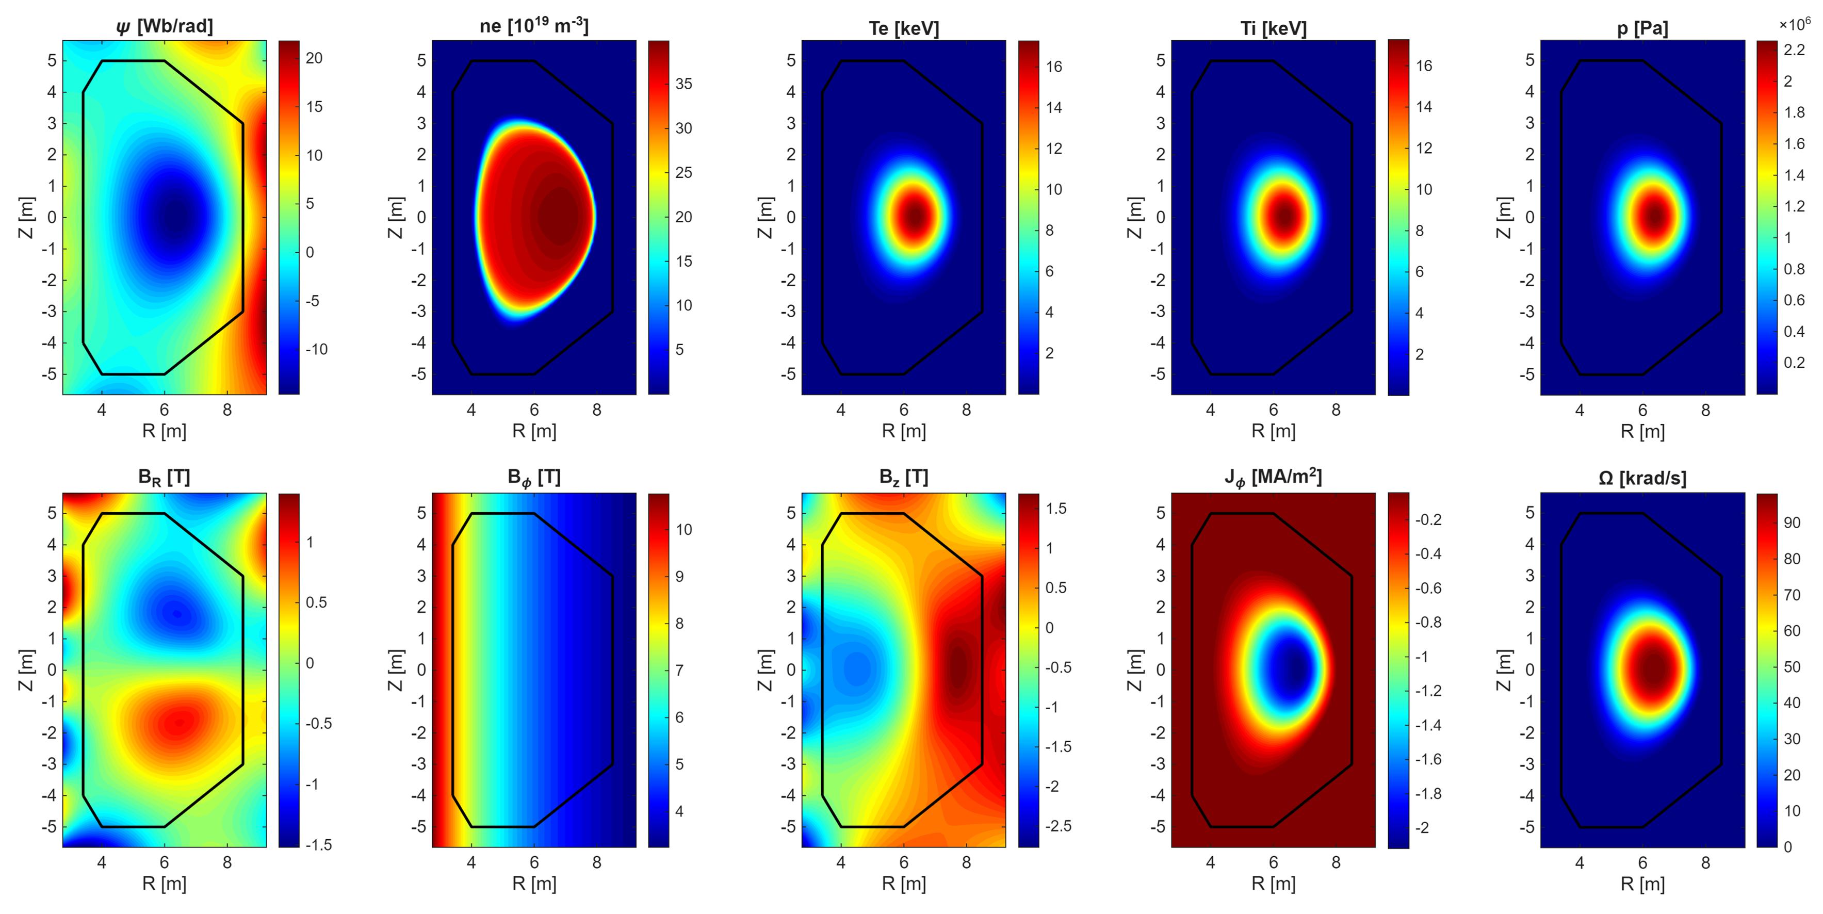
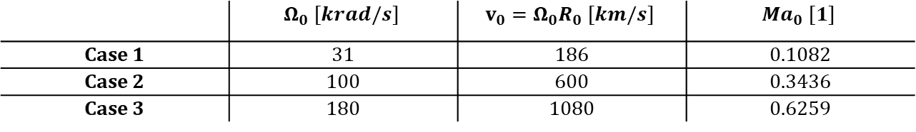
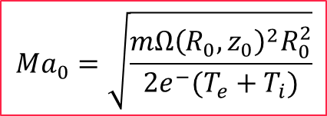
Targets for the non-static model with $T_{i}≠T_{e}$
Simulated fields at Ma₀ = 0.3436 (Case 2)
TokaLab diagnostic set for non-static study
Table 1. TokaLab scenarios at different Ma₀
$$Ma_{0}=\sqrt{\frac{mΩ{\left(R_{0} , z_{0}\right)}^{2}R_{0}^{2}}{2e^{−}(T_{e}+T_{i})}}$$
 | $$Ω_{0} [krad/s]$$ | $$v_{0}=Ω_{0}R_{0} [km/s]$$ | $${Ma}_{0} [1]$$
Case 1 | 31 | 186 | 0.1082
Case 2 | 100 | 600 | 0.3436
Case 3 | 180 | 1080 | 0.6259

Slide 20
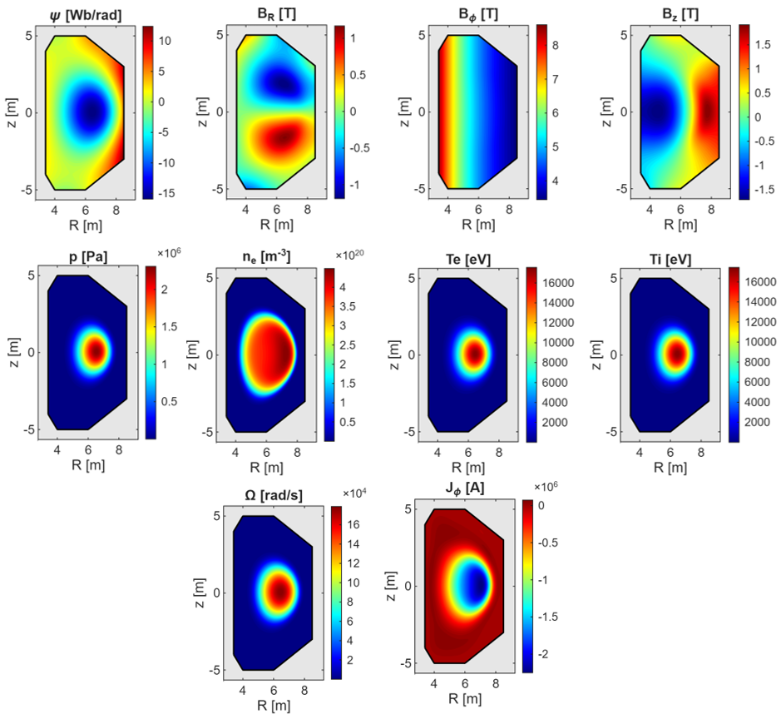
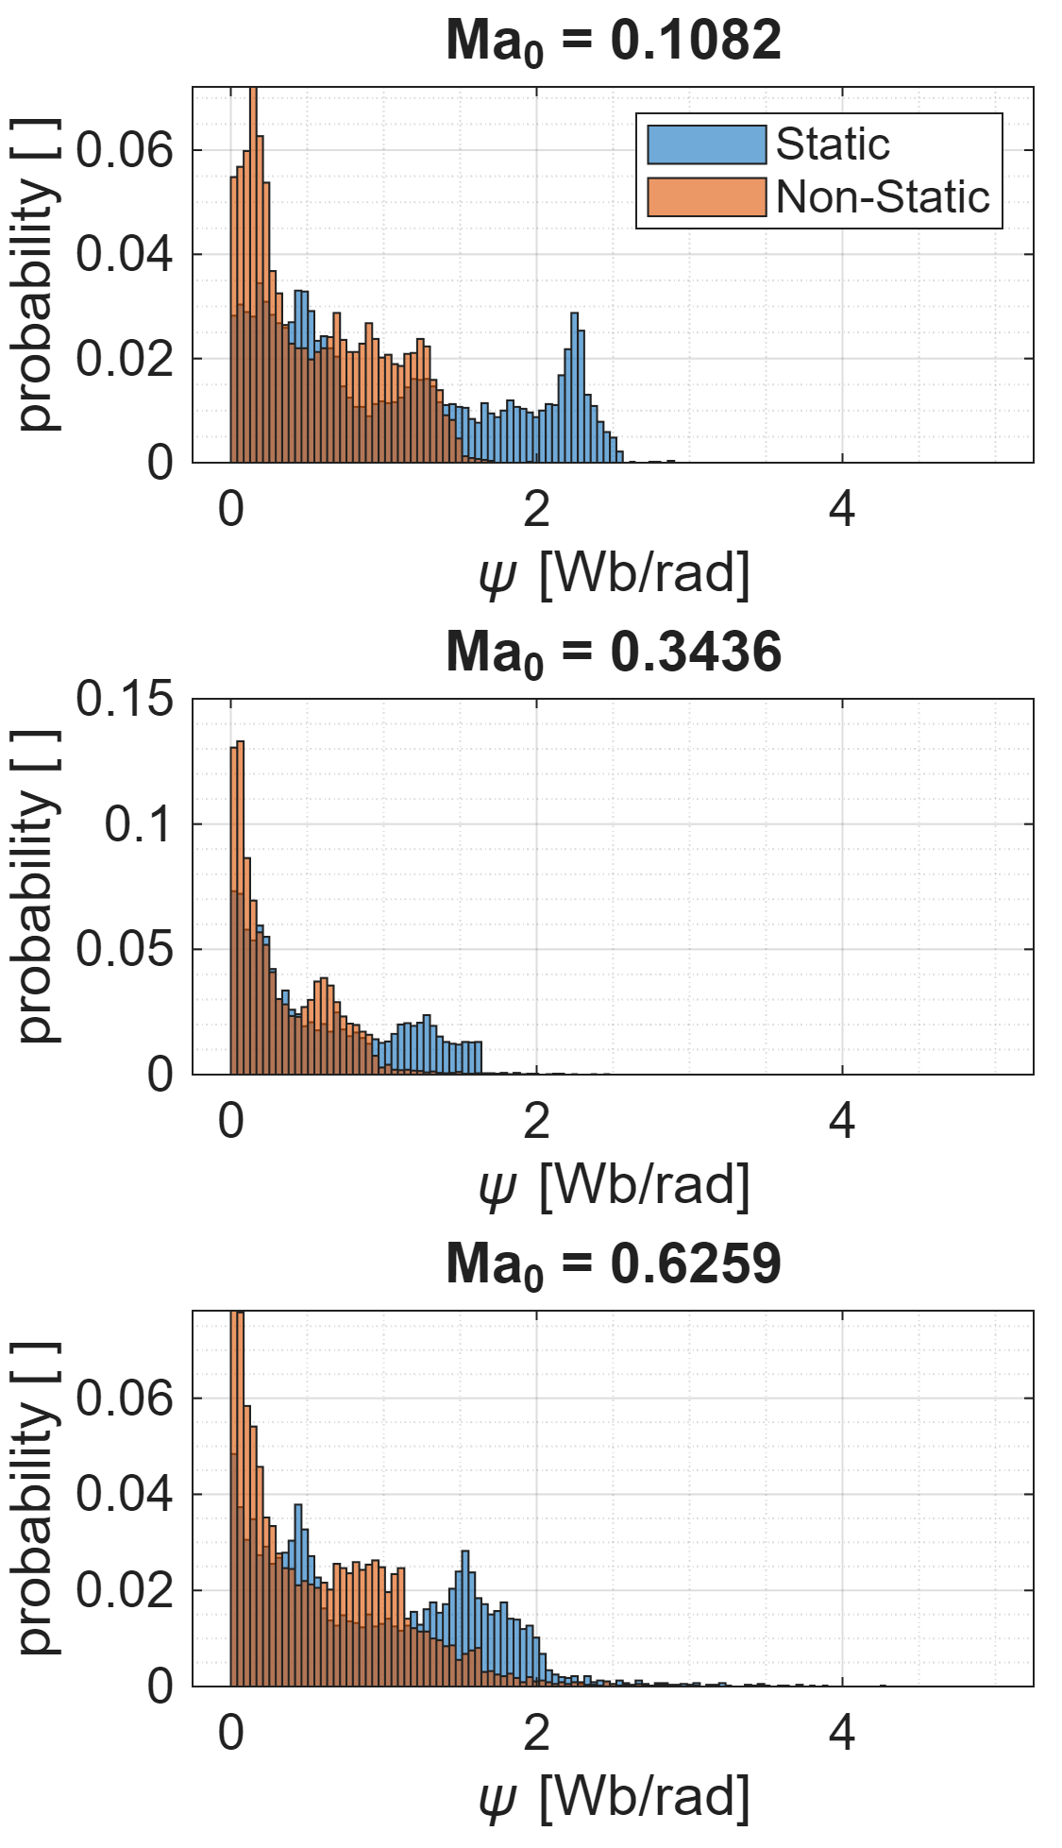
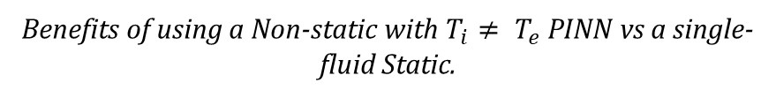
Preliminary results on the non-static model with $T_{i}≠T_{e}$
Reconstructed fields for Case 3 (Ma₀ = 0.6259)
Benefits of using a Non-static with $T_{i}≠ T_{e}$ PINN vs a single-fluid Static.

Slide 21
Conclusions
Physics-Informed Neural Networks are an interesting procedure for plasma state equilibrium reconstruction thanks to consistency requirements in fitting data AND physics.
Physics helps with extrapolation, robustness to noise and outliers.
A multi-diagnostics approach is important together with high-fidelity modelling of diagnostics.
Reducing assumptions on the physics model increases the reconstruction performances.
Each scenario requires a dedicated training, which takes hours, so the method is not suitable for real-time use. It is meant to support post-pulse analyses for physics interpretation and knowledge discovery.
Such an algorithm can be used both in support of physics studies and in support of diagnostics’ analyses (from supporting diagnostic design to detecting outliers).

Slide 22
Integrating magnetic and kinetic measurements in the equilibrium reconstruction of tokamaks with Physics Based Neural Networks
ICFDT8 – 8th International Conference on Frontier in Diagnostic Technologies
N. Rutigliano^{1,2} , A. Murari^{3,4}, P. Gaudio², M. Gelfusa², I. Wyss², R. Rossi²
On behalf of JET contributors and the EUROfusion Tokamak Exploitation Team
¹ DTT S.c.a.r.l.
² “Tor Vergata” University of Rome, Industrial Engineering Department
³ Consorzio RFX (CNR, ENEA, INFN, Università di Padova, Acciaierie Venete SpA)
⁴ Istituto per la Scienza e la Tecnologia dei Plasmi, CNR
Contact: novella.rutigliano@dtt-project.it

Slide 23
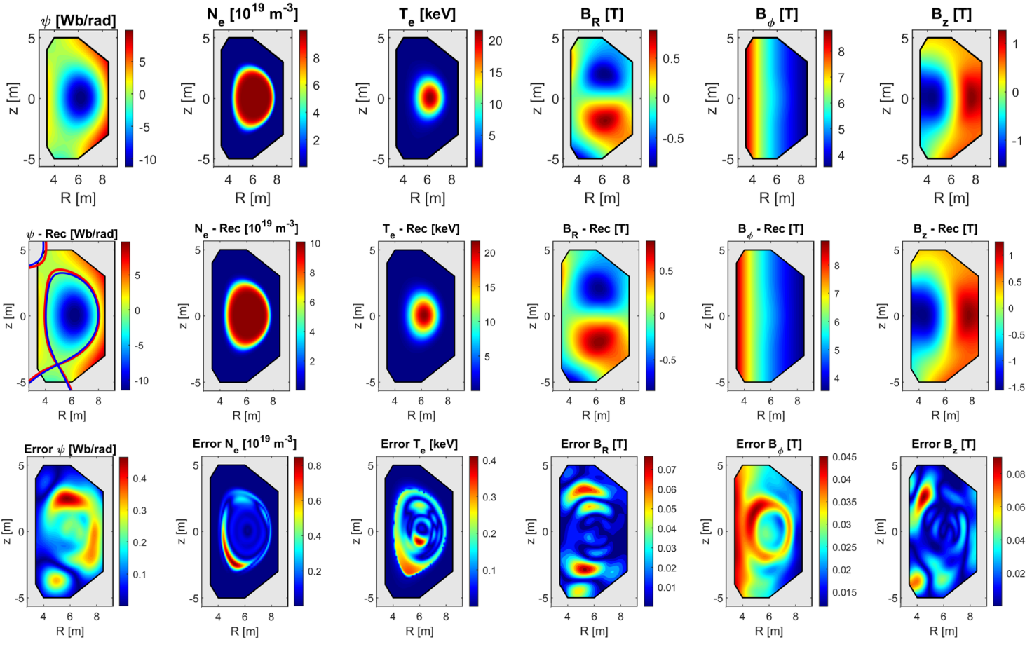
An example of PINN reconstruction on TokaLab
Target (TokaLab):
TokaLab
PINN
Reconstruction (PINN):
Reconstruction Error:

