Slide 1
From Discharge Physics to Reactive Chemistry:
an Integrated Diagnostic Path to Plasma Agriculture
A multi-diagnostic framework for atmospheric-pressure DBD reactors
DOMENICO ACETO
M. Ambrico, G. Dilecce, P. F. Ambrico
ISTP CNR – Bari, Italy
ICFDT – Frontiers in Diagnostic Technologies
19/10/2026 - Frascati

Slide 2
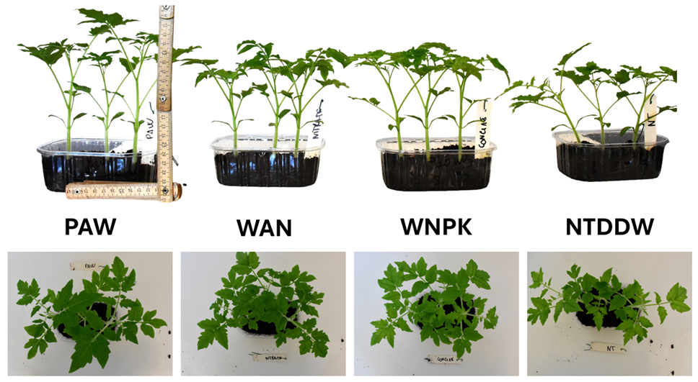
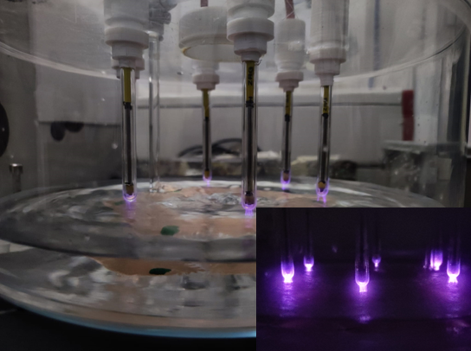
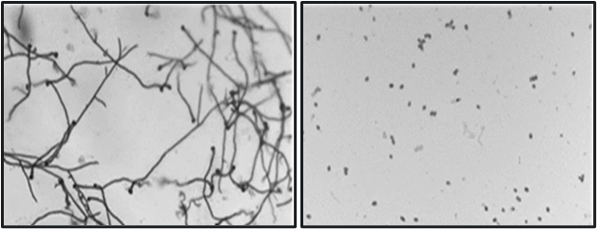
Plasma-Activated Water
MOTIVATION
Plasma Activated Water: indirect treatment
RONS produced in the plasma to substrates.
Aceto D. et al., Front. Phys. 12, 2024 | https://doi.org/10.3389/fphy.2024.1399910
Fertigation
H₂O₂
Decontamination
NO₃⁻
NO₂⁻
Rotondo, P.R., Aceto, D. et al., Sci Rep 15, 5536 (2025) | https://doi.org/10.1038/s41598-025-88369-7

Slide 3
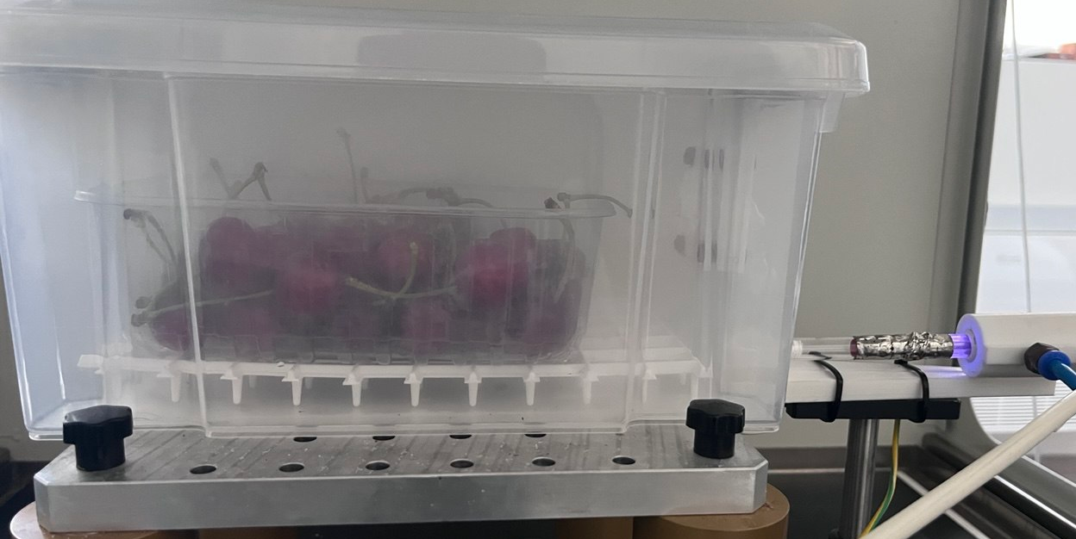
Plasma-Activated Fog
MOTIVATION
PAW shortcomings in decontamination
Chemical stability during storage
Washing wet-sensitive produce may damage them
Treating large volumes of water makes the process difficult to scale up
→
Plasma-Activated Fog (PAF)
Same RONS chemistry carried on an aerosol → very large gas–liquid interface
Delivered immediately without wetting and with no thermal or mechanical stress → suits delicate produce
scales more naturally toward industrial post-harvest
Objective
Thorough physico-chemical characterisation of the process for its full optimisation.

Slide 4
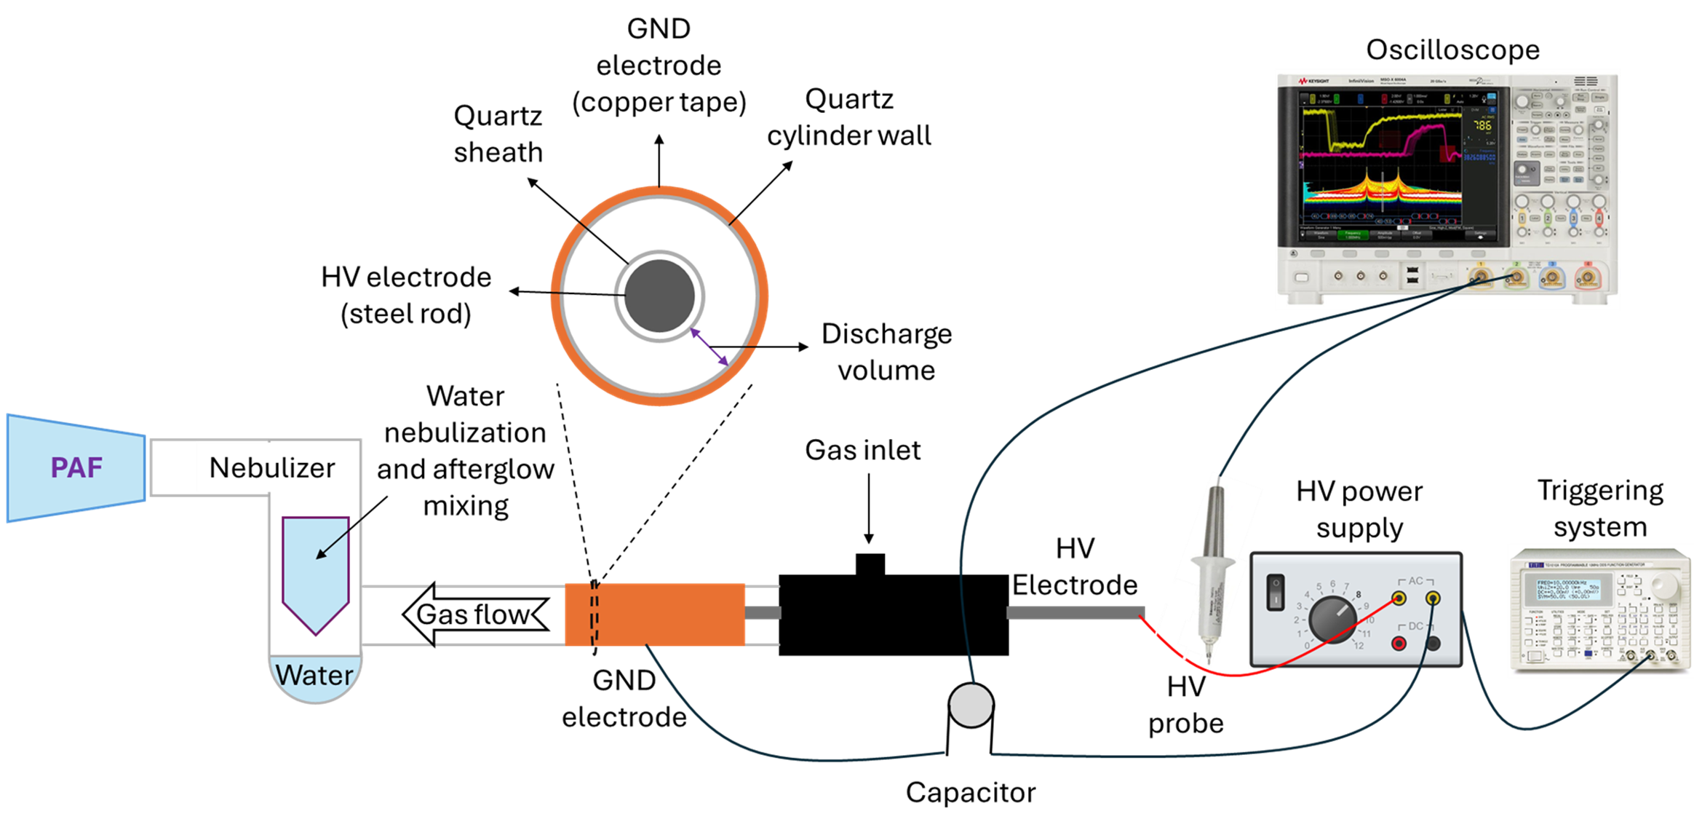
PAF reactor design
EXPERIMENTAL
Reactor
Coaxial DBD + medical glass nebulizer, double-distilled water
Power supply
AC, 19.5 kV peak voltage
Burst mode
15 cycles @ 25 kHz · 500 Hz repetition · 30% duty cycle
Feed gas
10 sLm ambient air → fog saturates the treatment chamber
Design choice: the discharge zone sits upstream of the nebulization chamber → stable discharge, humidity-robust electrical characteristics, low experiment-to-experiment variance.
Aceto, D. et al. Chem. Biol. Technol. Agric. 12, 151 (2025) | https://doi.org/10.1186/s40538-025-00865-0

Slide 5
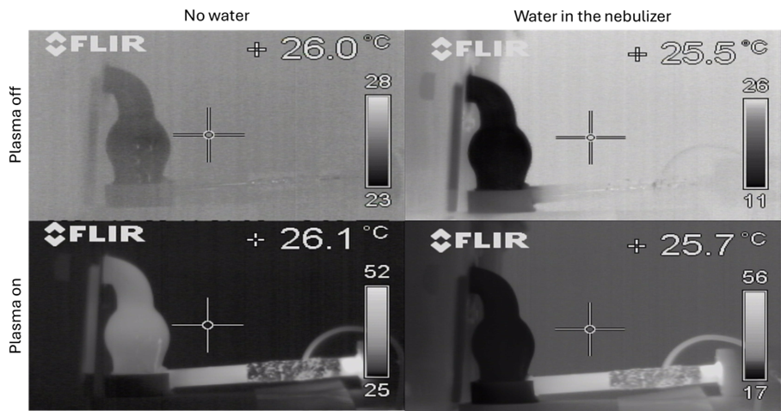
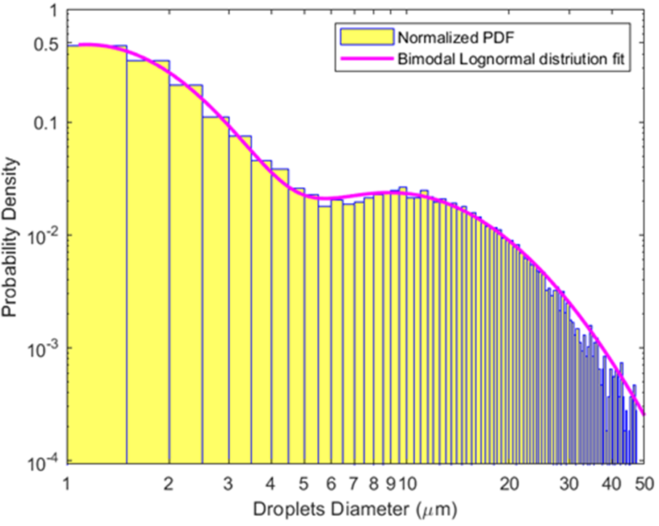
Aerosol characteristics
DIAGNOSTICS · PHYSICAL CHARACTERIZATION
After gas expansion and nebulization the fog reaches the substrate at ~17 °C → products are not thermally stressed.
< 5 µm
aerosol droplet diameter

Slide 6
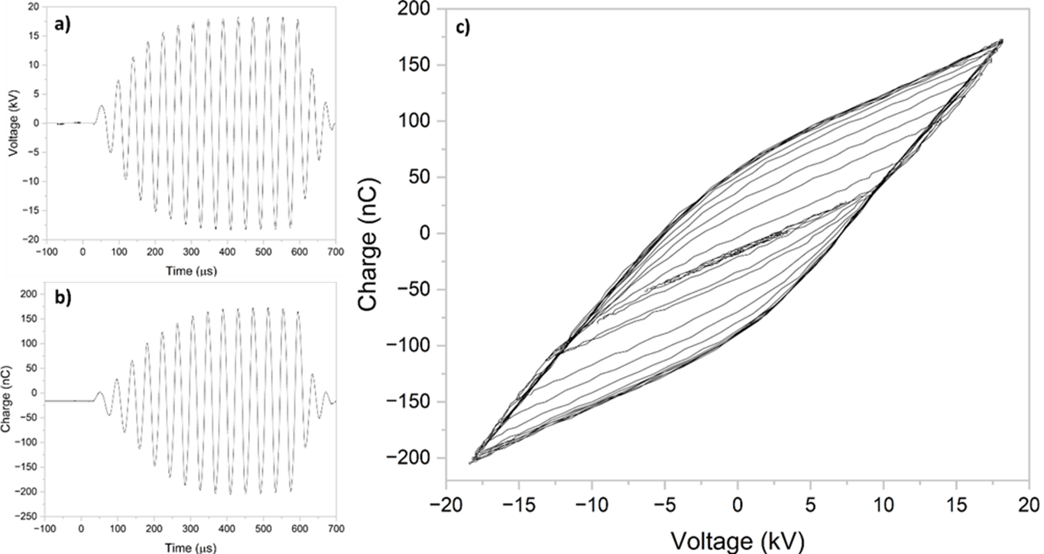
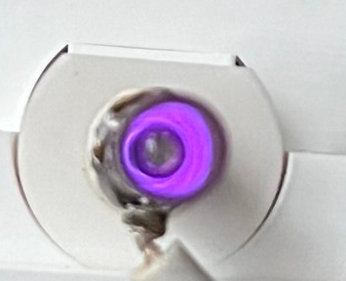
Electrical characteristics of the discharge
DIAGNOSTICS · PHYSICAL CHARACTERIZATION
38 mJ
dissipated per voltage burst
Almost ideal shape of the Lissajous figure indicates a regular, reproducible discharge
Notes:
Energy balance: 38 mJ per burst at 500 Hz = 19 W; into 10 slm of air this is an adiabatic rise of 88 K, i.e. 388 K, matching the 380 K SPS rotational temperature - almost all the dissipated power ends up as gas enthalpy. (Assumes 500 Hz burst repetition - confirm.)

Slide 7
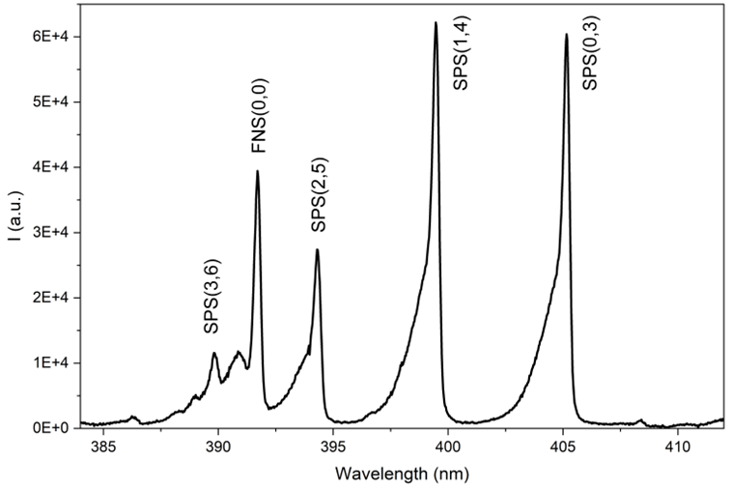
Optical Emission Spectroscopy
DIAGNOSTICS · PHYSICAL CHARACTERIZATION
E/N from line ratios
Gas temperature
FNS 391.4 / SPS 337.1 nm intensity ratio: an E/N proxy in air.
SPS(0,0) rotational structure: streamer gas temperature ≈ 107 °C.
Notes:
In air the N2+ FNS(0,0) 391.4 nm over N2 SPS(0,0) 337.1 nm ratio is the standard E/N proxy: the two upper states have very different thresholds (18.7 vs 11.0 eV), so their ratio is steeply field-dependent. The conversion to E/N needs a collisional-radiative model (quenching, cascade) - that is exactly why we add EFISH two slides later. The SPS(0,0) rotational envelope gives ~380 K, consistent with the energy balance on the electrical slide.

Slide 8
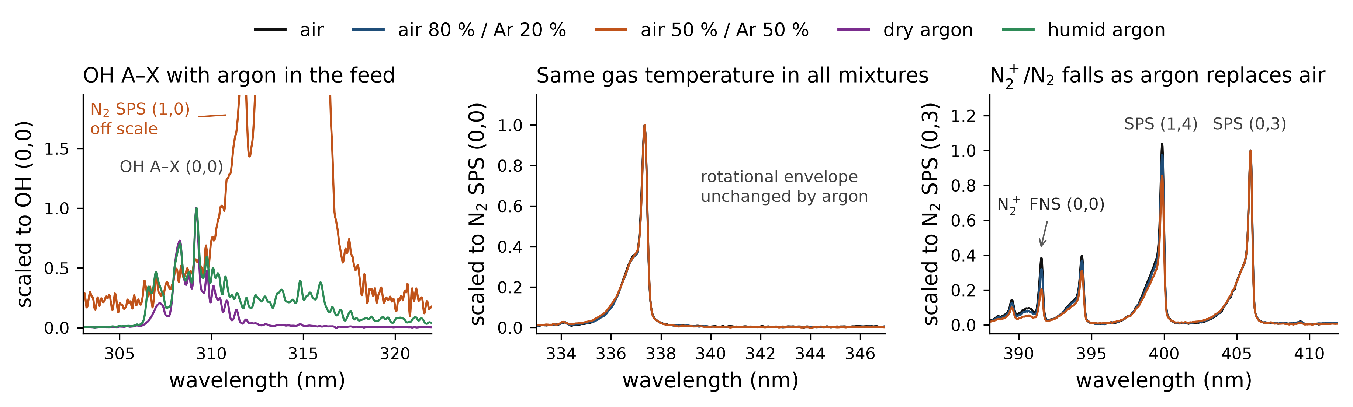
Emission spectra across feed-gas mixtures
DIAGNOSTICS · PHYSICAL CHARACTERIZATION
Closed reactor, burst-averaged spectra, each panel scaled to the named band.
FNS/SPS falls
N₂ vibration drops
Same gas temperature
0.23 → 0.19 → 0.13 with argon; Ar* → N₂(C) transfer also lowers it.
SPS (1,4)/(0,3): 1.01 → 0.95 → 0.84, a proxy of weaker N₂(v).
N₂(0,0) rotational envelope identical in the three air–argon mixtures.
Notes:
Closed reactor, burst-averaged. Two cautions for this audience. (1) The FNS/SPS drop with argon is NOT automatically a lower E/N: Ar metastables transfer energy to N2(C) and boost SPS, which lowers the ratio at constant field. OES alone cannot separate the two - this is the question EFISH answers. (2) The SPS Delta-v ratio tracks the C-state vibrational distribution, a proxy of ground-state N2(v), relevant because O + N2(v) -> NO + N is the low-temperature Zel'dovich channel. Rotational temperature is unchanged, so the trends are not thermal.

Slide 9
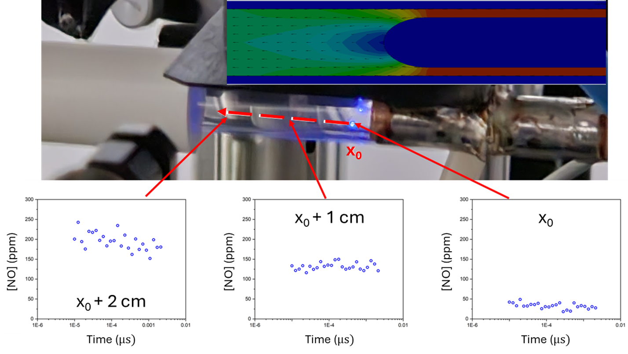
RONS transport in the afterglow
DIAGNOSTICS · LIF
Transport + conversion
NO rises along the afterglow. x₀ lies in the recirculation just after the discharge. Downstream stations span 2-3 ms after the discharge zone.
ICCD LIF in the open tube, along the axis downstream of the discharge; inset: CFD gas-density map.
Notes:
These are ICCD-LIF values in the OPEN tube, on the axis downstream of the discharge zone (x0 ~1 cm after the sheath). The flow model (next slide, backup) puts x0 exactly at the reattachment of the recirculation bubble behind the sheath, so only the two downstream points can be read as an afterglow time: 130 -> 200 ppm over 2-3 ms. CAUTION: these are two orders of magnitude above the PMT-LIF values at the nozzle exit (slide after next). Be ready to explain the different configuration and probe point, or do not quote both absolute scales.

Slide 10
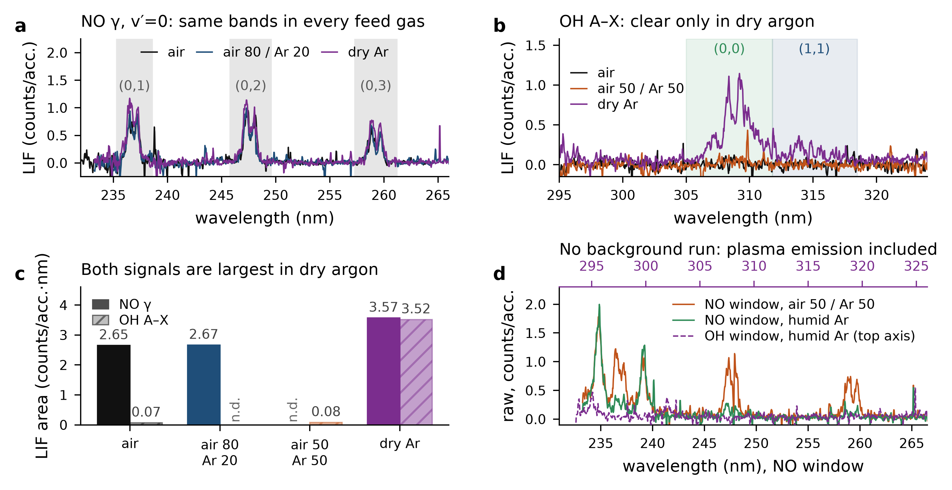
NO and OH fluorescence in the effluent
DIAGNOSTICS · LIF
NO even in argon
NO γ v′=0 clean in air, 80/20 and dry argon: ambient air is entrained.
OH marks the plasma
Strong in the discharge; marginal downstream, except in dry argon.
Yield, not density
Quenching by N₂, O₂ and H₂O is far stronger than by argon.
Background-subtracted LIF downstream of the open reactor
Notes:
Downstream of the nozzle. NO gamma v'=0 progression is clean in air, 80/20 and even dry argon: ambient air is entrained and the plasma still makes NO. OH is strong in the discharge (see backup OH-LIF slide) and marginal downstream, which is the "short-lived marker of the active region" point of the abstract. Caveat: LIF = density x fluorescence yield; quenching by N2/O2/H2O is much stronger than by Ar, so argon signals are favoured.

Slide 11
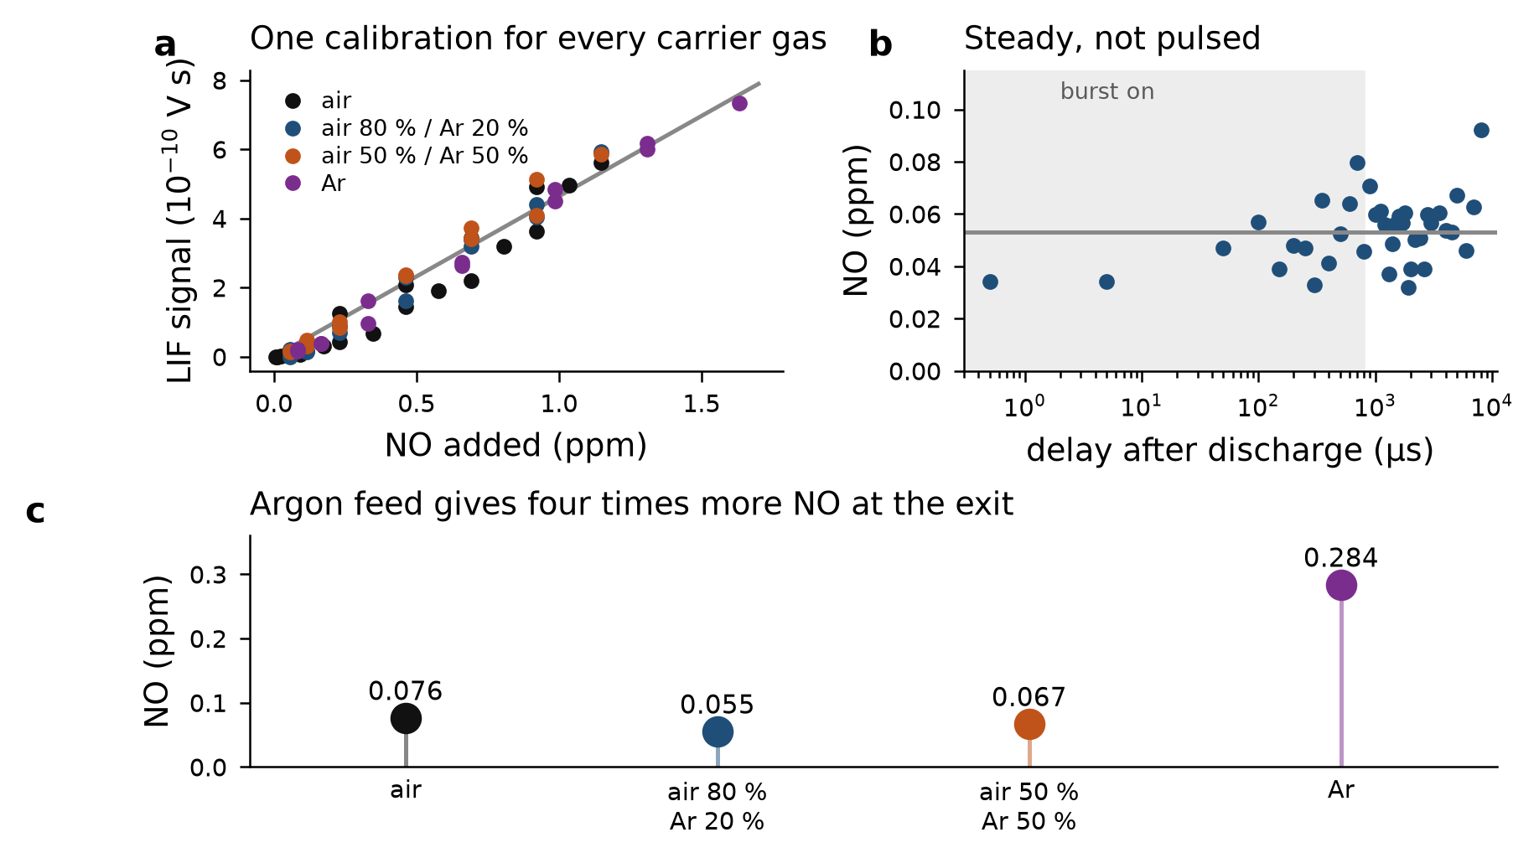
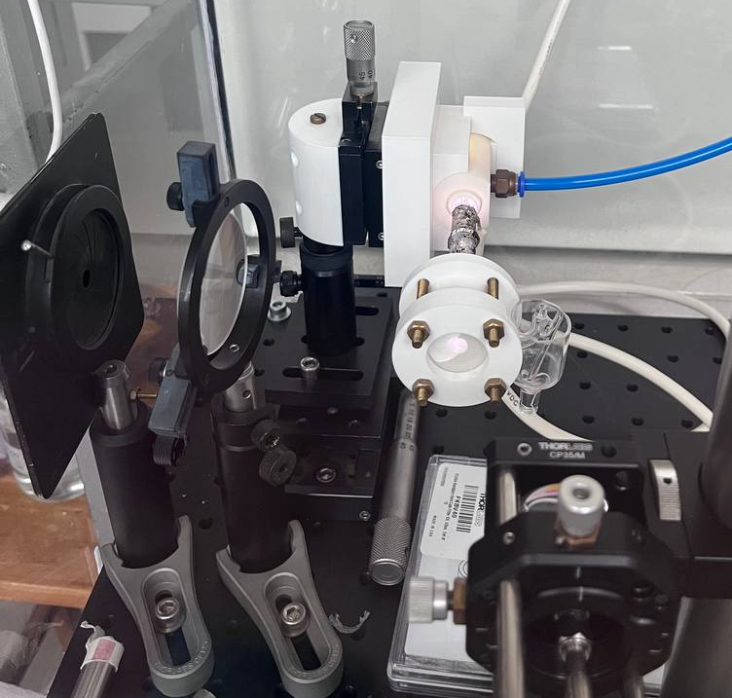
Absolute NO at the nozzle exit
DIAGNOSTICS · LIF
Sampling zone
Laser path
Collection with optical fiber to monochromator
LIF at 226.16 nm, closed configuration, discharge-off background subtracted.
Notes:
PMT LIF at 226.16 nm, closed reactor, at the nozzle exit. Calibration with the certified 116 ppm NO/N2 mixture in all four carriers: one slope (4.6e-10 V s/ppm) - the transition is saturated, so quenching differences cancel. The delay scan is flat because the gas needs ~10 ms from the discharge to the nozzle, five burst periods at 500 Hz (confirm the burst rate). Argon gives 0.28 ppm vs 0.06-0.08 ppm with air in the feed. These values are far below the open-tube ICCD scale: different configuration and probe point; jet dilution at the probe is below 1.4x, so it does not explain the gap.

Slide 12
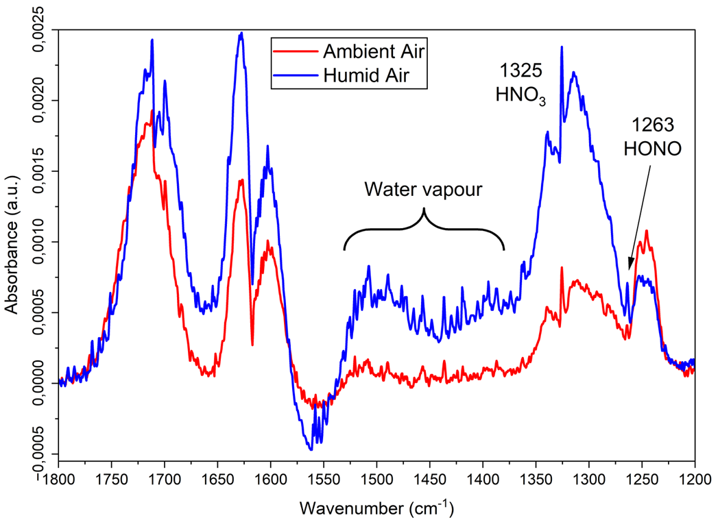
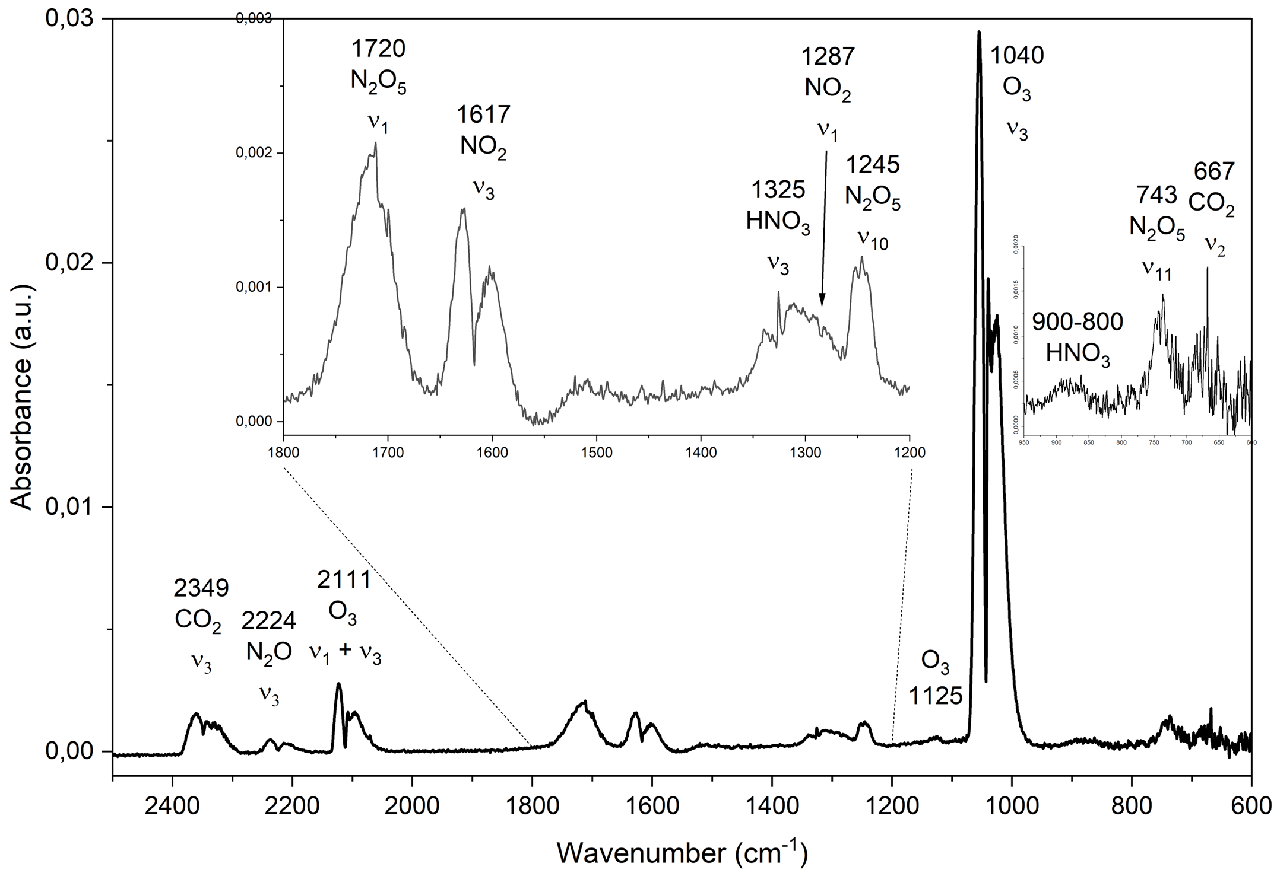
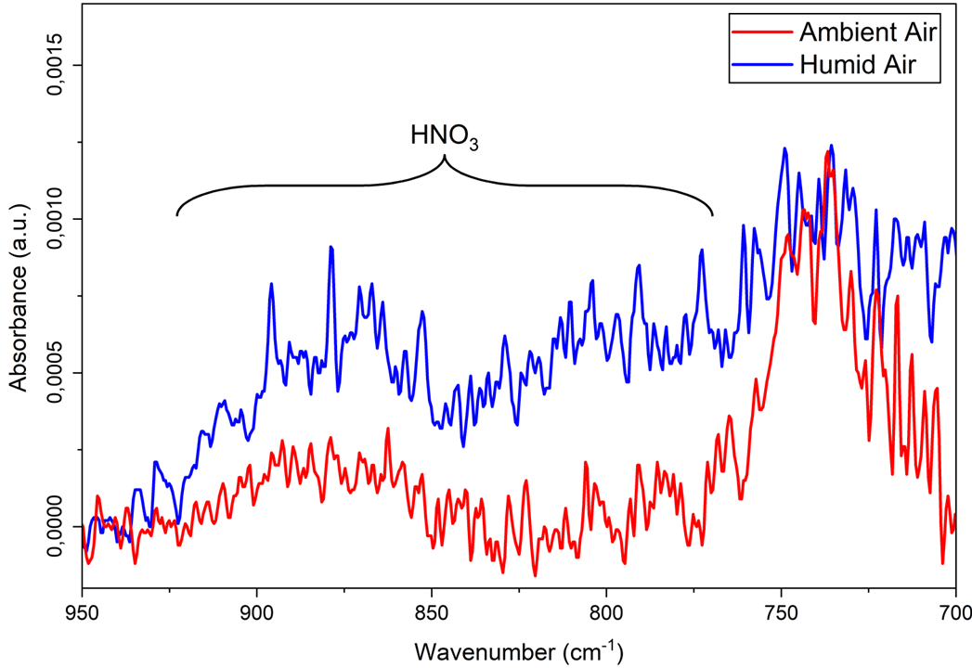
Long-lived RONS in the effluent
DIAGNOSTICS · FTIR
Ambient vs humid feed: adding water vapour to the plasma feed enhances HNO₃ and other oxygenated nitrogen species relevant to PAF chemistry.
FT-IR of effluent gases: N₂O, NO₂, HNO₃, N₂O₅, O₃, CO₂

Slide 13
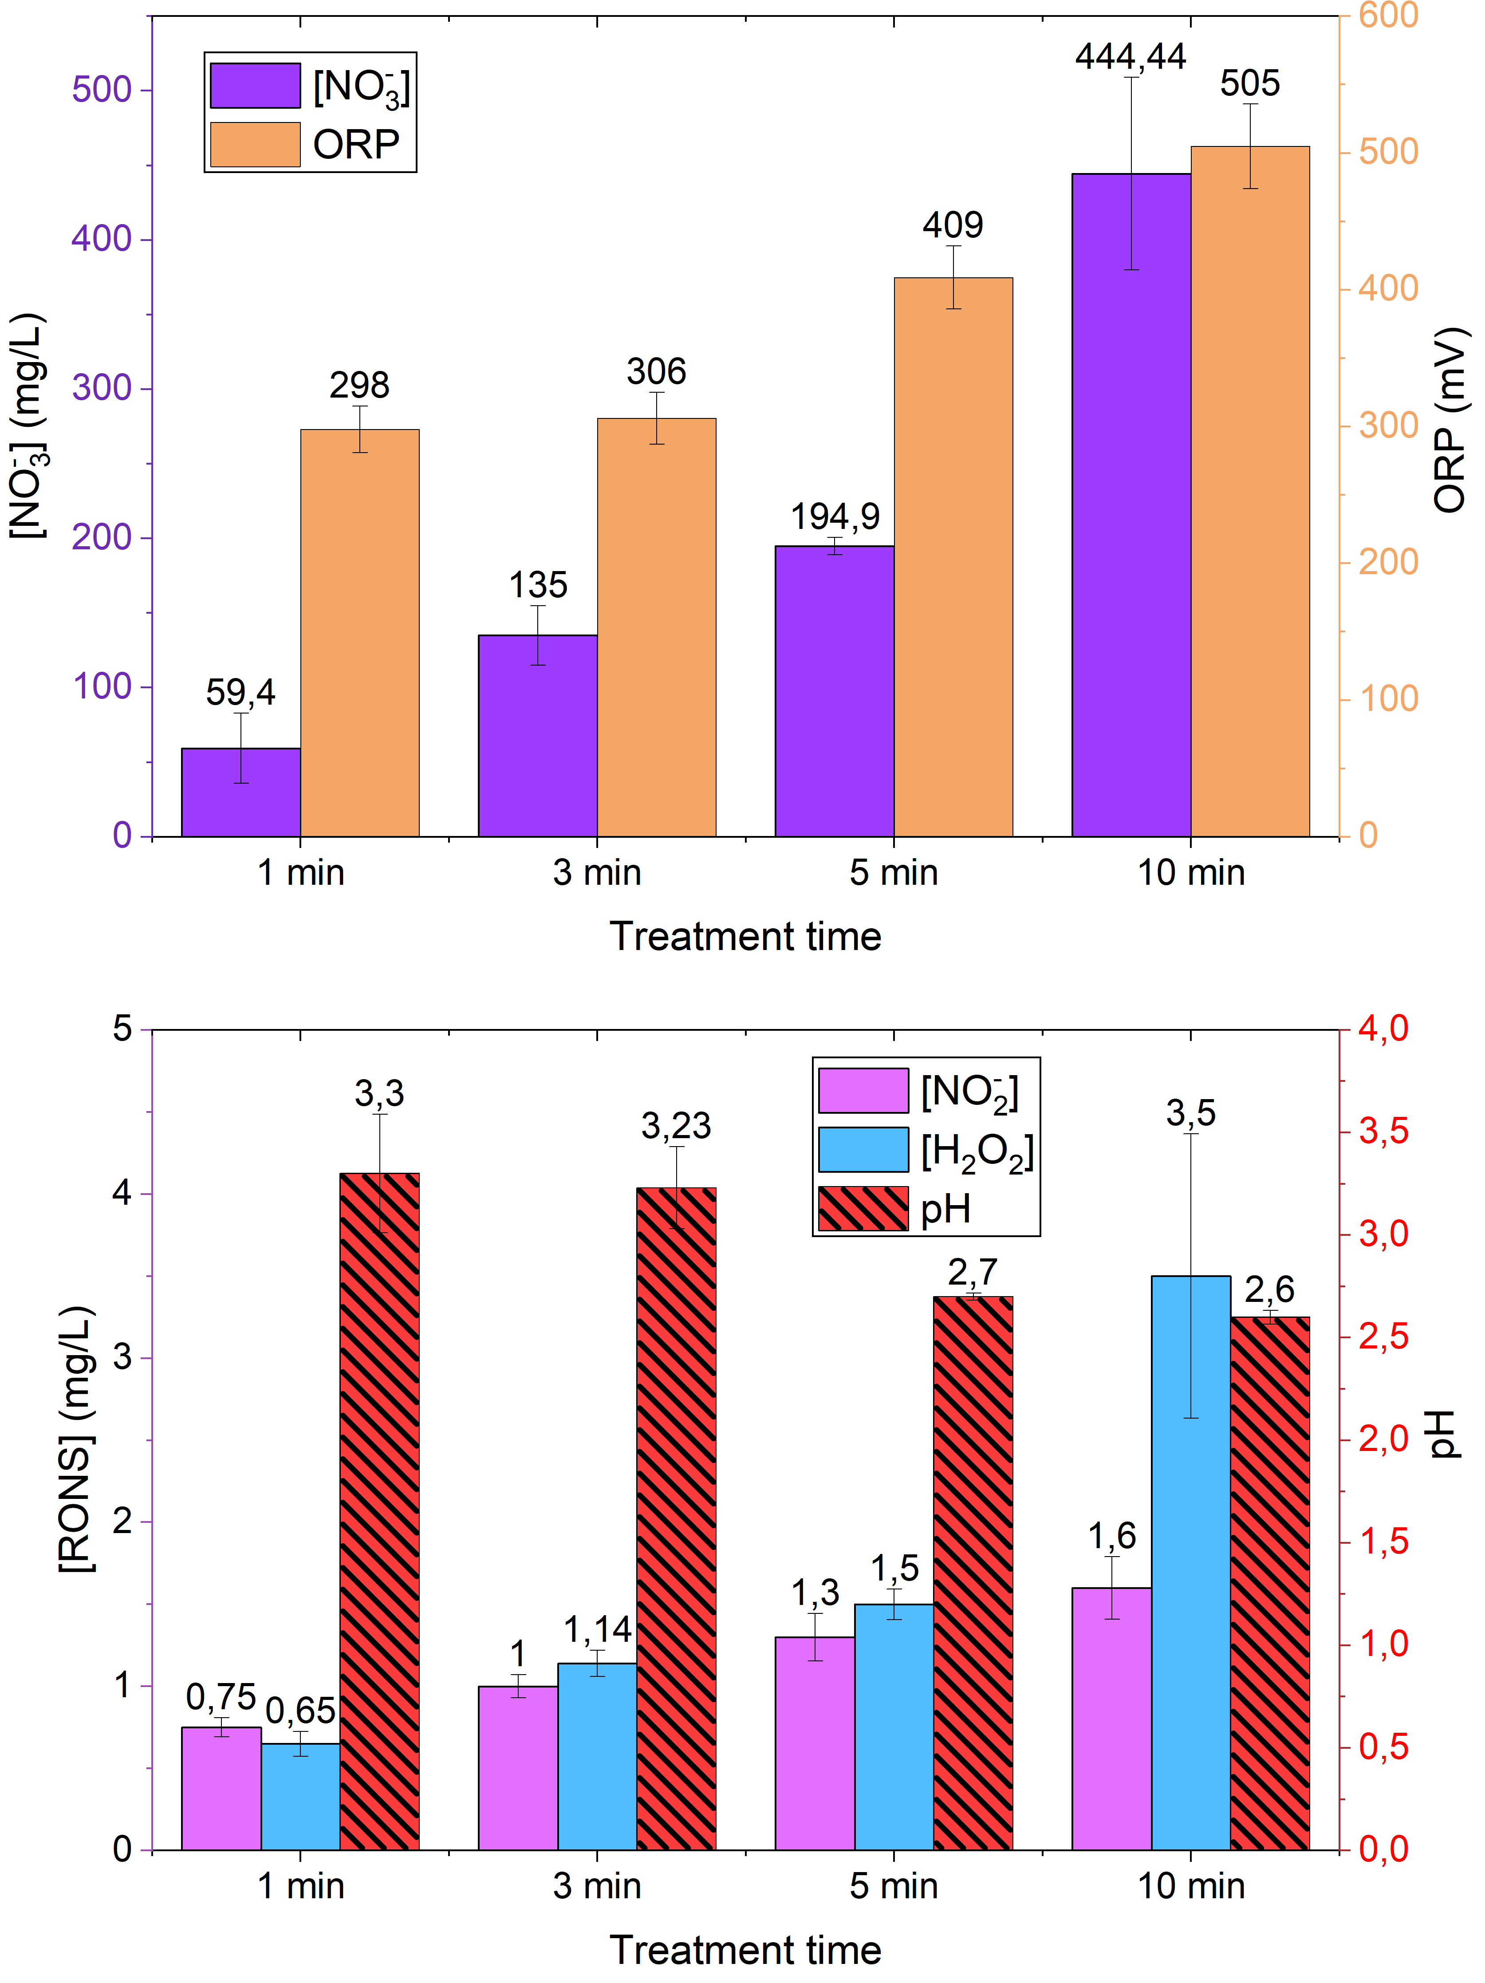
Condensed PAF composition
DIAGNOSTICS · LIQUID PHASE
Time-dependent chemistry
NO₃⁻ becomes the dominant species: ~40 → 445 mg L⁻¹ (1 → 10 min).
H₂O₂ rises to 3.5 mg L⁻¹ by 10 min; NO₂⁻ reaches 1.5 mg L⁻¹ then plateaus.
pH drops from 6 to 2.5, acidification tracks nitric-acid uptake.
Condensation promotes gas-to-liquid uptake, favouring nitrate accumulation.
H₂O₂, NO₂⁻, NO₃⁻ and acidic pH drive antimicrobial oxidative stress.

Slide 14
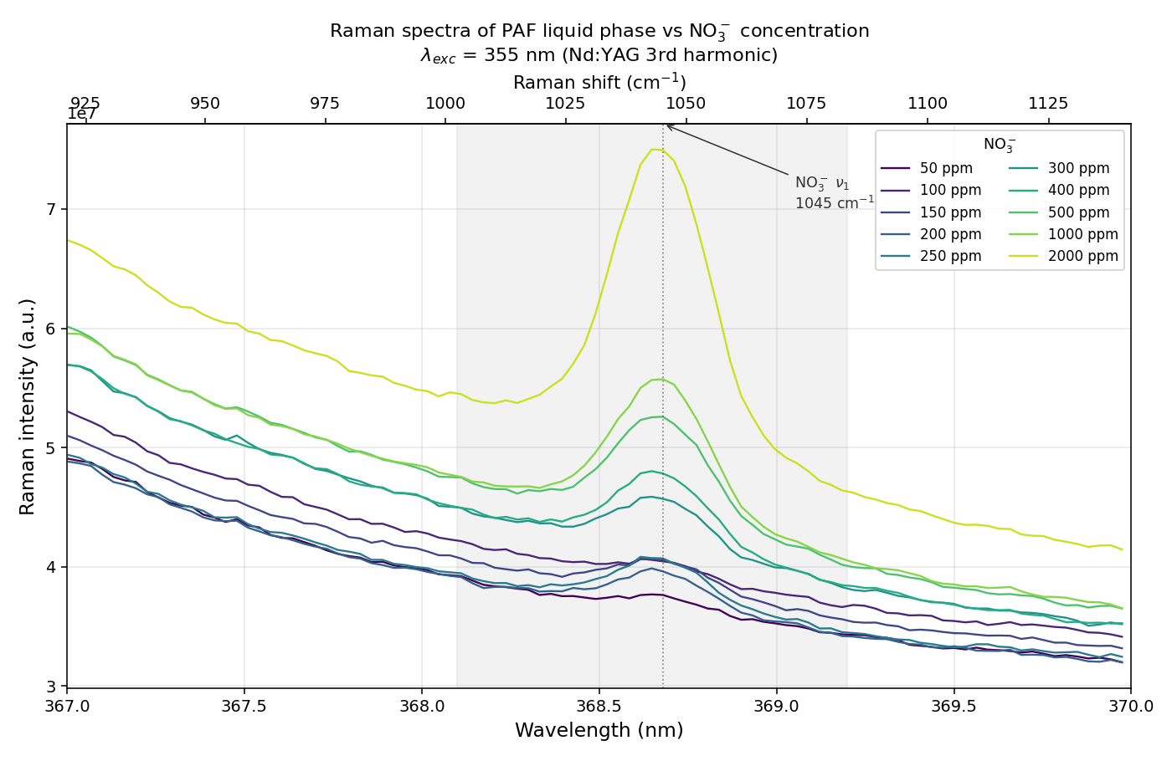
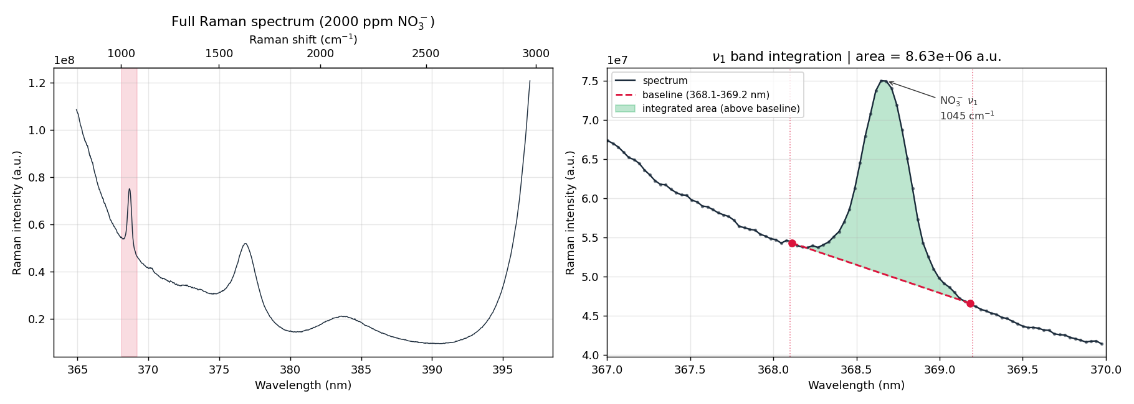
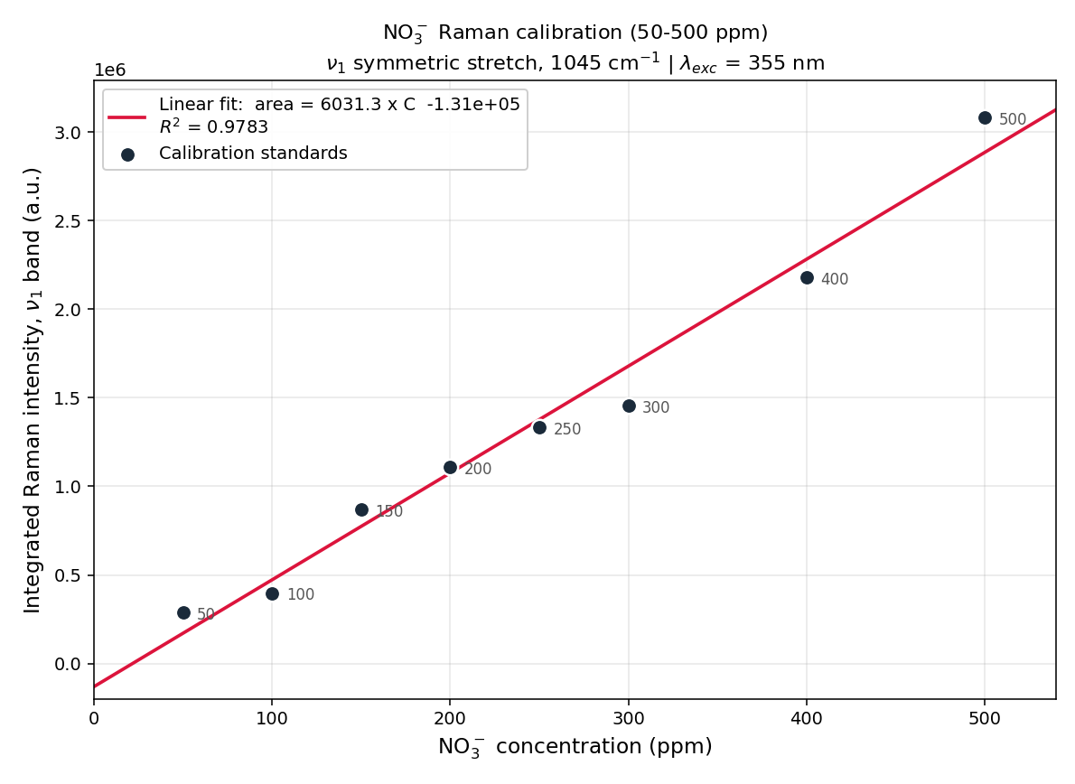
Raman Spectroscopy
DIAGNOSTICS · LIQUID PHASE
The nitrate ν₁ symmetric-stretch band (1045 cm⁻¹) gives a label-free measure of [NO₃⁻]

Slide 15
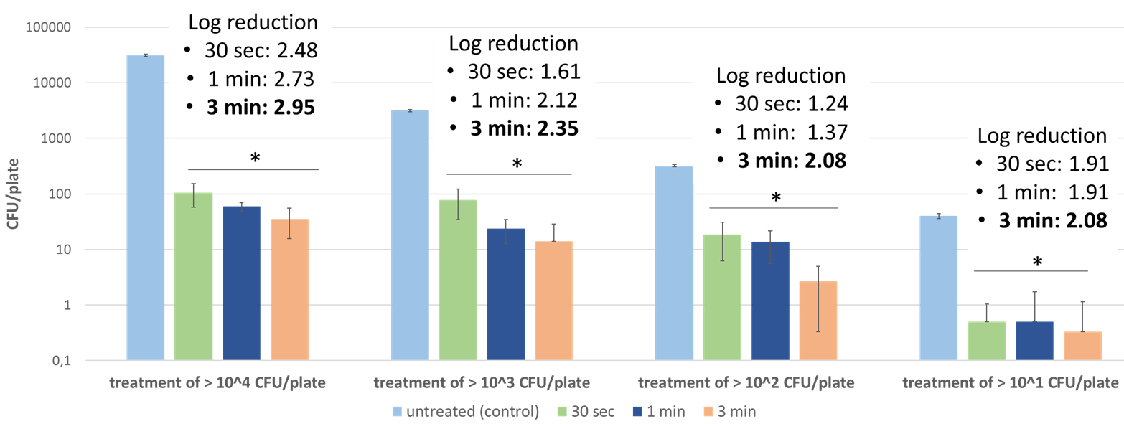
From reactive chemistry to decontamination – in vitro
TREATMENT PERFORMANCE
Conidial germination inhibition
Post-harvest fungi
Complete spore inhibition after 3–5 min for most species; M. fructicola most sensitive, A. alternata / A. carbonarius most resistant.
Listeria monocytogenes (five-strain mix): all conditions (p < 0.05)
≤ 30 s
for marked in-vitro CFU drop
Chieffi, D., Aceto, D. et al., Food Research International 236, 119114 (2026) | https://doi.org/10.1016/j.foodres.2026.119114

Slide 16
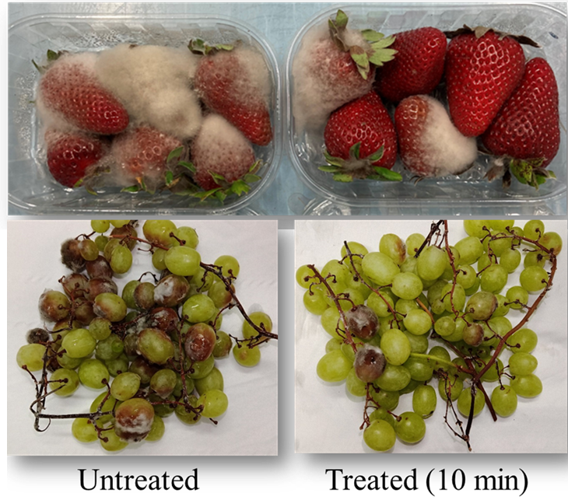
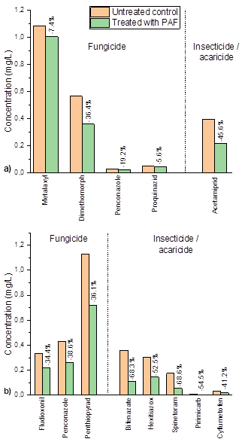
From reactive chemistry to decontamination – in vivo
TREATMENT PERFORMANCE
Pesticide residues: untreated vs. PAF
52–74 %
fewer rotted strawberries
45–80 %
fewer rotted table grapes (cultivar-dependent)
Strawberries & table grapes — untreated vs. 10 min PAF
up to 70 %
reduction of chemical pesticides

Slide 17
An integrated diagnostic path for plasma agriculture
CONCLUSIONS & PERSPECTIVES
One diagnostic path follows RONS from the discharge field to the treated liquid.
Discharge physics. 38 mJ/burst heats the gas to ≈380 K, OES identifies reactive species and gives E/N trends.
Gas phase. Calibrated LIF gives absolute NO, OH marks the active zone, FT-IR tracks NOₓ, HNO₃ and O₃.
Liquid phase. Raman, validated by colorimetry, quantifies NO₃⁻, NO₂⁻ and H₂O₂ as the PAF acidifies.
Linking operating conditions to RONS dose underpins scale-up and predictive treatments.
Next steps
E/N in all gas mixtures
N₂(v) kinetics and Zel’dovich NO
Dose-response optimisation
Pre-industrial post-harvest trials
Notes:
Close on the ladder: field (OES, EFISH) -> gas-phase species (LIF, FT-IR) -> liquid (Raman). The decontamination results are the application payoff, not the claim of this talk.

Slide 18
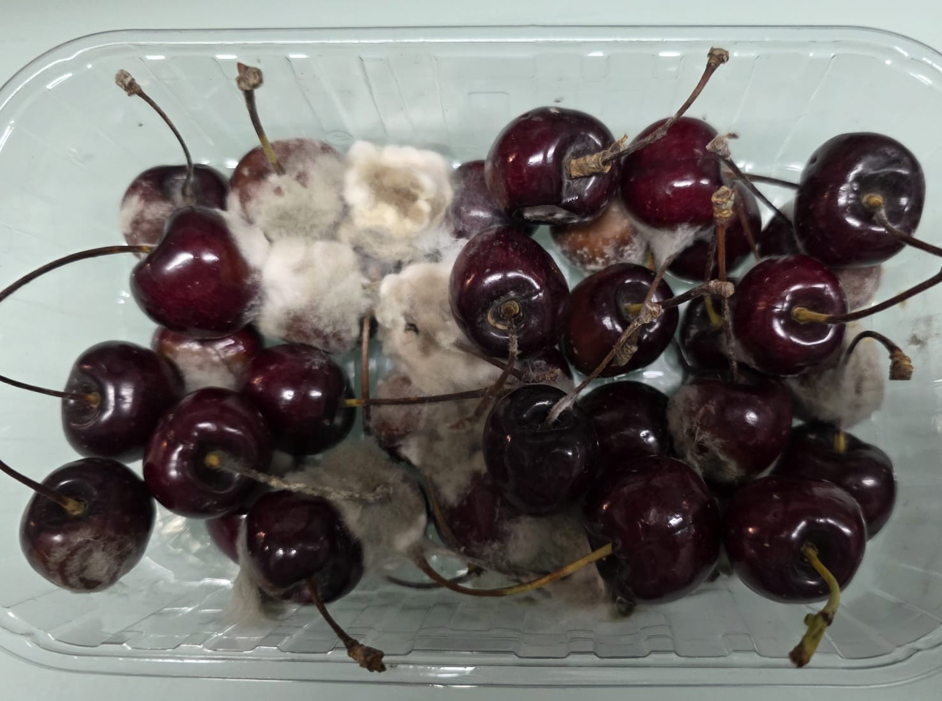
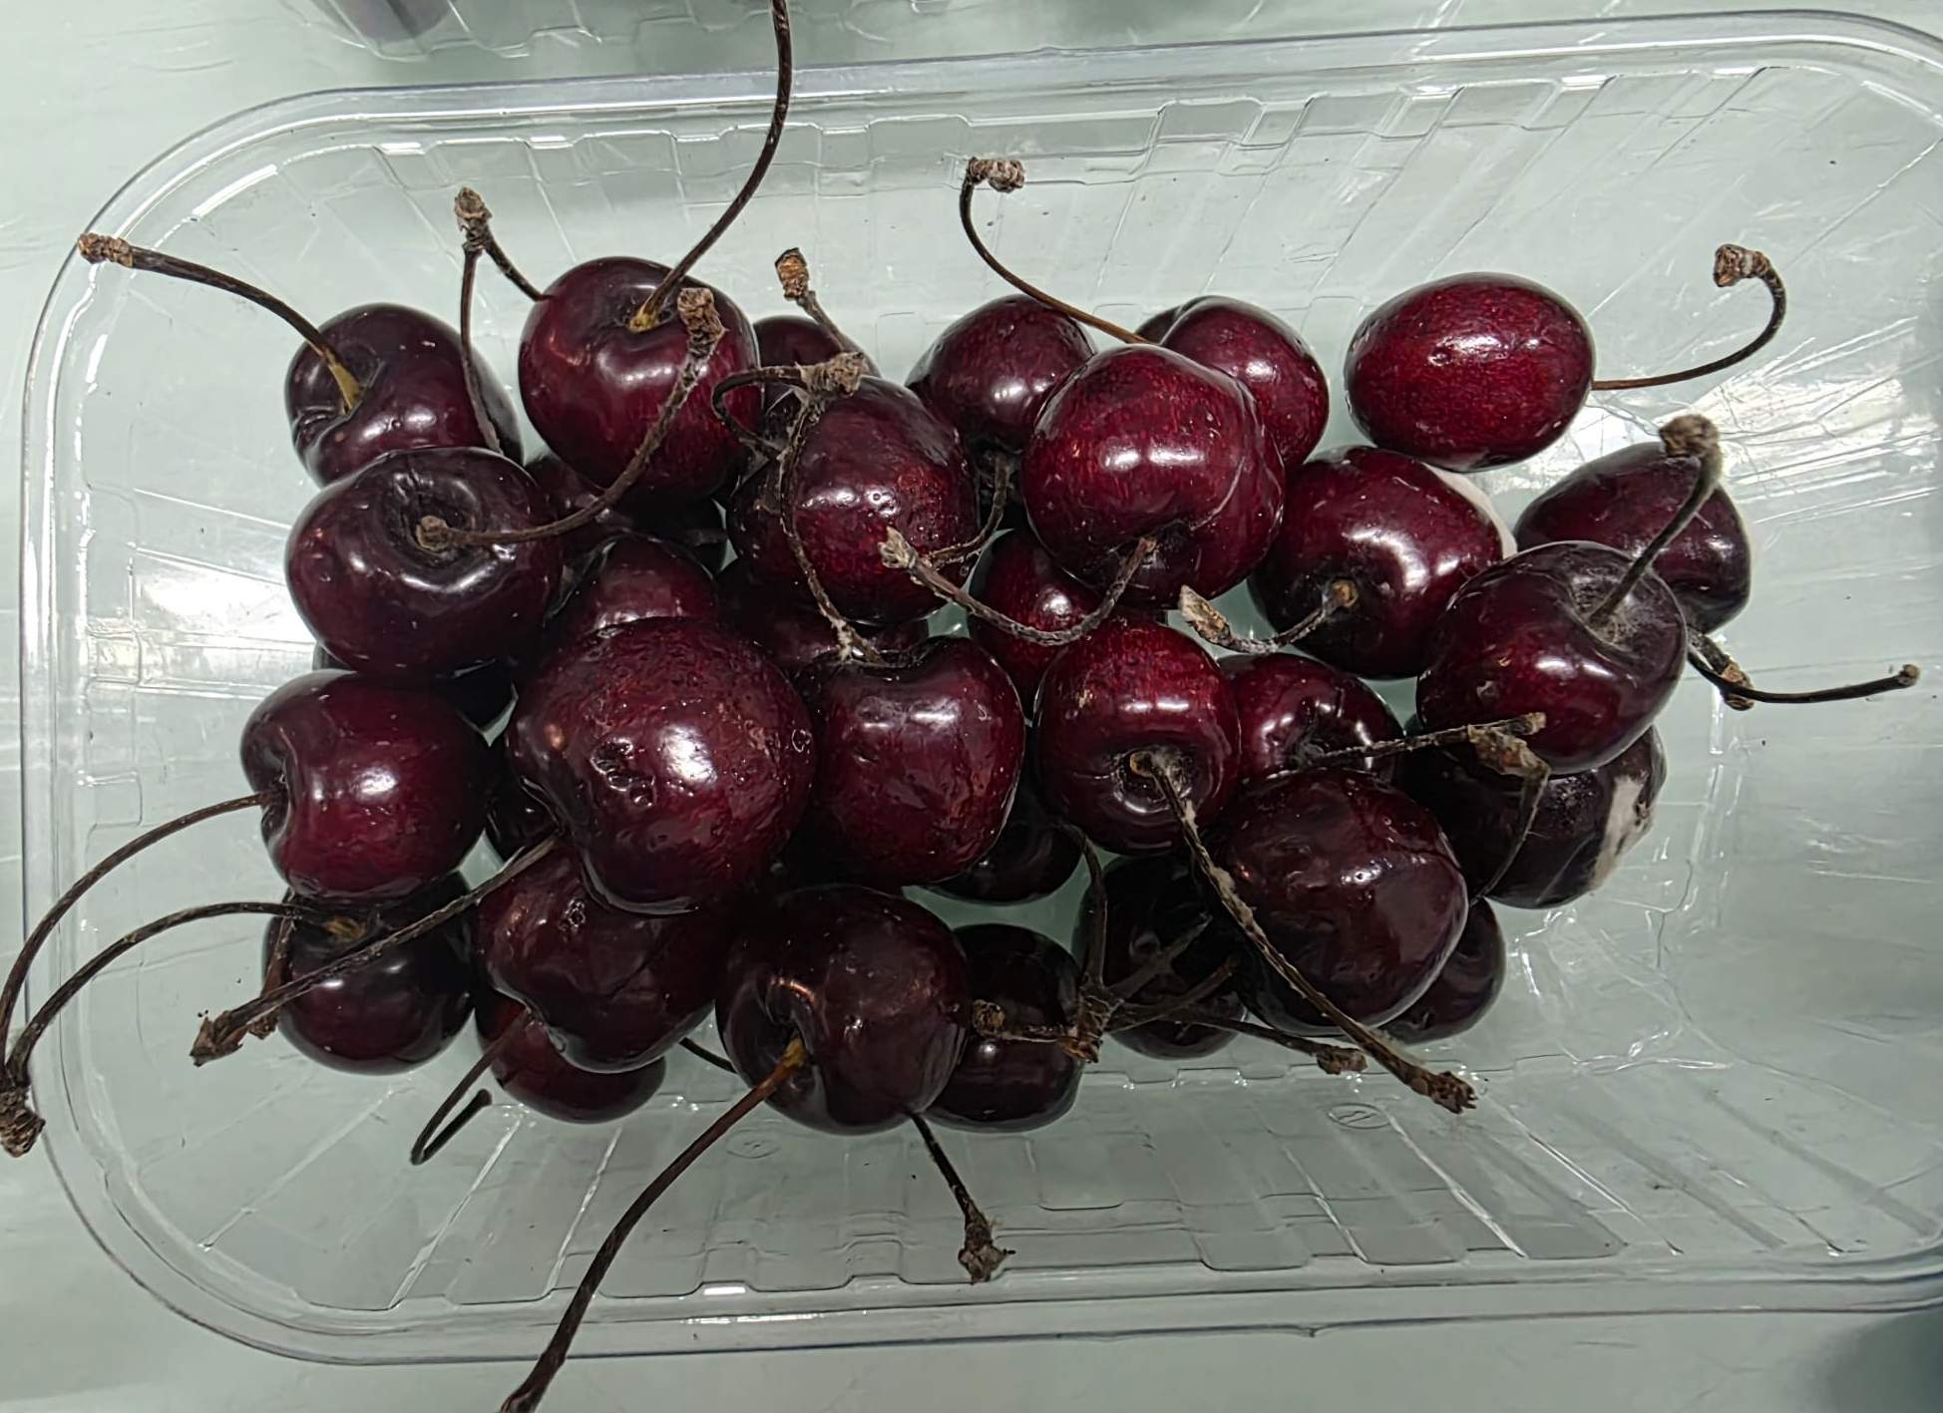
THANK YOU FOR YOUR ATTENTION!

Slide 19
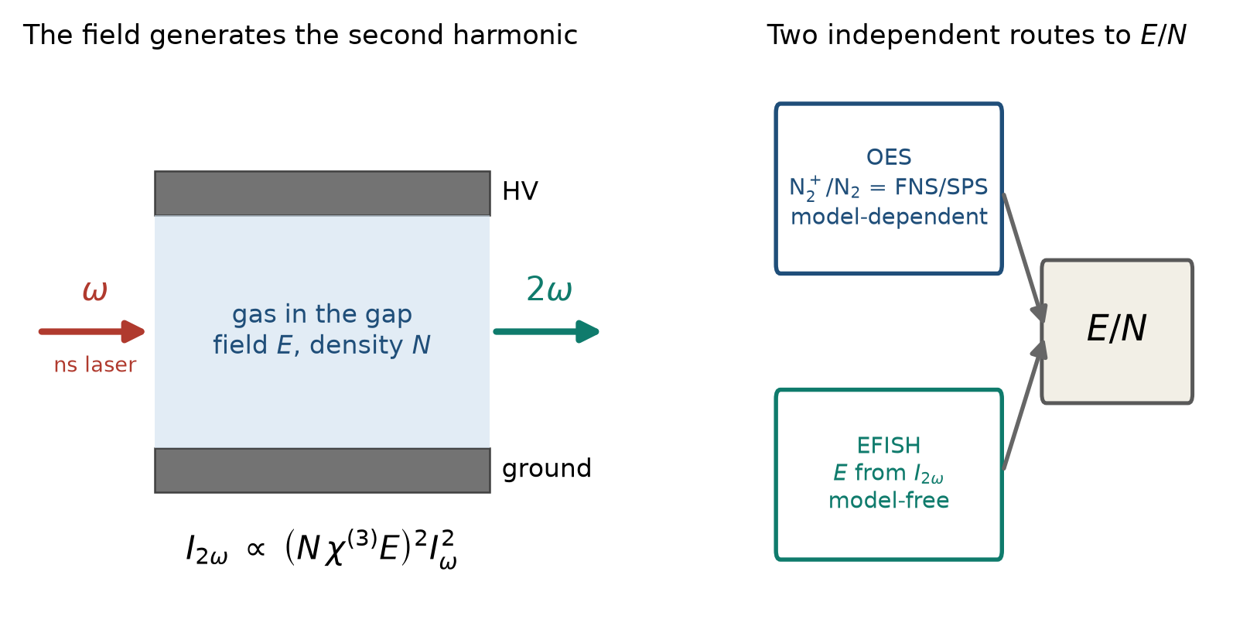
EFISH: an independent route to E/N
DIAGNOSTICS · PHYSICAL CHARACTERIZATION
Field-induced SHG
I(2ω) ∝ (Nχ⁽³⁾E)² I(ω)²: the signal reads E directly.
No kinetic model
E(t) at laser-pulse resolution, free of collisional-radiative rates.
The argon test
Is the FNS/SPS drop in argon a lower E/N, or Ar* energy transfer?
Principle of EFISH and its role as a model-free check of the OES-derived E/N; measurements on this reactor are in progress.
Notes:
The applied field breaks the inversion symmetry of the gas; a focused ns laser at omega then generates a coherent signal at 2 omega whose intensity scales as (N chi3 E)^2 I^2. Calibrated against a known Laplacian field (discharge off), it gives the absolute field with the laser-pulse time resolution and no assumption on excitation or quenching rates. Here it is set up to answer the question left open by OES in argon mixtures. [If you have field data by the talk, replace the schematic with the E(t) trace.]

Slide 20
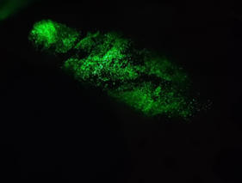
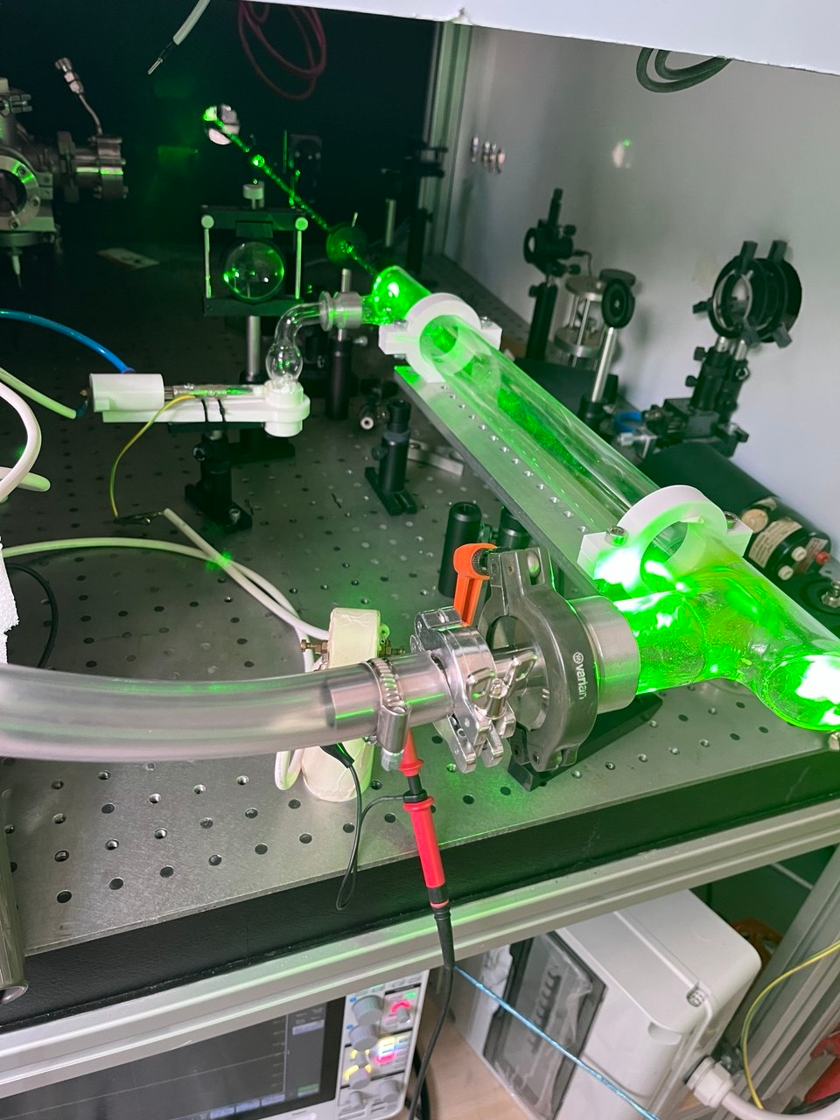
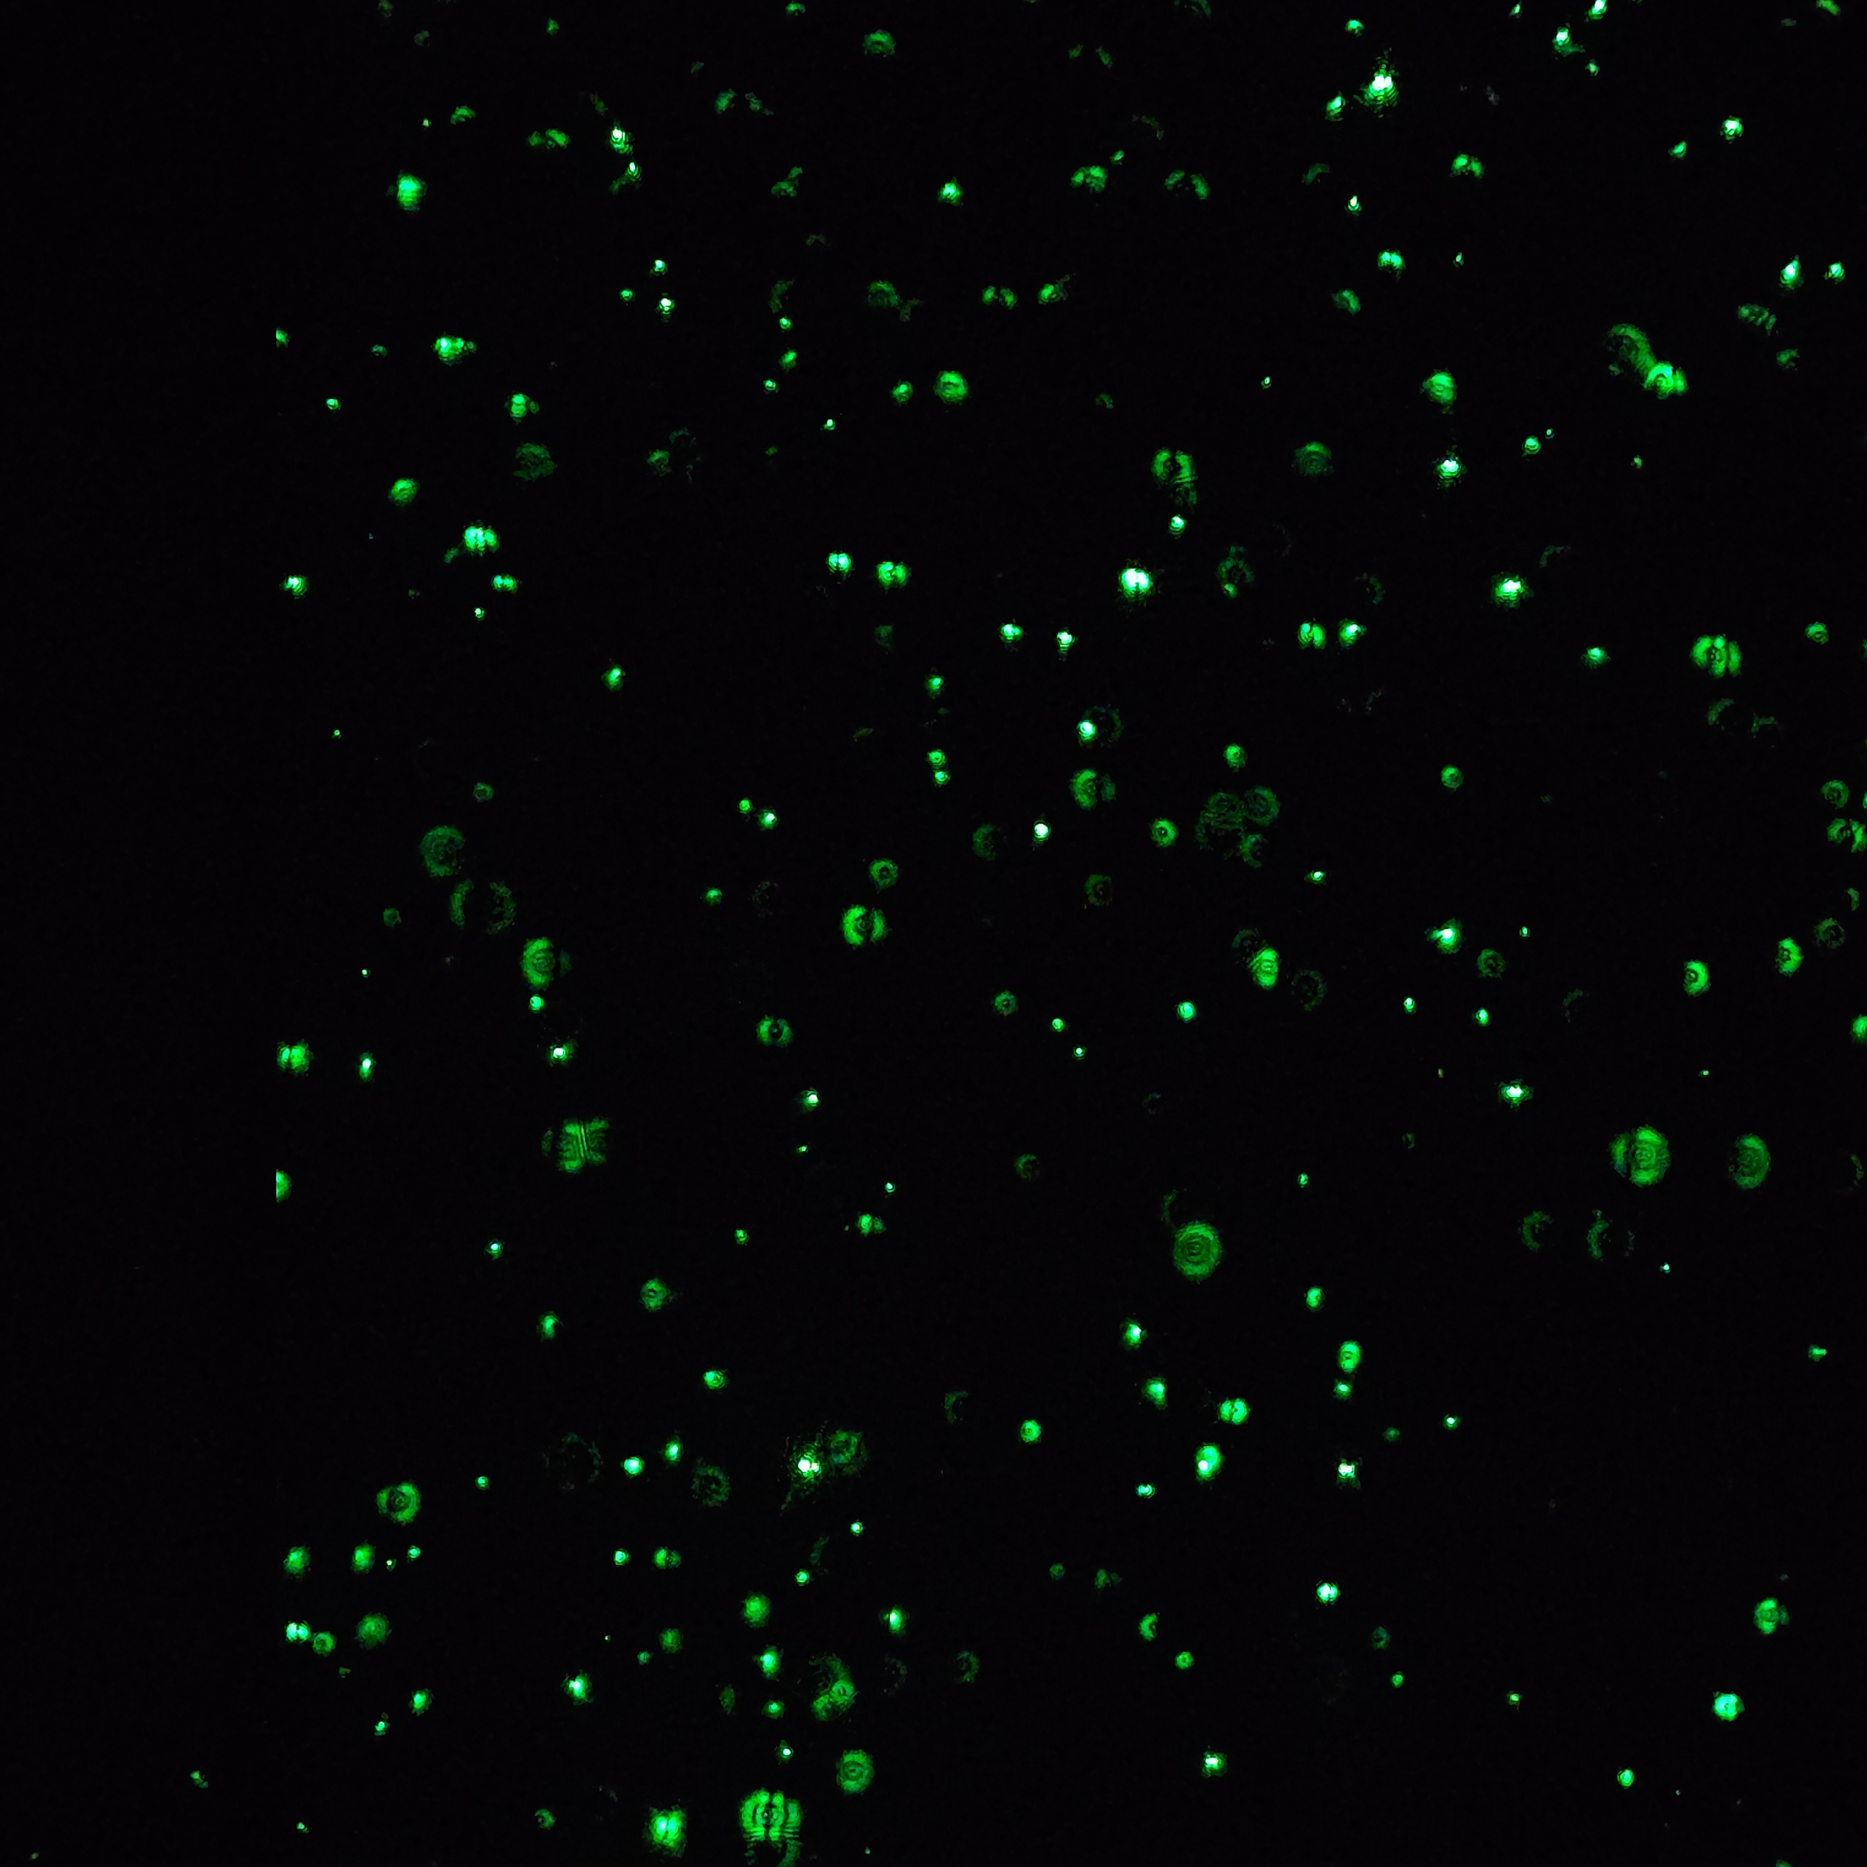

Slide 21
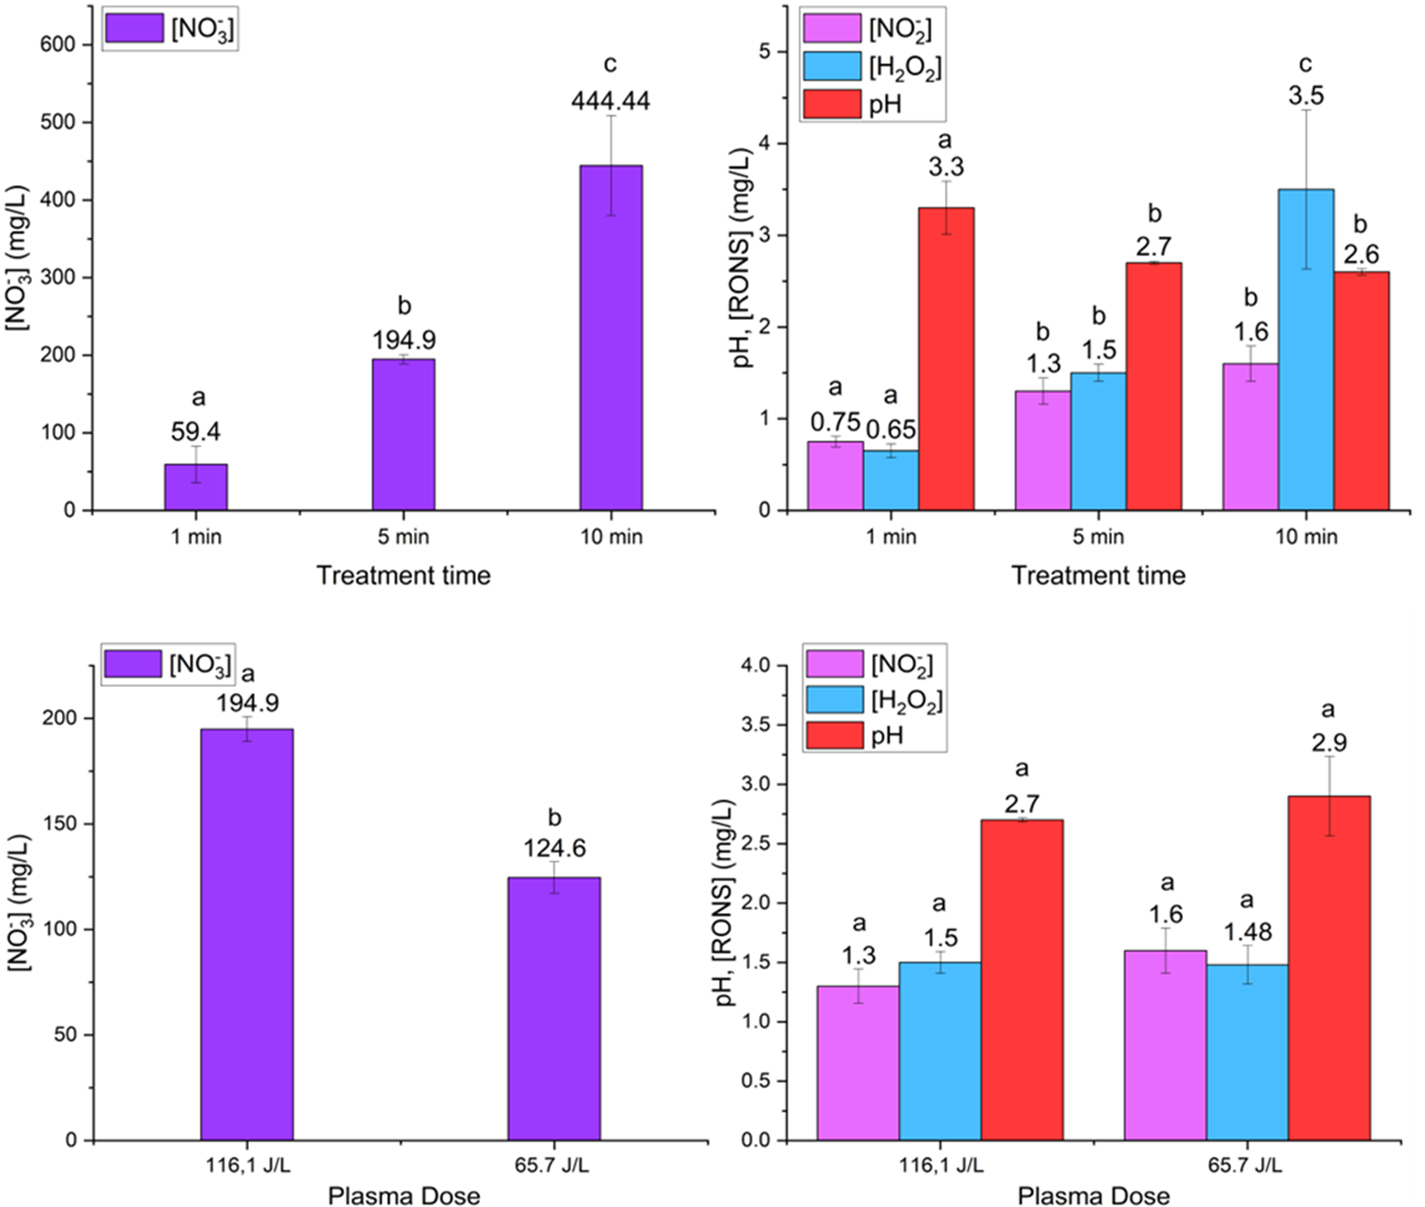
Condensed PAF composition
DIAGNOSTICS · LIQUID PHASE

Slide 22
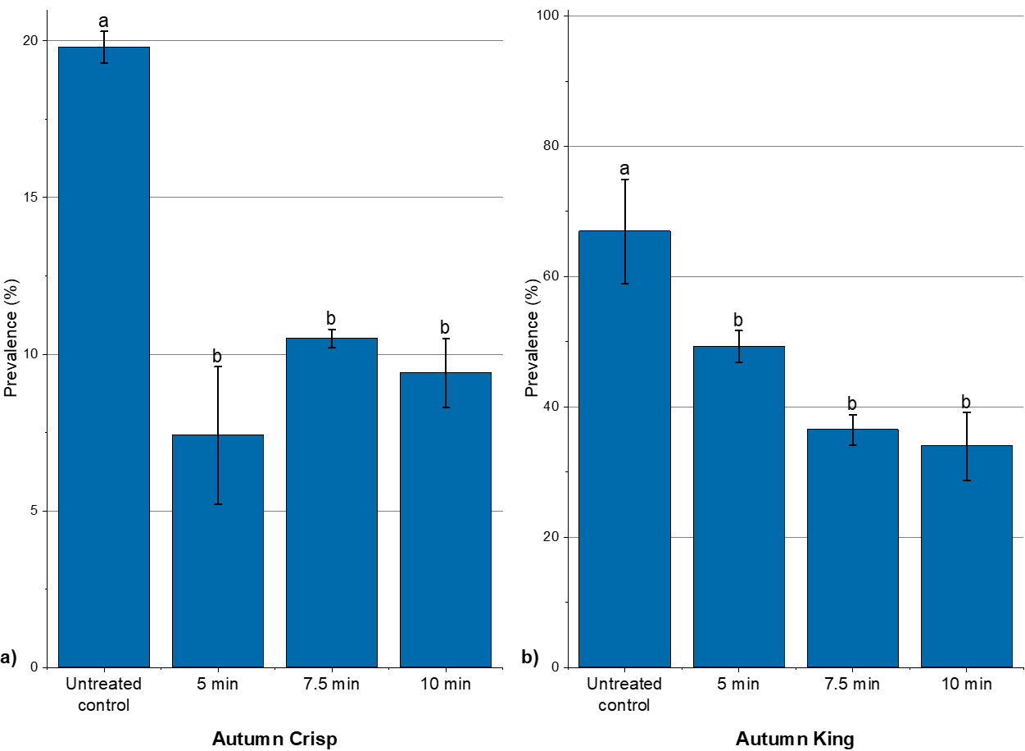
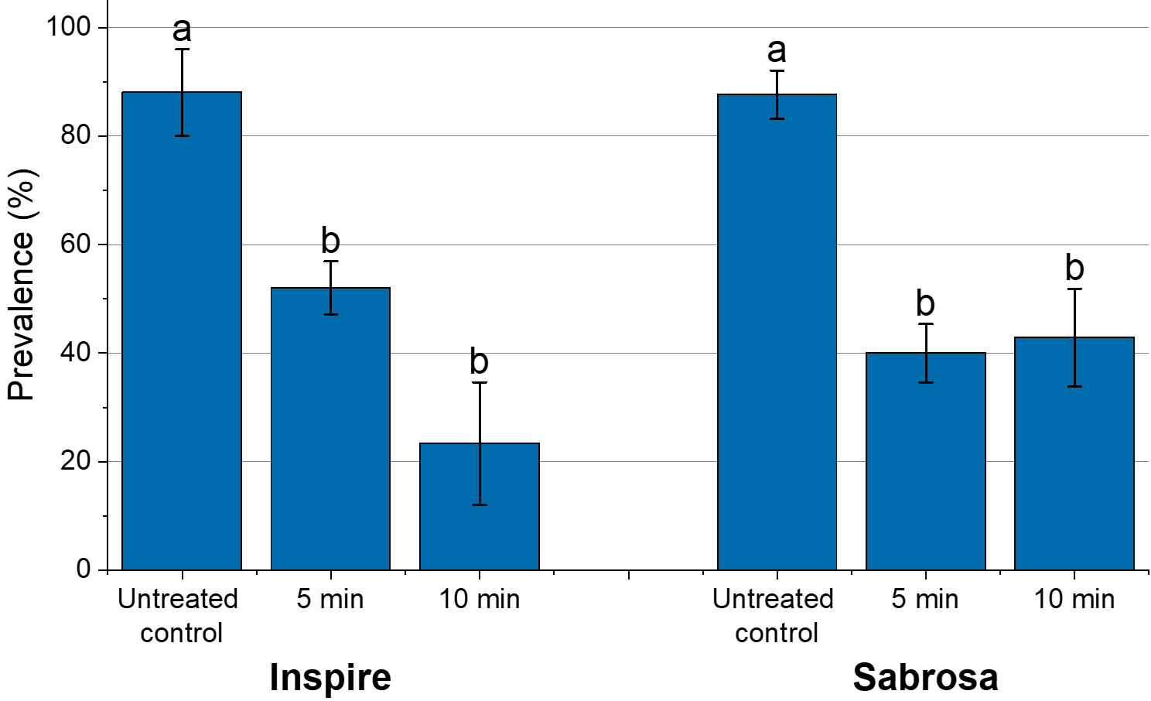
From reactive chemistry to decontamination – in vivo
TREATMENT PERFORMANCE
Strawberries
Grapes

Slide 23
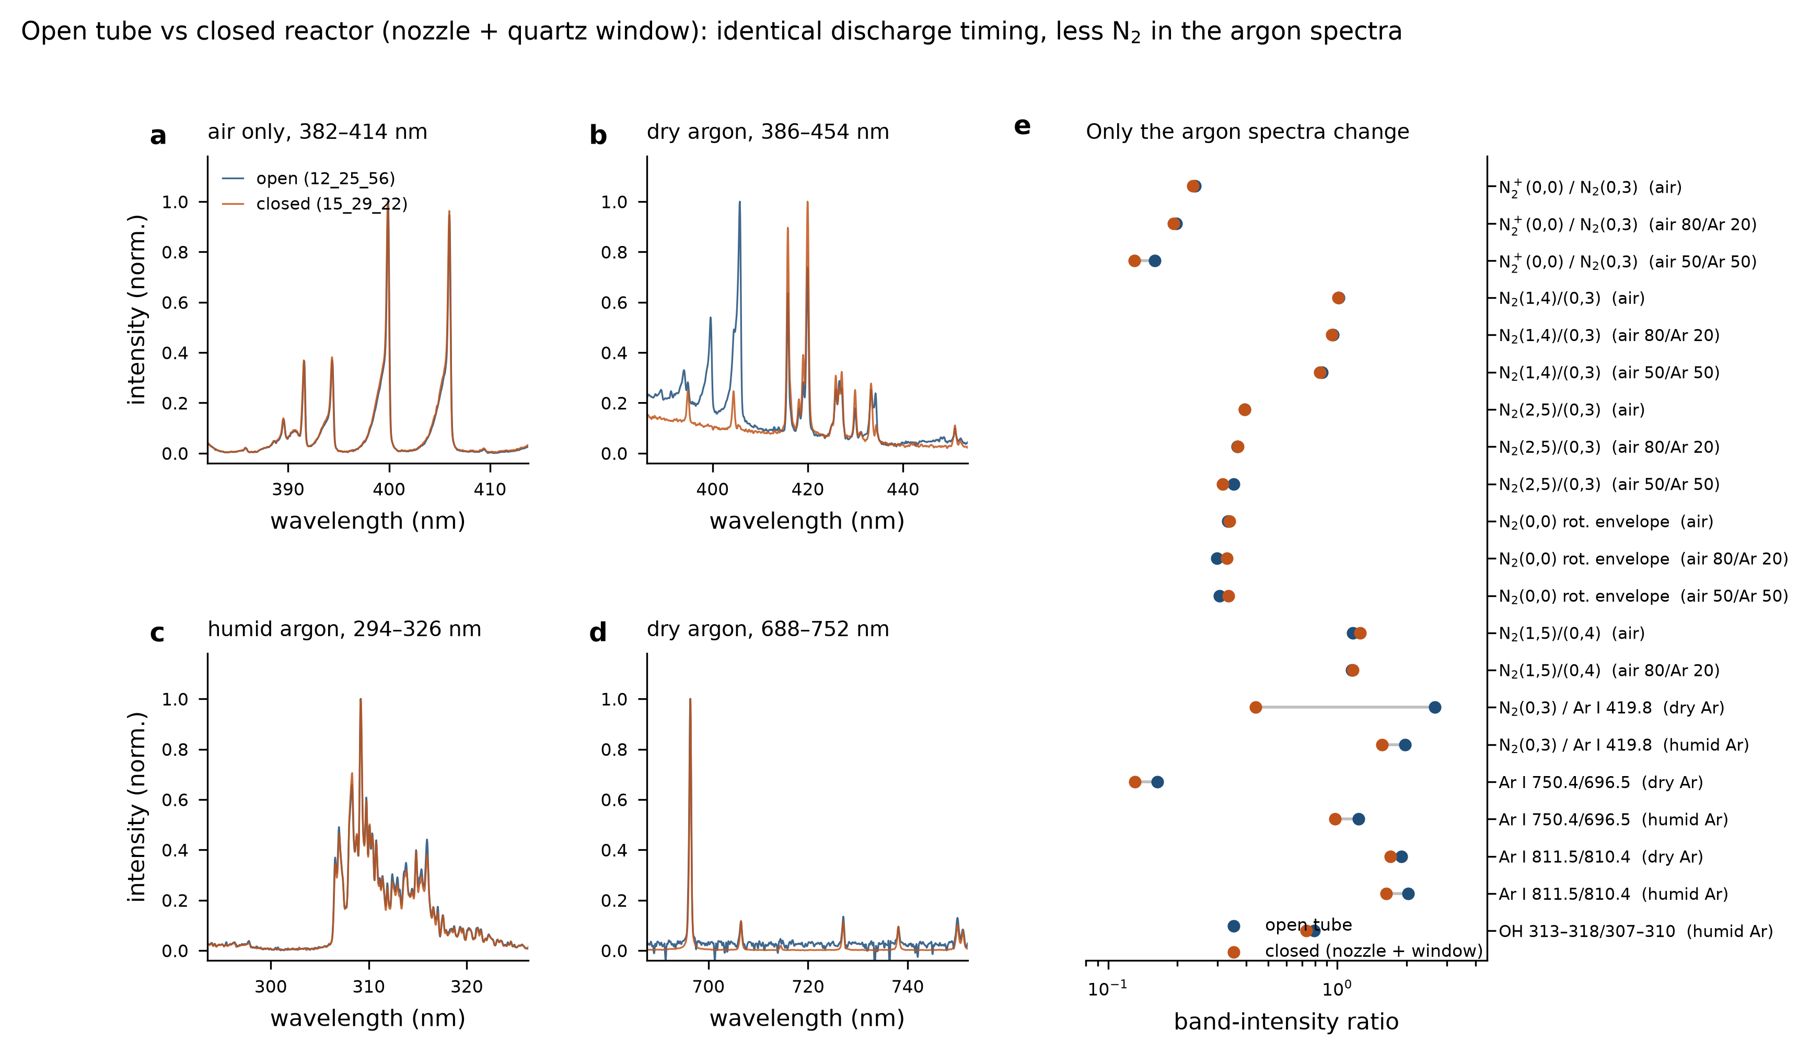
Does the optical port change what you measure?
BACKUP
Discharge identical
Packet period 38.26 ± 0.02 µs, burst 19–786 µs, in both geometries.
Air spectra identical
N₂⁺/N₂ and the vibrational ratios agree to within 2 %.
Argon spectra are not
N₂ (0,3)/Ar I 419.8 falls 6× once nozzle and window are fitted.
Seventeen spectral windows measured in both configurations; every ratio taken inside a single acquisition.

Slide 24
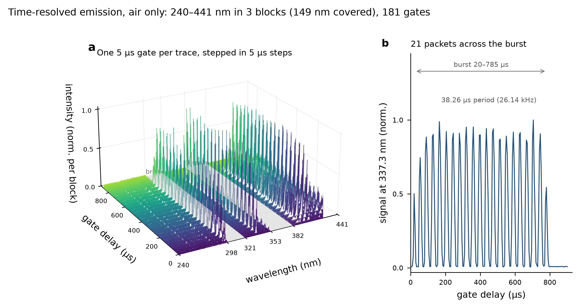
Emission inside a single voltage burst
BACKUP
Gate-delay scan
One 5 µs gate per trace, stepped through the 800 µs burst.
Emission comes in packets
21 packets, one per 38.26 µs cycle, each about 20 µs wide.
Ratios stay constant
N₂⁺/N₂ and OH/N₂ do not evolve within a packet, below 1.4 σ.
Air, 382–414 nm, 181 gates of 5 µs, 200 accumulations.

Slide 25
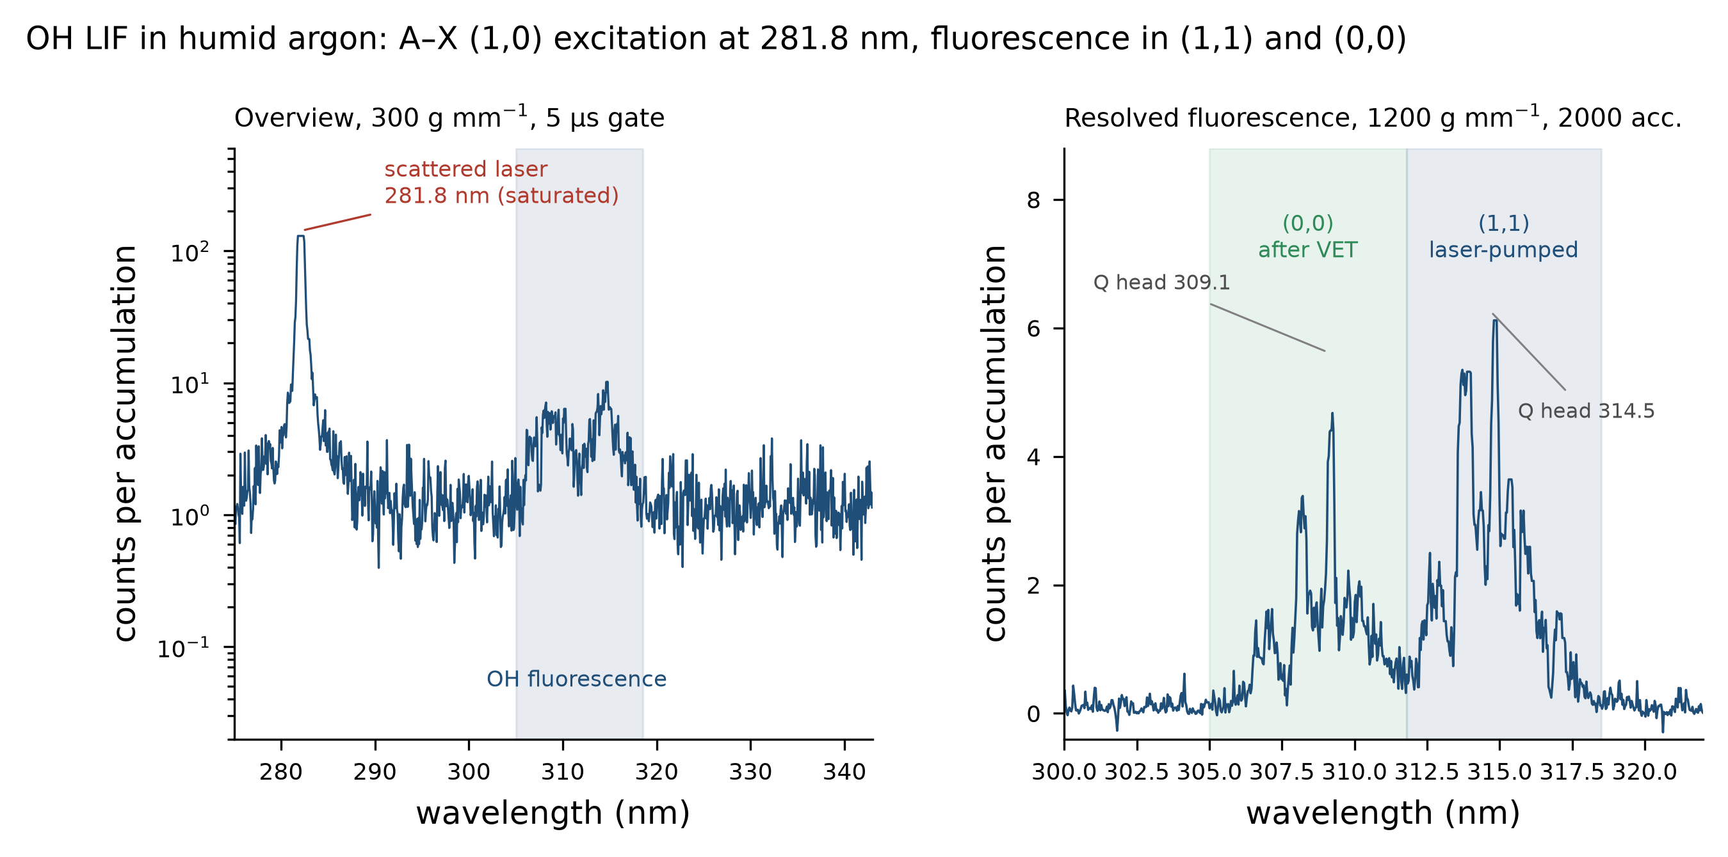
OH laser-induced fluorescence in the discharge
BACKUP
Excitation at 281.8 nm
A–X (1,0) pumped; fluorescence collected 25–35 nm away.
Proof that it is LIF
(0,0)/(1,1) inverts: 1.5–1.6 in emission, 0.6–1.0 under the laser.
Vibrational transfer
v′=1 → v′=0 competes with quenching at atmospheric pressure.
Humid argon, 2000 accumulations, 5 µs gate; single-gate data, so no lifetime information.

Slide 26
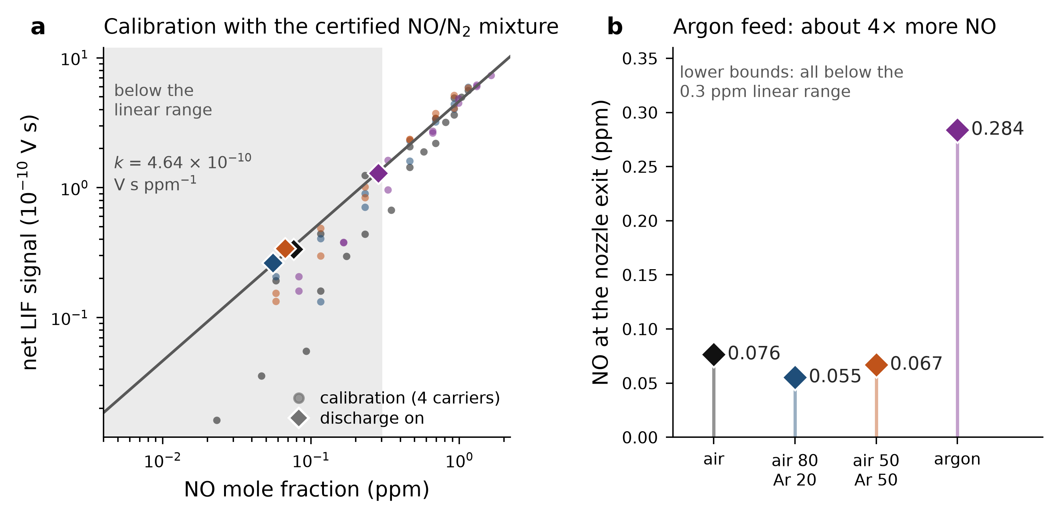
Calibrated NO at the nozzle exit
DIAGNOSTICS · LIF
One calibration
Certified NO/N₂ in four carriers: k = 4.64 × 10⁻¹⁰ V s ppm⁻¹.
Argon: 4× more NO
0.28 ppm with argon against 0.055–0.076 ppm with air in the feed.
Lower bounds
All four plasma signals fall below the 0.3 ppm linear range.
PMT LIF at 226.16 nm, closed reactor, nozzle exit; discharge-off background subtracted. Error bars: counting statistics and slope.
Notes:
Calibration: the certified 116 ppm NO/N2 standard is metered into the feed (10 slm; 7 slm for pure argon) and the PMT LIF signal is integrated 18-75 ns after the 226.16 nm pulse. One slope fits all four carriers within 7 %, because the transition is saturated. With the discharge on (discharge-off run subtracted) the nozzle exit carries 0.076 ppm (air), 0.055 (80/20), 0.067 (50/50) and 0.284 ppm (argon). All four lie below 0.3 ppm, where the calibration is sub-linear because of NO flow delivery, so read them as lower bounds. The argon/air factor of ~4 is the robust result. Expect the question about the much larger open-tube ICCD values: different configuration and probe point; jet dilution at the probe is below 1.4x.

Slide 27
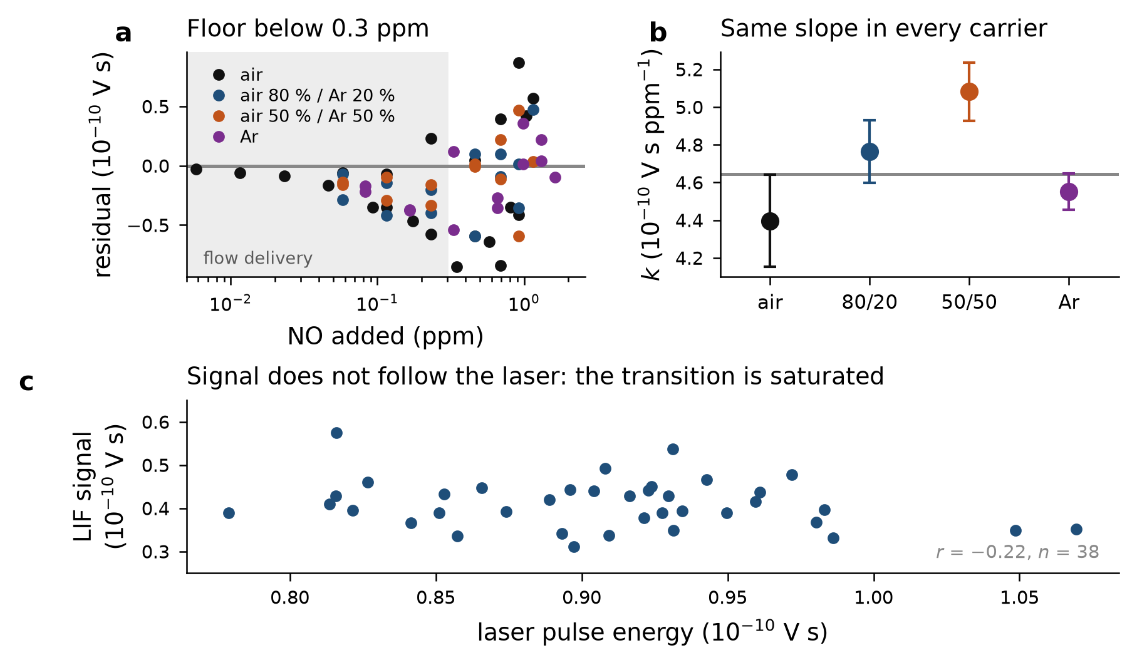
How the NO scale was set
BACKUP · LIF CALIBRATION
Same slope in every carrier
4.4–5.1 ×10⁻¹⁰ V s ppm⁻¹ from pure air to pure argon.
Saturated transition
Signal does not follow laser energy, so quenching differences cancel.
Floor below 0.3 ppm
All four series bend down: NO flow delivery, not photophysics.
70 calibration points, 116 ppm NO/N₂ standard diluted into 10 slm (7 slm for argon).

Slide 28
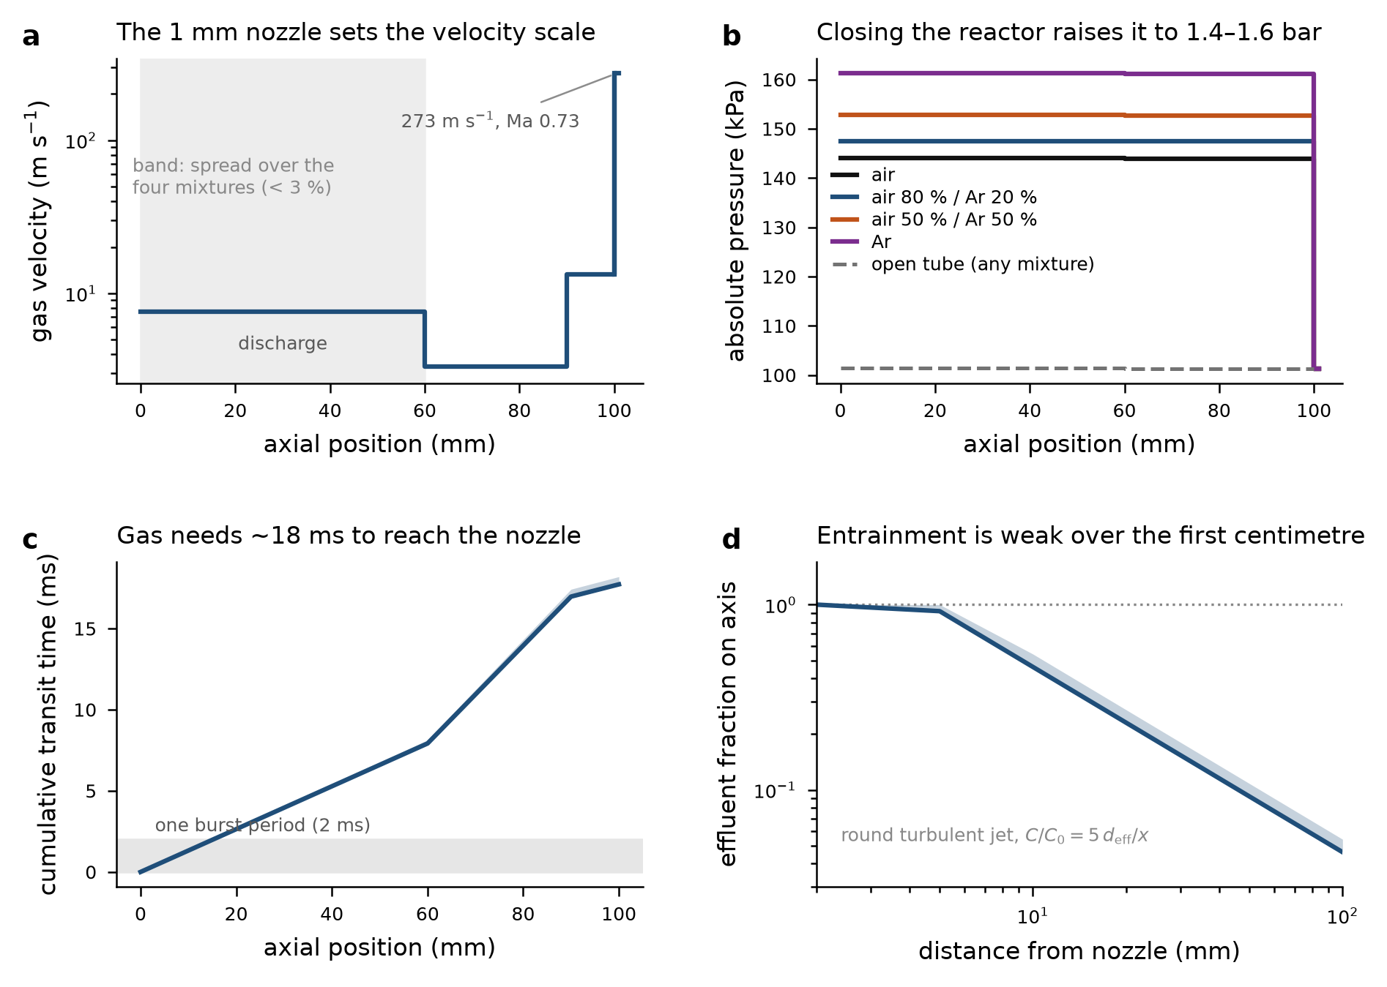
Flow model behind those numbers
BACKUP · FLOW MODELLING
Closed reactor at 1.4–1.6 bar
The 1 mm nozzle carries the whole pressure drop; falsifiable with a manometer.
Dilution below 1.4× at the probe
Round-jet entrainment anchored to the measured centreline decay constant.
Verified three ways
Exact mass balance, analytic annular profile, grid study within 10 %.
Quasi-1D balances plus an axisymmetric laminar solution written for this geometry; water droplets not included.

Slide 29
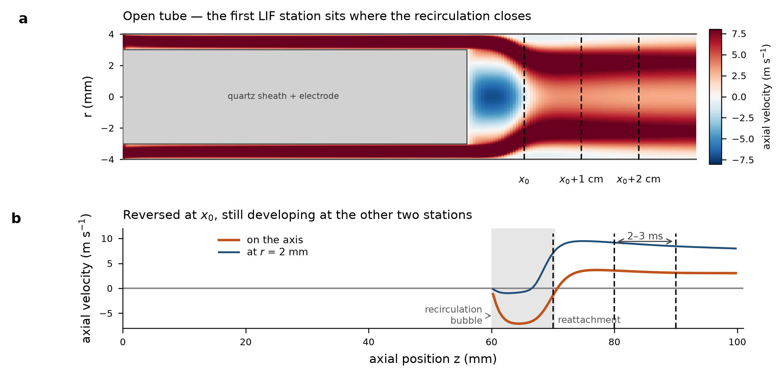
Where the LIF stations sit in the flow
DIAGNOSTICS · LIF
Recirculation behind the sheath
The annular jet separates at the sheath tip: a bubble ~10 mm long on the axis.
x₀ falls at the reattachment
Axial velocity there is still reversed, so no single residence time applies.
The two downstream points are 2–3 ms apart
130 → 200 ppm over that interval is a usable kinetic step.
Axisymmetric laminar solution, open tube, air at 10 slm; reattachment at 70 ± 1 mm from the grid study.

Slide 30
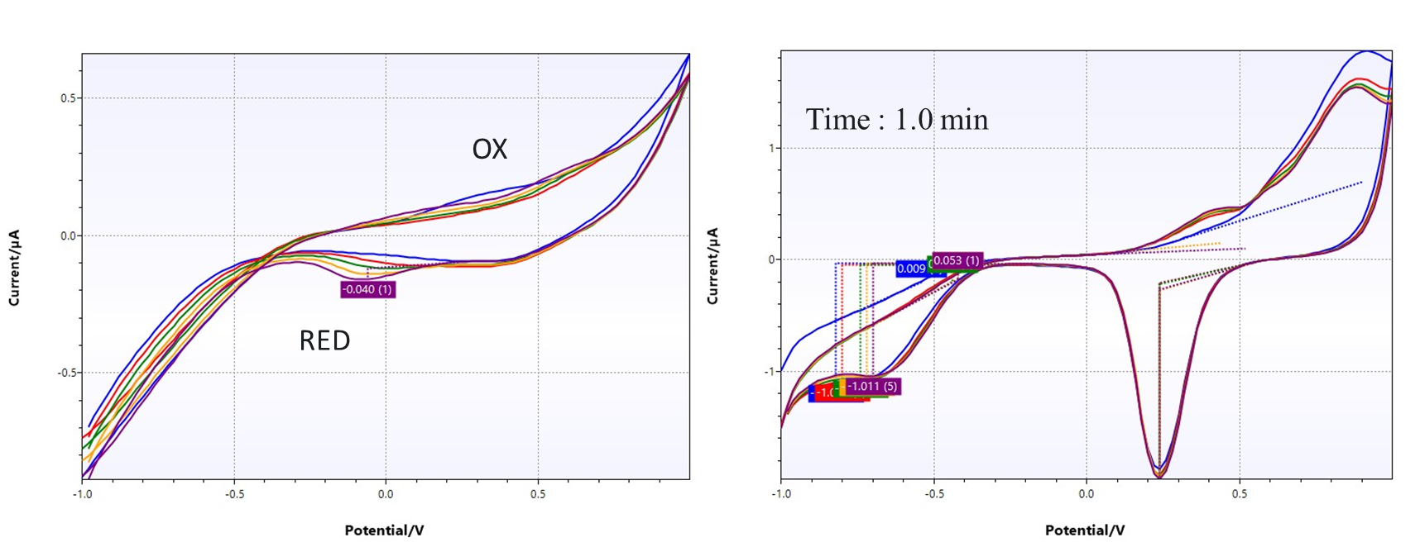
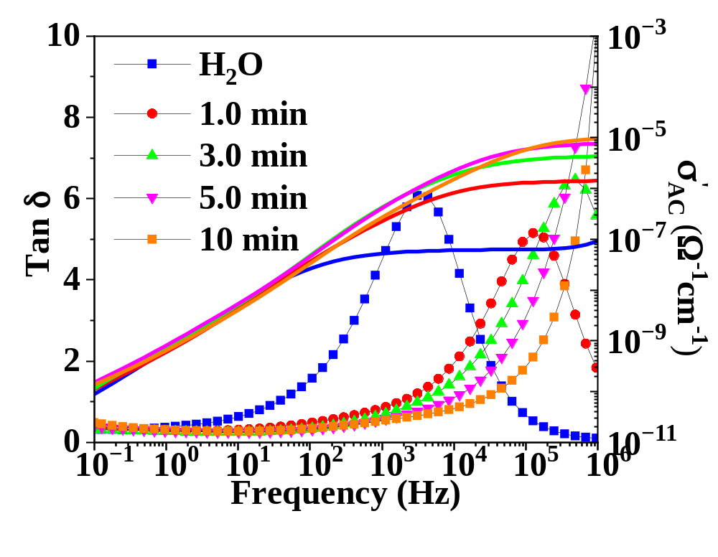
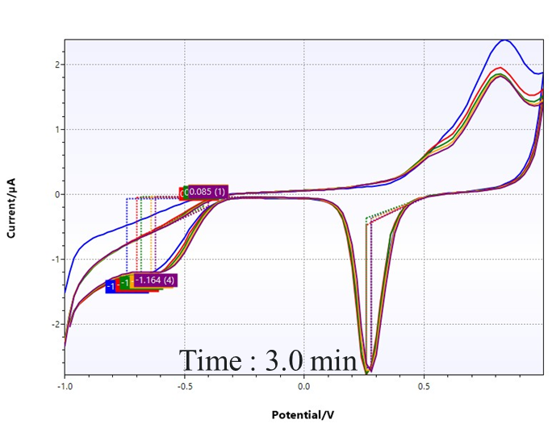
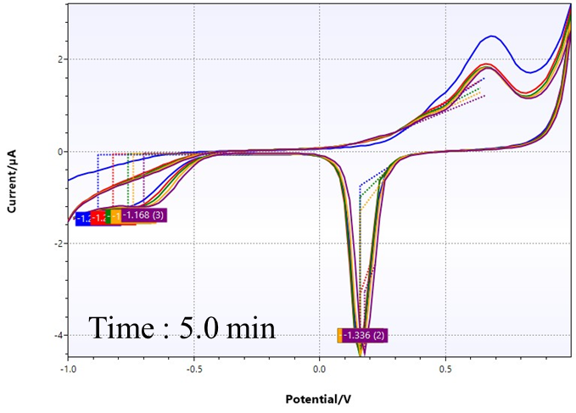
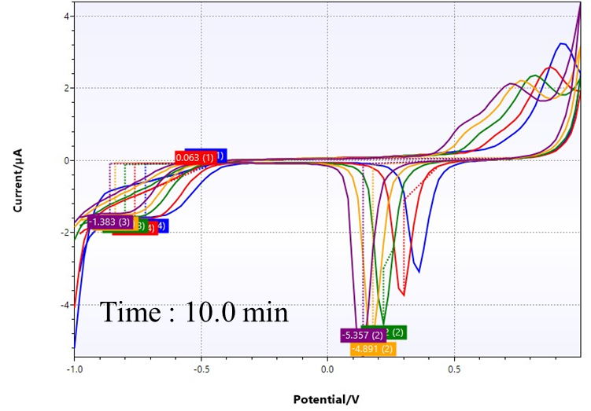
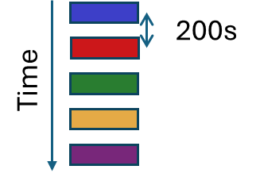
Voltammetry and Electrochemical Impedance Spectroscopy
DIAGNOSTICS · LIQUID PHASE
H₂O (baseline)
Cyclic voltammetry shows the condensed liquid turning electro-active with treatment time, as redox features grow from the flat H₂O baseline.
Impedance spectroscopy tracks the same trend quantitatively: AC conductivity rises by orders of magnitude, an independent fingerprint of accumulating ionic RONS.

