Slide 1


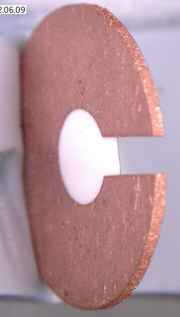
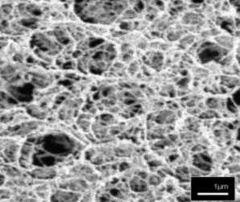
Laser Interaction with Foam Targets for the Generation of Laser-Driven Sources of Particles and Radiation for Nuclear Physics with Lasers
8th International Conference on Frontiers in Diagnostics Technologies (ICFDT8)
Frascati, Italy | October 2026
Sebastian Busch (Goethe University Frankfurt / GSI Darmstadt)
Prof. Dr. Olga Rosmej, Parysatis Tavana and collaborations
CHO-Foam
Foam Structure

Slide 2
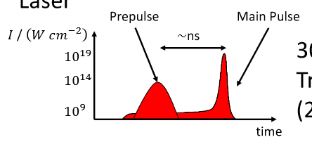
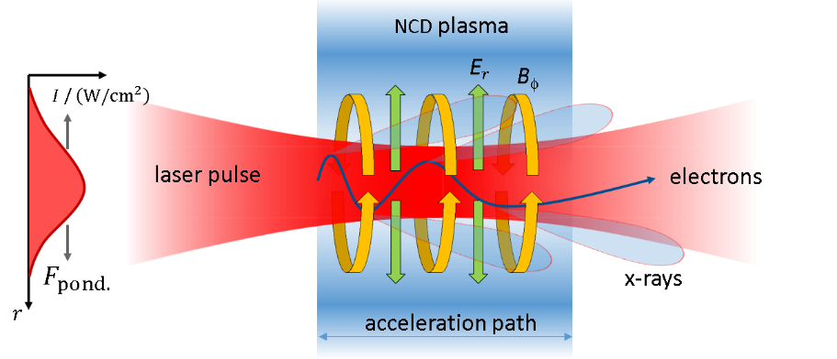
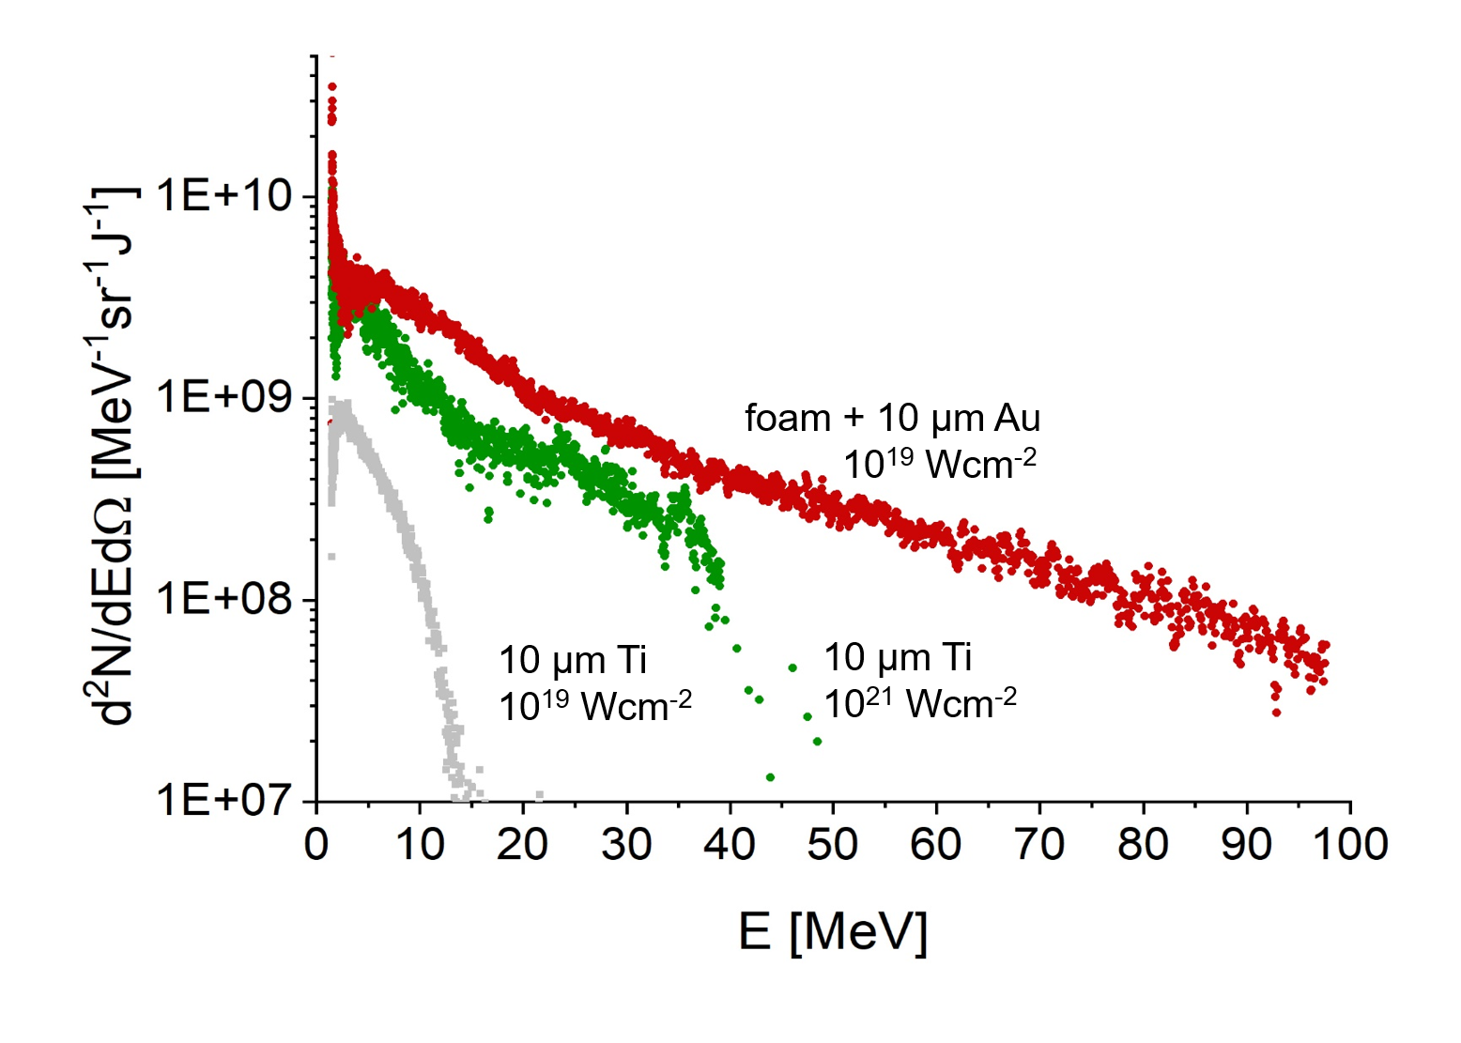

PHELIX Laser System Parameters and DLA Setup for Laser-Plasma Coupling
Foam ionization by suitable ns-pulse
→ depending on foam density and length
Longer acceleration path in foam-plasma
→ Higher electron energies and conversion efficiencies
Direct Laser Acceleration (DLA)
Electron spectra along the laser axis
Laser Parameters (2022)
Focus size | ~ (13 x 21) µm
Intensity ns-pulse | ~ 10¹³ W/cm²
Delay | ~ 5 ns
Intensity ps-pulse | ~ 10¹⁹ W/cm²
Wavelength | 1052 nm
Energy (FWHM) | 14–19 J
Foam Structure
19.10.2026 Sebastian Busch
1/16

Slide 3
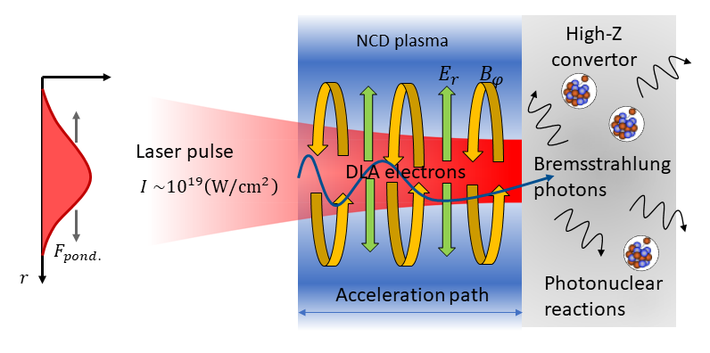
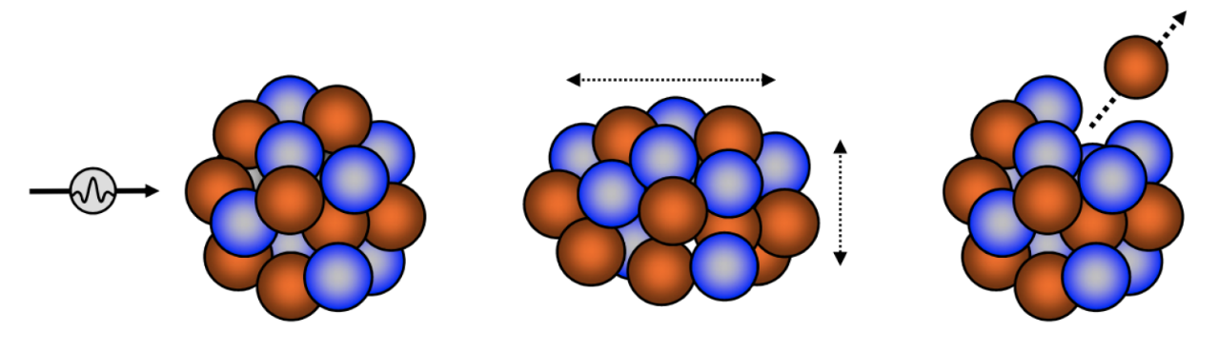
Theoretical Background
Generation of High Energetic Photon Using Foam Targets
Irradiation of target with PHELIX-Laser
→ MeV bremsstrahlung Photons via Direct Laser Acceleration (DLA):
High energy bremsstrahlung generation via deceleration of e⁻ in a high-Z converter
Emitted radiation directed onto different materials → nuclear reactions, esp. (γ, xn)-reactions
Photonuclear cross sections (GDR) peak above ~7.5 MeV
Principle: Analyze produced isotopes with High-Purity Germanium (HPGe) detectors
Giant Dipole Resonance (GDR): Collective oscillation of protons against neutrons within a nucleus leading to particle emission
19.10.2026 Sebastian Busch
2/16
Notes:
PHELIX = Petawatt High Energy Laser for Heavy Ion Experiments

Slide 4
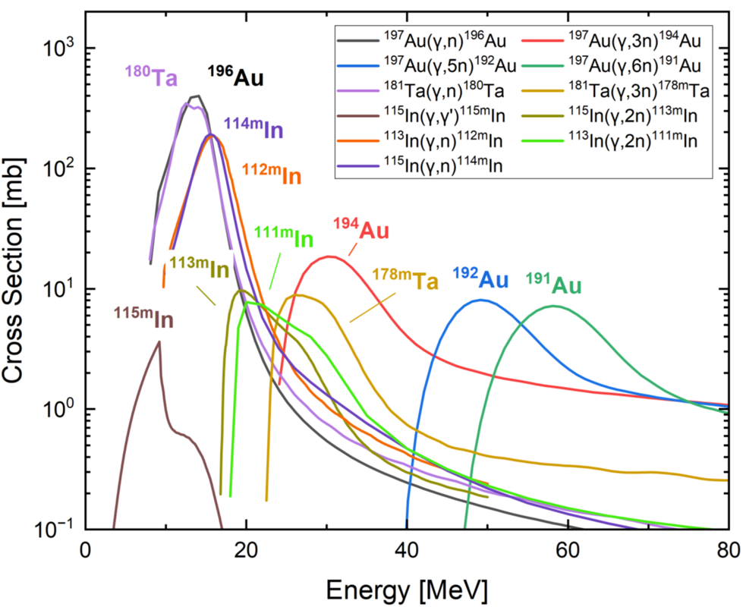
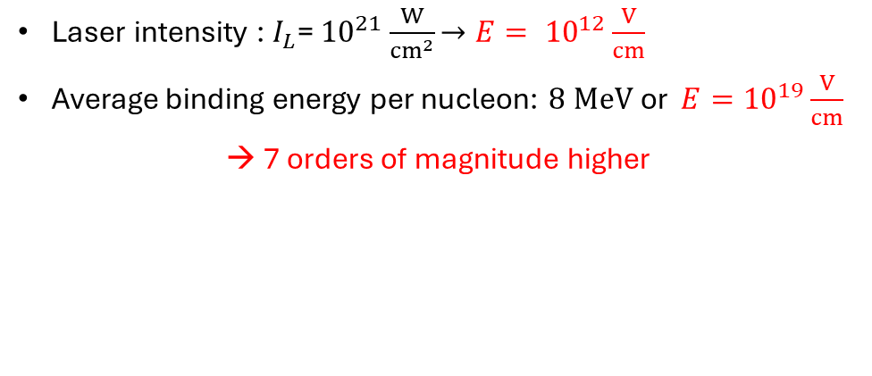
Theoretical Background
Principle of Nuclear Diagnostics in GDR Bremsstrahlung
Laser intensity : $I_{L}$= ${10}^{21}\frac{W}{{cm}^{2}}$ $→E= {10}^{12}\frac{V}{cm}$
Average binding energy per nucleon: $8 MeV$or ${E=10}^{19}\frac{V}{cm}$
→ 7 orders of magnitude higher
It is still not possible to induce nuclear reactions directly through high intensity infrared laser light
→ We use a promising indirect approach with low density foam targets
Select suitable materials with:
  High cross section in the energy range of interest
  Produced Isotopes must be detectable
  → suitable half-life & γ-energy
Used materials: Au, Ta, In, Cu, Nb, Cr
19.10.2026 Sebastian Busch
3/16
Notes:
$E=\sim \frac{10^{7}V}{10^{−12}cm}={10}^{19}\frac{V}{cm}$, I = 1/2c*epsilon_0*E^2

Slide 5
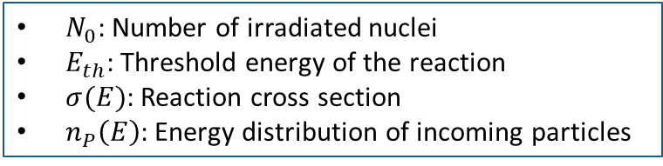
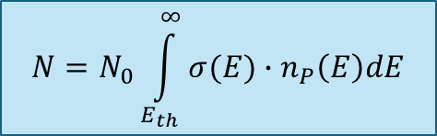
Theoretical Background
Principle of Nuclear Diagnostics
Select suitable materials with:
  High cross section in the energy range of interest
  Produced Isotopes must be detectable
  → suitable half-life & γ-energy
Used materials: Au, Ta, In, Cu, Nb, Cr
Post-shot procedure:
Record spectra using Ge-Detectors
Number of photon-induced reactions:
Determine isotope yields for bremsstrahlung
spectrum reconstruction
$$N=N_{0}\int_{E_{th}}^{∞}{σ(E)∙n_{P}\left(E\right)dE}$$
$N_{0}$: Number of irradiated nuclei
$E_{th}$: Threshold energy of the reaction
$σ(E)$: Reaction cross section
$n_{P}\left(E\right)$: Energy distribution of incoming particles
19.10.2026 Sebastian Busch
4/16

Slide 6
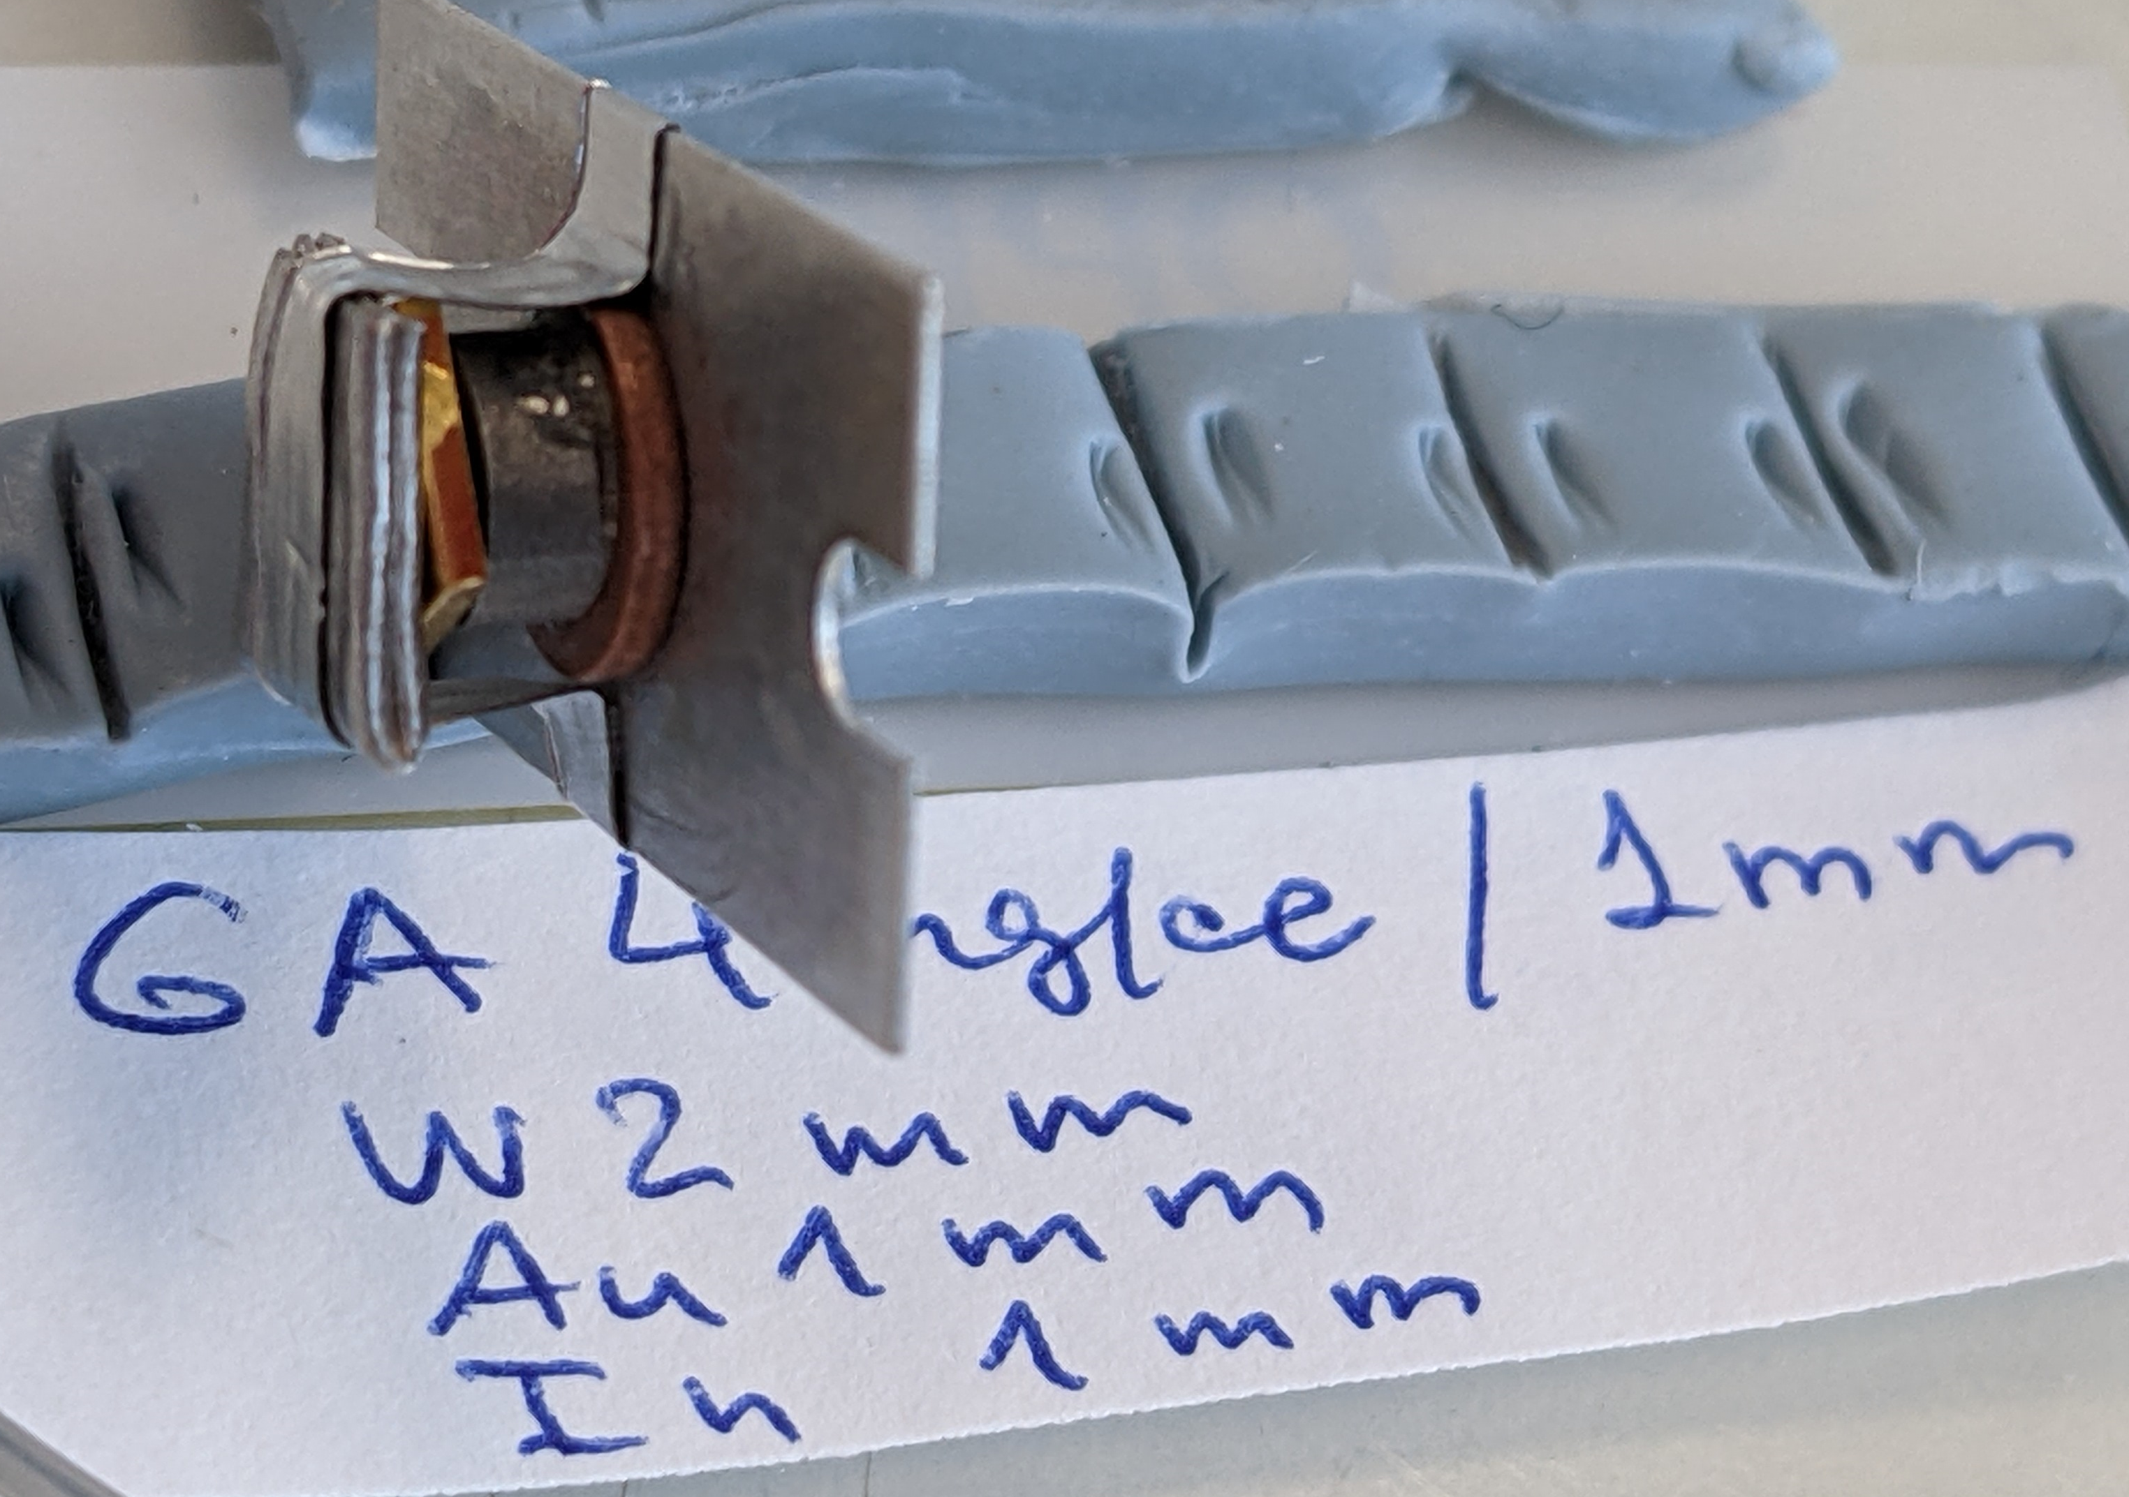
Experiments at PHELIX (GSI, Darmstadt)
  Application of directed DLA electron beams for the production of Bremsstrahlung > 10 MeV
  Characterization of Bremsstrahlung spectra using photonuclear reactions
Foam + Converter
Laser Parameters PHELIX (2022)
Focal spot size | Best focus: (13 x 15) µm²
Wavelength | 1052 nm
Intensity ns-pulse | ~ 10¹³–10¹⁴ W/cm²
Energy ns-pulse | 0.3–3 % of main-pulse
Delay | ~ 5 ns
Intensity ps-pulse | ~ 10¹⁹ W/cm²
Pulse duration | ~ 650 fs
Energy ps-pulse | ~ 70 J
Targets:
Foams of various thicknesses & densities
→ 300, 500, and 1000 µm & 2, 4, and 8 mg/cm³
Au- (10 µm), Cu- (1 µm), Al-foils (50 µm)
Foam + gold converter, tungsten, indium
CHO-Foam (8 mg/cm³)
Foam Structure
Foam ionization by a tailored ns-pulse
19.10.2026 Sebastian Busch
5/16

Slide 7
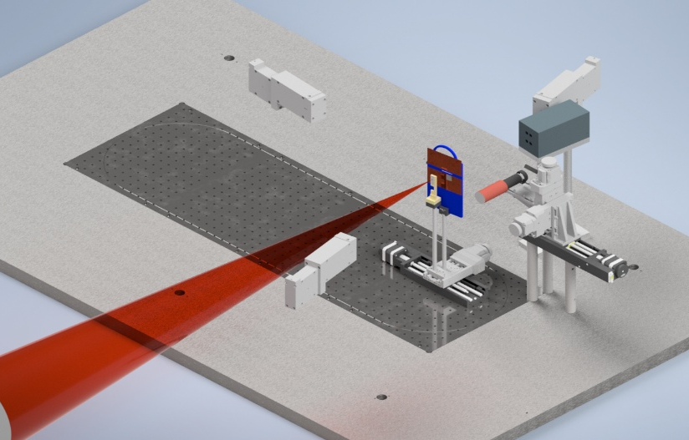
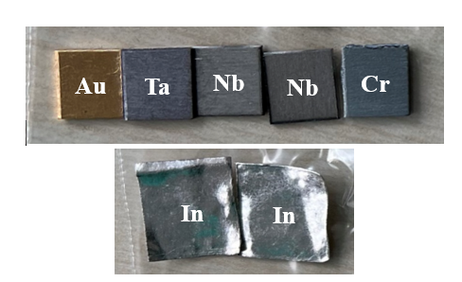
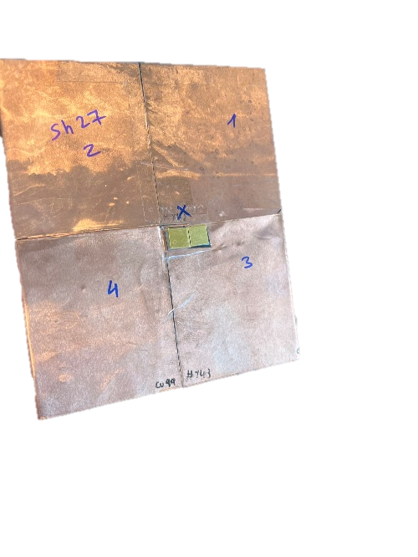
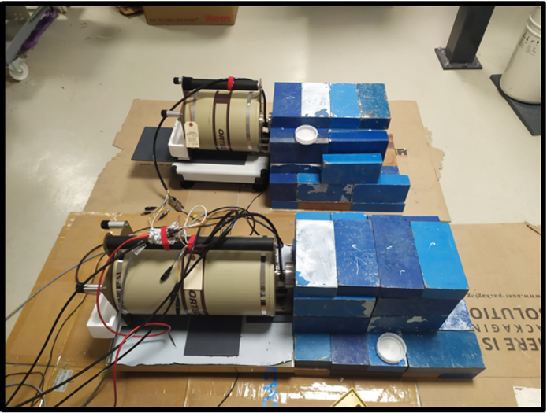
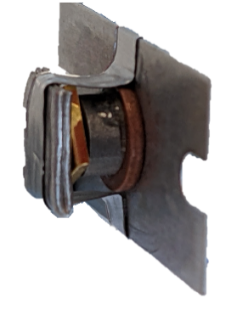
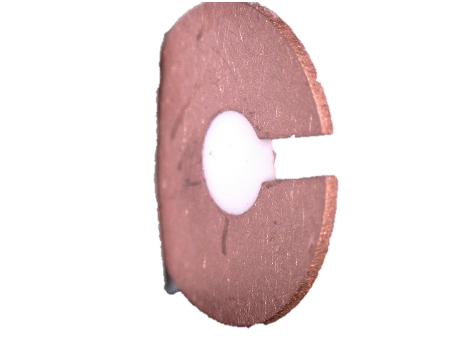
P-21-00005 – Experimental Setup
Nuclear Probes on Thin Copper Plates (4 cm to TCC)
0.99T-MS
-80°
0.99T-MS
0°, -5°
100 mm
TLD Spectrometer
7.5 mm
100 mm
7.5 mm
ps- & ns-pulse
0.99T-MS
+170°
Focus-Diagnostic
15 mm
Nuclear probes
15 mm
Target Set-Up
2 mm W,
1 mm Au
converter
1 mm Foam,
in copper washer
Detectors used:
- High-purity germanium detectors (HPGe)
- Model: GEM-S5020P4-B
Background reduction through:
- Nitrogen cooling
- Lead shielding
Al holder
1 mm
In probe
Foam target,
CHO, 8 mg/cc
0.2 mm Al-tape
19.10.2026 Sebastian Busch
6/16

Slide 8
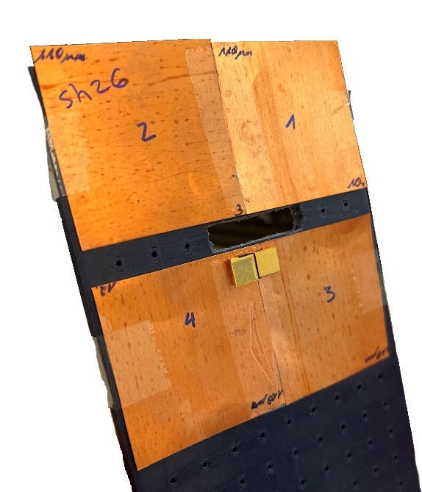
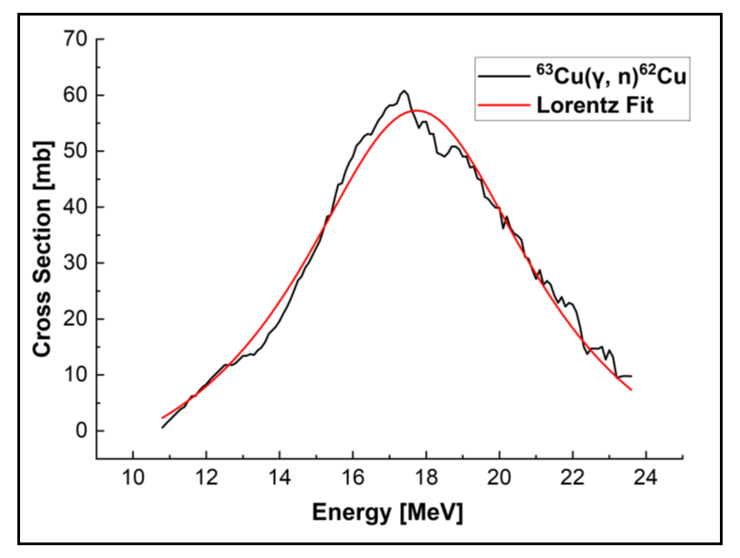
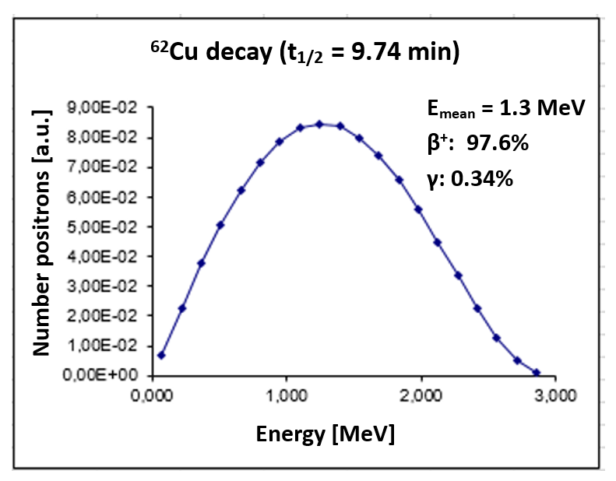
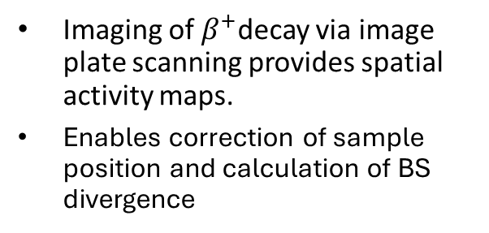
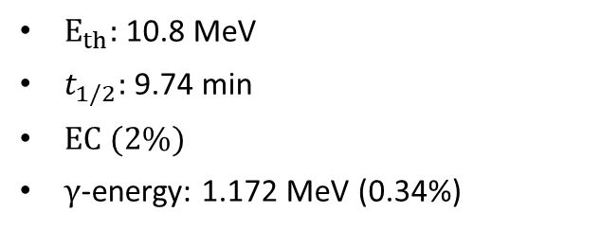
Nuclear Diagnostics
Autoradiography Using Thin Copper Foils
Autoradiography of copper foils irradiated by bremsstrahlung photons visualises the spatial distribution of radiation source
(E > 10 MeV)
Imaging of $β^{+}$decay via image plate scanning provides spatial activity maps.
Enables correction of sample position and calculation of BS divergence
$E_{th}:$ 10.8 MeV
$t_{1/2}:$ 9.74 min
$EC (2\%)$
$γ$-energy: 1.172 MeV (0.34%)
19.10.2026 Sebastian Busch
7/16
Notes:
(10-min exposure)

Slide 9
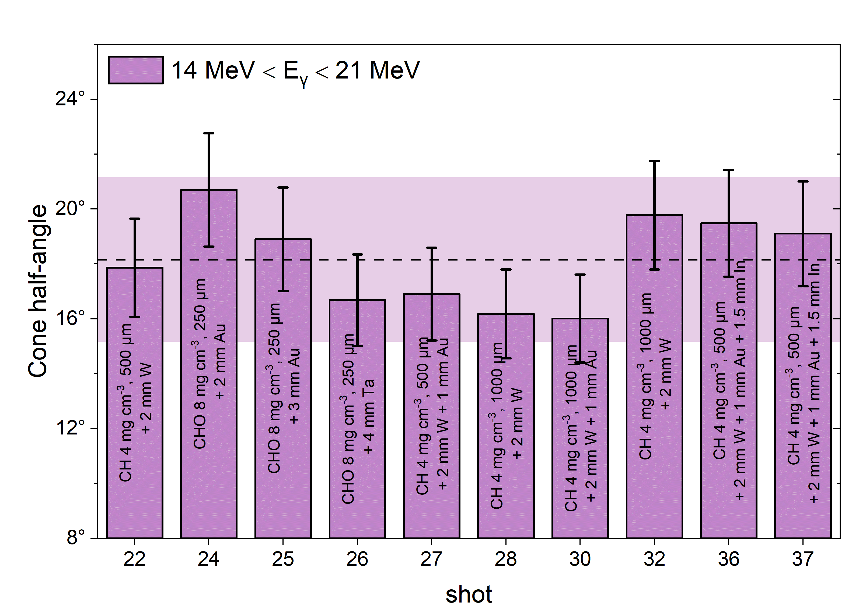

Nuclear Diagnostics
Autoradiography Using Thin Copper Foils
IP Scan for Autoradiography
Divergences for Various Foam Target Setups
Foam 1 mm, 4 mg/cm³, 2 mm W + ns-pulse
$θ_{1/2}$ = 20°
FWHM area
Vertical Position [mm]
Probe position
Autoradiography of copper foils irradiated by bremsstrahlung photons visualises the spatial distribution of radiation source
(E > 10 MeV)
Horizontal Position [mm]
19.10.2026 Sebastian Busch
7/16

Slide 10
Nuclear Diagnostics
Bremsstrahlung Reconstruction for Shot on Foam Target
Probe Spectrum for Foam-Target measured in HPGe-Detector
Reconstructed BS-Spectrum
19.10.2026 Sebastian Busch
8/16

Slide 11
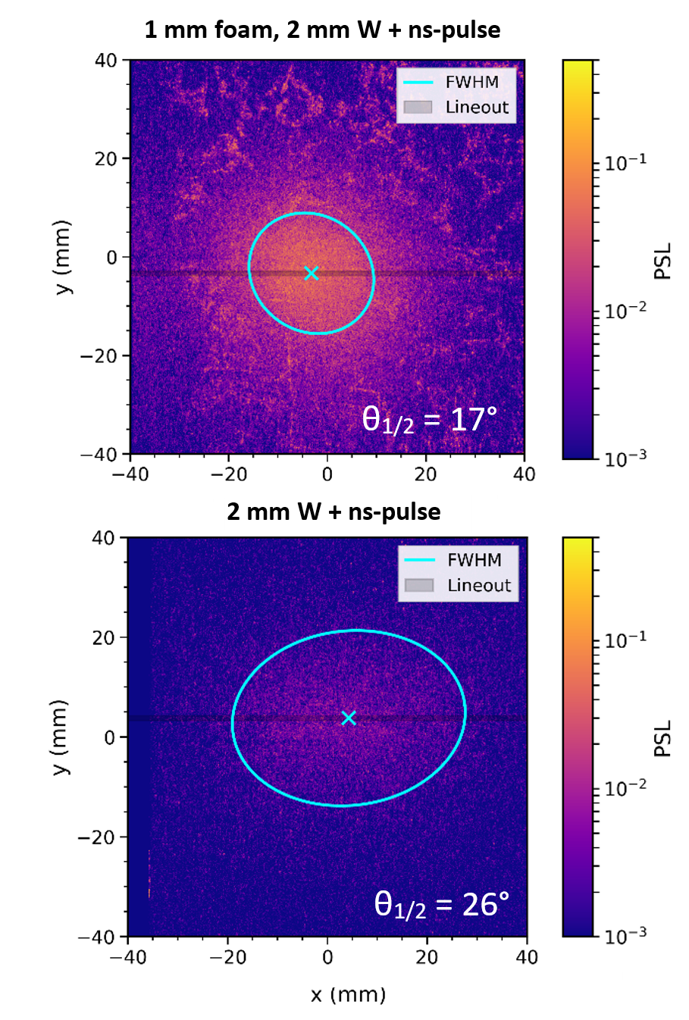
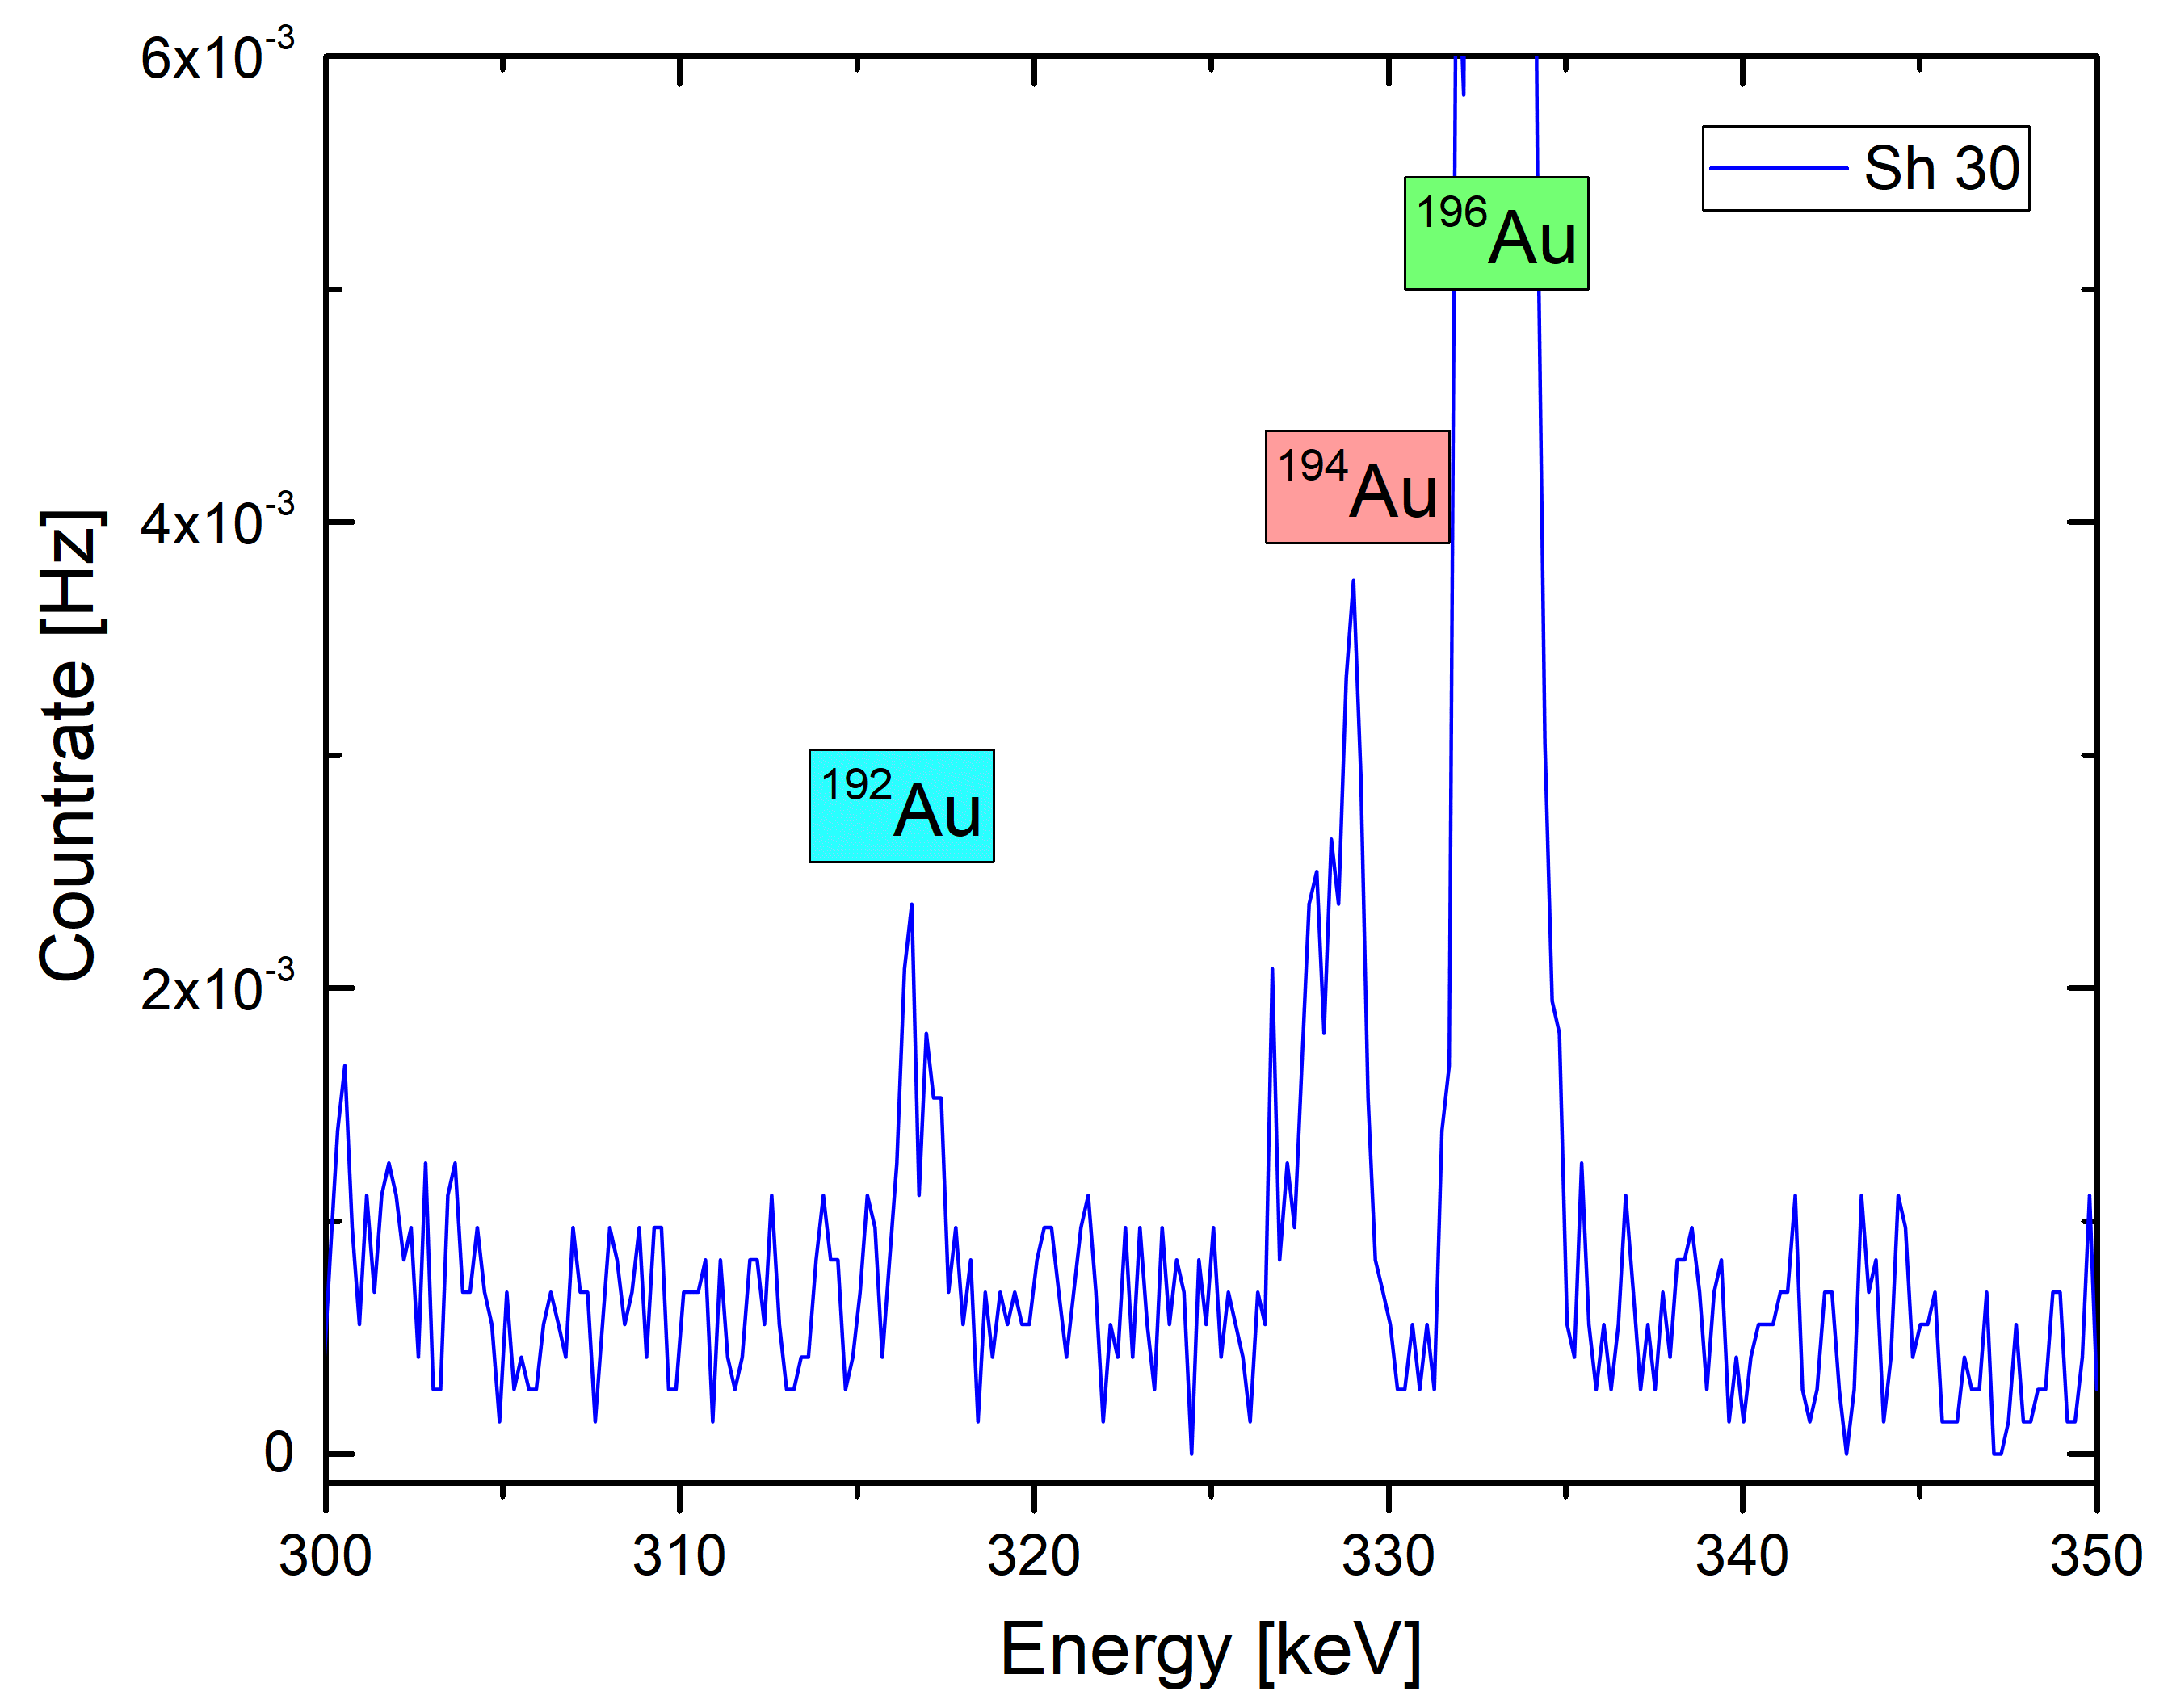
Nuclear Diagnostics
Comparison of Results for Foam Target with Converter and only Converter
Sh 30: 1 mm Foam 4 mg/cc + 3 mm converter and ns-pulse
Sh 41: 2 mm W and ns-pulse
→ Record conversion efficiency for Laser (FWHM) to BS (> 7 MeV) of up to 1.8%!
19.10.2026 Sebastian Busch
9/16

Slide 12
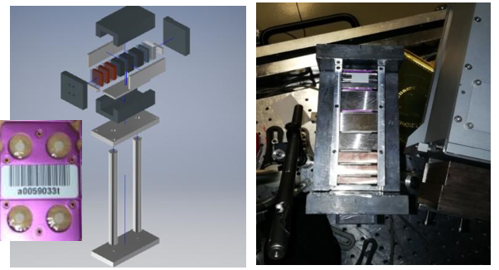
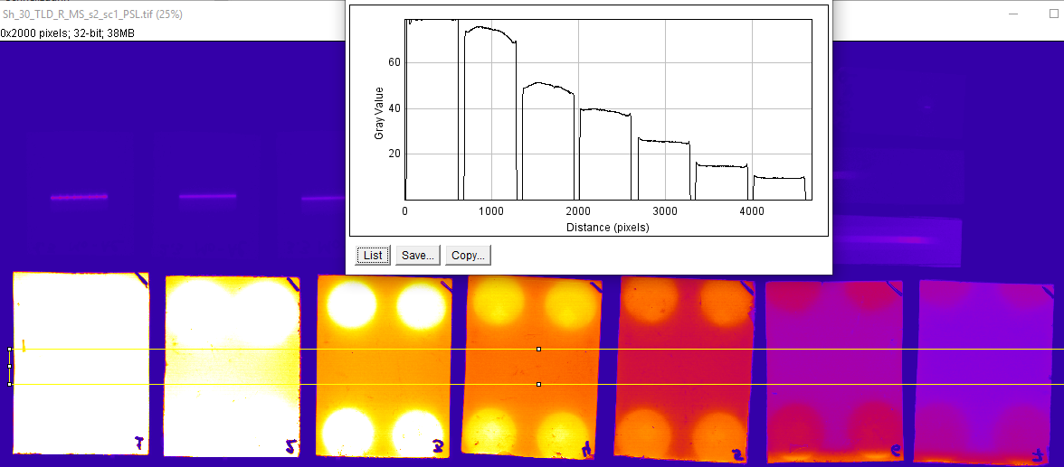
Results for Nuclear Diagnostics and Thermoluminescent Dosimeter (TLD) Spectrometer in Good Agreement
Results for Shot 30: 1 mm Foam 4 mg/cc + 3 mm Converter and ns-Pulse
8-Channel in Vacuum TLD Spectrometer at PHELIX
TLD Spectrometer Results
TLD vs. ND Bremsstrahlung Comparison
Signal on Imaging Plates
TLD simulations by:
Alessandro Tentori, GSI
19.10.2026 Sebastian Busch
10/16

Slide 13
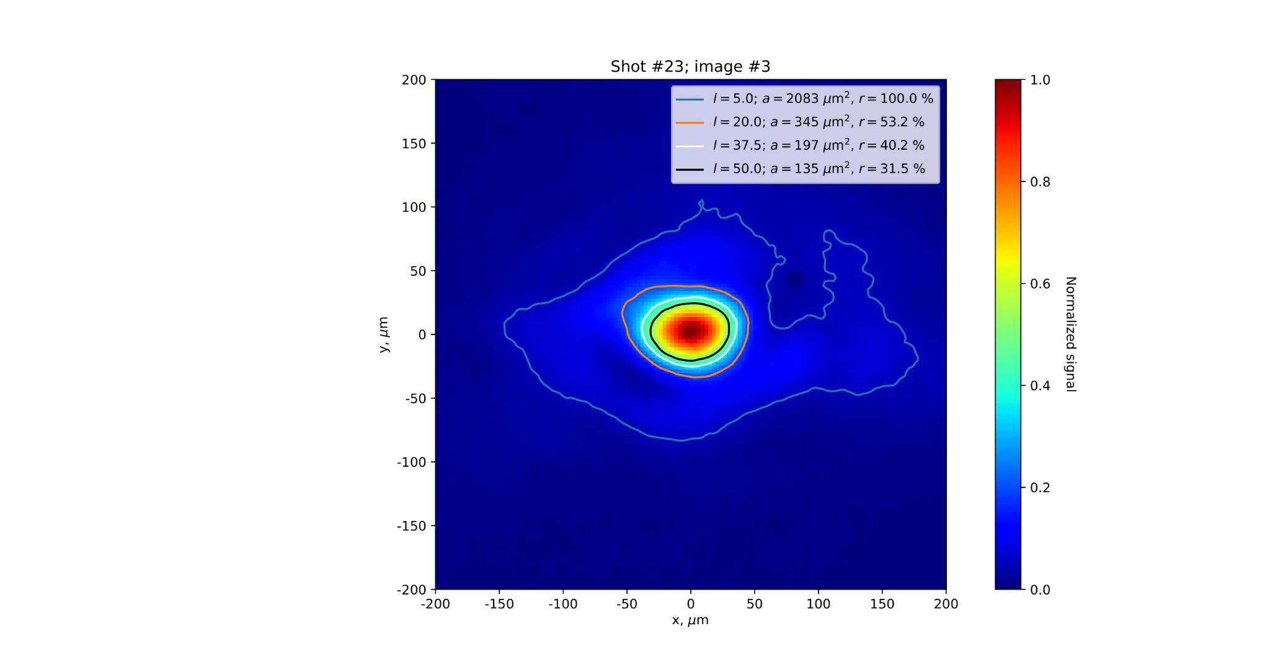
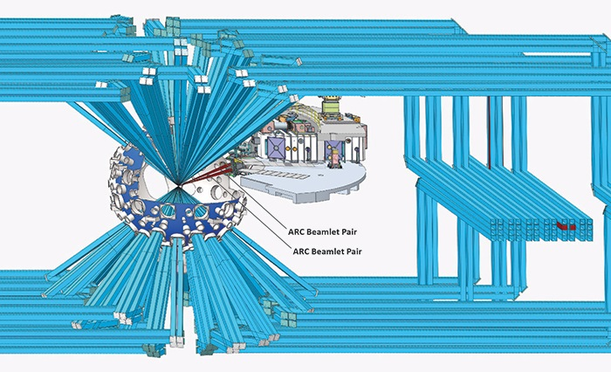
Experiments at PHELIX: P-23-00193 (2024)
  Transfer of previous approaches to Advanced Radiographic
  Capability (ARC) conditions
PHELIX Best Focus
→ For the development of ultra-bright MeV photon sources for ICF experiments at ARC/NIF
ARC Beamlet Pair
https://lasers.llnl.gov/news/nif-focus-inside-arc-laser
Laser peak intensity >10¹⁹ W/cm²
Mission of ARC: MeV Bremsstrahlung source to radiograph the moment of DT-implosion
19.10.2026 Sebastian Busch
11/16

Slide 14
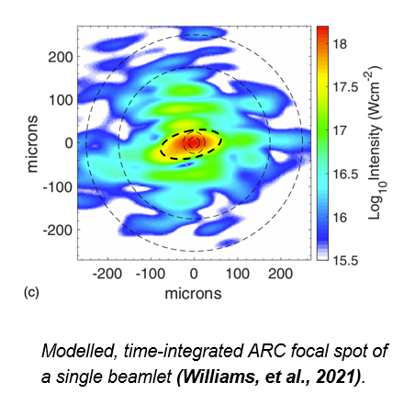
Experiments at PHELIX: P-23-00193 (2024)
  Transfer of previous approaches to Advanced Radiographic
  Capability (ARC) conditions
  → Near relativistic intensity (<10¹⁸ W/cm²) ,
  → Stretched PHELIX pulse & increased focal spot
ARC Focus
→ For the development of ultra-bright MeV photon sources for ICF experiments at ARC/NIF
ARC Beamlet Pair
→ Only 5–10 % energy with 10¹⁸ W/cm² peak intensity
https://lasers.llnl.gov/news/nif-focus-inside-arc-laser
19.10.2026 Sebastian Busch
11/16

Slide 15
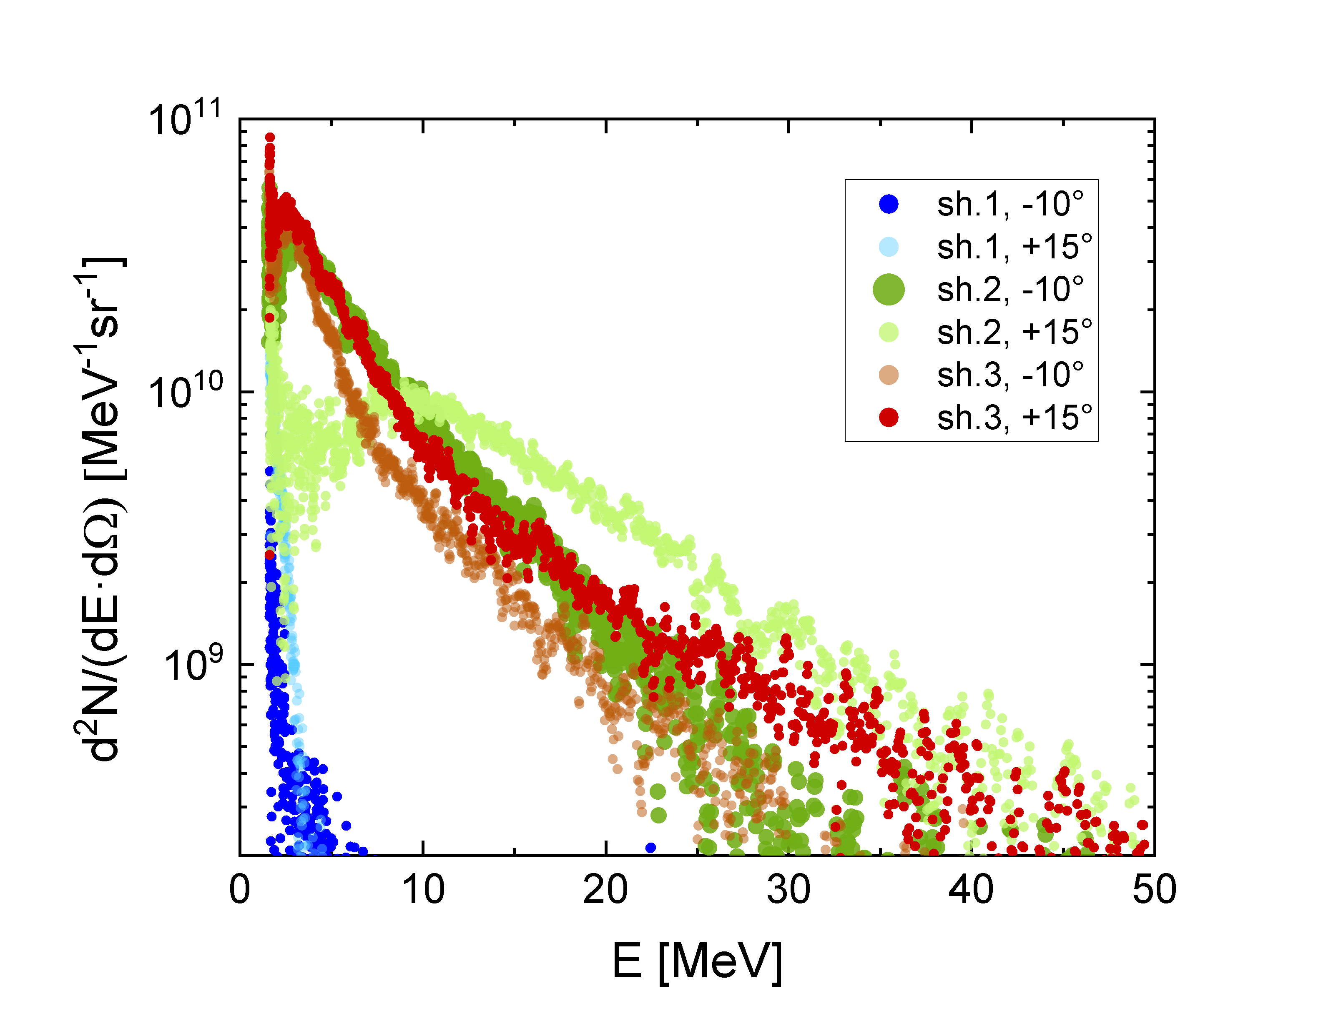
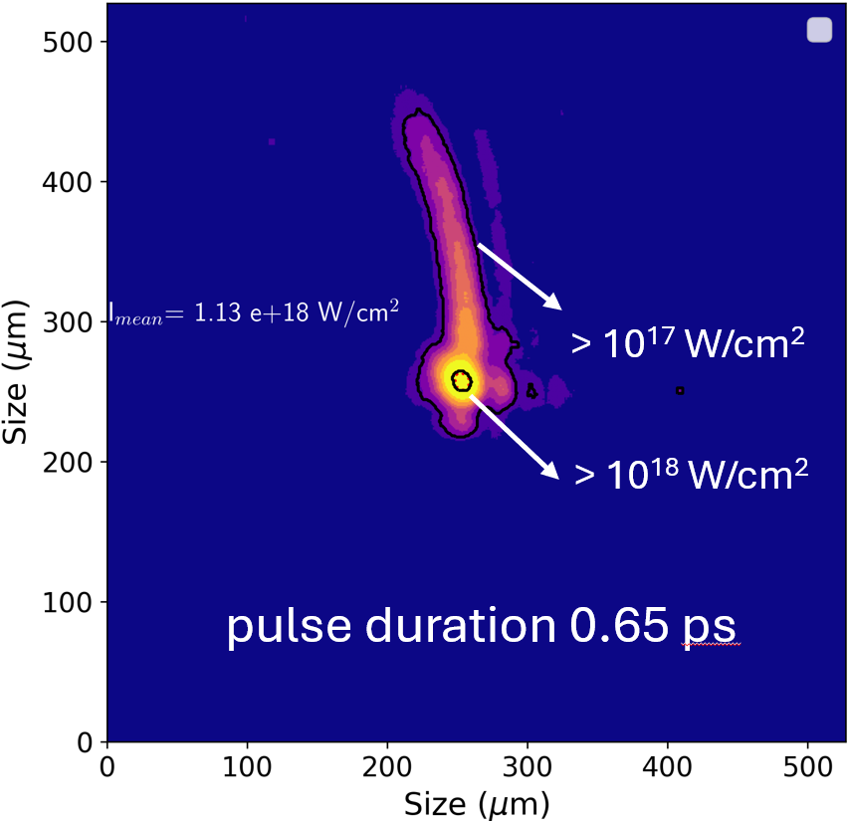
P-23-00193: Laser and Target Parameters
  Transfer of previous approaches to ARC conditions
  Investigation of neutron generation & measurement
Oct./Nov. 2024
PHELIX I ~ 10¹⁸ W/cm²
Electron Spectra (10¹⁸ W/cm²)
Laser parameters:
Nd:glass λ = 1.053 μm, s-polarized
Main pulse:
E = ~30 J
τ = ~ 0.65 ps up to 2.5 ps
ns-pulse:
E = 1–9 J
τ = 3 ns, delay = 2–7 ns
ns-pulse energy
& delay tailored to foam target
T_{eff} = 5–9 MeV
foam+foil
T_{eff} = 0.1 MeV (foil)
Very large focal spot (>40 µm) at near-relativistic intensity
19.10.2026 Sebastian Busch
12/16

Slide 16
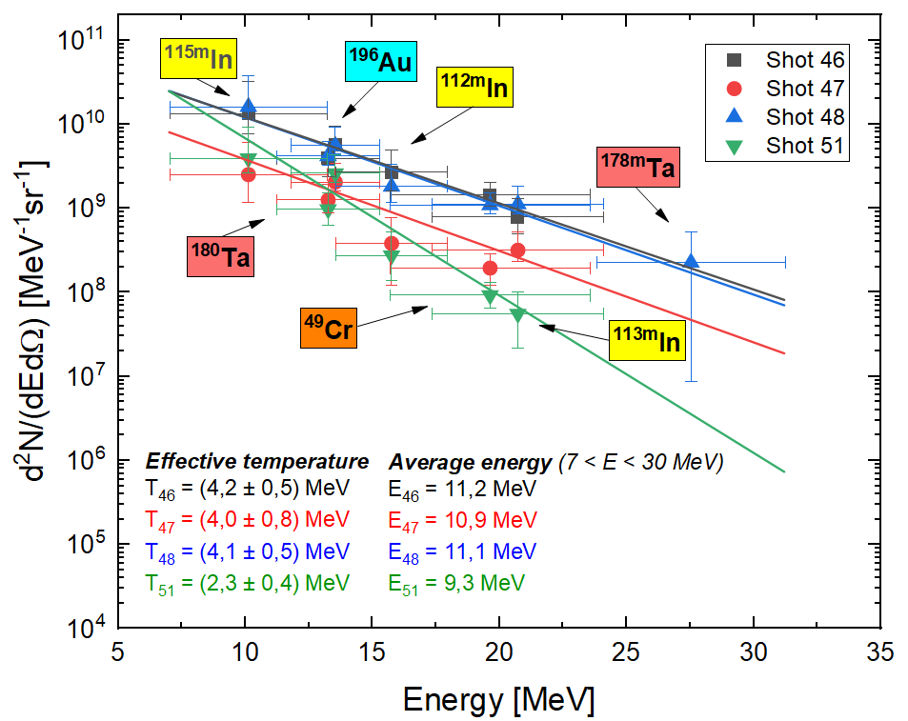
Experiments at PHELIX (P-23-00193)
Generation of MeV-BS with Sub-Relativistic Laser Intensities (ARC-Like)
Target: CHO-foam (2 mg/cc) + 1 mm Pb
Bremsstrahlung spectra with photon energies up to 25–30 MeV and an average energy of 9–11 MeV at near-relativistic intensity and below.
Same target (foam + Pb), different pulse durations
(0.65–2.5 ps) and laser intensities (2· 10¹⁷ – 10¹⁸ W/cm²)
0.65 ps
Shot | Target | Pulse duration / ps | Divergence / sr | N_{Ph} (> 7 MeV) | E_{avg} / MeV
46 | Foam (2 mg/cc, 800 µm) + 1 mm Pb | 0.65 | 0.21 | 2.2E+10 | 11.2
47 |  | 1.3 | 0.22 | 7.1E+09 | 10.9
48 |  | 0.65 | 0.19 | 2.0E+10 | 11.1
51 |  | 2.5 | 0.21 | 1.2E+10 | 9.3
1.3 ps
2.5 ps pulse duration
Similar MeV photon conversion efficiency at sub-relativistic intensities
19.10.2026 Sebastian Busch
13/16

Slide 17
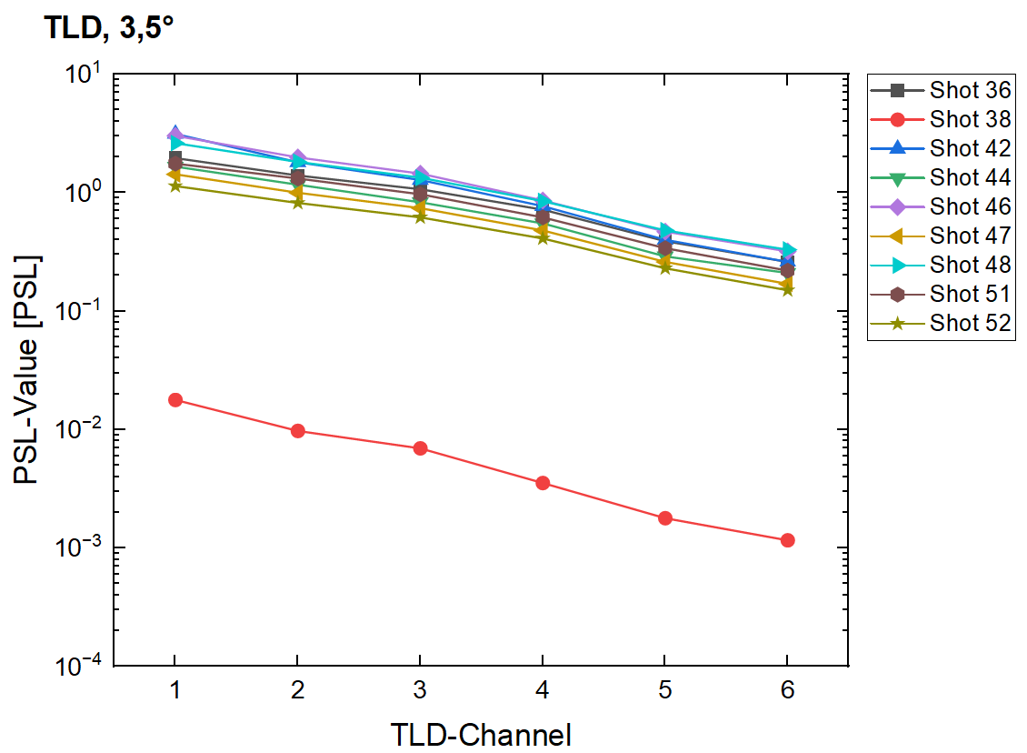
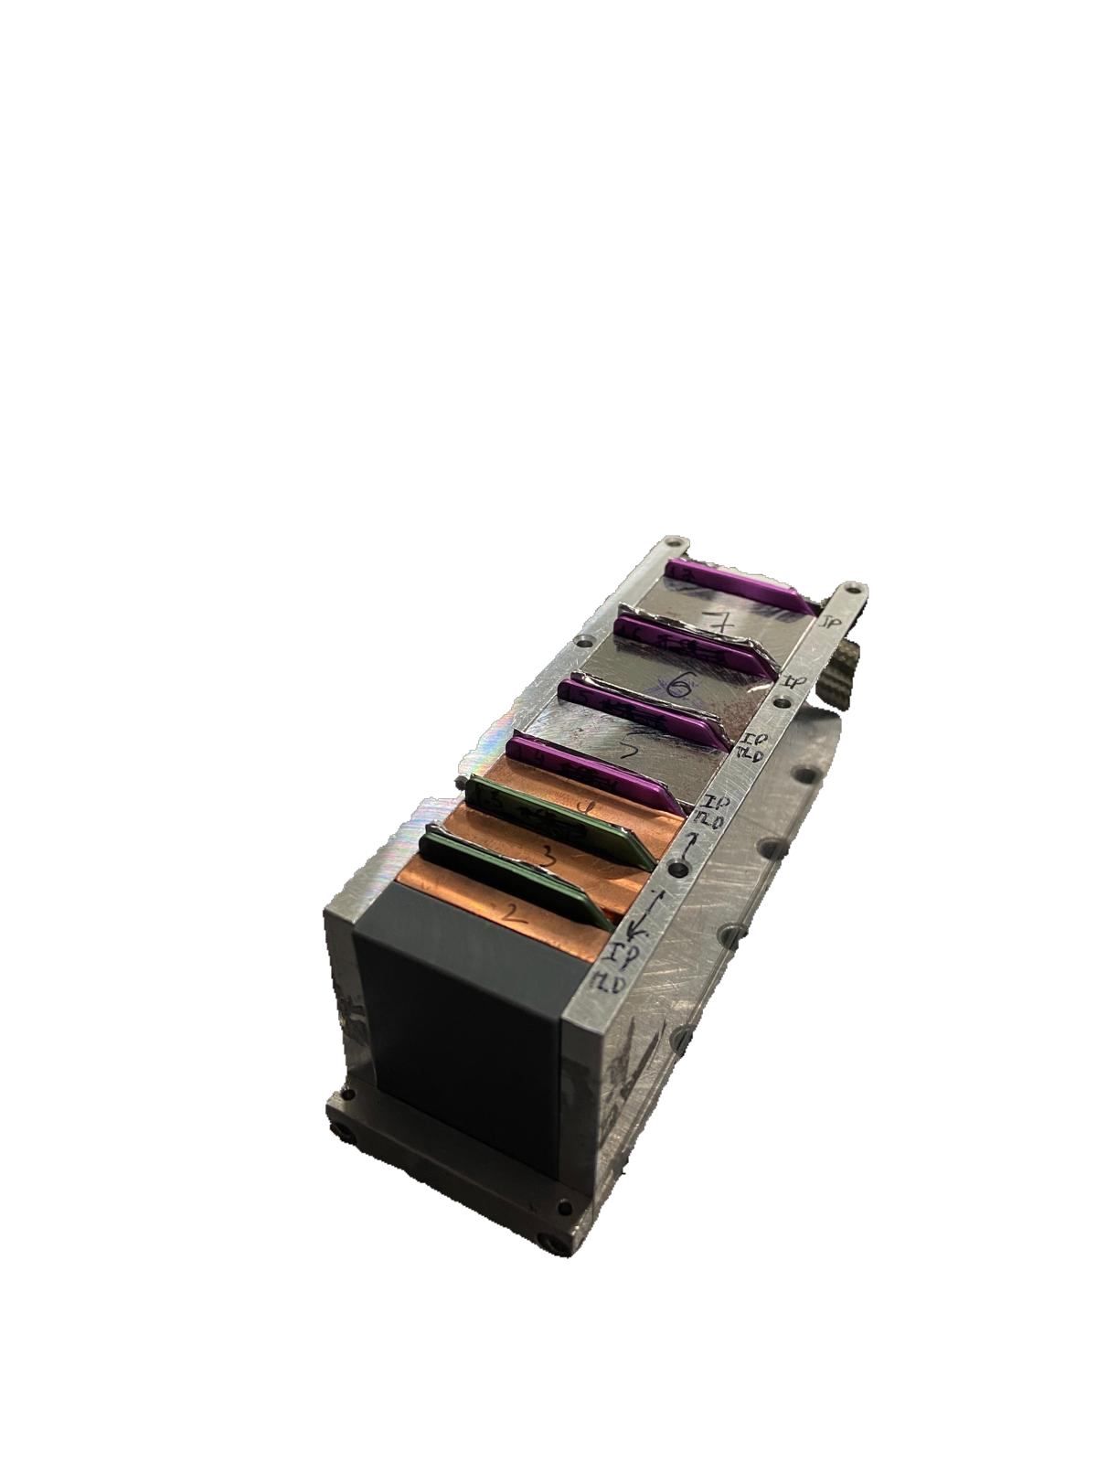
P-23-00193 - Results
TLD-Analysis: Similar Doses Across Different Pulse Durations and Target Setups
TLD-Results in Forward Direction (+3.5°)
TLD-BS-Results in Forward Direction (+3.5°)
10¹⁸ W/cm², 0.65 ps / > 2 ⋅ 10¹⁷ W/cm², 2.5 ps
Shot | Target (all with ns-pulse) | Laser parameters
36 | Foam (8 mg/cc, 300 µm) + 1 mm Ta | 0.65 ps / 10¹⁸ Wcm⁻²
38 | 1 mm Ta
42 | Foam (2 mg/cc, 800 µm) + 110 µm Pb
44 | Foam (2 mg/cc, 800 µm) + 10 µm Au
46 | Foam (2 mg/cc, 800 µm) + 1 mm Pb
47 |  | 1.3 ps / 5 ⋅ 10¹⁷ Wcm⁻²
48 |  | 0.65 ps
51 |  | 2.5 ps / 2.5 ⋅10¹⁷ Wcm⁻²
52 | Foam (2 mg/cc, 800 µm) + 2 mm Pb + 1 mm Au | 0.65 ps
Foam + converter + ns-pulse
10¹⁸ W/cm²
Converter + ns-pulse
Varying pulse durations (0.65–2.5 ps) and laser intensities (2· 10¹⁷ – 10¹⁸ W/cm²) were used
19.10.2026 Sebastian Busch
14/16

Slide 18
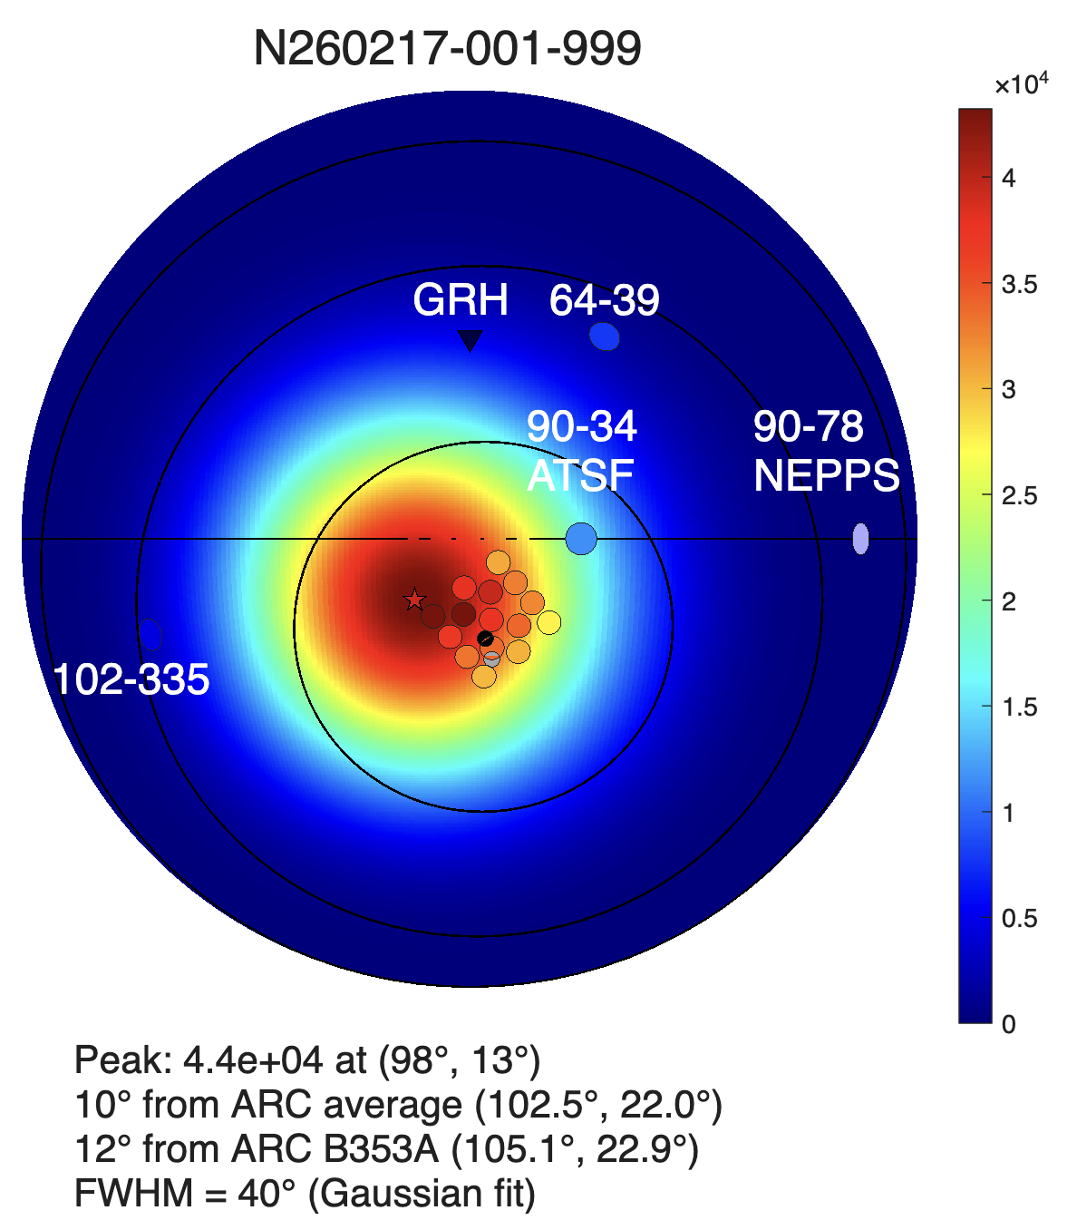
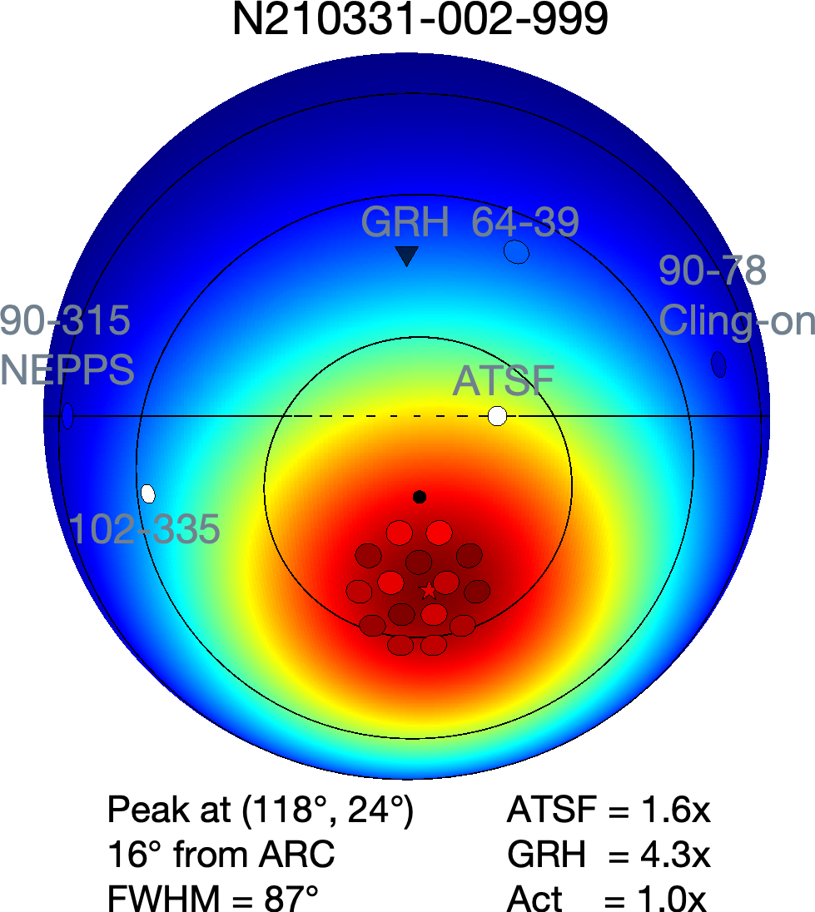
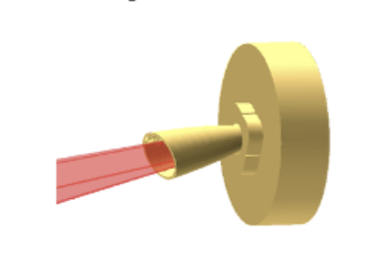
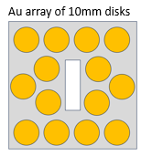
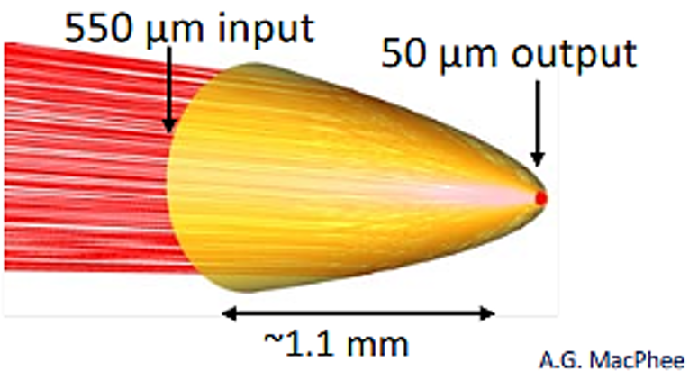
Stronlgy Enhanced Photon Fluence Using Foams compared to Compound Parabolic Concentrator (CPC)
Same activation of ¹⁹⁶Au with 10×lower laser energy → 10×higher photon fluence
DLA S02
Example of CPC source
Target: CHO 2 mg/cc,
1 mm + 2 mm Au
ARC: 1.8 ps, 0.27 kJ
Target: CPC + 2 mm Au
ARC: 4 beams, each
10 ps; 4x 600 J= 2.4 kJ
Au activations at 1 m per 1 g
CPC: FWHM 87°
BS in GDR (> 8 MeV)
DLA: FWHM 40°
BS in GDR (> 8 MeV)
Focusing in CPC-Cone
ARC axis,
20 cm from TCC
Array of Au-discs for
activation by gamma-rays
0.75 T spectrometer
S. Kerr, D. Rusby, NIF
19.10.2026 Sebastian Busch
15/16

Slide 19
Summary and Outlook
Nuclear diagnostics is an essential tool for characterizing (> 7 MeV) bremsstrahlung spectra
Up to 2% conversion efficiency from laser to bremsstrahlung (> 7 MeV) – new record!
Superiority of foam & converter confirmed compared to converter-only setups with pre-plasma:
- Yields and energies strongly exceed ponderomotive scaling even at subrelativistic intensities (< 10¹⁸ W/cm²)
Shot to shot stability using various kind of foam, converter and laser parameter combinations
Experiment at ARC/NIF 02/26 for the first time with foam targets demonstrated 10x higher photon fluence per Joule on target laser energy in GDR than commonly used target approach
Outlook
Further experiments at ARC/NIF and PETAL/LMJ (2028)
19.10.2026 Sebastian Busch
16/16

Slide 20













Thank you for your attention and to all participants and collaborators!
ROSMEJ, Olga (GSI)
MARTYNENKO, Artem (GSI)
KOZLOVA, Ekaterina (GSI)
KÜHL, Thomas (GSI)
SPIELMANN, Uwe (GSI)
TENTORI, Alessandro (GSI)
SCHULTHEIS, Simon (TU Darmstadt)
ZARROUK, Karim (TU Darmstadt)
BOLLER, Pascal (TU Darmstadt)
ROSMEJ, Olga (Goethe Uni Frankfurt, HFHF)
BUSCH, Sebastian (Goethe Uni Frankfurt, HFHF)
GYRDYMOV, Mikhail (Goethe Uni Frankfurt)
BELOIU, Philipp (Goethe Uni Frankfurt)
JACOBY, Joachim (Goethe Uni Frankfurt)
TAVANA, Parysatis (Goethe Uni Frankfurt/ Uni Jena)
BLEOTU, Petrisor-Gabriel (ELI-NP)
MAGUREANU, Alexandru (ELI-NP)
NAZAROV, Wigen (UOD)
ALONZO, Massimo (ENEA Frascati)
SCISCIO, Massimiliano (ENEA Frascati)
CIPRIANI, Mattia (ENEA Frascati)
CONSOLI, Fabrizio (ENEA Frascati)
VERONA, Claudio (University of Rome)
CHENG, RUI (Institute Of Modern Physics, China)
YANG, Jie (Institute of Modern Physics)
CIKHARDT, Jakub (Czech Technical University)
SCHNEIDER, Dieter (LLNL)
ANDREEV, Nikolai (JIHT)
Notes:
Olga zu GSI?

Slide 21
Backup

Slide 22
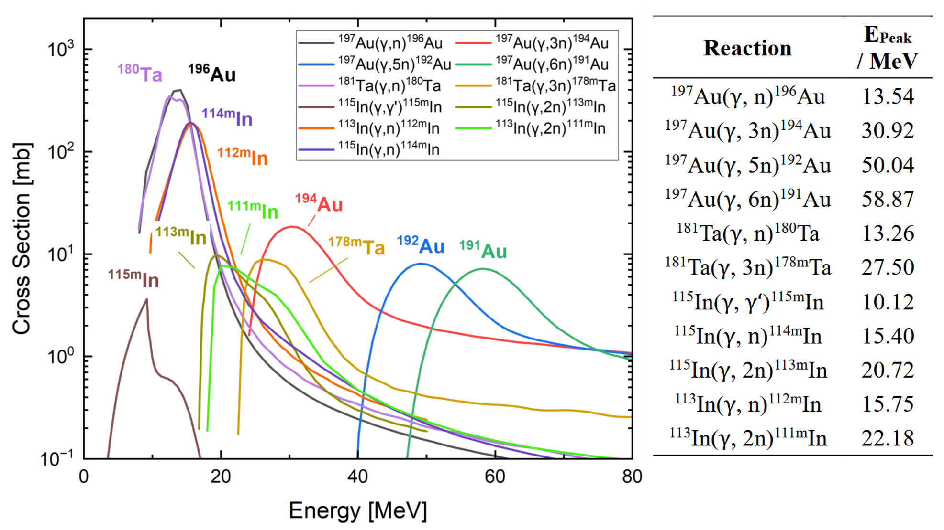
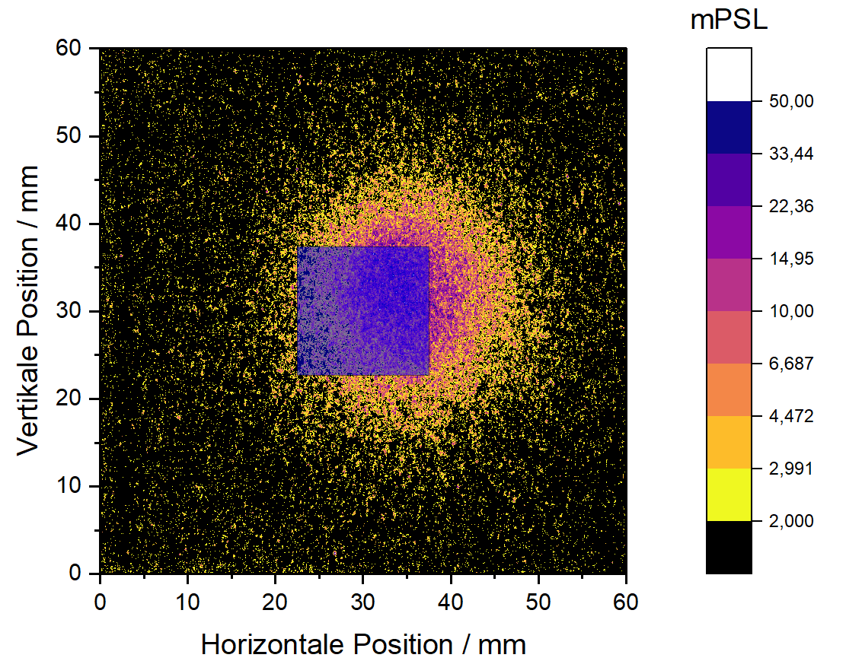
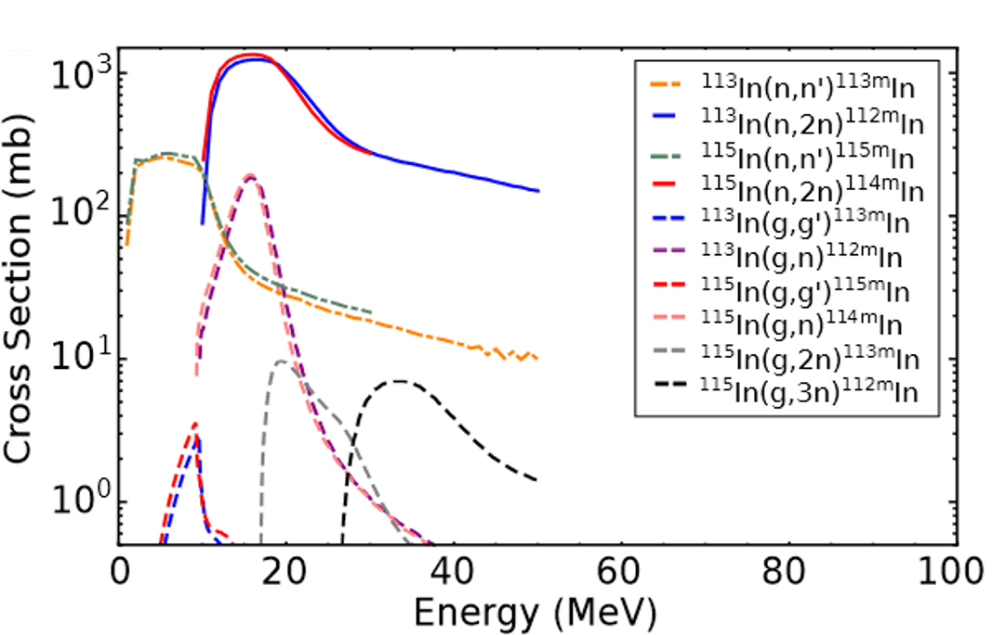
Theoretical Background
Cross Sections of Nuclear Reactions
Cross Sections for (γ,xn)-Reactions
MeV-BS
Reactions in Copper Plates
Autoradiography
Imaging Plate (IP) Scan with Probe
Reactions in Indium
Neutrons
19.10.2026 Sebastian Busch

Slide 23
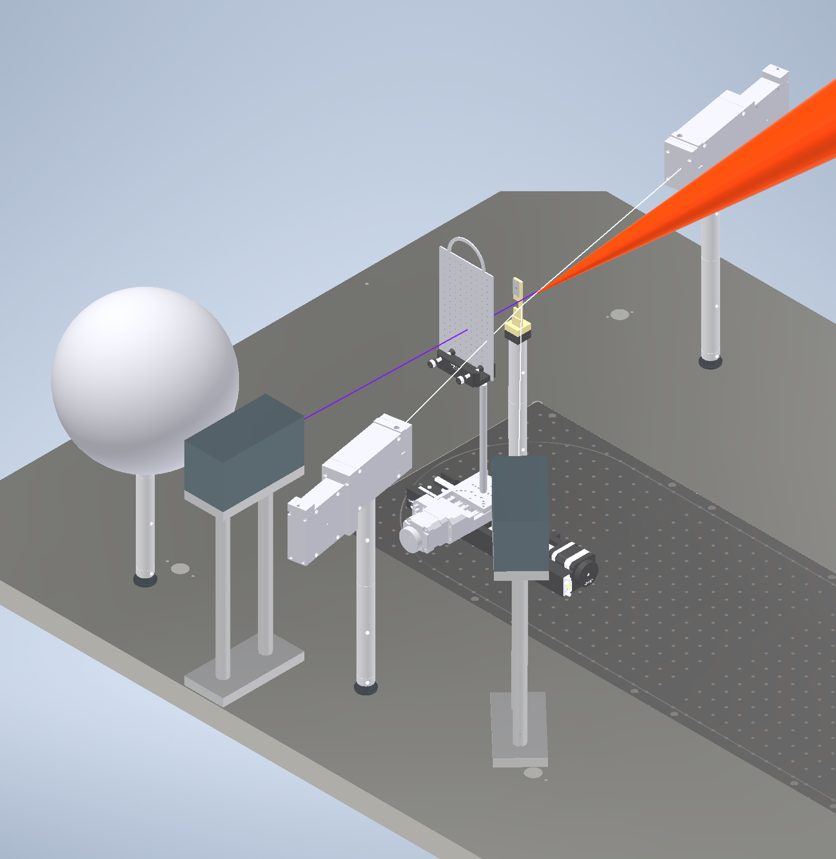
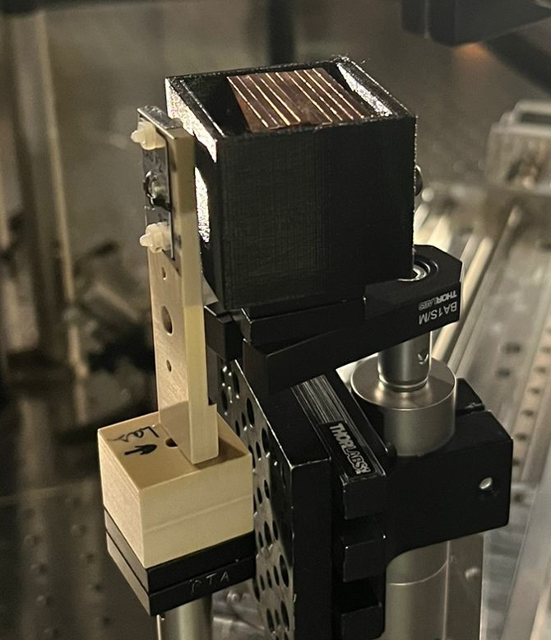
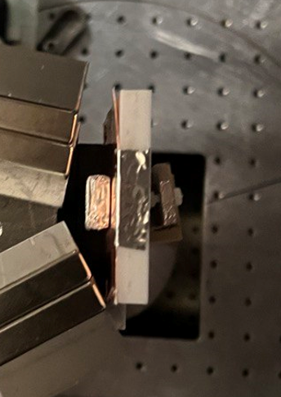
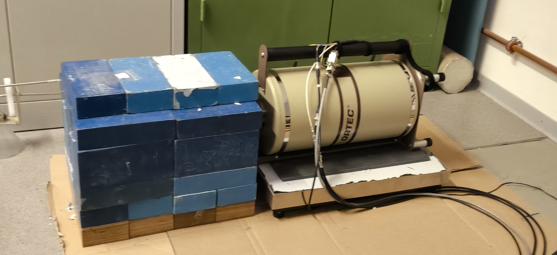
P-23-00193 – Experimental Setup
0.99T-MS
Gamma & Neutron Measurements
Experimental Setup and Placement of ND
+170°
Nuclear Diagnostic
Laser
0°, ~17 mm
Detectors used:
High-purity germanium detectors (HPGe)
Model: GEM-S5020P4-B
Background reduction through:
- Nitrogen cooling
- Lead shielding
Bonner Sphere
Target
+20°
Foam Target + Converter Box
TLD-Spectrometer
3.5°
0.99T-MS
Gamma Measurements
-10°
TLD-Spectrometer
20°
Foam Target + Diagnostic Stack
19.10.2026 Sebastian Busch

Slide 24
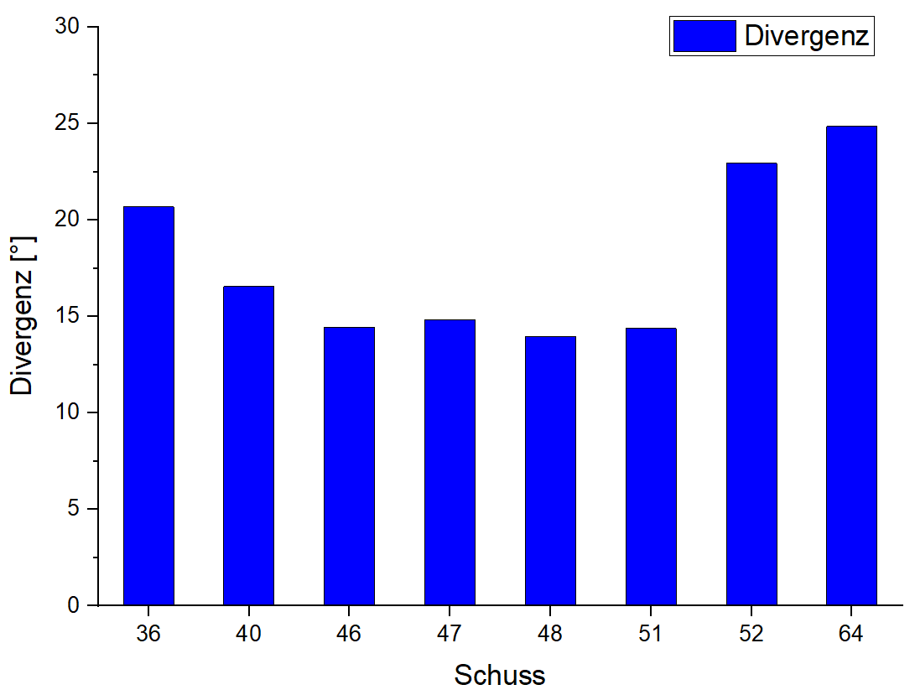
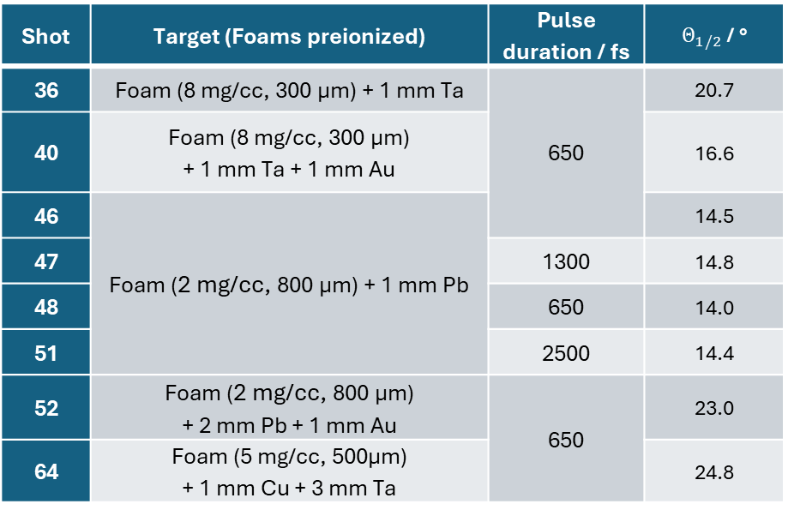
P-23-00193 - Results
Autoradiography: Divergence
Sh 36
Shot | Target (Foams preionized) | Pulse duration / fs | $Θ_{1/2}$ / °
36 | Foam (8 mg/cc, 300 µm) + 1 mm Ta | 650 | 20.7
40 | Foam (8 mg/cc, 300 µm) + 1 mm Ta + 1 mm Au |  | 16.6
46 | Foam (2 mg/cc, 800 µm) + 1 mm Pb |  | 14.5
47 |  | 1300 | 14.8
48 |  | 650 | 14.0
51 |  | 2500 | 14.4
52 | Foam (2 mg/cc, 800 µm) + 2 mm Pb + 1 mm Au | 650 | 23.0
64 | Foam (5 mg/cc, 500µm) + 1 mm Cu + 3 mm Ta |  | 24.8
Divergence
Half angle
Shot
19.10.2026 Sebastian Busch

Slide 25


P-23-00193 - Results
TLD-Analysis
6-channel in Vacuum TLD Spectrometer
TLD-Results in Forward Direction (+3.5°)
Shot | Target (all with ns-pulse) | Pulse Duration / fs
36 | Foam (8 mg/cc, 300 µm) + 1 mm Ta | 650
42 | Foam (2 mg/cc, 800 µm) + 110 µm Pb
44 | Foam (2 mg/cc, 800 µm) + 10 µm Au
46 | Foam (2 mg, 800 µm) + 1 mm Pb
47 |  | 1300
48 |  | 650
51 |  | 2500
52 | Foam (2 mg, 800 µm) + 2 mm Pb + 1 mm Au | 650
19.10.2026 Sebastian Busch

Slide 26




P-23-00193 – Experimental Setup
Nuclear Diagnostics
Target Holder
Gamma & Neutron Measurements
Nuclear Probes (Gamma Measurement)
15 mm
Cr
Cu
Nb
In
Ta
Au
15 mm
CHO-Foam
γ-Probe Stack
Foam Target + Converter Box
Gamma Measurements
Cu-Plate for Autoradiograpy
In Al, on Cu-plate
60 mm
60 mm
Foam Target + Diagnostic Stack
19.10.2026 Sebastian Busch

Slide 27



P-23-00193 – Experimental Setup
Nuclear Diagnostics
Neutron Box Setup (Expl.)
Gamma & Neutron Measurements
Nuclear Probes (Gamma Measurement)
15 mm
Cr
Cu
Nb
In
Ta
Au
15 mm
γ-Probe Stack
Foam Target + Converter Box
Gamma Measurements
Nuclear Probes for Neutron Measurement)
8x In (25x25x1 mm³)
1x Au (15x15x1 mm³)
Laser dir.
25 mm
25 mm
Foam Target + Diagnostic Stack
19.10.2026 Sebastian Busch

Slide 28




  Characterization of bremsstrahlung spectra
  using photonuclear reactions
Cross Sections: (γ, xn)-Reactions
Ge-Detector Spectrum (Up to 550 keV)
Target | Pulse Duration / fs
CHO (8 mg/cc, 300 µm) + 1 mm Ta | 650
Cross Section [mb]
Energy [MeV]
Energy [keV]
19.10.2026 Sebastian Busch

Slide 29


P-23-00193 - Results
Bremsstrahlung Reconstruction using Nuclear Diagnostics
Ge-Detector Spectrum (Up to 550 keV)
Reconstructed Bremsstrahlung Spectrum
Shot 36 – Gamma Probes
Energy [keV]
19.10.2026 Sebastian Busch

Slide 30


P-23-00193 - Results
Cu-Analysis for Neutron Box in Shot 64
Neutron box setup
Shot | Sequence
64 | Small Cu – large Ta – small Ta – gamma probes – 1st–20th small Cu – large Cu
Bremsstrahlung divergence: $\text{24.9°}$
$$N_{Ph}\left(E\right)=2.88⋅{10}^{10}⋅e^{−\frac{E}{4.55 MeV}}$$
15 mm
Cr
Cu
Nb
In
Ta
Au
15 mm
19.10.2026 Sebastian Busch

Slide 31

P-23-00193 – Experimental Setup
Neutron Conver Box
Shot 64
Converter Box Setup
Materials inside converter box (from laser direction, values in mm):
- Cu (15x15x1)
- Ta (33x35x2)
- Ta (15x15x1)
- Au (15x15x1), Ta (15x15x1), 2xIn (15x15x0.25 jeweils),
Nb (15x15x0.5), Cu (15x15x1), Cr (15x15x1)
- 20xCu (15x15x1 each)
- Cu (30x30x2)
Autoradiography
Converter
Gamma probes
Autoradiography
3 mm
Neutron Box Setup
Shot | Order
64 | Small Cu – big Ta – sm. Ta – Gamma probes – 1.-20. sm. Cu – big Cu
Target
Converter + Probes
10 mm
In + Au
19.10.2026 Sebastian Busch

Slide 32



P-23-00193 - Results
Cu-Analysis for Neutron Box in Shot 64
Neutron box setup
Shot | Sequence
64 | Small Cu – large Ta – small Ta – gamma probes – 1st–20th small Cu – large Cu
19.10.2026 Sebastian Busch

Slide 33


P-23-00193 - Results
Cu-Analysis for Neutron Box in Shot 64
Neutron box setup
Shot | Sequence
64 | Small Cu – large Ta – small Ta – gamma probes – 1st–20th small Cu – large Cu
Neutron Source | Neutrons
0. Cu (1 mm) | 4.6E+05
Ta-Converter (2 mm) | 3.6E+07
Cu-Stack (20 mm) | 3.1E+07
Au-Probe (1 mm) | 2.0E+07
Ta-Probe (1 mm) | 1.2E+07
Sum | >8.9E+07
Number
19.10.2026 Sebastian Busch
Notes:
Rechts ggf etwas schöner

Slide 34


P-23-00193 - Results
TLD-Analysis
TLD-Results in Forward Direction (+3.5°)
TLD-Results in 20° Direction
Shot | Target (all with ns-pulse) | Pulse Duration / fs
36 | Foam (8 mg/cc, 300 µm) + 1 mm Ta | 650
38 | 1 mm Ta
42 | Foam (2 mg/cc, 800 µm) + 110 µm Pb
44 | Foam (2 mg/cc, 800 µm) + 10 µm Au
46 | Foam (2 mg/cc, 800 µm) + 1 mm Pb
47 |  | 1300
48 |  | 650
51 |  | 2500
52 | Foam (2 mg/cc, 800 µm) + 2 mm Pb + 1 mm Au | 650
Shot | 36 | 38 | 42 | 44 | 46 | 47 | 48 | 51 | 52
$Θ_{1/2}$ (TLD) / ° | 26.0 | 56.3 | 10.9 | 13.2 | 13.4 | 17.2 | 15.3 | 19.0 | 23.9
$Θ_{1/2}$ (Cu-Scans) / ° | 20.7 | X | X | X | 14.5 | 14.8 | 14.0 | 14.4 | 23.0
19.10.2026 Sebastian Busch

Slide 35

PHELIX:
NIF/ARC:
Shot | Pulse duration / fs | Laser Energy Above:
 |  | 10¹⁸ W/cm² | 10¹⁷ W/cm² | Total
46, 48 | 650 | 0.70 J | 13.19 J | ~30 J
47 | 1300 | 0 | 14.51 J
51 | 2500 | 0 | 4.57 J
Experiment | Shot | Number of Activated Nuclei (¹⁹⁶Au) | Activations At 1m Per 1g
 |  |  | Total | Per J (Total) | Per J (>10¹⁸ W/cm²) | Per J (>10¹⁷ W/cm²)
ARC-like (2024) | 46 | 1.37E+06 | 2.01E+03 | 6.71E+01 | 2.89E+03 | 1.53E+02
 | 47 | 1.37E+06 | 2.02E+03 | 6.72E+01 | - | 1.39E+02
 | 48 | 3.06E+06 | 4.50E+03 | 1.50E+02 | 6.47E+03 | 3.41E+02
 | 51 | 1.90E+06 | 2.80E+03 | 9.32E+01 | - | 6.12E+02
NIF/ARC 2026 (avg.1-14 probes) | 1 | 2.64E+06 | 2.97E+04 | 1.07E+02 | 2.47E+03 | 2.06E+02
 | 2 | 3.16E+06 | 3.50E+04 | 1.27E+02 | 1.40E+03 | 2.52E+02
Same order of magnitude for number of activated ¹⁹⁶Au nuclei per laser energy for PHELIX- & ARC/NIF-experiment.

Slide 36




Detector Preparation: Calibration
Energy Calibration Calibration Sources Detector Efficiency
Mix- & ²²Na-source:
Nuclide | Half-Life | Activity / kBq
²⁴¹Am | 432.6 (6) a | 0.9501
¹⁰⁹Cd | 461.9 (4) d | 4.54
¹³⁹Ce | 137.641 (20) d | 0.4866
⁵⁷Co | 271.81 (4) d | 0.3953
⁶⁰Co | 5.2711 (8) a | 0.7703
¹³⁷Cs | 30.05 (8) a | 0.63
¹³³Ba | 10.539 (6) a | 0.4322
⁸⁵Sr | 64.850 (7) d | 0.7524
⁸⁸Y | 106.63 (5) d | 1.688
⁵¹Cr | 27.704 (4) d | 10.66
Nuclide | Half-life | Activity / kBq
²⁴¹Am | 432.6 (6) a | 0.9501
¹⁰⁹Cd | 461.9 (4) d | 4.54
¹³⁹Ce | 137.641 (20) d | 0.4866
⁵⁷Co | 271.81 (4) d | 0.3953
⁶⁰Co | 5.2711 (8) a | 0.7703
¹³⁷Cs | 30.05 (8) a | 0.63
¹³³Ba | 10.539 (6) a | 0.4322
⁸⁵Sr | 64.850 (7) d | 0.7524
⁸⁸Y | 106.63 (5) d | 1.688
⁵¹Cr | 27.704 (4) d | 10.66
/ kBq
Reference Date: 13.06.2023
Reference Date: 13.06.2023
Nuclide | Half-Life | Activity / kBq
²²Na | 949.69 d | 3.7⋅10⁴
Nuclide | Half-life | Activity / kBq
²²Na | 949.69 d | 3.7⋅10⁴
Reference Date: 01.06.2006
Reference Date: 01.06.2006
19.10.2026 Sebastian Busch

Slide 37
Detector Preparation: Background
HPGe-detector background
had to be considered:
Long measurements without
sample were performed
Substract background
for true number of counts
Avoid/Substract overlapping
lines
Background measurement
Up to 600 keV
Above 600 keV
19.10.2026 Sebastian Busch

