Slide 1
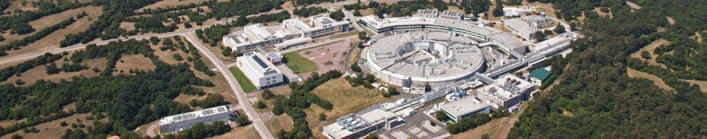
Beyond Absorption: New Detector Concepts for Spectral, Phase-Contrast, and Time-Resolved X-ray Imaging
Ralf Hendrik Menk
Elettra Sincrotrone Trieste, INFN Trieste, Uni Trieste,
^{Midsweden Universiy}
Notes:
Slide 2: Title of the Presentation
Before you start editing the slides of your talk change to the Master Slide view:
Microsoft Office :Menu: View > Slide Master;
Macintosh – View > Master > Slide Master
Edit the following items:
On the Slide Master (first master slide) – lower area
a) On the left Delete the text and write the title of the event/Conference, Location
b) On the right delete the text and write the name and surname of the speaker and the date (day, month , year)
Close Master View
To start adding slides insert a new slide and select a Layout:
For Title & Subtitle
For text with bullet points
For Text
For Picture, graphs, visuals
Two columns
Blank

Slide 2
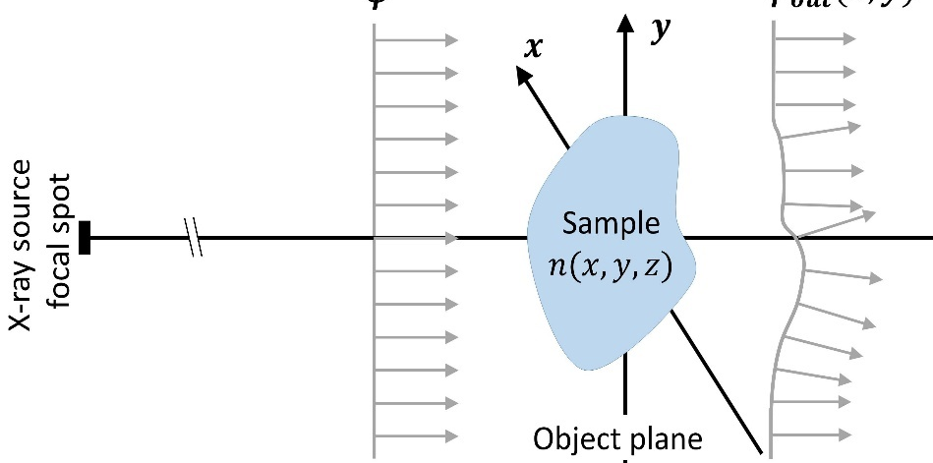
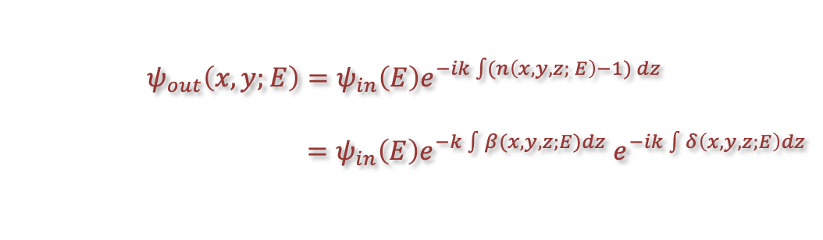
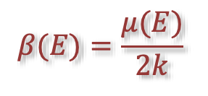
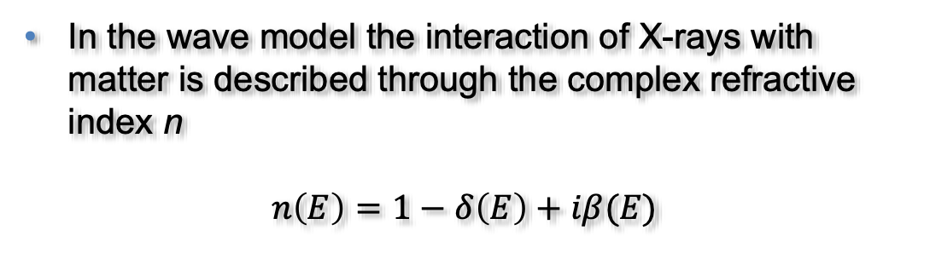
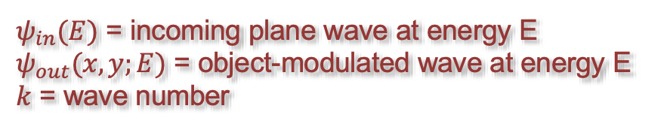


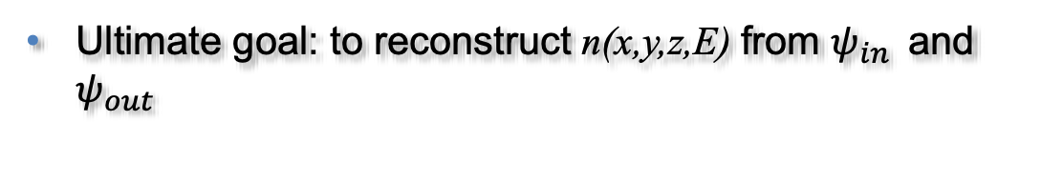
X-rays in matter
Ultimate goal: to reconstruct n(x,y,z,E) from $ψ_{in }$ and $ψ_{out }$
In the wave model the interaction of X-rays with matter is described through the complex refractive index n
$$n\left(E\right)=1−δ\left(E\right)+iβ(E)$$
$$β(E)=\frac{μ(E)}{2k}$$
$$ψ_{in}\left(E\right)$$
$$ψ_{out}\left(x,y;E\right)$$
attenuation
coefficient
Attenuation
Phase shift
$ψ_{in}(E)$ = incoming plane wave at energy E
$ψ_{out}(x,y;E)$ = object-modulated wave at energy E
$k$ = wave number
Spectral imaging
Phase-contrast imaging

Slide 3
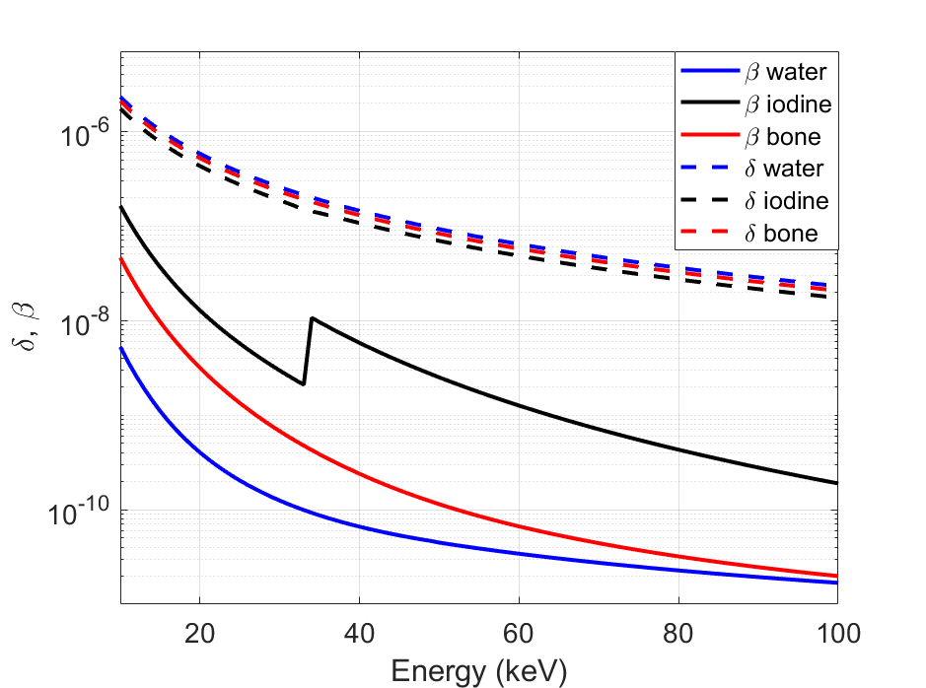
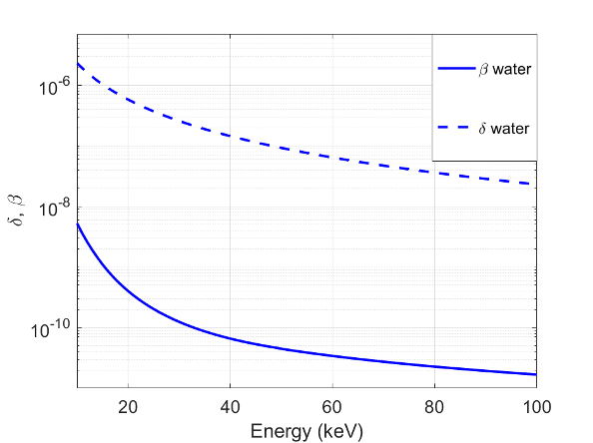

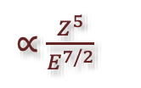
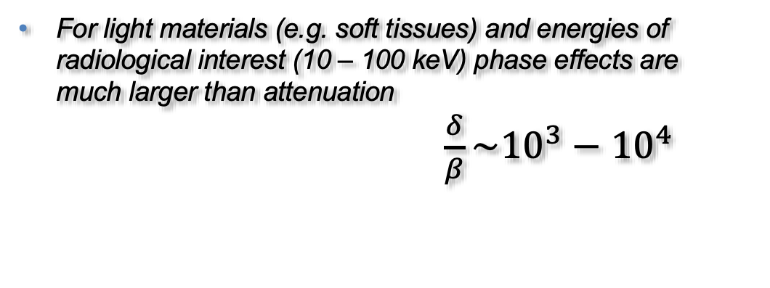
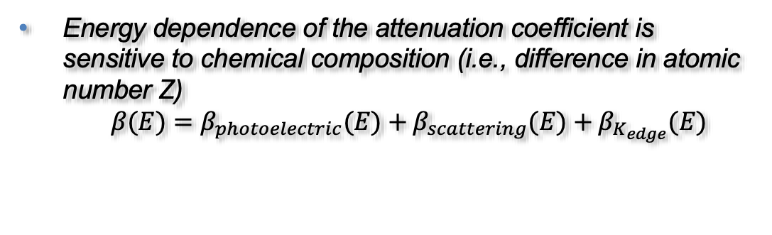

X-rays in matter
to separate and quantify chemical elements
to increase visibility of soft tissues!
Spectral Imaging
Phase contrast imaging
Energy dependence of the attenuation coefficient is sensitive to chemical composition (i.e., difference in atomic number Z)
$β(E)=β_{photoelectric}(E)+β_{scattering}(E)+β_{K_{edge}}(E)$
For light materials (e.g. soft tissues) and energies of radiological interest (10 – 100 keV) phase effects are much larger than attenuation
$\frac{δ}{β}\sim 10^{3}−10^{4}$
$∝\frac{Z^{5}}{E^{7/2}}$
$∝\frac{Z}{E}$
$$≠0 at$$
$$K_{edge} energies$$

Slide 4
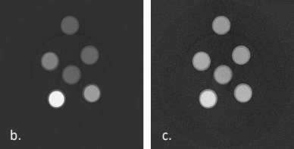
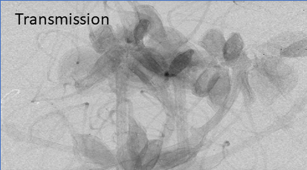
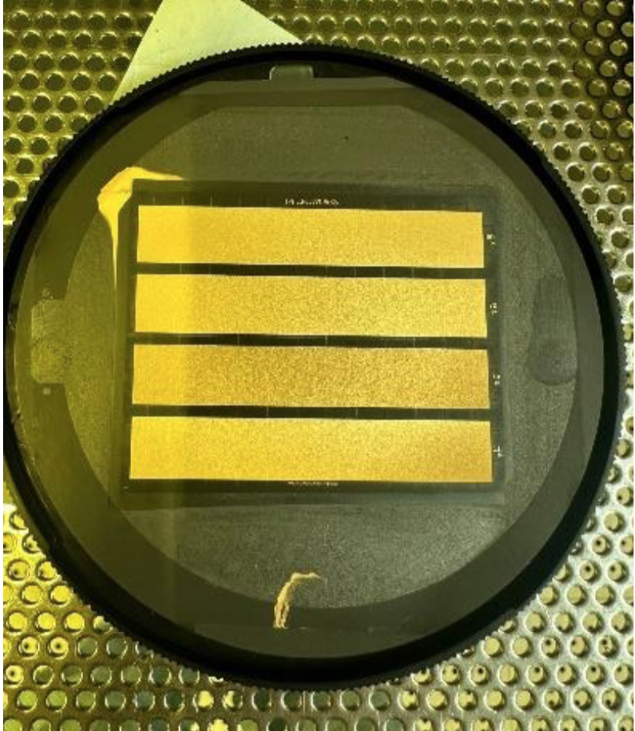
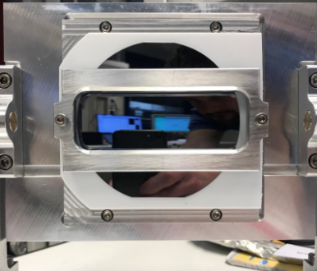
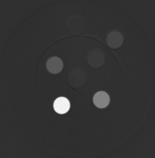
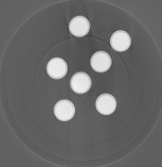
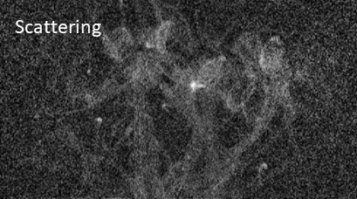
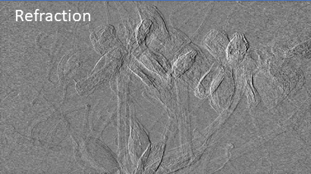
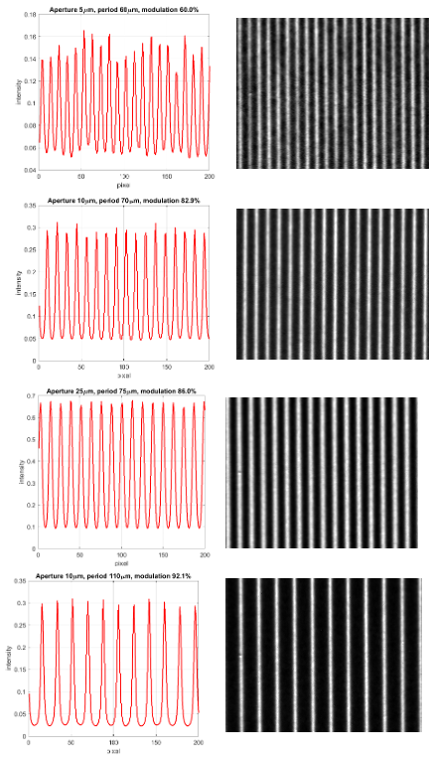
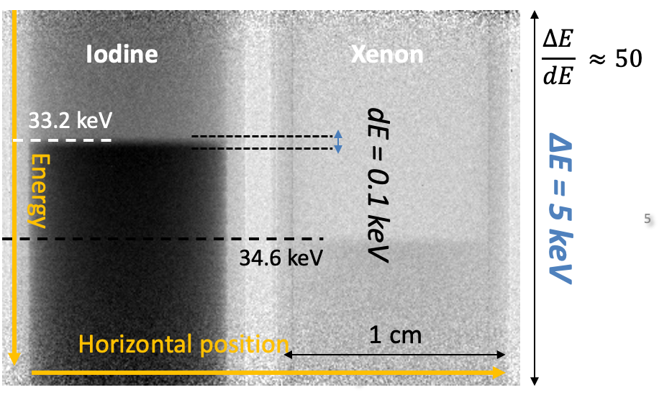
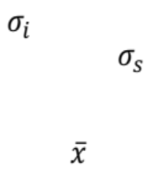
Combining Spectral and phase contrast imaging at synchrotrons
Spectral K–edge imaging
Differential phase contrast imaging via beam tracking
0
2.5
5
1
0.5
25
10
Fixed radius frames
Radius = 0.5 m
Focus ~ 0.25 m
Iodine
Water
dithering
absorbing mask
Illumination Curve without sample
Illumination Curve with sample
Detector pixels
Zhu Y. et al., Phys Med Biol, 59.10, 2485 (2014)
Vittoria F.A. et al., Scientific Reports 5, 16318 (2015)
Co-registration in space and time, in a single acquisition procedure, X-ray spectral K-edge and phase contrast measurements of planar images or CT, in order to separate phase and attenuation properties of different materials

Slide 5
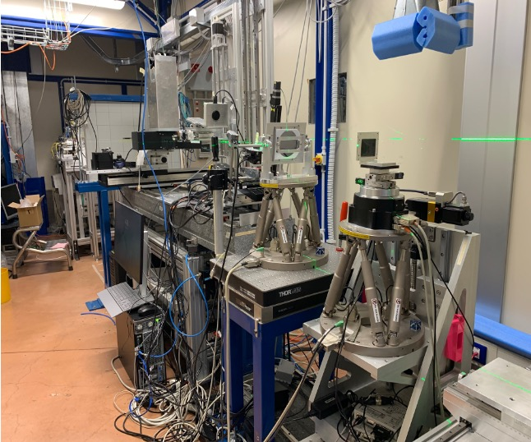

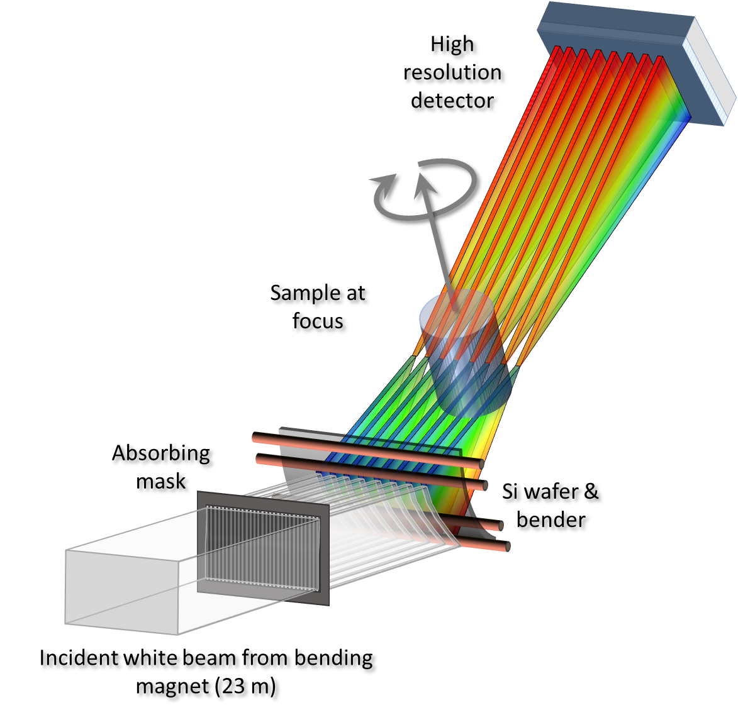
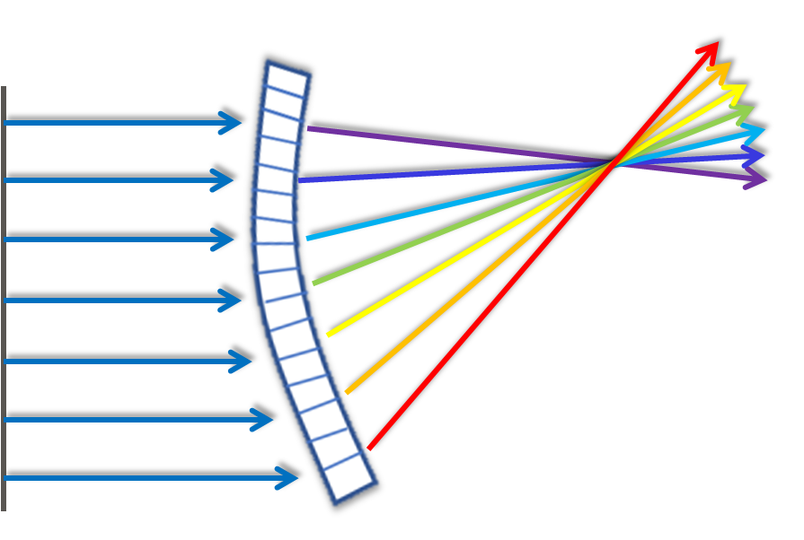
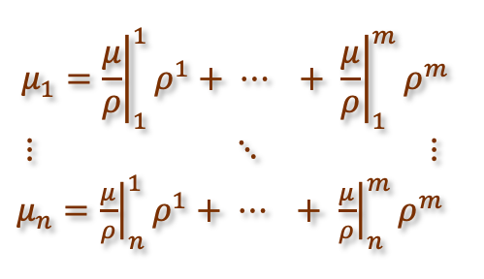



Methodology and setup
detector
crystal
mask
The absorbing mask forms vertical beamlets
Each beamlet is dispersed energetically in space, creating images whose vertical dimension is energy
For each energy the beam tracking reconstruction algorithm is applied and absorption, refraction and scattering images can be extracted
From the absorption images spectral decomposition is obtained and from the refraction the phase image is retrieved
Horizontal Position (x)
absorption
Photon Energy (E)
beam
refraction
scattering
Energy-dispersed beam
Energy dispersion α R
Focal length = R/2
Line focus
Cylindrically bent Si crystal
The crystal has an asymmetry angle chosen to match polychromatic and geometrical focus (“magic condition”) optimizing energy resolution
$n$ energy channels
Zhu Y. et al., Physics in Medicine & Biology, 59.10, 2485 (2014)
Bassey B. et al., Physics in Medicine & Biology,61, 8180 (2016)
The beam is shaped into an array of vertical beamlets
$m(≤n)$materials
Inversion performed through least-squares

Slide 6
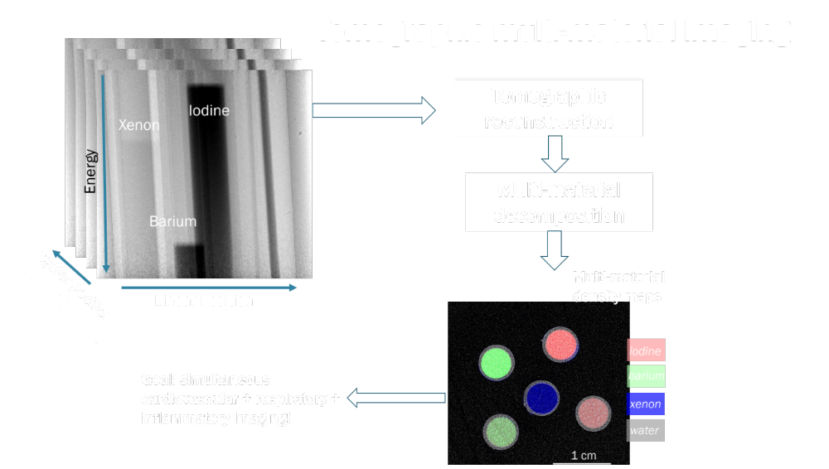
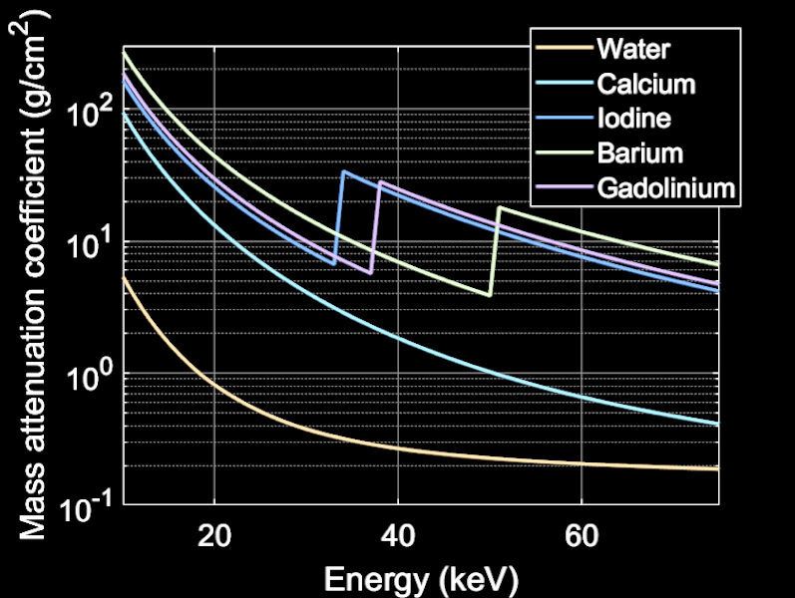
Multi material tomographic reconstruction

Slide 7
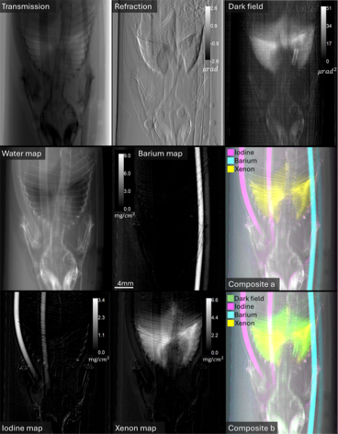
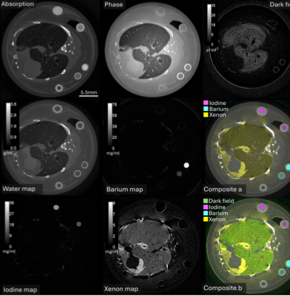

Slide 8
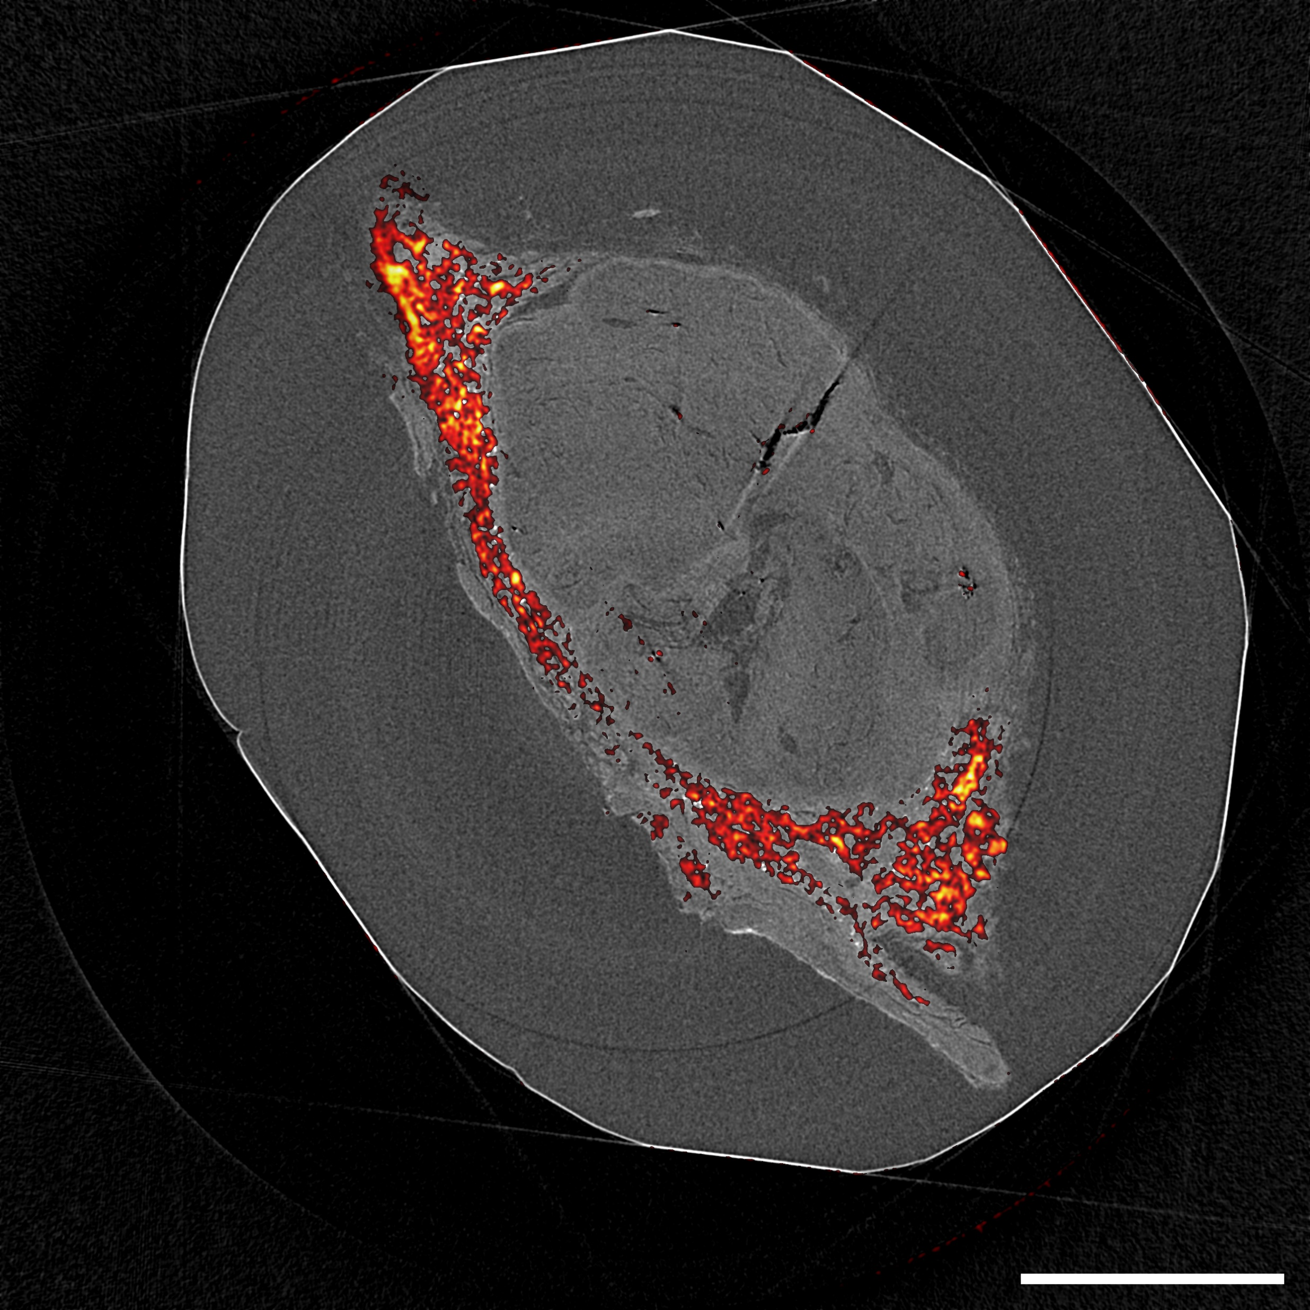
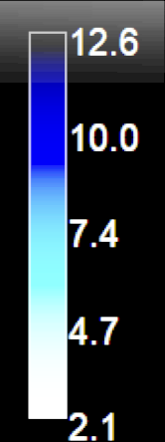
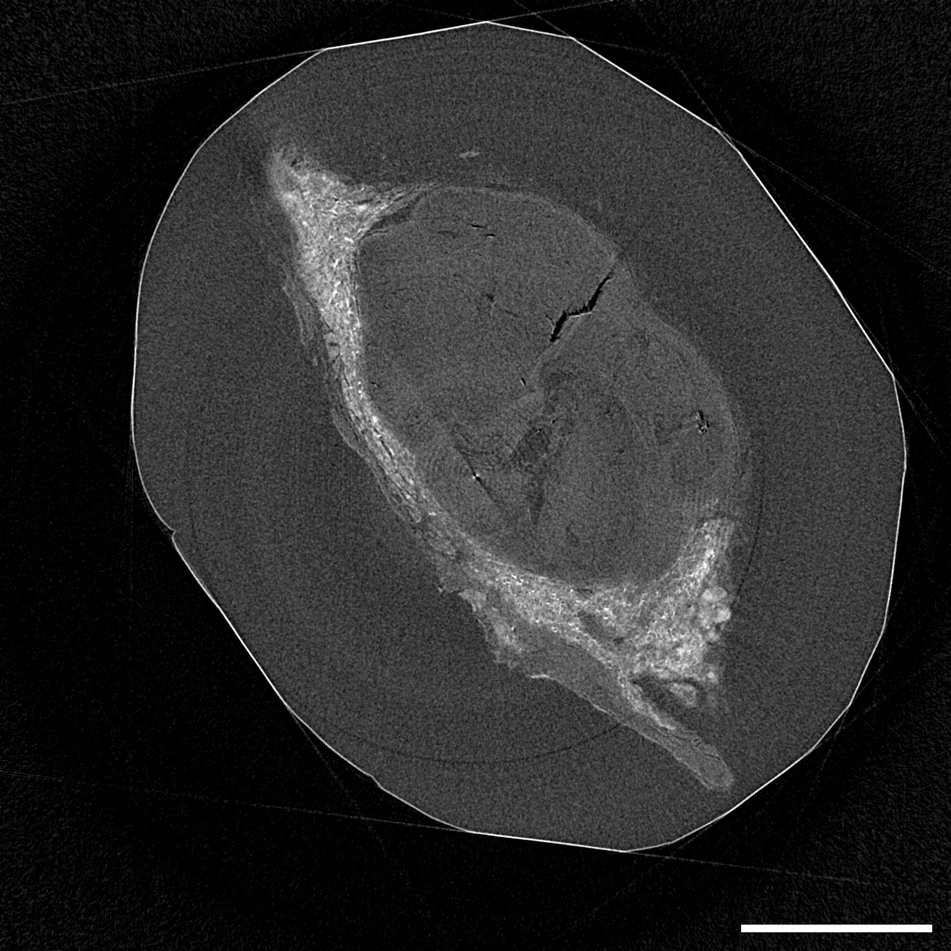
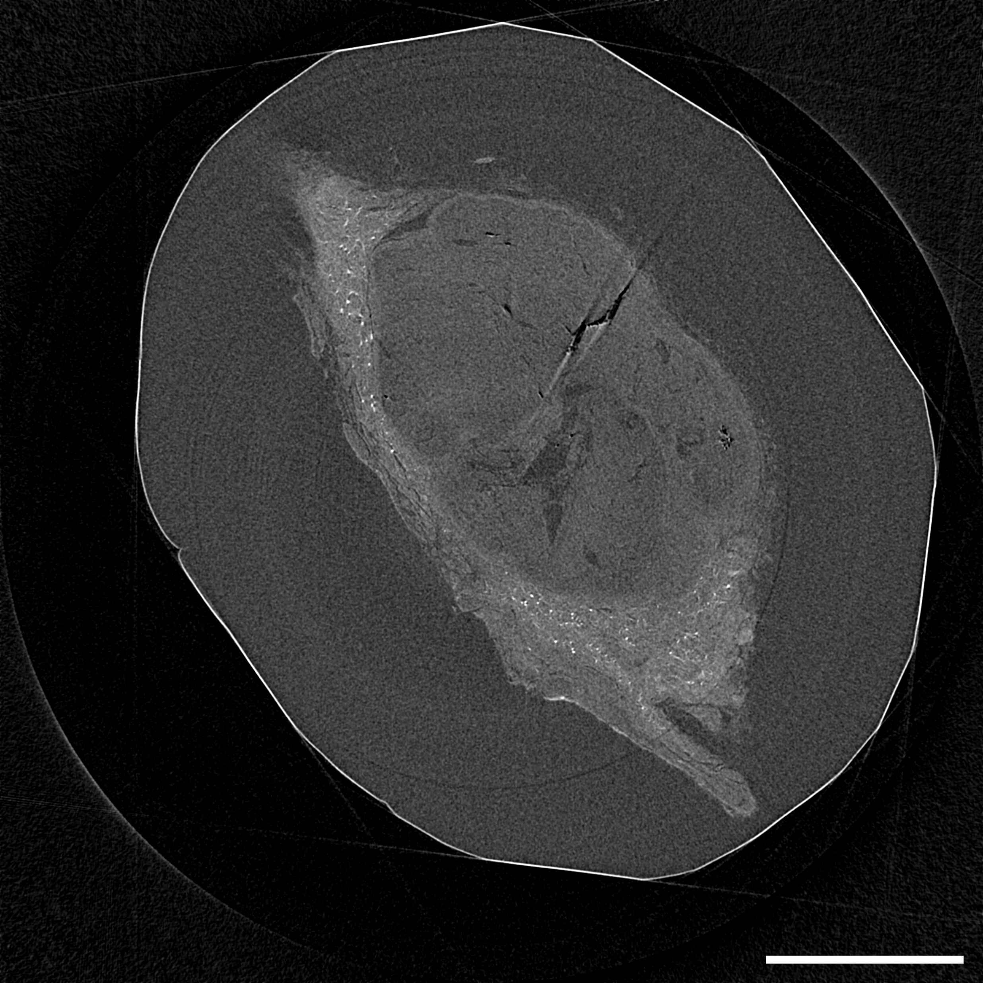
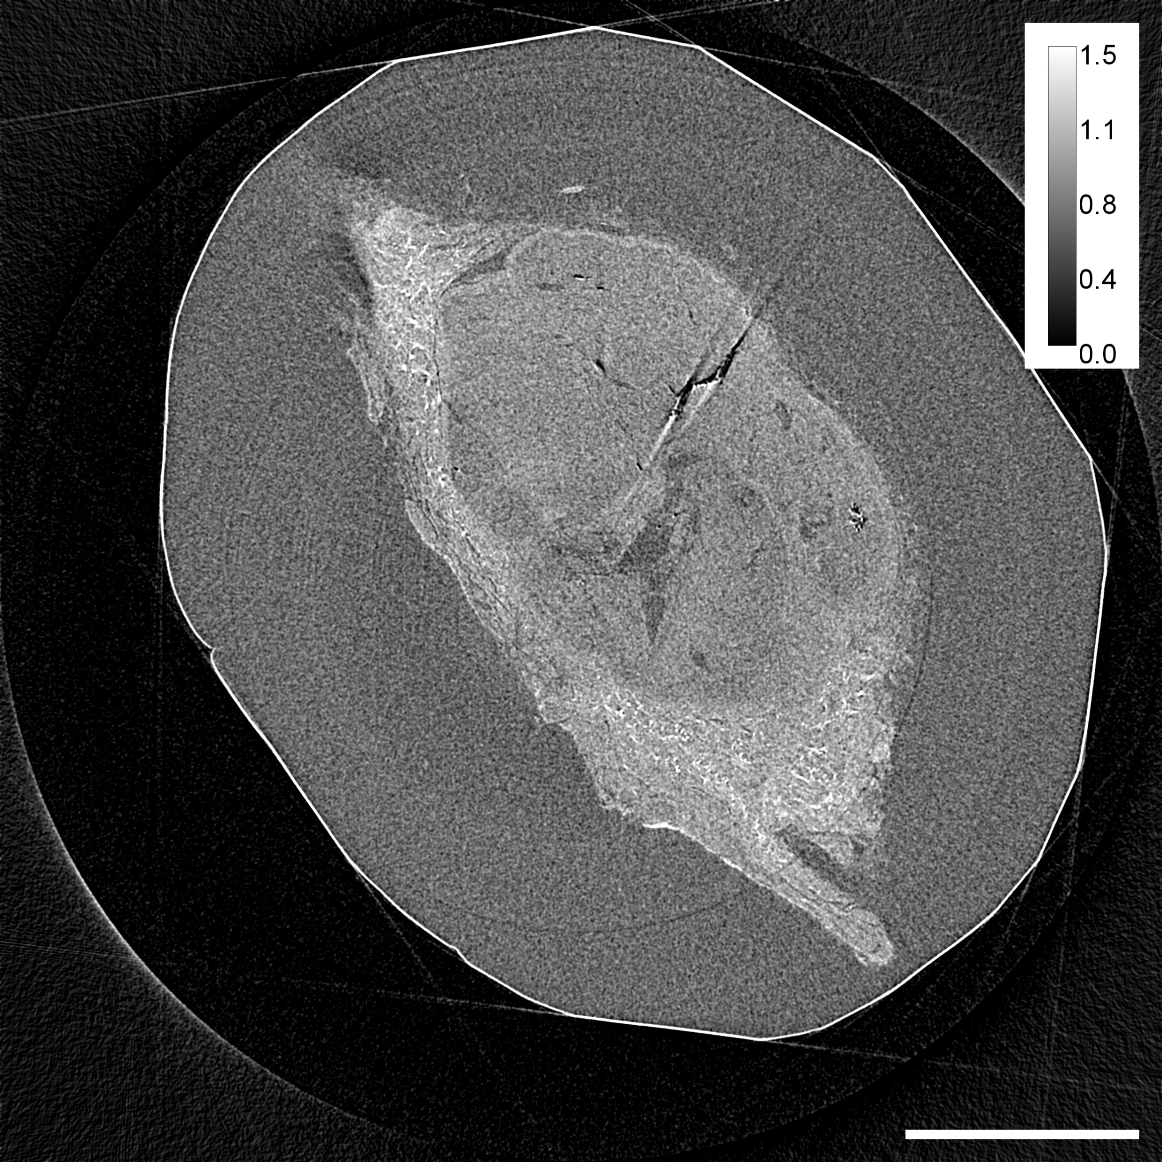

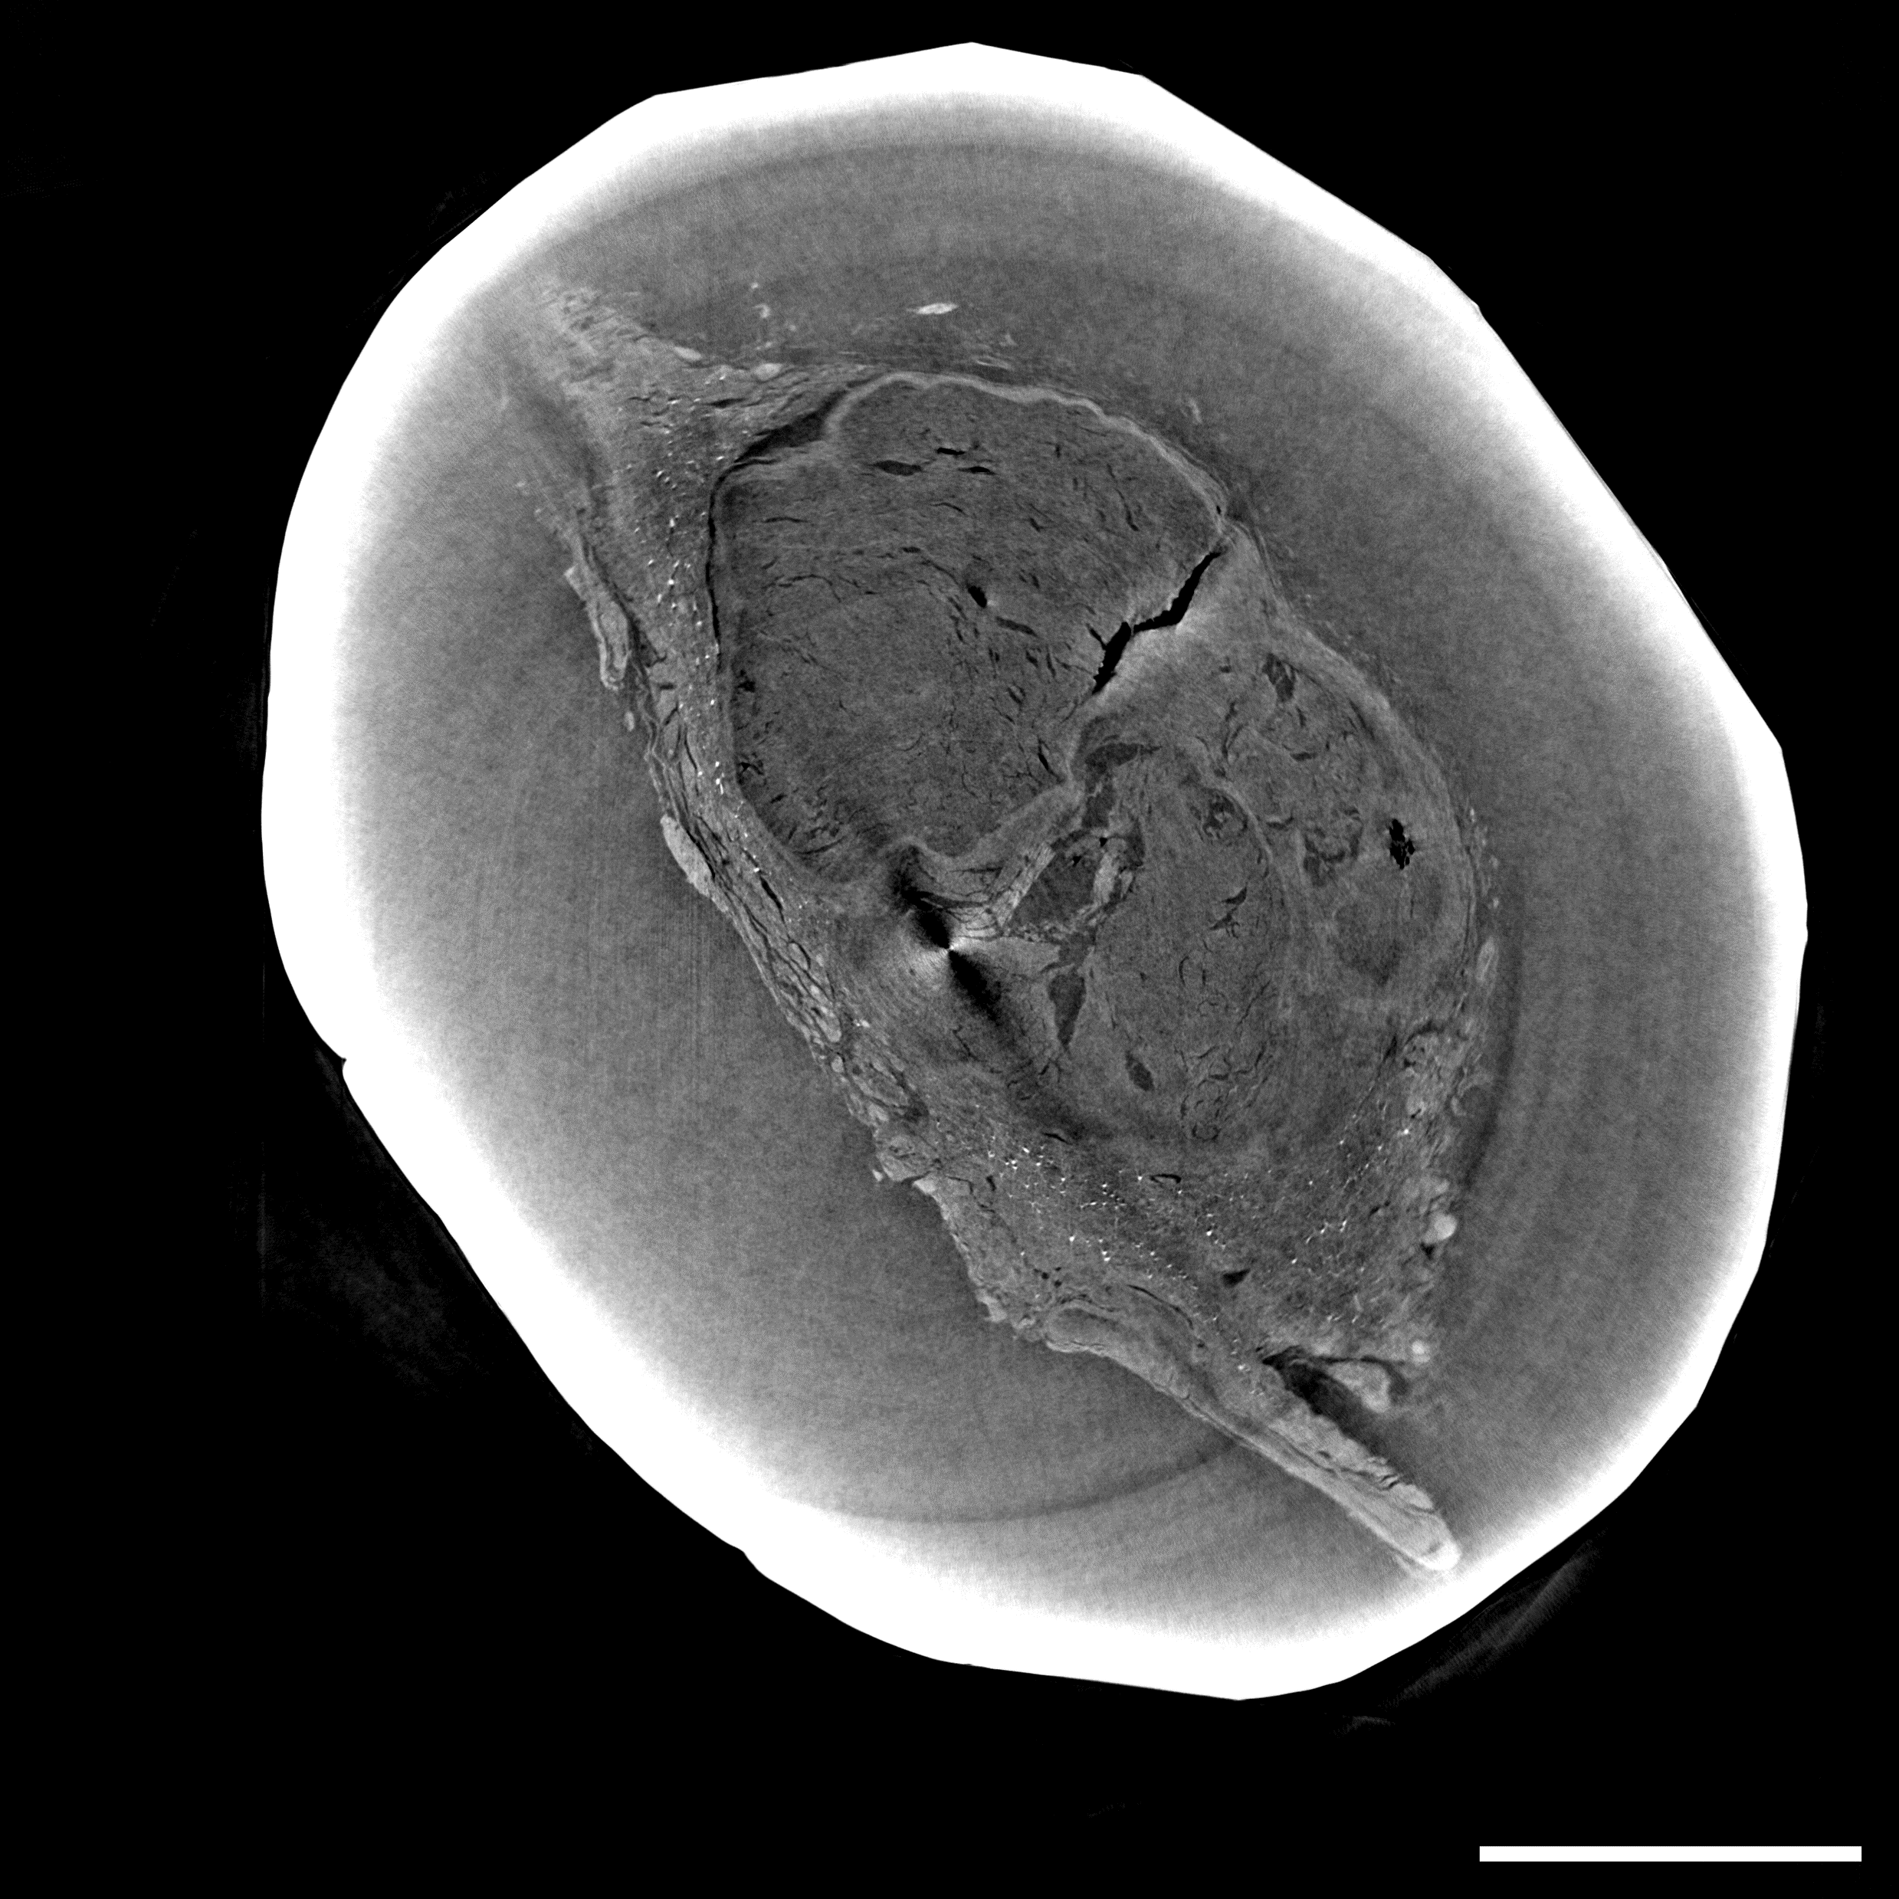
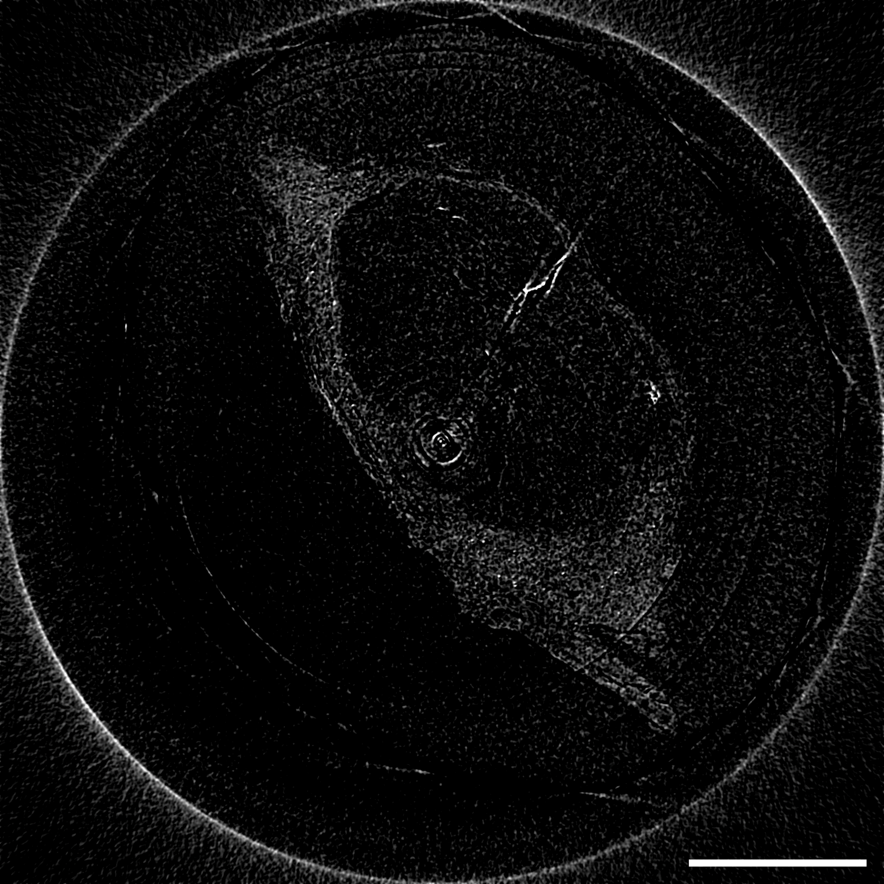
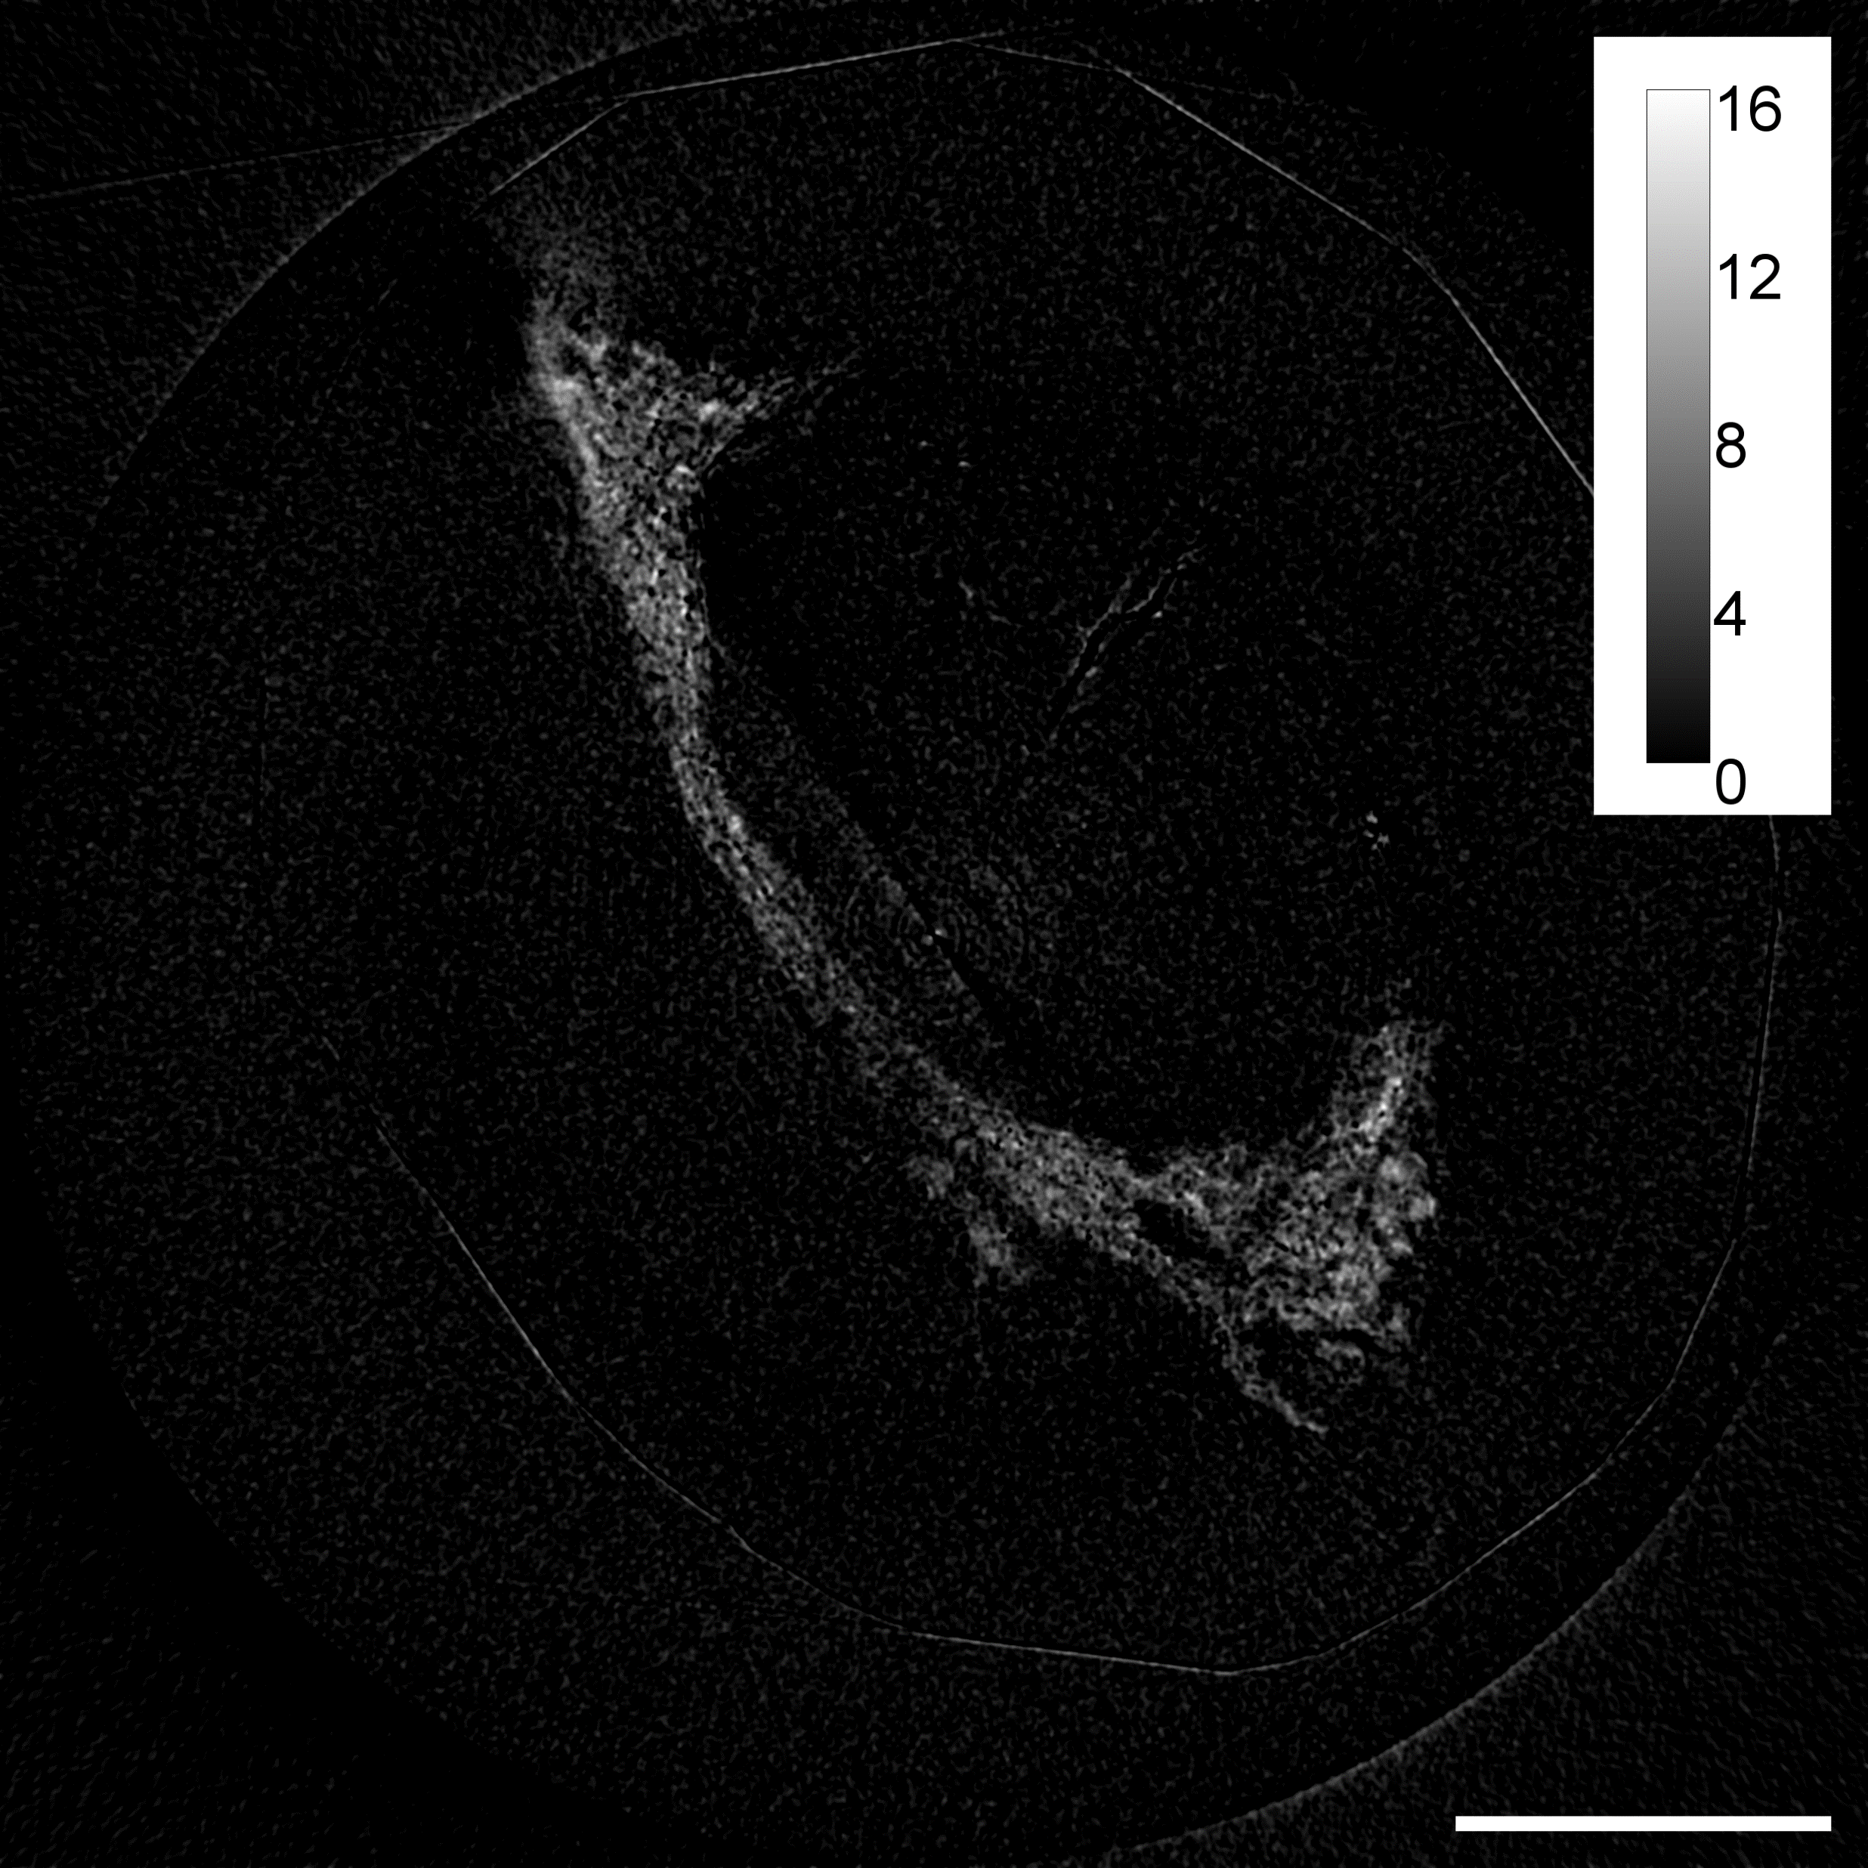
,
First experimental results: human thyroid sample
Post-processed images of a paraffin-embedded human thyroid sample with nodular neoplastic follicular carcinoma
attenuation above k-edge
tissue image
attenuation above k-edge
attenuation below k-edge
attenuation below k-edge
distinctions in iodine concentration between healthy and unhealthy thyroid tissues
Nodular neoplastic follicular carcinoma with well-defined margins not containing iodine.
Around the lesion appears the thyroid parenchyma, with distribution in follicles, the areas where thyroglobulin accumulates containing iodine. This is confirmed in the iodine image.
phase image
iodine image
phase image
scattering image
scattering image
Tomographic slice acquired at the iodine k-edge with Si (1-10) bent crystal and absorbing mask with 10μm aperture
Parameters: 1480 proj over 360 deg, 250 ms exp time/proj, focus-crystal 24.5 cm, sample-detector 68.5cm, mask 10um aperture, 70um pitch, 7 dithering steps

Slide 9
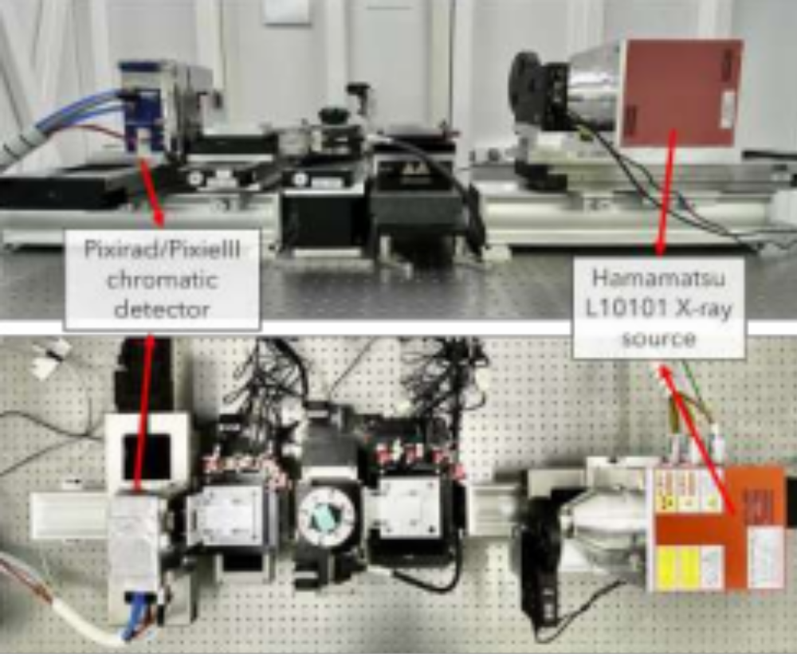
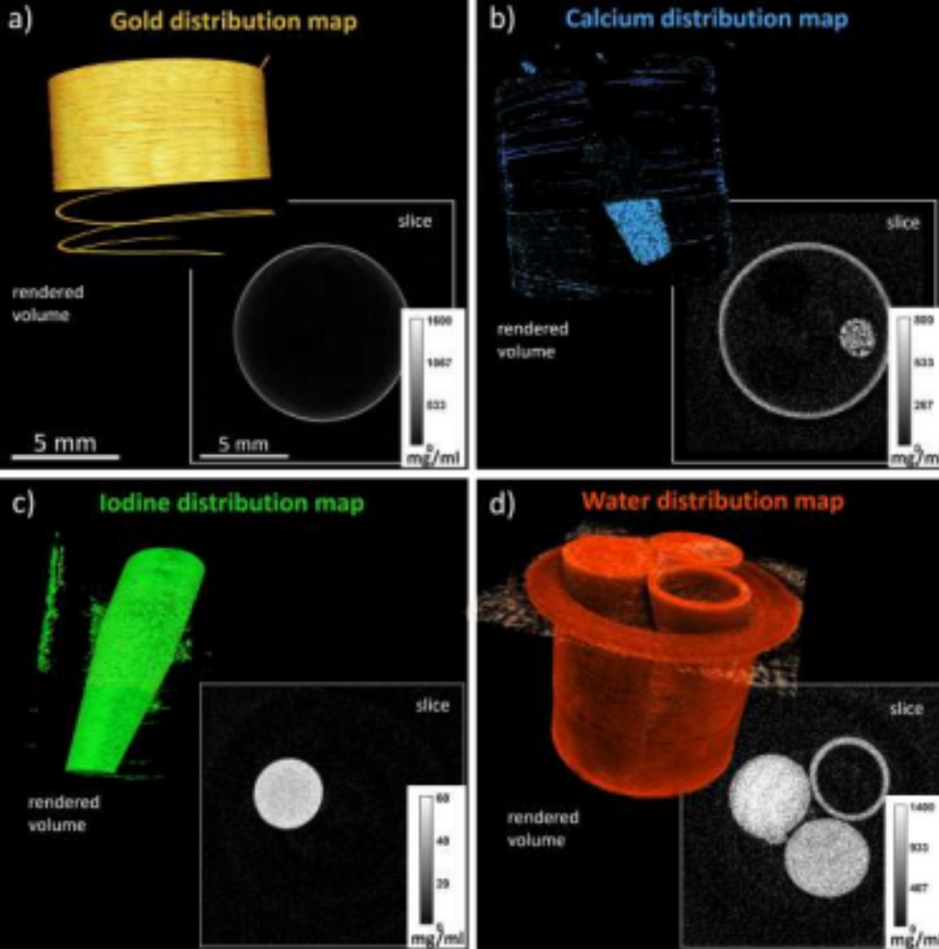

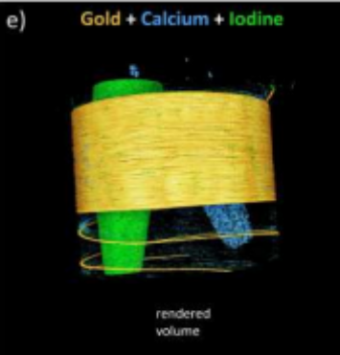
Translation to the lab 1)

Slide 10
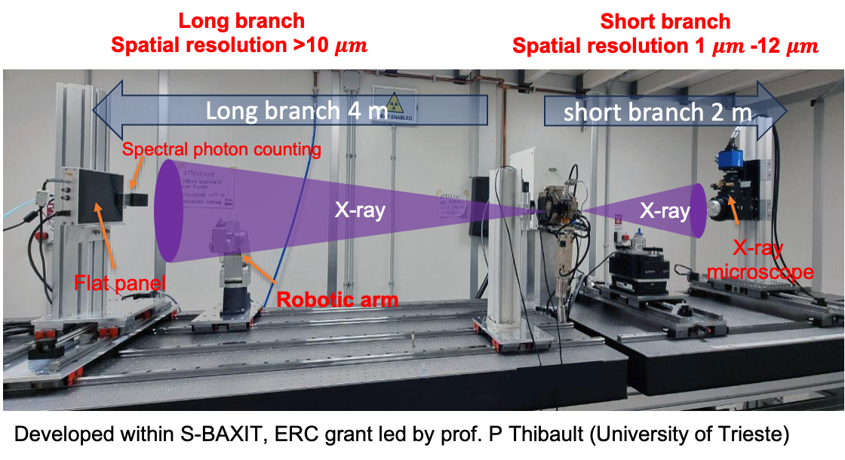
Translation to the lab 2) liquid metal jet x-ray tube
CITIUS / RIKEN

Slide 11
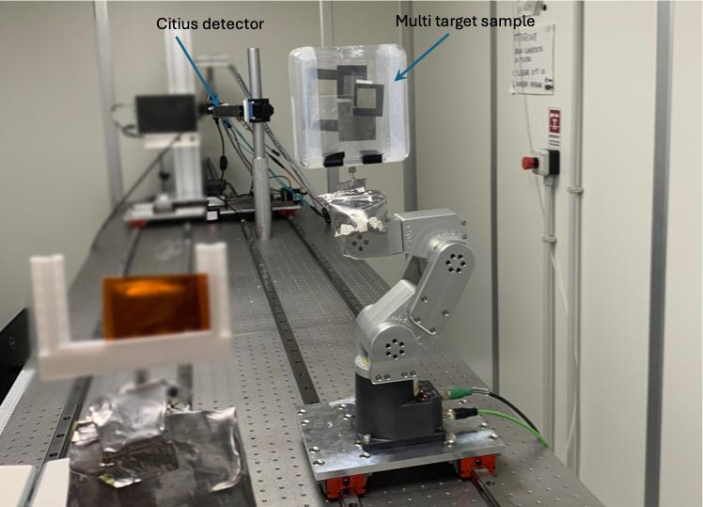
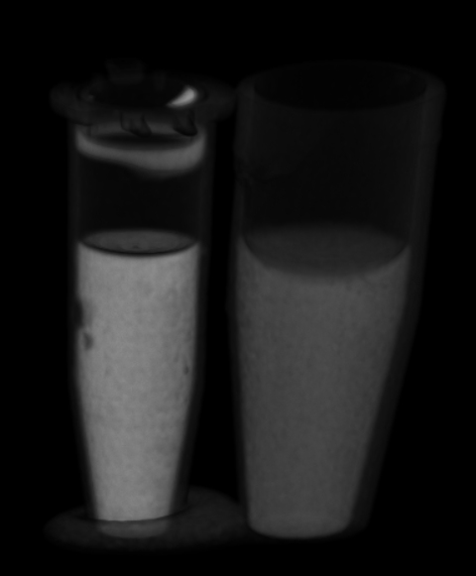
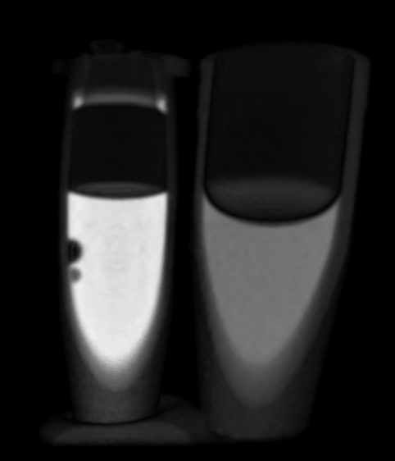
Translation to the lab 2) liquid metal jet x-ray tube
Spectral decomposed CT
(blue Ag, green KBr Gray polyethylene)
Conventional CT

Slide 12



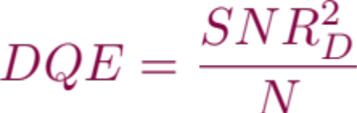
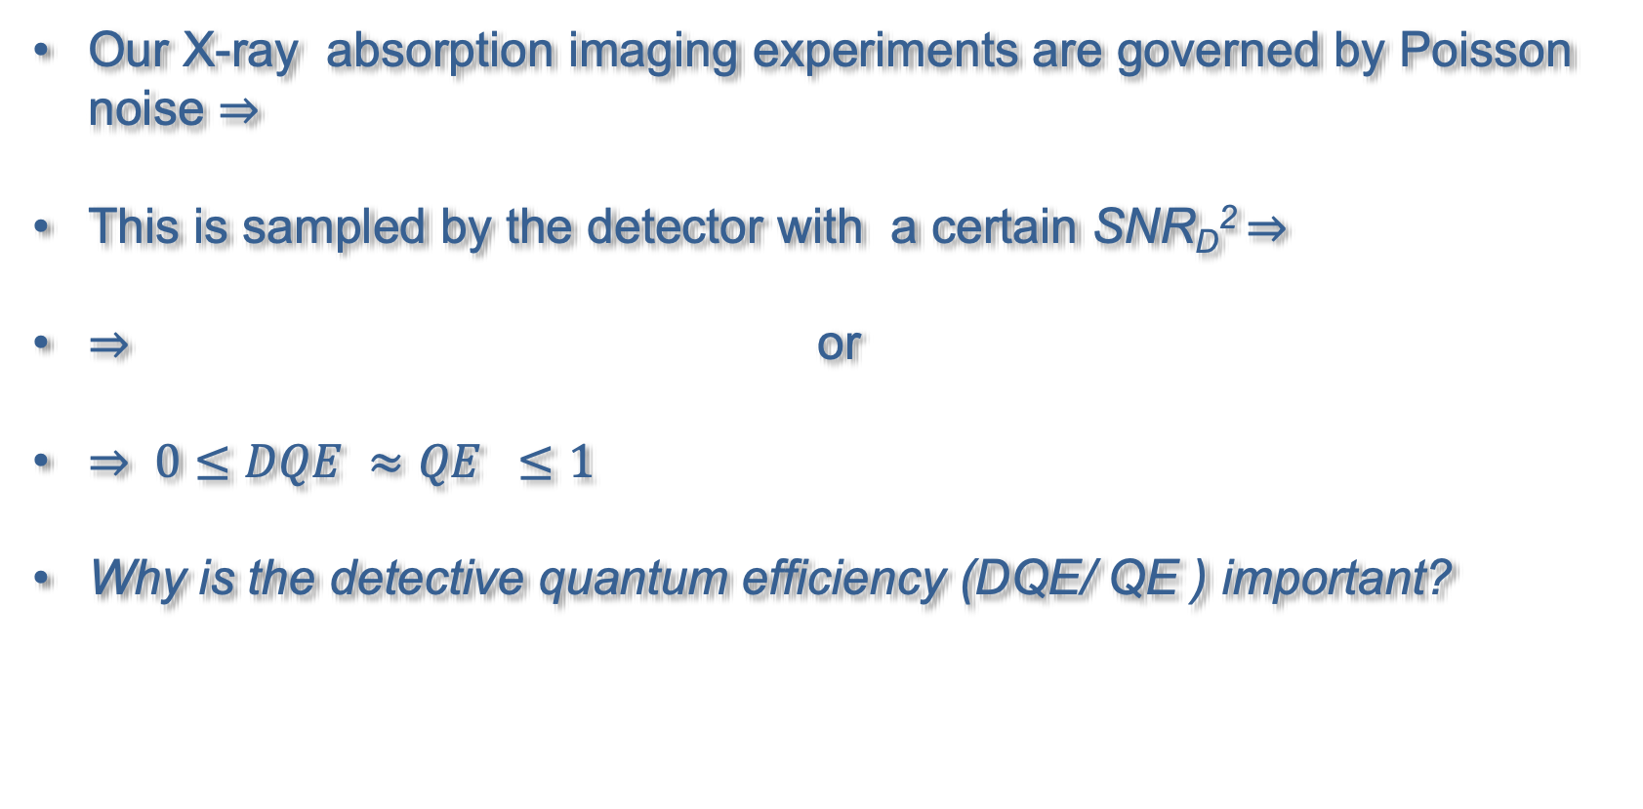
Absorption/ Spectral imaging
Our X-ray absorption imaging experiments are governed by Poisson noise $⇒$
This is sampled by the detector with a certain SNR_{D}² $⇒$
$⇒$ or
$⇒$ $0≤DQE ≈QE ≤1$
Why is the detective quantum efficiency (DQE/ QE ) important?

Slide 13
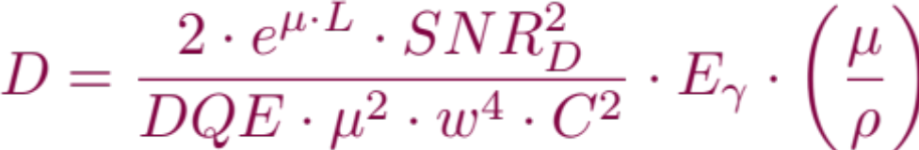
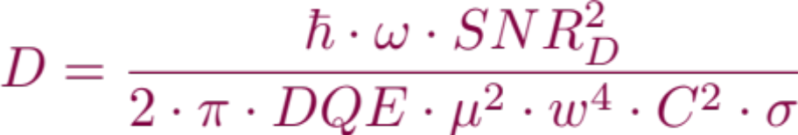

Absorption/ Spectral imaging
Why is the detective quantum efficiency (DQE) important?
$⇒It^{′}s a dose issue!$ D = entrance dose
For absorption imaging
  w = detail size, L, µ and $ρ$= length, attenuation coefficient and density of embedding matrix, C = object contrast, $E_{γ}$ = photon energy
For scattering
  $σ=$total surface area of the scatterers, w = 1/h with h being the scattering vector given by $h= \frac{4∙π∙sin\left(θ\right)}{λ}$
1 – DQE (1-QE) is the feature destroying fraction of photons that does not contribute to increase the SNR in your measurement

Slide 14



New developments (next 4 years)
We need stable high Z materials
We need charge amplification in the sensor
Hybrid pixel detectors have tremendously improved data quality over the past ~ 2 decades….
LGAD
750 µm Si
CdZTe/CdTe
…. and will continue to do so over the next two decades.
Will allow spectral and hyperspectral imaging over the entire energy range provided by the LEAPS facilities ( League of European Accelerator based Sources )

Slide 15

Can have some 10th ps time resolution

Slide 16
From the LEAPS roadmap
Parameter | Near-future wishlist | More ambitious target | Note
Continuous full-frame rate | ≥10–100 kHz | 0.1–1 MHz continuous | 4th generation Synchrotrons
Burst frame rate | ≥1 MHz | several MHz, ~4.5 MHz+ | XFELs
Read noise | <50 e⁻ ENC | <10–20 e⁻ ENC | access carbon edge 300 eV
Low-energy single-photon sensitivity | ~1 keV | 250–500 eV | access carbon edge 300 eV
Dynamic range | ≥10⁴ photons/pixel/frame | 10⁵ or more | CDI, Rice, ptychography
Pixel size | 50–100 µm | ~20–50 µm | where spatial resolution matters
Count-rate capability, SPC | >10 MHz/pixel | ~20–100 MHz/pixel
Area | multi-Mpixel | large, modular, gapless / 4-side buttable | Through vias
Dead time | Very low | effectively zero
Energy range | Si range | ~250 eV to >100 keV via sensor choice
Timing | µs–ns depending application | bunch-resolved / potentially sub-ns event timing
Readout | full frames | full-frame + ROI + sparse/event-driven + on-chip processing

Slide 17
From the DRD5 (Quantum materials)
Objective | First material/approach to investigate | Decisive measurement
Fast synchrotron imaging | CdS/CdSe/CdS quantum shells | Light output and afterglow under the actual bunch structure
High-resolution imaging screens | Quantum shells, perovskite nanocrystals, confined-screen geometries | MTF and DQE at matched absorbed dose
Ultrafast timing research | CdSe nanoplatelets; coupled perovskite-dot superlattices | Detected prompt photons per absorbed X-ray
Low-voltage beam monitoring | PbS quantum-dot films | Linearity, drift, response/recovery and flux dependence
Direct-conversion imaging R&D | Layered/quasi-2D perovskites | Transport anisotropy, polarization and array uniformity
High-resolution X-ray spectroscopy | TES microcalorimeters | Energy resolution versus usable count rate

Slide 18
Acknowledgment
Giuliana Tromba (Elettra Sincrotrone Trieste
Diego Dreossi (Elettra Sincrotrone Trieste)
Nicola Sodini (Elettra Sincrotrone Trieste)
Deborah Bonazza (Surgical Pathology Unit, Trieste Hospital, Italy)
Alessia Cedola (CNR-NANOTEC Rome, Italy)
Dean Chapman (University of Saskatchewan and Canadian Light Source)
Nazanin Samadi (DESY, Germany)
Alessandro Olivo (University College of London, UK)
Laura Bandiera (University Ferrara and INFN, Italy)
Andrea Mazzolari (University Ferrara and INFN, Italy)
Gianfranco Paterno’ (INFN Ferrara, Italy)
Paolo Cardarelli (INFN Ferrara, Italy)t
This work was supported by the Italian National Institute for Nuclear Physics (INFN), National Scientific Commission 5 for Technological and Inter-disciplinary Research in the frame of the SPHERE-X project, and EU Grant Agreement No. 101262866 (LEAPS-Tech)

Slide 19
Notes:
Last Slide 1: Thanks to the audience

Slide 20






Hyperspectral THz imaging
$\frac{\text{30 pW}}{\sqrt{\text{Hz}}}$ Noise Equivalent Power = $\sqrt{16∙k_{B}∙T^{5}∙σ∙A}$
Notes:
Slide 2: Title of the Presentation
Before you start editing the slides of your talk change to the Master Slide view:
Microsoft Office :Menu: View > Slide Master;
Macintosh – View > Master > Slide Master
Edit the following items:
On the Slide Master (first master slide) – lower area
a) On the left Delete the text and write the title of the event/Conference, Location
b) On the right delete the text and write the name and surname of the speaker and the date (day, month , year)
Close Master View
To start adding slides insert a new slide and select a Layout:
For Title & Subtitle
For text with bullet points
For Text
For Picture, graphs, visuals
Two columns
Blank

Slide 21







First experimental results: cartilage and osteoarticular tissues imaging
Ca Image
iodinated cationic contrast agents selectively bind to healthy cartilage structure
Bovine femoral cartilage sample after immersion in iodinated cationic contrast agent (CA4+). Contrast enhancement after 24 of diffusion reflecting the spatial distribution of the proteoglycans
Iodine concentration
Superficial zone
deep zone
Calcified cartilage
tidemark
Subchondral
bone
Iodine Image
phase Image
Samples from IRCCS Rizzoli Orthopedic Institute in Bologna
Diagnostics 2022, 12, 2111. https://doi.org/10.3390/diagnostics12092111

Slide 22



Hyperspectral
XSI branch
CdTe hybrid pixel detector
Absorbing mask
XPCI branch
Bent crystal
High resolution sCMOS detector
Sample
e)
Notes:
Slide 2: Title of the Presentation
Before you start editing the slides of your talk change to the Master Slide view:
Microsoft Office :Menu: View > Slide Master;
Macintosh – View > Master > Slide Master
Edit the following items:
On the Slide Master (first master slide) – lower area
a) On the left Delete the text and write the title of the event/Conference, Location
b) On the right delete the text and write the name and surname of the speaker and the date (day, month , year)
Close Master View
To start adding slides insert a new slide and select a Layout:
For Title & Subtitle
For text with bullet points
For Text
For Picture, graphs, visuals
Two columns
Blank

Slide 23











CaSO₄ Image
Ag Image
Water Image
$$\left[\frac{g}{ml}\right]$$
$$\left[\frac{mg}{ml}\right]$$
$$\left[\frac{g}{ml}\right]$$
1.6
1.2
0.8
0.6
0.4
0
1.0
0.8
0.6
0.4
0.2
0
10
8
6
4
2
1
a)
XPCI branch
3 mm
3 mm
3 mm
Scatter Image
phase Image
µrad²
30
20
10
0
3mm
Notes:
Slide 2: Title of the Presentation
Before you start editing the slides of your talk change to the Master Slide view:
Microsoft Office :Menu: View > Slide Master;
Macintosh – View > Master > Slide Master
Edit the following items:
On the Slide Master (first master slide) – lower area
a) On the left Delete the text and write the title of the event/Conference, Location
b) On the right delete the text and write the name and surname of the speaker and the date (day, month , year)
Close Master View
To start adding slides insert a new slide and select a Layout:
For Title & Subtitle
For text with bullet points
For Text
For Picture, graphs, visuals
Two columns
Blank

Slide 24






Iodine
mg/ml
Calcium
mg/ml
2mm
g/ml
Phase low + high
2mm
g/ml
2mm

Slide 25



Why are we doing, what we are doing?
For the ease of the discussion let’s consider only direct conversion detectors and among them counting detectors (hybrid pixel detectors but also Silicon drift chambers) and integrating detectors (sCMOS, CCDs, …) possessing a quantum efficiency QE
For paralyzed counting detectors with deadtime $τ$
For integrating detectors with an electronics noise equivalent of $σ$

Slide 26

Zero spatial frequency DQE

Slide 27




Spatial frequency DQE
For pixelated detectors with a pixel size w the DQE becomes also dependent from the spatial resolution PSF(x) in terms of spatial frequencies u [LP/mm] $⇒MTF\left(u\right)= 𝔉\left(PSF\right)$. In the best case $MTF\left(u\right)=Sinc\left(u\right), u≈\frac{1}{x}$
$⇒$ Even for high QE detectors the DQE can varnish when the pixel size (or photon flux) is not matched accordingly.

Slide 28

Multiplication as DQE shifter
For given electronics noise internal gain works as a DQE shifter towards lower photon fluences.
This works for gases [Menk et. Al. ﻿Nuclear Instruments and Methods in Physics Research A 440 (2000) 181-190 ], photomultiplier, MCPs and Si [LGADs] since the excess noise factor < multiplication / gain factor.
Higher multiplication factors

