Slide 1

Development of innovative Machine and Deep Learning
Algorithms for the Detection, Classification, and Monitoring of CBRNe Agents
Machine Learning and CBRNe Applications for Safety and Security
Tutor : Prof. Gaudio P.
Co-Tutor: Rossi R., Ph.D.
Alessandro Puleio
alessandro.puleio@uniroma2.it
21/10/2026

Slide 2

Machine and Deep Learning
AI Definitions
Training and Validation
Mode
Artificial Intelligence
Applications’ Problems:
“Programs (or System) that mimic the human learning”
Supervised Learning
Training a predictive model using:
- Input Data (Observations)
- Labelled Data (Expected Prediction)
Classification
Machine Learning
“Statistical method that mimic the human learning”
Regression
Unsupervised Learning
Deep Learning
Training a predictive model using:
- Unlabelled Input Data (Observations)
Clustering
“Neural Network that mimic the human learning directly from data”
Reinforcement Learning
Anomaly Detection
Training a predictive model using:
Agent interacting with an environment
Actions taken by the agent

Slide 3

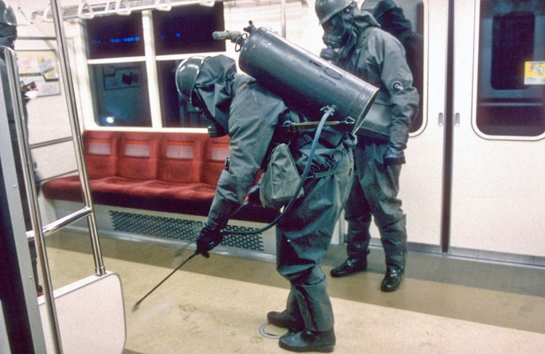
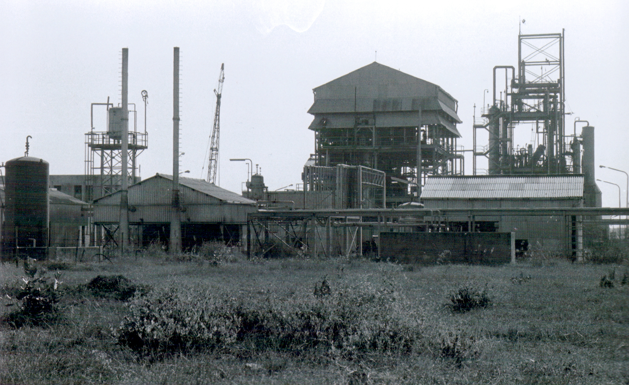
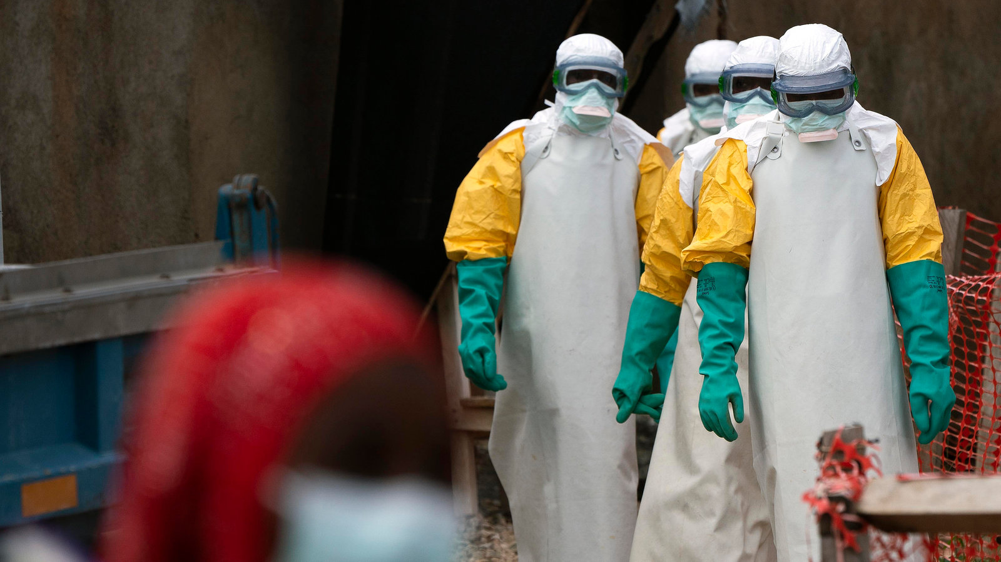
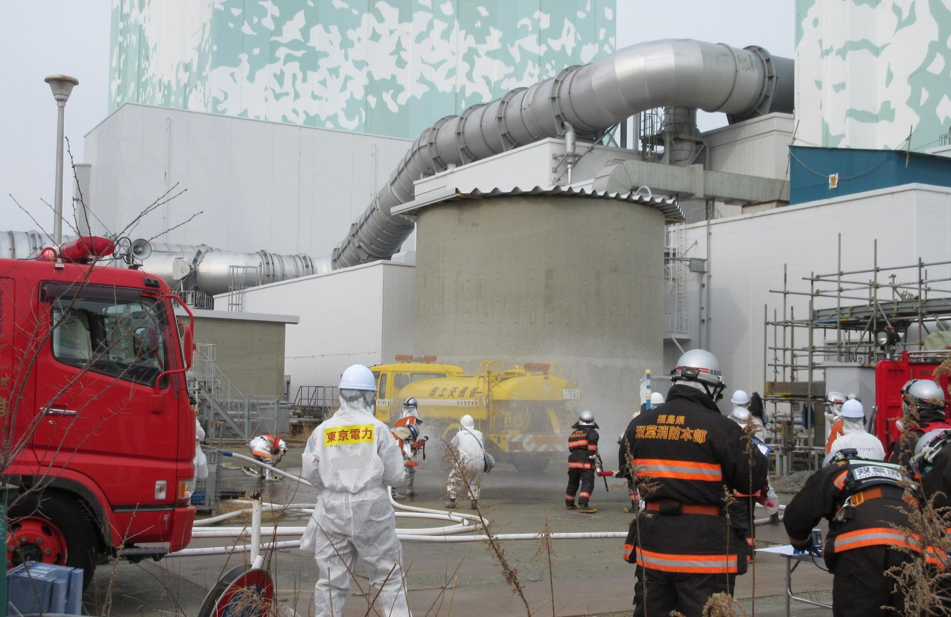
Chemical-Biological-Radiological-Nuclear (CBRN) Threats
Tokyo (JA),1995 – Sarin Dispersion
Chemical
Bhopal,1984 – Methyl isocyanate Leak
Biological
Kiwu (CF),2018-19 – Ebola Outbreak
Fukushima (JA), 2011– NPP Accident
Radiological
Nuclear

Slide 4
Machine and Deep Learning application for the CBRNe
C & B - Unsupervised Calibration for Classification with PINN (Physics Informed Neural Network)
  Puleio, A. & Gaudio, P. Unsupervised Spectra Information Extraction using Physics-Informed Neural Networks in Presence of Non-Linearities and Multi-class Problems. Engineering Application of Artificial Intelligence (2024).
  Puleio, A., Rossi, R., and Gaudio, P. (2023). Calibration of spectra in presence of non-stationary background using unsupervised physics-informed deep learning. Sci Rep 13. 10.1038/s41598-023-29371-9.
B - SR-LIF and Deep-Learning Algorithms to measure agents’ concentrations
  Puleio, A. et al. Spatially-Resolved Light Induced Fluorescence (SR-LIF) and Deep-Learning Algorithms for measure of concentration agents. “Journal”. (2024).
C - Deep-Learning Techniques for Reconstructing Chemical Dispersion Maps from Point Sensors
  Martellucci, L., Puleio, A., Rutigliano, N., Di Giovanni, D., and Gaudio, P. (2023). Deep learning methodologies for chemical dispersion map reconstruction. In Proceedings of SPIE - The International Society for Optical Engineering 10.1117/12.2685858.
R & N - Variational Auto-Encoders for Spectrum De-Noising and Radiological and Nuclear Sources Identification

Slide 5

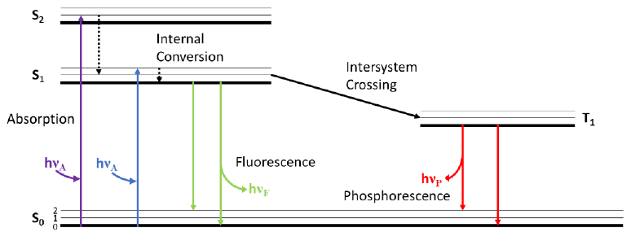
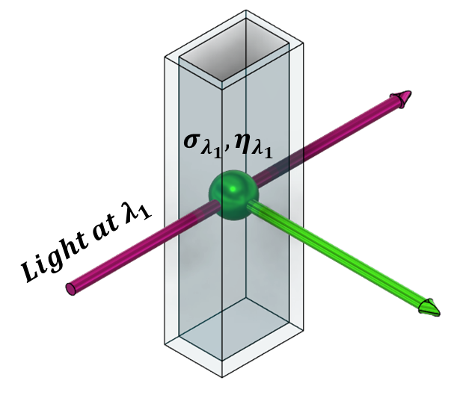
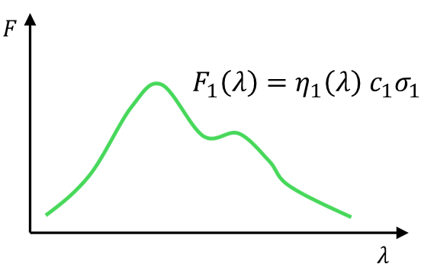
SR-LIF and Deep-Learning Algorithms for measure of concentration agents – Introduction
Fluorescence:
It is a phenomenon in which the excitation of electrons of molecules’ atoms (especially for biological compounds) originates the emission of specific light signals.
Light (or Laser)-Induced Fluorescence (LIF):
It is the technique useful to acquire spectroscopic data on a sample to classify and measure the contained agent in it (such as hazardous Biological Agents).
Excitation light
Emission light

Slide 6
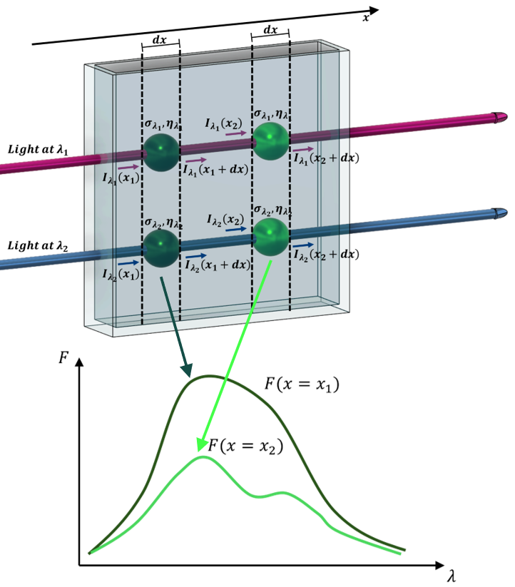
SR-LIF and Deep-Learning Algorithms for measure of concentration agents - Introduction
Spatially- Resolved Light (or Laser)-Induced Fluorescence (LIF):
It is a new approach of fluorescence spectroscopy to enrich the information contained in the fluorescence spectra.
The new approach is based on the use of a multi-wavelengths excitation sources to cause the fluorescence emission by different agents in the sample.
The principle is based on the changes that the excitation light suffers during its propagation in a agents’ mixture samples and the consequences on the emission signals.
Excitation light
Emission light
All the experimental measurements were performed in the laboratory at the German Aerospace Agency (DLR) of Dr. Dushek

Slide 7
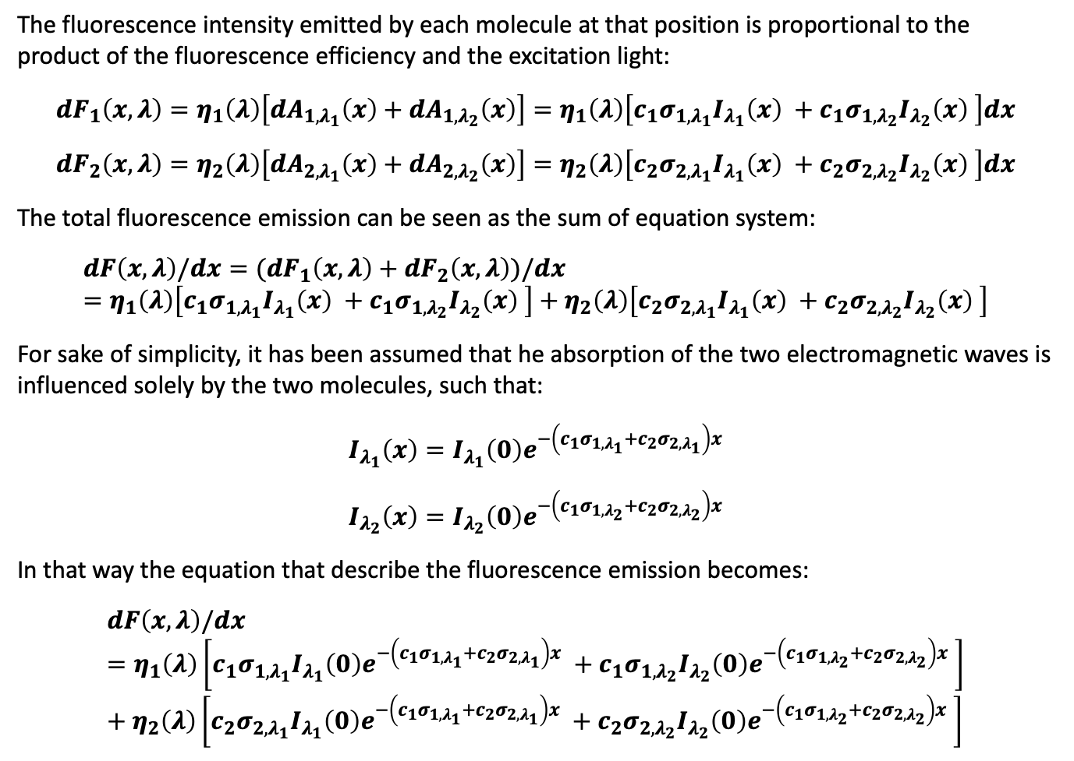
SR-LIF and Deep-Learning Algorithms for measure of concentration agents – The model of New Technique
The fluorescence intensity emitted by each molecule at that position is proportional to the product of the fluorescence efficiency and the excitation light:
$${dF}_{1}\left(x,λ\right)=η_{1}\left(λ\right)\left[dA_{1,λ_{1}}\left(x\right)+dA_{1,λ_{2}}\left(x\right)\right]=η_{1}\left(λ\right)\left[c_{1}σ_{{1,λ}_{1}}I_{λ_{1}}\left(x\right) +c_{1}σ_{1,λ_{2}}I_{λ_{2}}\left(x\right) \right]dx$$
$${dF}_{2}\left(x,λ\right)=η_{2}\left(λ\right)\left[dA_{2,λ_{1}}\left(x\right)+dA_{2,λ_{2}}\left(x\right)\right]=η_{2}\left(λ\right)\left[{c_{2}σ}_{2,λ_{1}}I_{λ_{1}}\left(x\right) +{c_{2}σ}_{{2,λ}_{2}}I_{λ_{2}}\left(x\right) \right]dx$$
The total fluorescence emission can be seen as the sum of equation system:
$$dF\left(x,λ\right)/dx={(dF}_{1}\left(x,λ\right)+{dF}_{2}\left(x,λ\right))/dx=η_{1}\left(λ\right)\left[c_{1}σ_{{1,λ}_{1}}I_{λ_{1}}\left(x\right) +c_{1}σ_{1,λ_{2}}I_{λ_{2}}\left(x\right) \right]+η_{2}\left(λ\right)\left[c_{2}σ_{2,λ_{1}}I_{λ_{1}}\left(x\right) +c_{2}σ_{{2,λ}_{2}}I_{λ_{2}}\left(x\right) \right]$$
For sake of simplicity, it has been assumed that he absorption of the two electromagnetic waves is influenced solely by the two molecules, such that:
$$I_{λ_{1}}\left(x\right)=I_{λ_{1}}\left(0\right)e^{−\left(c_{1}σ_{{1,λ}_{1}}+c_{2}σ_{{2,λ}_{1}}\right)x}$$
$$I_{λ_{2}}\left(x\right)=I_{λ_{2}}\left(0\right)e^{−\left({c_{1}σ}_{{1,λ}_{2}}+{c_{2}σ}_{{2,λ}_{2}}\right)x}$$
In that way the equation that describe the fluorescence emission becomes:
$$dF\left(x,λ\right)/dx=η_{1}\left(λ\right)\left[c_{1}σ_{{1,λ}_{1}}I_{λ_{1}}\left(0\right)e^{−\left({c_{1}σ}_{{1,λ}_{1}}+c_{2}σ_{{2,λ}_{1}}\right)x} +c_{1}σ_{1,λ_{2}}I_{λ_{2}}\left(0\right)e^{−\left(c_{1}σ_{{1,λ}_{2}}+c_{2}σ_{{2,λ}_{2}}\right)x} \right]+η_{2}\left(λ\right)\left[{c_{2}σ}_{2,λ_{1}}I_{λ_{1}}\left(0\right)e^{−\left(c_{1}σ_{{1,λ}_{1}}+c_{2}σ_{{2,λ}_{1}}\right)x} +c_{2}σ_{{2,λ}_{2}}I_{λ_{2}}\left(0\right)e^{−\left({c_{1}σ}_{{1,λ}_{2}}+c_{2}σ_{{2,λ}_{2}}\right)x} \right]$$
Excitation light
Emission light

Slide 8
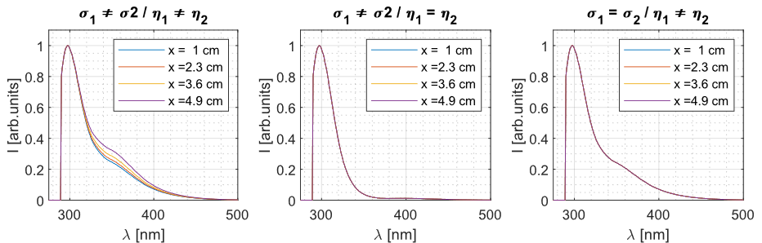
SR-LIF and Deep-Learning Algorithms for measure of concentration agents – Limit Conditions of Techniques
The samples for this technique application must be compose from at least two different species.
The techniques required the mandatory use of a multi-wavelength excitation approach.
The fluorescence signals between the different species in the sample must be different.
The absorption cross-section between the different species in the sample must be different.

Slide 9
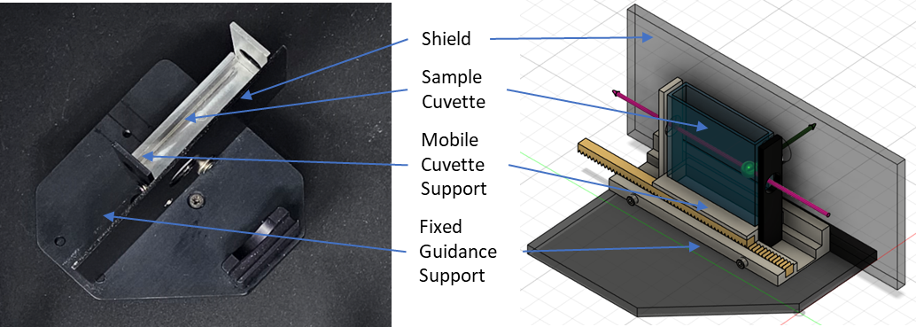
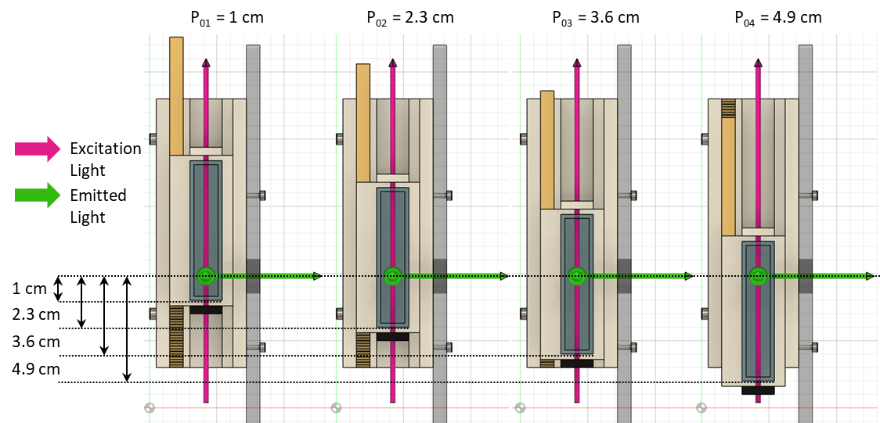
SR-LIF and Deep-Learning Algorithms for measure of concentration agents – Experimental Setup
Experimental Setups and Support
The support system of an Edinburgh®’s Spectrofluorometer Fs5 was modified to preform the experimental measurements
The mobile support created to test the new proposed techniques was characterised by 4 position to acquire the emission spectra
Two biological substances noted for their fluorophores’ properties were selected (two aromatic aminoacids, TYR and TRP)
Each samples was analysing using two wavelength of excitation: 266 nm and 280 nm

Slide 10
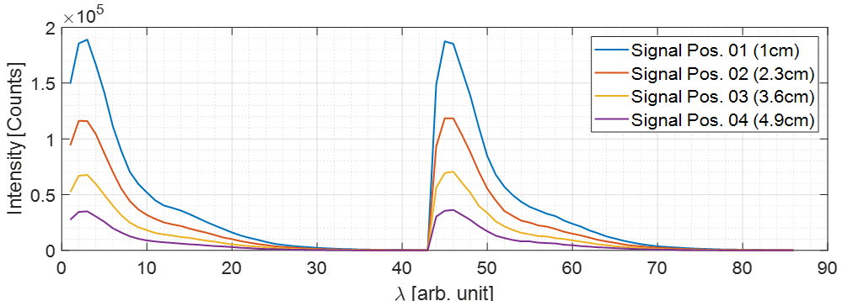
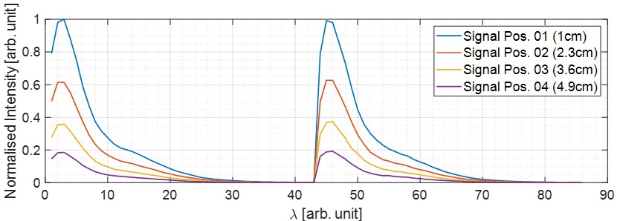




SR-LIF and Deep-Learning Algorithms for measure of concentration agents – Experimental Tests
Ten different mixture samples has been prepared
$$λ_{ex}=266 nm$$
$$λ_{ex}=280 nm$$
$$λ_{ex}=266 nm$$
The measurements were replied in different days;
A total of 30 fluorescence maps were acquired for each concentration mixture
Each samples was analysing using two wavelength of excitation: 266 nm and 280 nm
$$λ_{ex}=280 nm$$

Slide 11
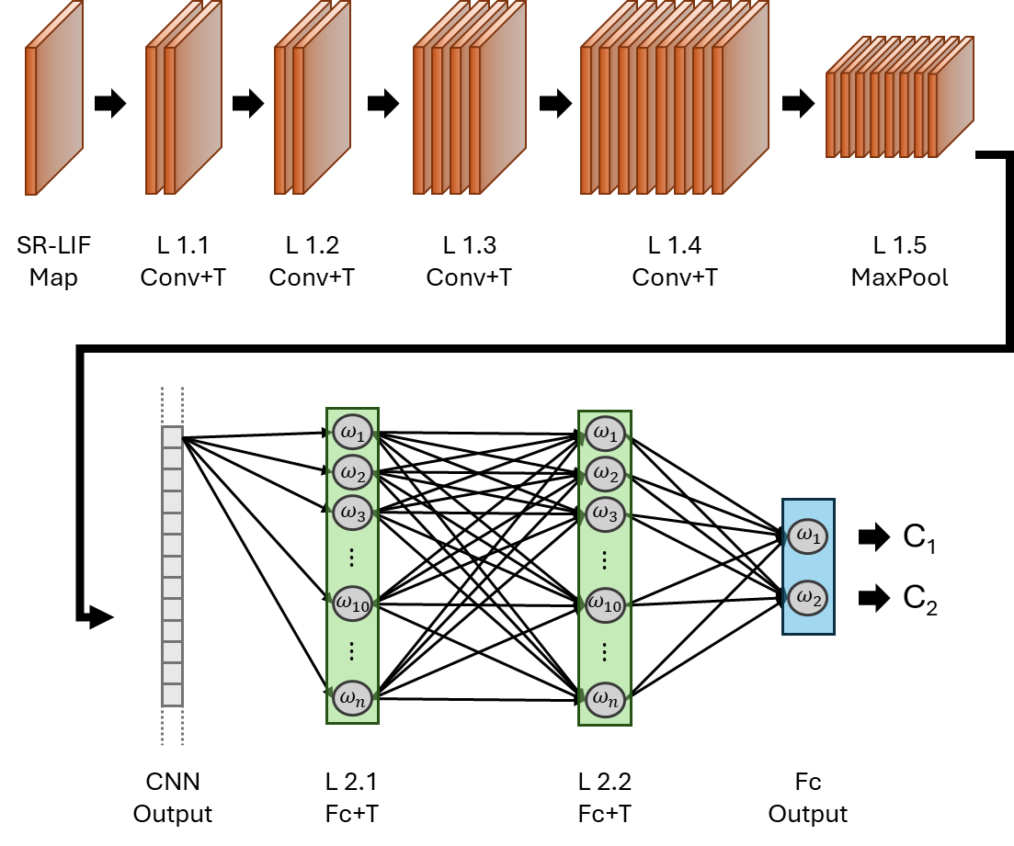
SR-LIF and Deep-Learning Algorithms for measure of concentration agents – Deep Learning Algorithm
Convolutional Neural Network (CNN)
Numerical model Development
A Numerical Model to simulate synthetic fluorescence maps was based on the physic principle and calibrated using the experimental collected data
Deep Learning (DL) Algorithm
To prepare the CNN algorithm two different Dataset has been used for Training/Validation phase and for the Test phase:
Training/Validation Phase: The simulated synthetic (numeric) database of fluorescence maps was used to guide the learning of CNN
Test phase: the CNN algorithm has been tested against the experimental dataset collected in collaboration with the German Aerospace Agency (DLR)

Slide 12
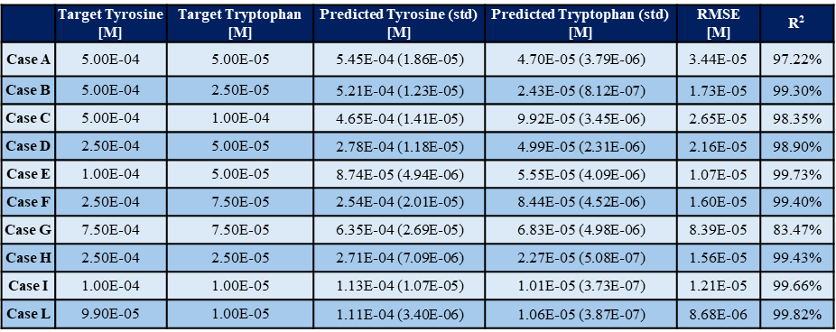
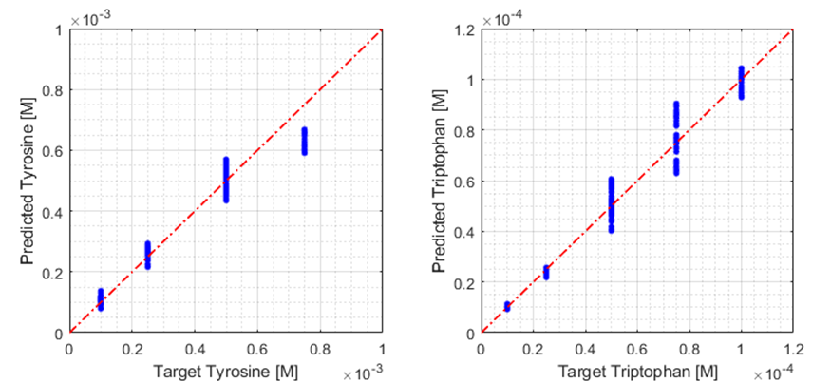
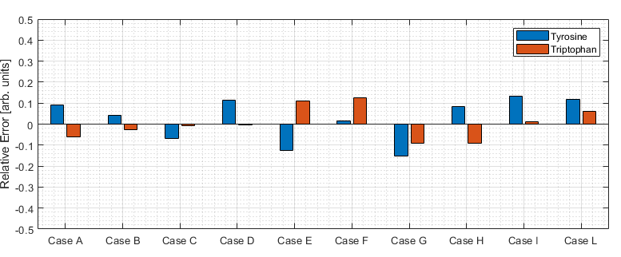
SR-LIF and Deep-Learning Algorithms for measure of concentration agents – Results
Target vs. Predicted Concentration Values
Relative Error for Concentration Values
The obtained results underline different aspects:
The SR-LIF permits a spectra normalisation by maximum ( or integral/average) without loss information about the concentration of agents, that implies we don’t need about source reference spectra;
The technique investigated has an inside multi-technique approach, because the fluorescence maps contains in itself information about the absorption, that permits the classification and measurements.

Slide 13
Conclusions
General Advantages and Perspectives:
AI algorithms, including ML and DL, can be crucial in managing unconventional emergencies or industrial applications related to CBRNe threats.
In the first two works (PINN for calibration and SR-LIF), the potential of AI algorithms to address specific problems—also involving new techniques—related to the identification and measurement of CBRNe agents was demonstrated.
  Possible use of numerical and mathematical model to training the algorithm successively used for experimental application.
  Possibility to perform Data Augmentation.
In the last work (GDM problem), the feasibility of using AI algorithms to address a classical problems related to CBRNe threats was demonstrated from a numerical perspective.
Application of AI algorithms, in particular a Deep Learning methodology, for the application to Radiological and Nuclear Threats show good perspective in the addressing of different problem that can be linked with the necessity to identify a source
Limits:
The most frequent limit in the ML and DL application is the dataset’s dimensions.
Unfortunately for some AI’s application to the CBRNe’s Threats the experimental validation remain at this moment the greatest limit for different reasons.

Slide 14
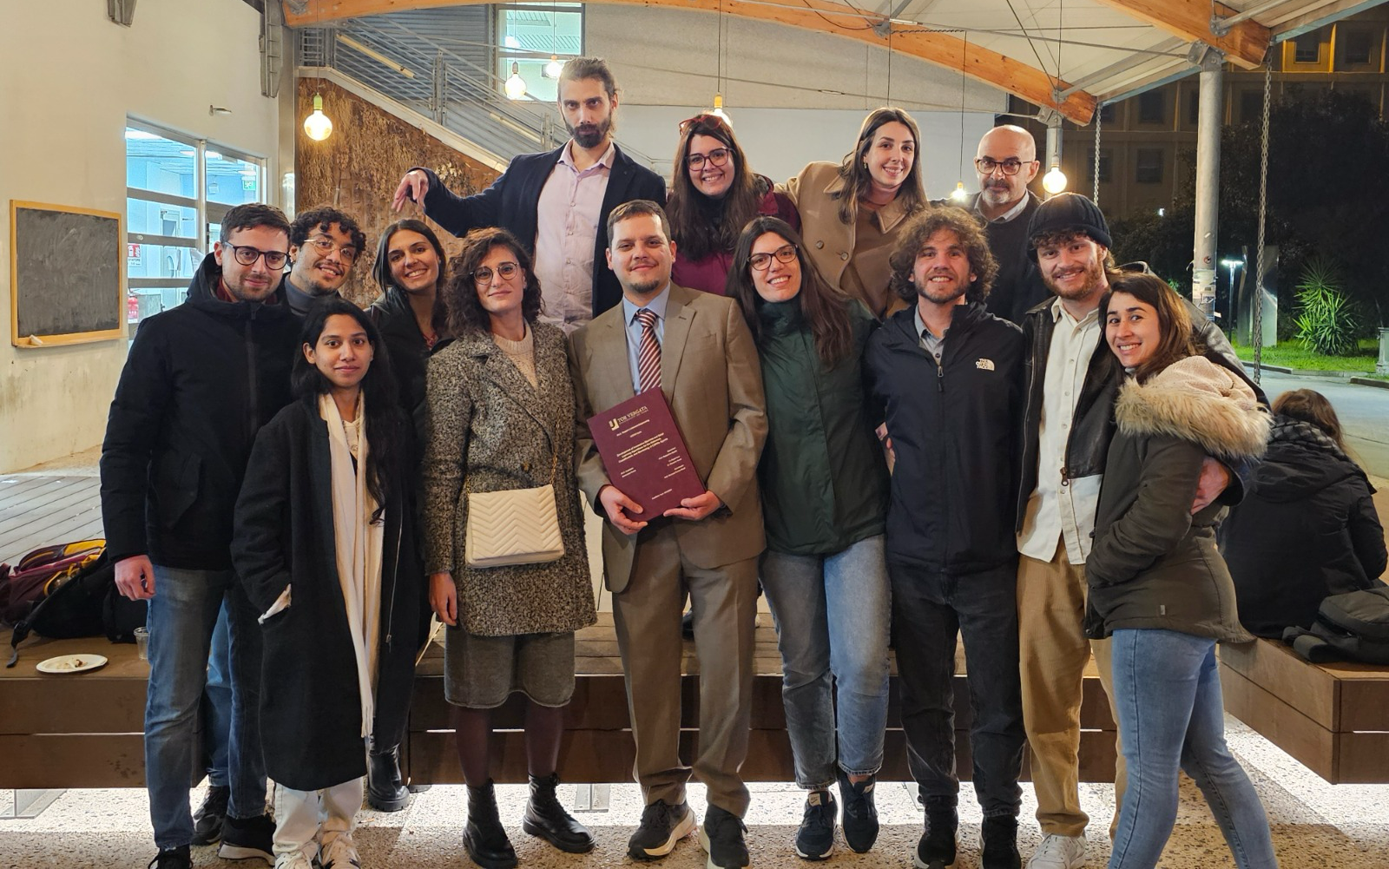
Thank you for your attention
Alessandro Puleio
alessandro.puleio@uniroma2.it
Thank you
To those in the photo, and also to those who weren’t there
For the strength of the Pack is the Wolf, and the strength of the Wolf is the Pack
The Law of the Jungle, The Second Jungle Book (1895) R. Kipling

Slide 15
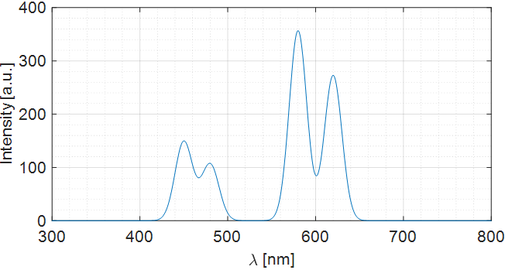
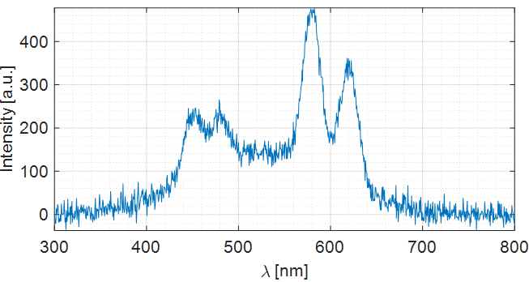


Unsupervised Calibration for Classification with PINN
– Introduction
Among the most widely used analysis techniques for the detection and measurement of hazardous agents are spectroscopy techniques:
Laser Induced Fluorescence Spectroscopy,
Raman Spectroscopy,
Laser Induced Breakdown Spectroscopy), etc.
Ideal Case
$$y_{n}=f(I_{d_{n}})$$
Supervised Calibration
(Controlled Experiments)
These techniques have normally the aims of:
To identify and classify the presence of an agent, and/or
To measure the quantity of an agent in a sample (e.g. the agent’s concentration).
Real Case
$$y_{n}=g(I_{d},I_{b},I_{n})$$

Slide 16
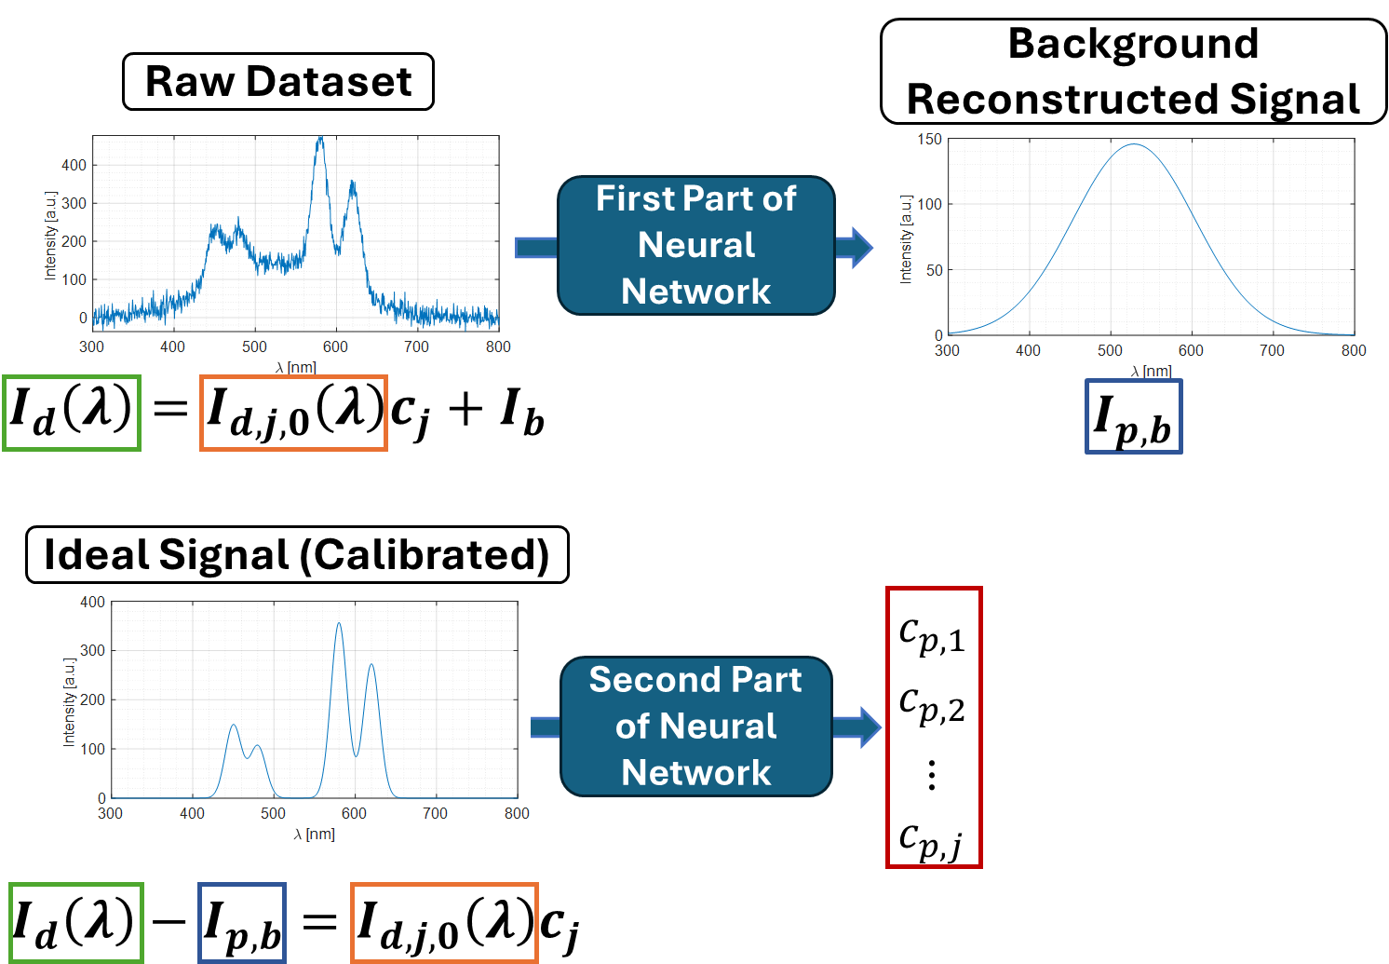
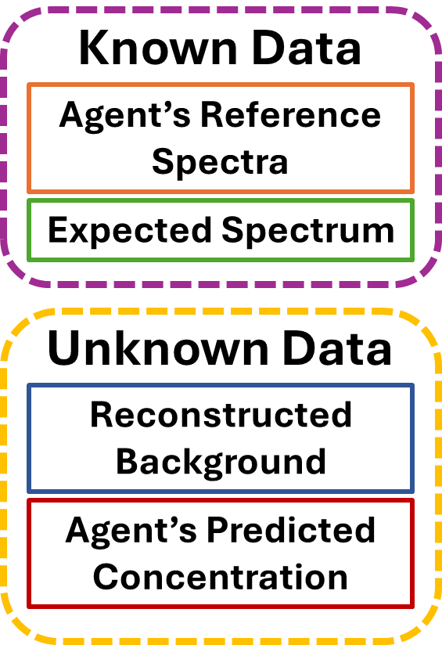
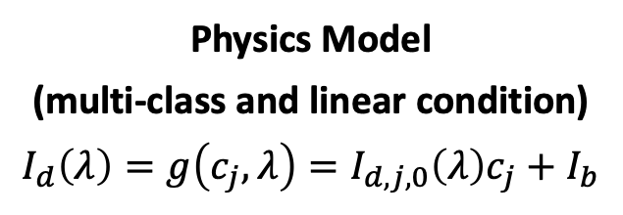
Unsupervised Calibration for Classification with PINN
– The Physics Informed Neural Network’s Opportunities
Physics-Informed Learning
It is a deep learning approach in which the model’s training and learning can rely on:
physics and boundary conditions (physics-guided learning), or
hybrid dataset and physics (physics-informed learning).
Physics Model
(multi-class and linear condition)
$$I_{d}\left(λ\right)=g\left(c_{j},λ\right)=I_{d,j,0}\left(λ\right)c_{j}+I_{b}$$

Slide 17
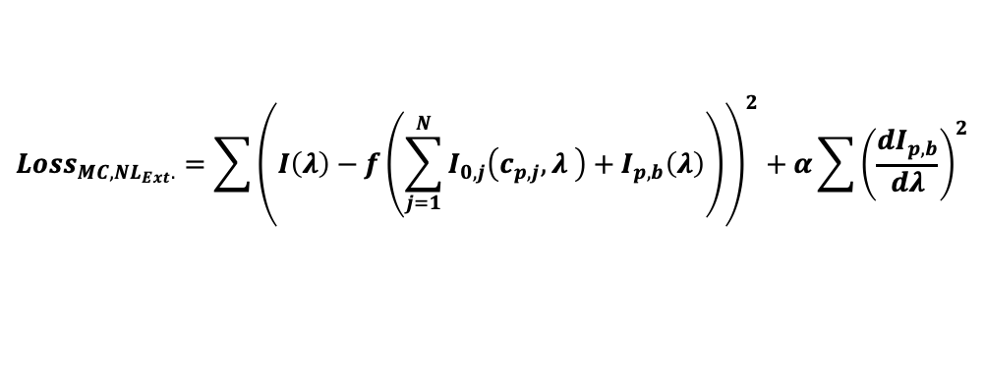
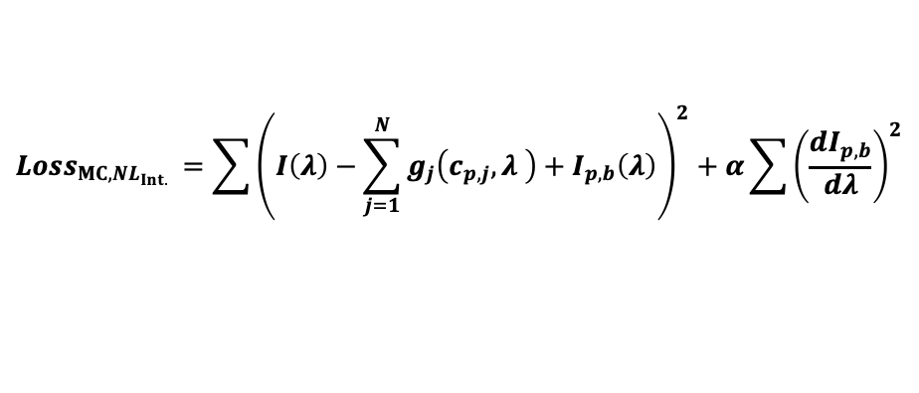
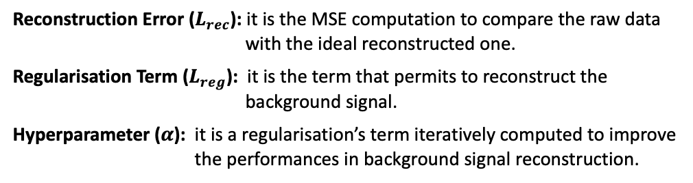
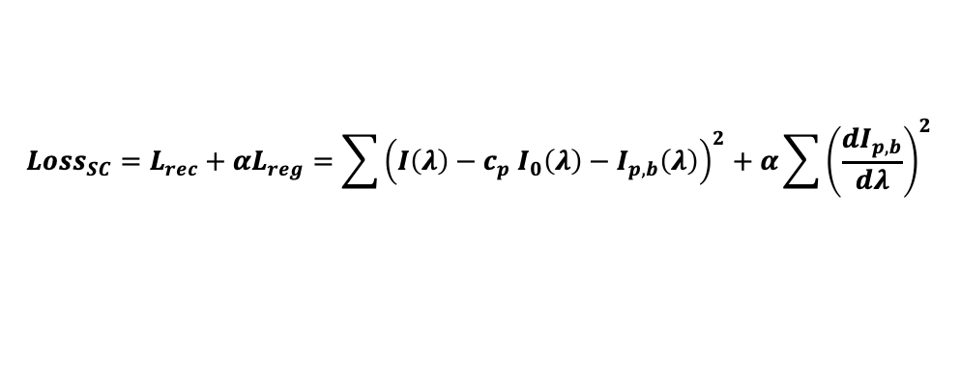
Unsupervised Calibration for Classification with PINN
– The Physics Informed Neural Network’s Applications
Phase01: Linear Conditions and/or in Single-Classes Samples’ Conditions
Phase02: Non-Linearity Conditions and/or in Multi-Classes Samples’ Conditions
Physics Model: $I_{d}\left(λ\right)=g\left(c_{j},λ\right)=I_{d,j,0}\left(λ\right)c_{j}+I_{b}$
Intrinsic Non-Linearity cases (concentrations’ effects):
Loss Function:
$${Loss}_{MC, NL_{Int.} }=\sum{{\left(I\left(λ\right)−\sum_{j=1}^{N}{g_{j}\left(c_{p,j},λ \right)+I_{p,b}\left(λ\right)}\right)}^{2}}+α\sum{{\left(\frac{dI_{p,b}}{dλ}\right)}^{2}}$$
<
$${Loss}_{SC}=L_{rec}+αL_{reg}=\sum{{\left(I\left(λ\right)−c_{p} I_{0}\left(λ\right)−I_{p,b}\left(λ\right)\right)}^{2}}+α\sum{{\left(\frac{dI_{p,b}}{dλ}\right)}^{2}}$$
Reconstruction Error
Regularisation Term
Reconstruction Error
Regularisation Term
Reconstruction Error ($L_{rec}$): it is the MSE computation to compare the raw data with the ideal reconstructed one.
Regularisation Term ($L_{reg}$): it is the term that permits to reconstruct the background signal.
Hyperparameter ($α$): it is a regularisation’s term iteratively computed to improve the performances in background signal reconstruction.
External Non-Linearity cases (sensors’ behaviours):
$${Loss}_{MC,NL_{Ext}.}=\sum{{\left(I\left(λ\right)−f\left(\sum_{j=1}^{N}{I_{0,j}\left(c_{p,j},λ \right)+I_{p,b}\left(λ\right)}\right)\right)}^{2}}+α\sum{{\left(\frac{dI_{p,b}}{dλ}\right)}^{2}}$$
Reconstruction Error
Regularisation Term

Slide 18
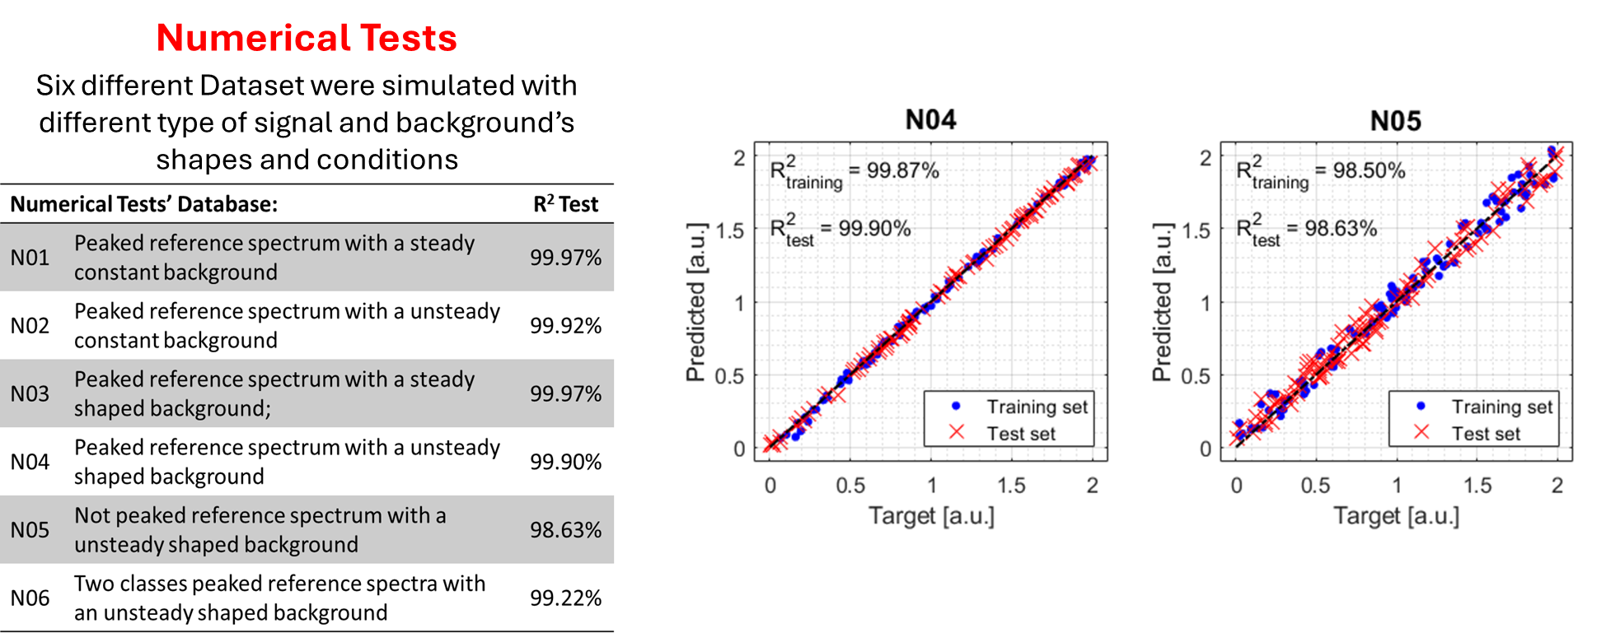
Unsupervised Calibration for Classification with PINN
– Test and Results
Phase01: Linear Conditions and/or in Single-Classes Samples’ Conditions

Slide 19
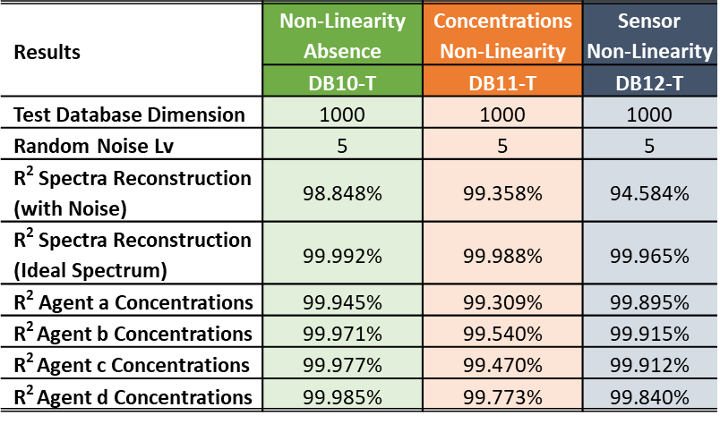
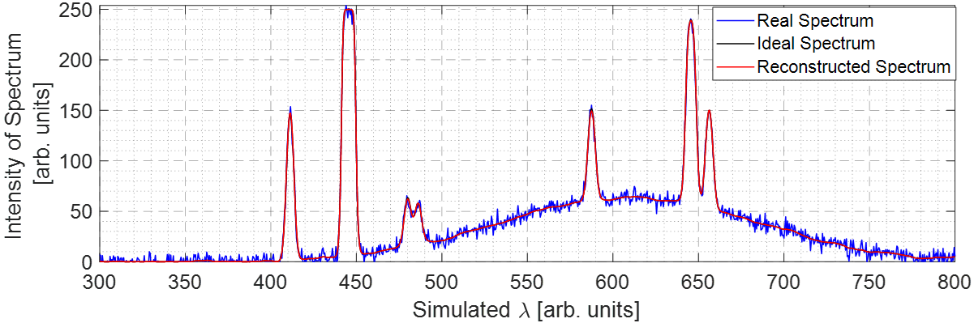
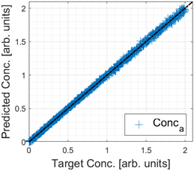
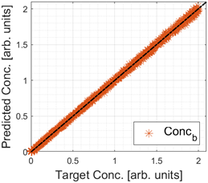
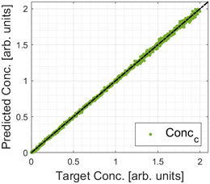
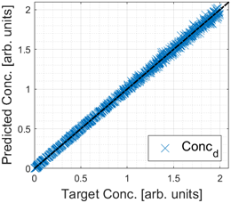
Unsupervised Calibration for Classification with PINN
– Test and Results
Phases02: Non-Linearity Conditions andMulti-Classes Samples’ Conditions
Numerical Tests
Three different Dataset were simulated with Multi-Class samples, in case of Extrinsic Non-Linearity Phenomena

Slide 20
Unsupervised Calibration for Classification with PINN
– Test and Results

Slide 21
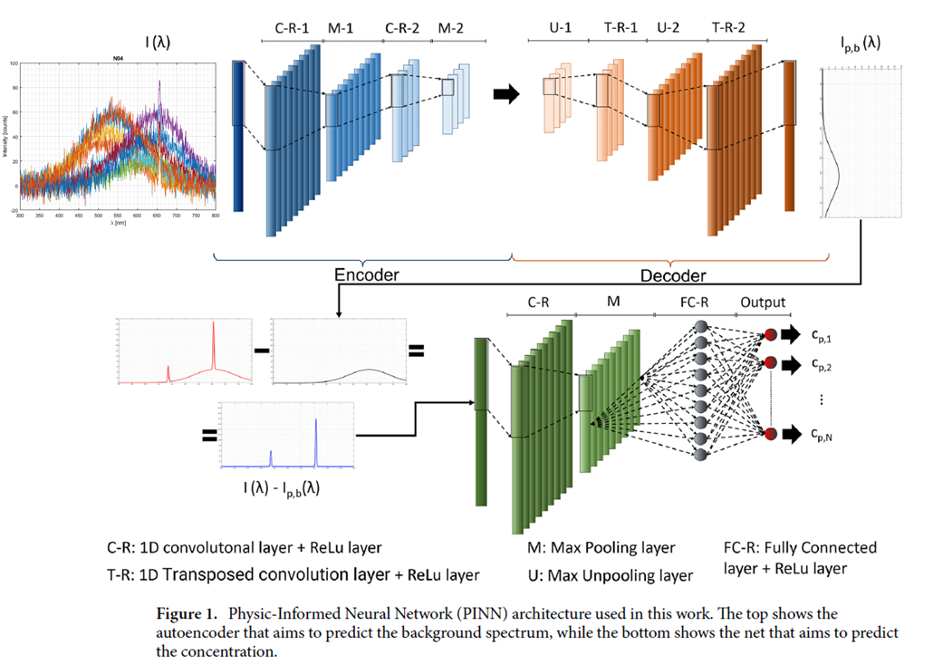
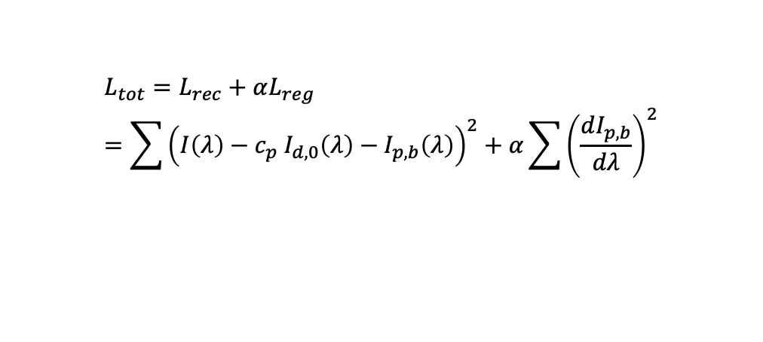
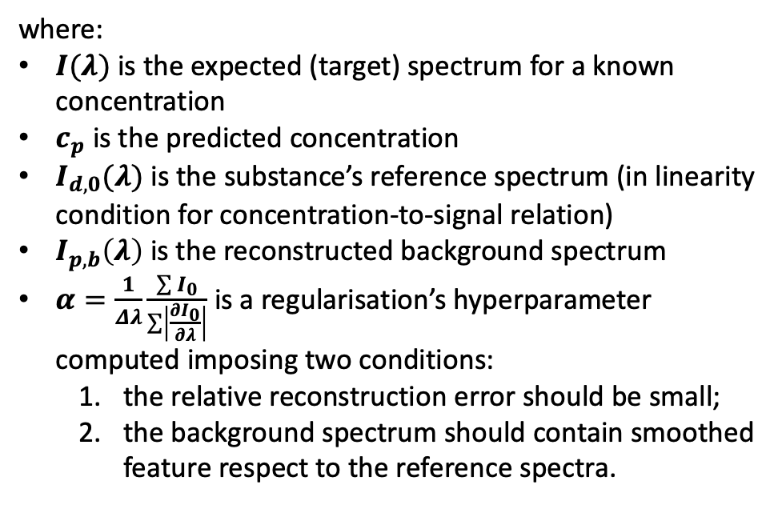
Unsupervised Calibration for Classification with PINN
– Loss function and PINN for Linearity Conditions
Signal-Concentration Linearity Condition
Loss Function:
$$L_{tot}=L_{rec}+αL_{reg}=\sum{{\left(I\left(λ\right)−c_{p} I_{d,0}\left(λ\right)−I_{p,b}\left(λ\right)\right)}^{2}}+α\sum{{\left(\frac{dI_{p,b}}{dλ}\right)}^{2}}$$
Reconstruction Error
Regularisation Term
where:
$I(λ)$ is the expected (target) spectrum for a known concentration
$c_{p}$ is the predicted concentration
$I_{d,0}(λ)$ is the substance’s reference spectrum (in linearity condition for concentration-to-signal relation)
$I_{p,b}\left(λ\right)$ is the reconstructed background spectrum
$α=\frac{1}{Δλ}\frac{\sum{I_{0}}}{\sum{\left|\frac{∂I_{0}}{∂λ}\right|}}$ is a regularisation’s hyperparameter computed imposing two conditions:
  the relative reconstruction error should be small;
  the background spectrum should contain smoothed feature respect to the reference spectra.

Slide 22
Unsupervised Calibration for Classification with PINN
– Test and Results
Phase01: Linear Conditions and/or in Single-Classes Samples’ Conditions

Slide 23
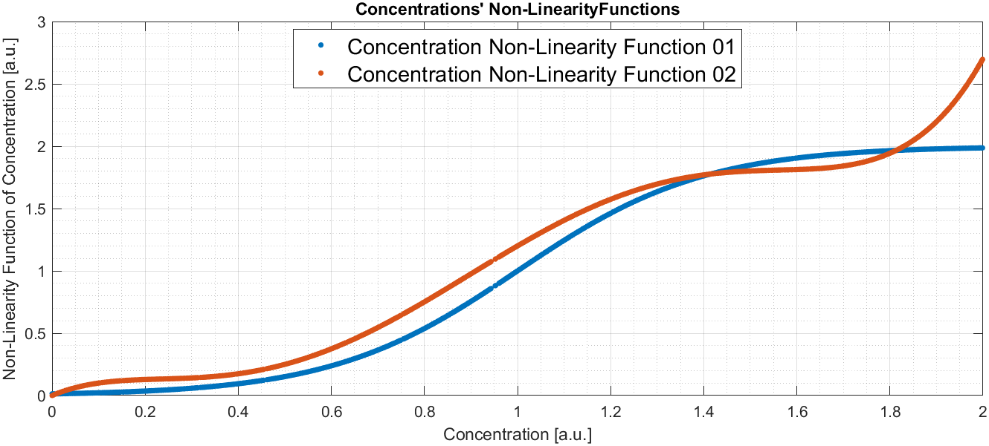
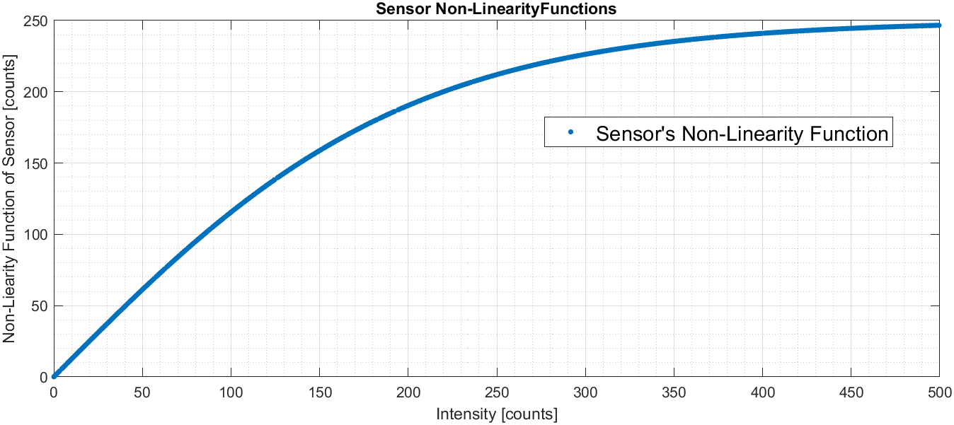
Unsupervised Calibration for Classification with PINN
– Non-Linearity Functions for Simulations
Two consecutive approaches:
Numerical approach: three different database of synthetic spectra has been simulated thinking about a Multi-Classes samples, with 4 different agents. Three cases of non-linearity phenomena has been tested:
  Non-Linearity phenomena absence;
  Non-Linearity phenomena on the concentration-to-signal relation (two non-linearity function has been supposed for each couple of agents: a and c, b and d;
  Non-Linearity phenomenon for the sensor behaviour has been simulated, as a typical saturation trend for the sensor response.

Slide 24
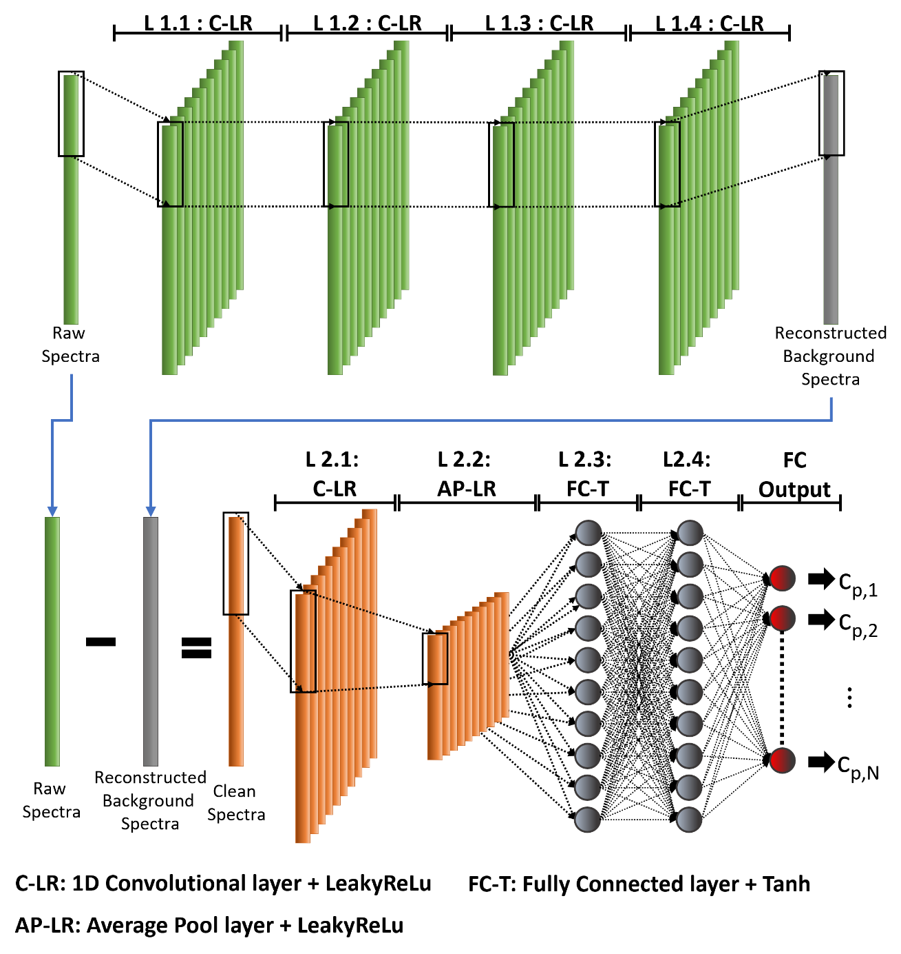

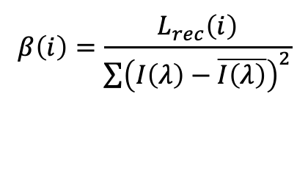
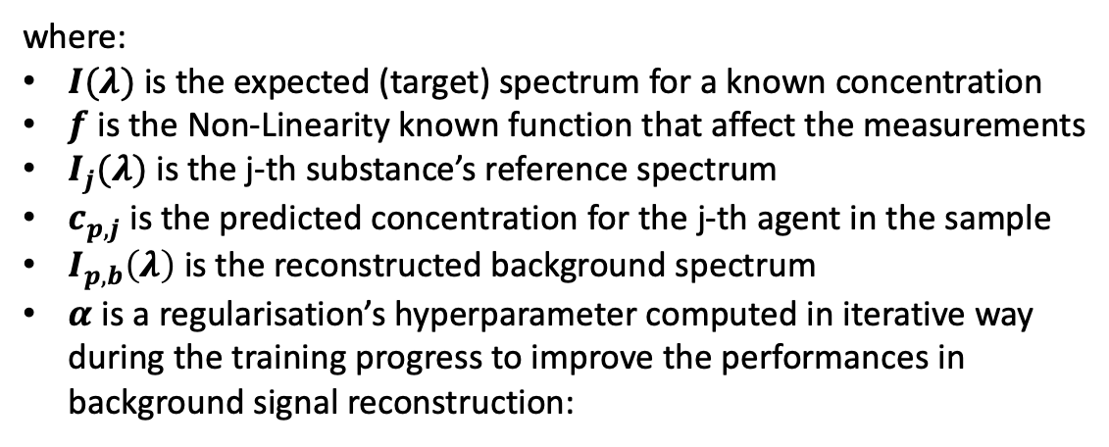
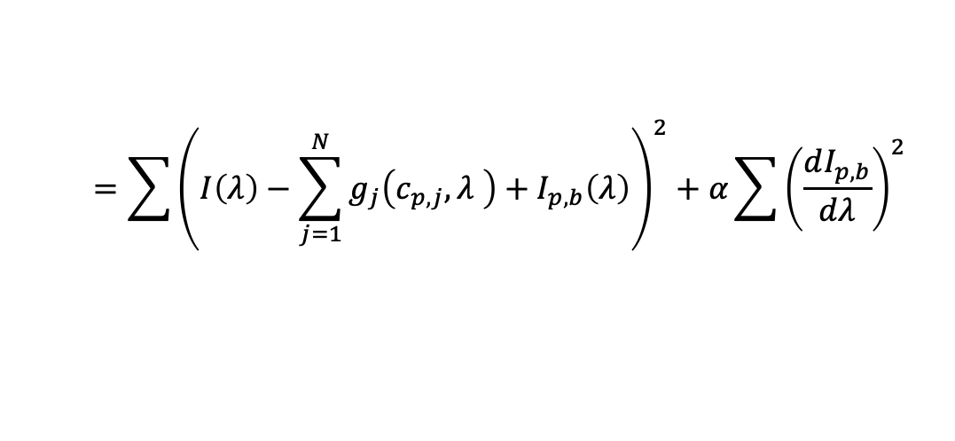

Unsupervised Calibration for Classification with PINN
– Loss function and PINN for Intrinsic Non-Linearity Conditions
Signal-Concentration
$L_{tot,NL,MC}=L_{Rec}+{αL}_{Reg}$ =
$$=\sum{{\left(I\left(λ\right)−\sum_{j=1}^{N}{g_{j}\left(c_{p,j},λ \right)+I_{p,b}\left(λ\right)}\right)}^{2}}+α\sum{{\left(\frac{dI_{p,b}}{dλ}\right)}^{2}}$$
Reconstruction Error
Regularisation Term
where:
$I(λ)$ is the expected (target) spectrum for a known concentration
$f$ is the Non-Linearity known function that affect the measurements
$I_{j}(λ)$ is the j-th substance’s reference spectrum
$c_{p,j}$ is the predicted concentration for the j-th agent in the sample
$I_{p,b}\left(λ\right)$ is the reconstructed background spectrum
$α$ is a regularisation’s hyperparameter computed in iterative way during the training progress to improve the performances in background signal reconstruction:
$$β\left(i\right)=\frac{L_{rec}\left(i\right)}{\sum{{\left(I\left(λ\right)−\overline{I\left(λ\right)}\right)}^{2}}}$$
$$α\left(i\right)=max(20∗\exp^{−8.5∗β},ε)$$

Slide 25
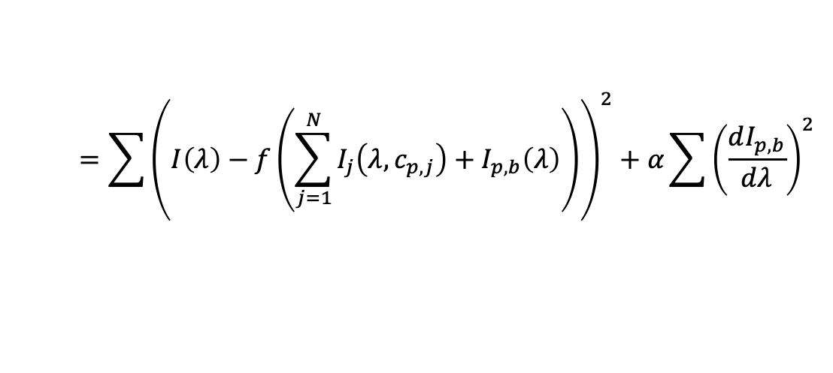
Unsupervised Calibration for Classification with PINN
– Loss function and PINN for Extrinsic Non-Linearity Conditions
Sensor Non-Linearity Condition
$L_{tot,NL,MC}=L_{Rec}+{αL}_{Reg}$ =
$$=\sum{{\left(I\left(λ\right)−f\left(\sum_{j=1}^{N}{I_{j}\left(λ,c_{p,j}\right)+I_{p,b}\left(λ\right)}\right)\right)}^{2}}+α\sum{{\left(\frac{dI_{p,b}}{dλ}\right)}^{2}}$$
Reconstruction Error
Regularisation Term
where:
$I(λ)$ is the expected (target) spectrum for a known concentration
$f$ is the Non-Linearity known function that affect the measurements
$I_{j}(λ)$ is the j-th substance’s reference spectrum
$c_{p,j}$ is the predicted concentration for the j-th agent in the sample
$I_{p,b}\left(λ\right)$ is the reconstructed background spectrum
$α$ is a regularisation’s hyperparameter computed in iterative way during the training progress to improve the performances in background signal reconstruction:
$$β\left(i\right)=\frac{L_{rec}\left(i\right)}{\sum{{\left(I\left(λ\right)−\overline{I\left(λ\right)}\right)}^{2}}}$$
$$α\left(i\right)=max(20∗\exp^{−8.5∗β},ε)$$

Slide 26
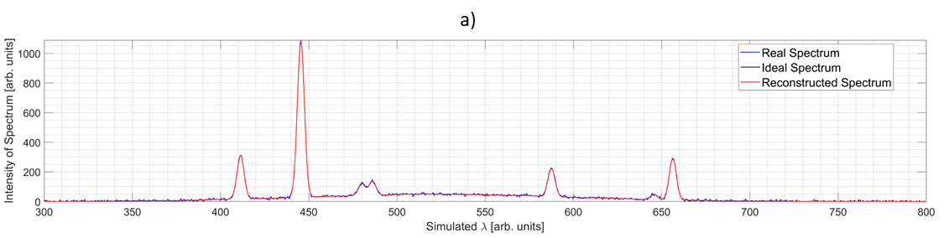
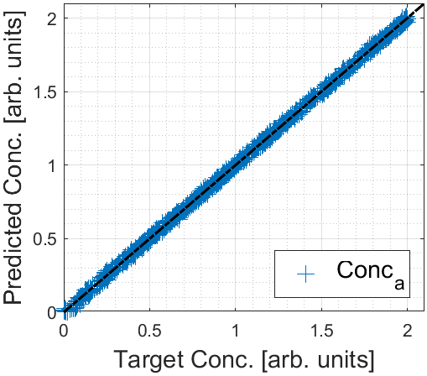
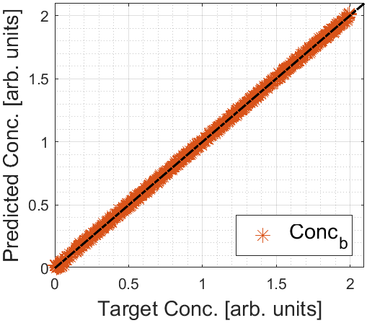
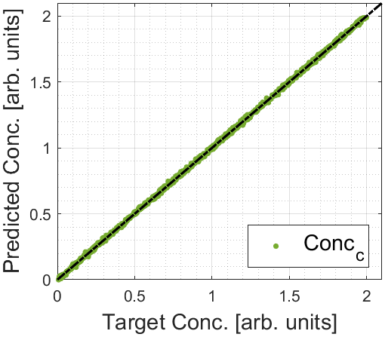

Unsupervised Calibration for Classification with PINN
– Test and Results
Phases02: Non-Linearity Conditions and/or in Multi-Classes Samples’ Conditions
Numerical Tests
Non-Linearity Absence
Agent A
Agent B
Agent C
Agent D

Slide 27
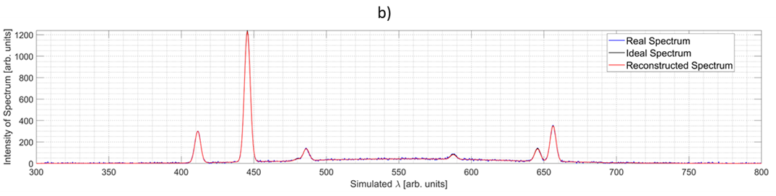





Unsupervised Calibration for Classification with PINN
– Test and Results
Phases02: Non-Linearity Conditions and/or in Multi-Classes Samples’ Conditions
Numerical Tests
Concentration Non-Linearity
Agent A
Agent B
Agent C
Agent D

Slide 28


Unsupervised Calibration for Classification with PINN
– Test and Results
Phases02: Non-Linearity Conditions and/or in Multi-Classes Samples’ Conditions
Numerical Tests
Sensor
Non-Linearity
Agent A
Agent B
Agent C
Agent D

Slide 29




Deep-Learning Techniques for Reconstructing Chemical Dispersion Maps from Point Sensors – Introduction
Standard Approach (in Emergencies’ Context):
ALOHA
(US Environmental
Protection Agency)
Based on Gaussian
Dispersion model
The measurement obtained may not be accurate for the characteristics of the Sensor Grid.
Is it possible to reconstruct the dispersion map of a chemical substances in the environment stating by the signals of point sensors in combination with the weather conditions?
Linear Interpolation
$$C_{x_{m_{1}},y_{m_{1}}}=C_{B}+\frac{\sqrt{{\left(x_{m_{1}}−x_{B}\right)}^{2}+{\left(y_{m_{1}}−y_{B}\right)}^{2}}}{\sqrt{{\left(x_{A}−x_{B}\right)}^{2}+{\left(y_{A}−y_{B}\right)}^{2}}}\left(C_{A}−C_{B}\right)$$

Slide 30


Deep-Learning Techniques for Reconstructing Chemical Dispersion Maps from Point Sensors – Introduction
Gas Dispersion Mapping
GDM

Slide 31







Deep-Learning Techniques for Reconstructing Chemical Dispersion Maps from Point Sensors – Data Simulation Model
Gaussian Dispersion Model:
$$C=\frac{Q}{2 π u{ σ}_{y} σ_{z}}\exp\left(−\frac{1}{2}\frac{y^{2}}{σ_{y}^{2}}\right)\left\{\exp\left[−\frac{1}{2}\frac{{\left(z−h\right)}^{2}}{σ_{z}^{2}}\right]+\exp\left[−\frac{1}{2}\frac{{\left(z−h\right)}^{2}}{σ_{z}^{2}}\right]\right\}$$
Gids’ Altitudes | Parametric study of Sensors per Layer
2 m | From 3x3 to 12x12
20 m | From 3x3 to 12x12
50 m | From 3x3 to 12x12
where:
$C$ is the simulated concentration (Norm. Log₁₀)
$u$ is the wind velocity $(m∗s^{−1})$
$σ_{y}$ e $σ_{z}$ are respectively the dispersion parameters in the horizontal and vertical directions, calculated with :
  Pasquill e Gifford Parameters
  Briggs Parameters
Open Rural Field
Cond.: Day (Varying ISR)
Random Coordinate for Origin Release Point
Plume Dispersion Map Simulation (Gaussian Plume Dispersion Model)
Sampling of concentration values by the hypothetical Sensors’ Grid
Random Emission Rate ($Q$)
Random Wind Speed and Direction

Slide 32



Deep-Learning Techniques for Reconstructing Chemical Dispersion Maps from Point Sensors – Parametric Study of DCNN Reconstruction
Grids’ Parametric Tests:
Different types of grids were simulated in parametric way, testing different level of resolution for the local measurements
Each grids were tested in each ISR Condition of Day of model:
  Strong
  Moderate
  Slight
Deep Learning Reconstruction Approach – De-Convolutional Neural Network:
Normally this type of Neural Network (NN) has been used inn problem of image reconstruction.
The Training process used was a Supervised approach, generating the training/validation dataset and test dataset for each condition of parametric study.

Slide 33


4.3.1 Deep-Learning Techniques for Reconstructing Chemical Dispersion Maps from Point Sensors – Results

Slide 34

Deep-Learning Techniques for Reconstructing Chemical Dispersion Maps from Point Sensors – Results
The proposed DCNN-based approach shows promise in reconstructing high-resolution dispersion maps in a average time of 0.00978 sec.
Numerical testing demonstrated its effectiveness, achieving over 90% performance even with a low number of sensors (48).

Slide 35


Deep-Learning Techniques for Reconstructing Chemical Dispersion Maps from Point Sensors – Neural Network

Slide 36

Deep-Learning Techniques for Reconstructing Chemical Dispersion Maps from Point Sensors – Neural Network

Slide 37



5.0 Variational Auto-Encoders for Spectrum De-Noising and Radiological and Nuclear Sources Identification – Introduction
Radiological and Nuclear threats:
In a radiological sources’ dispersion scenario a priority point is the possibility of identifying or understanding how many radiological sources are at the source of a contamination.
The analysis of the spectra collected by the instrumentation, however, often requires pre-processing steps to try to identify one or more emission sources.
Clustering
Raw Data
Classification

Slide 38



5.1 Variational Auto-Encoders for Spectrum De-Noising and Radiological and Nuclear Sources Identification – Data Simulation
Numerical Approach for Data Simulation:
Yamamoto (2013) reports how some commonly used radiological sources may have a chance of being used in Radiological Dispersion Devices (RDD).
The reference emission energy signals (IAEA Database) of seven probable RDD’s sources were used to simulate the acquired energy spectra by varying:
  Radiological sources’ masses
  Background signal
  Noise signal

Slide 39




5.2 Variational Auto-Encoders for Spectrum De-Noising and Radiological and Nuclear Sources Identification – The VAE Perspectives
Variational Auto-Encoders Perspectives:
Data reduction and projection;
De-Noising;
Raw Data
DeNoising Analysis
Unlabelled Training
Dataset
Clustering Analysis
Labelled Training
Dataset
Classification Analysis

Slide 40




5.3 Variational Auto-Encoders for Spectrum De-Noising and Radiological and Nuclear Sources Identification – Results
RAW Simulated Data
VAE’s Processed Data with Classification
VAE-NN
De-Noising Results: the R² show good performances for the signals’ denoising process by the VAE
Clustering Results: the Kmeans applications on the projected data’s codes indicate the expected number of clusters especially using two or more than two codes
Classification Results: using a Linear Discriminant Analysis the classification is totally correct independently by the used number of codes (800 in training and 200 in test per source)
Two Codes
Three Codes

Slide 41





5.3 Variational Auto-Encoders for Spectrum De-Noising and Radiological and Nuclear Sources Identification – Results
De-Noising Results
Kmeans Clustering Analysis Results
LDA Classification Analysis Results

