Slide 1



Combining Physics and Data driven methods through Physics-Informed Neural Networks in Nuclear Fusion: Application to Integrated Multi-Diagnostic Reconstruction of the Plasma State in Tokamaks
Novella Rutigliano
Internal Supervisor: Prof. Pasquale Gaudio
External Supervisor: Dr. Andrea Murari (CNR-ISTP, Consorzio RFX)
21/10/2026

Slide 2
Outline
Context and Introduction to the physical problem
Methodology presentation and development
Method verification through a synthetic scenario
Method benchmarking with standard equilibrium reconstruction codes
Method validation with experimental data from JET (Joint European Torus)
Conclusions

Slide 3
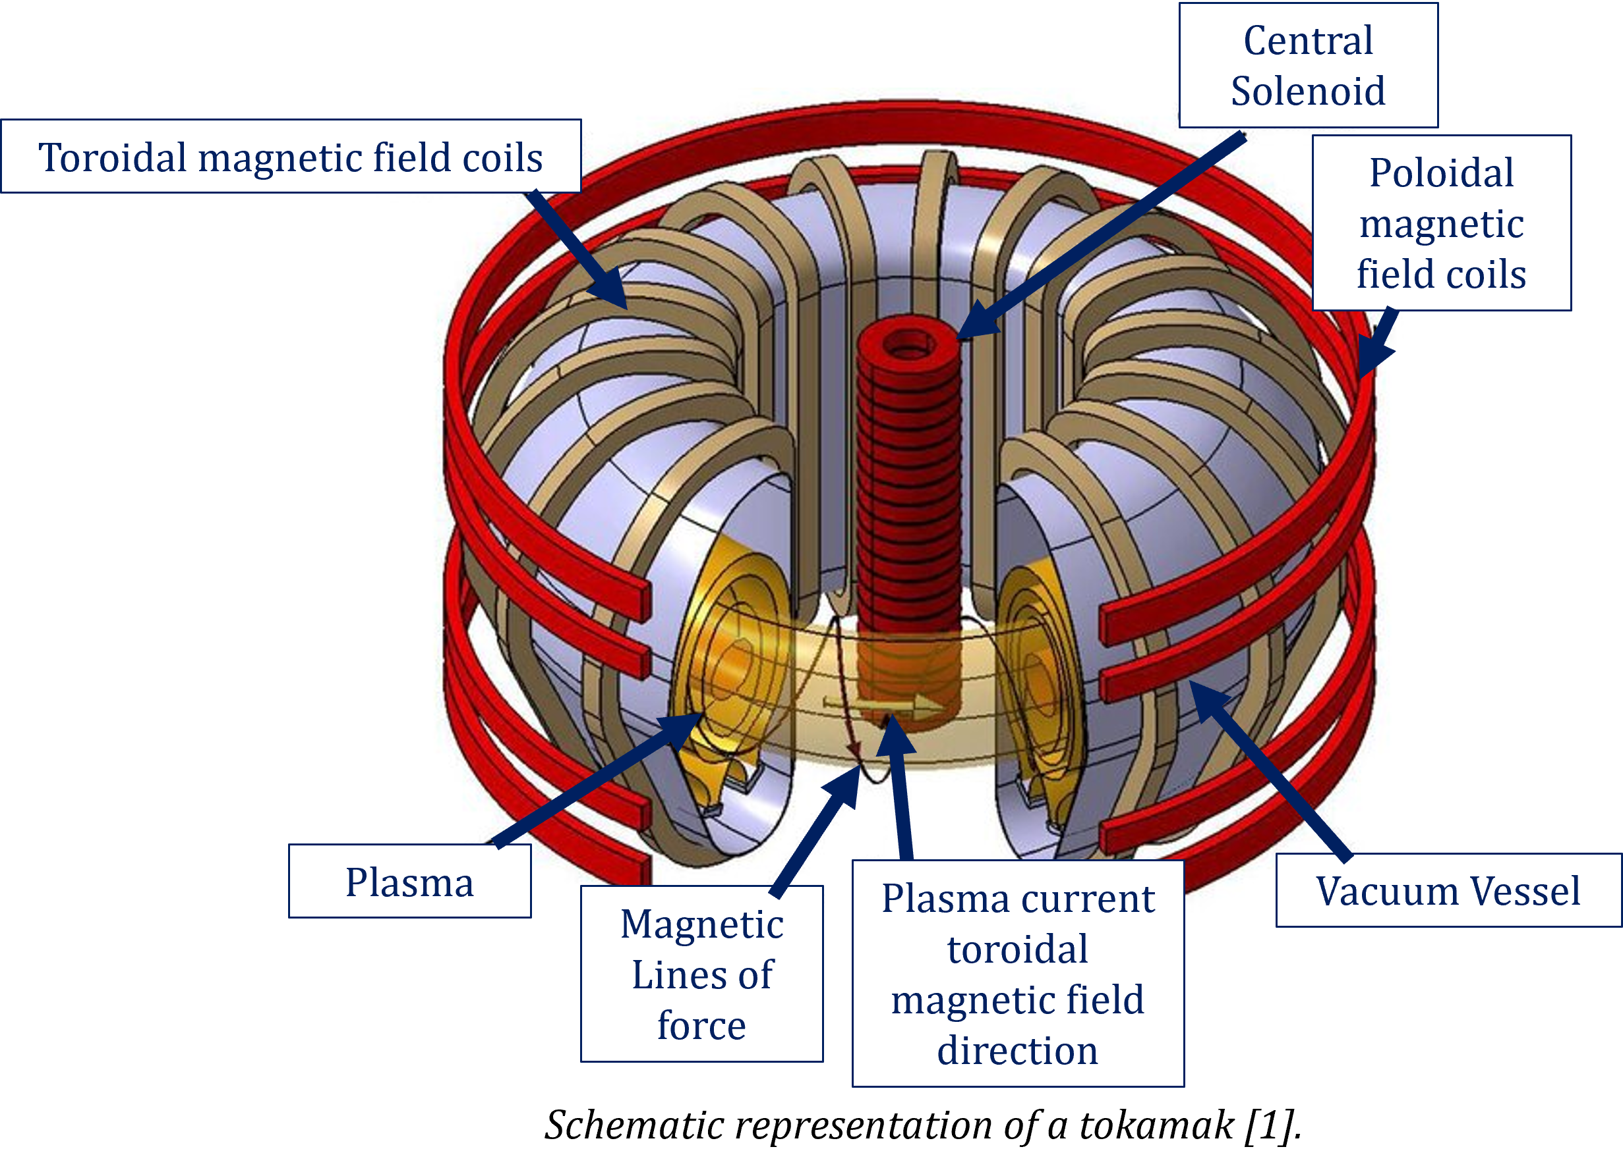
Tokamaks
One of the most challenging physics and engineering systems on Earth:
Multi-physics
Multi-scale
Materials
Electronics
Mechanics and Thermomechanics
…
One of the harshest environment on Earth due to high temperatures, neutron irradiation, difficulty to direct measure quantities.
Schematic representation of a tokamak [1].
Necessity to reconstruct quantities when direct measurements are not possible.

Slide 4
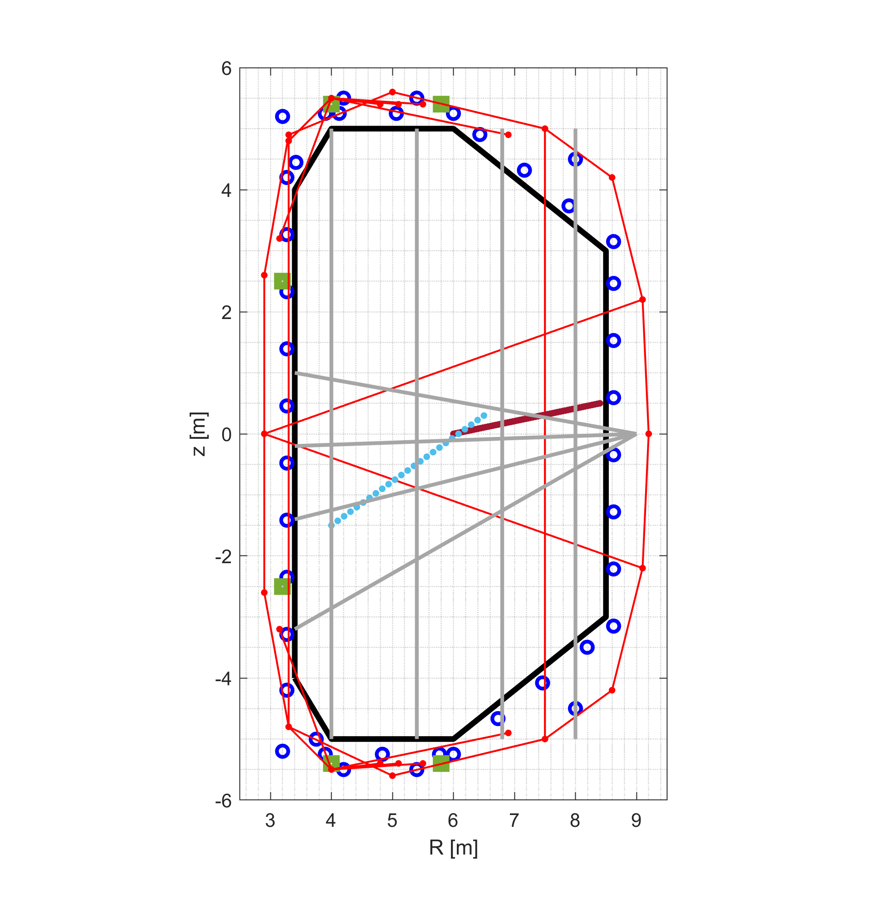
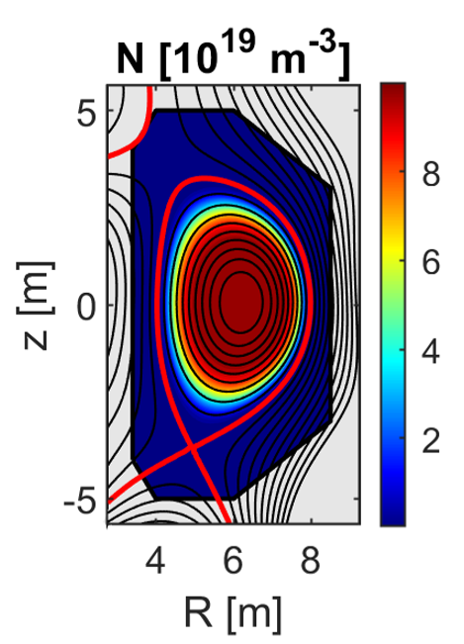
Aim: plasma state reconstruction
Equilibrium reconstruction in tokamaks is an inverse problem: it aims to infer plasma quantities from measurements.
Reconstructing the plasma state is fundamental
This thesis’ context
Control
Physics unknowns discovery
Real-time requirements
Accuracy, flexibility and modularity requirements
Diagnostics schematic representation
Inferred plasma density

Slide 5
Aim: multi-diagnostics plasma state reconstruction with Physics-Informed Neural Networks (PINNs)
The aim is to develop a accurate, flexible, and modular tool for plasma state reconstruction in the equilibrium condition to support post-pulse analyses for physics interpretation and knowledge discovery (to aid engineering design of future machines).
Diagnostics
Increasing the amount of information (adopting a multi-diagnostics approach)
High-fidelity modelling of diagnostics
Outlier management
Physics
Removing simplifying assumptions to get to a complete model.
AND
The methodology adopted is a Physics-Informed Neural Network (PINN).

Slide 6
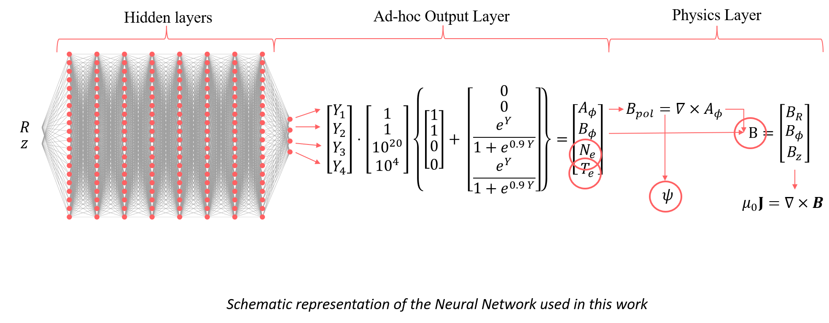
Fully-Connected Neural Network
A neural network (NN) is a mathematical model $f$ defined by several parameters $θ$ that, given the features (or inputs) $X$, returns the targets (or outputs) $Y$: $Y=f\left(θ,X\right)$
From the universal approximation theorem, we can assert that: “a sufficiently deep neural network can approximate any function”. The process to tune the parameters $θ$ is known as training.

Slide 7
Physics-Informed Neural Networks
PINNs are a deep learning methodology that combines information about the governing physical equations and measurements. (First article on PINNs is from 2019 [2])
The satisfaction of physics equations avoids the overfitting of noise or outliers (noise and outliers are not solution of the PDE). So, the algorithm can be used to “diagnose diagnostics” and cross-calibration.
They are a meshless approach (characterised by a feature called super-resolution – see backup slide) that are powerful to support the physics discovery in high-resolved zones of interest. Physics-guided extrapolation
The integration of new physical constraints or models and of new diagnostics in the model is very easy by an operational point of view.
Despite their potentialities, PINNs training requires specific training for each scenario, and significant computational time (~hours), so they are not suitable for real-time applications.
In this application, PINN is used as equations solver.

Slide 8
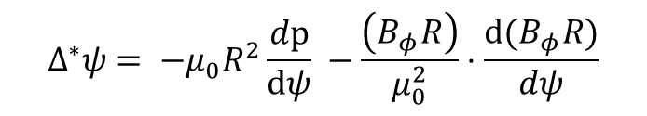
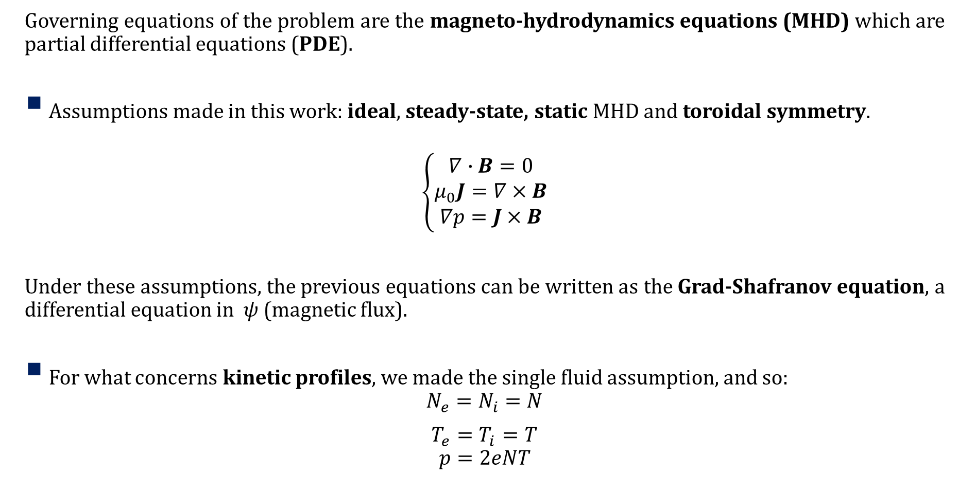


Physics…
Governing equations of the problem are the magneto-hydrodynamics equations (MHD) which are partial differential equations (PDE).
Assumptions made in this work: ideal, steady-state, static MHD and toroidal symmetry.
$$\left\{\begin{aligned}∇∙B=0 \\ μ_{0}J=∇×B \\ ∇p=J×B\end{aligned}\right.$$
Under these assumptions, the previous equations can be written as the Grad-Shafranov equation, a differential equation in $ψ$ (magnetic flux).
For what concerns kinetic profiles, we made the single fluid assumption, and so:
$$N_{e}=N_{i}=N$$
$T_{e}=T_{i}=T$
$$p=2eNT$$
$$J×B$$
plasma
$$p$$
Equilibrium equation
$$Δ^{∗}ψ= −μ_{0}R^{2}\frac{dp}{dψ} −\frac{\left(B_{φ}R\right)}{μ_{0}^{2}}⋅\frac{d(B_{φ}R)}{dψ}$$

Slide 9

… And data!
Following a multi-diagnostics approach, are data coming from different diagnostics:
Magnetic diagnostics (pick-up coils, flux loops, saddle loops – local external measurements of magnetic plasma quantities)
Thomson Scattering (internal local measurements of electron density and electron temperature)
Interferometry-Polarimetry (line-integrated internal measurements of electron density and of the state of polarisation of a probing laser beam)
Motional Stark Effect (local internal measurements of magnetic field direction based on the emission of neutral beams particles)
Pick Up Coils
Flux Loops
Saddle Loops
Thomson Scattering
Motional Stark Effect
Interferometer-
Polarimeter
z
$$φ$$
R
Schematic representation of a diagnostic set in the poloidal section

Slide 10
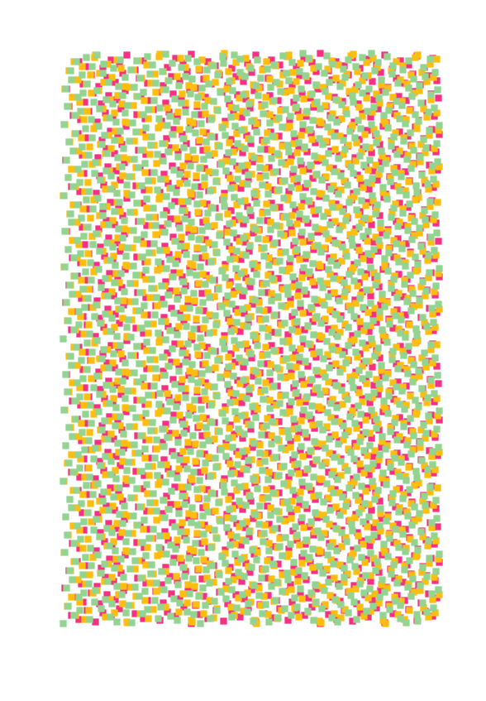
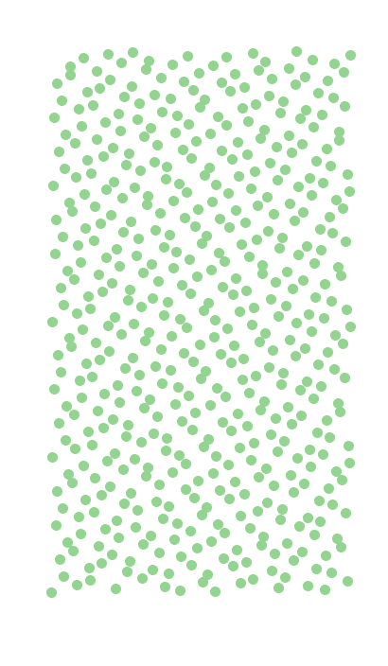
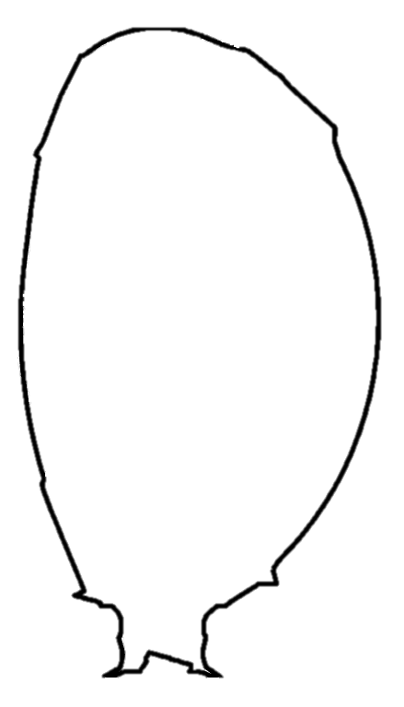
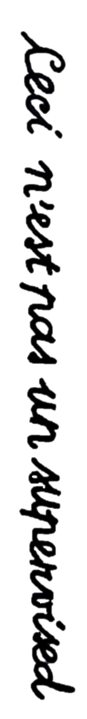
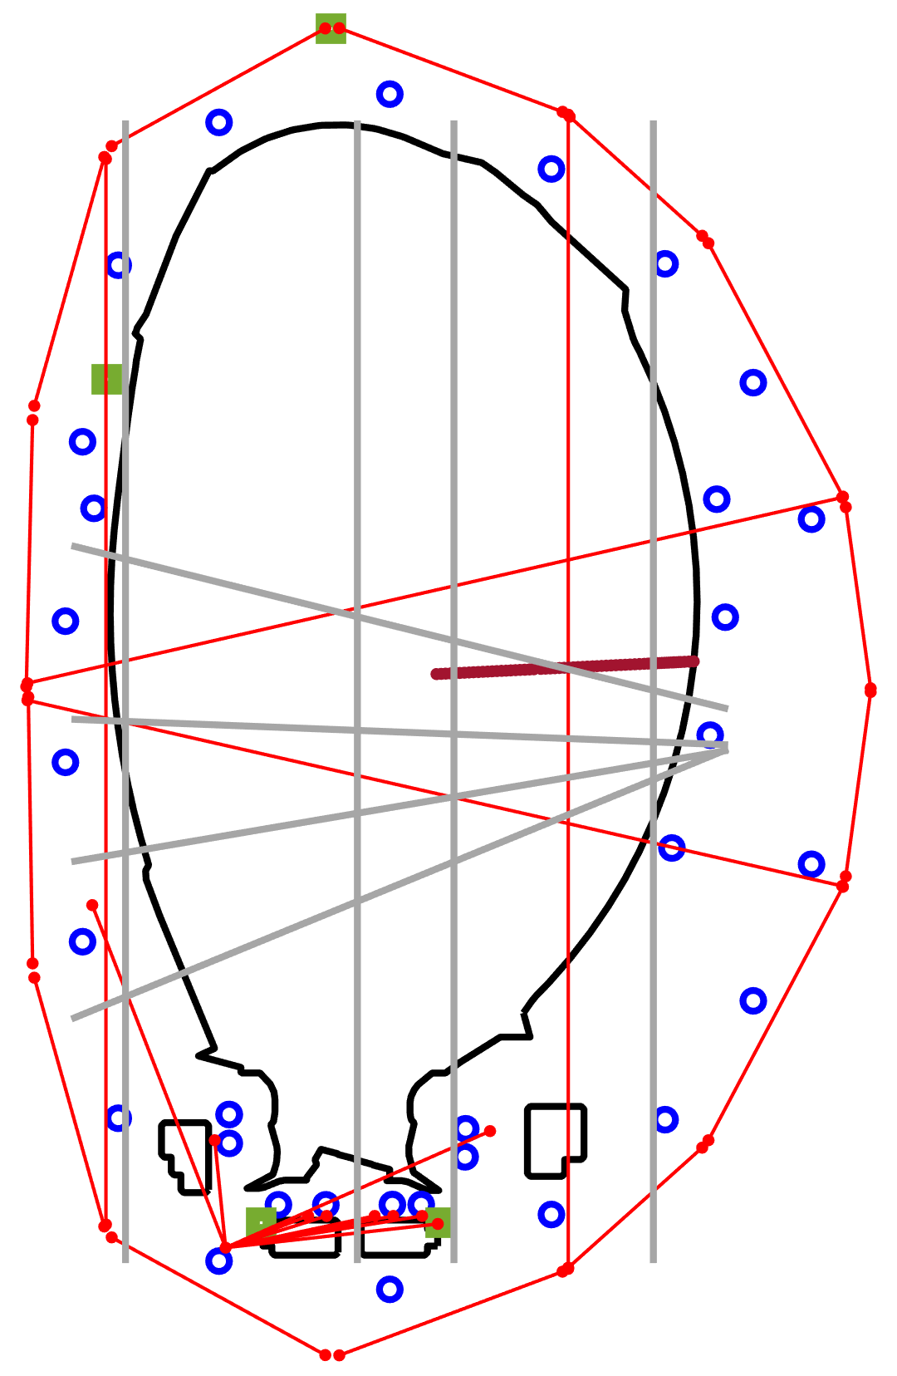

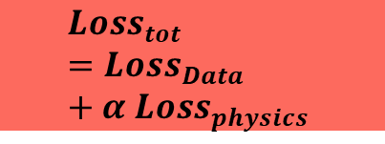



Training a Physics-Informed Neural Network
Proper modelling of diagnostics
Measurements
Collocation points
Physics equations
R
R
$$Loss_{Data}$$
Neural Network
Geometry
z
z
$$Loss_{tot}=Loss_{Data}+α Loss_{physics}$$
New mini-batch
$$Loss_{physics}$$
$θ$ update (ADAM)
Diagnostics Position (R_{i}, z_{i})
$∇_{θ}$(Loss_{tot})
iterations
Stop condition fulfilled?
NO
YES

Slide 11












Proper modelling of diagnostics: a study on the interferometer-polarimeter diagnostic
$$E_{y}$$
plasma
$$E_{y}$$
Faraday Rotation
$$E_{x}$$
$$E_{x}$$
In tokamaks, polarimetry measures two important effects of the interaction between plasma and a probing laser beam: the Faraday rotation and the Cotton-Mouton phase shift.
The propagation of these effects on the laser beam direction is non-linear. Usually the linear approximation (type-I approximation) is made to reconstruct polarimetric measurements in tokamaks.
$$E_{y}$$
$$E_{y}$$
plasma
Cotton-Mouton phase shift
$$E_{x}$$
$$E_{x}$$
$$E_{y}$$
plasma
$$E_{y}$$
$$E_{x}$$
$$E_{x}$$
In this work we used a complete Stokes formulation for polarimetric measurements and introduced also the relativistic effect for the hot plasma approximation. Formulation in Appendix A.
N. Rutigliano et al., 2025 Plasma Phys. Control. Fusion 67

Slide 12
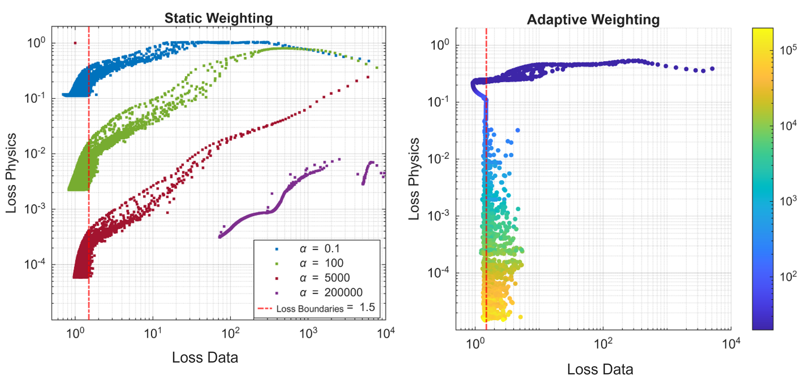

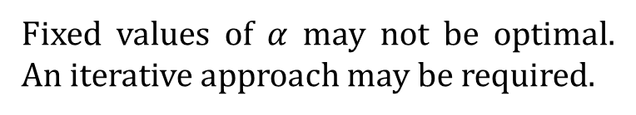
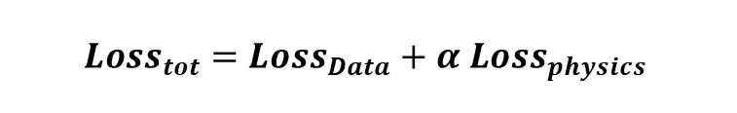
Adaptive weighting scheme: $α$ automatic updating
Balancing losses is a key aspect for PINNs’ training. In our case, we developed an adaptive weighting scheme considering the following formulation of $Loss_{boundaries}$.
$$α$$
$$Loss_{tot}=Loss_{Data}+α Loss_{physics}$$
Fixed values of $α$ may not be optimal. An iterative approach may be required.
The developed adaptive weighting scheme automatically updates α along the epochs.
Details of the mathematical formulation are in Appendix B.
Loss data vs loss physics with static weighting (left) using different values of $α$ and with adaptive weighting (right). On the right plot the colour code represents graphically the value of $α$.
N. Rutigliano et al., 2026 Eng. Res. Express 8 045217

Slide 13
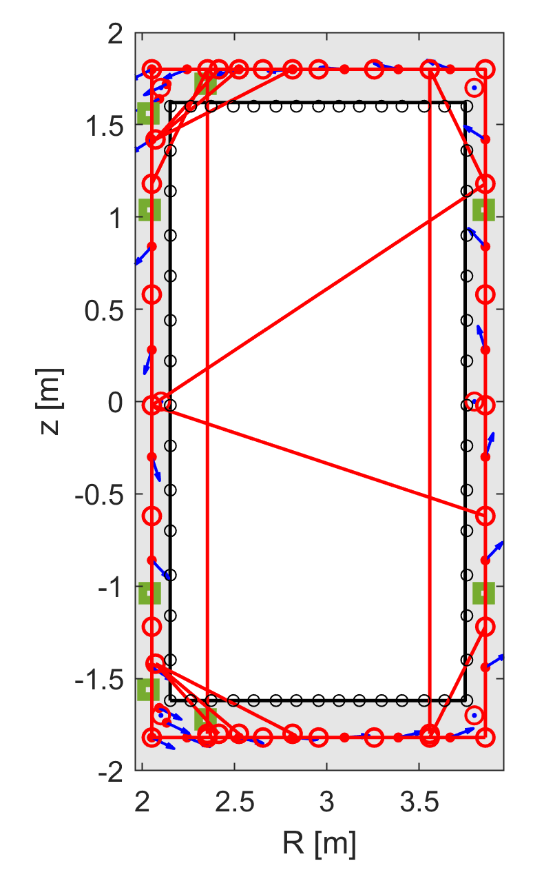
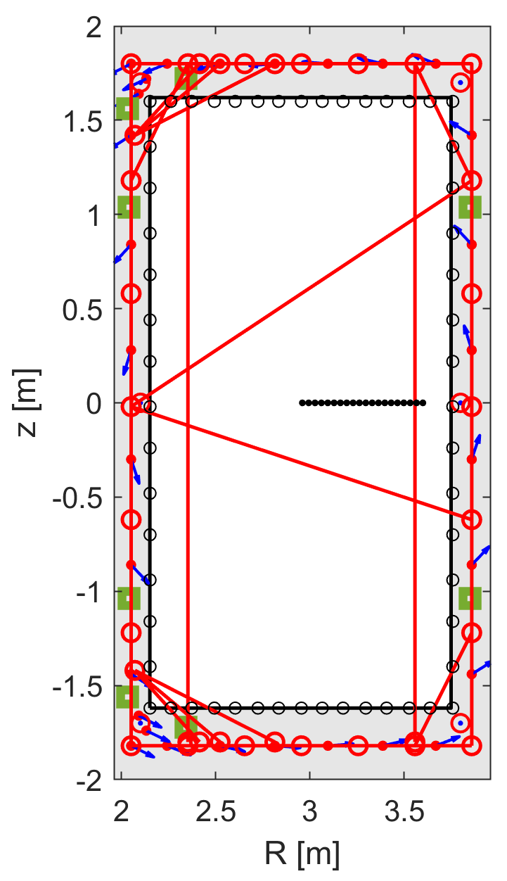
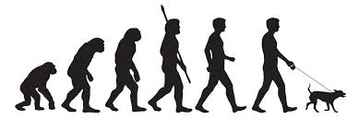
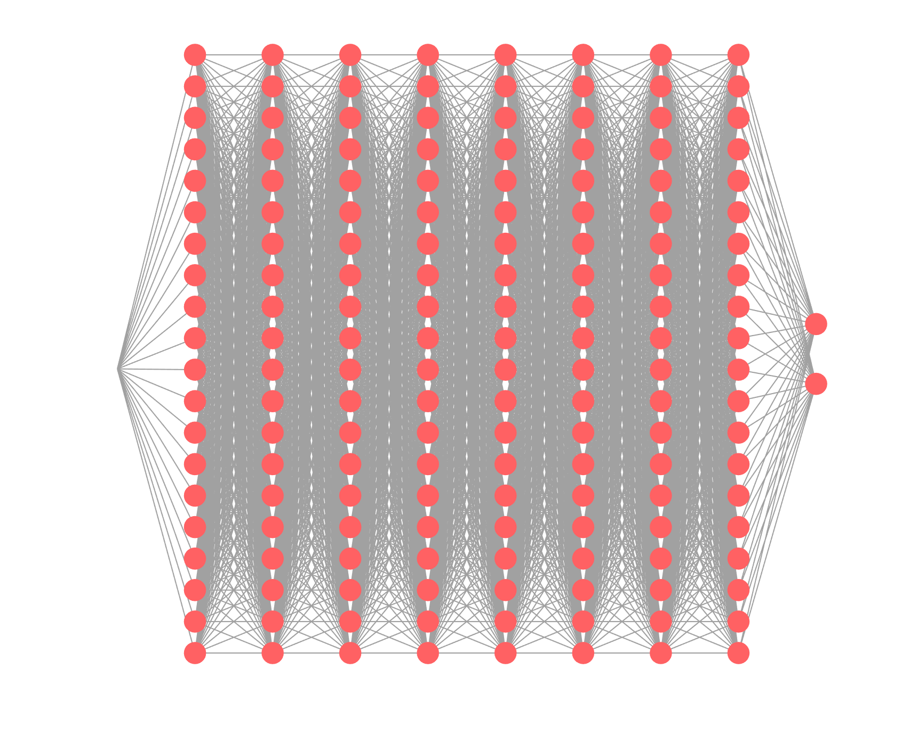
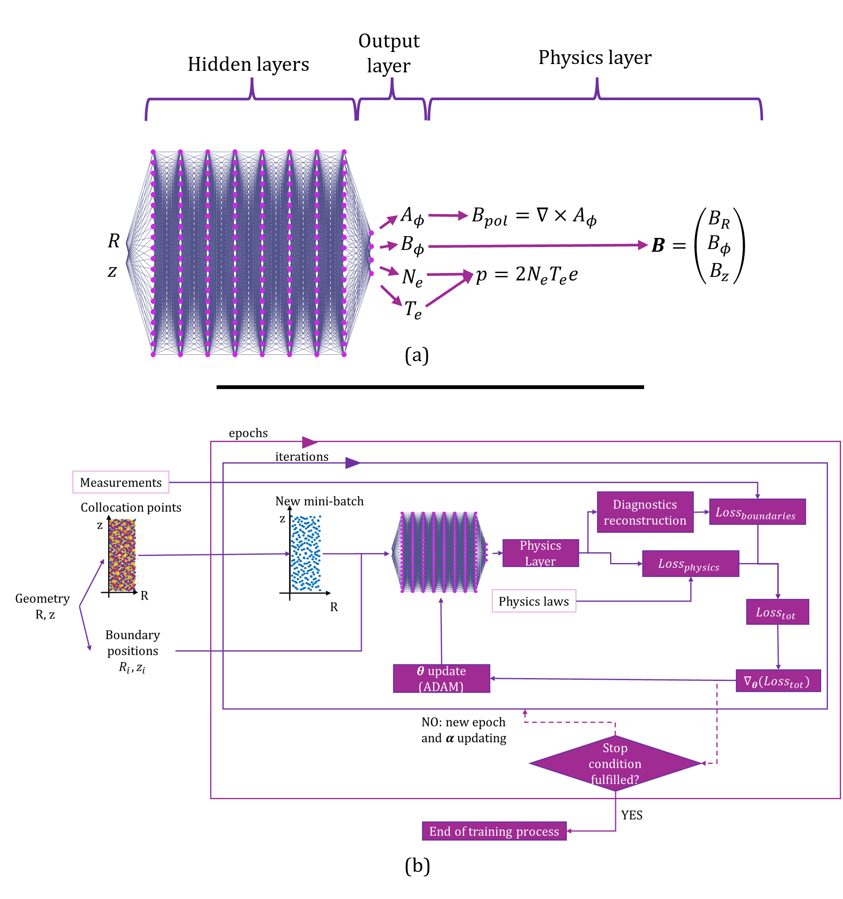
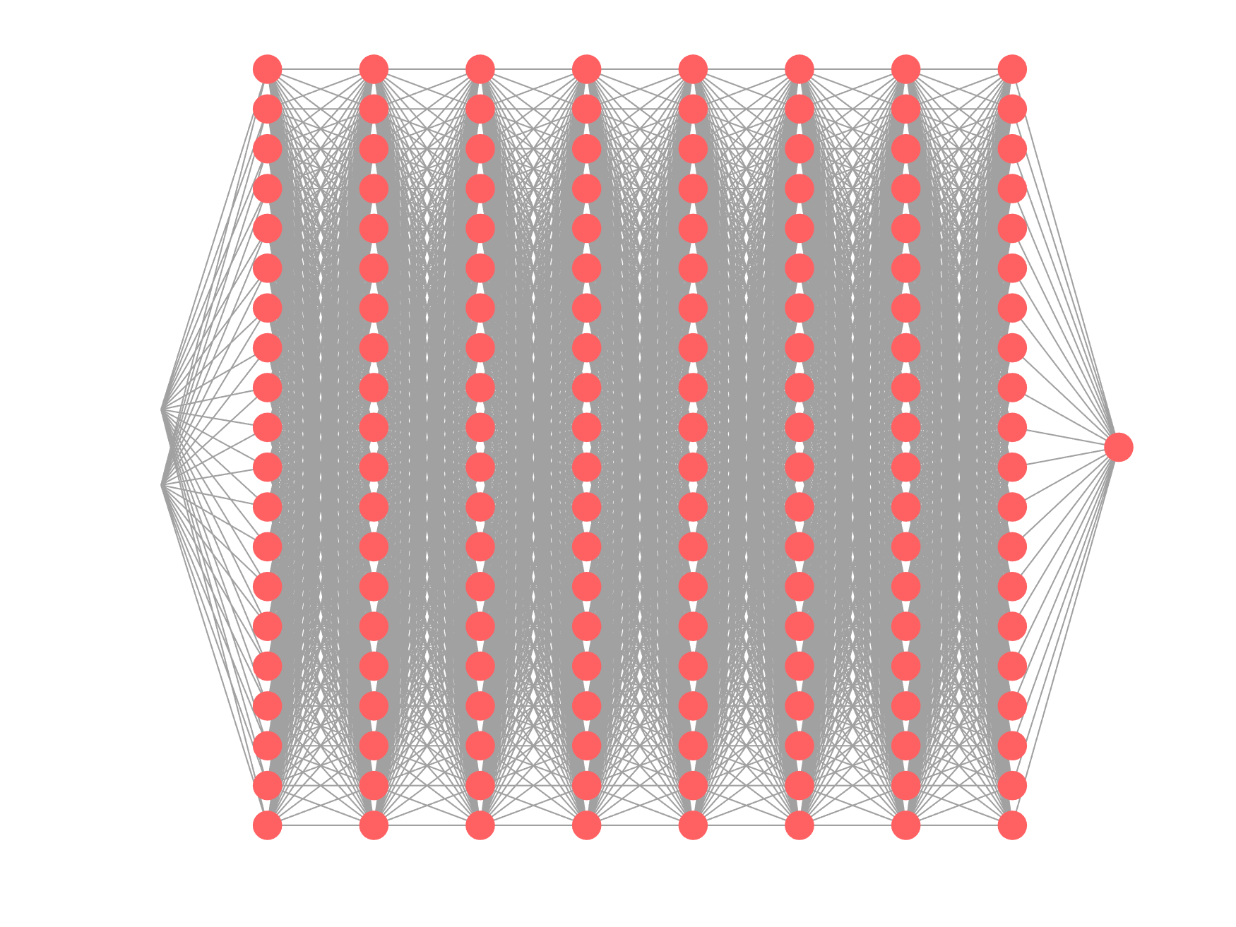
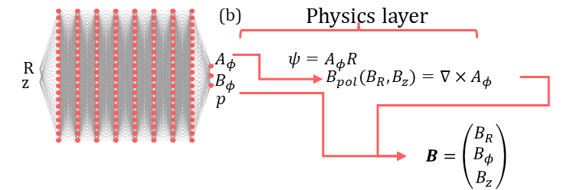
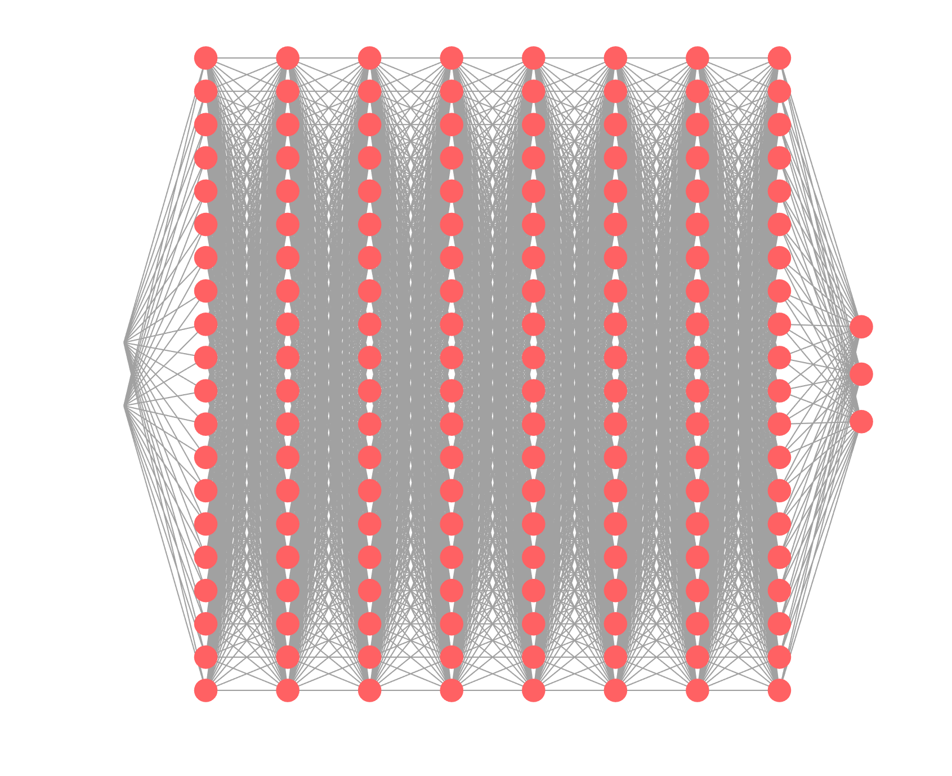






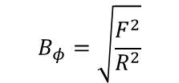

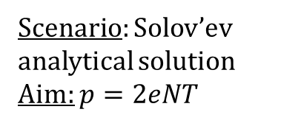

PINN Evolution and Optimisation: from the origin
Scenario: Solov’ev analytical solution
Aim: $p=2eNT$
Scenario: Solov’ev analytical solution
Aim: benchmarking the network with GS-Net [6].
(a)
Physics layer
$$B_{φ}=\sqrt{\frac{F^{2}}{R^{2}}}$$
R
$$p$$
z
$$ψ$$
$$F^{2}$$
$$B=\left(\begin{matrix}B_{R} \\ B_{φ} \\ B_{z}\end{matrix}\right)$$
$$B_{pol}(B_{R}, B_{z})=∇ψ$$
(b)
Physics layer
R
$$A_{φ}$$
$$ψ=A_{φ}R$$
z
$$B_{φ}$$
$$B_{pol}(B_{R}, B_{z})=∇×A_{φ}$$
$$p$$
$$B=\left(\begin{matrix}B_{R} \\ B_{φ} \\ B_{z}\end{matrix}\right)$$

Slide 14
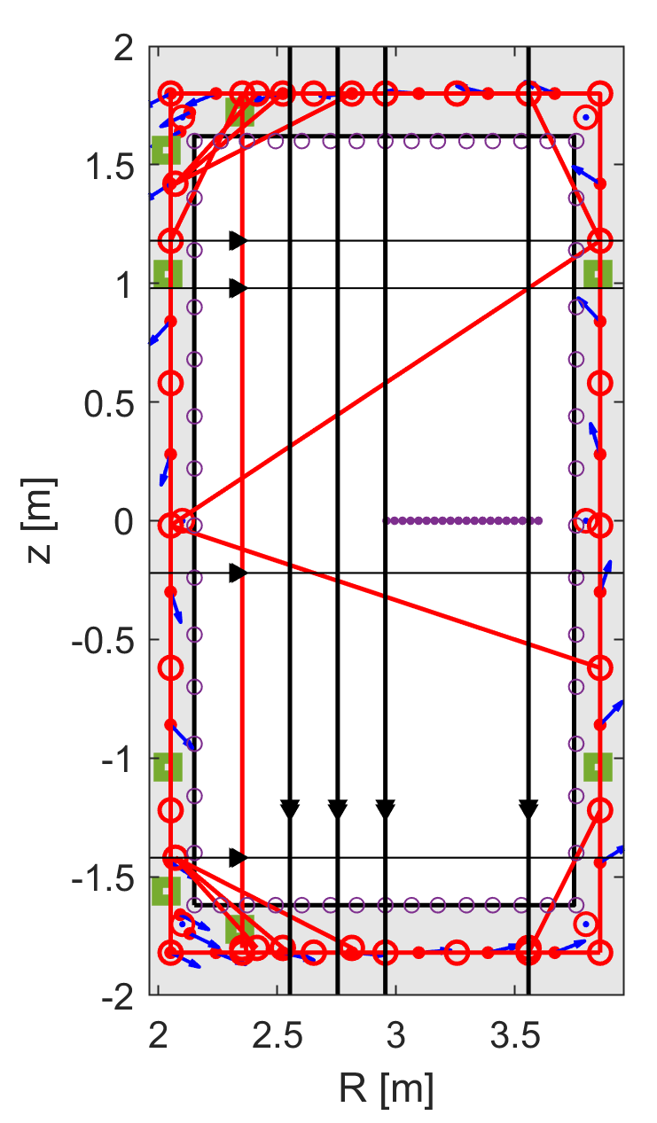

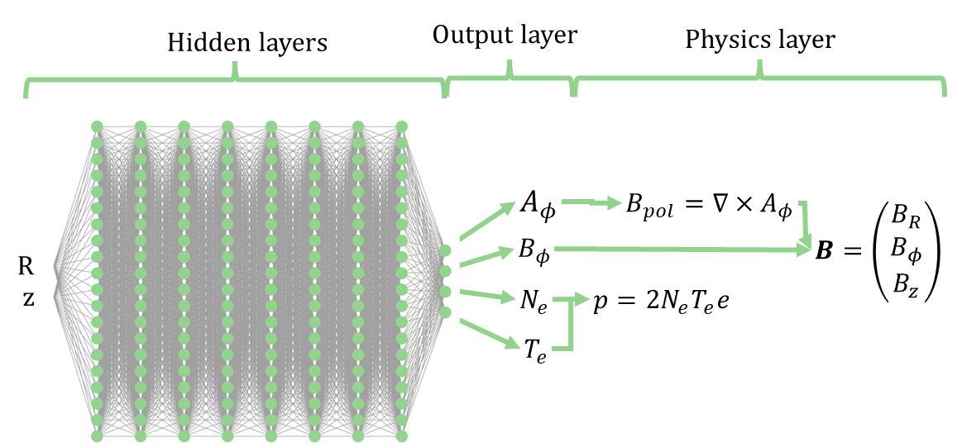
…to an optimised architecture
Scenario: Solov’ev analytical solution
Aim: adding other diagnostics
Scenario: Tokamak-like numerical solution
Aim: verification on a virtual tokamak case.
Optimised network. Applied to virtual tokamak and JET.
Optimisation concerning:
Best activation function parametric analysis
Parametric analysis on the benefits of using pre-trained network also from different plasma scenarios
Benefits of the adaptive weighting scheme
Further analyses on the comparison with a GS-Network
N. Rutigliano et al., 2026, PPCF (68)

Slide 15

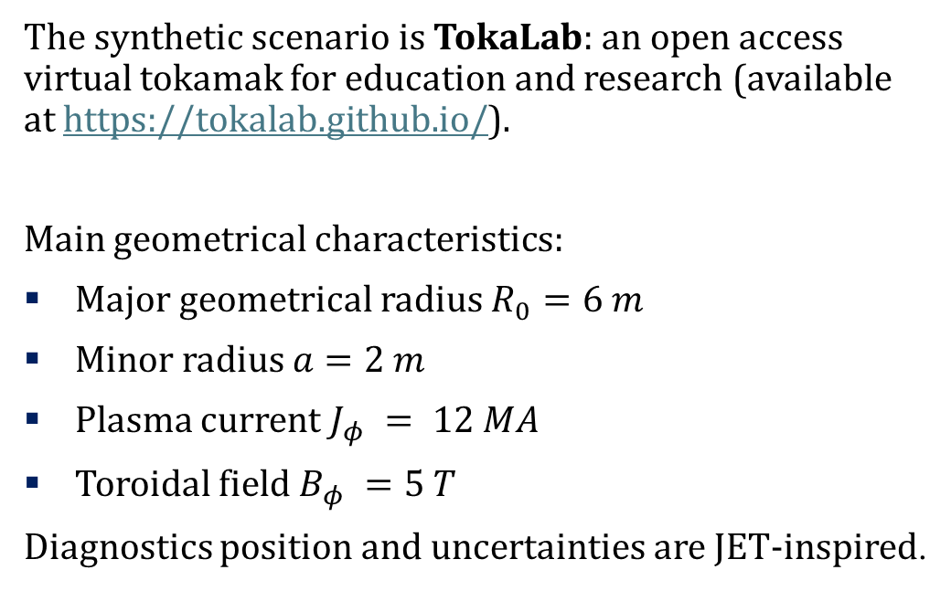
Method Verification
To verify the methodology a target for which the ground truth is known is needed. The target, in this case is a “synthetic” tokamak.
The synthetic scenario is TokaLab: an open access virtual tokamak for education and research (available at https://tokalab.github.io/).
Main geometrical characteristics:
Major geometrical radius $R_{0}=6 m$
Minor radius $a=2 m$
Plasma current $J_{φ} = 12 MA$
Toroidal field $B_{φ} =5 T$
Diagnostics position and uncertainties are JET-inspired.
Pick Up Coils
Flux Loops
Saddle Loops
Thomson Scattering
Motional Stark Effect
Interferometer-
Polarimeter
z
$$φ$$
R
TokaLab scheme for poloidal section and diagnostics

Slide 16
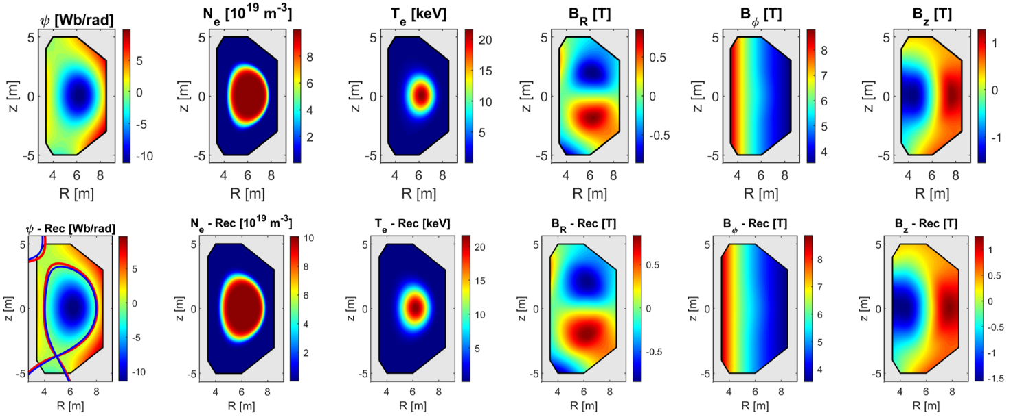
Method Verification: Reconstruction Performances
Target (TokaLab):
Target
Rec
Reconstruction (PINN):
$$99.90±0.05 \%$$ | $$99.82±0.08 \%$$ | $$99.60±0.26 \%$$ | $$99.70±0.10 \%$$ | $$\sim 100 \%$$ | $$99.82±0.08 \%$$
R²
The methodology developed is also robust (by repeating the training 10 times). Measurements noise level in this scenario 10% of measurements’ values.

Slide 17
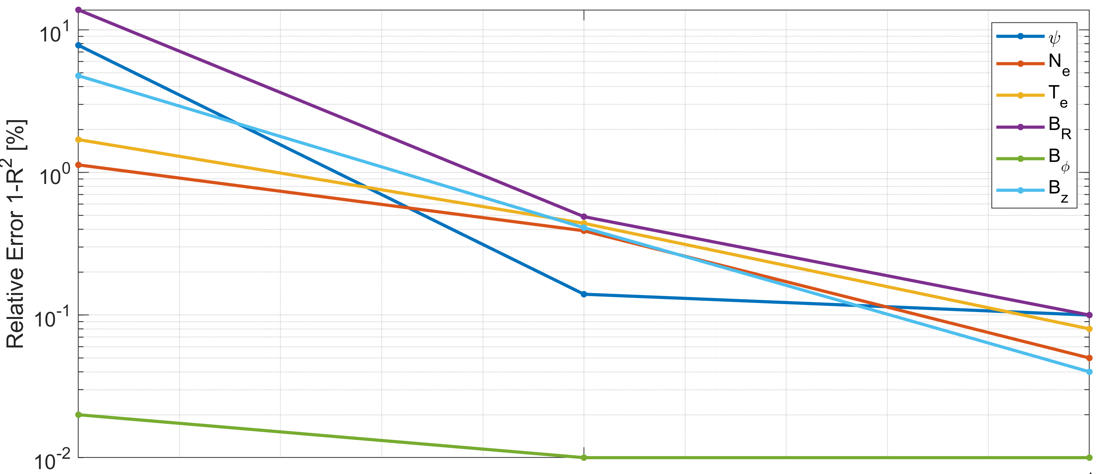
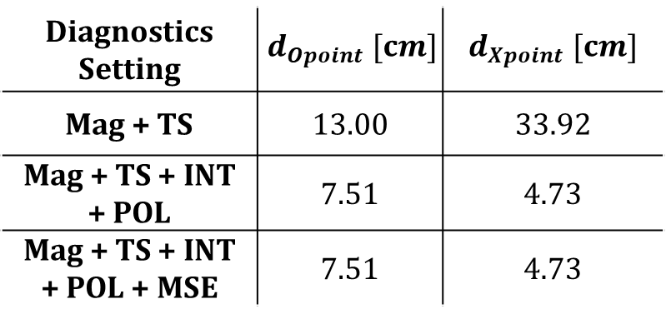
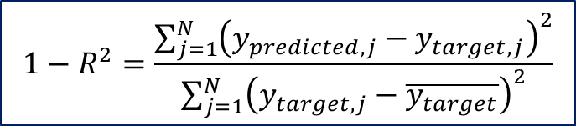
Method Verification: The importance of a multi-diagnostic approach
$$1−R^{2}=\frac{\sum_{j=1}^{N}{{\left(y_{predicted,j}−y_{target,j}\right)}^{2}}}{\sum_{j=1}^{N}{{\left(y_{target,j}−\overline{y_{target}}\right)}^{2}}}$$
Table 1. Euclidean distance between the reconstructed and target plasma centre (O) and X point (X)
Diagnostics Setting | $$d_{Opoint} [cm]$$ | $$d_{Xpoint} [cm]$$
Mag + TS | 13.00 | 33.92
Mag + TS + INT + POL | 7.51 | 4.73
Mag + TS + INT + POL + MSE | 7.51 | 4.73
Magnetics +
Thomson Scattering + Interferometer-Polarimeter +
Motional Stark Effect
Magnetics +
Thomson Scattering
Magnetics +
Thomson Scattering + Interferometer-Polarimeter
14cm
TokaLab’s mesh cells’ dimensions
9 cm

Slide 18
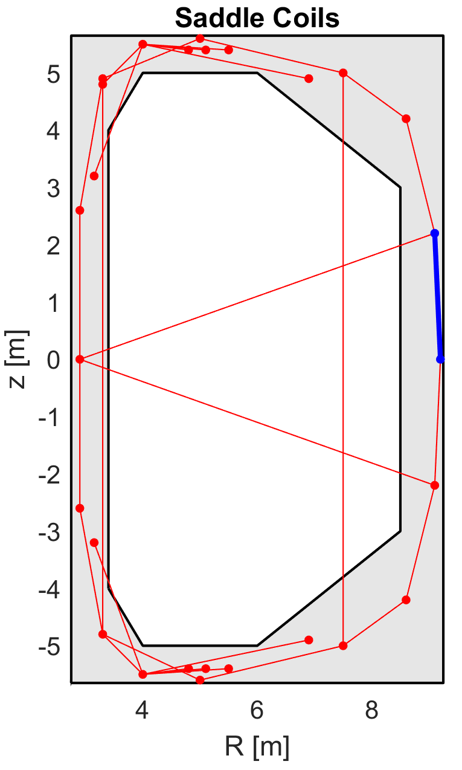
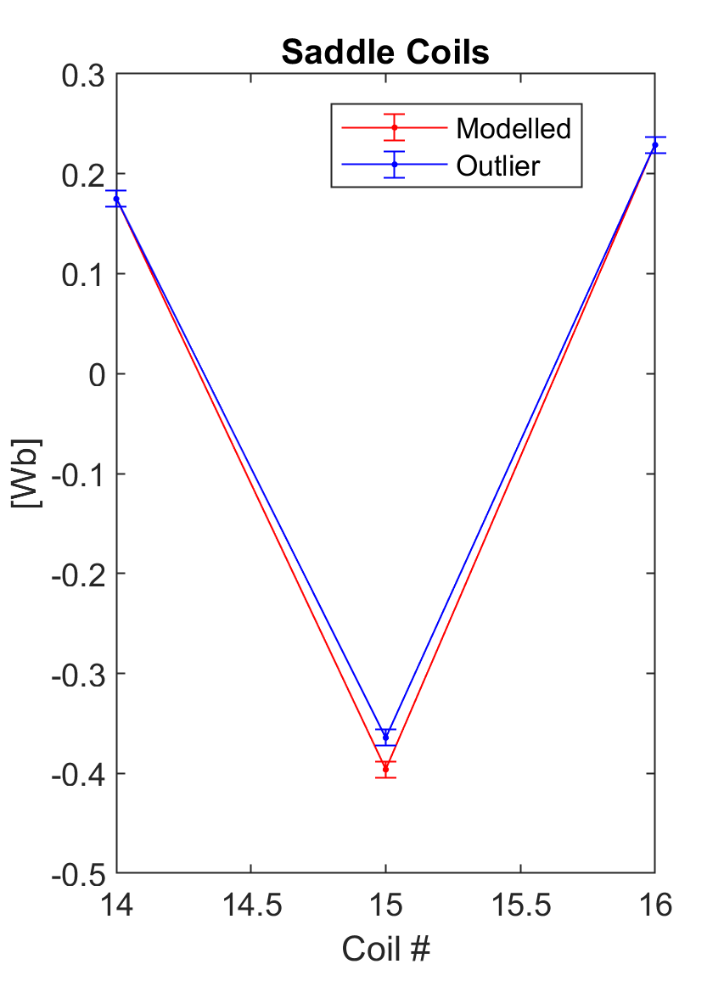
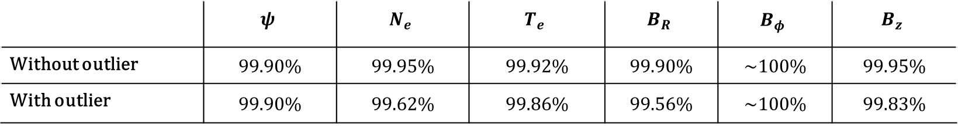

Method Verification: stability respect to unexpected outlier measurements
$$Outlier_{SL}=Modelled_{SL}+4 σ_{SL}$$
$$σ_{SL,outlier}=σ_{SL}$$
Sometimes diagnostics may be faulty resulting in outlier measurements. It could be difficult to detect them.
Outliers are not a solution to the PDE. So, thanks to the multi-diagnostics approach, the system is overconstrained, and the PINN can filter them out.
 | $$ψ$$ | $$N_{e}$$ | $$T_{e}$$ | $$B_{R}$$ | $$B_{φ}$$ | $$B_{z}$$
Without outlier | 99.90% | 99.95% | 99.92% | 99.90% | ~100% | 99.95%
With outlier | 99.90% | 99.62% | 99.86% | 99.56% | ~100% | 99.83%
Note: $σ_{R^{2}}<$ 0.3 % for all the reconstructed fields

Slide 19
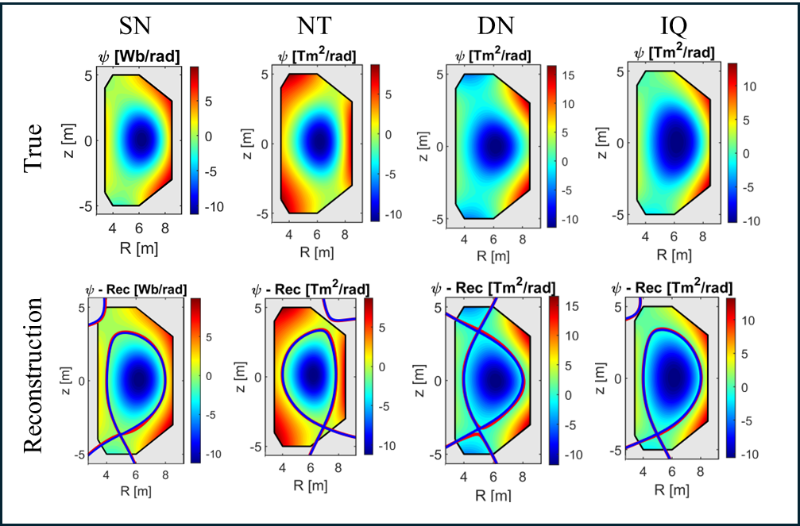
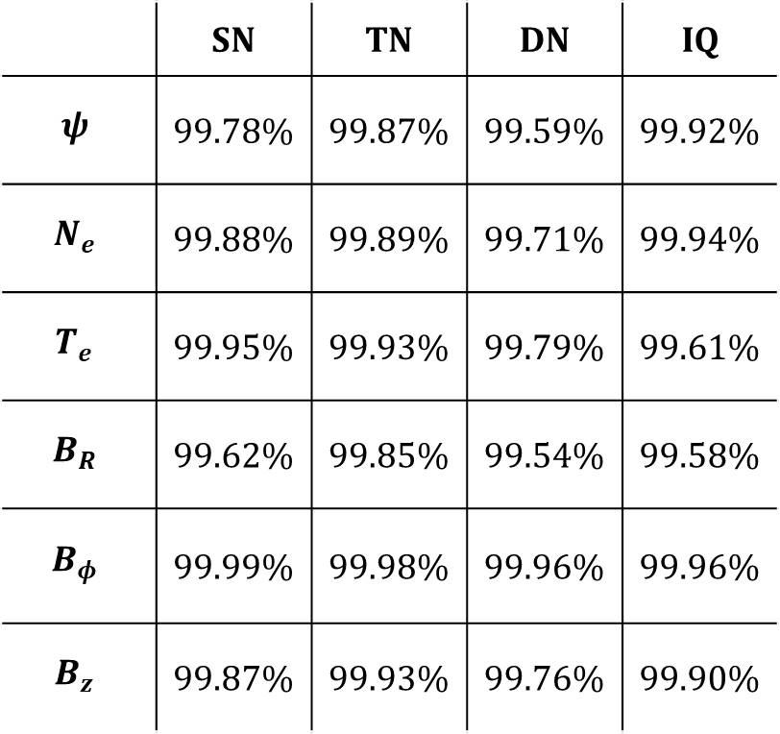
Method Verification: robustness respect to different scenarios
Target
 | SN | TN | DN | IQ
$$ψ$$ | 99.78% | 99.87% | 99.59% | 99.92%
$$N_{e}$$ | 99.88% | 99.89% | 99.71% | 99.94%
$$T_{e}$$ | 99.95% | 99.93% | 99.79% | 99.61%
$$B_{R}$$ | 99.62% | 99.85% | 99.54% | 99.58%
$$B_{φ}$$ | 99.99% | 99.98% | 99.96% | 99.96%
$$B_{z}$$ | 99.87% | 99.93% | 99.76% | 99.90%
~100%

Slide 20
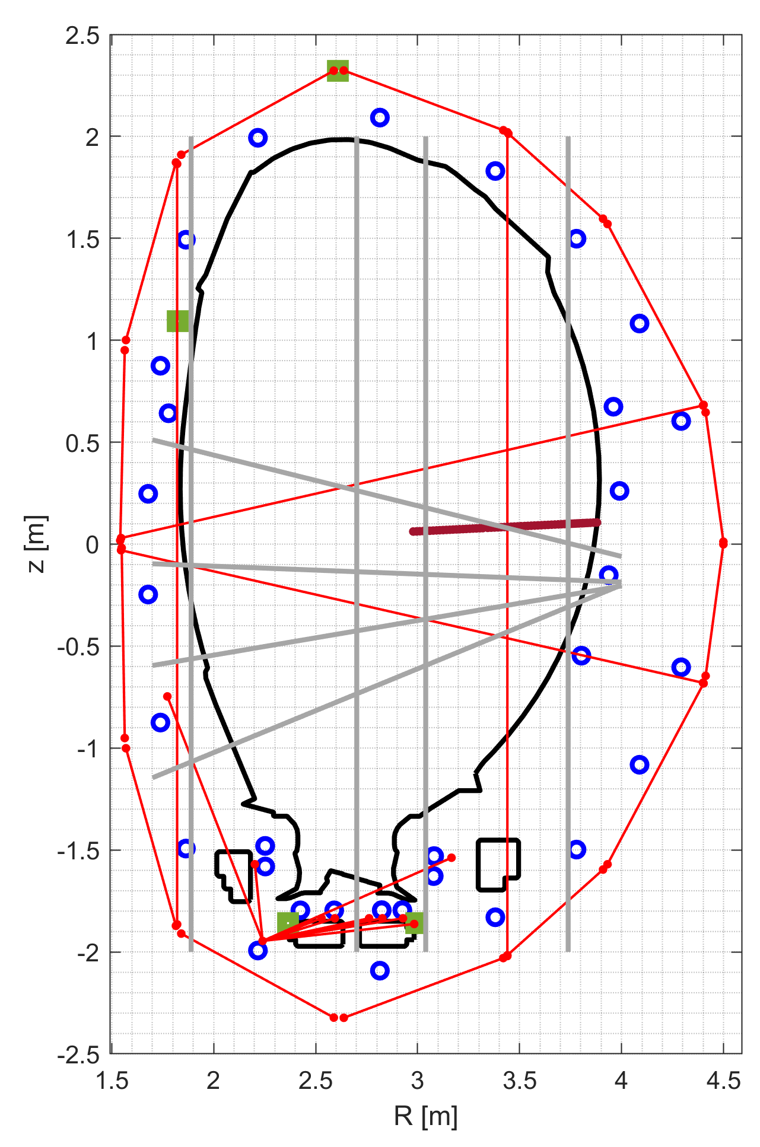

JET: Joint European Torus
The Joint European Torus (JET), in operation between 1983-2023, has been an important European tokamak experiment. The most relevant tokamak in the last 40 years with several research achievements and fundamental support for the design of ITER.
All the presented analyses in this work are based on pulses:
#99969 (at t = 10 s) for benchmarking;
#89724 (at t = 15 s) [7] for method validation;
Other aspects:
For the polarimeter, only Faraday Rotation measurements
Measurement uncertainties have been evaluated as the standard deviation of measurements in a time window of 50 ms.
For other diagnostic aspects, please refer to Appendix C.
Pick Up Coils
Flux Loops
Saddle Loops
Thomson Scattering
Interferometer-
Polarimeter
z
$$φ$$
R
JET scheme for poloidal section and diagnostics

Slide 21
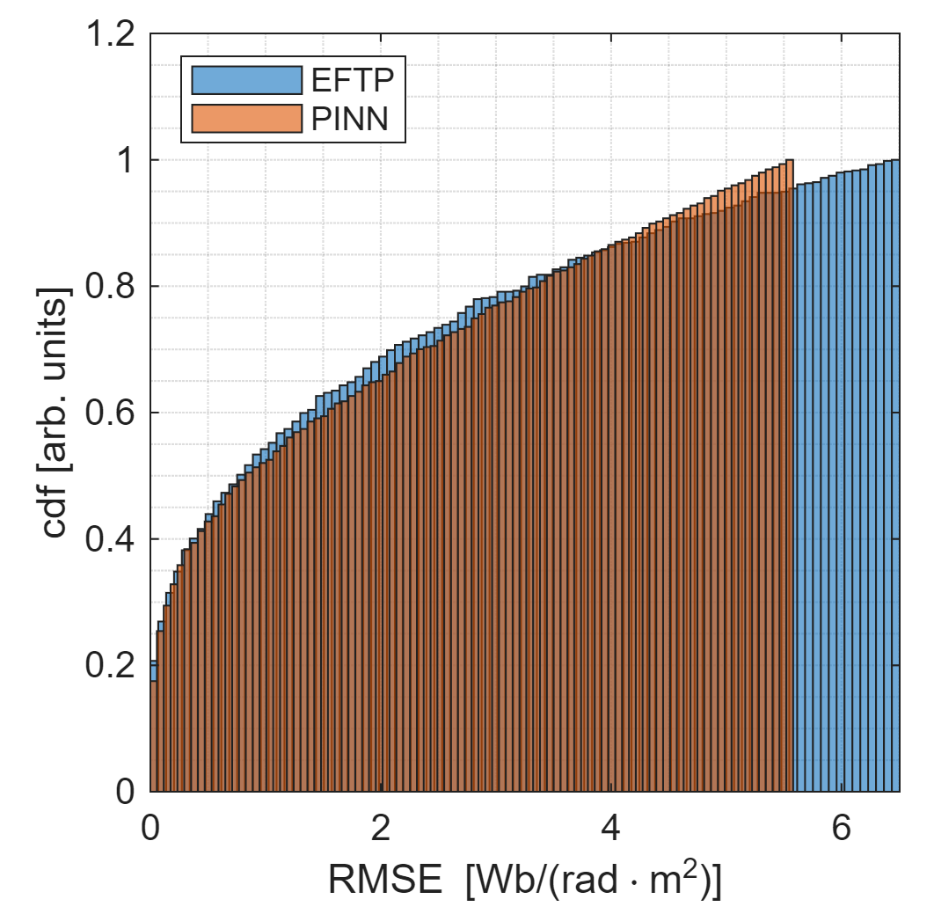
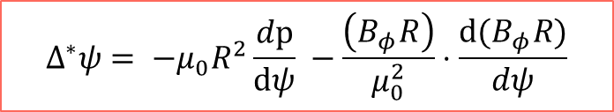
Method Benchmarking: A comparison with EFTF
To validate the methodology we need, at first, to demonstrate that the plasma quantities obtained are solution of Grad- Shafranov equation. To do so, we made a comparison with the error on Grad-Shafranov equation made by EFIT/EFTF reconstruction.
EFTF is the algorithm for equilibrium reconstruction at JET [10-11] that uses not only magnetic external diagnostics, but also Faraday rotation from polarimeter and pressure from Thomson Scattering. It is a measurement polynomial fitter (uses tensioned splines with 9 knots) for equilibrium reconstruction.
EFTF
PINN
$$Δ^{∗}ψ= −μ_{0}R^{2}\frac{dp}{dψ} −\frac{\left(B_{φ}R\right)}{μ_{0}^{2}}⋅\frac{d(B_{φ}R)}{dψ}$$
It does not directly predict, for example, density and temperature field.
On the other hand, PINNs algorithm can be extended predicting other quantities (if data are available and at least an incomplete physical model is known).
Reconstruction Error on Grad-Shafranov Equation

Slide 22
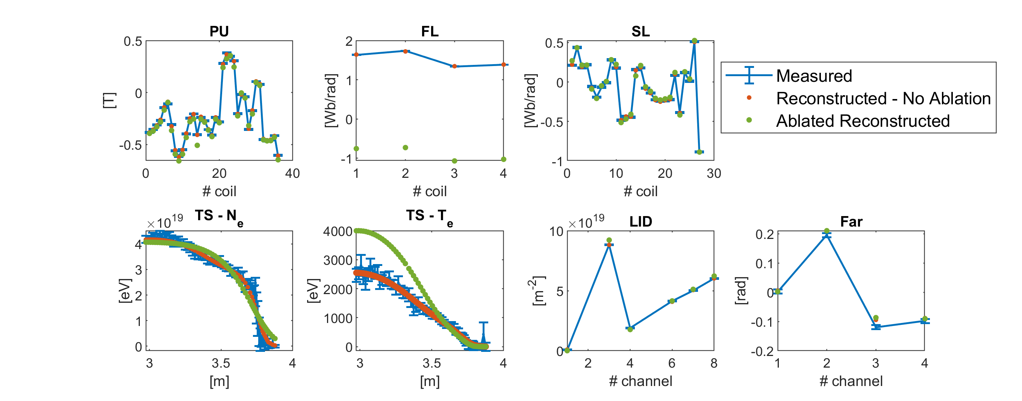






Method Validation: Ablation Tests
To validate the multi-diagnostic PINN algorithm an ablation test has been conducted: the aim is to evaluate the reconstruction performances of the ablated diagnostic.
Pick Up Coils
Saddle Loops
$$R^{2}=98.36\%$$
$$R^{2}=99.01\%$$
Thomson Scattering - N_{e}
Interferometer
Faraday Rotation
ρ = 99.98%
$$[m^{−3}]$$
$$R^{2}=92.18\%$$
$$R^{2}=99.55\%$$
$$R^{2}=97.73\%$$

Slide 23
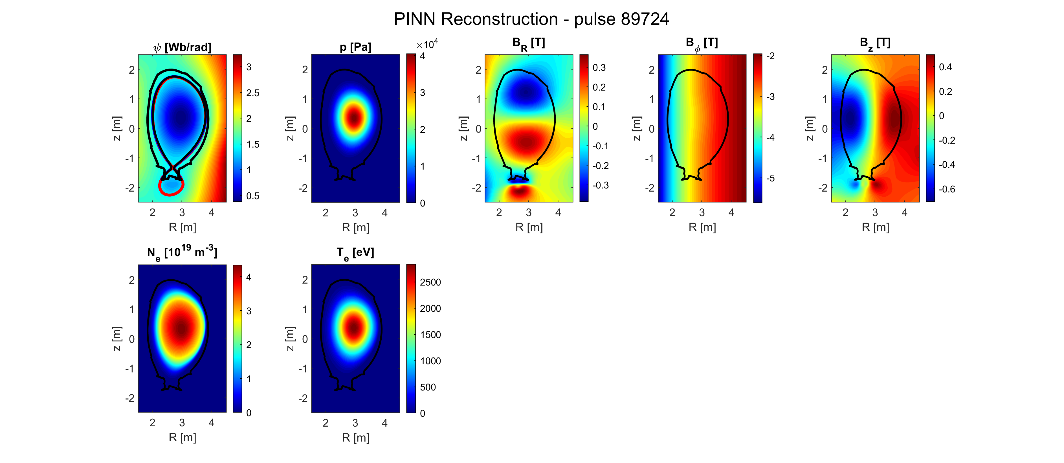
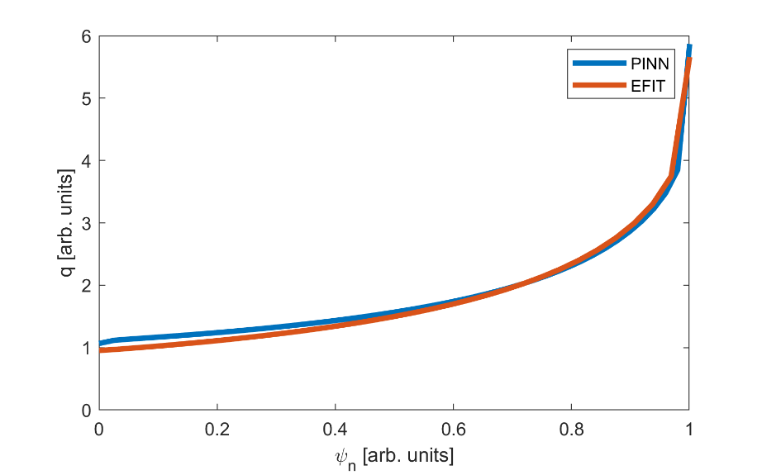
Reconstruction of pulse #89724 at 15 s
Once it is demonstrated that the PINN reconstructs the ablated diagnostics and the reconstructed fields are a solution of Grad-Shafranov, the methodology is validated and can be applied to experimental data.
EFIT
PINN
PINN reconstruction
N. Rutigliano et al., 2026, NF (66)

Slide 24
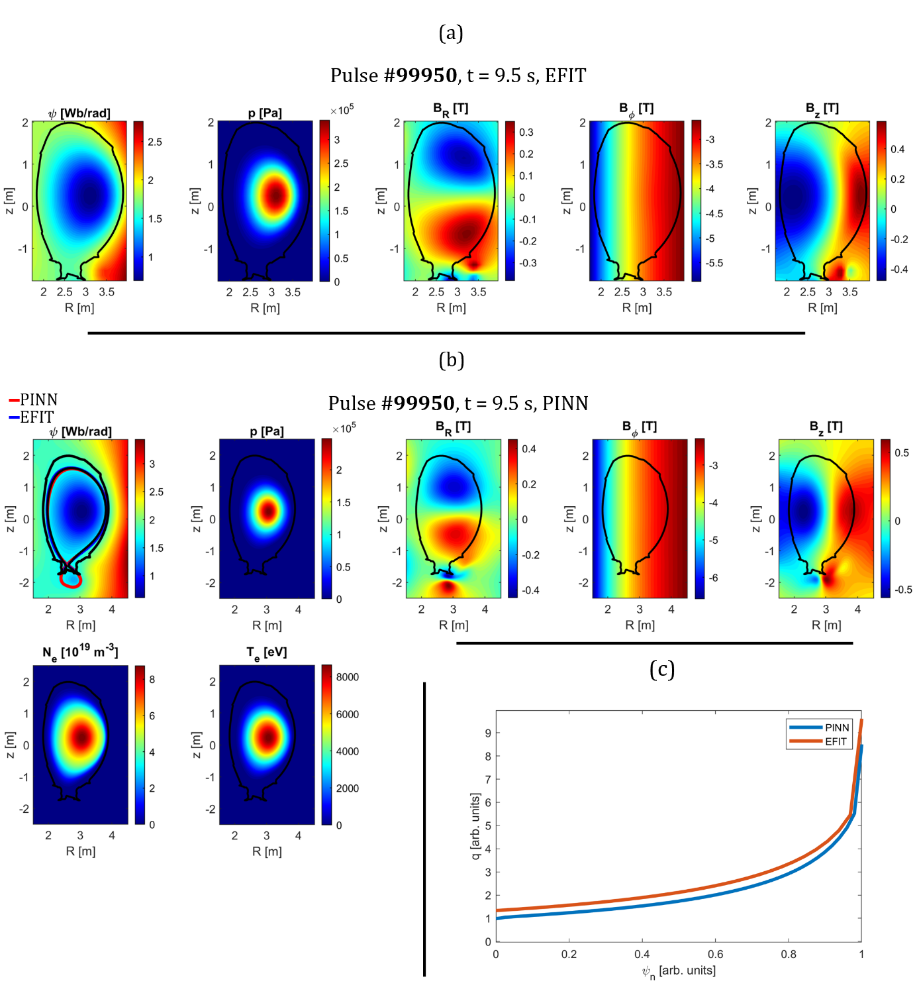
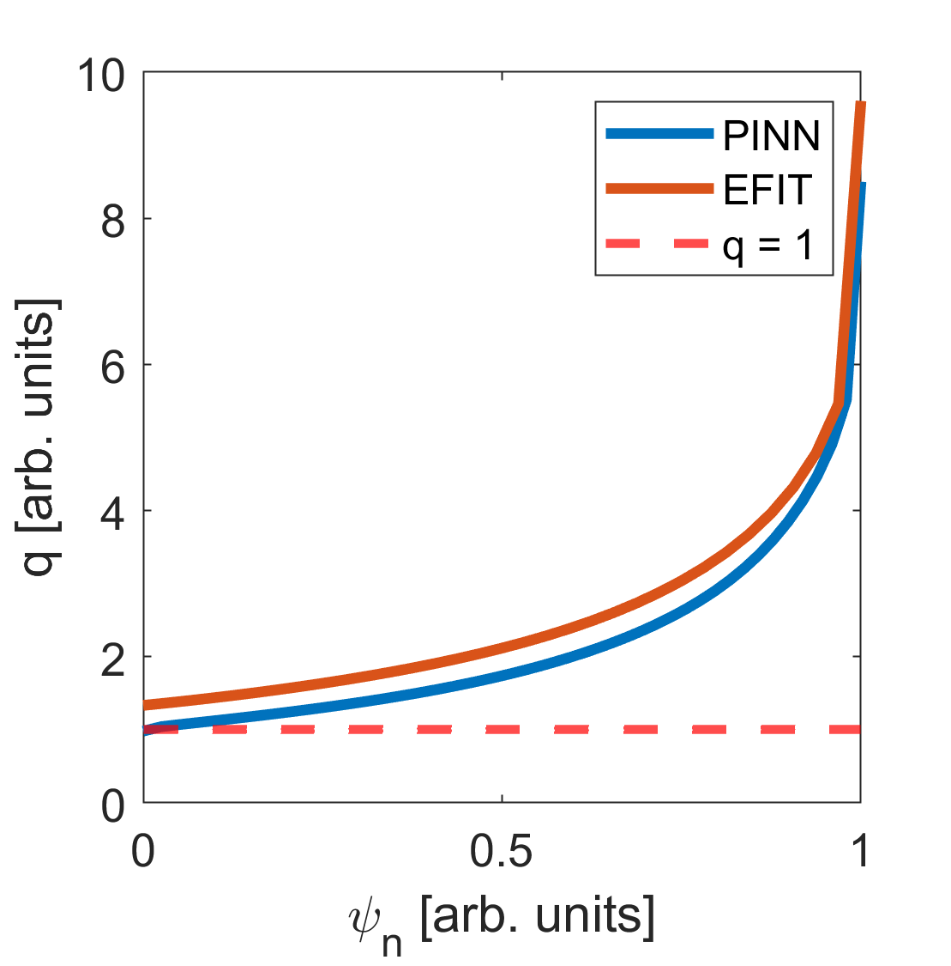
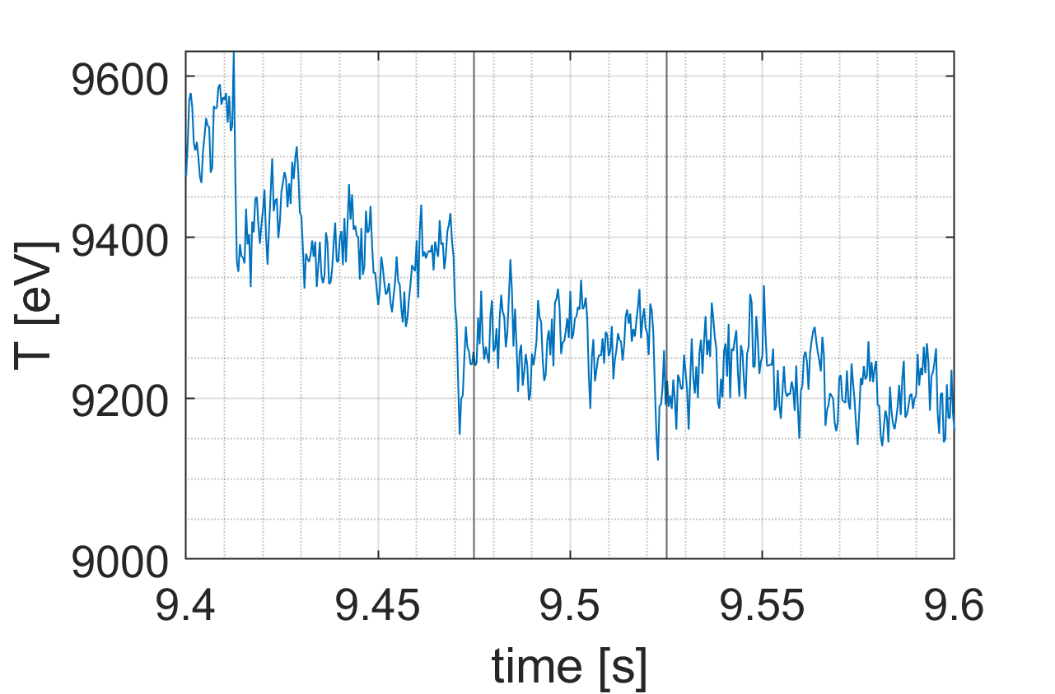
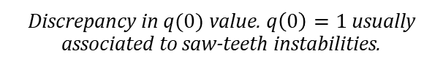
Reconstruction of pulse #99950 at 9.5 s
The ECE (Electron Cyclothrone Emission) diagnostic (not used in the PINN training) confirms the presence of saw-teeth instabilities.
This confirms the performances of PINN algorithm.
ECE measurements of Te in the reference time window.
Discrepancy in $q(0)$ value. $q\left(0\right)=1$ usually associated to saw-teeth instabilities.

Slide 25
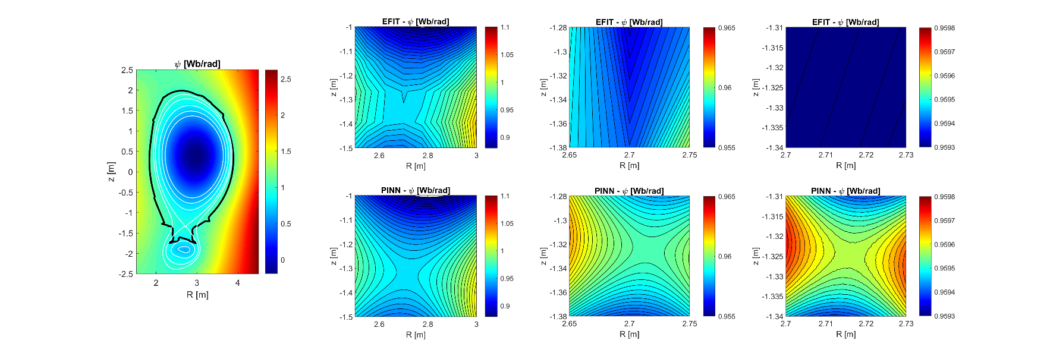
Super-resolution
PINNs are trained on a huge amount of collocation points, sub-sampled at each iteration. This implies that the PINN has been trained on a highly resolved space, and that therefore it is possible to infer information at small scales without applying an interpolation. An example is shown in this figure:

Slide 26
Conclusions
This presentation’s main purpose was to demonstrate the capabilities and performances of a PINN algorithm for multi-diagnostics tokamak equilibrium reconstruction.
The aim of such an algorithm is to support post-pulse analyses for physics interpretation and knowledge discovery AND data analysis. Modular algorithm allowing for continuous growth.
Neural Network and training algorithm optimisation
Focus on diagnostics modelling (interferometry/polarimetry study)
Adaptive weighting scheme to overcome the loss functions relative weighting in PINNs
Verification of the methodology through TokaLab. Trainings under extreme conditions (very noisy measurements, outlier, strong physics assumptions) tested with notable results
Benchmarking of the method with well-established algorithms (EFTF/EFIT)
Validation of the method through ablation tests with JET experimental data.

Slide 27
Combining Physics and Data driven methods through Physics-Informed Neural Networks in Nuclear Fusion: Application to Integrated Multi-Diagnostic Reconstruction of the Plasma State in Tokamaks
Novella Rutigliano
Internal Supervisor: Prof. Pasquale Gaudio
External Supervisor: Dr. Andrea Murari (CNR-ISTP, Consorzio RFX)
21/10/2026

Slide 28
Bibliography
[1] O. Kudlacek, 2016, DOI: 10.13140/RG.2.1.2656.9360
[2] M. Raissi et al., 2019 Journal of Computational Physics
[3] R. Rossi et al 2025 Nucl. Fusion 65
[4] R. Rossi et al 2023 Nucl. Fusion 63 126059
[5] Seo et al., 2024, Nuclear Engineering and Technology 65 (12)
[6] R. Rossi et al 2023 Nucl. Fusion 63 126059
[7] C.F. Maggi et al 2024 Nucl. Fusion 64 112012
[8] L. Garzotti et al 2025 Plasma Phys. Control. Fusion 67 075011
[9] M. Maslov et al 2023 Nucl. Fusion 63 112002
[10] P. Christiansen 1987 J. Comp. Physics 74
[11] A. Murari et al 2011 Nucl. Fusion 51 053012

Slide 29
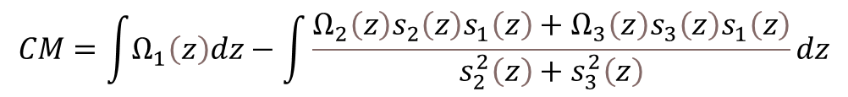
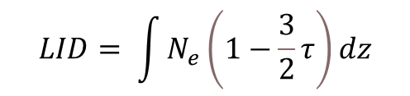




Appendix A: Proper modelling of diagnostics: a study on the interferometer-polarimeter diagnostic
In this work we used a complete Stokes formulation for polarimetric measurements and introduced also the relativistic effect for the hot plasma approximation. The complete Stokes formulation takes into account non-linearities, usually neglected in other reconstruction codes.
Faraday Rotation Stokes’ formulation:
$$FR=\frac{1}{2}\int{Ω_{3}\left(z\right)dz}−\frac{1}{2}\int{\frac{Ω_{1}\left(z\right)s_{1}\left(z\right)s_{3}\left(z\right)+Ω_{2}\left(z\right)s_{2}\left(z\right)s_{3}\left(z\right)}{s_{1}^{2}\left(z\right)+s_{2}^{2}\left(z\right)}}dz$$
Cotton Mouton Stokes’ formulation:
$$CM=\int{Ω_{1}\left(z\right)dz}−\int{\frac{Ω_{2}\left(z\right)s_{2}\left(z\right)s_{1}\left(z\right)+Ω_{3}\left(z\right)s_{3}\left(z\right)s_{1}\left(z\right)}{s_{2}^{2}\left(z\right)+s_{3}^{2}\left(z\right)}dz}$$
$$Ω^{\left(T\right)}\left(z\right)=\left[\begin{matrix}Ω_{1}\left(1+\frac{9}{2}τ\right) \\ Ω_{2}\left(1+\frac{9}{2}τ\right) \\ Ω_{3}\left(1−2τ\right)\end{matrix}\right]$$
In the hot plasma approximation, the relativisti effect can be introduced and the plasma matrix $Ω$ can be corrected as follows:
$$LID= \int{N_{e}\left(1−\frac{3}{2}τ\right)dz}$$
$τ=\frac{T_{e}}{m_{e}c^{2}}$

Slide 30


Appendix A: Proper modelling of diagnostics: a study on the interferometer-polarimeter diagnostic
Table 1 shows the improvement obtained in terms of R² when we adopt the complete Stokes’ formulation for polarimetric measurements in the PINN training instead of the type-I approximation.
 | $$ψ$$ | $$N_{e}$$ | $$T_{e}$$ | $$B_{R}$$ | $$B_{φ}$$ | $$B_{z}$$
Type-I approximation | 94.27% | 99.88% | 99.98% | 94.35% | 98.57% | 92.88%
Stokes’ formulation | 99.90% | 99.95% | 99.92% | 99.90% | ~100% | 99.96%
Table 2 shows the improvement obtained in terms of R² when we adopt the complete Stokes’ formulation for polarimetric measurements + the hot plasma assumption in the PINN training instead of the cold plasma assumption.
 | $$ψ$$ | $$N_{e}$$ | $$T_{e}$$ | $$B_{R}$$ | $$B_{φ}$$ | $$B_{z}$$
Cold plasma assumption | 99.06% | 97.18% | 99.16% | 94.87% | 99.41% | 97.46%
Hot plasma assumption | 99.90% | 99.95% | 99.92% | 99.90% | ~100% | 99.96%

Slide 31




Appendix B: Adaptive weighting scheme: $α$ automatic updating
Balancing losses is a key aspect for PINNs’ training. In our case, we developed an adaptive weighting scheme considering the following formulation of $Loss_{boundaries}$.
$$when prediction →expected$$
$${Loss}_{boundaries}= \frac{1}{N}\sum{\left[\frac{{\left(prediction−expected\right)}^{2}}{σ_{expected}^{2}}\right]→1}$$
$$∆α= 0.1∙tanh\left[−2(Loss_{boundaries}− {Loss}_{target})\right]$$
$$α_{epoch}= α_{epoch−1}(1+ ∆α)$$
Loss data vs loss physics with static weighting (left) using different values of $α$ and with adaptive weighting (right). On the right plot the colour code represents graphically the value of $α$.

Slide 32

Appendix C: Diagnostics’ Characteristics and Uncertainties
 | Pulse | PU | FL | SL | TS | LID | POL-Far | POL-CM | MSE
Tokalab | - | 42 | 6 | 30 | 60 | 8 | 8 | 8 | 25
 | $σ$ | $$0.05 T$$ | $$0.05 Wb/rad$$ | $$0.05 Wb/rad$$ | $$σ_{TS_{Ne}}={10}^{18}m^{−3}$$ $$σ_{TS_{Te}}=100 eV$$ | $${10}^{18}m^{−2}$$ | $$3.5 mrad$$ | $$3.5 mrad$$ | $$1.7 mrad$$
JET | 89724 | 36 | 4 | 27 | 63 | 6 [1,3,4,6,7,8] | 4 [1,2, 3,4] | - | -
 | 99948 | 36 | 4 | 27 | 63 | 5 [3,4,6,7,8] | 4 [1,2,3,4] | - | -
 | 99950 | 36 | 4 | 27 | 63 | 5 [3,4,6,7,8] | 6 [1,2,3,4,7,8] | - | -
 | 96996 | 36 | 4 | 27 | 63 | 6 [2,3,4,6,7,8] | 8 [1,2,3,4,5,6,7,8]
 |  | The uncertainties are calculated as the standard deviation of the measurements in the considered time window.

Slide 33

Appendix D: Proofs of Convergence
Figure B1 Loss functions trends for (a) the TokaLab reference scenario and (b) JET (pulse #89724) reconstructions with PINNs

Slide 34

Appendix E: Reconstruction of pulse #99948 at 10 s

