Slide 1
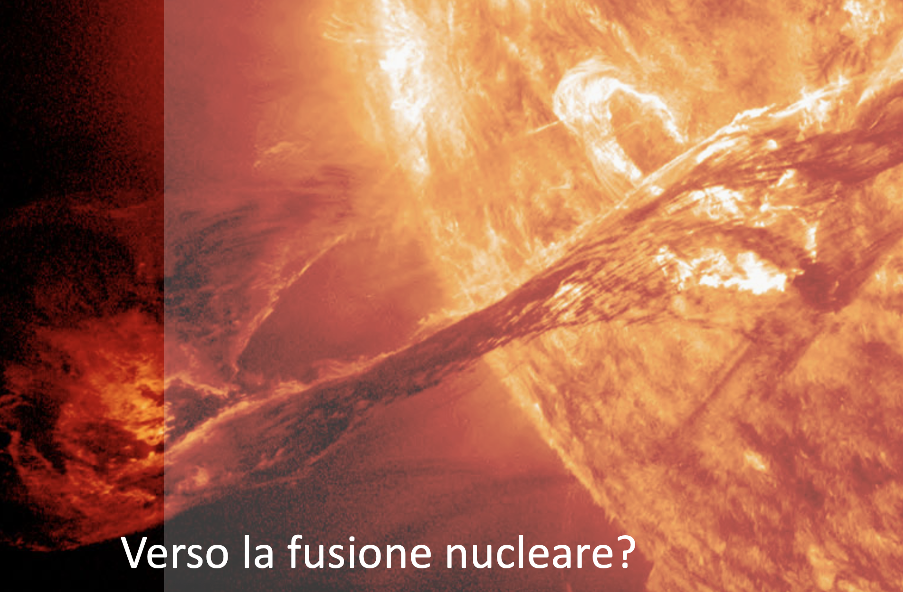
Verso la fusione nucleare?
A che punto siamo?

Slide 2
Perché?
Fra le affermazioni più ricorrenti primeggia quella secondo la quale la fusione magnetica sarebbe prossima a rendersi disponibile per applicazioni commerciali.
Sorge pertanto la curiosità di ragionare realmente, con un approccio scientifico e non commerciale, su a che punto sia il percorso verso il reattore, sia a confinamento magnetico che inerziale

Slide 3
Verso la fusione nucleare?
La fusione è tutto ☺
I dispositivi per lo studio della fusione
Le road map eurofusion 2012 e 2018
La road map DOE 10/2025
La road map cinese
Lo slancio verso la fusione
Indicatori di prestazioni (il fattore Q)
I risultati ottenuti (Jet campagne D-T)
La road map Inerziale
I risultati ottenuti

Slide 4
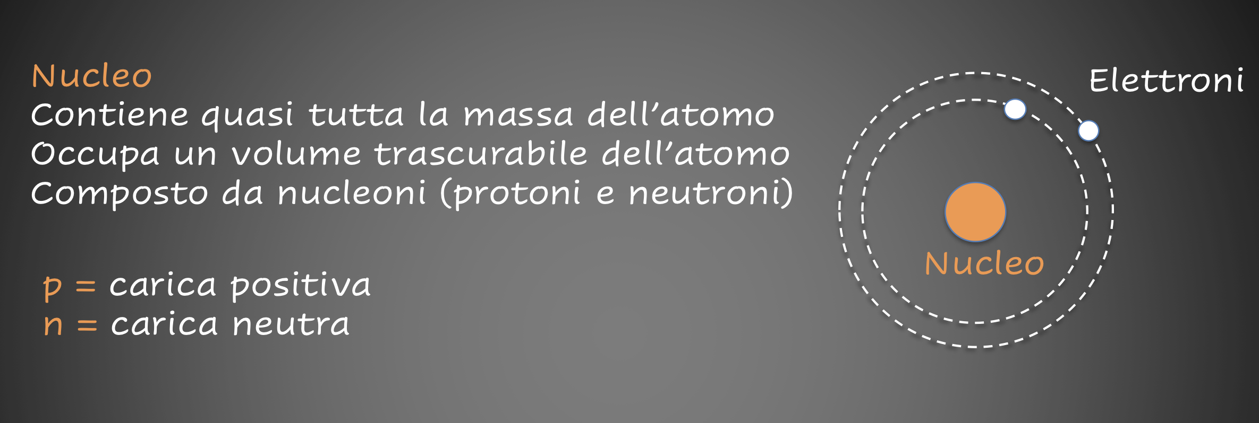
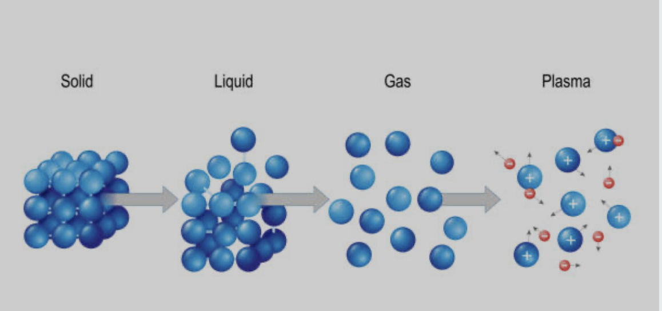
Lo stato della materia

Slide 5
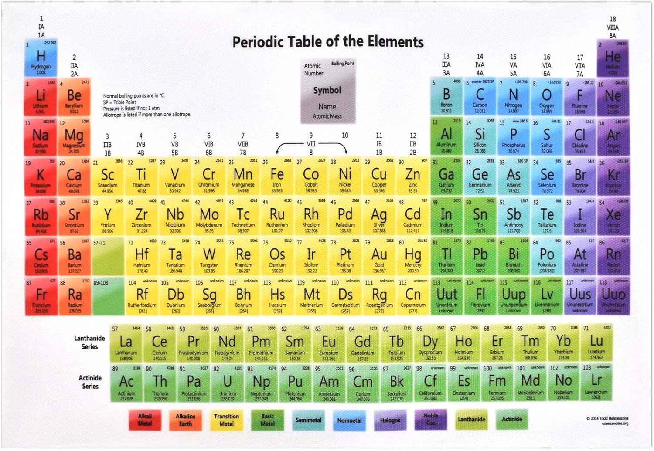
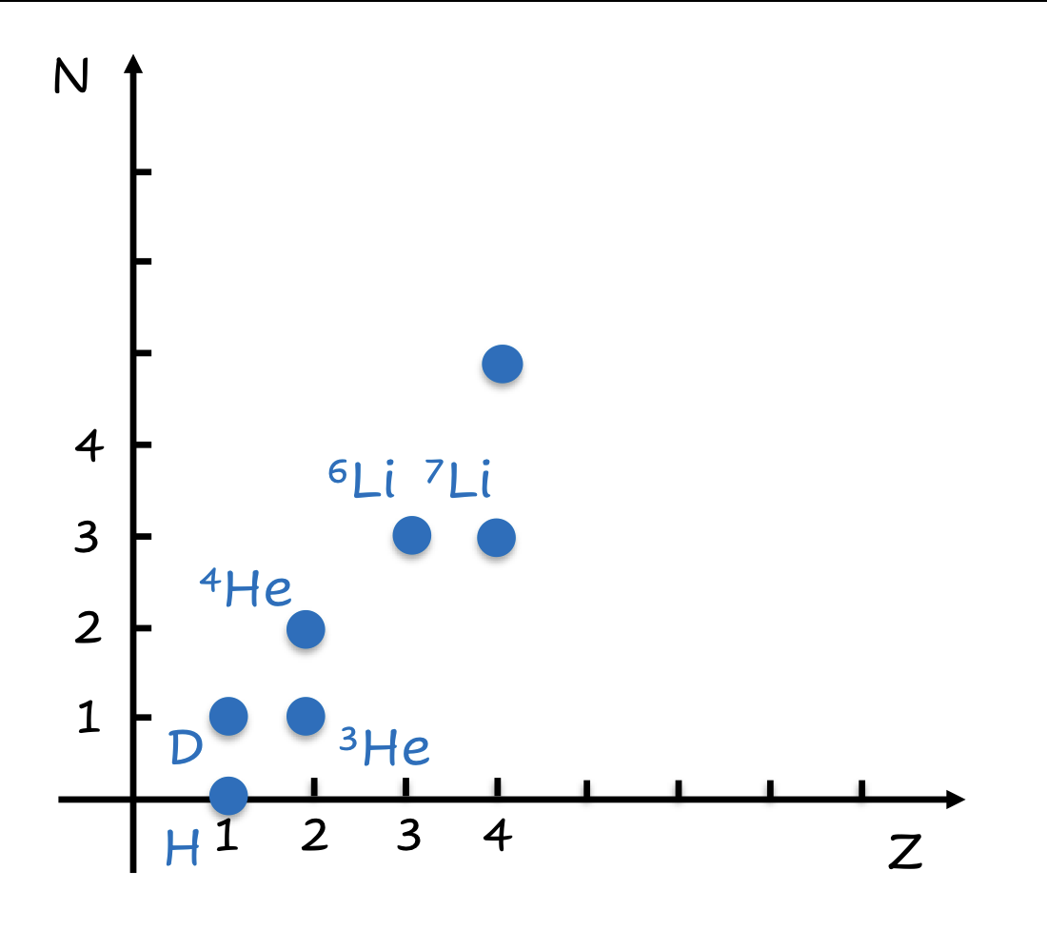
Gli elementi chimici si distinguono per il numero atomico
T.

Slide 6
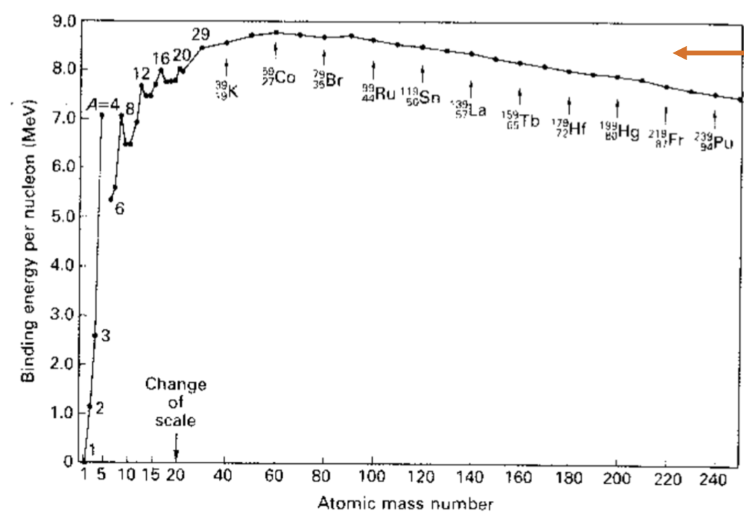
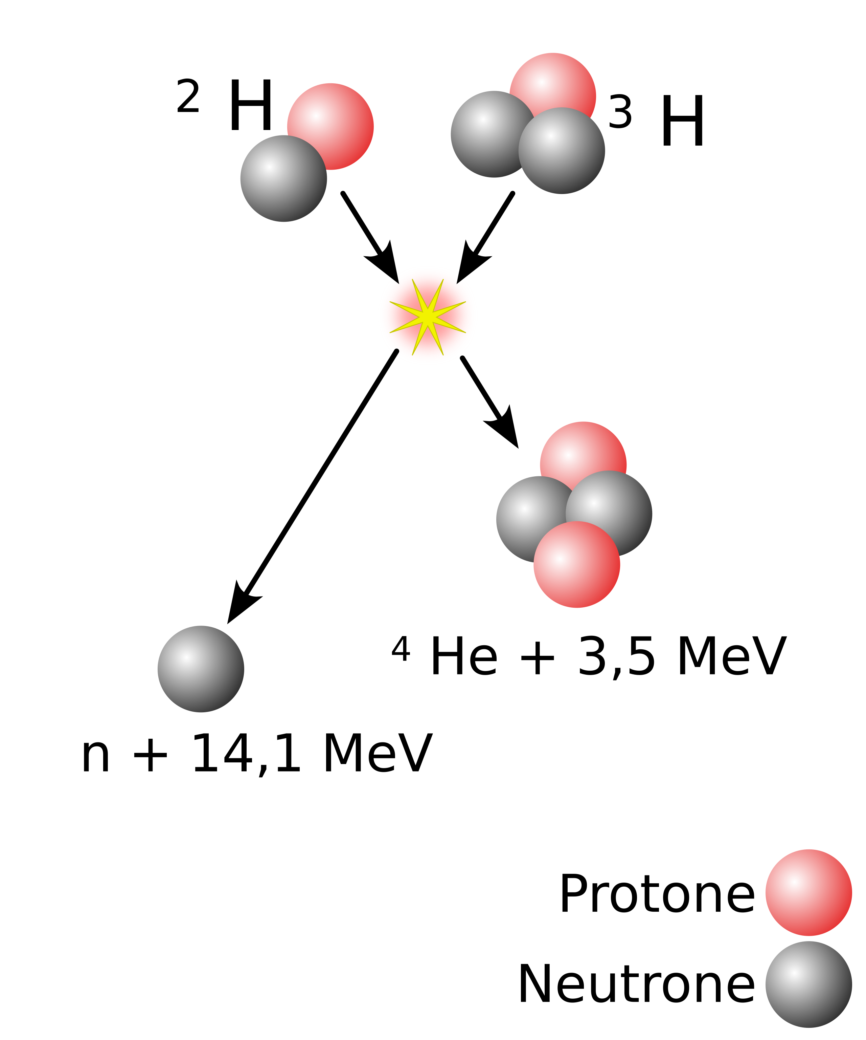
Fornendo energia i nuclei leggeri tendono ad aggregarsi (fusione), nuclei pesanti tendono a separarsi (fissione) entrambi i processi sono esoenergetici

Slide 7
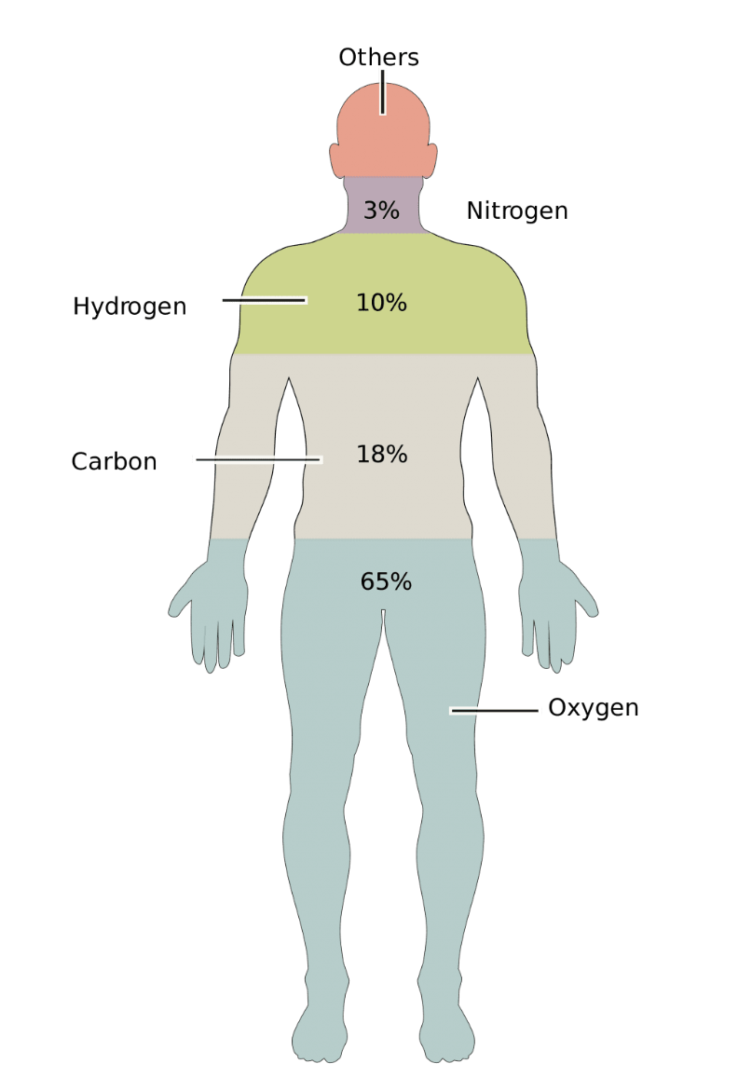
Nucleosintesi primordiale evoluzione stellare
La fusione è l’origine di tutto

Slide 8
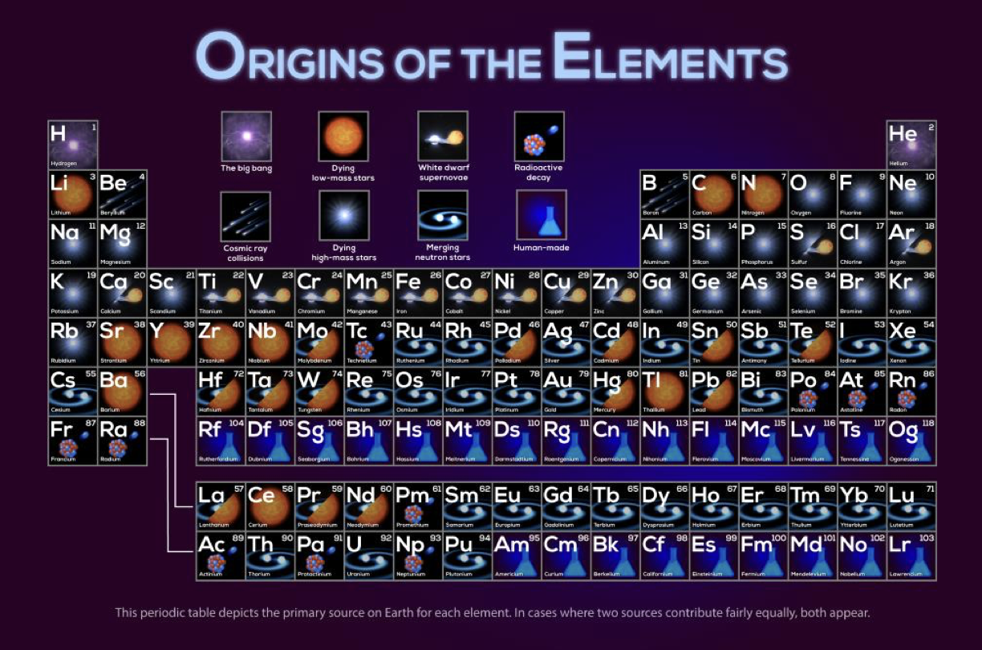

Slide 9
La sola energia di cui disponiamo è quella generata da reazioni nucleari
Tutti gli elementi chimici sono frutto di reazioni nucleari
Il vero motore dell’universo è l’energia nucleare
di Fusione o di Fissione
Solare reazioni di fusione
Idroelettrica (evaporazione)
Eolica (differenze di pressione atmosferica, onde)
Combustibili fossili, biomasse (fotosintesi)
Geotermica
Fissione
Riusciremo a produrla direttamente?

Slide 10
Pertanto cerchiamo di generare sulla terra le condizioni per le quali gli elementi possano fondere

Slide 11
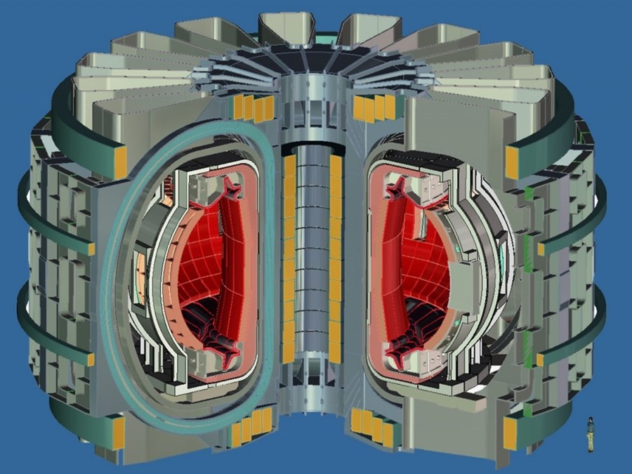
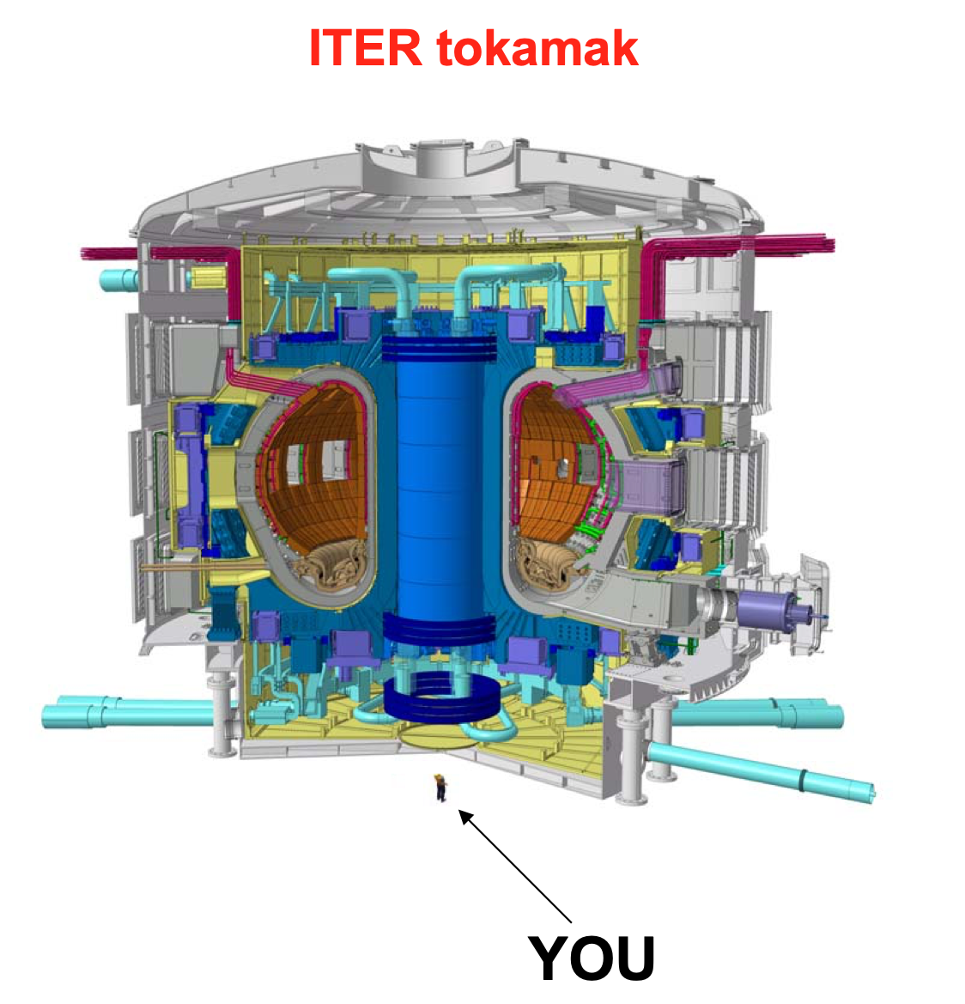
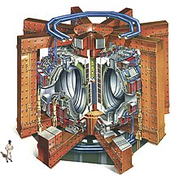
Macchine a confinamento magnetico
DEMO
>20??
Q ≈ 25
R₀ = 7-10 m
τ_{E >} 4 s
V_{p} = 2500 m³
P_{th} ≈ 1650MWth
_{350 MWe}
JET
1983
Q ≈ 0.3
R₀ = 3 m
τ_{E} = 1.2 s
V_{p} = 80 m³
P_{th} ≈ 16 MW_{th}
ITER
>2035
Q ≈ 10 nel 2044
R₀ = 6.2 m
τ_{E} = 3.7 s
V_{p} = 800 m³
P_{th} ≈ 500 MW_{th}
ITER: first reactor that will prove Q>1 (but no electricity production)
DEMO: first prototype that will generate electricity
Question: considering their size (and hence costs), will such reactors ever be competitive?

Slide 12
ITER parameters
Biggest fusion reactor ever built, twice the size of JET (the largest tokamak ever built) in linear dimension (8 times in volume).

Slide 13
ITER
International Thermonuclear Experimental Reactor
The biggest project on nuclear fusion.
Largest tokamak ever built, its goals are:
Reach Q≈10 (10 times the power used to heat the plasma).
Reach plasma duration of ~10 minutes (JET record is 5 s), producing 500 MWth.
Demonstrate steady-state operation («Advanced Tokamak» up to 1 h)
Develop and validate new fusion technologies (tritium breading, divertor operation, etc…).
30 m
Currently been built in Cadarache (France), should be completed by 2035.
ITER will not produce electricity, but will pave the way to a future reactor for energy production (DEMO).
30 m

Slide 14
China
BEST (Burning experiment superconducting Tokamak)
Site selectd in March 2019
Construction started in January 2023
First plasma in 2027
Burning plasma with Q<5 (10MW for 100s, 150MW for 10s)
Steady-state with Q>1 (20MW for hrs, 40MW for 1.000 s)
R = 3.6 m
a = 1.1 m

Slide 15
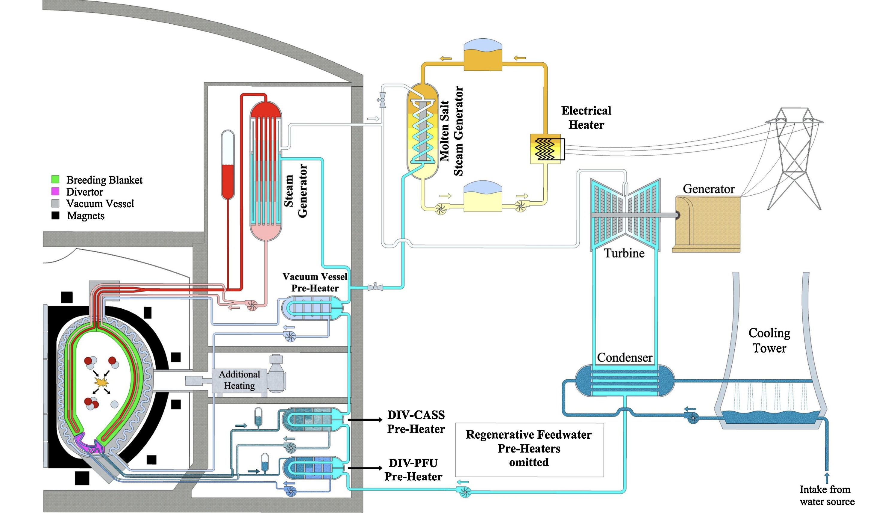
Schema di reattore nucleare a fusione

Slide 16
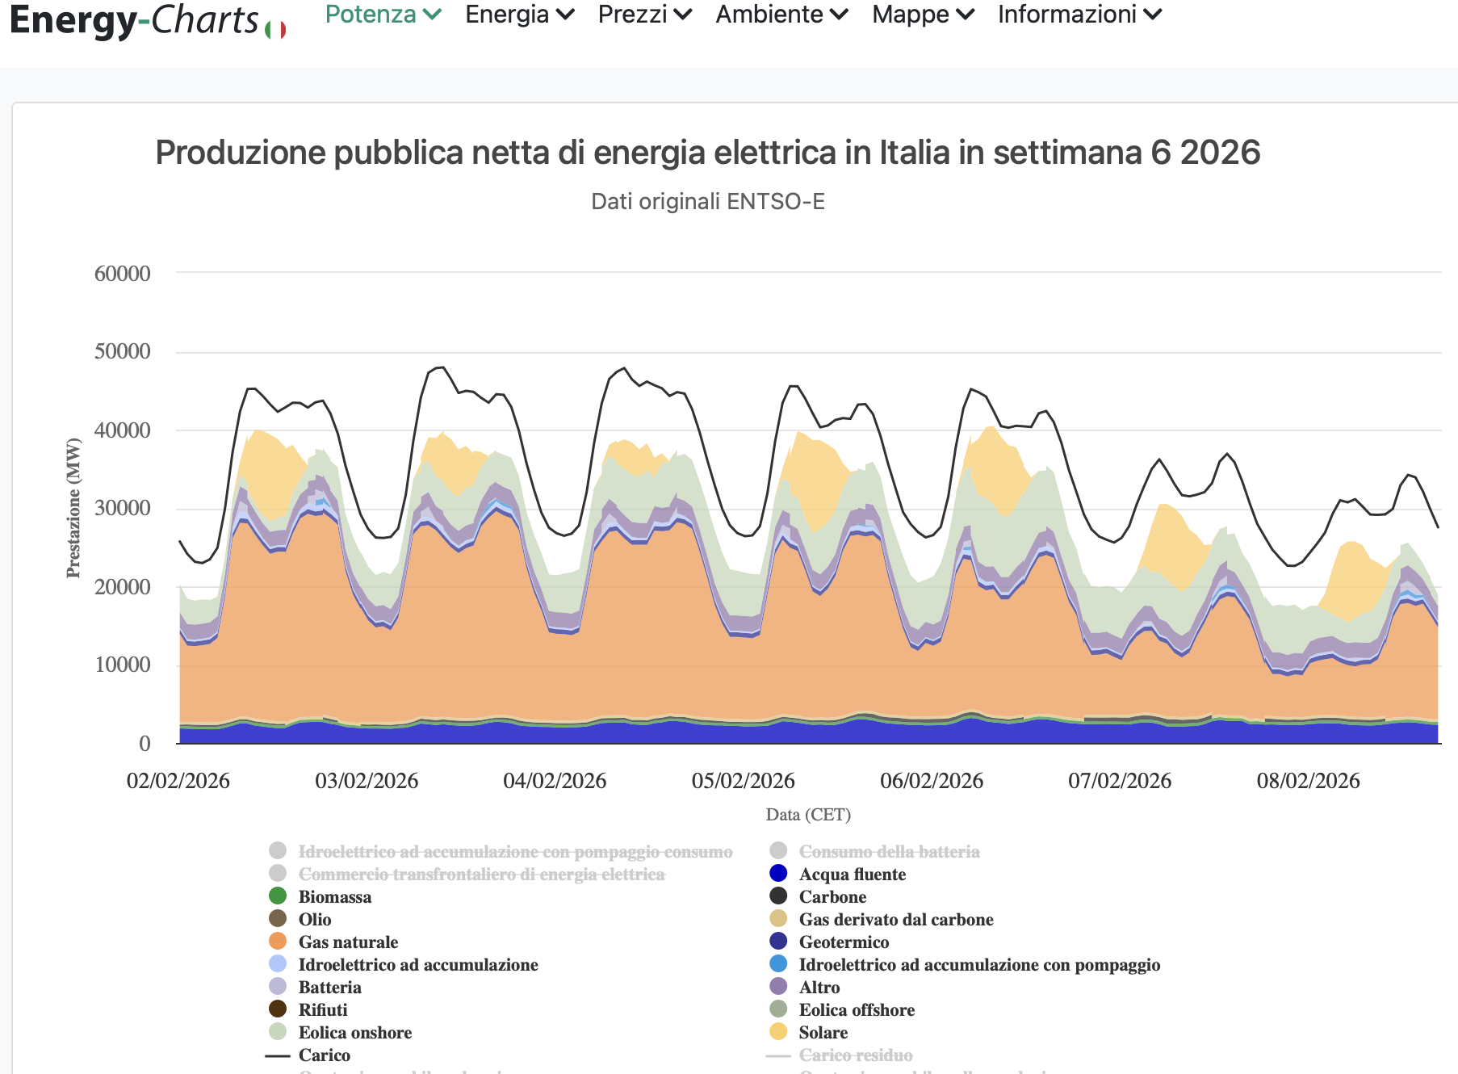
Carico di rete Nazionale compreso fra 50 e 25 GW

Slide 17
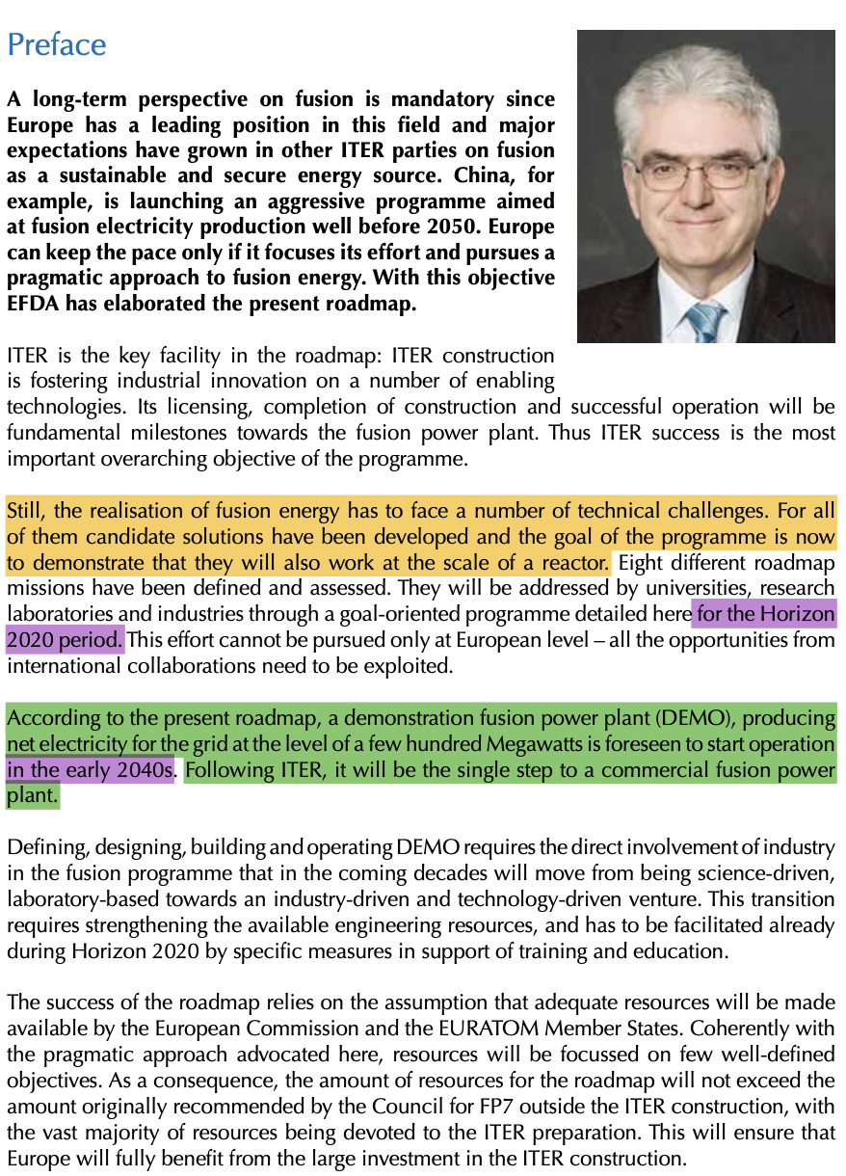
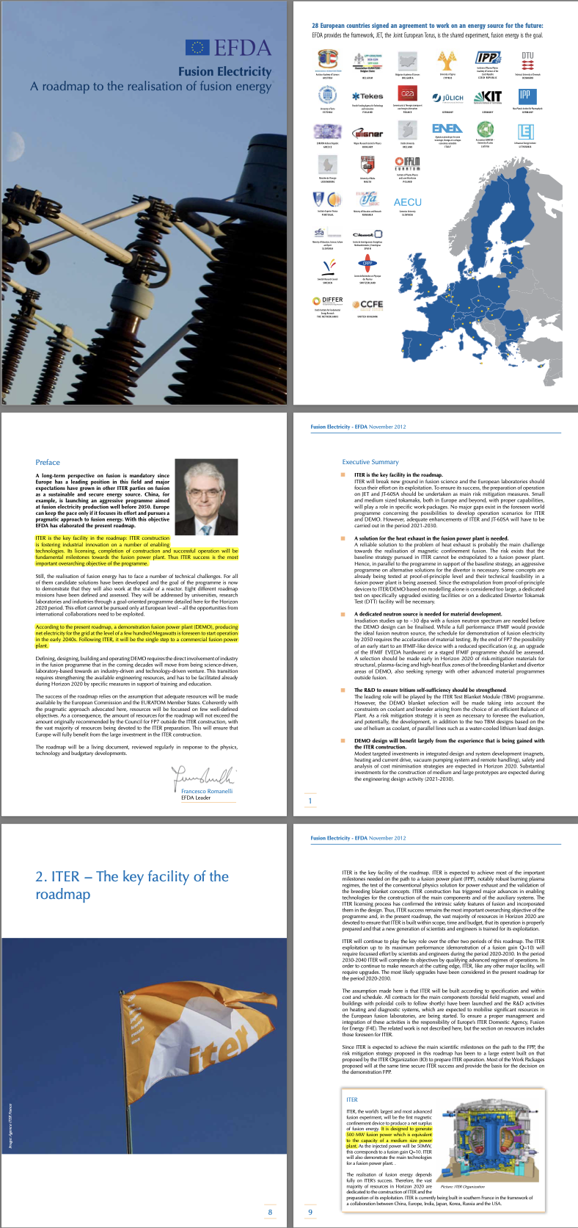
Roadmap Eurofusion 2012

Slide 18
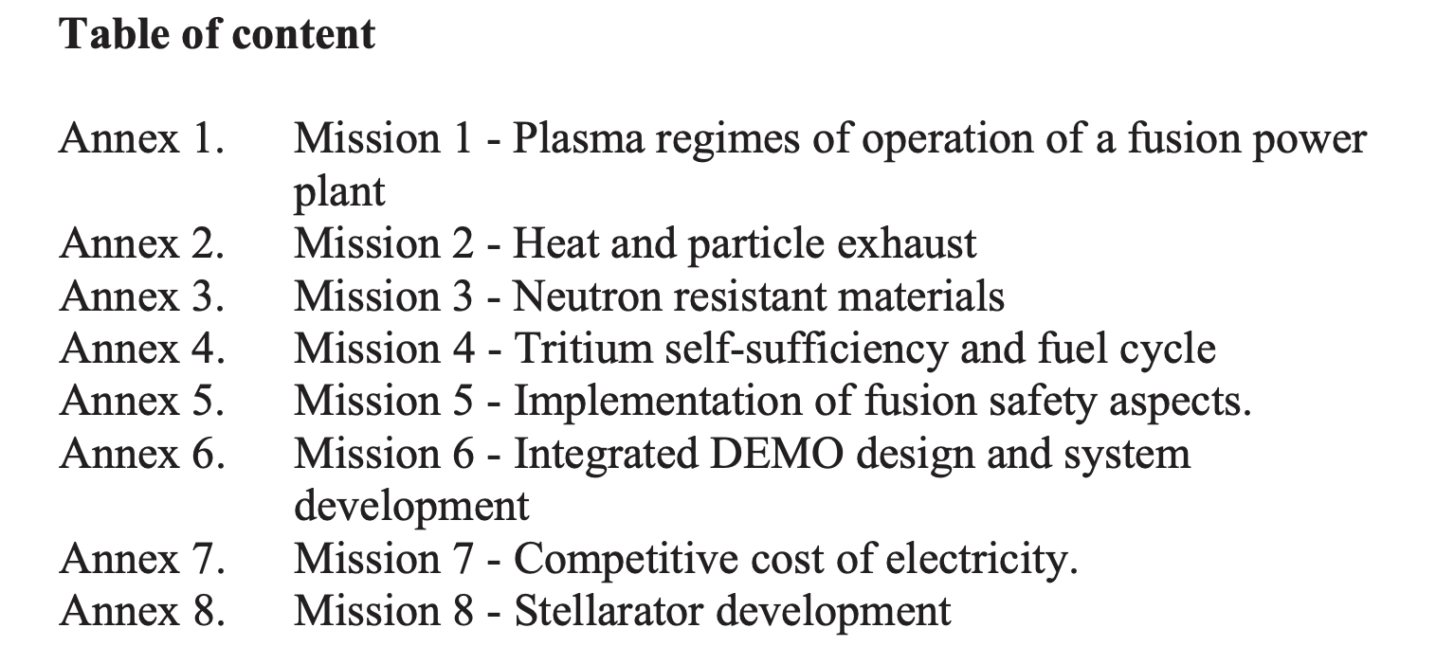
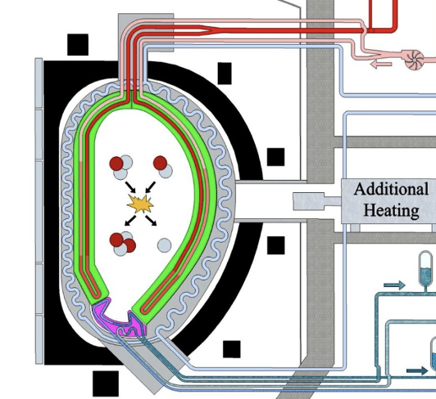
Roadmap «Missions»

Slide 19
Plasma regime
Specifically, plasma regimes of operation in a fusion reactor need to integrate:
1. Burning-plasma conditions in which fusion generated alpha particles are the dominant heating mechanism;
2. High density for achieving high fusion power and reactor-relevant values of the neutron wall load (~1-2MW/m2);
3. Large radiated power from a mantle surrounding the hot plasma core (to reduce the power conducted to the divertor and achieve acceptable divertor heat load);
4. Avoidance/mitigation of off-normal events (ELM, disruptions);
5. Diagnostics and actuators compatible with the reactor environment.
Requirements 1-5 are common to all magnetic fusion concepts. Plasma regimes that can achieve these conditions for long pulses (~8h in a Fusion Power Plant (FPP), relying in part on plasma current driven inductively by the tokamak’s central solenoid) have been already demonstrated in tokamaks and could be the basis for a conservative DEMO reactor.
……….

Slide 20
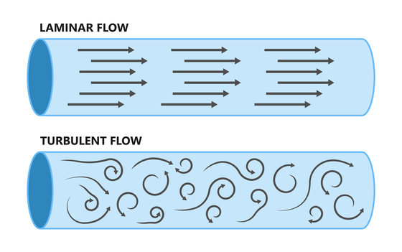
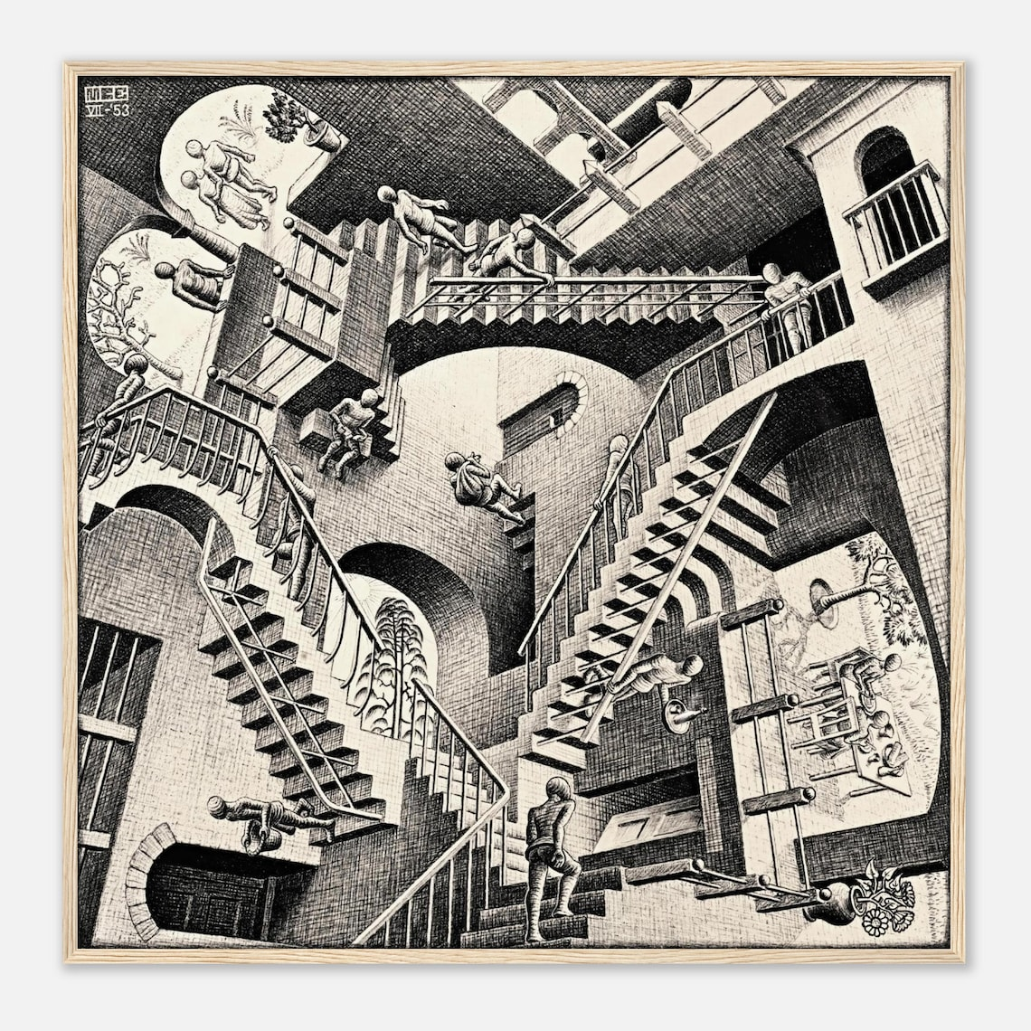
Plasma turbolento ed instabile
Si sporca a causa della interazione con le pareti
Il divertore screma lo strato più esterno nel tentativo di espellere i prodotti di fusione (He) e le impurezze, ma portando via una quantità rilevante di energia

Slide 21
Mission 2: heat and particle exhaust
The main challenge for the realization of a fusion power plant is the heat exhaust
problem. The power that crosses the magnetic separatrix is diverted along the magnetic field line to a remote region (the divertor) where it is exhausted on actively cooled
divertor targets.
Iter ipotizzando 500 MWt di potenza di plasma con 50 MW di riscaldamento addizionale
400MW trasportati dai neutroni e 150 MW di potenza trasportata dalle particelle, supponendo che di questa il 40% sia irradiato dal plasma di bulk, rimangono 90 MW da smaltire, se anche solo 60 arrivano (33% irradiato) alle piastre del divertore di ITER (massimo 2 m²) significa 30 MW/m², al di sopra dei limiti della tecnologia attuale.
Bisogna ulteriormente aumentare la potenza irradiata…..
Senza dimenticare che il divertore serve:
ad estrarre l’elio e le impurezze non il calore, che invece dovrebbe essere utilizzato per produrre energia
Se l’elio e le impurezze non si estraggono efficacemente il reattore NON funziona
Se si estrae troppo trizio si complica tutto
Se si estrae il gas che dà luogo al detacment si rompe tutto
.

Slide 22
Mission 3: Material Damage in a Fusion Reactor
The internal components of a Fusion Reactor will be subjected to an intense bombardment of high energy neutrons (up to loadings of 2MWm²) from the plasma deuterium-tritium (D-T) fusion reaction. The neutron spectrum has a peak at the energy released in the D-T reaction (14.1 MeV):
2D + 3T 4He (3.5MeV) + n (14.1MeV)
Several critical phenomena are known to occur when neutrons are incident on material surfaces.
radiation “hardening”, radiation embrittlement , radiation swelling and radiation-induced thermal creep……
These are primarily the result of displacements of atoms within the lattice following inelastic neutron-atom collisions, with the resultant formation of self-interstitial atoms and vacancies in the lattice that diffuse and aggregate to create a variety of extended defect complexes.
Metals and alloys with a ‘body-centred-cubic (bcc)’ crystal lattice structure, including iron and ferritic steels, and tungsten, show better resistance to prolonged irradiation, in terms of much lower swelling and lower embrittlement, than metals with face-centred-cubic (fcc) lattices. For example, the only class of steels that shows low swelling in the high-dose ~ 200 dpa limit, at temperatures close to 420°C, are ferritic (bcc) steels [3.2].
The effect of neutron collisional lattice damage is measured in‘displacements per atom (dpa)’ and

Slide 23
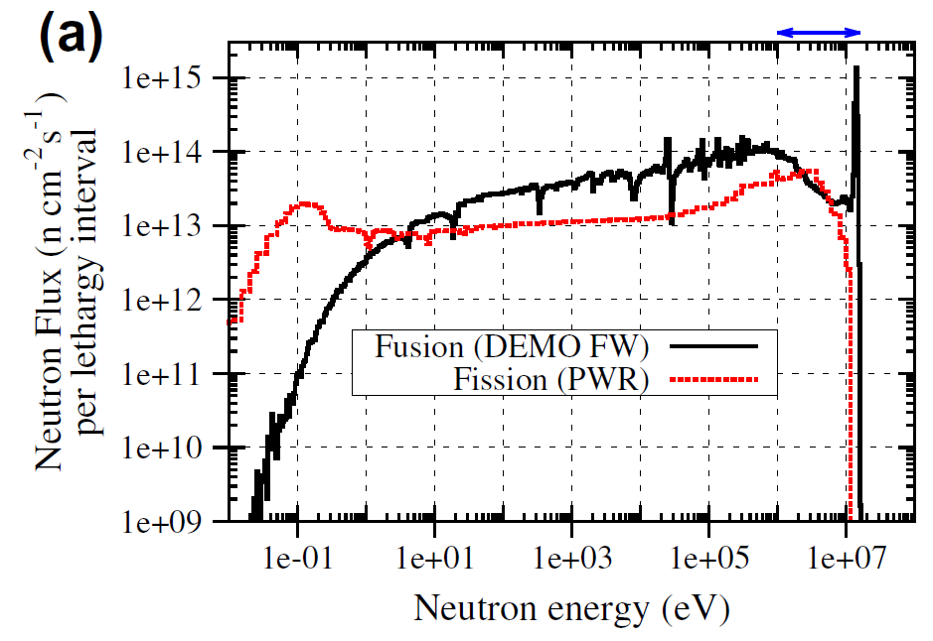
Mission 3: Material Damage in a Fusion Reactor
The huge neutron flux produced in a D-T fusion reactor can produce damage in the structural materials (blanket), severely limiting their lifetime.
Neutrons reactions with materials:
elastic scattering, causing atom displacement (lattice defects)
capture reaction, that could lead to transmutation (change chemical composition)
Emission of p, d, t and α, leading to gas formation.
Neutron damage causes deformation, embrittlement, bubble formation, loss of conductivity, and in general degradation of thermo-mechanical properties. Problem for all future fusion reactors.
Fusion neutrons energy spectrum is different (higher energy) than in fission reactors: peak at 14 MeV not present in fission.
The experience on neutron damage in fission reactors not directy applicable to fusion reactors. Much higher gas production in fusion structural materials.

Slide 24
Mission 3, materials
To develop full scientific and engineering characterisation, and theoretical
understanding of:
o Neutron resistant structural materials able to withstand high levels of
14MeV neutron flux and maintain their structural and thermo-mechanical
properties, including in a welded condition, in a sufficiently wide window
of operation and for a sufficiently long lifetime exposure (fluence) for
DEMO reactor and Fusion Power Plant;
o High heat flux and Plasma Facing Materials able to withstand the
combined effects of 14 MeV neutron flux and high intensity plasma
ion/neutral bombardment and maintain their mechanical and thermo-
mechanical properties and erosion resistance in a sufficiently wide
window of operation and for a sufficiently high combined fluence for
DEMO reactor and Fusion Power Plants;

Slide 25
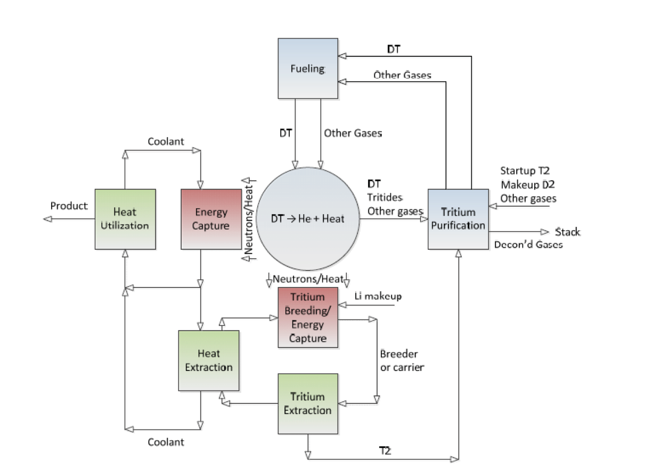
Mission 4: tritium self sufficiency and fuel cycle
The main functions of the blanket/fuel cycle system can be summarised as follows:
• Blanket tritium breeding and heat production: utilize and manage fusion neutrons by breeding tritium, converting neutron energy to heat. This region is exposed to high neutron fluence, especially in the first ~20 cm closest to the plasma.•
Blanket tritium and heat extraction: generate high-grade heat suitable for conversion to electricity through a heat exchanger and turbine cycle (see Mission 6 BoP). Extract tritium from the breeding blanket and send it to the purification and recycle loop.
• Tritium recovery and recycle: recover unburned tritium from the reactor exhaust and tritium extracted from the breeding blanket. This region must handle large tritium nventories and must prevent tritium release to the environment.
Accountancy of tritium in the fuel cycle for both safety and proliferation, given that kilogram quantities of tritium are circulating daily through the system, is another aspect of this challenge.
At the moment civilian tritium mostly comes from CANDU fission reactors.

Slide 26
Produzione all’interno del reattore
Il trizio non esiste in natura al contrario dell’uranio (il cui prodotto di decadimento è il radon…)
Anche se autoprodotto dal reattore (da verificare) per le fasi sperimentali e di accensione di un eventuale reattore servono rilevanti quantità di trizio
Lithium-6 Reaction: 6Li+n→4He(2.05MeV)+T(2.73MeV)
Lithium-7 Reaction: 7Li+n→4He+T+n′−2.47MeV bassa probabilità
Duplicazione neutronica, Reazione (n,2n):
⁹Be+n→2(⁴He)+2n
²⁰⁸Pb+𝑛→²⁰⁷Pb+2𝑛

Slide 27
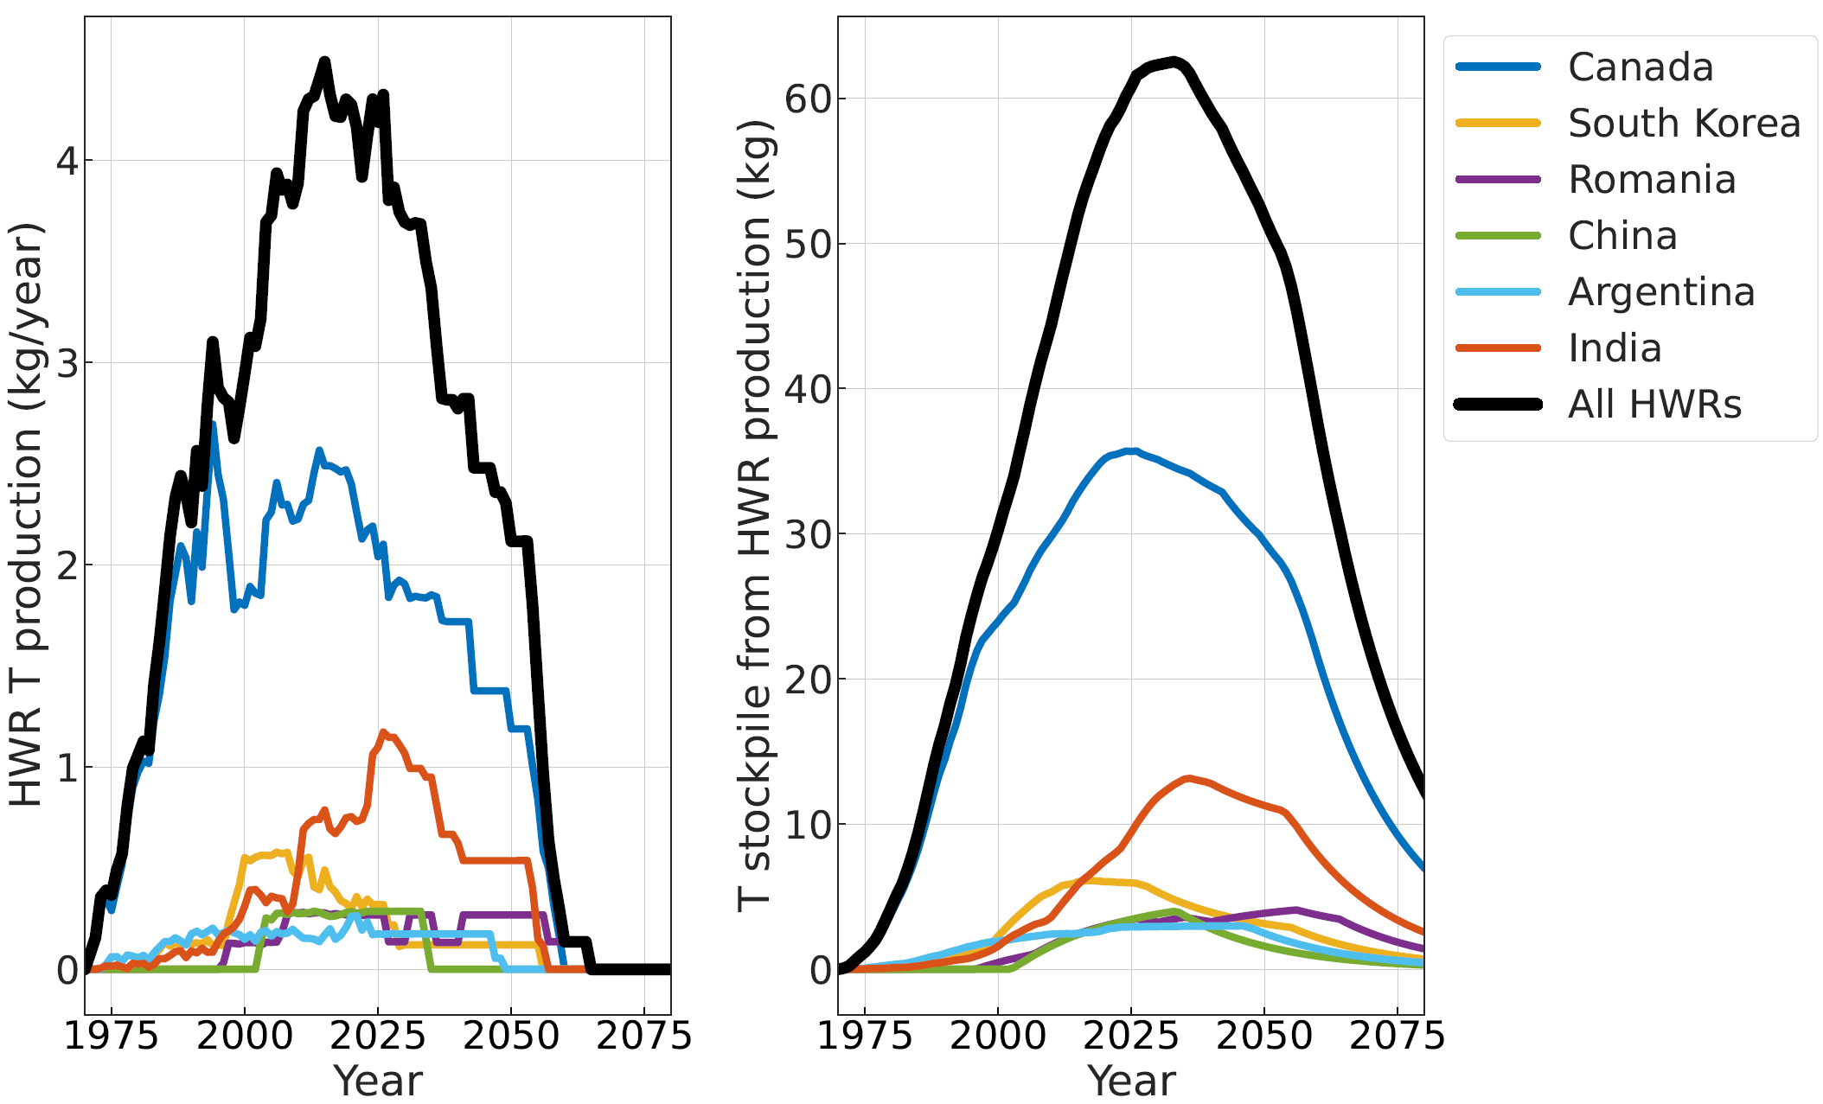
Global T production and stockpiles
27
M. Coleman – EFPW – 2025, Granada, Spain

Slide 28
Global tritium demand
Commercial demand:
Ontario Power Generation group in Canada sells T at approximately 25-30 M$/kg [1]
Commercial sales between 0.1-0.3 kg per year (since ~1980)
As far as I am aware, at present this is the only pathway to large-scale purchases of tritium
Fusion demand:
ITER demand totals 12.3 kg for the full D-T campaign over 15 years
ITER is obviously delayed… here I assume ITER D-T takes place in 2040, and that the full campaign takes places
VNS, if takes place as planned, would consume 6.8 kg of T over 7 years [9]. No date set, but I assume 2045 here
There are many fusion businesses that would also happily purchase tritium in the years to come:
CFS -> SPARC
UKIFS -> STEP
Tokamak Energy -> ???
Proxima -> ???
Gauss -> ???
…aggiungo io BEST????
The exact quantities and dates are not clear, here I have modelled this as 5 kg over 2035-2040
28
M. Coleman – EFPW – 2025, Granada, Spain

Slide 29
It’s tough to make predictions,
especially about the future.
Niels Bohr
N. Bohr

Slide 30
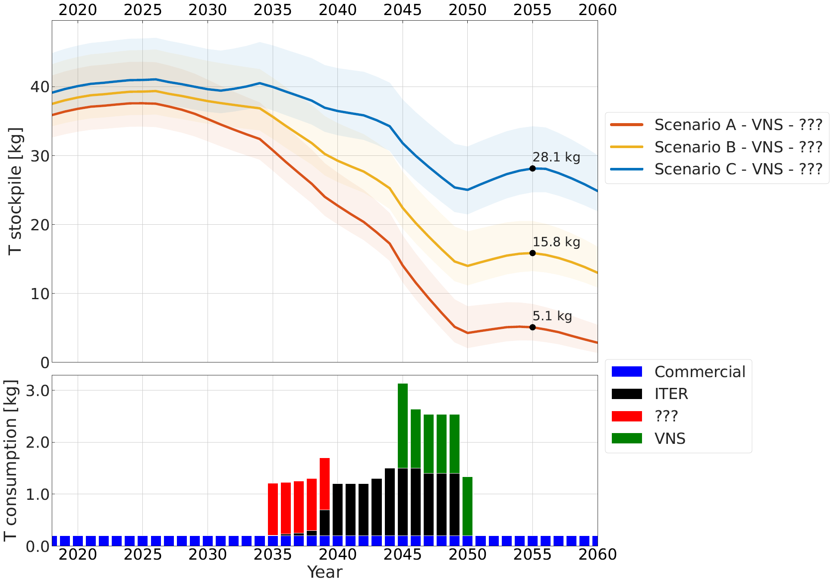
Supply and demand scenario: ITER – VNS – ???
30
M. Coleman – EFPW – 2025, Granada, Spain

Slide 31
Supply and demand - discussion
Of course, if multiple private fusion enterprises are successful, the demand for tritium will increase.
Under normal circumstances, an increase in demand for a rare commodity would lead to increased supply and price balancing. However:
Drivers for detritiation are not linked to tritium sales… drivers are regulatory, safety case, and environmental risk and worker dose rate reduction
Supply unlikely to increase with demand…
Ontario Power Generation group sells tritium at zero production cost! [10] at 25-30 M€ / kg
Cernavoda detritiation cost estimated at 275 M€/unit (excl. capital cost) [11] i.e. ~158 M€ / kg
Cost unlikely to decrease with demand… detritiation is expensive
Further limitations to supply:
Supply rate limited by detritiation facility capacity: cannot arbitrarily increase to cope with demand
Supply coincides with planned or opportunistic HWR maintenance / refurbishment
“Stockpiles” likely not fully recoverable
31
M. Coleman – EFPW – 2025, Granada, Spain

Slide 32
Tritium supply: conclusions and outlook
Clearly, if private fusion demand is high, it is possible that an EU-DEMO device cannot purchase sufficient tritium commercially.
The only side of the equation the fusion community can act upon is the demand, e.g.:
Limit machines with TBR < 1
ITER not running its full D-T campaign…
Engage with private fusion enterprises to avoid a tritium rush
Improve fuel cycle to reduce start-up inventories for reactors
Recommendation: EUROfusion should consider engaging with OPG to purchase tritium options, and/or with private fusion enterprises.
NOTE: D-D start-up theoretically possible, but complicated for the fuel cycle, and is slow and expensive.
M. Coleman – EFPW – 2025, Granada, Spain

Slide 33
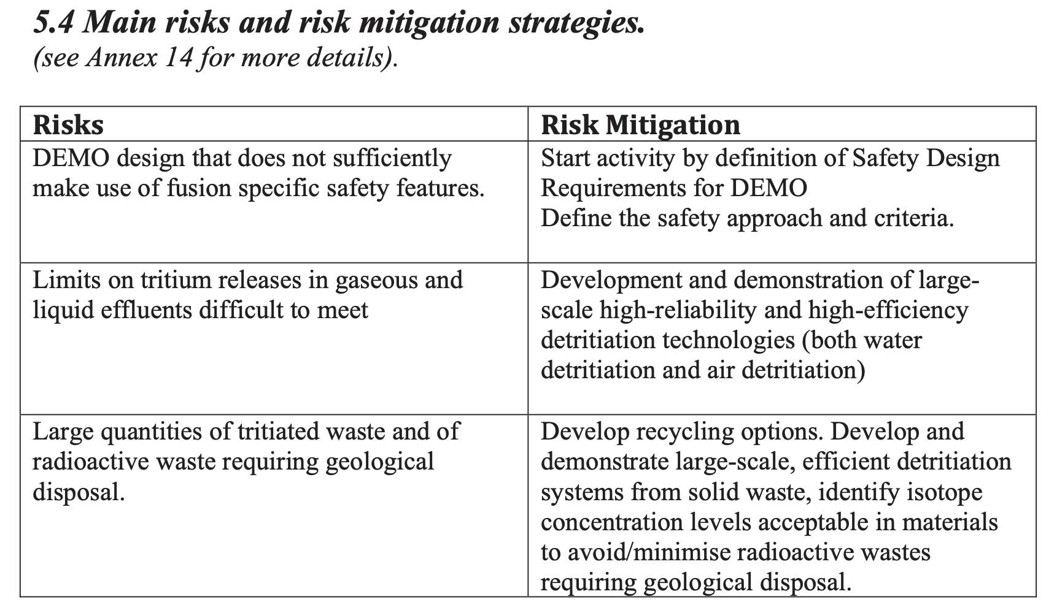
Mission 5: Implementation of fusion safety
The vacuum vessel can meet the low failure rate criteria with robust construction and double walls that confined tritium, neutron activated materials, and chemically toxic materials. Unfortunately, there are very many vacuum vessel penetrations that are necessary to operate the tokamak. The integration challenge was determining the boundary perimeter for these penetrations. The designers required many vacuum vessel interfaces to the vacuum pumping system, the radiofrequency plasma heating systems, the fuelling system, the diagnostics and their ports, penetrations for cooling system piping, and the maintenance access ports with port plugs. All of these systems extended the vacuum vessel strong barrier boundary and are part of the first confinement barrier, so their robustness has to be demonstrated as part of the licensing process.

Slide 34
Mission 6: Demo design
Definition of an EU-DEMO design point robust to epistemic plasma physics uncertainties
M. Coleman1,2,∗, H. Zohm1,3, C. Bourdelle F. Maviglia1,5, A.J. Pearce2, M. Siccinio, A. Spagnuolo1,6 and S. Wiesen1,7
Nucl. Fusion 65 (2025) 036039
«DEMO is in a pre-conceptual phase, mainly waiting for ITER results, or any result able to validate the calculation codes in close reactor conditions»
DEMO AIMS:
(i) Demonstrate tritium self-sufficiency
(ii) Produce net electricity
(iii) Operate safely and reliably over a reasonable time-span
(iv) Act as a component test facility, in particular for breeding blankets

Slide 35
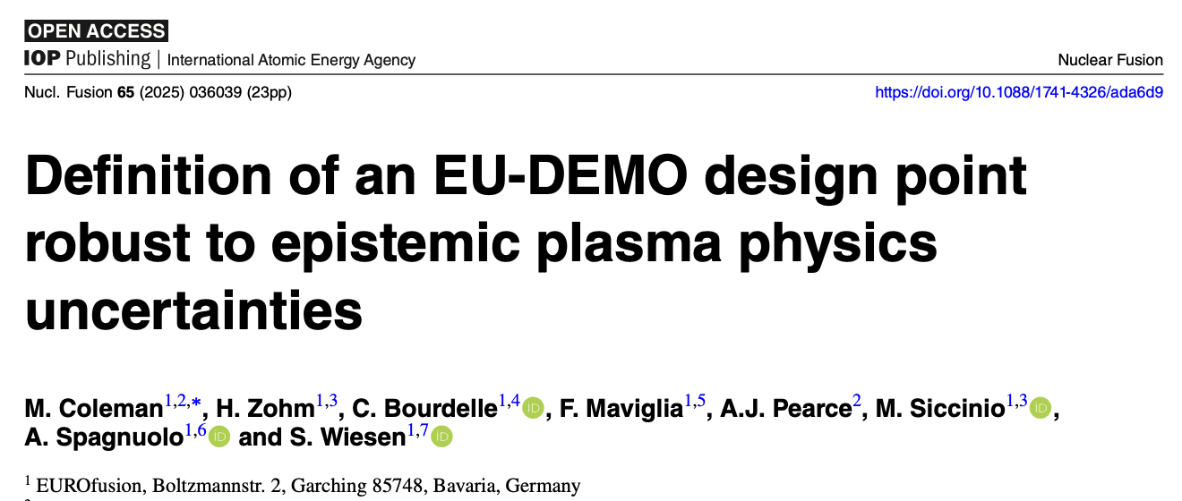
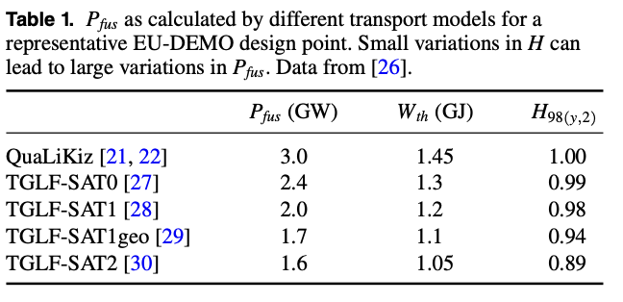
Mission 6: Demo design Demo in fase pre-concettuale
For instance, let us say we have a reactor for which we have
the low and high estimates of fusion power from table 1 (Pfus
= 1.6–3.0 GW). From previous EU-DEMO studies (e.g. [3])
we have Pel,net/Pfus ≈ 0.25, which we can use as a crude met-
ric to estimate the net electric output for a given fusion power
.
Assuming that the reactor could otherwise handle this range of
fusion power, and using the aforementioned metric to propag-
ate the uncertainty on Pfus, such a reactor could in theory pro-
duce Pel,net ≈ 400–750 MWe.
Nel dubbio usano il codice di sistema PROCESS
P_{fus} 1652MWt. P_{el}=350+/-50 MWe netti

Slide 36
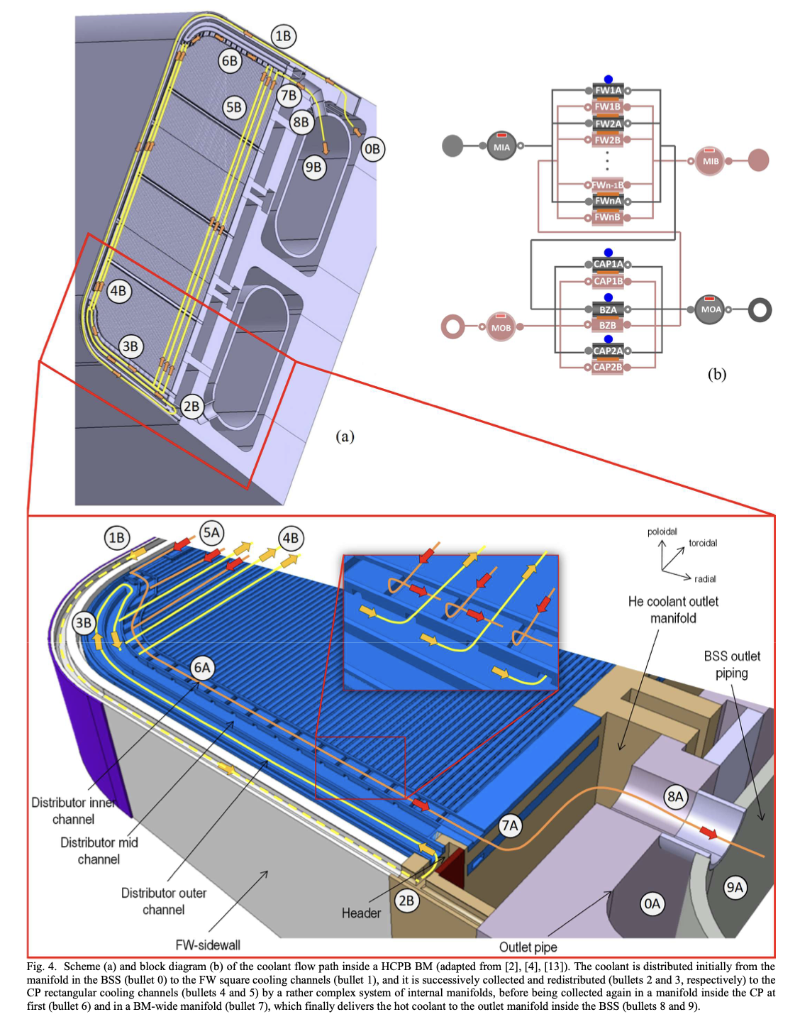
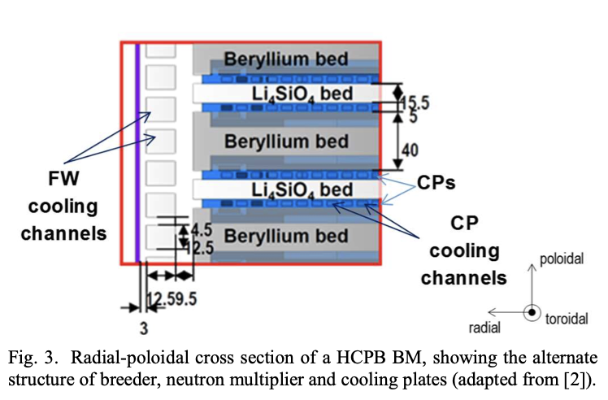
Mission 7: competitive cost of electricity. Secondo la road-map del DOE un Tokamak sarà difficilmente conveniente per la produzione di elettricità
DEMO:Circa 1400 m²
Iter 800m²

Slide 37
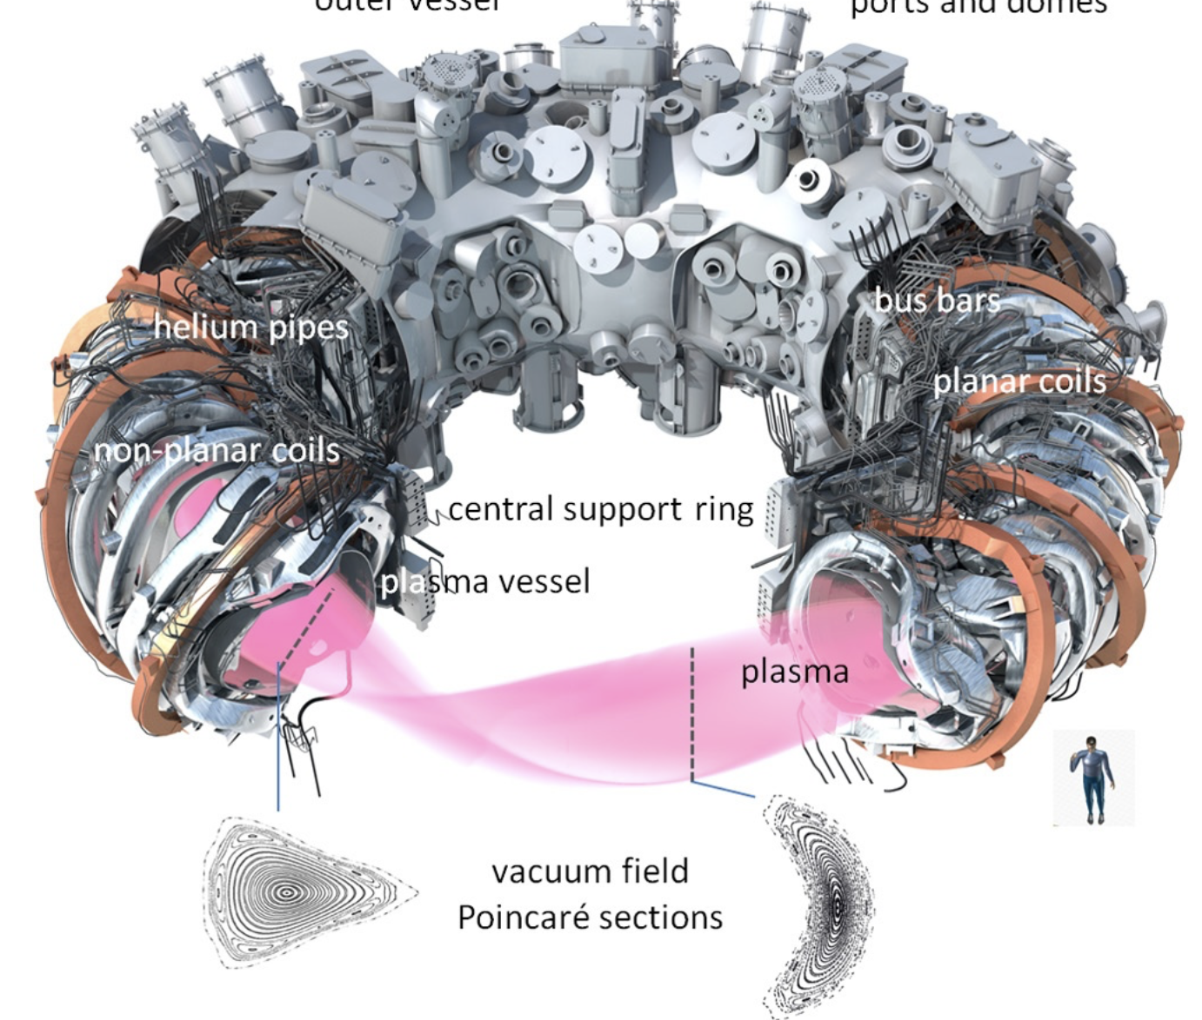
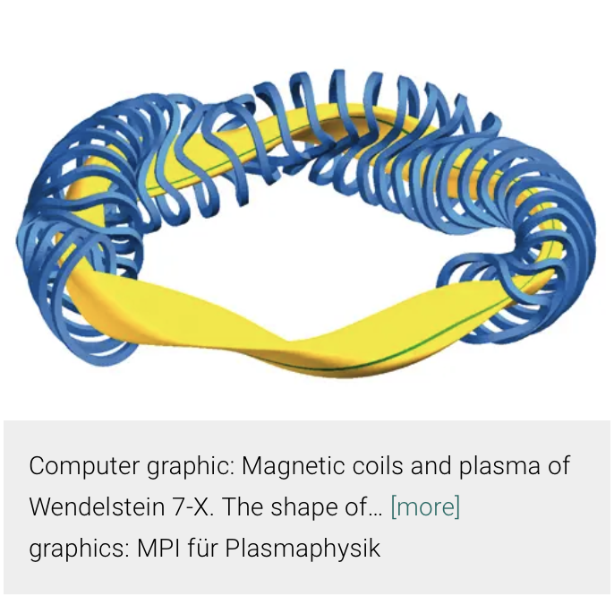
Mission 8: Stellarator development
The first contracts to industry for experiment components were placed in 1996. After the main installation was completed in 2014, the commissioning started. The first plasma was produced end of 2015. Since then, experimental phases have alternated with upgrading phases, which served to make the device fit for operation under reactor-relevant conditions.
Wendelstein 7-X
Progettazione iniziata anni ’90;Terminato nel 2014 ha subito molte modifiche
Ultimamente ha effettuato una campagna sperimentale
Macchina in continua, non impulsata
Dimensioni enormi, magneti di grandi dimensioni R₀=5.5 m diametro del criostato 16 m, complessa e costosa da realizzare, blanket molto difficile da costruire, limiti per aspect ratio
Ha mantenuto il plasma in condizioni di elevate prestazioni per 43 s

Slide 38
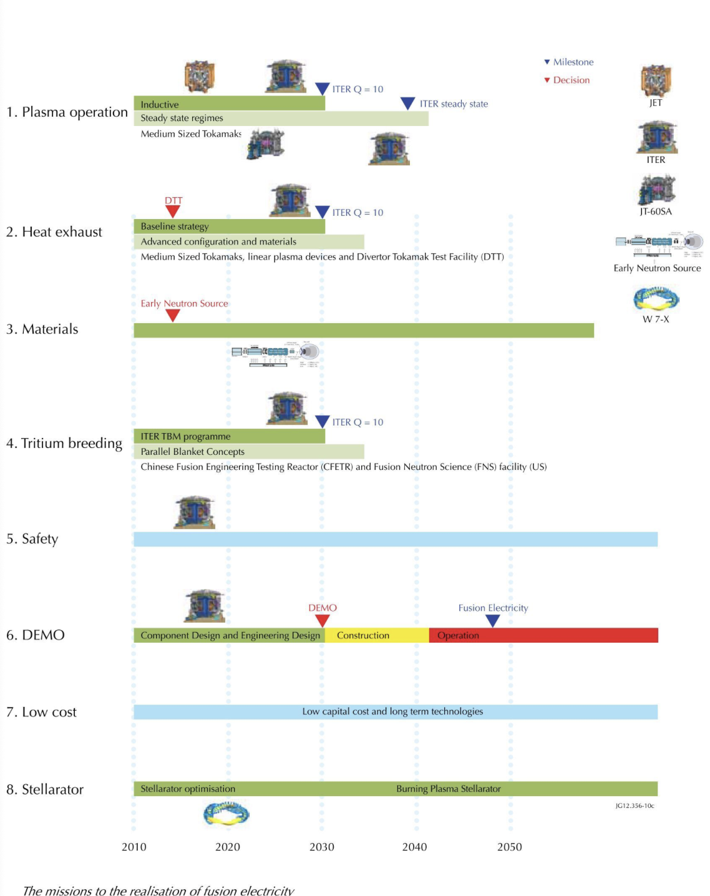

Slide 39
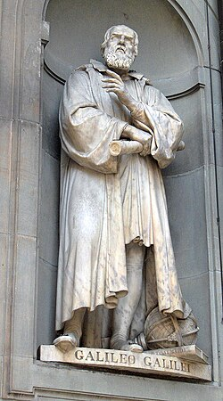
I valori dichiarati sono i target di progetto, sino ad oggi sempre rimandati
La scienza avanza formulando ipotesi e poi provando a dimostrarle
La mancata dimostrazione di un obiettivo in seguito ad un esperimento è un successo
La mancanza dell’esperimento un insuccesso
gli enunciati di per sé, non hanno alcun fondamento scientifico
Purtroppo a volte si applica un metodo che nulla ha a che vedere con il metodo scientifico, il metodo induttivo
Karl Popper critica radicalmente il metodo induttivo nella scienza, definendolo un "mito" incapace di giustificare le teorie universali a partire da osservazioni particolari. Sostiene che l'induzione non garantisce la verità, poiché un numero finito di casi non può confermare una legge generale
Questo non significa che se prendo 100 miliardi di miliardi di
nuclei di deuterio e trizio, li metto nel contenitore che dico io, li scaldo e provo a
tenerli vicini, che questi continueranno cheti cheti a scaldarsi fra di loro e a
produrre energia: deve essere dimostrato sperimentalmente
Le previsioni su quando, su come e su se
ciò avverrà, non hanno base scientifica

Slide 40
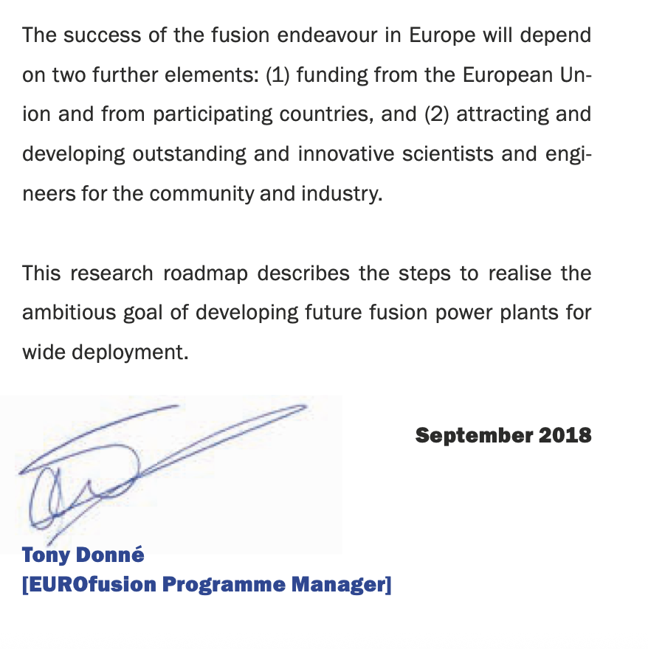
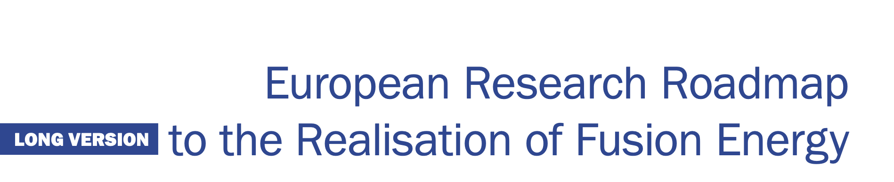
Roadmap Eurofusion 2018

Slide 41
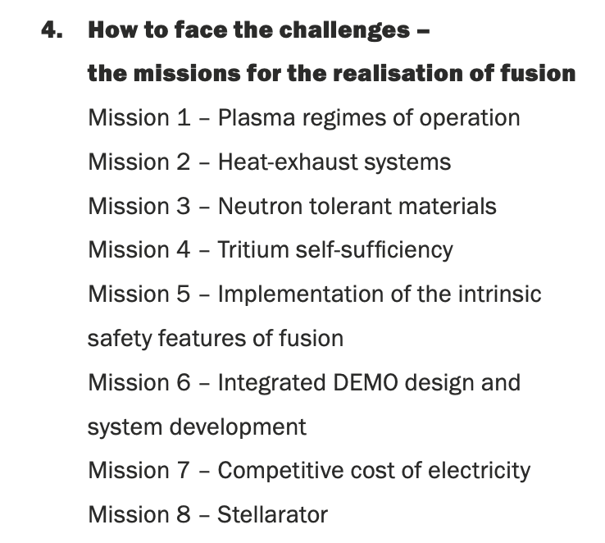
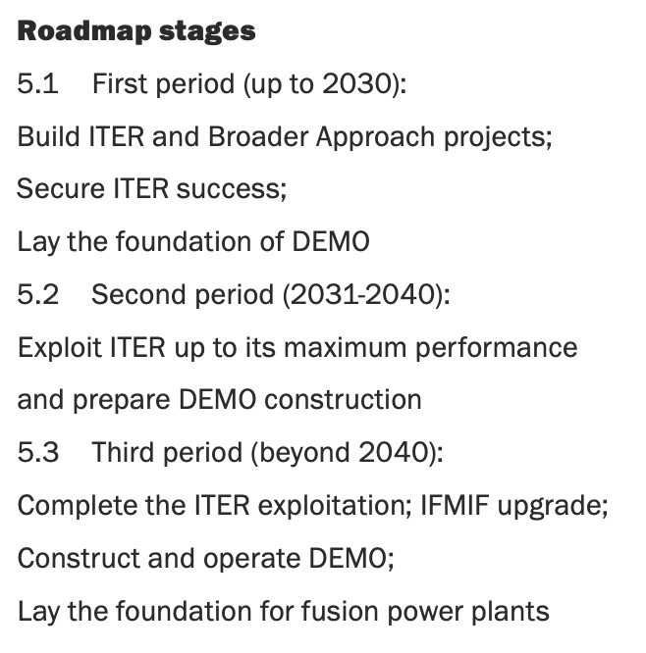
Roadmap 2018 (vs 2012)

Slide 42
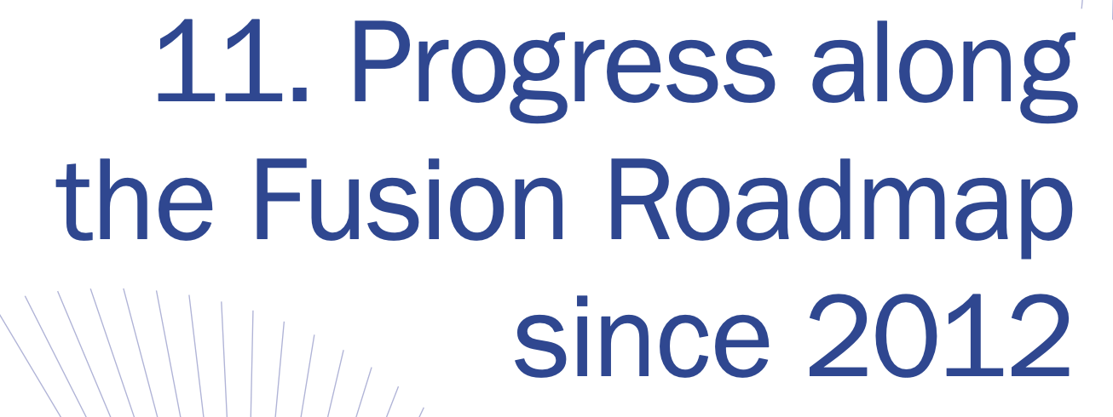
Mission 1
The EU programme has addressed operational issues of tokamaks with metallic wall for an efficient preparation of ITER, DEMO and the commercial fusion power plant.
Some of the changes in behaviour between carbon and metallic walls appears to be due to detailed changes in the edge pedestal observed on ASDEX Upgrade and JET linked to the gas fuelling used. First models have been developed
Encouraging discoveries have been made on the role of fast ions to reduce core transport…These findings, recently simulated in sophisticated integrated modelling coupled with first principles codes, underline the need for improved understanding, and expand beyond empirical scaling.
The European Transport Simulator used for integrated plasma modelling has undergone major development
ITER and DEMO need effective disruption mitigation tools, which depend on the dynamics of disruption and runaway electron beam formation
ITER (and DEMO) need edge pedestals (H-mode) if the fusion power is to be high enough.
ITER will have a preparatory non-active phase in hydrogen and helium
ITER will have ICRH heating which needs to be made as efficient as possible.
The lifetime of ITER divertor components is shortened by ELMs, and it is important to know how well ELMs need to be mitigated to allow sufficient lifetime.
ITER needs precise calibration of the neutron detectors

Slide 43
Mission 1
Mission 2
Deuterium retention studies (post-mortem analysis of retrieved PFCs and gas balance studies) in metallic wall tokamaks have demonstrated a significant reduction (by factor of 10-15) of the deuterium fuel retention with metallic first walls as compared to the previously used carbon-based first walls. The dust levels have been reduced by two orders of magnitude compared with the carbon wall.
ITER needs to be able to operate even when the metal wall components have some melted areas.
The ITER first wall components need to survive erosion for long periods before they are replaced,
For the preparation of ITER non-active operation in helium, the feasibility of using Ion Cyclotron Wall Conditioning in He plasmas was demonstrated
To protect the plasma facing components in ITER and DEMO, the divertor has to operate in partial or full detachment, and on DEMO the radiative losses from seed impurities in the main plasma need to be high. Radiative scenarios with detached plasmas have been demonstrated on different tokamaks and the effect of extrinsic impurity seeding in the core plasma explored with W divertors in different scenarios and machine sizes.
Major progress was also made in understanding filamentary transport across the Scrape-Off-Layer (SOL) in view of determining the power loads to the divertor and first wall of the machine
A credible exhaust solution for DEMO requires new experimental data and models. Following an extensive gap analysis in the field of plasma exhaust physics and technology, a number of upgrades of existing devices to study alternative power exhaust solutions (both alternative divertor geometries and materials) were initiated.

Slide 44
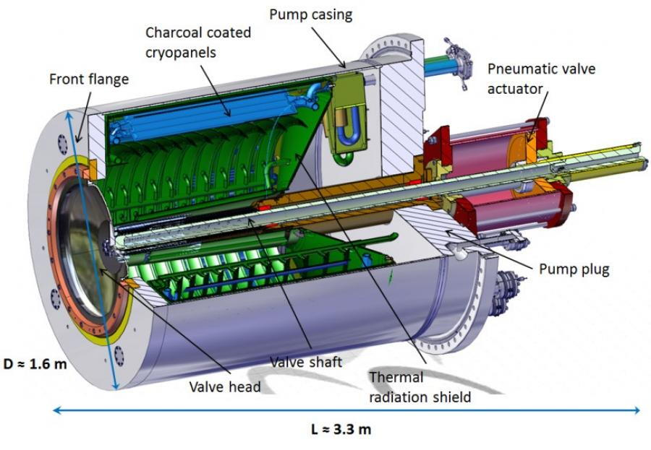
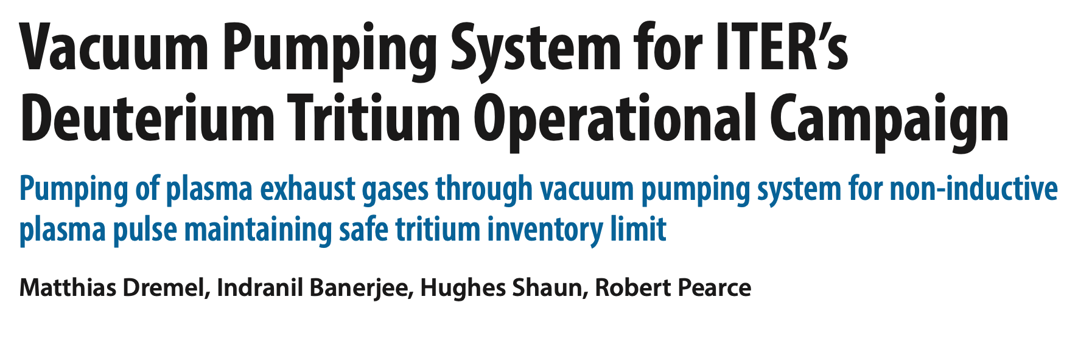
Verso la fusione nucleare?
Progettate per 50.000 cicli
1 ciclo circa 10 minuti. → 500.000 minuti 83000 ore, circa 9 anni
Valvole per 30000 cicli, 5 anni
Costo 3 M€ l’una, 8 pompe
Dispendio energetico rilevante, cicli per desorbimento acqua a 450K
DEMO avrà il triplo del volume. Il reattore?

Slide 45
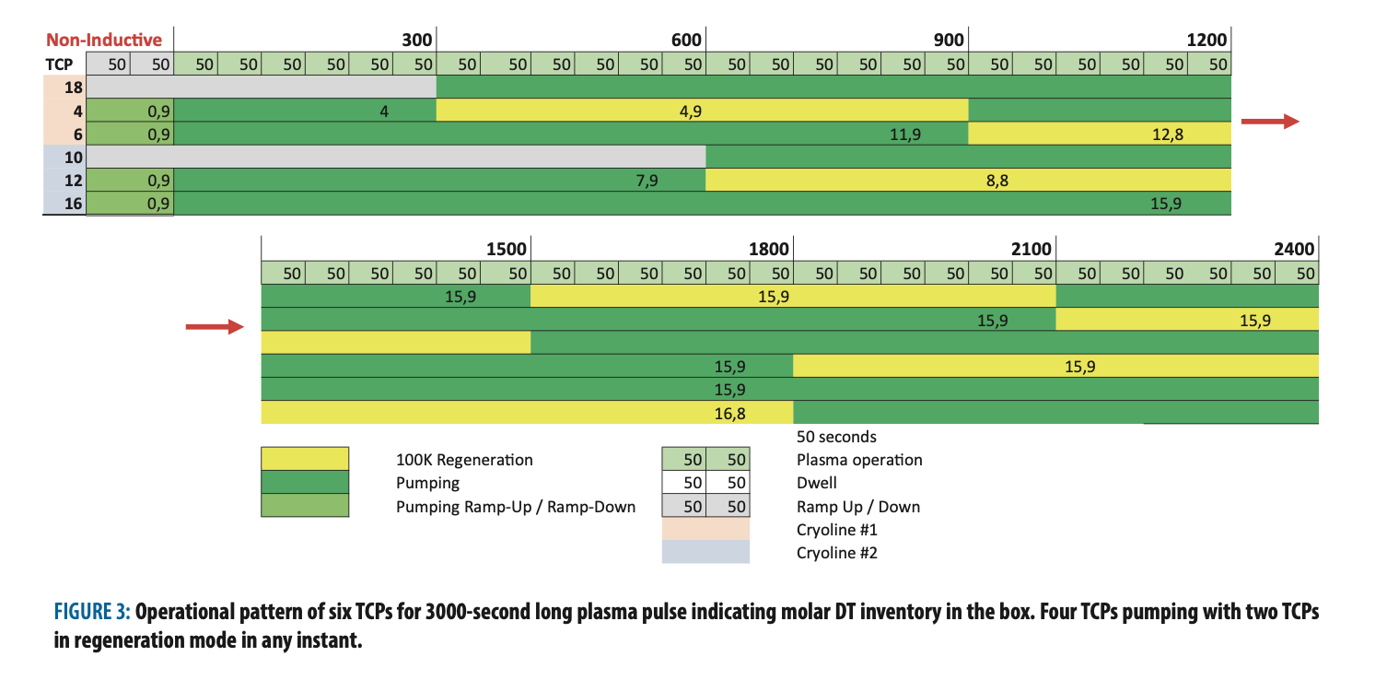
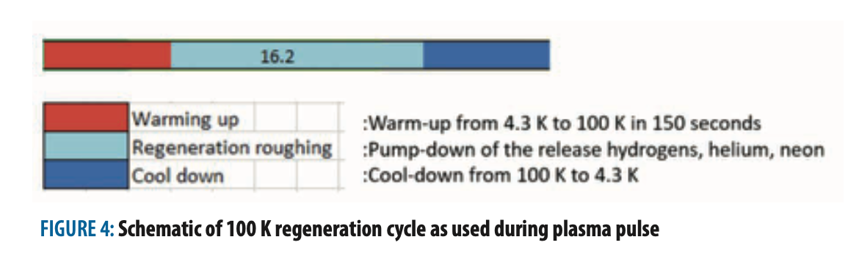
Verso la fusione nucleare?

Slide 46
Mission 3: neutron tolerant materials
DEMO requires the development, qualification and validation of (blanket) structural materials that are neutron tolerant and that can withstand 20 – 50 dpa with acceptable loss of performance.
Irradiation campaigns are underway for the baseline materials EUROFER97, tungsten and copper alloy
High Heat Flux Materials: Significant progress was made in both the maturity of newly developed fabrication technologies as well as in a growing database
Design and construction rules for mechanical components of nuclear installations:
detailed mechanical, thermo-physical and high heat flux characterization, including: plasma facing materials: particle and fibre reinforced
W materials fabricated by technologies without the final deformation step; heat sink materials: particle and fibre reinforced Cu-based materials;
W-laminates which are options for both plasma facing as well as heat sink materials;
joining technologies (W/Cu or W/CuCrZr, W/steel) and interfaces for alternative concepts (W/Cu function-ally graded materials, thermal barriers).
Functional Materials addressing insulators and optical reference materials:
Radiation stability of metallic mirrors was tested at higher doses in ion irradiation including He effects for down-selection of materials and fabrication options;
Surface dielectric properties of commercial diamond windows were characterised using different surfacetreatments, resulting in down-selection to three remain-ing options;
Irradiation modelling: Predictive capabilities wereachieved in certain areas of fusion materials modelling,
ion penetration depth profiles, and sputtering by energetic ions in the physical sputtering regime. These were done in preparation to approach the key issue of providing a set of multiscale predictive models for simulating changes of physical and mechanical properties due to exposure to neutrons under fusion power plant relevant conditions.
Early Neutron Source: The IFMIF-DONES PreliminaryEngineering Design Report was released, demonstrating that the facility is ready from the technical point of view for a site decision.

Slide 47
Missions 4,5,6,7
For Mission 4 (Tritium Self-Sufficiency) the most attractive design options for the DEMO breeding blanket have been identified and four concepts were investigated until the endof 2017.
For Mission 5 (Safety and Environment) initial safety analyses are in progress ……
For Mission 6: (DEMO design) molte chiacchiere
The high-level DEMO requirements have been defined
Sensitivity studies have been performed to determine the impact of uncertainties
A close contact has been established with Gen IV fission and ITER to learn from their project execution experience.
Competitive costs of electricity (Mission 7) has focused on reliability and availability (major overall factors in the costs of electricity), notably effective remote maintenance strategies, and early work on reducing costs of components by suitable design (e.g., the magnets). A wider scope is planned for the coming years as described above.

Slide 48
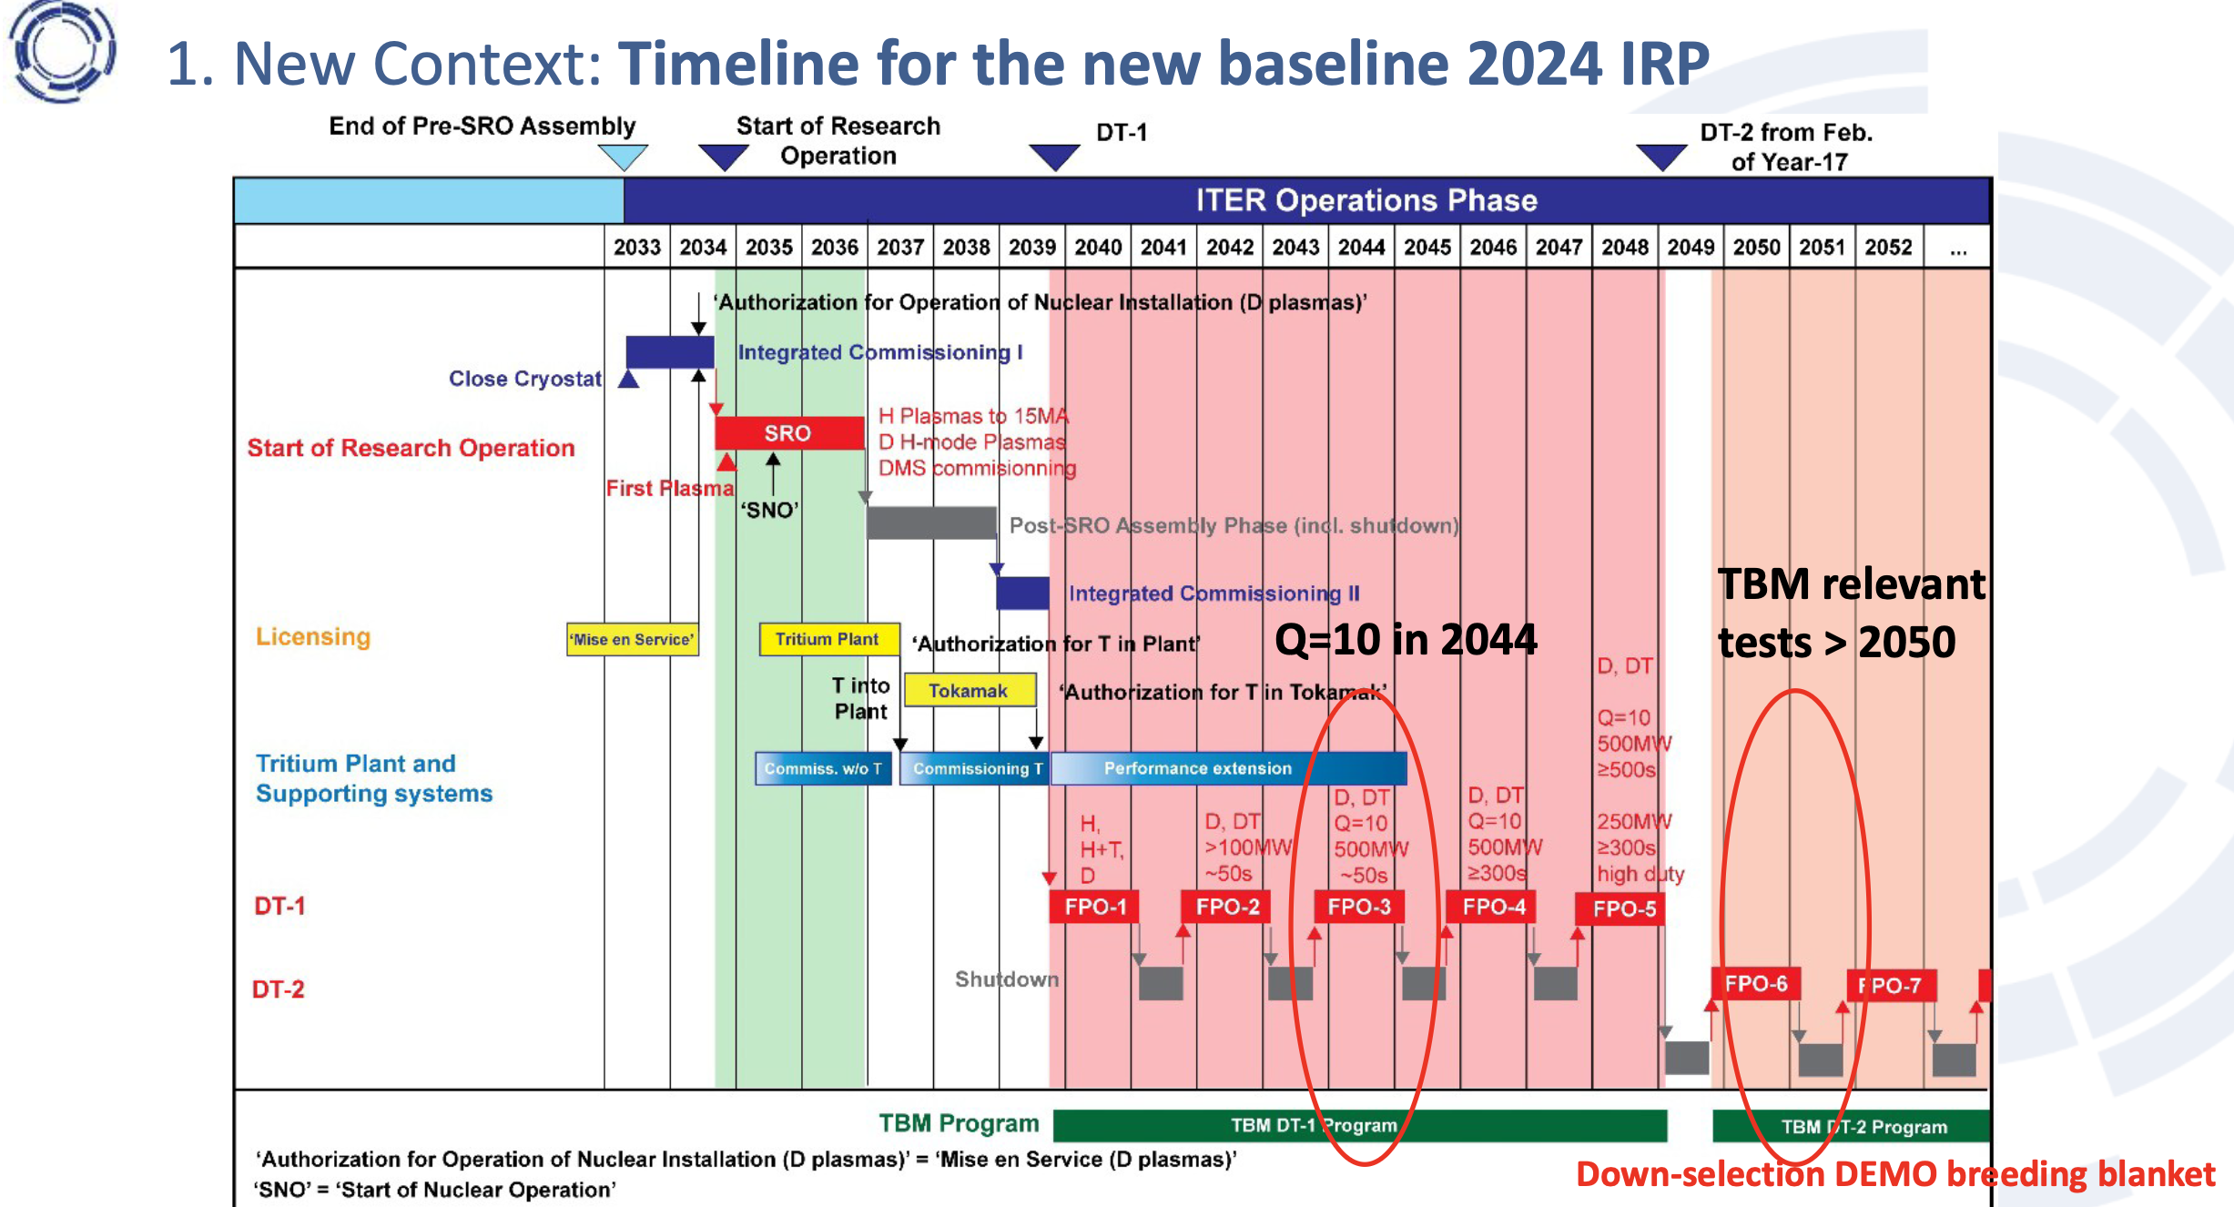

Slide 49

Ultima roadmap DOE 10/25

Slide 50
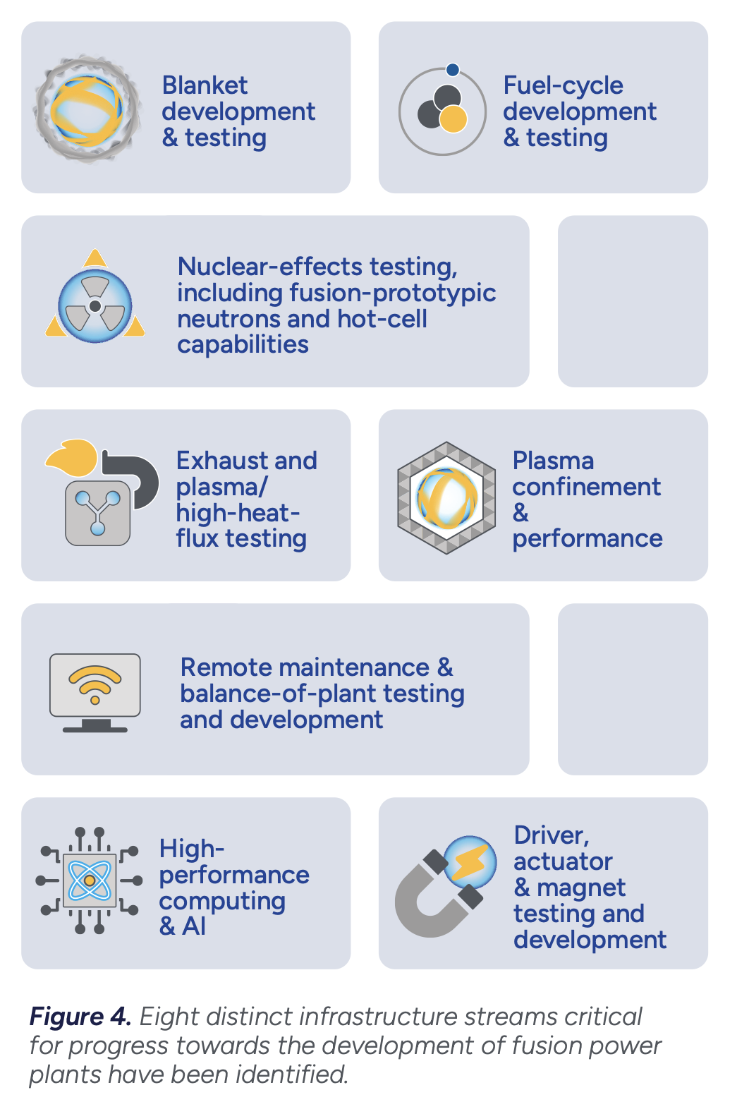
The Roadmap Strategy: Build-Innovate-Grow
Scopo del DOE: Deliver Fusion Science& Technology (FS&T) Infrastructure
In the long-term 5-10 years, DOE will deliver a
platform of small-to-midscale tritium fuel cycle
and blanket system test stands and capabilities to
address key science and technology gaps
Magnetic Fusion Energy (MFE): Bridging the
scientific gap between current confinement physics
knowledge and a robust understanding of sustained
burning plasma dynamics, which is crucial for high-
confidence extrapolation to FPPs and beyond, will
necessitate a combination of existing and future
infrastructure investments.

Slide 51
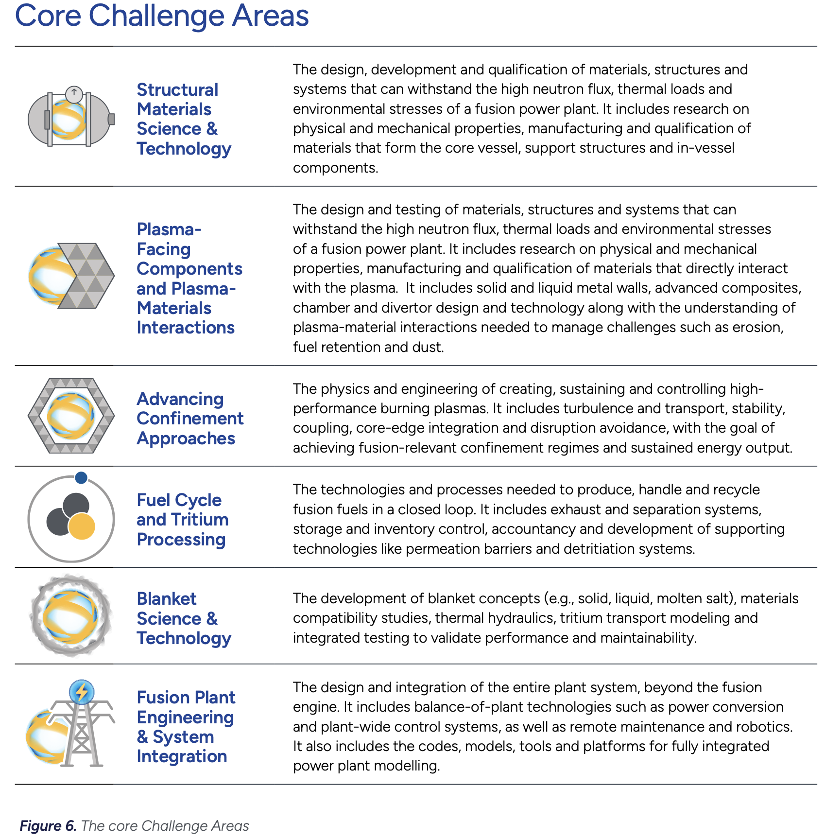


Slide 52
Liquid-Metal PFCs
The use of liquid walls with a fusion engine could
become a game-changing technology to address the
significant heat exhaust challenges in commercial
fusion power plants. The unmitigated parallel heat
flux anticipated in a compact, high-field tokamak
or spherical tokamak based fusion power plant
is estimated to be greater than 10 GW m-2 in the
divertor, which is significantly more than the MW m-2
heat fluxes generated by a propane torch

Slide 53
Cost
For reasons related to confinement physics and
engineering, the lowest-cost fusion power plant
may not be a tokamak.
Roadmap to deliver a low-cost fusion power plant
include advancing the understanding of the following:
energetic particle and burning plasma physics
relevant to a high-fusion-gain fusion power plant;
plasma-material interactions and material choices
for exhaust solutions; transport and stability physics
for sustaining disruption-free, high-average po

Slide 54
IFE-DOE
Inertial Fusion Energy (IFE): IFE has entered
a groundbreaking era, marked by significant
achievements at the National Ignition Facility (NIF). In
2022, NIF successfully achieved a burning plasma, a
pivotal step towards harnessing fusion energy. Since
this initial success, NIF has repeatedly demonstrated
burning plasma conditions, with eight successful
ignition experiments to date. The most recent of
these experiments set a new energy yield record that
delivered an impressive 8.6 MJ, more than four times
the 2.08 MJ of energy input to the target

Slide 55
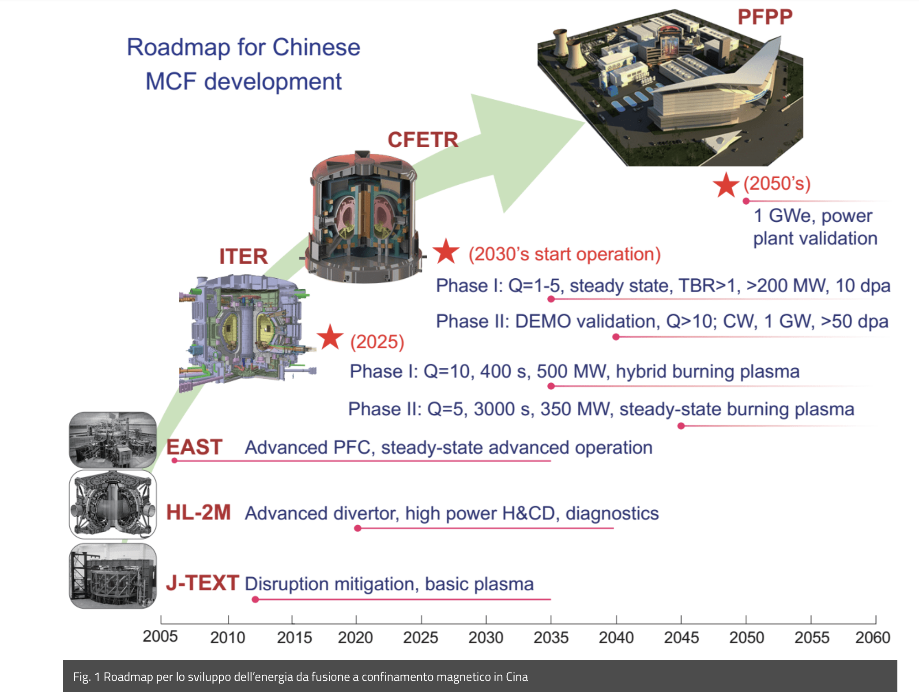
Chinese roadmap Jangang Li 2019

Slide 56
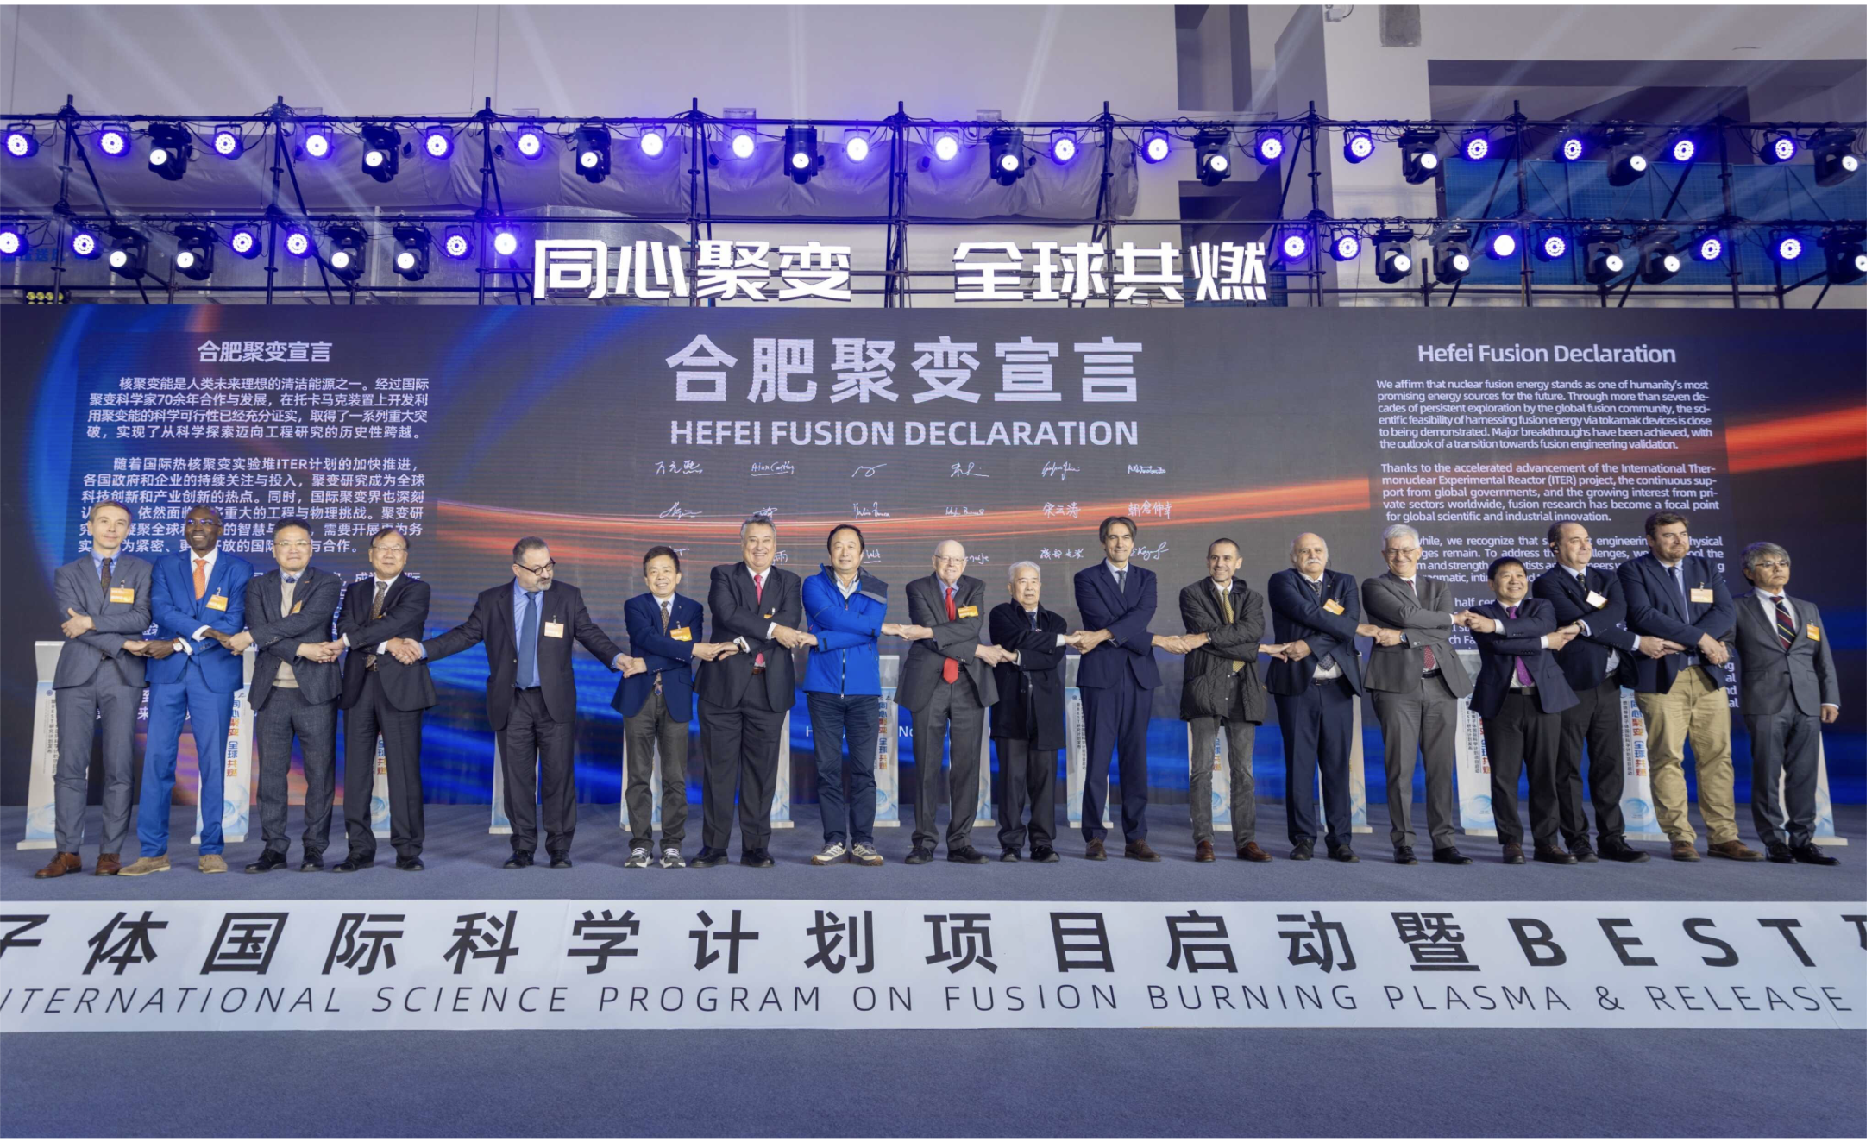


Slide 57
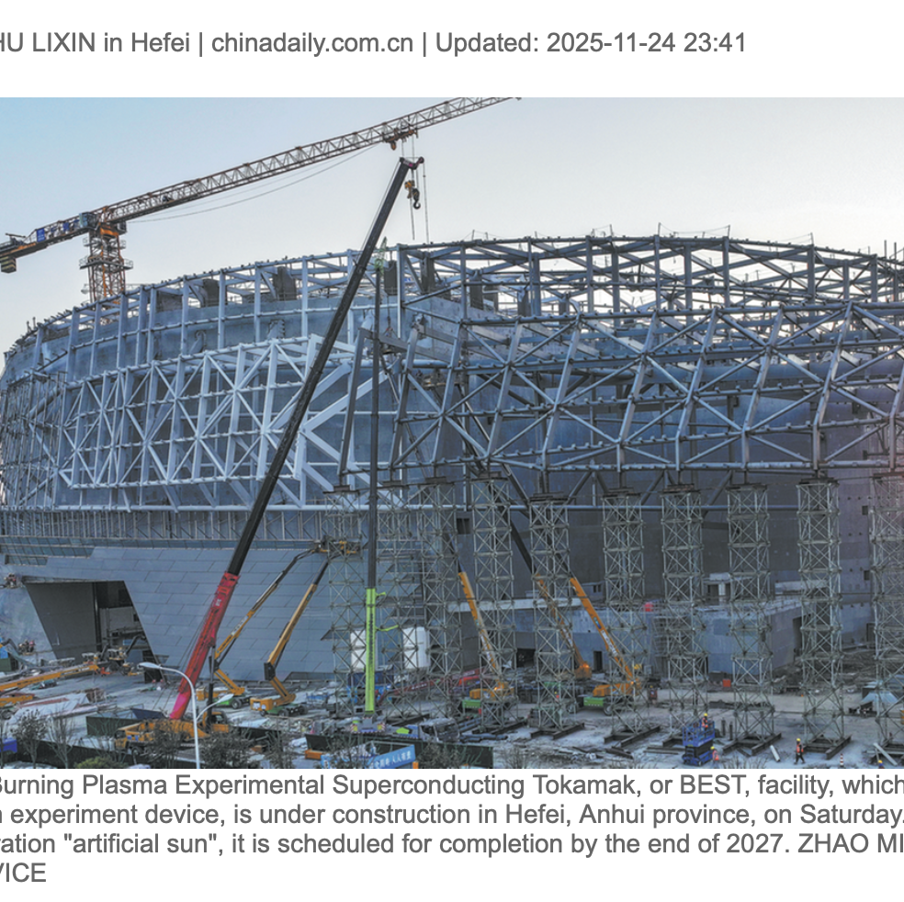
Costruzione iniziata nel 2023
Key Schedule and Goals for BEST (Hefei):
Construction Completion: The facility is scheduled to finish construction by the end of 2027.
First Plasma: Initial plasma experiments are anticipated in late 2027, with the project entering a new stage of burning plasma research.
Performance Goals:
Fusion Power: Generate 20 to 200 megawatts of fusion power.
Energy Gain: Achieve a fusion gain factor of 1<Q<5 (producing more energy than consumed).
Operational Goal: Achieve net energy gain and demonstrate electricity generation by around 2030.
R=3.6m. a=1.1m (Compact design for high-field performance).
Magnetic Field (Bt): 6.15 T, utilizing superconducting technology to confine plasma at over 100 million degrees Celsius.
Plasma Current (Ip): 4–7 MA.
Goal: To test advanced steady-state D-T operation,
tritium breeding/cycling, and high-heat-flux materials
(divertor).

Slide 58
Sviluppo degli impianti per lo studio della fusione nel mondo

Slide 59
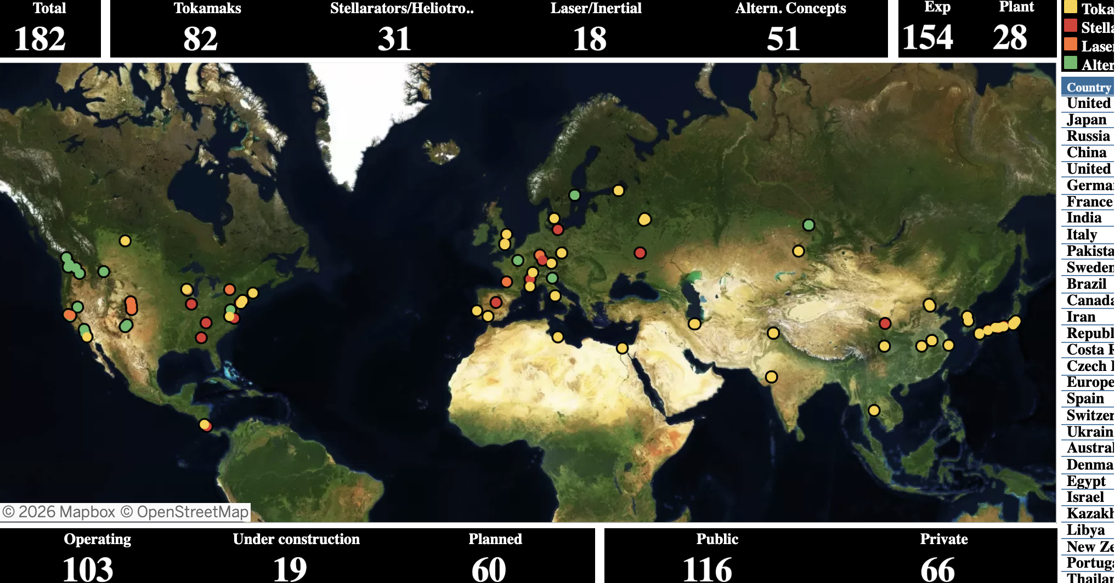
Impianti sperimentali e facilities per lo studio della fusione

Slide 60
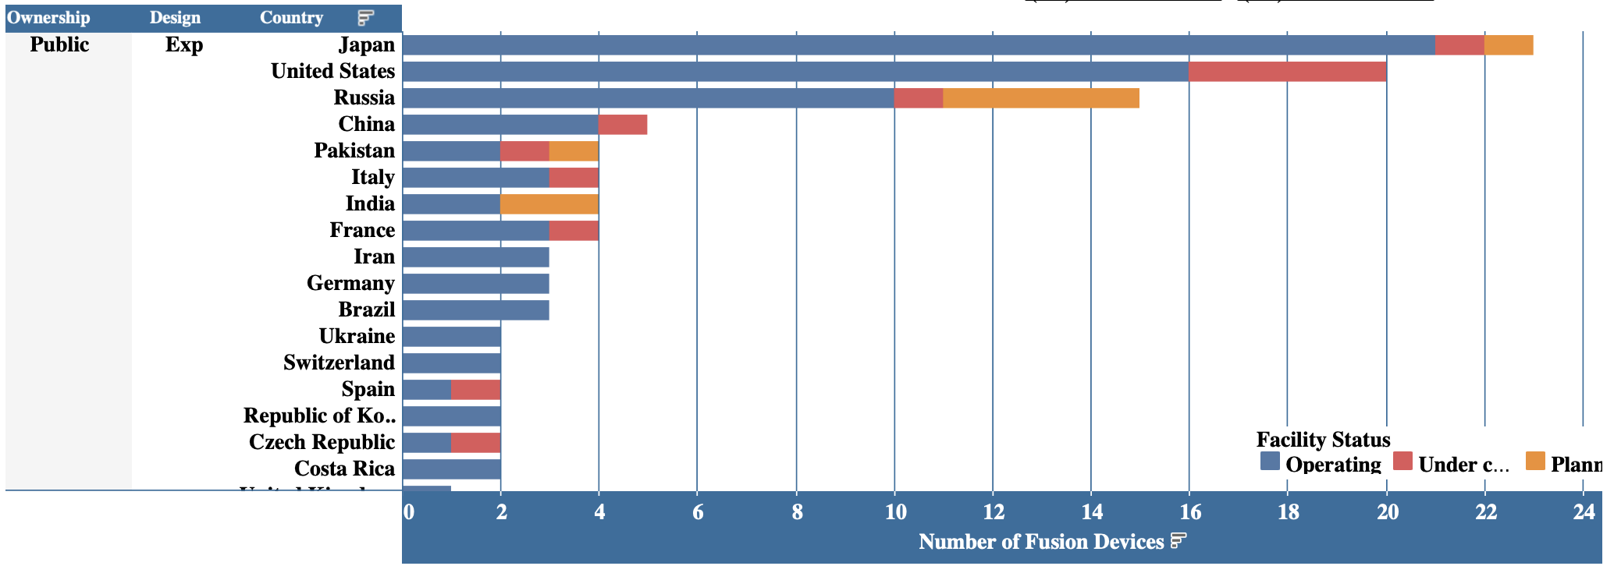
Impianti sperimentali pubblici per lo studio della fusione
Fonte IAEA fusion portal
https://nucleus.iaea.org/sites/fusion-portal/SitePages/FFDB.aspx?web=1

Slide 61

Impianti sperimentali privati per lo studio della fusione

Slide 62


Slide 63



Helion venderà energia elettrica a Microsoft PPA a partire dal 2028 utilizzando il suo reattore da 50MWe a conversione diretta che diventeranno 500 MWe a partire dal 2030; nel 2014 era il 2020, nel 2020 il 2024, nel 2024 il 2028……..
CFS ha stipulato PPA da 1B$ per la vendita di energia elettrica dal suo impianto ARC da 400MW a partire dal 2035
Ha raccolto oltre 1 B$

Slide 64
A che punto siamo

Slide 65

Fattore di guadagno Q
Q _{scientifico} =P_{in}/P_{fus} Pareggio Q=1
Q _{ingegneristico} (P_{in}/0.3)=P_{fus}*0.8*0.8*0.35
P_{in}= 20 MW →60MW_{e} alla spina pareggio con Q=15 ovvero P_{fus}=300MW_{th}*0.2=60 MW_{e}
Con bilancio completo (criogenia, sistema da vuoto, pompe idrauliche, diagnostiche, analisi e immagazzinamento dati, ecc…….., In realtà la potenza immessa in rete inquadrata in modo olistico

Slide 66
Stato della fusione
Macchine con supporto europeo
Il Jet è stato il faro della ricerca europea
ITER nel 2006 annunciato primo plasma nel 2016 https://news.newenergytimes.net/2021/10/26/iter-timeline-delayed-again-first-experiments-most-likely-in-2031/, in ritardo di 20 anni previsione 2035, DT speriamo 2042-2044
DTT , nel 2020 annunciato primo plasma 2025, in ritardo di 7 anni, 2032. Full power anni ’40, no DT, indispensabile NBI, indispensabili 45 MW
JT60-SA in ritardo di circa 10 anni, scarica politica 2023, ancora in fase di sistemazione, annunciata prima campagna sperimentale per fine 2026, no DT. Riparazioni con probabilità di successo non totale
RFX in ritardo indefinito, ferma da molti anni
L’Europa manifesta la sua crisi culturale anche nella fusione
Cina e USA entrano in competizione diretta anche su questo campo
USA
SPARC (Smallest Possible ARC, where ARC for Affordable, Robust, Compact) rapida costruzione (4 anni), annunciato ritardo di 1, probabilmente 2 anni, DT previsto ma ancora non programmato, probabile inizio anni ‘30, Q>1, teoricamente fino a 11.
CINA
BEST (Burning Experiment Superconducting Tokamak) in rapidissima costruzione previsto entrata in funzione novembre 2027, DT early ’30, Q=5
La corsa fra Cina e USA vede in forte ritardo l’Europa
Per l’inerziale USA molto avanti, almeno noi abbiamo il vecchio ABC

Slide 67
La macchina europea JET
Ha consentito all’Europa di mantenere la leadership sulla fusione per 40 anni, persa poi a causa dei ritardi di ITER
Costruita in tempi accettabili
Funzionato per 40 anni
Accolto scienziati da tutti i team, la divisione PLAS ha sempre incoraggiato la partecipazione alle attività della macchina;
Contributo Enea sia con partecipazione e coordinamento campagne sperimentali, diagnostiche, che con ricercatori in in distacco
team sperimentale di alto livello
Prodotto ottimi risultati, molto utili
Gli esperimenti sono un successo se producono risultati, sia che questi siano in accordo con le aspettative
che in contrasto, ma anche in chiave opaca, producendo ulteriori interrogativi; questo è il percorso della Conoscenza;
sono un fallimento se non producono risultati.
Se i risultati si distorcono secondo il piacere delle lobby del momento diventano una sconfitta per la comunità scientifica
Accendere un piccolo sole è difficile, molto difficile, ma può essere di grande sollievo per l’umanità: se mai l’energia
dovesse scarseggiare un giorno gli uomini si distruggeranno per averne il controllo.
Cerchiamo di prevenire questo momento.

Slide 68
Le campagne sperimentali con trizio
Due macchine a fusione hanno ad oggi immesso trizio all’interno del Tokamak,
TFTR (USA) e JET (UK) entrambe con l’obiettivo di raggiungere Q=1.
La prima ha effettuato una campagna di misure nel 1994, ha prodotto 10.7 MW di fusione a fronte di un input di 39.5 MW, con Q_{sci}=0.27
https://minds.wisconsin.edu/bitstream/handle/1793/10484/file_1.pdf?sequence=1&isAllowed=y
Il Jet ha effettuato tre campagne: DTE1 nel 1997, DTE2 nel 2021 entrambe indirizzate anche alla ricerca delle massime performances, e DTE3 nel 2023 indirizzata principalmente su studi specifici quali materiali, confinamento, ma che ha anche ottenuto la migliore prestazione in termini di energia prodotta.
Per il Jet è interessante il confronto fra i risultati ottenuti nelle campagne DTE1 e DTE2 del 1997 e del 2021, per spari che avevano fra gli obiettivi anche quello di ottenere dalla macchina le massime performance possibili.
The Tokamak Fusion Test Reactor (TFTR) was an experimental tokamak built at Princeton Plasma Physics Laboratory (PPPL) circa 1980 and entering service in 1982. Shut down in 1997
JET (Joint Europena Torus) progettato negli anni ’70 e realizzato a Culham (UK) ha iniziato a funzionare nel 1983. Da allora ha avuto diversi corposi aggiornamenti. Ha terminato la sua attività nel 2023

Slide 69

Campagna DTE1, 1997
Di seguito è mostrata la figura 1 riportata sull’articolo scientifico https://iopscience.iop.org/article/10.1088/1741-4326/ad3e16, primo autore Costanza Maggi, la voce ufficiale del team sperimentale del JET. Tutte le successive informazioni sono tratte dal suddetto articolo.
Le migliori scariche ottenute in DTE1:
Il primo picco traccia grigia con 16 MW di potenza di fusione (campagna 1997) si ottiene in un regime privo di interesse reattoristico (hot Ion mode) con gli ioni più caldi degli elettroni; ma siccome in un reattore sono gli elettroni che riscaldano gli ioni questo regime non è di interesse, perdipiù in un regime fortemente transitorio (circa 100 ms). Corrisponde al Q più alto mai ottenuto su un Tokamak Q=0.68. Evidentemente è un breve transiente
Il secondo risultato traccia grigia ottenuto in DTE1 (1997) corrisponde ad un regime definito stazionario (ELMy H-Mode), in realtà la scarica viene terminata volontariamente a causa del manifestarsi dell’inizio della formazione di un GiantELM (Edge Localized Mode), una piccola disruzione. Pertanto, non è definibile come stazionario, ma un regime nel quale si sviluppano fenomeni potenzialmente dannosi incompatibili con le modalità di funzionamento di un reattore, o anche di ITER.
In queste condizioni si ottiene un Q=0.25, praticamente lo stesso valore del TFTR.

Slide 70
Campagna DTE2, 2021
Nella nuova campagna, effettuata a 24 anni di distanza, dopo profende modifiche tecnologiche,
nuovo divertore
Nuovo materiale di prima parete (ITER relevant, da carbonio a tungsteno berillio)
Potenziamento dei sistemi di riscaldamento addizionale passati da 25 a 40 MW.
Estensivamente remotizzato (remote handling system)
Continui aggiornamenti (€1.6 billion for the period 2014-2018)

Slide 71

Confronto campagne
Questo è il grafico riportato sul sito di ITER (https://www.iter.org/node/20687/jet-makes-history-again), la didascalia è:
The results confirm that sustained high-fusion energy production is achievable using the D-T fuel mix planned on ITER and future devices. They also show that the fusion community has the capability to model what will happen in a fusion reactor. (UKAEA)
il grafico riporta il confronto tra energia prodotta nella migliore scarica del 1997 DTE1 e la migliore del 2021, DTE2: 22 e 59 MJ, rispettivamente in 6 e 7 s.
E’ evidente che la curva relativa alla campagna recente, quella rossa, mostra esattamente il contrario di quanto riportato nella didascalia, la potenza di fusione decresce durante la scarica ovvero il plasma non tende ad accendersi, ma più energia si mette dentro più diminuisce la potenza da fusione

Slide 72

Base line scenario è quello che se applicato su ITER si pensa di avrà in DT un Q=10, le massime prestazioni.
Purtroppo, non si riesce al JET ad ottenere un regime stazionario, come si vede dalla traccia della potenza di fusione (DT fusion power), che raggiunge il valore massimo di potenza da fusione dopo circa due secondi, per poi iniziare a calare.
Il picco di potenza è di 8.3MW, a fronte di 34 MW in ingresso, ovvero ancora Q=0.25, ma perdipiù in condizioni palesemente non stazionarie, e con un plasma che pur in presenza di un input di potenza costante diminuisce nel tempo la potenza di fusione prodotta.
Questo è dovuto al ristagno di impurezze ad alto Z, tungsteno, all’intero del plasma che fanno aumentare notevolmente la “bulk radiation” (curva nera).
E’ evidente che qualora si aumentasse di più la potenza in input il plasma collasserebbe immediatamente, anche con rischi di danneggiamento della macchina.
Pertanto, questa che è riportata come la migliore scarica ottenuta dal JET nel regime più “reactor relevant” possibile, è poco confortante.
Lo stesso Q di 24 anni prima, scarica contaminata da impurezze, potenza di fusione decrescente così come le temperature elettronica e ionica.
Figure 2. Best performing 50–50 D–T JET baseline scenario pulse in DTE2 (#99948, 3.5 MA/3.35 T, 30 MW NBI, 4 MW ICRH, D-pellet pacing). From top to bottom panel: (1) NBI power, bulk plasma radiation and ICRH power; (2) outer divertor Be II line intensity used as ELM marker; (3) plasma stored energy; (4) D–T fusion power; (5) core T_{e} (from ECE) at ρ_{tor} = 0.0 and T_{i} (from CXRS) at ρ_{tor} ∼ 0.2.

Slide 73


Simulazioni a piena potenza
Non potendo immettere più potenza il team del Jet ha provato a vedere mediante simulazioni cosa sarebbe potuto succedere estrapolando alle condizioni estreme raggiungibili nel JET (40MW di potenza addizionale), ovviamente trascurando la l’aumento della radiazione che fa collassare il plasma, insomma in condizioni ipoteticamente ottimali. I risultati sono ancora più scoraggianti, il Q non cresce (vedi figura ) arriva al massimo a 11 MW di fusione a fronte di 40 MW in input, la massima potenza disponibile al JET. E questo in condizioni ideali molto migliorative rispetto a quelle reali.
Rimane Q=0.27 $±0.07$
Figura 3 Estrapolazione ottenuta dai codici alle condizioni di massima potenza disponibile al Jet. Le stelle gialle sono i punti sperimentali ottenuti, gli altri punti estrapolazioni di diversi parametri.

Slide 74

Hybrid scenario
Le stesse misure sono state ripetute con uno scenario di plasma diverso (Hybrid scenario) potenzialmente ritenute per alcuni aspetti più reactor relevant in quanto lo scenario candidato alle operazioni di ITER con impulsi lunghi (>1000s); in tali condizioni il Q previsto è di 5.
Andando a scegliere la parte della scarica a Pfus massimo, si ottiene Q=0.32 se mediato su un secondo, mentre mediando su 5 secondi si ottiene Q=0.25. Questo con 34MW di potenza addizionale. Nella campagna DTE1, in condizioni di potenza da fusione crescente con il tempo, si era ottenuto su 5 secondi Q=0.18, ma in tal caso la Pin era 23.8 MW. Estrapolando per Q=5 servirebbero 660 MW
Figura 4 Time traces of main parameters of the JET DTE2 hybrid H-mode pulse #99950 (2.3 MA/3.45 T, 50–50 D–T), which set a new record fusion energy of 45.8 MJ in a 50–50 D–T mixture. Reproduced from [51]. © EURATOM 2023. CC BY 4.0.

Slide 75

Beam target
In figura 4 è inoltre riportato il risultato della simulazione ottenuta mediante il codice TRANSP (https://www.sciencedirect.com/science/article/pii/S0010465525001134) ; Scopo del calcolo è separare il contributo alle reazioni di fusione ottenuto da interazione diretta target (vedi traccia azzurra), da quelle che invece avvengono all’interno del plasma. E’ infatti evidente che le prime nulla hanno a che fare con il funzionamento di un reattore, ma sono l’effetto di interazione fra il beam ed il plasma utilizzato come un bersaglio, sostanzialmente gli esperimenti condotti dagli acceleratoristi per gli studi di fisica pura, a ben altre energie.
Il codice stima una percentuale del 60% da beam target ed il restante 40% realmente termonucleari, all’interno del plasma.
Ma non è viene riportato l’errore da attribuire al risultato, né come il codice sia stato validato, visto che misure relative alle due frazioni non ce ne sono.
Nel recente articolo che descrive il codice
(https://www.sciencedirect.com/science/article/pii/S0010465525001134) è riportato:
“While interpretive analysis can be challenging due to the difficulty in isolating separate aspects of the problem, it provides a comprehensive understanding of the complex interactions within the tokamak plasma, which is crucial for optimizing its performance. “
Si tratta di un codice che acquisisce gli input da altri codici che evidentemente è utilizzato più per provare a comprendere che per fornire risultati numerici; evidentemente una stima dell’errore del risultato è fuori dalla portata di questo strumento.
Ammesso che risultati di un codice senza valutazione dell’errore e senza riferimenti alla sua validazione, agli input utilizzati e come desunti, possano avere un qualche interesse, si evince che non solo il Q è estremamente modesto, ma in gran parte ottenuto con reazioni beam target, che nulla hanno a che fare con il plasma reattoristico. Essendo la potenza di beam aumentata nell’ultima campagna è evidente che si ottiene più energia da fusione, ma non è dato saper se ce ne sia la benché minima percentuale da fusione termonucleare, e non da interazione diretta beam taget.

Slide 76

Scarica record
Nel tentativo, o nella necessità, di ottenere risultati migliori, si è cercato di spostare i parametri del plasma completamente al di fuori del possibile interesse reattoristico, realizzando un plasma di solo trizio sul quale vengono sparati, mediante la NBI, atomi di deuterio ad elevata energia, circa 120kEv.
In questo modo l’esperimento è evidentemente il più possibile beam driven, ovvero è un esperimento relativo ad un fascio di particelle (D) che urtano su un target (il plasma di T)
Questo non ha nulla a che vedere con la fusione magnetica, i Tokamak, i reattori e gli scenari di plasma ad essi estrapolabili, dove necessariamente il plasma deve essere 50%D e 50% T.
In tal caso si è riuscito ad ottenere il record di produzione di energia di 59 MJ, sempre con un Q bassino, fra 0.33 per 5 s e 0.38 per 2 s, comunque in condizioni non stazionarie, ma con potenza di fusione calante, ovvero un plasma che più lo si scalda più si raffredda.
Risultato completamente inutile e quantitativamente deludente.
Comparison of the two best performing T-rich hybrid pulses at similar input engineering parameters: #99971 (magenta), with sustained high fusion power = 10.1 MW for 5 s and #99972 (green) with higher P_{fus} = 12.5 MW for 2 s, but degrading later in the discharge due to core impurity accumulation. Reproduced from [38]. © 2023 Crown copyright, UKAEA. CC BY 4.0.

Slide 77

Overall DT campaigns
https://iopscience.iop.org/article/10.1088/1361-6587/adbd75
Fusion power produced in JET in DTE1 (ELM-free H-mode #42976 and ELMy H-mode #42982, in grey), DTE2 (hybrid scenario with #99869 in blue, T-rich hybrid scenario #99971 in red) and DTE3 campaigns (T-rich hybrid scenario #104522 in orange, Ne-seeded ITER baseline scenario #104600 in purple, JET baseline scenario #104663 in teal).
The tritium stored in different regions of the vessel should be limited to comply with safety regulations. During operations, excessive tritium retention would mean that operations cannot continue until the tritium inventory is reduced below the safety limits. In addition, high tritium retention limits the amount of tritium that can be used to fuel the plasma, placing additional demands on the tritium breeding ratio in fusion power plants. Therefore, the quantification of the fuel retention and the characterisation of the tritium cycle is crucial information for ITER and any future fusion device.

Slide 78

Tutto da rifare?
A key message from these results is that, in the absence of performance degrading MHD or impurity effects, a higher heating power would be expected to lead to a further increase in the fusion power. If this could be maintained at a constant level, a higher 5 s averaged fusion power would result. The experimental fusion power obtained is a non-linear function of input power, best fitted with a quadratic (or higher order) function, as illustrated in figure 23. In this figure only data during the power ramp-up and in the heating flattop is included. It should be noted that the low input power points are generated mostly in the power ramp-up phase, which means that the fusion powers determined for these points include the transient phase at the H-mode entry. This means that the trend in figure 23 may be slightly different to that of an input power scan in otherwise similar conditions. This trend is similar to observations in Deuterium only.
Bisogna modellizzare e validare, teoria ed esperimenti
Figure 23. Obtained fusion power compared to D-T equivalent fusion power from pre-D-T reference as function of input power (ITB phase removed).
Nuclear Fusion, Volume 63, Number 11, J. Hobirk et al

Slide 79
Conclusioni JET
I risultati forniscono una enorme quantità di informazioni, indispensabili per procedere
I risultati ottenuti in termini di Q_{sci} sono sostanzialmente gli stessi di 24 anni prima (se non inferiori) e gli stessi di TFTR (27 anni prima)
Le condizioni ottenute sono molto distanti da quelle pensabili in un futuro reattore (percentuale di particelle alfa trascurabile), e ottenute in condizioni o palesemente non stazionarie o marginalmente tali, spesso in scenari privi di significatività scientifica, bisogna fare di più
L’aumento della potenza in ingresso da 25 a 34 MW sembra peggiorare le cose. Ciò significa che siamo ancora lontani dal riuscire ad ottenere condizioni prossime alle reazioni a catena necessarie all’autoriscaldamento del plasma, quelle condizioni alle quali la fusione inerziale sembra si stia affacciando.
In molti casi più si scalda il plasma più questo si raffredda, cosa che fa dubitare che ulteriore potenza addizionale avrebbe potuto migliorare i risultati, come anche mostrano le simulazioni effettuate in condizioni ideali.
La evoluzione tecnologica della macchina si è rivelata parzialmente efficace, visto che non si riescono a controllare le impurezze ad alto Z che entrano nel core del plasma, aumentandone la radiazione, ma la ritenzione del trizio è migliorata

Slide 80
Conclusioni 2
Rimane ancora molta incertezza su quali potrebbero essere gli scenari di plasma futuri, in realtà ancora non si è trovato uno scenario soddisfacente, ITER avrebbe dovuto fornire questa informazione, speriamo arrivi quanto prima e che sia positiva
è necessario intensificare gli sforzi per approfondire la comprensione dei fenomeni di base, tanta teoria e tante simulazioni, tanti esperimenti ma in condizioni rappresentative.
E’ necessario comprendere meglio i meccanismi che regolano la diffusione delle impurezze e cercarla di ostacolarle (barriere di trasporto), o riuscire ad estrarle prima che inizino ad entrare nel core del plasma. In DTE3 dei passi in avanti sono stati fatti
Si evidenzia un importate effetto isotopico che porta ad una maggiore produzione di impurezze a causa della presenza del trizio, con massa maggiore rispetto al deuterio . E’ pertanto evidente che gli esperimenti necessari ad un ulteriore progresso non possono che essere con macchine in DT, pena la non rappresentatività delle misure per un futuro reattore.
E’ oltremodo chiaro che in queste condizioni, il contributo di ditte esterne o di accordi pubblico privato sono di marginale utilità; i fisici del plasma sono i soli in grado di comprendere cosa succede e provare ad immaginare una soluzione. Queste persone lavorano in ENEA o in luoghi simili, non di certo nelle industrie, che hanno il compito primario di far tornare i conti economici

Slide 81
Bilancio energetico di un ipotetico reattore

Slide 82



Demo electricity consumption
HCPB version > 500MWe
Energies 2020, 13(9), 2269; https://doi.org/10.3390/en13092269

Slide 83

Energies 2020, 13(9), 2269; https://doi.org/10.3390/en13092269

Slide 84

Overall plant energy consumption
Nominal SSEN active and reactive powers in each plasma phase, option HCPB
Demo ultima versione dichiara 1652 MWth e 350 MWe netti in rete, ovvero 536+350=886 prodotti,
rendimento del 54%, impossibile. Considerando 33% si hanno 545 MWe

Slide 85


Slide 86
Produrrà mai energia?
Un EPR ha il 36/37% di efficienza, misurata.
Se DEMO avesse la stessa efficienza 1652X0.37 =611MWe, confrontabili ai consumi durante la scarica: Il DEMO team si limita a dire che assume una efficienza overall del 20% già epurata dei consumi della macchina, con un valore di MWe netti in rete di 350+/-50.Dalle referenze non si traggono informazioni utili
Quindi, considerando i 536 MWe di autoconsumo, produrrebbe 886MWe….54% di rendimento 🤭
La complessità delle geometrie di un reattore a fusione rendono difficile credere ad una sua maggiore efficienza rispetto ad uno a fissione, un pentolone con a bagno gli elementi di combustibile che scambiano direttamente con il refrigerante senza perdere un W
Demo assume che il liquido di raffreddamento del divertore possa essere mandato in turbina malgrado la permeazione da trizio
Con un conto realistico *0.8 neutron energy*0.8 geometric factor=0.64*1.2 exothermal reaction=0.77*0.33=0.25 , quindi con 1652 MWth= 413 MWe da cui detrarre gli oltre 500MWe dei consumi elettrici…quando in funzione
Per il reattore finale avesse la stessa potenza termica di un EPR 4.6 GWt*0.33= 1530 MWe…….consumi >>>>9x536????MWe……dwell time-20%??…….load factor-30%….
Il blanket sembra vada rimpiazzato ogni 5 anni, se si trovano materiali idonei, il divertore almeno sostituite le tegole, tutto in remote handling, tempi e costi proibitivi
Un EPR ha 4.6 GWt, produzione lorda 1.77 GWe, netta 1.65 GWe load factor 85-95% (misurato)

Slide 87
Prestazioni di un futuro reattore
NWL = 80 % P_{fus} / A_{Wall}, with A_{wall} being the surface area of the plasma-facing wall. Too low values of the NWL correspond to an unattractively large device with respect to the produced fusion power. We consider a NWL target of ∼1 MW/m² as reasonable, which lays in between the ITER target of 0.57 MW/m² [26] and ∼2 MW/m² as considered for fusion power plants in the PPCS [36].
1.0 MW/m3
The target for the net electric output of the DEMO plant is defined in [1] as “hundreds of MW of electricity”. With common assumptions regarding the heat conversion efficiency and recirculating power for various DEMO systems, this translates into a requirement for the fusion power of P_{fus} = ∼2000 MW, which corresponds to a net electricity output of 400–500 MW, Fusion Engineering and Design,Volume 204, July 2024, 114518
Rendimento 20-25%

Slide 88
Ma la fusione è prestazionale?
Formula1 1050 CV, cica 750kW, volume 1.6l, circa 500kW/l
Panda 45 kW, volume 1l, 45 kW/l, autotreno 13l 450kW, 35kW/l
Reattore fusione 1 MW/m³ (ipotetici) progettazione 2025, limitato dal neutron load factor, 1 MW/m²
Reattore fissione 89,3 MW/m³ (misurati), progettazione 2000 Nuclear Engineering and Design,Volume 187, Issue 1, January 1999, Pages 79-119

Slide 89

Fusion-fission hybrid systems
In a hybrid reactor, the neutron flux emerging from nuclear fusion reactor is used to induce fissions (or transmutations) in a fission blanket in subcritical mode (k<1).
FFHS can contain a blanket for:
Energy generation
Radioactive waste transmutation
Nuclear fuel production (fertilization)
Tritium breeding (currently produced by CANDU reactors)
These systems could represent an intermediate step towards the industrialization of nuclear fusion
Fission
Fusion

Slide 90
Fission blanket design
Plasma
(high energy neutron source)
Fissile material
(neutron multiplier)
Minor actinides
Transmutation
Φ ≈ 3 10¹³ ncm⁻²s⁻¹
1-2 MeV
Tritium – LLFP transmutation – Radioisotopes production
14.1 MeV
Moderator
0.025 eV
neutrons
neutrons

Slide 91



Blanket design
An RFP-based hybrid system concept has been studied (R=6 m, a=0.8 m). The fission blanket proposed is characterized by a multi-zone design:
A fast core (fuel MOX- cooling fluid Molten salt)
A thermal neutron spectrum zone for tritium breeding (FLiBe)
THERMAL ZONE
FISSION
SIDE VIEW
SUPERCONDUCTORS
RADIATION SHIELD
PLASMA
TOP VIEW

Slide 92
La Cina si allontana
World’s first fusion-fission plant aims to generate 100MW nuclear power by 2030
The Xinghuo reactor, a joint venture between China Nuclear Industry 23 Construction Corporation and Lianovation Superconductor, aims for a Q value exceeding 30.
Finanziamento 2.76 Miliardi di $

Slide 93
Ma quale dovrebbe essere il Q sufficiente?
Un reattore a fusione ha consumo un ordine di grandezza maggiore di uno a fissione
Fissione 5-7% della produzione di energia elettrica, principalmente pompe per raffreddamento
Per un reattore a fusione ci sono molti elementi in più
Criogenia, 15%, 110 MW
Sistemi da vuoto, 2-3% 20MW
Riscaldamento ausiliario 15%, 130MW
Impianto detriziazione 2% , 15 MW
Blanket 15-30% 100-200MW
Power supplies, 20 MW
Neutroni persi dove depositano loro energia, impianto di condizionamento…..
I consumi allo stato stazionario, quando il plasma è acceso sono dell’ordine di circa 500 MW
Inoltre:
alla accensione può servire il doppio
Alternanza fasi acceso fasi spento, 20% del tempo?
Manutenzione e incidenti, load factor 50%?
Per mettere in rete 400 MWe ne deve produrre 900MWe. Per 900MWe ne servono almeno 4 GWt, ma i consumi aumentano all’aumentare della potenza termica……
In realtà l’immissione in rete dell’energia andrebbe decurtata del ciclo completo in senso olistico
Energia per la costruzione
Energia per estrazione e lavorazione dei materiali
Energia per il decommissioning
Energia per la manutenzione
Petrolio consumato nella realizzazione dei lavori (autocarri e ruspe…….)
……….

Slide 94
inerziale

Slide 95

Inerziale: indirect drive

Slide 96
A new starting point: the NIF success from December 2022 up to February 2024
On December 2022 at the National Ignition Facility (NIF) (Lawrence Livermoore National Laboratories) èan historical result has been obtained; the first time in the world a energy production by nuclear fusion reaction larger than the input energy
Ignition was experimentally demonstrated; a milestone in the human knowledge
a gain of 153% was otained
The result was repeated with increasing values: an increase of 7% in the input energy lead to a 70 % increase of the produced energy, as forecasted by theoretical model

Slide 97

A fronte di un incremento dell'1.5% dell'energia in ingresso hanno ottenuto un incremento del 110% (Q=4.1) di energia prodotta. Risultato che conferma ancora di più quanto già visto in precedenza , si sta entrando in un regime di parametri in cui si iniziano ad innescare reazioni a catena.
Si conferma quanto previsto dalla teoria.
Previsto incremento energia dei laser fino a 2.7MJ ( +20% ) e successivamente 3.0MJ

Slide 98


Materiali microstrutturati (FOAM) e irraggiamento diretto: miglioramento dell’efficienza
Irraggiamento diretto studi del laser ABC dal lontano 1991:
aumento di un fattore 6 dell’efficienza di trasferimento
Leadership internazionale
Conduzione dei gruppi europei micro e nano structured materials e progetto Hiper+ (road map europea)
Il tal caso si contorna il bersaglio con una schiuma che uniforma la radiazione con maggiore efficienza di trasferimento energetico.
Su ABC, grazie a raffinato sistema di diagnostiche di elevata accuratezza e numerosità, si caratterizza il funzionamento di varie
schiume;
Produzione mediante stampante 3D

Slide 99

Overall efficiency low
The overall efficiency was quite low of the order of 1% but the facility was designed to obtain ignition (Q=1) not for maximize efficiency and the concept is 30 years old
In order to increase efficiency two roads have to be covered
Laser efficiency: in 1982 blue diode realization by Nakamura (nobel prize) shocked the illumination concept; this innovation is transforming laser efficiency of more than one order of magnitude. From 1% to 20-50%
Indirect drive (15% efficiency) has to be replaced by direct drive (90% efficiency): study are performed also on the ABC laser
Efficienza dell’ordine del 20% è teoricamente raggiungibile, ma già ricomprende le alimentazioni elettriche, non c’è la criogenia, possible funzionamento in continua (10Hz)
Le reazioni ottenute sono rappresentative della dinamica reale

Slide 100
Inertial advantages/disadvantages
No criogenics hundred’s MW
No superconducting magnets
Un limited space for neutron dumping
Simpler geometry and machine accessibility
No dwell time (????)
Some results, not only forecast
Higher predictibility
Increasing interest
only indirect drive test
No developed reactor plan (road map)
High repetition rate and high power 10 Hz still not technologically achieved
Exact target positioning critical
Target manufacturing critical
Vacuum chamber cleaning extremely critical
No forecast possible

Slide 101
Chi sa fa,
chi sa poco scrive,
chi sa nulla parla…..

Slide 102



Laser ABC dell’ENEA
Unico esperimento di fusione nucleare funzionante in Italia
Laser con la maggiore energia-per-impulso in Italia: 100 J x 2 fasci
Neodimio vetro fosfato:
lunghezza d’onda 1054/527 nm
durata 3 ns
potenza 30 GW
Intensità 2x10¹⁵ Wcm⁻²
Notevole numero di diagnostiche operative
Planar compression
Studi di fisica di base in compressione planare, direct drive
ABC: two-beam neodymium-phosphate glass laser

Slide 103


Frascati Tokamak Upgrade (FTU) 1988-2019
Major radius 0.93 m
Minor radius 0.3 m
Magnetic field 2 - 8 T
Full metal first wall
TZM toroidal limiter
Density 6.0 10²⁰ m⁻³

Slide 105


PROTO-SPHERA e il TOKAMAK
Tokamak convenzionale:
superfici magnetiche del plasma toroidale
circondano un “palo centrale metallico”
…geometria toroidale della camera da vuoto
PROTO-SPHERA:
superfici magnetiche del plasma toroidale
circondano un “palo centrale di plasma”
sottili gambe di ritorno chiudono la
corrente elettrica all’esterno (senza magneti toroidali)
…geometria cilindrica della camera da vuoto
…elettrodi necessari entro la camera da vuoto
3
Marco Ciotti –Lincei, 18/10/24- Protosphera

Slide 106

The DTT proposal
Superconducting tokamak
Under construction at ENEA Labs, in
Frascati
First plasma expected
2032

Slide 107
Conclusioni generali
Che Madre Natura abbia scritto le proprie regole prevedendo la possibilità per l’umanità di avere produzione industriale di energia da fusione nucleare sulla terra, ad oggi, non è dato sapere
Se poi ciò possa avvenire in ciambelle cave mediante confinamento magnetico o in pasticche compresse da radiazione, non è noto
Bisogna dimostrare che è possibile accendere un plasma e mantenerlo acceso per periodi molto lunghi; Servono esperimenti per provare a riuscire a capire quali possano essere i parametri di un plasma potenzialmente idoneo a produrre energia in grandi quantità, in modo stabile sicuro ed efficiente
Il trizio non esiste, il suo reperimento è particolarmente difficoltoso, è radiottivo e difficilmente maneggiabile
Il blanket è un componente complesso , costoso poco durevole, intrinsecamente poco efficiente e il cui funzionamento è da dimostrare
Che il divertore sia idoneo ad espellere le ceneri della reazione, ovvero l’elio in modo compatibile con il mantenimento del cuscino di gas necessario ad evitare il contatto diretto del plasma con il divertore (detachment) , con l’asportazione delle impurezze, con il bilancio del deuterio e del trizio, non stato verificato
I carichi termici sul divertore non sono sostenibili
Seri problemi di sicurezza e licensing si affronteranno con il crescere della potenza delle macchine
La complicazione è tale da far dubitare su una accettabile grado di affidabilità

Slide 108
Conclusioni generali 2
I materiali ad oggi non sono stati provati alle fluenze di neutroni previste, che ne esistano di idonei non è dato sapere
Il costo di un tokamak ad oggi è concettualmente neanche confrontabile con la produzione di energia elettrica da fissione
L’efficienza globale dell’impianto deve essere notevolmente aumentata, ad oggi sembrerebbe in forse la produzione netta di energia in quantità accettabili con l’investimento necessario, questo sembra contrastare con l’uso della criogenia
Qualunque previsione sui tempi si è rivelata sempre sbagliata
Una eccessiva esaltazione di risultati modesti e banalizzazione di una sfida enormemente complessa non giova alla credibilità della comunità scientifica: gli scienziati si devono distinguere per una informazione corretta e realistica
Il grande flusso di soldi in arrivo è benvenuto e può, nell’immediato portare a dei benefici, ma potrebbe essere nel medio termine un boomerang
La corsa verso la fusione è una maratona, che va corsa a passo di marcia, tenendo sempre un piede per terra

Slide 109
Commenti benvenuti
Grazie

Slide 111


Slide 112


Q vero
Il Q scientifico perde senso
Il Q ingegneristico deve essere olistico

Slide 113

M. Coleman et al 2025 Nucl. Fusion 65 036039

Slide 114
Quanti neutroni
1MeV= 1.6 10⁻¹³ Joule, 15 MeV =2.5 10⁻¹²
1GW*1 s =1GJoule
10 ²¹ reazioni/s = 2.5 10⁹ W
=10 ²¹ neutroni

