Slide 1
Tile HFGC LH14W (2011-2023)
LIBS surface composition (Be, W, Mo, Ni, Cr, other)
Joint LID-QMS/LIBS meeting, ENEA-Frascati, 9-12 December 2025
Salvatore Almaviva
ENEA, Italian National Agency for New Technologies, Energy and Sustainable Economic Development

Slide 2
Summary
Introduction
Depht profiling analysis of points 59-61-60-62-63
Correlation analysis
Intensity ratio between the T-D-H band and peculiar emission lines of W and Be
Conclusions and possible development of the analysis

Slide 3
Introduction
LIBS can perform chemical analyses of PFCs in different areas of the first wall, up to a depth of several tenths of microns, studying the in-depth chemical composition of the samples and revealing the presence of T due to the processes occurring in the vicinity of the fusion plasma (erosion, re-deposition, implantation etc.). This analysis is generally called depth profiling
The detection of Tritium and other Hydrogen isotopes by LIBS is accomplished by recording the spectral emission of the Balmer alpha lines (T_{α}, D_{α}, H_{α}) located respectively at 656.045 nm, 656.1 nm, 656.28 nm.
The detection of any other chemical element present in the target to be analyze, both as constituent or as deposited material is accomplished by looking at representative emission lines of that element.

Slide 4
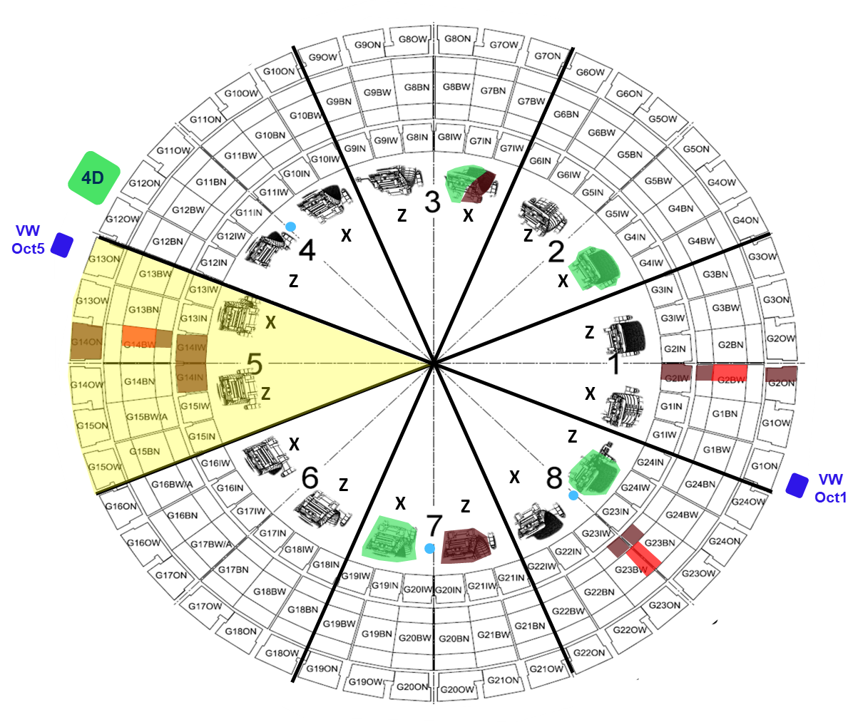
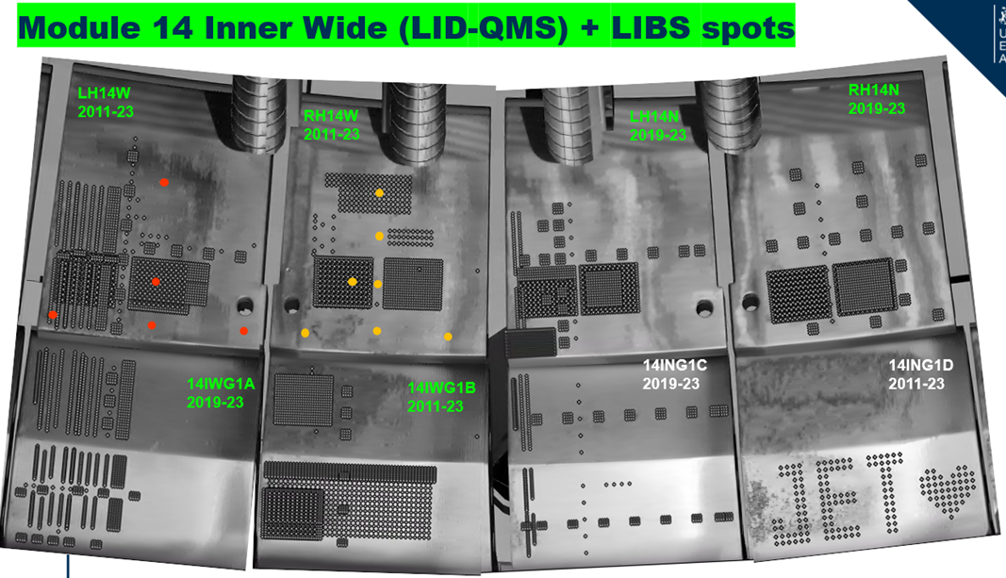
LIBS analysis of points 59-60-61-62 (HFGC LH14W)
The analysis area is located in octant 5 of JET and is composed of W - coated CFC PFCs
Bulk Be
W – coated CFC
Be coated inconel
Bulk W
Inconel (vacuum vessel)
Courtesy by UKAEA (I. Iepu)

Slide 5
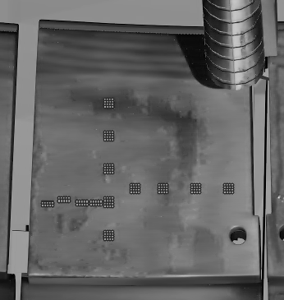
LIBS analysis of points 59-60-62-63 (HFGC LH14W)
HFGC LH14W (2011-23)
LID-QMS #no | LIBS #no | Comment
105852 | 63 | Poloidal assessment
105853
105854 | 62
105855
105856 | 60
105858 | 61 | Toroidal assessment
105859
105860
105855 | 60
105866
105865
105864
105867 | 59
HFGC
LH14W (2011-23)
852
63
Poloidal
853
854
866
865
864
867
858
859
861
855
62
860
856
61
60
59
Toroidal

Slide 6
Depht profiling analysis of points 59-60-62-63 (HFGC LH14W)
The depth profiling analysis consists in ablating the sample on the same point with consecutive laser pulses recording the spectrum from each pulse to get information about its in-depth elemental composition
The typical depth resolution, i.e. average ablation rate for LIBS on metallic PFCs falls between 50 and 500 nm per laser shot depending on:
  Laser pulse energy (main parameter)
  Focusing optics
  Material under analysis and material morfology
The depth profiling analysis has been applied through the development of algorithms processing a large number of spectra automatically, in a relatively short time (see Lidia Baiamonte’s talk)

Slide 7
Depht profiling analysis of points 59-60-62-63 (HFGC LH14W)
  In the depht profiling analysis the intensity of peculiar emission lines for each chemical element, representative of materials to be found inside the JET VV have been monitored as a function of the applied laser shots shot per shot to better check any change in the LIBS spectrum related to the complete ablation of each layer
Atom/Ion | Wavelength (nm) | Motivation
Be I | 457.27 | Be as material eroded from the first wall and re-deposited on the divertor
W I | 407.44 | W as bulk (or coating) material of the divertor or re-deposited after erosion
T_{α}-D_{α}-H_{α} | 656-656.3 | Unburned (or implanted) fuel
Mo I | 550.65 | Mo interlayer (when present)
Ni I | 341.48 | Inconel structural material of the first wall
Cr I | 425.44 | Inconel structural material of the first wall

Slide 8
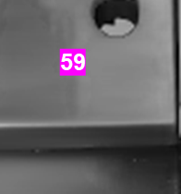
Depht profiling analysis of points 59-60-62-63 (HFGC LH14W)
  In the depht profiling analysis the intensity of peculiar emission lines for each chemical element, representative of materials to be found inside the JET VV have been monitored as a function of the applied laser shots, to better check any change in the LIBS spectrum related to the complete ablation of each layer
Point 59 (HFGC LH14W R1C1)
Re-deposited layer
W coating
CFC-substrate
Mo-interlayer
Mo-interlayer

Slide 9
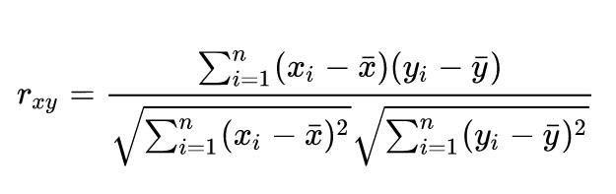
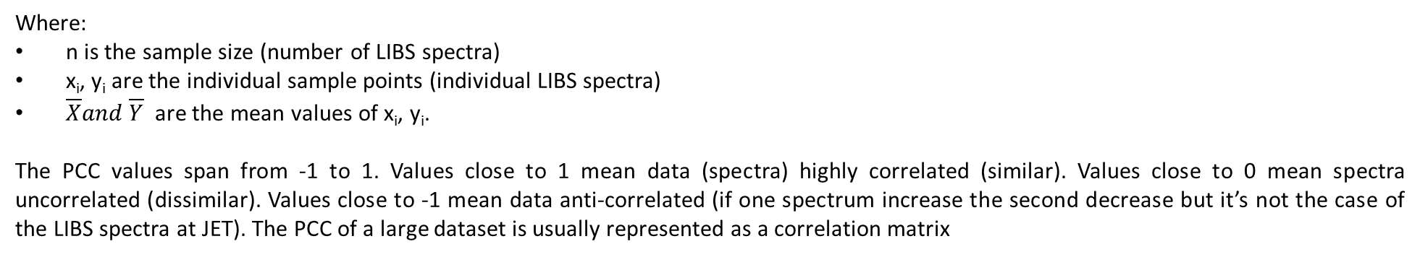
Correlation analysis of points 59-60-62-63
Correlation is a statistical measure that expresses the extent to which two variables (LIBS spectra) are linearly related (meaning they change together at a constant rate).
Correlation analysis can be applied comparing LIBS spectra without any pretreatment
The correlation coefficient, r, quantifies the strength of the relationship and it is obtained computing the Pearson correlation coefficient (PCC):
Where:
n is the sample size (number of LIBS spectra)
x_{i}, y_{i} are the individual sample points (individual LIBS spectra)
$\overline{X}and \overline{Y}$ are the mean values of x_{i}, y_{i}.
The PCC values span from -1 to 1. Values close to 1 mean data (spectra) highly correlated (similar). Values close to 0 mean spectra uncorrelated (dissimilar). Values close to -1 mean data anti-correlated (if one spectrum increase the second decrease but it’s not the case of the LIBS spectra at JET). The PCC of a large dataset is usually represented as a correlation matrix
Example of correlation matrix (r_{xy} values for a set of spectra composed by two group of spectra not correlated (dissimilar)

Slide 10
Correlation analysis of points 59-60-62-63 (HFGC LH14W)
The PCC values of the correlation matrix involves the whole shape of the spectra, it is not related to the study of some emission lines, therefore it gives a more reliable information about the thickness (in terms of laser shots) of the different layers ablated and sampled by the laser
The correlation matrix can also be used to train an artificial neural network by collecting a large number of samples (LIBS spectra) very similar (or dissimilar) and using them as training and test sets for different points of the vacuum vessel
Point 59 (HFGC LH14W R1C1)
Surface layer
Mo interlayer
to substrate

Slide 11
Intensity ratio of points 59-60-62-63 (HFGC LH14W)
The Intensity ratio between the T-D-H alpha band and the two lines Be I at 457.27 nm and W I at 407.06 nm have been calculated to give the semi-quantitative ratio of the Hydrogen isotopes with respect to Be (as main contaminant deposited on the surface of the divertor PFCs) and W (main component of the PFCs)

Slide 12
Results for points 59-60-62-63 (HFGC LH14W): depth profiling
HFGC
LH14W (2011-23)
62
63
852
63
853
854
866
865
864
867
858
859
861
860
855
62
856
61
60
59
61
60
59

Slide 13
Results for points 59-60-62-63 (HFGC LH14W): correlation
HFGC
LH14W (2011-23)
62
63
852
63
853
854
866
865
864
867
858
859
861
860
855
62
856
61
60
59
61
60
59

Slide 14
Results for points 59-60-62-63 (HFGC LH14W): intensity ratio
HFGC
LH14W (2011-23)
62
63
852
100
130
63
853
854
866
865
864
867
858
859
861
860
855
62
856
61
60
59
61
60
59
65
20
20

Slide 15
Summary and conclusions
The four layers (surface deposit, W coating, Mo interlayer, CFC substrate) constituting the sampled points were identified with the depth profiling procedure and the spectral correlation as a function of the number of laser shots as follows:
HFGC
LH14W (2011-23)
852
Point | Surface layer (shot #) | W layer (shot #) | Mo interlayer (shot#) | CFC substrate
59 | 1-20 | 21-54 | 54-580 | 581…
60 | 1-11 | 12-155 | 156-1050 | 1051…
61 | 1-20 | 21-330 | 331-1200 | 1201…
62 | 1-7 | 8-25 | 26-520 | 521…
63 | 1-14 | 14-235 | 236-540 | 541…
63
853
854
866
865
864
867
858
859
861
860
855
62
856
61
60
59
The in-depth distribution of retained hydrogen isotopes appears to be maximum in the first shots, in the redeposited layer, but also extending beyond this layer.

