Slide 1
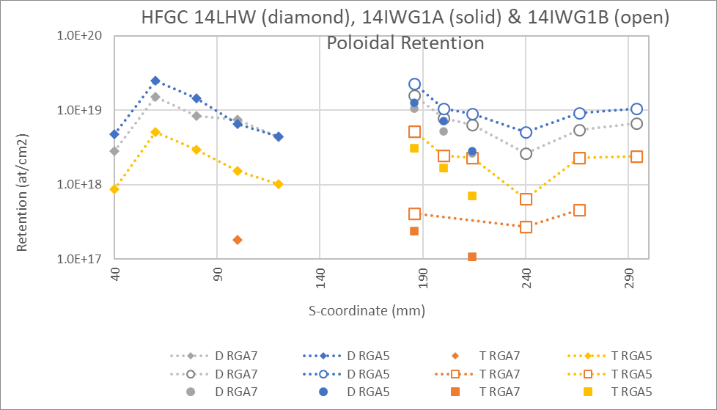
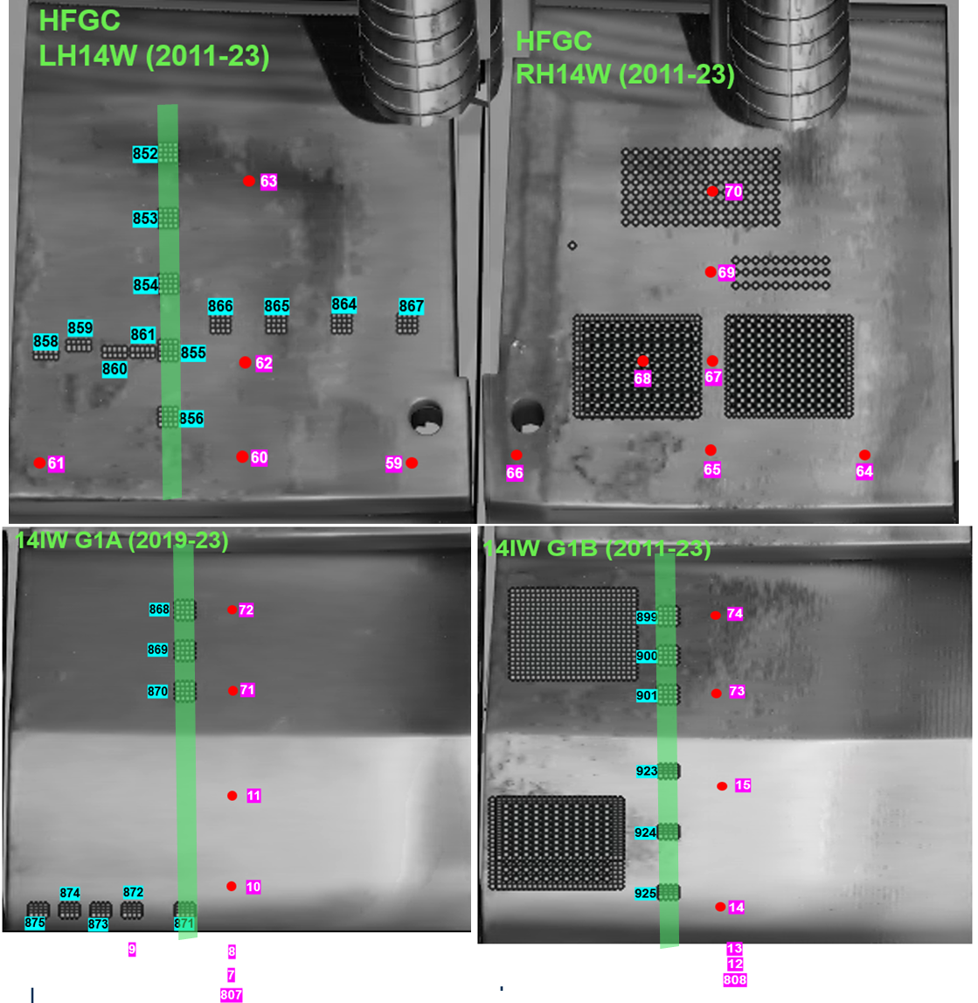
LID-QMS areal fuel retention at end of JET operations 19 & 20 December 2023
Assumptions:
AMU4 calibration factor used for AMUs
19/12/2023 AMU4 calibration factor used for 20/12/2023 data points
Calibration = Jump method

Slide 2
Assumptions
4 x 4
1.5 mm step in x
1.0 mm step in y
~0.45 cm²
Area of laser raster is approximate
Gas calibrations from 19th December for AMU4
No calibration for 20th December
No scaling for AMU3, 5, 6
AMU converted to atoms
AMU2 = 2 x H
AMU3 = 50:50 H:D
AMU4 = 2 x D
AMU5 = 50:50 D:T
Jump method for data analysis and calibration factor
Started to apply 3σ
Any jumps < 3σ considered limit of detection
No pumping of calibration gas puffs…see Gennady’s presentation later
5 x 2
1.5 mm step in x & y
~0.405 cm²
4 x 4
1.5 mm step in x & y
~0.563 cm²

Slide 3
HFGC LH14W

Slide 4
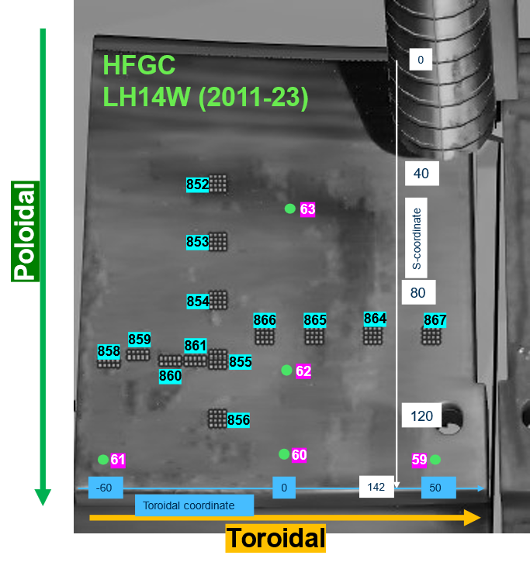
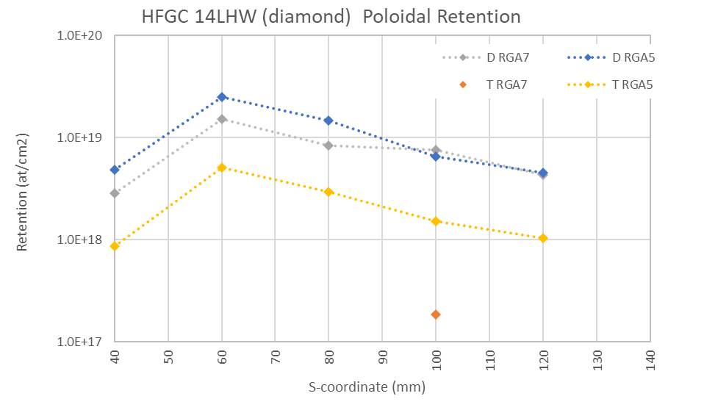
HFGC LH14W Poloidal
Area used is large ⇒ areal retention will increase
Ratio of RGA5 D/T very uniform ⇒ issue with data?
All data collected on 19th December
4 x 4
1.5 mm step in x & y
~0.563 cm²

Slide 5
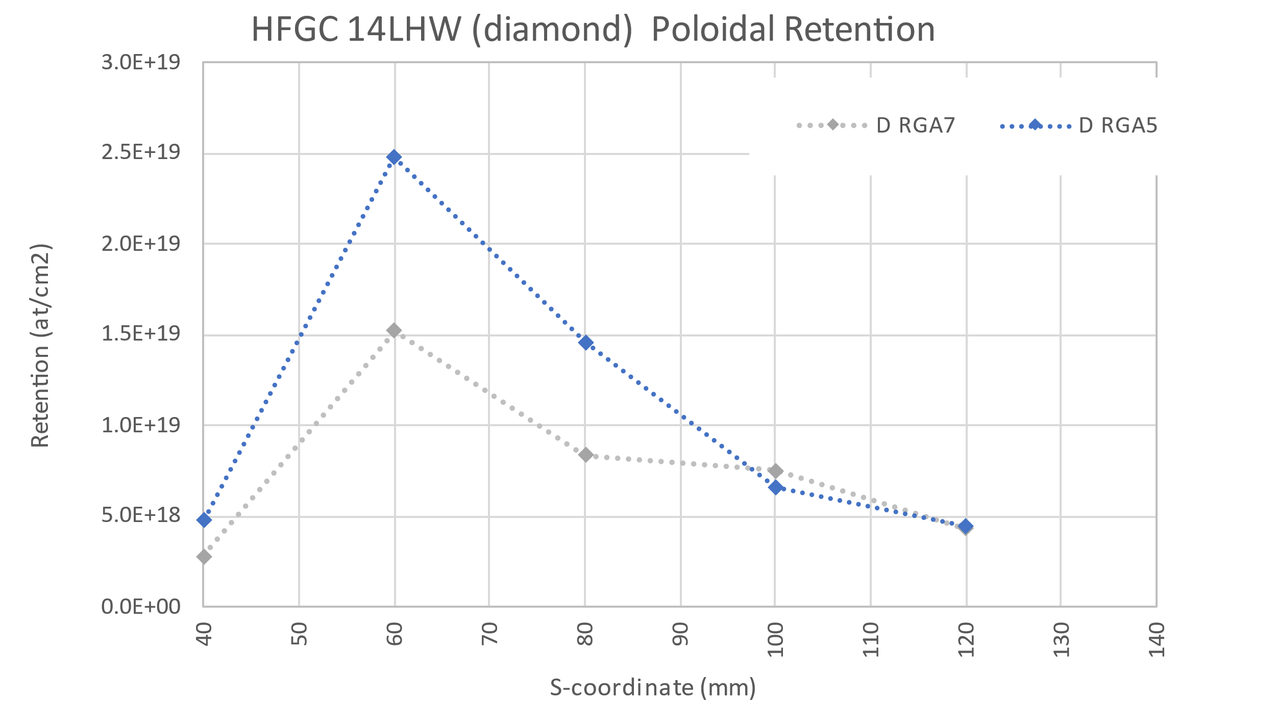
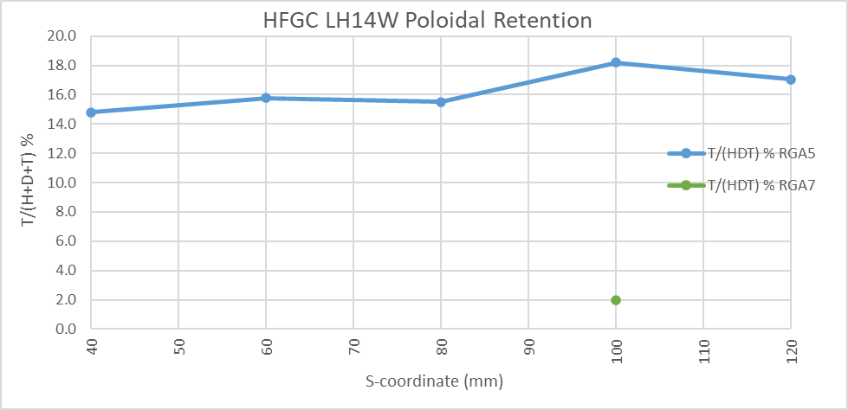
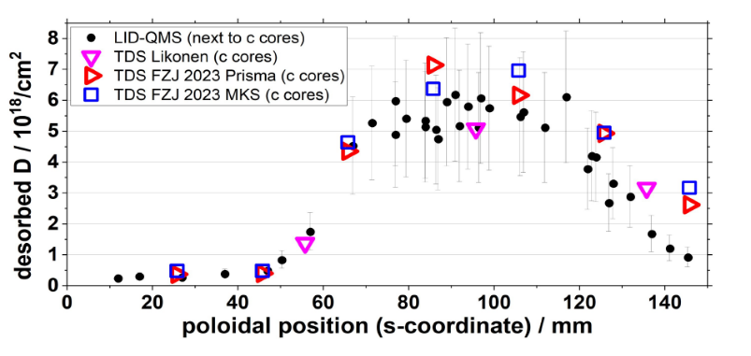
HFGC LH14W Poloidal
Deuterium only
Indicative retention from previous post-mortem
Lots of caveats….

Slide 6
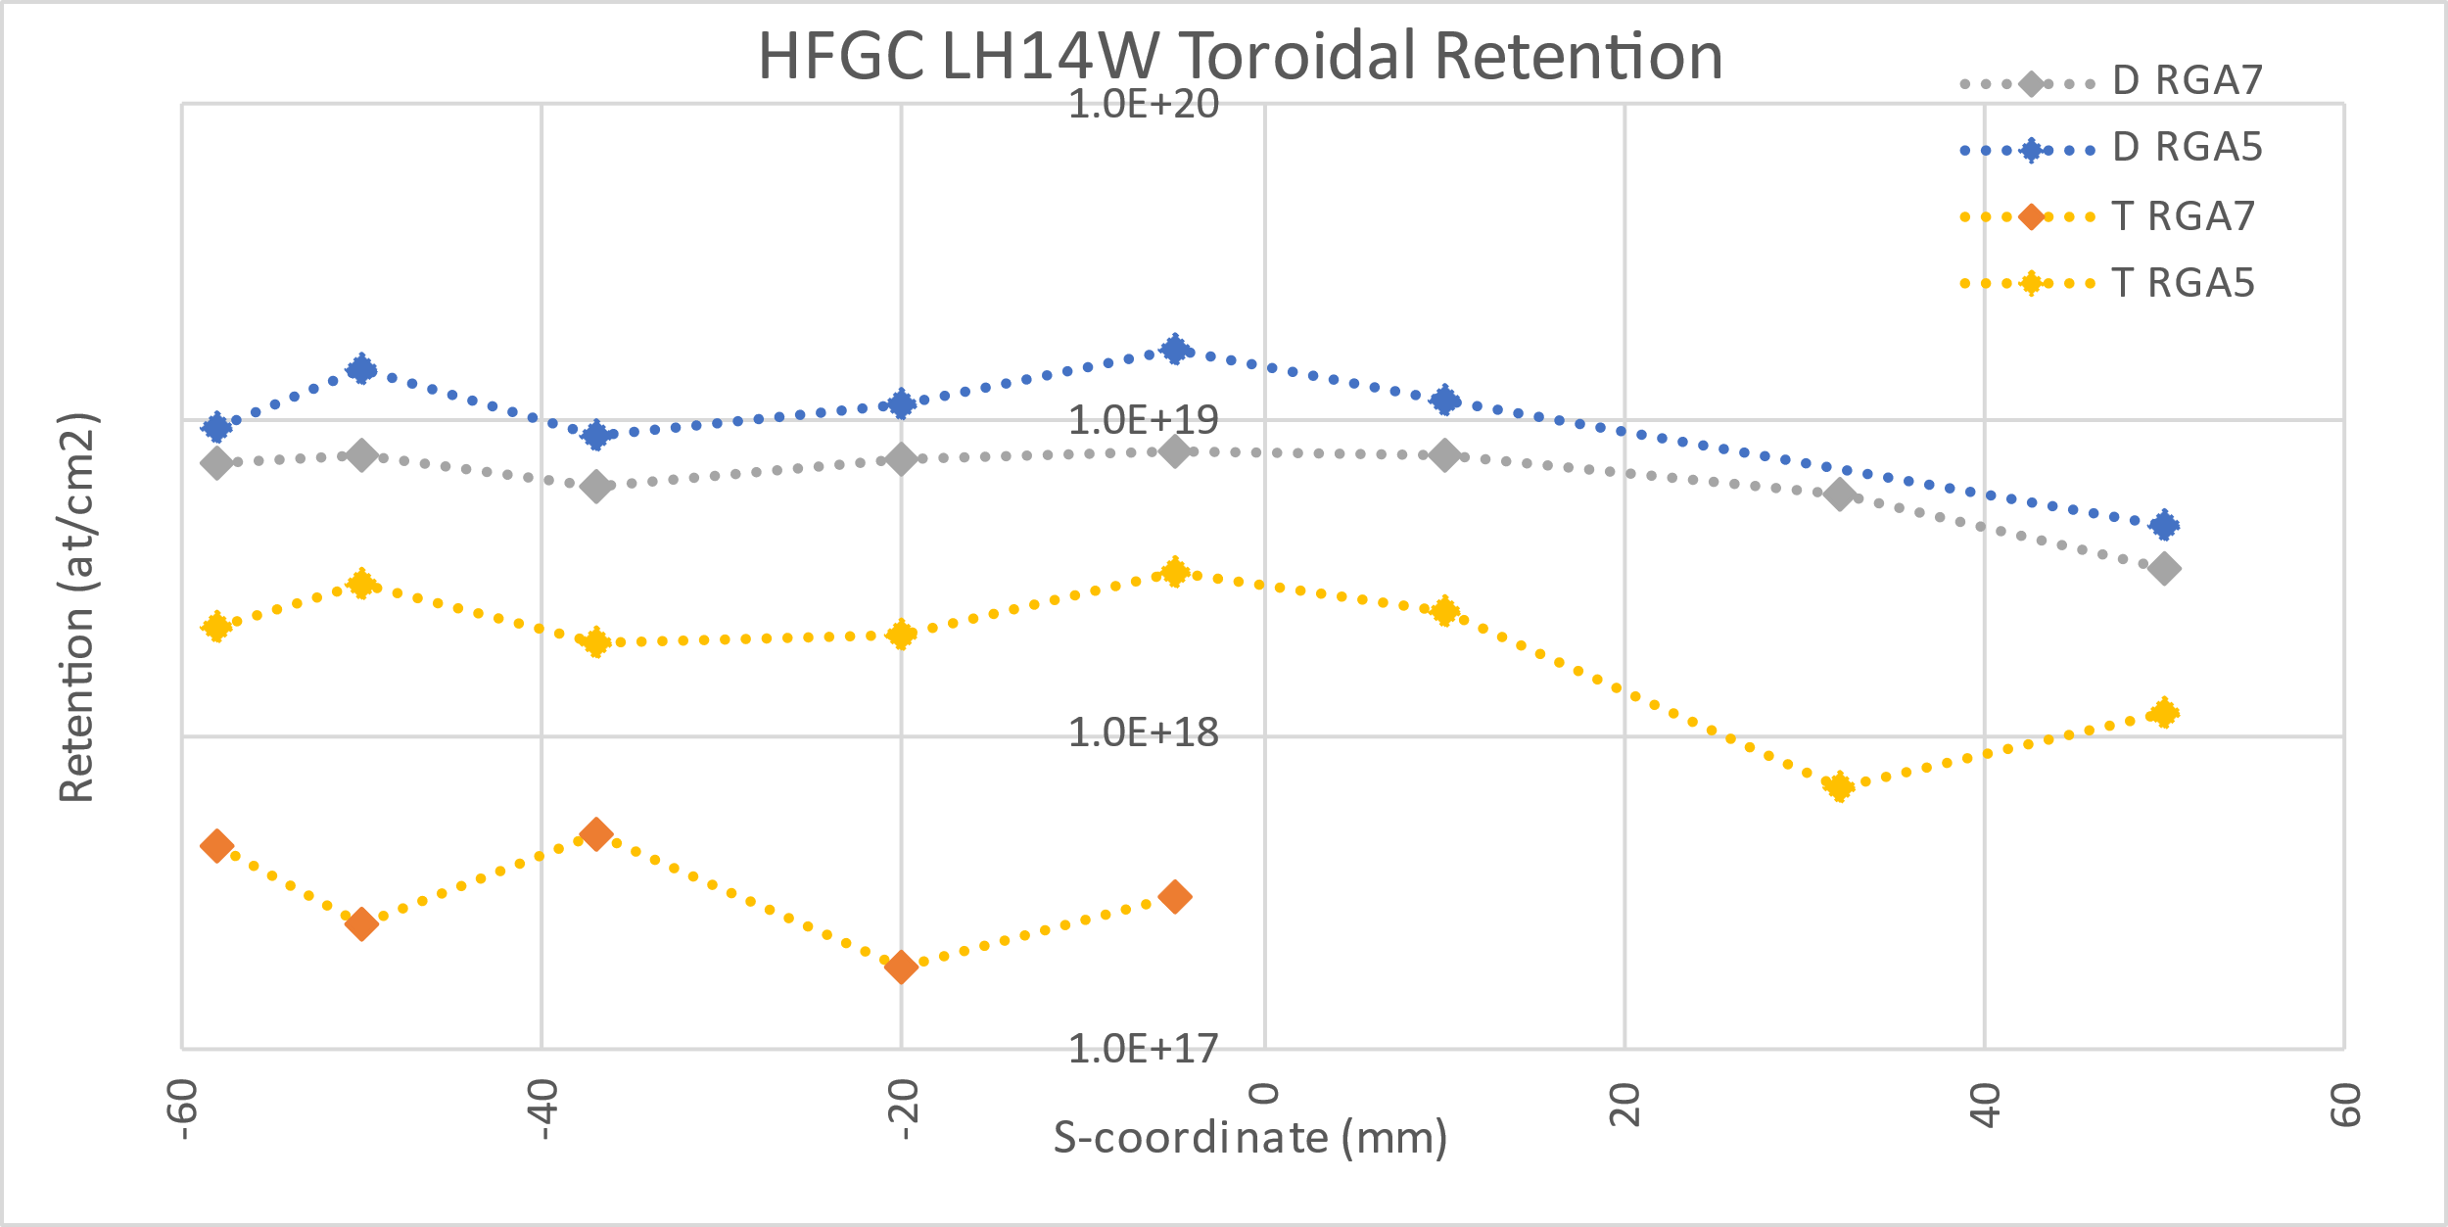
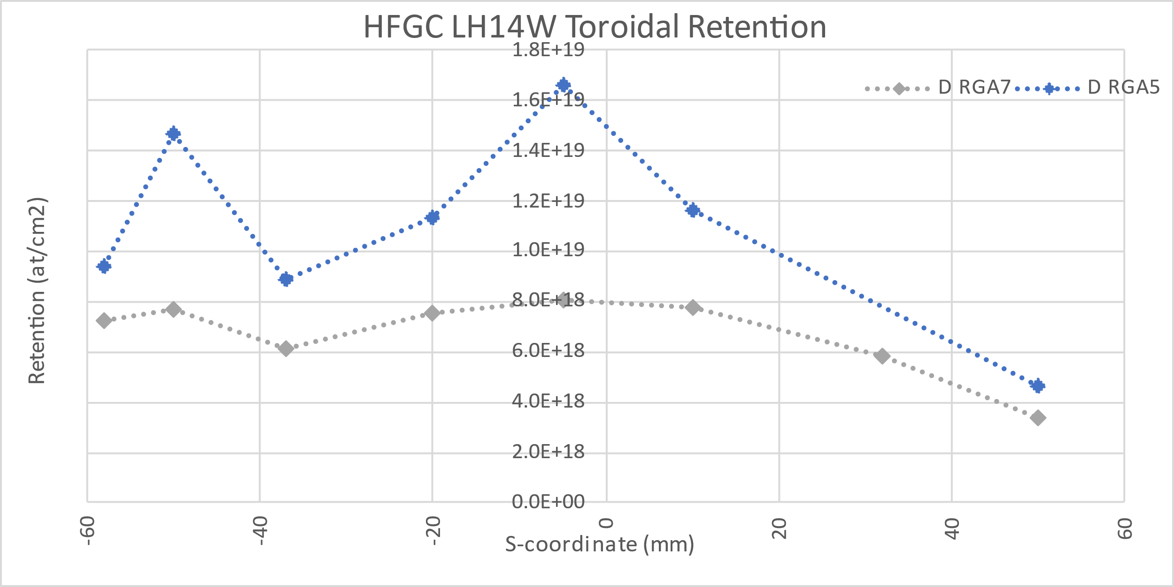
HFGC LH14W Toroidal
Deuterium only
4 x 4
1.5 mm step in x & y
~0.563 cm²
5 x 2
1.5 mm step in x & y
~0.405 cm²

Slide 7
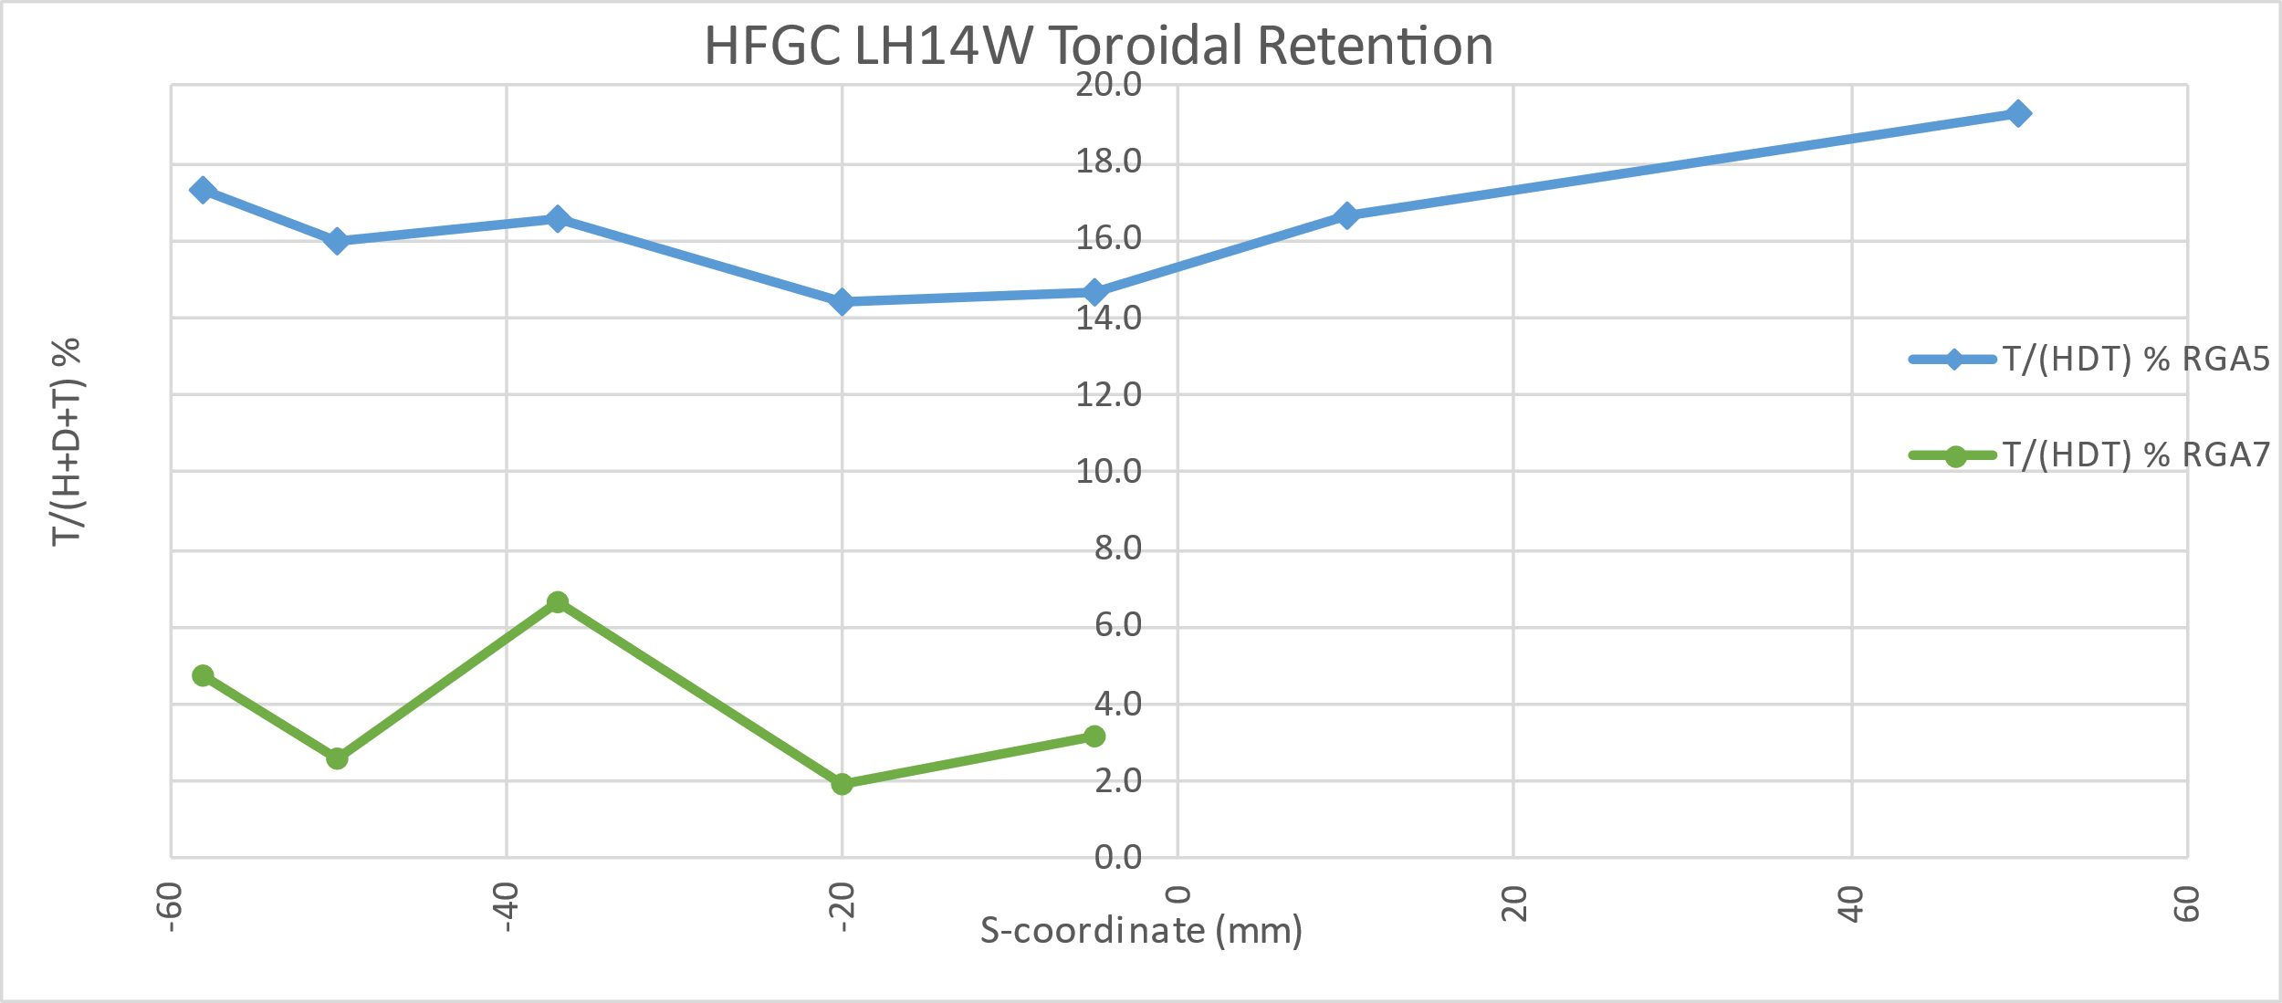
HFGC LH14W Toroidal
T/(H+D+T) %
4 x 4
1.5 mm step in x & y
~0.563 cm²
5 x 2
1.5 mm step in x & y
~0.405 cm²

Slide 8
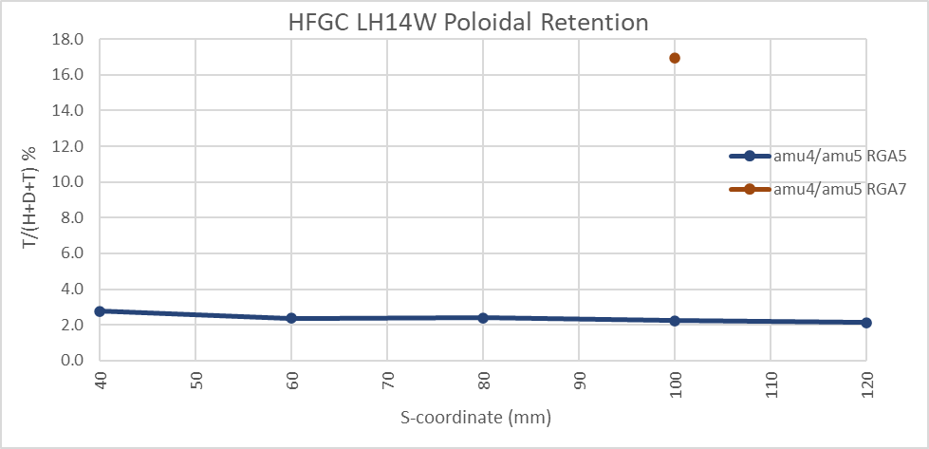
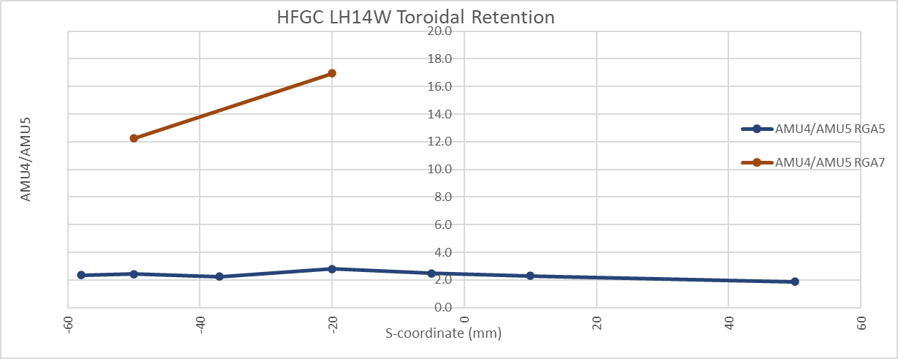
AMU4/AMU5 for RGA5 and RGA7
RGA7: AMU4 > x10 AMU5
RGA5: AMU4 ~ x2 AMU5
Why the difference between RGA5 & RGA7
⇒ Issues with RGA5 data?

Slide 9
T/(HDT) % for RGA5 and RGA7
Why the difference between RGA5 & RGA7
⇒ Issues with RGA5 data?

Slide 10
14IWG1B

Slide 11
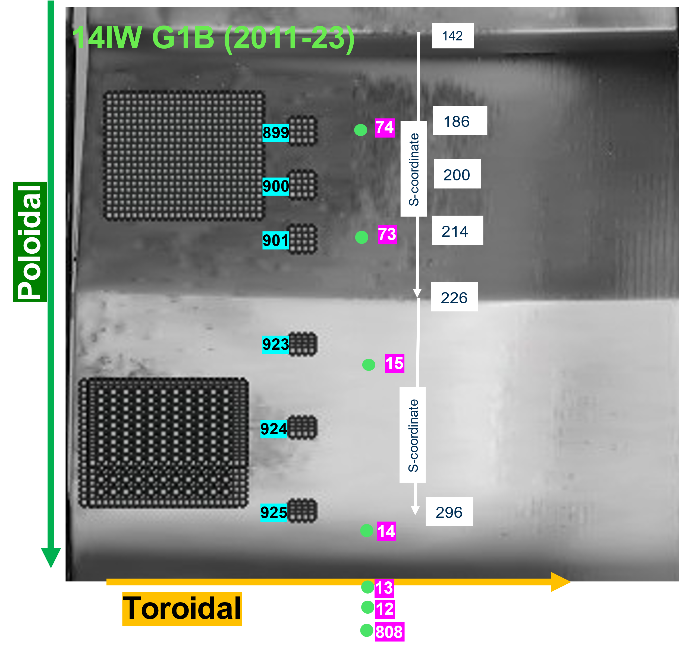
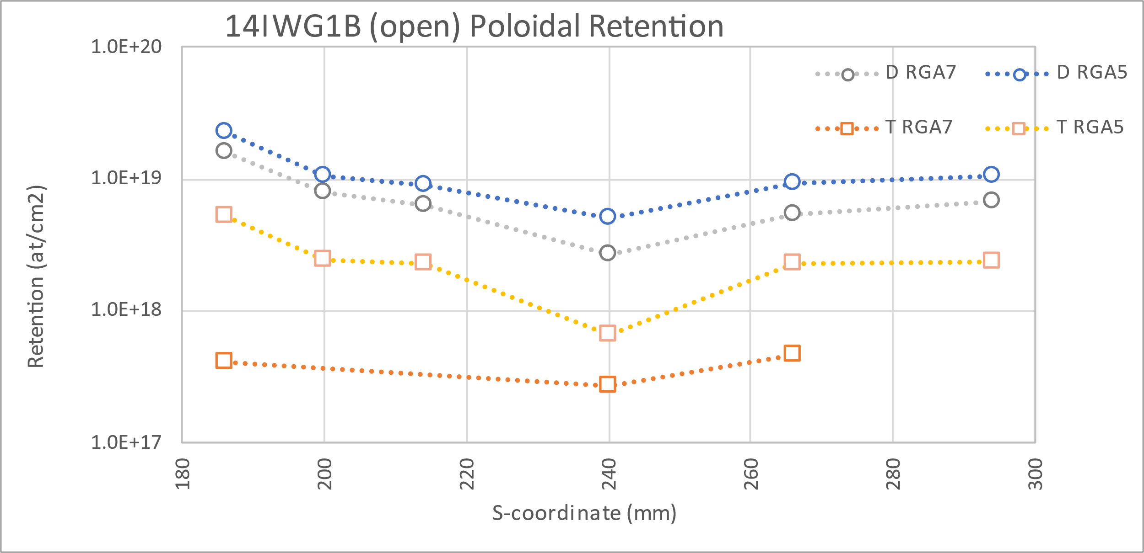
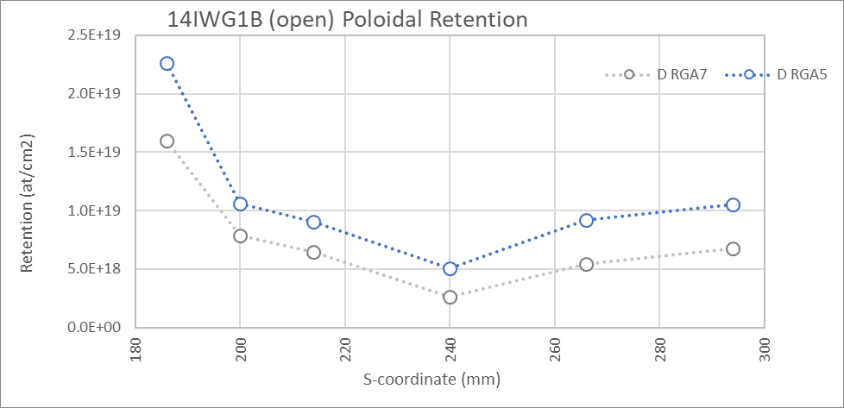
14IWG1B Poloidal
Calibration factor for 20th December needed
Deuterium only
4 x 4
1.5 mm step in x & y
~0.563 cm²
4 x 4
1.5 mm step in x
1.0 mm step in y
~0.45 cm²

Slide 12
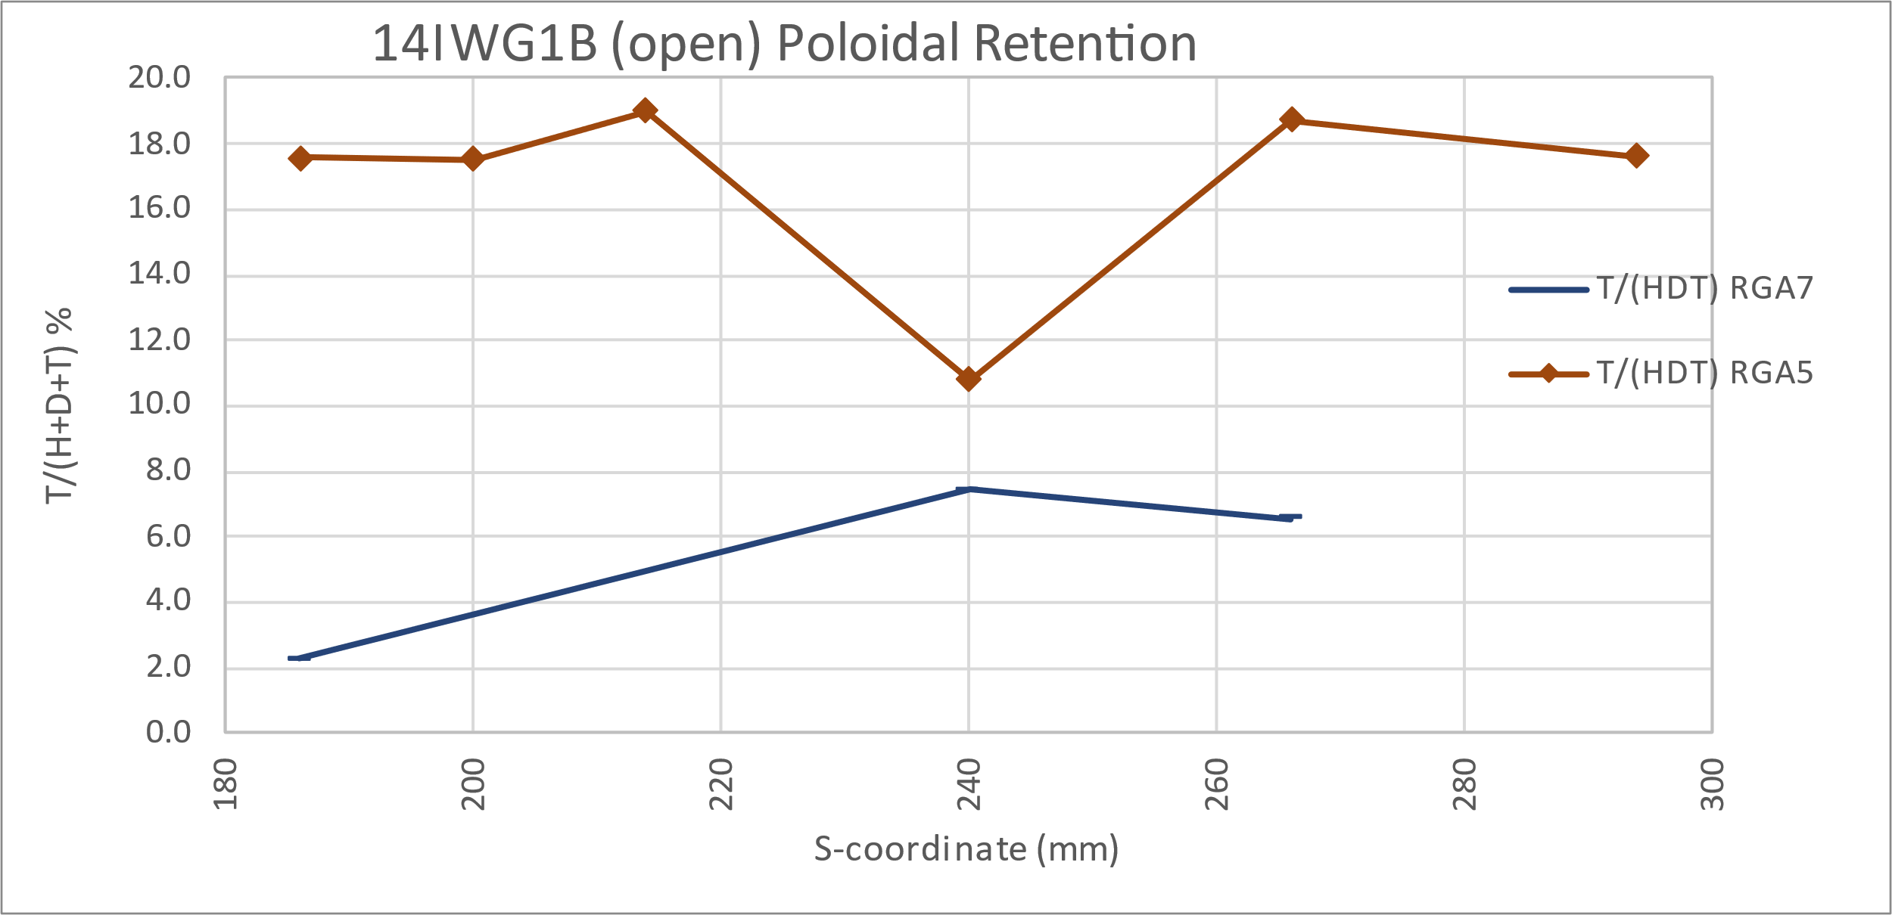
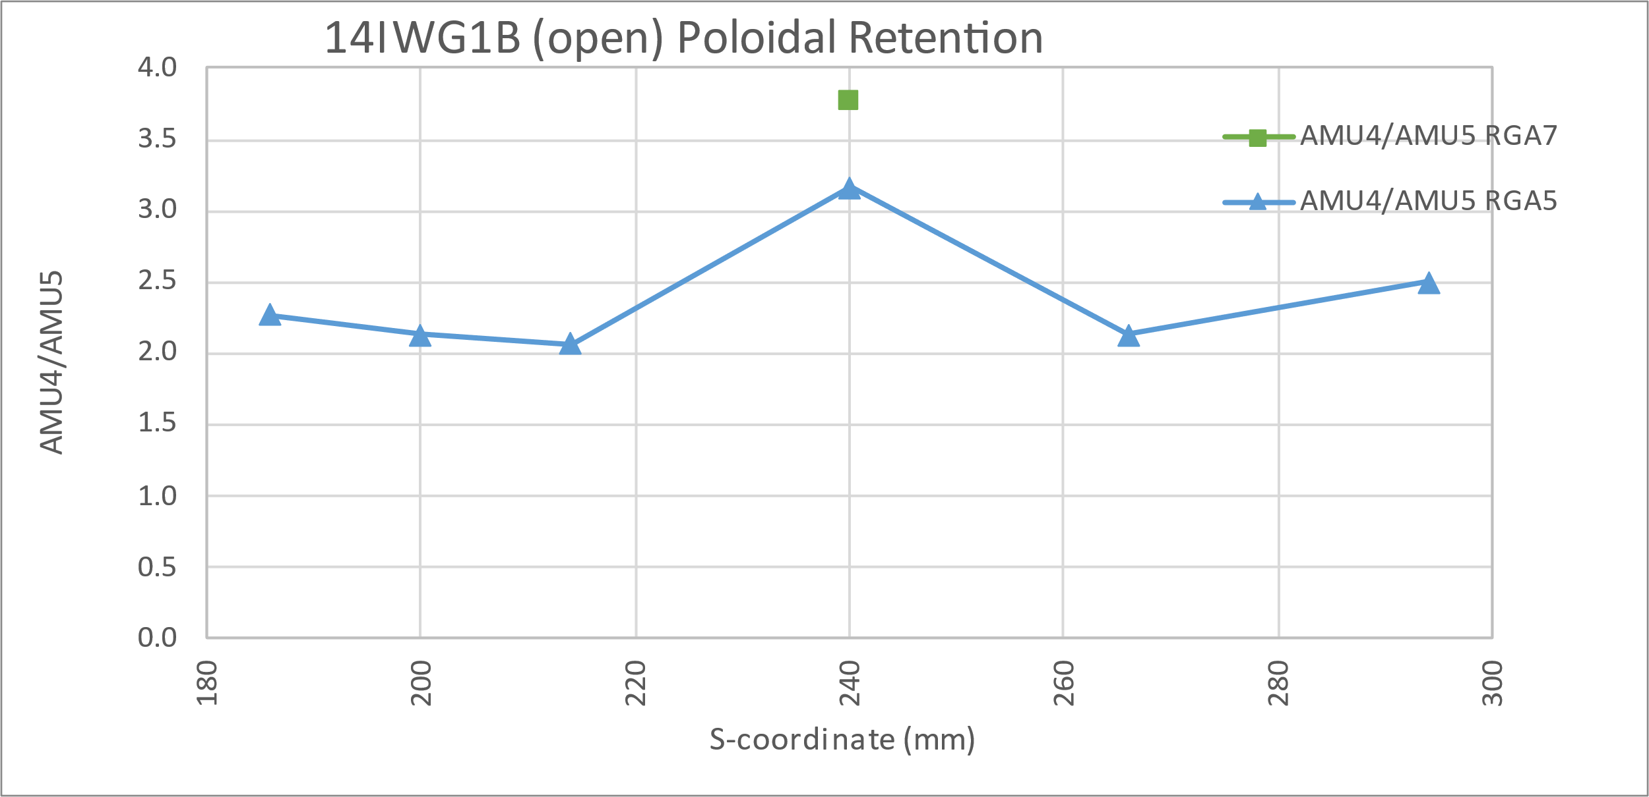
14IWG1B Poloidal

Slide 13
14IWG1A

Slide 14
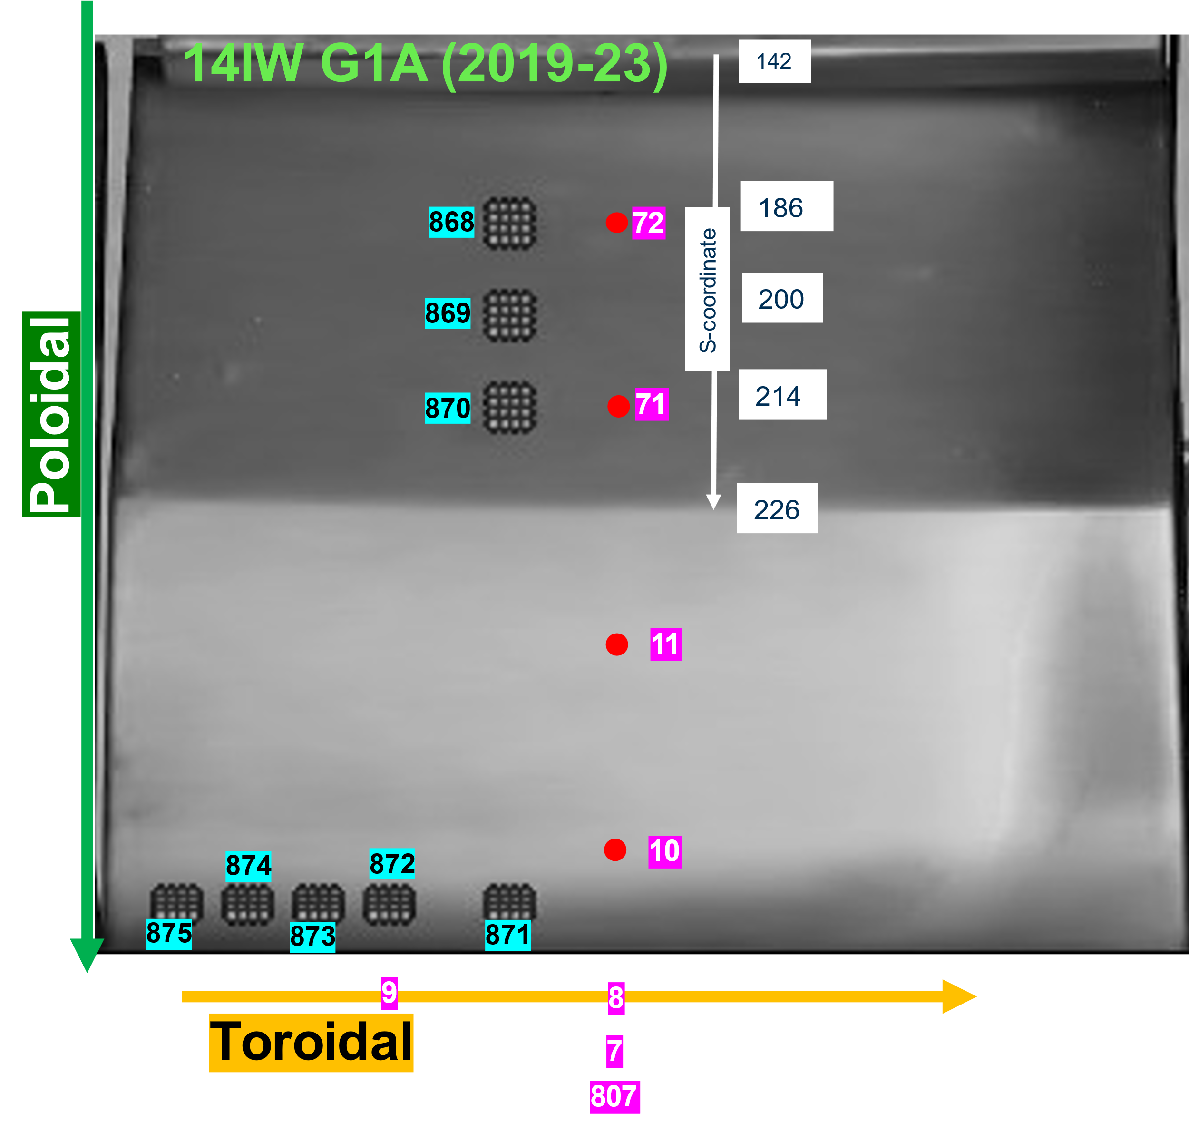
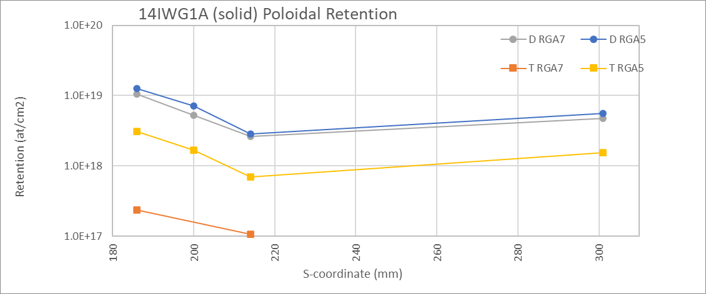
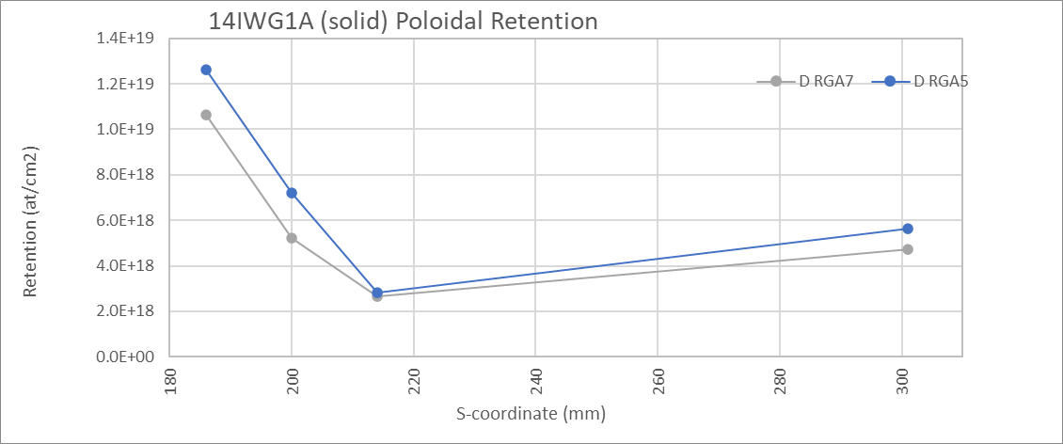
14IWG1A Poloidal
Deuterium only
4 x 4
1.5 mm step in x & y
~0.563 cm²
4 x 4
1.5 mm step in x
1.0 mm step in y
~0.45 cm²

Slide 15
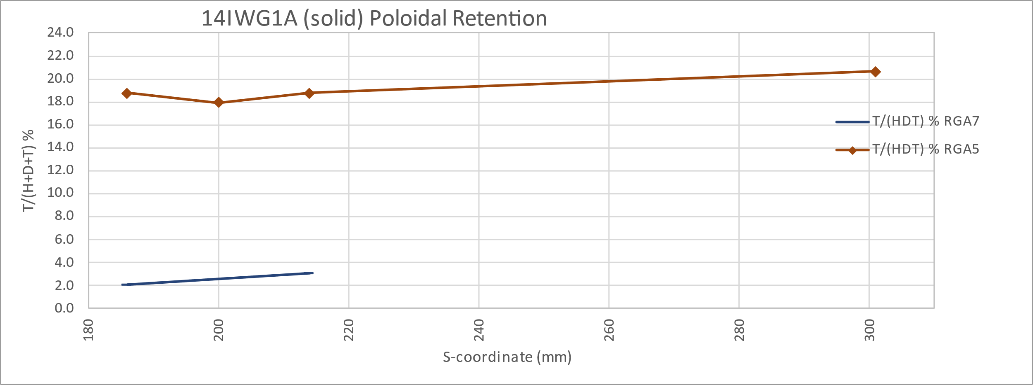
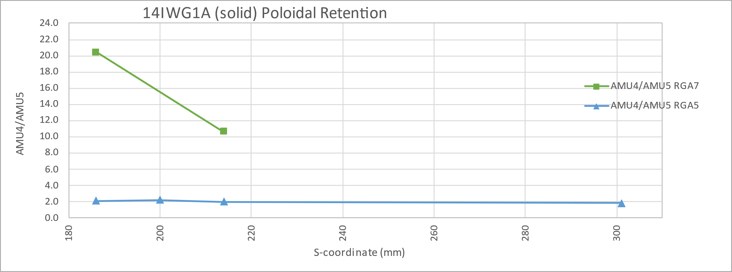
14IWG1A Poloidal

Slide 16
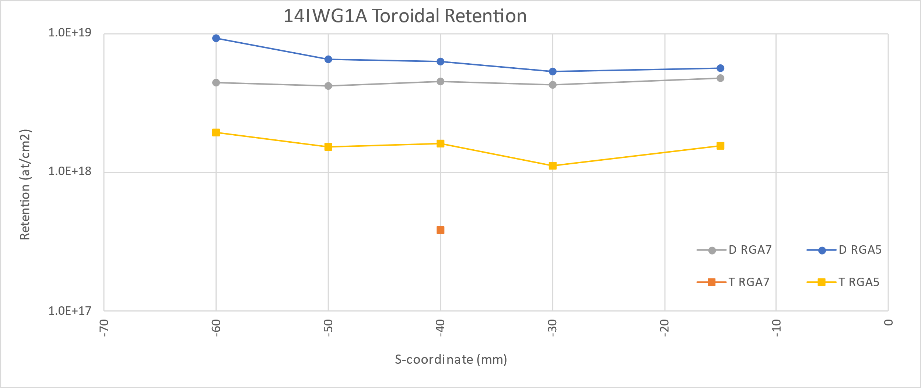
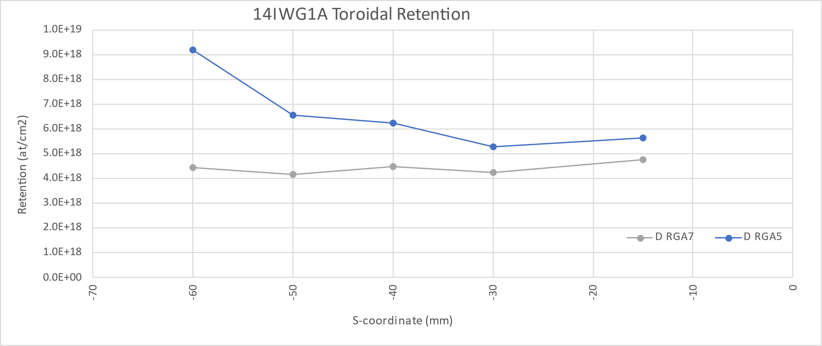
14IWG1A Toroidal
Deuterium only
4 x 4
1.5 mm step in x
1.0 mm step in y
~0.45 cm²

Slide 17
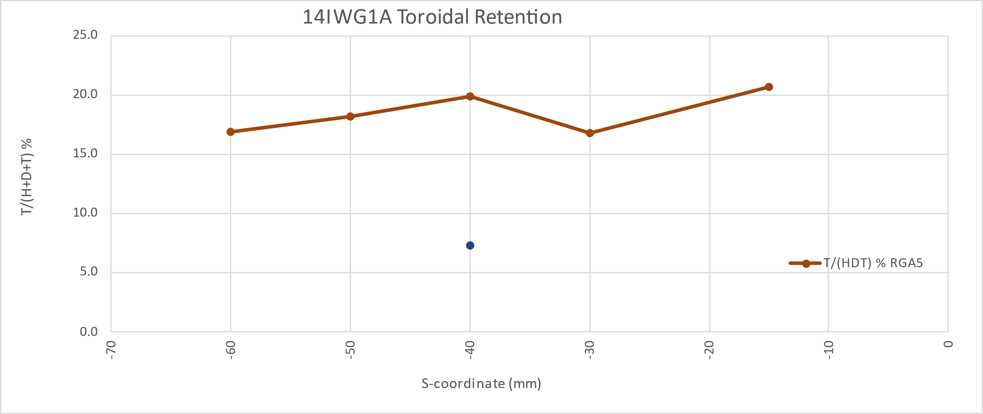
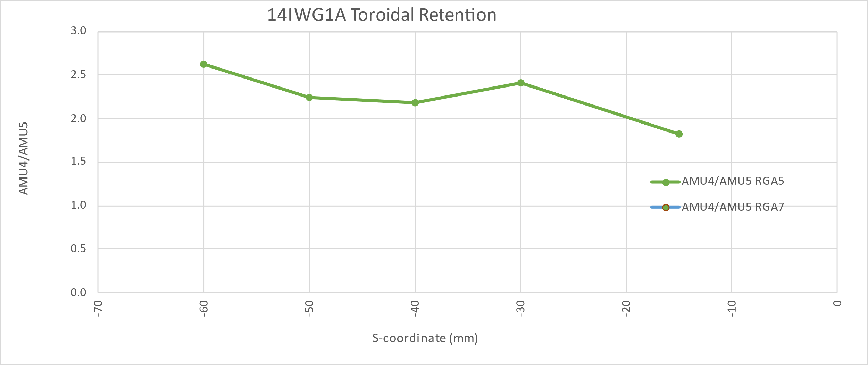
14IWG1A Toroidal
Deuterium only
4 x 4
1.5 mm step in x
1.0 mm step in y
~0.45 cm²
No RGA7 data as AMU5 LOD

