Slide 1
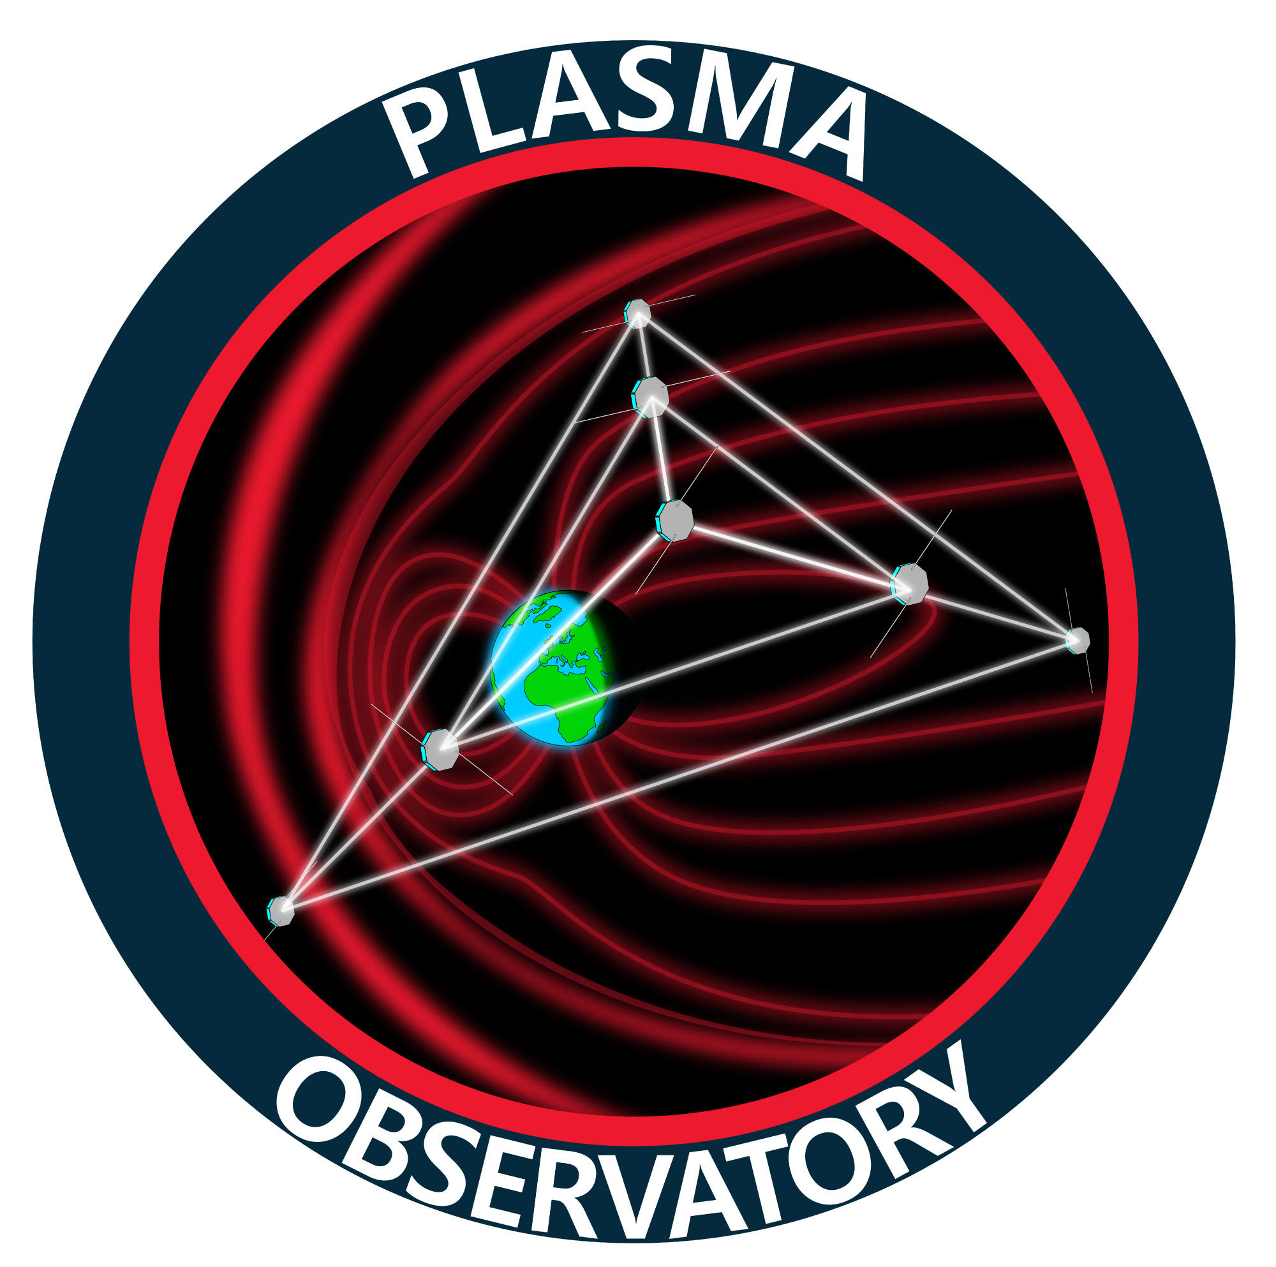

Maria Federica Marcucci on behalf of Plasma Observatory and HENON teams
1° Conferenza Italiana sui Plasmi 03-06 febbraio 2026 – ENEA Centro Ricerche Frascati

Slide 2

Plasma Observatory
Science Theme
Unveiling plasma energization and energy transport in the near-Earth plasma environment
through multiscale observations
Scientific Question SQ1 - How are particles energized in space plasmas?
Scientific Question SQ2 - Which processes dominate energy transport and drive coupling between the different regions of the Earth’s Magnetospheric System?
ESA M7 candidate in competitive Phase A.
Final M7 selection in June 2026. Launch 2037.
Large scientific community: 400+ researchers from 25 countries (17 in Europe) including US, Japan and China
Payload team including 10+ ESA countries with US and Japanese contributions
Courtesy M. Palmroth, Univ. Helsinki
Maria Federica Marcucci
INAF-IAPS (Italy)
maria.marcucci@inaf.it
Alessandro Retinò
LPP (France)
alessandro.retino@lpp.polytechnique.fr

Slide 3
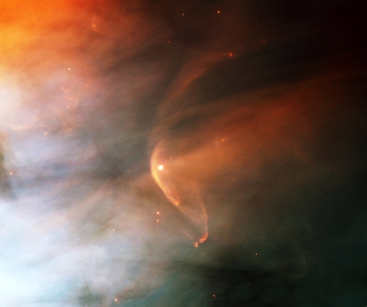

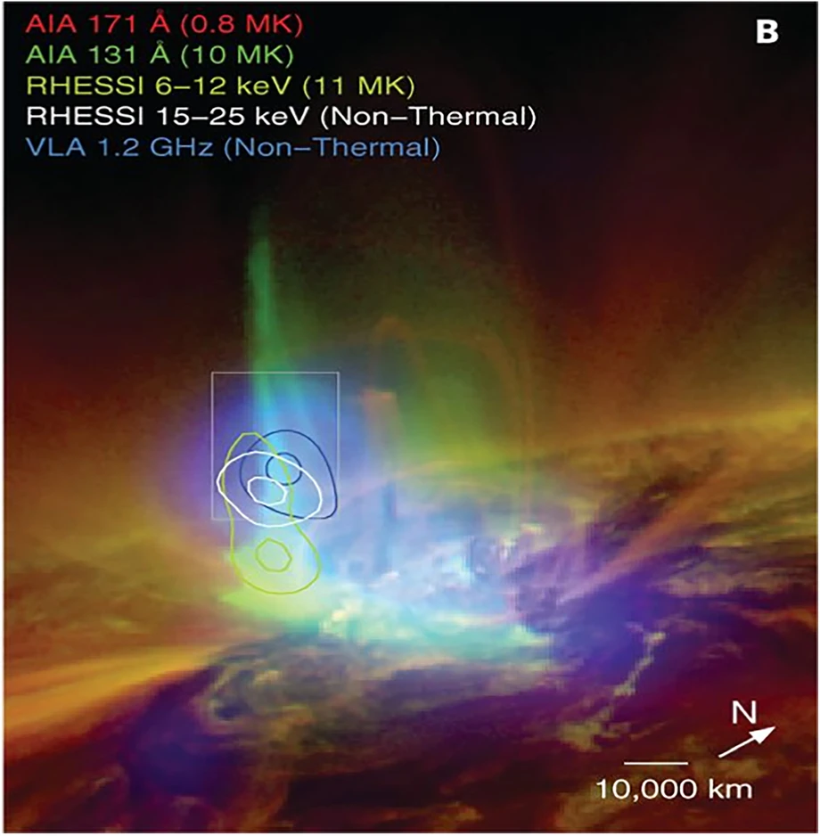
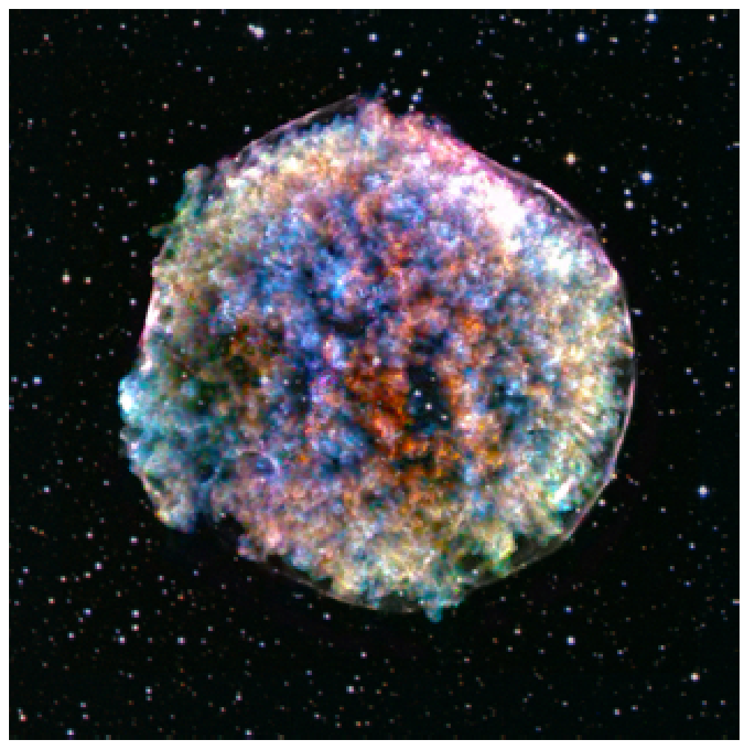

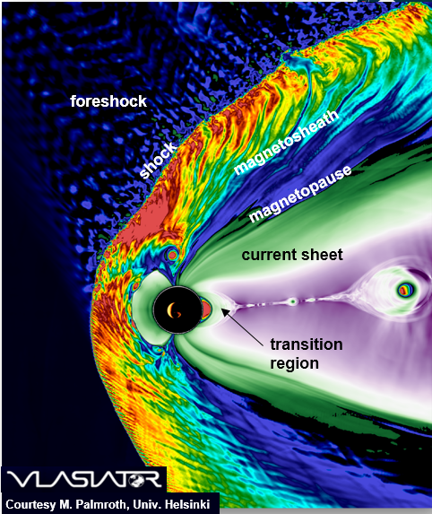
Plasma is the main state of visible cosmic matter.
However, we still miss the final comprehension of the plasma energization and energy transport mechanisms.
These mechanisms are inherently driven by coupling of plasma scales.
In the Earth’ Magnetospheric System:
Complex and highly dynamic with massive energy transport and particle energization
Energy transport and plasma energization largest when fluid scales couple with smaller ion scales.
Through multi-scale processes within non-planar/non-stationary 3D structures governed by wave-particle interaction
Image credit: NRAO/AUI

Slide 4

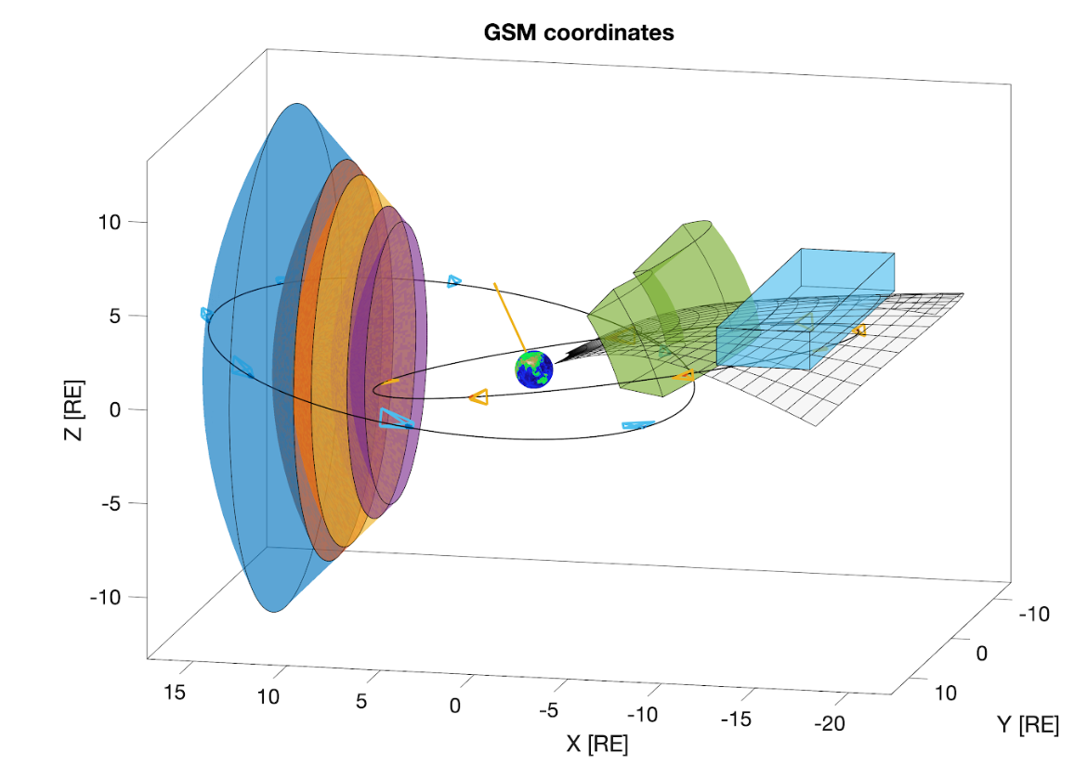
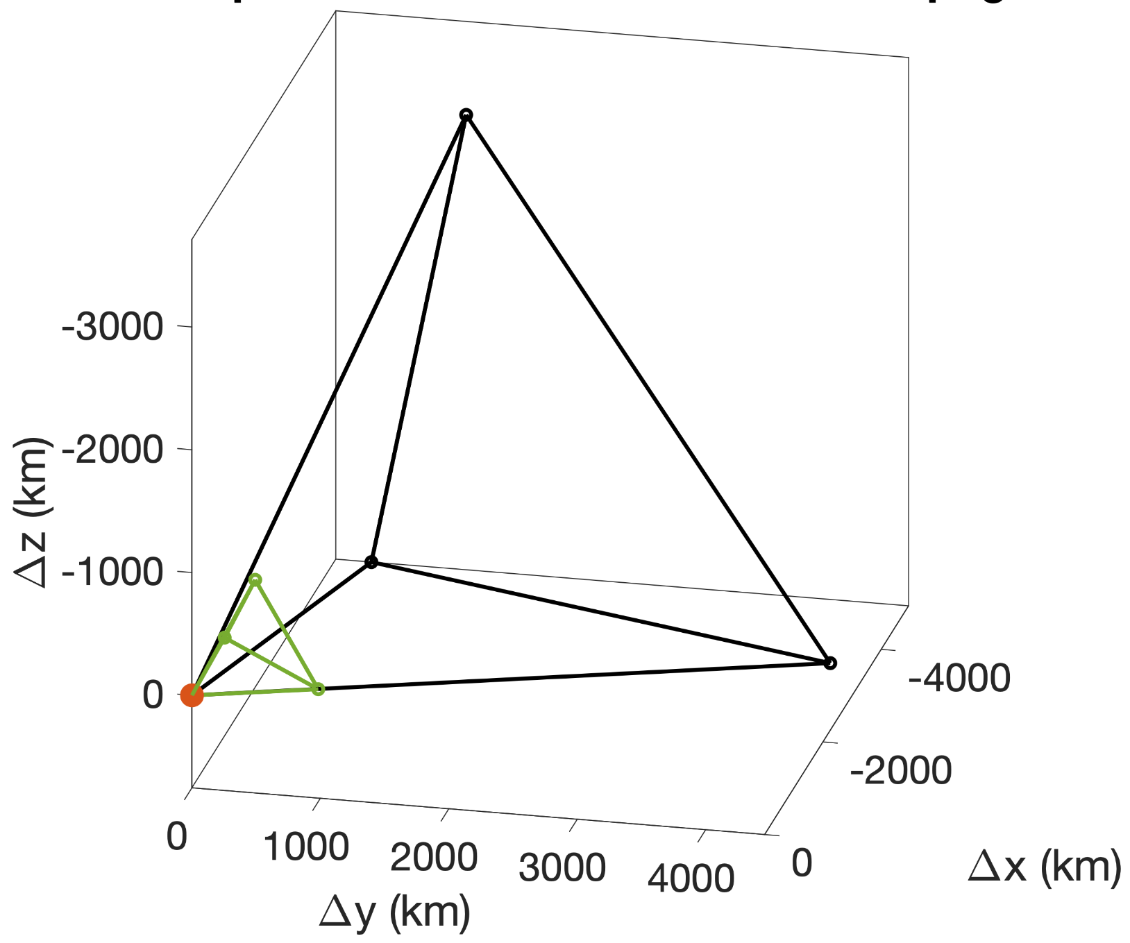
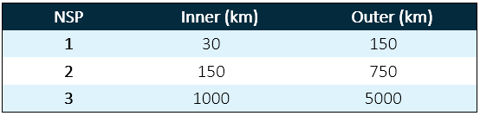
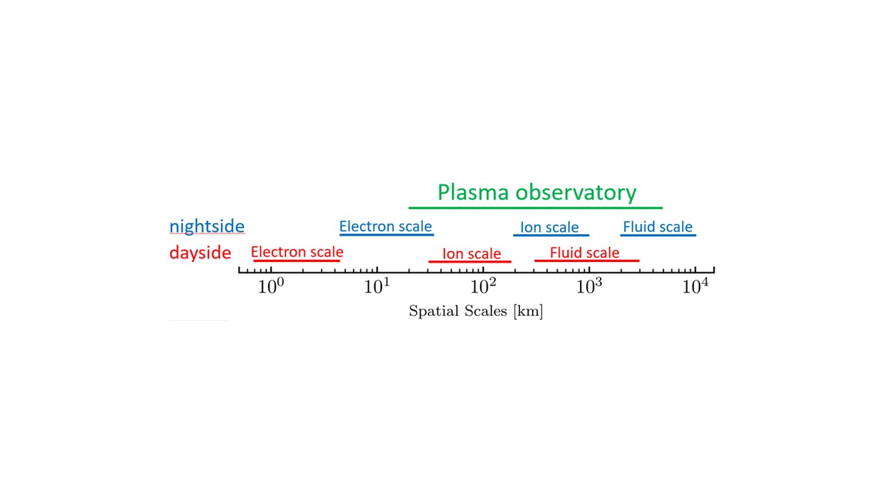
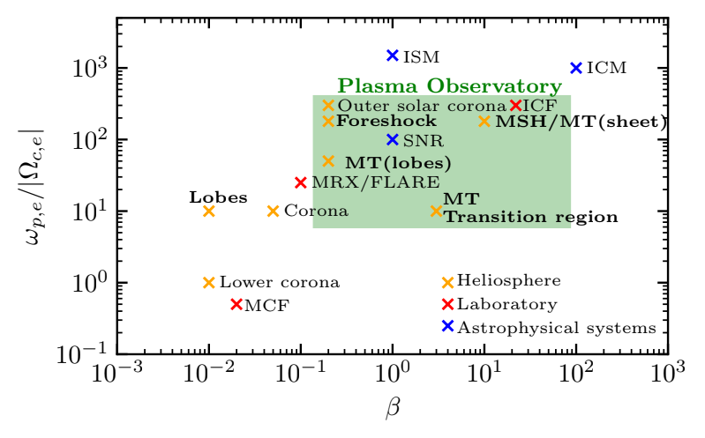
Foreshock
Bowshock
Magnetosheath
Magnetopause
Transition region
Tail current sheet
New multi-scale fields and particles measurements at both ion and fluid scales required to ultimately understand how our planet works.
Constellation. 7 SC in two tetrahedra sharing one corner.
Orbit (baseline). Equatorial HEO 7 x 17 RE with 15° inclination
Can help understanding of distant plasma environments (solar, astro) and laboratory plasma. Important for Space Weather comprehension.
IMPACT
Image credit: NRAO/AUI

Slide 5
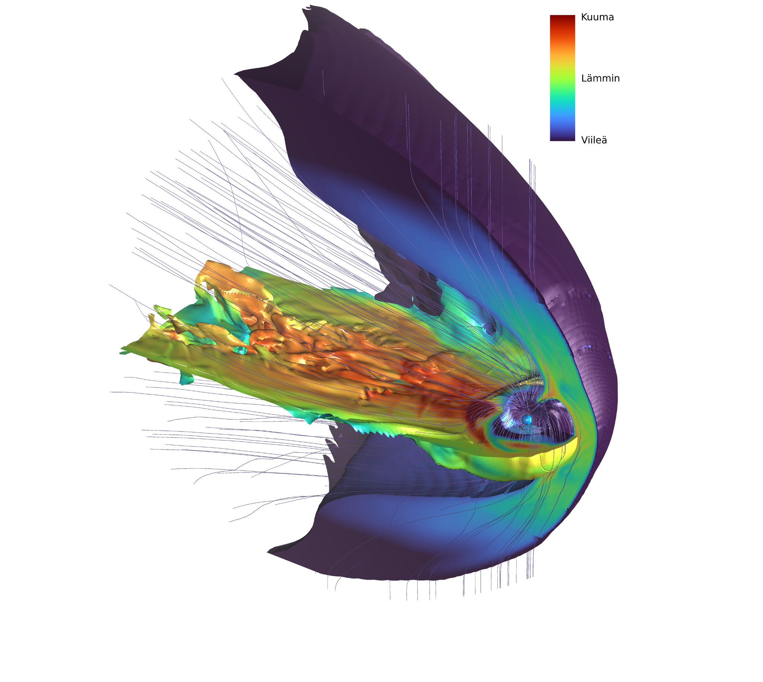

Plasma Observatory Scientific Objectives
1
How are particles energized at shocks?
How are particles energized in plasma jets?
2
How are particles energized during magnetic reconnection?
3
Bowshock
Magnetosheath
4
How are particles energized by waves and turbulent fluctuations?
5
How do different processes combine to energize particles?
Tail current sheet
Foreshock
Transition region
4
1
2
9
5
3
4
6
How is energy partitioned in different energy transport processes?
6
5
8
7
9
7
How do field-aligned currents connect different regions of the Magnetospheric system?
7
Magnetopause
6
3
8
How do plasma jets interact with the Earth’s dipole field in the transition region?
9
Which are the key plasma instabilities involved in energy transport?

Slide 6
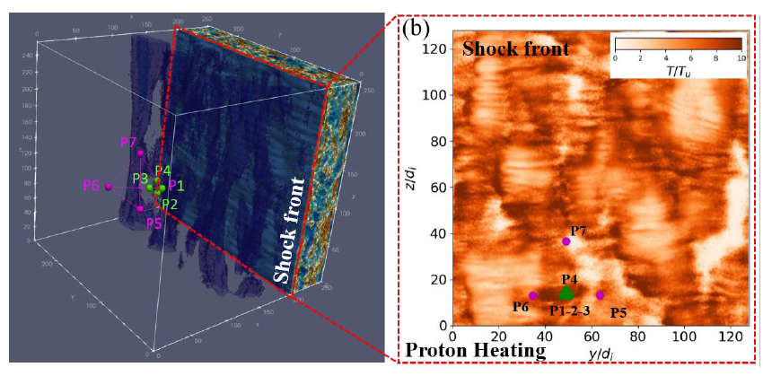
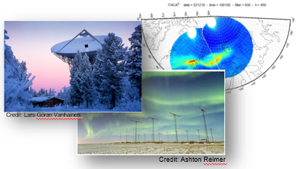
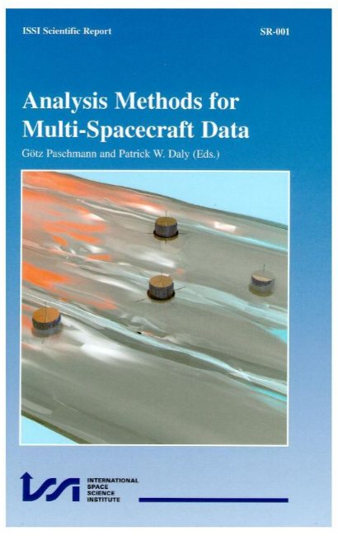

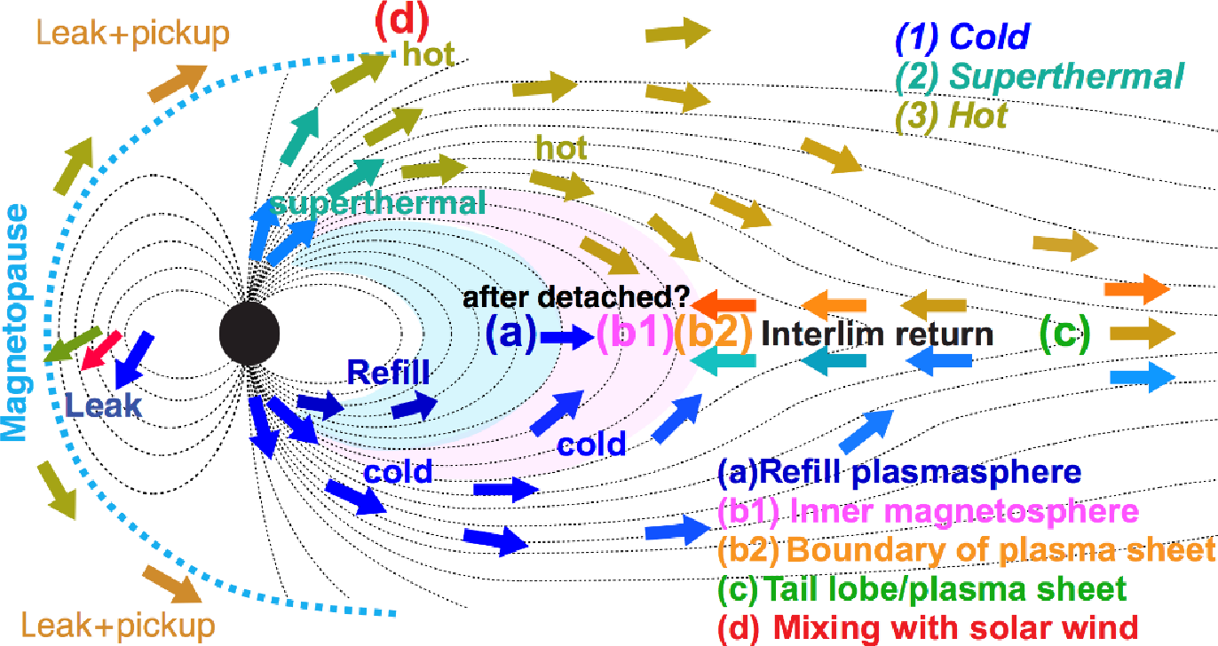
PO Working Groups
See WG splinters on Wed
PO thematic Working Groups (with Lead and Co-Lead) to expand PO specific and crucial themes:
Numerical Simulations (M. Alho, D. Trotta)
Multi-Point Data Analysis Methods (G. Cozzani, A. Chasapis)
Plasma Astrophysics (O. Pezzi, L. Comisso)
Scientific synergies/Additional science (S. Benella, J.-L. Ripoll)
Ground-based observations (SST Contact: J. Rae)
Public Outreach (C. Forsyth)
Early Career Scientists (M. Taylor)
Yamauchi M. AG, 2019)V
Notes:
Also our ambitions is to involve community
Credit: Lars-Göran Vanhainen
Credit: Ashton Reimer

Slide 8
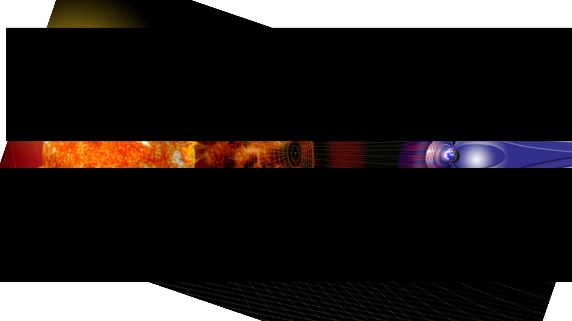
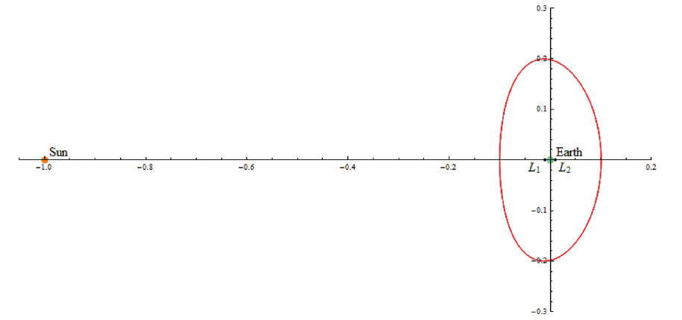
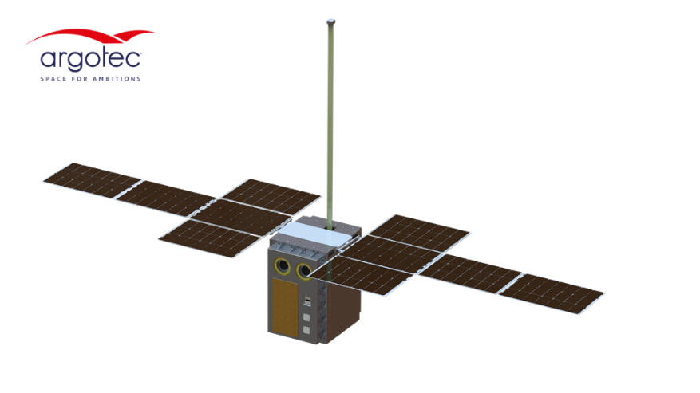
HENON concept
HENON is a pathfinder mission that will explore for the first time ever the Distant Retrograde Orbit (DRO) bringing a payload tailored for Space Weather operations and science.
Platform: cubesat based on the HAWK-12 platform by Argotec
Payload: the Relativistic Electron and Proton Experiment (REPE), the Faraday Cup (FC) and the The MAGnetometer from Imperial College (MAGIC)
Part of the ASI program ALCOR
Phase D study under the ESA GSTP program
Launch in January 2027

Slide 9
HENON goals
Provide a near real time monitoring of the deep space environment well beyond L1
Give an exceptional outcome in terms of operational Space Weather: real time alerts of solar energetic particles (SEPs) and interplanetary perturbations, offering a 10 times improvement in the lead time of geoeffective events prediction
Give useful scientific data to enhance our knowledge of Heliophysics
Fly for the first time ever the unexplored distant retrograde orbits (DROs), which have a critical importance also in other space contexts
Demonstrate reliability, availability and maintainability of the CubeSat technologies in deep space mission

Slide 10
RESERVE

Slide 11
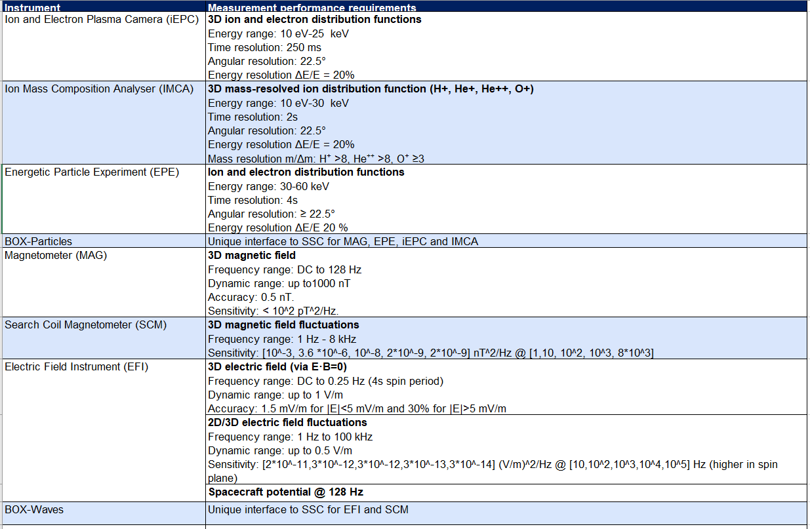
Summary of SSCs measurement capabilities
See talks by PIs

Slide 12
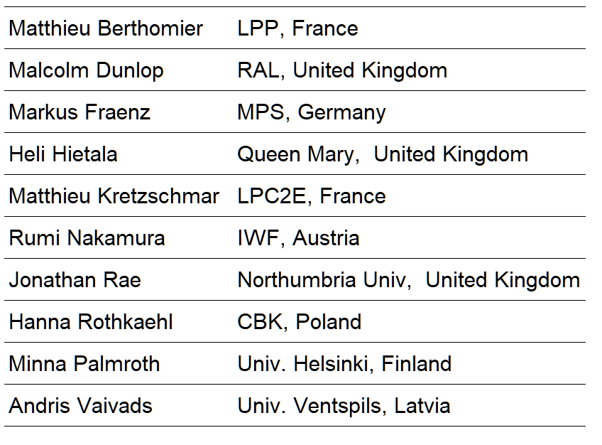
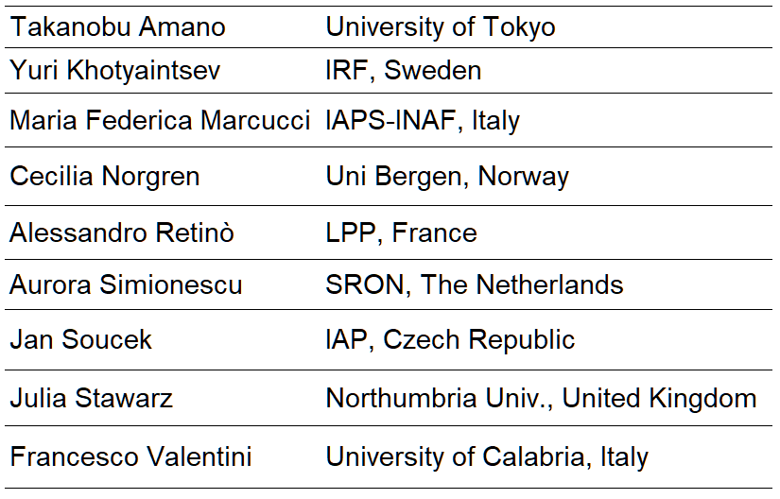
PO Scientific Organization
See talk by M. Taylor
Science Study Team (SST)
represents the community scientific interests during Phase A Study and produces the Assessment Study Report (“Yellow Book”)
Cross-Discipline Working Group (CDWG)
gives fundamental support to SST
Notes:
+ recomended member from NASA

Slide 13
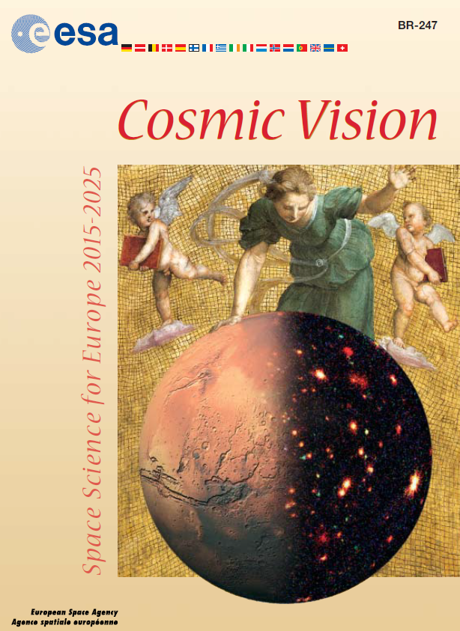
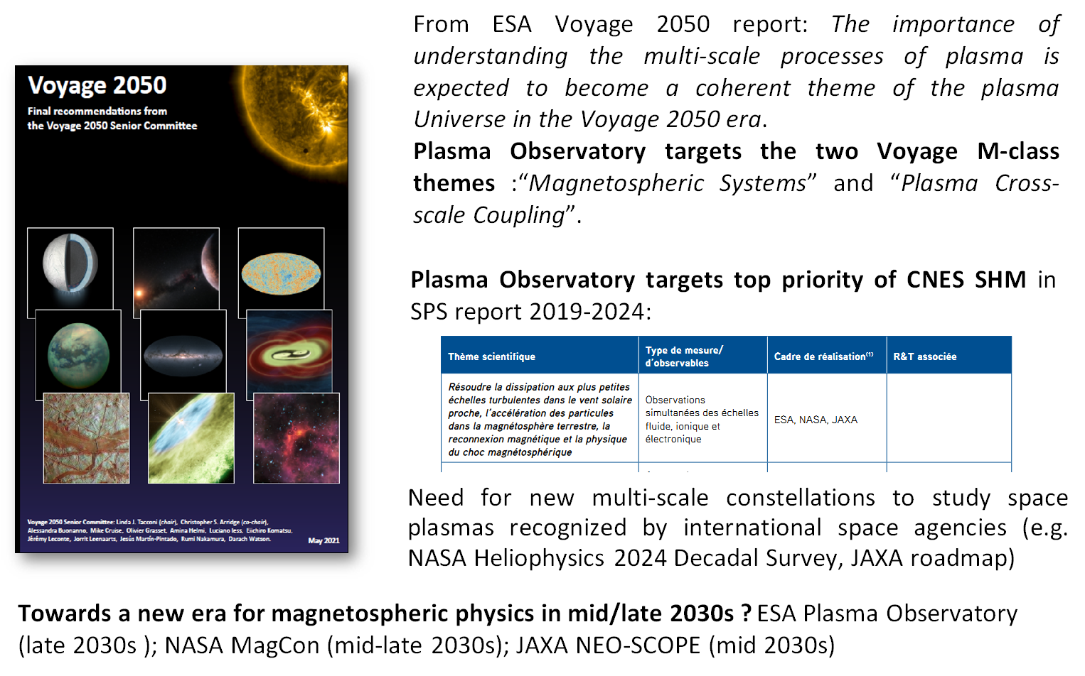


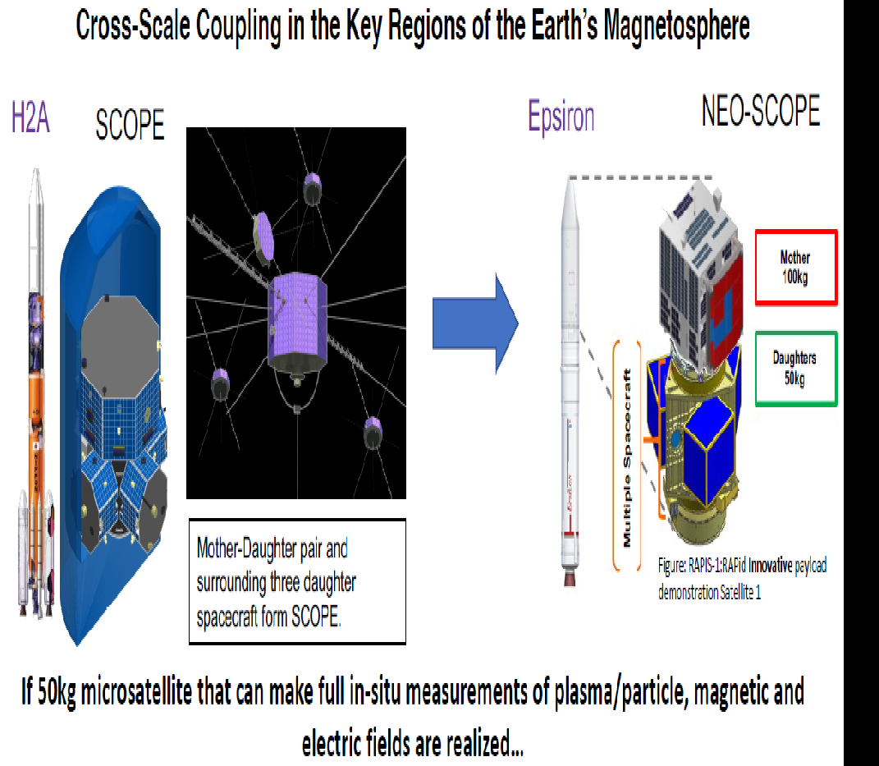
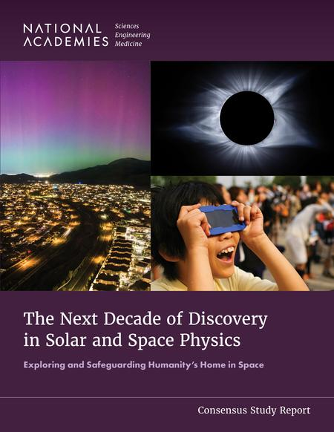

Multi-scale constellations: strong programmatic international framework towards a new era of magnetospheric physics in mid/late 2030s
See also:
A. Retinò et al., Particle energization in space plasmas: towards a multi-point, multi-scale plasma observatory, Exp. Astr., 2021 (ESA Voyage 2050 White Paper)
D. Verscharen, …, A. Retinò, et al., The Plasma Universe:ACoherent Science Theme for Voyage 2050, Front. Astron. Space Sci., 2021
...it is now vital to move on from Cluster, which has four satellites operating in company at relatively large distances, to simultaneous observations at a much larger number of points…
Plasma Observatory explicitly mentioned in Helio Decadal Survey
Possible synergy with Links magnetospheric constellation (24x spacecraft focused on mesoscales -> PMO scales)
NASA budget cuts ???
Cross-scale coupling in key regions of the Earth’s magnetosphere focusing on kinetic scales
Image credits: Y. Saito (ISAS-JAXA)
+ coordination with current & future ground observatories such as SuperDARN, ALIS4D, EISCAT3D, INTERMAGNET etc. to provide for the first time a multi-scale coverage of the Magnetospheric System from kinetic to global scales !

